Slide 1

用冷原子方法寻找原子固有电偶极矩，检验CP对称性破缺
夏添
合肥国家实验室 (HFNL)
第三届惠州大装置高精度物理研讨会
April 22, 2025
Notes:
Good afternoon everyone. My name is Tian Xia, from University of Science and Technology of China. This is my first visit in Japan. Visiting KMI institute and Nagoya University is very exciting. I would like to thank KMI institute for invitation, especially Junji and Kaori. My talk today is Measurement of the electric dipole moment of 171Yb atoms in an optical dipole trap.

Slide 2
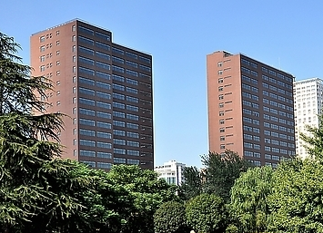
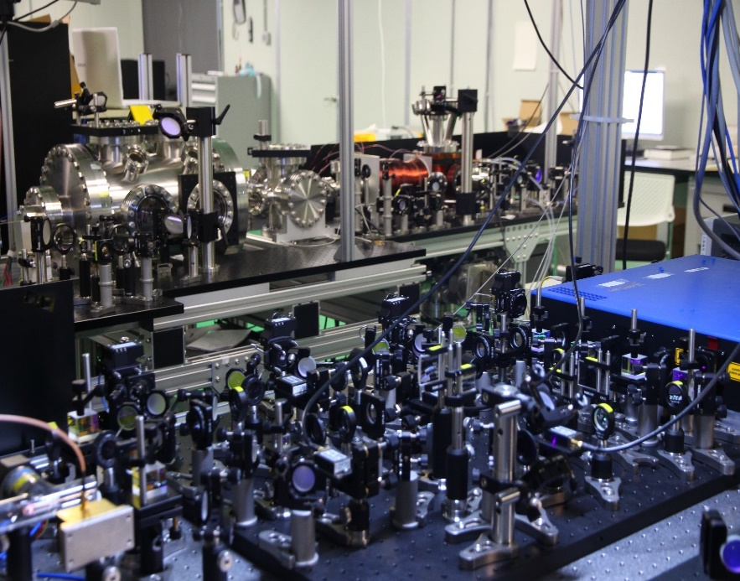

Laser Laboratory for Trace Analysis and Precision Measurements
Notes:
Our research lab is located in this twin tower on the west campus. Our joint group is called laser laboratory for trace analysis and precision measurements.

Slide 3
Outline
Introduction
Nuclear EDM.
  Overview
  ¹⁷¹Yb, QND method, statistics, systematics, outlook
  ²²⁵Ra, advantage, status, challenge, outlook
conclusion
Notes:
This is the outline of today’s talk. This is EDM workshop, but still I will start with some very brief introduction, and the overview of nuclear EDM. The biggest part of the talk is 171Yb EDM experiment, I will present the QND measurement method, the statistics and systematics in the measurement, and also the outlook.
For 225Ra, a radioactive isotope, I will discuss the reason why we are interested in it, what is the current measurement precision, why it is so hard to work on it, and what we can do in the future. Then I will conclude.

Slide 4
Outline
Introduction
Notes:
So what is permanent electric dipole moment? We usually call it EDM.

Slide 5
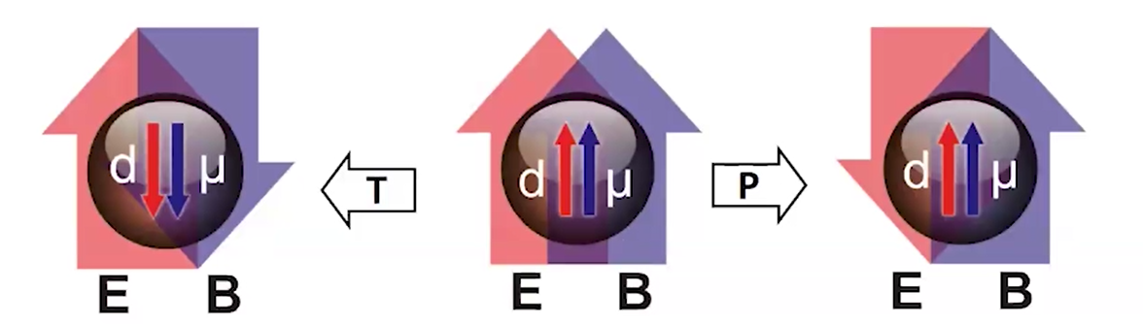
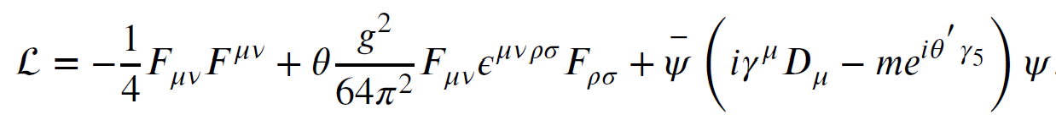
Explore new physical CP mechanism
Picture courtesy：Klaus Kirch
CP problem in strong interaction: θ term
T
=
CP
SUSY:
Explore new physics
in the scale 10~100TeV
via EDM measurement
New elementary particles→ new CP phase
Origins of matter - antimatter
New physical CP mechanism
Notes:
EDM is a quantity represented by the separation of plus and minus charge in the same particle. Imagine in this particle that we have a non-zero EDM along the spin axis (while the spin is represented by the circular current). If we make a time inversion, what happens? The EDM keeps the same as before, but the spin direction flips. If we make a 3-D space reversal, EDM is flipped, but the spin keeps the same. So under the operation of either time inversion or space reversal, the two parallel vectors become anti-parallel, meaning the property of this particle is fundamentally changed. So the non-zero EDM violates T symmetry and P symmetry. Under CPT theorem, EDM also violates CP symmetry. CP symmetry violation is related to a lot of fundamental physics problems. For example, the CP problem in strong interaction lagrangian has a theta term. In super symmetry model, the introduction of new elementary particles require new CP violating phase. And the interpretation of the observed matter-antimatter imbalance also requires new CP violating mechanisms.
Also, EDM of the fermion is associated with the energy scale of the new physics. In this expression, you can see if this energy is at a higher level, the EDM would be a smaller quantity, making it more challenging for our measurement.

Slide 6
Searching for EDM in three different categories
PSI, US, Germany,
Japan, KAIST
Neutron, proton
Quark EDM
U of Washington
PTB, Argonne, USTC
CENTREX
Nuclear Schiff moment diamagnetic
TlF, Hg, Xe, Ra, Yb
New physics beyond SM: SUSY et al.
Quark chromo-EDM
4 fermions, 3 gluons
ACME, JILA
Imperial, Harvard, Caltech
Electron
paramagnetic molecules
YbF, ThO, PbF, HfF⁺
Electron-EDM,
electron-quark force
Engel, Ramsey-Musolf, van Kolck, Prog. Part. Nucl. Phys. 71, 21 (2013)
system | Upper limit (e-cm) | method | Value in Standard model (e-cm)
Electron | 4 x 10⁻³⁰ | Molecules – trap/beam | 10⁻³⁸
Neutron | 2 x 10⁻²⁶ | Neutrons – bottle | 10⁻³¹
¹⁹⁹Hg | 7 x 10⁻³⁰ | Atoms – vapor cell | 10⁻³⁴
¹⁷¹Yb | 3 x 10⁻²⁷ | Atoms – trap | 10⁻³⁴
Notes:
In the experiments, there are basically three categories of searching for permanent electric dipole moment. They are neutron, proton; nucleus of diamagnetic atoms, electron of paramagnetic molecules. We work on Ytterbium, in the nuclear sector. EDMs in these three categories originate from different CP violating mechanisms. The three different systems are both competitive and complementary to each other in the sense that they all want to search for new physics beyond standard model. The table below lists some best experimental limits and the expected values in the standard model. The best limit in the nuclear sector is 199Hg, it is performed in University of Washington-Seattle with hot atoms in a vapor cell.

Slide 7
Outline
Introduction
Nuclear EDM.
  Overview
Notes:
Since we are in the nuclear sector of EDM searching, I will start with some overview of this sector.

Slide 8
Measurability of Nuclear EDM
L.I. Schiff, Phys. Rev. 132, 2194 (1963)
Schiff shielding
Permanent electric dipole moment of the nucleus is perfectly shielded by its surrounding electrons
True for point-like nuclei, nonrelativistic electrons
However
since nuclear charge distribution differs from EDM distribution.
              Arises from deformations in the nucleus and its constituent nucleons
              Very large in nuclei with both a quadrupole and octupole deformation
Candidates: heavy atom with a nuclear deformation
Notes:
Back in 1960s, Shiff performed analysis of atomic EDM originating from the nucleus. The permanent EDM of the nucleus is perfectly shielded by its surrounding electrons, so the atomic EDM is zero. But there are two conditions for this conclusion, the first is that it is true only for point-like nuclei, the second is that it is true only for nonrelativistic electrons. However, in a finite size of nucleus, the nuclear charge distribution differs from EDM distribution, so that the electron shielding of the nuclear EDM is not perfect. In the real cases, the Schiff moment arises from the deformations in the nucleus and its constituent nucleons. So the good candidates for EDM searching in the nuclear sector should be heavy atoms with a nuclear deformation, which could be a quadrupole or octupole deformation.

Slide 9

The Seattle EDM Measurement
¹⁹⁹Hg stable, high Z, groundstate ¹S₀, I = ½, high vapor pressure
E
E
$$\left|f_{+}−f_{−}\right|<25 pHz$$
Courtesy of Michael Romalis
The best limit on atomic EDM
EDM (¹⁹⁹Hg) < 7 x 10⁻³⁰ e-cm
Graner et al., Phys Rev Lett (2016)
Unit
EDM
+e
-e
cm
Notes:
As I said, the best limit in the nuclear sector is from 199Hg, this program has a history of more than thirty years. The atoms are sealed in a glass cell, the number of atoms is really big, when you repeat the measurement cycle, you don’t have to reload the atoms, you just polarize the atoms again. So this technique does give you a fairly good precision limit, 7 times 10-30 e-cm. This is still the precision record of atomic EDM measurement.

Slide 10
Measure EDM in an Optical Dipole Trap
M.V. Romalis and E.N. Fortson, Phys. Rev. A 59, 4547 (1999)
Fiber laser: λ = 1036 nm, Power = 10 Watts
Focused to 50 μm → trap depth 60 μK
EDM in an optical dipole trap （ODT）
v x E , Berry’s phase effects suppressed
E field is enhanced
Cold scattering suppressed between cold Fermionic atoms
Rayleigh scat. rate ~ 10⁻¹ s⁻¹ ; Raman scat. rate ~ 10⁻¹² s⁻¹
Parity mixing induced shift under control
Conclusion: possible to reach 10⁻³⁰ e cm for ¹⁹⁹Hg
Notes:
Romalis and Fortson, who were in charge of the Hg EDM experiment, did an analysis of EDM measurement in an optical dipole trap. At that time, this technique was already employed in the quantum gas research. With ODT, there could be a lot of advantages compared with the vapor cell beam experiments, when the atoms are trapped, the systematic v x E effect can be suppressed. (Where V is the velocity of the particles). And E field amplitude can be enhanced by at least one order of magnitude. The cold collision rate is small for the fermions. And Rayleigh scattering rate, which is relevant only for atom heating is reasonable. And Raman scattering rate, which is a systematic error source. This rate is negligibly small. The parity mixing effect, which I will discuss later, it can be controlled as well. The conclusion of this analysis is that the EDM measurement limit can reach 10-30 e cm with cold-atom technique.

Slide 11
Outline
Introduction
Nuclear EDM.
  Overview
  ¹⁷¹Yb, QND method, statistics, systematics, outlook
Notes:
With cold atom technique, the species we select is 171Yb.

Slide 12
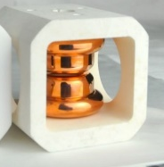
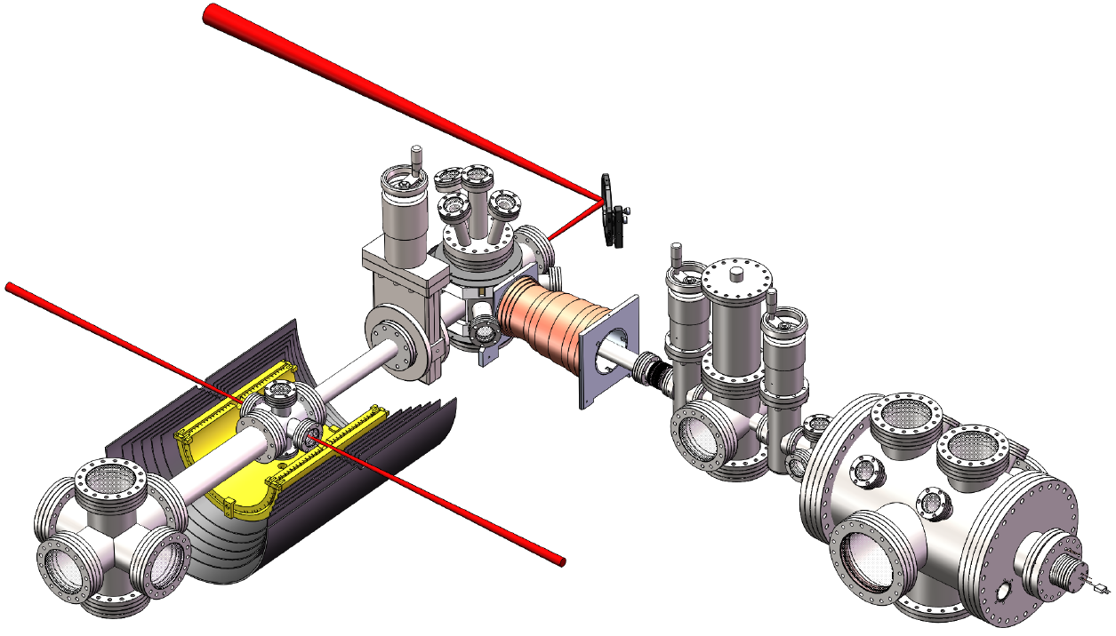

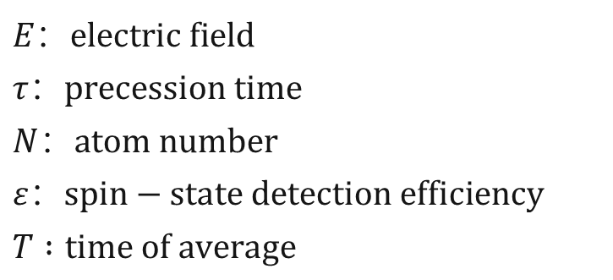
¹⁷¹Yb EDM Apparatus: Trapping + Science
Movable ODT (the “bus”)
Cold atoms loading and transportation
Electrodes
$$E：electric field$$
$$τ：precession time$$
$$N：atom number$$
$$ε：spin−state detection efficiency$$
$$T :time of average$$
Notes:
This is the schematics of the apparatus, the atom source produces an atomic beam going through a zeeman slower, then cooled by a magneto-optical trap, which we call MOT. With the MOT, we load the atoms from the MOT to the optical dipole trap and move the trap by an air-bearing stage into a science chamber, which is enclosed by a magnetic shield. In science chamber, the atoms are loaded from a movable ODT into a fixed ODT, which has the focus just between this pair of copper electrodes.
In the magnetic shield, we apply a small static B field that is fixed, and a static E field either parallel or antiparallel with the B field, under these two conditions, we spin polarize the atoms perpendicular to the B field, measure the Larmor precession frequencies, and take the differentiation, then we derive EDM, which is d here.
The applied E field is either parallel or antiparallel to the static magnetic field, while the magnetic field is always fixed. We measure the Larmor precession frequencies and take the differentiation, then we derive EDM, which is d in the equations.
This is the statistical error, but the efficiency of the atomic spin state is usually not 100%. If it is 100%, that is the atomic projection noise limit. In our work, we improved the detection efficiency from 1% to 50% by employing Quantum nondemolition detection method.

Slide 13
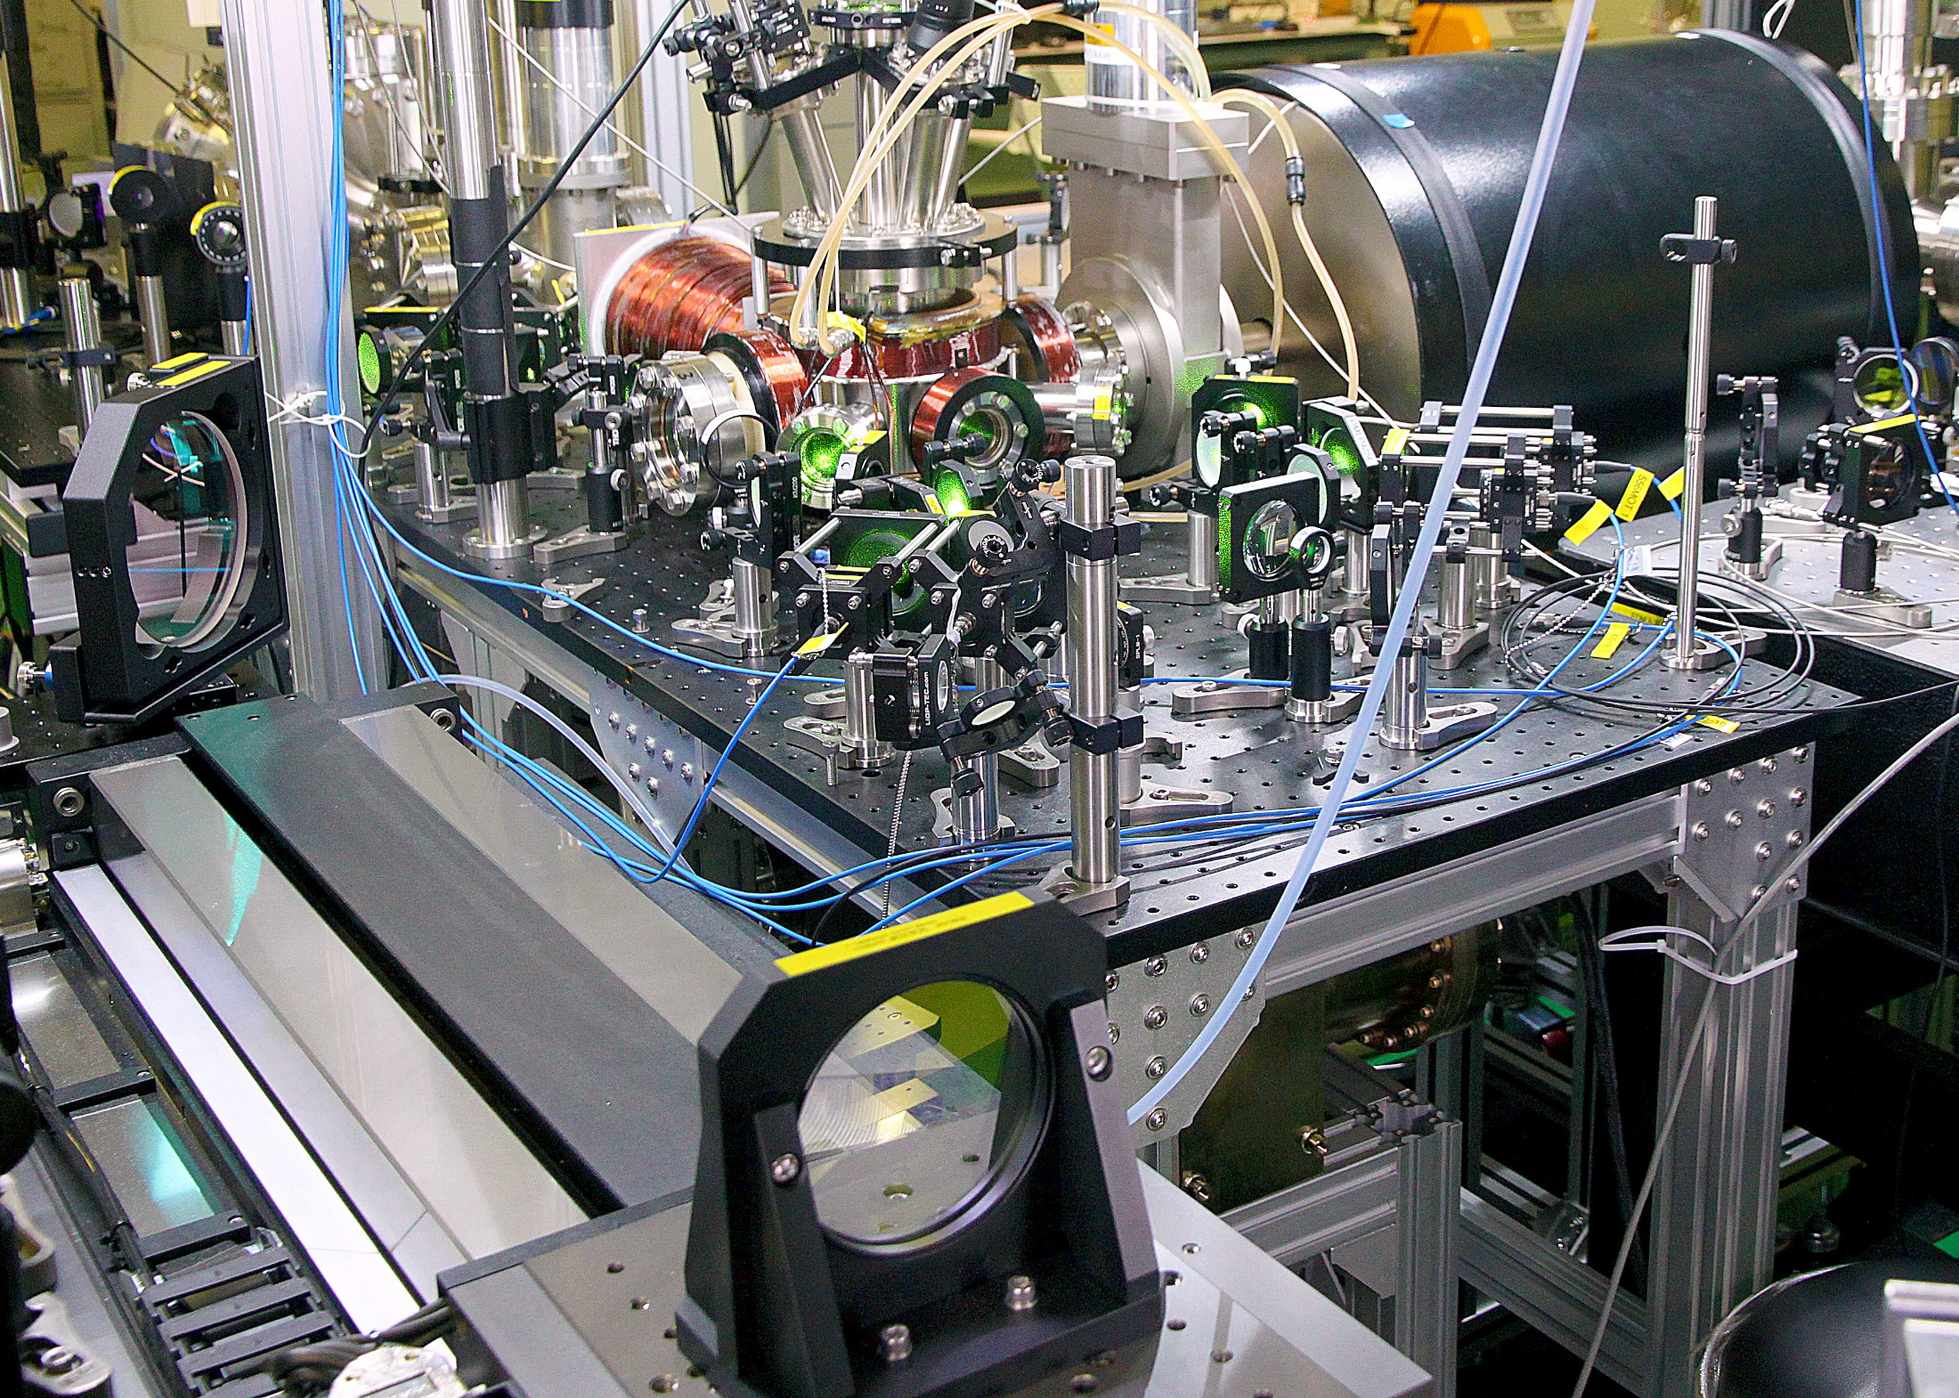
Magnetic shields
Air bearing stage
Notes:
This is the picture of the apparatus in the lab. This is the air-bearing stage which helps to transport the atoms by 65cm from the MOT to the science chamber in the center of the magnetic shield.

Slide 14
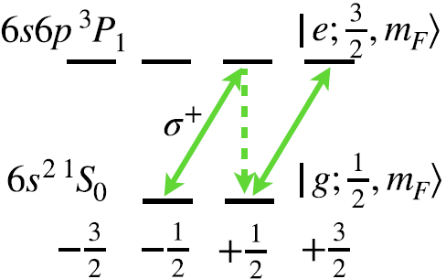
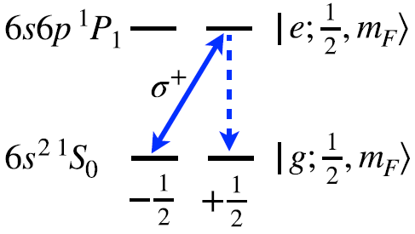
Spin-state detection – conventional method
Bright state：~ 3 photons before state “demolished”
Dark state：no photons,
state preserved
Bright state：state
“demolished”
Brighter state:
cycling,
state preserved
Notes:
This slide shows the possible transitions for spin-state detection, 1S0 is the electronic ground state, the angular momentum ½ is from the nuclear spin. The upper state 1P1 has a hyperfine state ½, which we can use for detection, if we apply a circularly polarized laser beam, the mF=+1/2 state doesn’t scatter photon because of selection rule of angular momentum, we call it dark state, while the bright state -1/2 scatters photons ,but on average it scatters only 3 photons before it spontaneously decay to the dark state. This method can be used to perform the detection, but the number of photon scattered by each atom is very limited, so the detection efficiency is very poor.
For the other case, the transition to a hyperfine state 3/2, the two zeeman states are both bright state now. The +1/2 state takes cycling transition, but the -1/2 state scatters photon and might decay to the other state and demolish the spin-state, so the detection efficiency is also small.

Slide 15
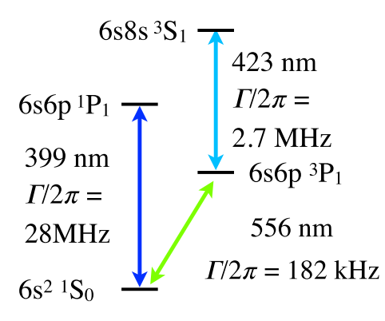
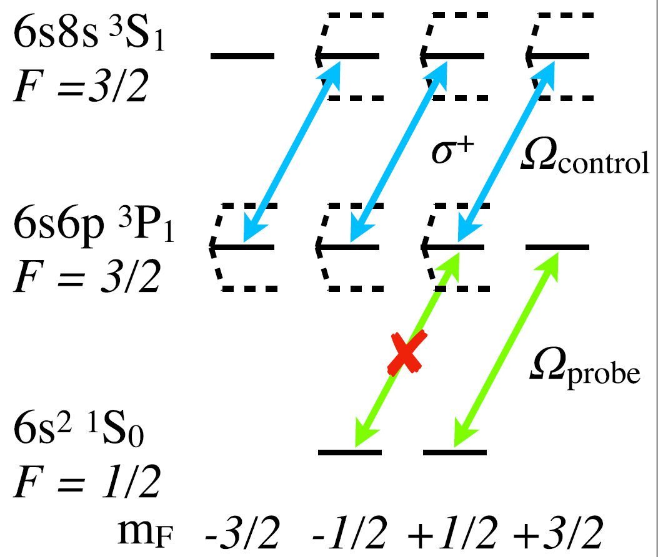
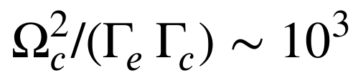


Spin-state detection by a QND method
Quantum Non-Demolition
$Ω_{control }\sim 2π×40MHz$
Dark state：
no photons,
state preserved
Bright state:
cycling,
state preserved
$Ω_{probe }\sim 2π×70kHz$
Spin flip suppressed by:
Need ODT to be at magic wavelength
-- T. Zheng, M.S. Safronova et al., PRA 102, 062805 (2020)
Notes:
We employ a method here called Quantum Non-Demolition detection. The P state we use for detection can be coupled to some higher S state, so if we use a laser beam tuned to the resonance of the transition from P state to this S state, and if the Rabi frequency is large compared with the natural linewidth of this transition, the AC Stark shift of the relevant states in the P level will be large enough, so that the transition from the -1/2 state will be off-resonance and becomes dark. Under this condition, the probe beam makes the transition from the bright state +1/2 cycling, and the transition from the other state -1/2 completely dark. So this scheme is spin-state preserving, and cycling transition, making the number of scattered photons per atom a lot bigger than that in the previous slide. In practice, it about 20 photons per atom, while for the conventional method in the previous slide, this photon number is just 3. I should mention that this QND detection requires that the trapping wavelength is a magic wavelength for the probe transition, otherwise the probing laser will be off-resonant. The magic wavelength information is in this paper.

Slide 16
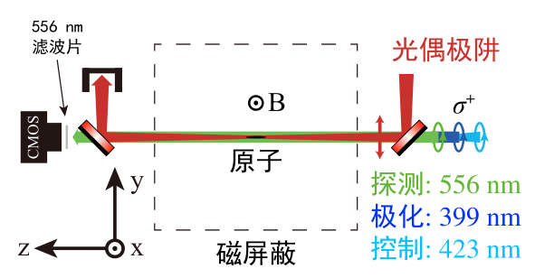
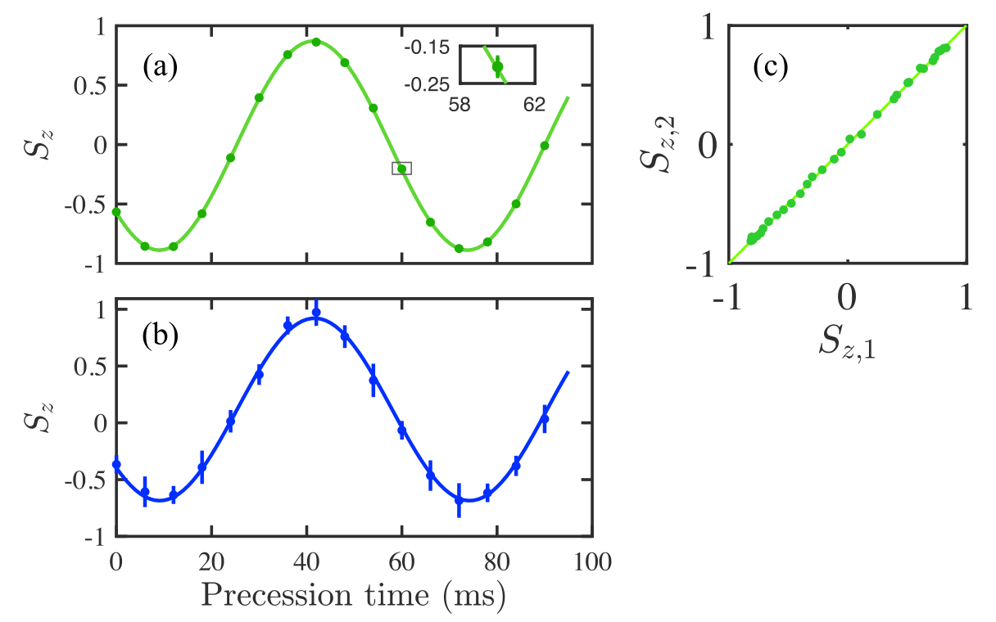
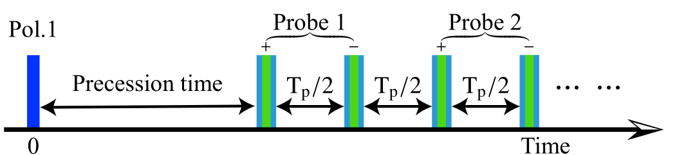



Larmor precession frequency measurement
Quantum Non-Demolition
ODT
~20 mG
Atoms
$$S_{z}=\frac{N_{+}−N_{−}}{N_{+}+N_{−}}$$
$$N_{+}$$
$$N_{−}$$
Notes:
This slide shows how we determine the larmor precession frequency. We load the atoms into the science chamber, then we polarize the nuclear spin, then the spin precess about the B field and E field, after a given precession time, we measure Sz to determine precession phase. With QND detection, we can use multiple probing pulses, the first one detects the population in +1/2 state (we call it N+), then after half of the period, the population of the other state -1/2 (N-) and N+ perfectly swap, so this second detection pulse measures N-. Since it’s QND, we can keep doing this, and make the number of photon scattering as large as we want. If we change the precession time, we get this precession curve. And the error bar here is significantly smaller with QND method.

Slide 17
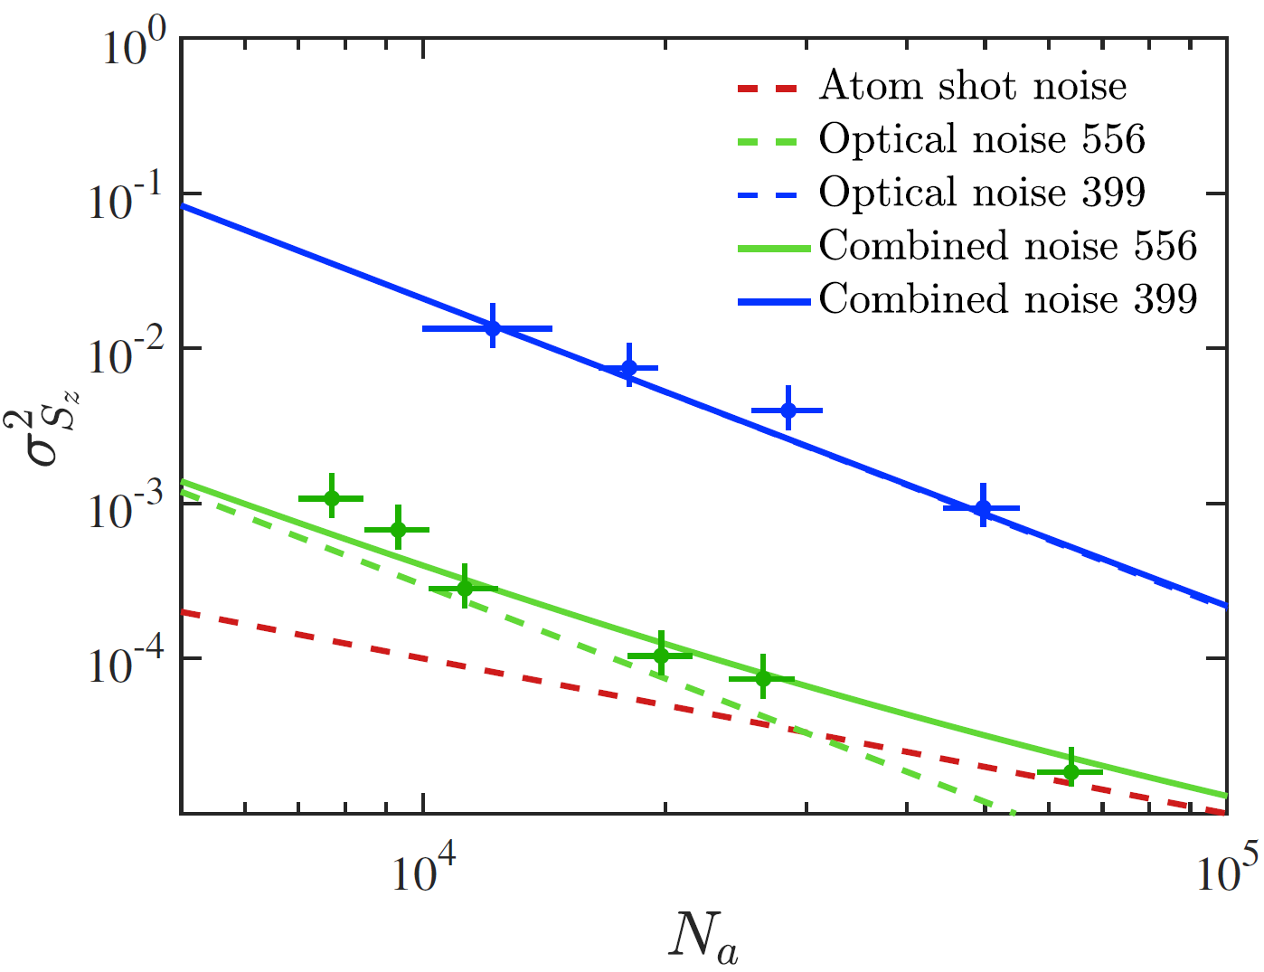
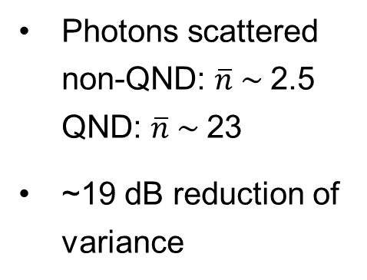
QND reduces measurement noise
Photons scattered non-QND: $\overline{n} \sim$2.5 QND: $\overline{n} \sim$23
~19 dB reduction of variance
Non QND
Photon shot
QND
Atom shot
QND measurement on the spin precession of laser-trapped ¹⁷¹Yb atoms
Y.A. Yang et al., Phys. Rev. Applied 19, 054015 (2023)
Notes:
This slides shows the performance of the QND detection compared with the non-QND. X axis is the number of atoms, Y axis is the variance of Sz.
Of course, the atomic shot noise is the same, and is always there. The dashed green curve is the optical noise for QND, so the green solid line is the sum of the atomic shot noise and the optical noise.
While for non-QND measurement, the blue dashed curve, which is overlapped with the solid blue curve is 19 dB higher than the QND case, so for Non QND, the optical noise is dominant. While for QND, when the atoms is more than 30 thousand, the atomic shot noise is bigger than the technical noise, becomes dominant.

Slide 18
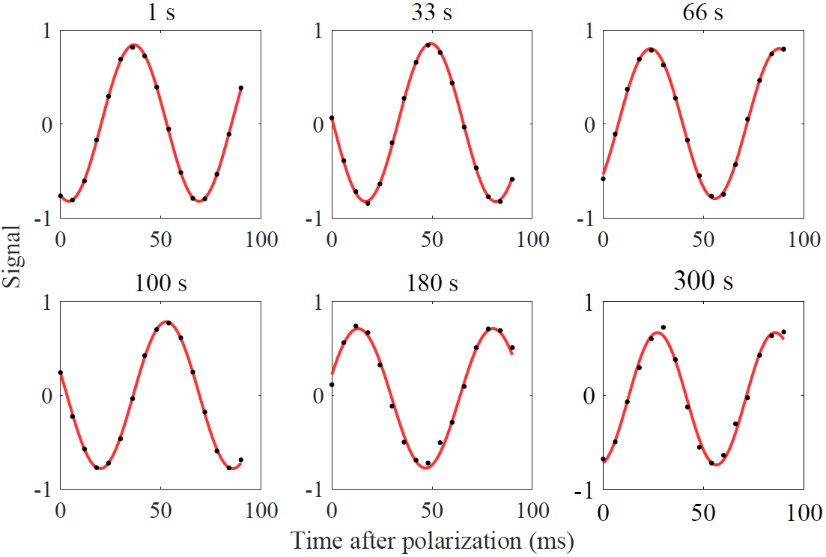
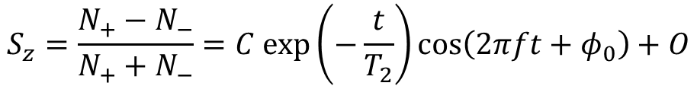
Long spin coherence time (T₂)
$$S_{z}=\frac{N_{+}−N_{−}}{N_{+}+N_{−}}=C exp\left(−\frac{t}{T_{2}}\right)\cos\left(2πft+φ_{0}\right)+O$$
Observed precession to: 300 s
Vacuum-limited trap lifetime: 75 s
EDM measurement precession time: 100 s
T₂ : (9 ± 4) x 10³ s (2.5±1.1 hr)
Notes:
The coherence time is very critical for the measurement statistics. In our case, the coherence time is very long, after 300 s precession time, you can see the contrast of the precession signal is still about 80% of the contrast at 1 s. So we claim the coherence time is longer than 300 s. Actually, in our case, it is limited by the cold atom trap lifetime, which is about 75 s. So our single shot interrogation time is about 96 s. I would say this is a very nontrivial result in cold-atom experiment.

Slide 19
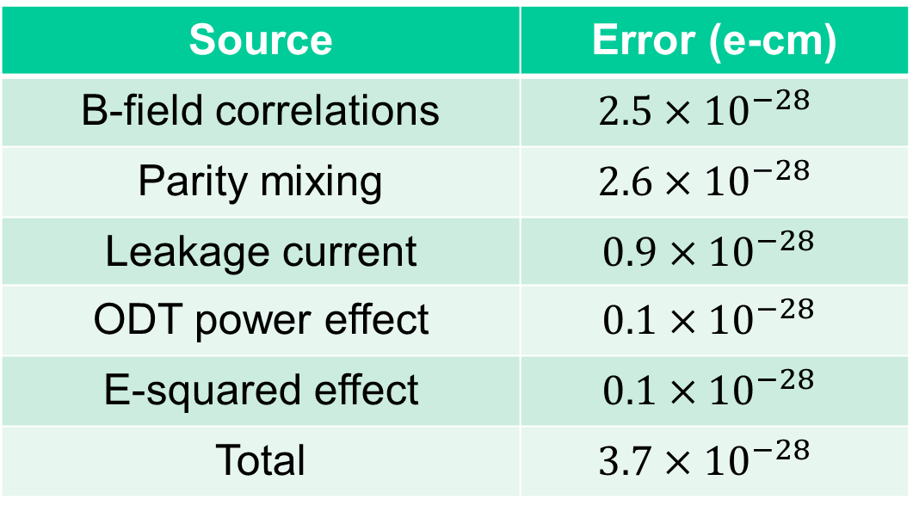
Systematic errors
- effects correlated with E-field flipping
Source | Error (e-cm)
B-field correlations | $$2.5×{10}^{−28}$$
Parity mixing | $$2.6×{10}^{−28}$$
Leakage current | $$0.9×{10}^{−28}$$
ODT power effect | $$0.1×{10}^{−28}$$
E-squared effect | $$0.1×{10}^{−28}$$
Total | $$3.7×{10}^{−28}$$
Notes:
This table lists the systematic error budget. Remember EDM measurement is performed by differentiating the E-field parallel and anti-parallel conditions, so all systematic errors are correlated with E-field flipping. For example, for B-field correlations, we record the B field change correlated with E field flipping. And the second error source is due to the parity mixing effect, this effect is unique with dipole trap method. The other errors are much smaller. And the total is on the order of 10-27 e-cm.

Slide 20
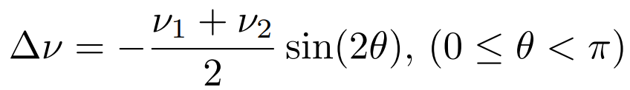
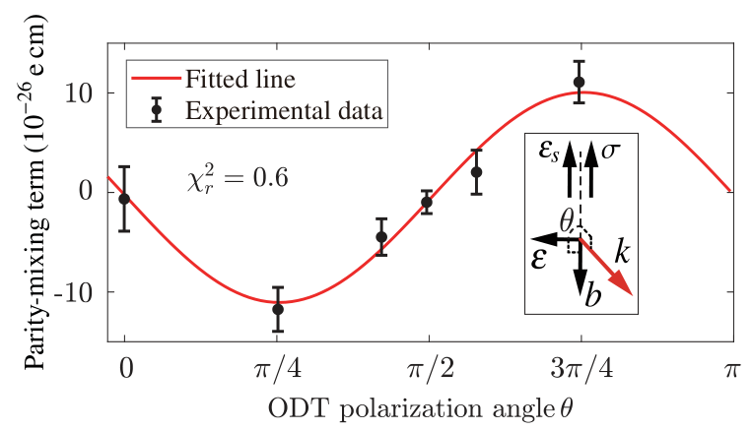
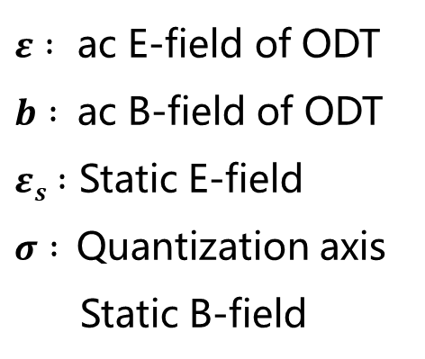

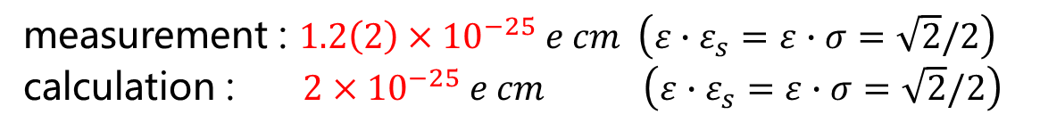
Parity mixing
M.V. Romalis and E.N. Fortson, Phys. Rev. A 59, 4547 (1999)
$$≈$$
T-even, P-even
yet EDM-like
$ε :$ ac E-field of ODT
$b :$ac B-field of ODT
$εs :$ Static E-field
$σ :$Quantization axis
Static B-field
measurement : $1.2\left(2\right)×{10}^{−25} e cm \left(ε∙ε_{s}=ε∙σ=\sqrt{2}/2\right)$
calculation : $2×{10}^{−25} e cm \left(ε∙ε_{s}=ε∙σ=\sqrt{2}/2\right)$
Notes:
So what is parity mixing? It is basically energy shift of the two mF states due to the interplay of the optical dipole trap, and the static E field. It’s actually a third-order perturbation of energy, the AC E field, AC B field, and the DC E field. It’s proportional to DC E field, but it’s T-even and P-even, so it’s a systematic error of EDM. If we mathematically rearrange the third-order perturbation, we get this expression. What we can change in the experiment is the polarization of the trap laser. So the geometric factor is changed. In this measurement, the DC E field and DC B field are both fixed. The measurement shows the biggest parity mixing effect is as large as 10 times 10-26 e-cm.

Slide 21
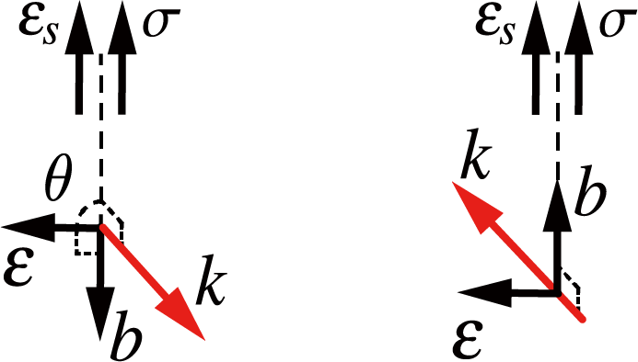
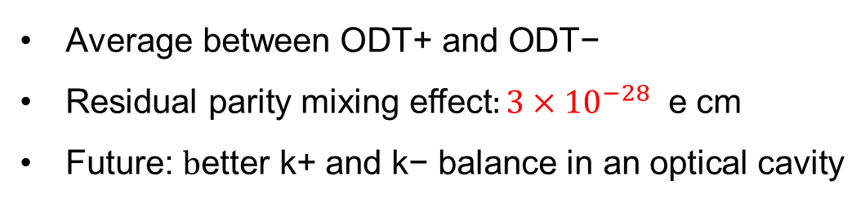
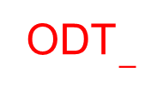
Parity mixing
M.V. Romalis and E.N. Fortson, Phys. Rev. A 59, 4547 (1999)
ODT₊
Control:
θ = π/2 ± 50 mrad
(θ₊ - θ₋) = 0 ± 3 mrad
ODT$−$
$\text{Average} \text{between} \text{ODT}\text{+ }\text{and} \text{ODT}\text{−}$
$\text{Residual} \text{parity} \text{mixing} \text{effect}:3×{10}^{−28} \text{e} \text{cm}$
Future: $\text{b}\text{etter} \text{k}\text{+ }\text{and} \text{k}\text{− }\text{balance} \text{in} \text{an} \text{optical} \text{cavity}$
Notes:
This is how we suppress this error. If the k vector of the trap laser is reversed, the sign of the error is also reversed. So we measure EDM under the +k, and –k conditions to cancel out the effect. The residual error comes from the power imbalance and the imperfect polarization alignment. If this error becomes the dominant, we will use an optical cavity for better optical balance.

Slide 22
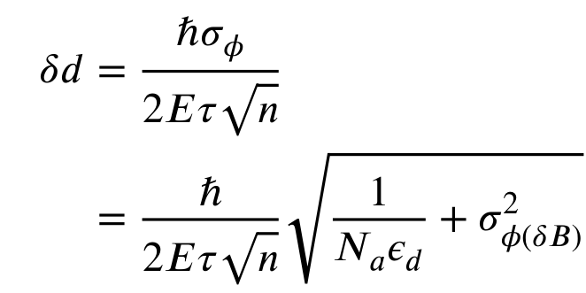
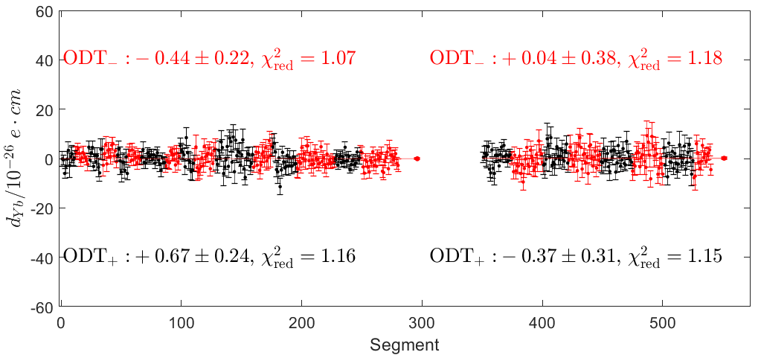
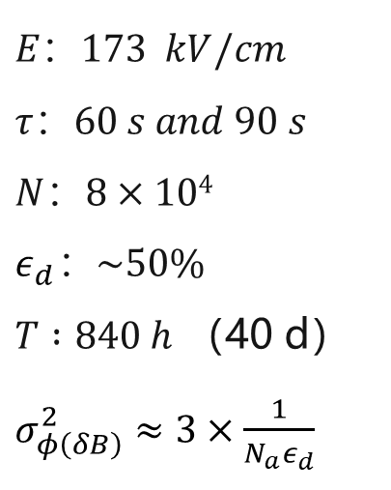
¹⁷¹Yb EDM measurement results
70s
100s
$$E：173 kV/cm$$
$$τ：60 s and 90 s$$
$$N：8×104$$
$$ε_{d}：\sim 50\%$$
$T :840 h$ （40 d）$σ_{φ\left(δB\right)}^{2}≈3×\frac{1}{N_{a}ε_{d}}$
* Average ODT+ and ODT- to cancel parity-mixing systematic
$$d\left(171Yb\right)=\left(0.33±{1.54}_{stat}±{0.4}_{syst}\right)×{10}^{−27} e cm$$
Upper limit (95%) ：$\left|d\left(171Yb\right)\right|<3.2×{10}^{−27} e cm$
* B-field noise due to Seebeck effect
* 5× improved over 2022 result
Measurement of the EDM of ¹⁷¹Yb atoms in an ODT
T.A. Zheng et al., PRL 129, 083001 (2022)
Notes:
This figure shows all the data, black and red are for +k and –k. Besides the atomic projection noise and optical noise, there is some random B-field noise contributing to EDM uncertainty, it is mainly the thermal noise on the titanium chamber and the copper electrodes due to the higher power laser scattering. Currently, the measurement error is dominated by statistics.

Slide 23
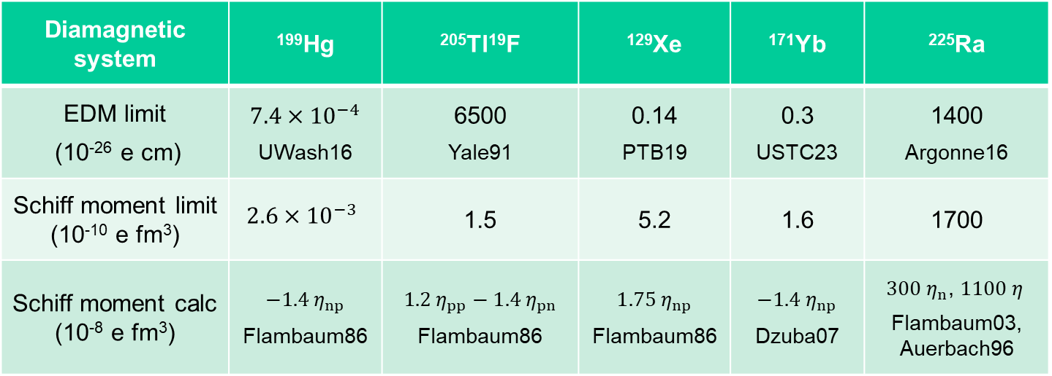
Upper limits on Schiff moments
Diamagnetic system | ¹⁹⁹Hg | ²⁰⁵Tl¹⁹F | ¹²⁹Xe | ¹⁷¹Yb | ²²⁵Ra
EDM limit (10⁻²⁶ e cm) | $$7.4×{10}^{−4}$$ UWash16 | 6500 Yale91 | 0.14 PTB19 | 0.3 USTC23 | 1400 Argonne16
Schiff moment limit (10⁻¹⁰ e fm³) | $$2.6×{10}^{−3}$$ | 1.5 | 5.2 | 1.6 | 1700
Schiff moment calc (10⁻⁸ e fm³) | $$−1.4{ η}_{np}$$ Flambaum86 | $$1.2 η_{pp}−1.4{ η}_{pn}$$ Flambaum86 | $$1.75 η_{np}$$ Flambaum86 | $$−1.4{ η}_{np}$$ Dzuba07 | $300 η_{n}$, $1100 η_{ }$ Flambaum03, Auerbach96
The ¹⁷¹Yb EDM result contributes to constraining BSM physics:
on the same order of as ¹²⁹Xe, ²²⁵Ra, ²⁰⁵Tl¹⁹F, although lagging ¹⁹⁹Hg.
The global analysis of EDM results requires different systems with
complementary sensitivities to BSM parameters, rather than ¹⁹⁹Hg alone.
T. E. Chupp et al., Rev. Mod. Phys. 91, 015001 (2019)
Notes:
This slide lists all the results of EDM upper limits due to Schiff moments. The first row is the EDM upper limits from the experiments. For each species of atom and molecule, there is a conversion factor for the Schiff moments. So the second row is the upper limits of the Schiff moment, and particle and nuclear physicists calculate the Schiff moments in terms of CP violating parameters, \etas are the interactions between nucleons that violate CP symmetry. You can see that 199Hg measurement limit is much better than all the others. Schiff moments’ sensitivities to the eta numbers are different, 225Ra is the most sensitive than all the others, the coefficients are three orders of magnitude bigger than the others. What it matters here is the how strong we can constrain the etas, it actually the ratio of the second row numbers and the coefficients in the third row.
Since there are multiple etas, limits from multiple systems make it possible to globally constrain these etas, rather than 199Hg alone.

Slide 24
Outlook (¹⁷¹Yb)
Upgrade: ¹⁷¹Yb EDM precision improves into E-28 e-cm
  Larger E-field
  Longer trap lifetime
  Less B-field noise
  Optical cavity
E-field
2023 work: 173 kV/cm, copper electrodes
2025 setup: 237 kV/cm, copper
Other works: 500 kV/cm, niobium - Ready et al. NIM A (2021)
Preliminary results in 2025
$$d\left(171Yb\right)=\left(??±{4.8}_{stat}±{??}_{syst}\right)×{10}^{−28} e cm$$
B-field
This work: ~ 3 pT over 100 s, Seebeck effect due to ODT heating
Environmental noise: ~ 1 pT, use magnetometers
Johnson noise: ~ 0.6 pT, use co-magnetometer (¹⁷³Yb)
Notes:
Of course, we still have potential to improve our result in the near future. The following measures can make the precision into 10to -28 e-cm. The larger E-field, less B-field noise due to the laser heating, longer trap lifetime, and the implementation of an optical cavity.
For E field, we did it with 73 kV/cm, and we just increased it to 200 kV/cm without discharge, of course. And in other works, it is up to 500 kV/cm with niobium.
For B field, the noise is about 3 pT over 100s, the thermal noise in condensed matter physics is called Seebeck effect. The environmental noise in the shield should be about 1 pT. And the Johnson noise from the electrodes should be even smaller.

Slide 25
Outline
Introduction
Nuclear EDM.
  Overview
  171Yb, QND method, statistics, systematics, outlook
  ²²⁵Ra, advantage, status, challenge, outlook
Notes:
As I said, the 225Ra has a much bigger Schiff moment than the other isotopes, Let’s look into it.

Slide 26
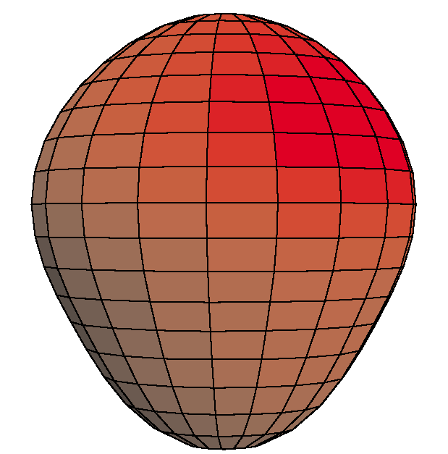
EDM of ²²⁵Ra enhanced and more reliably calculated
Closely spaced parity doublet – Haxton & Henley, PRL (1983)
Large Schiff moment due to octupole deformation – Auerbach, Flambaum & Spevak, PRL (1996)
Relativistic atomic structure (²²⁵Ra / ¹⁹⁹Hg ~ 3) – Dzuba, Flambaum, Ginges, Kozlov, PRA (2002)
Parity doublet
|α⟩
|β⟩
Enhancement Factor: EDM (²²⁵Ra) / EDM (¹⁹⁹Hg)
 | Isoscalar | Isovector
Skyrme SIII | 300 | 4000
Skyrme SkM* | 300 | 2000
Skyrme SLy4 | 700 | 8000
Ψ⁻ = (|α⟩ − |β⟩)/√2
Ψ⁺ = (|α⟩ + |β⟩)/√2
55 keV
Schiff moment of ²²⁵Ra, Dobaczewski, Engel, PRL (2005)
Schiff moment of ¹⁹⁹Hg, Dobaczewski, Engel et al., PRC (2010)
“[Nuclear structure] calculations in Ra are almost certainly more reliable than those in Hg.”
– Engel, Ramsey-Musolf, van Kolck, Prog. Part. Nucl. Phys. (2013)
Constraining parameters in a global EDM analysis.
– Chupp, Ramsey-Musolf, arXiv1407.1064 (2014)
Notes:
225Ra has a special nuclear structure, it has an octupole deformation, and also it has two closely spaced energy levels with opposite parity, which enhances the Schiff moment. The relativistic effect is even bigger than 199Hg. And nuclear physicists said that calculations in Ra are almost certainly more reliable than those in Hg.

Slide 27
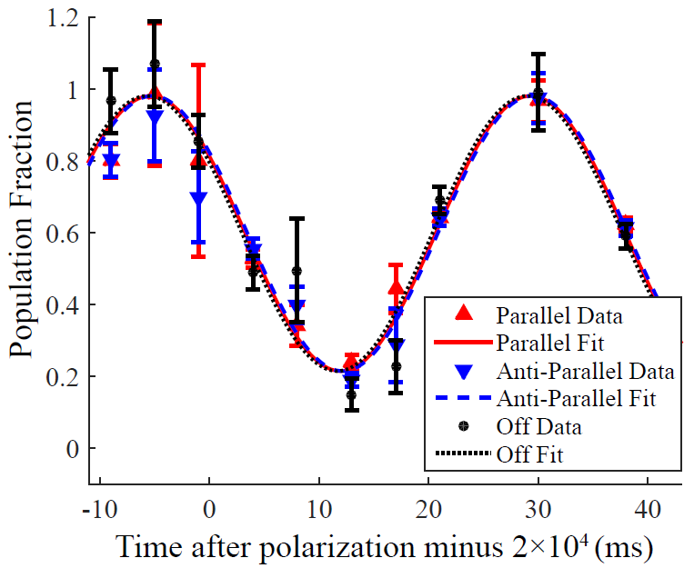
Ra-EDM Results
Argonne National Laboratory
2007 – Laser trapping of ²²⁵Ra
--- Guest et al., PRL 98, 093001 (2007)
2014 – EDM < 5.0 × 10⁻²² e-cm (95%)
--- Parker et al., PRL 114, 23302 (2015)
First EDM measurement on octupole deformed nucleus
2015 – EDM < 1.4 × 10⁻²³ e-cm (95%)
--- Bishof et al., PRC 94, 025501 (2016)
 | E (kV/cm) | τ (s) | ε | N | T (hour) | EDM limit (e cm) 95% c.l.
Ra-225 | 70 | 20 | 0.2% | 400 | 12 | 1.4E-23
Yb-171 | 173 | 90 | 50% | 80,000 | 840 | 3E-27
Notes:
225Ra EDM has been measured by Argonne National Lab. It was trapped in 2007, the first result was published in 2015, on the order of 10-22 e-cm. one year later, it was improved by a factor of 40, so the limit is 1.4 times 10-23 e-cm. This is almost 1000 times worse than our result of 171Yb. The biggest difference is the number of atoms, the optical detection efficiency, and the measurement time.

Slide 28
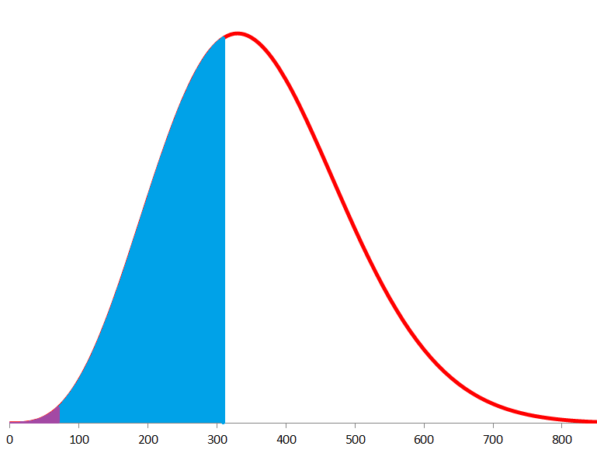
Improve trapping efficiency with a blue upgrade
7p ¹P₁
6 ns
7p ¹P₁
6 ns
M. Dietrich, M. Bishof et al., Argonne National Laboratory
Pump #3
Scheme
1st slowing laser: 483 nm (strong)
2nd slowing laser: 714 nm
3 repumpers: 1428 nm, 1488 nm, 2.75 mm
¹⁷¹Yb as co-magnetometer
Benefits
100 times more atoms in the trap, get 1x10⁵ atoms in ODT
Improved control on systematic uncertainties
Pump #1
Pump #1
6d ¹D₂
430 μs
Pump #2
420 ns
7p ³P₁
420 ns
7p ³P₁
Slow, 483 nm
6d ³D₂
6d ³D₁
6d ³D₁
310 m/s
Trap, 714 nm
Slow & Trap, 714 nm
60
m/s
Atom Flux
KVI barium trap
S. De et al. PRA (2009)
7s² ¹S₀
7s² ¹S₀
Atom Velocity
Notes:
The reason for the small number of Radium atoms is not only its radio-activity, but also it’s electronic state property. For alkali earth atoms, we usually use the singlet P state for Zeeman slower and MOT loading, but for heavy species, this P state has branching ratio decaying to the D state, which is metastable. Atoms in these metastable states stop interacting with the lasers, so in Argonne experiments, they use the narrow line transition to triplet P state for Zeeman slowing, the velocity capture range is very small, upto 60 m/s. If we use repumping lasers to make up the patches for the leakage channels, it is hopeful that we can load 100 times more Radium atoms into the trap.

Slide 29
Outlook (²²⁵Ra)
¹⁷¹Yb
2-electron system
Nuclear spin I = ½
Stable and abundant
²²⁵Ra:
Group II
Nuclear spin I = ½
Radioactive t_{1/2} = 15 d
6s8s ³S₁
7s8s ³S₁
423 nm
Γ/2π =
2.7 MHz
784 nm
Γ/2π =
8.8 MHz
6s6p ¹P₁
7s7p ¹P₁
399 nm
Γ/2π =
28 MHz
483 nm
Γ/2π =
29 MHz
6s6p ³P₁
7s7p ³P₁
556 nm
Γ/2π = 182 kHz
714 nm
Γ/2π = 442 kHz
6s² ¹S₀
7s² ¹S₀
Notes:
For QND detection scheme, we have a similar transition for dressing purpose at 784 nm, very feasible for lasers. Ok, so with these upgrades, we should be able to improve the measurement precision of 225Ra EDM.

Slide 30
国际合作团队
Conclusion
EDM measurement is a good tool to probe for new physics, especially for that related to CP violation.
We focus on nuclear EDM measurement with cold atoms
  The first ¹⁷¹Yb EDM result has similar contribution to constraining BSM physics as ¹²⁹Xe, TlF, and ²²⁵Ra, lagging ¹⁹⁹Hg. There is potential to improve the precision.
  ²²⁵Ra, octupole deformation enhances EDM significantly.
  Currently, ²²⁵Ra EDM upper limit~ 10⁻²³ e-cm, is limited by the number of atoms in the trap.
  The improvement relies on new cooling scheme, will push ²²⁵Ra EDM limit to 10⁻²⁶ e-cm (10TeV new physics).

Slide 31


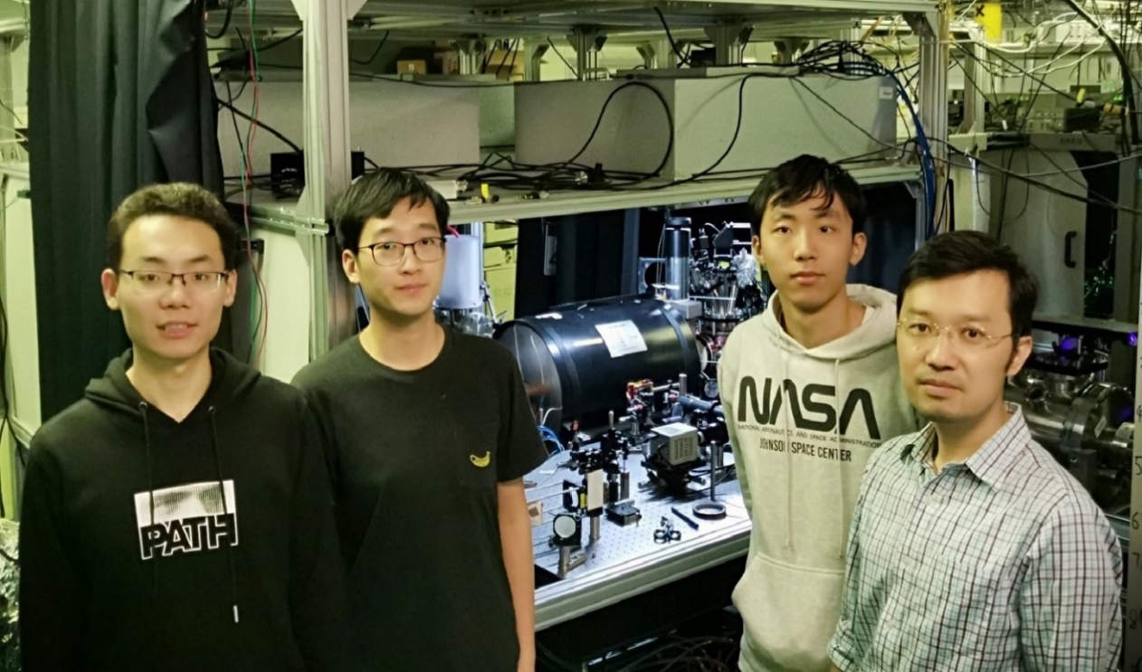
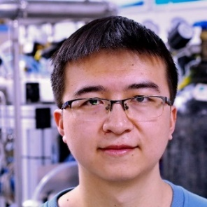





国际合作团队
Collaboration and Support
USTC
HFNL
Z.-T. Lu, Tian Xia, Tao Zheng, Yang Yang, S.-Z. Wang, S.-B. Wang, Z.-J. Tao
We acknowledge support by:
Michigan State University
Jaideep Singh

Slide 32

Explore new physical CP mechanism
+
T
+
P
_
+
_
_
EDM
spin
EDM
spin
EDM
spin
CP problem in strong interaction: θ term
T
=
CP
SUSY:
Explore new physics
in the scale 10~100TeV
via EDM measurement
New elementary particles→ new CP phase
Origins of matter - antimatter
New physical CP mechanism
Notes:
EDM is a quantity represented by the separation of plus and minus charge in the same particle. Imagine in this particle that we have a non-zero EDM along the spin axis (while the spin is represented by the circular current). If we make a time inversion, what happens? The EDM keeps the same as before, but the spin direction flips. If we make a 3-D space reversal, EDM is flipped, but the spin keeps the same. So under the operation of either time inversion or space reversal, the two parallel vectors become anti-parallel, meaning the property of this particle is fundamentally changed. So the non-zero EDM violates T symmetry and P symmetry. Under CPT theorem, EDM also violates CP symmetry. CP symmetry violation is related to a lot of fundamental physics problems. For example, the CP problem in strong interaction lagrangian has a theta term. In super symmetry model, new elementary particles require new CP violating phase. And the interpretation of the observed matter-antimatter imbalance also requires new CP violating mechanisms.
Also, EDM of the fermion is associated with the energy scale of the new physics. In this expression, you can see if this energy is at a higher level, the EDM would be a smaller quantity, making it more challenging for our measurement.

Slide 33

EDM measurement method
B
E
Statistical error
μ, s
d, s
$$δd=\frac{ħ}{2E\sqrt{2NτT}}$$
B
example:
B = 10 mGauss
E = 100 kV/cm
f = 11 Hz
f₊ - f₋ = 100 nHz
d = 1×10⁻²⁷ e cm
B
E
s
s
E
Notes:
This slide shows how we measure EDM. The EDM is along the only nontrivial vector, spin. If the spin is polarized and perpendicular with the external B field, the magnetic moment precess about B field. Likewise, if the spin is polarized and perpendicular with the external E field, the permanent electric dipole moment precess about E field. So we measure the spin precession frequencies under the two conditions, the E field is either parallel or anti-parallel with the B field. Then we take the differentiation between the two frequencies, and get d measured. Mu B is cancelled out. Here I show an example, where B is 10 m Gauss, E is 100kV/cm, if the frequency is about 11 Hz, more importantly if the measured frequency difference is 10nHz, then the EDM is 1times 10to minus 28 e-cm. But there has to be some statistical error bar coming into play as well, it is inversely proportional to the E field, and the square root of the number of particles, the measurement time in a single shot and total time T for averaging. And I have to mention that any change of the B-field during these two conditions will make the systematic error for EDM. So we want the E field as large as possible, and B field as stable as possible.

Slide 34
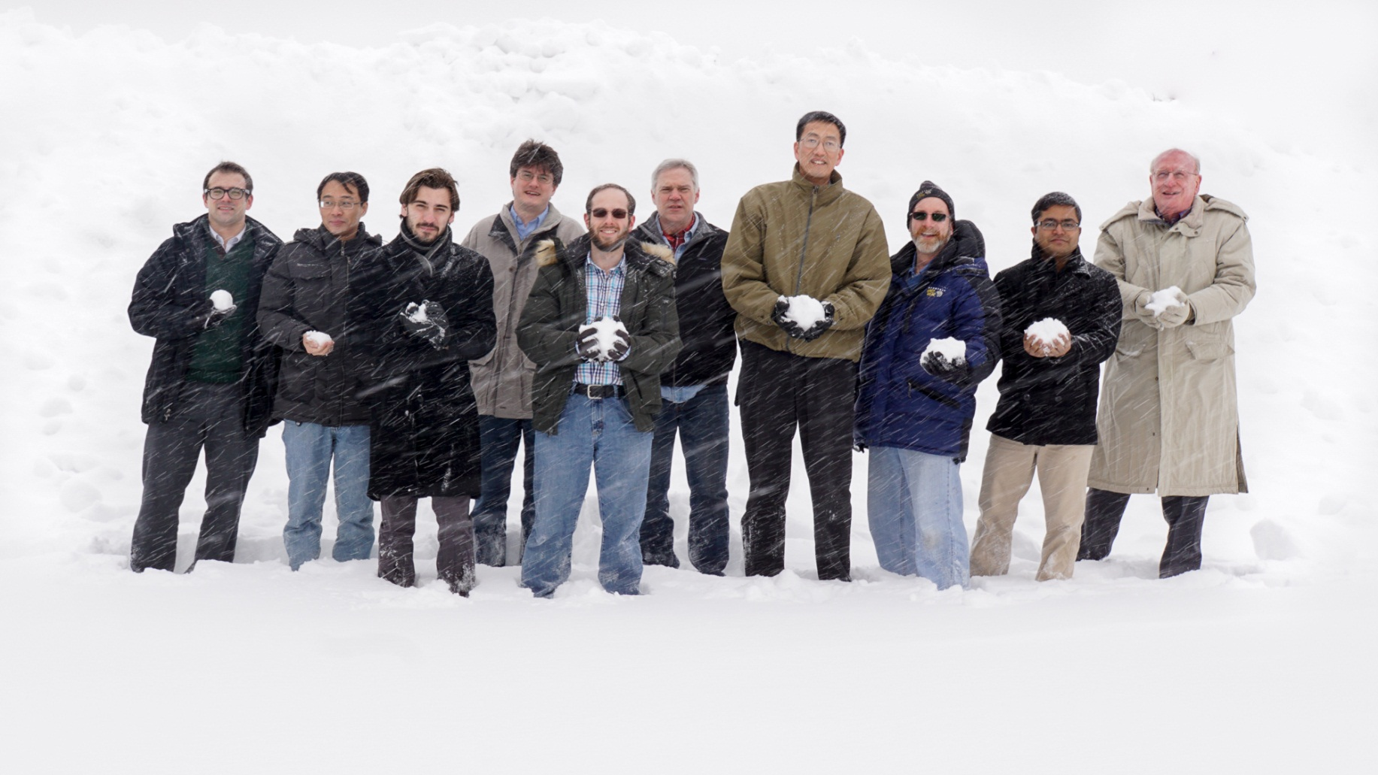
Michael
Bishof
Peter
Mueller
Tom
O’Connor
Z.-T.
Lu
Kevin
Bailey
Mukut
Kalita
Roy
Holt
Richard
Parker
Cold Atom Trappers
Argonne: Kevin Bailey, Michael Bishof, John Greene, Roy Holt, Nathan Lemke, Zheng-Tian Lu, Peter Mueller, Tom O’Connor, Richard Parker
Kentucky: Mukut Kalita, Wolfgang Korsch
Michigan State: Jaideep Singh
Northwestern: Matt Dietrich

Slide 35
²²⁵Ra Yields
²³³U
159 kyr
α
²²⁵Ac
10 d
²²⁹Th
7.3 kyr
α
β
α
Fr, Rn,…
~4 hr
²²⁵Ra
15 d
Presently available
National Isotope Development Center, ORNL
  Decay daughters of ²²⁹Th ²²⁵Ra: 10⁸ /s
Projected
FRIB (B. Sherrill, MSU)
  Beam dump recovery with a ²³⁸U beam 6 x 10⁹ /s
  Dedicated running with a ²³²Th beam 5 x 10¹⁰ /s
ISOL@FRIB (I.C. Gomes and J. Nolen, Argonne)
  Deuterons on thorium target, 1 mA x 400 MeV = 400 kW 10¹³ /s
MSU K1200 (R. Ronningen and J. Nolen, Argonne)
  Deuterons on thorium target, 10 uA x 400 MeV = 4 kW 10¹¹ /s
35

Slide 36
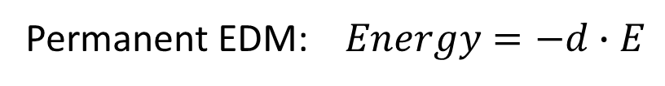
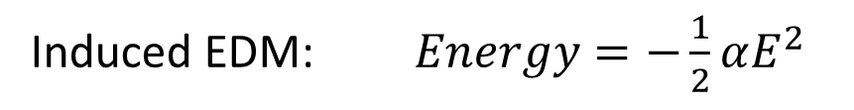
Permanent EDM violates P-, T- symmetry
Induced EDM: $Energy=−\frac{1}{2}αE^{2}$
Permanent EDM: $Energy=−d∙E$
+
T
+
P
_
+
_
_
EDM
spin
EDM
spin
EDM
spin
CP problem in strong interaction: θ term
SUSY:
New elementary particles→ new CP phase
Origins of matter – antimatter asymmetry:
New physical CP mechanism

Slide 37
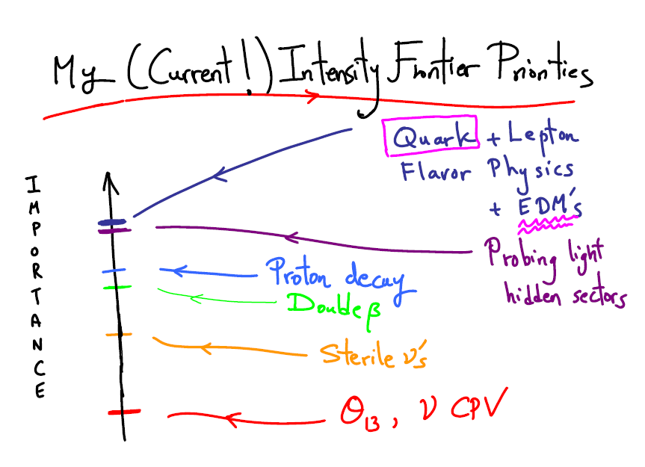
Intensity Frontier Workshop, Dec 2011, www.intensityfrontier.org
Convenors for nuclear physics: Haxton, Lu, Ramsey-Musolf
Priorities according to Nima Arkani-Hamed,
Institute for Advanced Study
“The existence of an EDM can provide the “missing link” for explaining why the universe contains more matter than antimatter.”
“A nonzero EDM would constitute a truly revolutionary discovery.”
-- Nuclear Science Advisory Committee (NSAC) Long Range Plan (2007)
“The non-observation of EDMs to-date, thus provides tight restrictions to building theories beyond the Standard Model.”
-- P5 report : The Particle Physics Roadmap (2006)

Slide 38

Measurability of Nuclear EDM
L.I. Schiff, Phys. Rev. 132, 2194 (1963)
Schiff shielding
However, since nuclear charge distribution differs from EDM distribution
$$d_{atom}∝d_{nucleus}∙\left(r_{d}^{2}−r_{c}^{2}\right)∙r_{atom}^{−1}∙r_{c}^{−1}$$
simplified
rigorous
Schiff moment

Slide 39
Measurability of Nuclear EDM
L.I. Schiff, Phys. Rev. 132, 2194 (1963)
Schiff shielding
However, since nuclear charge distribution differs from EDM distribution
$$d_{atom}∝d_{nucleus}∙\left(r_{d}^{2}−r_{c}^{2}\right)∙r_{atom}^{−1}∙r_{c}^{−1}$$
simplified
rigorous
Schiff moment

