Slide 1
Fundamental Asymmetry in the neutron nuclei interaction
报告人：樊瑞睿（中国科学院高能物理研究所）
报告内容来自：NOPTREX合作组，北京大学，JINR-FLNP

Slide 2
中子与原子核相互作用
中子与原子核相互作用的基本对称性破缺研究
宇称破缺的放大效应
裂变截面中的宇称破缺
共振俘获中的宇称破缺
时间反演破缺
放大效应中的时间反演
宇称破缺研究
中子与轻核相互作用
10⁻⁷
10⁻³
10^{-?}

Slide 3
核物理的宇称破坏
The violation of Parity in nuclear

Slide 4
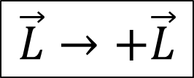
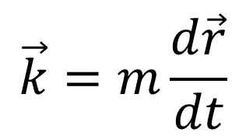
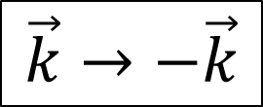
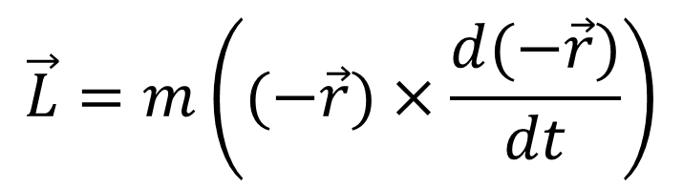
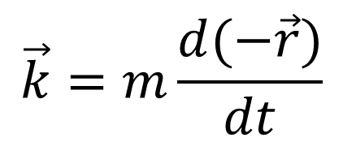
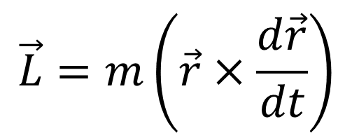
Theoretical Framework
We could understand the vectors characteristics under Parity and Time transformation with their classical expression.
Parity Transformation:
$$\vec{k}=m\frac{d\vec{r}}{dt}$$
$$\vec{k}=m\frac{d(−\vec{r})}{dt}$$
$$\vec{k}→−\vec{k}$$
P-odd
$$\vec{L}=m\left(\vec{r}×\frac{d\vec{r}}{dt}\right)$$
$$\vec{L}=m\left((−\vec{r})×\frac{d(−\vec{r})}{dt}\right)$$
$$\vec{L}→+\vec{L}$$
P-even
4

Slide 5
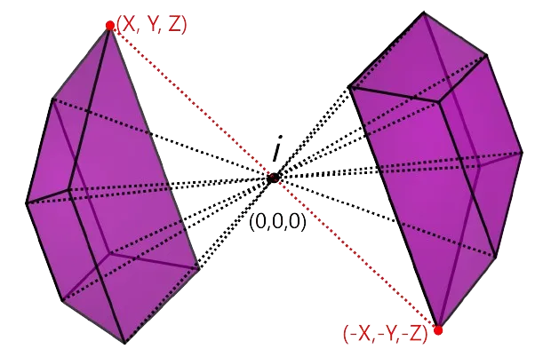
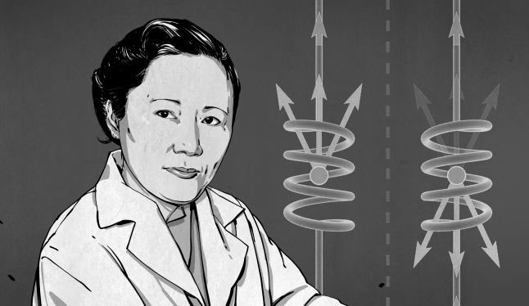
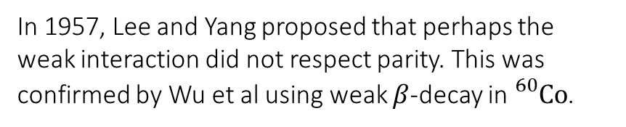

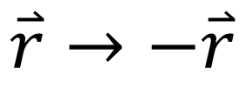
Parity transformation
宇称变换
$$\overset{⃑}{r}→−\overset{⃑}{r}$$
常见概念中的镜像（x）→（-x）并不能与宇称变换等价，所以宇称检验的核心在于检验赝标量期望值守恒。
最常见的赝标量就是：
In 1957, Lee and Yang proposed that perhaps the weak interaction did not respect parity. This was confirmed by Wu et al using weak $β$-decay in ${}_{}^{60}Co$.
$$<I∙k>$$
其中I为自旋或角动量，k为动量或速度

Slide 6
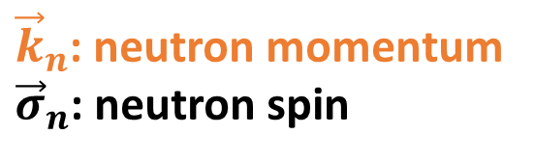

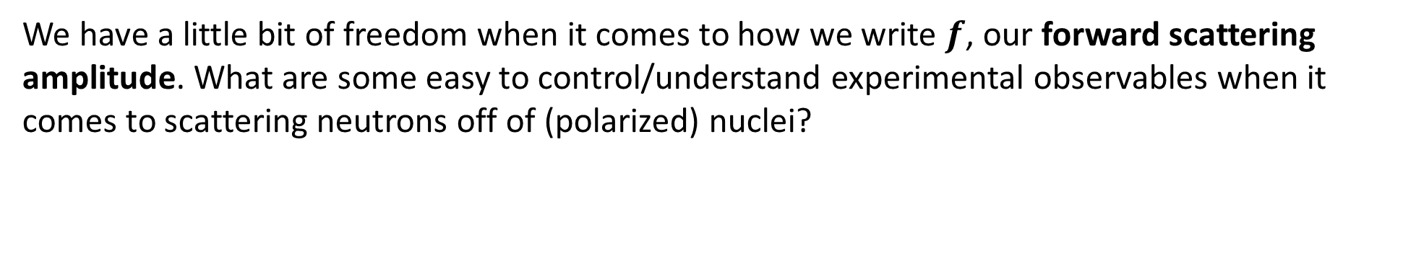



极化束流
We have a little bit of freedom when it comes to how we write $f$, our forward scattering amplitude. What are some easy to control/understand experimental observables when it comes to scattering neutrons off of (polarized) nuclei?
${\vec{k}}_{n}$: neutron momentum
${\vec{σ}}_{n}$: neutron spin
Parity
$${\vec{k}}_{n}$$
$${\vec{k}}_{n}$$
$${\vec{σ}}_{n}$$
$${\vec{σ}}_{n}$$
极化束流或极化的靶是在真实物理实验中构建赝标物理量的最好方式。

Slide 7
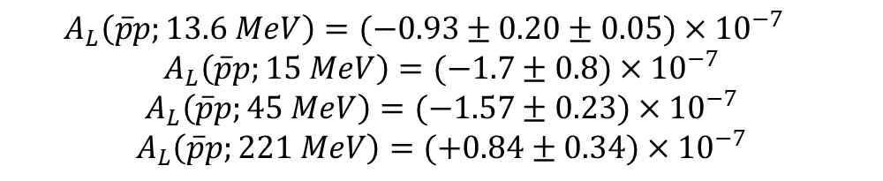

探索宇称破坏的实验
通过纵向极化的质子与非极化的质子靶散射测量的实验有四组，结果如下：
$$\vec{p}+p→p+p$$
$$A_{L}\left(\overline{p}p;13.6 MeV\right)=(−0.93±0.20±0.05)×{10}^{−7}$$
$$A_{L}\left(\overline{p}p;15 MeV\right)=(−1.7±0.8)×{10}^{−7}$$
$$A_{L}\left(\overline{p}p;45 MeV\right)=(−1.57±0.23)×{10}^{−7}$$
$$A_{L}\left(\overline{p}p;221 MeV\right)=(+0.84±0.34)×{10}^{−7}$$
Parity violation in proton proton scattering at 13.6-MeV. Phys Lett B. (1991) 256:11–4.
Parity violation in the scattering of 15 MeV protons by hydrogen. AIP Conf Proc. (1979) 51:224–30.
Precision measurement of parity violation in proton proton scattering at 45-MeV.Phys Rev Lett. (1987) 58:1616.
Parity violation in proton proton scattering at 221-MeV. Phys Rev C. (2003) 68:034004.

Slide 8

探索宇称破坏的实验
NPD实验使用极化中子轰击质子，寻找被质子俘获后γ出射角度与中子极化方向不对称性关系。最终结果：
$$\vec{n}+p→d+γ$$
$$α_{γ} = (−3.0 ± 1.4 ± 0.2) · {10}^{−8}$$
Blyth D, Fry J, Fomin N, Alarcon R, Alonzi L, Askanazi E,et al. First observation of P-odd γ asymmetry in polarizedneutron capture on hydrogen. Phys Rev Lett. (2018) 121:242002.
NPDGamma experiment

Slide 9

探索宇称破坏的实验
实验使用极化中子轰击³He，寻找出射质子与入射中子夹角不对称性关系。最终结果：
$$\vec{n}+3He→p+3H$$
$$α_{z} = (−1.55 ±0.97 ± 0.24) · {10}^{−8}$$
The n3He experiment: parity violation in polarized neutron capture on 3He. arXiv preprint arXiv:2004.10889 (2020).
The Parity violating asymmetry in the 3He(n,p)3H reaction. Phys Rev C. (2010) 82:044001
First precision measurement of the parity violating asymmetry in cold neutron capture on 3He. arXiv preprint arXiv:2004.11535 (2020).

Slide 10
宇称破缺的放大
Parity Violation Amplification

Slide 11
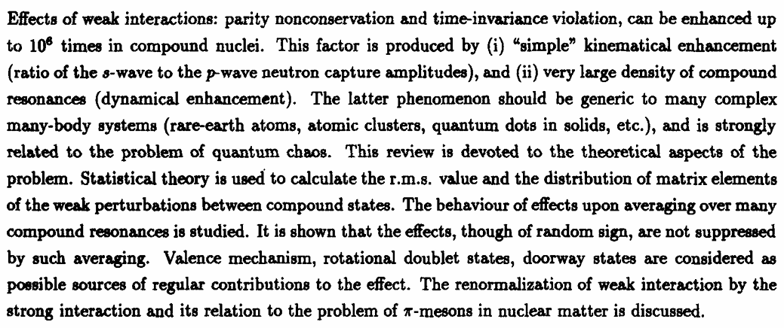
宇称破坏的增强
Flambaum, V. V., & Gribakin, G. F. (1995). Enhancement of Parity and Time-Invariance Violating Effects in Compound Nuclei. Physics Letters B, 354(4), 423-503.

Slide 12
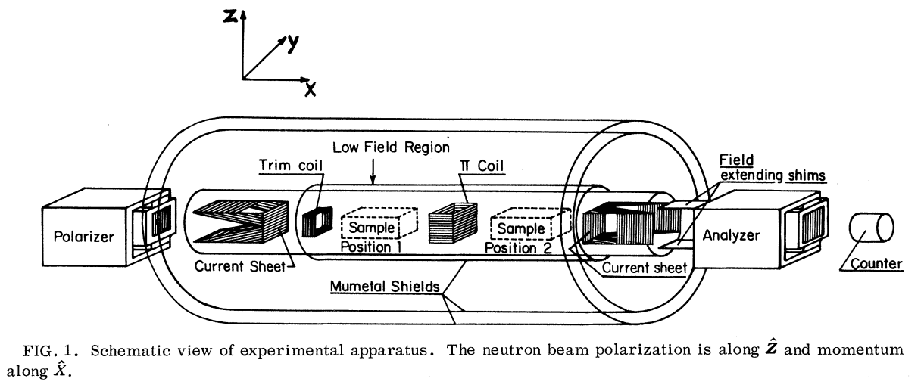
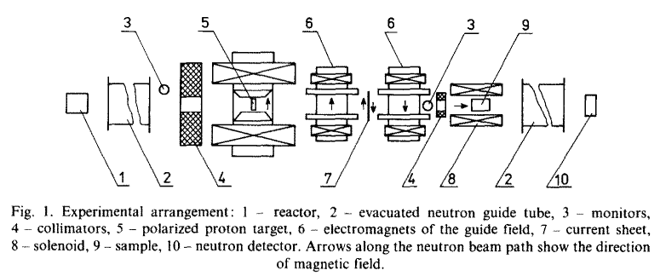
Brief history of the experiments(1)
in 1980 after the ILL measurements [64] on tin with polarized cold neutrons. In ¹¹⁷Sn PNC effects were observed: the spin rotation angle Φ=(3.7±0.3)×10⁻⁵rad/cm and the cross section longitudinal asymmetry A=(9.8±4.0)×10⁻⁶.
Experiments at Dubna were performed using the IBR-30 pulsed reactor as a neutron source for time-of-flight measurements. The proton-filter transmission technique for polarizing resonance neutrons was first developed at the Joint Institute of Nuclear Research (JINR) by another team.
Phys. Rev. Lett., 45 (1980), p. 2088
Nucl. Phys. A, 398 (1983), p. 93
Phys. Lett., 12 (1964), p. 334

Slide 13
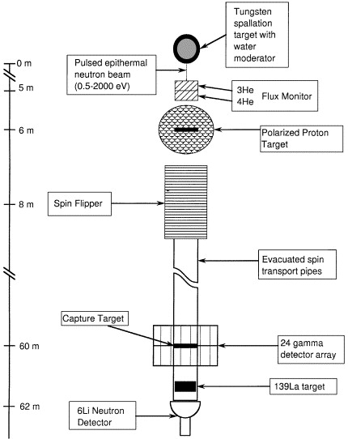
Brief history of the experiments(2)
KIAE (Kurchatov Institute of Atomic Energy), Moscow ¹¹⁷Sn and ¹³⁹La
KEK (High Energy Institute), Tsukuba, ¹³⁹La
TRIPLE Collaboration
S.A. Biryukov et al., Yad. Fiz. 45 (1987) 1511 [Sov. J. Nucl. Phys. 45 (1987) 937].
Nucl. Phys. A, 504 (1989), p. 289
Physics Reports, Volume 354, Issue 3, November 2001, Pages 157-241

Slide 14
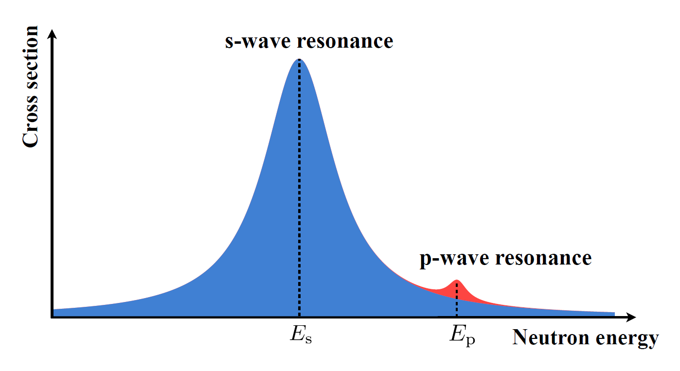
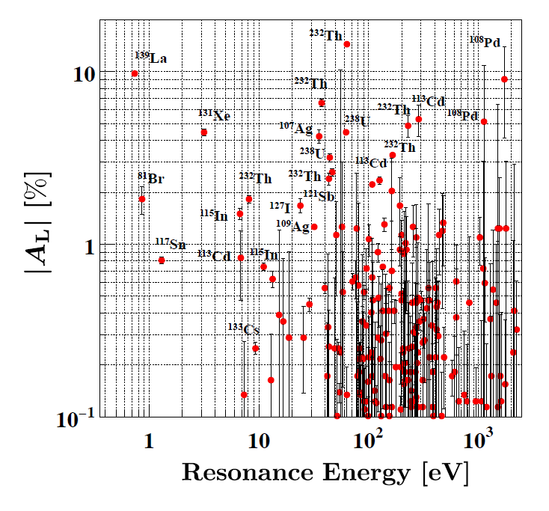
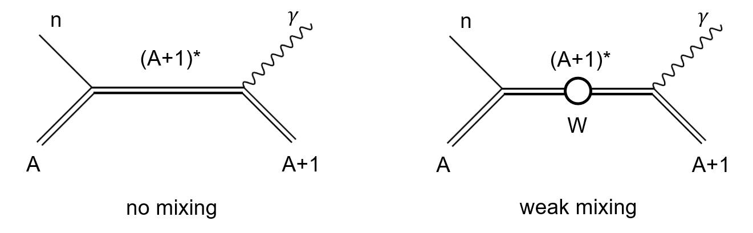

s,p-wave mixing enhances P-odd effects
Weak NN interaction amplitude: $Gm_{π}^{2} \sim {10}^{−7}$
Observed ${\sim 10}^{6}$ enhancement of P-odd effects!
P-odd Asymmetry
s
s
s
p
p
p
p
s
Feynman diagram of (n, γ) channel
Notes:
Optical Theorem: We treat the probed material like a material of cross section $σ$ and index of refraction n. The material will react to neutron with different helicity differently. P-odd dichroism means that the cross sections $σ_{+}$and $σ_{−}$ for neutrons with opposite helicity are not equal. The difference between n+ and n- (birefringence) leads to the rotation of neutron polarization around the neutron momentum. N the number of nuclei per unit volume of the target.

Slide 15
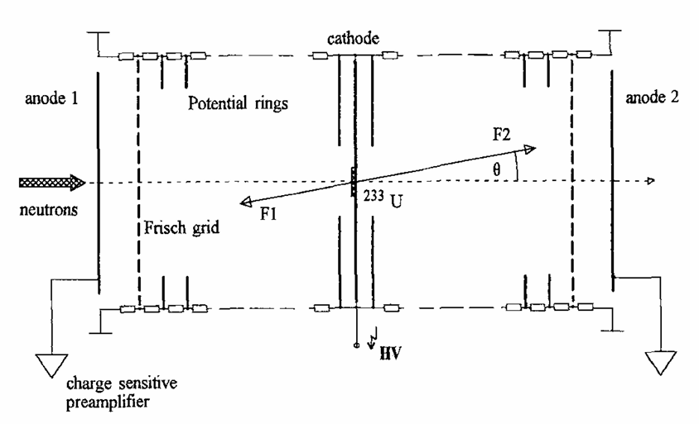


另一个故事
$$W\left(θ\right)=1+α\overset{⃑}{σ}∙\overset{⃑}{p}=1+α\cos{θ}$$
The asymmetry coefficient for the group of light fission fragments is
$$α=(3.29±0.31)×{10}^{−4}$$
JETP Lett. 1979, 30, 470. 99.
JETP Lett. 1979, 30, 527. 100.
JETP Lett. 1980, 32, 41. 101.
Sov. Phys. Usp. 1980, 23, 3231.
Z. Physik A - Hadrons and Nuclei 351, 281–288 (1995).

Slide 16
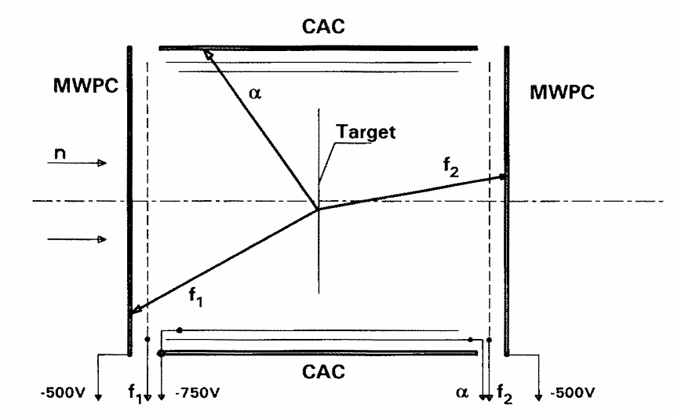
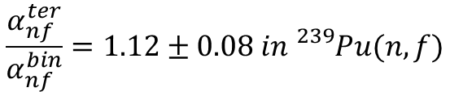
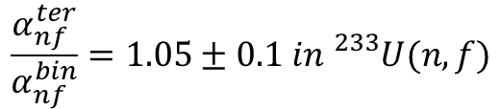
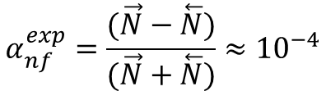
三分裂变
$$α_{nf}^{exp}=\frac{(\vec{N}−\overset{⃖}{N})}{(\vec{N}+\overset{⃖}{N})}≈{10}^{−4}$$
$$\frac{α_{nf}^{ter}}{α_{nf}^{bin}}=1.12±0.08 in {}_{}^{239}{Pu}(n, f)$$
$$\frac{α_{nf}^{ter}}{α_{nf}^{bin}}=1.05±0.1 in {}_{}^{233}U(n, f)$$
宇称不守恒相关性：实验测得的三元裂变与二元裂变的宇称不守恒不对称性系数比值接近1，表明两者在宇称不守恒方面没有显著差异。
三元裂变的发射时机：根据实验结果和理论模型，三元裂变中的轻粒子（如α粒子）在裂变过程的最后阶段才被发射，即在通过双峰裂变势垒的外鞍点之后。
裂变路径的一致性：实验结果表明，无论是二元还是三元裂变，裂变核在变形空间中的路径在通过第二鞍点之前是一致的。
理论模型的支持：实验结果与现有理论模型一致，支持了三元裂变是一个两步过程的观点，即在接近分裂点时，二元裂变后序贯发射第三个轻粒子。
Z Physik A 321, 271–274 (1985).
Nuclear Physics A Volume 567, Issue 2, 17 January 1994, Pages 303-316

Slide 17
时间反演破缺
Time reversal violation

Slide 18
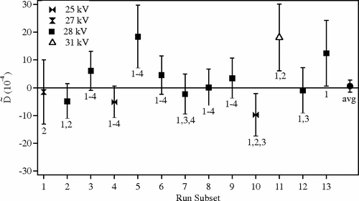
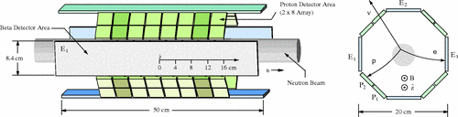
New Limit on Time-Reversal Violation in Beta Decay
极化中子衰变概率dW可以表示为
$$dW∝1+α\frac{p_{e}∙p_{ν}}{E_{e}E_{ν}}+b\frac{m_{e}}{E_{e}}+P∙(A\frac{p_{e}}{E_{e}}+B\frac{p_{ν}}{E_{ν}}+D\frac{p_{e}×p_{ν}}{E_{e}E_{ν}})$$
$$D=\left[−0.96±1.89(stat)±1.01(sys)\right]×{10}^{−4}$$
Phys. Rev. Lett. 107, 102301

Slide 19
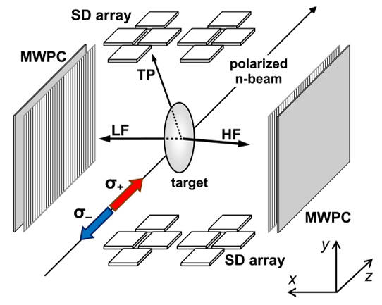
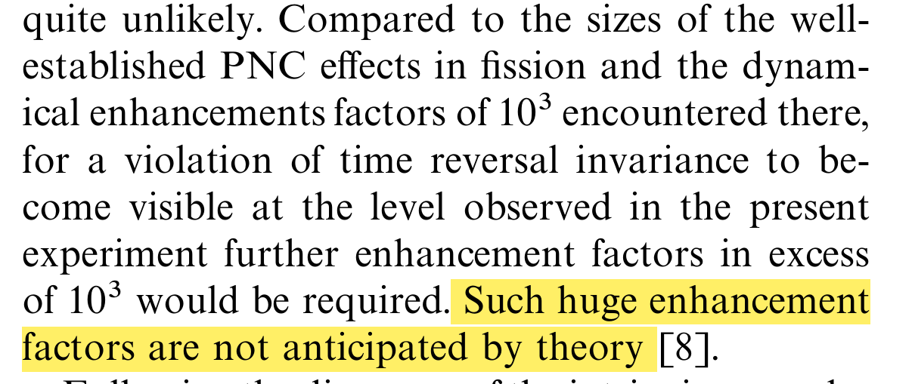
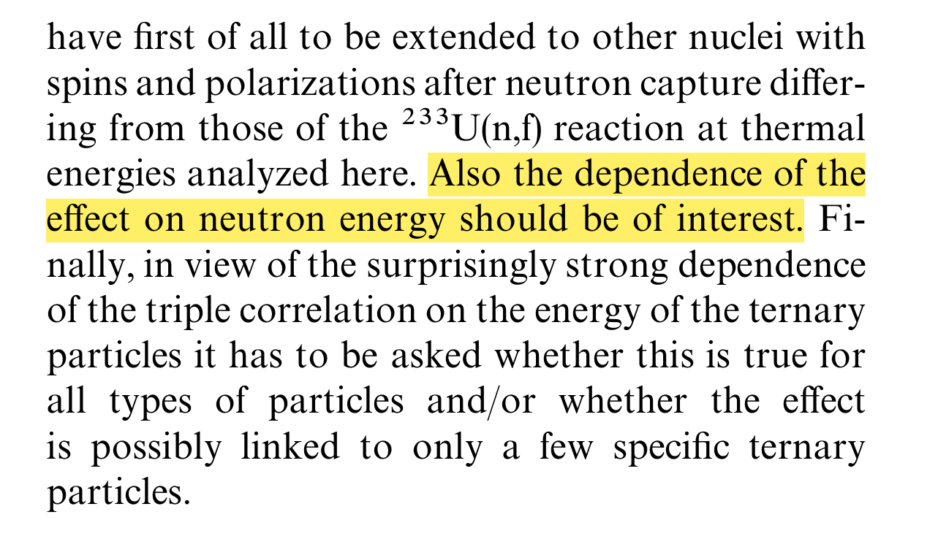

杜布纳团队的三体裂变测量尝试
实验观察到的 B 的期望值 为 -(2.35 ± 0.05) × 10⁻³，这个值远大于预期
$$B=\hat{σ}∙\left[\hat{p_{LF}}×\hat{p_{TP}}\right]$$
AIP Conf. Proc. 447, 395–404 (1998)
AIP Conf. Proc. 529, 577–585 (2000)
Nuclear Instruments and Methods in Physics Research A 440 (2000) 618-625

Slide 20
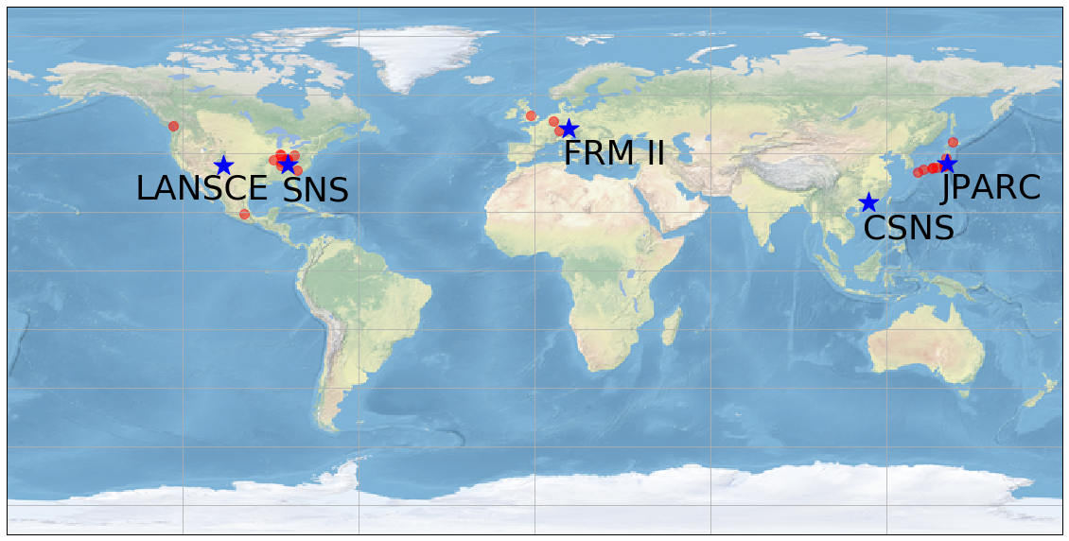
NOPTREX Collaboration List October 2022
C. Auton¹⁶, E. Babcock²⁹, M. Barlow³⁰, L. Barron-Palos²⁷, J. D. Bowman¹⁸, J. Carini¹⁶, L. E. Charon-Garcia²⁷, E. Y. Chekmenev³², C. Crawford¹⁹, J. Curole¹⁶, K. Dickerson¹⁶, J. Doskow¹⁶, D. Eigelbach²⁰, S. Endoh^{1,3}, R. Fan¹⁵, J. Fry²⁴, H. Fujioka⁷, B. M. Goodson²², V. Gudkov¹⁷, C. Haddock²¹, K. Hagino¹¹, H. Harada³, P. Hautle²⁸, M. Hino¹¹, K. Hirota¹, I. Ide¹, M. Iinuma⁶, H. Ikegami¹⁰, T. Ino⁴, R. Ishiguro¹³, S. Ishimoto⁴, K. Ishizaki¹, T. Iwata⁹, C. Jiang¹⁸, W. Jiang¹⁵, K. Kameda⁷, G. N. Kim¹⁴, A. Kimura³, P. King²³, M. Kitaguchi¹, Y. Kiyanagi¹, J. Koga², H. Kohri⁸, A. Komives³¹, S. W. Lee¹⁴, H. Lu¹⁶, G. Luan³⁴, D. Lutes¹⁶, M. Luxnat¹⁶, T. Matsushita¹, M. McCrea³⁶, K. Mishima⁴, Y. Miyachi⁹, T. Momose⁵, T. Morishima¹, Y. Niinomi¹, I. Novikov²⁵, T. Okudaira¹, K. Ogata⁸, T. Oku³, G. Otero¹⁶, J. Peck¹⁹, S. Penttila¹⁸, A. Perez-Martin²⁷, B. Plaster¹⁹, X. Ruan³⁴, D. Sahibnazarova¹⁹, K. Sakai³, S. Samiei¹⁶,D. Schaper²⁰, R. Shchepin³³ ,T. Shima⁸, H. M. Shimizu¹, W. M. Snow¹⁶, D. Spayde³⁵, H. Tada¹, J. Tang¹⁵, Z. Tang²⁰, Y. Tani⁷, S. Takada², Y. I. Takahashi¹¹, D. Takahaski¹², K. Taketani⁸, K. Tateishi¹⁰, X. Tong¹⁵, T. Uesaka¹⁰, J. Vanderwerp¹⁶, M. Veillette²⁶, G. Visser¹⁶, N. Wada¹, Y. Wang¹⁹, T. Yamamoto¹, Y. Yamagata¹⁰, X. Yamanaka¹ , H. Yoshikawa⁸, T. Yoshioka², M. Yosoi⁸ , M. Zhang^{15,16}, Q. Zhang³⁴, G. Ziemyte¹⁹
____________________________________________________________________________________________________________________________________
¹Nagoya, ²Kyushu, ³JAEA, ⁴KEK, ⁵British Columbia, ⁶Hiroshima, ⁷Tokyo Inst. Tech., ⁸Osaka, ⁹Yamagata, ¹⁰RIKEN, ¹¹Kyoto, ¹²Ashikaga, ¹³Japan Women’s, ¹⁴Kyungpook, ¹⁵CSNS, ¹⁶Indiana, ¹⁷South Carolina, ¹⁸ORNL, ¹⁹Kentucky, ²⁰LANL, ²¹Phase III Physics, ²²Southern Illinois, ²³Ohio, ²⁴Eastern Kentucky, ²⁵Western Kentucky, ²⁶Berea, ²⁷UNAM, ²⁸PSI, ²⁹Juelich, ³⁰Nottingham, ³¹DePauw, ³²Wayne State, ³³SDSM&T, ³⁴CIAE, ³⁵Hendrix, ³⁶Manitoba
中国组成员：高能所、原子能院、理化所、山东大学、大湾区大学

Slide 21
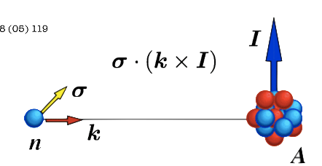
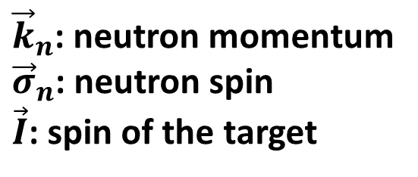
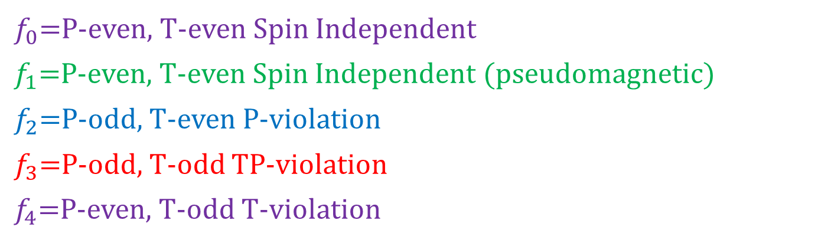
NOPTREX Theoretical Framework
$$f=f_{0}+f_{1}\left({ \overset{⃑}{σ}}_{n}∙\overset{⃑}{I} \right)+f_{2}\left({ \overset{⃑}{σ}}_{n}∙{\overset{⃑}{k}}_{n} \right)+f_{3}\left({ \overset{⃑}{σ}}_{n}∙\left[{ \overset{⃑}{k}}_{n}×\overset{⃑}{I} \right] \right)+f_{4}\left({ \overset{⃑}{σ}}_{n}∙\left(\overset{⃑}{I}×{ \overset{⃑}{k}}_{n}\right)\left(\overset{⃑}{I}∙{ \overset{⃑}{k}}_{n}\right)\right)$$
$f_{0}$=P-even, T-even Spin Independent
$f_{1}$=P-even, T-even Spin Independent (pseudomagnetic)
$f_{2}$=P-odd, T-even P-violation
$f_{3}$=P-odd, T-odd TP-violation
$f_{4}$=P-even, T-odd T-violation
${\vec{k}}_{n}$: neutron momentum
${\vec{σ}}_{n}$: neutron spin
$\vec{I}$: spin of the target
What we are mostly interested in!

Slide 22
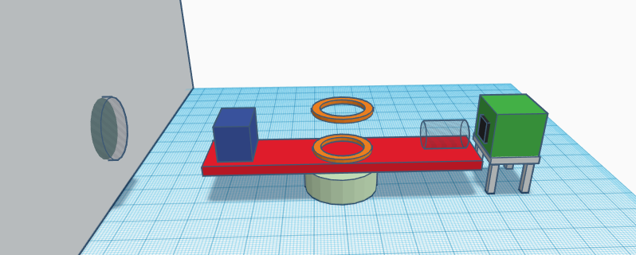
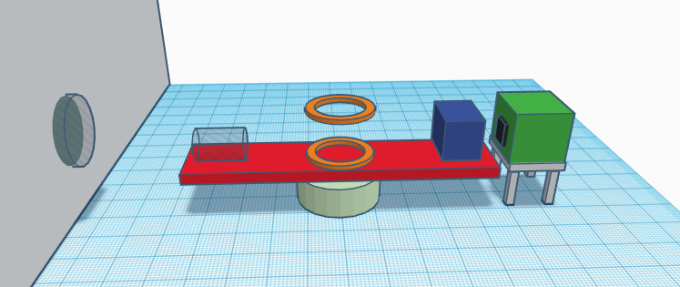
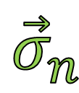
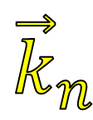




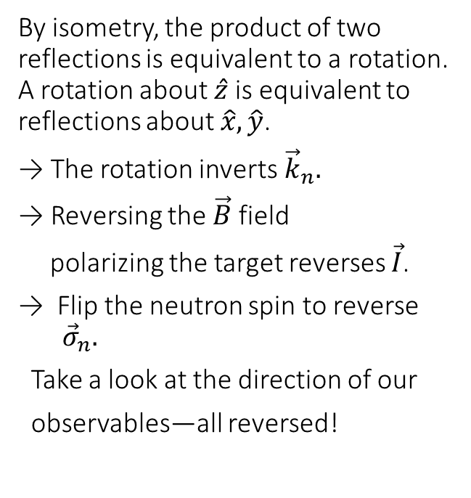



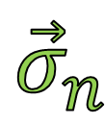
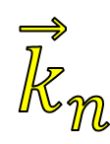

Basic idea of NOPTREX
$$\hat{z}$$
$$f_{3}\left({ \overset{⃑}{σ}}_{n}∙\left[{ \overset{⃑}{k}}_{n}× \overset{⃑}{I} \right] \right)$$
$${\vec{k}}_{n}$$
$${\vec{σ}}_{n}$$
P-odd, T-odd forward scattering term
$$\hat{y}$$
By isometry, the product of two reflections is equivalent to a rotation. A rotation about $\hat{z}$ is equivalent to reflections about $\hat{x},\hat{y}$.
→ The rotation inverts${\vec{k}}_{n}.$
→ Reversing the $\vec{B}$ field
polarizing the target reverses $\vec{I}$.
→ Flip the neutron spin to reverse ${ \vec{σ}}_{n}.$
Take a look at the direction of our
observables—all reversed!
$$\hat{x}$$
$$\vec{I}$$
$$\vec{I}$$
$$\hat{z}$$
$$\hat{x}$$
$$\hat{y}$$
$${\vec{k}}_{n}$$
$${\vec{σ}}_{n}$$

Slide 23
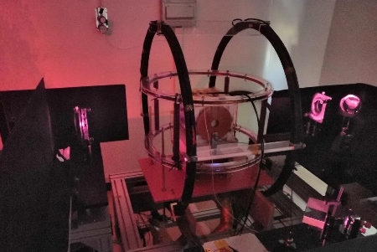
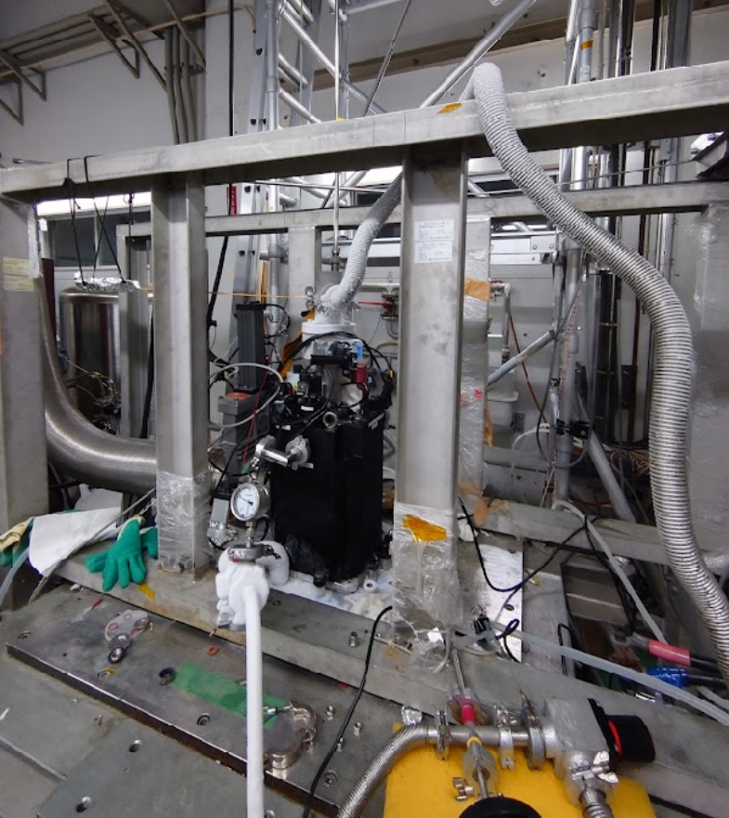
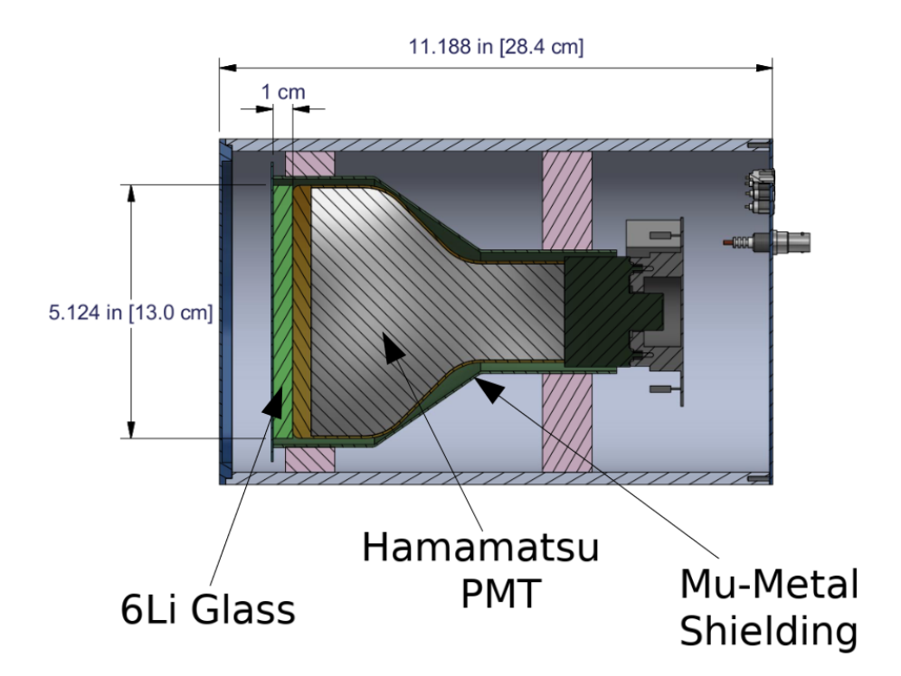
NOPTREX
NOPTREX
Selection of target nuclei with high t-violation amplification factor
Development of nuclear polarization technology
Neutron detection
Development of neutron polarization technology
Validating the S-P Mixing Model
Epithermal neutron
³He spin-exchange optical pumping
dynamic nuclear polarization
Side view of the detector design

Slide 24
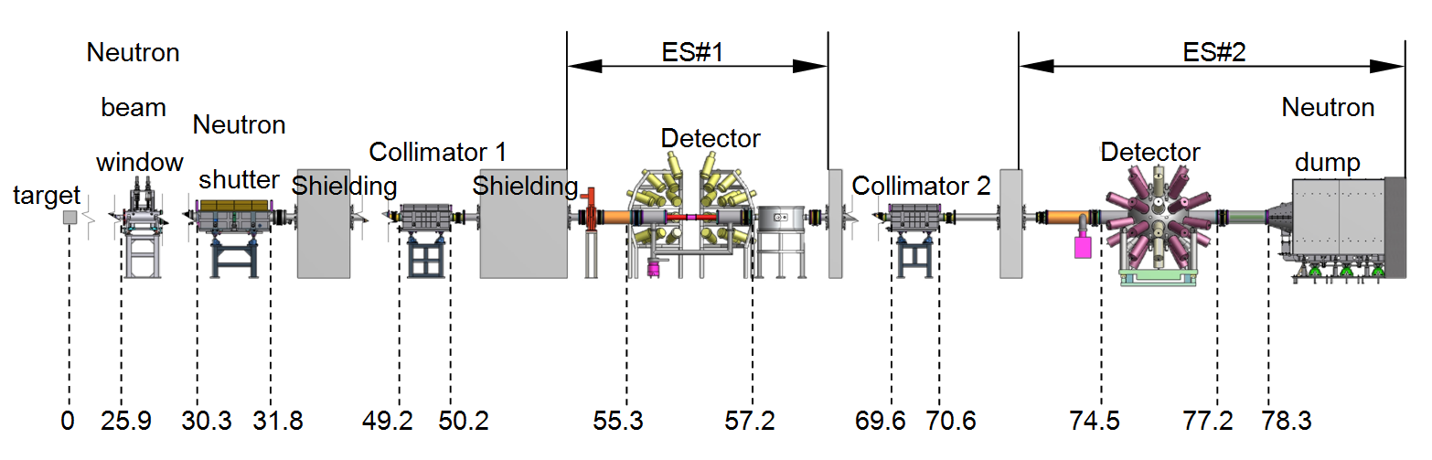
Back-n
Layout of the Back-n
neutron
The back-streaming neutrons are leading to the Back-n tunnel, which has a long flight distance for the neutron time-of-flight method. Two end stations ES#1 and ES#2 are constructed for different nuclear data measurements. The ES#1 has a distance of about 55 m, and ES#2 is about 70 m from the target. Different sets of beam spots, collimator apertures and neutron fluxes at Back-n at 100 kW in proton beam power can be found in table.
2017 JINST 12 P07022
Eur. Phys. J. A (2019) 55: 115

Slide 25
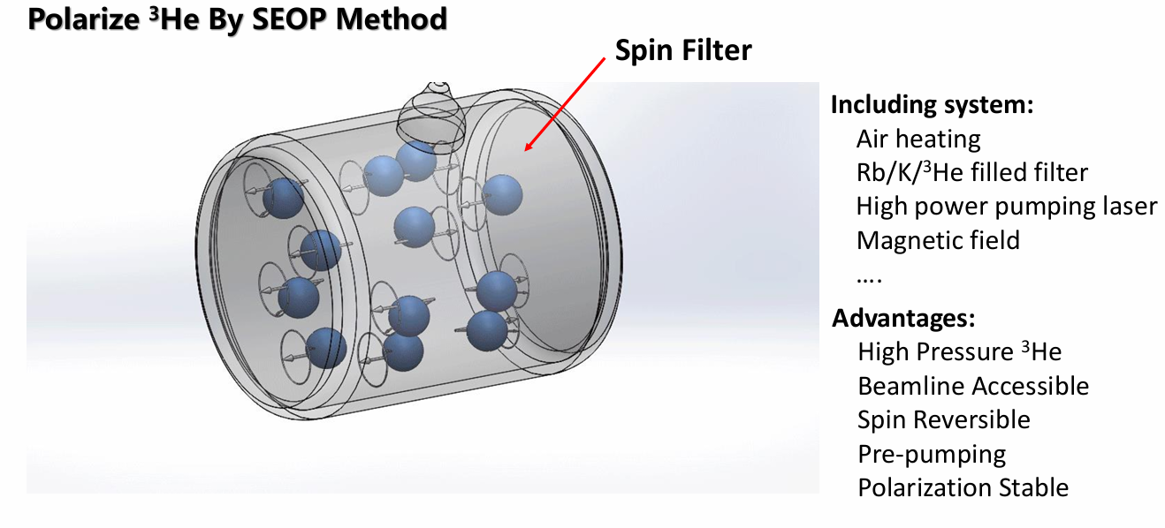
³He中子极化装置

Slide 26
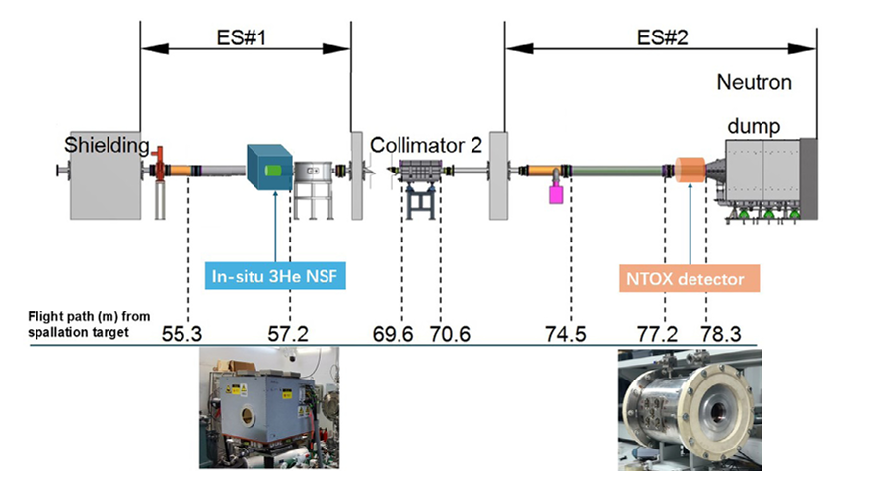
Back-n polarized 3He transmission experiment

Slide 27
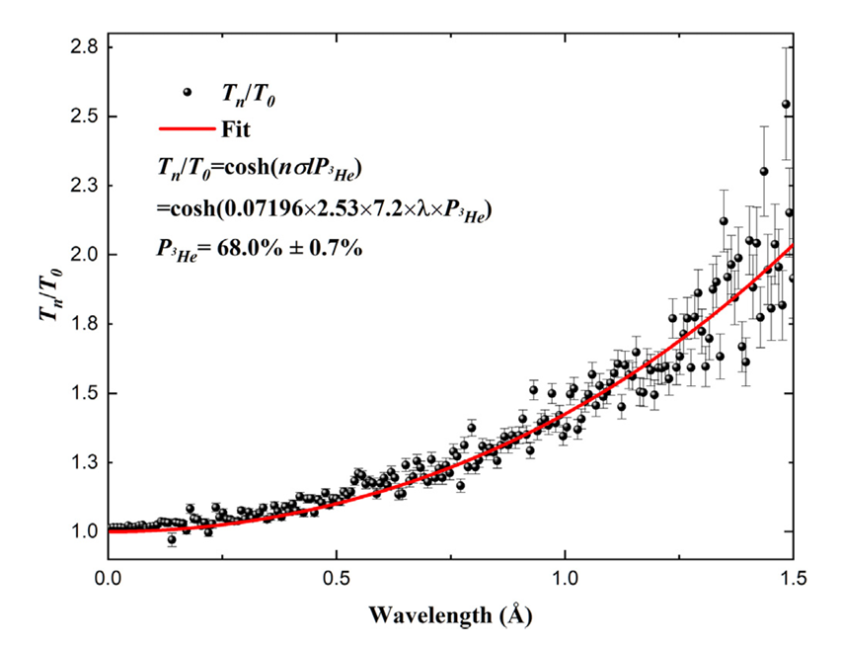
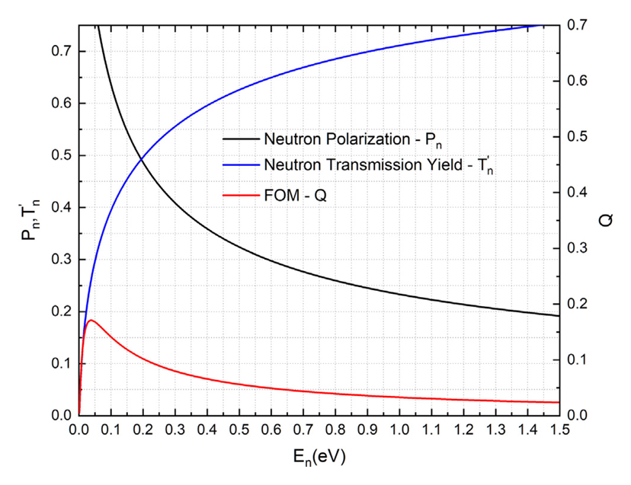
实验结果
0.038eV
First use of a polarized 3He neutron spin filter on the Back-n White Neutron Source of CSNS, NIMA, 1072,2025,170184

Slide 28





Parity Violation in p-wave resonances of unmeasured nuclei
In-situ #2 neutron polarizer
GTAF-II
BaF2 array
Current Mode 6Li Neutron Detector
Unpolarized
Beam
$${ \overset{⃑}{σ}}_{n}$$
γ
γ
γ
γ
γ
γ
γ
$$T_{+}$$
3He SEOP NSF
Spin
Transport
Target
$${ \overset{⃑}{k}}_{n}$$
$$T_{−}$$
γ
γ
γ
γ
γ
γ
γ
Beamtime: 240h
Time: Dec 31st, 2024 – Jan 11th, 2025

Slide 29
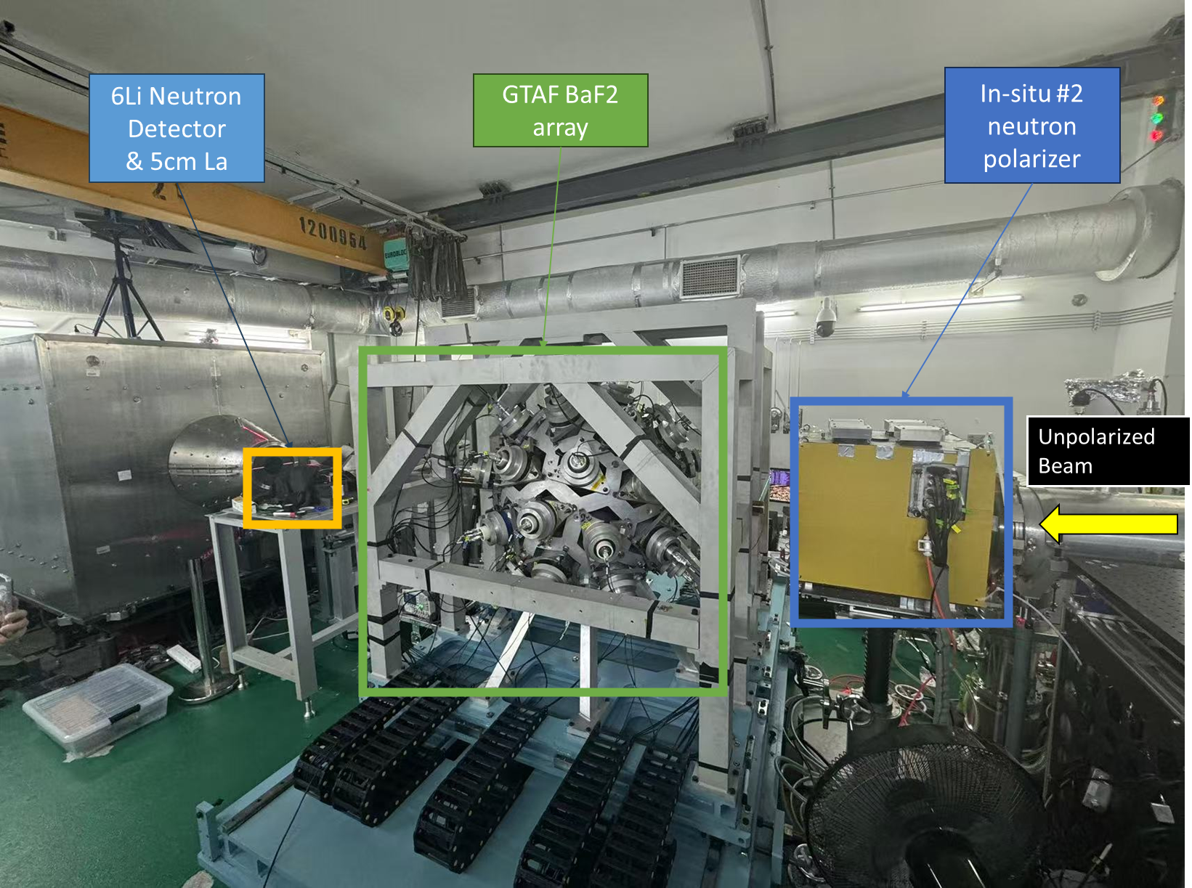

2025年1月的第一次尝试

Slide 30



Slide 31



Slide 32


中子屏蔽的诸多问题
In-situ 3He neutron polarizer:
  4 face B 3mm shielding
  1 face Pb 1mm shielding
Copper solenoid in place
Sample in air
6Li detector in place
15mins data

Slide 33

极化中子装置设计

Slide 34

高效率极化系统
Courtesy of: Takuya(Nagoya Uni)

Slide 35

NOPTREX合作组下一步计划
What about
140<A<210?
No data!
Courtesy of: W. M. Snow(Indiana Uni)

Slide 36



JPARC P Violation Scientific Work 2021-2025
Search for P-odd asymmetries in unmeasured nuclei, for:
New nuclei for P-odd/T-odd NOPTREX time reversal experiment
Test of statistical theory of parity violation in heavy nuclei
(2) Search for new p-wave resonances in unmeasured nuclei
First NOPTREX experiment with China, Japan, US groups!

Slide 37

Courtesy of: Shimizu(Nagoya Uni)

Slide 38



JINR-FLNP团队
Courtesy of: Gadir(JINR FLNP)

Slide 39

共振态的宇称破坏测量
0.3 eV
1.14 eV
Back-n覆盖能区

Slide 40

为什么是1.14eV？
选择在1.14 eV处测量PV效应，主要是因为这个能量点是²³⁵U核的一个纯共振态，主要由J = 4的自旋态贡献。这使得实验结果更加清晰，能够直接反映单一自旋态对宇称破缺效应的贡献，从而验证理论模型并深入理解裂变机制。此外，这个能量点的实验条件相对成熟，适合在现有的极化中子源上进行研究
When a ²³⁵U nucleus in its ground state (spin I = 7/2 ) captures an s wave neutron (with an orbital angular momentum of 0), a compound ²³⁶U nucleus is formed in states with
spins J+ = 1 + 1/2 = 4 and J = 1 – 1/2 = 3.
Spin-separated Fission cross sections for ²³⁶U* depending on the energy of the incident neutron. Red line corresponds to J = 3 spin, blue line to J = 4 spin, black line to the sum of both, respectively. Calculated by SAMMY
Courtesy of: Daniyar(JINR FLNP)

Slide 41


一个初步的实验方案
Neutron Spin Filter
Time Project Chamber
$$B=\hat{σ}∙\left[\hat{p_{LF}}×\hat{p_{TP}}\right]$$

Slide 42
中子与原子核相互作用
中子与原子核相互作用的基本对称性破缺研究
宇称破缺的放大效应
超热中子能区
时间反演破缺
？？？
宇称破缺研究
高通量冷中子源

Slide 43

ISINN31
The ISINN conference is the International Seminar on Neutron and Nuclear Reactions organized by the FLNP of JINR and is held annually.
In 2025, it will be hosted by CSNS from May 26 to 31.
This conference is highly relevant to the NOPTREX experiment's theme, and I warmly welcome everyone to attend in Dongguan.
https://indico.ihep.ac.cn/event/23550/

Slide 44

感谢各位老师聆听！
欢迎加入我们

