Slide 1
缪子探测器和ECAL研究
Yi Wang
Department of Engineering Physics
Tsinghua University

Slide 2
谱仪结构

Slide 3
缪子TOF探测器
结构及功能：
采用MRPC技术，飞行时间
分辨缪子和π介子
飞行时间法：30ps
介质吸收法：<80ps
端部+桶部

Slide 4
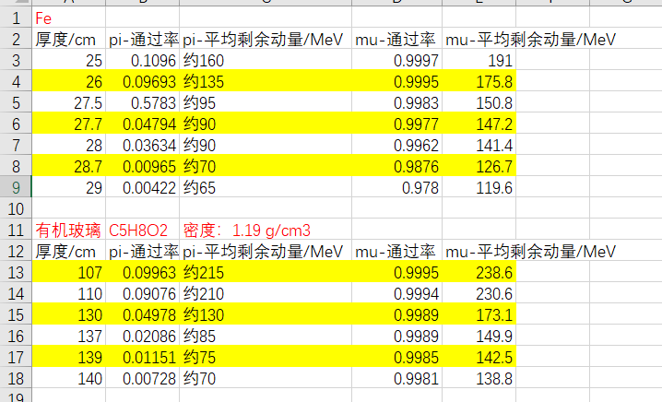
缪子TOF探测器及吸收体
如果TOF时间分辨达到30ps。π的质量为0.139GeV/c2，μ的质量为0.104GeV/c2
要使n=3，则L=1.58m
不同厚度吸收体对π和μ的吸收情况

Slide 5
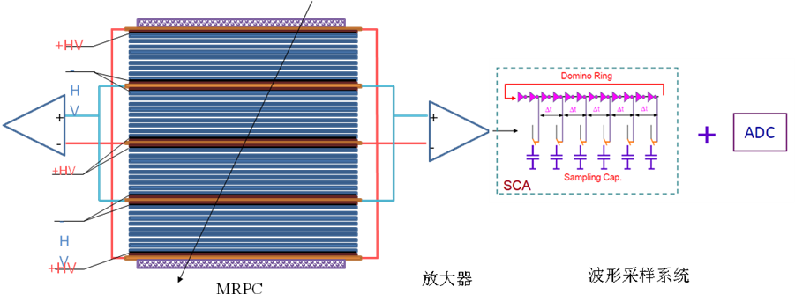
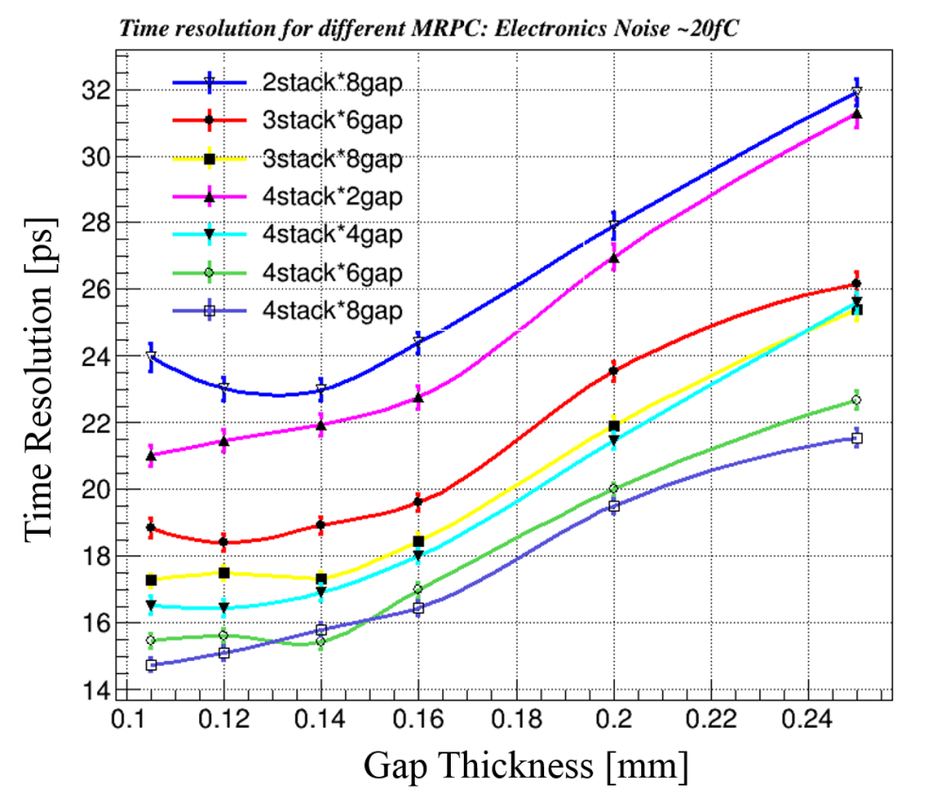
20ps MRPC结构及读出电子学
Simulation indicates proper ways to design the gap thickness and arrange the stacks
Narrower gap thickness required
σ_{TOF} <20 ps， the intrinsic resolution of narrow gaps MRPC is around 15ps，so the time jitter of readout electronics <13~15 ps。
σ_{MRPC} <20 ps，the gas gap: <0.18mm
gap number: >16

Slide 6
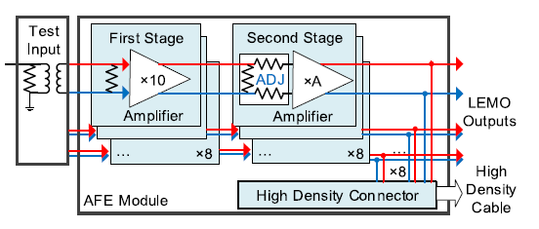
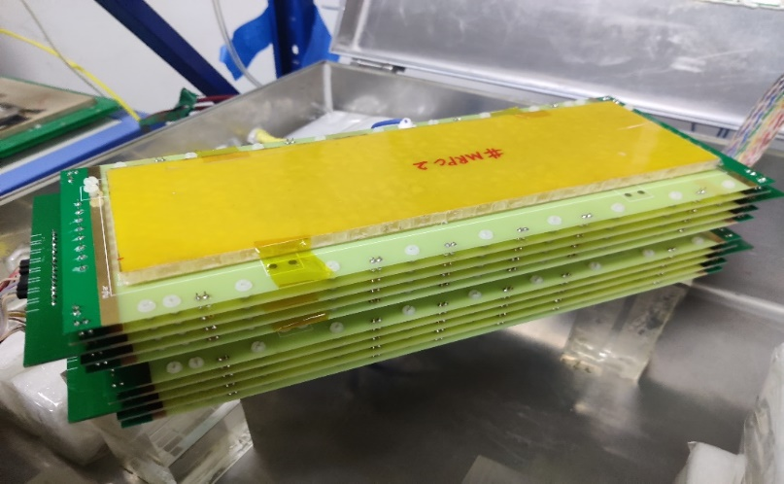
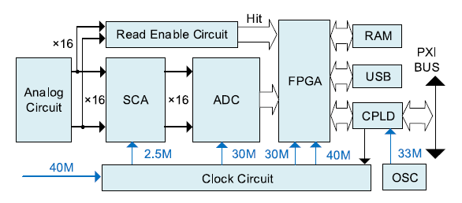
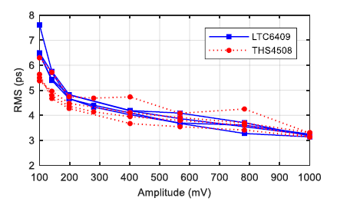
Toward 20ps resolution: fast readout electronics
Fast amplifier
Bandwidth=1.4GHz
 | MRPC prototype
gas gap thickness | 128 μm
number of gas gaps | 4 chambers × 8 gaps
glass material | low resistivity glass
glass thickness | 400
readout strips | 5 mm in width (2 mm clearance)
Waveform sampling
Based on DRS4
Sampling freq=5 GS/s
材料厚度：<0.1X₀
Fast amplifier & Waveform sampling
Electronic system time σ<7ps

Slide 7
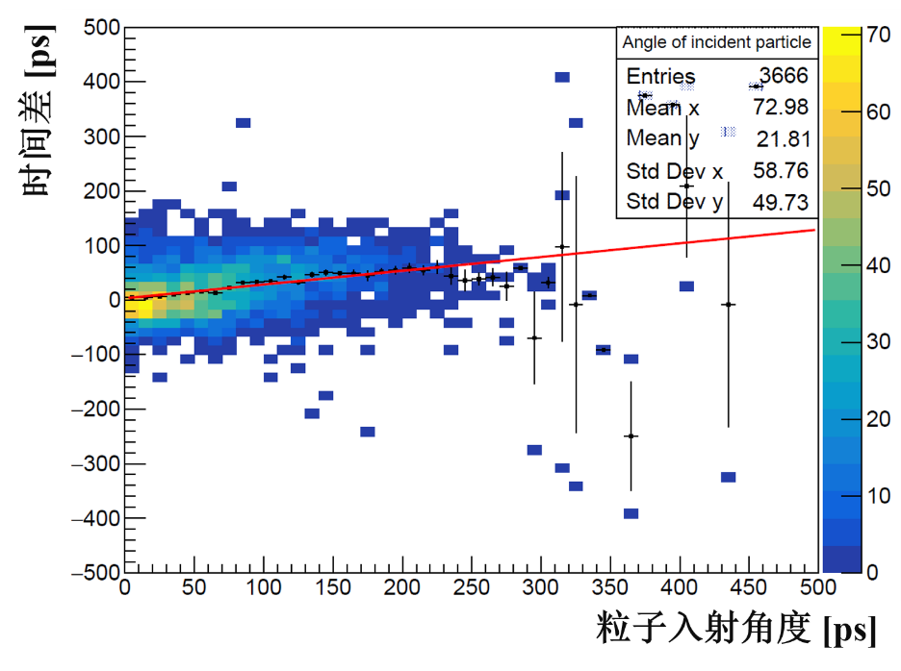
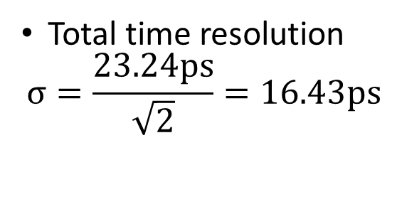
MRPC + fast amplifier + DRS4
Timing：CFD
Event choose：Vertical cosmic ray
Total time resolution
$$σ=\frac{23.24ps}{\sqrt{2}}=16.43ps$$

Slide 8
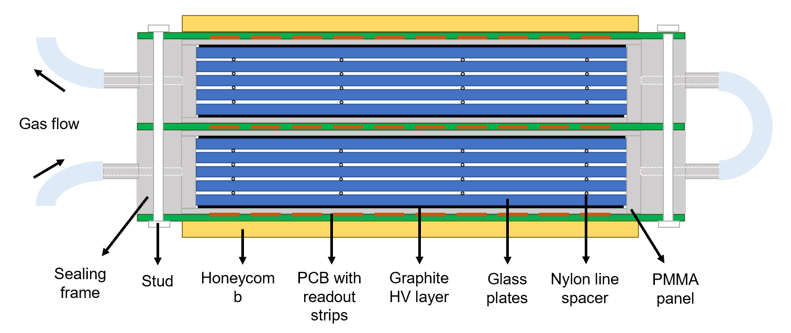
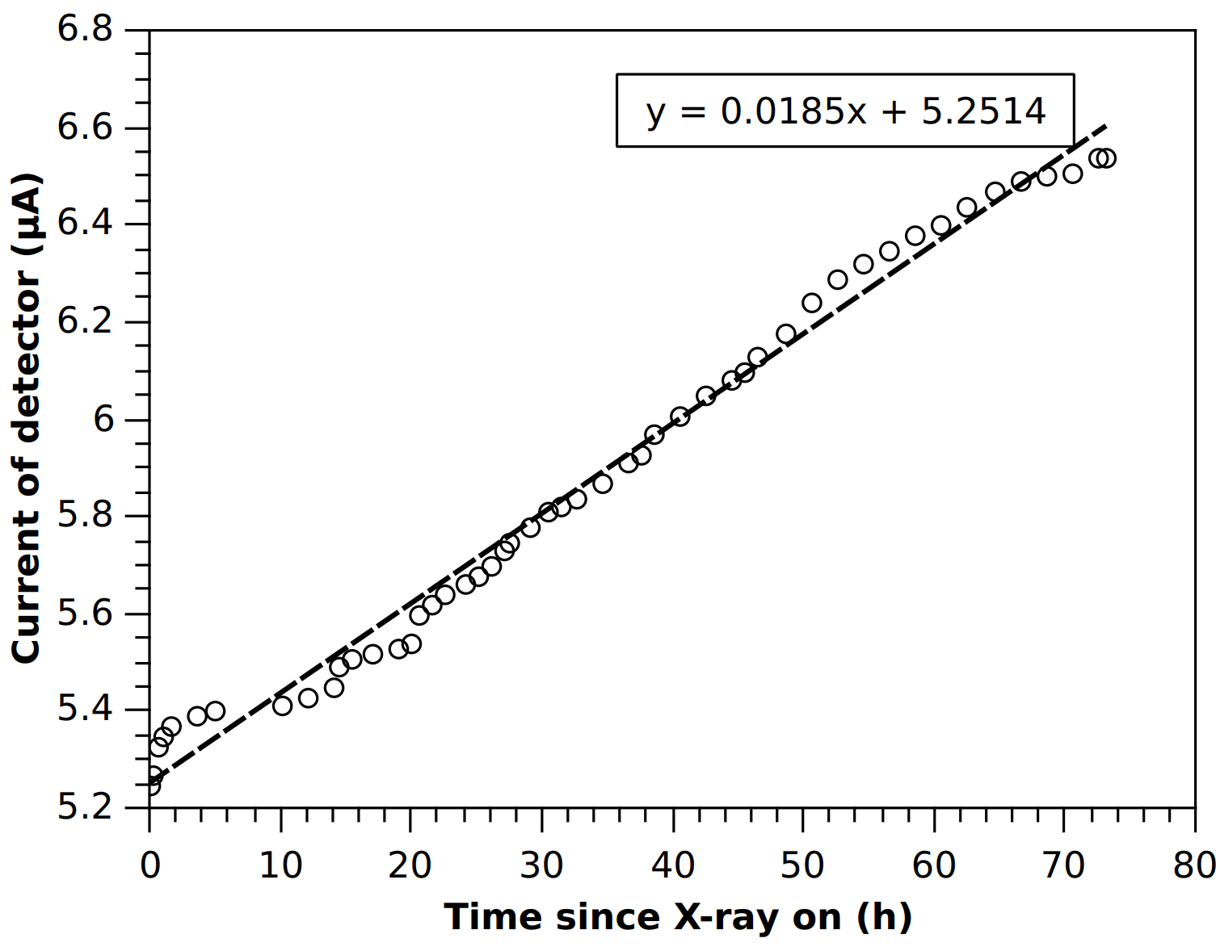
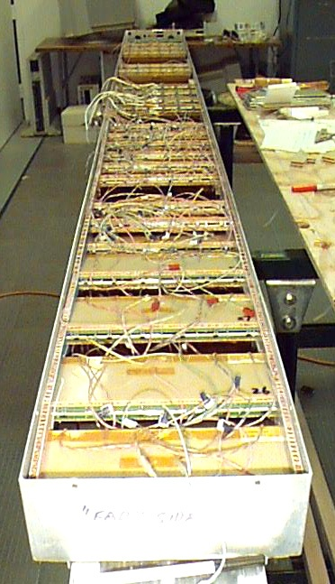
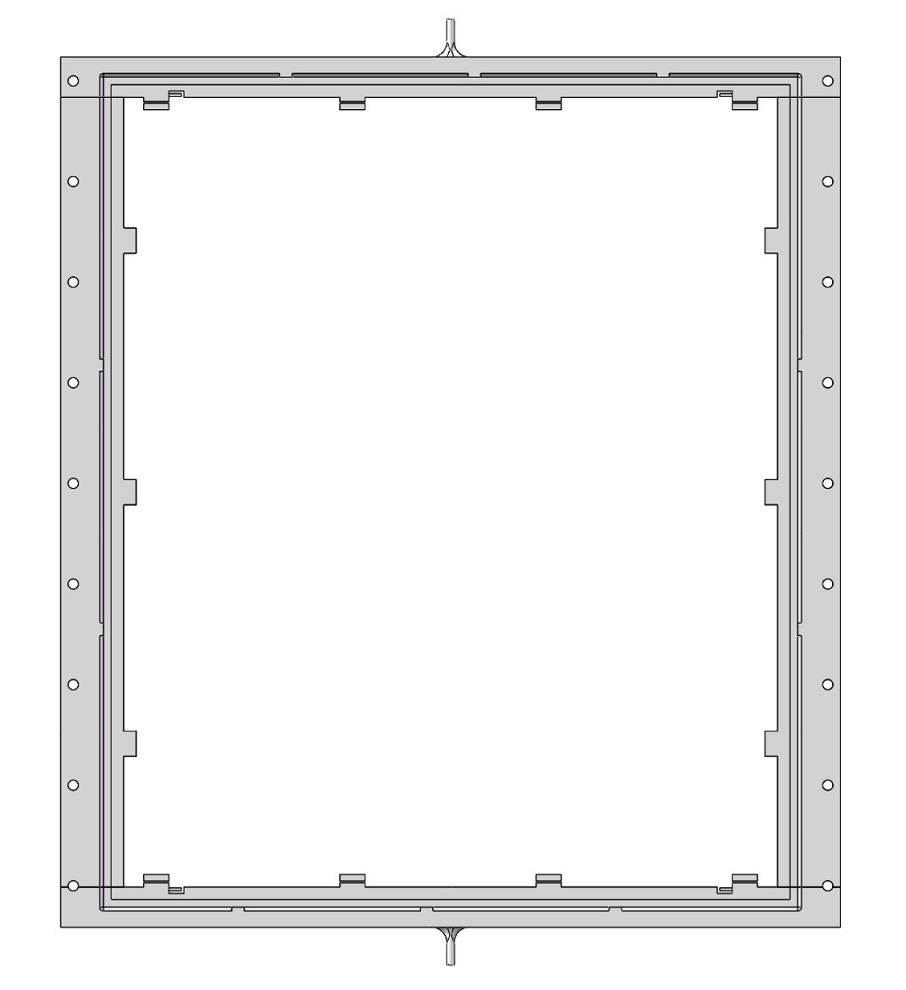
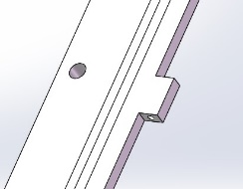
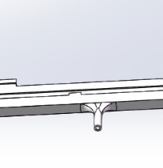
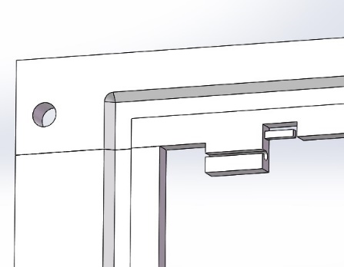
密封式可以大大节省气体消耗量
Constant rate condition of 1kHz/cm²
Gas tube
Inlet/outlet
The gas pollution in the gas gap caused the increase of current!
Fishline hook
3D printed sealing frame with Good strength, insulation and radiation persistency
Sealing MRPC speed up gas exchange and can reduce to 1sccm/m² flush rate at cosmic experiment!

Slide 9
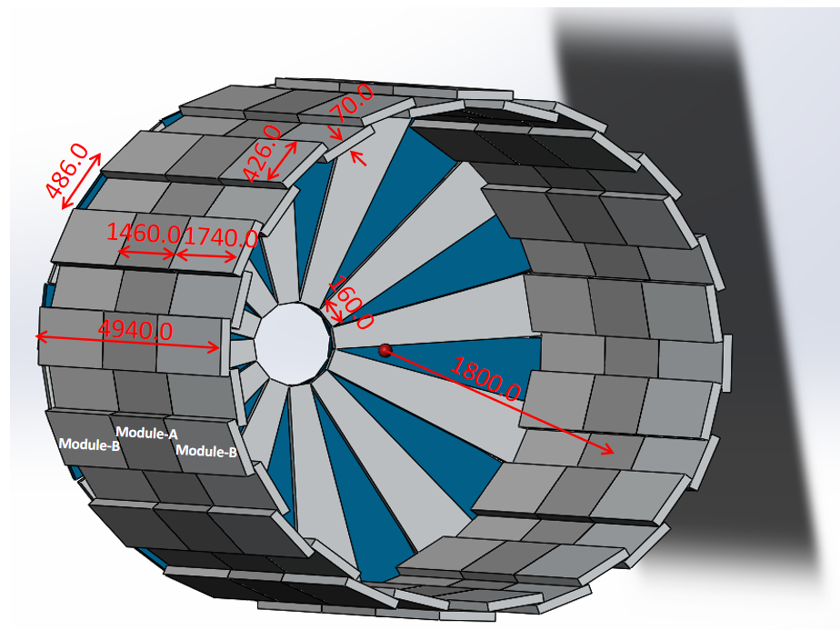
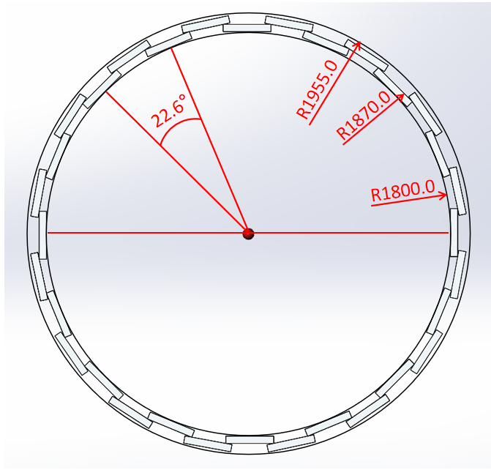
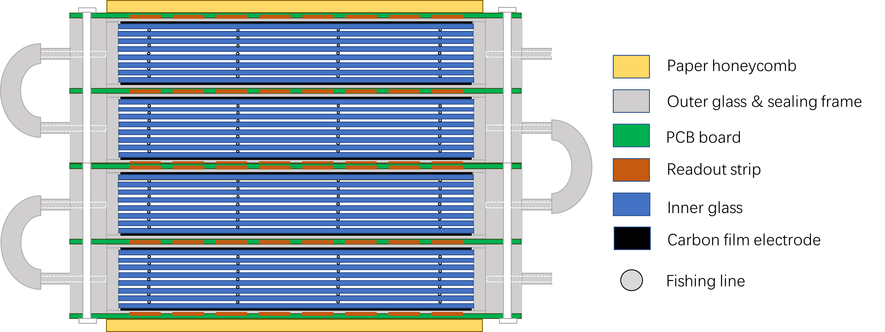
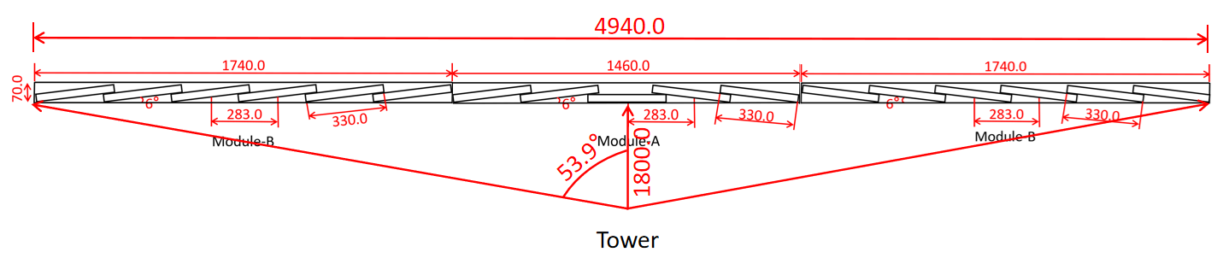
HIAF高能谱仪的缪子探测器概念设计
Performance：
1、Time resolution：<35ps
2、PID of π/μ: 500MeV@3σ
3、Material：0.1X₀

Slide 10
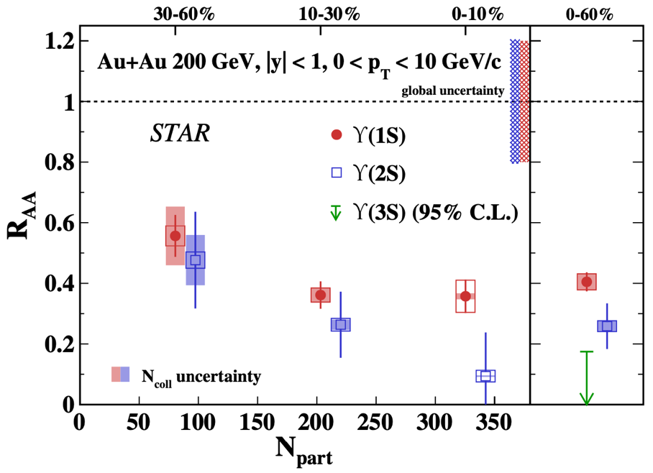
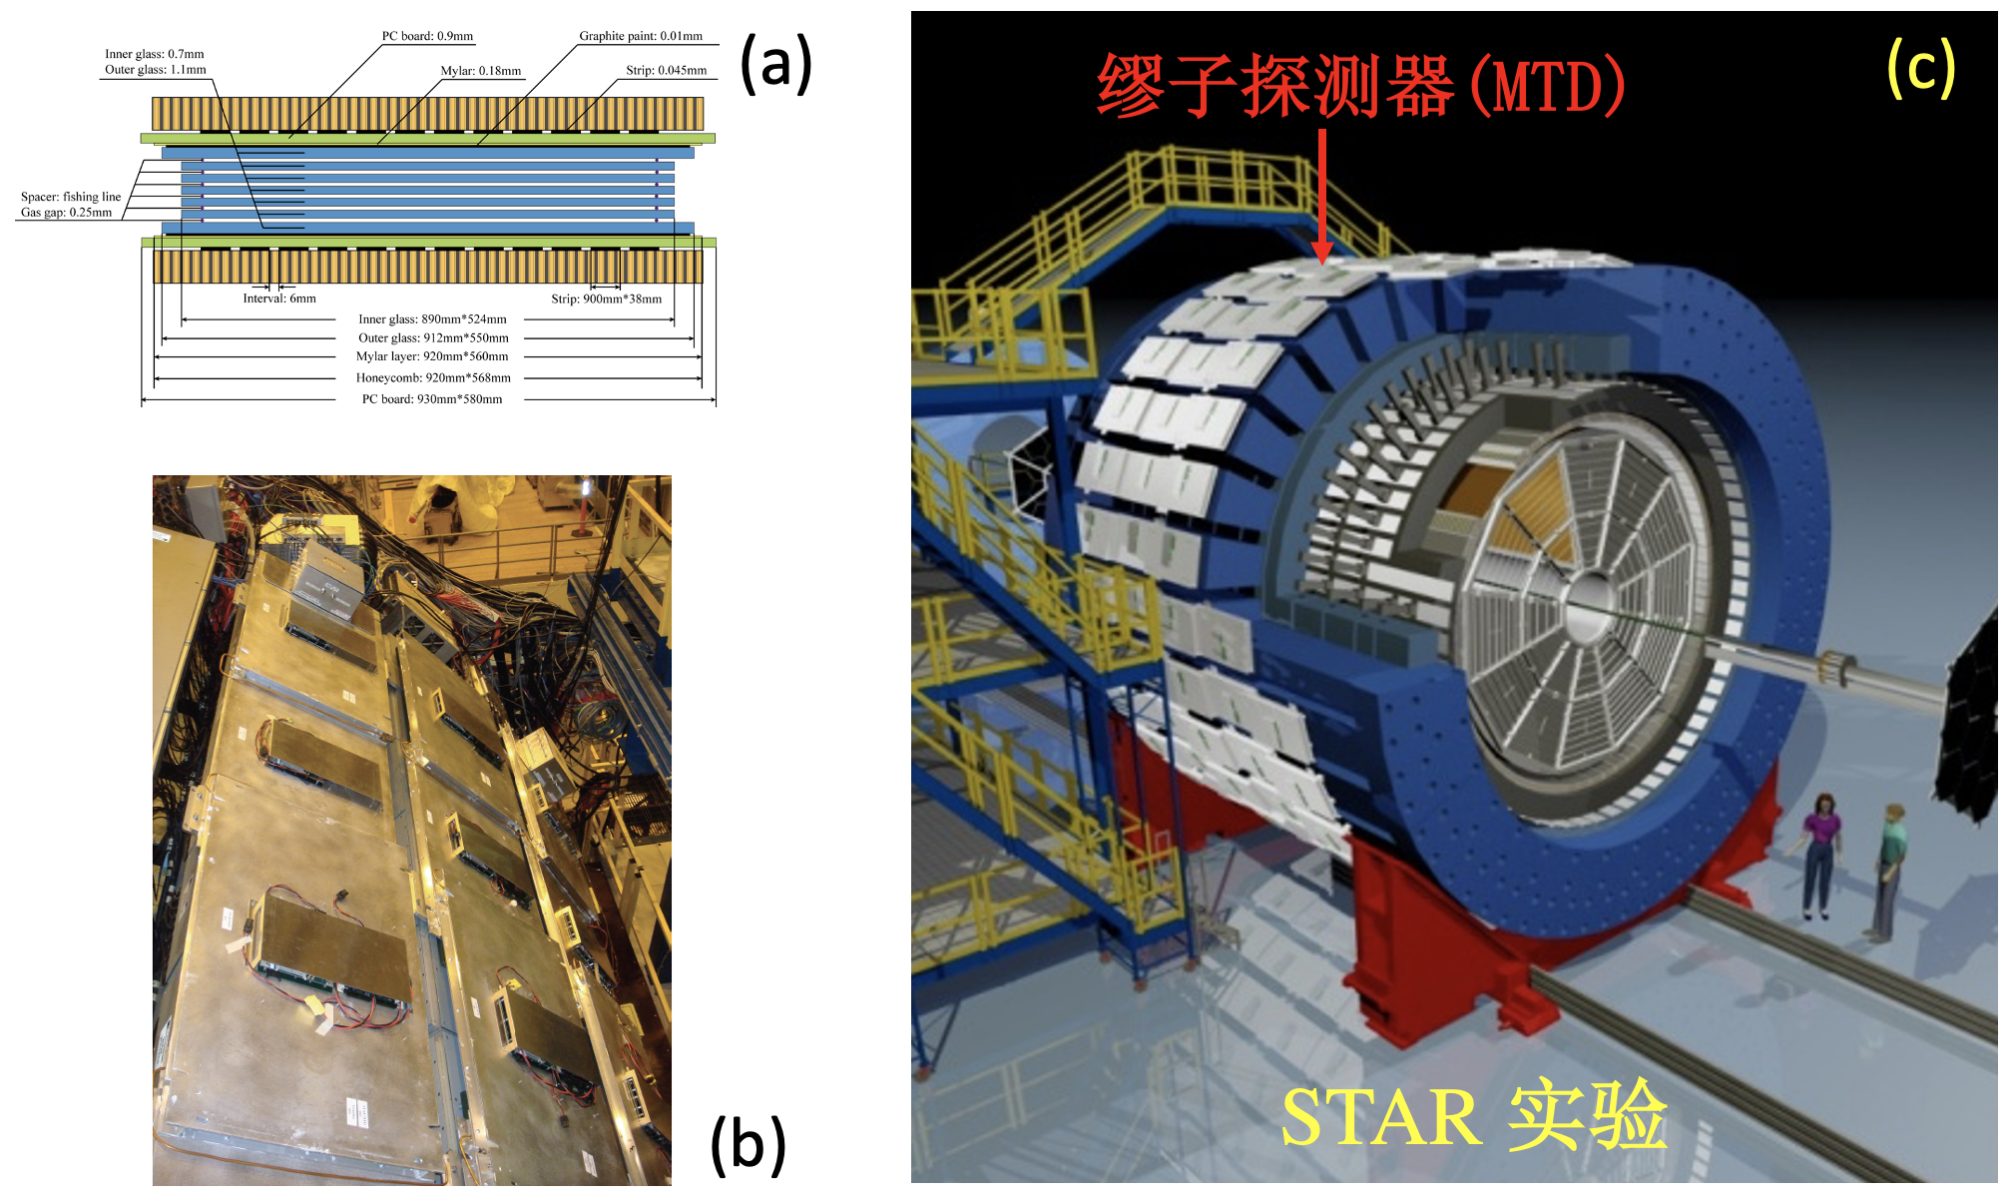
STAR 缪子探测器（MTD）
”Measurement of Sequential Υ Suppression in Au + Au Collisions at √s_{NN} = 200 GeV with the STAR Experiment”
Phys. Rev. Lett. 130 (2023) 112301，2023年3月14日
结果显示出RHIC能区的重离子碰撞中存在底夸克偶素“顺次压低”的实验迹象，表明碰撞中产生的高温介质强烈压制了激发态Υ的产生。该测量对理解高温介质中的强相互作用性质以及提取QGP热力学参数提供了重要实验约束

Slide 11
HIAF高能谱仪上Ecal
功能及要求：
测量e, γ, π, n等
重建π⁰
横动量: 50MeV-500MeV
时间分辨：<200ps
位置分辨？

Slide 12
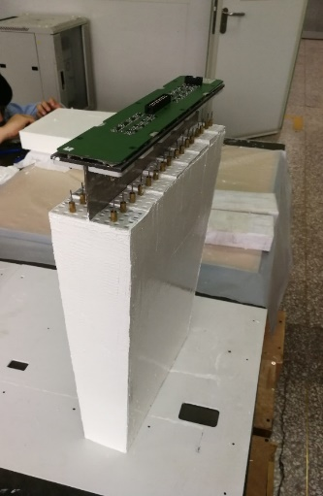
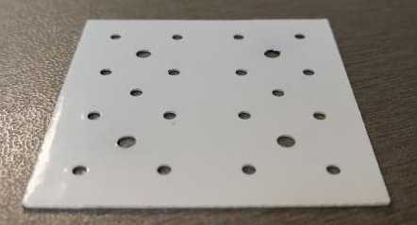
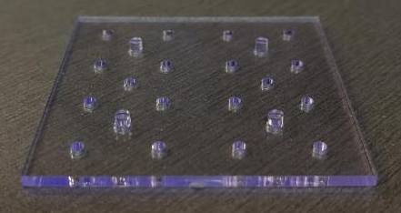
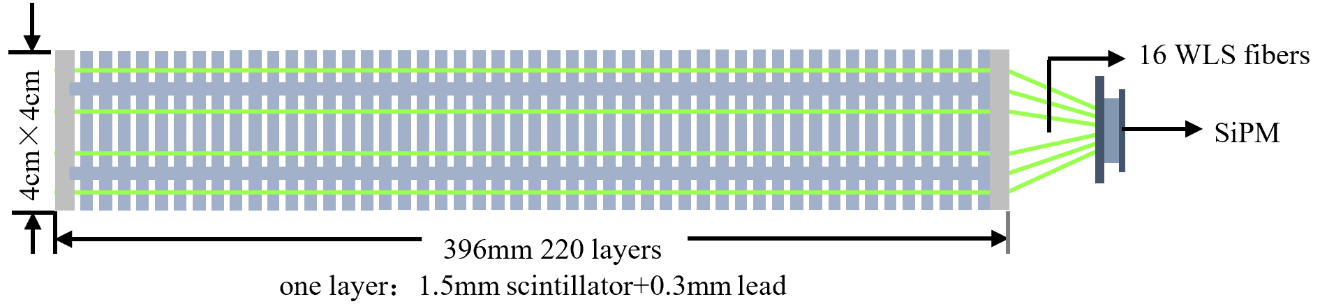
Performance of shashlyk Ecal for NICA/MPD
Parameters of main module
Transverse size, mm² | 40 x 40 | Scintillator thickness, mm | 1.5
WLS fibers | 16 | Moliere radius, mm | 62
Number of layers | 220 | Radiation length, X₀ | 11.8
Lead absorber thickness, mm | 0.3 | Effective radiation length, mm | 32.4

Slide 13
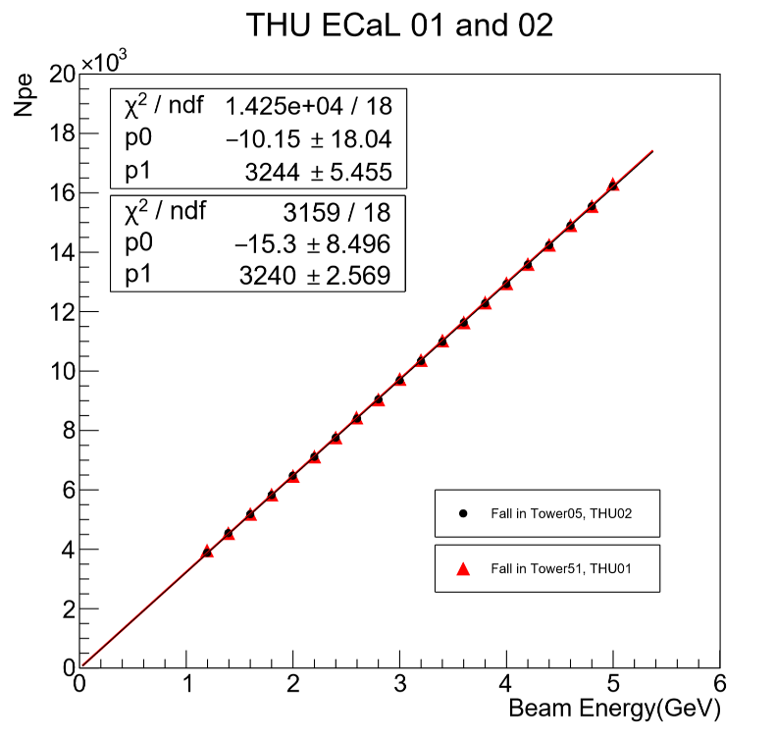
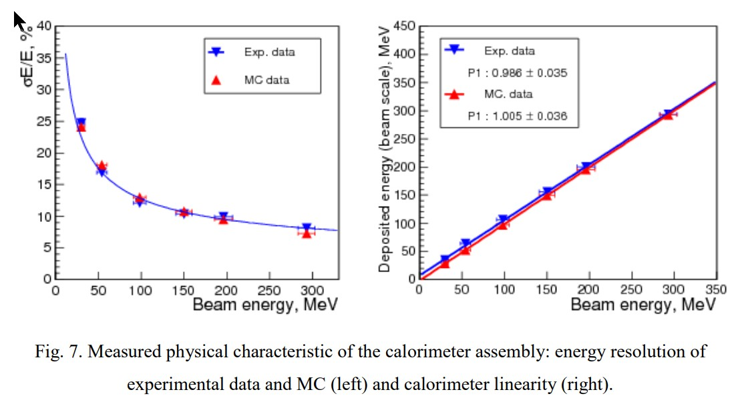
Performance of shashlyk Ecal for NICA/MPD
1-5GeV
能量分辨率
10MeV-350MeV
Spatial resolution Vs. energy
位置分辨

Slide 14
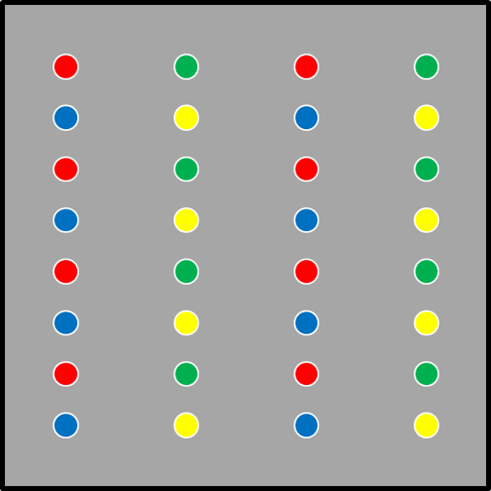
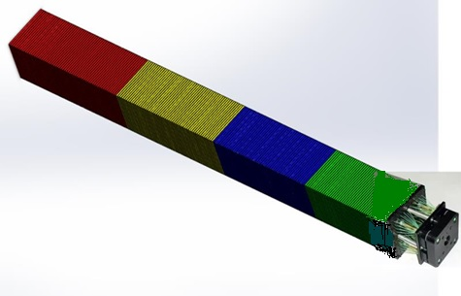
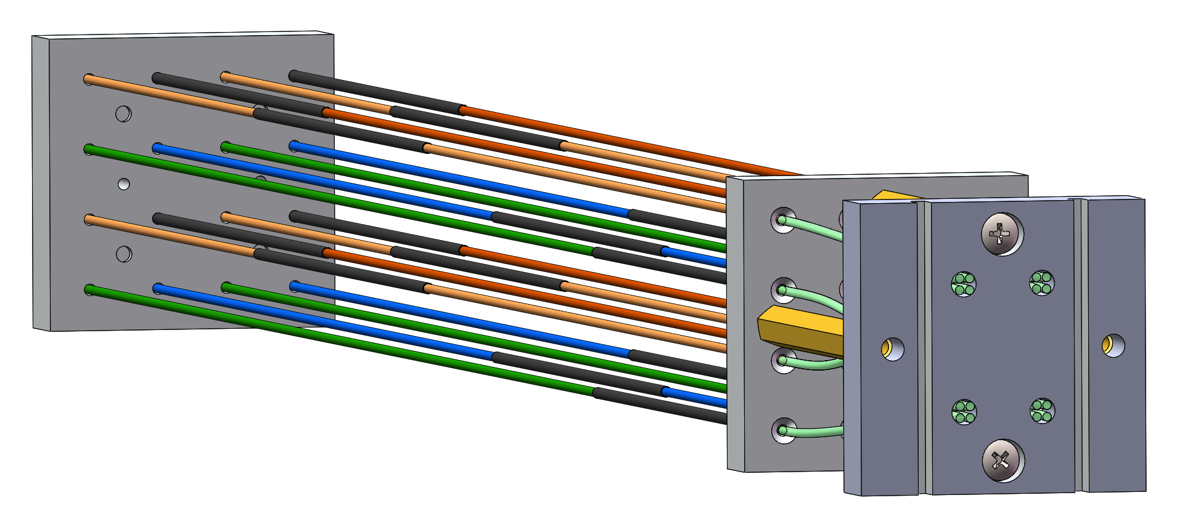
The conceptual structure of 5D ECAL
220 layer is separated into 4 parts, each part consists of 55 layers
Readout with 32 WLSFs, each part is readout with 8 WLSFs+SiPM
Mask technology of WLSF
5D: x,y,z, energy (<5%), time (<100ps)

Slide 15
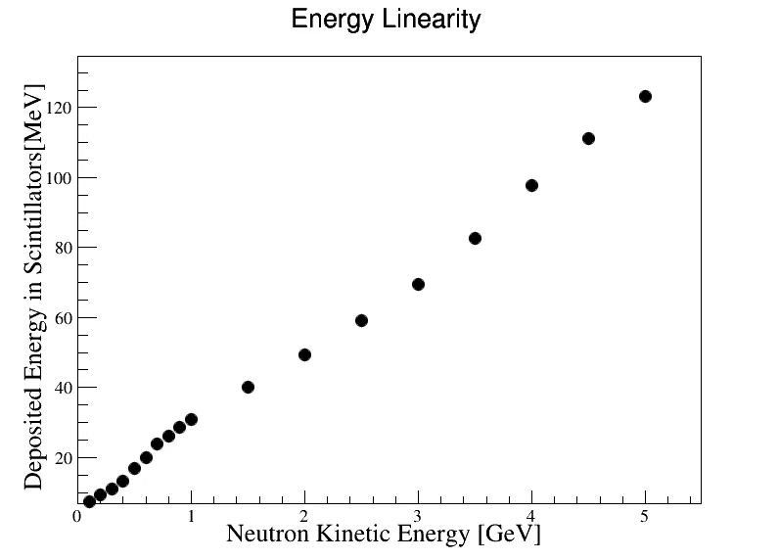
e, γ
Electron can be separated from Pion, Proton and Kaon
Neutron can be separated from charged particles by TOF
Neutron energy can be measured by amplitude
PID capability = TOF+ ECal
更准确测量电子伽马的角度

Slide 16
以低能伽马和高能中子分辨为例
模拟了动能1GeV-2GeV的中子和450MeV-550MeV的gamma，筛选出闪烁体中沉积能量在100-150MeV的事例。
鉴别方法如下：设入射粒子在四段闪烁体中沉积能量分别为en (n=1,2,3,4)，etot=e1+e2+e3+e4，an=en/etot (n=1,2,3,4)，利用an做简单判选，图中横轴为判选阈值，当a1,a2,a3均小于阈值且a4小于0.3时判定为gamma，否则判定为中子。

Slide 17
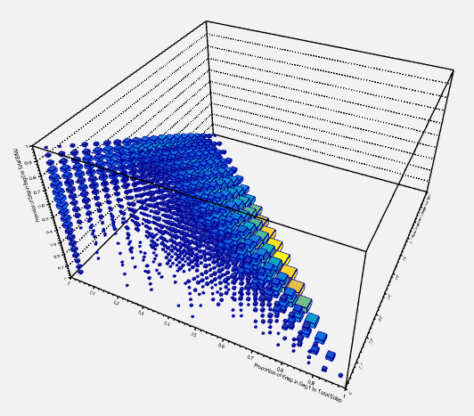
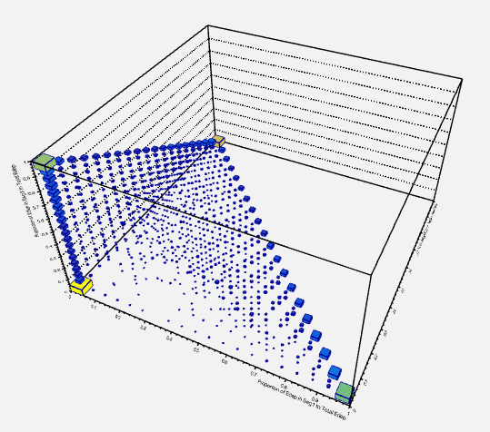
排除低能γ事例中的中子事例
γ
中子
Z
Z
Y
Y
X
X
X、Y、Z轴分别为入射粒子在第1、2、3段中沉积能量占总沉积能量之比
中子沉积能量集中于某一段
低能γ沉积能量集中于前方

Slide 18
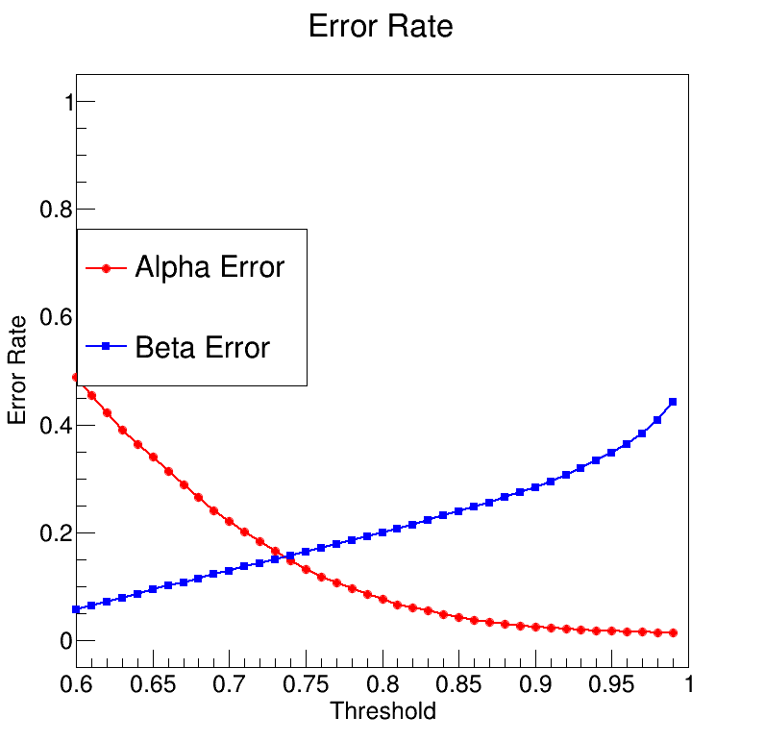
排除低能γ事例中的中子事例
中子沉积能量集中于某一段
低能γ沉积能量集中于前方
利用入射粒子在各段中沉积能量占比鉴别γ与中子
α错误：将γ事例误认为中子事例
β错误：将中子事例误认为γ事例
后续计划尝试用机器学习方法进行鉴别
α错误率约为2%时， β错误率约为32%
α错误率约为5%时， β错误率约为23%
α错误率约为10%时， β错误率约为18%

Slide 19
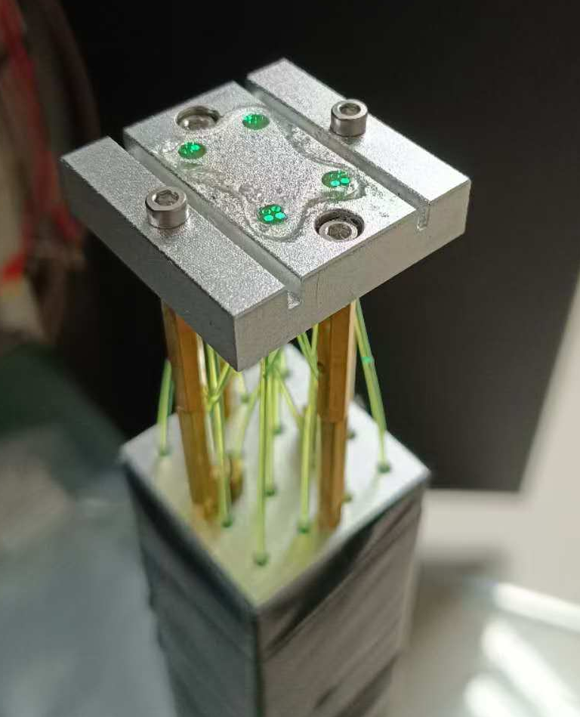
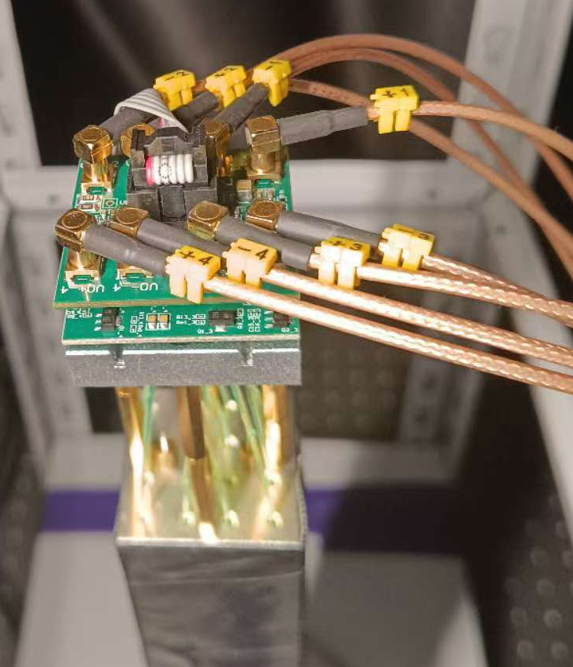
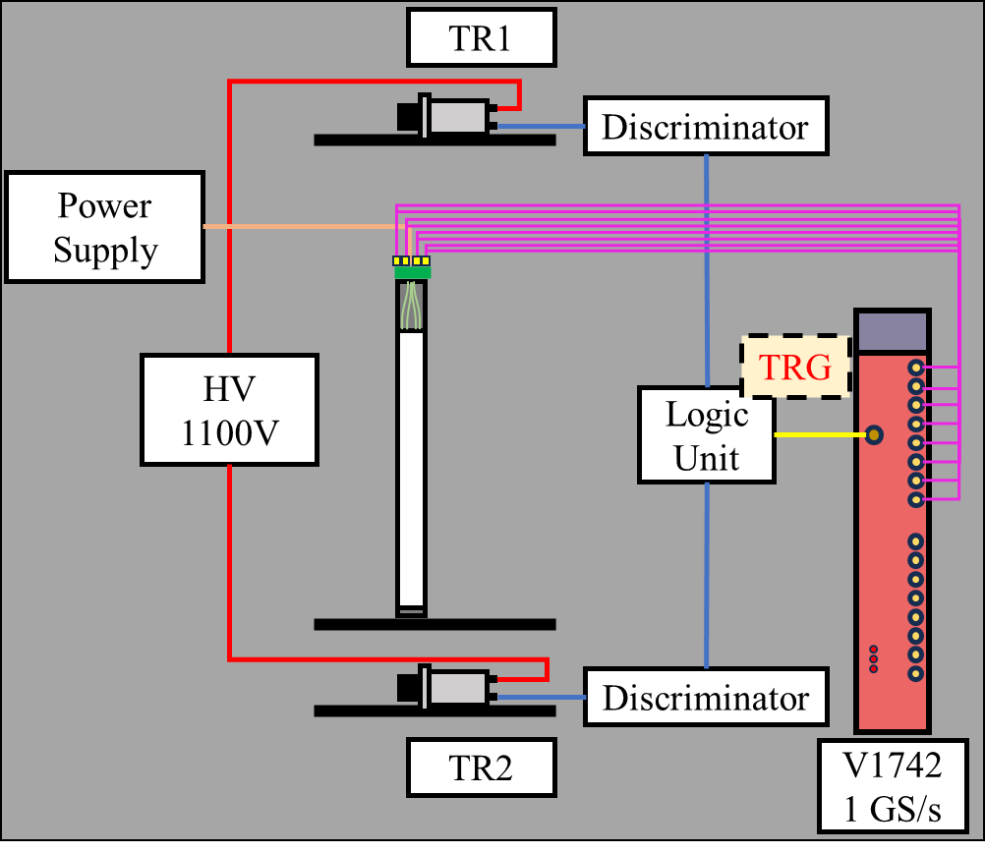
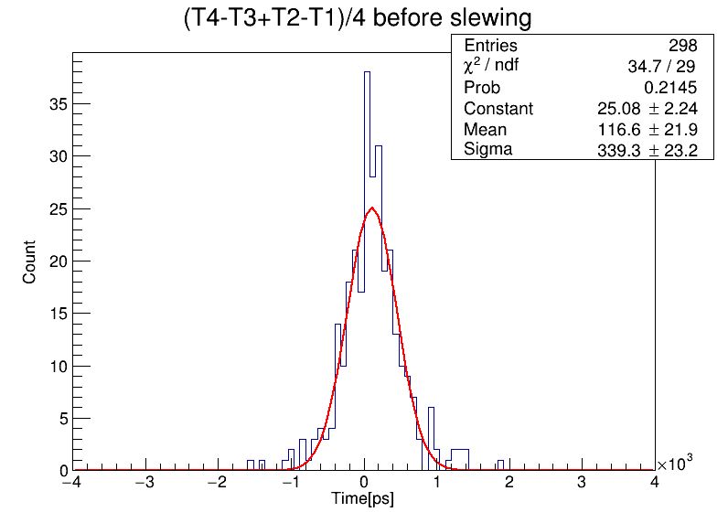
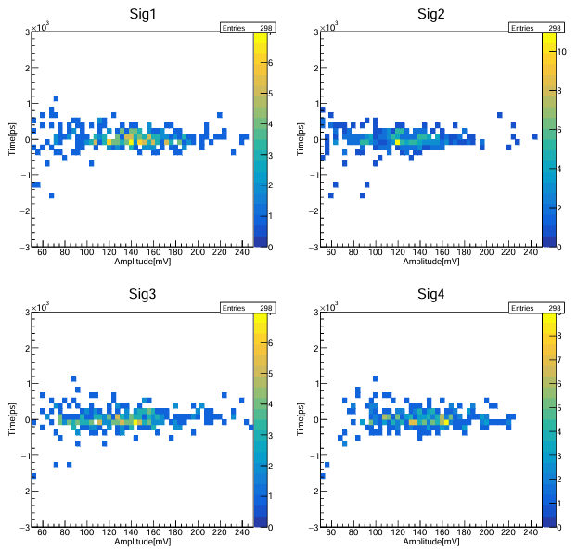
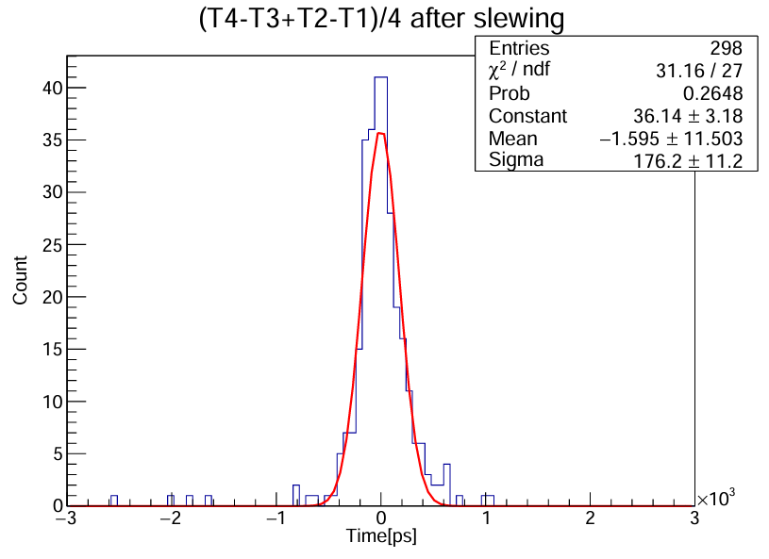
Performance of prototype
Transverse size, mm² | 40×40
Number of layers | 216
Thickness of scintillator, mm | 1.5
Thickness of lead absorber, mm | 0.3
Moliere radius, mm | 62
Number of radiation length, X0 | 11.8
Number of WLS fibers | 16
Shading material | Aluminum ally tubes internal: ϕ1.3mm external: ϕ1.5mm
Time resolution
  Compare with normal Shashlyk ECal:
  356.6 ps →176 ps (Cosmic)
19

Slide 20
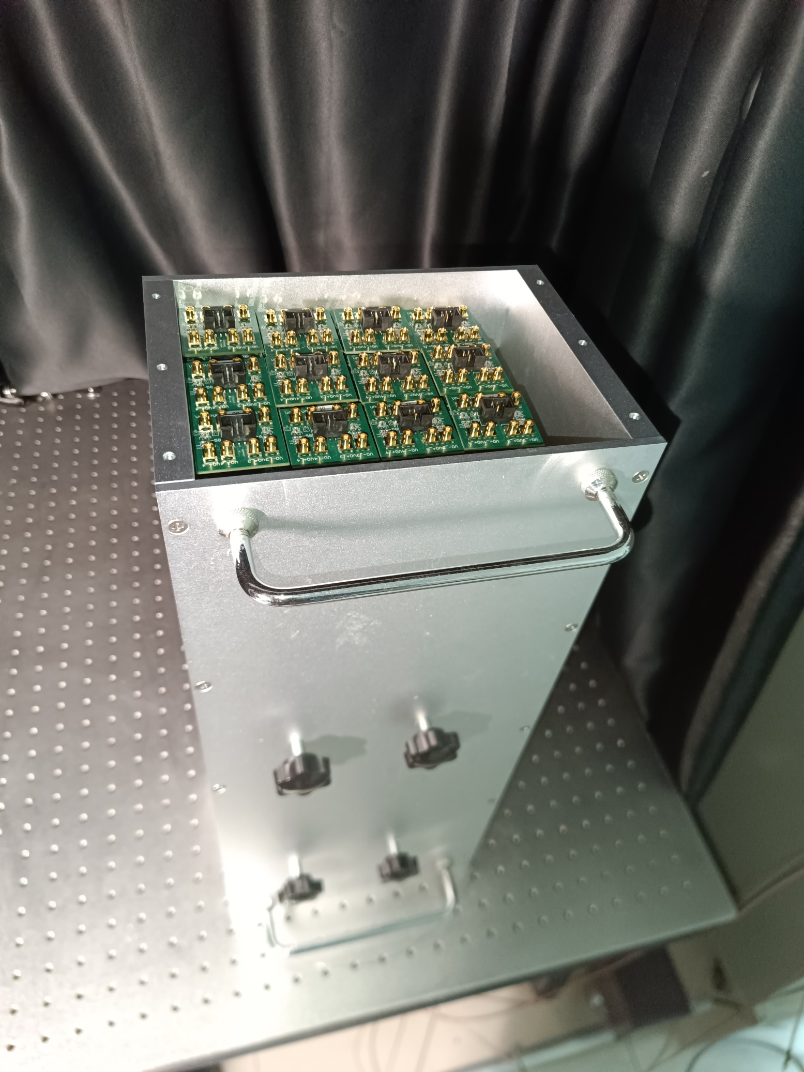
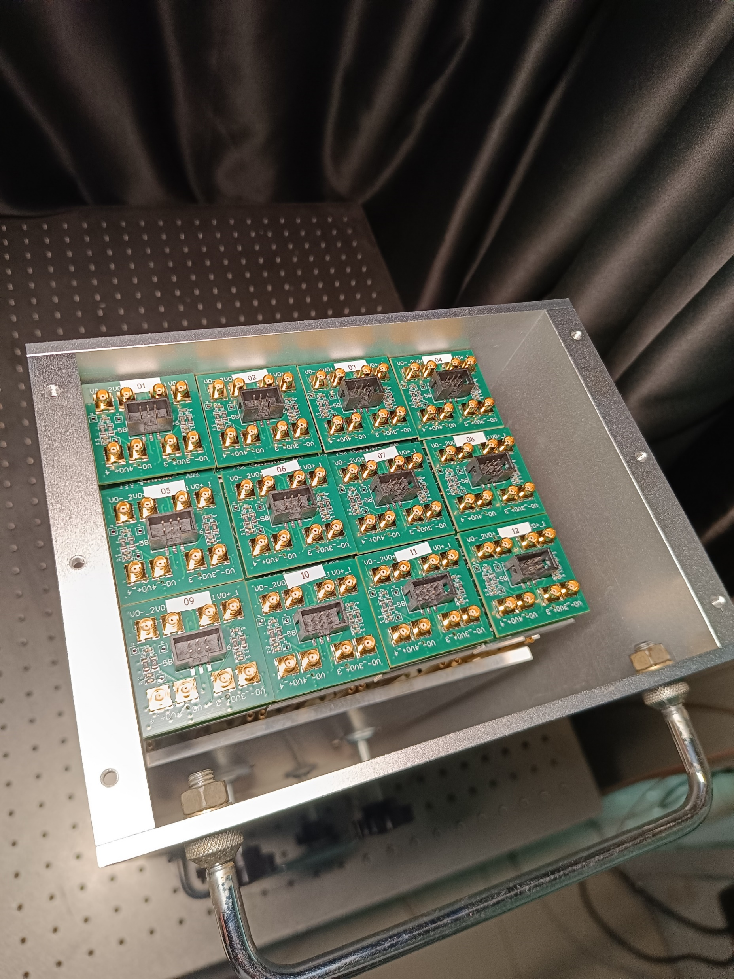
3 x 4 Ecal 模块
总共48路读出，12月
参加CEE束流测试，主要测试中子，γ的响应

Slide 21
Thanks for your
attention !

