Slide 1
Some Issues on
Hadron Properties in Nuclear Medium
马永亮
南京大学
2024 年HIAF 高能终端谱仪合作组会议
2024.11.16-2024.11.18
广东，惠州

Slide 2
目录
Introduction
Mesic nuclei bound states
Nuclear matter properties
Discussion

Slide 3
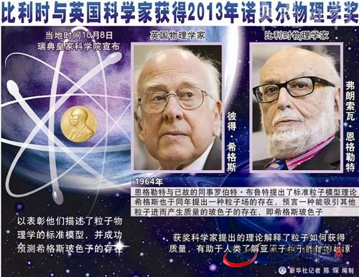
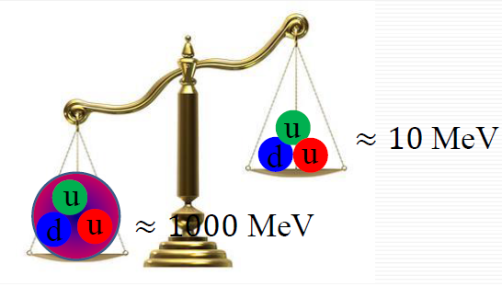

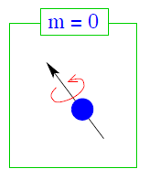
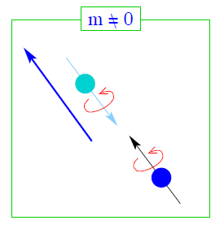
I. Introduction
粒子物理与核物理中的重大科学问题：手征对称性破缺机制与核子质量的起源
计算机利用无质量的基本元素 – 夸克和胶子– 模拟出了有质量的粒子。清淡的量子色动力学方程从无质量产生出了质量，这听起来就像是“无中生有”一样令人难以置信。这是如何发生的？
粒子物理的标准模型指出所有粒子的质量都可以通过Higgs机制产生；Higgs给出核子（三个夸克构成）的质量为10 MeV， 但是现实世界中核子的质量为1000MeV；相差100倍！
机制？
传统观点认为核子质量产生于正—反夸克凝聚。
强相互租用中的手征对称性破缺机制是什么？核子质量的起源是什么？
（Clay数学研究所的千禧年大奖问题之一。）
Clay数学研究所的千禧年大奖问题之一。
无质量夸克具有手征性对称性！
有质量夸克手征性对称性破坏！

Slide 4
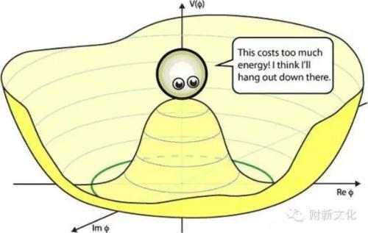
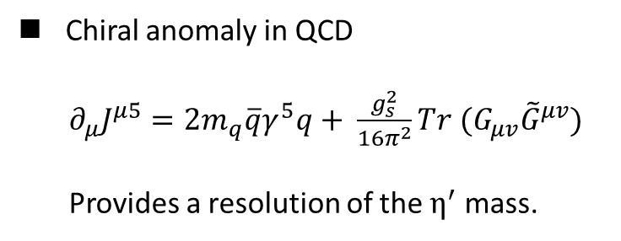
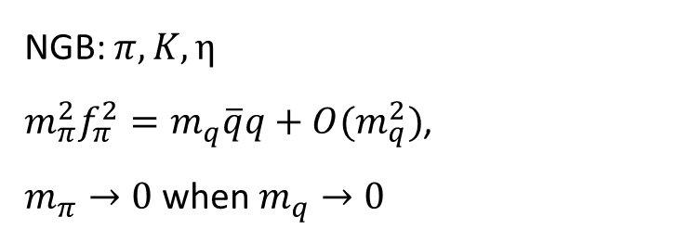

I、Introduction
赝标介子
$${SU(N_{f})}_{L}×{SU(N_{f})}_{R}→{SU(N_{f})}_{V}$$
NGB: $π, K, η$
$m_{π}^{2}f_{π}^{2}=m_{q}\overline{q}q+O(m_{q}^{2})$,
$m_{π}→0$ when $m_{q}→0$
Chiral anomaly in QCD
$∂_{μ}J^{μ5}=2m_{q}\overline{q}γ^{5}q+ \frac{g_{s}^{2}}{16π^{2}}Tr (G_{μv}{\tilde{G}}^{μv})$
Provides a resolution of the $η^{′}$ mass.

Slide 5

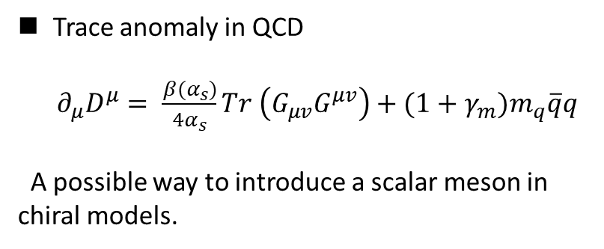
I、Introduction
标量介子 $f_{0}(500)$
内部组分？
手征四重态的第四分量（pion 的手征伴子）？
标度对称性破缺对应的NGB？
Trace anomaly in QCD
$∂_{μ}D^{μ}= \frac{β(α_{s})}{4α_{s}}Tr \left(G_{μv}G^{μv}\right)+{(1+γ_{m})m}_{q}\overline{q}q$
A possible way to introduce a scalar meson in chiral models.

Slide 6

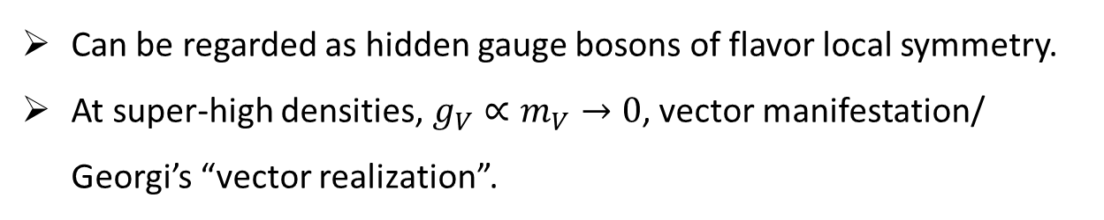
I、Introduction
矢量介子（$ρ，ω$）
Can be regarded as hidden gauge bosons of flavor local symmetry.
At super-high densities, $g_{V}∝m_{V}→0$, vector manifestation/ Georgi’s “vector realization”.
M. Harada, K. Yamawaki, Phys.Rev.Lett. 86 (2001) 757-760, e-Print: hep-ph/0010207 [hep-ph]
H. Georgi, Phys.Rev.Lett. 63 (1989) 1917-1919, Nucl.Phys.B 331 (1990) 311-330

Slide 7
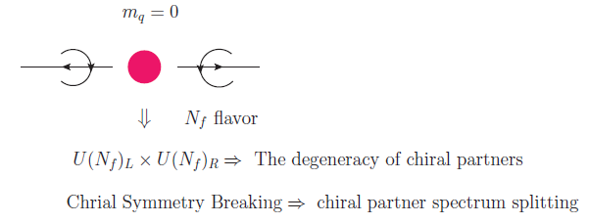
I. Introduction
Chiral symmetry and chiral symmetry breaking have played predominant roles in hadron physics.
The study of the chiral partner structure of hadrons can help us to reveal the magnitude of the chiral symmetry breaking, i.e., the order parameter.

Slide 8
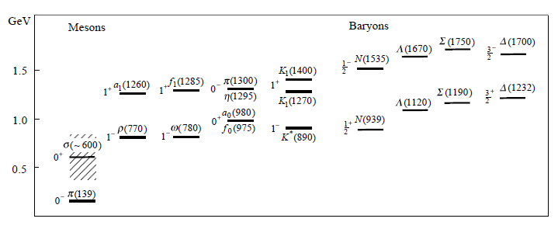
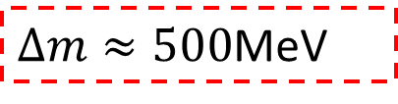
I. Introduction
D. Jido, M. Oka, A. Hosaka, Prog. Theor. Phys. 106 (2001) 873-908, e-Print: hep-ph/0110005 [hep-ph]
Figure: Mass splitting of positive and negative parity hadrons in various channels.
$∆m≈500$MeV
Chiral doubling works!

Slide 9
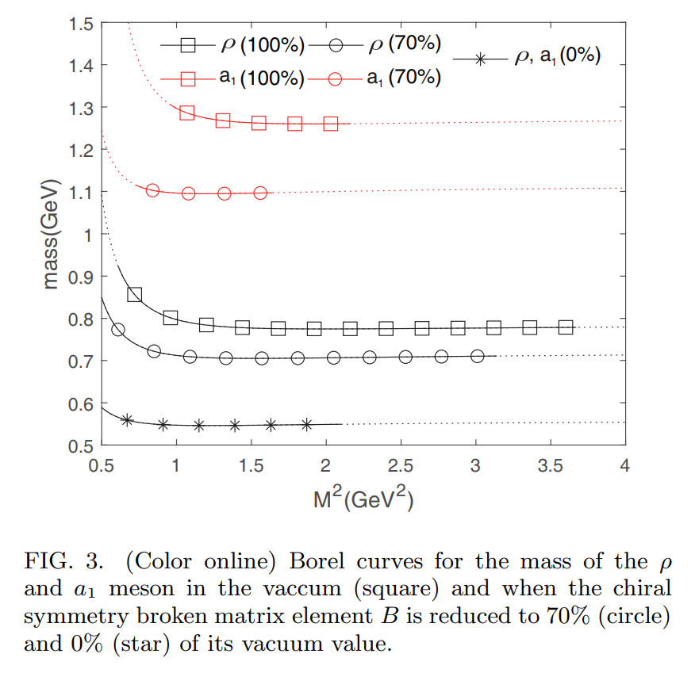
I. Introduction
利用QCD 求和规则:
  The chiral symmetric part of the vector and axial vector meson mass to be between 550 and 600 MeV. This demonstrates that chiral symmetry breaking, while responsible for the mass difference between chiral partner, accounts only for a small fraction of the symmetric part of the mass.
J.Kim, S. H. Lee, Phys.Rev.D 103 (2021) 5, L051501, e-Print: 2012.06463 [nucl-th]

Slide 10
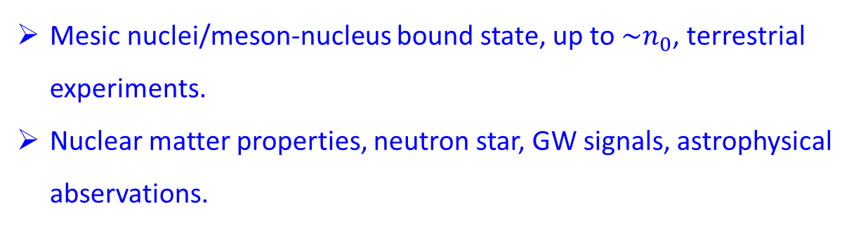
I. Introduction
研究强子性质随密度的变化有助于揭示
手征对称性破缺机制及核子质量的起源
Mesic nuclei/meson-nucleus bound state, up to $\sim n_{0}$, terrestrial experiments.
Nuclear matter properties, neutron star, GW signals, astrophysical abservations.

Slide 11

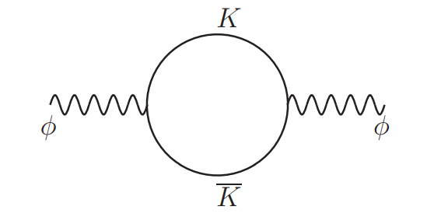


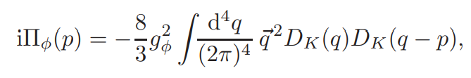
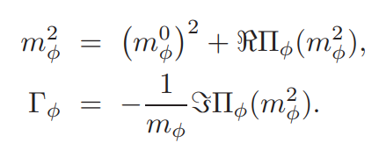
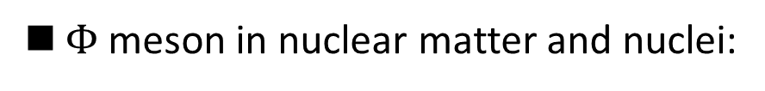
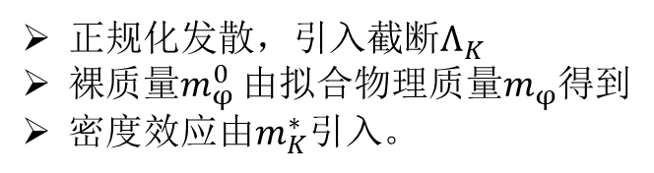
II. Mesic Nucleus bound state
$Φ$ meson in nuclear matter and nuclei:
正规化发散，引入截断$Λ_{K}$
裸质量$m_{φ}^{0}$ 由拟合物理质量$m_{φ}$得到
密度效应由$m_{K}^{∗}$引入。
J.J. Cobos-Martínez, K. Tsushima, G. Krein, A.W. Thomas, Phys.Rev.C 96 (2017) 3, 035201, e-Print: 1705.06653 [nucl-th]

Slide 12

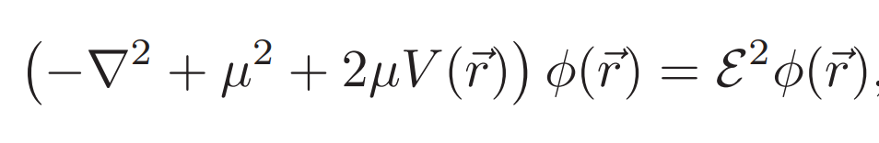
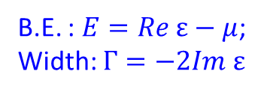

II. Mesic Nucleus bound state
Φ-原子核束缚态/Φ放入原子核中
Using a local density approximation the φ-meson complex potentials for a nucleus A can be written as
: Φ 介子质量变化
$$W_{Φ}\left(r\right)=Γ_{Φ}(ρ_{B}(r))$$
: Φ 介子的衰变宽度
原子核的重子数密度分布：QMC 模型或线性近似。
K. Saito, K. Tsushima, and A. W. Thomas, Nucl.Phys.A609,339(1996); Phys.Rev.C.56,566(1997).
Φ-原子核束缚态
B.E. : $E=Re ε−μ$;
Width: $Γ=−2Im ε$

Slide 13
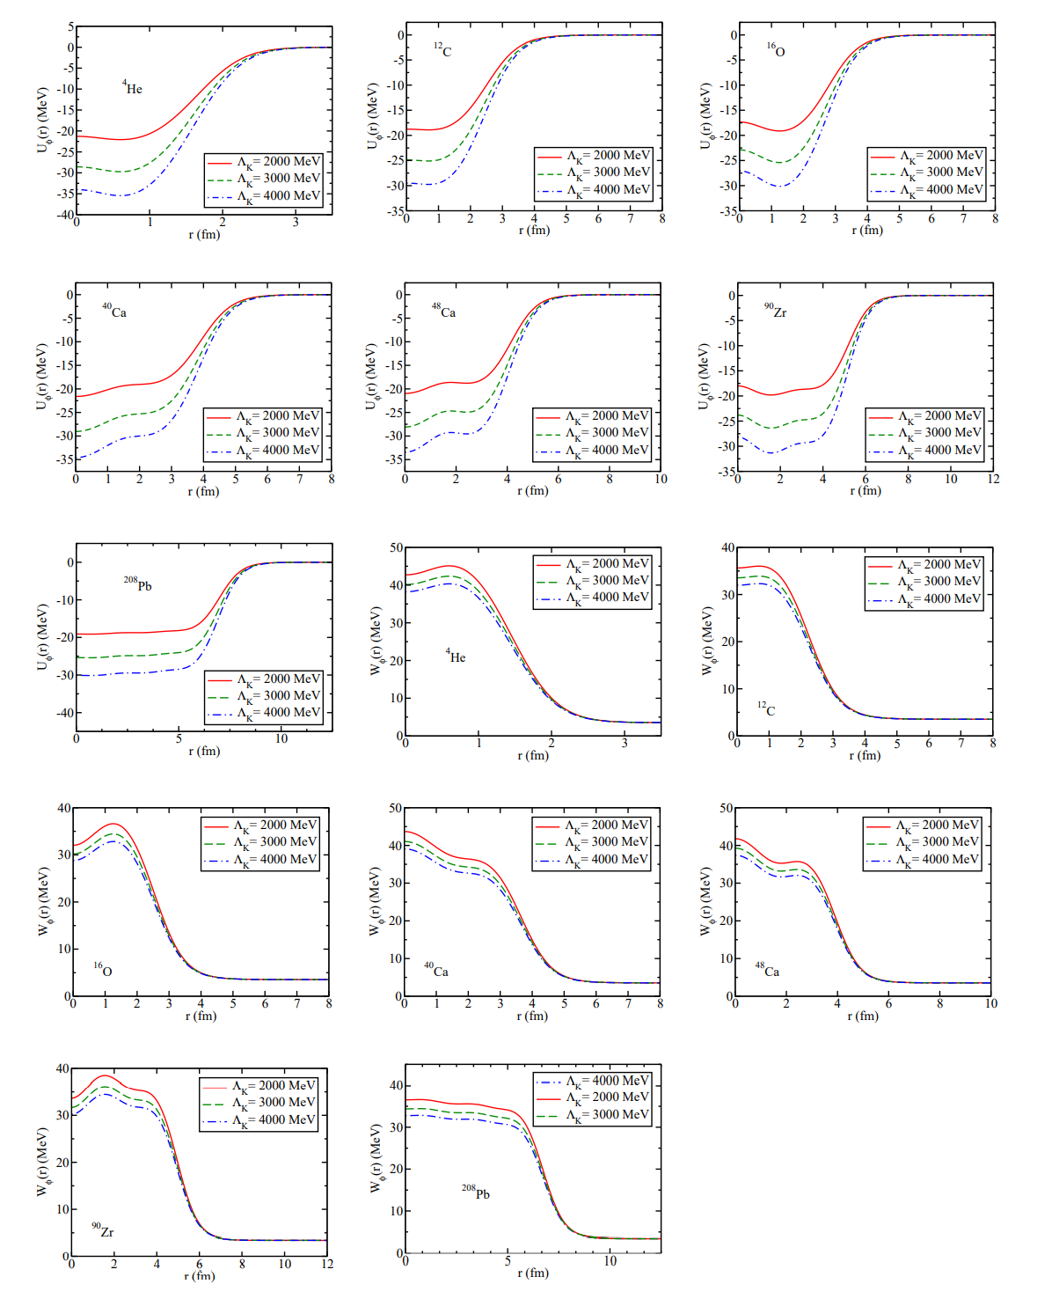
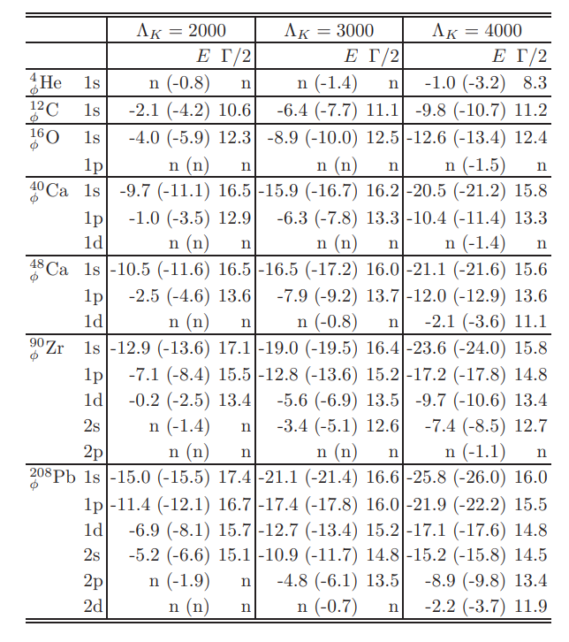
II. Mesic Nucleus bound state

Slide 14
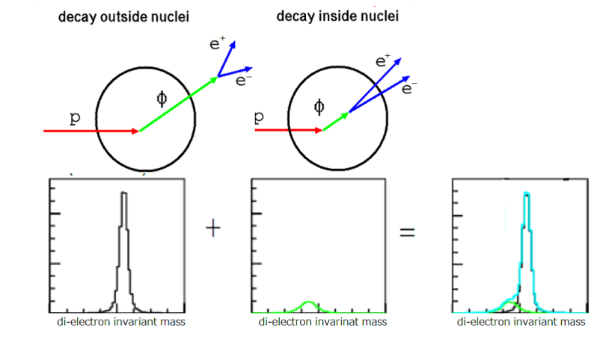
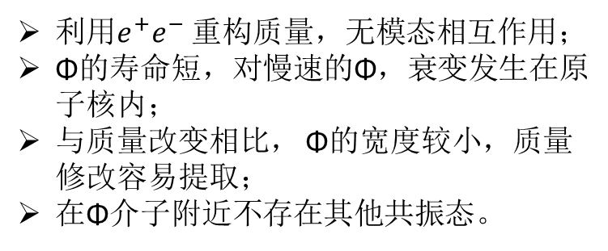
II. Mesic Nucleus bound state
Measurement of Vector Meson Decays in Nuclei:
J-PARC E16 Collaboration, Y. Morino, et al. (2015) JPS Conf.Proc. 8 (2015) 022009.
利用$e^{+}e^{−}$ 重构质量，无模态相互作用；
Φ的寿命短，对慢速的Φ，衰变发生在原子核内；
与质量改变相比， Φ的宽度较小，质量修改容易提取；
在Φ介子附近不存在其他共振态。

Slide 15
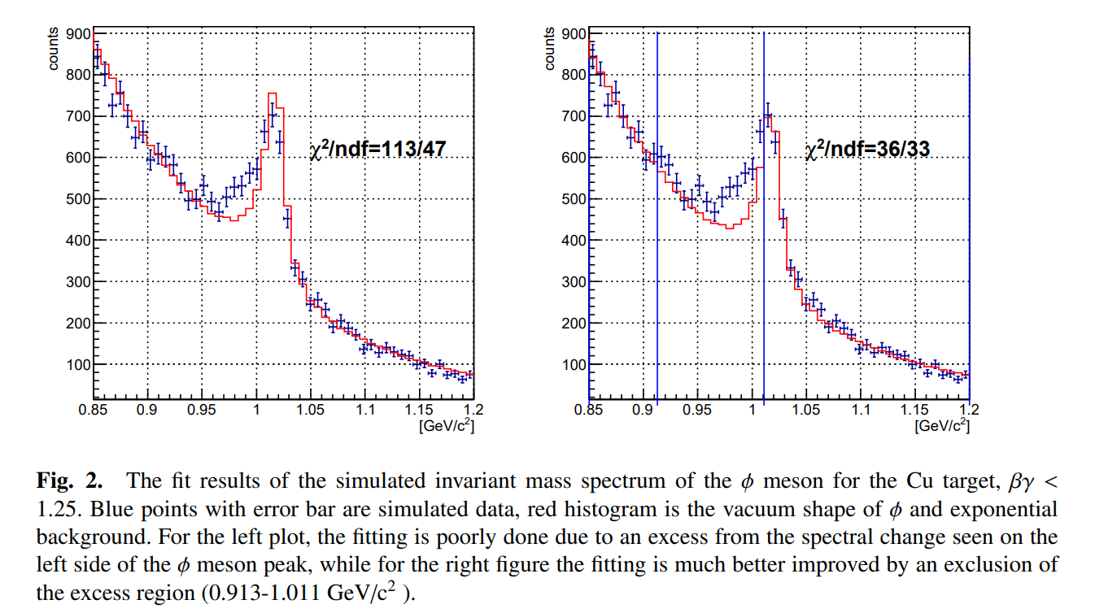
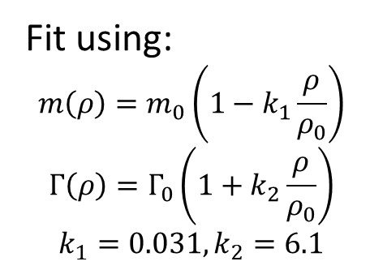
II. Mesic Nucleus bound state
Fit using:
$$m\left(ρ\right)=m_{0}\left(1−k_{1}\frac{ρ}{ρ_{0}}\right)$$
$$Γ\left(ρ\right)=Γ_{0}\left(1+k_{2}\frac{ρ}{ρ_{0}}\right)$$
$$k_{1}=0.031,k_{2}=6.1$$
Y. Komatsu, K. Aoki, S. Ashikaga, T. Chujo, et al. (2017), JPS Conf.Proc. 13 (2017) 020005

Slide 16
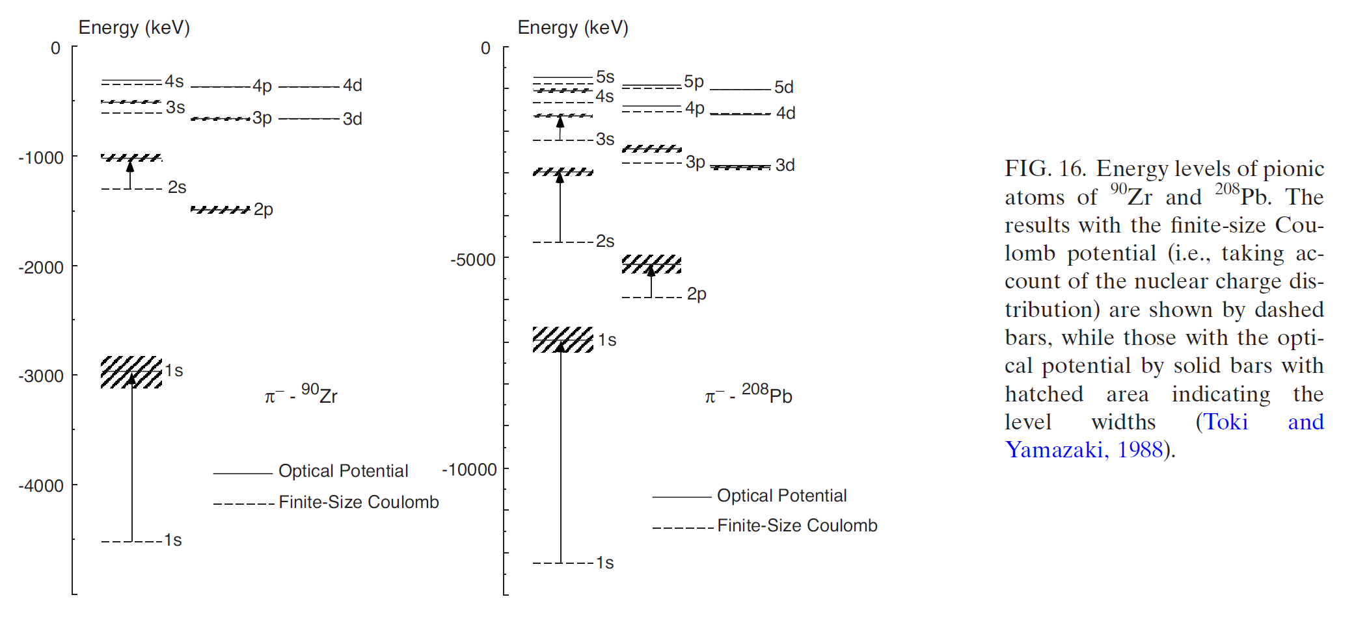
II. Mesic Nucleus bound state
Note, pion mass is nearly density independent due to its NGB character.

Slide 17
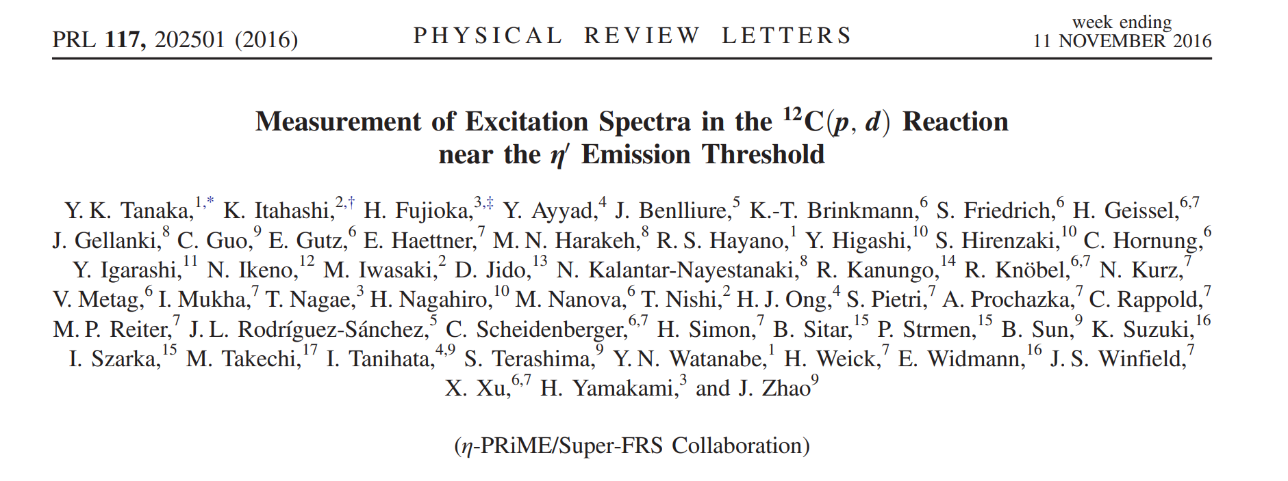
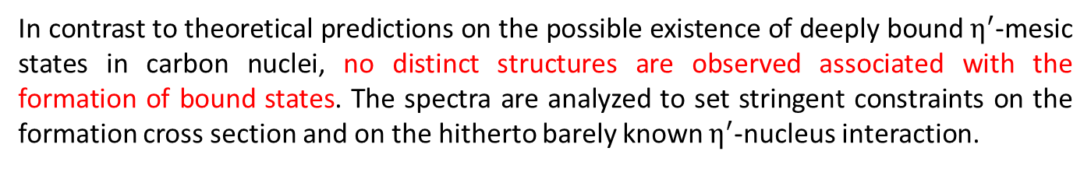
II. Mesic Nucleus bound state
In contrast to theoretical predictions on the possible existence of deeply bound $η^{′}$-mesic states in carbon nuclei, no distinct structures are observed associated with the formation of bound states. The spectra are analyzed to set stringent constraints on the formation cross section and on the hitherto barely known $η^{′}$-nucleus interaction.

Slide 18
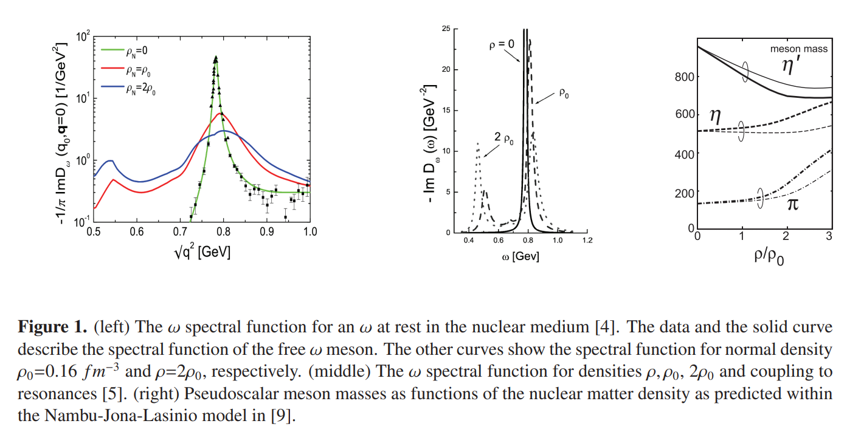
II. Mesic Nucleus bound state

Slide 19
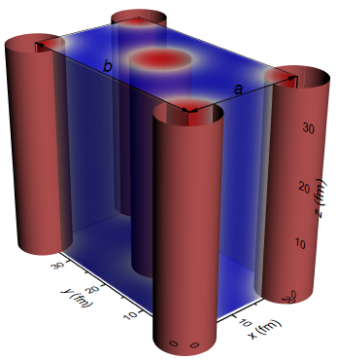
III. Nuclear matter properties
Property of nuclear matter has be studied for several decades:
Hana Gil, et al, 1805.11321
Terrestrial experiments on nucleon physics;
中子星外壳，白矮星内核
Cannot be accessed by terrestrial experiments, lattice QCD, fundamental QCD!
Indirect information from astrophysics.
Other geometry structure than homogeneous matter?
What is the matter made of?
What are the patterns of the symmetries involved?
……
19

Slide 20
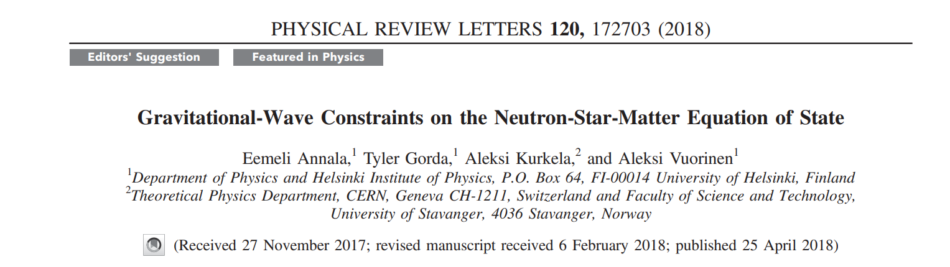
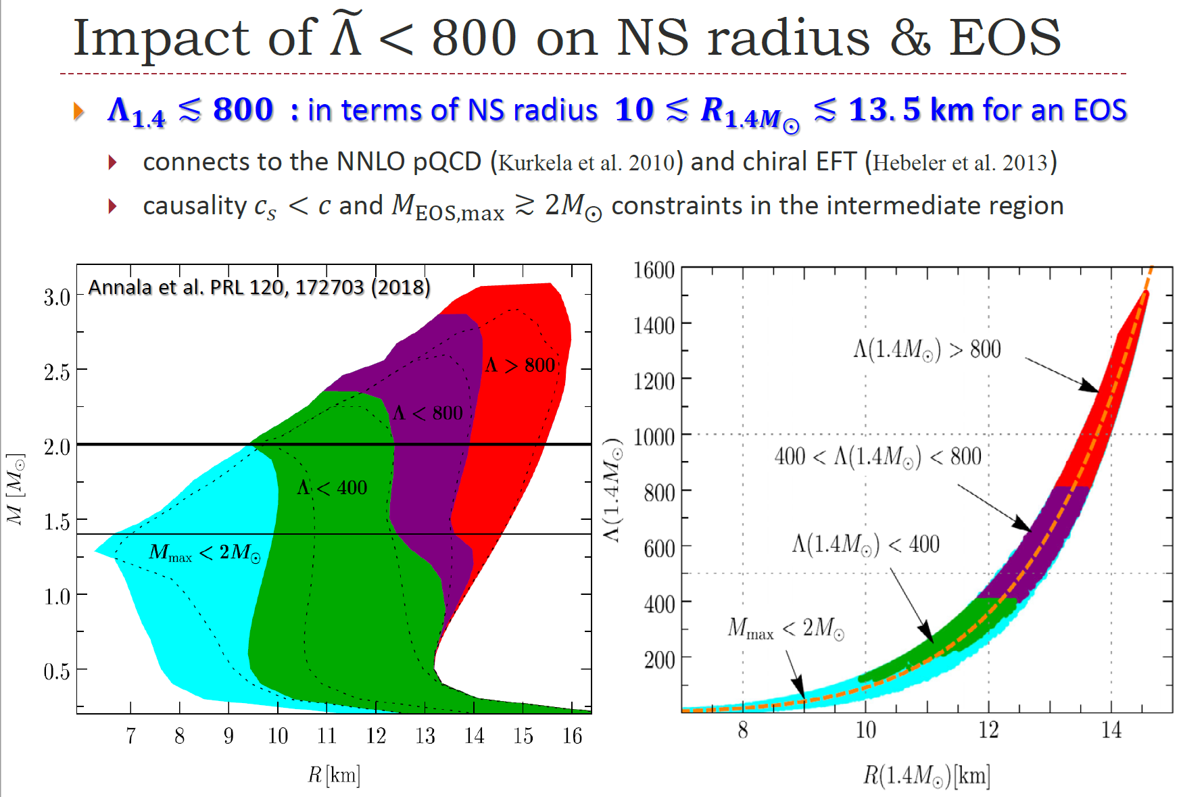
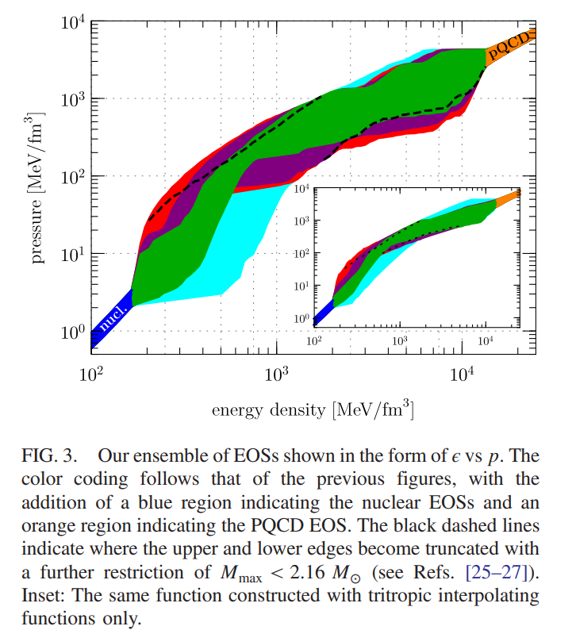

Tidal deformability(GW170817):
$Λ_{1.4}<800$
$$\tilde{Λ}= {300}_{−230}^{+420} →\tilde{Λ}= {190}_{−120}^{+390}$$
$$R= {11.9}_{−1.4}^{+1.4} km$$
C. Y. Tsang, et al., 1807.06571

Slide 21
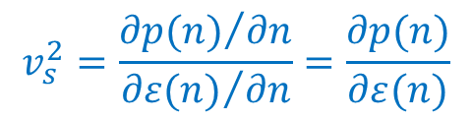
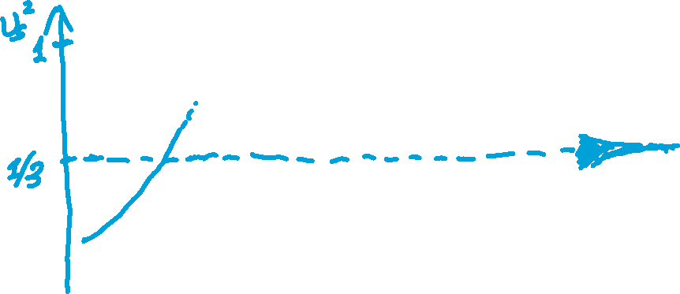

III. Nuclear matter properties
$$v_{s}^{2}=\frac{{∂p(n)}/{∂n}}{{∂ε(n)}/{∂n}}=\frac{∂p(n)}{∂ε(n)}$$
At least one peak

Slide 22
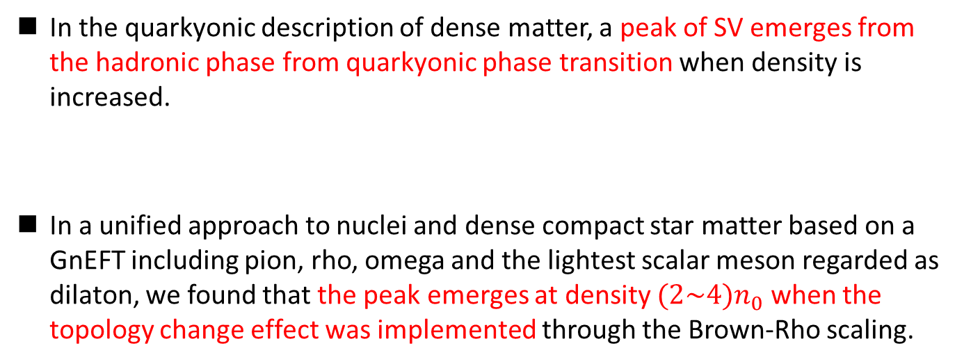
III. Nuclear matter properties
In the quarkyonic description of dense matter, a peak of SV emerges from the hadronic phase from quarkyonic phase transition when density is increased.
In a unified approach to nuclei and dense compact star matter based on a GnEFT including pion, rho, omega and the lightest scalar meson regarded as dilaton, we found that the peak emerges at density $(2\sim 4)n_{0}$ when the topology change effect was implemented through the Brown-Rho scaling.
L. McLerran and S. Reddy, Phys. Rev. Lett. 122, 122701 (2019).
K. S. Jeong, L. McLerran, and S. Sen, Phys. Rev. C 101, 035201 (2020).
T. Zhao and J. M. Lattimer, Phys. Rev. D 102, 023021 (2020).
J. Margueron, H. Hansen, P. Proust, and G. Chanfray, Phys. Rev. C 104, 055803 (2021).
Y.-L. Ma and M. Rho, Phys. Rev. D 99, 014034 (2019).
Y.-L. Ma and M. Rho, Prog. Part. Nucl. Phys. 113, 103791 (2020).
Y.-L. Ma and M. Rho, AAPPS Bull. 31, 16 (2021).
H. K. Lee, Y.-L. Ma, W.-G. Paeng, and M. Rho, Mod. Phys. Lett. A 37, 2230003 (2022).
Y.-L. Ma and W.-C. Yang, Symmetry 15, 776 (2023).

Slide 23
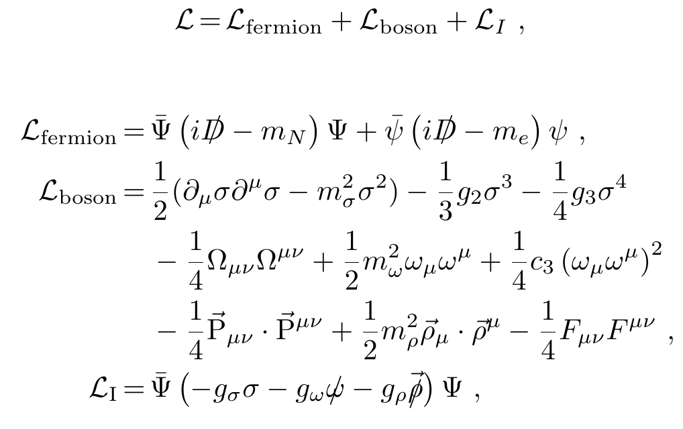
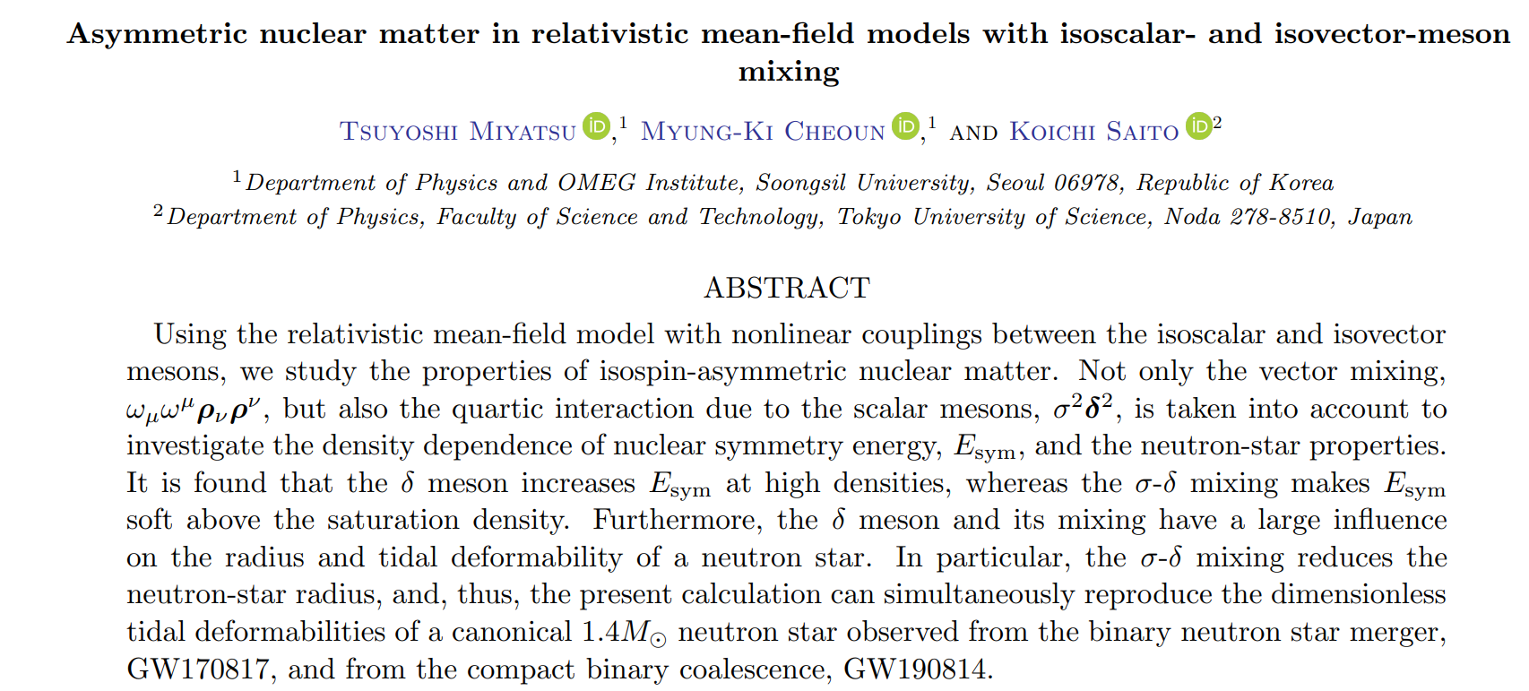
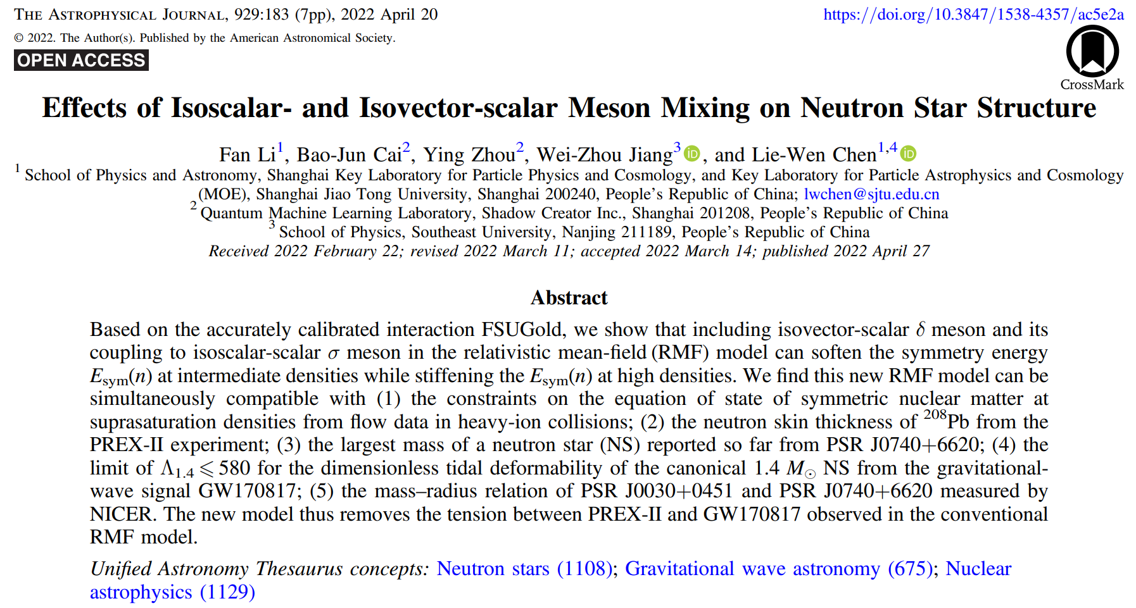
III. Nuclear matter properties
量子强子动力学是描述低能强相互作用不可缺少的工具
B. D. Serot and J. D. Walecka, Adv. Nucl. Phys. 16, 1 (1986);
Y. Sugahara, H. Toki, Nucl.Phys.A 579 (1994) 557-572;
H. Shen, H. Toki, K. Oyamatsu, K. Sumiyoshi, Nucl.Phys.A 637 (1998) 435-450 .
2202.06468

Slide 24
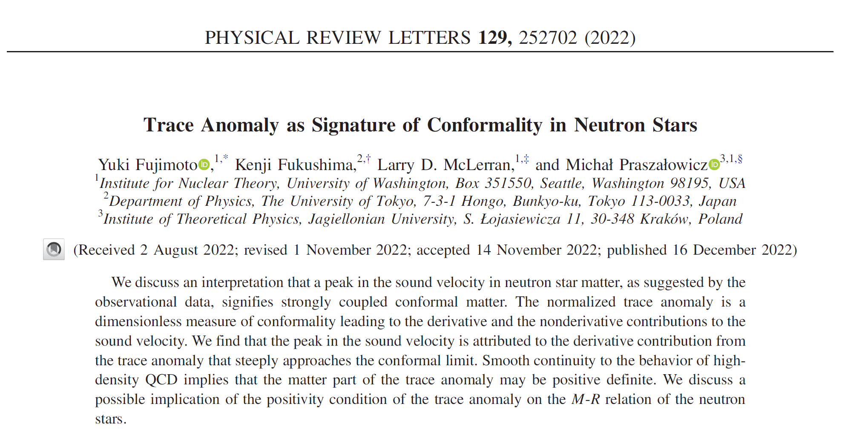

Slide 25
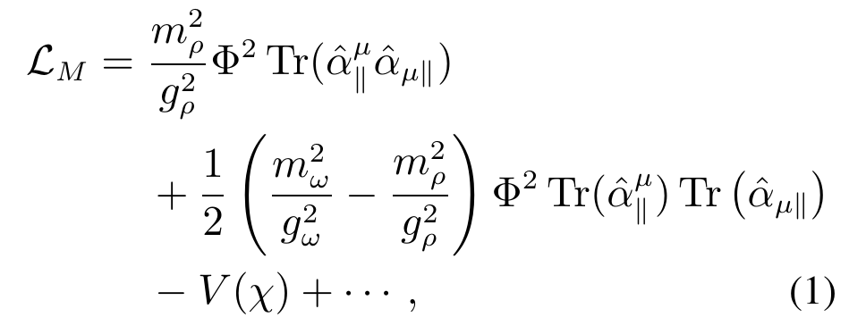
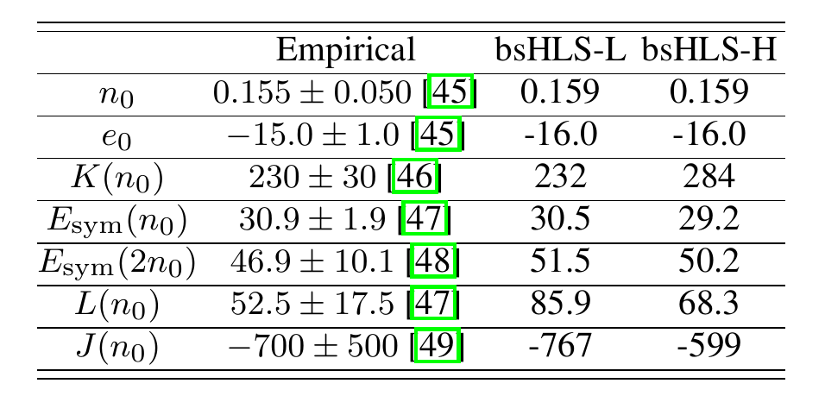

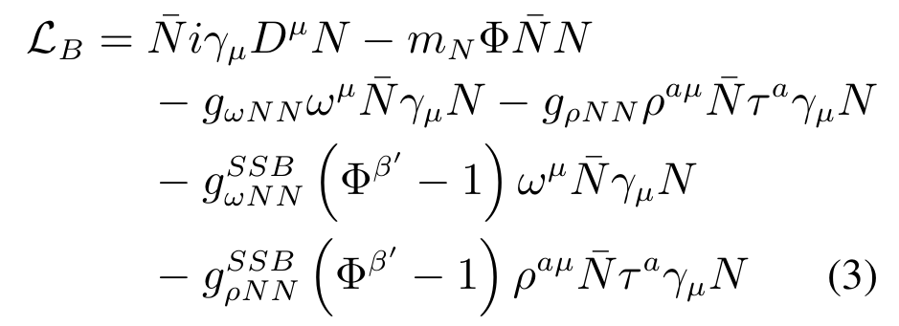
III. Nuclear matter properties
A mean field calculation based on chiral-scale EFT
L. Q. Zhang, Y. Ma and YM, 2410.04142; in preparation

Slide 26
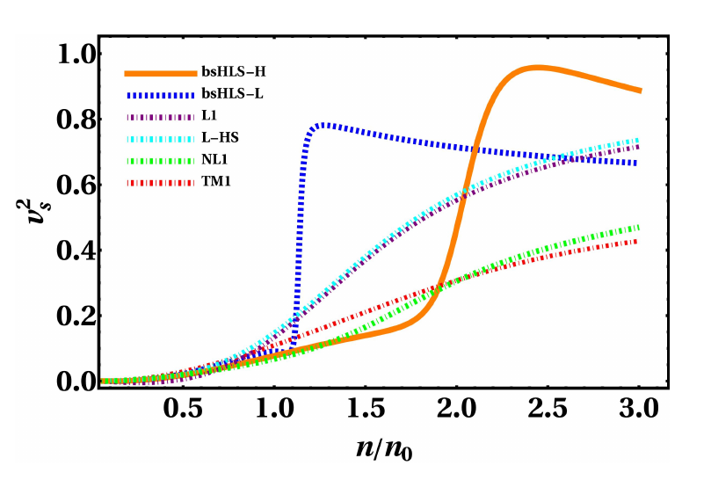

III. Nuclear matter properties
Linear model
$$(1\sim 2.5)n_{0}$$
There are only hadrons, NO phase/configuration transition!

Slide 27
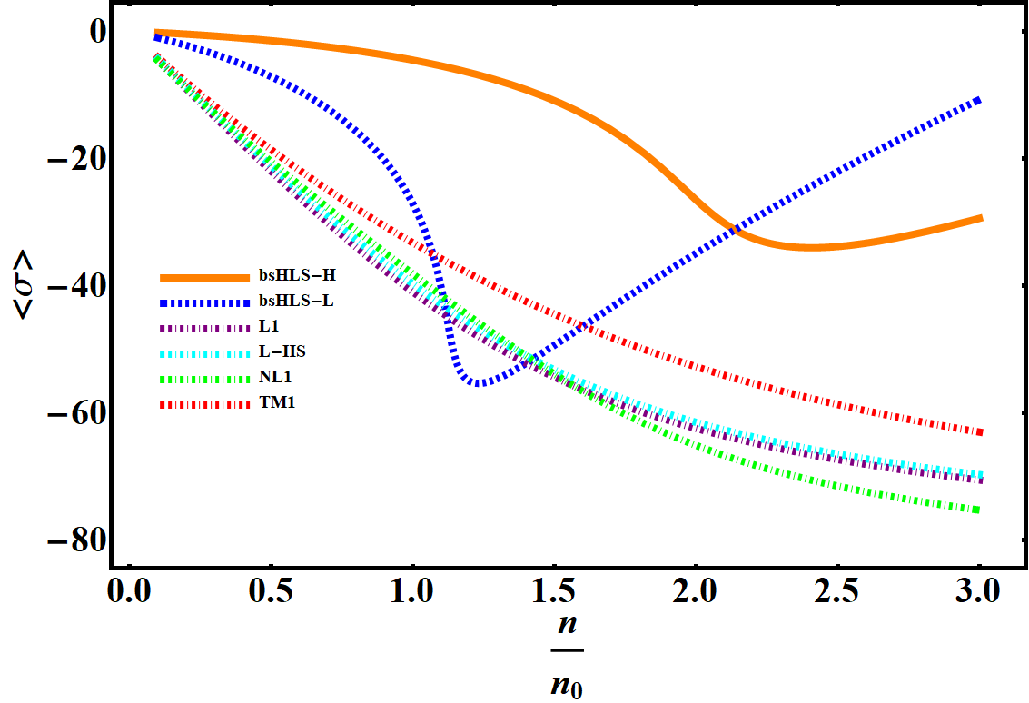
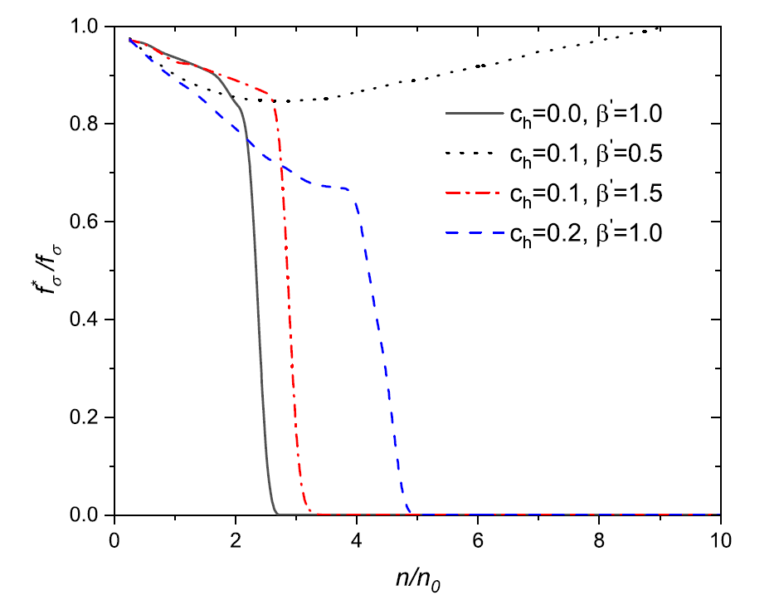
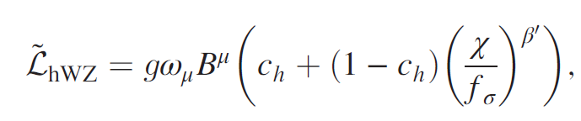

III. Nuclear matter properties
Why in Chiral-scale EFT?
Scale symmetry is first partially restored with density, but then broken again. Contradict to naïve expectation!
$$χ=f_{χ}e^{σ/f_{χ}}$$
Also found in skyrmion crystal approach.
Long-Qi Shao, YM, arXiv:2202.09957

Slide 28
III. Nuclear matter properties
$$v_{s}^{2}=\frac{{∂p(n)}/{∂n}}{{∂ε(n)}/{∂n}}=\frac{∂p(n)}{∂ε(n)}$$
Scale invariant.
Scale symmetry is hidden.
Scale invariant.

Slide 29

III. Nuclear matter properties
The peak of SV emerges due to the nonlinear realization of scale symmetry, NOT phase/configuration change.
Links to the charactor of scalar meson, fourth-component of chiral-four vector?
Location $\sim (1−2.5)n_{0}$, detectable at HIAF?

Slide 30


III. Nuclear matter properties
Hadron mass in medium
Weakly depend on density
$\sim (550\sim 750)$ MeV at $n_{0}$

Slide 31

III. Nuclear matter properties

Slide 32

III. Nuclear matter properties

Slide 33





III. Nuclear matter properties
G.E. Brown and R. Machleidt 1994 … A. Carbone et al 2013
Same as above for $n<n_{1/2}$ but $R_{ρ}^{∗}≈Φ^{2}$ for $n>n_{1/2}$.
$$n_{1/2}=2n_{0}$$
33

Slide 34

III. Nuclear matter properties
全息QCD 计算
K. Jo, M. Rho, Y. Seo, S. J. Sin, JHEP 07 (2011) 008, e-Print: 1104.2362 [hep-ph].

Slide 35

IV. Conclusion and Discussion
手征对称性的破缺机制与强子质量起源仍然是低能强相互作用物理所面临的重大科学问题；
核物质中强子性质的改变（质量、介子-原子核散射、介子-原子核束缚态$⋯$）会对这一问题的最总解决提供有用的信息；
加强低能核物理与高能天体物理的交叉研究。

Slide 36
Thank you for your attention!

Slide 37


II. Mesic Nucleus bound state
$$−2μU\left(s−wave\right)\left(r\right)=4πε_{1}\left\{b_{0}ρ\left(r\right)+b_{1}∆ρ\left(r\right)\right\}+4πε_{2}B_{0}ρ^{2}\left(r\right),$$
$$ρ\left(r\right)=ρ^{\left(n\right)}\left(r\right)+ρ^{\left(p\right)}\left(r\right),$$
$$∆ρ\left(r\right)=ρ^{\left(n\right)}\left(r\right)−ρ^{\left(p\right)}\left(r\right)$$
Among the parameters to parametrize the potential, isovector parameter $b_{1}$is known to have close connection with the chiral condensate at a finite density through the GMOR relation and Tomozawa-Weinberg relation.

Slide 38



II. Mesic Nucleus bound state
$${[D_{π}(ω,q)]}^{−1}=ω^{2}−q^{2}−m_{π}^{2}−Π(ω,q)$$
$$Π\left(ω,q\right)=−T^{+}ρ−εT^{−}δρ$$
$$T^{+}\left(ω\right)=\frac{σ_{πN}−βω^{2}}{f_{π}^{2}}, T^{−}=\frac{ω}{{2f}_{π}^{2}}$$

