Slide 1
Search for Dibaryons
Jialun Ping, Hongxia Huang
Nanjing Normal university

Slide 2
Contents
  History of dibaryon searches
  Symmetry and quark models
  Interesting dibaryons
  Summary
Notes:
首先是对研究背景进行简单的介绍，

Slide 3
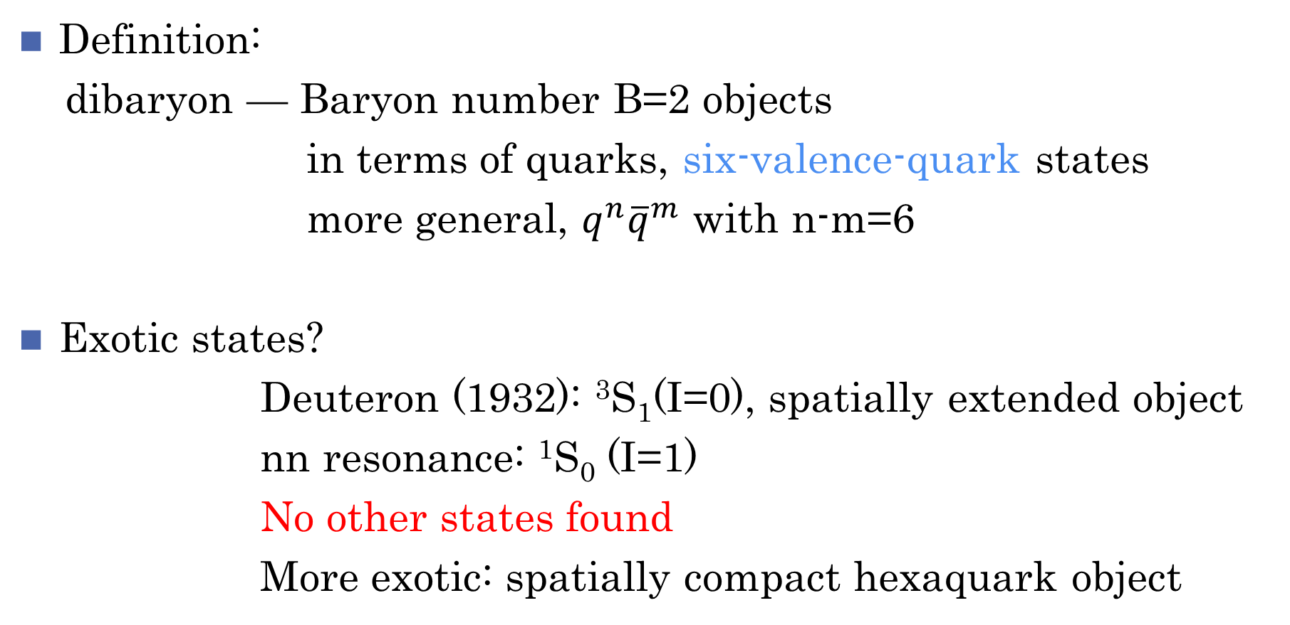
History of dibaryon searches
Definition:
dibaryon — Baryon number B=2 objects
in terms of quarks, six-valence-quark states
more general, $q^{n}{\overline{q}}^{m}$ with n-m=6
Exotic states?
Deuteron (1932): ³S₁(I=0), spatially extended object
nn resonance: ¹S₀ (I=1)
No other states found
More exotic: spatially compact hexaquark object

Slide 4
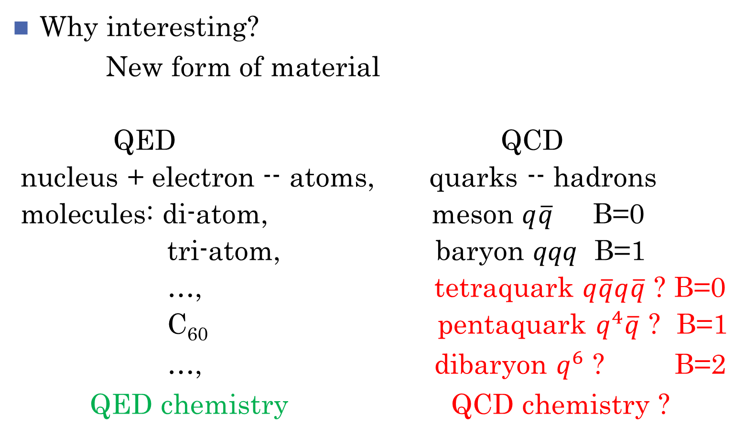
Why interesting?
New form of material
QED QCD
nucleus + electron -- atoms, quarks -- hadrons
molecules: di-atom, meson $q\overline{q}$ B=0
tri-atom, baryon $qqq$ B=1
…, tetraquark $q\overline{q}q\overline{q}$ ? B=0
C₆₀ pentaquark $q^{4}\overline{q}$ ? B=1
…, dibaryon $q^{6}$ ? B=2
QED chemistry QCD chemistry ?
Notes:
X3872 普遍的被认为是ddbar的分子态。 而实际上，现在有较多的理论工作者
认为 x3872仍然是ccbar的态，但是含有ddbar的成分，他的性质会受到ddbar四夸克的影响。
过度：
从这两个简单的例子我们可以看出，既然普通强子态和奇特态并没有明确的界限，我们就需要去寻求一种方法去研究这样的体系。
希望能够找到一个方法，能够对普通强子态和奇特态有一个统一的描述。

Slide 5
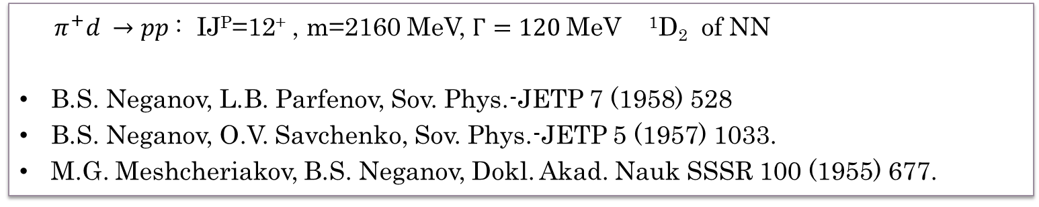
History of dibaryon searches
Early days:
$π^{+}d →pp$: IJ^{P}=12⁺ , m=2160 MeV, $Γ=120$MeV ¹D₂ of NN
B.S. Neganov, L.B. Parfenov, Sov. Phys.-JETP 7 (1958) 528
B.S. Neganov, O.V. Savchenko, Sov. Phys.-JETP 5 (1957) 1033.
M.G. Meshcheriakov, B.S. Neganov, Dokl. Akad. Nauk SSSR 100 (1955) 677.
Oakes’s prediction: J^{P}=1⁺ resonances R. Oakes, Phys. Rev. 131 (1963) 2239.
1 state with (Y, I) = (2, 0) containing the baryon–baryon configuration (np),
2 states with (Y, I) = (1, 1/2) containing the baryon–baryon configurations (ΛN,ΣN),
3 states with (Y, I) = (0, 1) containing the baryon–baryon configurations (ΣΛ,ΣΣ,ΞN)
4 states with (Y, I) = (−1, 3/2) containing the baryon–baryon configurations (ΞΣ).
The prediction of Dyson and Xuong: F.J. Dyson, N.-H. Xuong, Phys. Rev. Lett. 13 (1964) 815
SU(6) symmetry → six D_{IJ} with IJ=01, 10, 12, 21, 03, 30
1876 2160 2350 MeV

Slide 6
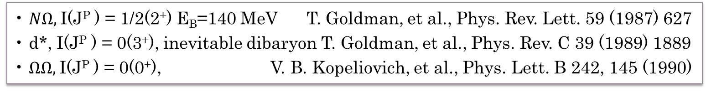
Rush era:
$H$dibaryon: IJ^{P}=00⁺ m=2150 MeV R.L. Jaffe, Phys. Rev. Lett. 138 (1977) 195
Oka’s prediction: M. Oka, Phys. Rev. D 38 (1988) 298
• S = 0, I(J^{P} ) = 0(3⁺) and BB structure ΔΔ,
• S = −1, I(J^{P} ) = 1/2(2⁺) and BB structure Σ∗N and ΣΔ,
• S = −2, I(J^{P} ) = 0(0⁺) with BB structure ΛΛ, ΞN and ΣΣ (the H dibaryon)
• S = −3, I(J^{P} ) = 1/2(2⁺) with BB structure ΩN, Ξ∗Σ, Ξ∗Λ and ΞΣ∗
Nijmegen group’s work: many resonances
NN ¹P₁, ³P₀, ³P₂: 2.2 GeV, ³F₃: 2.34 GeV,
P.J.G. Mulders, et al., Phys. Rev. Lett. 40 (1978) 1543
NN ³S₁-³D₁, ¹S₀, ¹D₂, ³D₃-³G₃, NΛ 1+, 2+, ΛΛ 0+, NΞ 1+, ...
Phys. Rev. D 17 (1978) 260; 21 (1980) 2653; 26 (1982) 3039
• $NΩ,$I(J^{P} ) = 1/2(2⁺) E_{B}=140 MeV T. Goldman, et al., Phys. Rev. Lett. 59 (1987) 627
• d*, I(J^{P} ) = 0(3⁺), inevitable dibaryon T. Goldman, et al., Phys. Rev. C 39 (1989) 1889
• $ΩΩ,$I(J^{P} ) = 0(0⁺), V. B. Kopeliovich, et al., Phys. Lett. B 242, 145 (1990)

Slide 7
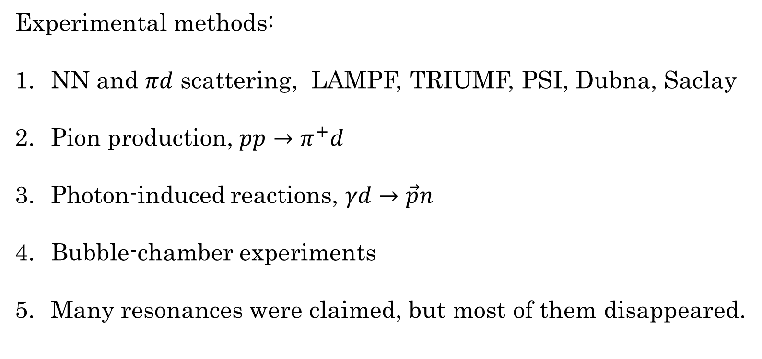
History of dibaryon searches
Experimental methods:
NN and $πd$ scattering, LAMPF, TRIUMF, PSI, Dubna, Saclay
Pion production, $pp→π^{+}d$
Photon-induced reactions, $γd→\vec{p}n$
Bubble-chamber experiments
Many resonances were claimed, but most of them disappeared.

Slide 8
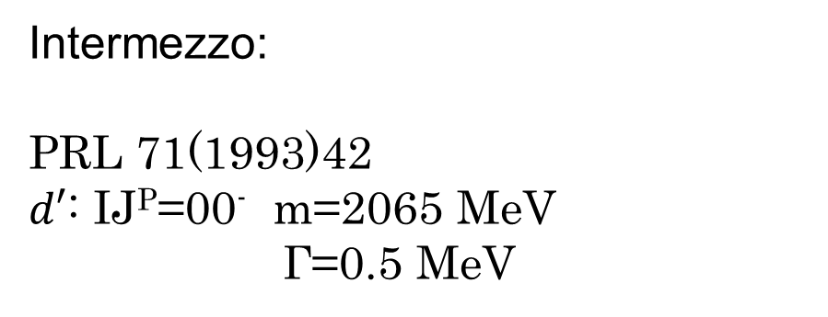
History of dibaryon searches
Intermezzo:
PRL 71(1993)42
$d′$: IJ^{P}=00⁻ m=2065 MeV
Γ=0.5 MeV
PRC 62(2000)054007

Slide 9
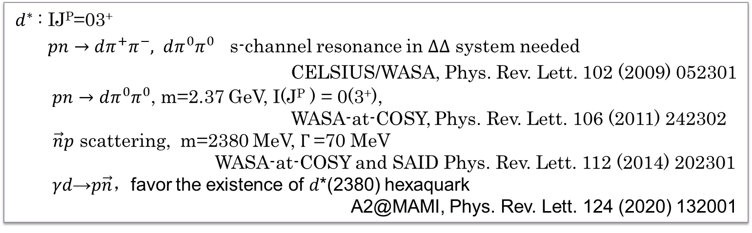
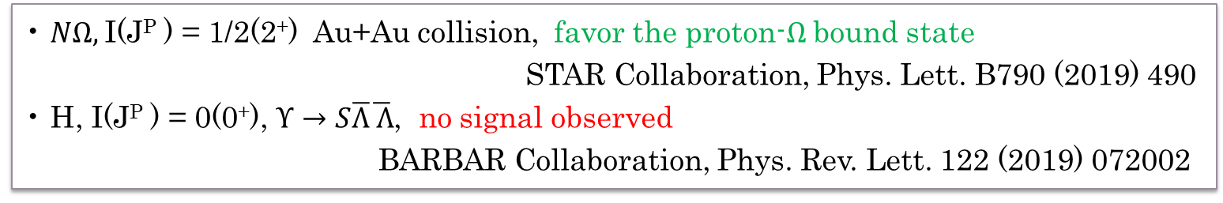
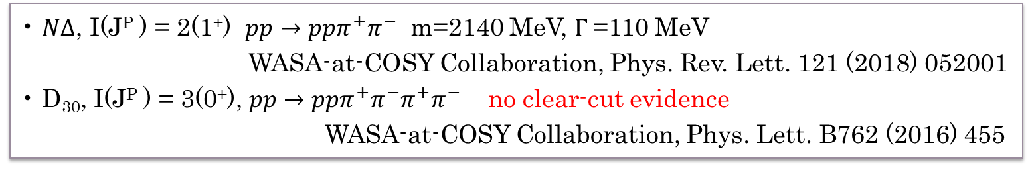
New era:
$d^{∗}$: IJ^{P}=03⁺
$pn→dπ^{+}π^{−}, dπ^{0}π^{0}$ s-channel resonance in $∆∆$ system needed
CELSIUS/WASA, Phys. Rev. Lett. 102 (2009) 052301
$pn→dπ^{0}π^{0}$, m=2.37 GeV, I(J^{P} ) = 0(3⁺),
WASA-at-COSY, Phys. Rev. Lett. 106 (2011) 242302
$\vec{n}p$ scattering, m=2380 MeV, $Γ$=70 MeV
WASA-at-COSY and SAID Phys. Rev. Lett. 112 (2014) 202301
𝛾𝑑→𝑝$\vec{n}，$favor the existence of 𝑑*(2380) hexaquark
A2@MAMI, Phys. Rev. Lett. 124 (2020) 132001
• $N∆$, I(J^{P} ) = 2(1⁺) $pp→ppπ^{+}π^{−}$ m=2140 MeV, $Γ$=110 MeV
WASA-at-COSY Collaboration, Phys. Rev. Lett. 121 (2018) 052001
• D₃₀, I(J^{P} ) = 3(0⁺), $pp→pp{π^{+}π^{−}π}^{+}π^{−}$ no clear-cut evidence
WASA-at-COSY Collaboration, Phys. Lett. B762 (2016) 455
• $NΩ,$I(J^{P} ) = 1/2(2⁺) Au+Au collision, favor the proton-$Ω$ bound state
STAR Collaboration, Phys. Lett. B790 (2019) 490
• H, I(J^{P} ) = 0(0⁺), $Υ→S\overline{Λ}\overline{ Λ}$, no signal observed
BARBAR Collaboration, Phys. Rev. Lett. 122 (2019) 072002
Notes:
PLB743(2015)325: np -> np \pi0 \pi0
PRL 110(2013)222002: Upsilon decays, no signal of H (Belle)

Slide 10
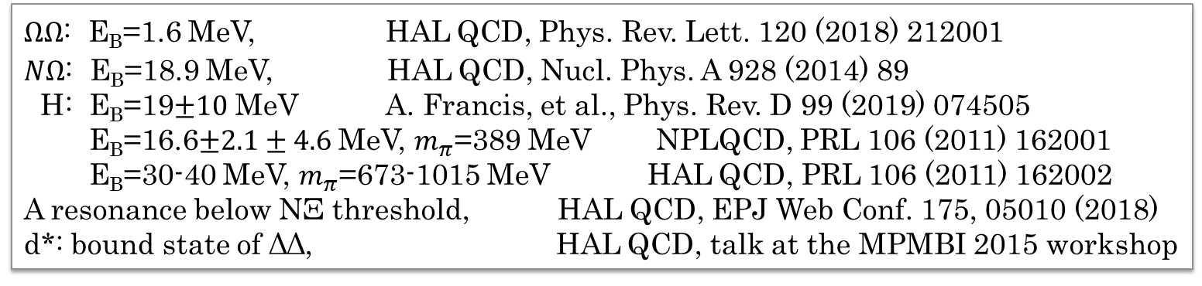
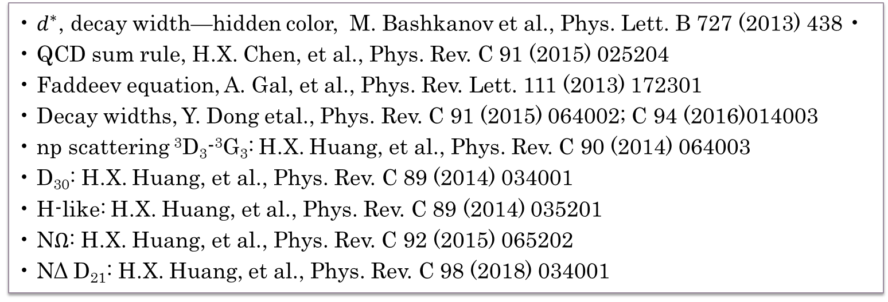
Lattice calculations:
$ΩΩ$: E_{B}=1.6 MeV, HAL QCD, Phys. Rev. Lett. 120 (2018) 212001
$NΩ$: E_{B}=18.9 MeV, HAL QCD, Nucl. Phys. A 928 (2014) 89
H: E_{B}=19$±10$ MeV A. Francis, et al., Phys. Rev. D 99 (2019) 074505
E_{B}=16.6$±2.1±4.6$ MeV, $m_{π}$=389 MeV NPLQCD, PRL 106 (2011) 162001
E_{B}=30-40 MeV, $m_{π}$=673-1015 MeV HAL QCD, PRL 106 (2011) 162002
A resonance below NΞ threshold, HAL QCD, EPJ Web Conf. 175, 05010 (2018)
d*: bound state of ΔΔ, HAL QCD, talk at the MPMBI 2015 workshop
• $d^{∗}$, decay width—hidden color, M. Bashkanov et al., Phys. Lett. B 727 (2013) 438 • • QCD sum rule, H.X. Chen, et al., Phys. Rev. C 91 (2015) 025204
• Faddeev equation, A. Gal, et al., Phys. Rev. Lett. 111 (2013) 172301
• Decay widths, Y. Dong etal., Phys. Rev. C 91 (2015) 064002; C 94 (2016)014003
• np scattering ³D₃-³G₃: H.X. Huang, et al., Phys. Rev. C 90 (2014) 064003
• D₃₀: H.X. Huang, et al., Phys. Rev. C 89 (2014) 034001
• H-like: H.X. Huang, et al., Phys. Rev. C 89 (2014) 035201
• N$Ω$: H.X. Huang, et al., Phys. Rev. C 92 (2015) 065202
• NΔ D₂₁: H.X. Huang, et al., Phys. Rev. C 98 (2018) 034001

Slide 11
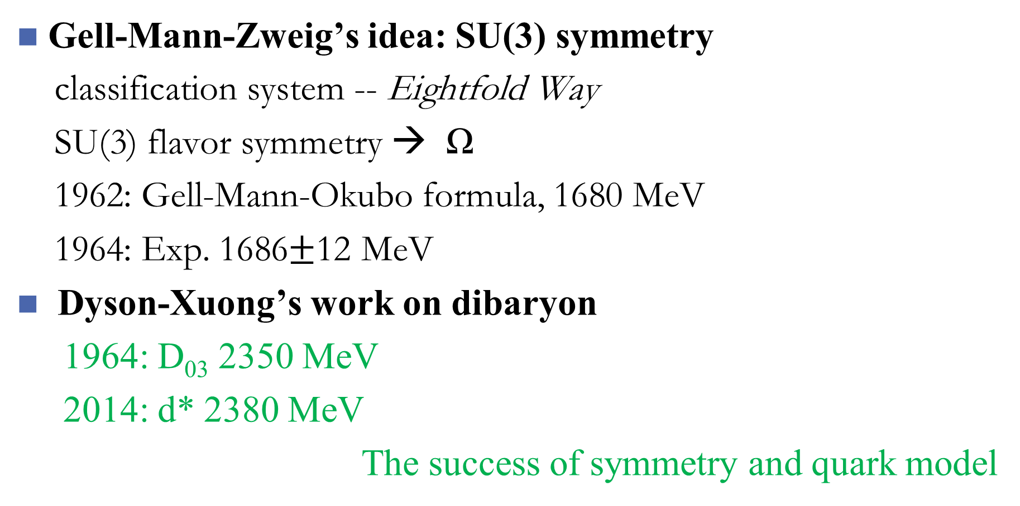
Symmetry and quark models
Gell-Mann-Zweig’s idea: SU(3) symmetry
classification system -- Eightfold Way
SU(3) flavor symmetry → Ω
1962: Gell-Mann-Okubo formula, 1680 MeV
1964: Exp. 1686$±$12 MeV
Dyson-Xuong’s work on dibaryon
1964: D₀₃ 2350 MeV
2014: d* 2380 MeV
The success of symmetry and quark model

Slide 12
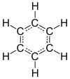
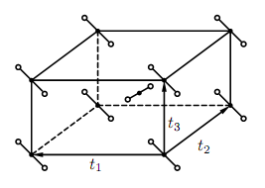
Geometry symmetry
molecules: point group,
C₆H₆ (D_{6h}), C₆₀ (I_{h})
crystal: space group
TiO₂(D_{4h}¹⁴)
[G,H]=0
……

Slide 13
Dynamical symmetry
Dynamical symmetry:
H: Hamiltonian of a system
C,C₁,C₂,……: Casimir operators or class operators of
group chain
properties:
Eigen energy of the system:
eigenvalues of operators C,C₁,C₂,……

Slide 14
Group chain of quark system
Light hadron ground states:
orbital: U^{x}(1) (baryon) or (dibaryon)
color: SU^{c}(3)
flavor: SU^{f}(3)
spin: SU^{σ}(2)
Group chain:

Slide 15
Dynamical symmetry applied to light quark systems
Color: singlet, [c] fixed
Gursey-Radicati mass formula (PRL13(1964)173)

Slide 16
Parameters the masses of baryons
A=9.2962 B=48.238 C=-196.34 D=35.080
(unit: MeV)
Baryon: M₀=1021.9 MeV
Dibaryon: M₀=2093 MeV

Slide 17
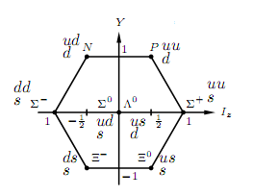
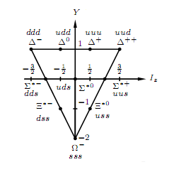

Slide 18
Baryons:
 | N | Λ | Σ | Ξ | Δ | Σ* | Ξ* | Ω
Y | 1 | 0 | 0 | -1 | 1 | 0 | -1 | -2
I | ½ | 0 | 1 | ½ | 3/2 | 1 | ½ | 0
J | ½ | ½ | ½ | ½ | 3/2 | 3/2 | 3/2 | 3/2
[f] | [21] | [21] | [21] | [21] | [3] | [3] | [3] | [3]
theo | 935 | 1114 | 1184 | 1328 | 1241 | 1384 | 1528 | 1672
err | 2.6 | 1.9 | 2.6 | 1.6 | 4.8 | 3.8 | 2.7 | 1.7
exp | 939 | 1116 | 1193 | 1318 | 1232 | 1383 | 1533 | 1672

Slide 19
[f]=[6] dim=28

Slide 20
[f]=[51] dim=35

Slide 21
[f]=[42] dim=27

Slide 22
[f]=[411] dim=10 [f]=[33] dim=10

Slide 23
[f]=[321] dim=8
[f]=[222] dim=1

Slide 24
Dibaryons:
 | D₀₁ | D₁₀ | D₀₃ | D₃₀ | D₁₂ | NΩ | ΩΩ | H
Y | 2 | 2 | 2 | 2 | 2 | -1 | -4 | 0
I | 0 | 1 | 0 | 3 | 1 | ½ | 0 | 0
J | 1 | 0 | 3 | 0 | 2 | 2 | 0 | 0
[f] | [33] | [42] | [33] | [6] | [42] | [321] | [6] | [222]
theo | 1873 | 1884 | 2355 | 2420 | 2173 | 2652 | 3072 | 2093
err | 5.6 | 6.6 | 6.6 | 13 | 7.2 | 4.0 | 4.7 | 2.9
exp | 1876 | 1878? | 2380 | ? | 2148? | ? | ? | ?

Slide 25
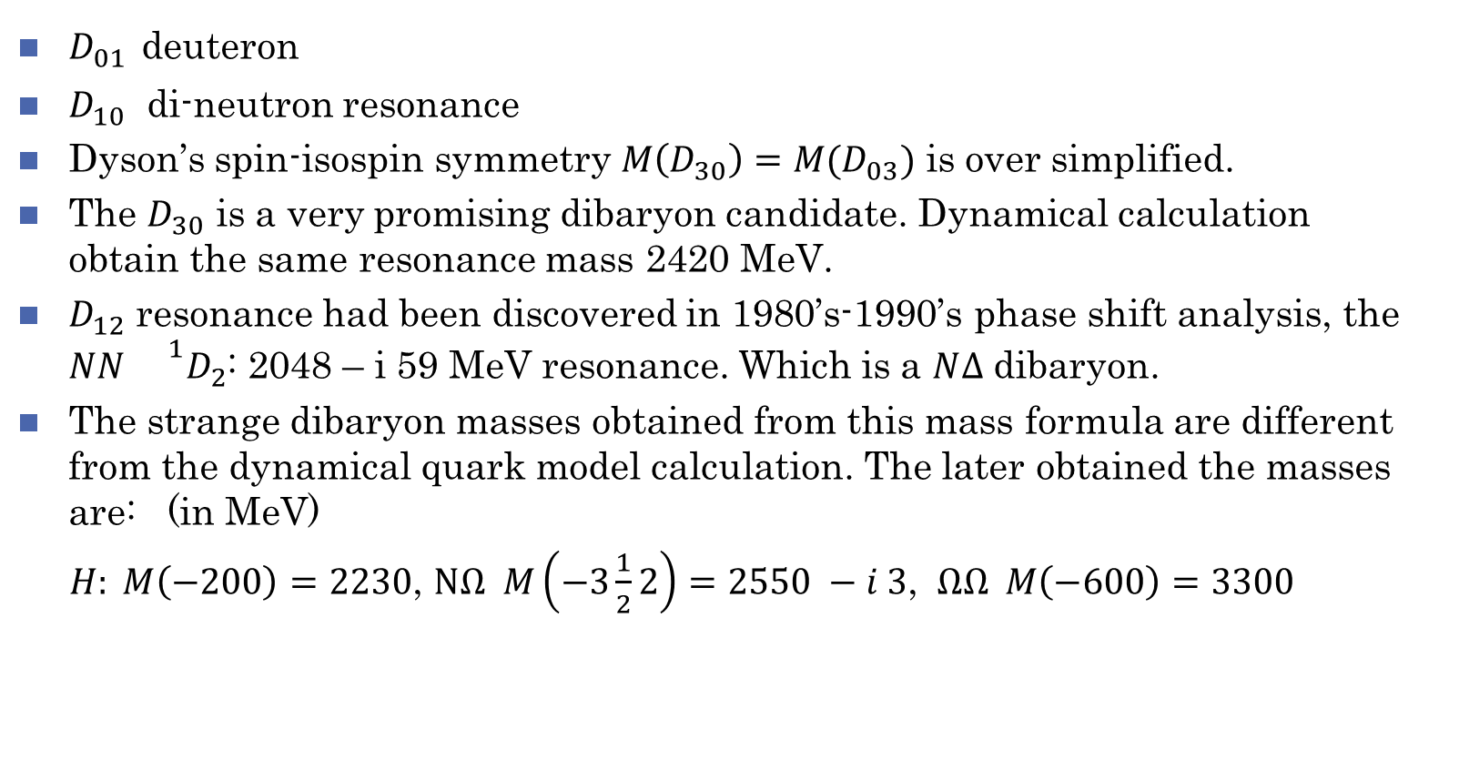
Note to the table
$D_{01}$ deuteron
$D_{10}$ di-neutron resonance
Dyson’s spin-isospin symmetry $M\left(D_{30}\right)=M(D_{03})$ is over simplified.
The $D_{30}$ is a very promising dibaryon candidate. Dynamical calculation obtain the same resonance mass 2420 MeV.
$D_{12}$ resonance had been discovered in 1980’s-1990’s phase shift analysis, the $NN {}^{1}D_{2}$: 2048 – i 59 MeV resonance. Which is a $N∆$ dibaryon.
The strange dibaryon masses obtained from this mass formula are different from the dynamical quark model calculation. The later obtained the masses are: (in MeV)
$H: M\left(−200\right)=2230$, $NΩ M\left(−3\frac{1}{2}2\right)=2550 −i 3$, $ΩΩ M\left(−600\right)=3300$

Slide 26
Quark delocalization color screening model (QDCSM)
QDCSM: F.Wang et al. (Nanjing University) PRL69(1992)2901.
Two gradients (based on cluster model):
quark delocalization (orbital excitation)
color screening (color structure)
Apply to baryon-baryon interaction:
NN，N ，N ，…
deuteron success！
Explain the similarity between nuclear force and molecular force

Slide 27
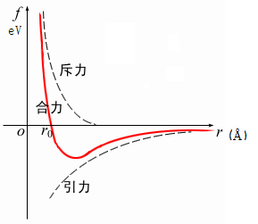
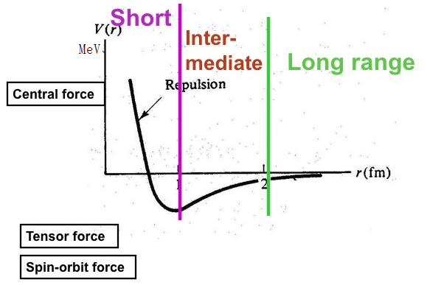
Molecular force vs nuclear force
Similarity:
electron percolation quark delocalization

Slide 28
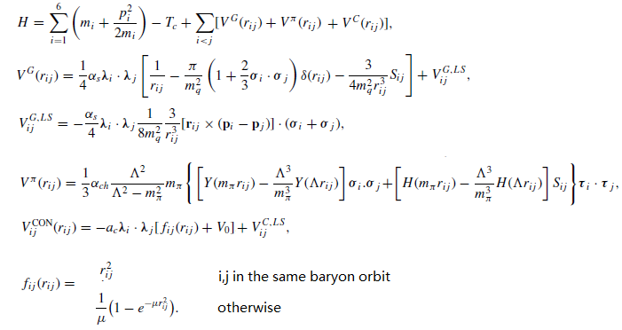
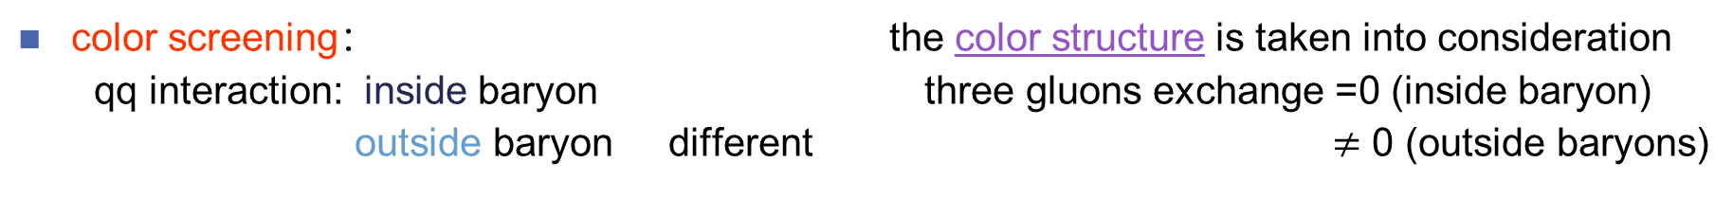
color screening： the color structure is taken into consideration
qq interaction: inside baryon three gluons exchange =0 (inside baryon)
outside baryon different $≠$ 0 (outside baryons)

Slide 29
Quark delocalization:
the parameter εis determined by system dynamics。
The main advantage of QDCSM :
Quark and gluon distribution: self-consistent
the delocalization parameter is determined through its own dynamics, so multiquarksystem choose its most favorable configuration by variation.

Slide 30
RGM+GCM
Resonating group method
Generating coordinate method

Slide 32
Several Interesting dibaryons
deuteron

Slide 33
d*
Dyson & Xuong, PRL 13 (1964) 815
“inevitable”dibaryon
T.Goldman, K. Maltman, and F. Wang et al.,
Glueballs, hybrids and exotic hadrons, Brookhaven (1988) 413;
PRC39 (1989)1889.
1. Kinetic energies:
2. Color-Magnetic Interaction:
the existence of IJ^{P}=03⁺ dibaryon is inevitable
IJ^{P}=03⁺ dibaryon: a spin excitation of d, named d*

Slide 34
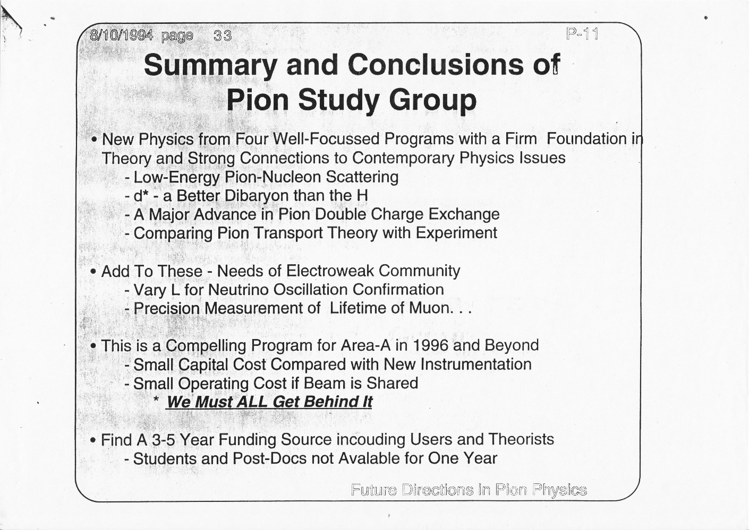
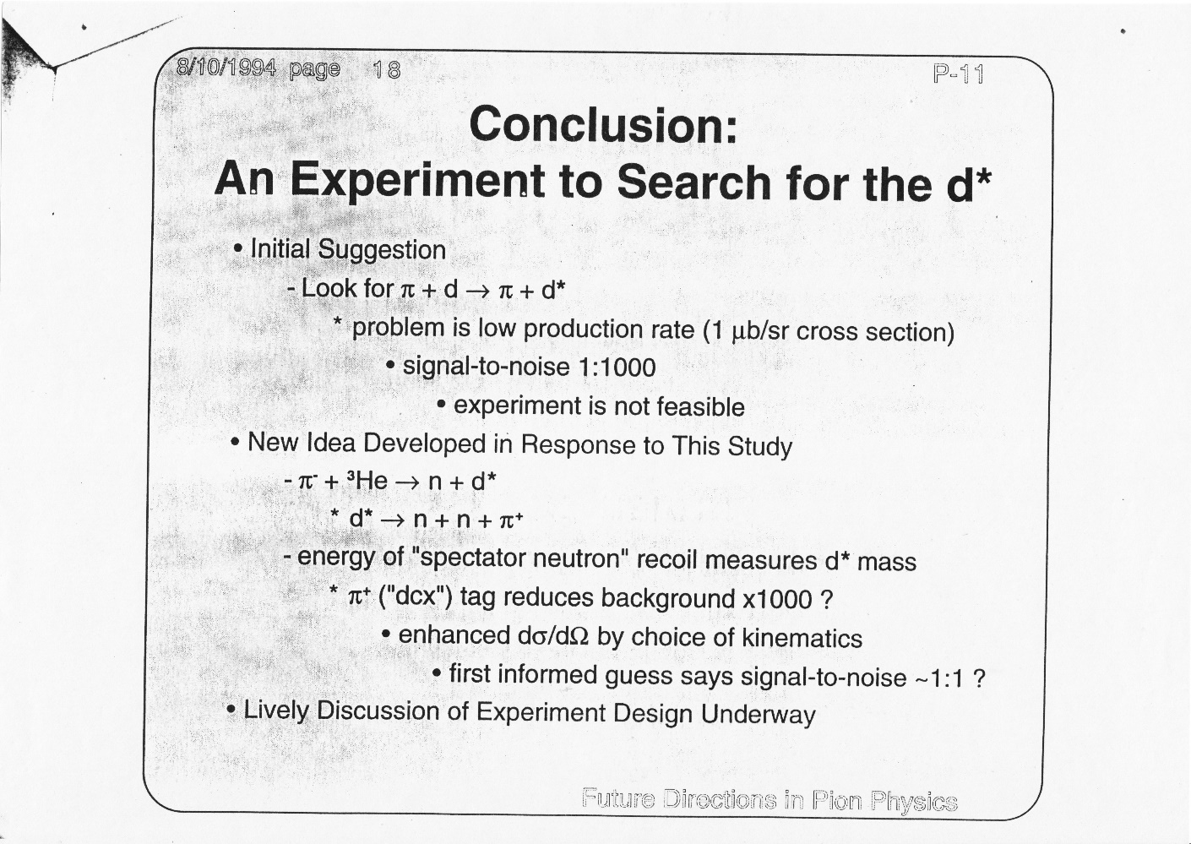
Proposals for d* searching
1994: LANL

Slide 35
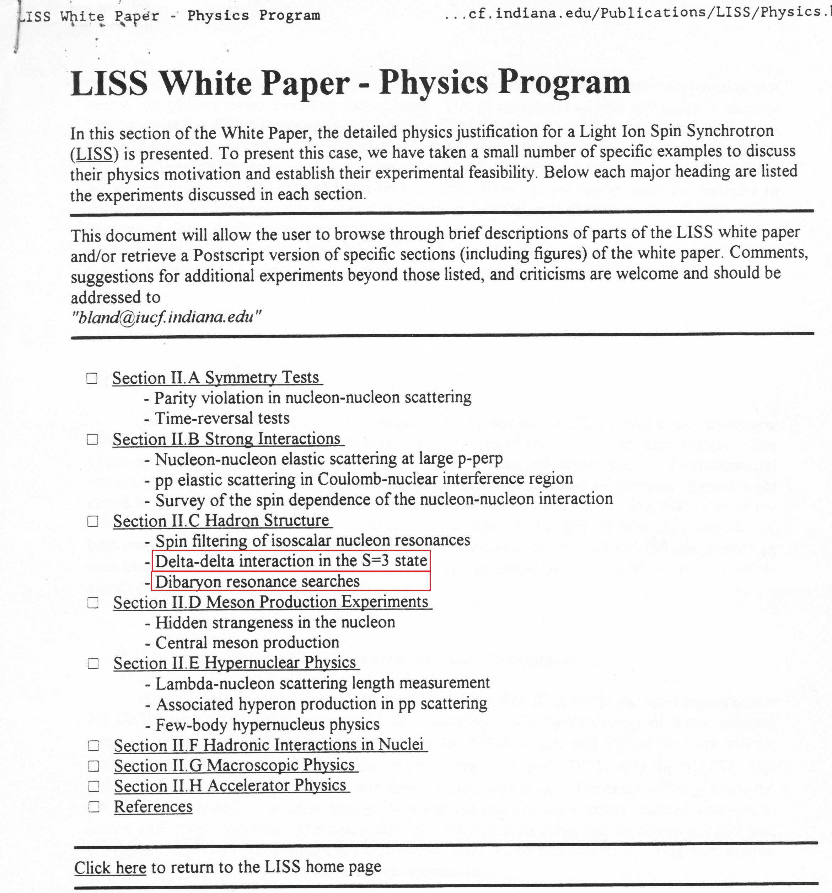
1995

Slide 36
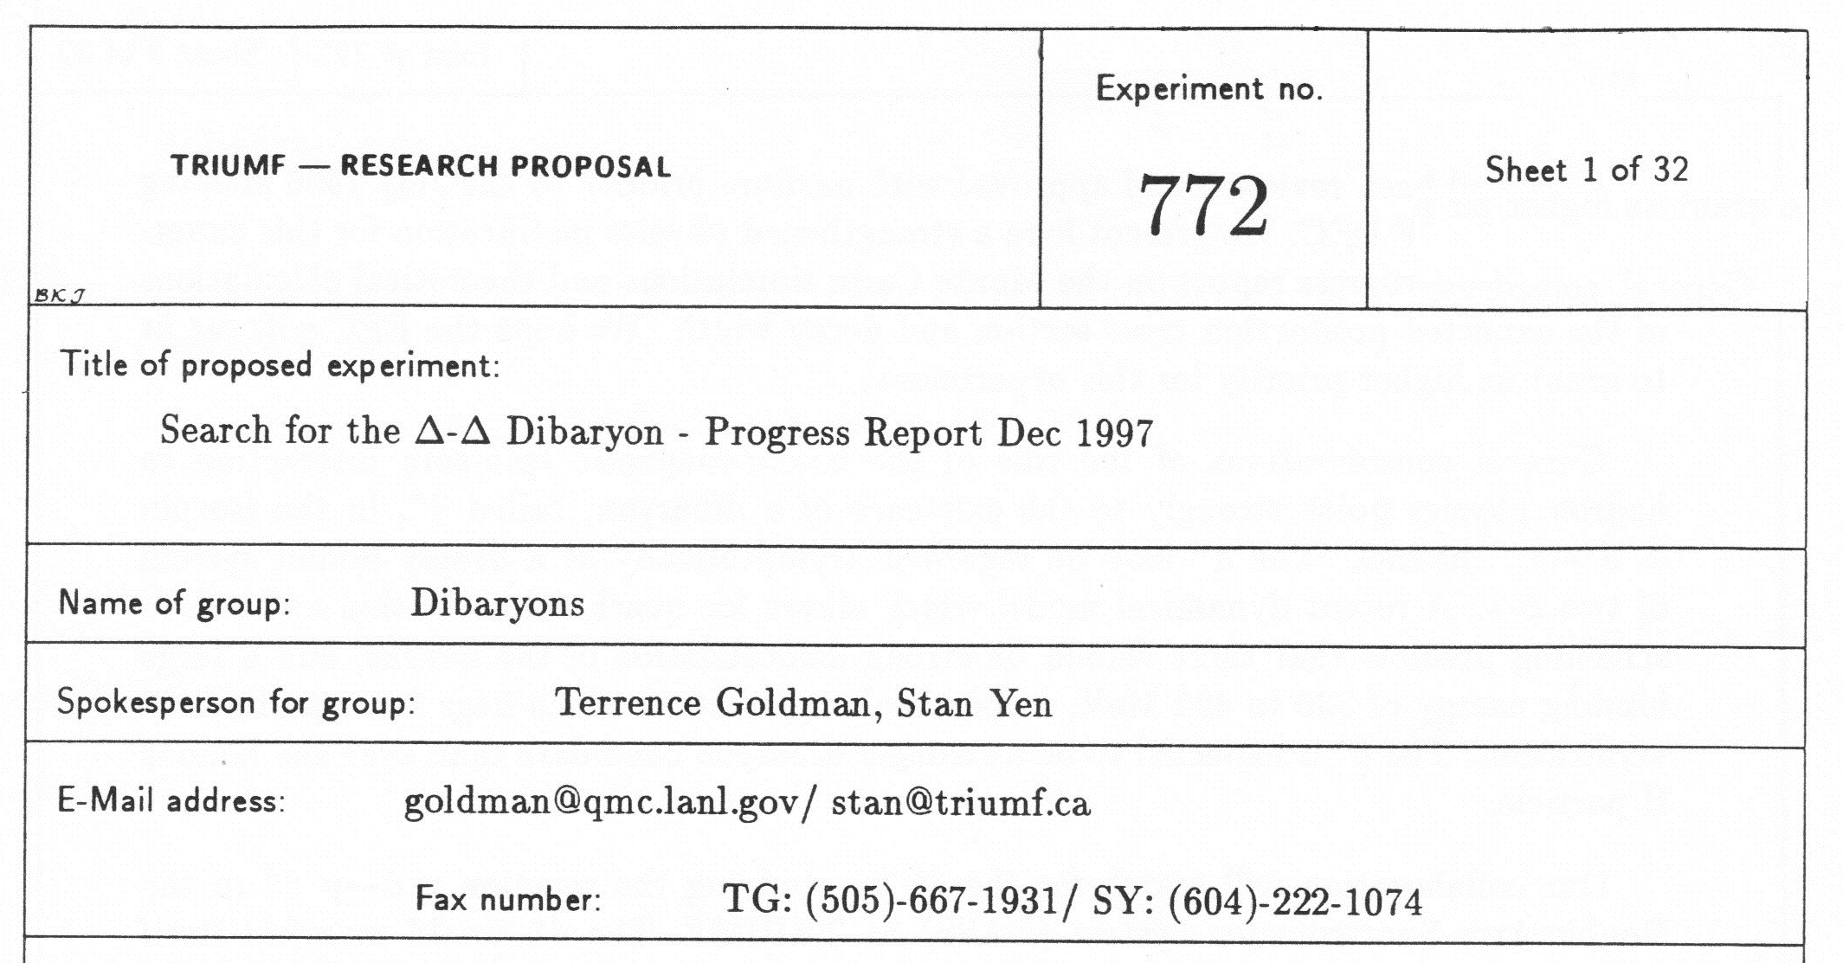
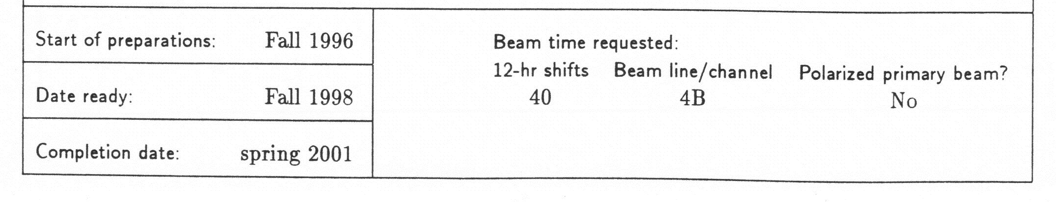
d* search at Triumf

Slide 37
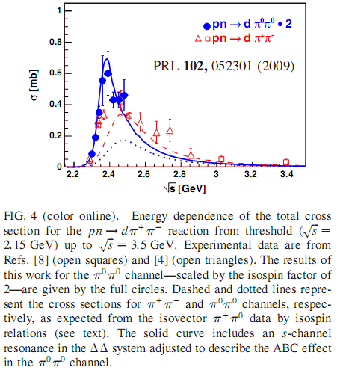
WASA-at-COSY measurements
Fudan University, 2019.9

Slide 38
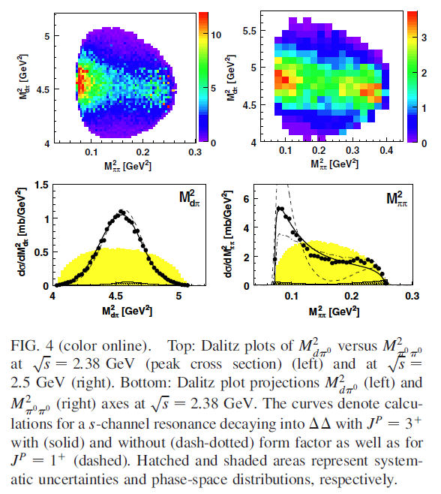
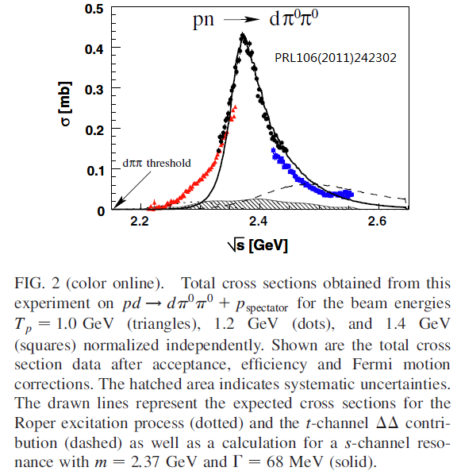
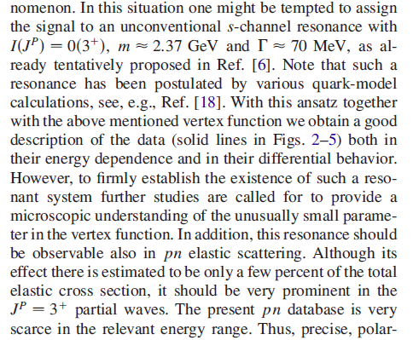

Slide 39
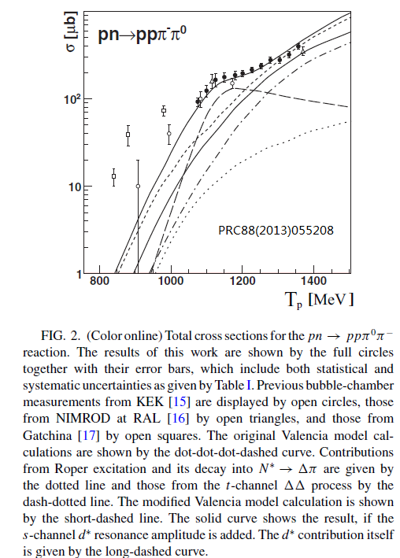
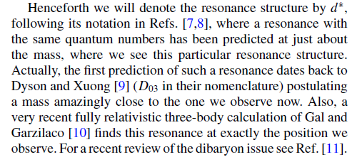

Slide 40
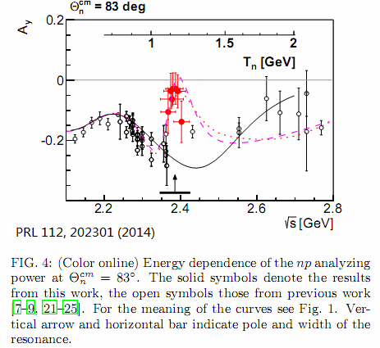
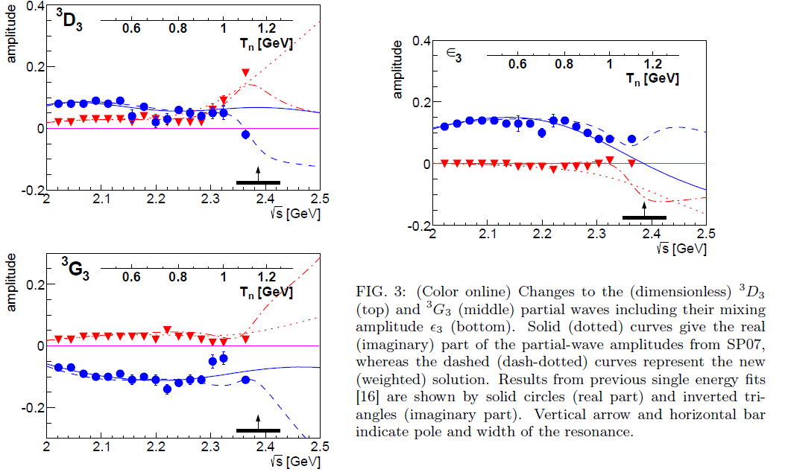

Slide 41
D₁₂ and D₂₁
Dynamical symmetry approach

Slide 42
D₁₂ and D₂₁
Dynamical calculation: ¹D₂: E_{B}< 1 MeV
PRC 98(2018)034001
PRC 79(2009)024001

Slide 43
D₁₂ and D₂₁
Phys.Rev.165(1968)1834
PRL121(2019)052001

Slide 44

D₃₀
Dyson & Xuong: M(D₃₀)=M(D₀₃)
$pp→pp{π^{+}π^{−}π}^{+}π^{−}$ no clear-cut evidence
WASA-at-COSY Collaboration, Phys. Lett. B762 (2016) 455
PRC 89(2014)034001

Slide 45
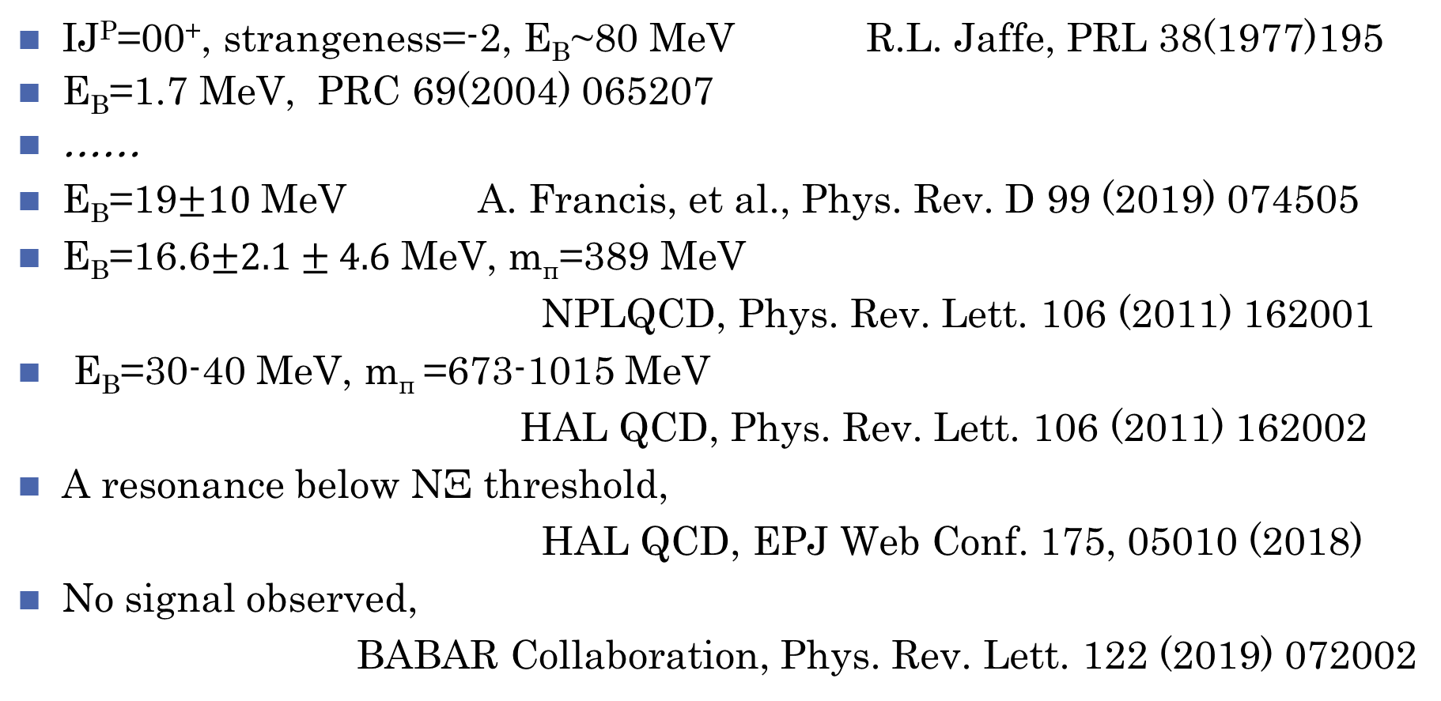
H
IJ^{P}=00⁺, strangeness=-2, E_{B}~80 MeV R.L. Jaffe, PRL 38(1977)195
E_{B}=1.7 MeV, PRC 69(2004) 065207
……
E_{B}=19$±10$ MeV A. Francis, et al., Phys. Rev. D 99 (2019) 074505
E_{B}=16.6$±2.1±4.6$ MeV, m_{π}=389 MeV
NPLQCD, Phys. Rev. Lett. 106 (2011) 162001
E_{B}=30-40 MeV, m_{π} =673-1015 MeV
HAL QCD, Phys. Rev. Lett. 106 (2011) 162002
A resonance below NΞ threshold,
HAL QCD, EPJ Web Conf. 175, 05010 (2018)
No signal observed,
BABAR Collaboration, Phys. Rev. Lett. 122 (2019) 072002

Slide 46
H-like dibaryons: s → Q=c,b

Slide 47
NΩ
J=1,2, two bound states, T. Goldman, et al., PRL 59(1987)627
J=2, narrow resonance state, m=2557 MeV, PRC 69(2004)065207
Q.B.Li and P.N. Shen, EPJA 8(2000) 417
E_{B}=18.9 MeV, HAL QCD, NPA 928(2014)89
2.46 MeV, PLB 792 (2019) 284
PRC 92 (2015) 065202
Favor pΩ state E_{B}~27 MeV slightly,
STAR Collaboration, Phys. Lett. B790 (2019) 490

Slide 48
NΩ-like dibaryons: s → Q=c,b

Slide 49
N$Σ_{Q} Q=c,b$

Slide 50
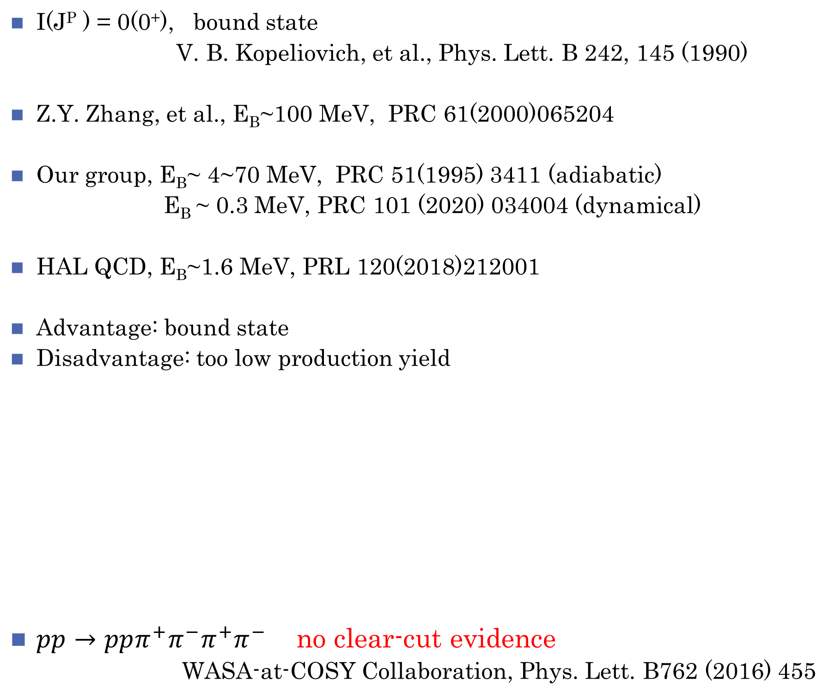
ΩΩ
I(J^{P} ) = 0(0⁺), bound state
V. B. Kopeliovich, et al., Phys. Lett. B 242, 145 (1990)
Z.Y. Zhang, et al., E_{B}~100 MeV, PRC 61(2000)065204
Our group, E_{B}~ 4~70 MeV, PRC 51(1995) 3411 (adiabatic)
E_{B} ~ 0.3 MeV, PRC 101 (2020) 034004 (dynamical)
HAL QCD, E_{B}~1.6 MeV, PRL 120(2018)212001
Advantage: bound state
Disadvantage: too low production yield
$pp→pp{π^{+}π^{−}π}^{+}π^{−}$ no clear-cut evidence
WASA-at-COSY Collaboration, Phys. Lett. B762 (2016) 455

Slide 51
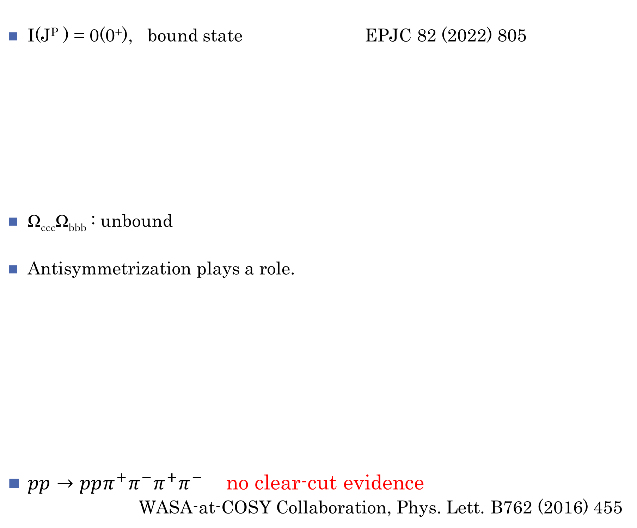
Ω_{ccc}Ω_{ccc} and Ω_{bbb}Ω_{bbb}
I(J^{P} ) = 0(0⁺), bound state EPJC 82 (2022) 805
Ω_{ccc}Ω_{bbb} : unbound
Antisymmetrization plays a role.
$pp→pp{π^{+}π^{−}π}^{+}π^{−}$ no clear-cut evidence
WASA-at-COSY Collaboration, Phys. Lett. B762 (2016) 455

Slide 52
Correlation function
Experimental measurement:
Theoretical calculation:
Correlation function ---- hadron-hadron interaction
Nature 588 (2020) 232

Slide 53
Summary
1、Since 2003, important progresses on tetra-, penta- and hexa-quark
systems have been made experimentally.
2、Dibaryon is a unique system with B=2, which cannot mix with mesons
and baryons.
3. The multiquark spectroscopy needs more data. The theoretical method
will be more efficient based upon the large set of data.
4、QCD chemistry begins?

Slide 54
Thank you!

