Slide 1


第一届 HIAF 高能终端谱仪合作组会议 η π 相互作用和 $η$ 形状因子研究
肖 楮 文 (C. W. Xiao)
广西师范大学 (Guangxi Normal University)
2024.11.17 近物所，惠州

Slide 2
Outline
Muon g-2 anomaly
η π interaction
η transition form factor
Prospect

Slide 3

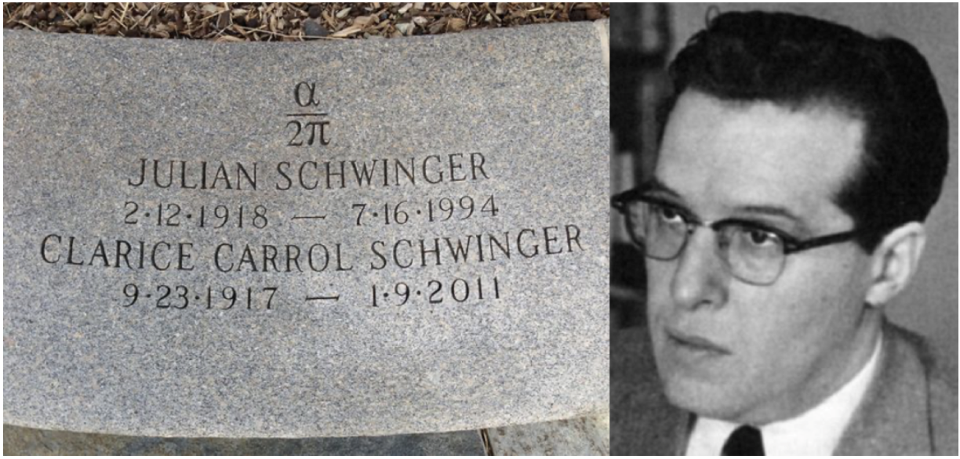
§1. Muon g-2 anomaly
The anomaly of the electron magnetic moment
In 1947, Schwinger predicted:
one loop

Slide 4
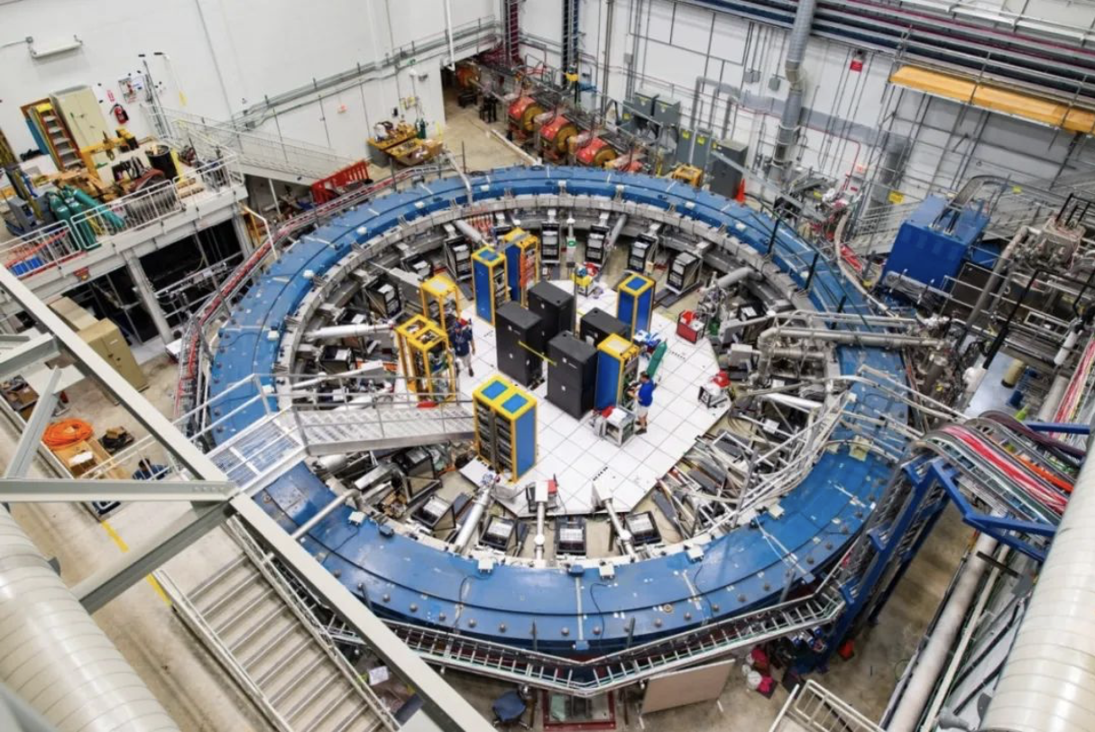
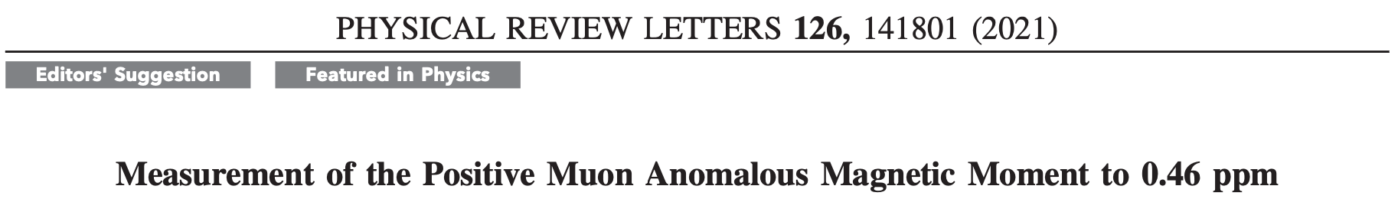
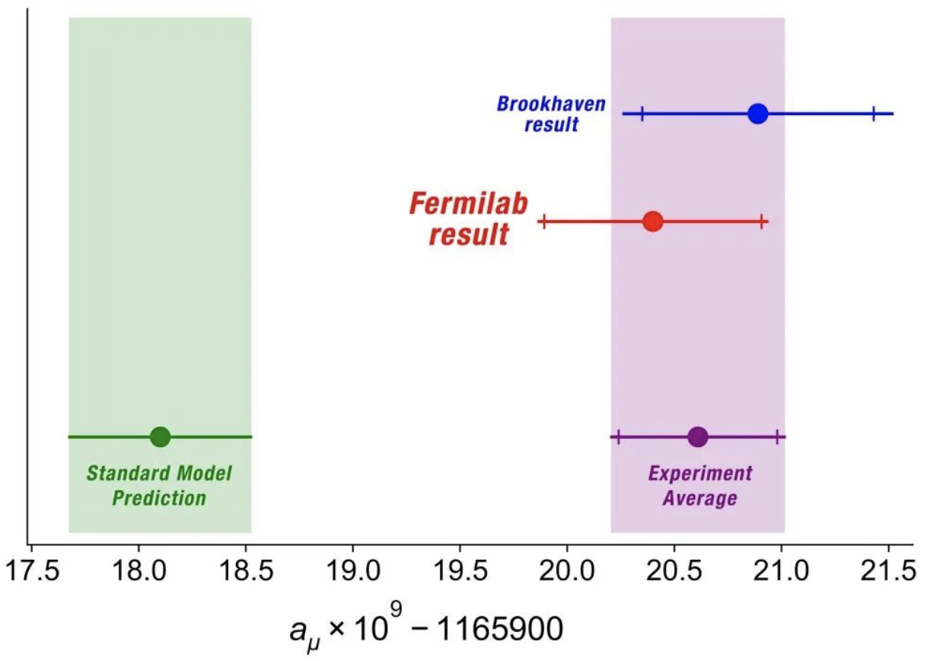
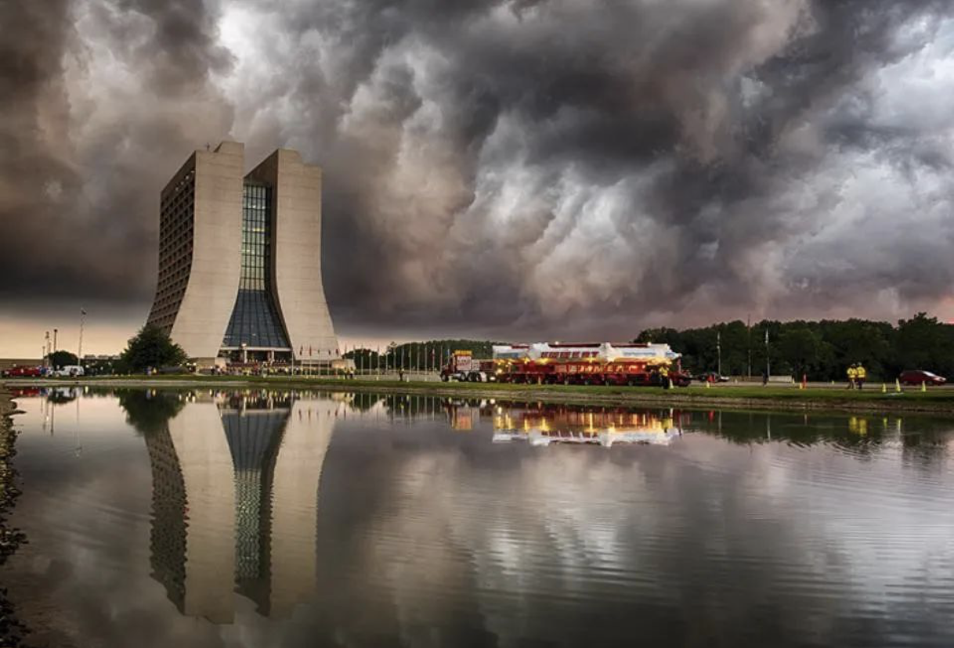
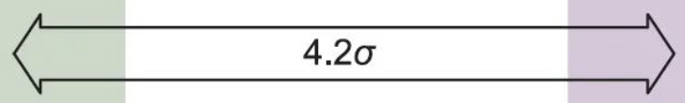

Muon Anomalous Magnetic Moment
2021年4月7日当地时间上午 10 点，费米实验室召开在线新闻发布会，公布合作组对缪子反常磁矩测量的最新结果。实验组的新结果已经在《Physical Review Letters》杂志发表文章。
“一朵乌云”
预示着在该领域存在新物理效应的可能性
PRL (2021)

Slide 5
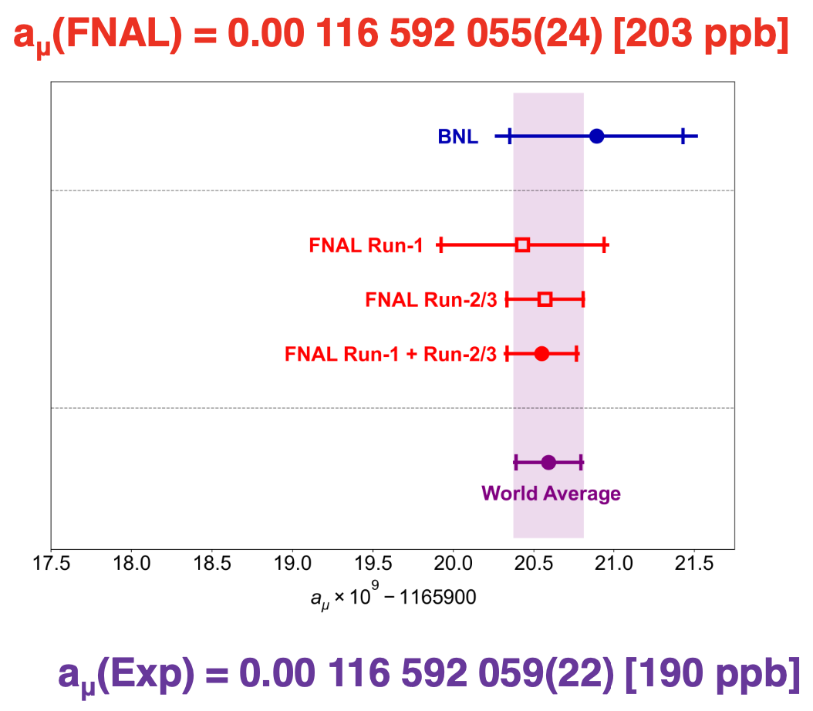
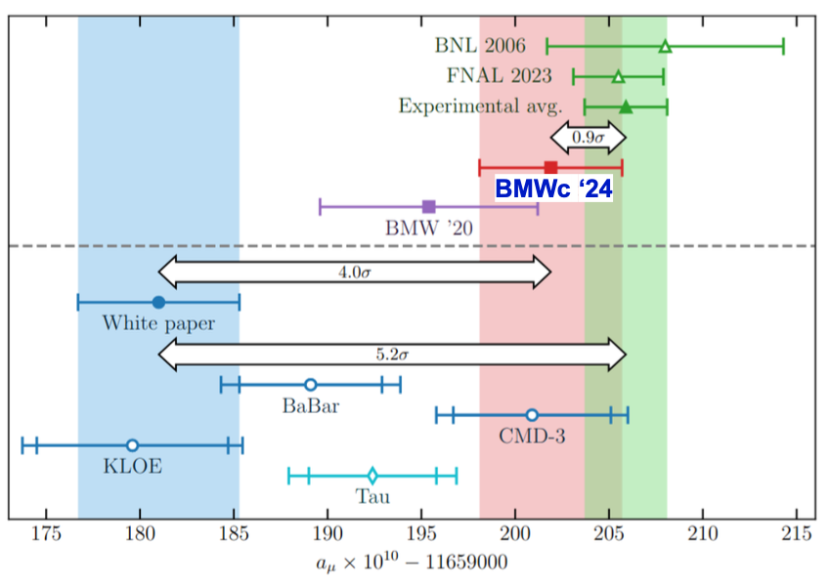
New result by the Muon g − 2 experiment at Fermilab announced on August 10, 2023
Taken from Liang Li’s slides

Slide 6
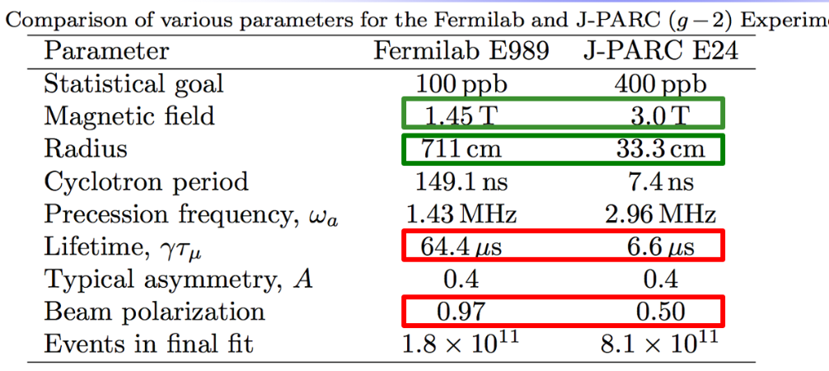
J-PARC is working on a separate muon g − 2 experiment with very different setup
Taken from Liang Li’s slides

Slide 7
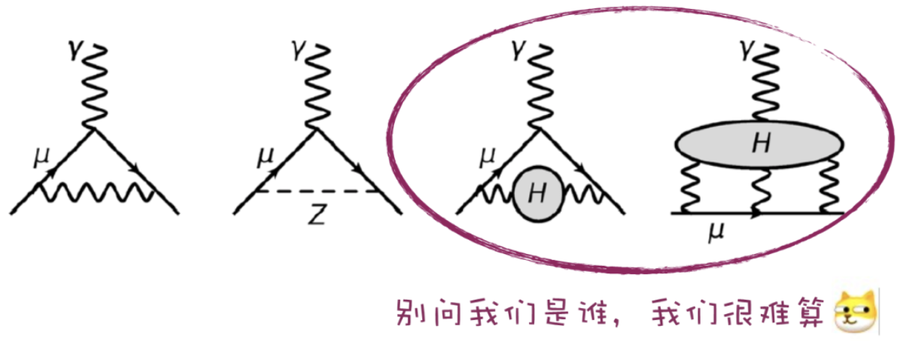
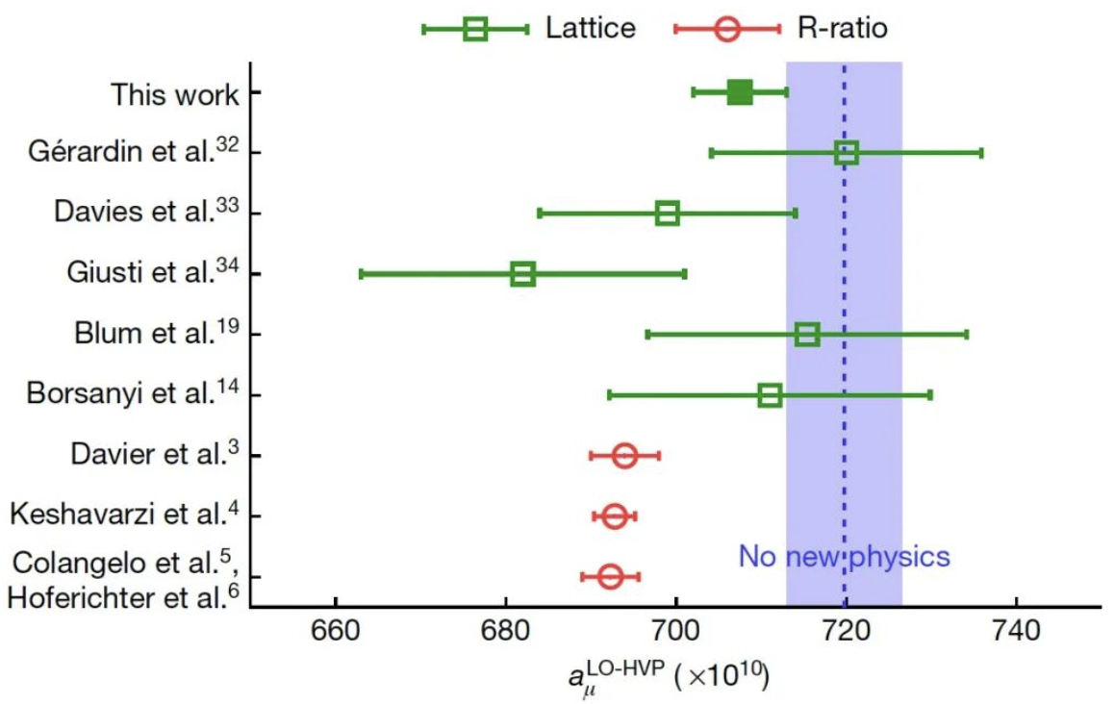
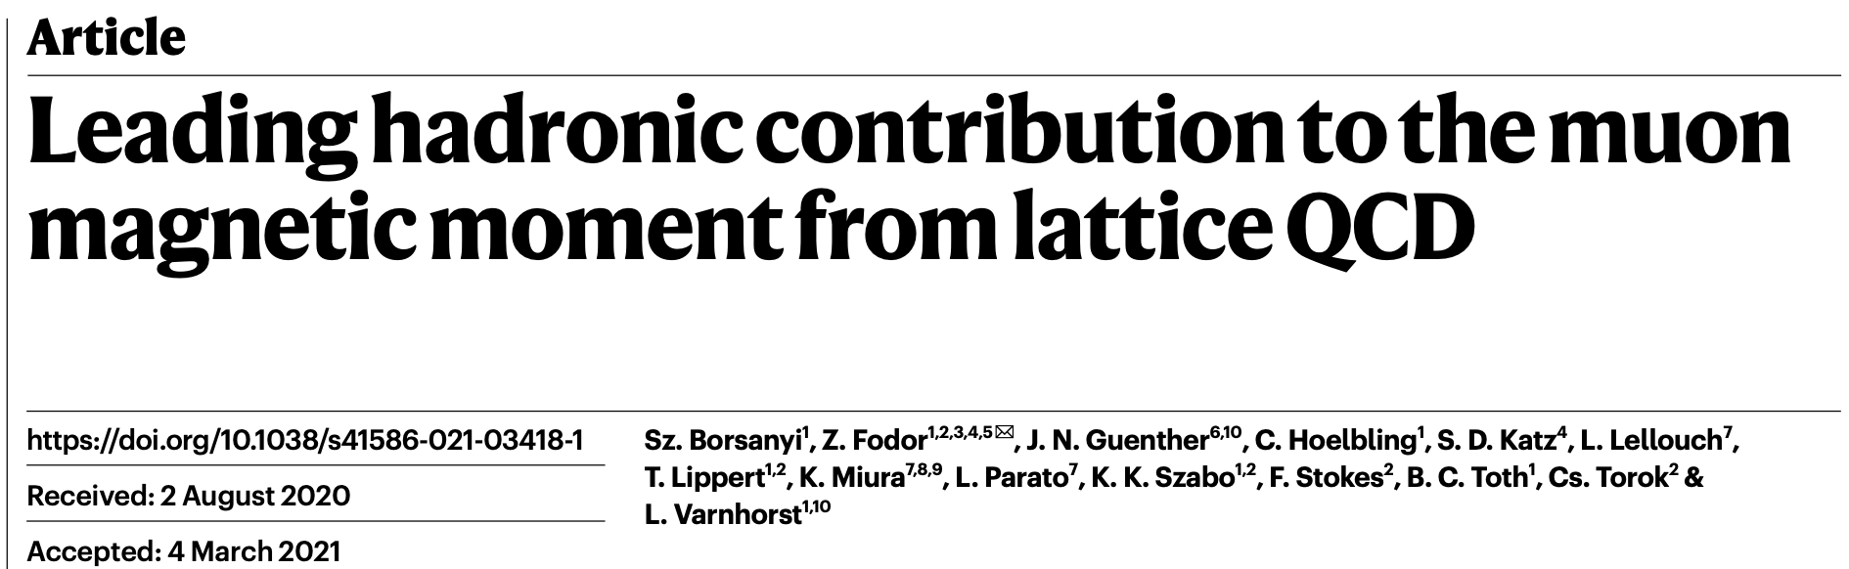
强子态的贡献
《自然》上发表的一篇论文表示，此次出现的偏差，也有可能根本不是什么新物理，而是理论计算出现了偏差。
格点QCD数值计算的结果
虚线为实验测量值
通过R值色散关系计算的结果
Nature (2021)

Slide 8







five-loop order
two-loop order
Due to the confinement and nonperturbative properties in the low-energy region
T. Aoyama, et al., Phys. Rep. 887, 1 (2020)
S. Borsanyi, et al., Nature 593, 51 (2021)

Slide 9

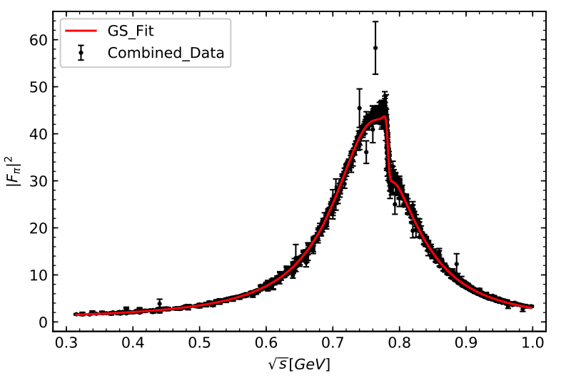
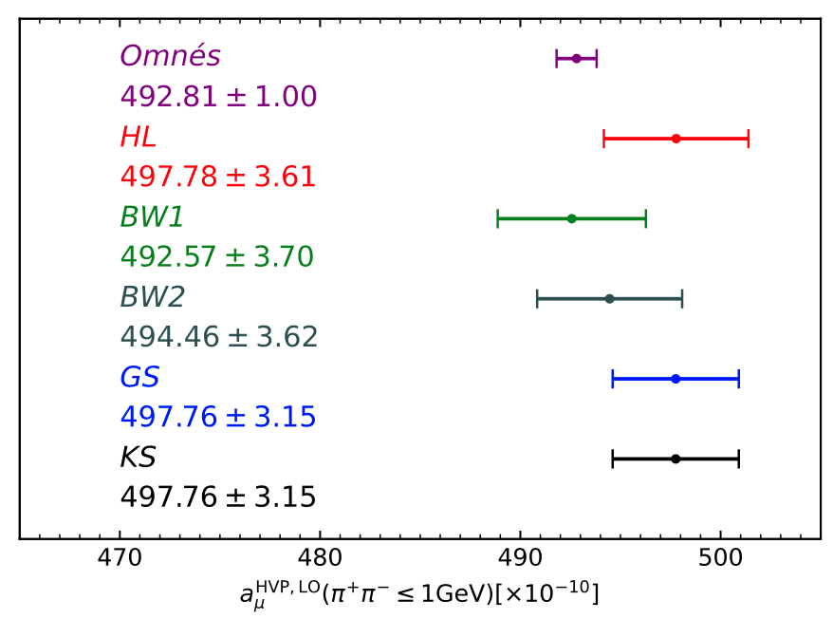
The hadronic vacuum polarization (HVP) contribution
J. Y. Yi, Z. Y. Wang and CWX, Phys. Rev. D 104, 116017 (2021)

Slide 10
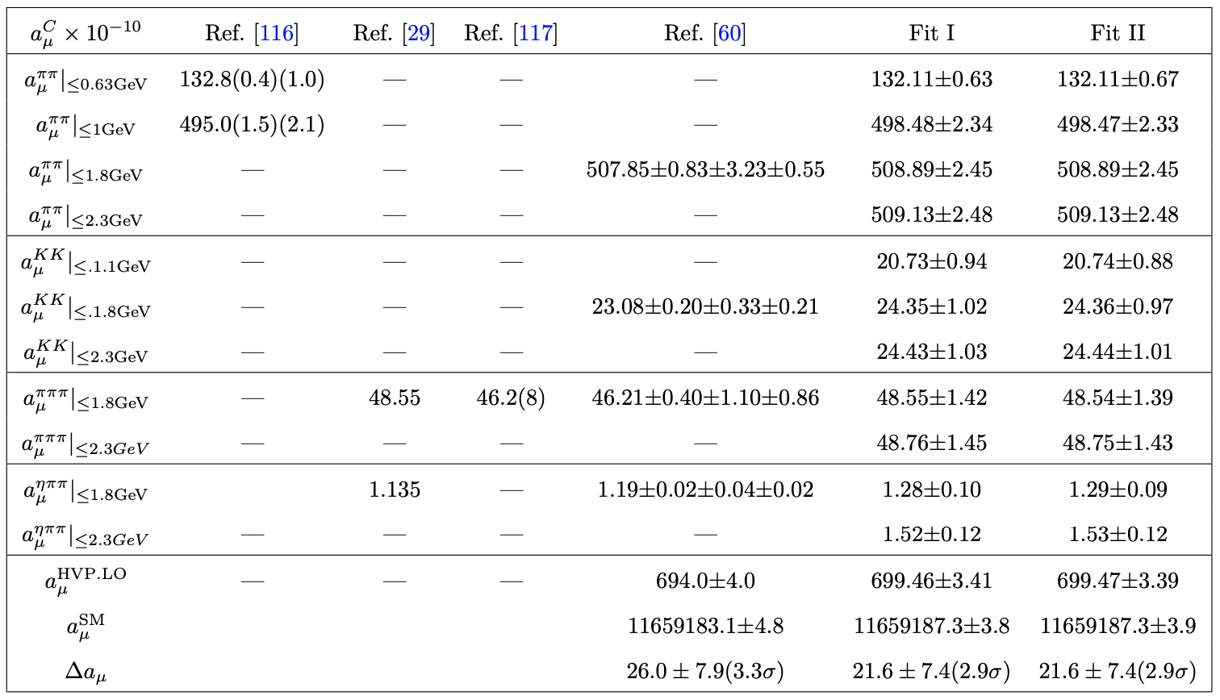
W. Qin, L. Y. Dai, and J. Portole ́s, JHEP03 (2021) 092

Slide 11
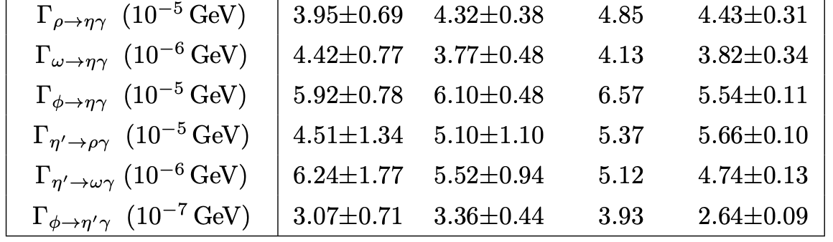

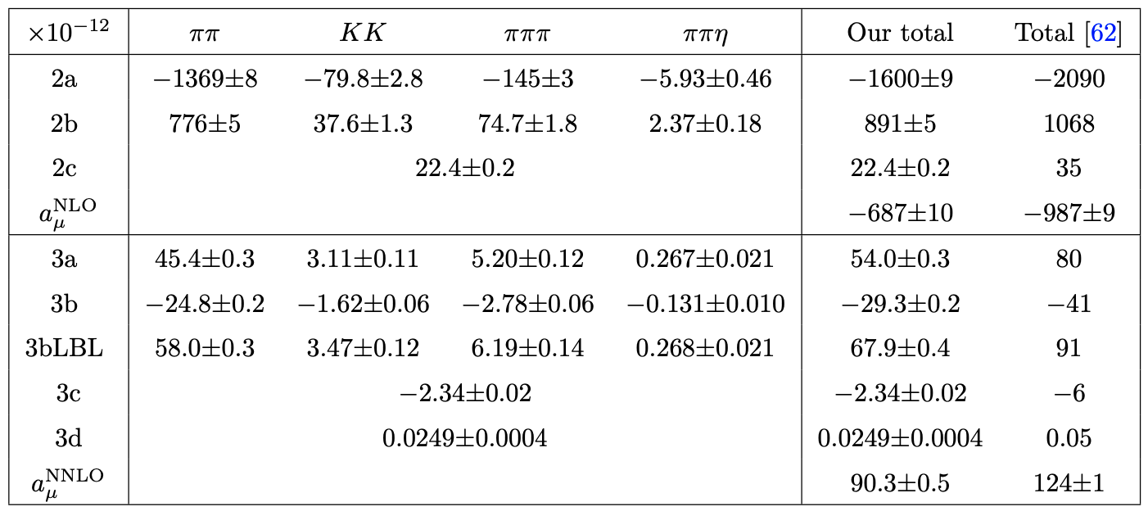

The vector form factors
Estimation of the higher-order HVP contributions
W. Qin, L. Y. Dai, and J. Portole ́s, JHEP03 (2021) 092

Slide 12
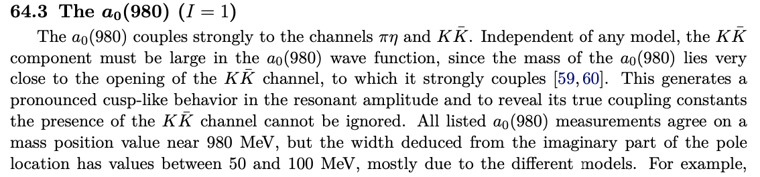
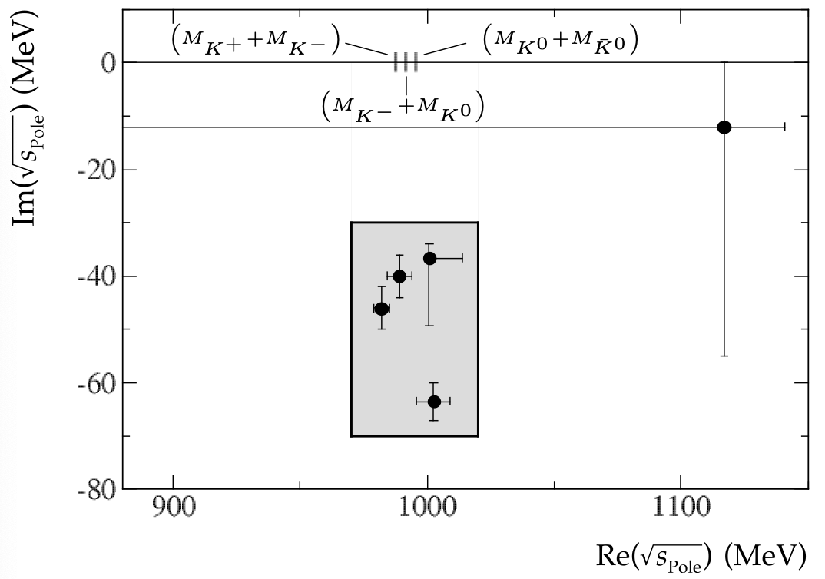

§2. η π interaction
Review of PDG

Slide 13
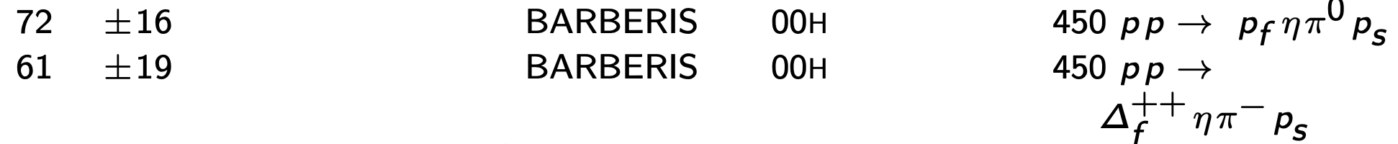
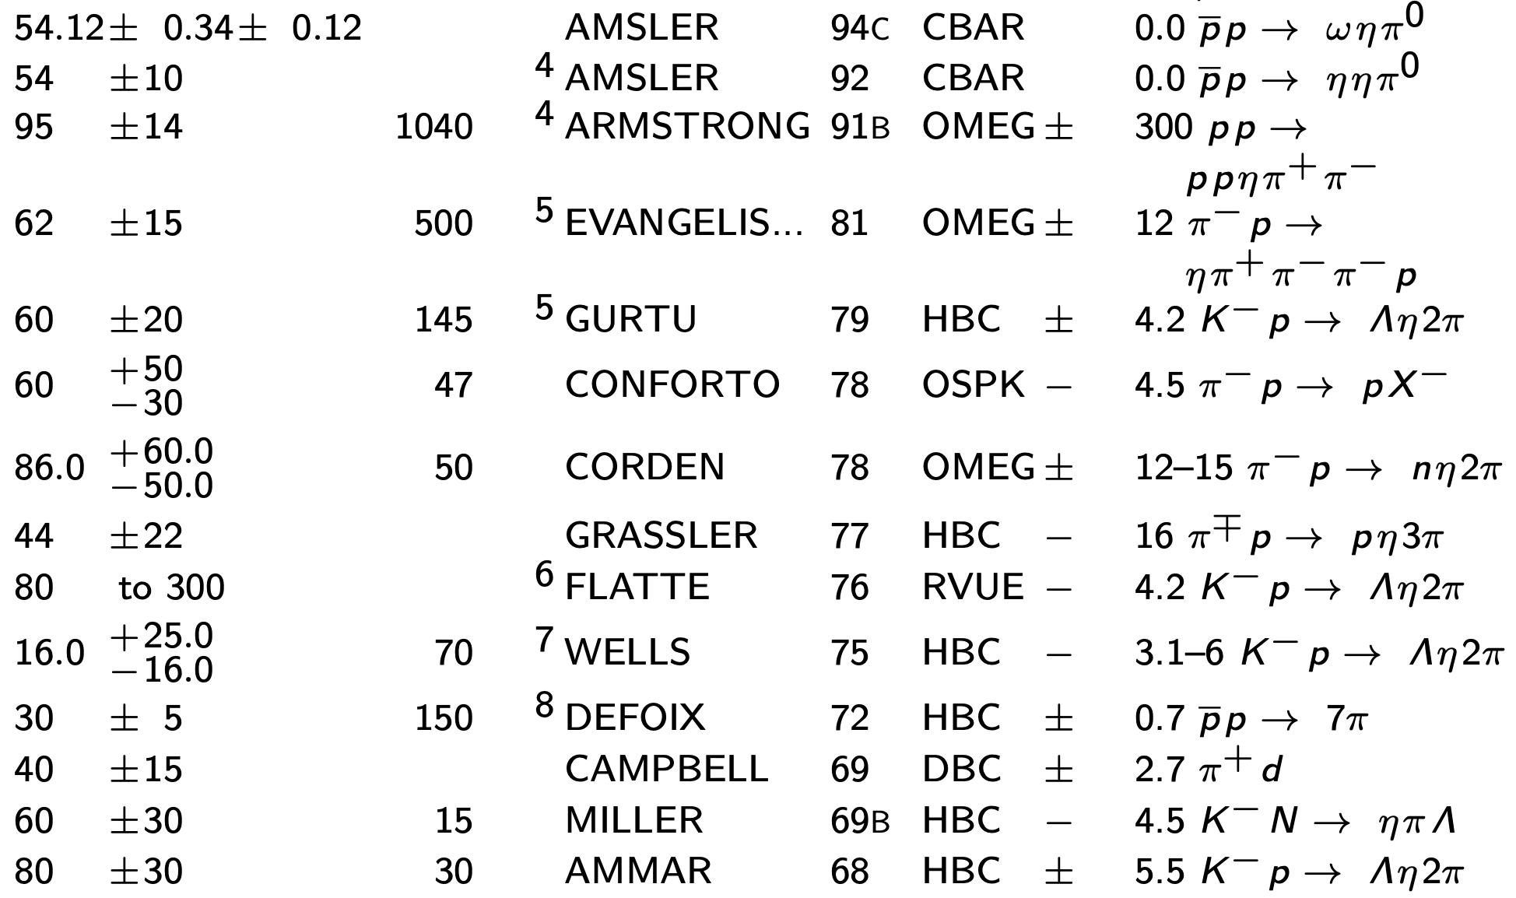
Some Measurements on the width
未来HIAF最高能量9.3GeV的强流质子束流是否可以测量一些类似的过程……

Slide 14
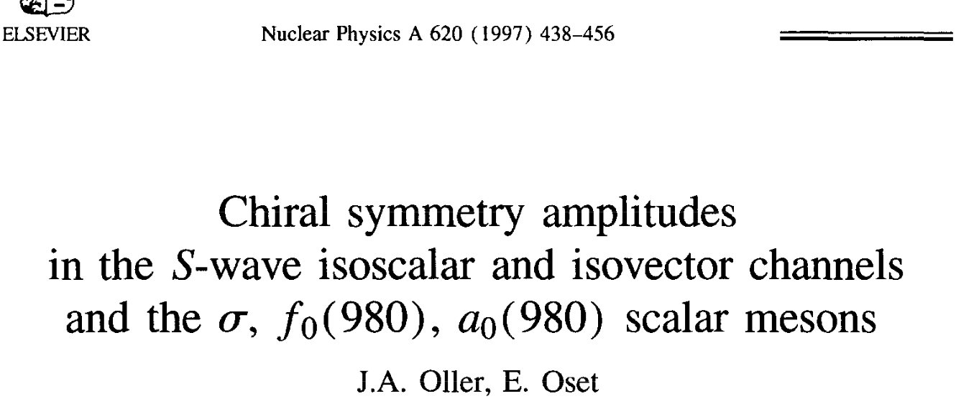

$K\overline{K}$ molecular state
Coupled Channel Unitary Approach：solving Bethe-Salpeter equations, which take on-shell approximation for the loops.
where V matrix (potentials) can be evaluated from the interaction Lagrangians.
J. A. Oller and E. Oset, Nucl. Phys. A 620 (1997) 438

Slide 15
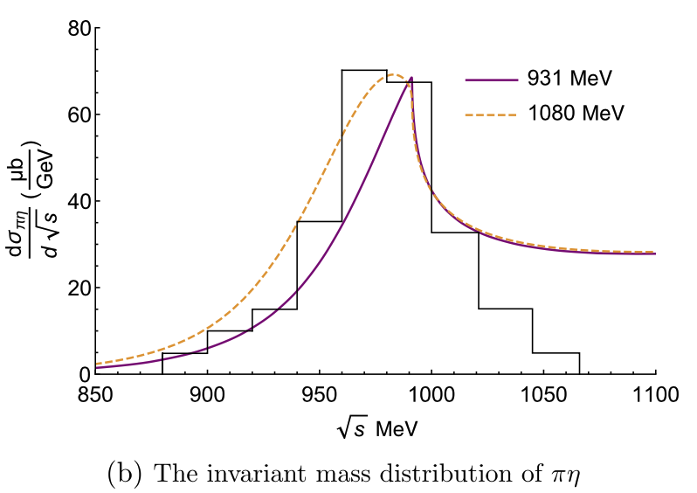
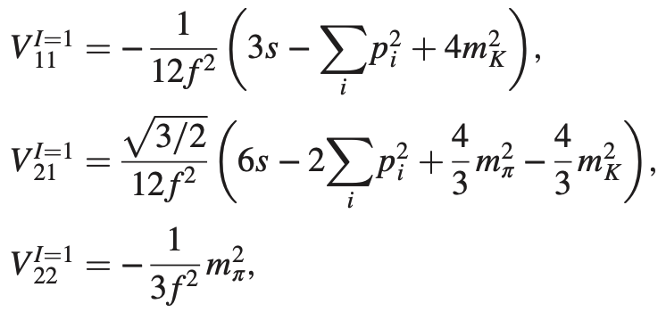


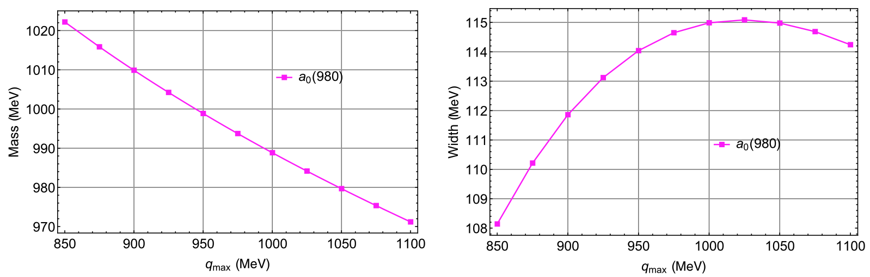
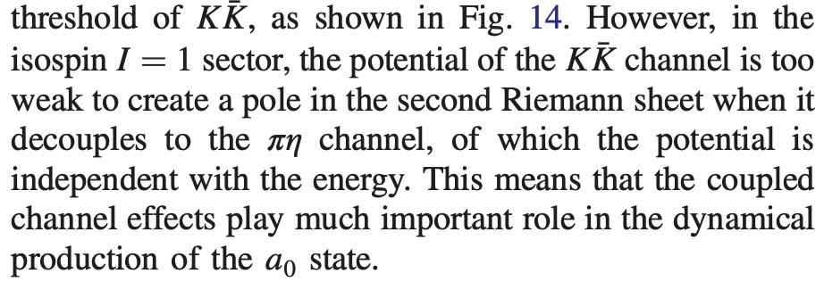

Cusp-like structure
The width is more stable!
H. A. Ahmed and CWX, Phys. Rev. D 101, 094034 (2020)

Slide 16
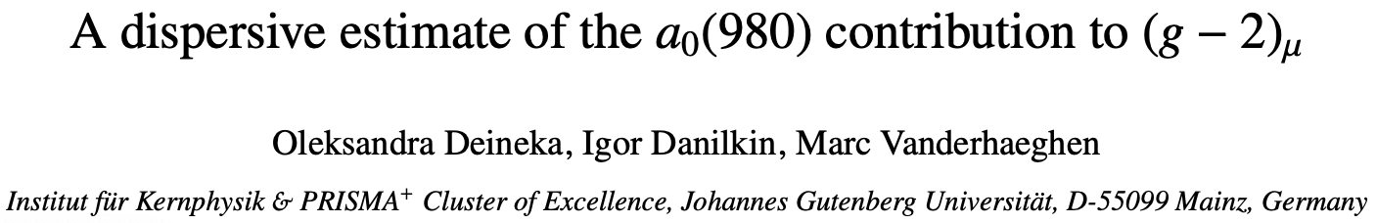
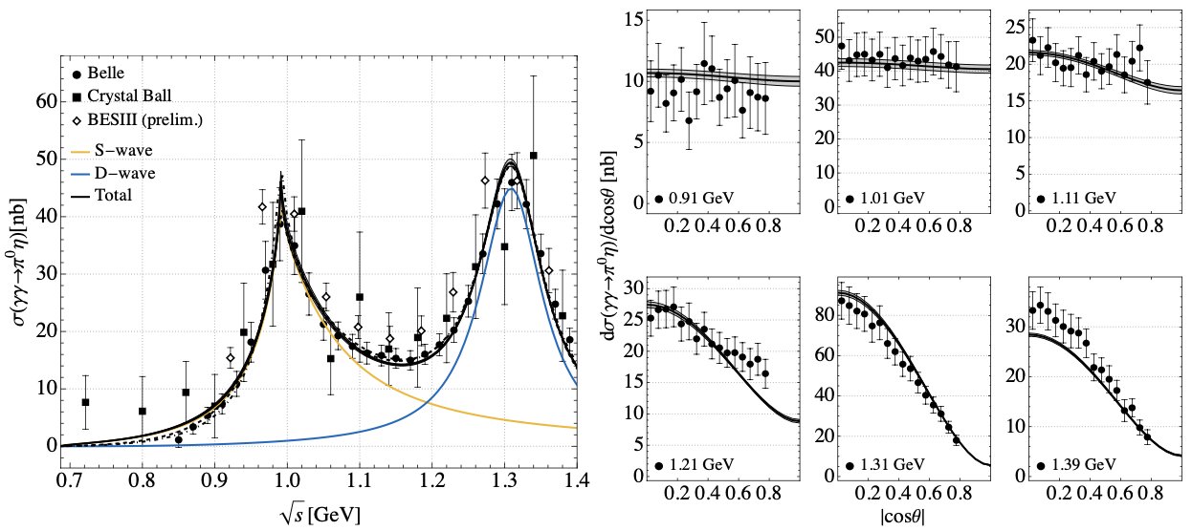
arXiv:2410.12894
Experimental input

Slide 17
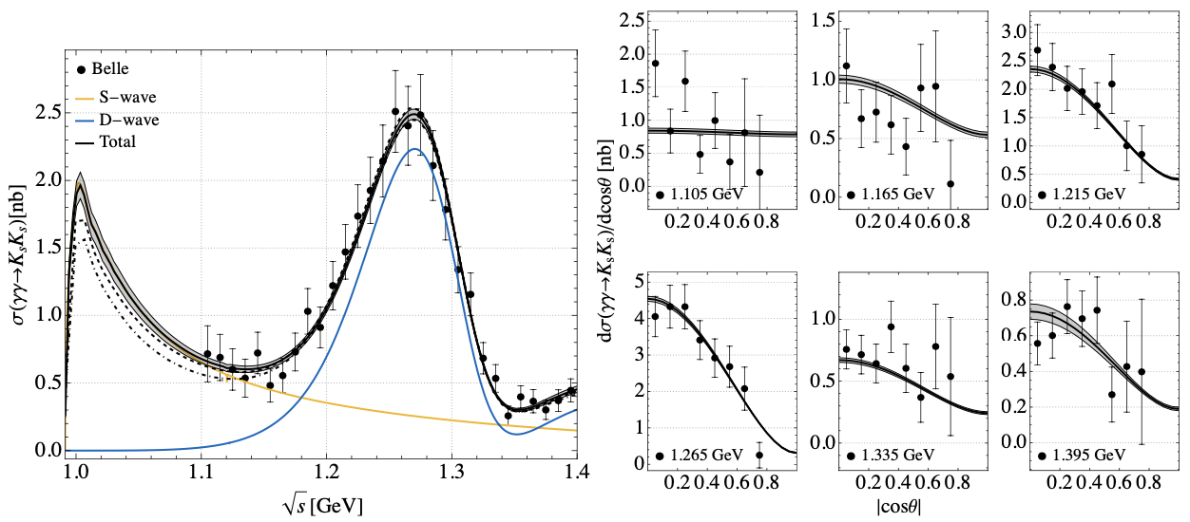

Slide 18
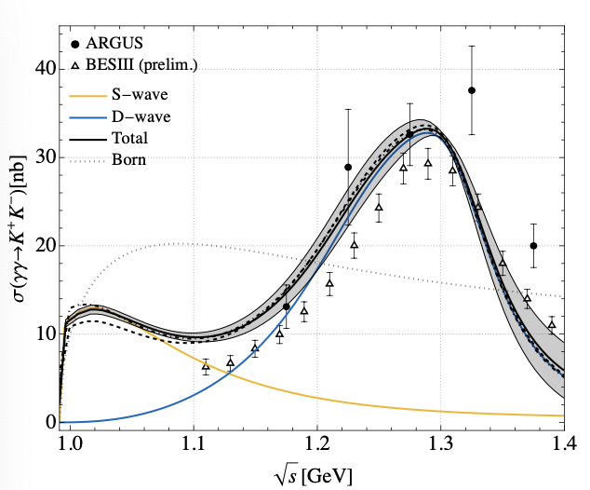
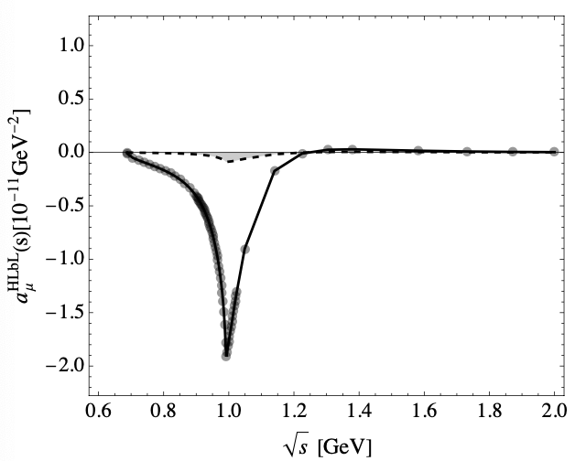
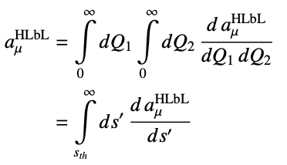


I. Danilkin, M. Hoferichter and P. Stoffer, Phys. Lett. B 820, 136502 (2021)

Slide 19
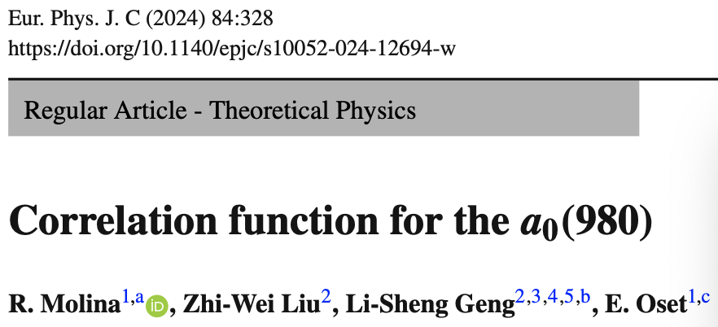
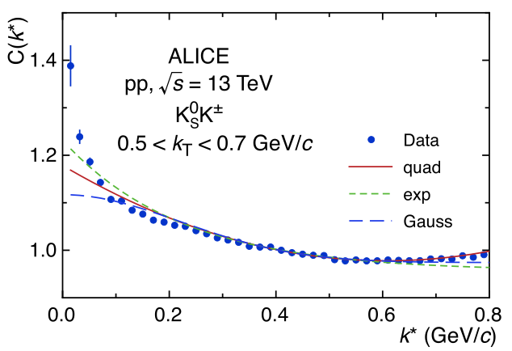
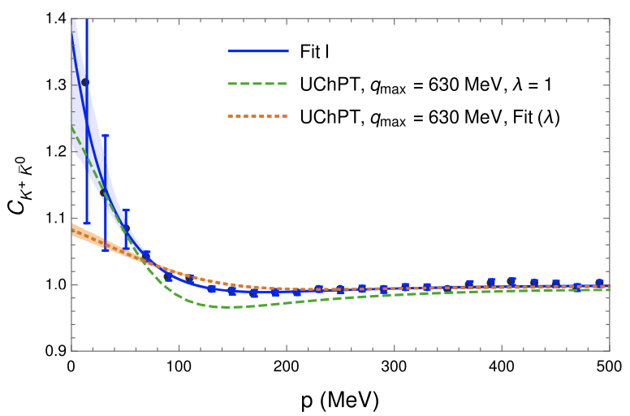
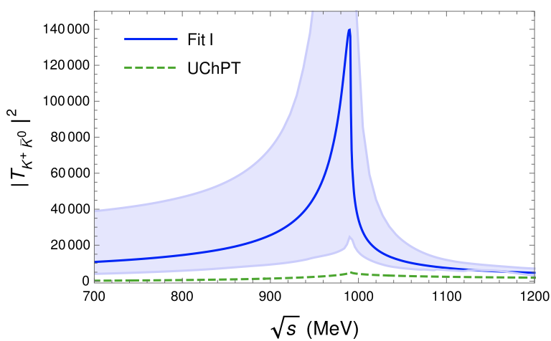
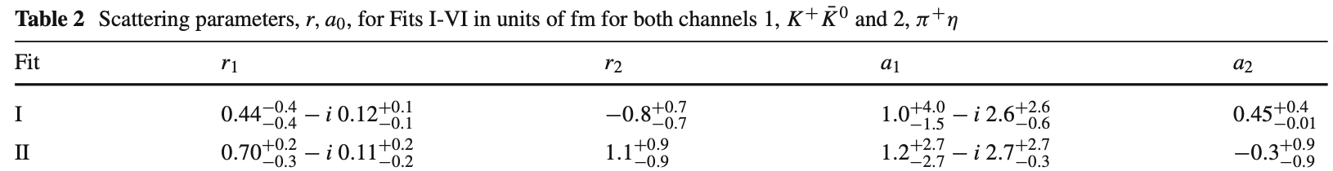
Physics Letters B 833 (2022) 137335

Slide 20
§3. η transition form factor
Why is the η transition form factor investigated?
Transition form factor
(g-2)_{μ}
Muon g-2
Theories
Experiments

Slide 21

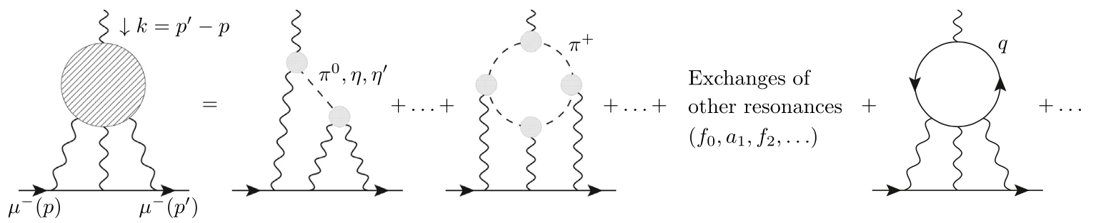


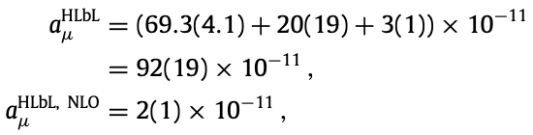
The hadronic light-by-light (HLbL) scattering
By considering the pion-pole contribution to HLbL using a simple VMD model for the transition form factor (TFF),
T. Aoyama, et al., Phys. Rep. 887, 1 (2020)

Slide 22
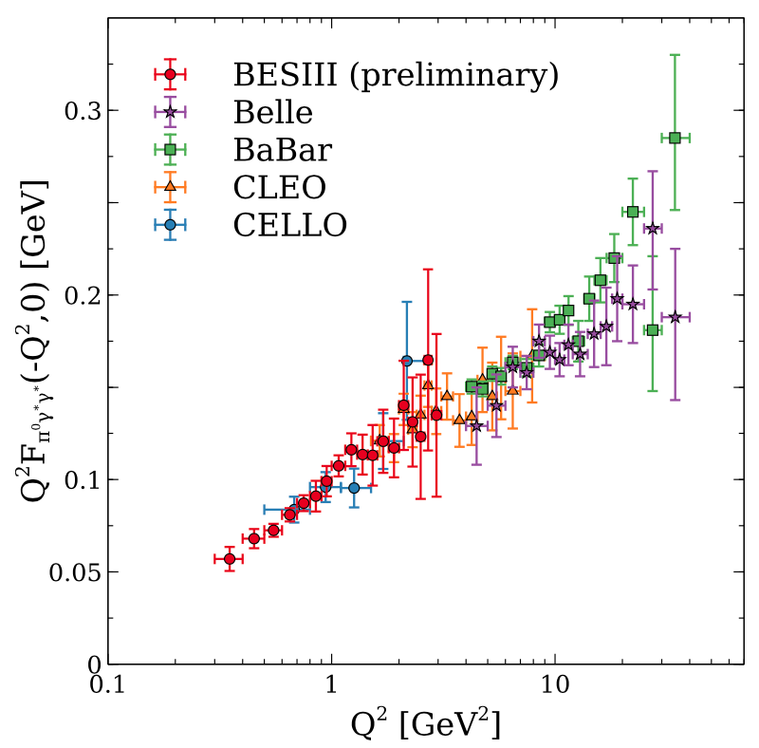
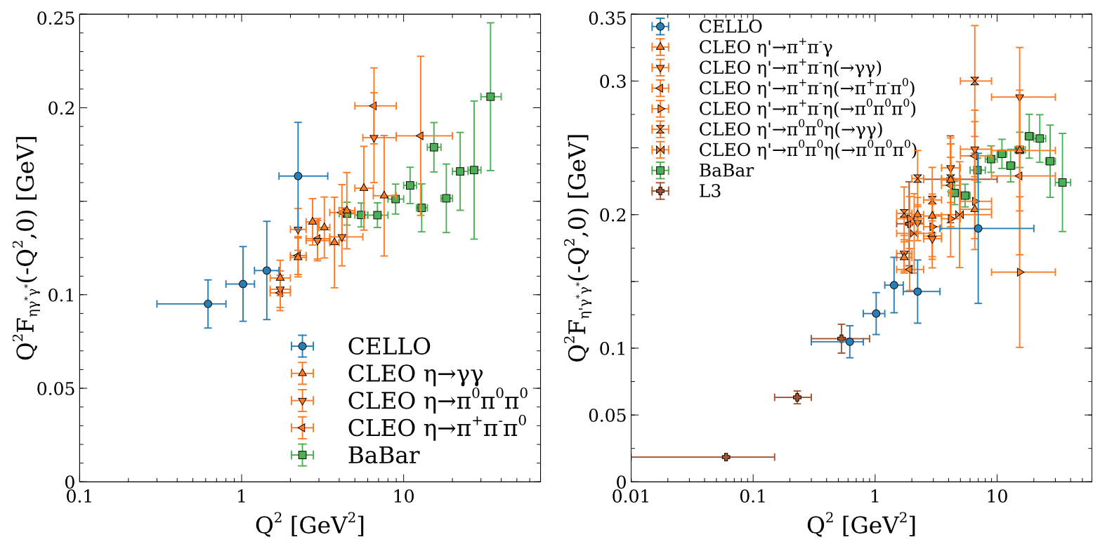
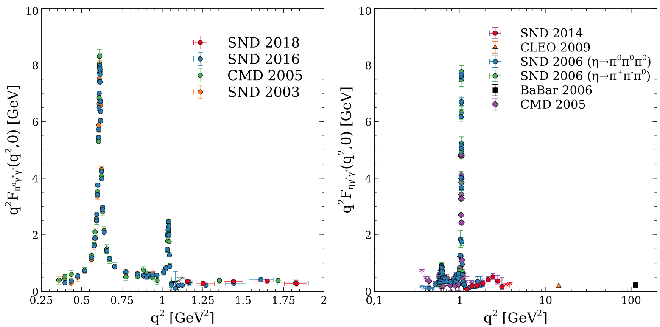
spacelike TFFs
timelike TFFs
T. Aoyama, et al., Phys. Rep. 887, 1 (2020)

Slide 23
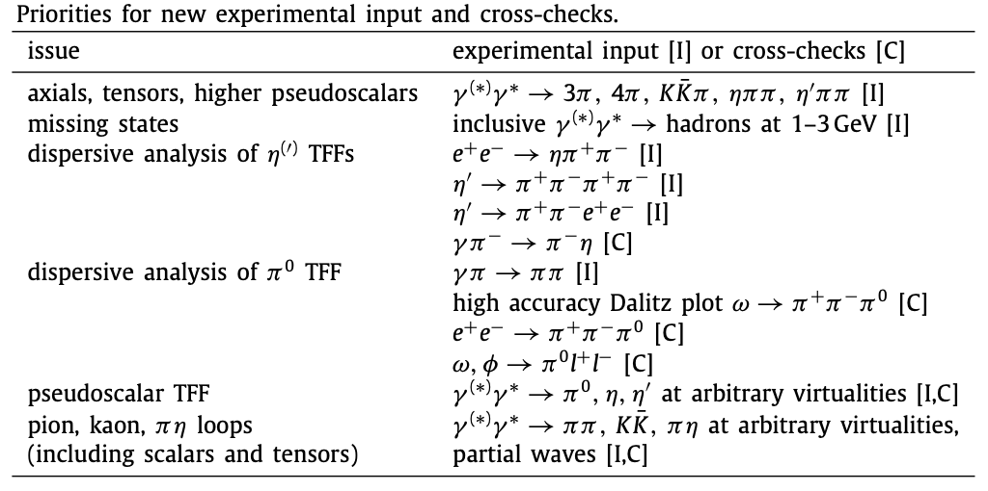
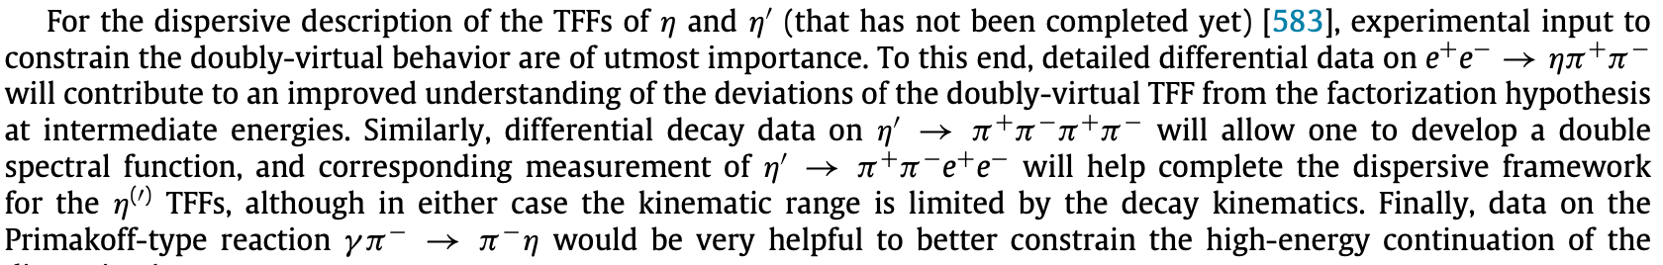
T. Aoyama, et al., Phys. Rep. 887, 1 (2020)

Slide 24

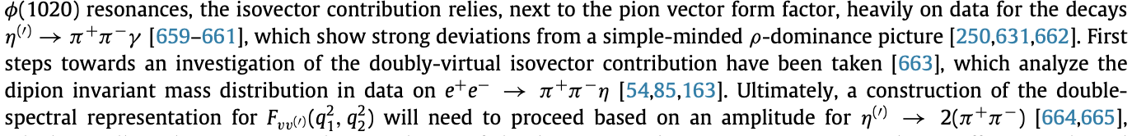
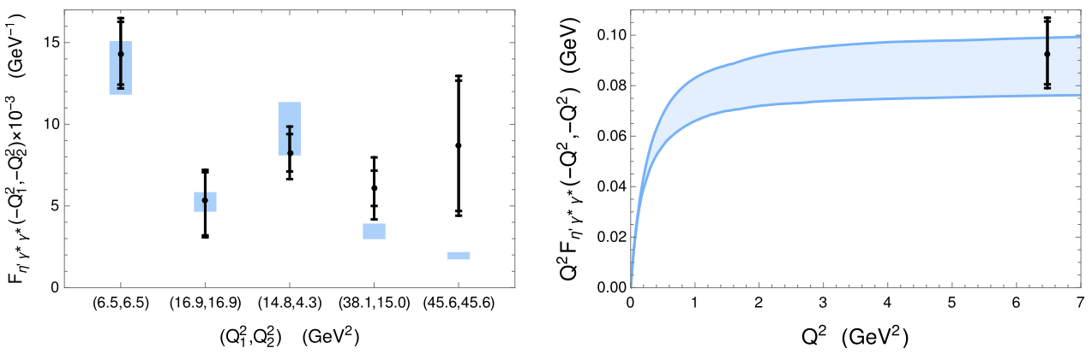

T. Aoyama, et al., Phys. Rep. 887, 1 (2020)

Slide 25
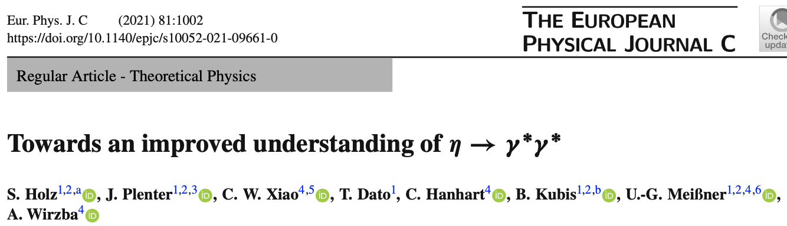
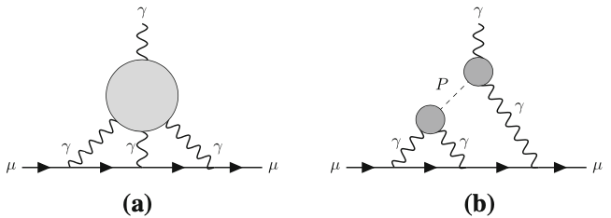
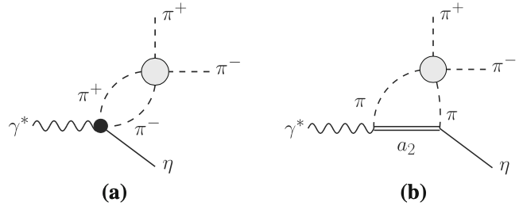
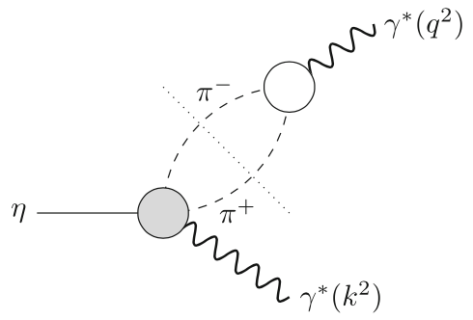


Slide 26






Slide 27







Slide 28






Slide 29




Anomalous η and η′ decays and the physics of transition form factors
L. Gan, B. Kubis, E. Passemar and S. Tulin, Phys. Rept. 945, 1 (2022)

Slide 30


space-like
L. Gan, B. Kubis, E. Passemar and S. Tulin, Phys. Rept. 945, 1 (2022)

Slide 31


Slope parameters of the η (left) and η′ (right) TFFs
L. Gan, B. Kubis, E. Passemar and S. Tulin, Phys. Rept. 945, 1 (2022)

Slide 32





L. Gan, B. Kubis, E. Passemar and S. Tulin, Phys. Rept. 945, 1 (2022)

Slide 33
§4. Prospect
η and η′ transition form factors are important for the issue of (g-2)_{μ} , which need more experimental measurements to constraint the input.
η-factory has a good opportunity to test the new physics in (g-2)_{μ} ….
Hope future experiments in HAIF bring more exciting results on these issues…….

Slide 34

Thanks for your attention!
感谢大家的聆听！

Slide 35


借宝地广告一下：
会议网址：https://indico.ihep.ac.cn/event/24044/

