Slide 1
第二届惠州大科学装置高精度物理研讨会—暨基于HIAF加速器集群的缪子科学与技术研讨会
中微子相干散射:
CICENNS Experiment for Studying Neutrino Wave Properties
Soo-Bong Kim
Sun Yat-sen University (中山大学)
August 25, 2024

Slide 2
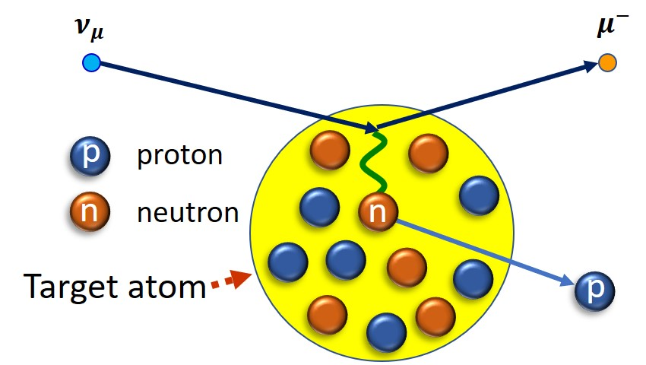

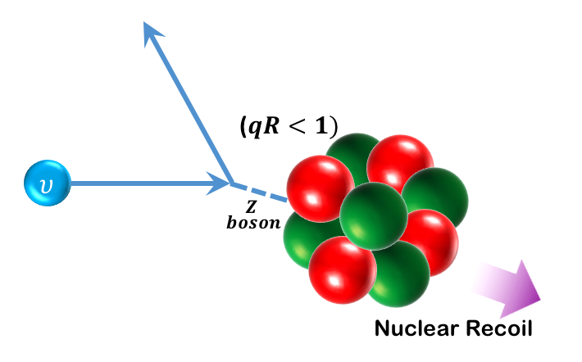
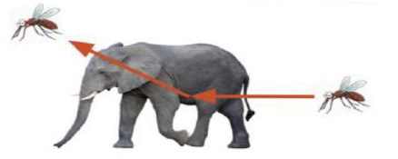


Coherent elastic neutrino-nucleus scattering (CEvNS)
Conventional method of neutrino detection
New method of neutrino detection at low E
Neutrino + nucleon scattering (at high E)
ν + N → ν + N
$$ν_{μ}$$
$$μ^{−}$$
Extremely small nuclear recoil energy
N
ν
Need a new detection technology
Neutrino properties for last 70 years (4 Nobel prizes)
Neutrino (ν） interaction with “a whole nucleons” inside a nucleus coherently
Neutrino
“Enhanced (~1000 times) neutrino interaction”
(D.Z. Freedman, 1974)
Nucleus

Slide 3

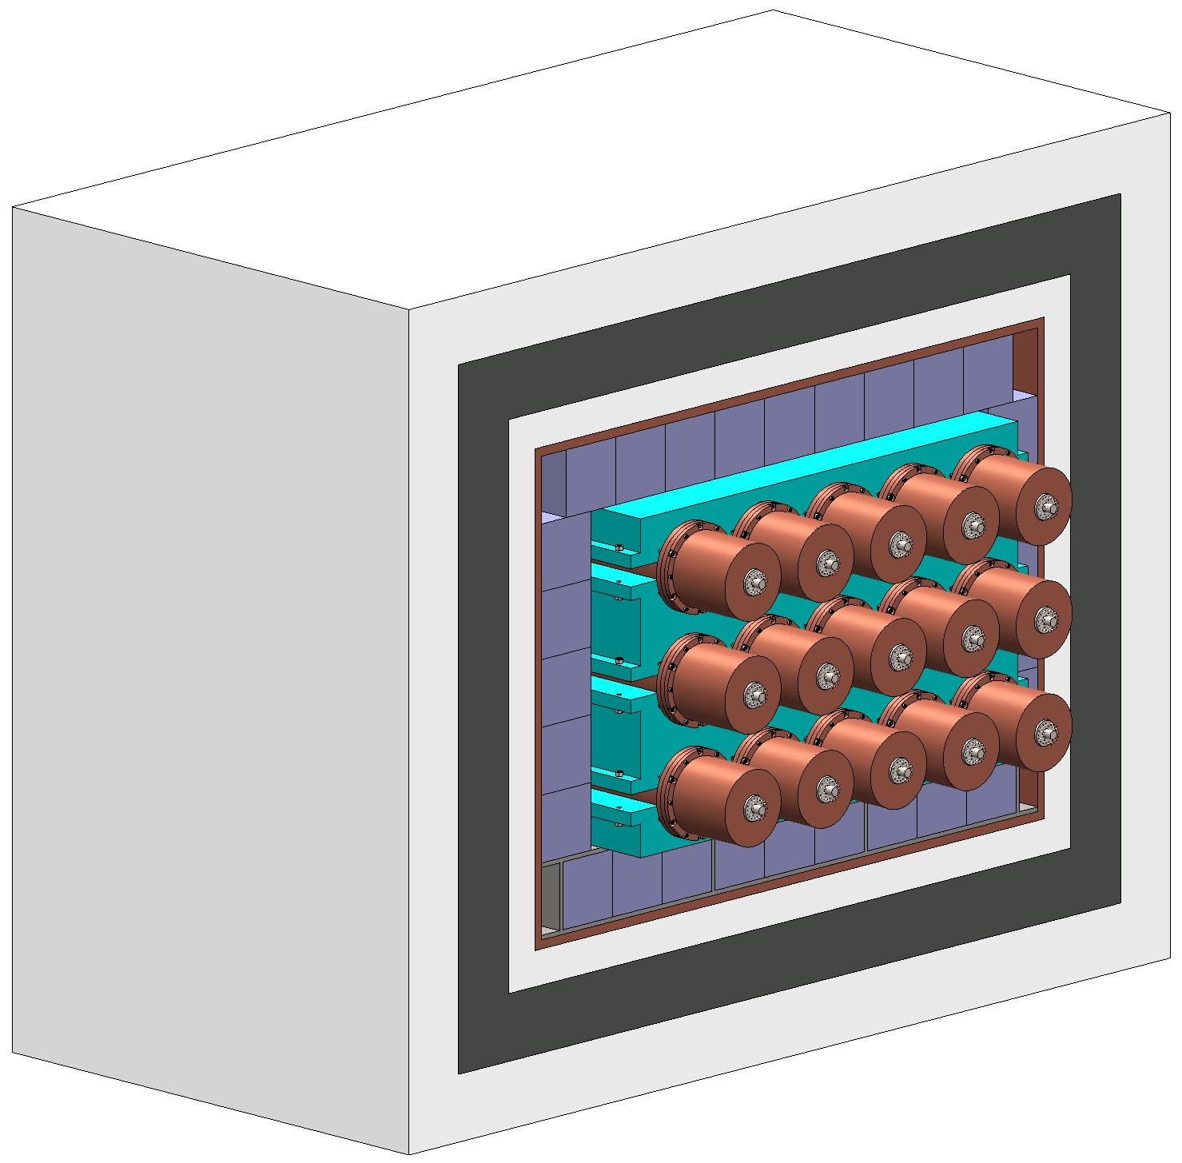
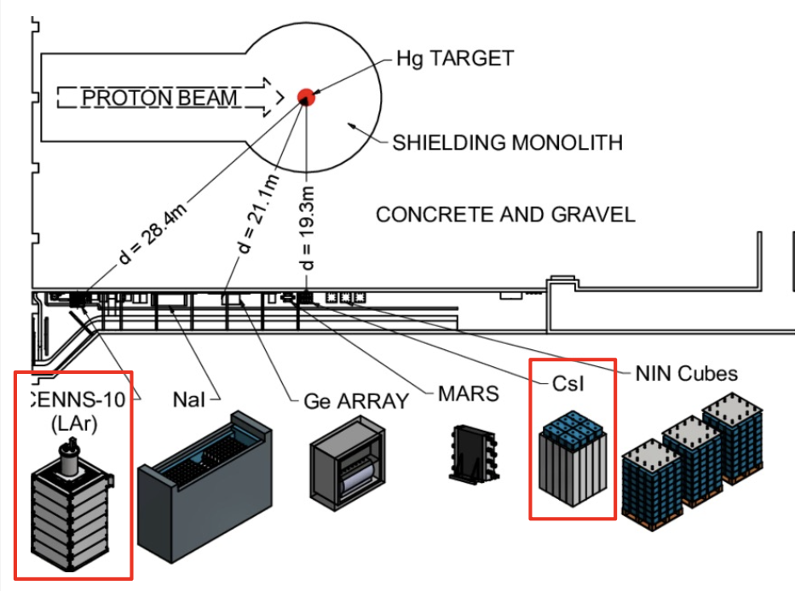
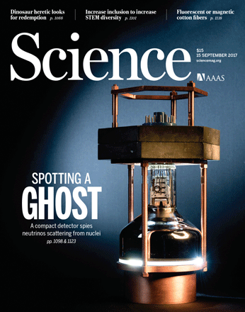

Motivation and physics significance
CICENNS (2023~ )
First observation (2017)
Prediction (1974)
- Precise measurements with world largest event sample
(> 5000)
→ Any deviation from SM prediction indicates a new physics signature
→ Potential for a big discovery
by COHERENT experiment
- Create a new tool for unexplored low-energy neutrino interaction
- Motivate world competition on CEvNS experiments
“Enhanced neutrino interaction” by coherent neutrino-nucleus scattering (CEvNS)
Insufficient event sample (~300)

Slide 4
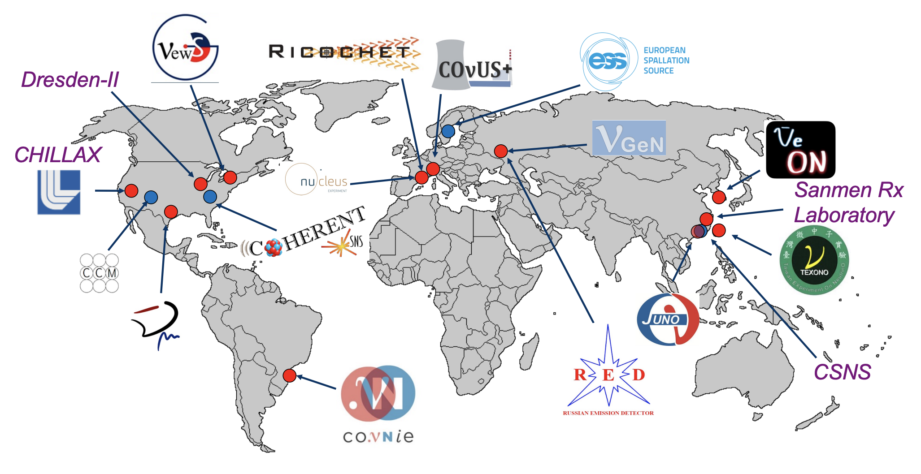
Worldwide efforts on CEvNS
(~300 events)
CICENNS
(>5000 events)

Slide 5
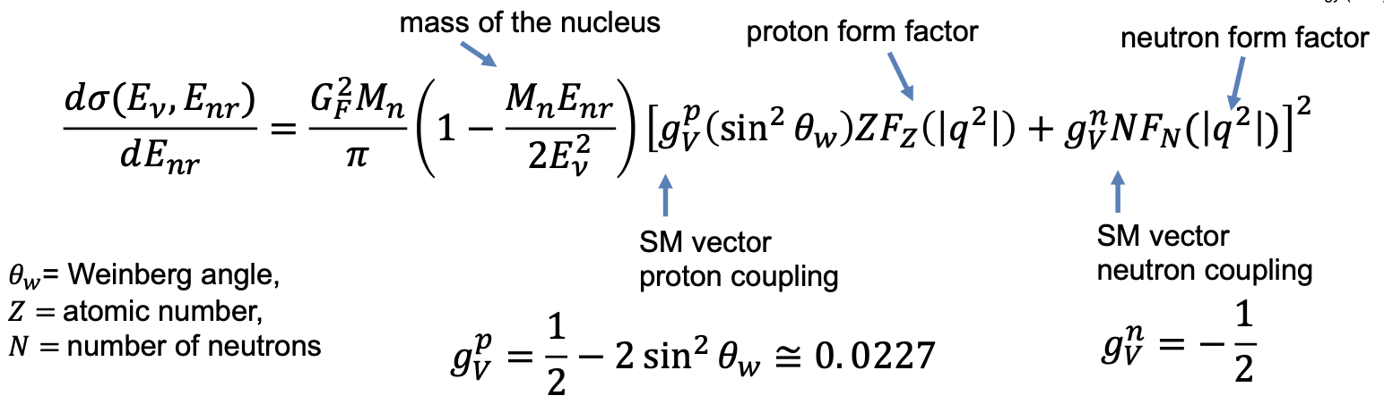
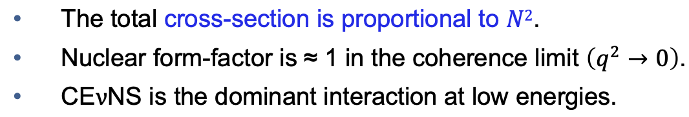
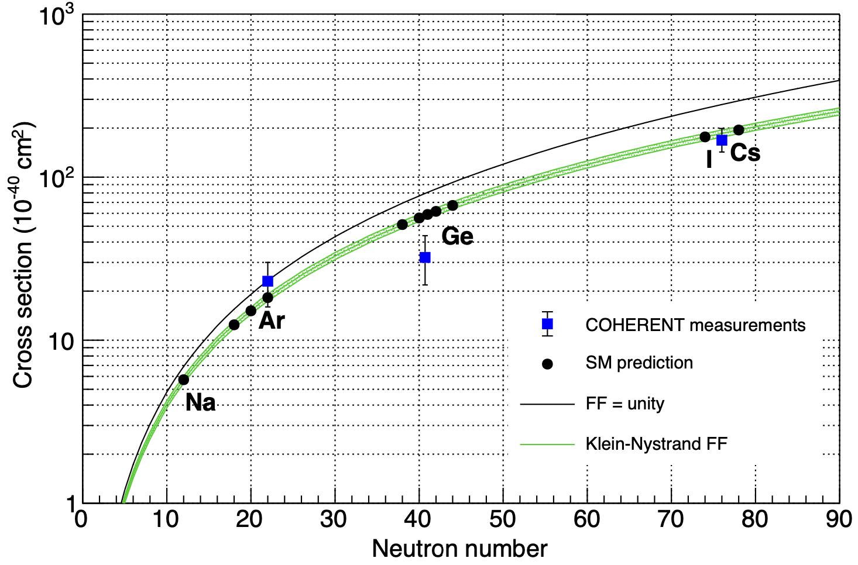
Enhanced Neutrino Cross Section via CEvNS
x1000 times enhancement
CsI crystal can provide sufficient CEvNS cross sections.

Slide 6
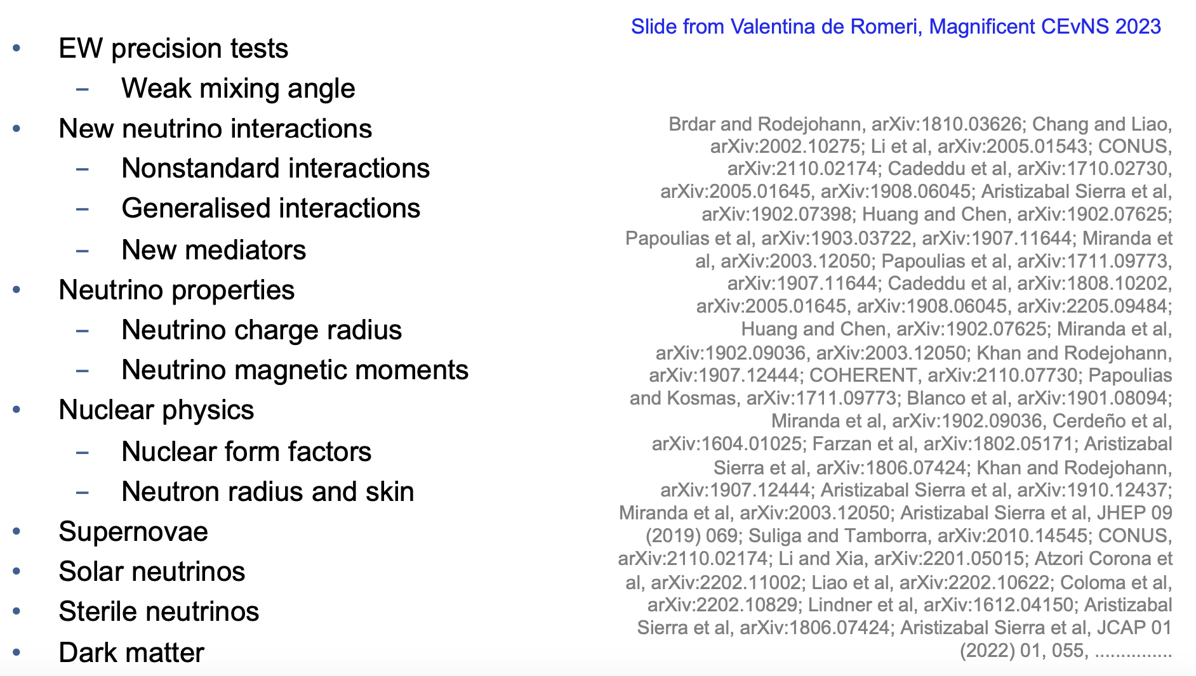
Physics with CEvNS

Slide 7
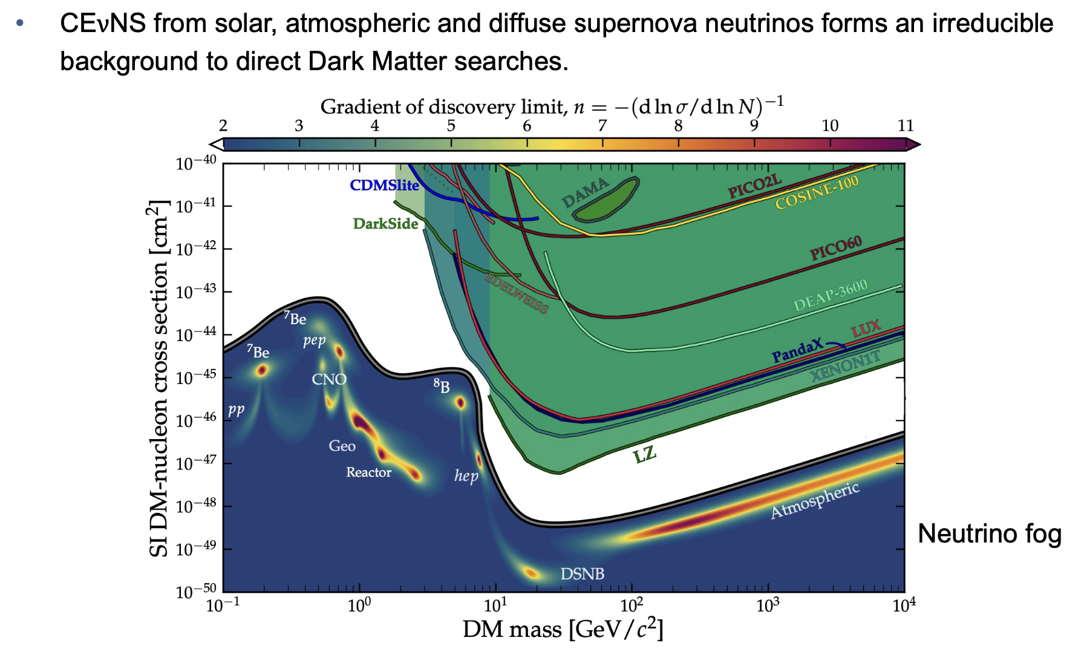
Physics with CEvNS

Slide 8
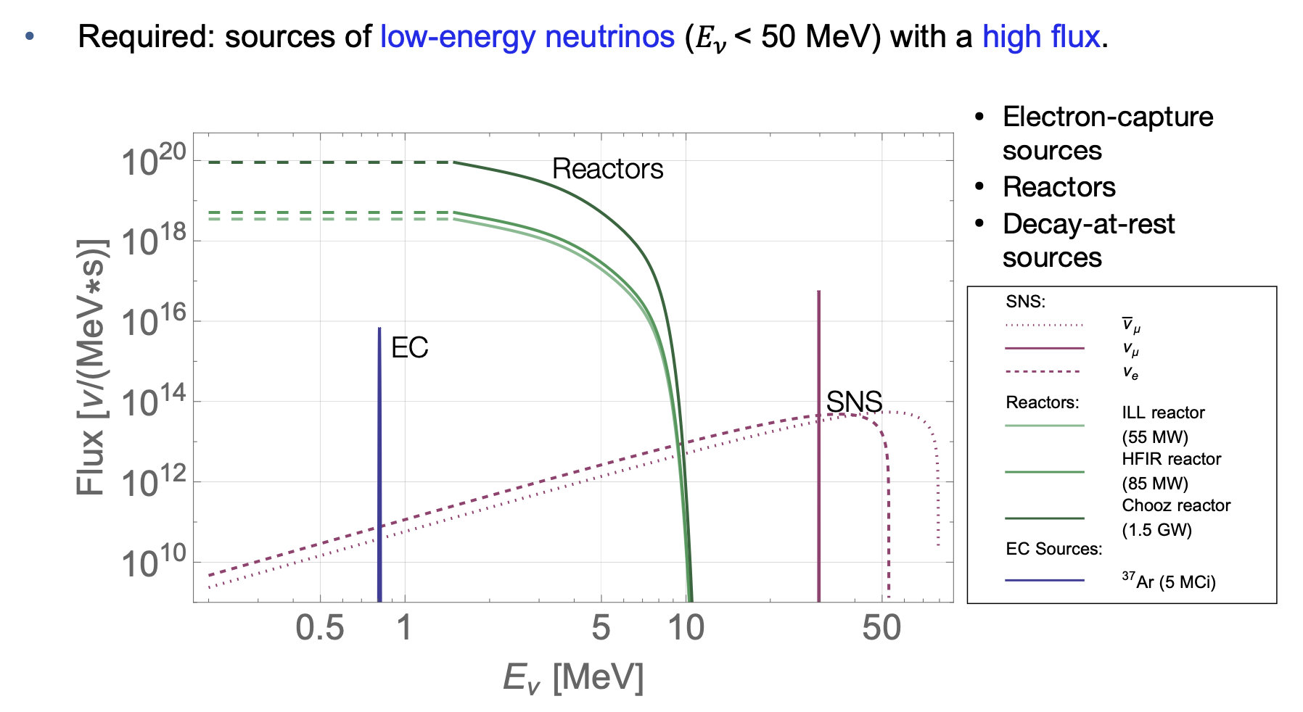
Neutrino sources

Slide 9
CICENNS Collaboration
Sun Yat-Sen University: F.P. An, Z. Huang, S.B. Kim, J. Liao, J.J. Ling, J. Mai, T. Song, W. Wang, Y. Wei, X. Xiao, Z. You, J. Zhang
Shanghai Institute of Ceramics Chinese Academy of Sciences: X. Chen, Y. Wu
Institute of Modern Physics/Lanzhou University: X. Tang
Kyungpook National University: J.S. Park

Slide 10
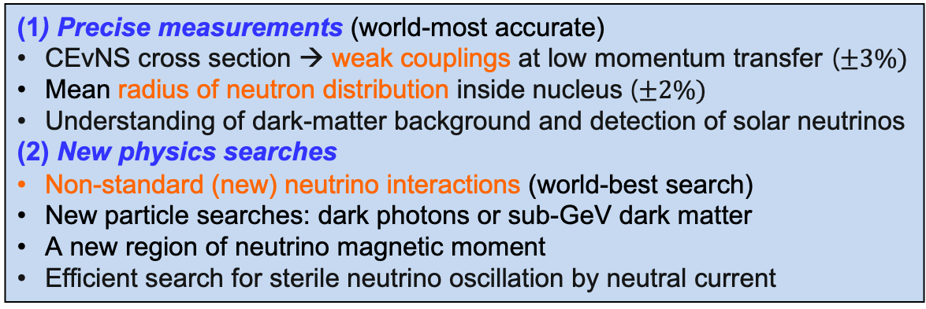
Goals of CICENNS experiment
Development of 300kg CsI(Na) detector
For Coherent Elastic Neutrino Nucleus Scattering (CEvNS)
Obtain sufficient CEvNS event rate with substantial target mass
Establish a new field of studying unexplored physics using CEvNS
“Research contents”
Detection of neutrinos from pion/muon decays at rest
(at China Spallation Neutron Source)
(1) Precise measurements (world-most accurate)
CEvNS cross section → weak couplings at low momentum transfer ($±3\%)$
Mean radius of neutron distribution inside nucleus ($±2\%)$
Understanding of dark-matter background and detection of solar neutrinos
(2) New physics searches
Non-standard (new) neutrino interactions (world-best search)
New particle searches: dark photons or sub-GeV dark matter
A new region of neutrino magnetic moment
Efficient search for sterile neutrino oscillation by neutral current
“Scientific goals”
[* CICENNS: CsI detector for Coherent Elastic Neutrino Nucleus Scattering]

Slide 11
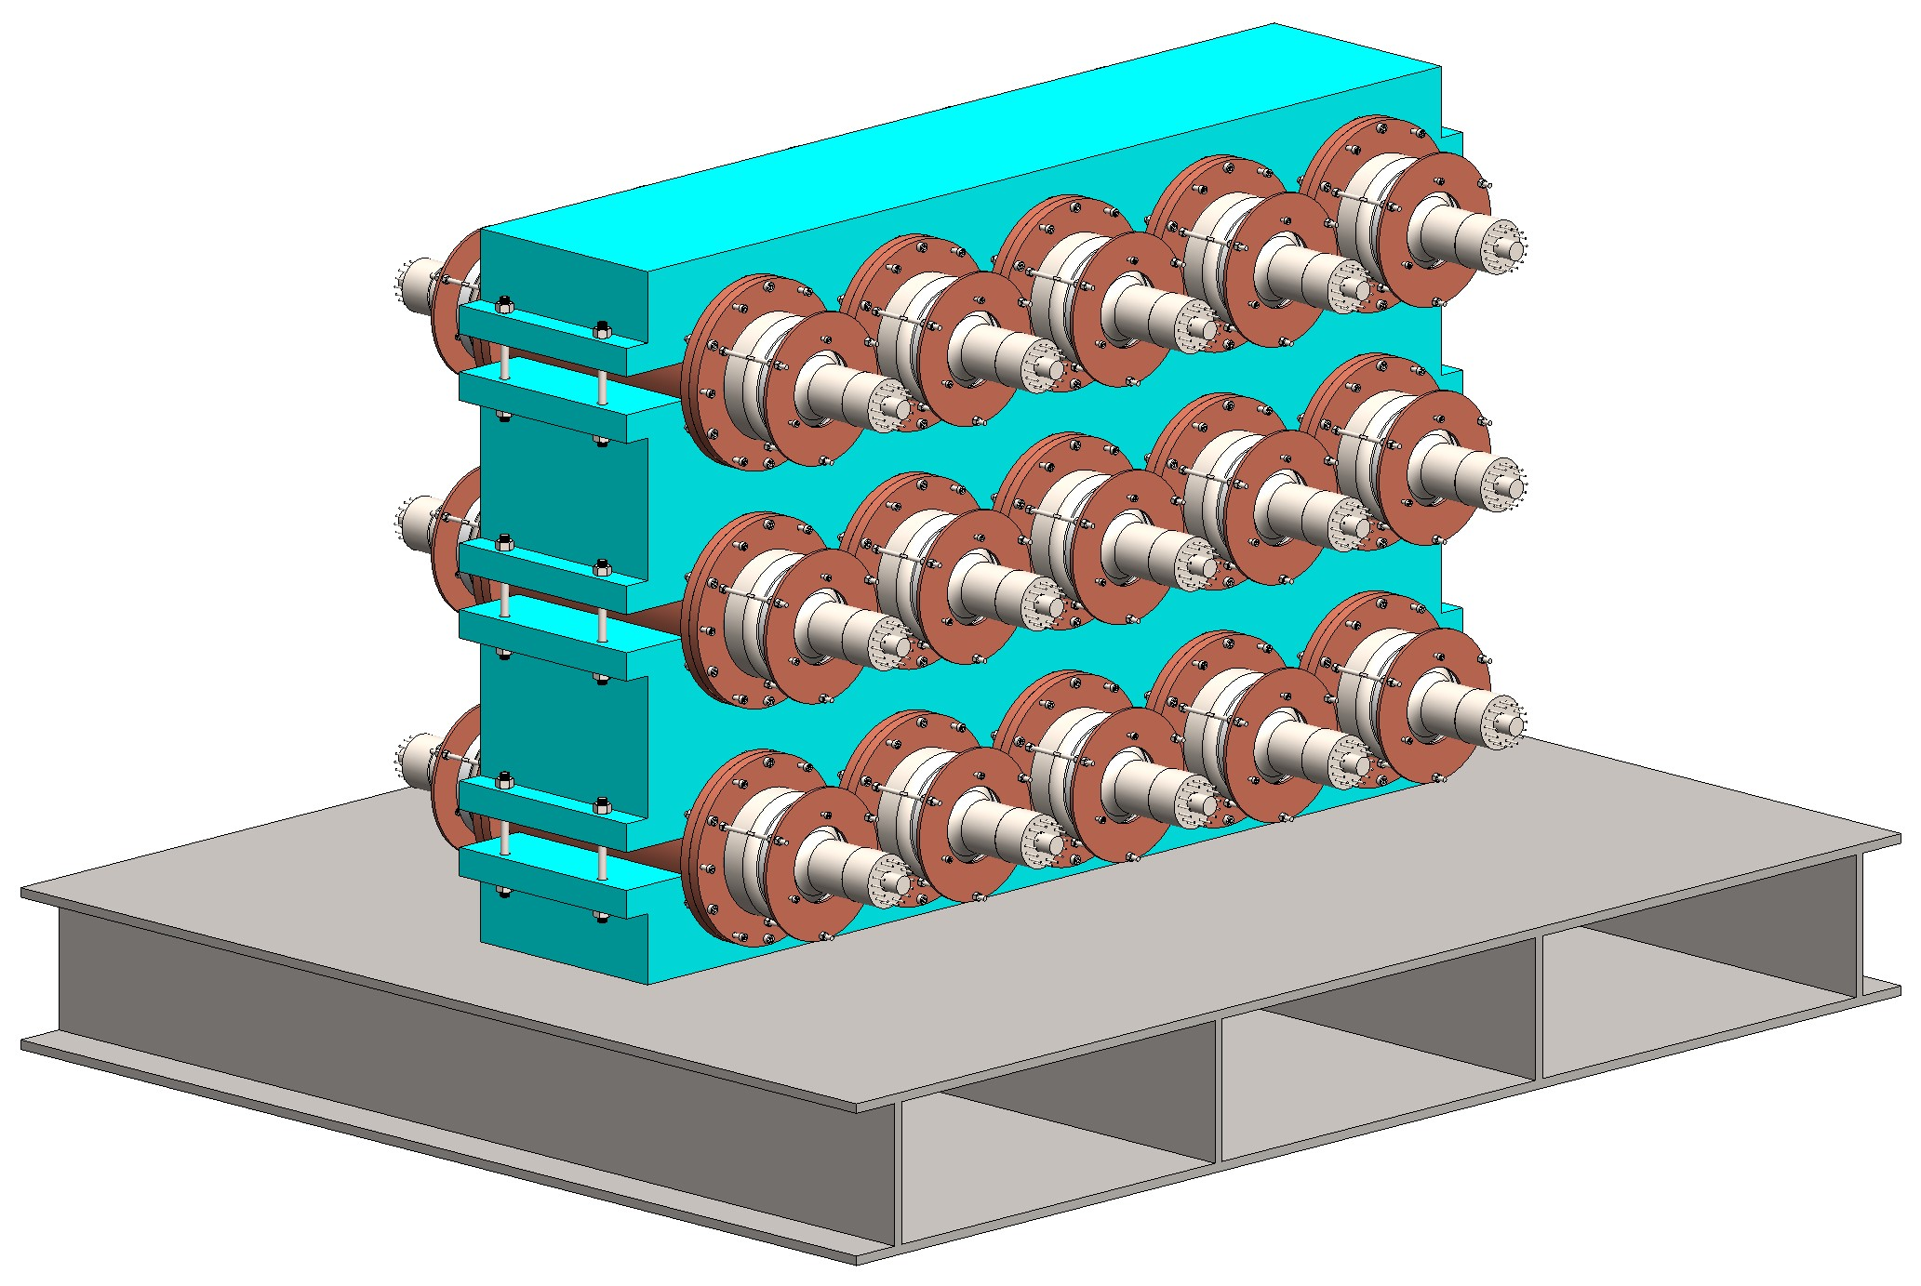
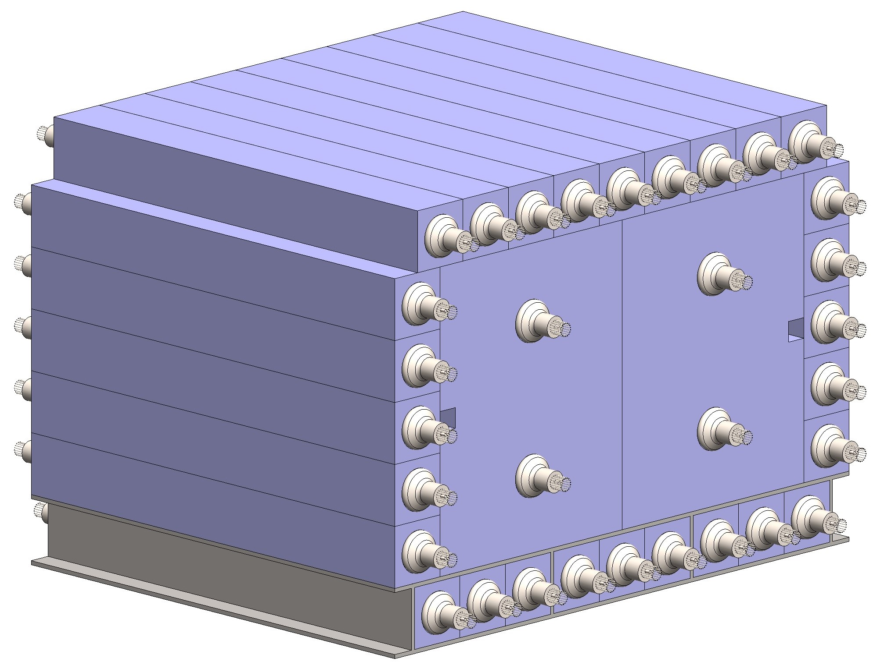


Schematic drawing of CsI(Na) crystal detector (CICENNS)
CsI crystal
20 kg CsI x 15
14 cm (φ) x 28.7 cm each
World largest CsI(Na) crystal
$$ν$$
5-inch PMT
Plastic scintillator
$$ν$$

Slide 12
Major improvement from COHERENT detector
Sufficient signal events for precise measurement: 300 → 6500
- Increase of neutrino target mass: 14.6 → 300 kg
- Lowering energy threshold: 7 → 3 keV_{nr}
Significantly (20 times) lower radioactivity contamination of CsI crystal
by purification (in collaboration with中国科学院上海硅酸盐研究所)
Significant (3 orders of magnitude) reduction of PMT dark rate by coincidence between two PMTS of each crystal
Rejection of most beam neutron backgrounds with plastic scintillator veto component

Slide 13
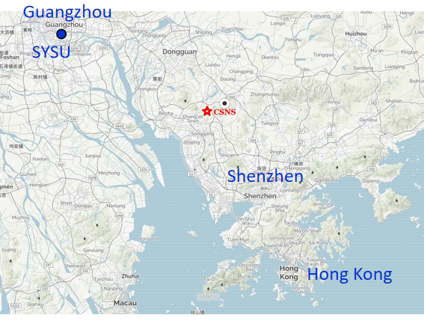
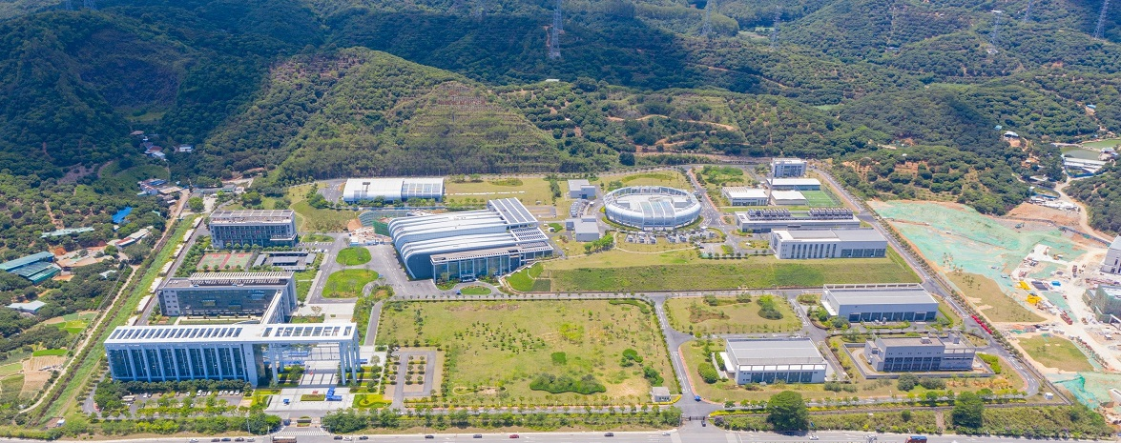
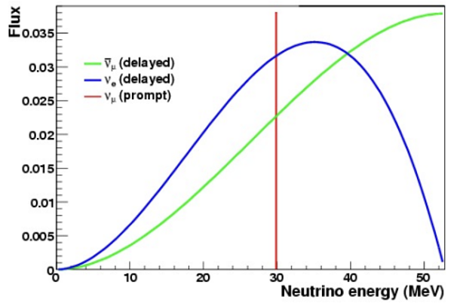
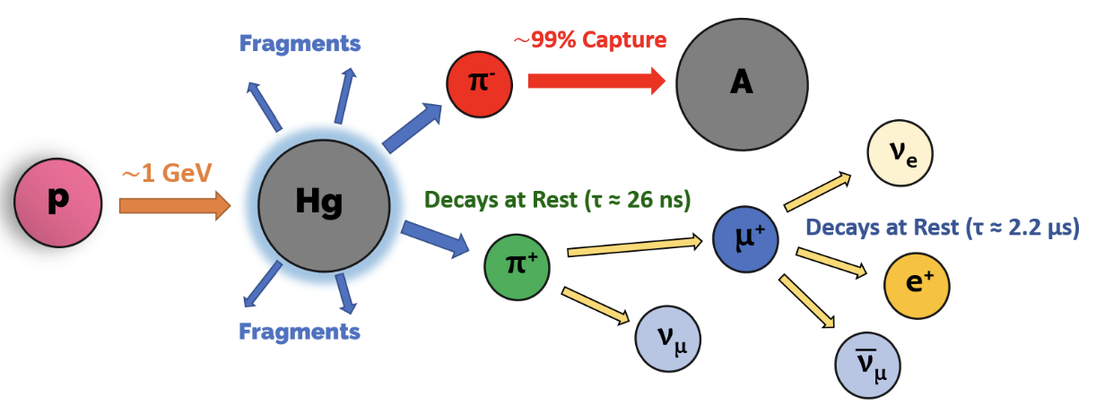
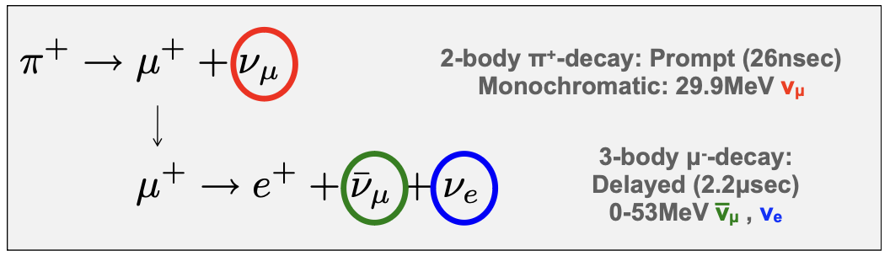
China Spallation Neutron Source (CSNS)
1.6 GeV proton beam
140 kW (→ 500 kW)
25 Hz repetition rate
W
Neutrino flux at 10.5 m: 6.71×10⁶/cm²/s/flavor (~40% of COHERENT)

Slide 14
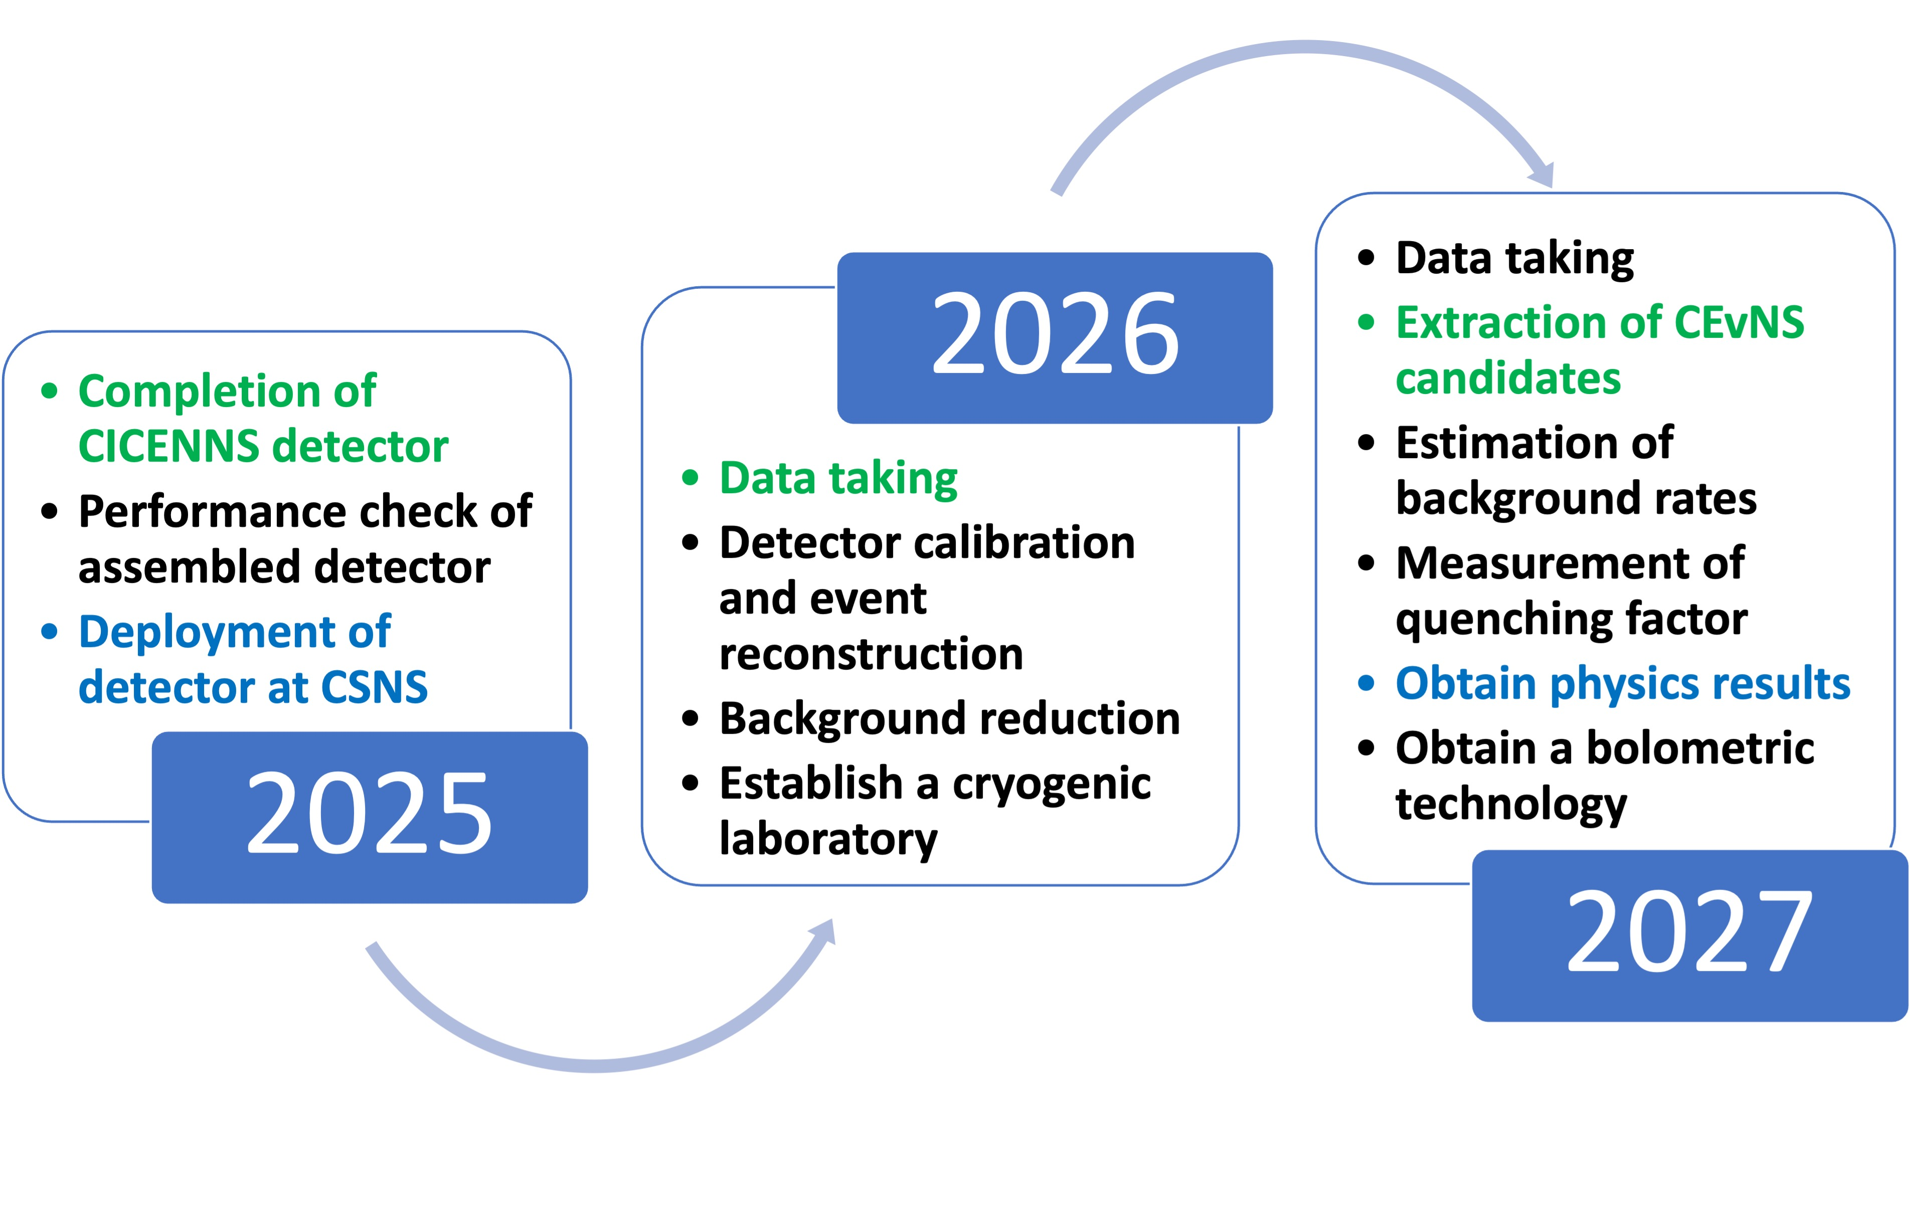
Annual research plan
2023: Detector design, parts placed in order
2024: Check components, MC simulation, detector assembly

Slide 15
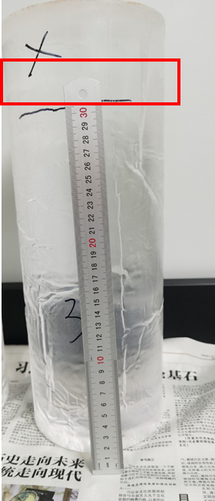
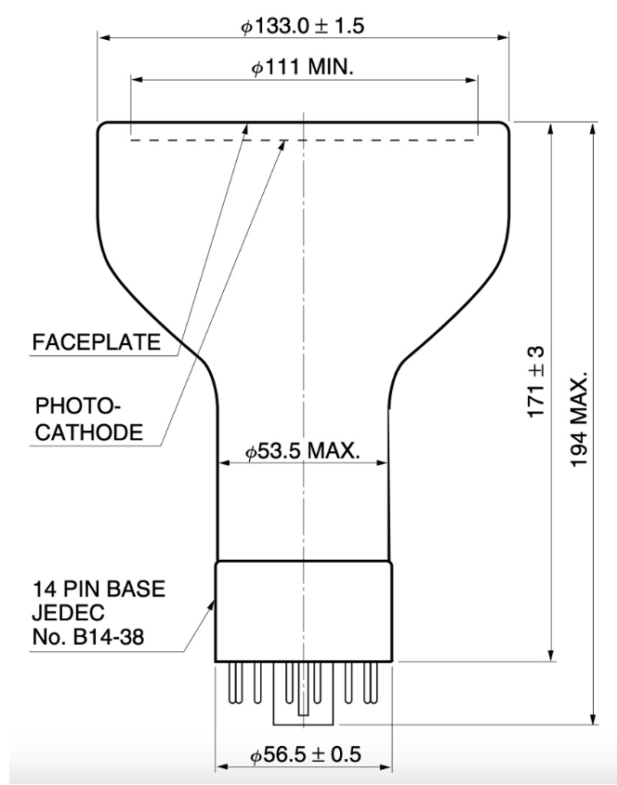
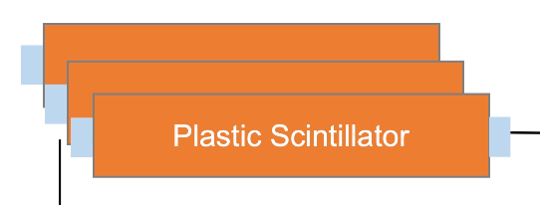
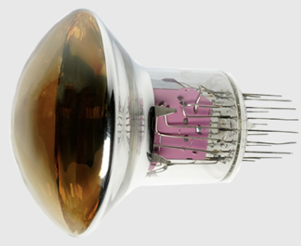
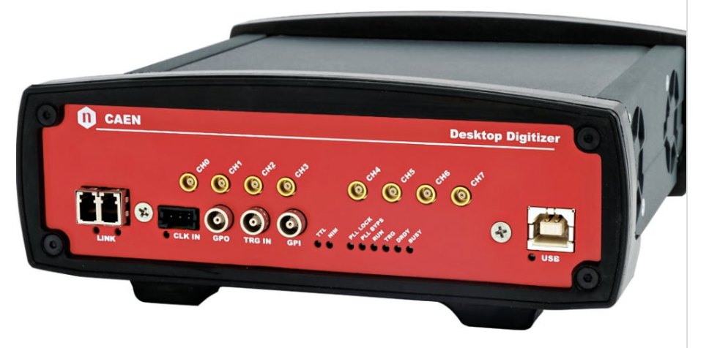
Feasibility and status of detector construction
An instrumentation fund (7.2M RMB), corresponding to a large fraction of total detector cost of ~10M RMB, provided by SYSU in November, 2022.
Detector design was completed.
Most of essential components are under manufacturing and will be delivered before the end of 2024.
- CsI(Na) crystals:中国科学院上海硅酸盐研究所
- 5-inch PMTs: 滨松中国
- Plastic scintillators:北京昊唐兴核技术有限公司
- 4-inch PMTs: 北方夜视技术股份有限公司
- DAQ electronics: CAEN
- Shielding materials, etc.
Under SYSU’s discussion with CSNS for the best detector location and future operational cooperation.
First crystal produced by SICCAS!! (26/June/2024)

Slide 16
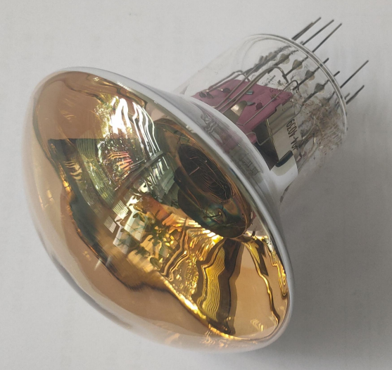
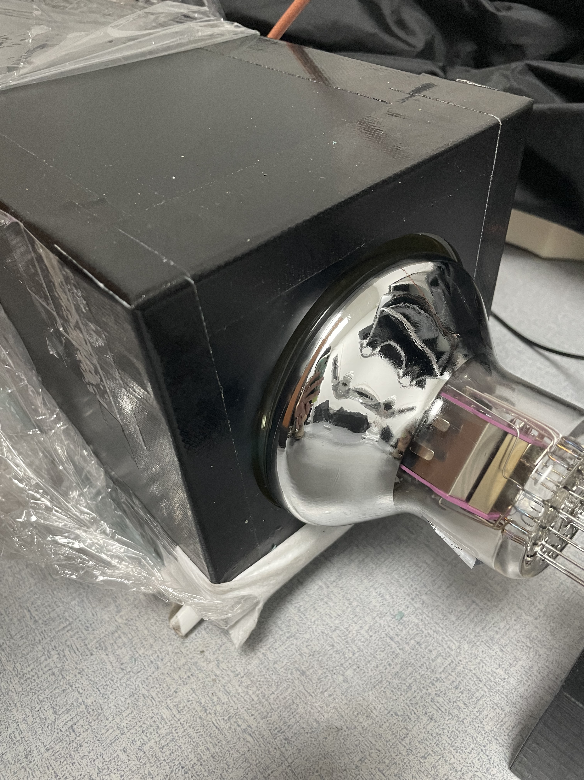
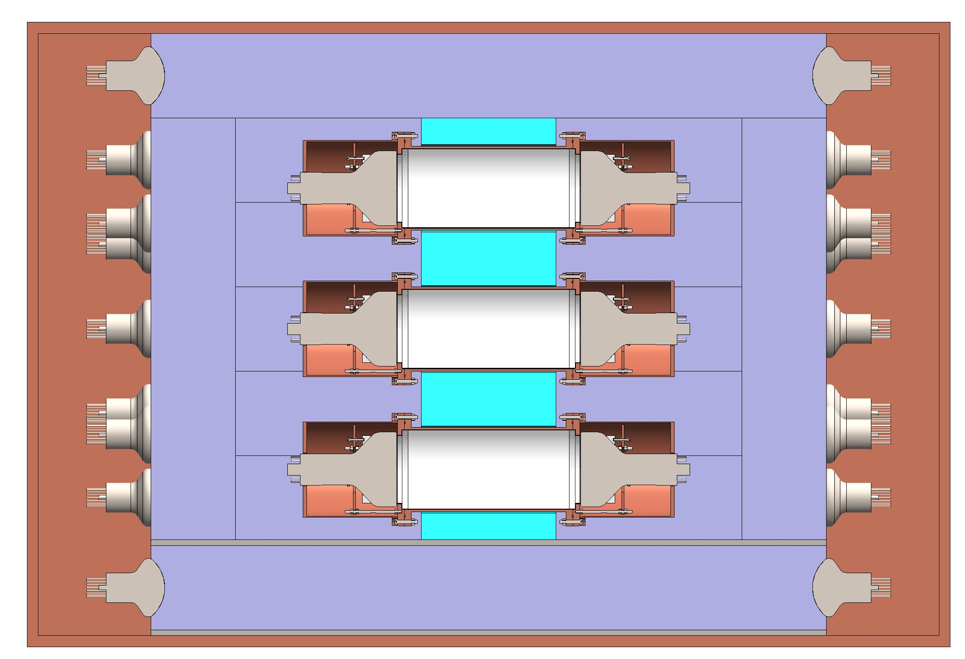
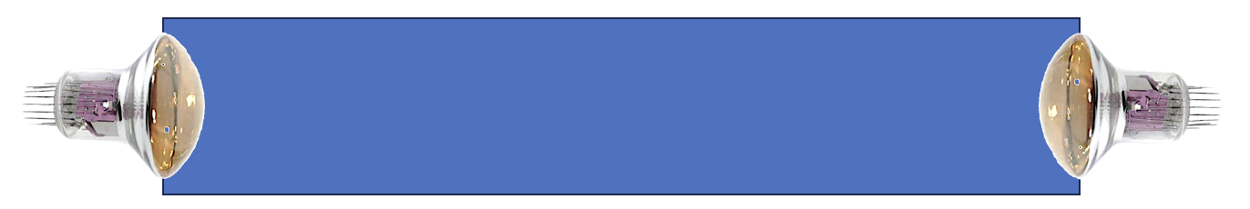
Plastic scintillator veto
NNVT 4-in PMT
PSV detector
Plastic Scintillator × 32
150 mm × 150mm × 1200 mm (L) each
Two 4-inch N2041 PMTs
Coupling of round photocathode surface to plastic scintillator with light collection efficiency of 16%
(by GEANT4)
Identify and veto beam fast neutrons, cosmis muons, and gamma rays.

Slide 17
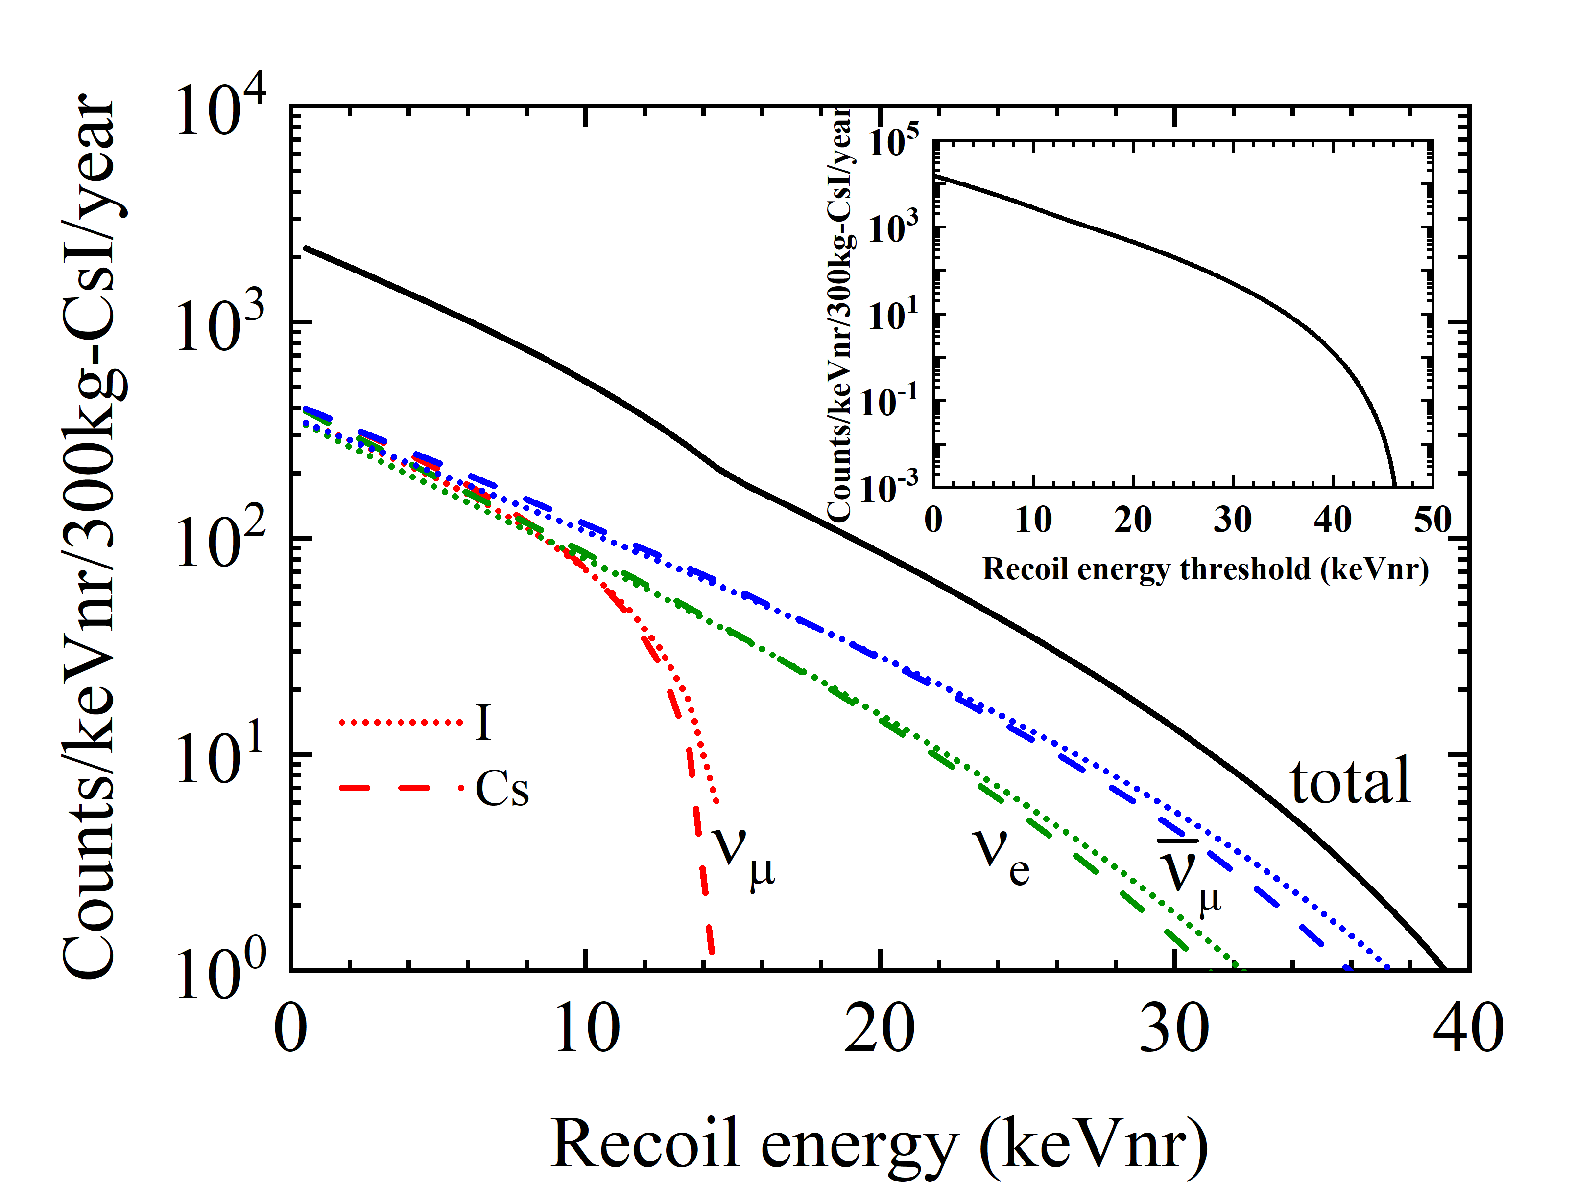
Expected CEvNS signal of CICENNS at CSNS
The maximum nuclear recoil energy is roughly 35 keVnr.
14.6 kg CsI(Na) crystal for ~300 CEvNS events (PRL 129, 081801, 2022)
Expected CEvNS observed rate per 300 kg for a year:
~4950 events at energy threshold of 5 keVnr
~6450 events at 3 keVnr

Slide 18
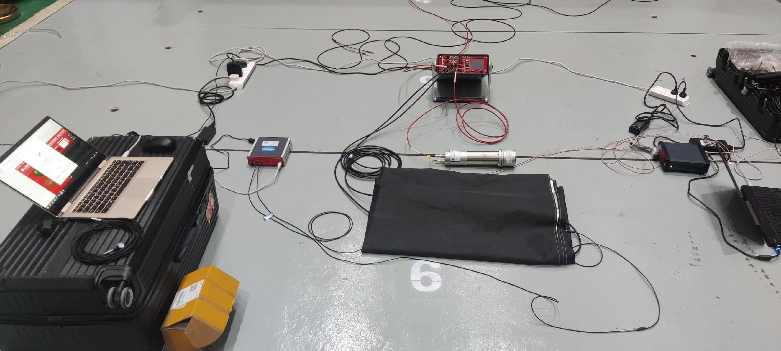
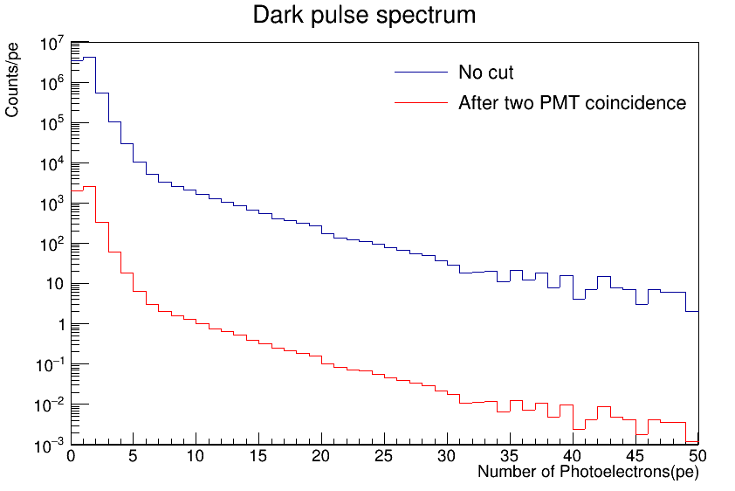
Backgrounds
Beam related fast neutron
Significantly reduced by PSV
On-site measurement, joint effort from SYSU and UCAS
PMT dark-current noise
By attaching two PMTs at both ends of a crystal, reduce PMT dark-current noise events by 3 orders of magnitude.
Noise reduction algorithm by pulse shape and time
Radioactivity in detector materials
Low internal radioactivity in CsI(Na) crystal by purification
Background from PMTs and surrounding materials.
Environmental radioactivity
Most of gamma rays from the environmental radioactivity are expected to be attenuated by lead and other shielding.
Cosmic muon induced neutrons and gammas
Estimated to be negligible

Slide 19
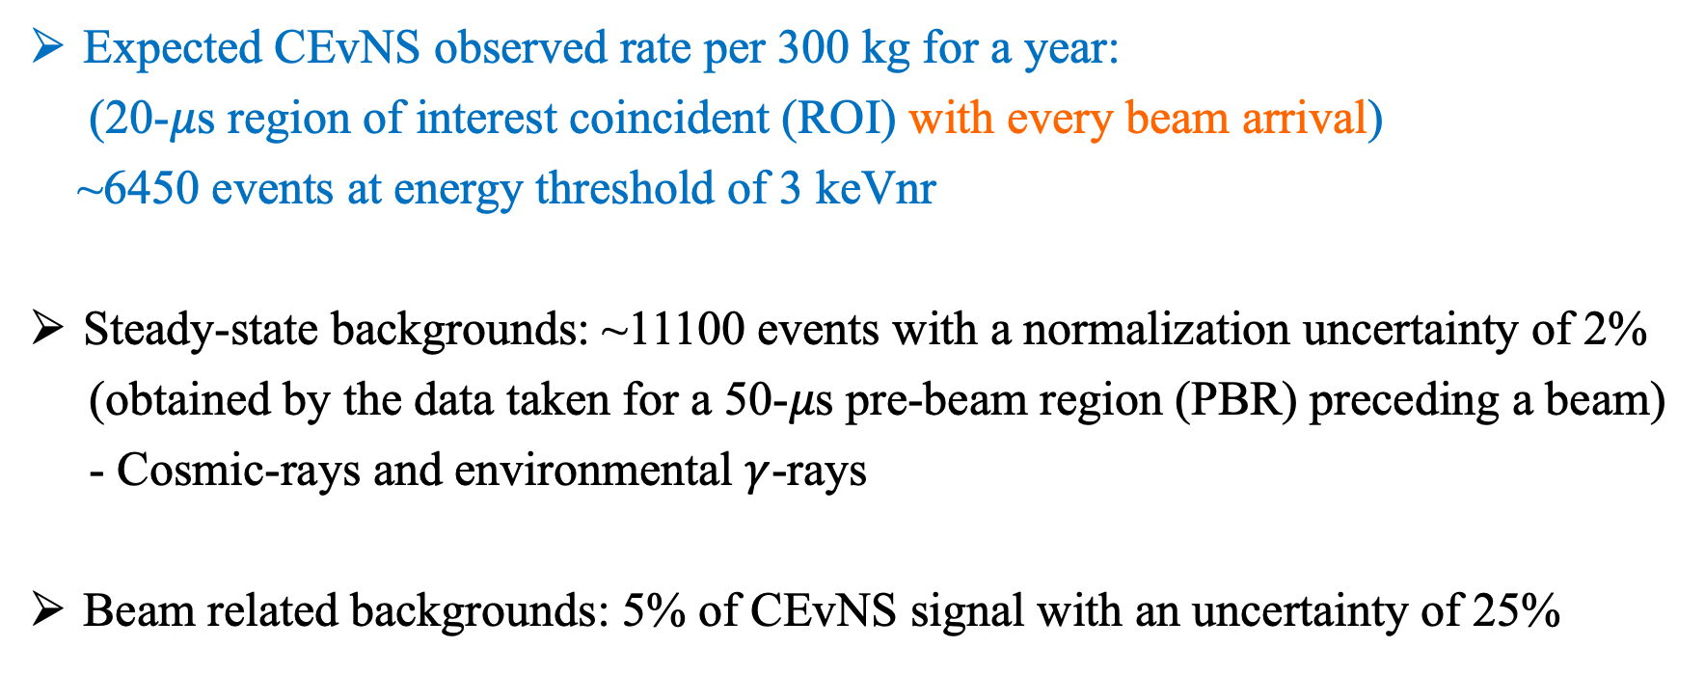
Expected CEvNS signal and background
Expected CEvNS observed rate per 300 kg for a year:
(20-$μ$s region of interest coincident (ROI) with every beam arrival)
~6450 events at energy threshold of 3 keVnr
Steady-state backgrounds: ~11100 events with a normalization uncertainty of 2%
(obtained by the data taken for a 50-𝜇s pre-beam region (PBR) preceding a beam)
- Cosmic-rays and environmental $γ$-rays
Beam related backgrounds: 5% of CEvNS signal with an uncertainty of 25%

Slide 20
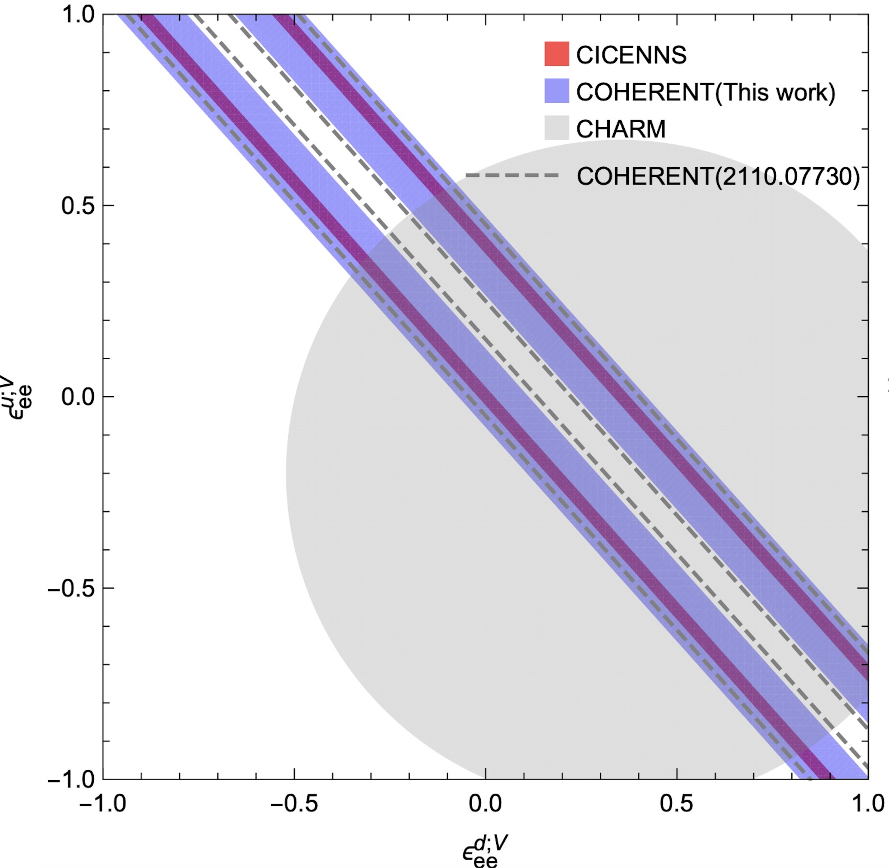
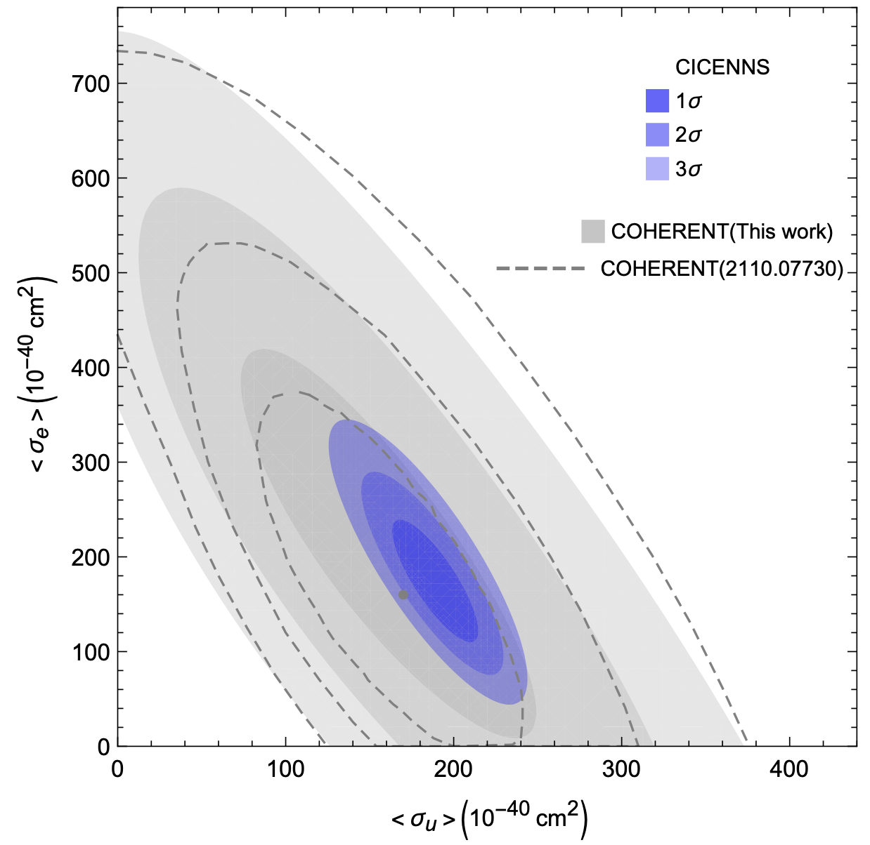
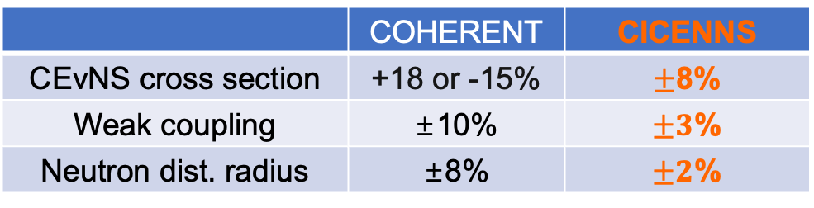
Expected sensitivities and results
(Based on estimates of backgrounds & detection efficiency)
 | COHERENT | CICENNS
CEvNS cross section | +18 or -15% | $±$8%
Weak coupling | ±10% | $±3$%
Neutron dist. radius | ±8% | $±2$%
← World-most precise
← World-most precise
World-best search
World-most precise measurement
Weak couplings at low Q²
Search for NSI
CEvNS cross section

Slide 21
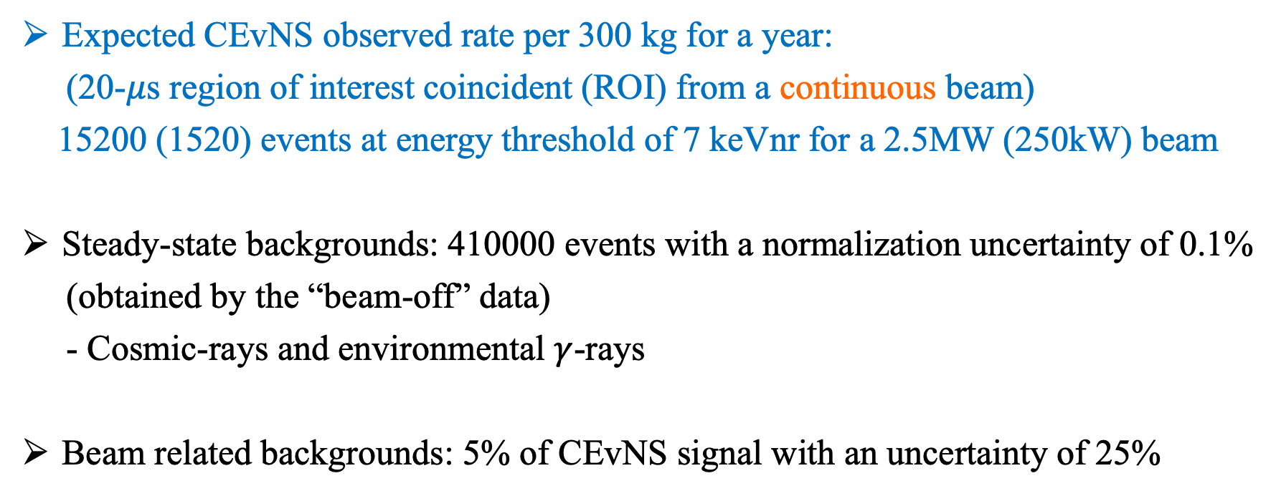
Expected CEvNS signal and background at CiADS
Expected CEvNS observed rate per 300 kg for a year:
(20-$μ$s region of interest coincident (ROI) from a continuous beam)
15200 (1520) events at energy threshold of 7 keVnr for a 2.5MW (250kW) beam
Steady-state backgrounds: 410000 events with a normalization uncertainty of 0.1%
(obtained by the “beam-off” data)
- Cosmic-rays and environmental $γ$-rays
Beam related backgrounds: 5% of CEvNS signal with an uncertainty of 25%

Slide 22
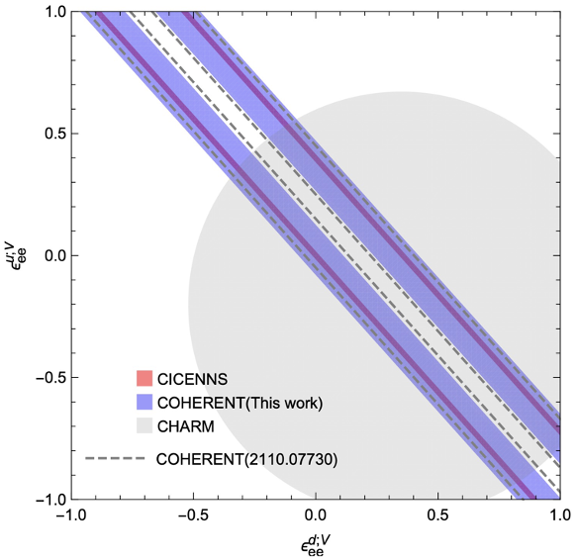
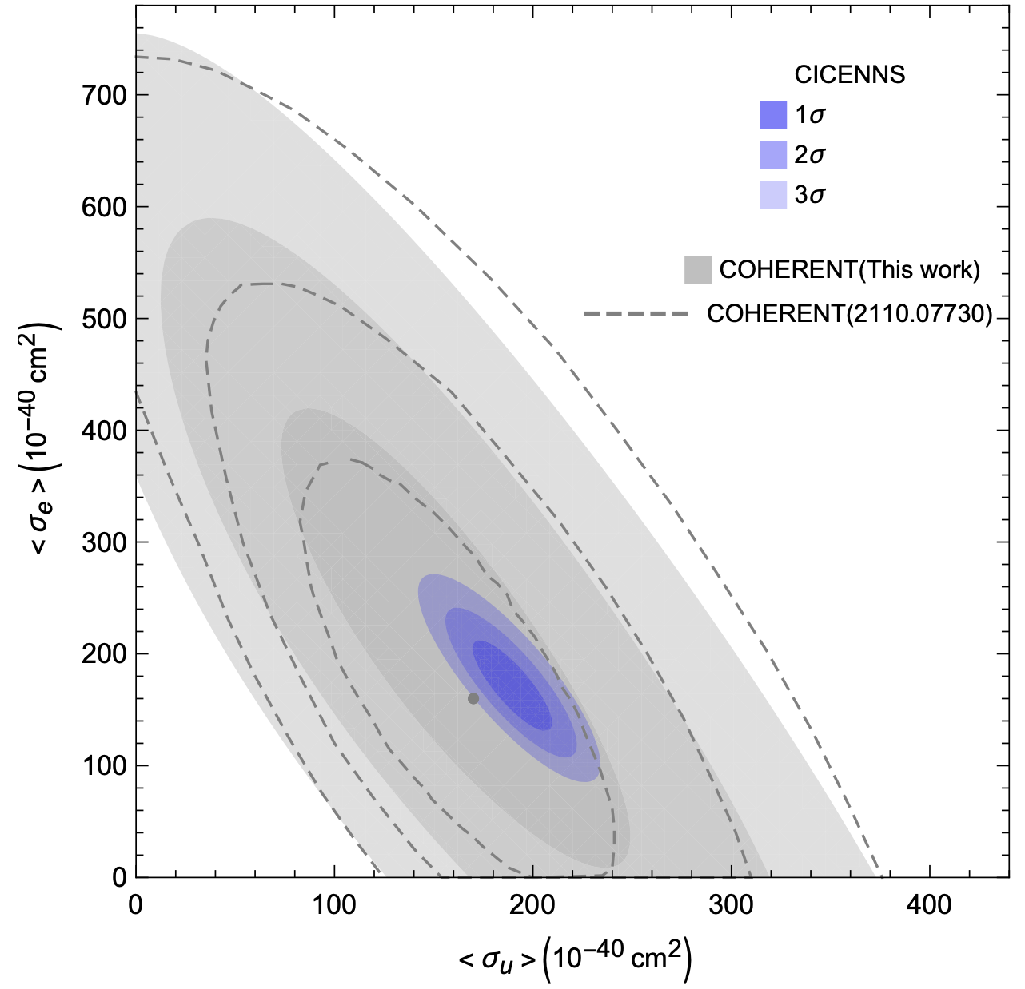
Expected sensitivities and results at CiADS (2.5MW)
Weak couplings at low Q²
Search for NSI
CEvNS cross section

Slide 23
Summary
We build a large CsI crystal detector of CICENNS in order to make the world-most precise measurement of coherent elastic neutrino-nucleus scattering, aiming at studying an unexplored physics region and making a surprising discovery.
The CICENNS detector design was completed and all of necessary parts are placed an order and under manufacturing. They will be delivered before the end of 2024 and assembled in the summer of 2025.
We wish to understand wave properties of neutrino interaction with a large enhancement at low energy using an existing (CSNS) and future (CiADS) neutrino source facilities in Guangdong province.

Slide 24
Backup

Slide 25
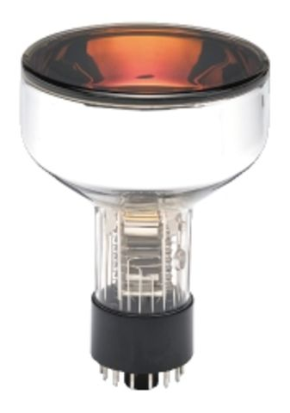
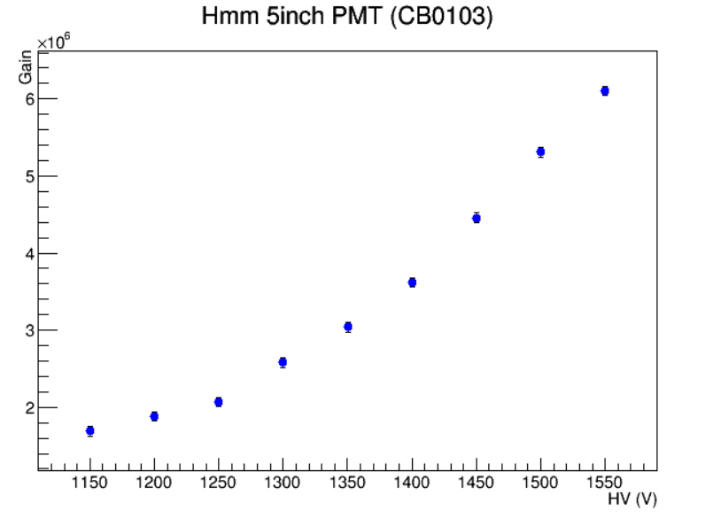
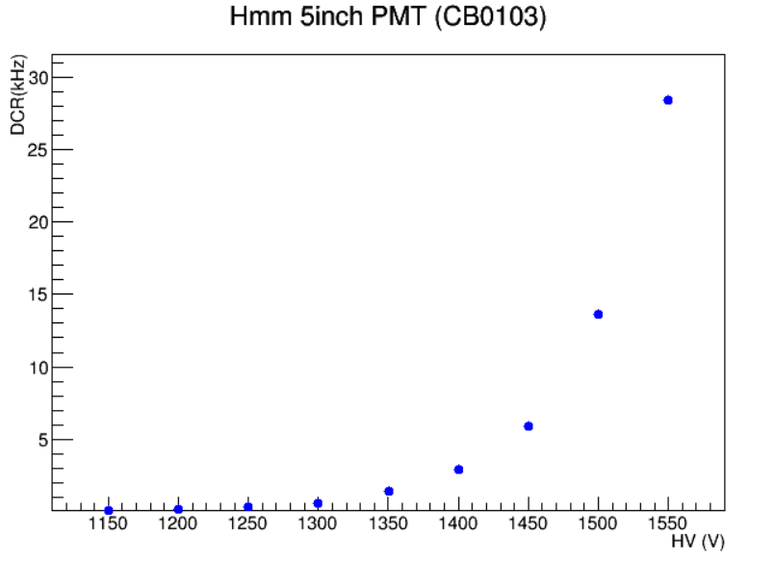
Performance of 5-inch SBA PMT for crystals
Gain and DCR of PMT at different operating voltages.
Gain: 3.6 × 10⁶ @1400V
DCR：2.9KHz @1400V
R877-100 PMT (Super-bialkali)
QE：37% @420nm

Slide 26
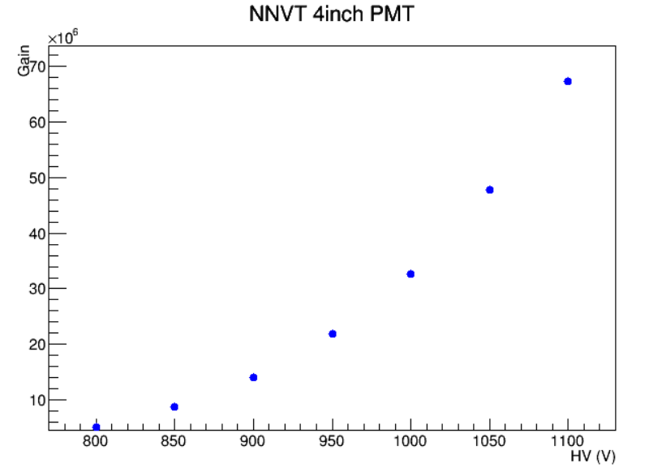
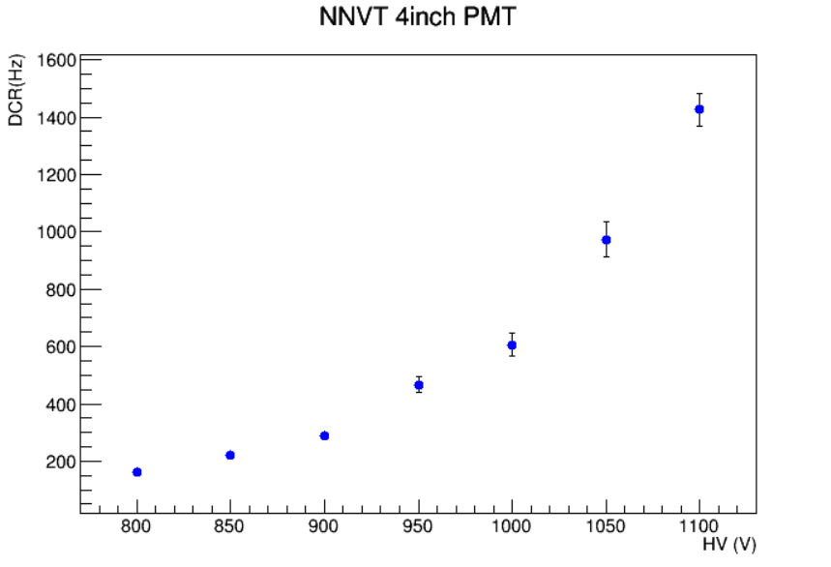
Performance of 4-inch PMT for plastic scintillator veto
N2041 4-inch PMT
QE：25% @420nm
Gain and DCR of PMT at different operating voltages.
Gain: 1.4 × 10⁷ @900V
DCR：290Hz @900V

Slide 27
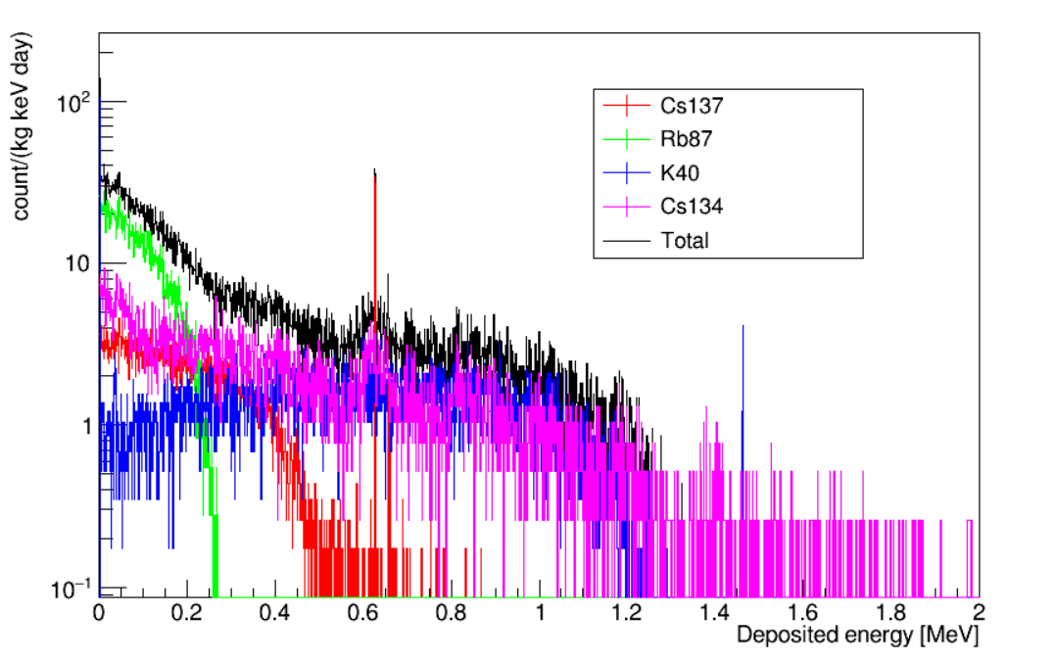
Internal radioactivity of CsI(Na) crystal
Isotopes | ²³⁸U (ppt) | ²³²Th (ppt) | ⁸⁷Rb (ppb) | ¹³⁷Cs (mBq/kg) | ¹³⁴Cs (mBq/kg)
CICENNS | 50±10 | 47±10 | ~2 | <5.9 | ~23
KIMS | 0.75±0.23 | 0.38±0.07 | 1.3±0.4 | 6.3±0.7 | 14.1±1.1
COHERENT | <1000 | <1000 | ~20 | 28±3 | 26±2
Background spectra obtained using GEANT4 simulation for a CsI(Na) crystal with:
⁸⁷Rb: 10ppb,
¹³⁷Cs: 10mBq/Kg, ¹³⁴Cs: 30mBq/Kg, ⁴⁰K: 20mBq/Kg.

Slide 28
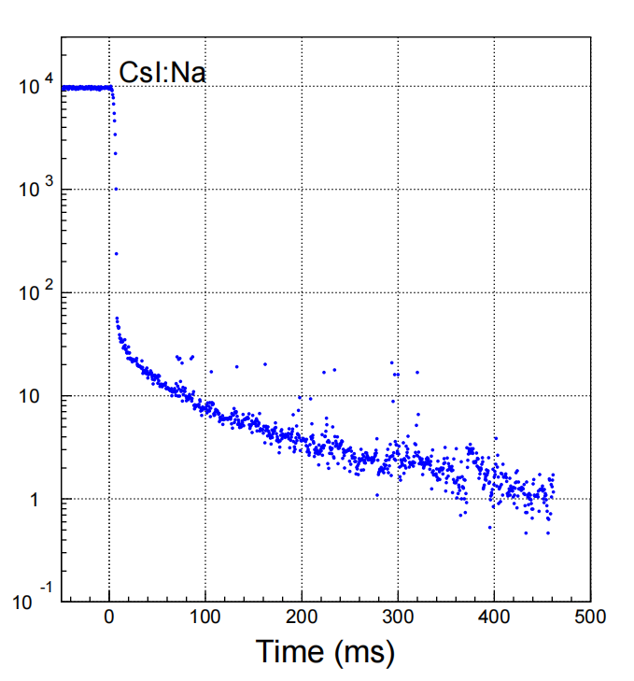
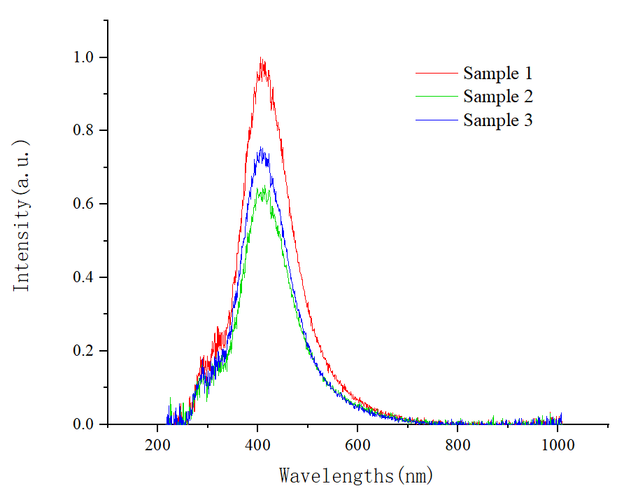
Measured optical properties of CsI(Na) crystal
Emission spectrum of CsI(Na) crystal: peak at 410 nm
Afterglow：~0.5%@6ms

Slide 29
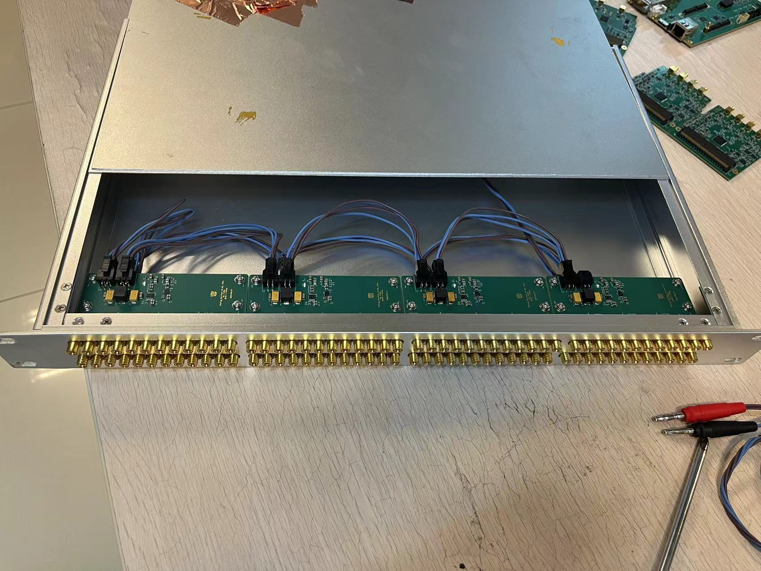

Data readout and processing

Slide 30


Sensitivity: flavored CEvNS cross section and weak couplings
At momentum transfer Q=50 MeV/c
COHERENT:
→ CICENNS: ~1%
(±10%)
* SM prediction: 0.23857(5)
preliminary
Uncertainty of CEvNS cross section:
COHERENT: +18/-15%
→ CICENNS: 8%
preliminary

Slide 31


Sensitivity: Non-standard neutrino interaction
preliminary

Slide 32
Sensitivity: Radius of neutrons in nucleus
• Observed CEvNS recoil energy spectrum
→ mean radius of neutron distribution inside a nucleus (Cs or I: ~5 fm)
Uncertainty of neutron form factor
COHERENT: ~8%
→ CICENNS: ~2%

