Slide 1
Generalized parton distributions of the proton from nonlocal chiral EFT
Ping Wang
Institute of high energy physics, CAS
Light-Cone 2024: Hadron Physics in the EIC era (LC2024), Nov. 25-29, 2024, Huizhou, China

Slide 2
I. Introduction — why nonlocal ?
a. perturbative chiral quark model
b. nonlocal quark-meson coupling model
c. finite-range-regularization
II. Nonlocal Lagrangian
a. nucleon form factors
b. baryon octet form factors
III. Parton distribution functions
a. dbar-ubar asymmetry
b. s-sbar asymmetry
c. polarized distributions
IV. Generalized PDFs
a. zero skewness
b. nonzero skewness
V. Nonlocal QED
lepton g-2
Summary

Slide 3
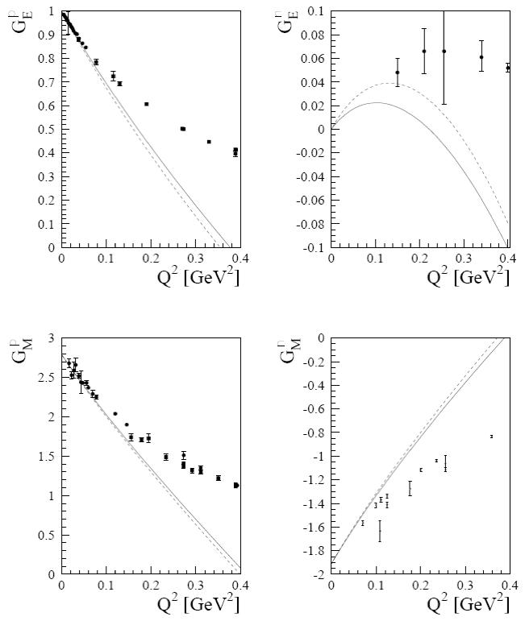
Why nonlocal EFT?
ChPT: hadron degrees of freedom, same chiral symmetry as QCD, systematic approach for hadron physics
valid at small momentum transfer
Nucleon EM Form Factors in traditional ChPT
T. Fuchs, J. Gegelia, S. Scherer, J. Phys. G30 (2004) 1407

Slide 4
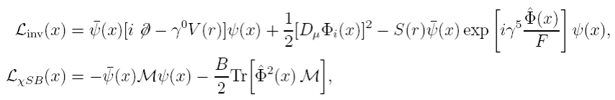
Three phenomenological models
a. Perturbative chiral quark model

Slide 5
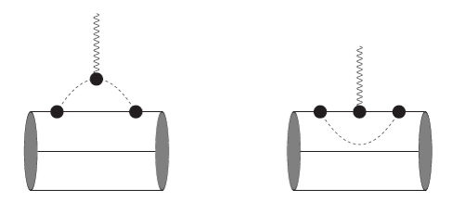
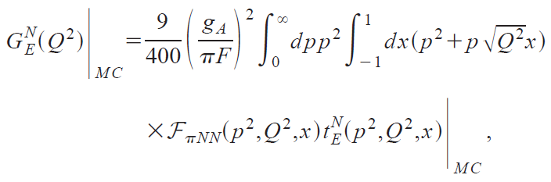
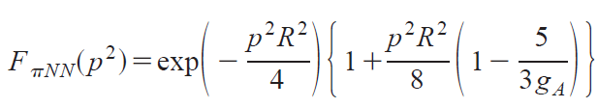
Nucleon electromagnetic form factors

Slide 6
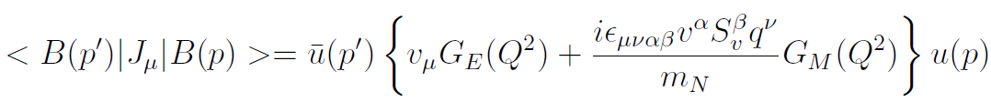
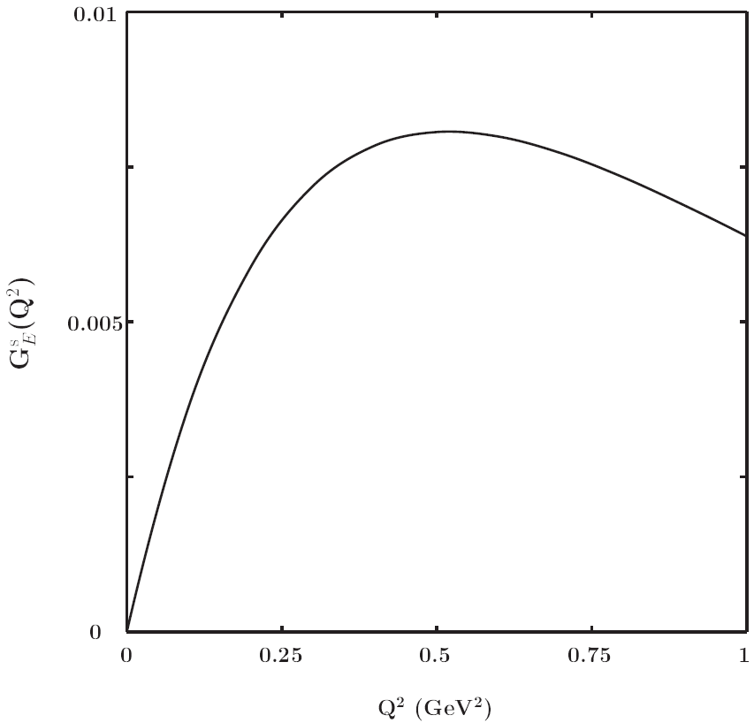
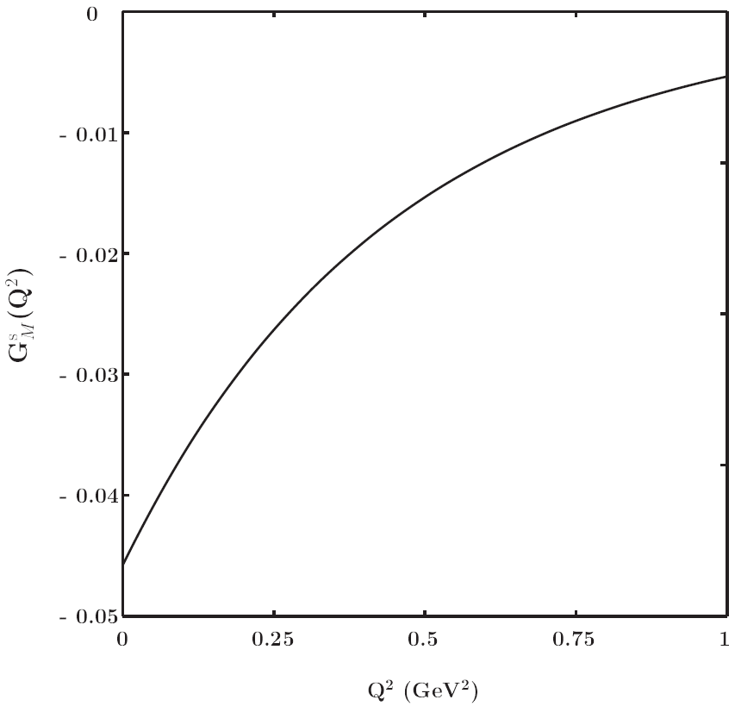
Strange quark contribution to the form factor
V. Lyubovitskij, P. Wang, T. Gutsche, A. Faessler, Phys. Rev. C 66 (2002) 055204

Slide 7
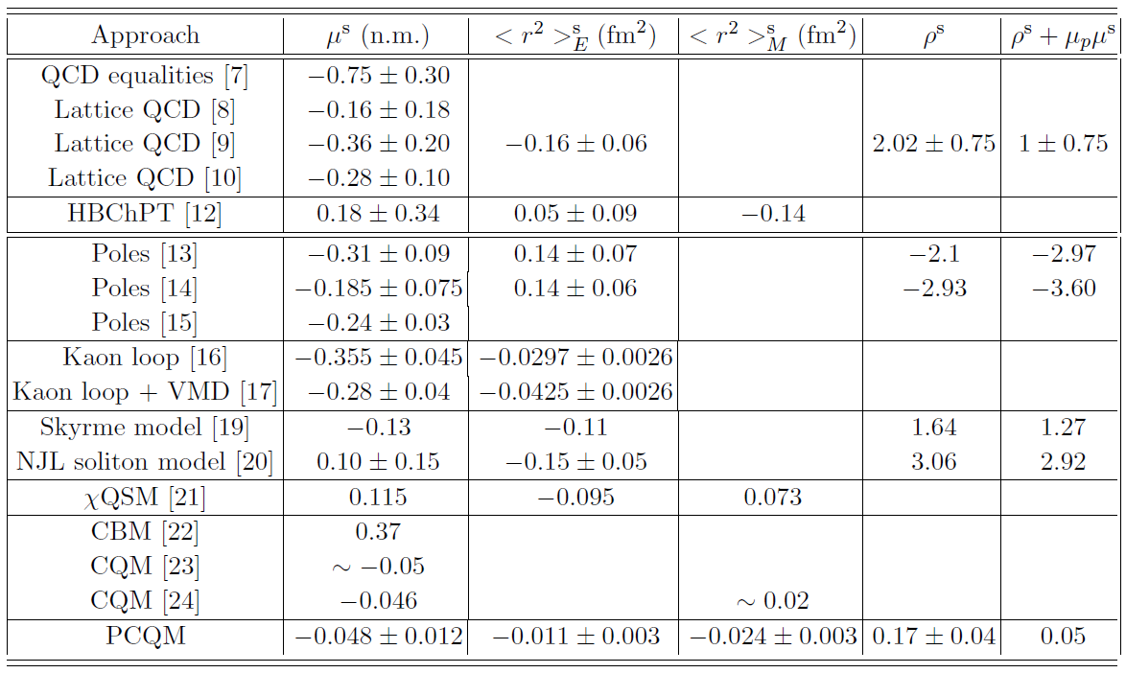

Slide 8
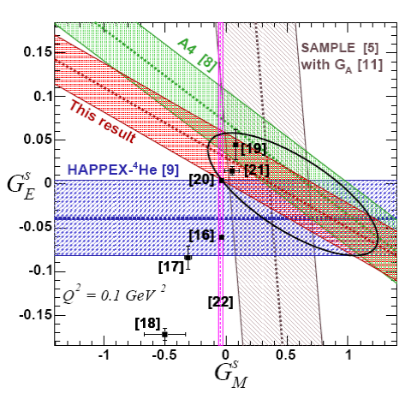
HAPPEX Collaboration
Phys. Lett. B635 (2006) 275
[5] D. T. Spayder et al, Phy. lett. B583 (2004) 79
[8] F. E. Mass et al, Phys. Rev. Lett. 94 (2005) 152001
[9] D. S. Armstrong et al, Phys. Rev. Lett. 95 (2005) 092001
[11] S. Escoffier et al, Nucl. Instrum. Meth. A551 (2005) 563
[20] V. Lyubovitskij, P. Wang, T. Gutsche, A. Faessler, Phys. Rev. C 66 (2002) 055204

Slide 9
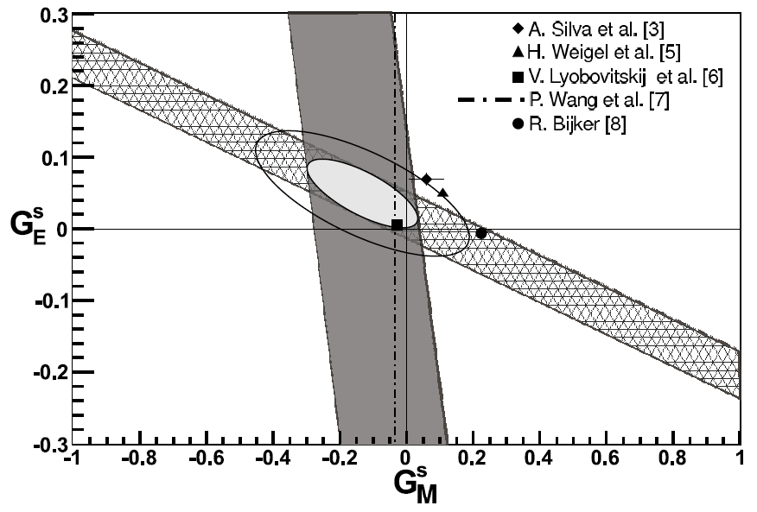
S. Baunack et al.,
Phys.Rev.Lett.102 (2009) 151803
[3] A. Silva et al., Phys. Rev. D74 (2006) 054011
[5] H.Weigel et al., Phys. Lett. B353 (1995) 20
[6] V. Lyubovitskij, P. Wang, T. Gutsche, A. Faessler, Phys. Rev. C66 (2002) 055204
[7] P. Wang, D. Leinweber, A. Thomas, R. Young, Phys. Rev. C79 (2009) 065202
[8] R. Bijker, J. Phys. G32 (2006) L49

Slide 10



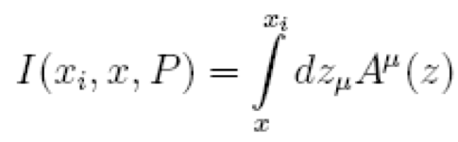
b. Non-local quark-meson coupling model

Slide 11
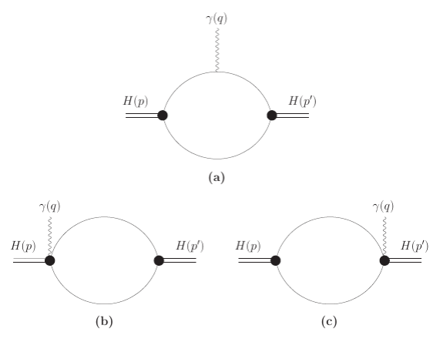
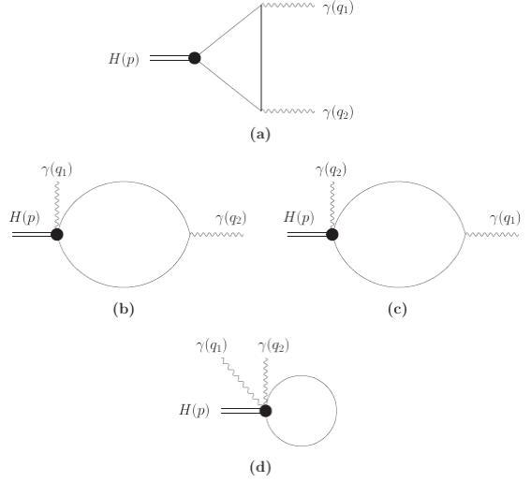
pion form factor
pion —> 2 gama

Slide 12
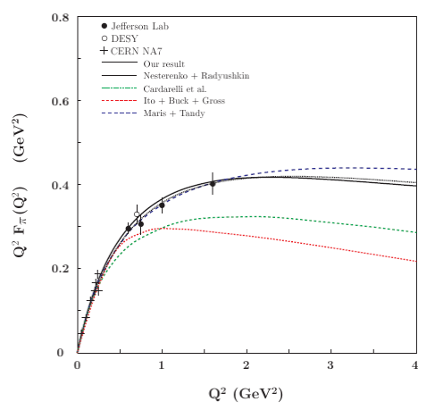
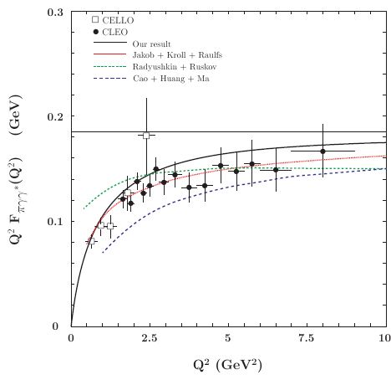
A. Faessler, T. Gutsche, M.A. Ivanov, Valery E. Lyubovitskij and P. Wang, Phys. Rev. D 68 (2003) 014011

Slide 13

c. Finite-Range-Regularization
L = 0.8 GeV

Slide 14
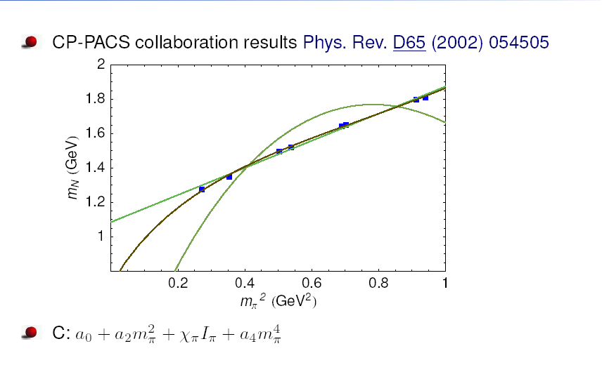
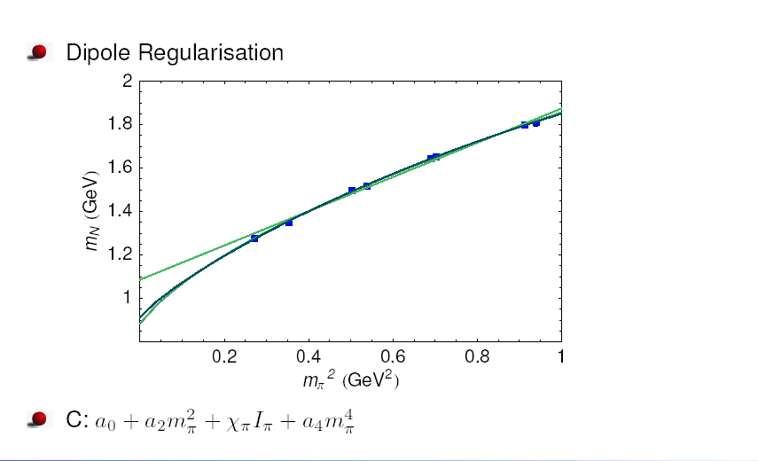
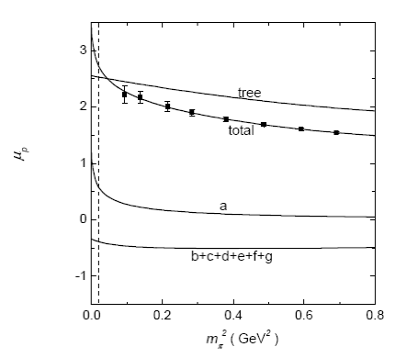
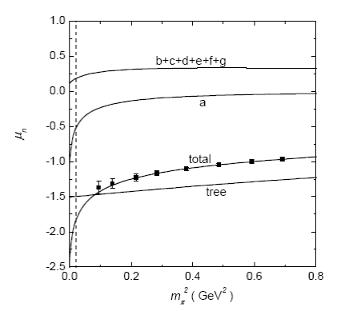
P. Wang, D. B. Leinweber, A. W. Thomas and R. D. Young, Phys. Rev. D 75 (2007) 073012

Slide 15
Nonlocal effective Lagrangian
Motivation:
Finite-range-regularisation
Relativistic regulator
Heavy baryon EFT Covariant EFT
Gauge symmetry distroyed Gauge symmetry restored
Ward identity, Charge conservation, Renormalised nucleon charge
Solution:
Gauge invariant nonlocal chiral effective Lagrangian
Regulator derived from the Lagrangian
Make it possible to study hadron structure at relatively large Q^2
FFs, PDFs, GPDs, TMDs, … …

Slide 17

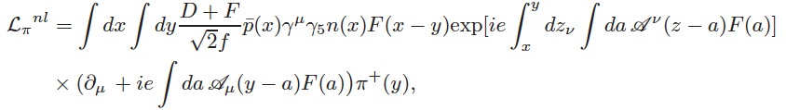

Local interaction including pi meson
Corresponding nonlocal Lagrangian
Local EM interaction
Corresponding nonlocal EM interaction
EM currents with pi meson:

Slide 18

The Lagrangian is gauge invariant under the following transformation:

Slide 19
Vertices of Nonlocal EFT

Slide 20
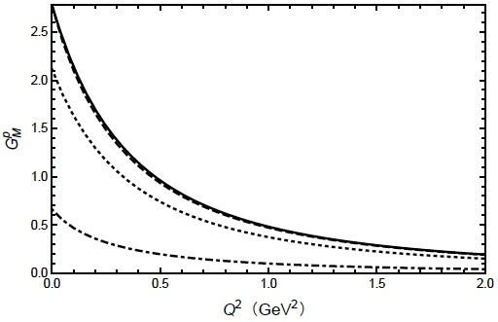
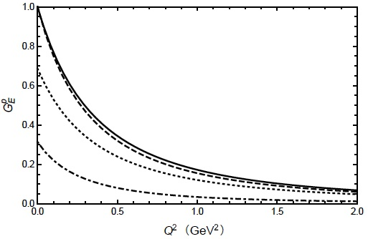
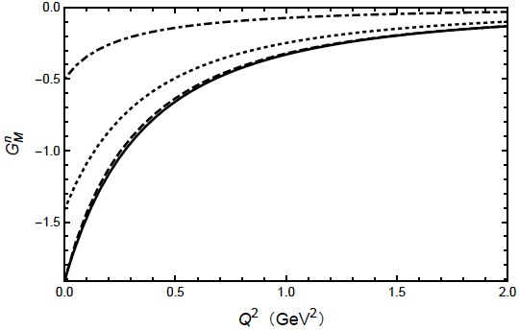
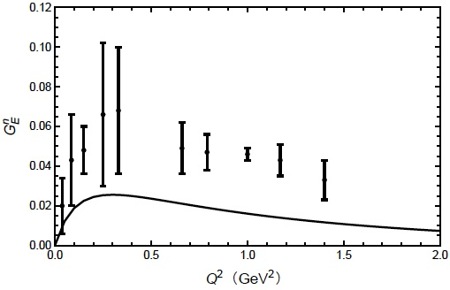
Nucleon Form Factors in nonlocal EFT
fm
fm
fm
fm^2
<rM>p = 0.848 (0.836)
<rE>p = 0.857 (0.847)
<rM>n = 0.867 (0.889)
<r^2_E>n = -0.077 (-0.113)
F. C. He and P. Wang, Phys. Rev. D97 (2018) 036007

Slide 21
Strange form factors
F. C. He and P. Wang, Phys. Rev. D98 (2018) 036007

Slide 22
Octet form factors
M. Y. Yang and P. Wang, Phys. Rev. D102 (2020) 056024

Slide 24
M. Y. Yang and P. Wang, Phys. Rev. D105 (2022) 016006

Slide 25
Nucleon PDFs and GPDs:
deeply-virtual Compton scattering (DVCS)
deeply-virtual meson production (DVMP)
timelike Compton scattering (TCS)
unpolarized and polarized experiments:
Jefferson Lab, HERMES, H1, ZEUS, and CLAS over a wide range of kinematics
future experiments:
COMPASS, J-PARC, the Electron-Ion Collider (EIC), Large Hadron electron Collider (LHeC)
Factorization, parameterization
Phenomenological quark models
Lattice simulation: quasi-PDF or pseudo-PDF
ChPT
Nonlocal EFT

Slide 26
Parton Distributions Functions
EFT allows the quark operators to be matched to hadronic operators:

Slide 27
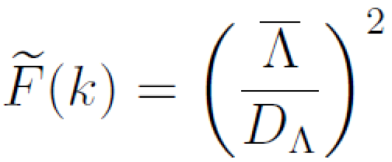
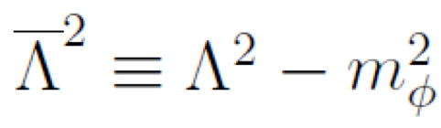
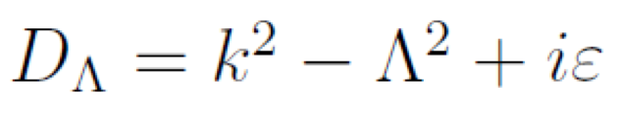
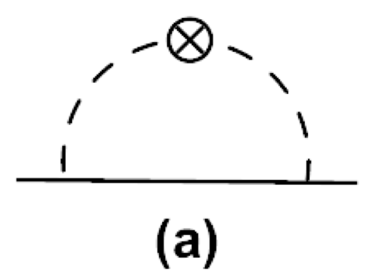
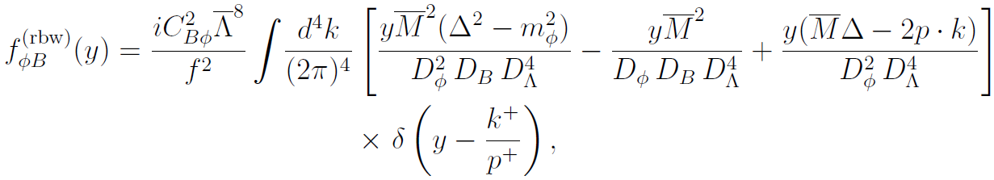
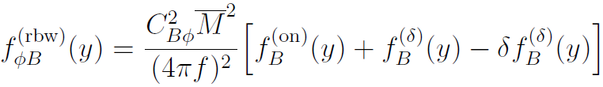
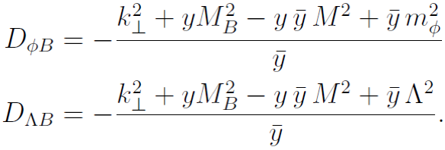
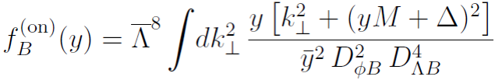
Parton Distributions Functions
Dipole regulator:
On-shell contribution:

Slide 28
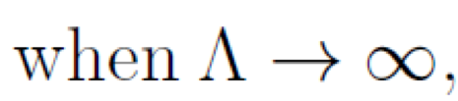
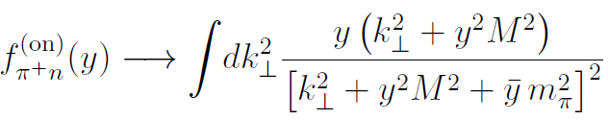
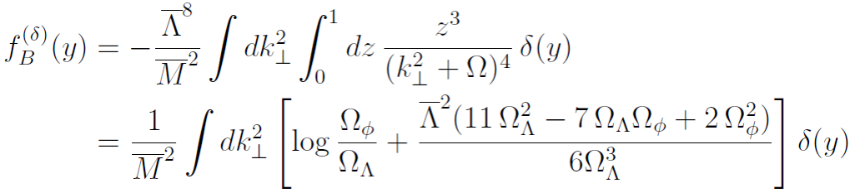
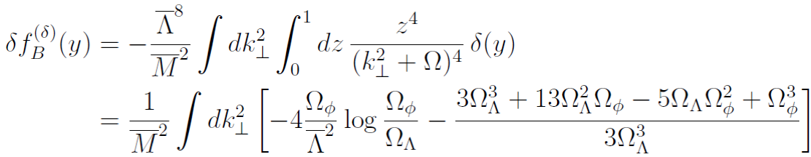
Delta function terms:
In the point particle limit, the splitting functions are the same as our previous results.
Y. Salamu, C. R. Ji, W. Melnitchouk and P. Wang, Phys. Rev. Lett. 114 (2015) 122001.

Slide 29
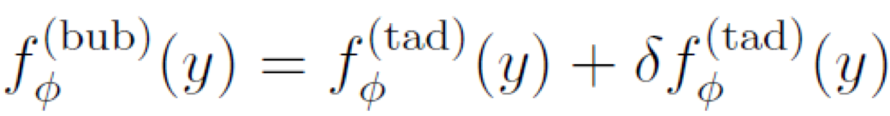
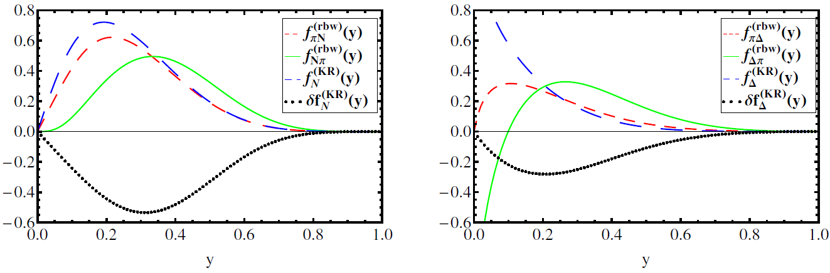
Relationships between splitting functions:
Gauge invariance of nonlocal Lagrangian, net strangeness zero.
Y. Salamu, C. R. Ji, W. Melnitchouk, A. W. Thomas and P. Wang, Phys. Rev. D 99 (2019) 014041.

Slide 32
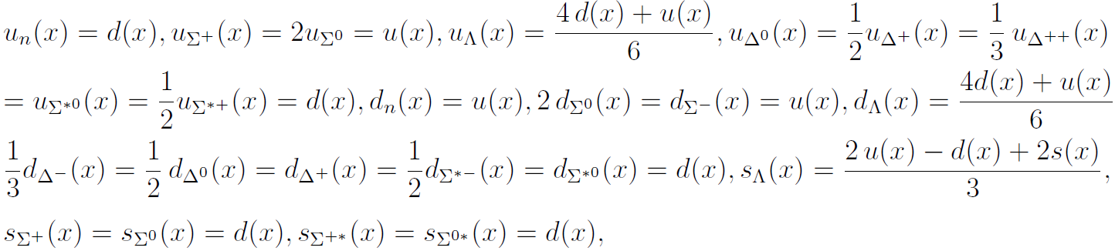
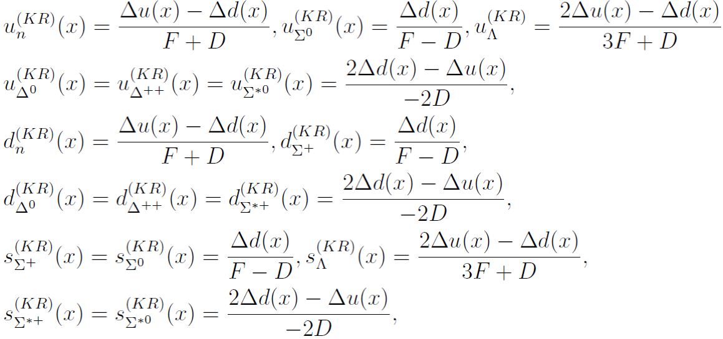
Input PDFs of valence at tree level:
valence quark
in mesons:
valence quark
in baryons:
quark distributions
For KR diagrams:

Slide 33
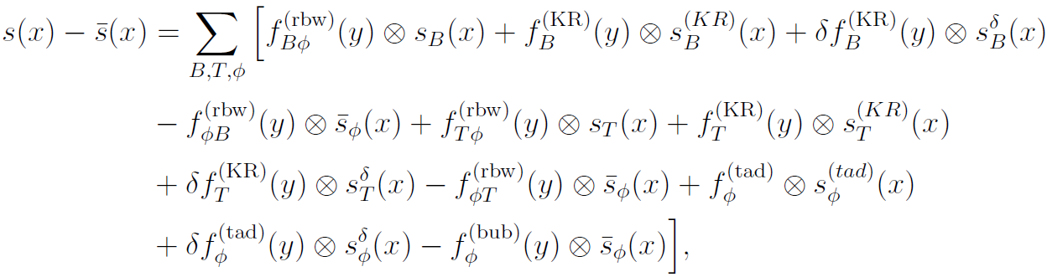
dbar-ubar asymmetry:
strange-antistrange quark asymmetry:

Slide 34
Lambda determination
The differential cross section for the inclusive process

Slide 35
dbar - ubar asymmetry
Y. Salamu, C. R. Ji, W. Melnitchouk, A. W. Thomas, P. Wang and X. G. Wang, Phys. Rev. D 100 (2019) 9, 094026

Slide 36
Lambda determination

Slide 37
s-sbar asymmetry
Y. Salamu, C. R. Ji, W. Melnitchouk, A. W. Thomas, P. Wang and X. G. Wang, Phys. Rev. D 100 (2019) 9, 094026

Slide 39
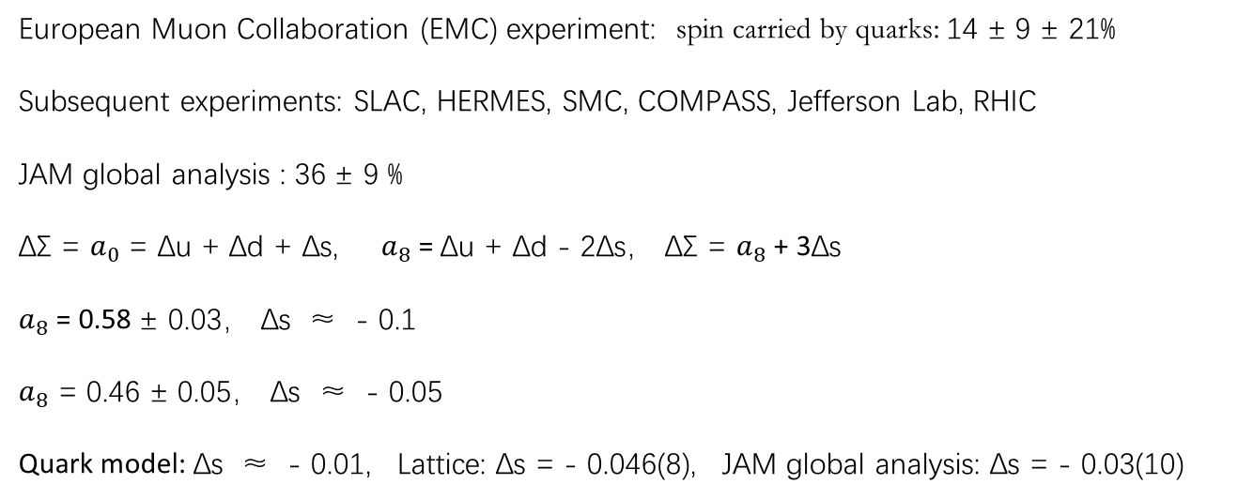
Helicity-dependent distribution
European Muon Collaboration (EMC) experiment: spin carried by quarks: 14 ± 9 ± 21%
Subsequent experiments: SLAC, HERMES, SMC, COMPASS, Jefferson Lab, RHIC
JAM global analysis : 36 ± 9 %
ΔΣ = $a_{0}$ = Δu + Δd + Δs, $a_{8}$ = Δu + Δd - 2Δs， ΔΣ = $a_{8}$ + 3Δs
$a_{8}$ = 0.58 ± 0.03， Δs ≈ - 0.1
$a_{8}$ = 0.46 ± 0.05， Δs ≈ - 0.05
Quark model: Δs ≈ - 0.01, Lattice: Δs = - 0.046(8), JAM global analysis: Δs = - 0.03(10)

Slide 40
Polarized Distributions Functions

Slide 42
F.C. He, C.R. Ji, W. Melnitchouk, Y. Salamu,
A.W. Thomas, P. Wang and X.G. Wang,
Phys. Rev. D 105 (2022) 094007

Slide 43
Generalized PDFs

Slide 48
F.C. He, C.R. Ji, W. Melnitchouk, A.W. Thomas and P. Wang, Phys. Rev. D 106 (2022) 054006

Slide 49
F.C. He, C.R. Ji, W. Melnitchouk, A.W. Thomas and P. Wang, Phys. Rev. D 106 (2022) 054006

Slide 50
Nonzero skewness GPDs:

Slide 56
Nonlocal chiral contributions to generalized parton distributions of the proton at nonzero skewness,
Z. Y. Gao, F. C. He, C. R. Ji, W. Melnitchouk, Y. Salamu and P. Wang, Phys. Rev. D 110 (2024) 5, 054049

Slide 57
Nucleon form factors and parton distributions in nonlocal chiral effective theory,
Prog. Part. Nucl. Phys. 129 (2023) 104017
Generalized parton distributions of sea quarks in the proton from nonlocal chiral effective theory, Phys. Rev. D 106 (2022) 054006
Helicity-dependent distribution of strange quarks in the proton from nonlocal chiral effective theory, Phys. Rev. D 105 (2022) 094007
Sea quark contributions to the electromagnetic form factors of Sigma hyperons,
Phys. Rev. D 105 (2022) 016006
Electromagnetic form factors of octet baryons with the nonlocal chiral effective theory,
Phys. Rev. D 102 (2020) 056024
Strange quark helicity in the proton from chiral effective theory,
Phys. Rev. D 102 (2020) 116020
Sivers distribution functions of sea quark in proton with chiral effective theory,
Phys. Rev. D 100 (2019)074032
Parton distributions from nonlocal chiral SU(3) effective theory II: Flavor asymmetries,
Phys. Rev. D 100 (2019) 094026
Parton distributions from nonlocal chiral SU(3) effective theory I: Splitting functions,
Phys. Rev. D 99 (2019) 014041
Strange form factors of nucleon with a nonlocal chiral effective Lagrangian,
Phys. Rev. D 98 (2018) 036007
Nucleon electromagnetic form factors with a nonlocal chiral effective Lagrangian,
Phys. Rev. D 97 (2018) 036007

Slide 58
Nonlocal behavior is general for all the interactions?
Nonlocal EFT (Nucleon structure, FFs, PDFs)
Nonlocal QED (lepton g-2)， Nonlocal Gravity (Gravitational FFs)

Slide 65
Nonlocal QED and lepton g-2 anomalies,
H. Li and P. Wang, Eur. Phys. J. C 84 (2024) 7, 654

Slide 66
Summary
Nonlocal Lagrangian is constructed by introducing the correlation function and the gauge link.
Correlation function generates the relativistic regulator and the loop integral is convergent.
Gauge link guarantees the locally gauge invariance and generate additional diagrams.
When Lambda goes to infinity, all the formulas are the same as those in the local case.
The nonlocal Lagrangian can be applied to study hadron properties at relatively at large Q^2.
EM form factors, strange form factors, light sea quark form factors, octet form factors, gravitational
form factors, unpolarized PDFs, polarized PDFs, GPDs, TMDs … …
Without fine-tuning, the agreement between the calculation and experiment is very good.
The nonlocal behavior could be the general property for all the interactions.
Lepton g-2 anomaly can be explained in nonlocal QED.
… …
Thank you!
66

