Slide 1


Basis Light-Front Quantization:
Recent Results and Future Prospects
James P. Vary
Department of Physics and Astronomy
Iowa State University
Ames, USA
Light-Cone 2024
Hadron Physics in the EIC era
Huizhou, China
November 25-29, 2024
Notes:
Adapted from PHYS526 file: 12-LC2023_BLFQ.pptx
Adapted from LC2018, JLAB
The submitted abstract:
Basis Light Front Quantization provides a practical framework and is actively used for solving the mass eigenvalue problem of the light-front Hamiltonian for hadronic systems. I will review recent results for mixed-flavor and light mesons as well as for baryons. These results include masses, decay constants, transition rates, form factors, parton distribution functions including their QCD evolution, transverse momentum distributions, non-perturbative time-dependent scattering amplitudes and others. Comparisons with experimental data as well as with results from Lattice QCD and the Dyson-Schwinger approach will be presented where available. Prospects for applications to more complex multi-quark and multi-gluon systems will be outlined.
Resides in file: LC2019_Vary_Paris_full_updated.pptx
Updated from File: LC2021_Vary_Jeju_Korea_final.pptx
Updated from file: IGFAE_Santiago_de_Compostela_BLFQ_Vary_Final.pptx

Slide 2
General starting point: QCD Lagrangian
Lattice Gauge theory
Feynman Covariant Perturbation Theory
Hamiltonian Field Theory
Covariant Wave Equations
Steps to set up non-perturbative Specific selections for these applications
calculational framework
Make Legendre Transform L --> T^{μν} Energy-Momentum tensor
Select a coordinate system Light-Front coordinates & identify generators
Fix the Gauge Light-Front Gauge (A⁺ = 0)
Eliminate dependent fields Dirac -> Pauli fields
Select basis for the fields 2D HO + Jacobi Polynomials or DLCQ
Quantize the theory Basis Light-Front Quantization (BLFQ)
Select cutoffs N_{max}, L or K, Fock space limits
Evaluate/store Hamiltonian matrix High-Performance Computers (HPCs)
Solve for eigenpairs (mass states &
Light-Front Wavefunctions (LFWFs)) High-Performance Computers (HPCs)
Solve for experimental observables Matrix elements of operators with LFWFs
Notes:
Adapted from PHYS526 file: 12-LC2023_BLFQ.pptx

Slide 3
Dirac’s forms of relativistic dynamics [Dirac, Rev. Mod. Phys. 21, 392 1949]
Instant form is the well-known form of dynamics starting with x⁰ = t = 0
Front form defines relativistic dynamics on the light front (LF): x⁺ = x⁰+x³ = t+z = 0
Adapted from talk by Yang Li
Notes:
Taken from Phys624_light_front_field_theory.pptx
Adapted from Yang Li’s talk in Florida – May 2016
In the front form, 7 of the 10 Poincare’ generators are kinematic (J^- or ang. mo. projection along the longitudinal direction, 3-boosts, 3-translations) and 3 are dynamical (Hamiltonian and 2 rotations –one about x and one about y)
Shown in LC2016-Lisbon (previous version)
Shown in LC2017 – Mumbai (previous version)
LC2018 – this is an updated version
Discuss choosing the maximal set of commuting observables to define the basis for BLFQ . . .
Not Shown at LC2019 or LC2021
File: LC2021_Vary_Jeju_Korea
File: . . . LC2023_BLFQ (where these notes were improved)
Adapted from PHYS526 file: 12-LC2023_BLFQ.pptx

Slide 4
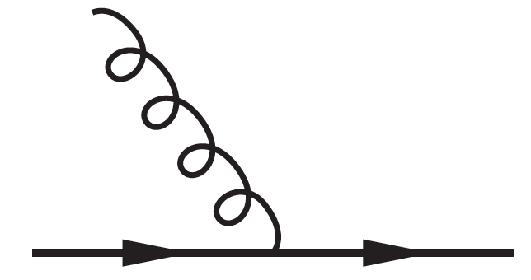
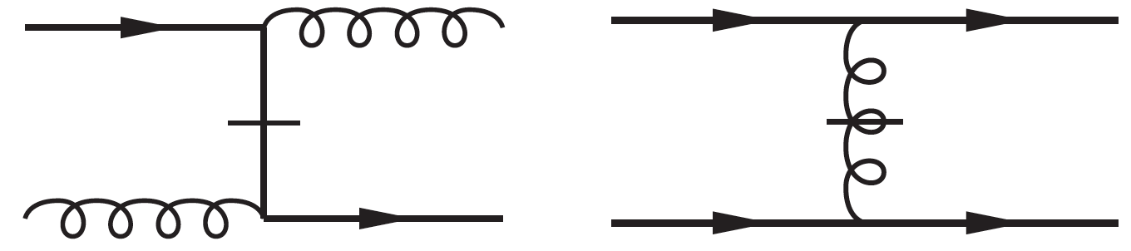

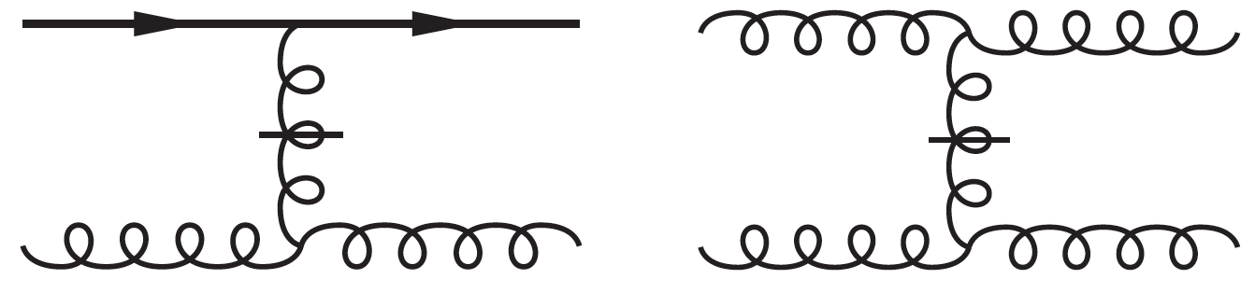
Light Front (LF) Hamiltonian Defined by its
Elementary Vertices in LF Gauge
QED & QCD
QCD
Notes:
Now in: LC2017_Vary_Mumbai_full_updated.pptx
darker images are from Yang Li’s 2016 Florida talk
Shown in LC2016-Lisbon
Shown in LC2017 – Mumbai
Shown in LC2018 - JLAB
Resides in file: LC2019_Vary_Paris_full_updated.pptx
Shown at LC2019
Shown in LC2021 – File: LC2021_Vary_Jeju_Korea
Adapted from PHYS526 file: 12-LC2023_BLFQ.pptx

Slide 5
Discretized Light Cone Quantization
[H.C. Pauli & S.J. Brodsky, PRD32 (1985)]
Basis Light Front Quantization
[J.P. Vary, et al., PRC81 (2010)]
Orthonormal:
Complete:
For mesons we adopt (later extended to baryons):
[Y. Li, et al., PLB758 (2016)]
Notes:
New version for LC2018 – specific to hadrons
*J.P. Vary, et al., PRC81, 035205 (2010).
**Y. Li, et al., PLB758, 118 (2016).
Shown at LC2018, May 2018, JLAB
Modified and shown at LC2019, Paliseau, France
Resides in file: LC2019_Vary_Paris_full_updated.pptx
Shown at LC2019 and LC2021
File: LC2021_Vary_Jeju_Korea_final.pptx
Adapted from PHYS526 file: 12-LC2023_BLFQ.pptx

Slide 6
BLFQ
Symmetries & Constraints
All J ≥ J_{z} states
in one calculation
Finite basis
regulators
Preserve transverse
boost invariance
Notes:
Shown in LC2016-Lisbon
Shown in LC2017-Mumbai
Updated in LC2018 to include Longitudinal mode regulator
Shown at LC2018, May 2018, JLAB
Resides in file: LC2019_Vary_Paris_full_updated.pptx
File: Phys624_from_LC2019_Vary_Paris.pptx
Updated to add last line for transverse motion boost invariance and for convenience of relative motion 2DHO basis
for the two-fermion applications (Li, et al.,)
Shown at LC2019 and LC2021
File: LC2021_Vary_Jeju_Korea_final.pptx
Adapted from PHYS526 file: 12-LC2023_BLFQ.pptx

Slide 7
Notes:
Adapted from file: YangLi_StrongInteraction_Lecture_Phys625.pdf – page 9
Earlier version shown in LC2017 – Mumbai
This version is updated for LC2018
Shown at LC2018, May 2018, JLAB
Resides in file: LC2019_Vary_Paris_full_updated.pptx
Shown at LC2019 and at LC2021
File: LC2021_Vary_Jeju_Korea_final.pptx
File: Granada_Hamiltonian_Methods_Vary
Note that DIS and DVCS are two processes depicted to leading order in the two small diagrams at the upper
left and upper right of the “integration flow chart” for various ”distributions” of experimental interest
Adapted from PHYS526 file: 12-LC2023_BLFQ.pptx

Slide 8
Research results from BLFQ as of LC2024
There have been ~60 papers on BLFQ and tBLFQ from 2010 – present.
Of these, 48 have either “Basis Light-Front Quantization” or “BLFQ” in the title.
Since 2020, the “BLFQ Collaboration” has posted ~ 30 papers on the arXiv
and has ~27 published plus accepted papers.
This year, to date, the BLFQ Collaboration has posted 9 papers to the arXiv:
5 have been published with one more accepted for publication. 3 are submitted
for publication and are under review.
LC2024 Talks – Yiping Liu, Tianyang Hu, Chandan Mondal, Meijian Li, Wenyang Qian,
Sreeraj Nair, Zhi Hu, Satvir Kaur, Lingdi Meng, Tiancai Peng, . . .
Notes:
The “BLFQ Collaboration” has an h-index = 14.

Slide 9
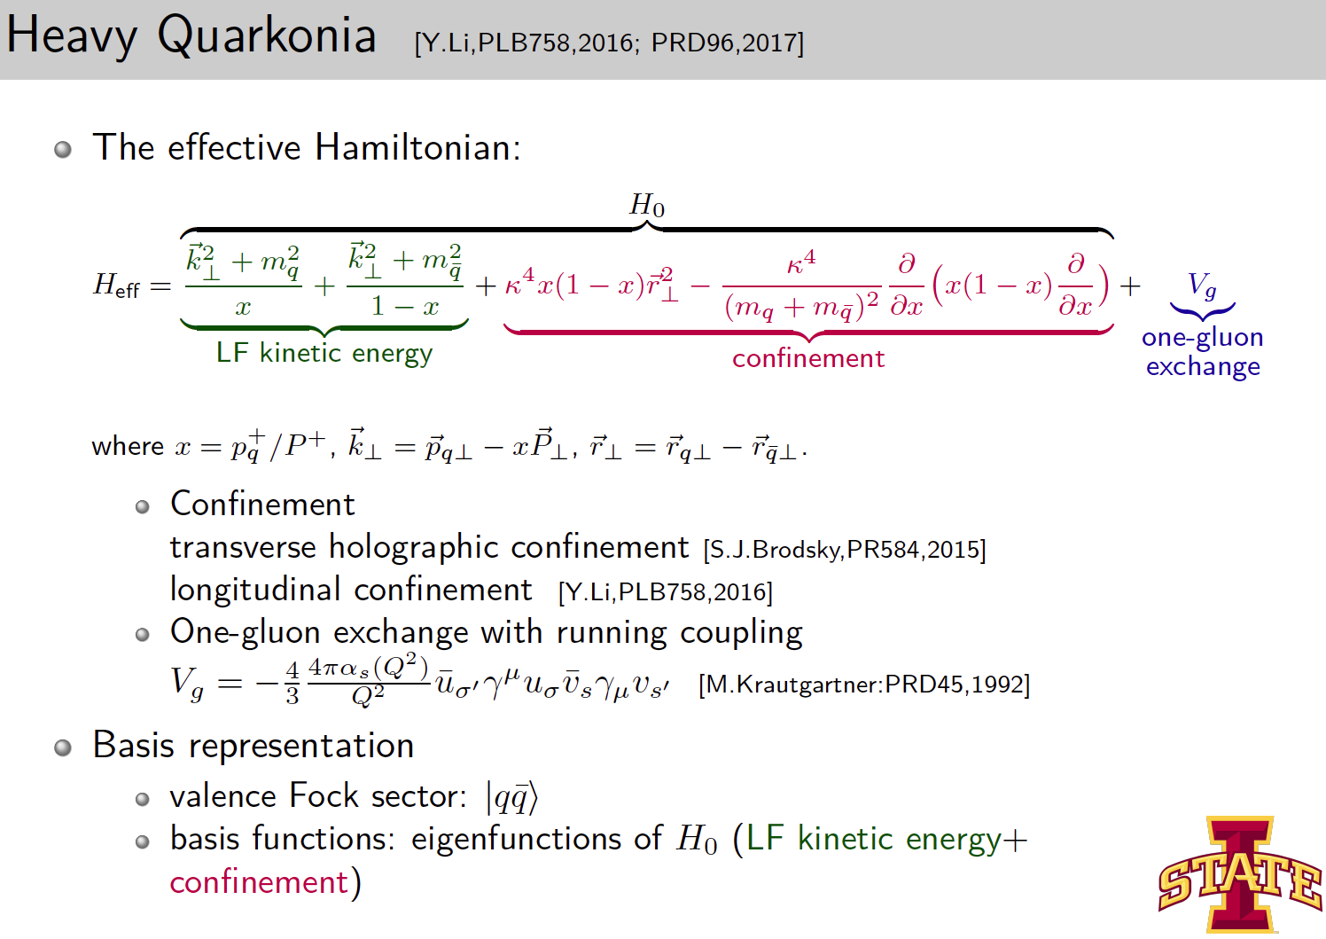
_
Effective Hamiltonian in the qq sector
Notes:
Page 13 of Meijian Li’s Oral Prelim exam. File: Preliminary_Meijian.pdf
This is a screen-shot version – take a pdf version and crop it . . . for LC2018
Appears in LC2018_
Vary_JLAB_full_updated.pptx
Shown at LC2018, May 2018, JLAB
Resides in file: LC2019_Vary_Paris_full_updated.pptx
Shown at LC2019 & LC2021
But updated for Phys624 class with additional relations among the variables
File: LC2021_Vary_Jeju_Korea_final.pptx
Adapted from PHYS526 file: 12-LC2023_BLFQ.pptx

Slide 10
[Y. Li, et al., Phys. Letts. B 758, 118 (2016); Phys. Rev. D 96, 016022 (2017)]
Notes:
Adapted from file: YangLi_StrongInteraction_Lecture_Phys625.pdf – page 28
Not shown at LC2021 Jeju, Korea
File: LC2021_Vary_Jeju_Korea
From: ECTstar_Tomography_Vary_revised_full.pptx
From: IGFAE_Santiago_de_Compostela_BLFQ_Vary_Full.pptx
JV: Be sure to improve the citation in blue font above: did this after the talk . . .
Note that there are more than 30 quarkonia states from PDG shown here
JV-F24: Note that Nmax = K = 32
Adapted from PHYS526 file: 12-LC2023_BLFQ.pptx

Slide 11
Tianyang Hu on Charmonium
LC2024: Tuesday @ 16:20
Notes:
From File: TianyangHu_charmonium_GFFs_results.pdf

Slide 12
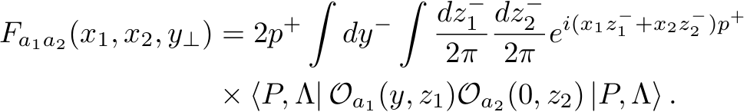
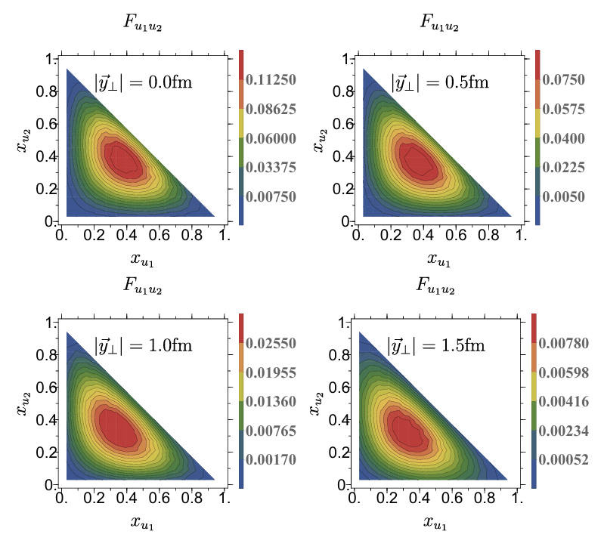
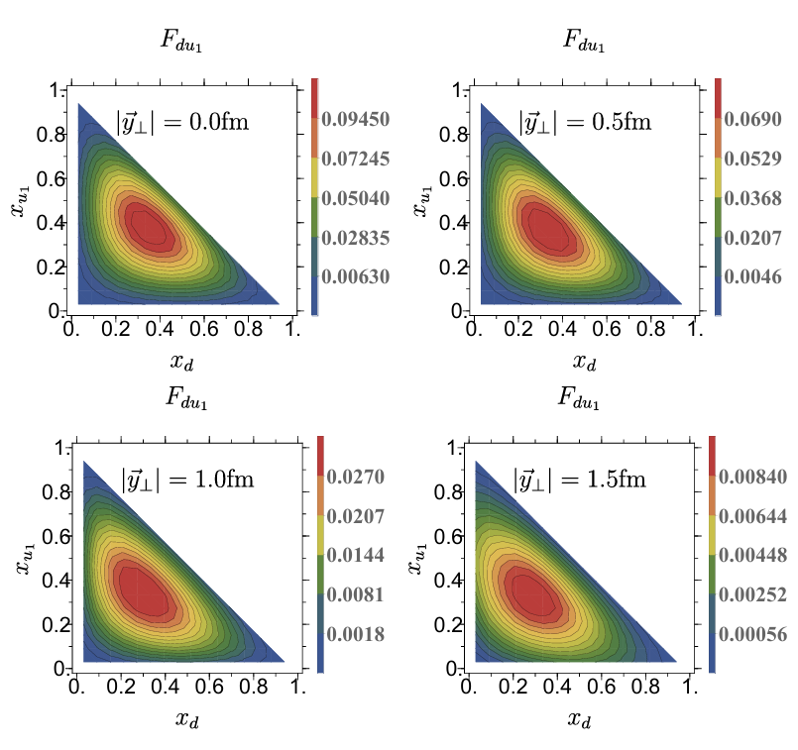
Double parton distributions (DPDs) of the proton
from basis light-front quantization in valence sector
[arXiv:2410.11574]
Tian-Cai Peng
17:30, Nov 26th Parallel-1
Unpolarized u-u DPDs
Unpolarized d-u DPDs

Slide 13
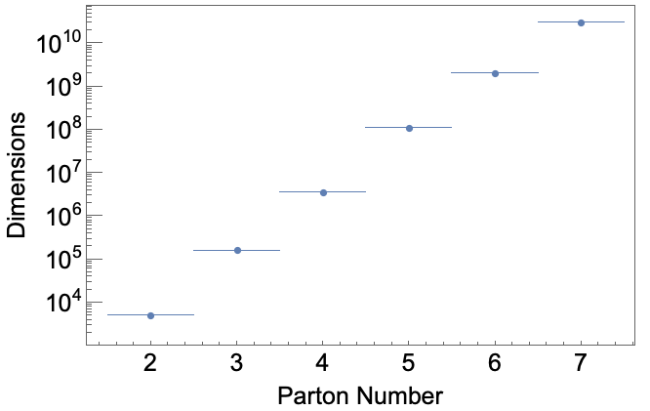
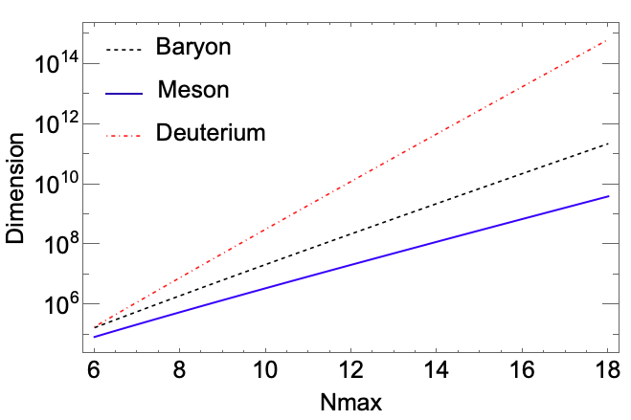

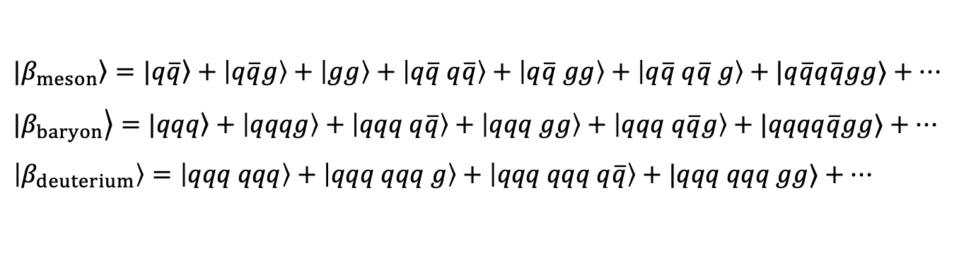
BLFQ Basis States
BLFQ basis: expansion in Fock space beyond the valence sector
$$|\left.β_{meson}\right\rangle =|\left.q\overline{q}\right\rangle +\left|q\overline{q}g\right\rangle +\left|gg\right\rangle +\left|q\overline{q} q\overline{q}\right\rangle +\left|q\overline{q} gg\right\rangle +\left|q\overline{q} q\overline{q} g\right\rangle +|q\overline{q}q\overline{q}gg⟩+…$$
$$|\left.β_{baryon}\right\rangle =|\left.qqq\right\rangle +\left|qqqg\right\rangle +\left|qqq q\overline{q}\right\rangle +\left|qqq gg\right\rangle +\left|qqq q\overline{q}g\right\rangle +|qqqq\overline{q}gg⟩+…$$
$$\left|β_{deuterium}\right\rangle =\left|qqq qqq\right\rangle +\left|qqq qqq g\right\rangle +\left|qqq qqq q\overline{q}\right\rangle +|qqq qqq gg⟩+…$$
Dimension of basis states increases with number of Fock sectors
=> motivation for quantum computing
$N_{max}=10$, $K_{max}$=16
= Kmax
Notes:
File: Siqi_Xu_EicC_CDR.pptx
From File: IGFAE_Santiago_de_Compostela_BLFQ_Vary_Full.pptx
Here, I interchanged the first two lines to achieve a more natural ordering
Adapted from PHYS526 file: 12-LC2023_BLFQ.pptx
Future improvements: Add which system (e.g. baryon) to the left panel and define the Fock space truncation for both panels.
Also, what is Kmax for the right panel? For example = Nmax?
Also, are only basis states that are global color singlets included?
Answers from Siqi’s email of 11/25/24:
Regarding the slides:
Left Panel: The basis dimensions shown are for each Fock sector, not specific to mesons or protons. For example, when the Parton number equals 3, it represents the qqq Fock sector only. In this calculation, we removed the color index, so the basis dimensions are the same whether it’s qqq or qq̅g.
Right Panel: This shows the basis dimensions for physical states. For mesons, this would include the sum of all Fock sectors, along with the color contributions. On the x-axis, I set Nmax = Kmax, so only Nmax is displayed.

Slide 14
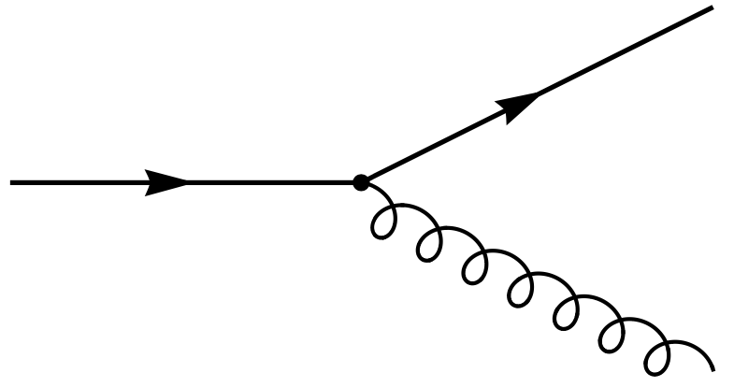
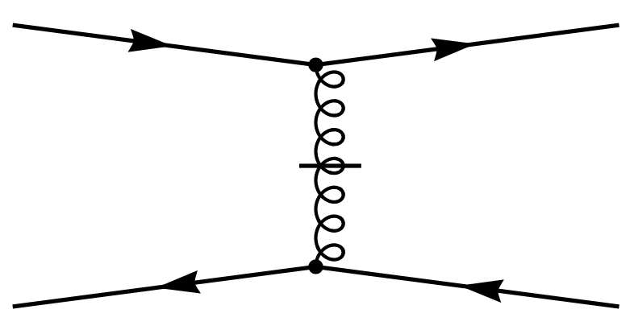
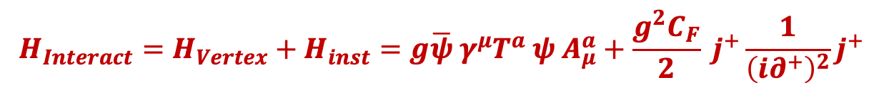
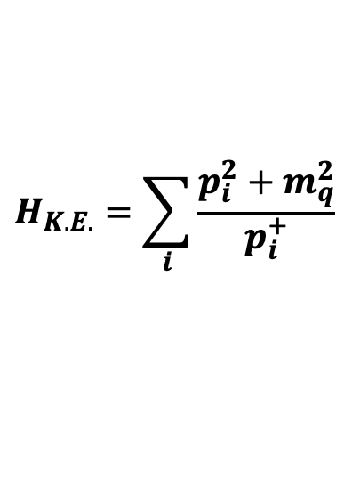
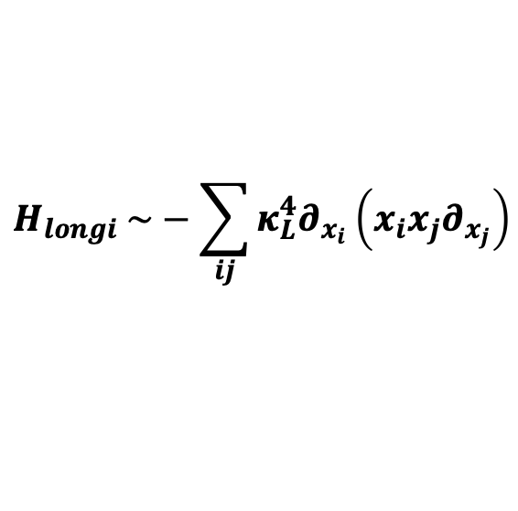
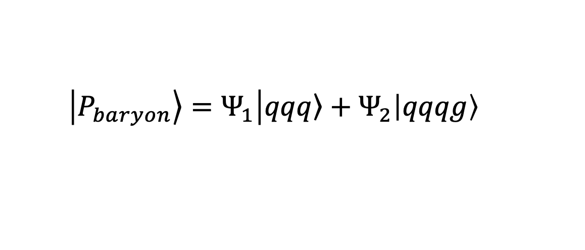

Baryons with one dynamical gluon
  $$\left|\left.P_{baryon}\right\rangle =Ψ_{1}\right|\left.qqq\right\rangle +Ψ_{2}\left|qqqg\right\rangle$$
$$P^{−}=H_{K.E.}+H_{trans}+H_{longi}+H_{Interact}$$
$$H_{K.E.}=\sum_{i}{\frac{p_{i}^{2}+m_{q}^{2}}{p_{i}^{+}}}$$
$H_{trans} \sim κ_{T}^{4}r^{2}$
-- Brodsky, Teramond arXiv: 1203.4025
$$H_{longi} \sim −\sum_{ij}{κ_{L}^{4}∂_{x_{i}}\left(x_{i}x_{j}∂_{x_{j}}\right)}$$
---Y Li, X Zhao , P Maris , J Vary, PLB 758(2016)
$$H_{Interact}=H_{Vertex}+H_{inst}=g\overline{ψ} γ^{μ}T^{a} ψ A_{μ}^{a}+\frac{g^{2}C_{F}}{2} j^{+}\frac{1}{{\left(i∂^{+}\right)}^{2}}j^{+}$$
Notes:
File: adapted from Siqi_Xu_EicC_CDR.pptx
File: Granada_Hamiltonian_Methods_Vary_vx.pptx
File: IGFAE_Santiago_de_Compostela_BLFQ_Vary_Final.pptx
Adapted from PHYS526 file: 12-LC2023_BLFQ.pptx

Slide 15
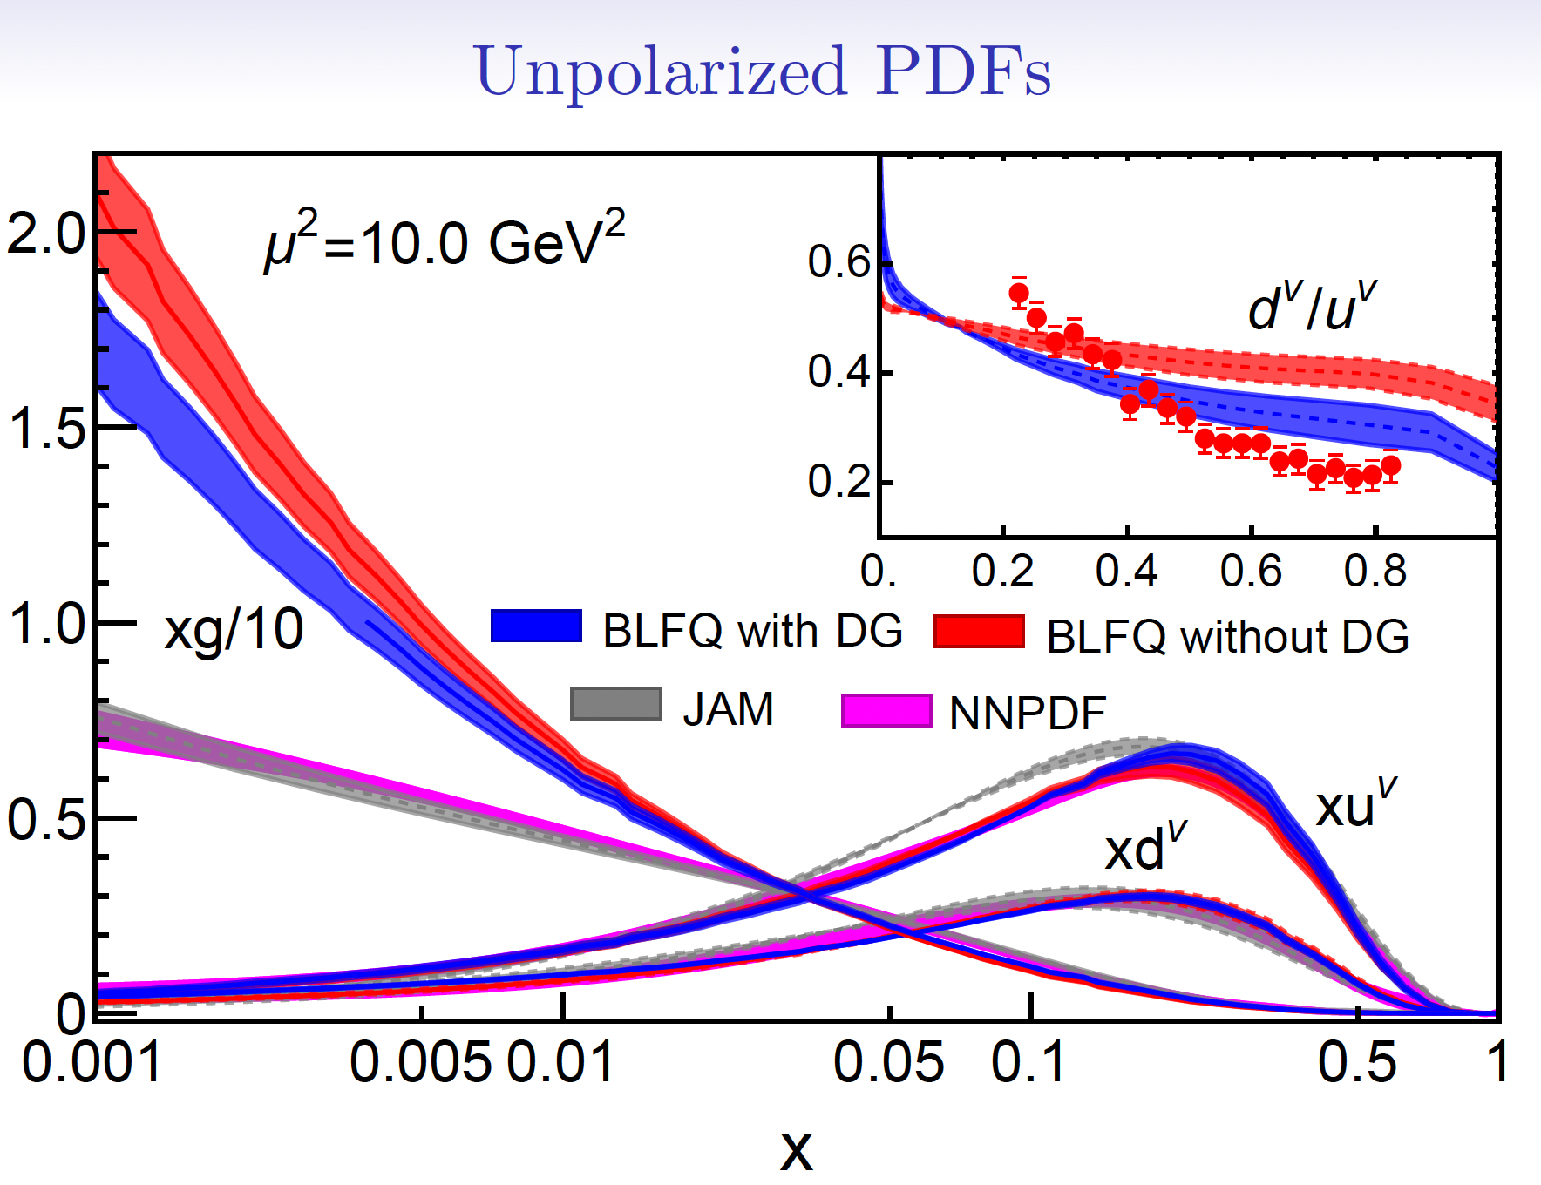


Proton Unpolarized PDFs
$$μ_{0}^{2}=0.19±0.02 GeV^{2}$$
$$μ_{0}^{2}=0.24±0.01 GeV^{2}$$
JAM and NNPDF are global fits to experimental data
[EPJC 77 (2017) 663]
With the dynamical gluon Fock sector, the gluon distribution is closer to the global fits
S. Xu, C. Mondal, X. Zhao, Y. Li, J. P. Vary, Phys. Rev. D 108, 094002 (2023); 2209.08584 [hep-ph].
Notes:
Updated with reference for LC2024
File: Siqi_Xu_EicC_CDR.pptx
Nmax = 9
K = 16.5
Assume that our 8 parameters absorb all renormalization effects
File: IGFAE_Santiago_de_Compostela_BLFQ_Vary_Final.pptx
File: IMP-CAS_Lanzhou_BLFQ_Vary_Final.pptx (with modified wording in the next-to-last line)
Figure updated from Chandan Mondal’s talk at LC2023 – Note that the global fits are different from the one used in previous talks.
Adapted from PHYS526 file: 12-LC2023_BLFQ.pptx

Slide 16
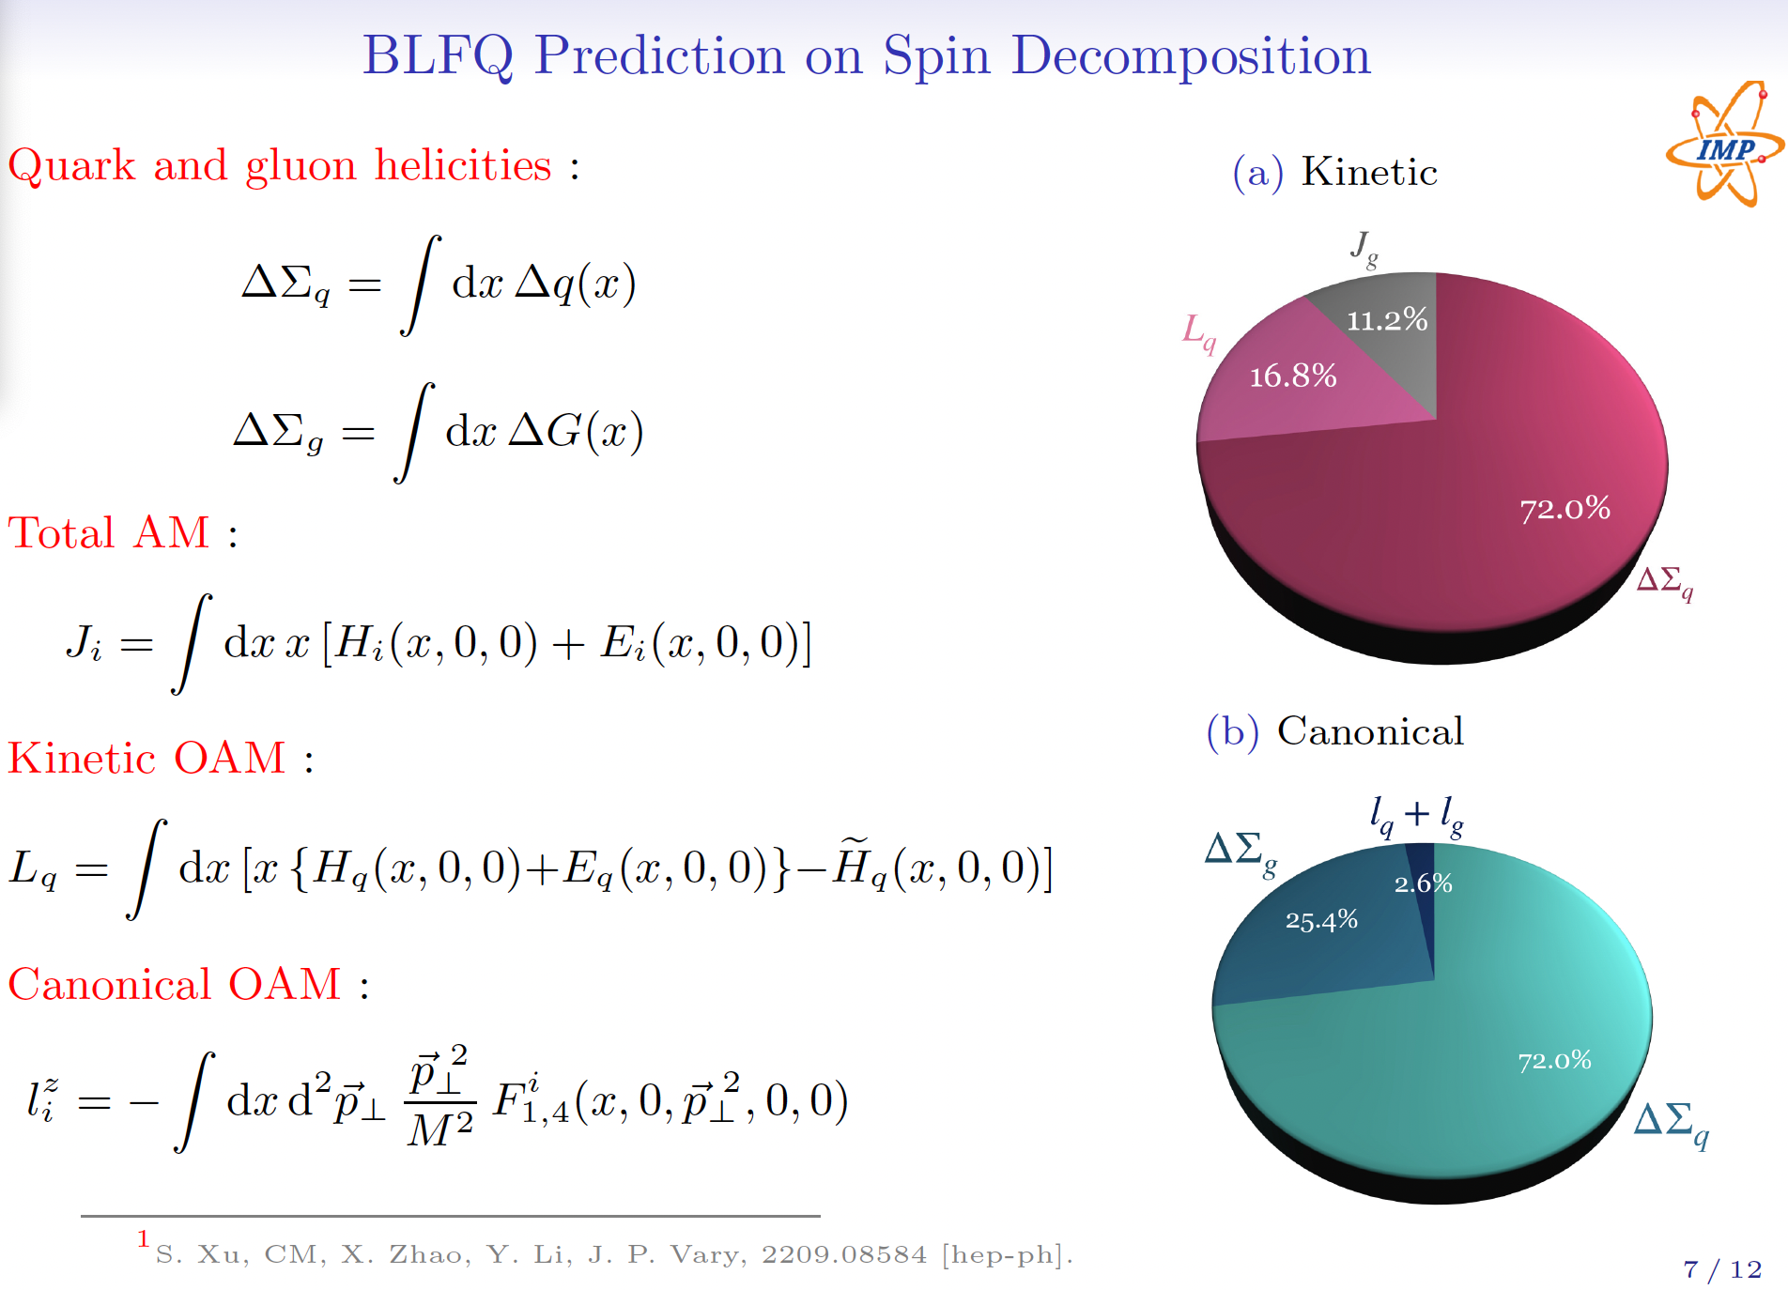
S. Xu, C. Mondal, X. Zhao, Y. Li, J. P. Vary, Phys. Rev. D 108, 094002 (2023); 2209.08584 [hep-ph].
Notes:
Updated with publication info for LC2024
Updated version from File: Chandan_LC2023.pdf
Adapted from PHYS526 file: 12-LC2023_BLFQ.pptx

Slide 17
Sreeraj Nair, LC2024: Tuesday@16:00
Notes:
From file: sreeraj_lc2024_jpv.pdf
What Fock sector truncation? What Nmax and Kmax?

Slide 18
Sreeraj Nair, LC2024: Tuesday@16:00
Notes:
From file: sreeraj_lc2024_jpv.pdf

Slide 19
SU(3) Sea included
Major Change:
Only QCD Terms
Notes:
From file: XingboZhao_Meson_USA20240627V2_XZ_240627.pdf

Slide 20
Notes:
From file: XingboZhao_Meson_USA20240627V2_XZ_240627.pdf

Slide 21
SU(3) Sea included
Notes:
From file: XingboZhao_Meson_USA20240627V2_XZ_240627.pdf

Slide 23
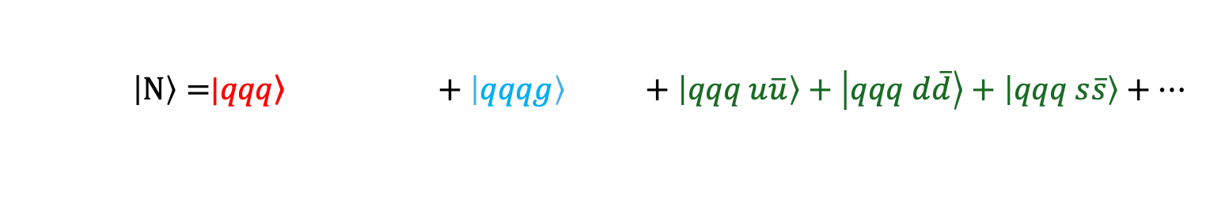
Progress toward First Principles
  $\left|N\right\rangle =$|$\left.qqq\right\rangle +\left|qqqg\right\rangle +\left|qqq u\overline{u}\right\rangle +\left|qqq d\overline{d}\right\rangle +\left|qqq s\overline{s}\right\rangle +…$
Wave Functions:
[PRD,102,016008] (2019)
[PRD,108 9, 094002] (2023)
[arXiv:2408.11298] (2024)
GPDs:
[PRD,104,094036] (2021)
[PRD,105,094018] (2022)
[PRD,109,014015] (2024)
[PLB,855,138809] (2024)
[PLB,847,138305] (2023)
[PRD,110.056027] (2024)
[PLB accepted; arXiv:2408.09988] (2024)
TMDs:
[PLB,833,137360] (2022)
[PRD,108,036009] (2023)
[PLB,855 138831] (2024)
Higher-twist Distribution (GPD,TMD,DPD):
[PRD,109,034031] (2024)
[PLB,855 138829] (2024)
[arXiv:2410.11574] (2024)
Gravitational Form Factors:
[PRD,110,056027] (2024)
Notes:
From File: for_prof_zhao_20241109 . . .

Slide 24
Chandan Mondal: Wednesday at 14:00
Notes:
From File: Chandan_Proton_with_glue_and_sea.pdf
JV: The vertices in the red boxes are active with a dynamical gluon as in the current application

Slide 25
Chandan Mondal: Wednesday at 14:00
Notes:
From File: Chandan_Proton_with_glue_and_sea.pdf

Slide 26
Chandan Mondal: Wednesday at 14:00
Notes:
From File: Chandan_Proton_with_glue_and_sea.pdf

Slide 27
Chandan Mondal: Wednesday at 14:00
Notes:
From File: Chandan_Proton_with_glue_and_sea.pdf

Slide 28
Chandan Mondal: Wednesday at 14:00
Helicity
Transversity
Notes:
From File: Chandan_Proton_with_glue_and_sea.pdf

Slide 29
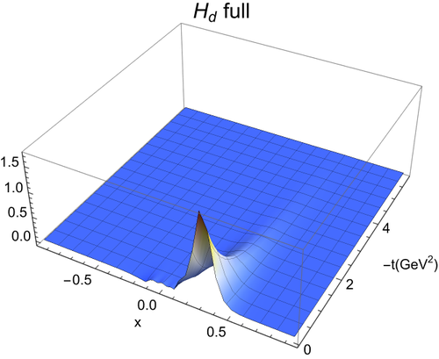
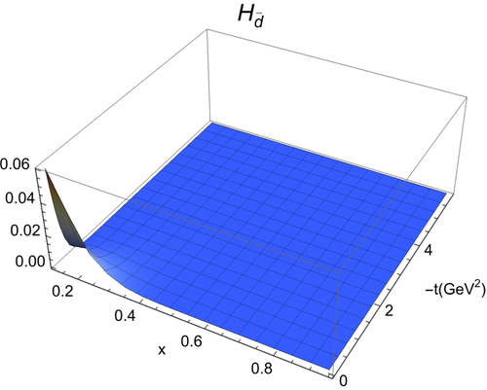
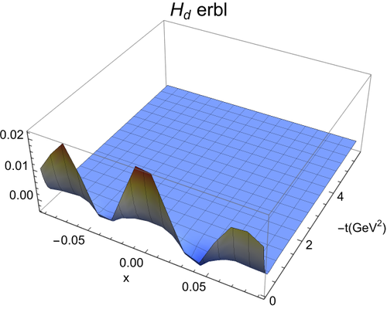

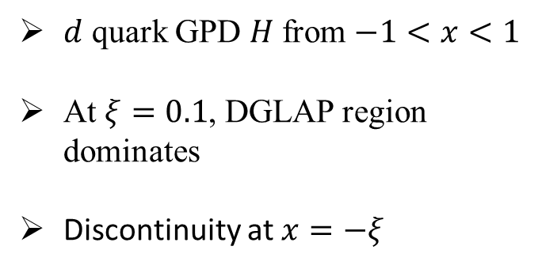
Yiping Liu, LC2024: Monday@17:40
GPDs at $ξ=0.1$
We use symmetric frame
$d$ quark GPD $H$ from $−1<x<1$
At $ξ=0.1$, DGLAP region dominates
Discontinuity at $x=−ξ$
Notes:
From File: Yiping Liu some slides.ppt
WHAT SYSTEM AND WITH WHAT FOCK SPACES ETC

Slide 30
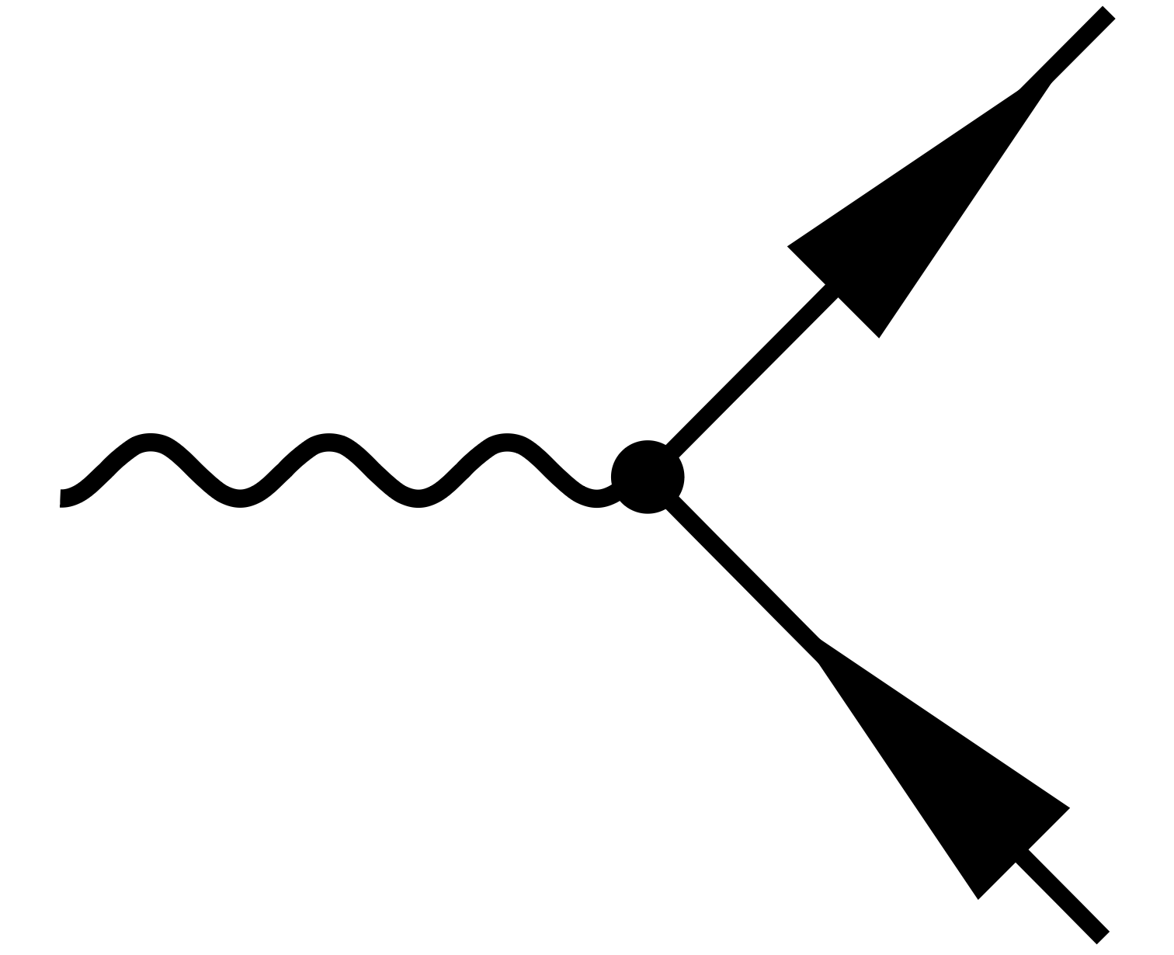
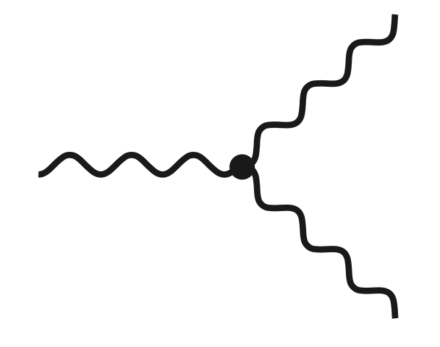
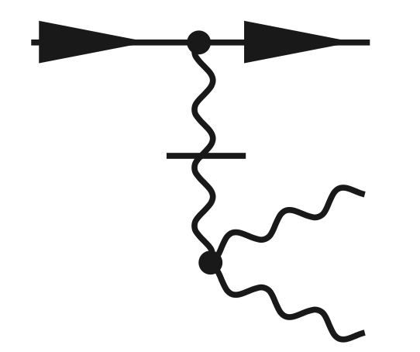
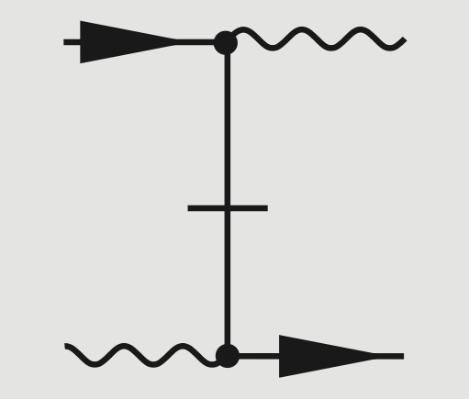
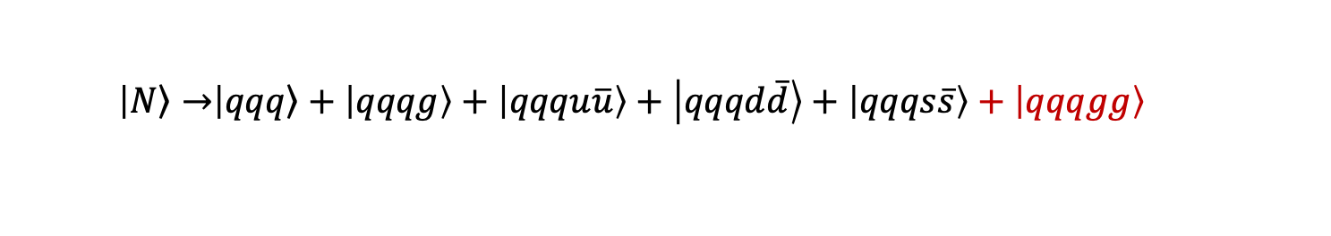
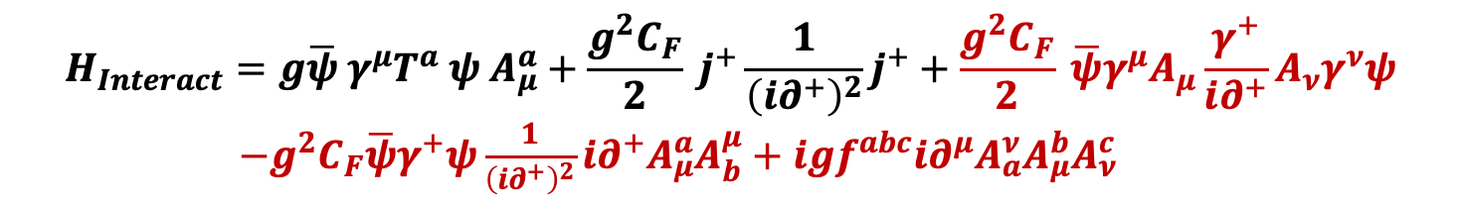
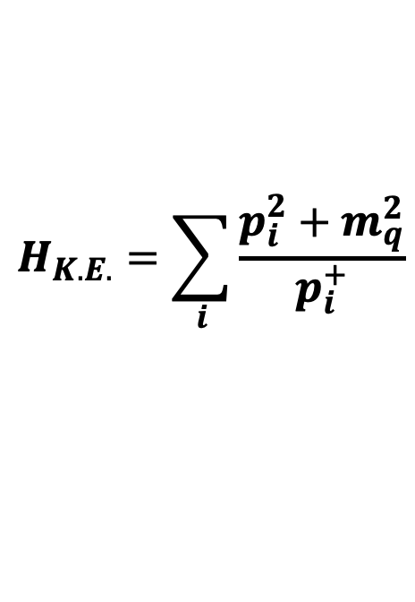

Full BLFQ
  $$\left|\left.N\right\rangle →\right|\left.qqq\right\rangle +\left|qqqg\right\rangle +\left|qqqu\overline{u}\right\rangle +\left|qqqd\overline{d}\right\rangle +\left|qqqs\overline{s}\right\rangle +\left|qqqgg\right\rangle$$
$$P^{−}=H_{K.E.}+H_{Interact}$$
Preliminary
Further progress
towards first principles
$$H_{K.E.}=\sum_{i}{\frac{p_{i}^{2}+m_{q}^{2}}{p_{i}^{+}}}$$
$$H_{Interact}=g\overline{ψ} γ^{μ}T^{a} ψ A_{μ}^{a}+\frac{g^{2}C_{F}}{2} j^{+}\frac{1}{{\left(i∂^{+}\right)}^{2}}j^{+}+\frac{g^{2}C_{F}}{2} \overline{ψ}γ^{μ}A_{μ}\frac{γ^{+}}{i∂^{+}}A_{ν}γ^{ν}ψ$$
$−g^{2}C_{F}\overline{ψ}γ^{+}ψ\frac{1}{{\left(i∂^{+}\right)}^{2}}i∂^{+}A_{μ}^{a}A_{b}^{μ}+igf^{abc}i∂^{μ}A_{a}^{ν}A_{μ}^{b}A_{ν}^{c}$
Notes:
From File: for_prof_zhao_20241109 . . .

Slide 31
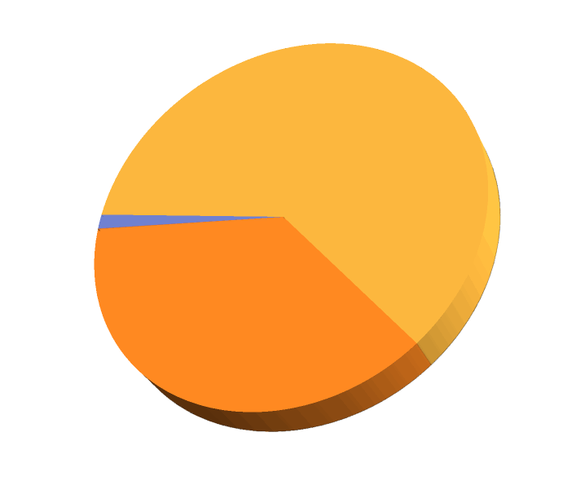
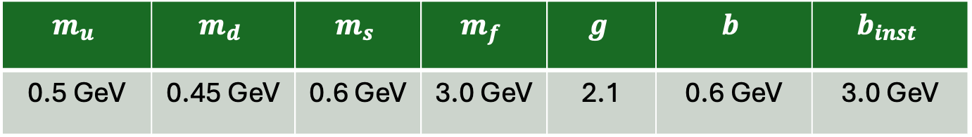

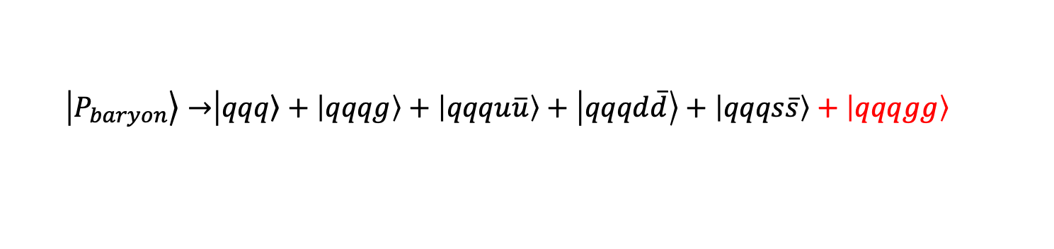


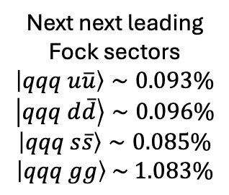




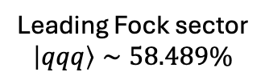


Fock Sector Decomposition
  $$\left|\left.P_{baryon}\right\rangle →\right|\left.qqq\right\rangle +\left|qqqg\right\rangle +\left|qqqu\overline{u}\right\rangle +\left|qqqd\overline{d}\right\rangle +\left|qqqs\overline{s}\right\rangle +\left|qqqgg\right\rangle$$
Preliminary
$\left|qqq q\overline{q}\right\rangle \sim 3$ color singlet state
Leading Fock sector
$$\left|qqq\right\rangle ∼58.489\%$$
1 singlet $⨂$ singlet
2 octet $⨂$ octet
Next next leading
Fock sectors
$$\left|qqq u\overline{u}\right\rangle ∼0.093\%$$
$$\left|qqq d\overline{d}\right\rangle ∼0.096\%$$
$$\left|qqq s\overline{s}\right\rangle ∼0.085\%$$
$$\left|qqq gg\right\rangle \sim 1.083\%$$
$\left|qqq gg\right\rangle \sim 6$ color singlet state
1 singlet $⨂$ singlet
4 octet $⨂$ octet
Next leading Fock sector
$$\left|qqqg\right\rangle ∼40.154\%$$
1 decuplet $⨂$ octet $⨂$ octet
$$m_{u}$$ | $$m_{d}$$ | $$m_{s}$$ | $$m_{f}$$ | $$g$$ | $$b$$ | $$b_{inst}$$
0.5 GeV | 0.45 GeV | 0.6 GeV | 3.0 GeV | 2.1 | 0.6 GeV | 3.0 GeV
Truncation parameter: $N_{max}=7$ and $K_{max}=10$
Notes:
From File: for_prof_zhao_20241109 . . .

Slide 32
Summary and Outlook
Basis Light Front Quantization approach to mesons and baryons
yields competitive descriptions and predictions
Bound states and transitions of hadrons are described
New advances towards first principles calculations
Plan: continue to expand the Fock spaces (e.g. more gluons)
Plan; include three-gluon and four-gluon vertices
Plan: continue to develop renormalization & counterterms
Efficient utilization of supercomputing resources
Well-positioned to exploit advances in quantum computing
Thank you for your attention
Notes:
Now in: LC2017_Vary_Mumbai_full_updated.pptx
Shown in LC2017-Mumbai
Edited this for LC2018
Expanding the Fock space brings in the self-energy contributions
Where to mention renormalzation approaches such as RGPEP, OLS, SRG, . . . .
Shown at LC2018, May 2018, JLAB
Removed one bullet: Future – additional methods for emergent phenomena
Resides in file: LC2019_Vary_Paris_full_updated.pptx
Shown at LC2019
Edited for LC2021
From File: LC2021_Vary_Jeju_Korea_final.pptx
File: IGFAE….
Added new first bullet for QED + QCD version of the talk
File: IMP-ZcAS_Lanzhou . . .
Improved the 5th bullet
Adapted from PHYS526 file: 12-LC2023_BLFQ.pptx

