Slide 1




Electron Ion Collider in China:
based on the HIAF project
Jiancheng Yang and Lijun Mao
On behalf of the HIAF project group
Institute of Modern Physics (IMP)
Chinese Academy of Sciences (CAS)

Slide 2
Outline
General information of the HIAF
Technical challenges and construction status
Experimental terminals
Towards to the EicC
Conclusion

Slide 3
Outline
General information of the HIAF
Technical challenges and construction status
Experimental terminals
Towards to the EicC
Conclusion

Slide 4

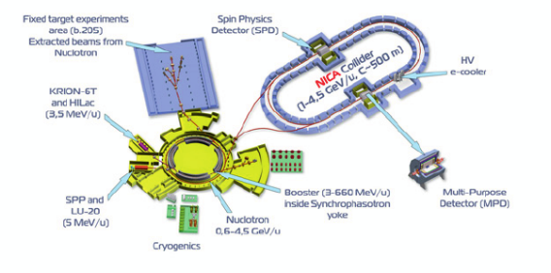
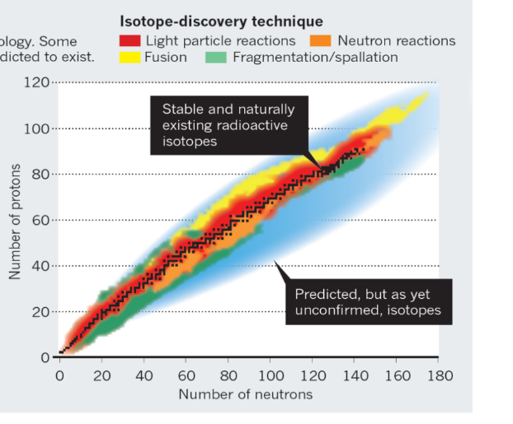
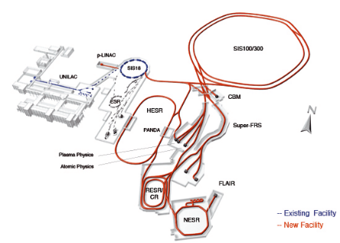
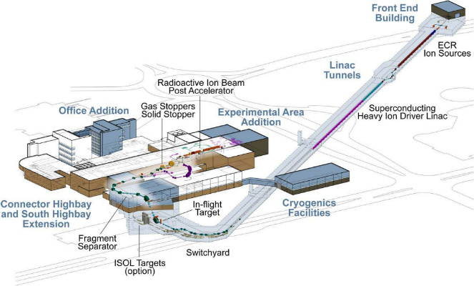
High-Intensity Heavy Ion Accelerator Facility-HIAF
Next-generation high intensity facilities are required for advances in nuclear physics and related research fields:
Fascinating and crucial questions
To explore the limit of nuclear existence
To study exotic nuclear structure
Understand the origin of the elements
NICA@JINR
Available today
To study the properties of High-Energy-Density Matter
FAIR@GSI
Next-generation facilities are being constructed
FAIR at GSI in Darmstadt, Germany
FRIB at MSU in the U.S.
NICA at JINR, Dubna, Russia
HIAF at IMP, China
FRIB@MSU

Slide 5
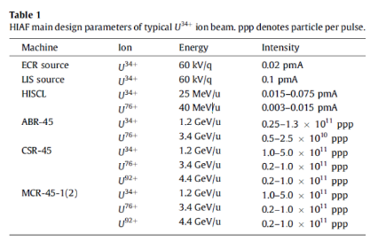
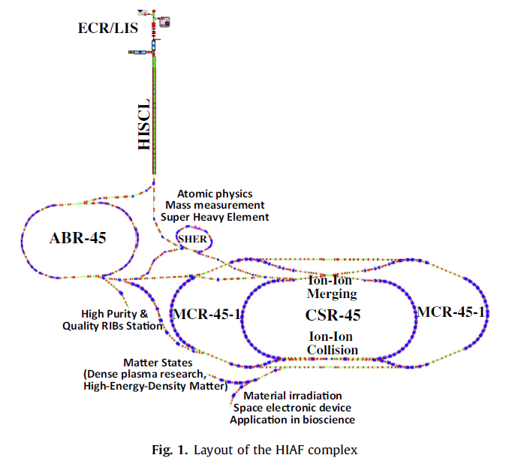
High-Intensity Heavy-Ion Accelerator Facility-HIAF
Jul. 2010
May 2011
Dec. 2015
Apr. 2017
Jun. 2018
Aug. 2023
Dec. 2024
Approval
Start-up of construction
Installation
Commissioning
Proposal
Assessment
Budget
Nuclear physics
First idea of electron-ion collider
Merging beams

Slide 6
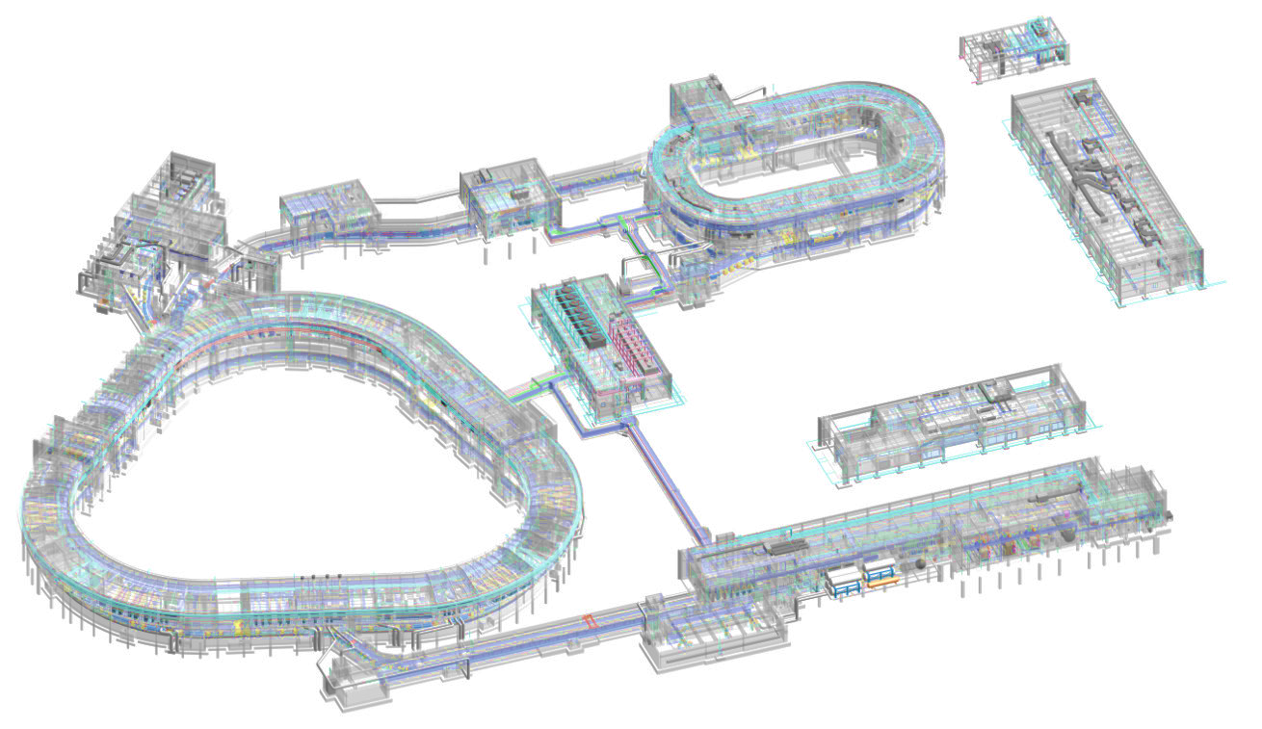
High-Intensity Heavy Ion Accelerator Facility-HIAF
Accelerator components and experiment terminals
High energy experiment station
4
Radioactive beams physics station
HFRS: Radioactive beam line
5
High precision
spectrometer ring
Hyper nuclear physics
Phase diagram of strongly interacting matter
2
3
6
e-ion recombination
spectroscopy
SRing:
Spectrometer ring
Circumference: 273m
Rigidity: 13-15 Tm
BRing
Fast cycle ring
Circumference: 569 m
Rigidity: 34 Tm
SECR:
Superconducting
ECR source
iLinac:
Superconducting linac
Low energy nuclear structure and irradiation terminal
1

Slide 7
High-Intensity Heavy Ion Accelerator Facility-HIAF
HIAF main parameters
To provide very high intensity heavy ion beam
 | SECR | iLinac | BRing | HFRS | SRing
Length / circumference (m) | --- | 114 | 569 | 192 | 277
Final energy of U (MeV/u) | 0.014 (U³⁵⁺) | 17 (U³⁵⁺) | 835 (U³⁵⁺) | 800 (U⁹²⁺) | 800 (U⁹²⁺)
Max. magnetic rigidity (Tm) | --- | --- | 34 | 25 | 15
Max. beam intensity of U | 50 pμA (U³⁵⁺) | 28 pμA (U³⁵⁺) | 2×10¹¹ppp (U³⁵⁺) 6×10¹¹pps (U³⁵⁺) | ------- | (0.5-1) ×10¹²ppp (U⁹²⁺)
Operation mode | DC | CW or pulse | fast ramping (12T/s, 3Hz) | Momentum-resolution 1100 | DC, deceleration
Emittance or Acceptance (H/V, π·mm·mrad, dp/p) |  | 5 / 5 | 200/100, 0.5% | ±30mrad(H)/±15 mrad(V), ±2% | 40/40, 1.5% (normal mode)

Slide 8
High-Intensity Heavy Ion Accelerator Facility-HIAF
HIAF main parameters
More typical beams
BRing
SRing
Rigidity | 34Tm，fr=3Hz
Ion | Intensity (ppp) | Energy (GeV/u)
²³⁸U³⁵⁺ | 2.0×10¹¹ | 0.84
²³⁸U⁷⁶⁺ | 5.0×10¹⁰ | 2.5
¹²⁹Xe²⁷⁺ | 3.6×10¹¹ | 1.4
⁷⁸Kr¹⁹⁺ | 5.0×10¹¹ | 1.7
⁴⁰Ar¹²⁺ | 7.0×10¹¹ | 2.3
¹⁸O⁶⁺ | 8.0×10¹¹ | 2.6
p | 1.0×10¹³ | 9.3
Rigidity | 15 Tm
Ion | Intensity (ppp) | Energy (GeV/u)
²³⁸U⁹²⁺ | (1-5)×10¹¹ | 1.1
¹²⁹Xe⁵⁴⁺ | 3.6×5×10¹¹ | 1.2
⁷⁸Kr³⁶⁺ | 5.0×5×10¹¹ | 1.3
⁴⁰Ar¹⁸⁺ | 7.0×5×10¹¹ | 1.3
¹⁸O⁸⁺ | 8.0×5×10¹¹ | 1.3
p | 2.0×1×10¹³ | 3.5

Slide 9
Outline
General information of the HIAF
Technical challenges and construction status
Experimental terminals
Towards to the EicC
Conclusion
Notes:
Here is the outline of this report

Slide 10

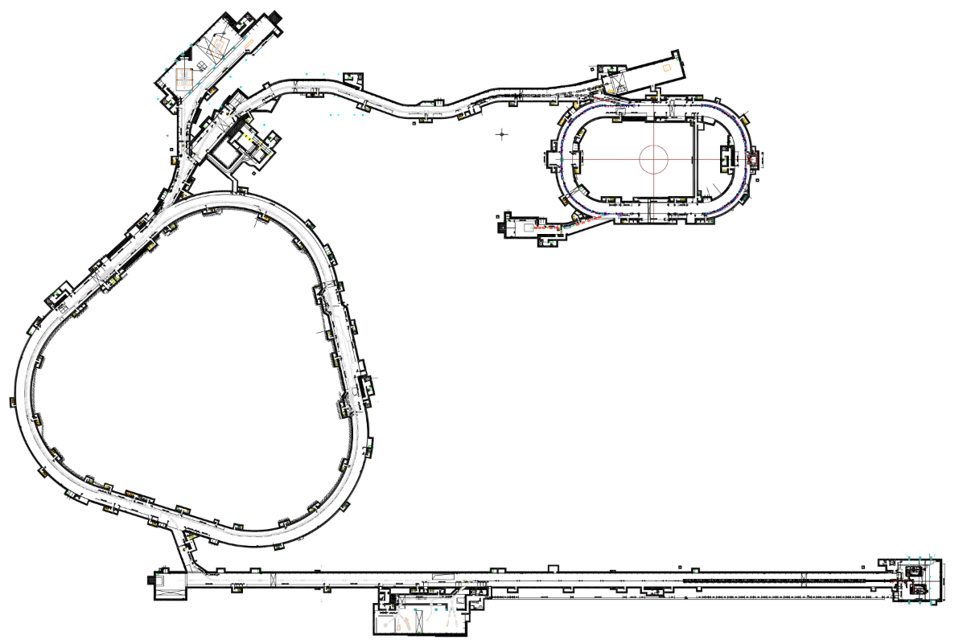
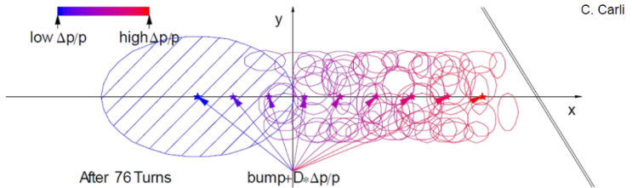
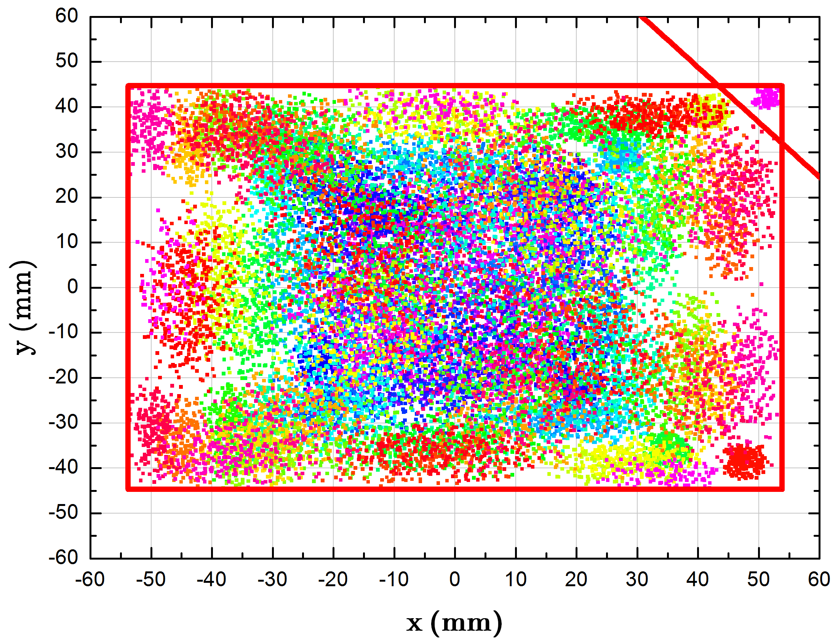
High intensity beam dynamics studies
Concepts for approaching the unprecedented heavy ion intensity
Stripper
3-5 times Barrier bucket
²³⁸U³⁵⁺
²³⁸U⁹²⁺
HFRS
SRing
1×10¹²ppp
²³⁸U⁹²⁺
Novel two planes painting injection scheme - 2.0×10¹¹ ppp (6×10¹¹pps)
Fast ramping rate - 12T/s
High repetition frequency - 3-5Hz
BRing
34 Tm
0.8 GeV/u (²³⁸U³⁵⁺)
Stacking longitudinally from BRing to SRing
Ions | Plane | Injection Turns | Single injection
²³⁸U³⁵⁺ | H | 33 | 3.3×10¹⁰
 | V | 16 | 1.6×10¹⁰
 | H+V | 150 | 2.0×10¹¹
iLinac
SECR
High current superconducting linac
Pulsed 28 pμA U³⁵⁺, U^{4x+}
CW 15 pμA U³⁵⁺
17 MeV/u
45 GHz superconducting ECR
Pulsed 50 pμA U³⁵⁺, U^{4x+}
CW 20 pμA U³⁵⁺
14 KeV/u
2.0 ×10¹¹ with two planes painting, nearly 10 times over the conventional single-plane injection.
Notes:
BRing is the most important component of the HIAF. With the superconducting ECR and iLinac, it is still not enough to achieve the high intensity for BRing. So we adopt the 4-D painting injection to the booster ring. Compare with the conventional multi-turn injection scheme, that only painting in the horizontal plane, this method can conduct both the horizontal and vertical painting simultaneous using a loss-corner septum . And a nearly 10 times over the conventional injection method can be achieved.
This is the simulating results and our design of the corner septum.

Slide 11
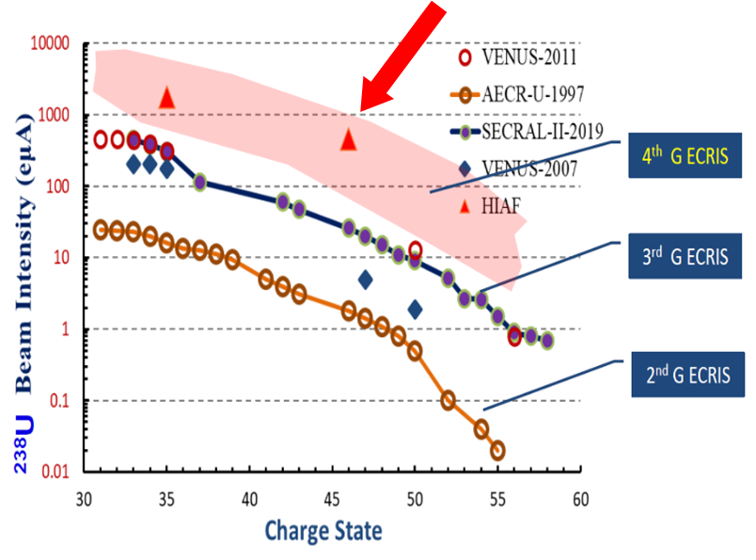
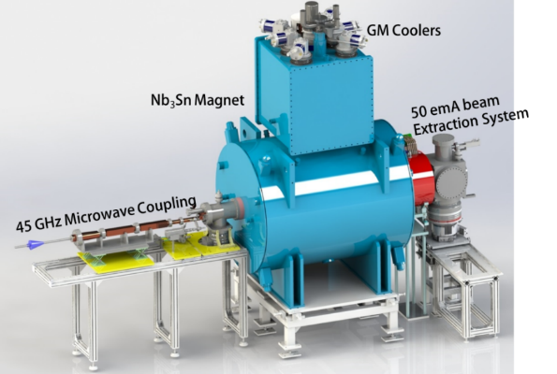
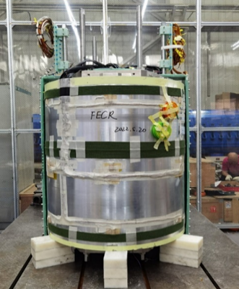
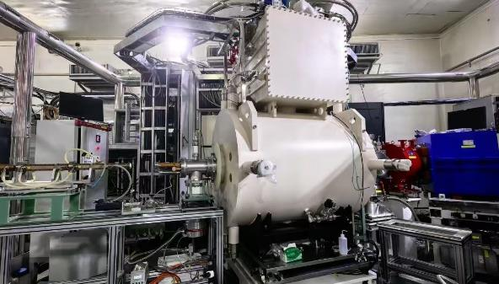
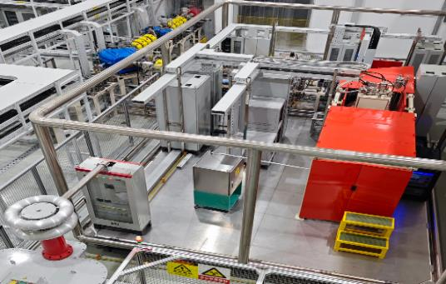
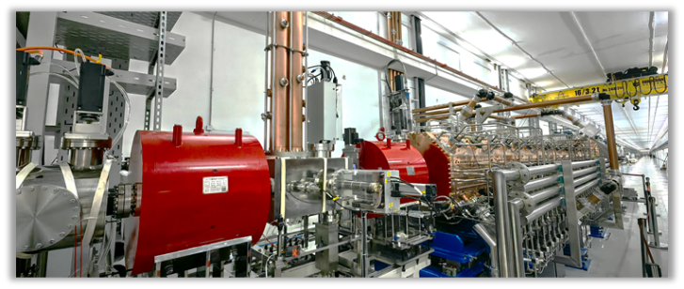
45 GHz superconducting ECR ion source
The first 45GHz superconducting ECR in the world: 50 pμA (U³⁵⁺)
The critical one is to fabricate a fully Nb₃Sn superconducting magnet
Full-sized cold mass
O6+ ions with 100uA accelerated by RFQ
FECR on the LEAF facility
The HV platform of ECR

Slide 12
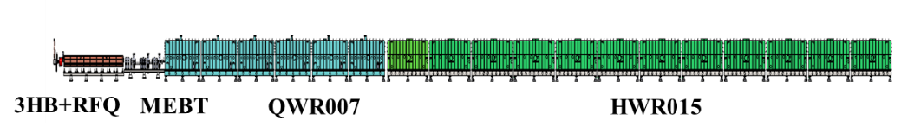
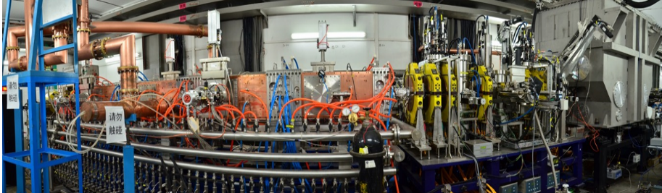
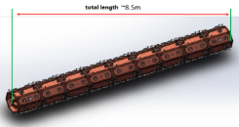
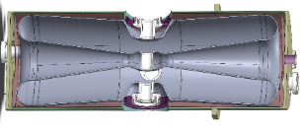
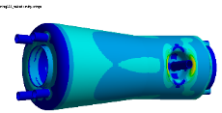
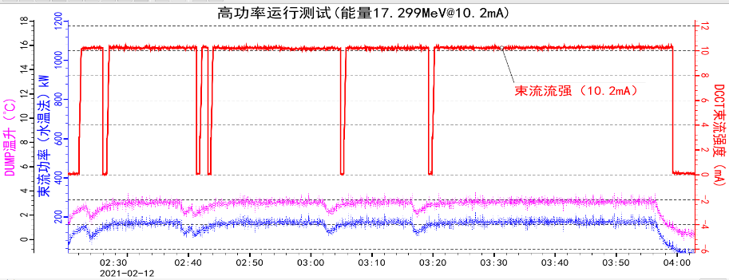
High current superconducting ion linac - iLinac
iLinac
Pulsed, 28 pμA U³⁵⁺
CW, 15 pμA U³⁵⁺
To BRing or Terminal 1
RFQ
QWR 007
HWR 015
ADS Demo
In order to demonstrate the SRF technologies, a 25MeV SC linac has been built
Several types of SC cavities have been developed
The CW beam power reached 200kW in 2021
Proton beam

Slide 13
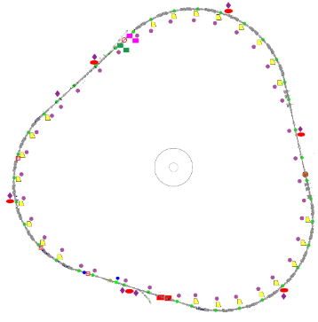
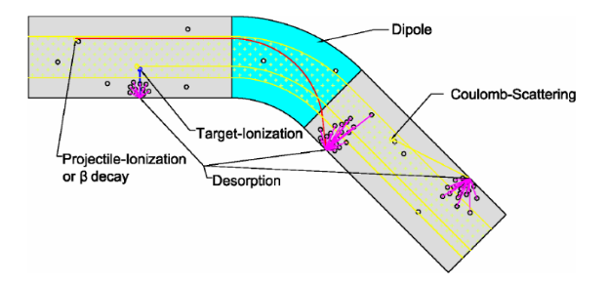
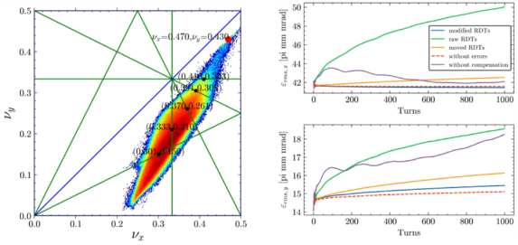
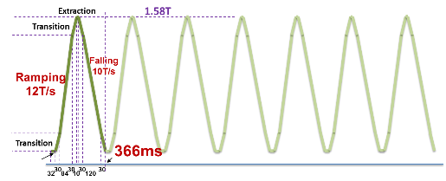
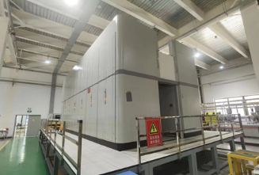
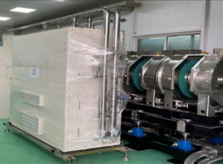
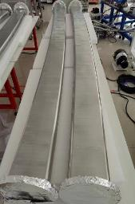
Fast cycle booster synchrotron BRing
Fast ramping rate mode
dynamic vacuum
BRing
Why？
Due to space charge and dynamic vacuum effect, beam should be launched to the high energy as soon as possible.
12T/s
38000A/s
Repetition rate：3-5 Hz, 5-10Hz
space charge
The highest ramping rate for heavy ion synchrotron, challenges for key system, such as power supply, RF and vacuum chamber
1. Fast ramping rate full energy storage power supply
2. Magnetic alloy core loaded RF system
3. Ceramic-lined thin wall vacuum chamber

Slide 14
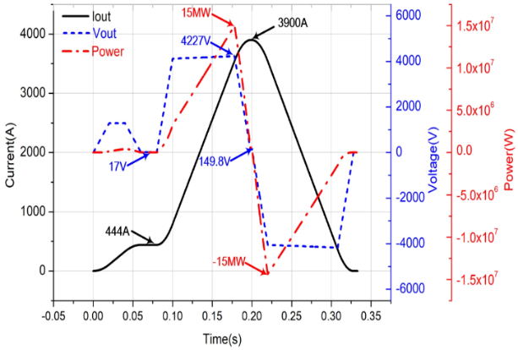
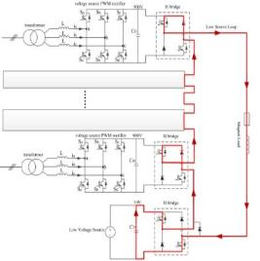
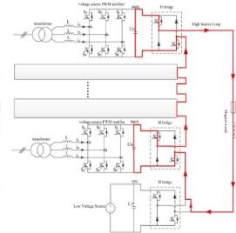
Fast ramping full energy storage power supply
Load specification and performance requirement of magnet power converters featured by fast ramping rate：12T/s, ±38000A/s, the peak power reaches ±230MW totally at full load
Items
Excitation current/voltage | 3900A/4300V
load inductance | 116mH
Load Resistance | 36.4mΩ
Current changing rate | ≤±38000A/s
Flat bottom error | ≤±0.2A
tracking error | ≤±0.2A
Flat top error | ≤±0.2A
Challenges:
High tracking precision and low current ripple, especially strong un-allowable line voltage fluctuation due to very large cyclic variation of reactive power
Parameters of BRing bending magnet power supply
Parameters of BRing bending magnet power supply
A innovative power supply topology are proposed for HIAF BRing ( variable forward excitation, full energy storage, PWM rectification technology )
Energy capacitor will be used to store energy during the falling, and provide the energy for next fast ramping
Energy from capacitor tank to magnet load
Energy from magnet load to capacitor tank
The energy can be controlled by PWM rectification technology, only active power will be taken from the grid!
Circuit diagram of bending magnet power supply

Slide 15
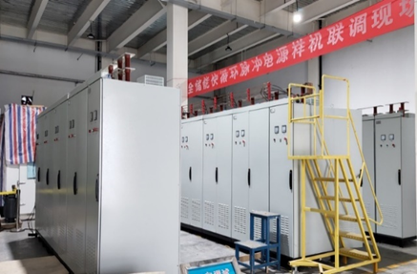
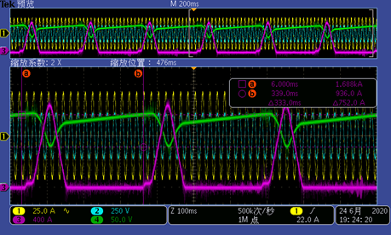
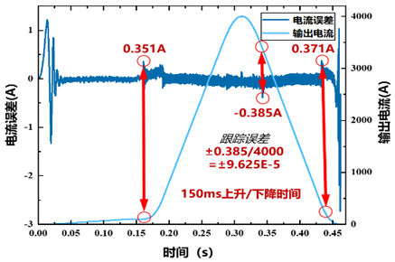
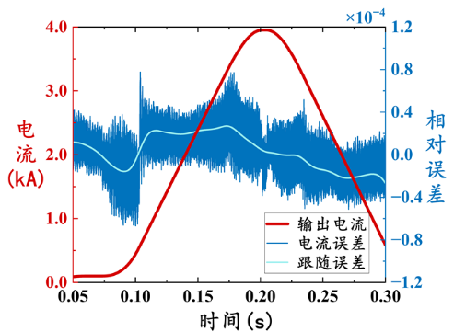
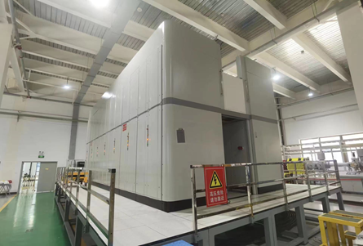
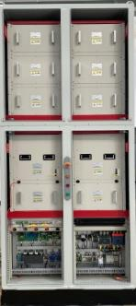
Key technical challenges and R&D
A full size prototype has been developed, the key technology and design of the power supply have been verified
First actual power supply of mass production, leading level performance has been achieved
Power requirement (MVA) | Conventional | Energy storage
BRing bendng magnet | 180 | 15
BRing quadruple magnet | 50 | 6
Total of BRing | 250 | 41
Total of HIAF | 297 | 88
Test results on the real magnet loads:
Current 4000A, ramping rate > 40000A/s, tracking error< ±9.625e-5, power requirement of power convertors for bending and quadrupole magnets will reduce from 230MVA to 21MVA

Slide 16
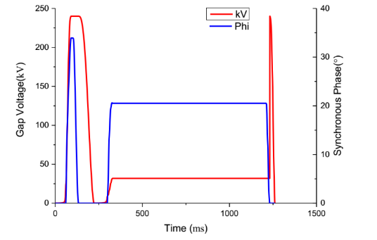
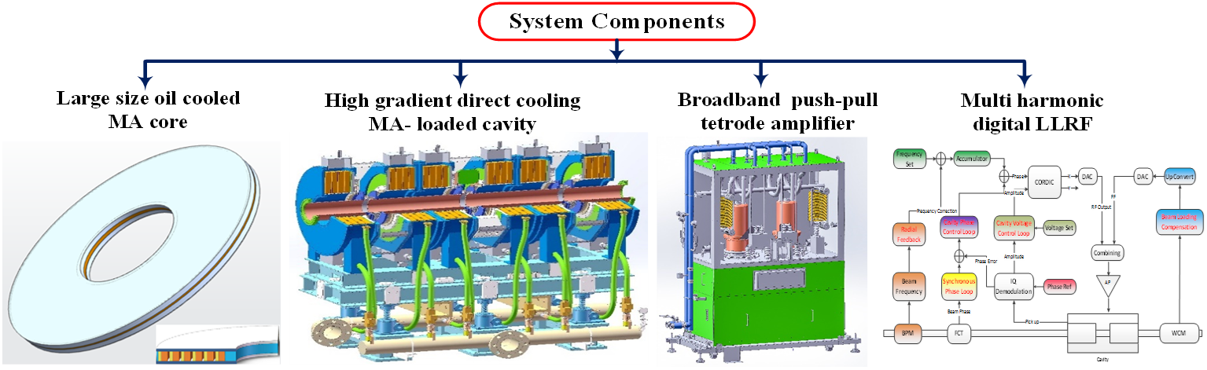
Magnetic alloy core loaded RF system
Short rise time( ≤10μs) for beam compression
High voltage: 240kV
MA RF system:
Compared with ferrite, MA cores have the characteristics of high gradient, wide band, and fast response
Not well established yet:
Fabrication of MA core module
Cooling of MA-loaded cavities operating at intense power dissipation
Voltage and phase waveform of BRing RF system
MA fabrication:
Q value: (0.65~0.3)@
(0.1~20MHz), μ’_{p}Q_{f} :5.3GHz @0.3MHz

Slide 17
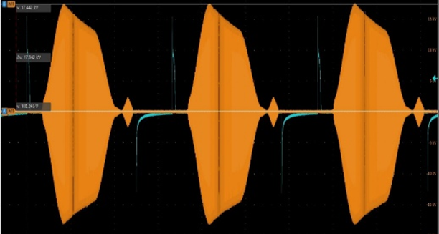
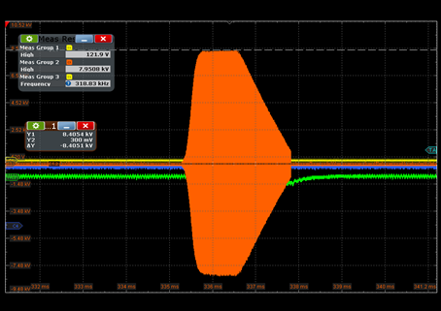
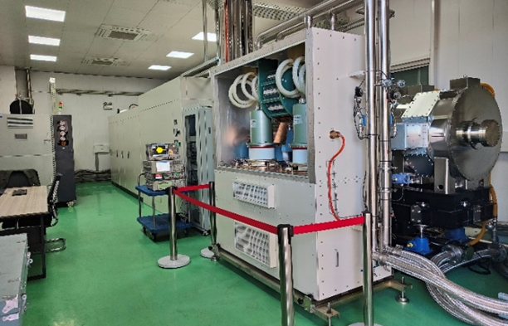
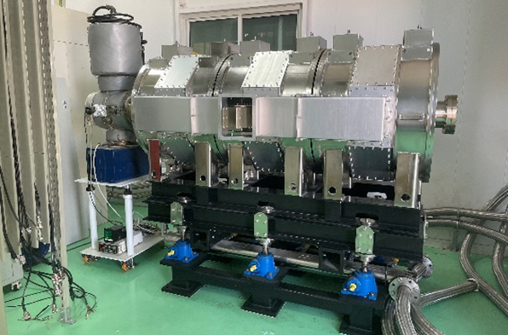
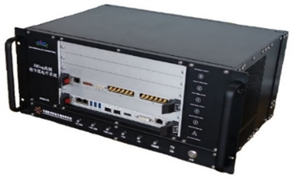
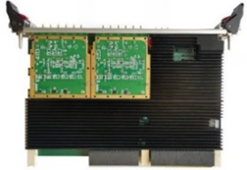
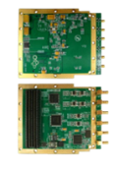
Magnetic alloy core loaded RF system
MA RF system with oil cooling has been constructed and power test show the good performance
The cavity RF voltage can reach 66kV@0.3~2.1MHz, with 3Hz and 70% duty cycle operating mode
Cavity pick (3Hz operating mode)
Impedance of MA cavity
High voltage pulse (50kV/10us)
MA loaded RF system prototype
MA loaded cavity
LLRF VPX hardware

Slide 18
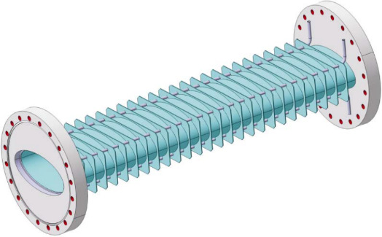
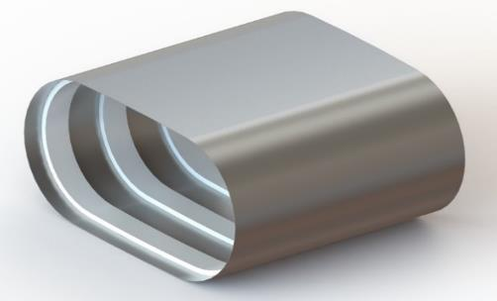
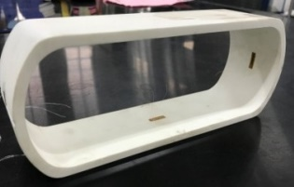







Titanium alloy lined thin-wall vacuum chamber
Due to high ramping rates, thin wall vacuum chambers are needed for all magnets to keep eddy currents at a tolerable level.
Thin-wall vacuum chamber with reinforcing ribs
New scheme:
Thin-wall chamber supported by ceramic rings
Complicated fabrication process
Special material with high cost
Low finished production rate
Large gap of the magnet
Stainless steel-0.3mm
Rib-15mm,one side
Stainless steel-0.3mm
Ring-4 mm,one side
Ceramic ring with golden coating
Titanium alloy-CT4 cage
Cerium-stabilized zirconia ceramics
Thickness :4mm
Thickness :5mm
Thickness :4mm

Slide 19
High-Intensity Heavy Ion Accelerator Facility-HIAF
HIAF construction time schedule
2019 | 2020 | 2021 |  | 2022 | 2023 |  |  |  | 2024 |  |  |  | 2025 |  |  |  | 2026
Civil construction
 |  | Electric power, cooling water, compressed air, network, cryogenic, supporting system, etc.
ECR design & fabrication |  |  | SECR installation and commissioning
 | Linac design & fabrication |  |  |  |  | iLinac installation and commissioning |  |  |  |  |  |  |  |  | Day one exp
Prototypes of PS, RF cavity, chamber, magnets, etc. |  |  |  | fabrication |  |  |  | BRing installation and commissioning |  |  |  |  |  |  | Day one exp
 |  |  |  |  |  |  |  |  |  | HFRS installation & commissioning
 |  |  |  |  |  |  |  |  |  |  |  |  |  |  |  | Day one exp
 |  |  |  |  |  |  | Terminals installation
First beam
Complete
Installation
SRing installation
& commissioning
Complete Installation
The ion source SECR provides first beam in September
The low energy CW ion beam of iLinac is expected at the middle of 2025
The high energy pulse ion beam from BRing is in September of 2025
The Day One Experiment in SRing will be in April of 2026

Slide 20






High-Intensity Heavy Ion Accelerator Facility-HIAF

Slide 21
Outline
General information of the HIAF
Technical challenges and construction status
Experimental terminals
Towards to the EicC
Conclusion

Slide 22

Experimental Setups
High Energy Fragment Separator
High Energy Station:
Setup for Nuclear Matter Study
High Energy Irradiation Terminal
Setup for Hypernuclear Study
Storage Ring:
Isochronous Mass Spectrometer
Schottky Spectrometer
In-ring Reaction Setup
DR Spectrometer
4
5
3
1
Low Energy Station:
Gas-filled Recoil Separator
Low Energy Spectrometer
Low Energy Irradiation Terminal
2
Keep Space

Slide 23



Experiments@iLinac
Low Energy Station
Pulse Mode: injector of the Booster; CW Mode: deliver intense beams for low-energy experiments
Booster
Pulse mode:
1.0 emA beams with A/Q=2~7
CW mode:
10 pμA beams with A/Q=2~5
SECR
LEBT
RFQ
QWR005
HWR010
HWR015
Energy Adjustable
Fusion and MNT Reactions
Fusions
synthesize new elements and isotopes
measure nuclear masses and lifetimes
build the decay schemes
map out the drip lines
build a bridge to the island of SHN
simulate the rp and r processes
study the evolution of shell structure
MNT
reactions
To produce heavy and super-heavy nuclei by fusion reactions and by multi-nucleon transfer reactions

Slide 24


Experiments@BRing
High Energy Station
Stable beams provided by the Booster
DC-type extraction from the Booster
Typical beam parameters from the Booster Ring
Slow extraction: ~ 3s beam duration
Not supported by the approved budget
The high-energy stable beams are ideal to produce hypernuclei and nuclear matter
Properties of nuclear matter: supported already by CAS and NSFC, about 200 Million CNY
Synthesis of new hypernuclei: seeking for financial support, international collaboration?
Moderate beam intensity and higher energies. A/Z=2 primary beams up to 4.25 GeV/u energy will be available

Slide 25




Experiments@HFRS
High Energy Fragment Separator (HFRS)
Slowly extracted beams from the Booster
Radioactive ion beams produced by HFRS
Physics Cases @HFRS
New isotopes in the south east of ²⁰⁸Pb (PF of ²⁰⁸Pb and ²³⁸U)
Neutron dripline up to Ni isotopes (PF of Kr and Xe)
New isotopes by ²³⁸U fission (In-flight fission of ²³⁸U)
New isotopes using two step projectile fragmentations
Synthesis of neutron rich hypernuclei
Study of tensor interactions: a basic change in structure model
Particle decay in flight of unbound nuclei
Nuclear matter radii (Interaction cross sections)
Nuclear proton radii (Charge changing cross sections)
Charge exchange reactions and β decay of r-process nuclei
Nucleon excitations in nuclei
Giant resonance of neutron rich nuclei
Elastic scattering and transfer reactions
Spectroscopy of meson-nucleus bound system
…
Requirements from Physics
Various experiments can be done at HFRS
Acceptance, and Momentum Resolution

Slide 26



Experiments@SRing
Spectrometer Ring: Multi Working Modes of Storage Ring
With fast extracted projectiles from the Booster, HFRS produces, separates and injects the isotopes of interests into the Spectrometer Ring
Experiments:
Spectrometer Ring:
Circumference:188.7 m
Rigidity: 15 Tm
Electron cooler
Stochastic cooler
Isochronous Mass Spectroscopy
Schottky Spectroscopy
DR Spectroscopy
In-ring Nuclear Reactions
Carbon target sustainable to beam power
Notes:
Using fast, extracted projectiles from the Booster, HFRS produces, separates and injects the nuclides of interest into the Spectrometer Ring, which is in essence a storage ring equipped with an electron cooler, a stochastic cooling device, and a deacceleration cavity. Based on the Spectrometer Ring, we will build the Dielectronic Recombination Spectrometer, Isochronous Mass Spectrometer, Schottky Spectrometer, and Setup for In-ring Nuclear Reactions, as schematically shown.

Slide 27
Outline
General information of the HIAF
Technical challenges and construction status
Experimental terminals
Towards to the EicC
Conclusion
Notes:
Here is the outline of this report

Slide 28


Future facility - CNUF
China advanced NUclear physics research Facility - An upgrade of the HIAF and CiADS
Electron ion collider in China
Scientific motivation:
The limit of existence of nuclides
Nuclear matter phase structure
Strong-field QED effect
Spin decomposition and origin of mass
High-energy-density physics
New physics beyond SM
p-Ring
e-Ring
Muon research
e-injector
MRing
Surface muon
SRing
BRing-N/S
ISOL
iLinac
CiADS
EicC
Consists of p-Ring, e-Ring and beam injectors, realizes dual-polarized high intensity electron ion collision, with full energy beam injection and rapid replacement based on e-injector and BRing-S.
HIAF-U
ISOL
Upgrade HIAF with 200MeV/u iLinac, fast-cycle injector BRing-N, superconducting synchrotron BRing-S and the merging ring MRing, providing high-intensity, high-quality ion beams from proton to uranium.
Driven by the high power proton beam from CiADS Linac, producing high intensity neutron-rich nuclides and be post-accelerated by HIAF-U. Also producing high flux surface muon.
Notes:
Based on HIAF and CiADS, our future plan is to combine the two facilities to build the China advanced NUclear physics research Facility (briefly CNUF).
It mainly consists of three parts: the ISOL facility driven by ciADS, and the HIAF upgrade project and the electron ion collider. The three parts are connected with each other, and there are several operating modes for different experimental terminals, including the Muon research platform.

Slide 29



EicC beam parameters
Parameter | electron | proton
Circumference (m) | 1151.20 | 1149.81
Kinetic energy (GeV) | 3.5 | 19.08
CM energy (GeV) | 16.76
f_{collision} (MHz) | 100
Polarization | 80% | 70%
Bρ (T·m) | 11.7 | 67.2
Bunch intensity (x10¹¹) | 1.7 | 1.05
$ε_{x},ε_{y}$ (nm·rad, rms) | 50/15 | 100/50
$β_{x}^{∗}/β_{y}^{∗}$ (cm) | 10/4 | 5/1.2
RMS divergence (mrad) | - | 1.4/2.0
Bunch length (cm, rms) | 0.75 | 8
Beam-beam parameter${ξ_{x}}/{ξ_{y}}$ | 0.102/0.118 | 0.0144/0.01
Laslett tune shift ${Δν_{x}}/{Δν_{y}}$ | - | 0.066/0.105
Energy loss per turn (MeV) | 0.32 | -
Total SR power (MW) | 0.86 | -
Average current (A) | 2.7 | 1.68
Crossing angle (mrad) | 50
Hourglass | 0.52
Luminosity at nucleon level (cm⁻²s⁻¹) | 4.25 × 10³³
High luminosity mode:
Peak luminosity of e-p: $4.25×10^{33} cm^{−2}s^{−1}$
Integral luminosity of e-p: 106 fb⁻¹ /year with 80% duty factor
Large emittance & intensity
Large beam divergence at the IP
High luminosity but ultra-small angle productions not covered (only >= 16 mrad)
Spin flip:
  1.04MHz
Notes:
Based on HIAF and CiADS, our future plan is to combine the two facilities to build the China advanced NUclear physics research Facility (briefly CNUF).
It mainly consists of three parts: the ISOL facility driven by ciADS, and the HIAF upgrade project and the electron ion collider. The three parts are connected with each other, and there are several operating modes for different experimental terminals, including the Muon research platform.

Slide 30

CNUF ion complex
iSource
  Generate polarized proton, D and ³He²⁺ beams, and other unpolarized ion beams
Only pRing will be newly built in the ion complex of the EicC accelerator facility
iLinac
  Accelerate all kinds of ion beams, including H⁻ beams for stripping injection in the future
  Maximum energy (like proton) is 200 MeV
BRing-N & BRing-S
  The maximum momentum rigidity ~ 34 T m & 86 T m
  Intensity of p ~ 6.8×10¹² ppp & 2.03×10¹³ ppp
  The required emittance is achieved in the BRing-N
pRing
  Swap-out inj. to replace 384 bunches online (p), collision freq. is 100 MHz (e-p) or 500 MHz (e-A)
Notes:
Based on HIAF and CiADS, our future plan is to combine the two facilities to build the China advanced NUclear physics research Facility (briefly CNUF).
It mainly consists of three parts: the ISOL facility driven by ciADS, and the HIAF upgrade project and the electron ion collider. The three parts are connected with each other, and there are several operating modes for different experimental terminals, including the Muon research platform.

Slide 31



CNUF ion complex
Mode: Multi-plane painting injection + Multi-stage electron cooling
CW
1 bunch
3 injections
2.03×10¹³ ppp
RMS $ε_{x}/ε_{y}$ ~ 200/100 π nm·rad
192 bunches
2 injections, 384 bunches
1.05×10¹¹ ppb
4.05×10¹³ ppp
RMS $ε_{x}/ε_{y}$ ~ 100/50 π nm·rad
6.8×10¹² ppp
RMS $ε_{x}/ε_{y}$ ~
12/6 π mm·mrad
Proton beams as an example!
2 GeV
9.3 GeV
Acc. ~ 0.1 s
E.C. ~ 120 s
To replace all collision bunches ~ 12 mins
Acc. ~ 4 s
Notes:
Based on HIAF and CiADS, our future plan is to combine the two facilities to build the China advanced NUclear physics research Facility (briefly CNUF).
It mainly consists of three parts: the ISOL facility driven by ciADS, and the HIAF upgrade project and the electron ion collider. The three parts are connected with each other, and there are several operating modes for different experimental terminals, including the Muon research platform.

Slide 32


CNUF electron complex
eSource
  Polarized electron beams, and intensity of 5 ~ 10 nC per pulse
eLinac
  Accelerate to 300 ~ 500 MeV
AR
  Circumference ~ 287.8 m
  Accumulate 4 times to reach the intensity of 27 nC per bunch
  Accelerate to 2.8 ~ 5.0 GeV
eRing
  Circumference ~ 1151.2 m
  384 bunches (100 MHz in e-p)
  Swap-out injection scheme
Notes:
Based on HIAF and CiADS, our future plan is to combine the two facilities to build the China advanced NUclear physics research Facility (briefly CNUF).
It mainly consists of three parts: the ISOL facility driven by ciADS, and the HIAF upgrade project and the electron ion collider. The three parts are connected with each other, and there are several operating modes for different experimental terminals, including the Muon research platform.

Slide 33

Future facility - CNUF
4 e-p energy points in 12 ~ 23 GeV, peak luminosity >= $1×10^{33} cm^{−2}s^{−1}$
Designs | VE1 |  | VE2 |  | VE3 |  | VE4
Particle | e | p | e | p | e | p | e | p
Kinetic energy [GeV] | 2.8 | 12 | 5 | 12 | 2.8 | 24.85 | 5 | 24.85
CM energy [GeV] | 12.07 |  | 16.10 |  | 17.02 |  | 22.73
Bρ (T·m) | 9.34 | 43.05 | 16.68 | 43.05 | 9.34 | 86 | 16.68 | 86
Bunch intensity [×10¹¹] | 1.7 | 0.4 | 1.7 | 0.4 | 1.7 | 0.7 | 1.7 | 1.2
$ε_{x}/ε_{y}$ [nm·rad] | 80/24 | 160/80 | 80/24 | 160/80 | 40/12 | 80/40 | 40/12 | 80/40
$β_{x}^{∗}/β_{y}^{∗}$ [cm] | 10/4 | 5/1.2 | 10/4 | 5/1.2 | 10/4 | 5/1.2 | 10/4 | 5/1.2
x/y RMS beam size [μm] | 90/31 |  | 90/31 |  | 63/22 |  | 63/22
x/y RMS divergence [mrad] | - | 1.79/2.58 | - | 1.79/2.58 | - | 1.27/1.83 | - | 1.27/1.83
Bunch length [cm] | 0.75 | 8 | 0.75 | 8 | 0.75 | 8 | 0.75 | 8
Beam-beam parameter${ξ_{x}}/{ξ_{y}}$ [10⁻³] | 0.031/0.035 | 0.014/0.010 | 0.017/0.020 | 0.014/0.010 | 0.106/0.123 | 0.014/0.010 | 0.102/0.118 | 0.014/0.010
Laslett tune shift, x/y, [10⁻²] | - | -0.06/-0.095 | - | -0.06/-0.095 | - | -0.025/-0.04 | - | -0.043/-0.068
Crossing angle [mrad] | 50
Hourglass factor | 0.52
Luminosity [cm⁻²s⁻¹] | 1.00 × 10³³ |  | 1.00 × 10³³ |  | 3.54 × 10³³ |  | 6.06 × 10³³
Notes:
Based on HIAF and CiADS, our future plan is to combine the two facilities to build the China advanced NUclear physics research Facility (briefly CNUF).
It mainly consists of three parts: the ISOL facility driven by ciADS, and the HIAF upgrade project and the electron ion collider. The three parts are connected with each other, and there are several operating modes for different experimental terminals, including the Muon research platform.

Slide 34

Future facility - CNUF
e-A collisions up to e-U, and D & ³He²⁺ beams are polarized, integral luminosity >= 18.6 fb⁻¹/year
Parameter | e | d | ³He⁺⁺ | ⁷Li³⁺ | ¹²C⁶⁺ | ⁴⁰Ca²⁰⁺ | ¹⁹⁷Au⁷⁹⁺ | ²⁰⁸Pb⁸²⁺ | ²³⁸U⁹²⁺
Kinetic energy (GeV) | 3.5 | 12.00 | 16.30 | 10.16 | 12.00 | 12.00 | 9.46 | 9.28 | 9.09
CM energy (GeV/u) | - | 13.48 | 15.55 | 12.48 | 13.48 | 13.48 | 12.09 | 11.98 | 11.87
f_{collision} (MHz) | - | 499.63 | 500.20 | 499.16 | 499.63 | 499.63 | 498.91 | 498.84 | 498.76
Polarization | 80% | Yes | Yes | No | No | No | No | No | No
Bρ (T·m) | 11.67 | 86.00 | 86.00 | 86.00 | 86.00 | 86.00 | 86.00 | 86.00 | 86.00
Particles per bunch (x10⁹) | 40 | 6.1 | 3.0 | 2.04 | 1 | 0.3 | 0.07 | 0.065 | 0.055
$ε_{x},ε_{y}$ (nm·rad, rms) | 50/15 | 100/50 | 100/50 | 100/50 | 100/50 | 100/50 | 100/50 | 100/50 | 100/50
$β_{x}^{∗}/β_{y}^{∗}$ (cm) | 10/4 | 5/1.2 | 5/1.2 | 5/1.2 | 5/1.2 | 5/1.2 | 5/1.2 | 5/1.2 | 5/1.2
Bunch length (cm, rms) | 0.75 | 1.5 | 1.5 | 1.5 | 1.5 | 1.5 | 1.5 | 1.5 | 1.5
Beam-beam parameter${ξ_{x}}/{ξ_{y}}$ (10⁻³) | 6/7 | 3/2 | 3/2 | 3/2 | 3/2 | 3/2 | 3/2 | 3/2 | 3/2
Laslett tune shift ${Δν_{x}}/{Δν_{y}}$ (10⁻²) | - | 3.7/5.9 | 2.1/3.3 | 5.1/8.1 | 3.7/5.8 | 3.7/5.8 | 5.2/8.3 | 5.2/8.3 | 5.1/8.2
Current (A) | 3.3 | 0.42 | 0.48 | 0.49 | 0.48 | 0.48 | 0.44 | 0.43 | 0.40
Crossing angle (mrad) | 50
Hourglass | - | 0.9 | 0.9 | 0.9 | 0.9 | 0.9 | 0.9 | 0.9 | 0.9
Luminosity at nucleon level (cm⁻²s⁻¹) | - | 10.09 × 10³² | 7.44 × 10³² | 11.81 × 10³² | 9.92 × 10³² | 9.92 × 10³² | 11.40 × 10³² | 11.18 × 10³² | 10.82 × 10³²
Spin flip is also feasible
Notes:
Based on HIAF and CiADS, our future plan is to combine the two facilities to build the China advanced NUclear physics research Facility (briefly CNUF).
It mainly consists of three parts: the ISOL facility driven by ciADS, and the HIAF upgrade project and the electron ion collider. The three parts are connected with each other, and there are several operating modes for different experimental terminals, including the Muon research platform.

Slide 35
Outline
General information of the HIAF
Technical challenges and construction status
Experimental terminals
Towards to the EicC
Conclusion
Notes:
Here is the outline of this report

Slide 36
Conclusion
The HIAF project can provide stable ions up to Uranium, and produce many kind of secondary isotopes
The maximum magnetic rigidity is 34Tm, which corresponds to the energy of Uranium is about 830 MeV/u and proton is 9.3 GeV
High beam intensity and fast ramping (12T/s) is the main feature of the synchrotron
The first beam will be extracted in 2025
EicC is one important motivation for the HIAF upgrade.
Notes:
Some devices and equipment are under test and measurement

Slide 37

Thanks for your attention!

Slide 38

Thanks for your attention!

Slide 39

2. Ion and Electron Accelerators – Interaction Region (Ion)
Further studies should be performed with detector group …
50 mrad
40% ~ 80% off-momentum
Maximum gradient ~ 52.9 T/m @ 19.08 GeV
Space for crab cavities ~ 16 m * 2
Space for central detector ~ +4.4 m/-3.6 m
Endcap dipole tracker (EDT) is in the BpF1 with acceptance +/-16~60 mrad
Roman pot detectors are placed before and after BpF2 to cover ultra-small angle productions in +/-5~16 mrad
Zero-degree calorimeter (ZDC) for the neutral particles should cover +/- 25 mrad
Notes:
Interaction region design is also important for researching beam-beam effects or other coupling effects. It is strongly constrained by detectors and necessary accelerator devices. Each crab cavity section needs 16 m. And we can provide 4.4 m to minus 3.6 m space for central detector. Then, endcap dpole tracker is in the first dipole magnet and will accept productions in the angle of 16 to 60 mrad.Roman pot detectors are placed before and after the second dipole inside the vacuum chamber to cover ultra-small angle productions in the angle of 5 to 16 mrad. Zero degree calorimeter is placed along the IP’s extended line to cover neutral particles in the angle 25 mrad. But further studies should be performed with detector group to generate a more reasonable interaction region design.

Slide 40


2. Ion and Electron Accelerators – Interaction Region (e)
50 mrad
Maximum $β_{x}/β_{y}$ ~ 853 / 400 m
Space for crab cavities ~ 9 m * 2
Space for central detector ~ +/- 4 m
A Chicane section formed by four dipoles is employed to measure lumi. and polarization, which has severe impact on emittance (20%)
Notes:
The interaction region in the electron complex contains 9 m space for each crab cavity, 8 m space for central detector and a chicane section that measures luminosity and polarization. This section has severe impact on emittance, almost 20%.

Slide 41




3. Challenges & Status of BB Research – Crab Cavities
It is necessary to employ local crab cavities to perform head-on collision as the luminosity is severely limited by large cross angle ~ 50 mrad
However, the nonlinear effects and imperfection effects of crab cavities will have detrimental impacts on beams
Notes:
Last but not least, it is necessary to employ local crab cavities to perform head-on collision as the luminosity is severely limited by large cross angle about 50 mrad. But the nonlinear effects and imperfection effects of crab cavities will have detrimental impacts on beams and reduce the luminosity and luminosity life. This shows the nonlinear resonances, and we should consider phase advance errors, and dispersion function errors.

Slide 42

2. Ion and Electron Accelerators – Polarization (e-p)
Ion Complex
The proton beams with opposite spin directions are injected and accelerated
Fixed field Siberian snakes will be employed in rapid-cycling boosters
pRing will be spin-transparent, and required spin directions are achieved at the injection line
Electron Complex
Electron beams matched with self-polarization direction are inj. & acc.
Opposite spin directions are achieved at the injection line
2 Spin rotators around the IP
Swap-out injection is necessary to maintain high polarization in eRing
Lose polarization much quicker
Notes:
The last important design is polarization. Here we use electron proton collisions as example. In the ion complex, the proton beams with opposite spin directions are generated by ion source or the spin rotator at the exit of the ion source, injected and accelerated. Fixed field Siberian snakes will be employed in rapid-cycling boosters, as normal snakes cannot catch up with the ramping rate of these boosters. Then, we want to use a spin-transparent design in the pRing, which means pRing can receive beams with any spin directions. The required spin directions are achieved at the injection line. In the electron complex, due to the self-polarization effect, electron beams are injected, accumulated and accelerated with only one spin direction, not like ion complex. Then, the opposite spin directions are achieved at the injection line. We place 2 spin rotators at the both sides of IP to get the required spin directions at the IP and match the spin directions again with the arc sections. And due to the self-polarization effect again, the polarization of beams with inverse spin direction will lose much quicker than another. Swap-out injection is necessary to maintain high polarization in eRing when there is spin flip. With these schemes, a spin flip with the frequency of 1.04 MHz is designed.

