Slide 1
Measurement of charge-dependent directed flow in STAR Beam Energy Scan (BES-II) Au+Au and U+U Collisions
Muhammad Farhan Taseer
for the STAR collaboration
25-11-2024
In part supported by

Slide 2
Outline
Physics Motivation
STAR Experiment at RHIC
Directed Flow Results
System size dependence (U+U 193 GeV; Au+Au & Zr(Ru)+Zr(Ru) at 200 GeV)
Beam energy dependence (Au+Au: 7.7 - 19.6 GeV)
Summary

Slide 3
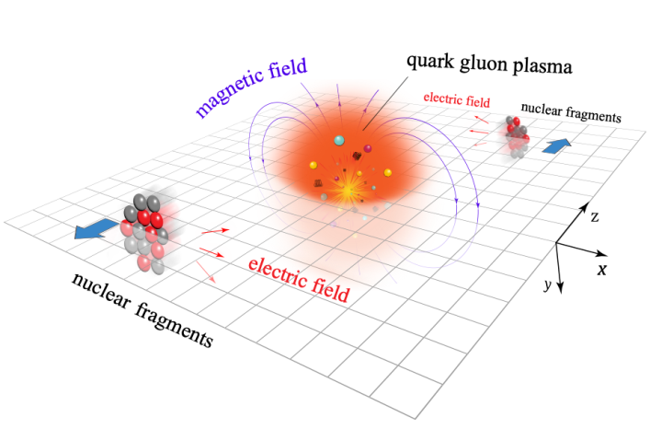
Physics Motivation
Ultra strong magnetic fields (B~10¹⁸ Gauss) are expected at very early stages in Heavy Ion Collisions
B ~ Time dependent, decays rapidly as the medium (QGP) expands
PRX 14, 011028 [STAR]
Important to understand QGP evolution in the presence of initial electromagnetic fields [1]
[1] U. Gürsoy et al. PRC 98,055201, PRC 89 054905

Slide 4
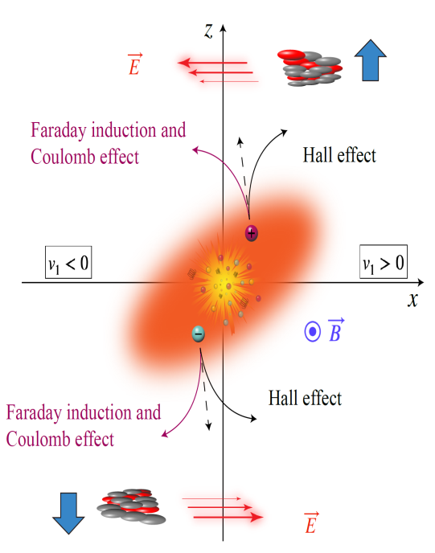
Electromagnetic Field Effects
Directed Flow (v₁) describes the collective sideward motion of the produced particles and nuclear fragments → carries information from the early stages of collision
R Event Plane Resolution
Ψ Event Plane azimuthal Angle
ф Azimuthal angle of outgoing particles
In the expanding QGP, quarks experience following electromagnetic effects [1]
Hall Effect: F = q (v x B) by Lorentz Force
Coulomb Effect: E generated by spectator nucleons
Faraday Induction: decreasing B as spectators fly away
These electromagnetic forces provide opposite contribution of v₁ to particles with opposite charges
I _{(total)} = I _{(Hall)} + I _{(Faraday)}
Directed Flow (v₁)
PRX 14, 011028 [STAR]

Slide 5
Electromagnetic Field Effects on v₁
The splitting of v₁ between particle and antiparticle is measured as:
Δv₁ = dv₁⁺ /dy - dv₁⁻ /dy
Transported Quark → Positive Δv₁
EM Field → Negative Δv₁
Combination
(Transported Quarks + EM)
PRX 14, 011028 [STAR]

Slide 6
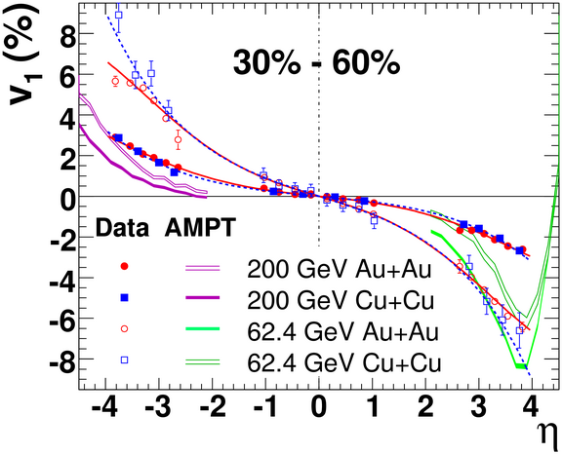
System Size Dependence on v₁
PRL. 101, 252301 [STAR]
For inclusive charged particles, v₁ of Au+Au ≈ Cu+Cu at a fixed centrality
We shall present v₁ and Δv₁ in U+U, Au+Au and Isobar (RuRu + ZrZr)

Slide 7
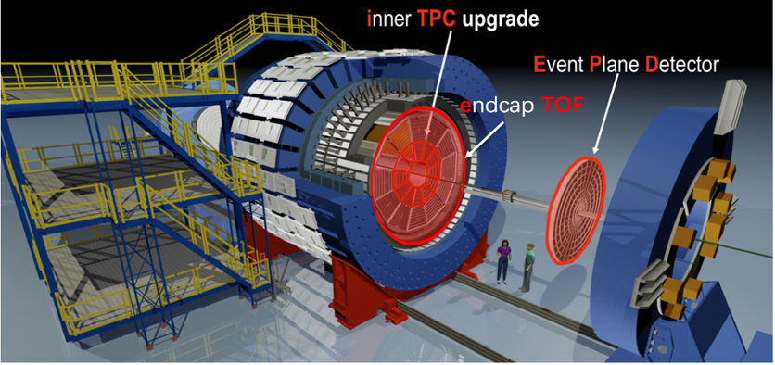
STAR Experiment
Solenoidal Tracker at RHIC is a multipurpose detector with full azimuthal coverage
Upgrade of inner-TPC (Better Track Quality, Wide acceptance (|η| < 1.5)
Event Plane Detector and Zero Degree Calorimeter used for event plane reconstruction, EPD (2.1<|η|<5.1), ZDC-SMD(|η|>6.3)
Excellent Particle Identification
Tracking of charged particles using TPC
Momentum reconstruction using TPC
Energy loss (dE/dx) using TPC
mass square information using TOF
The STAR detector

Slide 8
Results

Slide 9
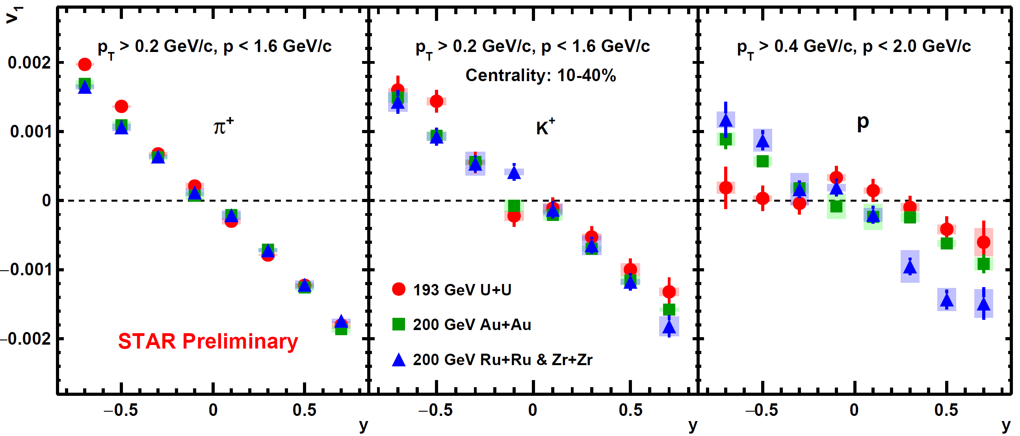
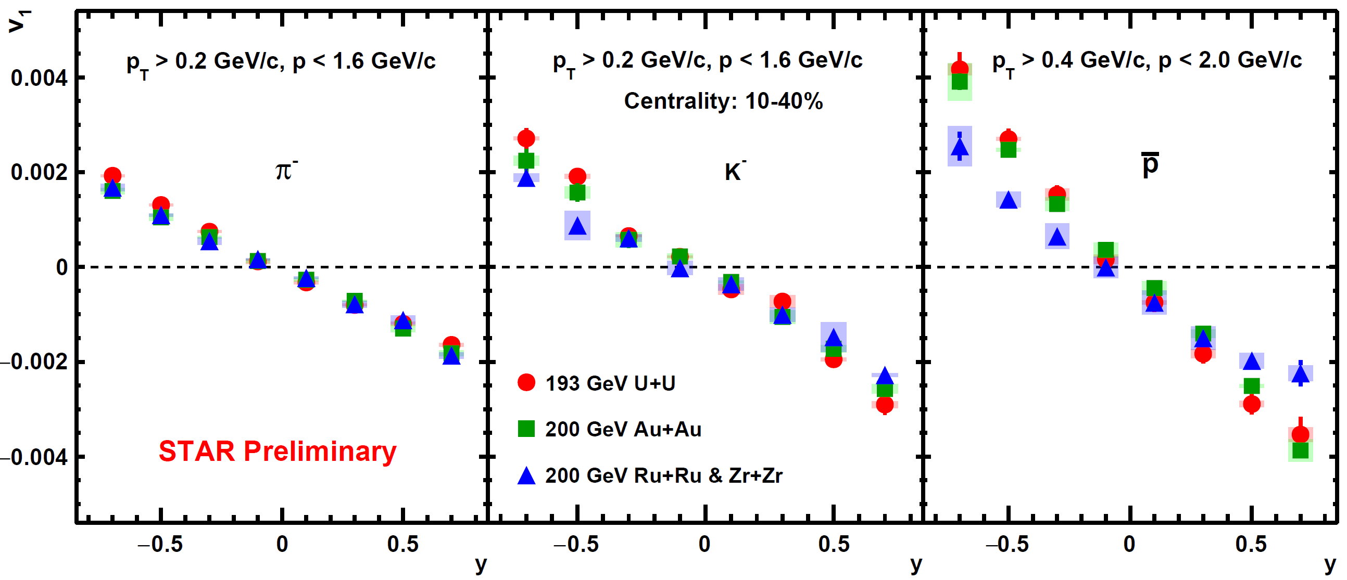
v₁(y) for Mid-Central U+U, Au+Au & Isobar
Positive Particles
Negative Particles
v₁ vs y in U+U, Au+Au and Isobar collisions
Extracted v₁ slope using linear fit (|y| < 0.8)

Slide 10
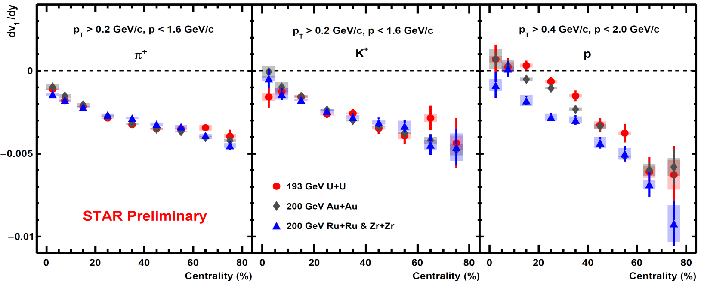
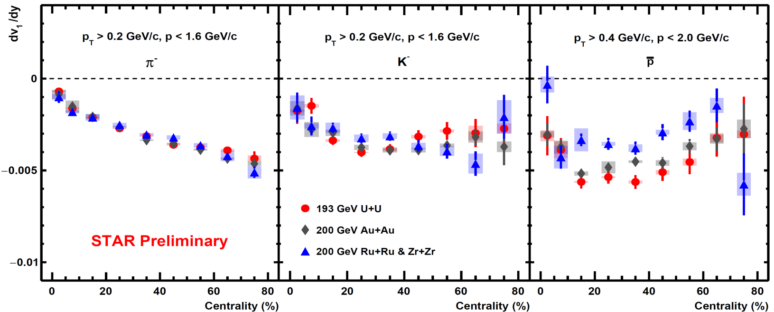
Slope (dv₁/dy) vs centrality for U+U, Au+Au & Isobar
Positive Particles
Negative Particles
Positive and Negative Pions (Kaons) → consistent within uncertainties
Protons and antiprotons → observe system size dependence in mid-central collisions

Slide 11
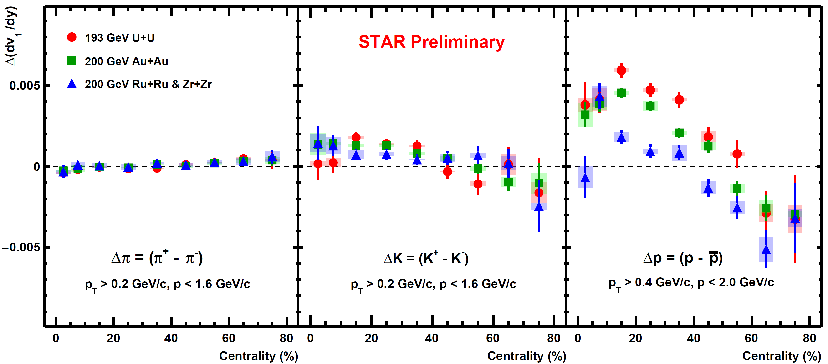
Δ(dv₁/dy) for U+U, Au+Au & Isobar
Δ(dv₁/dy) = [dv₁⁺ /dy - dv₁⁻ /dy]
Pions (Kaons) → consistent within uncertainties
Protons → clean ordering and a system size dependence in the mid- central collisions 10-40%
→ sign change in the peripheral collisions 50-80%
Δv₁ sign change → consistent with naive expectations of transport + EM effects

Slide 12
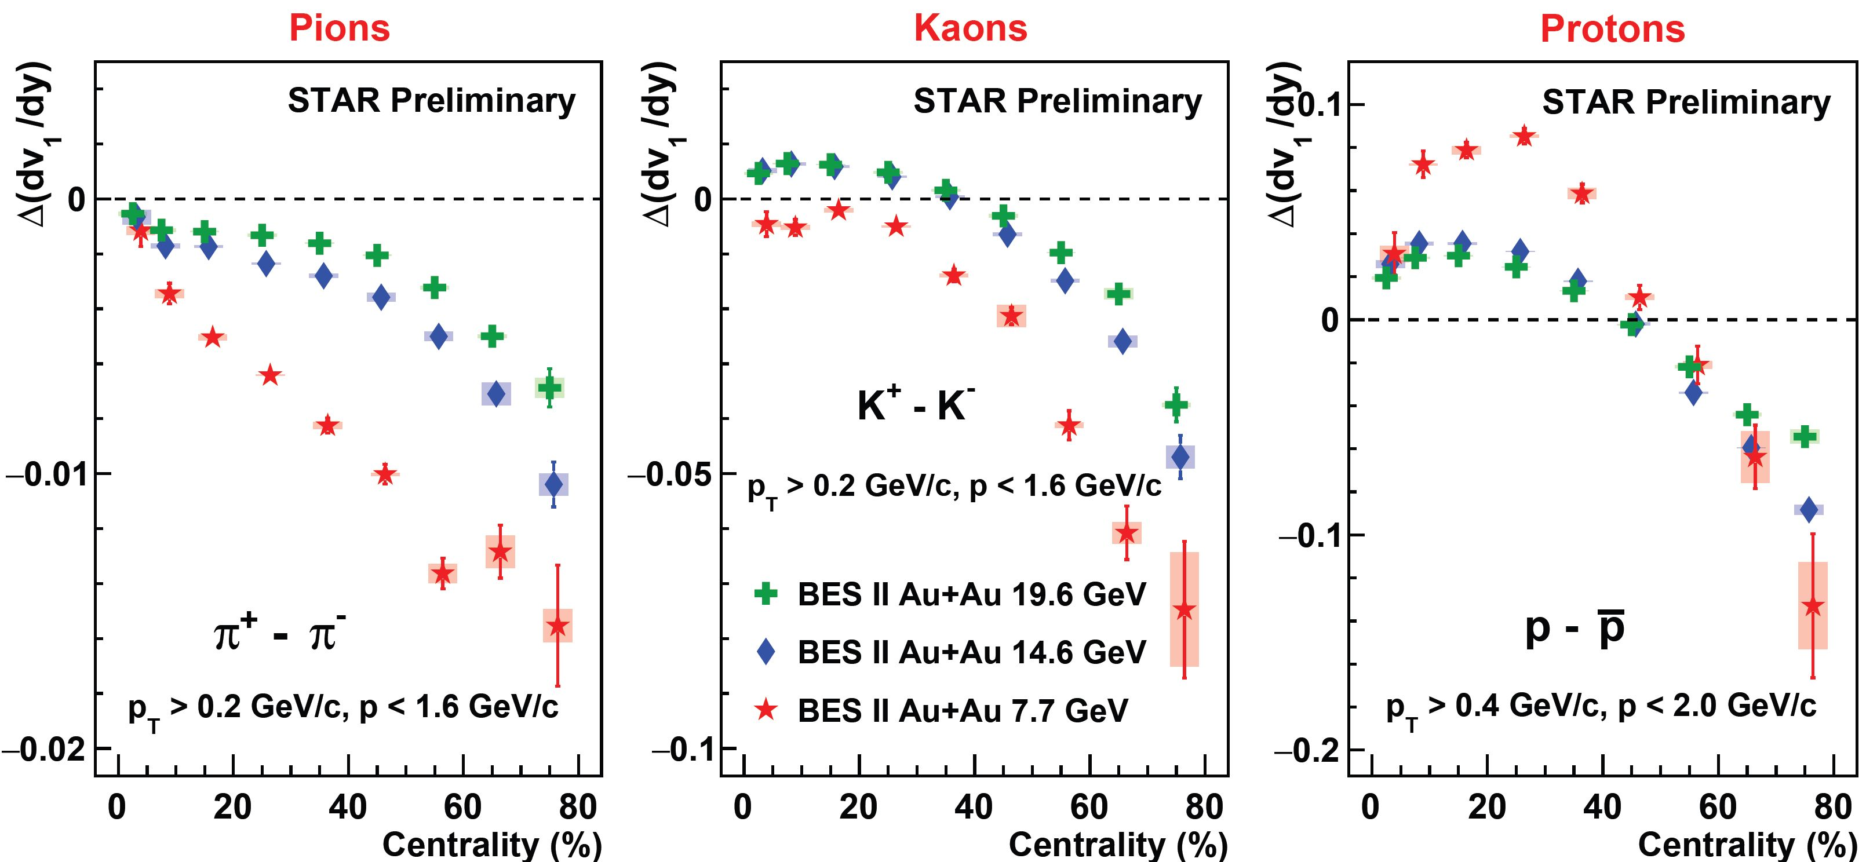
Δ(dv₁/dy) for Beam Energy Dependence in Au+Au
Negative Δ(dv₁/dy) in peripheral collisions meet naive expectation from transport + EM effects
Δv₁ increases with decrease in beam energy
Consistent with the dominance of (Faraday + Coulomb) effect in peripheral collisions (other mechanisms such as baryon inhomogeneities are under investigation) [T. Parida et al. arXiv:2305.8806]

Slide 13
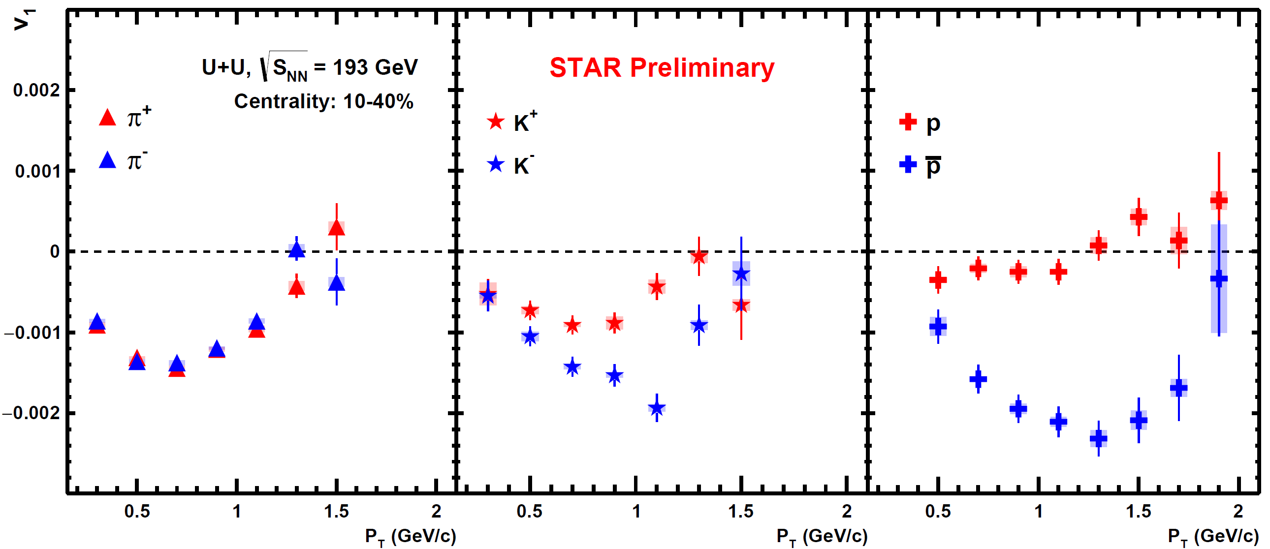
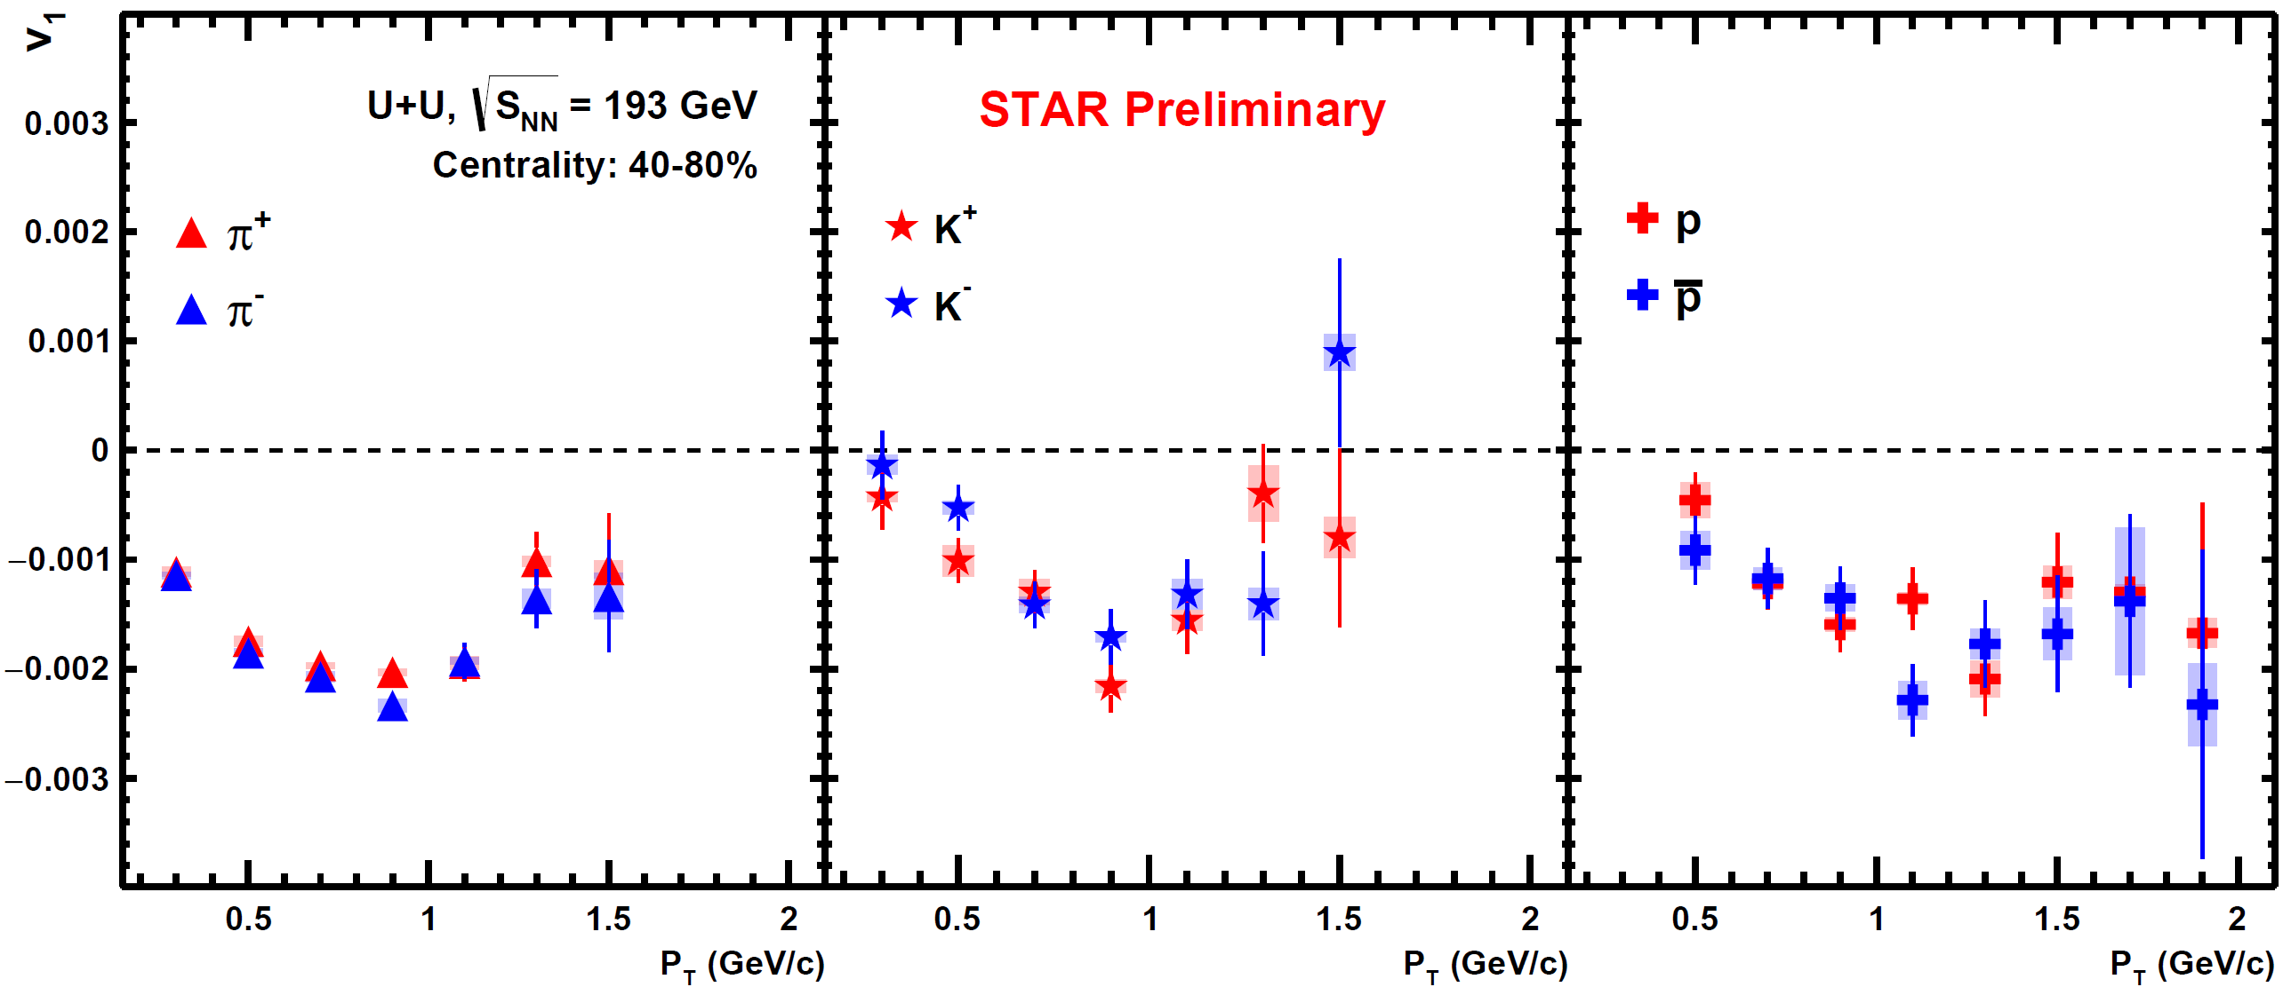
v₁(p_{T}) for U+U Collisions at 193 GeV
Mid Central
10-40 %
Peripheral
40-80 %
For Proton (antiproton) → Significant splitting in mid-central collisions (10-40)%

Slide 14
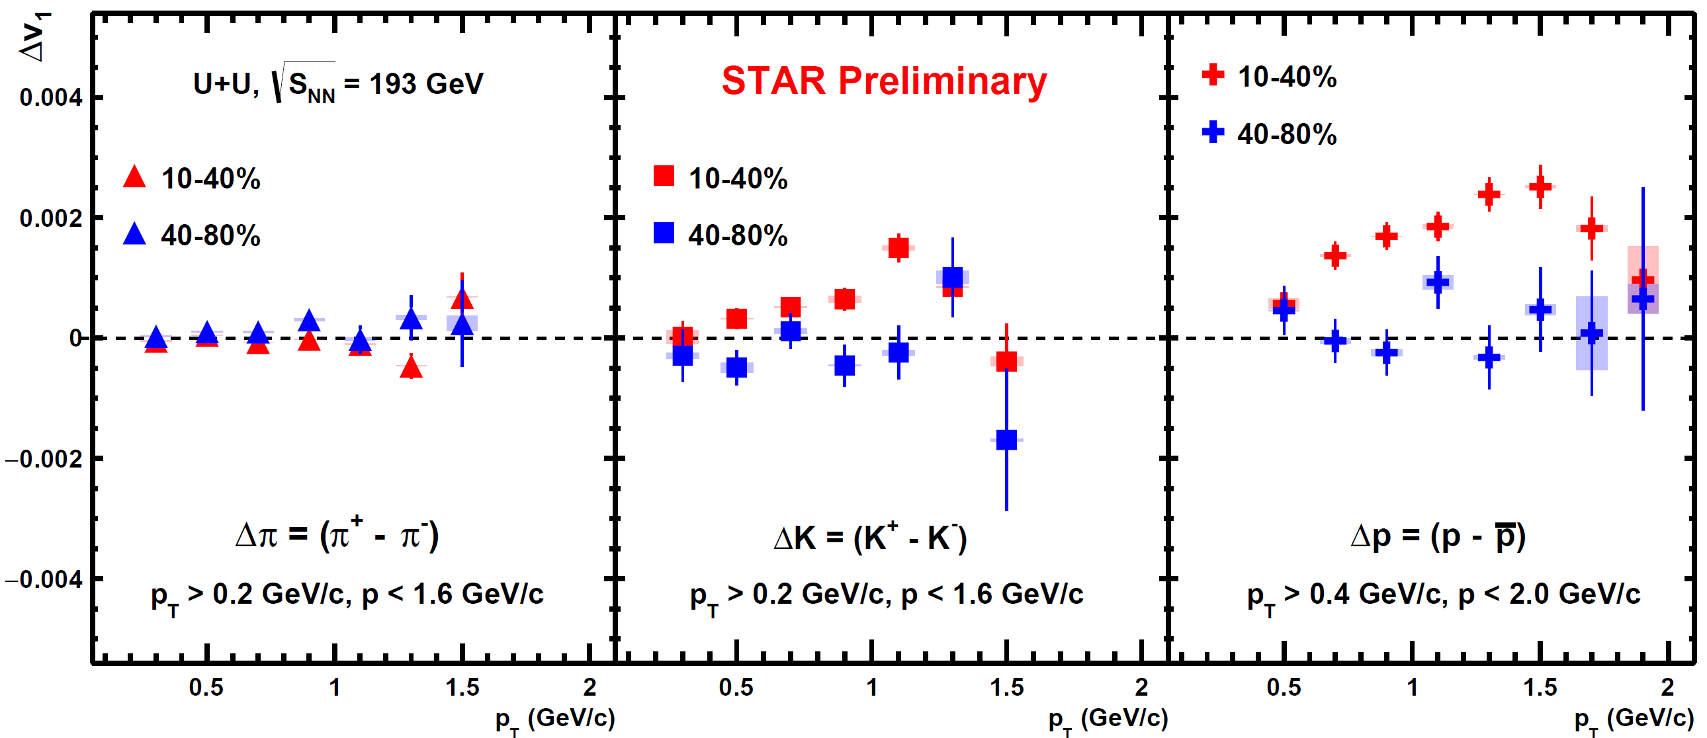
Δv₁(p_{T}) for U+U Collisions at 193 GeV
Δv₁ = v₁⁺ - v₁⁻
Pions (Kaons) → consistent with zero within uncertainties
Protons → mid-central collisions → Δv₁ keep increasing with p_{T}
peripheral collisions → no obvious p_{T} dependence

Slide 15
Δv₁(p_{T}) for BES-II Au+Au Collisions at 7.7 - 19.6 GeV
Au+Au 7.7 GeV
Au+Au 14.6 GeV
Au+Au 19.6 GeV
For peripheral collisions, Δv₁ is negative
Indication of larger splitting with increasing p_{T} as expected from theory [U. Gürsoy et al. PRC 98,055201, PRC 89 054905]

Slide 16
Summary
System size dependence
We observe a significant difference for proton Δv₁ in the mid-central collisions (10-40)% among the three different collision systems
For Proton, Δv₁ changes sign in peripheral collisions as observed in the previous Au+Au and isobar data
For pion and kaon all data points are consistent among three different collision systems at the same collision energy
Proton Δv₁ : U+U > Au+Au > Isobar
Beam energy dependence
Splitting in Δv₁ increases with decreasing beam energies
More negative Δv₁ for lower collision energies → consistent with longer lifetime of the electromagnetic field → shorter lifetime of the fireball
These results will help to understand baryon deposition/transport mechanism. It also provide constraint on the strength and lifetime of the electromagnetic field as well as the medium electrical conductivity in Heavy-Ion collisions

Slide 18
Backup Slides

Slide 19
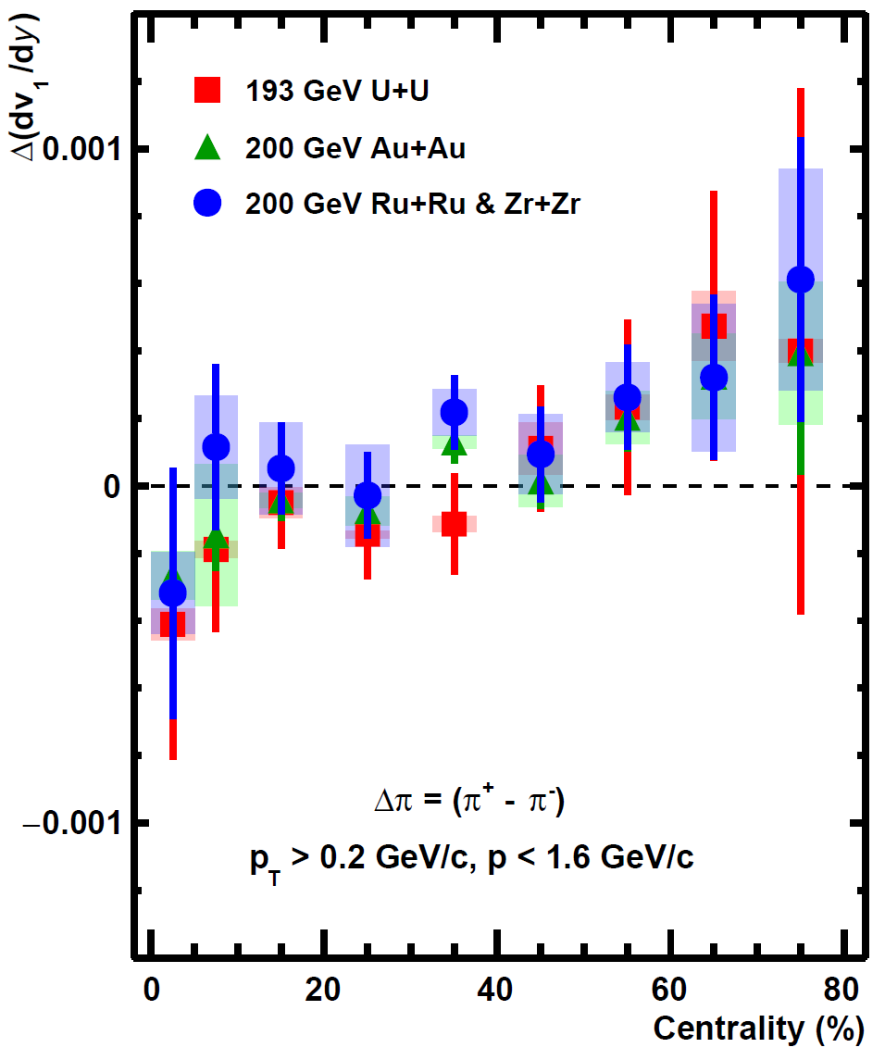
Δv₁ as a function of Centrality (Pion)
STAR Preliminary

Slide 20
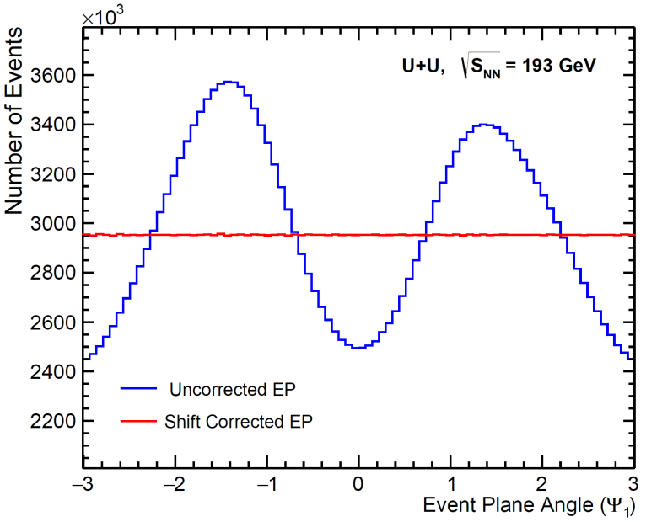
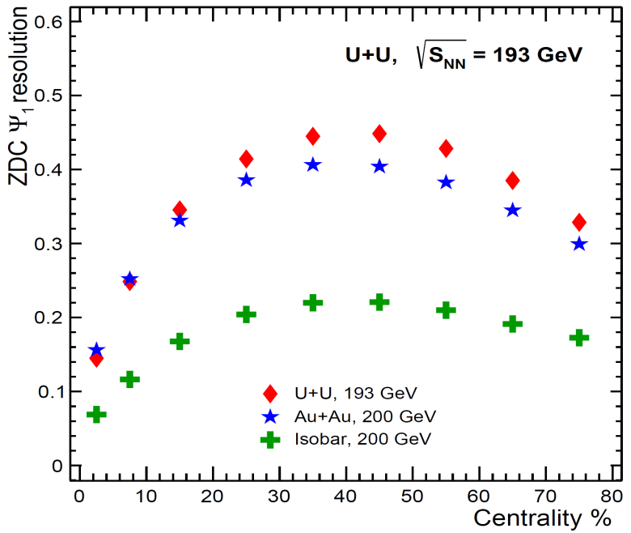
Event Plane & Resolution Plots
Ψ₁ is reconstructed using ZDC
First order Full ZDC calculated from the correlation between East and West ZDC
Resolution Values: -
U+U[9] = {0.145016, 0.248548, 0.345383, 0.414196, 0.444727, 0.448302, 0.428285, 0.385058, 0.328569}
Au+Au[9] = {0.1563, 0.252126, 0.331136, 0.385756, 0.406247, 0.404069, 0.382588, 0.344916, 0.299311}
Isobar[9] = {0.0688674, 0.11634, 0.167703, 0.204098, 0.21988, 0.220753, 0.20985, 0.191277, 0.1727}

Slide 21
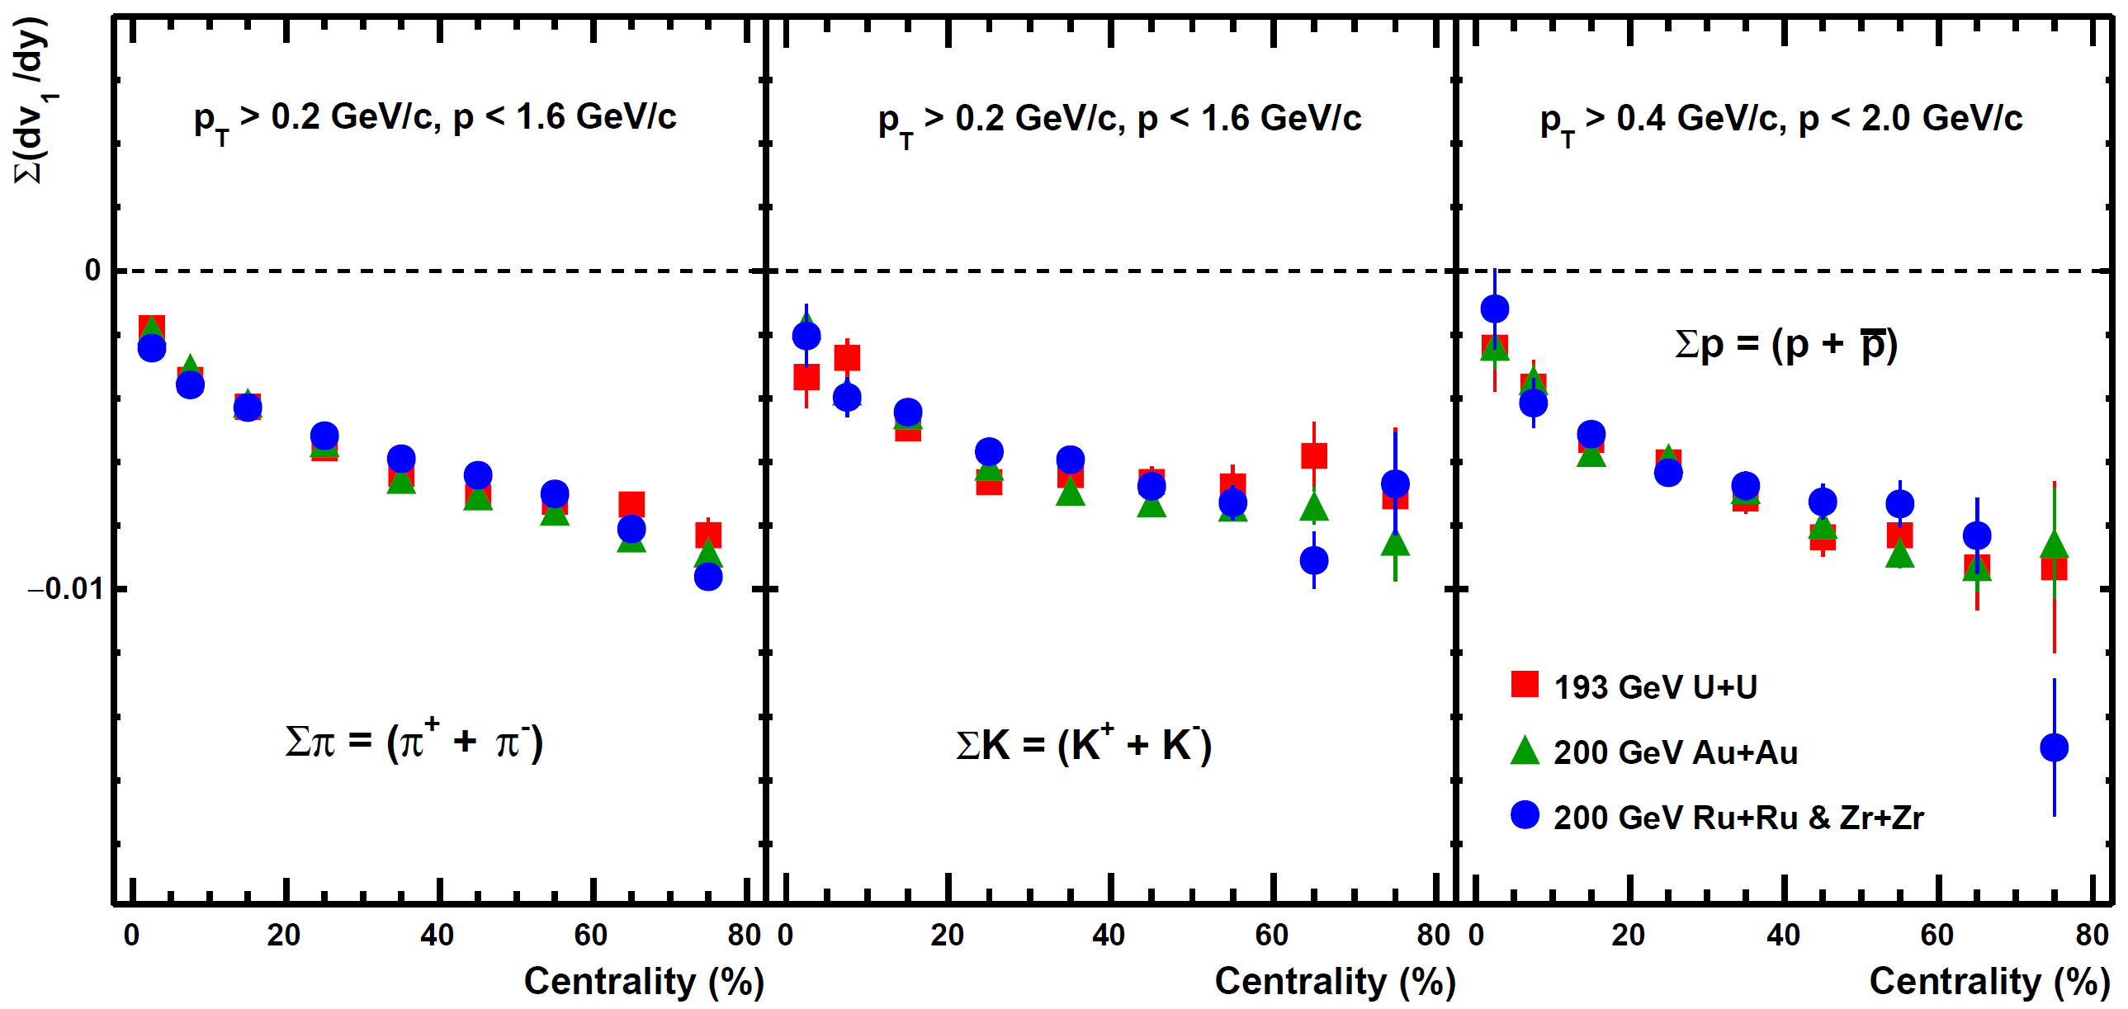
Centrality dependent ∑(dv₁/dy) for Different Collision Systems
STAR Preliminary
STAR Preliminary

