Slide 1
Reduction of ¹⁴⁶Sm-¹⁴²Nd chronology in the early solar system
Shulin Tang and Yibin Qian
Nanjing University of Science and Technology
OMEG2024， Chengdu， China， 2024.09.08-13

Slide 2
Contents
1
Motivation
Theoretical treatment on α decay of ¹⁴⁶Sm
2
Comprehensive analysis on ¹⁴⁶Sm half-life and its applications
3

Slide 3
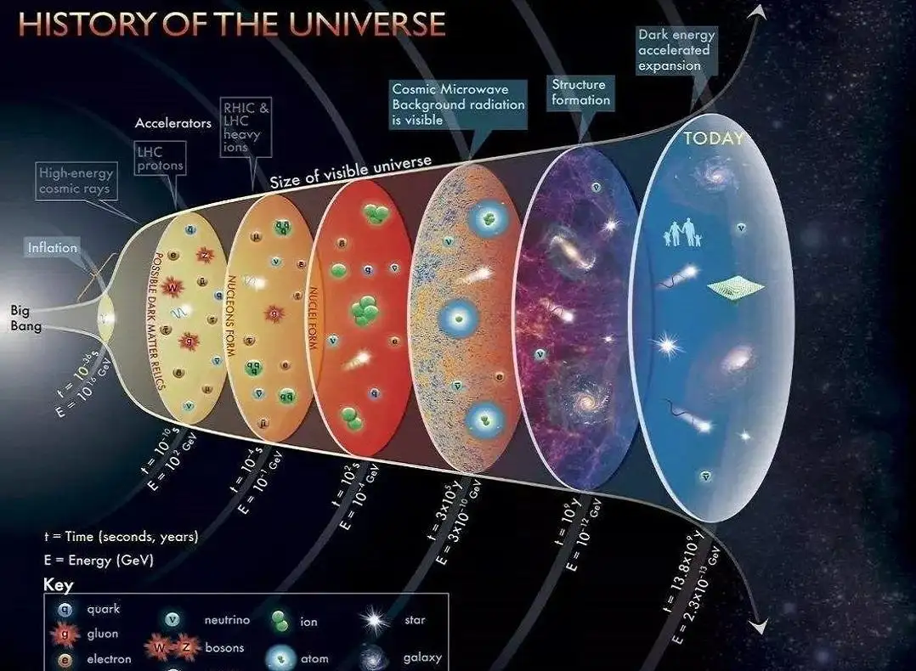
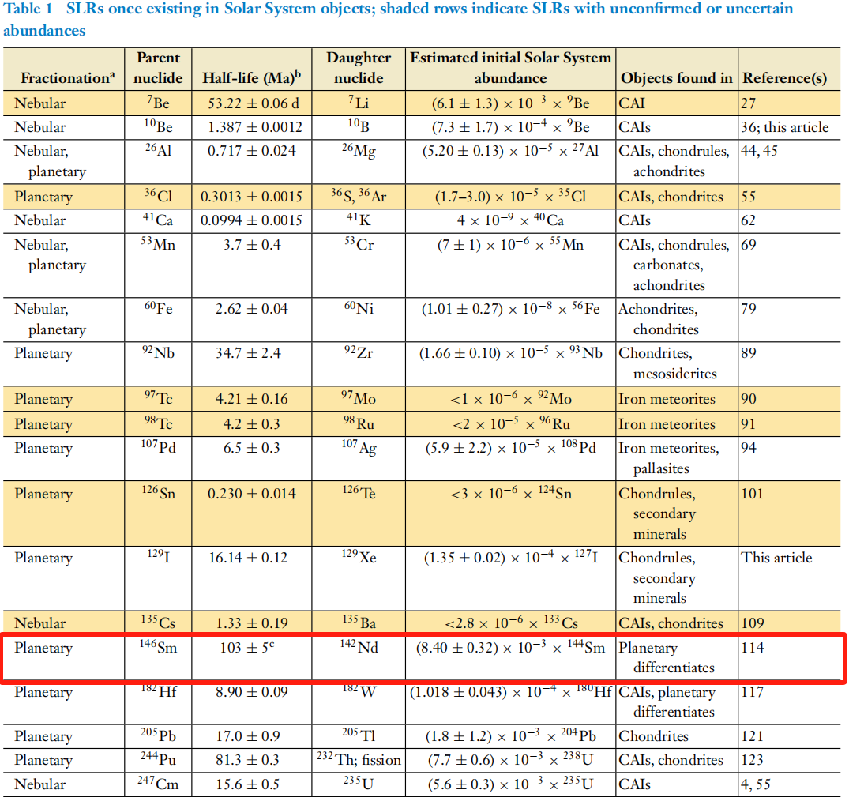
Short-Lived Nuclides in the Early Solar System:
The ¹⁴⁶Sm-¹⁴²Nd chronometers system regularly exhibit sufficient parent-daughter fractionation during partial melting so as to allow isotopic differences to develop in planetary reservoirs.
A. M. Davis, Annu. Rev. Earth Planet. Sci. 72, 339 (2022).
G. Caro, Annu. Rev. Earth Planet. Sci. 39, 31 (2011).

Slide 4
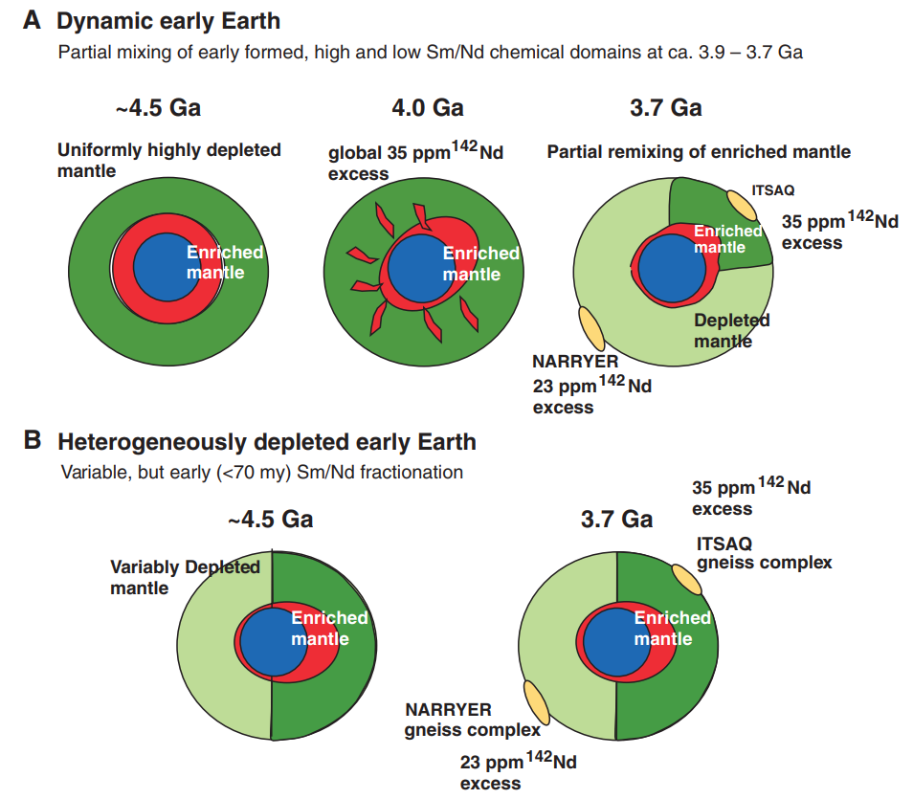
The ¹⁴⁶Sm-¹⁴²Nd Chronology in the Solar System
(A) Formation of uniform mantle (dark green) with high Sm/Nd early in Earth’s history. A global mantle with uniformly high Sm/Nd within ~50 million years shows that the mantle was transient but survived locally until at least 3.6 Ga.
(B) Early-formed heterogeneous mantle. It will satisfy the ¹⁴²Nd constraints is that two (or more) mantle domains with variable Sm/Nd formed in the first ~50 My of Earth history and retained their distinct identities until at least 3.7 Ga.
V.C.Bennett,A.D.Brandon, and A.P.Nutman, Science 318,1907(2007)
Notes:
Two scenarios to account for the distinctive 142Nd signatures of Archean rocks from coeval early crustal terranes.

Slide 5
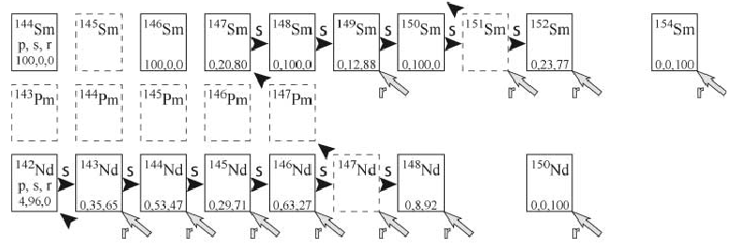
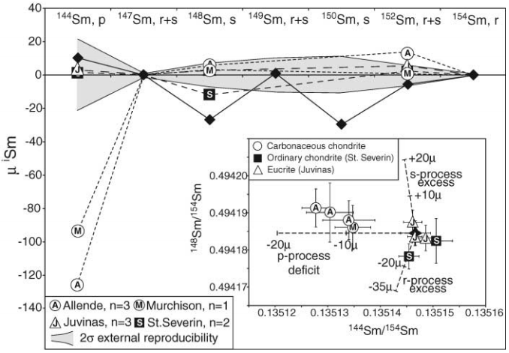
Solar Nebula Heterogeneity in p-Process Samarium and Neodymium Isotopes
Chart of nuclides showing the s-process path in the vicinity of Sm and Nd.
The p-process involved in the Sm isotope. The calculation of the ¹⁴²Nd/¹⁴⁴Nd ratio depends on the p-process ¹⁴⁶Sm, ¹⁴⁴Sm, and ¹⁴²Nd yields of the stellar models.
P.Frossard, C.Israel, A.Bouvier, and M.Boyet, Science 377, 1529 (2022)

Slide 6
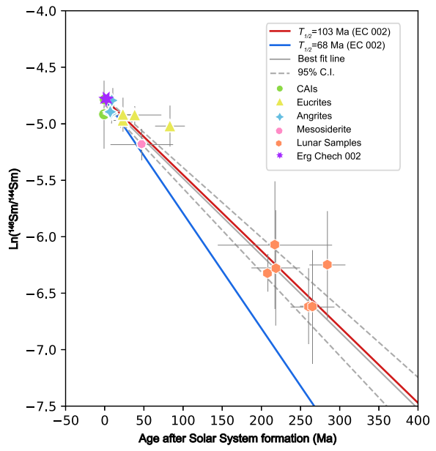
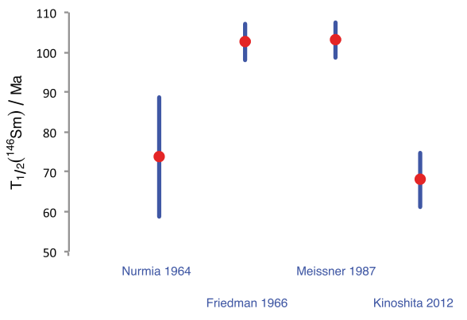
The irreconcilable bimodal half-life of ¹⁴⁶Sm
IUPAC-IUGS:
All ¹⁴⁶Sm half-life counting measurements. The most relevant problem is that the distribution of estimated half-life values is bimodal, with 68 Ma and 103 Ma differ by a factor of 1.5.
Effects of different half-life on the ratio of ¹⁴⁶Sm/¹⁴⁴Sm.
I. M. Villa et al., Geochim. Cosmochim. Acta 285, 70 (2020).
L. Fang et al., Proc. Natl. Acad. Sci. U.S.A. 119, e2120933119 (2022).
Notes:
A consensus on the half-life might only be reached if new, dedicated experiments will take into account the systematic errors identified over recent years. Effect on the initial ratio and the Isochron

Slide 7
Contents
1
Motivation
Theoretical treatment on α decay of ¹⁴⁶Sm
2
Comprehensive analysis on ¹⁴⁶Sm half-life and its applications
3

Slide 8
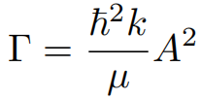
Theoretical treatment on α decay of ¹⁴⁶Sm
α-core interaction potential of the cluster model:
(1)
A new technique for calculating decay width:
(2)
(3)
(4)
As for the half-life:
(5)

Slide 9
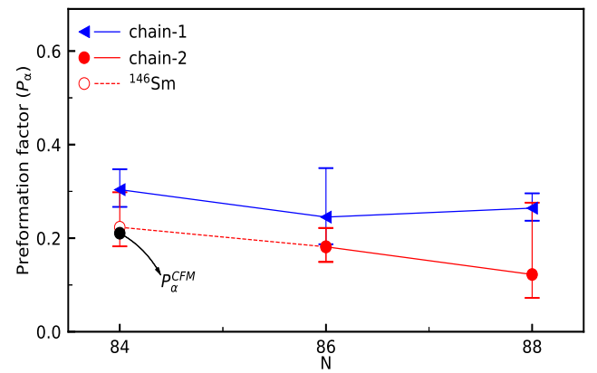
The Pα is constrainted by the CFM
The Pα extracted by the cluster formation model (CFM) is given by:
(6)
where
(7)
(8)
The preformation probability of nuclei in the vicinity of ¹⁴⁶Sm versus neutron number.
The α decay half-life of ¹⁴⁶Sm: 64.2±10.1 Ma
Model-independent to a great extent
Attention: The preformation factors range from 0.10 to 0.82 as the interaction potential varies from 180 MeV to 220 MeV, yet the final calculated half-life changes by only 4%.

Slide 10
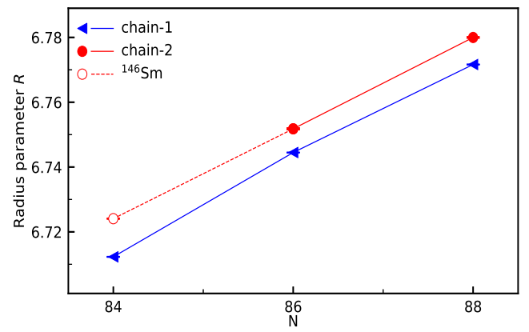
Examination from local extrapolation
The radius R of an α-decay chain is assumed to have a linear relationship with $A_{d}^{1/3}$, namely
(9)
The α decay energy of ¹⁴⁶Sm
Exp: 2.529±0.003 MeV
Calc: 2.554±0.003 MeV
The radius parameter R in the vicinity of ¹⁴⁶Sm versus neutron number.

Slide 11
Contents
1
Motivation
Theoretical treatment on α decay of ¹⁴⁶Sm
2
Comprehensive analysis on ¹⁴⁶Sm half-life and its applications
3

Slide 12
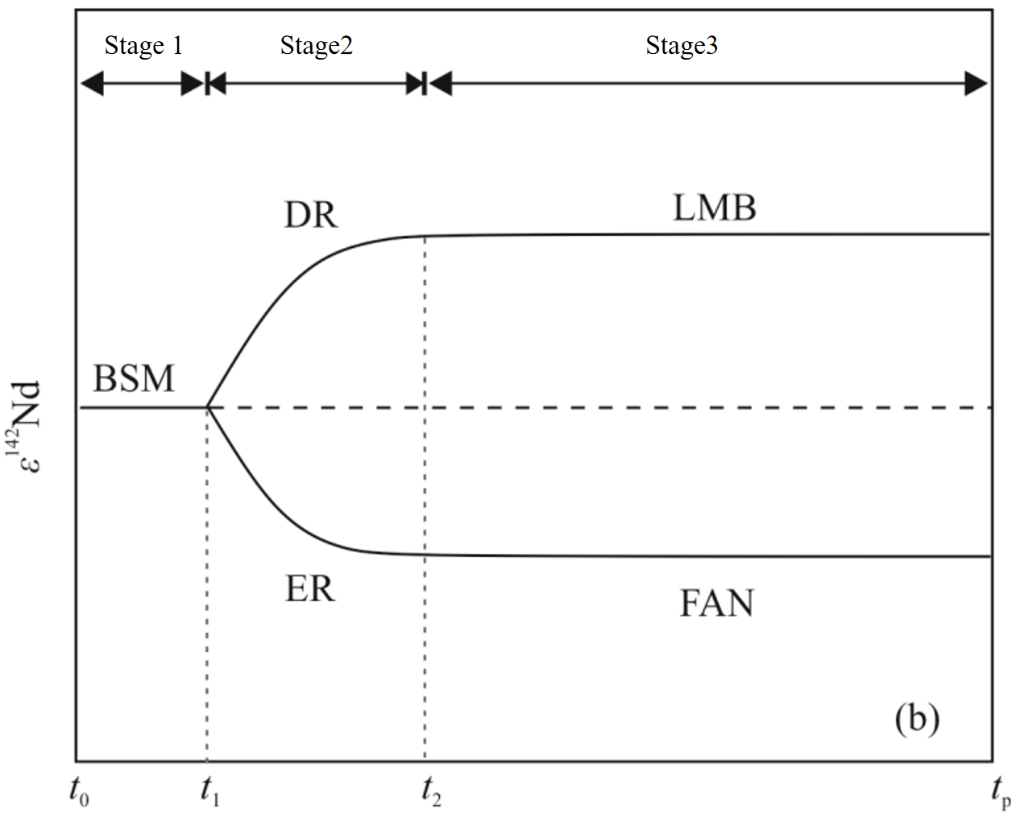
Comprehensive analysis on ¹⁴⁶Sm half-life and its applications in the planetary differentiation
The initial ratio of ¹⁴⁶Sm to ¹⁴⁴Nd needs to be converted into a parameter that can be easily measured,
(10)
The age of source formation:
(11)
ε¹⁴²Nd represents the deviation of the ¹⁴²Nd/¹⁴⁴Nd value:
(12)
Notes:
bulk silicate Moon, BSM enriched reservoirs, ER depleted reservoirs, DR chondritic uniform reservoir, CHUR

Slide 13
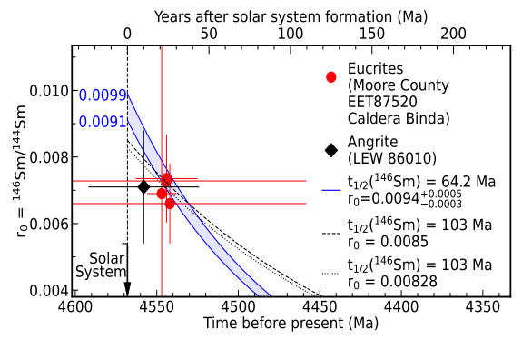
Comprehensive analysis on ¹⁴⁶Sm half-life and its applications in the planetary differentiation
The ¹⁴⁶Sm/¹⁴⁴Sm ratio versus the meteorite age after solar system formation in Ma (upper horizontal axis) or versus the time of solar system formation (lower horizontal axis).

Slide 14
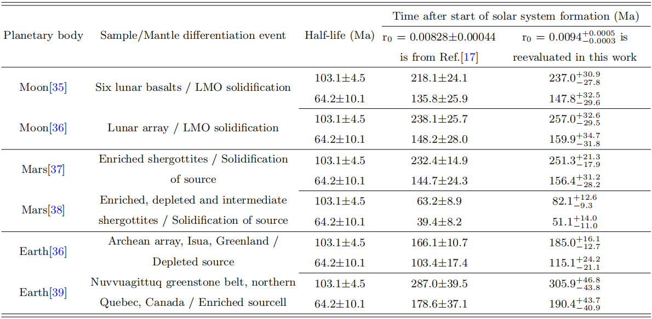
Comprehensive analysis on ¹⁴⁶Sm half-life and its applications in the planetary differentiation
The effect of the shorter ¹⁴⁶Sm half-life on the estimated time of differentiation events is considered, with two different half-life values for ¹⁴⁶Sm: 103.1±4.5 Ma and 64.2±10.1 Ma.
Notes:
Lunar magma ocean, LMO

Slide 15
Conclusion
The half-life of ¹⁴⁶Sm is determined using the cluster model plus a new technique proposed to treat the α decay width, in which the Pα is evaluated in a model-independent way.
Reconfirmation from the local extrapolation of neighboring isotopes.
The recalculated half-life of ¹⁴⁶Sm is utilized to evaluate source formation time in cosmochronology.

Slide 16
Thanks for your attention!

