Slide 1
Conceptual design of a novel gaseous scintillation neutron detector for $(α,n)$ cross-section measurement
Jianqi Chen(陈建琪)，Junsheng Jing(景俊升)，Yongce Gong(贡庸策)
Great Bay University
chenjianqi@gbu.edu.cn
2024/9/8

Slide 2
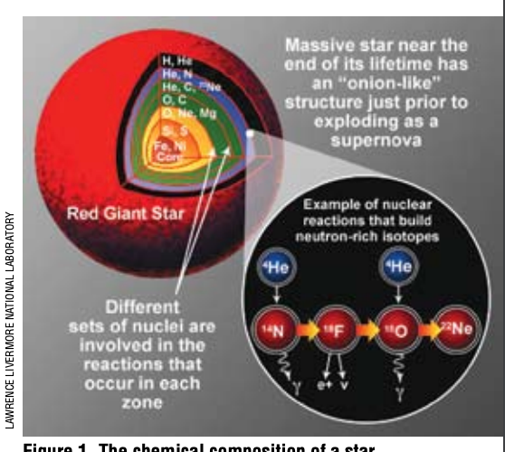
Background
How did elements heavier than iron form?
One of greatest unanswered questions of physics
[科学通报, 2022, 67(28):10.]
https://cosmicopia.gsfc.nasa.gov/nucleo.html
• Neutron capture reaction is the main path of producing ultra iron elements
$\text{•} {}_{}^{23}{Ne}\left(α,n\right){}_{}^{25}{Mg}$ ${}_{}^{13}C\left(α,n\right){}_{}^{16}O$, two main neutron source reaction
$\text{•} \left(α,n\right)$cs is also important for evaluating dark matter and neutrino detector backgrounds
Notes:
owever, the astrophysical models have yet to adequately reproduce the observed solar abundances of those elements beyond iron(referred to as ultra-iron elements). It is widely believed that these ultra-iron elements were primarily synthesized via the slow neutron capture process(s-process) and the fast neutron capture process(r-process). The fundamental s-process component is thought to originate from thermally pulsing low-mass AGB stars, with reaction pathways closed after the stable nuclides. About half of the heavy elements(up to bismuth) were produced via the s-process. The r-process is thought to occur in the explosive burning of core-collapse supernova and/or neutron-star mergers. Although the r-process site remains a mystery, experts believe that more than half of the ultra-iron elements(up to thorium and uranium) were produced via the r-process.

Slide 3
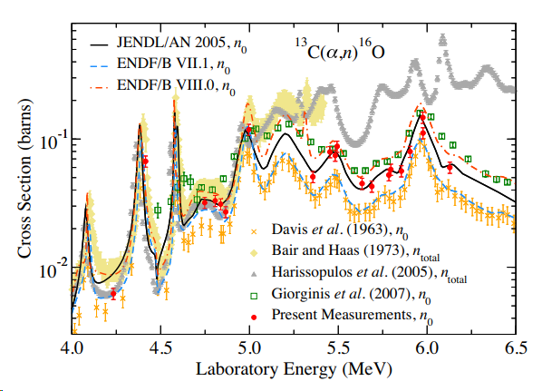
Challenge of $(α,n)$ cs at high neutron energy
Status of ¹³C(alpha, n) ¹⁶O cs measurement
[PHYSICAL REVIEW LETTERS 125, 062501 (2020)]
• When $E_{n}>5 MeV,$ cross section measurements by different group differ greatly.
• In addition¹³C $,$⁹⁶Zr $,$⁴⁸Ti $,$⁵⁰Ti $,$and ⁷⁶Ge (alpha, n) cross section are also needed.
Notes:
Zirconium titanium Germanium

Slide 4
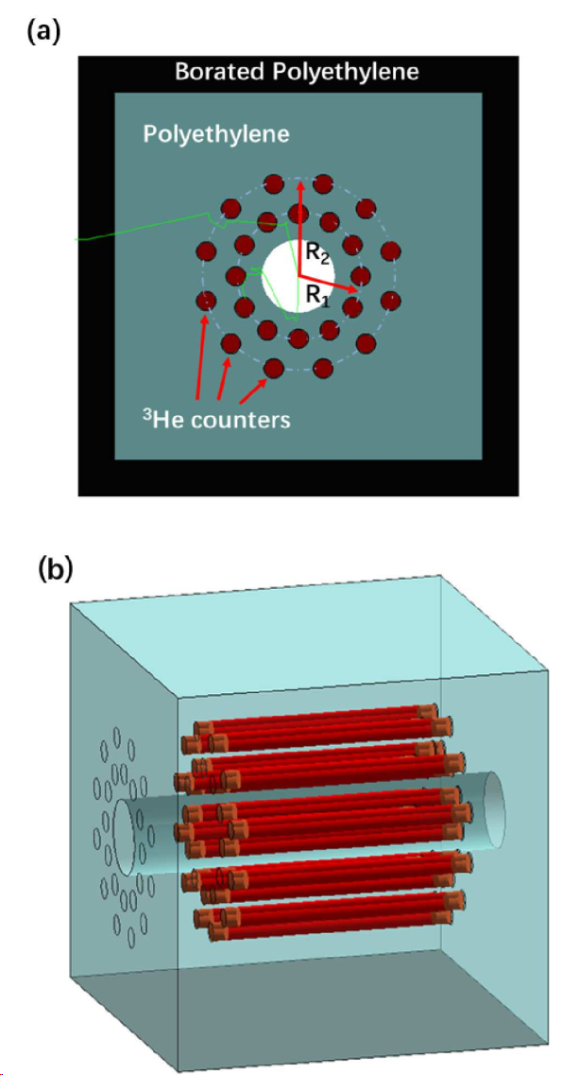
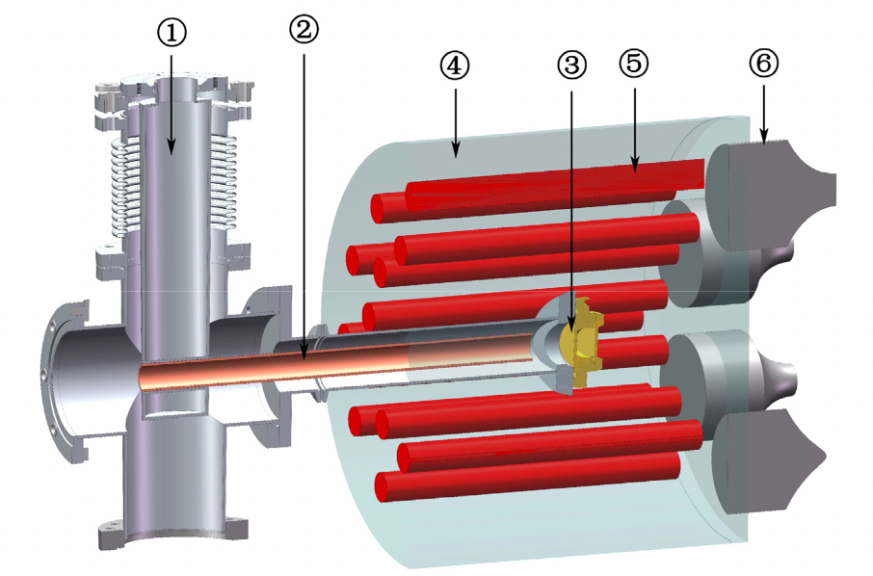
$(α,n)$ cs meas by direct counting method
HeBGB
(Ohio University)
Neutron detector array
(Sichuan University & IMP)
LERDA
(IMP & CIAE)
18 BF₃ detectors
16 ³He detectors
[Journal of Instrumentation 17.05 (2022): P05004]
[Nuclear Science and Techniques 33.4 (2022): 41.]
[Nuclear Inst. and Methods in Physics Research, A 1003 (2021) 165323.]
• Polyethylene moderated ³He tube array detectors are widely used for (alpha, n) cross section measurement.
• high detection efficiency for thermal neutron
• good n/gamma discrimination
• low price of polyethylene and easy to be designed in different shape

Slide 5
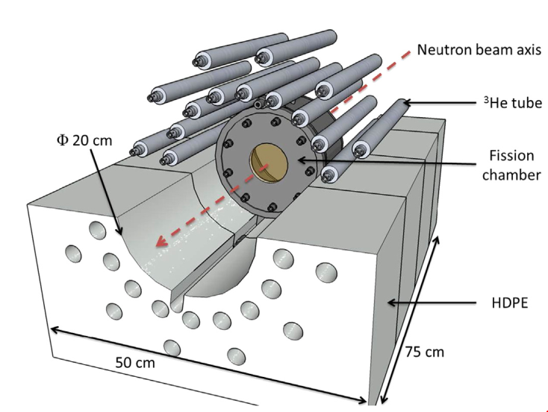
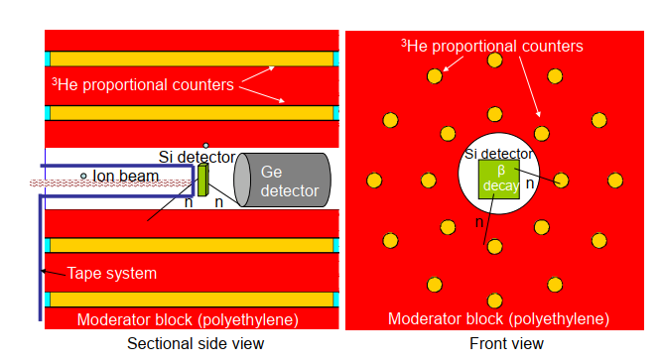
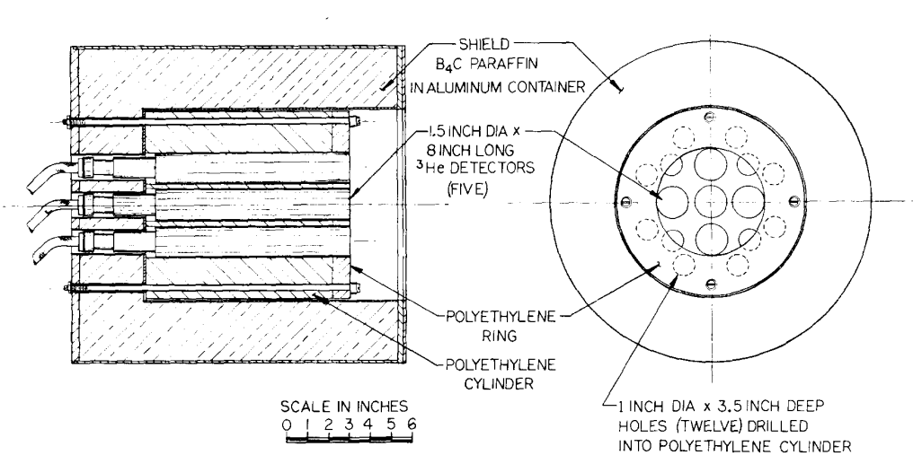
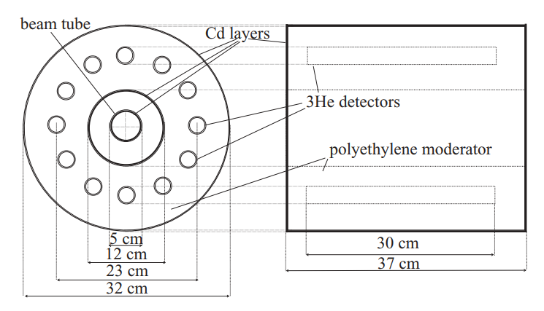
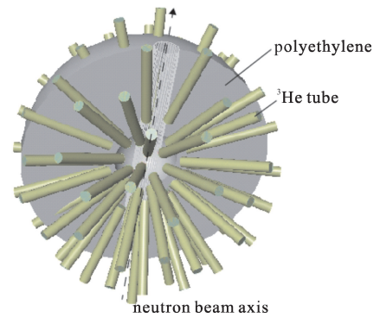
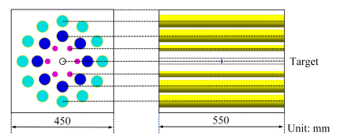
“Polyethylene+³He” tube detector application
Neutron flux monitor
Fission study
$β$ delayed neutron
[NIM-A, 1969,72(2):161-166]
[NIM-A, 2014,99-105]
[NIM-A, 422.1-3, 1999: 43-46]
$(n,n^{′})$ cs measurement
$(n, 2n)$ cs measurement
$(γ, n)$ cs measurement
[Physical Review C 83.6(2011):064617]
[强激光与粒子束,2017,29(12):149-154]
[核技术,2020,43(11):9]
• “Polyethylene +³He tubes” array detectors are widely used in nuclear physics field.

Slide 6
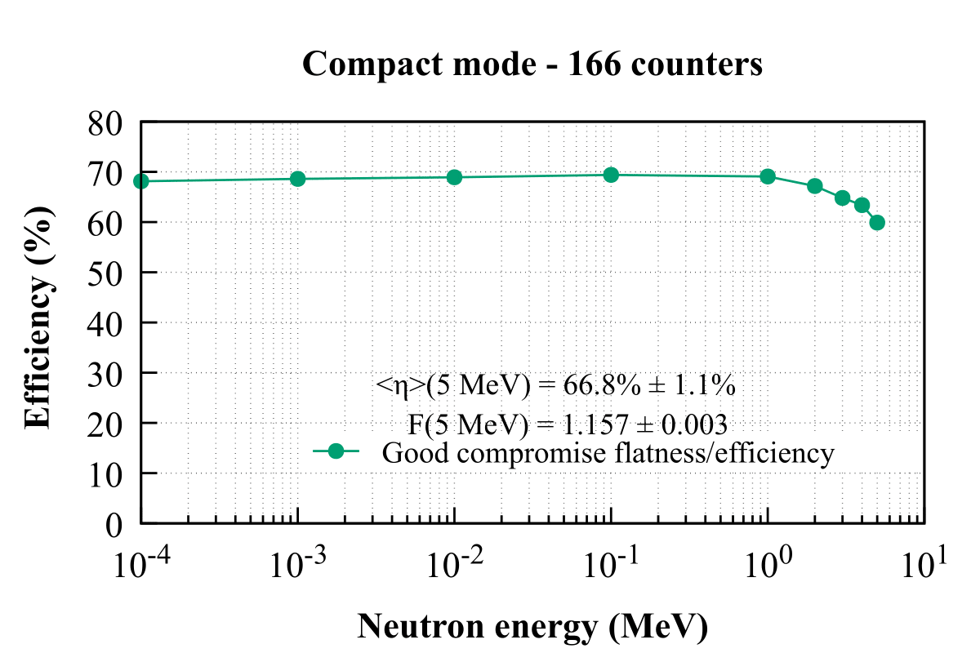
Performance of “polyethylene+ ³He”detector
BRIKEN Configuration
Expected features
Compact mode(166 tubes)
• High detection efficiency
• Efficiency is less sensitivity to neuron energy
• Efficiency is less sensitivity to neuron
emission angle
³He Volume：
($\sim$120 L)@1 atm
Detection efficiency vs Neutron energy
Real Performance
• High detection efficiency
• Efficiency heavily depends on neuron energy when $E_{n}$ >1 MeV
$$√$$
[The BRIKEN collaboration, Jinst, 2017, 12]
Notes:
The aim was to obtain a detection efficiency as high and as constant as possible in the energy range of interest for these neutrons from 1 keV to a few MeV. This constant efficiency is crucial since the information on the initial energy of the neutron will be lost during the moderation process. For neutron-emitters with unknown neutron energy spectrum the same efficiency will be used regardless of neutron energy.

Slide 7
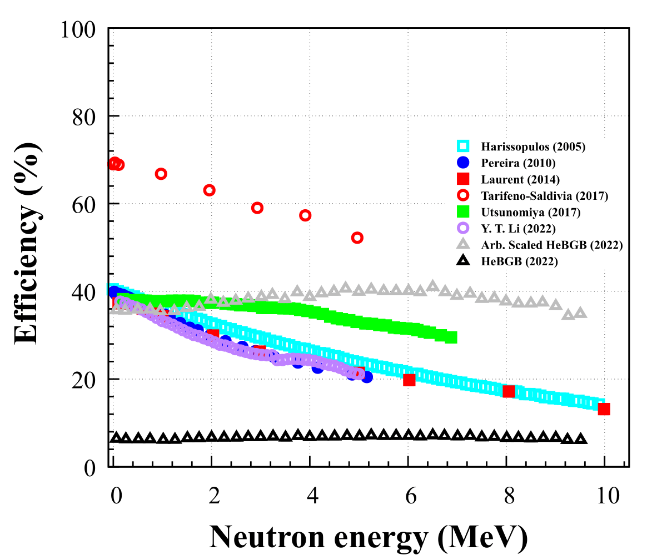
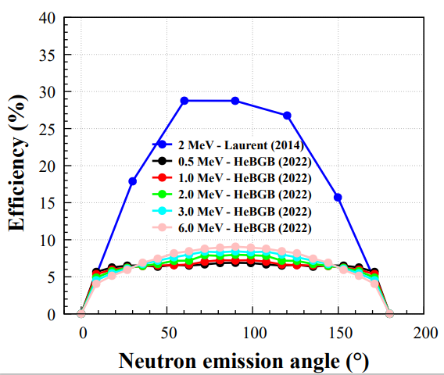
Response to energy and emission angle
Efficiency vs Neutron energy
Efficiency vs Neutron emission angle
[Journal of Instrumentation 17.05 (2022): P05004.]
[NIM-A 745 (2014): 99-105.]
• When $E_{n}>1 MeV,$detection efficiency falls clearly except HeBGB detector(flatness $\sim$1.17 but with a rather low detection efficiency 7%).
• Efficiency is also sensitive to neutron emission angle, and sensitive region varies with neutron energy.

Slide 8
Efficiency analysis
Low efficiency reason
• A substantial fraction of thermal neutrons are absorbed by polyethylene.
• ³He tube can’t achieve full coverage of $4π$，partial neutrons may emitted through the ³He tubes gap.
Energy dependency reason
• Elastic cross section varies with the neutron energy in the interest region of energy.
Angle dependency reason
• ³He tube can’t achieve full coverage of $4π$，partial neutron emitted through the ³He tube gap.
New detector with less sensitivity to neutron energy and angular distribution is required!

Slide 9
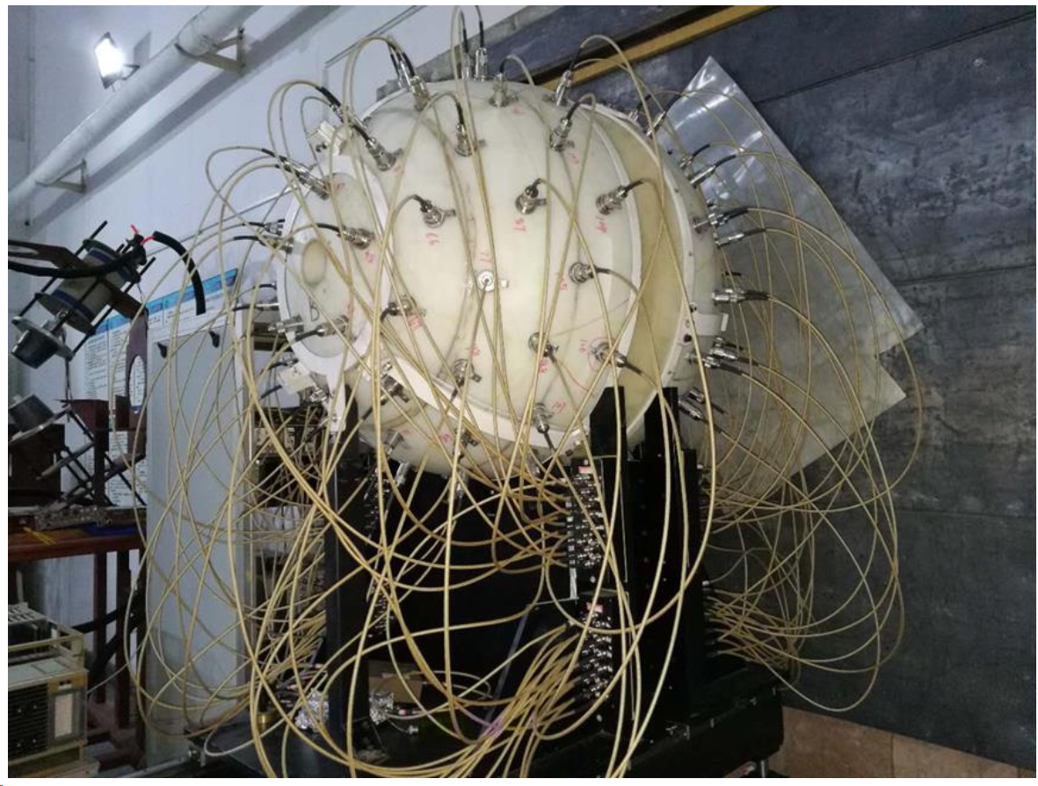
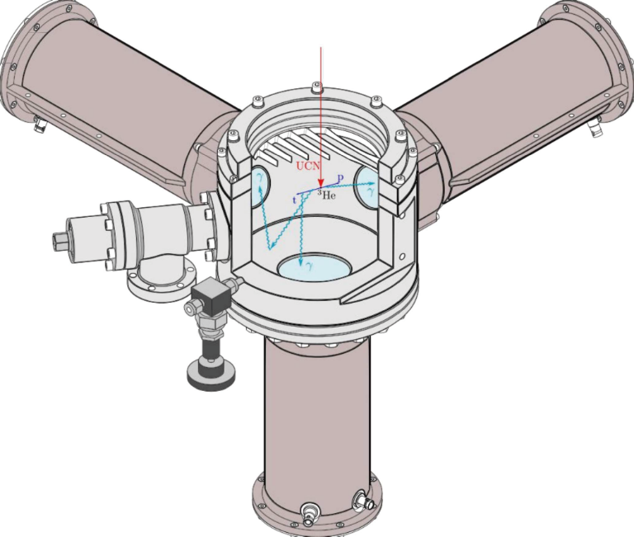
Inspiration of new detector design
“³He+CF₄”detector configuration
PMT
PMT
PMT
PMT
D₂O
CF₄+³He/BF₃
Alpha beam
Sample
[陈建琪,博士论文,基于直接中子法测量⁹³Nb(n,2n)^{92g+m}Nb反应截面的实验研究]
TMP
PMT
PMT
$$ε_{tot}=ε_{capt}{×ε}_{lum}×ε_{coll}$$
Using heavy water to slow down fast neutron
n + ³He → p + t (Q = 0.764 MeV)
p and t ionize and excite CF₄ emit light
Emitted light are detected by surrounding PMTs
Decay time 15 ns,
10⁶ cps
[William PhD thesis neutron to hidden neutron oscillation in ultracold neutron beam]

Slide 10
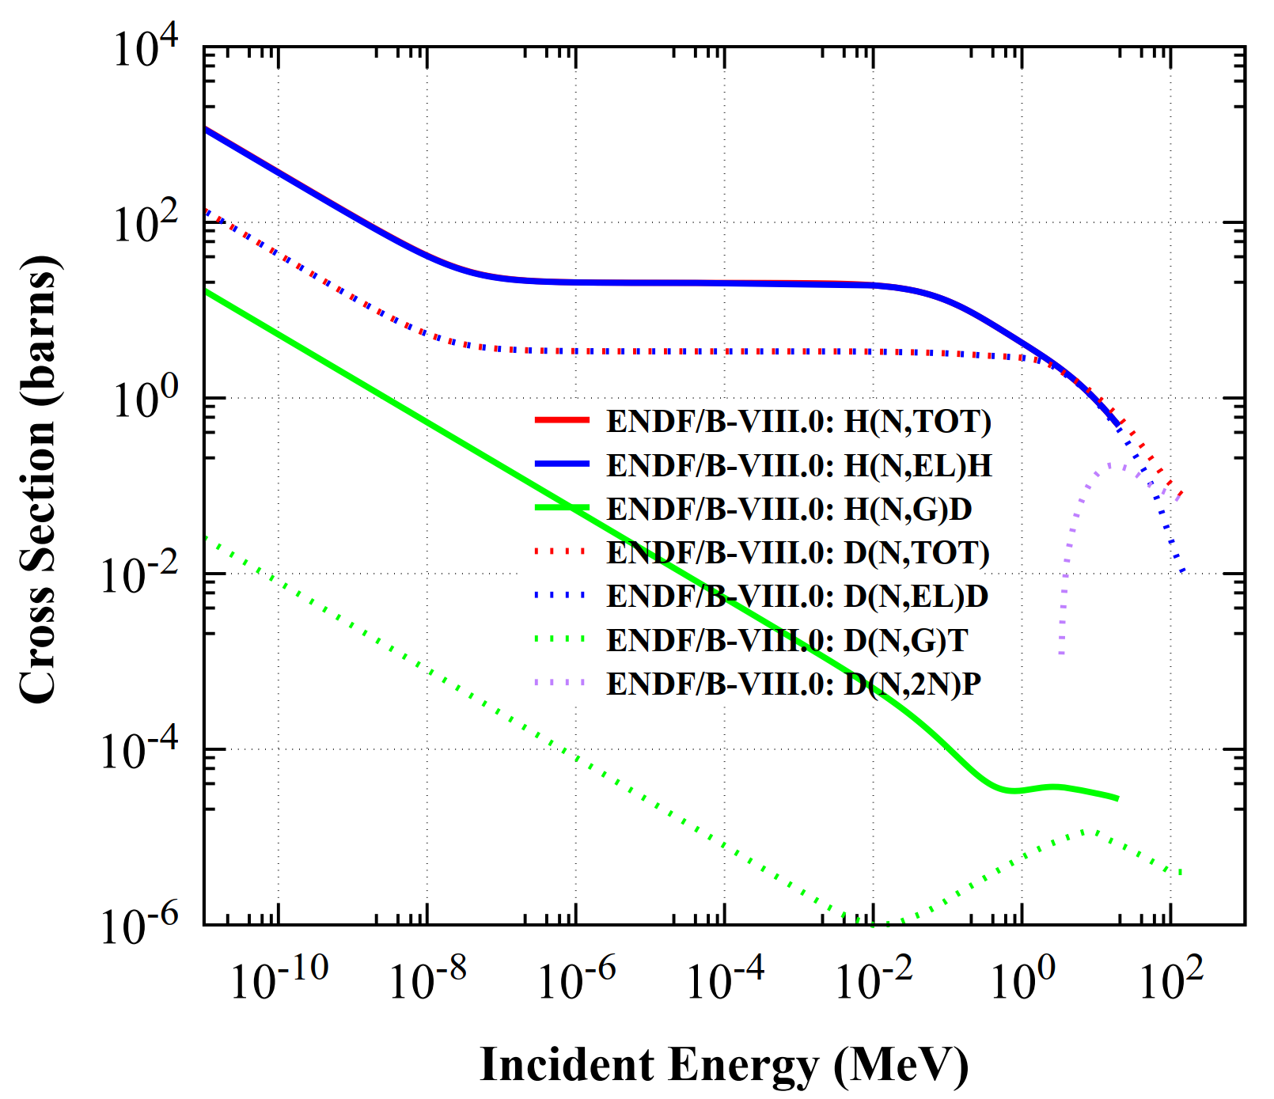
Why choose D₂O？
Excitation function of H and D
• D has a wider flatness region than H for excitation function curve of elastic scatter.
• The (n, gamma) cross-section of D is 2-3 orders of magnitude lower than that of H, greatly reducing neutron absorption.
• When $E_{n}>$3 MeV, it can open the (n, 2n) channel of D, which can significantly increase neutron number to compensate the loss of falling elastic scatter cross section.
[ENDF/B-VIII]

Slide 11
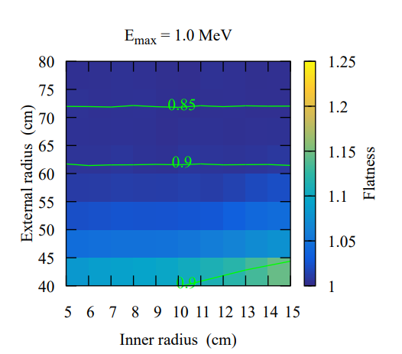
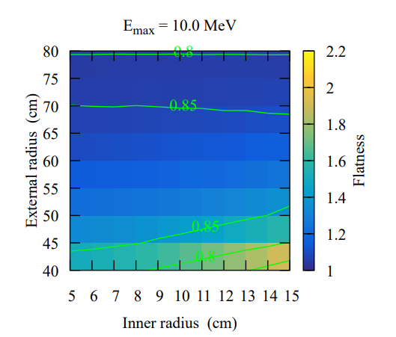
Optimal configuration
$E_{max}=1 MeV$
$E_{max}=10 Me$V
Outer radius (cm)
Outer radius (cm)
[Courtesy：Junsheng]
[Courtesy：Junsheng]
Software: MCNPX, Emission angle: isotropic distribution
$$E_{n}=\left\{0.01, 0.1, 1.0, 2.0, 3.0, 4.0, 5.0, 6.0, 7.0, 8.0, 9.0, 10.0\right\} MeV$$
• average detection efficiency $ε_{av}\left(E_{max}\right)=\frac{1}{{Num(E}_{i})}\sum_{E_{i}≤E_{max}}{ε(E_{i})}$
• flatness factor $F\left(E_{max}\right)=\frac{Max(ε(E_{i}))}{Min(ε(E_{j}))}$
[The BRIKEN collaboration, Jinst, 2017, 12]

Slide 12
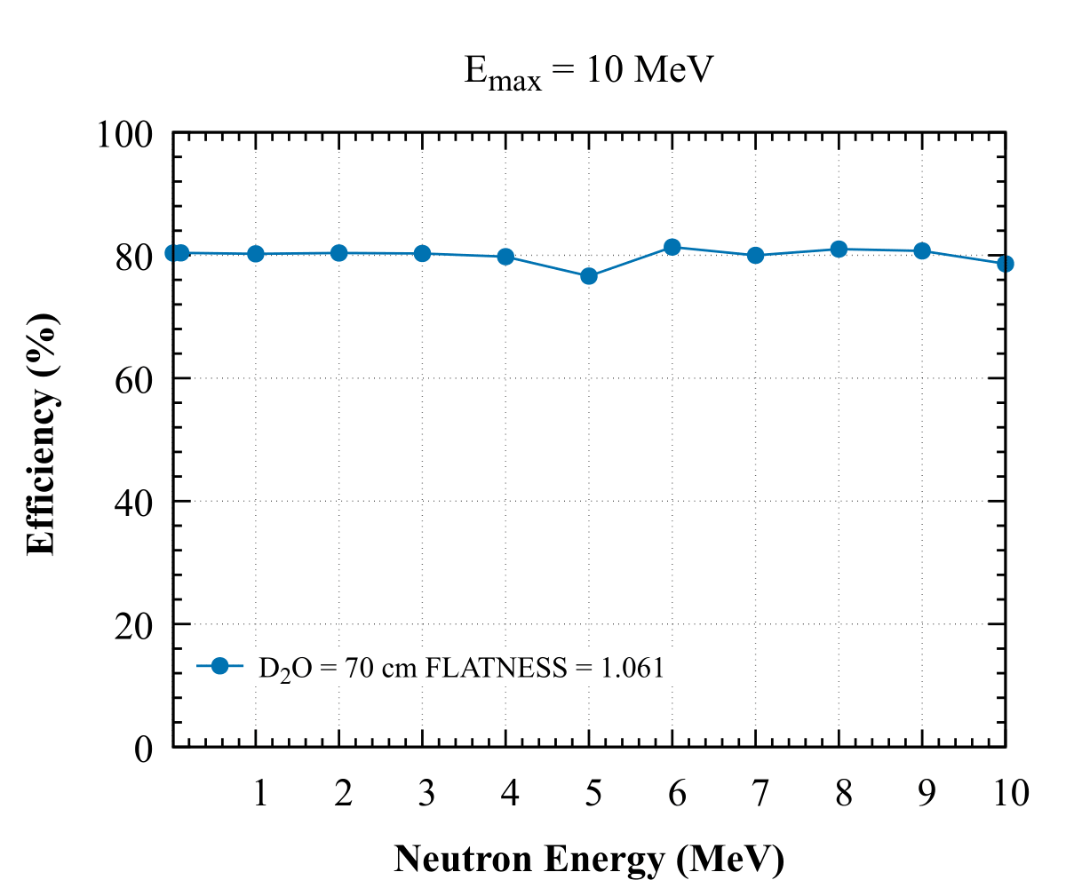
Detection efficiency @${D_{2}O}_{th}=70 cm$
configuration
Efficiency vs neutron energy
PMT
PMT
PMT
PMT
D₂O
CF₄+³He
SOURCE
TMP
PMT
PMT
• $E_{n}=\left\{0.01, 0.1, 1.0, 2.0, 3.0, 4.0, 5.0, 6.0, 7.0, 8.0, 9.0, 10.0\right\} MeV$
[Courtesy：Junsheng]
• Neutron emitted isotropically
• optimal configuration：$∅_{in}=20 cm$，$∅_{out}=160 cm$，$∅_{ch}=8 cm$，³He thickness 3.2 cm

Slide 13
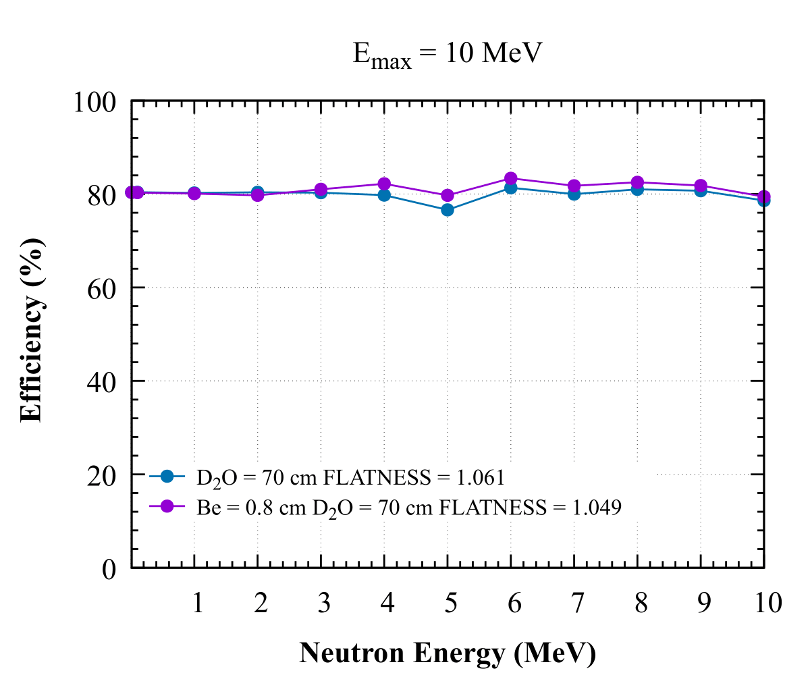
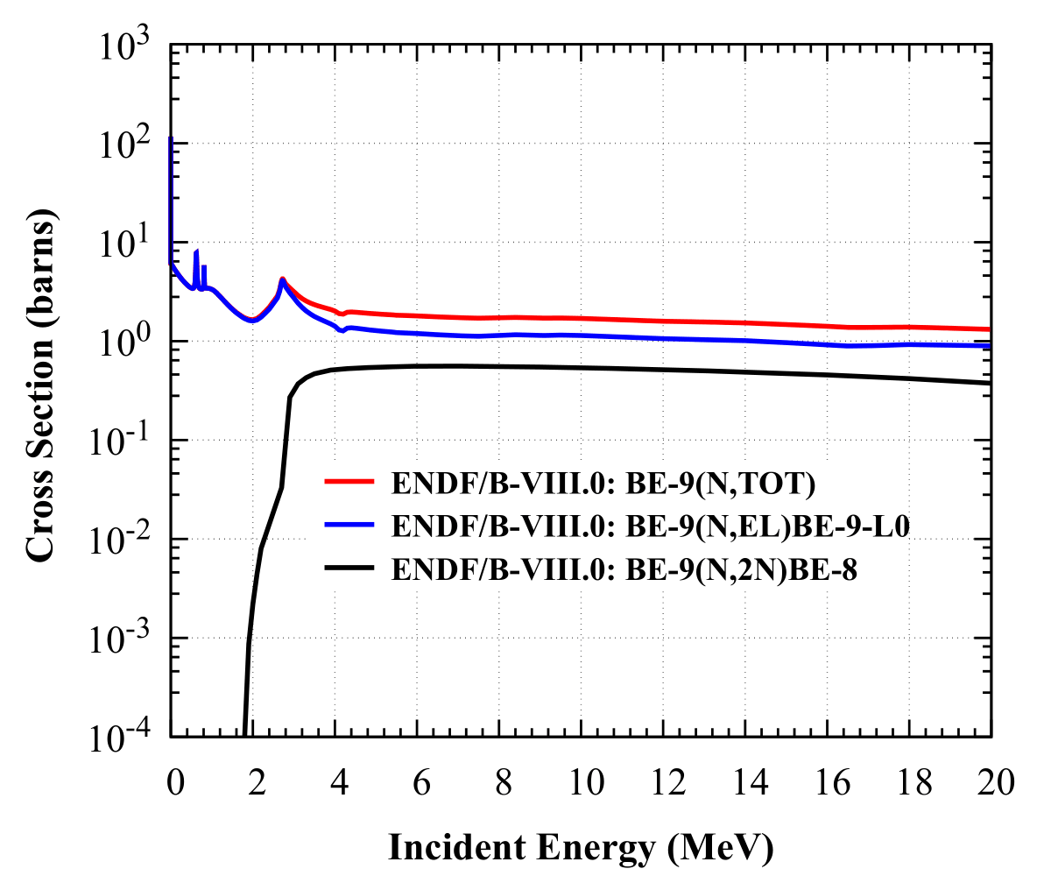
Detection efficiency@$0.8 cm Be+70 cm D2O$
⁹Be excitation function
Efficiency vs Neutron energy
[ENDF]
[Courtesy：Junsheng]
• After adding 0.8 cm Be, efficiency curve lift a bit, but the valley around 5 MeV still exists.

Slide 14
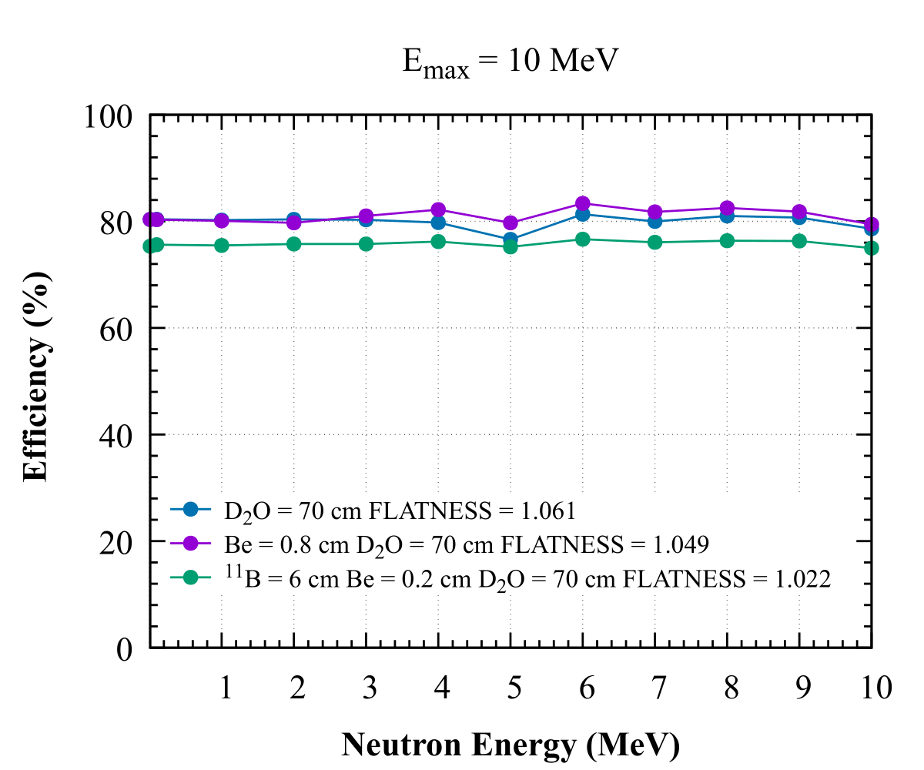
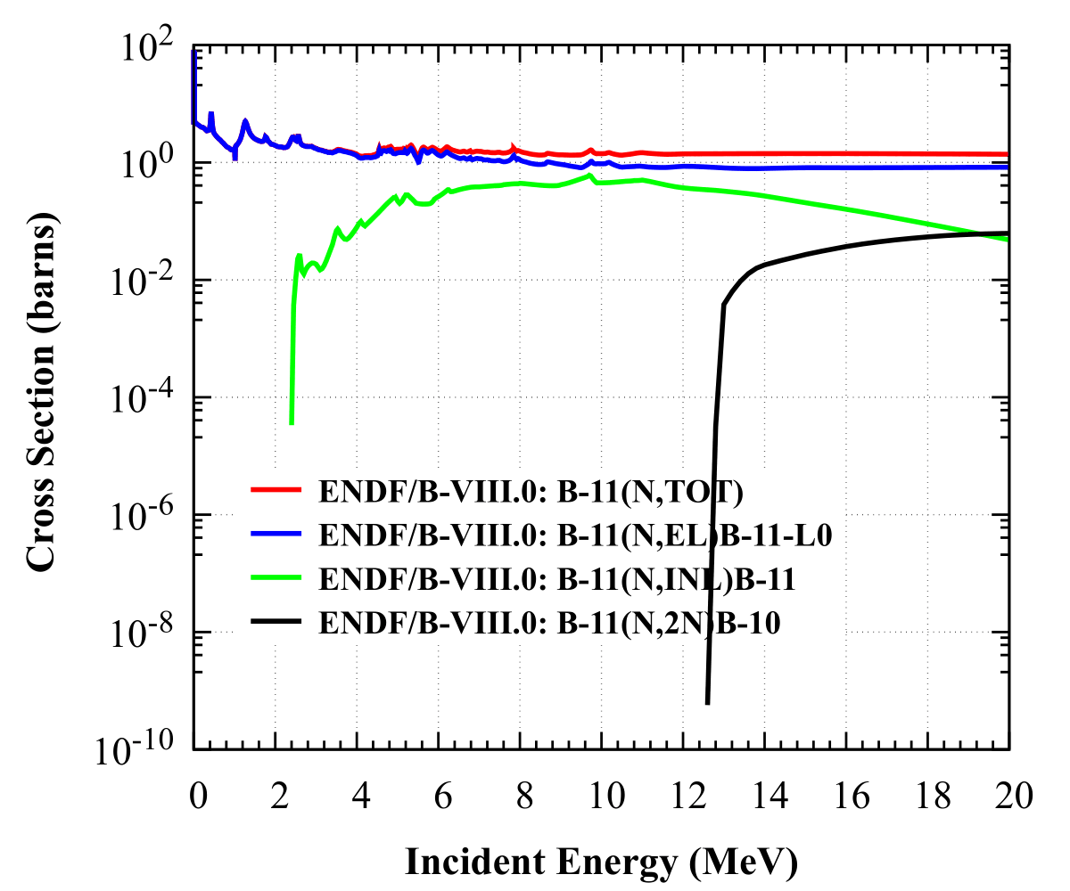
Detection efficiency@$6 cm 11B+0.8 cm Be+70 cm D2O$
¹¹B excitation function
Efficiency vs Neutron energy
[ENDF]
[Courtesy：Junsheng]
• After adding 6 cm ¹¹B，efficiency drops to 75%，flatness has significant improvement, reaching to 1.02.

Slide 15
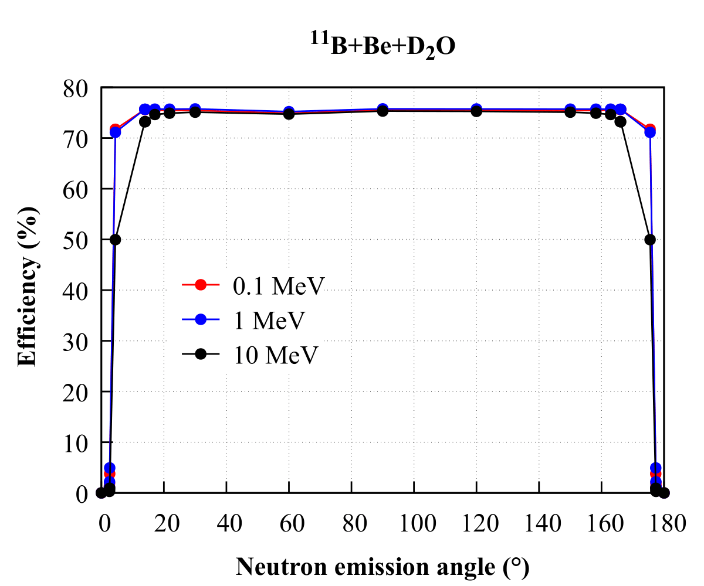
Efficiency angular dependency
Optimal configuration
Efficiency vs Neutron Emission Angle
³He
D₂O
Be
B
PMT
PMT
PMT
PMT
SOURCE
PMT
PMT
PMT
Neutron energy: $\{0.1, 1, 10\}$ MeV
Neutron emission angle:$\left\{{30}^{°},{60}^{°},{90}^{°},{120}^{°},{150}^{°}\right\}$ and angle with respect to different materials
Run number： ${10}^{7}$
[Courtesy：Junsheng]
• Efficiency independency angle region: [${16}^{°}$, ${164}^{°}$]
• Flatness region independent with neutron energy

Slide 16
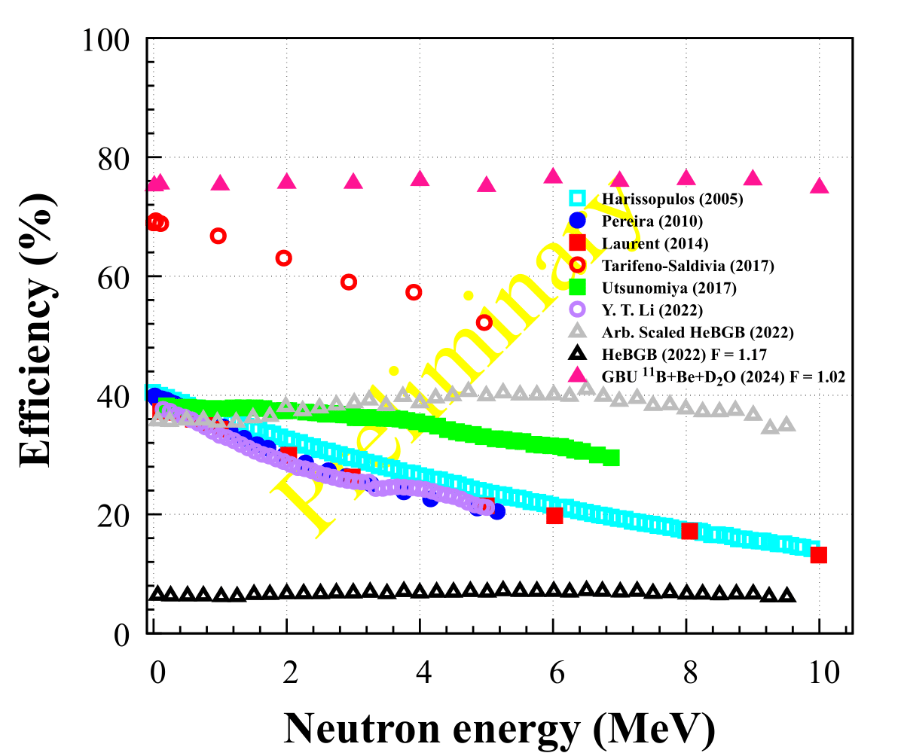
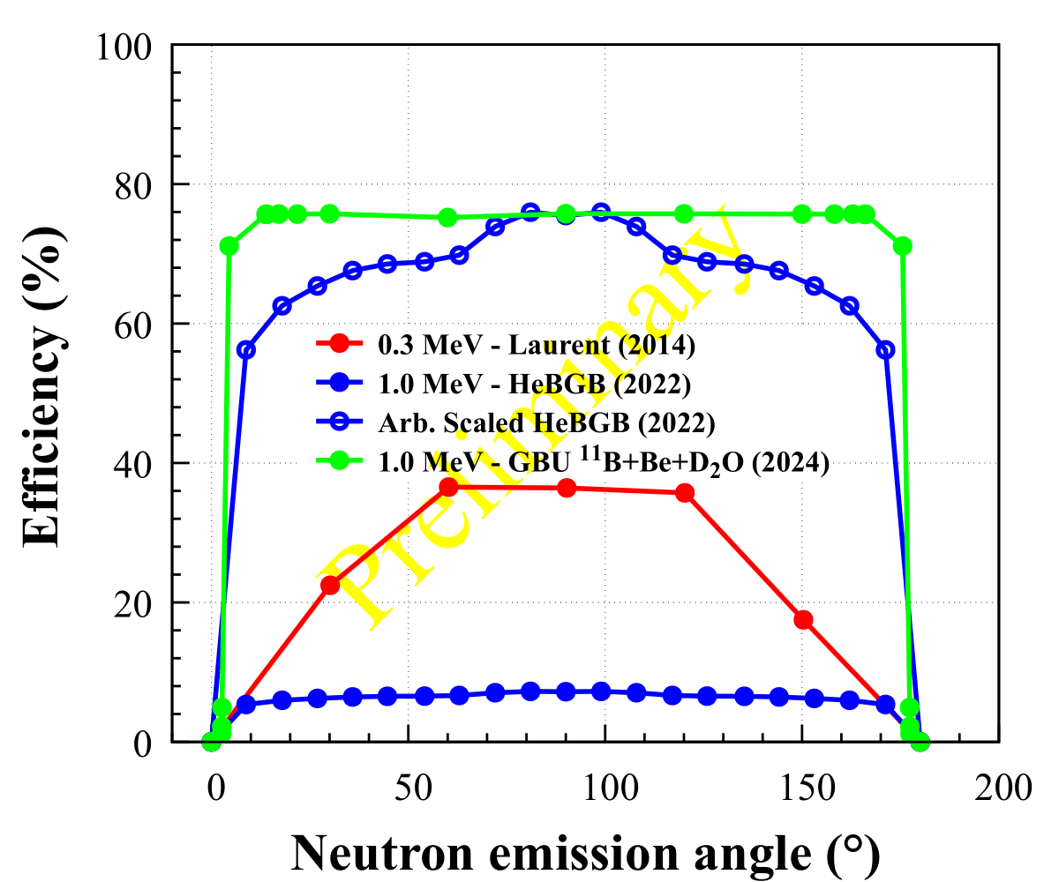
Performance comparison
Efficiency vs Neutron Energy
Efficiency vs neutron emission angle
[Courtesy：景俊升]
[Courtesy：Junsheng]
• “CF₄+³He” gas scintillation detector(6 cm ¹¹B+0.2 cm Be+70 cm+2.8 cm ³He) has a better flatness of 1.02, and detection efficiency as high as 75%.
• “CF₄+³He” gas scintillation detector has a wider insensitive angular region.

Slide 17
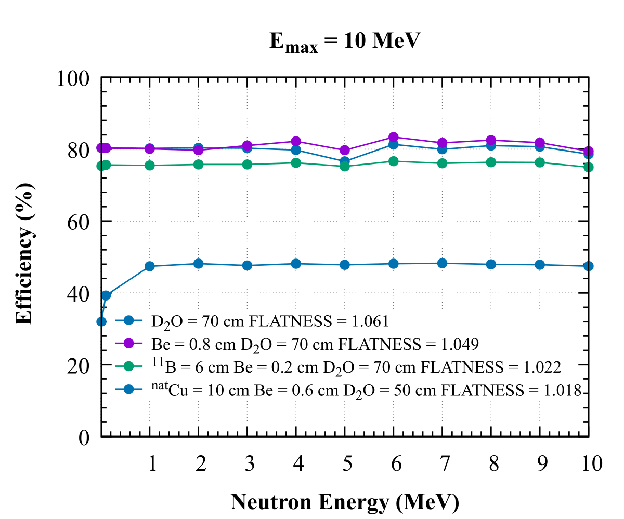
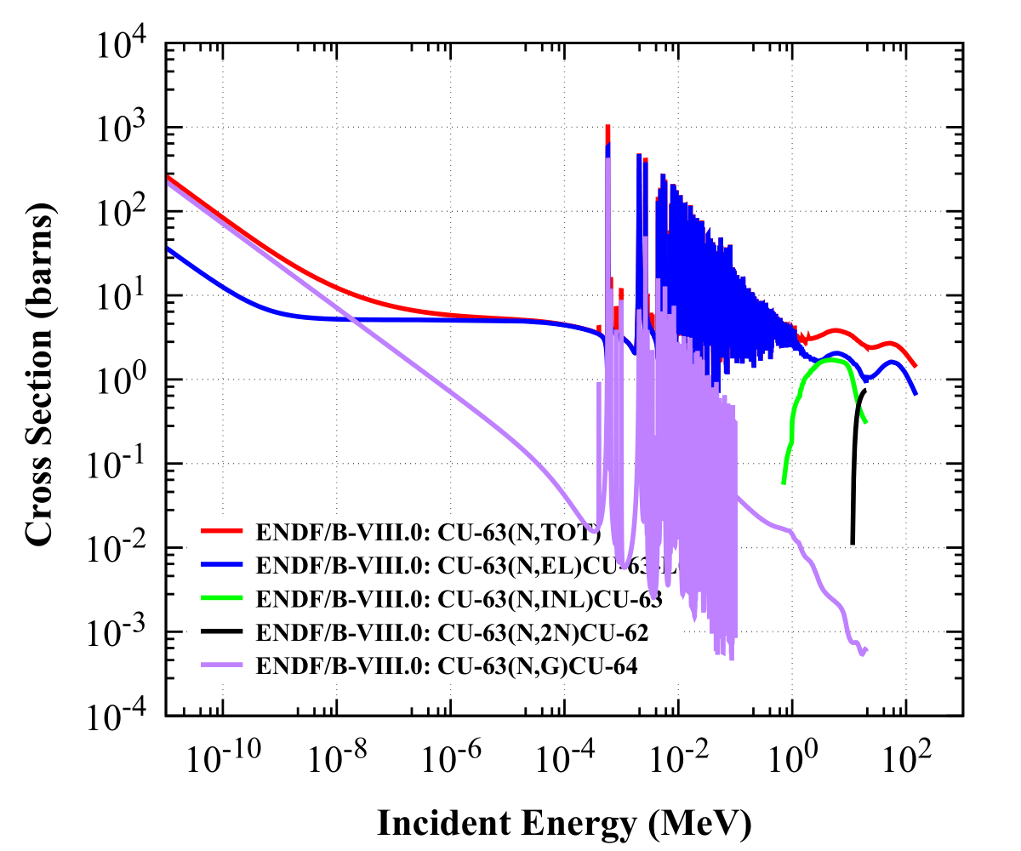
Alternative configuration 1-${}_{}^{11}B→{}_{}^{nat}{Cu}$
⁶³Cu excitation function
Efficiency vs Neutron Energy
[ENDF]
[Courtesy：Junsheng]
• After substituting 10 cm ^{nat}Cu by 6 cm ¹¹B, detection efficiency drops to 50%, and flatness curve get worse when $E_{n}<1 MeV.$

Slide 18
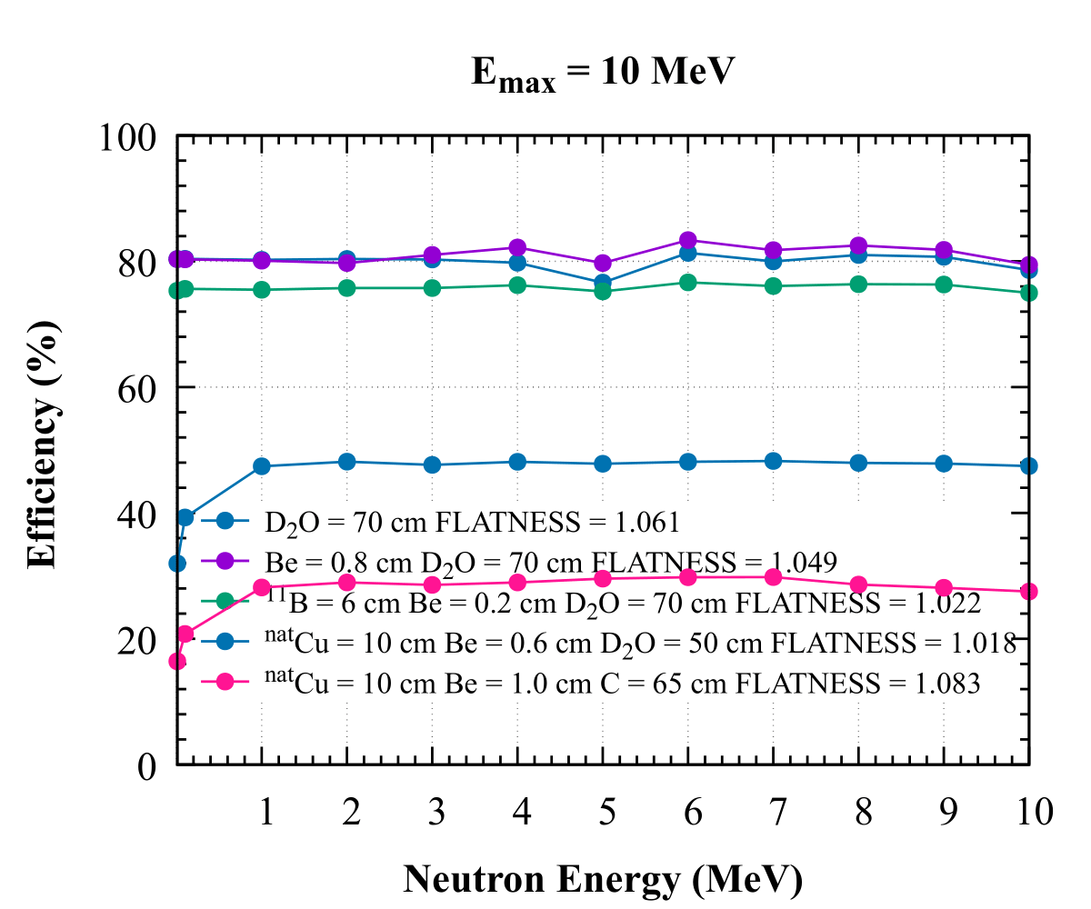
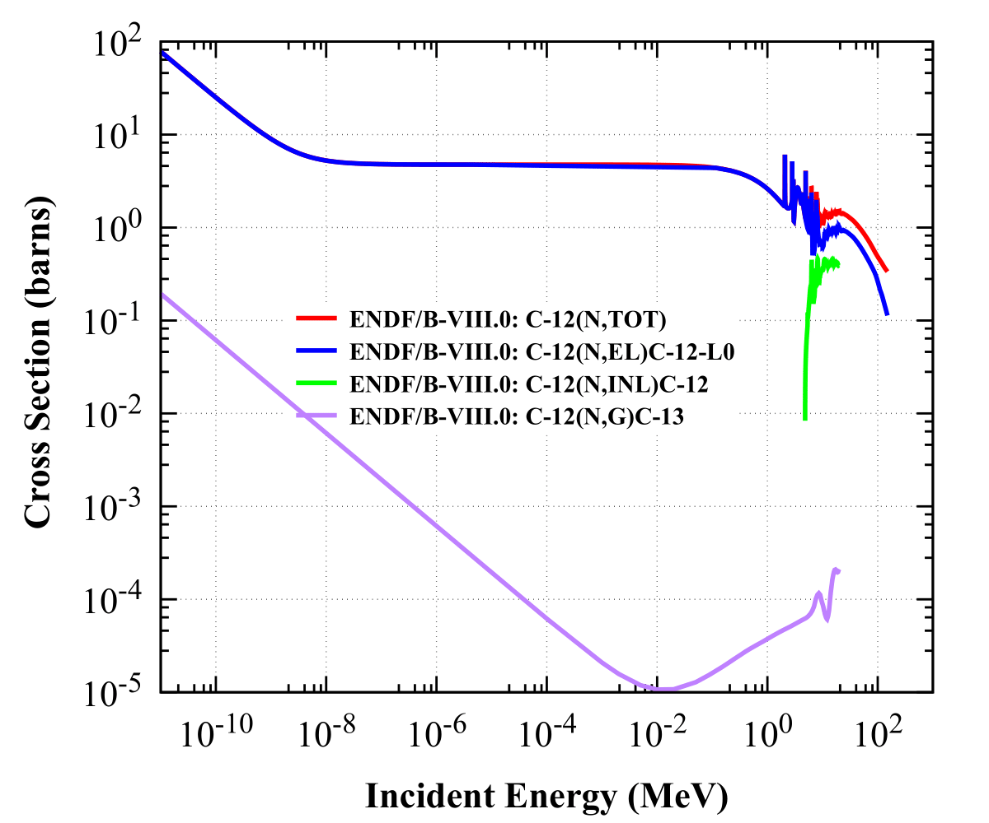
Alternative configuration 2-${}_{}^{11}B→{}_{}^{nat}{Cu}+D2O→C$
C excitation function
Efficiency vs Neutron energy
[Courtesy：Junsheng]
• Besides replacing ¹¹B by ^{nat}Cu, also substitute D₂O by C(Graphite), detection efficiency drops to 30% and flatness curve still is bad when $E_{n}<1 MeV$.

Slide 19
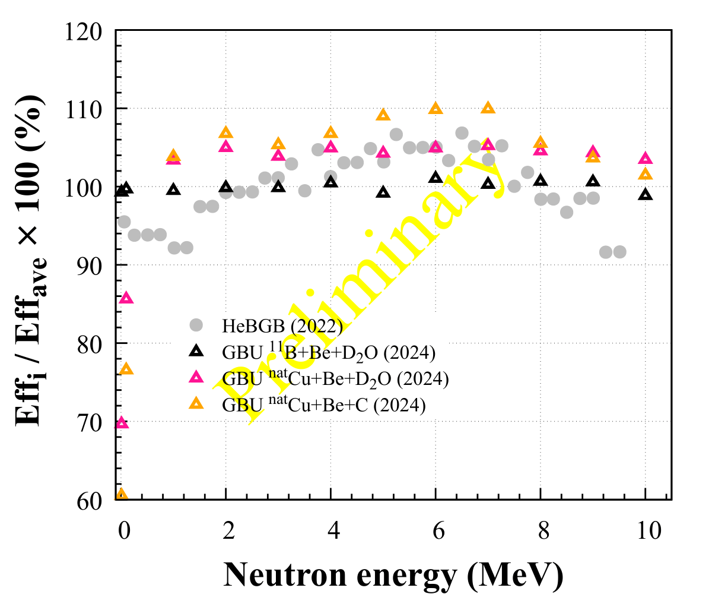
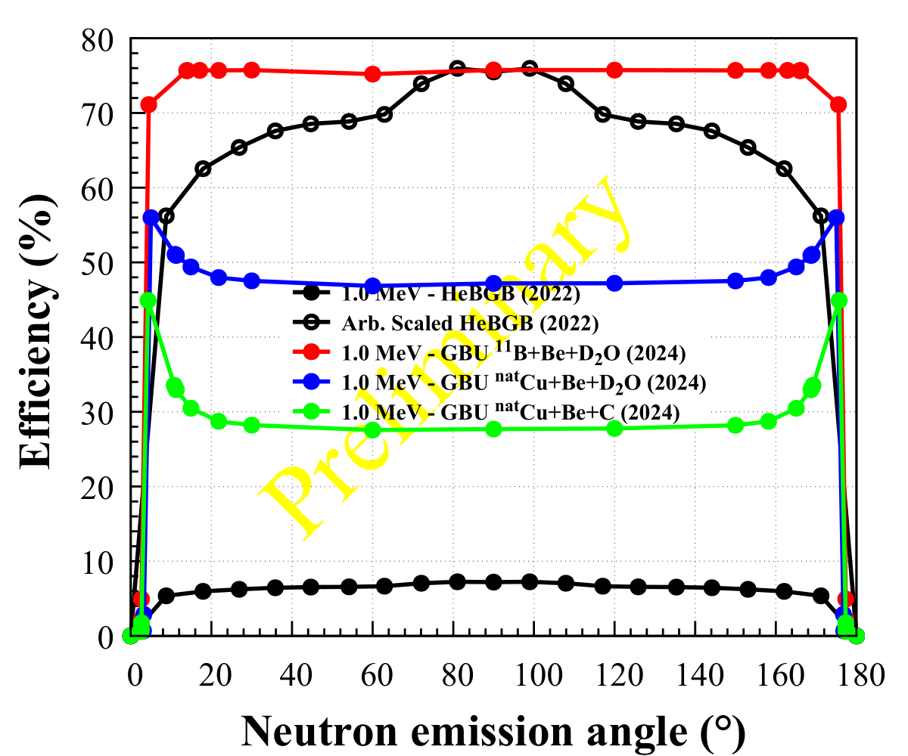
Performance comparison
Efficiency vs Neutron energy
Efficiency vs Neutron emission angle
[Courtesy：Junsheng]
[Courtesy：Junsheng]
Detector/Performance | HeBGB | ¹¹B+B+D₂O | ^{nat}Cu+B+D₂O | ^{nat}Cu+B+C
Efficiency deviation | 10% | <2% | 10%($>1MeV$) | 10%($>1MeV$)
Efficiency angle independence region |  | [16,164]$°$ | [30,150] $°$ | [30,150] $°$

Slide 20
Summary
• Merits
• high detection efficiency of 75% and less sensitivity to neutron energy and emission angle.
• less sensitivity to neutron energy, flatness: 1.02.
• less sensitivity to neutron emission angle: independency region:[${16}^{°}$,${164}^{°}$]
with respect to the incident beam.
• Demerit
• Volume is big and Cost is high(6 cm¹¹B + 0.2 cm Be +70 cm D₂O)
• Two alternative configurations(^{nat}Cu+Be+D₂O and ^{nat}Cu+Be+C) have relative low detection efficiency and a bad flatness when $E_{n}<1$ MeV.
• Not consider the contribution of light generation probability and light collection efficiency yet, more simulation and experimental work need to do.

Slide 21
Thank you!
Welcome to visit GBU!

Slide 22
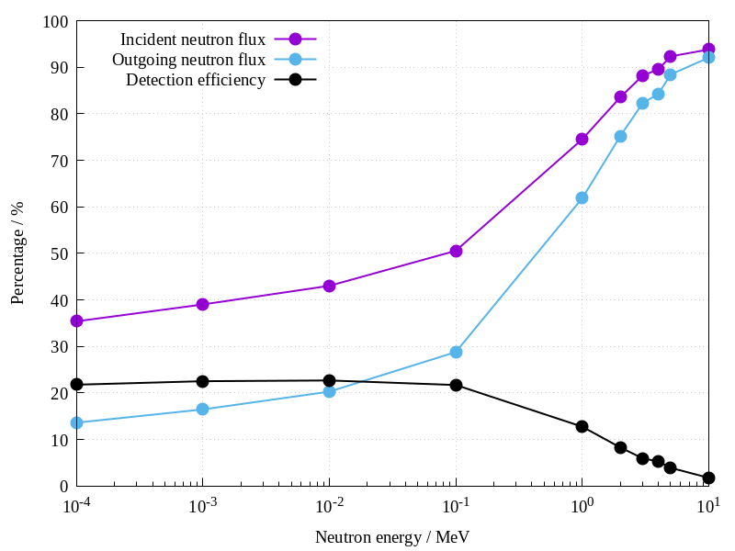
Toy Model
Geometry
➢ Detection efficiency
PM
PMT
Polyethylene
³He
5 cm
5 cm
2 cm
Neutron Source
$$N_{det}=\int{N_{inc}(E)∙σ(E)}dE$$
$$E_{i}={\{10}^{−4},{ 10}^{−3},{ 10}^{−2}, {10}^{−1}, 1, 2, 3, 4, 5, 10 \} MeV$$
Direction: isotropic emission
Run number: 200000
• Leaking neutron increase with the increasing neutron energy.
• $When E_{n}>1MeV,$ detection efficiency drops apparently.

Slide 23
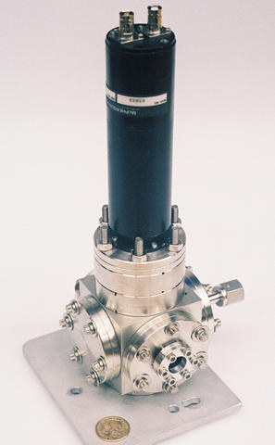
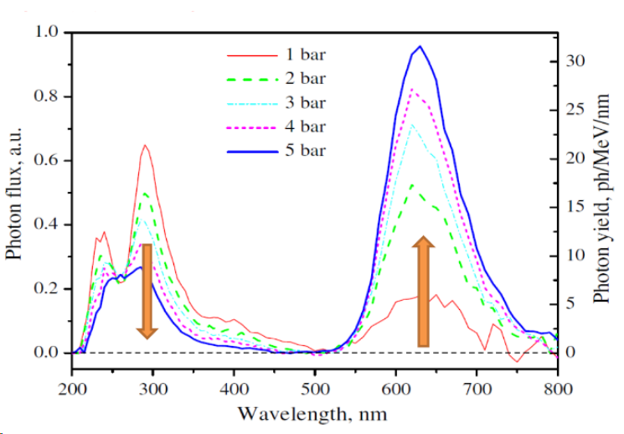
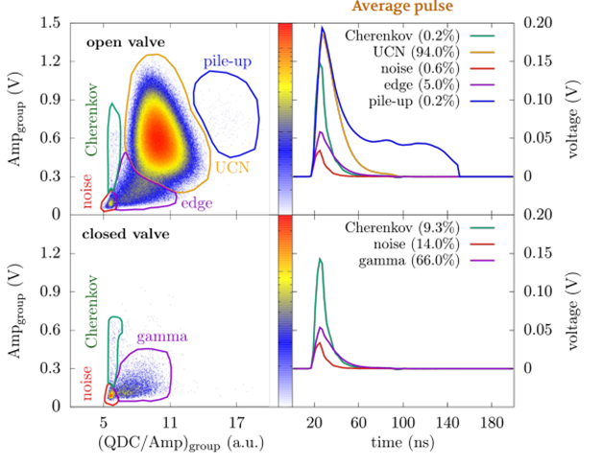
Next work plan
4 atm ³He
1-2 atm CF₄
Light Yield : 1000 photon/MeV
[祁辉荣，COUSP2024 CONFERENCE]
[J. Res. Nat. Inst. Standards Tech. 113, 69 (2008)]
[William Master Thesis]

Slide 24
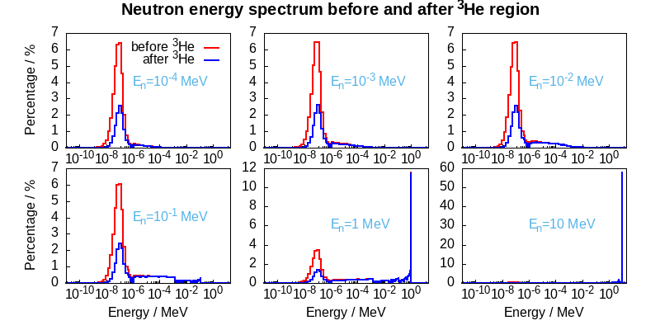
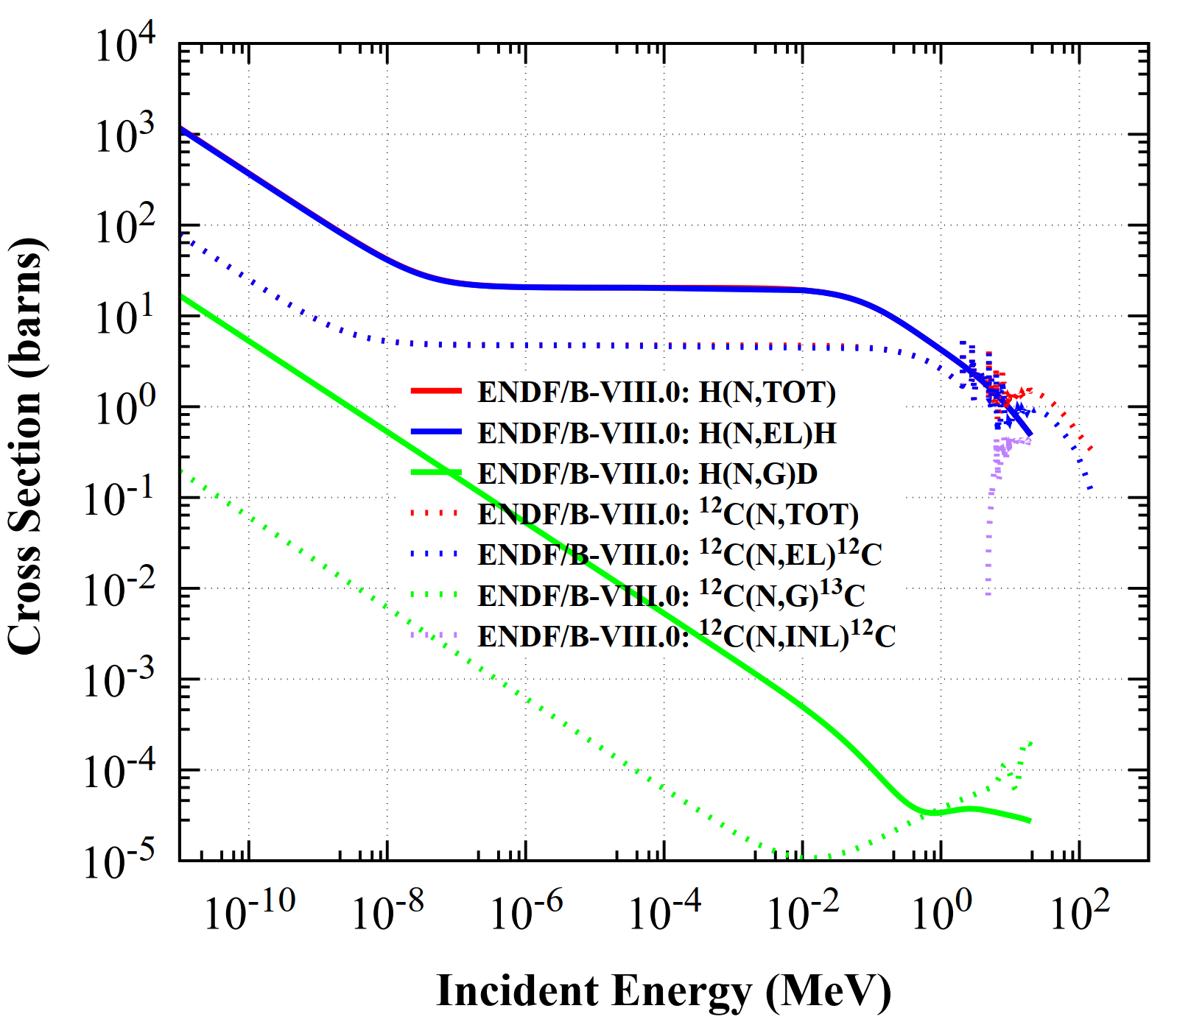
Toy Model
Geometry
• $E_{n}<1MeV,$ incident neutron spectrum small difference in thermal neutron region.
• $E_{n}>1MeV,$ great difference.

Slide 25
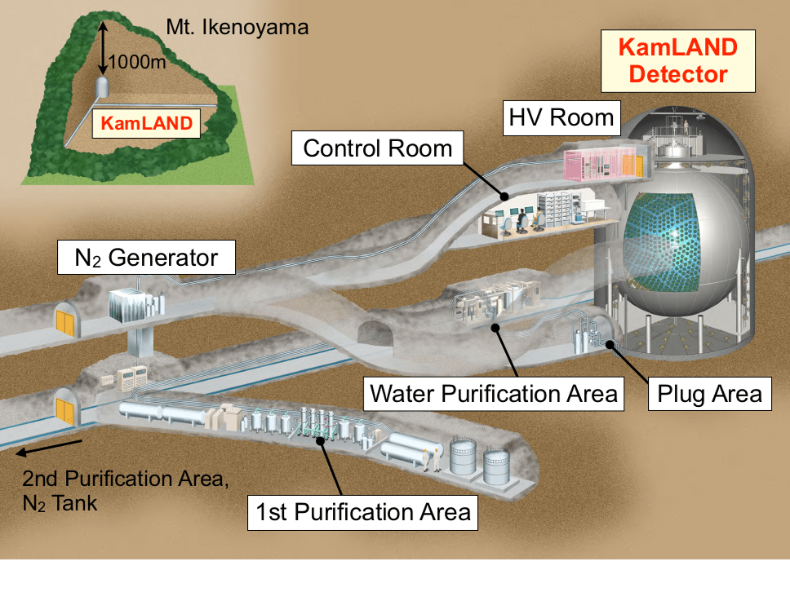
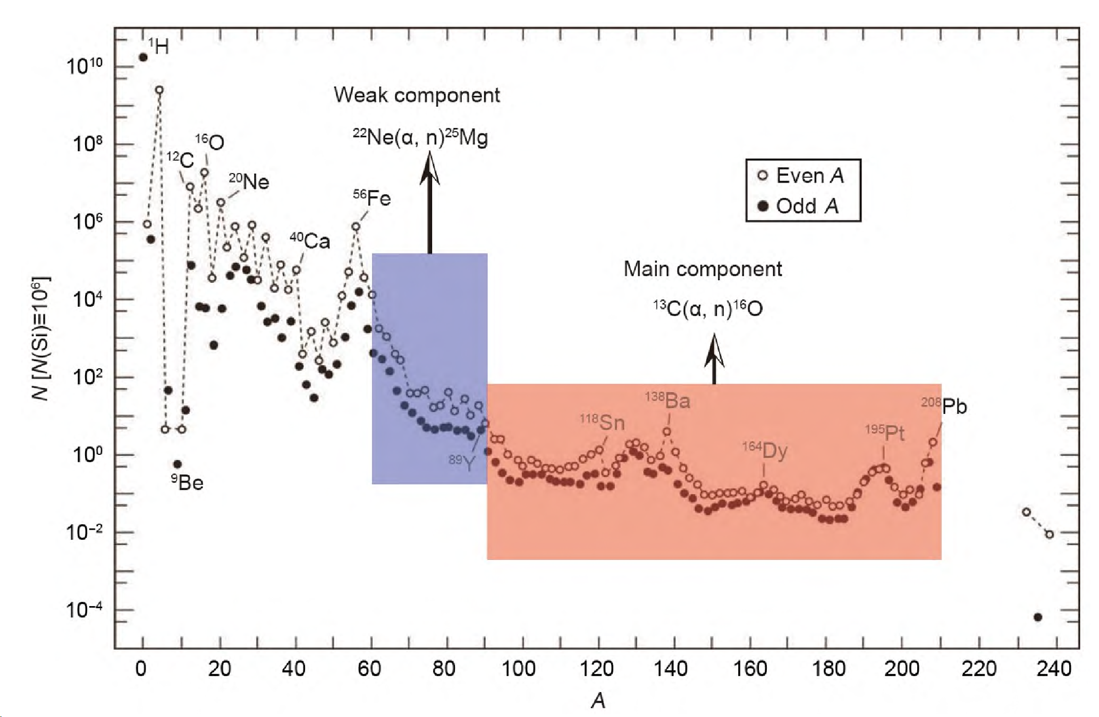
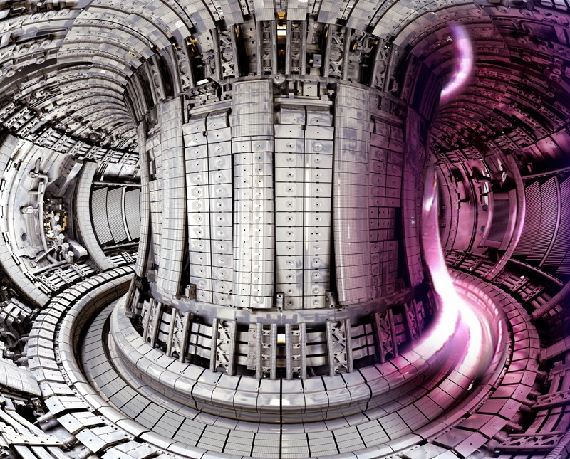
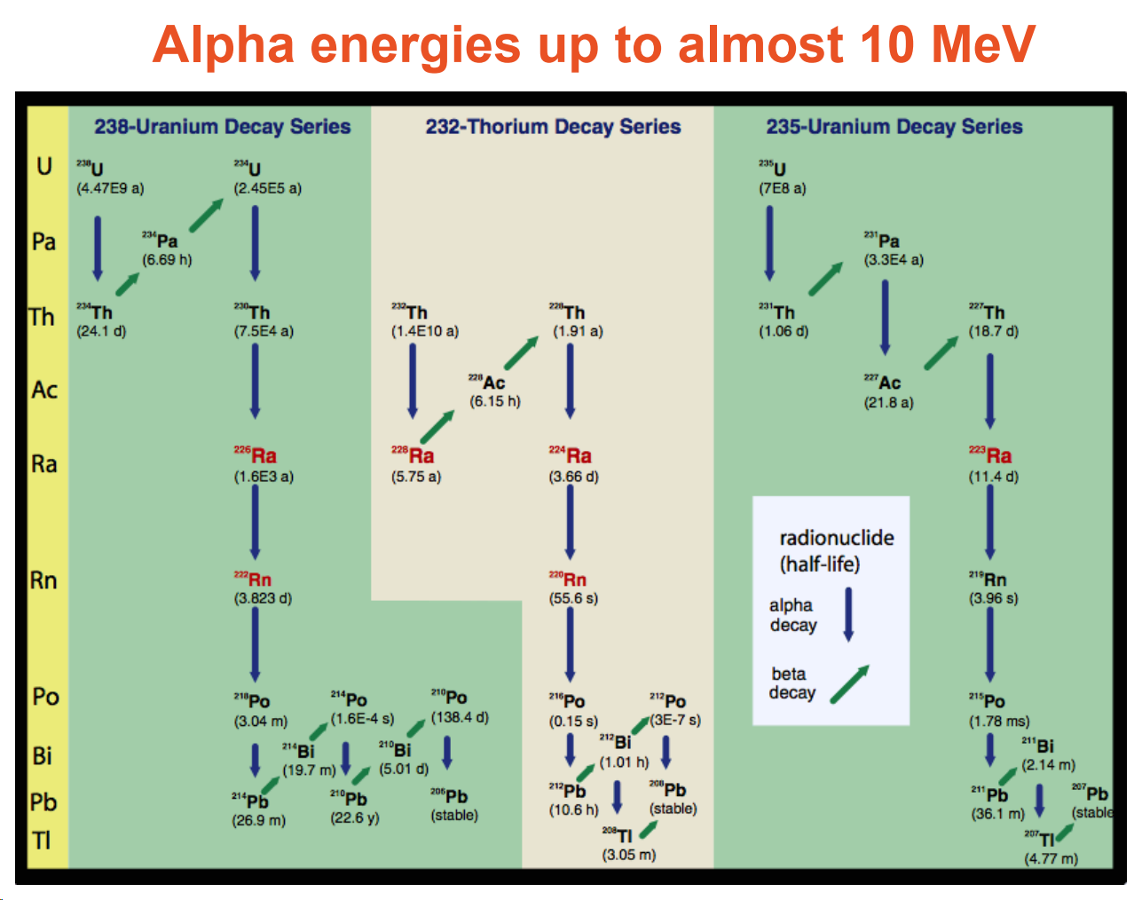
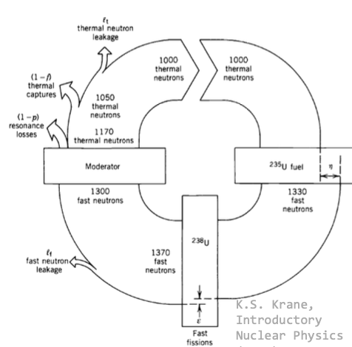
Background
WIMP & Geo-neutrinos detector background
Nuclear astrophysics
Nuclear technique
$E_{alpha}$~1 MeV (around the Gamow peak)
[Matsuda Sayuri’s doctoral thesis (2018, Tohoku University)]
[科学通报, 2022, 67(28):10.]
[ITER，来源于网络]
✓ 5.0 MeV以下，测量结果符合的较好
✓ 5.0 MeV以上，测量结果有明显偏差
• D + T → ⁴He (3.52 MeV) + n (14.1 MeV)
• D + ³He → ⁴He (3.66 MeV) + p (14.7 MeV)
• P + ¹¹B → 3 ⁴He (8.68 MeV)
10 tons of ¹³C in detector
[Juergen Reichenbacher (SDSM&T)]
• ¹⁶O(n, alpha)¹³C 反应堆中常见的反应
[PHYSICAL REVIEW LETTERS 125, 062501 (2020)]
[Mark Gilbert, IAEA technical meeting on (alpha, n) nuclear data]

Slide 26
$(α, n)$ CS measurement method
Polyethylene + ³He tubes
[Nuclear Science and Techniques 33.4 (2022): 41.]
Detectors used for direct measurement
Reference | Detector configuration
Sekharan(1967) | Paraffin + BF₃ counters
Davids(1968) | Stilbene crystal + scintillation counter
Brune and Kellogg(1993) | Polyethylene + ³He counters
Heil(2008) | BaF₂ crystal+ scintillation counter
Droleff(1993) | Polyethylene + ³He counters
[陈涵博士论文，¹³C(alpha, n)¹⁶O深地实验的相关技术研究]

Slide 27
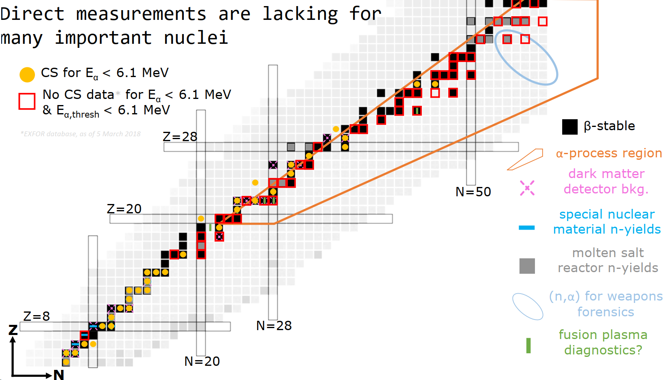
Status of $(α,n)$ cs measurement
[Zach Misel, IAEA technical meeting on (alpha,n) nuclear data]

Slide 28
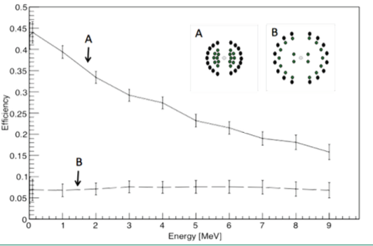
HeBGB detector
HeBGB detector configuration
18 BF₃ detectors
16 ³He detectors
[Journal of Instrumentation 17.05 (2022): P05004]
[Zach Meisel, IAEA technical meeting on (alpha, n) nuclear data]

