Slide 1
Radiative $α$ capture on ${}_{ }^{12}C$ in cluster effective field theory
Shung-Ichi Ando
Sunmoon University
OMEG2024@Chengdu, China, September 8-11, 2024

Slide 2
Contents
Introduction:
Effective field theory for ${}_{ }^{12}C(α,γ){}_{ }^{16}O$ at $E_{G}=0.3$ MeV
Elastic $α$-${}_{ }^{12}C$ scattering at low energies (brief review)
E1 transition of ${}_{ }^{12}C(α,γ){}_{ }^{16}O$ and
$β$ delayed $α$ emission from ${}_{ }^{16}N$
E2 transition of ${}_{ }^{12}C(α,γ){}_{ }^{16}O$and
ANC of subthreshold $2_{1}^{+}$ state of ${}_{ }^{16}O$
Summary and discussion

Slide 3
EFT for ${}_{ }^{12}C(α,γ){}_{ }^{16}O$ at $E_{G}=0.3$ MeV
A targe energy, $E_{G}=0.3$ MeV
its momentum scale, $Q=\sqrt{2μE_{G}}=40$ MeV
its length scale, $Q^{−1}=4.8$ fm
A separation scale, the energy difference of $p$-${}_{ }^{15}N$ and $α$-${}_{ }^{12}C$
$∆E=12.13−7.16=4.97$ MeV
its momentum scale, $Λ_{H}=\sqrt{2μΔE}=160$ MeV
The perturbative expansion parameter, $Q/{Λ_{H}}=1/4$
Construct the effective Lagrangian and calculate reaction amplitudes including Coulomb interaction non-perturnatively

Slide 4
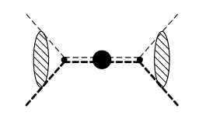
Elastic $α$-${}_{ }^{12}C$ scattering at low energies
Effective Lagrangian
Feynman diagrams
-- Dressed ${}_{ }^{16}O$ propagators
-- Elastic scattering amplitudes

Slide 5
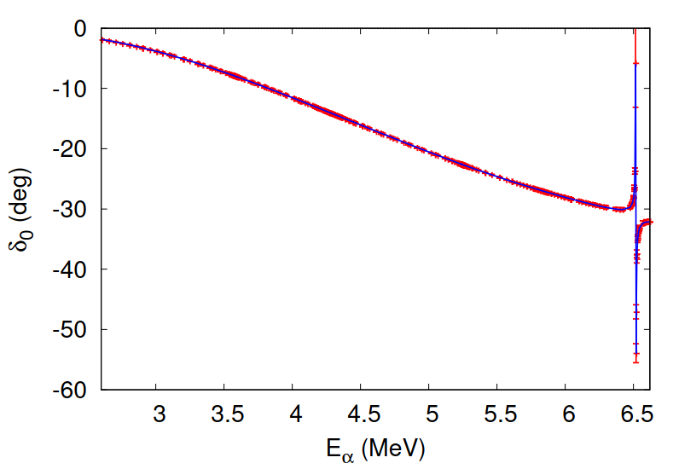
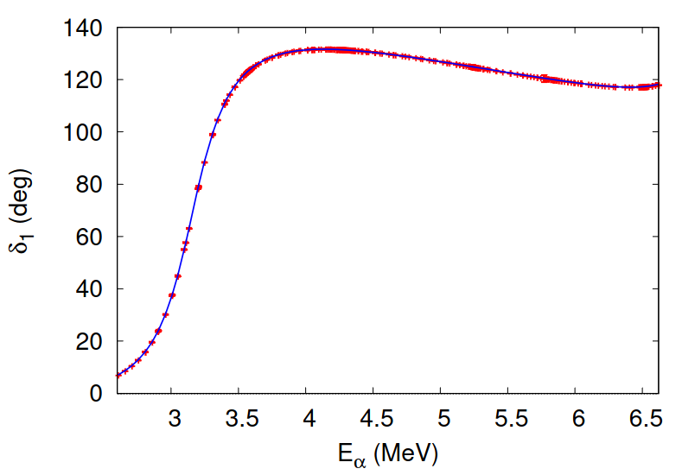
Formalism of the elastic scattering
S matrices for the elastic scattering for l=0,1,2,3,4,5,6
4 parameters for each bound and resonant states of ${}_{ }^{16}O$
Parameters fitted to the accurate phase shift data up to the $p$-${}_{ }^{15}N$ breakup reported by Tishchhauser et al. (2009).

Slide 6
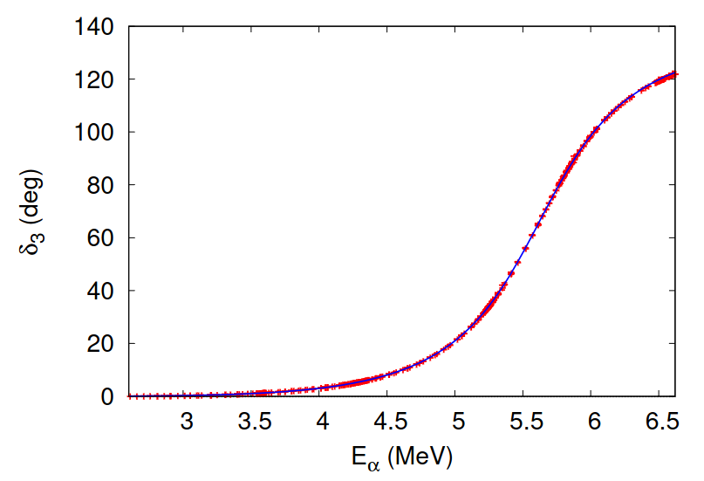
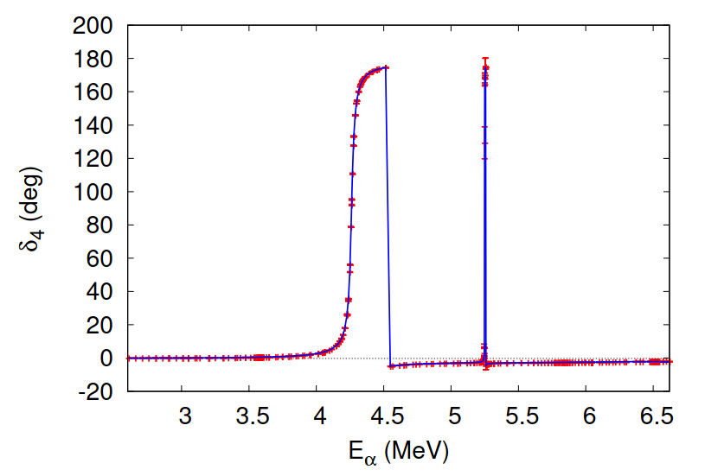
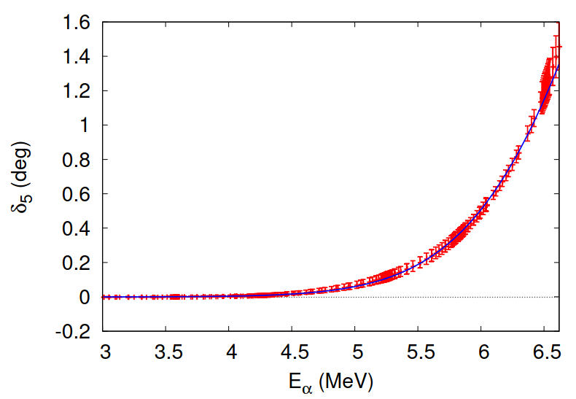

Slide 8
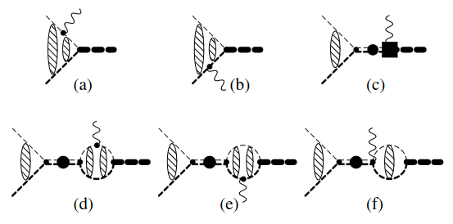
E1 transition of ${}_{ }^{12}C(α,γ){}_{ }^{16}O$
Feynman diagrams
-- Five parameters
ERPs $r_{1}$, $P_{1}$, $Q_{1}$,
an ANC $y^{(0)}$,
counter term $h_{R}^{(1)}$
-- $y^{(0)}$ and $h_{R}^{(1)}$ are
fitted to the data of
$S_{E1}$ factor

Slide 9
$S_{E1}$ factor of ${}_{ }^{12}C(α,γ){}_{ }^{16}O$ at $E_{G}$
$h_{R}^{(1)}=2.67×{10}^{4}$ ${MeV}^{3}$
$$y^{(0)}=0.260 {MeV}^{−1/2}$$
$${χ^{2}}/N=1.73$$
$S_{E1}=59±2 keVb$ at $E_{G}$

Slide 10
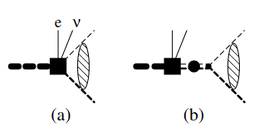
$β$ delayed $α$ emission from ${}_{ }^{16}N$
Feynman diagrams
Two sets of experimental data, Azuma et al. and Tang et al.
Final p-wave and f-wave states
Seven parameters in total; two are fixed by ordinary $β$ decay to the subthreshold $1_{1}^{−}$ and $3_{1}^{−}$ states of ${}_{ }^{16}O$

Slide 11
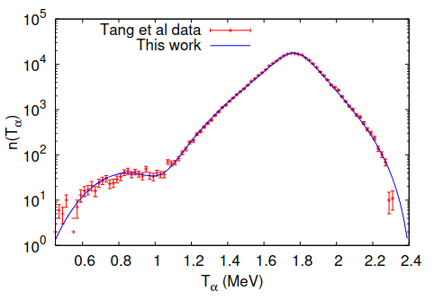
Fitted results
${χ^{2}}/N$ ($N$) = 4.06 (91) ${χ^{2}}/N$ ($N$) = 3.56 (93)

Slide 12
ANC of subthreshold $2_{1}^{+}$ state of ${}_{ }^{16}O$
A problem
-- Effective range parameters from elastic scattering for l = 2
${\left|C_{b}\right|}_{2}=\left(2.41±0.38\right)×{10}^{4} {fm}^{−1/2}$
-- Deduced from the $α$-transfer reactions, ${}_{ }^{12}C({}_{ }^{6}{Li},d){}_{ }^{16}O$
${\left|C_{b}\right|}_{2}=\left(11.1±1.1\right)×{10}^{4} {fm}^{−1/2}$
-- About a factor of five difference

Slide 13
Inverse of dressed ${}_{ }^{16}O$ propagator, $D_{2}(E)$
-- Two ANCs
$${\left|C_{b}\right|}_{2}=3.24×{10}^{4} {fm}^{−1/2}$$
$${\left|C_{b}\right|}_{2}=22.8×{10}^{4} {fm}^{−1/2}$$
-- Both the lines reproduce
the phase data for l=2 well.
-- The phase shift data cannot
determine the ANC of $2_{1}^{+}$ state
of ${}_{ }^{16}O$

Slide 14
E2 transition of ${}_{ }^{12}C(α,γ){}_{ }^{16}O$
Feynman diagrams
-- Five parameters
ERPs $r_{2}$, $P_{2}$, $Q_{2}$,
an ANC $y^{(0)}$,
counter term $h_{R}^{(2)}$
-- $y^{(0)}$ and $h_{R}^{(2)}$ are
fitted to the data of
$S_{E2}$ factor

Slide 15
$S_{E2}$ factor of ${}_{ }^{12}C(α,γ){}_{ }^{16}O$ at $E_{G}$
-- Small ANC
$h_{R}^{\left(2\right)}={7.15}_{−0.56}^{+0.39}×{10}^{11}$ ${MeV}^{4}$
$y^{(0)}={8.8}_{−3.6}^{+8.4}×{10}^{−3} {MeV}^{−1/2}$
${χ^{2}}/N=1.55$
$S_{E2}={3.6}_{−0.6}^{+0.3} keVb$ at $E_{G}$
-- Large ANC
$h_{R}^{\left(2\right)}={7.8625}_{−0.0035}^{+0.0017}×{10}^{11}$ ${MeV}^{4}$
$y^{(0)}={8.43}_{−0.38}^{+0.26}×{10}^{−2} {MeV}^{−1/2}$
${χ^{2}}/N=1.25$
$S_{E2}={81}_{−9}^{+19} keVb$ at $E_{G}$

Slide 16
Preliminary results for $S_{E1}$ and $S_{E2}^{ }$ factors
$S_{E1}$ and $S_{E2}^{ }$ factors are fitted
-- Dimensional regularization
-- $S_{E1}$ factor; two parameters, $h_{R}^{(1)}$, $y^{(0)}$
-- $S_{E2}^{ }$ factor; two parameters, $h_{R}^{(2)}$, $y^{(0)}$
using a set of the ERPs obtained by Sparenberg, Capel, Baye
-- $S_{E1}$ and $S_{E2}^{ }$ factors; five parameters, $h_{R}^{(1)}$, $h_{R}^{(2)}, y^{(0)}$, $c_{11}$, $c_{21}$
form factors to the contact interactions are introduced
$h_{R}^{(1)}→h_{R}^{(1)}\left(1−c_{11}\frac{p^{2}}{m_{O}^{2}}\right)$, $h_{R}^{(2)}→h_{R}^{(2)}\left(1−c_{21}\frac{p^{2}}{m_{O}^{2}}\right)$

Slide 17
$S_{E1}$ factor; two parameters, $h_{R}^{(1)}$, $y^{(0)}$
$h_{R}^{(1)}=2.67×{10}^{4} {MeV}^{3}, y^{(0)}=0.260 {MeV}^{−1/2}$
$S_{E1}=59±2 keVb$, ${χ^{2}}/N\sim 1.726$
-- The previous result is reproduced.
$S_{E2}^{ }$ factor; two parameters, $h_{R}^{(2)}$, $y^{(0)}$
$h_{R}^{(2)}=7.84×{10}^{11} {MeV}^{4}, y^{(0)}=0.0813 {MeV}^{−1/2}$
$S_{E2}={58}_{−20}^{+24} keVb$, ${χ^{2}}/N\sim 1.172$
-- Large error in $S_{E2}$ and small $χ^{2}$ values
-- Very different $y^{(0)}$ values, i.e. ANC of $0_{1}^{+}$ state of ${}_{ }^{16}O$

Slide 18
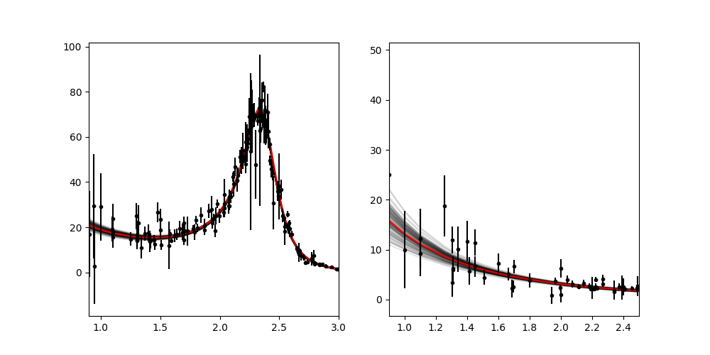
$S_{E1}$ and $S_{E2}^{ }$ factors; five parameters, $h_{R}^{(1)}$, $h_{R}^{(2)}, y^{(0)}$, $c_{11}$, $c_{21}$

Slide 19
$S_{E1}$ and $S_{E2}^{ }$ factors; five parameters, $h_{R}^{(1)}$, $h_{R}^{(2)}, y^{(0)}$, $c_{11}$, $c_{21}$
-- Fitted values
$h_{R}^{(1)}=2.59×{10}^{4} {MeV}^{3}, h_{R}^{(2)}=7.84×{10}^{11} {MeV}^{4}$,
$y^{(0)}=0.0766 {MeV}^{−1/2}$, $c_{11}=0.48×$ ${10}^{3}$, $c_{21}=−0.88×{10}^{3}$,
${χ^{2}}/N\sim 1.484$
-- Estimate of the S factors at $E_{G}=0.3 MeV$
$S_{E1}=93±9 keVb$, $S_{E2}={68}_{−23}^{+27} keVb$
-- Larger center value and error for $S_{E1}$,
-- Agreement with in the error for $S_{E2}$

Slide 20
Summary and discussion
Preliminary results of the S factors are reported
In the fit, a small error bar and a large $χ^{2}$ value for $S_{E1}$,
and a large error bar and a small $χ^{2}$ value for $S_{E2}$
Inconsistent fitted values of $y^{(0)}$,
the ANC of the ground state of ${}_{ }^{16}O$, the $αCO$ vertex function
There are the other data to be included in the fit
New data will be taken in the near future.

Slide 22
$S_{E2}$ factor of ${}_{ }^{12}C(α,γ){}_{ }^{16}O$ at $E_{G}$
-- Small ANC
$S_{E2}={3.6}_{−0.6}^{+0.3} keVb$ at $E_{G}$
${χ^{2}}/N=1.55$
-- Large ANC
$S_{E2}={81}_{−9}^{+19} keVb$ at $E_{G}$
${χ^{2}}/N=1.25$

