Slide 1
Improved proton capture reaction rates in the rp-process
Suqing Hou
Institute of Modern Physics, Chinese Academy of Sciences

Slide 2
Outline
01
Introduction to X-ray burst
02
Astrophysical reaction rate
03
Impact of nuclear masses
04
Summary

Slide 3
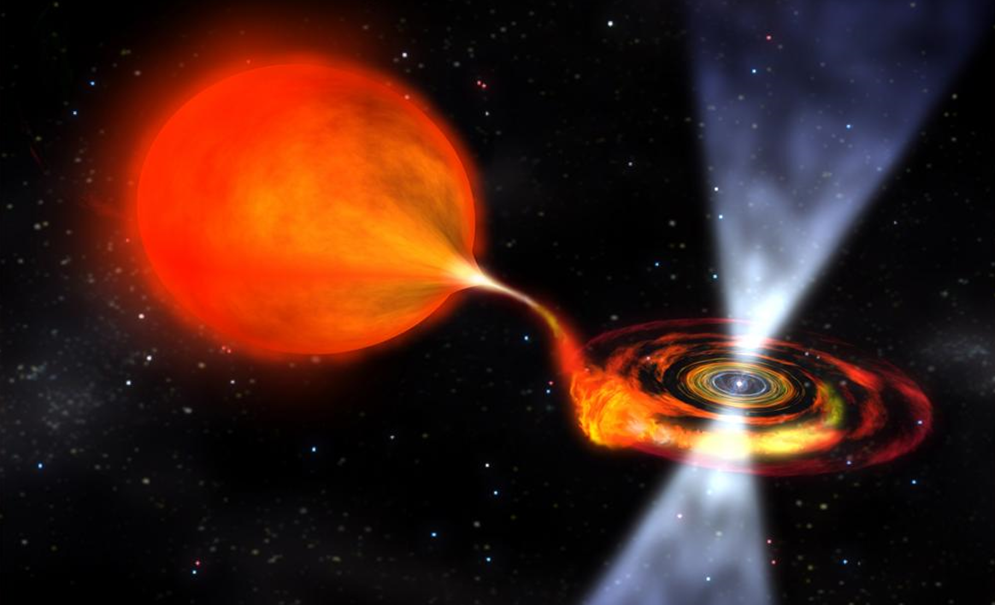

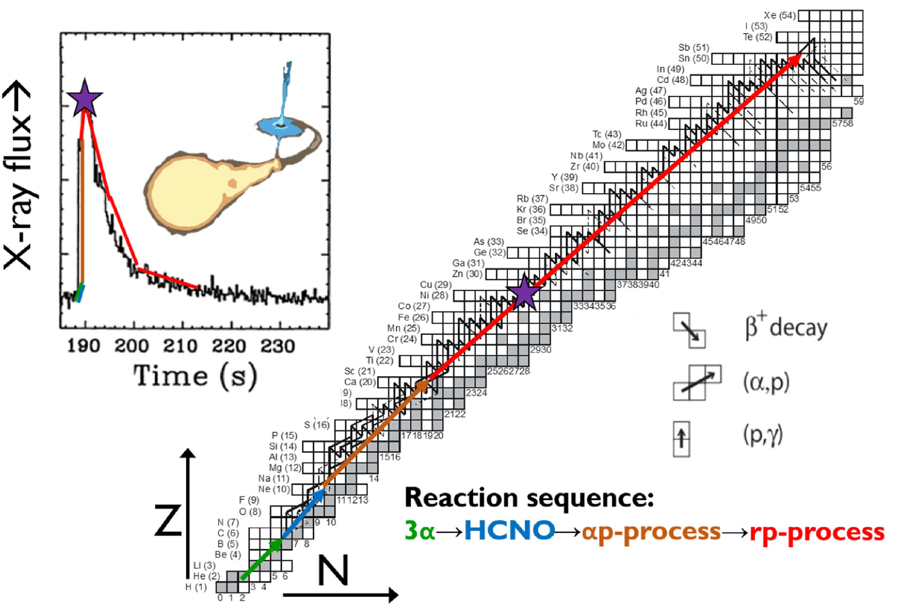
Burst
Companion star
(H + He envelope)
Neutron star
(H and He burn
into heavier elements)
Credit：NASA

Slide 4
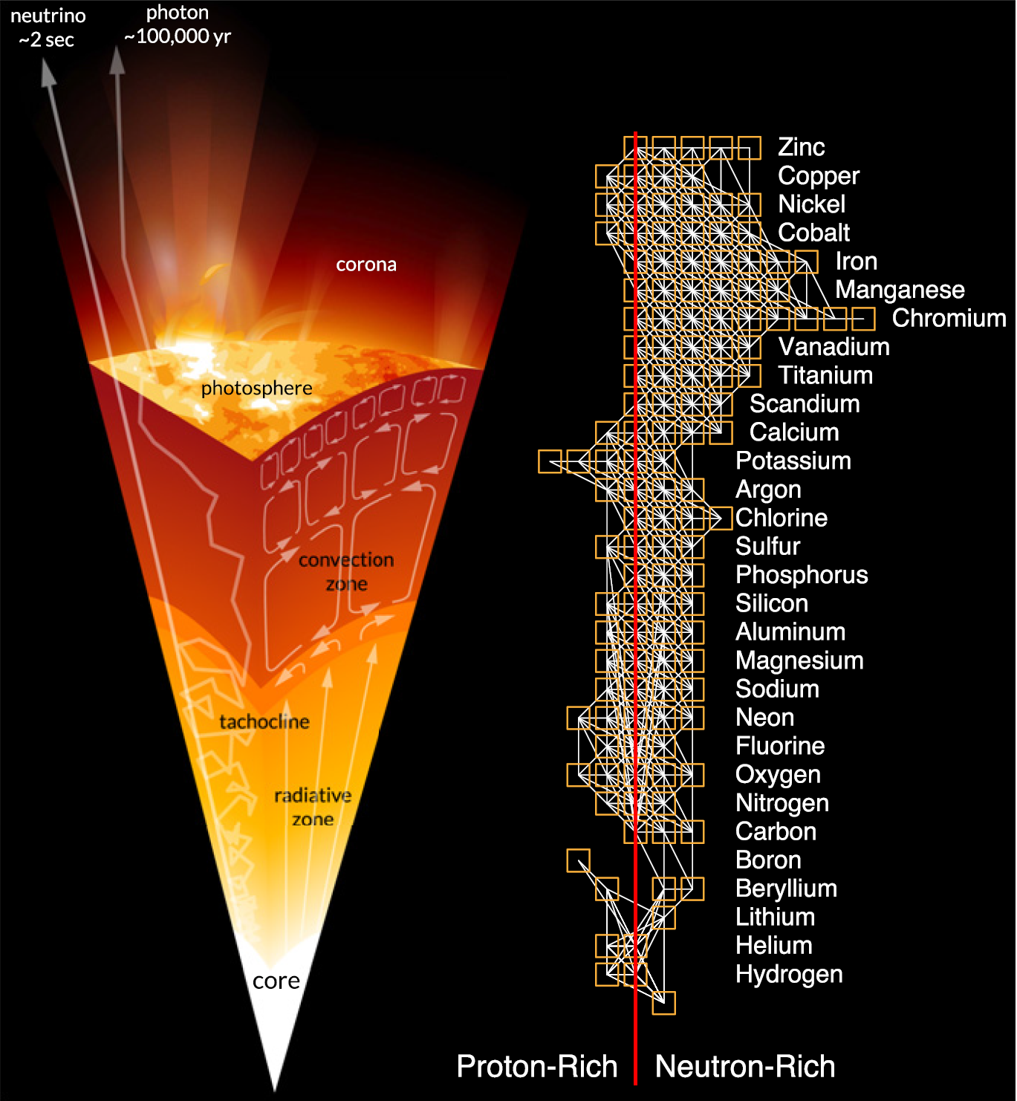
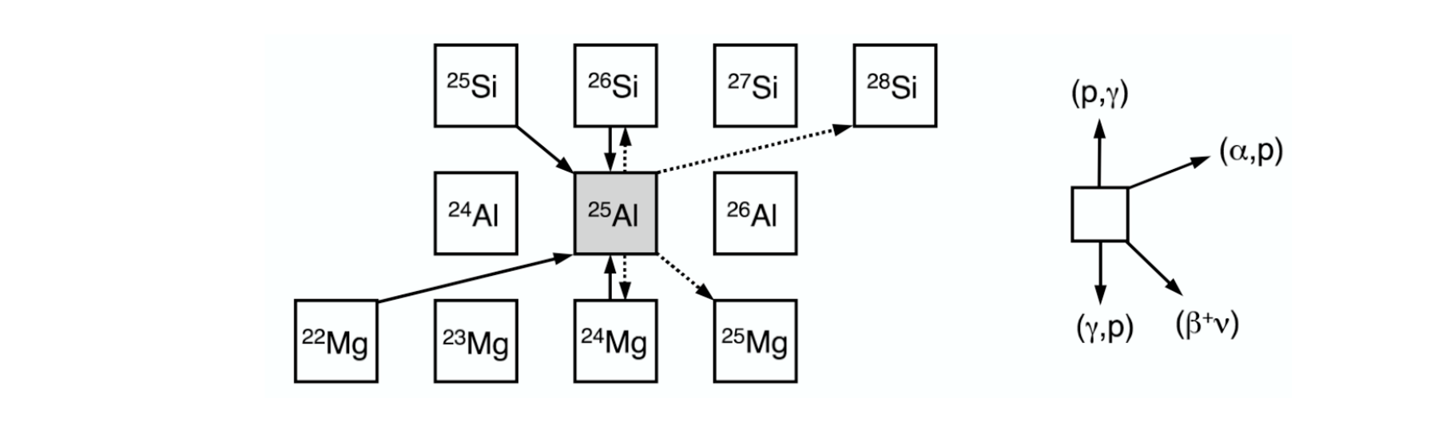
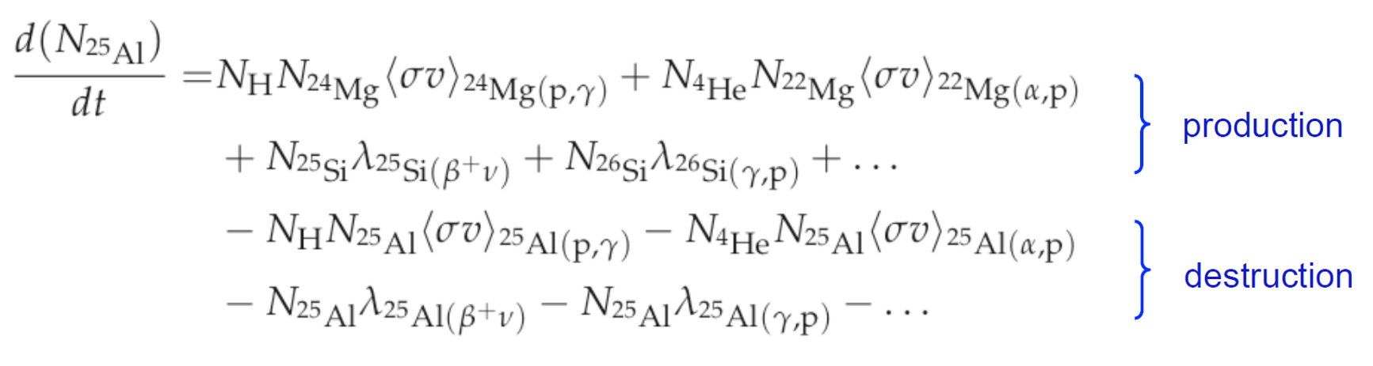
Nuclear reaction network
Example:
Different kind of particles
Described by system of coupled differential equations.
One of the Key inputs: reaction rate

Slide 5
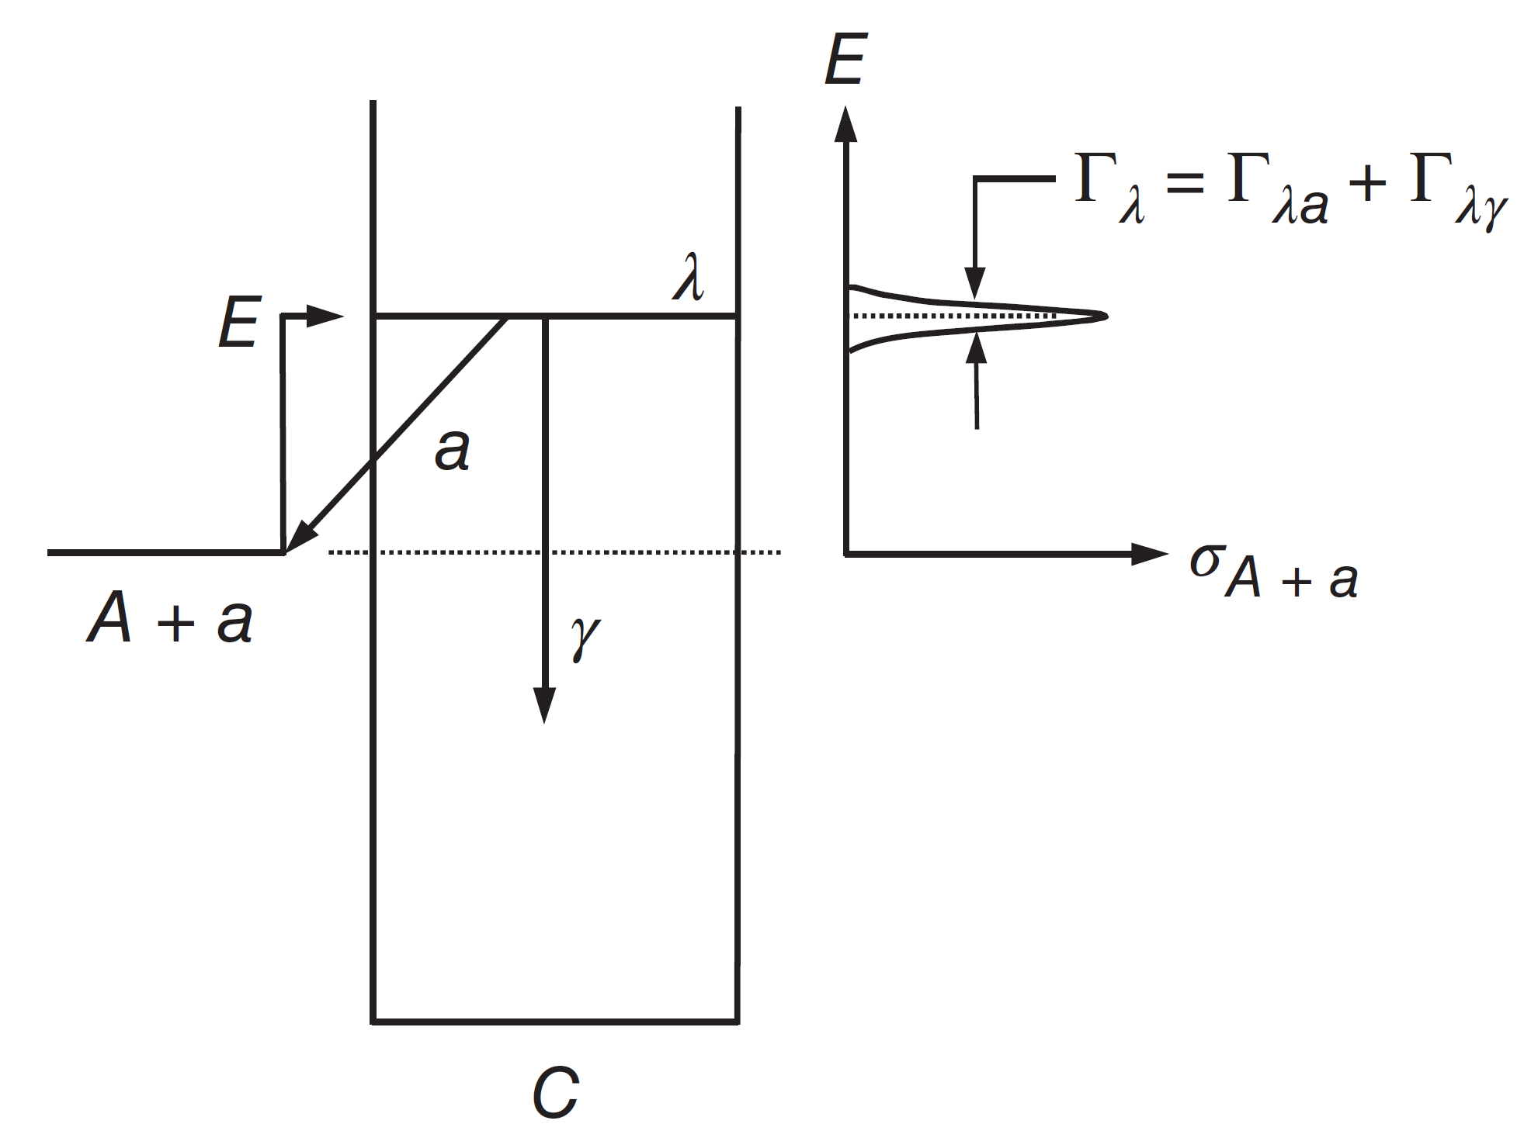


Astrophysical reaction rate
Reaction rate:
Resonant reaction:
form an unbound state
Decay to a bound state
E_{a}
T
γ
S_{a}=Q
(Threshold)
Direct reaction

Slide 6
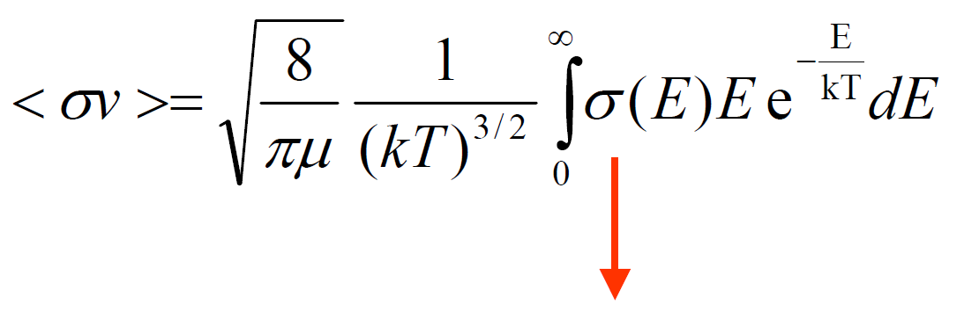
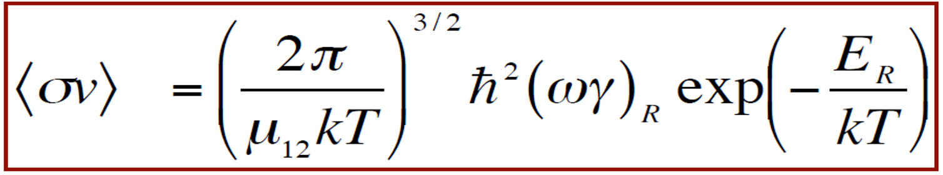
If the resonance is a narrow one
Which in turn depends mainly on the total and partial widths of the resonance at resonance energies.
→ A confirmation of E_{R}, J_{R}, Γ_{p}(E_{R}), Γ_{γ} completely defines rate
→ A measurement of E_{r}, J_{r}, Γ_{p}, Γ_{g} completely defines rate
Exponential dependence.
E_{R} = E_{x} – Q, Q=m₁+ m₂- m₃- m₄

Slide 7
Reverse reaction rate
The reverse reaction also has a tight relationship with the nuclear masses

Slide 8
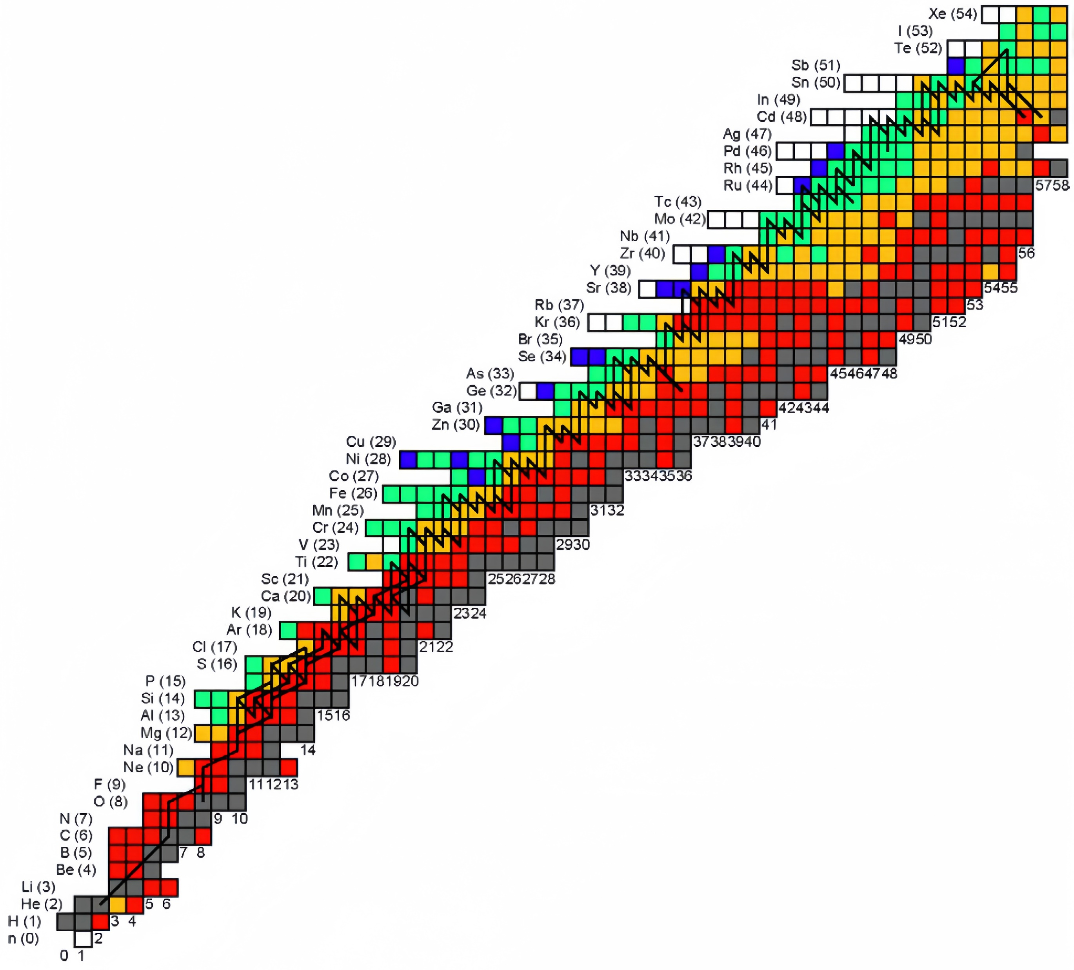
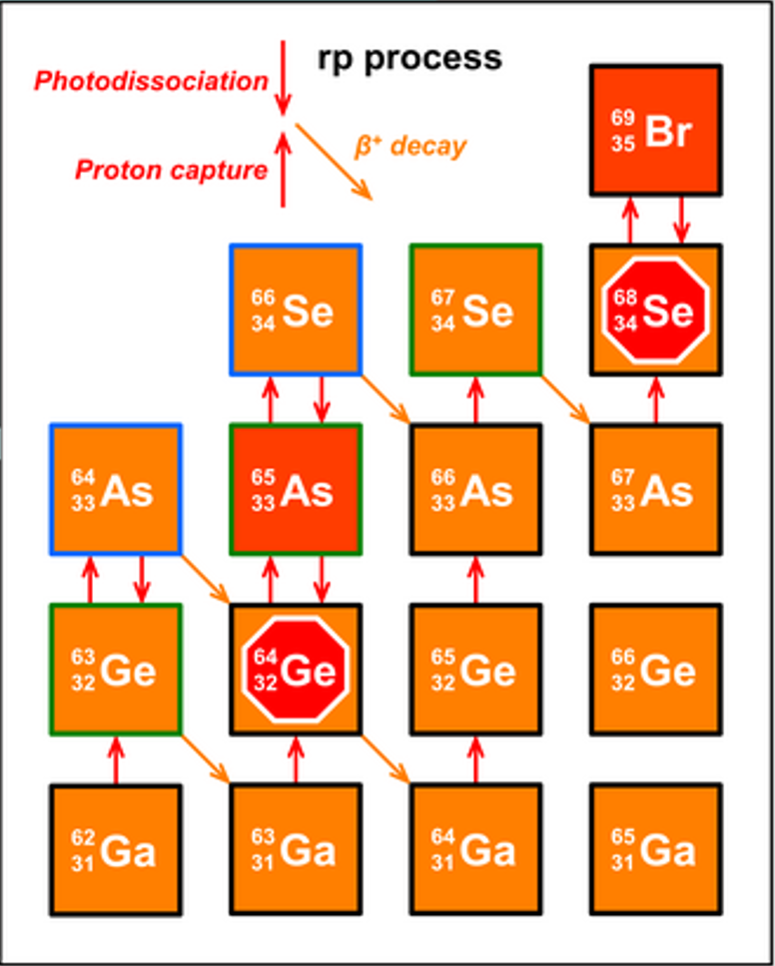
Nuclear physics needed for rp-process:
β-decay half-lives
masses
reaction rates
particularly (p,γ)
Mass known <10 keV
Mass known <100 keV
Mass unknown & lifetime known
Both Mass and lifetime unknown

Slide 9
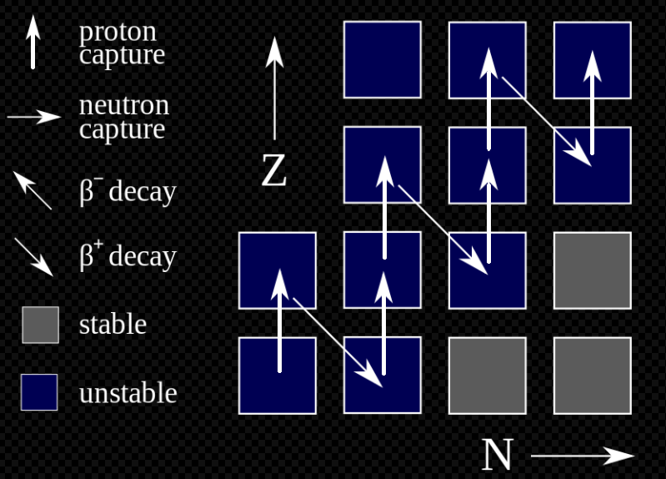
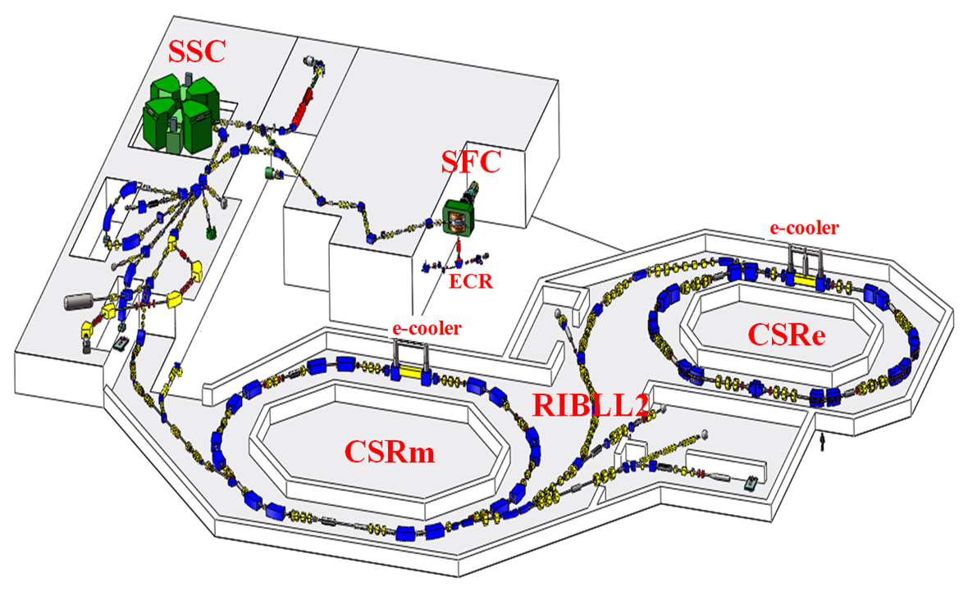
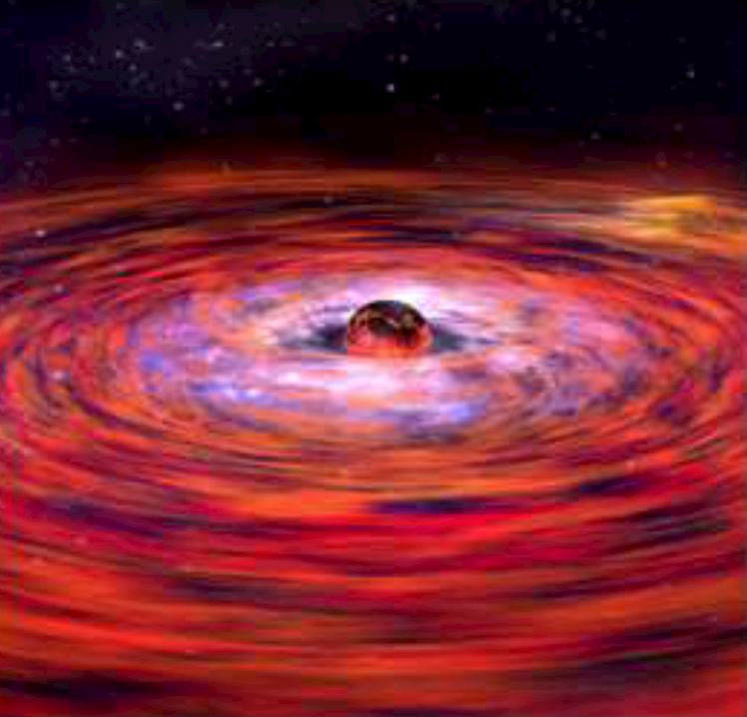
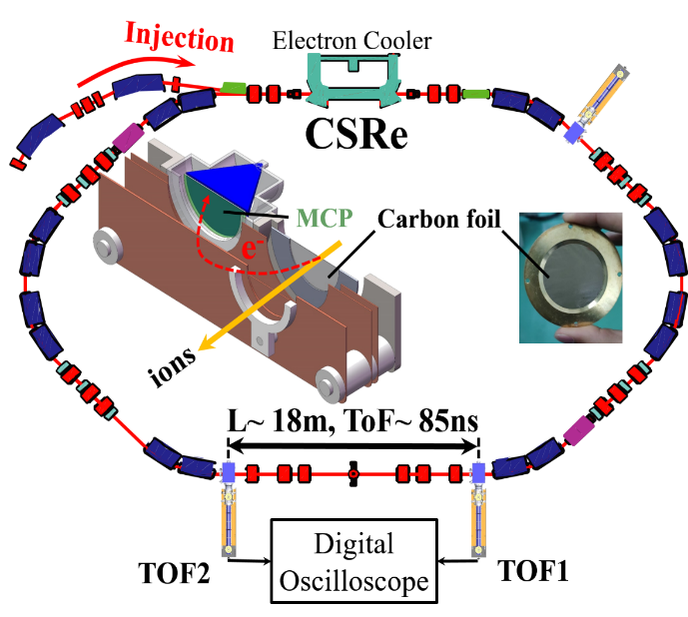
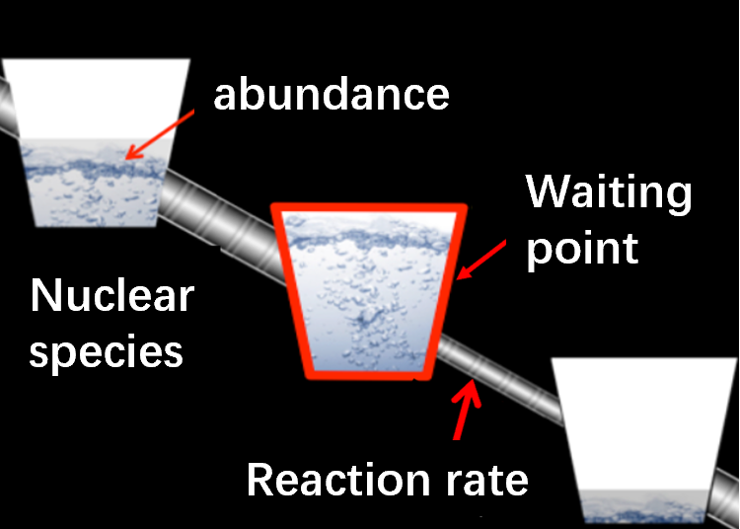
Nuclear masses affect rp-process
γ
Reaction：1+2->3+ Q=m₁+m₂ -m₃
Nuclear masses are sensitive to both forward and reverse reation rate
rp-process calculations
rp-process path
High-precision mass data

Slide 10
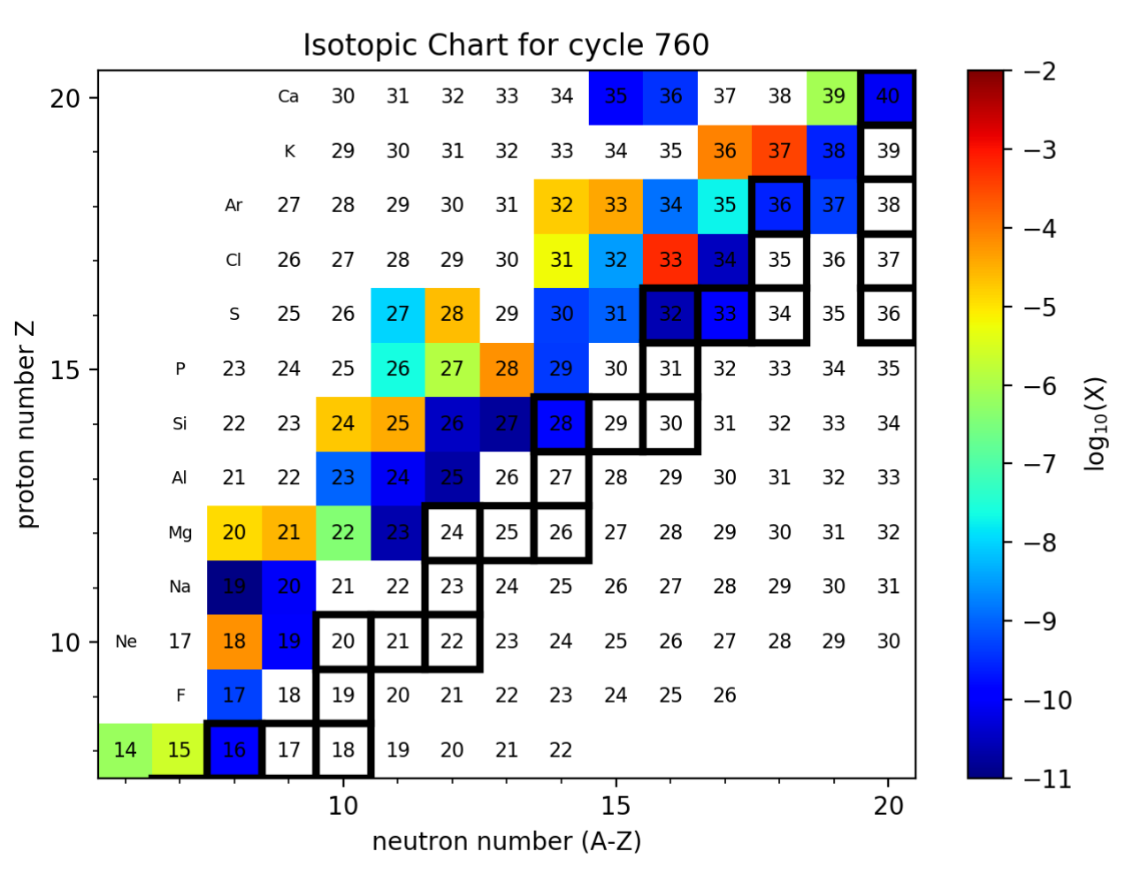
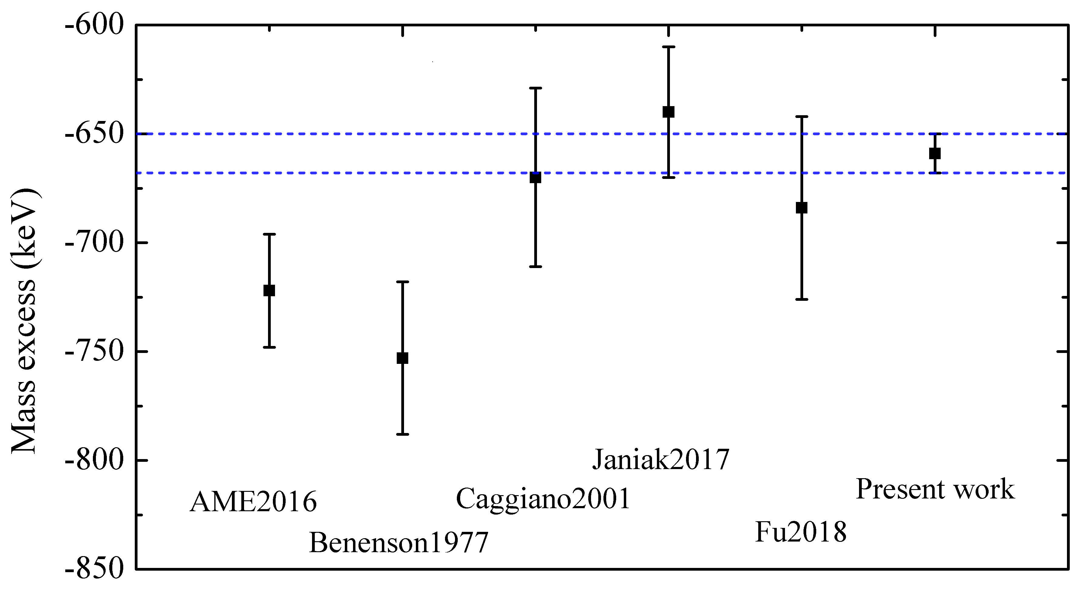
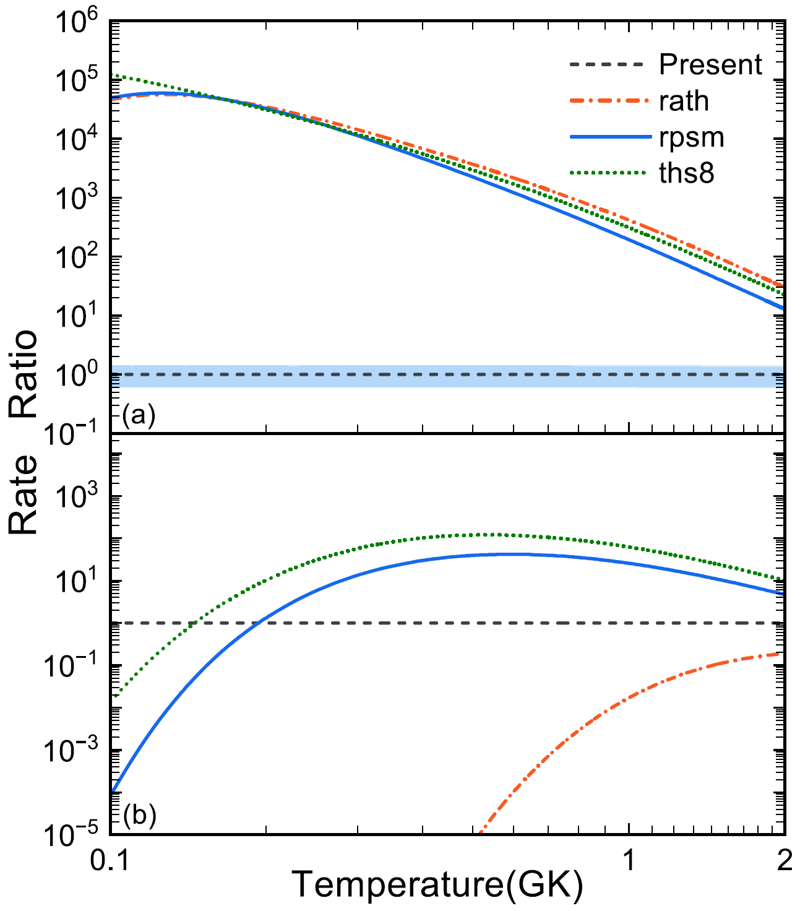

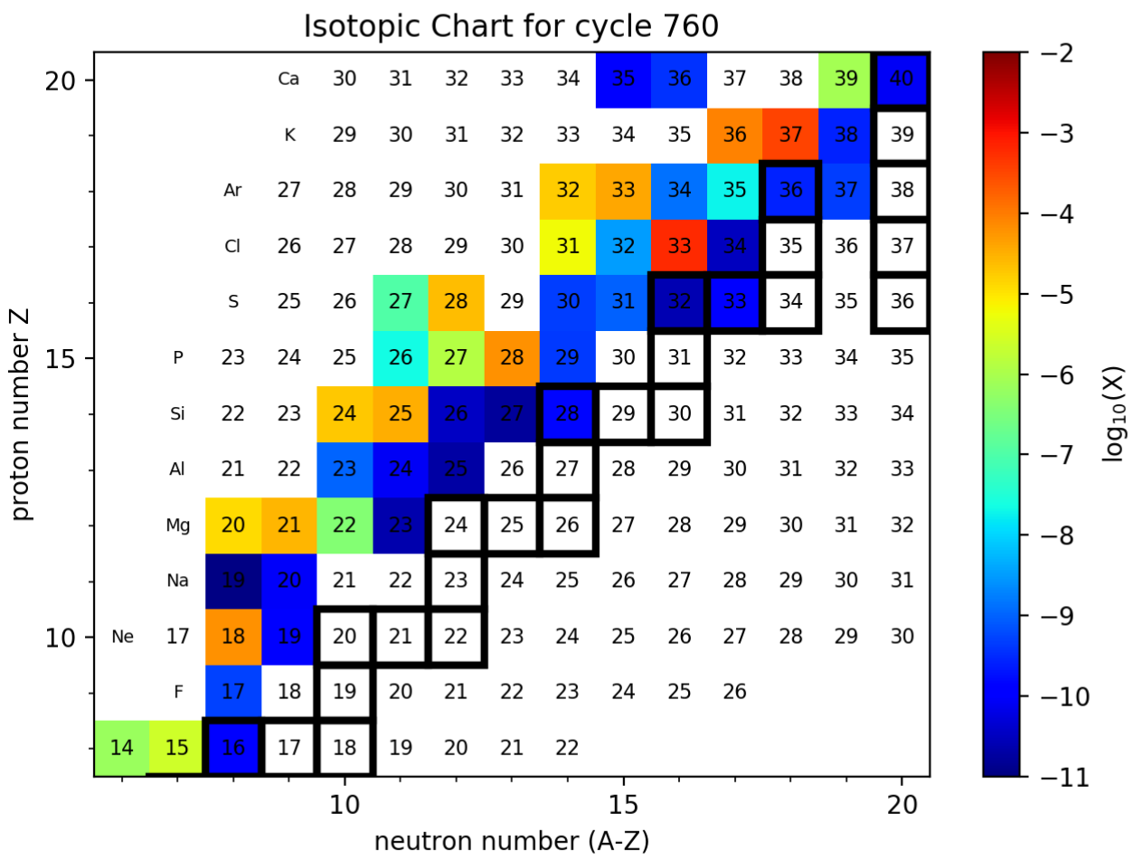
New masses of ²⁷P & ²⁷S in rp-process
new
²⁶P(p,γ)²⁷S
²⁷S(γ,p)²⁶P
old
New mass of ²⁷P result in an increase of the abun-dance of ²⁶Al to 2.4 times that using old mass.
Sun et al. PLB 802 135213 (2020)
Material accumulated on ²⁷S is reduced by one order of magnitude.
Hou et al. ApJ 950 133 (2023)
Notes:
P27：9 keV 误差

Slide 11
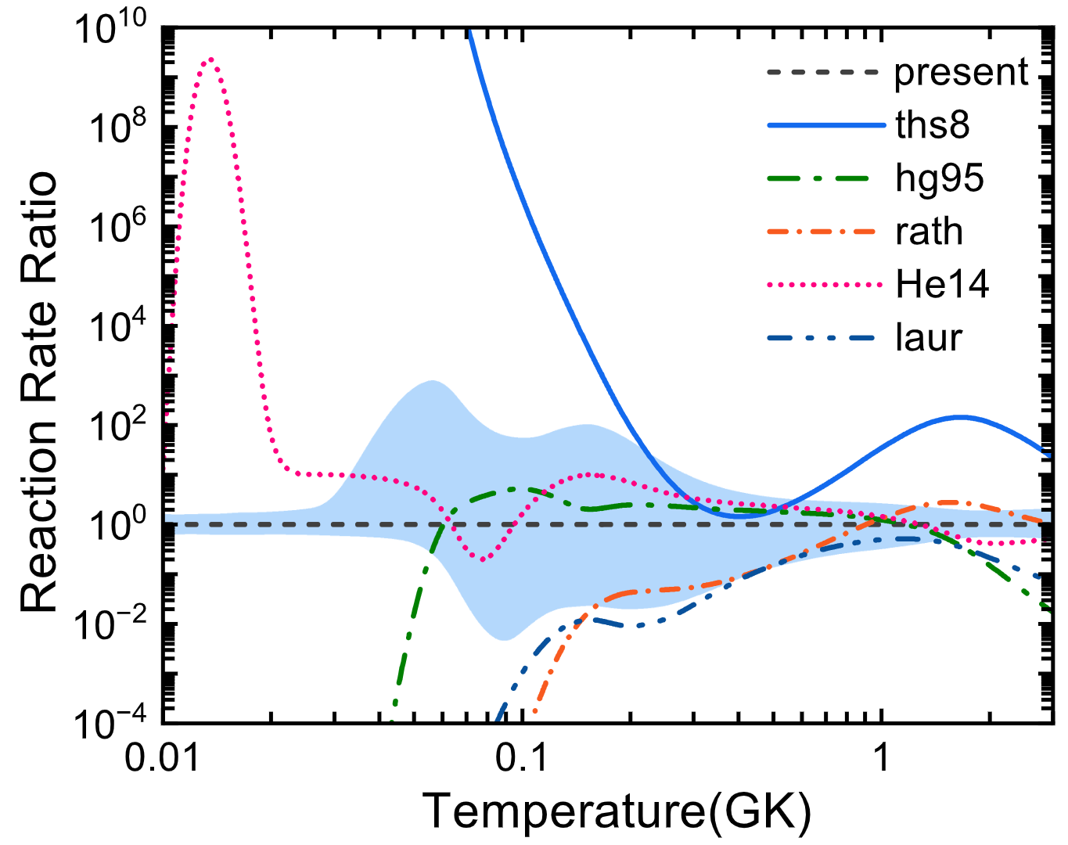
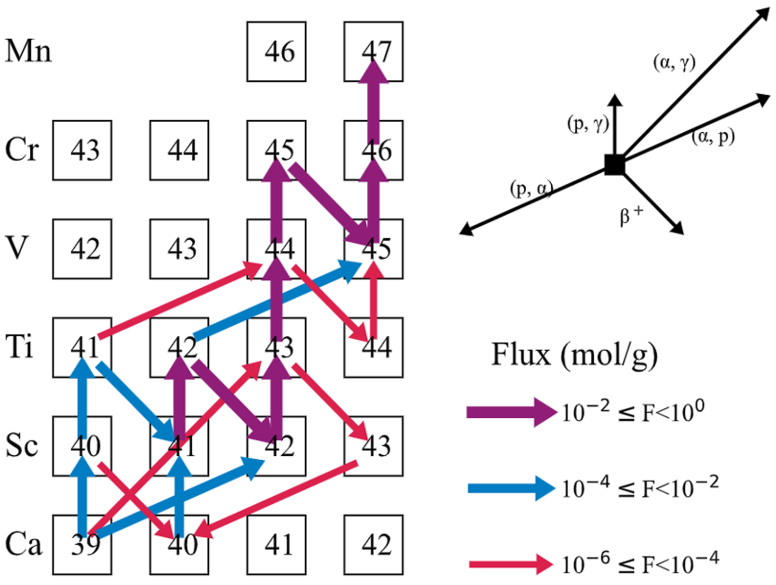
New mass of ⁴³V
Result：Adopting new rates，we found that the rp-process path can not bypasses the nucleus 43V. It is confirmed that green reaction path is a key branch of the rp process. Hou et al. A&A 677 A139 (2023)

Slide 12
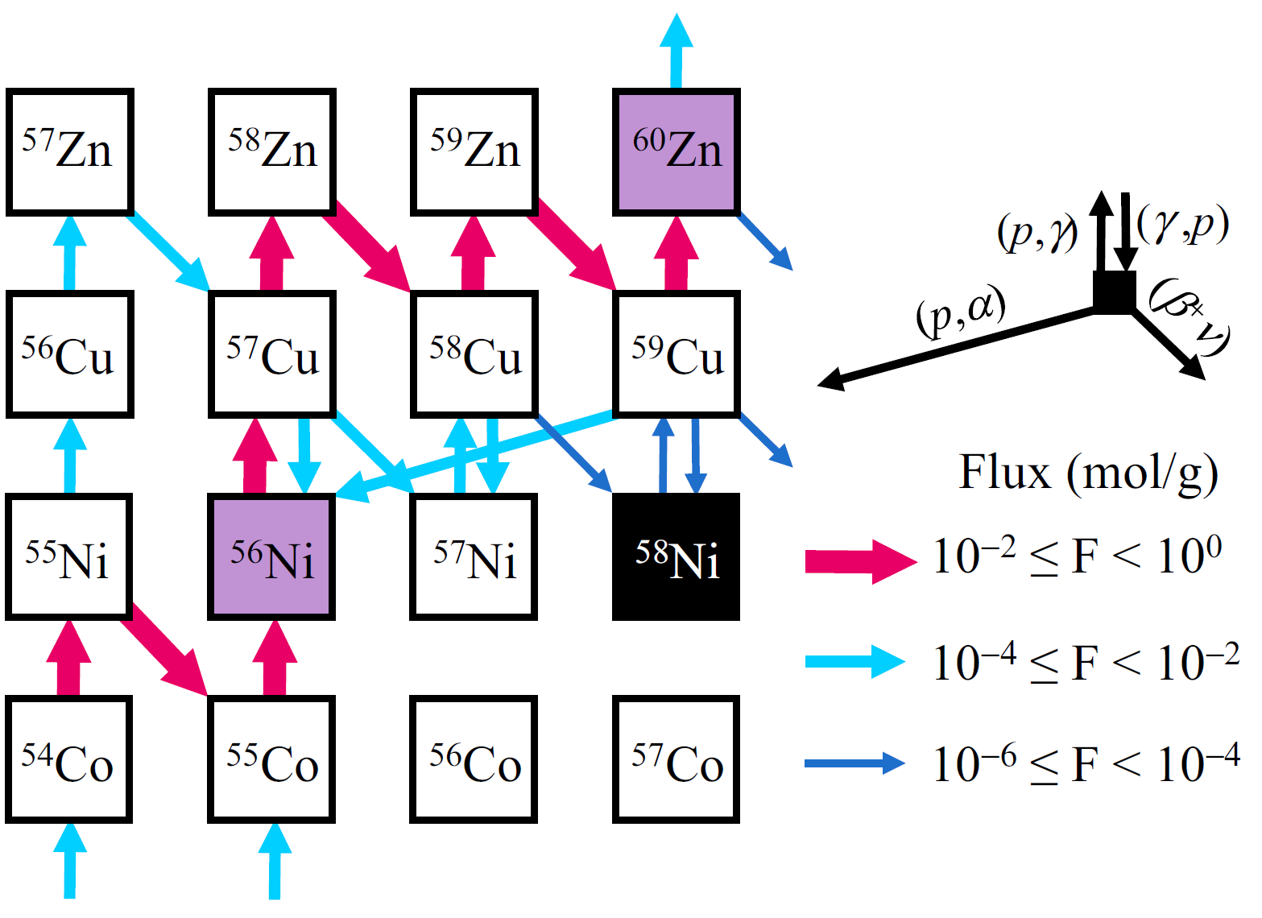
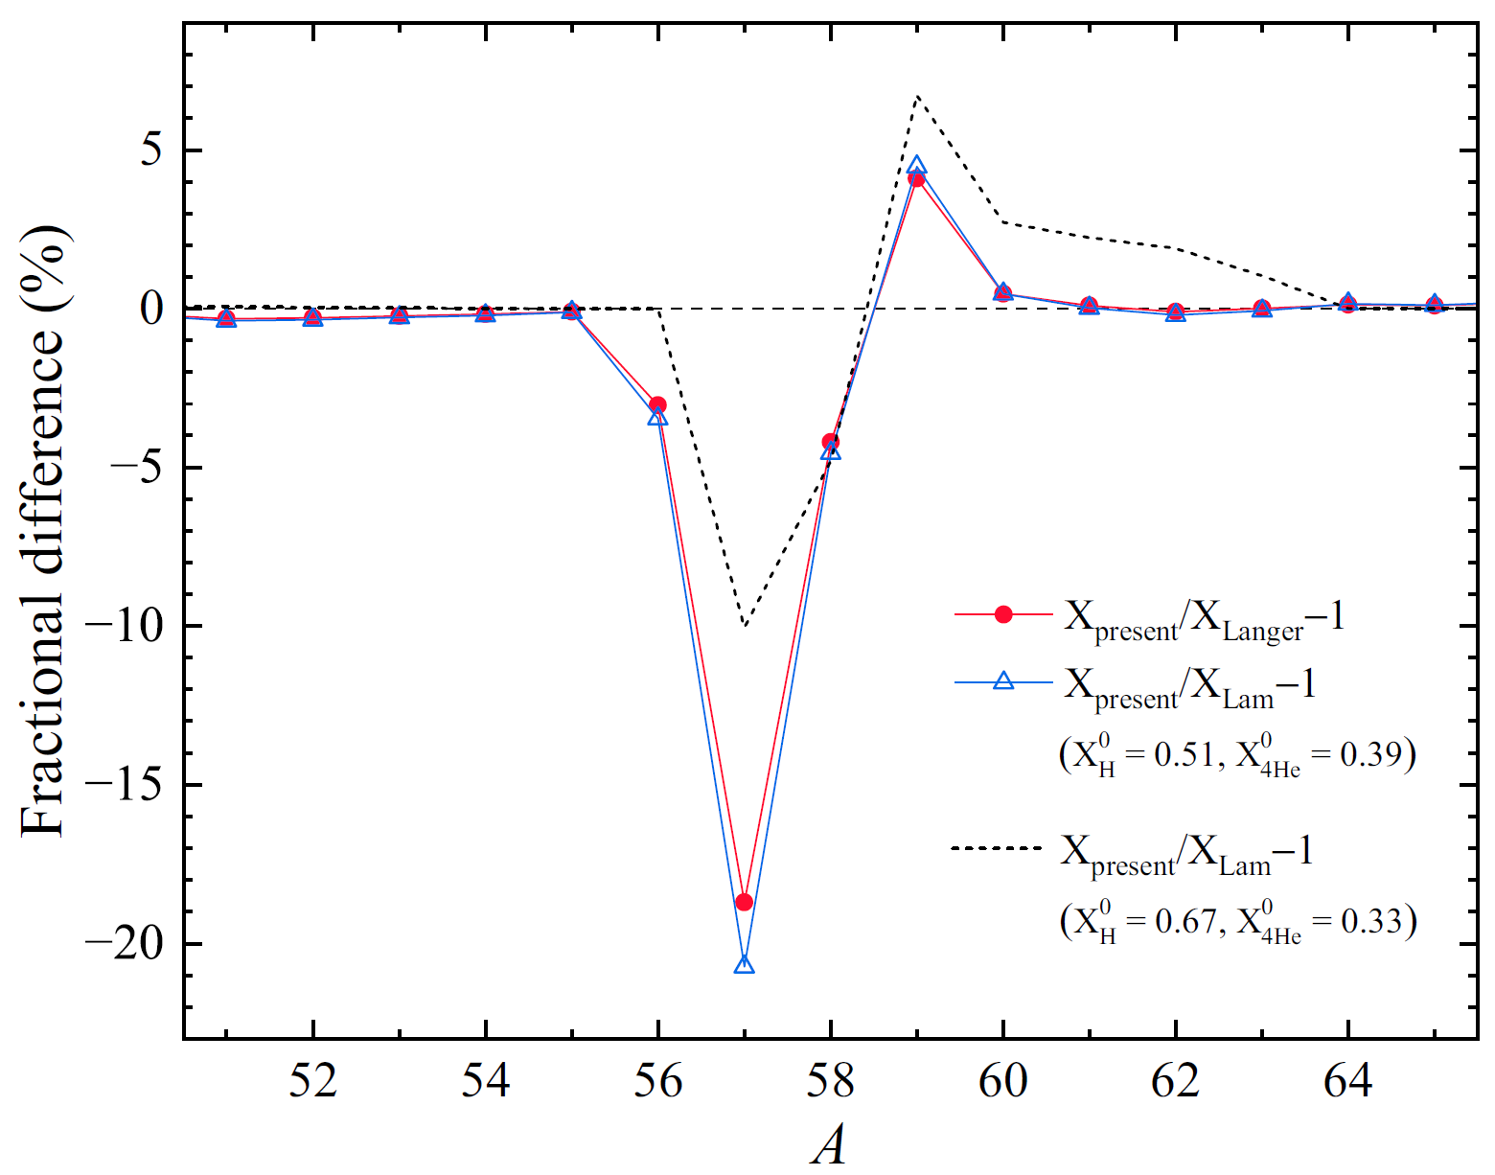
⁵⁸Zn new mass
Result：Adopting new mass of ⁵⁸Zn, ⁵⁷Cu(p,γ) ⁵⁸Zn rate will be increased, leading to the abundances of nuclei with A=57-59 have an obvious variation。 M. Zhang et al. PRC 109 045802 (2024)
Notes:
ME Zn58: -42300(50) -> -42280(36)

Slide 13
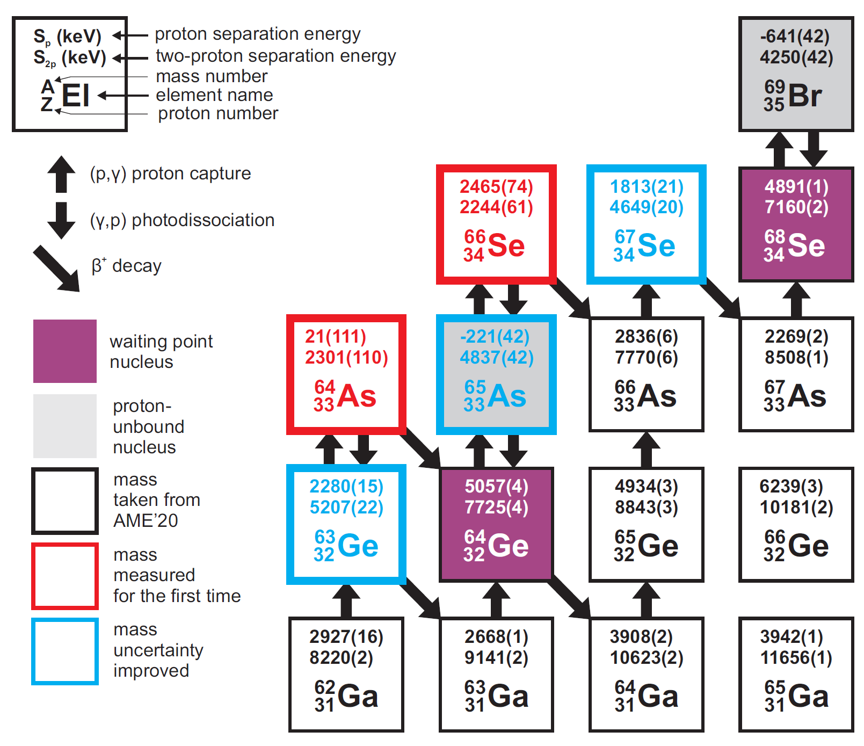
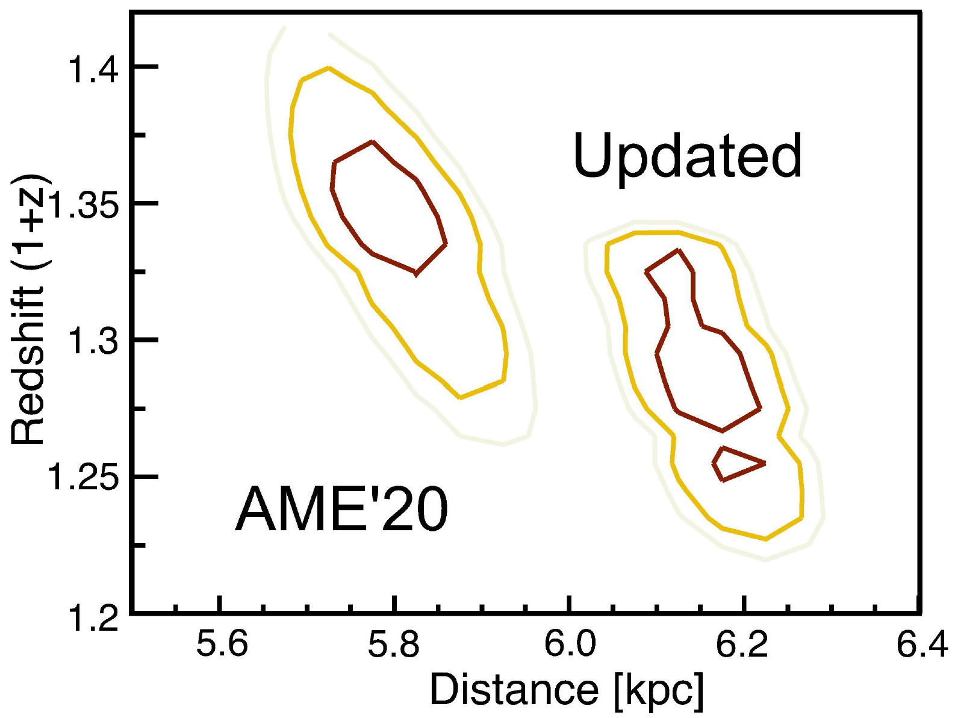
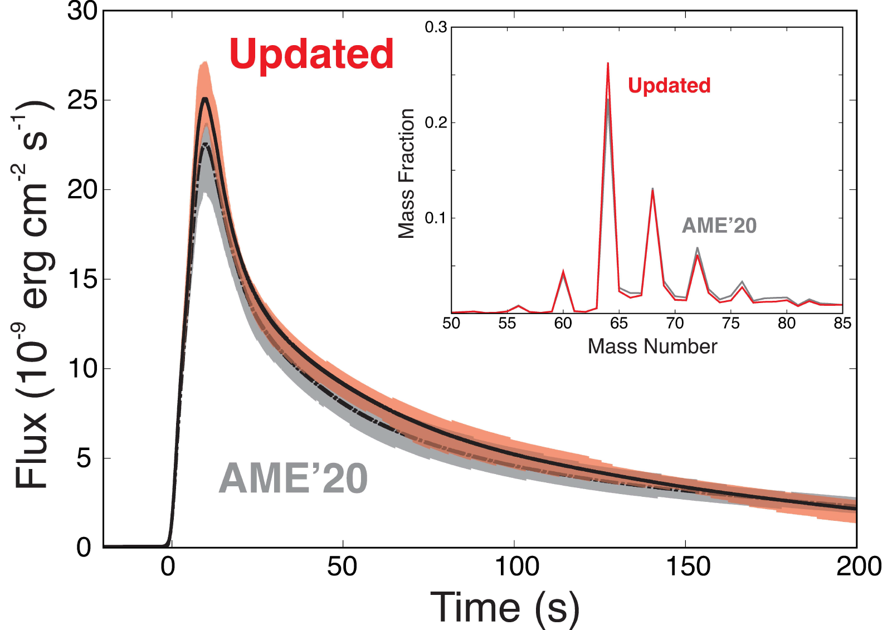
Nuclear masses constrain NS
Compared to XRB (GS 1826-24)
Implications: The distance between NS and earth is increased by 6.5%, and the redshift parameter (1+z ) will be reduced by 4.8%。 Zhou et al. Nature Physics 19 1091 (2023）

Slide 14
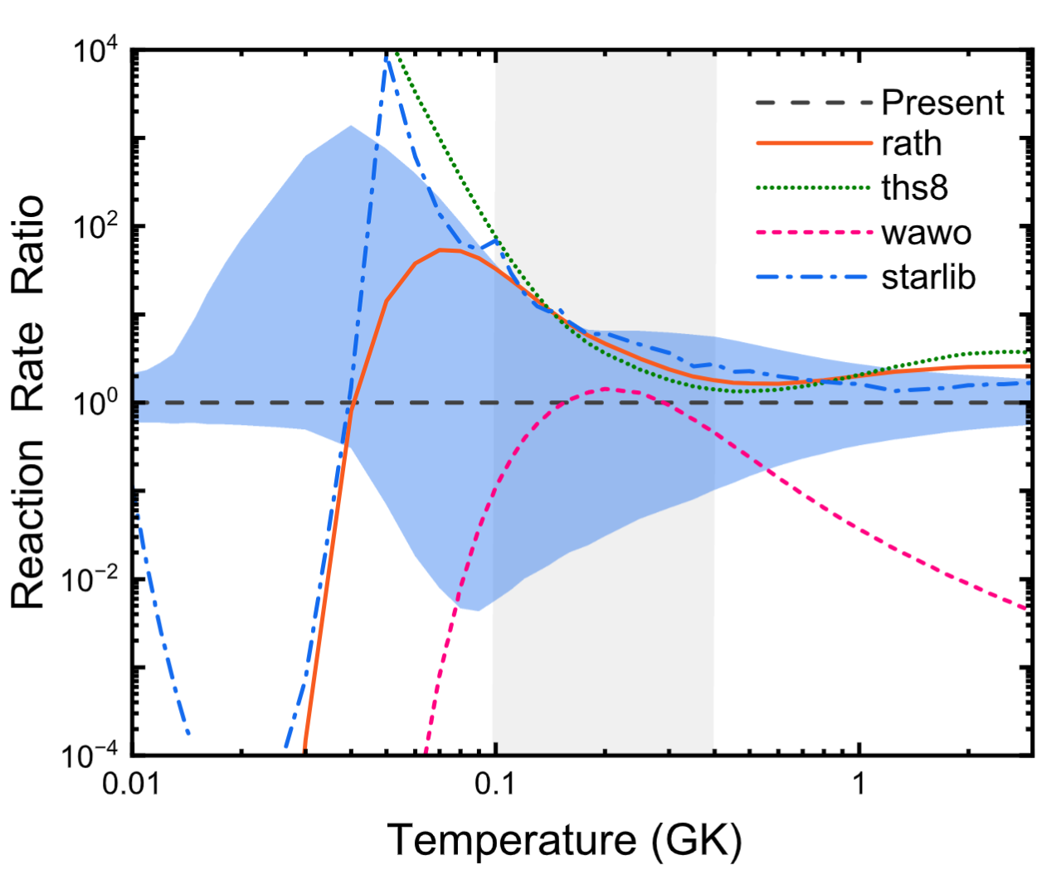
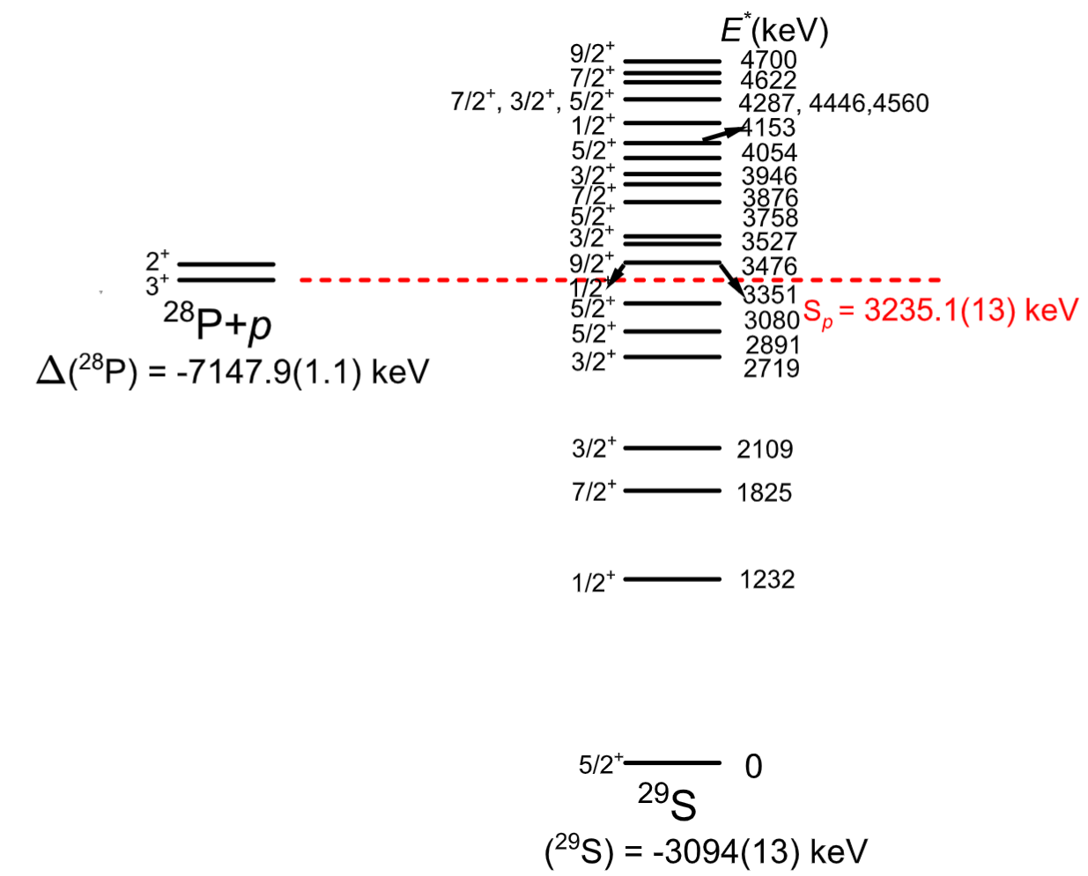
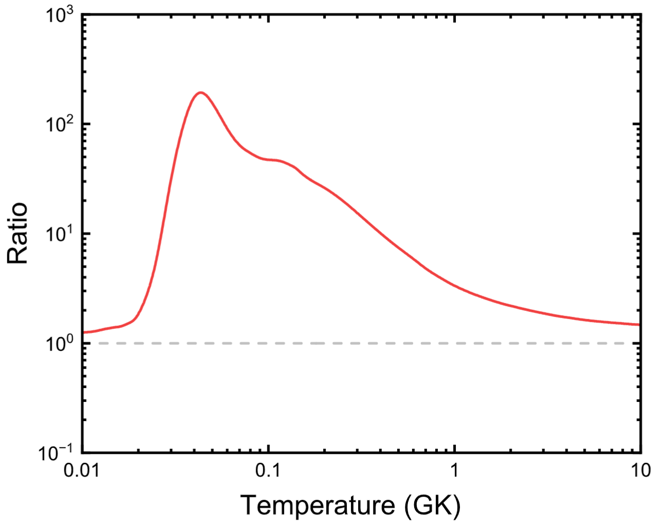
New mass of ²⁹S
第一激发态
Nova温区
Result：We give the uncertainty of ²⁸P(p,γ) ²⁹S rate for the first time，and confirm that statistical model works for the rate prediction in Nova temperature region. J.B. Liu et al. A&A 687 A199 (2024)
Notes:
Q:3290(50)->3235(13) keV

Slide 15
Summary
As the most frequent explosion in our galaxy, it was proposed that this explosions are powered by thermonuclear runaways on the surface of accreting neutron stars.
Despite numerous advances in our understanding of X-ray bursts, many challenges remain in the astrophysics theory of accreting neutron stars.
We found newly measured nuclear masses of unstable nuclei still have an important impact on rp-process nucleosynthesis.
High precision nuclear masses of unstable nuclei in rp-process remain required for comprehensive understanding rp-process and constraints to the basic properties of neutron star.

Slide 16

Thank you for your attentions

Slide 17
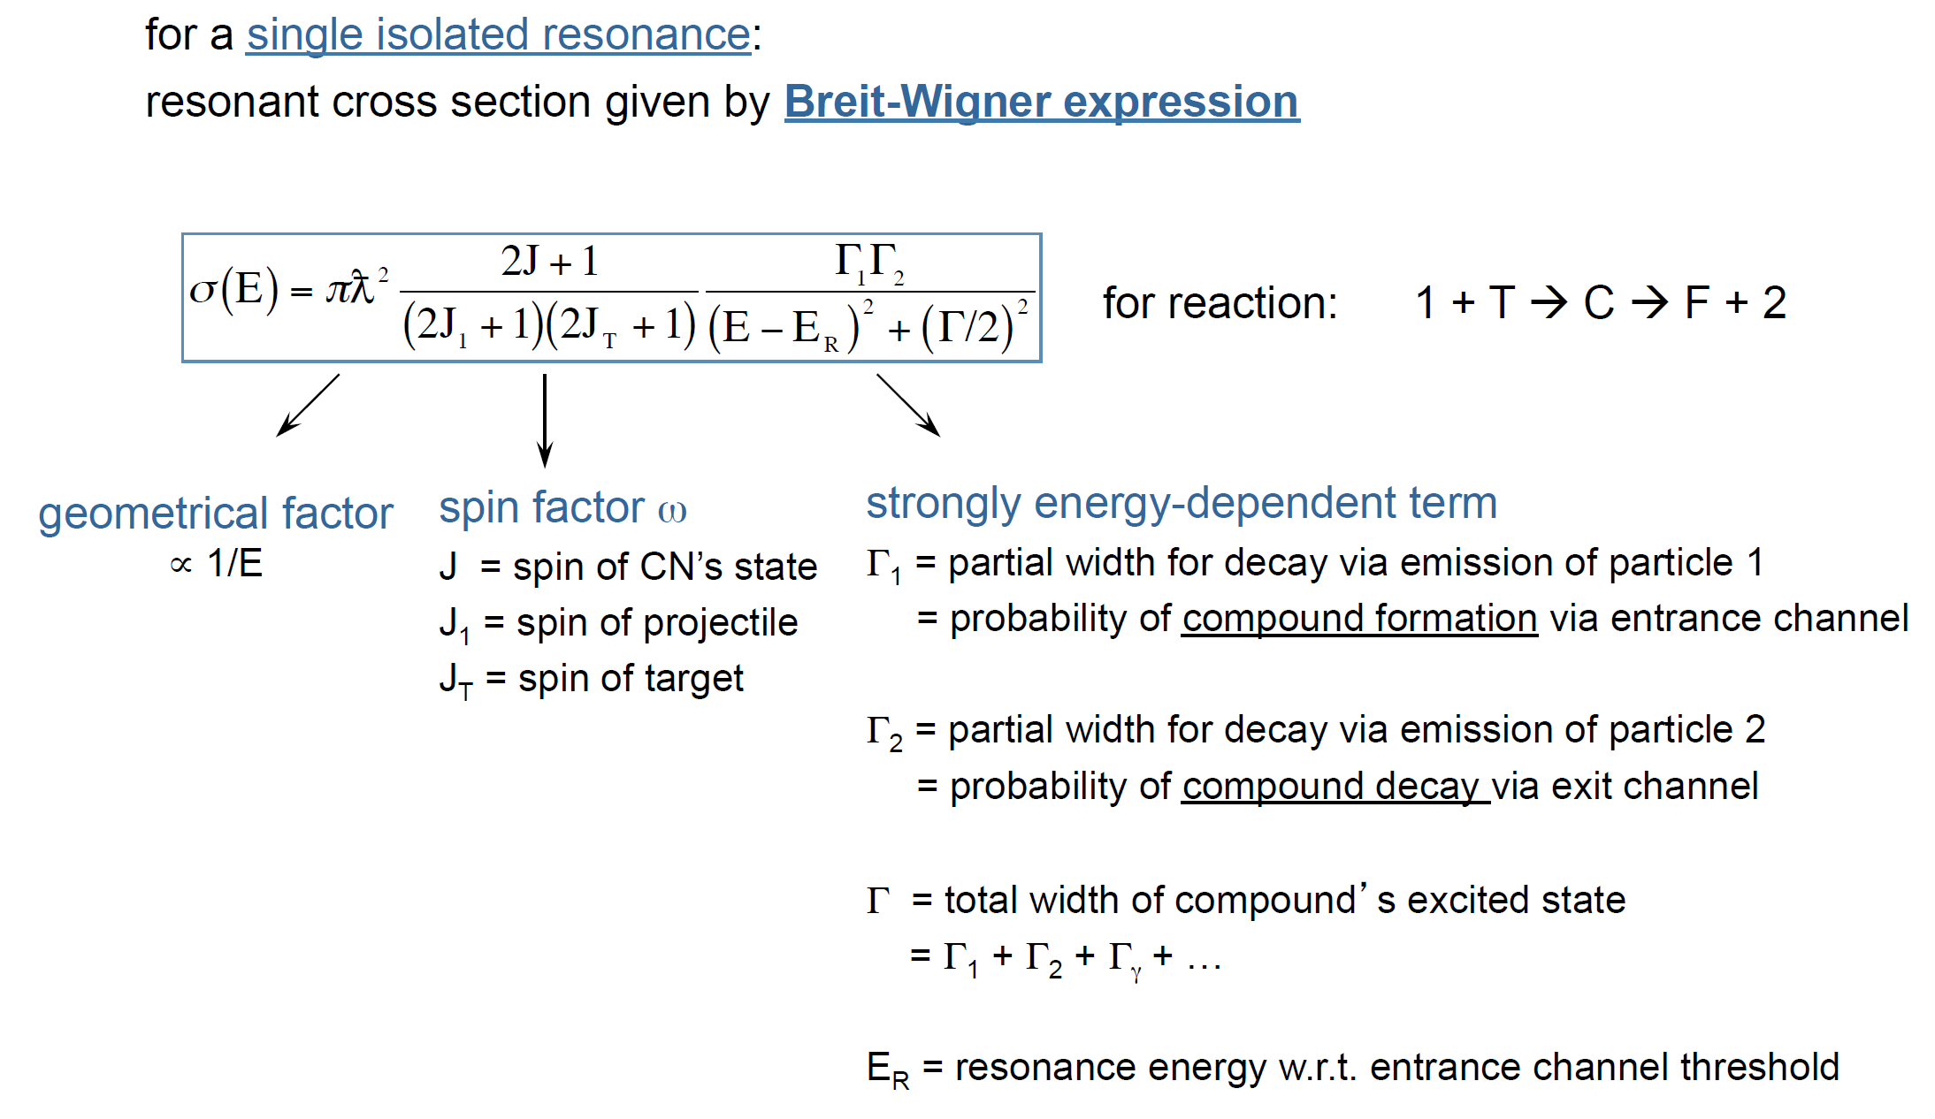
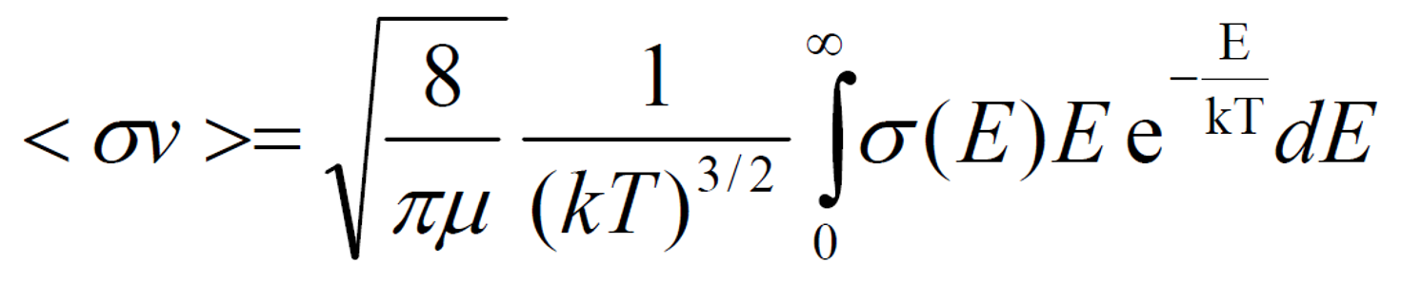

Slide 18
For the contribution of a single narrow resonance to the stellar reaction rate:
III.68
The rate is entirely determined by the “resonance strength”
Nuclear species | Mass excess (error) keV
²⁷P | -659 (9)
²⁷S | 17678 (77)
²⁸P | -7147.9 (1.1)
²⁹S | -3094 (13)
⁴²Ti | -25104.35 (0.27)
⁴³V | -17920 (40)
III.68a
Which in turn depends mainly on the total and partial widths of the resonance at
resonance energies.
→ A measurement of E_{r}, J_{r}, Γ_{p}(E_{r}), Γ_{γ} completely defines rate
→ A measurement of E_{r}, J_{r}, Γ_{p}, Γ_{g} completely defines rate

