Slide 1
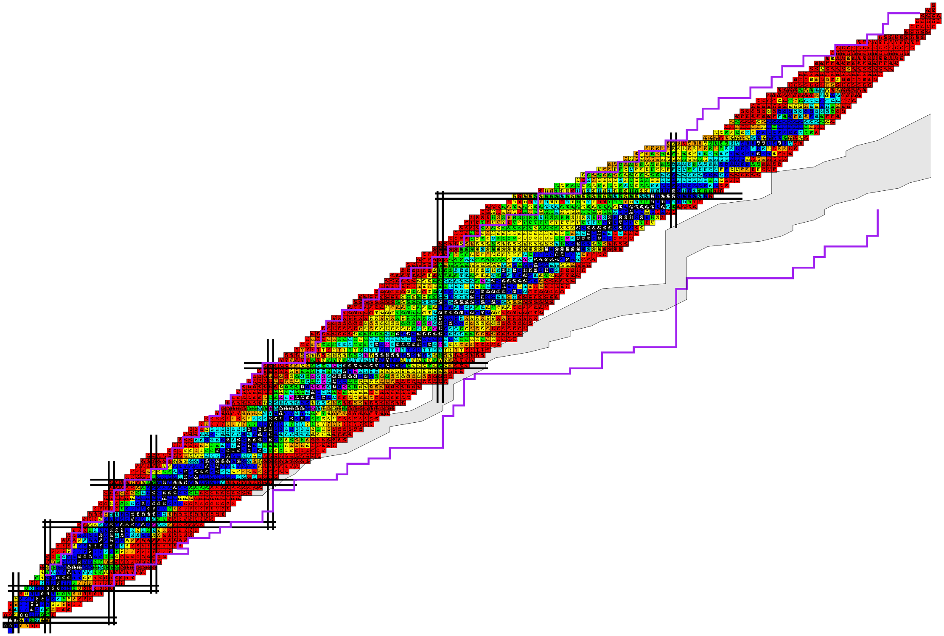

Nuclear β-decay half-life and its impact on r-process nucleosynthesis
The 17th International Symposium on Origin of Matter and Evolution of Galaxies
Chengdu Sep. 7-13, 2024
Yifei Niu
MOE Frontiers Science Center for Rare Isotopes
School of Nuclear Science and Technology
Lanzhou University

Slide 2

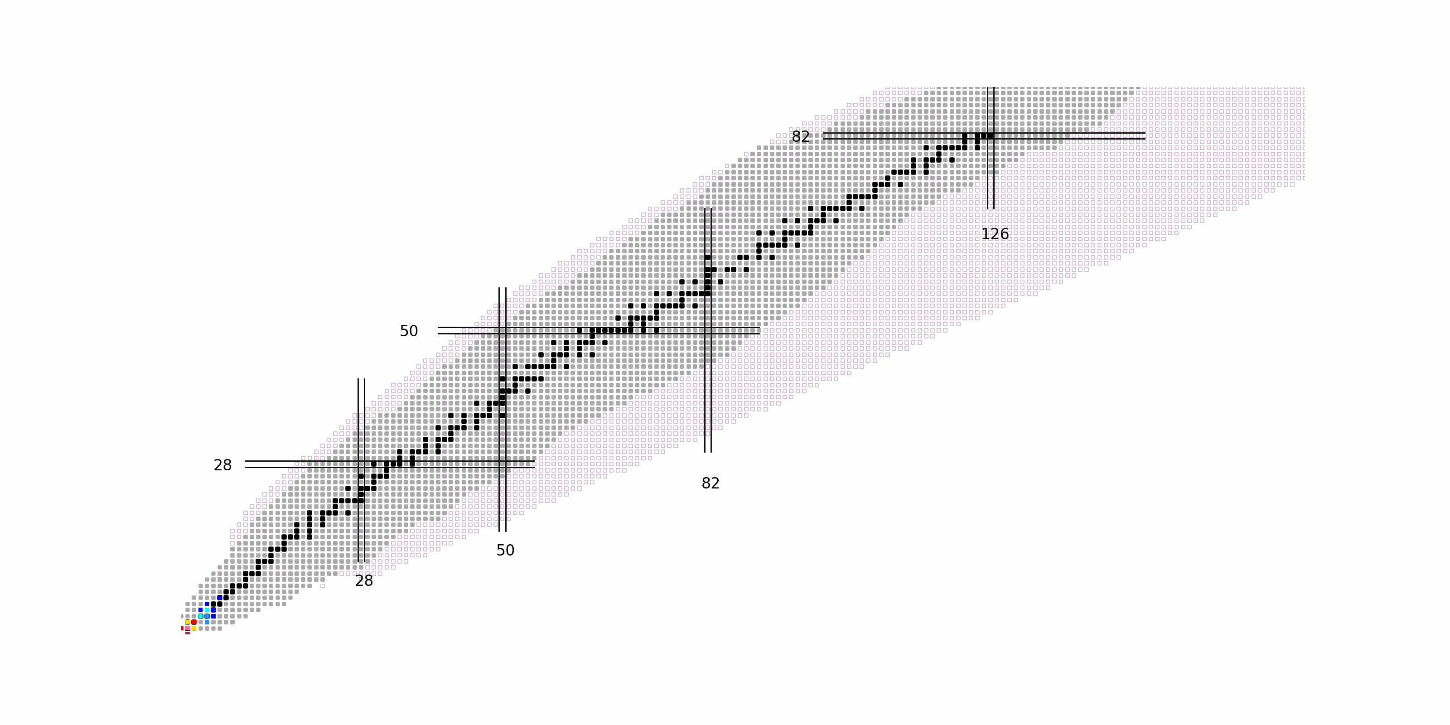
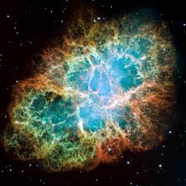
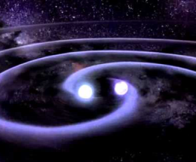
How Were the Heavy Elements Made?
How were the heavy elements from iron to uranium made?
The 11 greatest unanswered questions of physics
r-process
Where does r-process happen?
Supernova
Neutron star merger (NSM)
GW170817 NSM：
One of the main r-process sites
r-process
β decay
Accurate nuclear physics inputs
Nature 551,64; 67; 75; 80 (2017)
Science 358, 1559 (2017)
ApJL 848, L17; L19 (2017)
Neutron capture
Nuclear mass,
β decay half-lives,
Neutron-capture cross section,
…
NSM:
minimal contribution?
R-process path: far from stability, relies on theory!
Nature 574, 497; 569,241 (2019)
arXiv:2102.05891v1

Slide 3
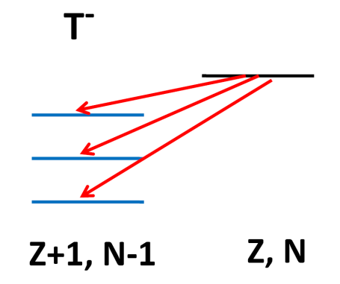

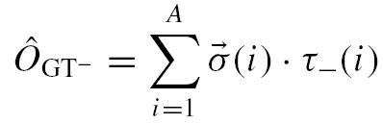
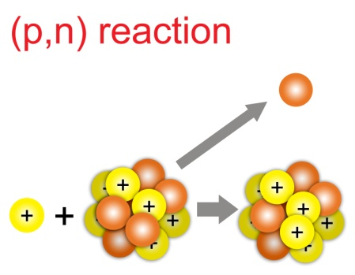
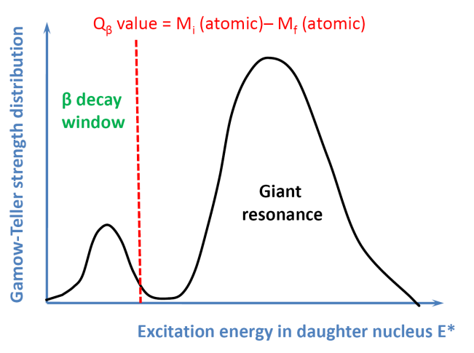
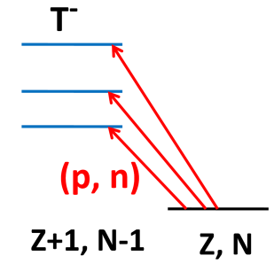
β decay and Gamow-Teller Transition
β-decay
dominant nuclear transition
Gamow-Teller transition
ΔS=1 ΔL=0 ΔT=1
electron antineutrino
β-decay and Gamow-Teller Resonance
Strong
β-decay weak
To describe well the β-decay half-life, the key is Gamow-Teller transition

Slide 4
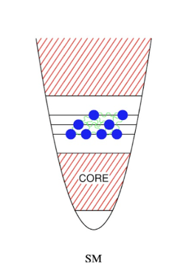
Microscopic Theoretical Investigations
Ab initio approach: for very light nuclei Barrett, et al., PPNP 69, 131 2013
Shell model: up to A=60 or around magic regions
Langanke et al., ADNDT 79, 1 2001; Suzuki, et al., PRC 85, 015802, 2012;
Li and Ren, JPG 41, 105102, 2014; Zhi, et al., PRC 87, 025803 (2013)
Quasiparticle Random Phase Approximation (QRPA)
  Spherical Approximation
    Non-self-consistent
      FRDM + Quasiparticle RPA (QRPA)
      Moller, et al., ADNDT 66, 131 1997
    Self-consistent
      Skyrme QRPA
      Engel, et al., PRC 60, 014302, 1999
      Relativistic QRPA
      Marketin, et al., PRC 93, 025805, 2016;
      Niu, et al., PLB 723, 172, 2013.
K. Langanke et al., Rev. Mod. Phys. 75, 819, 2003

Slide 5
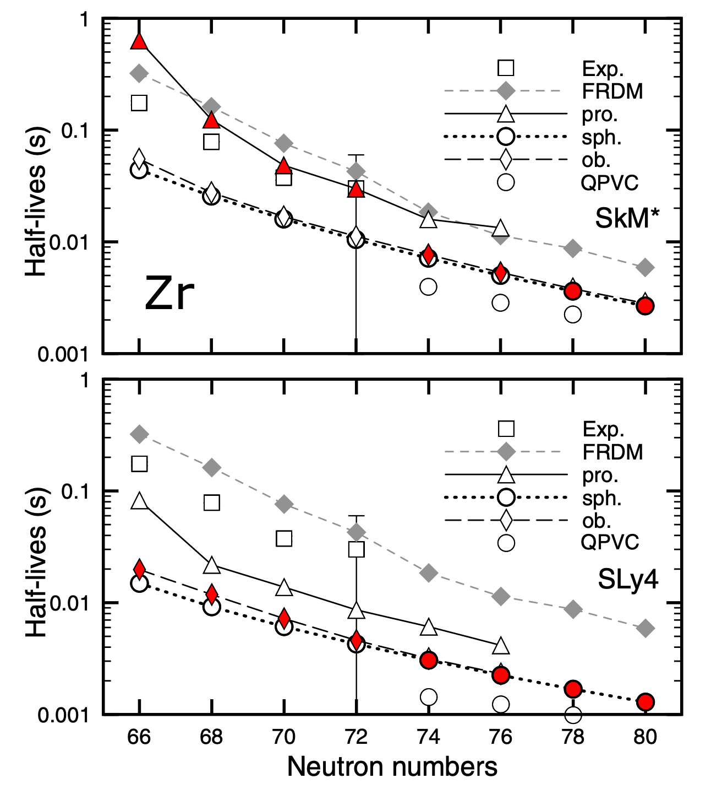
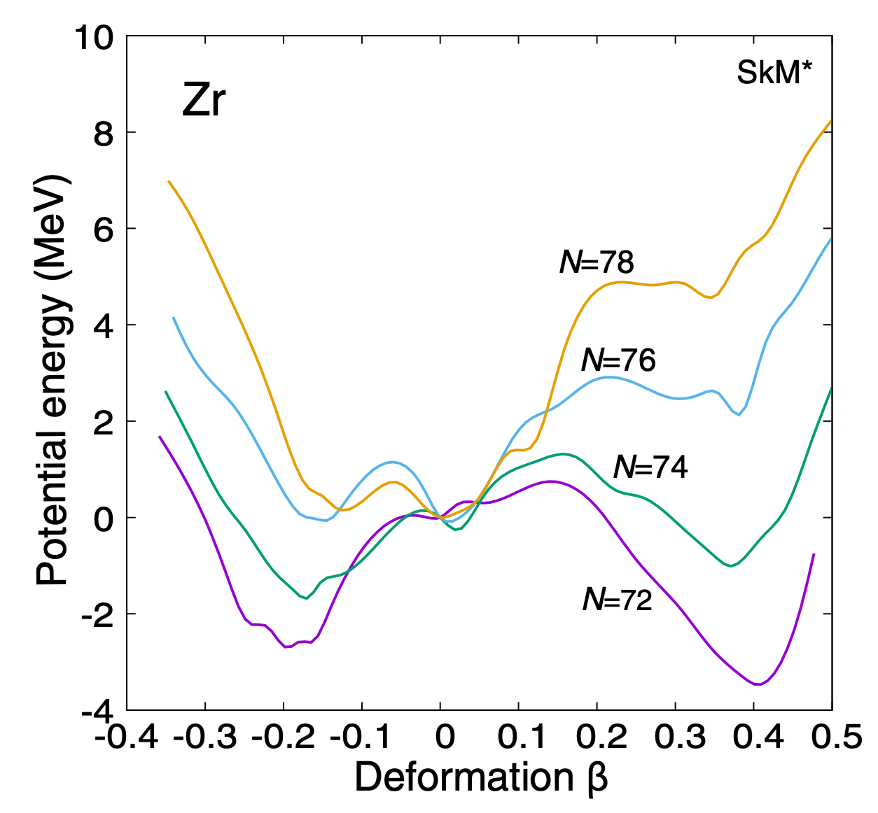
Inclusion of deformation degree of freedom
Matrix diagonalization: solve the QRPA equation by diagonalization
  deformed QRPA with realistic force Ni and Ren, PRC 89, 064320, (2014)
  Skyrme deformed QRPA Sarriguren, et al., NPA 635, 55 (1998); Yoshida, PTEP 2013, 113D02 (2013)
A sudden shortening of β-decay half-lives is found when the nuclear shape changes
K. Yoshida, Y. F. Niu and F. Minato, Phys. Rev. C 108, 034305 (2023)

Slide 6
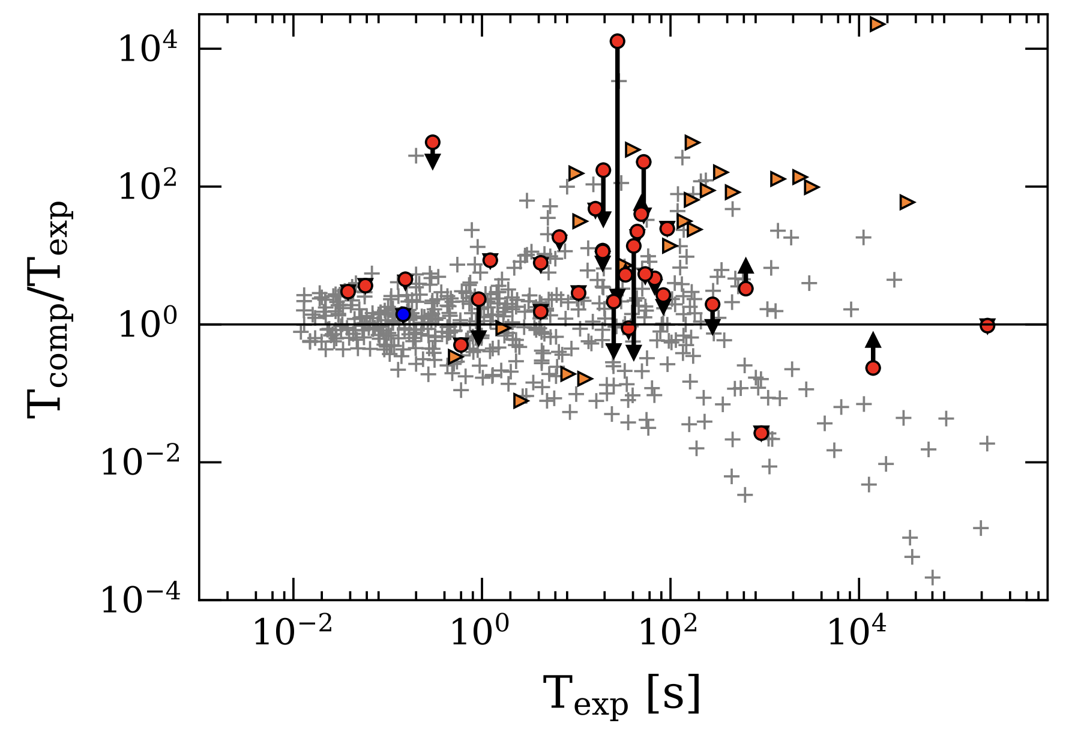
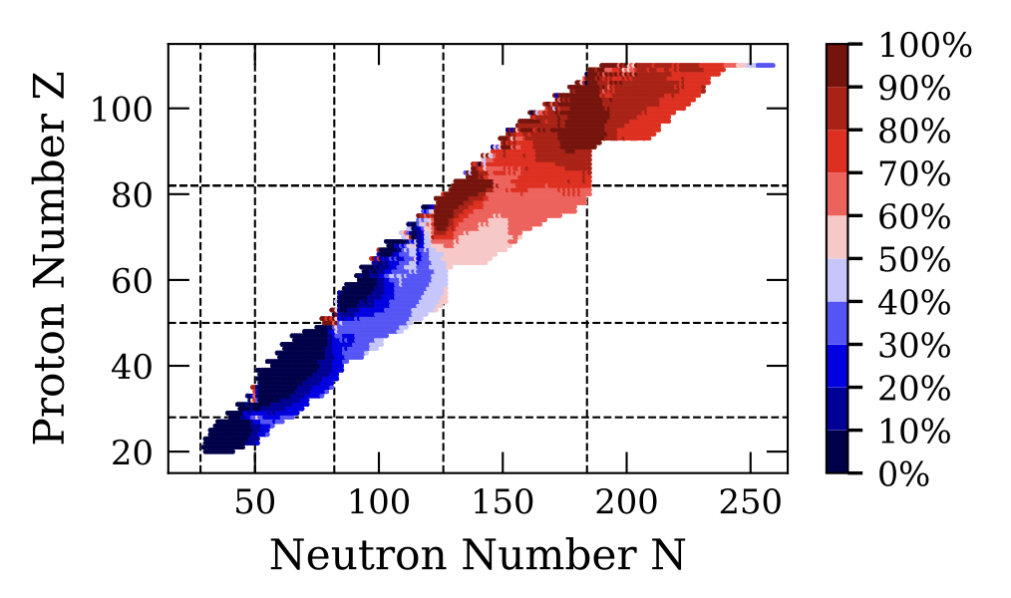
Inclusion of deformation degree of freedom
Quasiparticle Finite Amplitude Method (QFAM) :
solve the QRPA equation by iteration
  Skyrme QFAM even-even, even-odd, odd-odd nuclei
  Mustonen et al., PRC 93, 014304 (2016); Ney et al., PRC 102, 034326 (2020)
T. Nakatsukasa et al., PRC 76, 024318 (2007)
Comparison with exp. data for odd nuclei
First-forbidden contribution to the rates

Slide 7
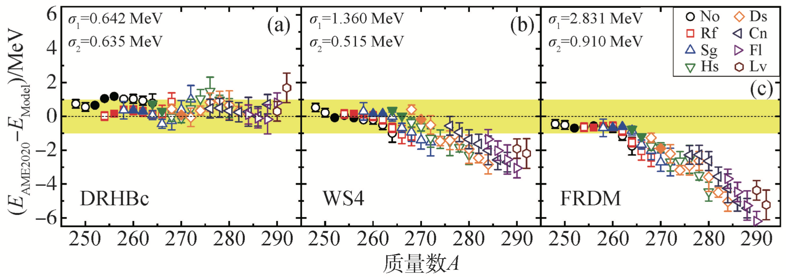
Relativistic density functional
Start from Lagrangian, which satifies the Lorentzian invariance
Naturally give rise to the spin-orbit splitting
…
J. Meng et al., Prog. Part. Nucl. Phys. 57, 470 (2006)
Better predictive power due to better isospin dependence
孟杰、张开元，物理 50, 789 (2021)
Compare with the new superheavy nuclear mass data from AME2020

Slide 8
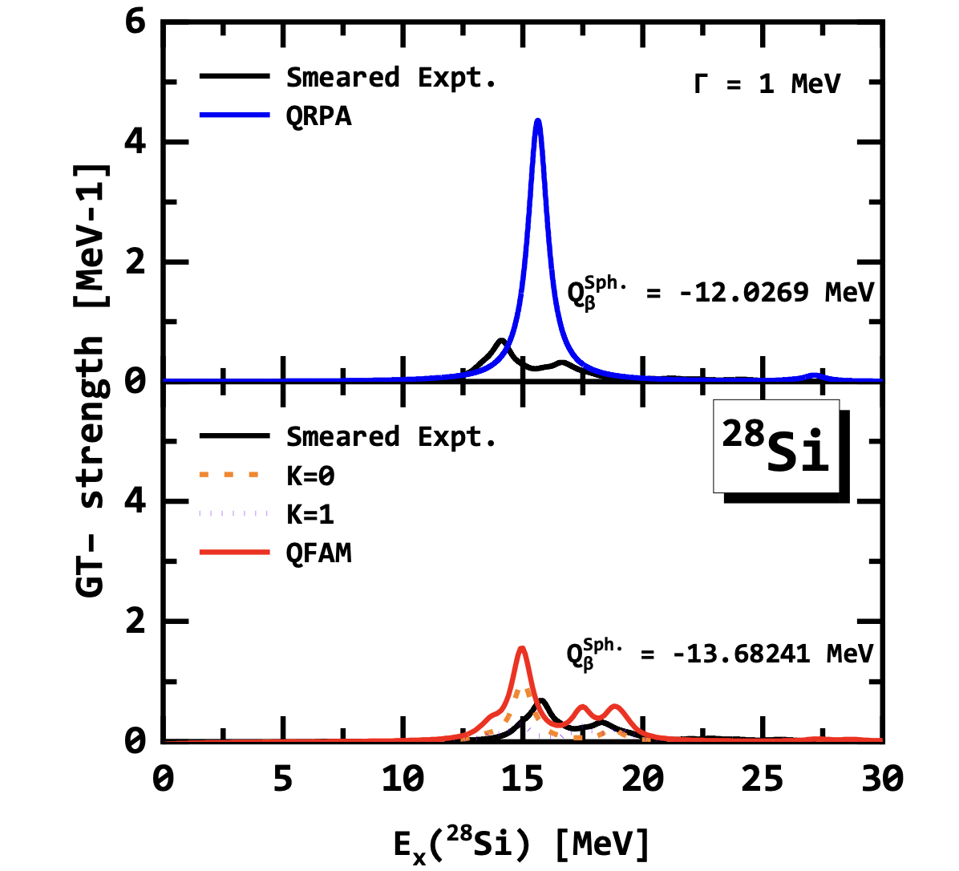
Include deformation within Relativistic QRPA
QFAM: DD-PC1 Gamow-Teller Resonance

Slide 9
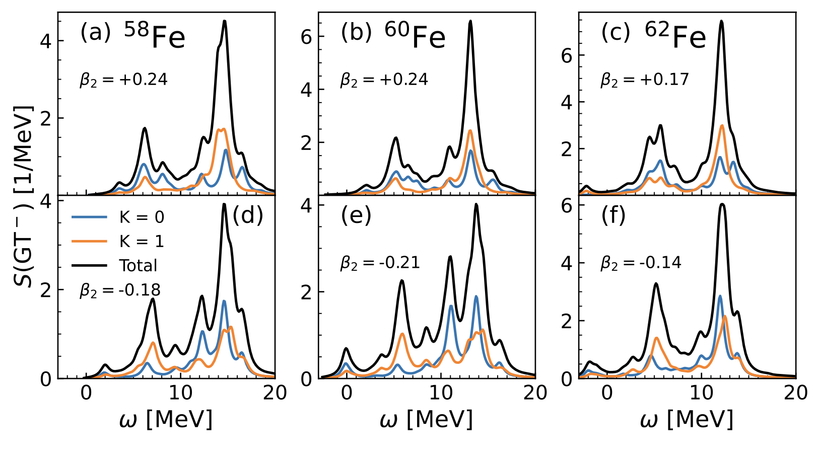
Include deformation within Relativistic QRPA
Linear response theory in terms of separable interaction forms
comparable calculation efficiency with QFAM
A. Ravlic, Y. F. Niu et al., PRC 104, 064302 (2021)
A. Ravlic, T. Niksic, Y. F. Niu, et al., PRC 110, 024323 (2024)

Slide 10
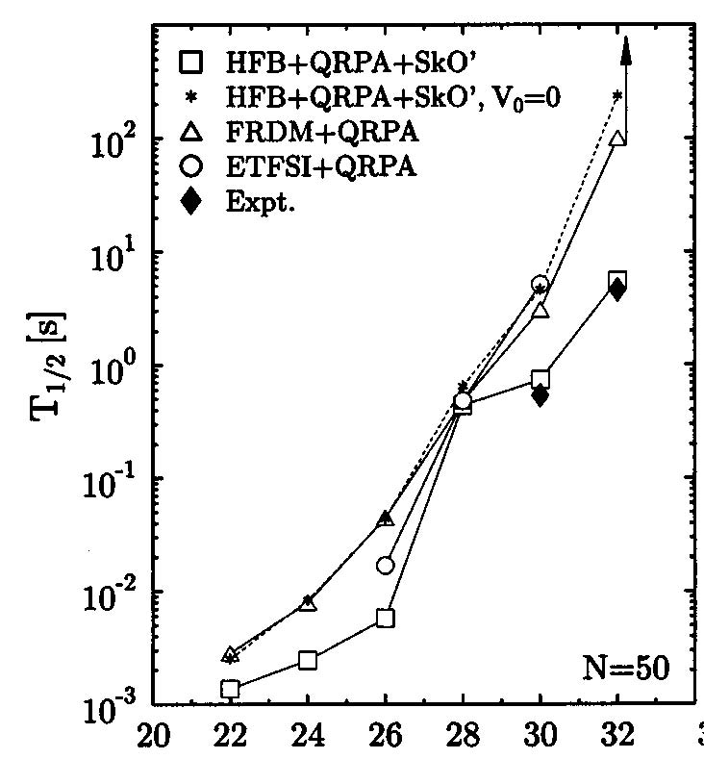
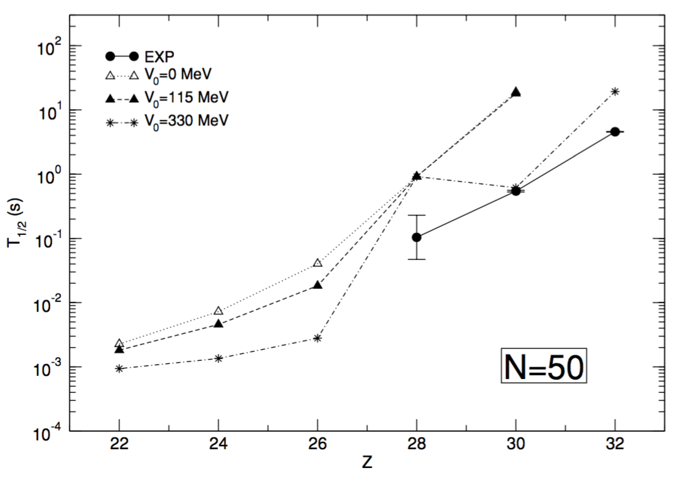
Half-life Is a Hard Problem …
RHB+QRPA
Skyrme HFB+QRPA
⁷⁸Ni
⁷⁸Ni
.
Niksic, et al., PRC 71, 014308 (2005)
Engel, et al., PRC 60, 014302 (1999)
Half-lives are overestimated
Due to the nuclear structure part – Gamow-Teller transition

Slide 11
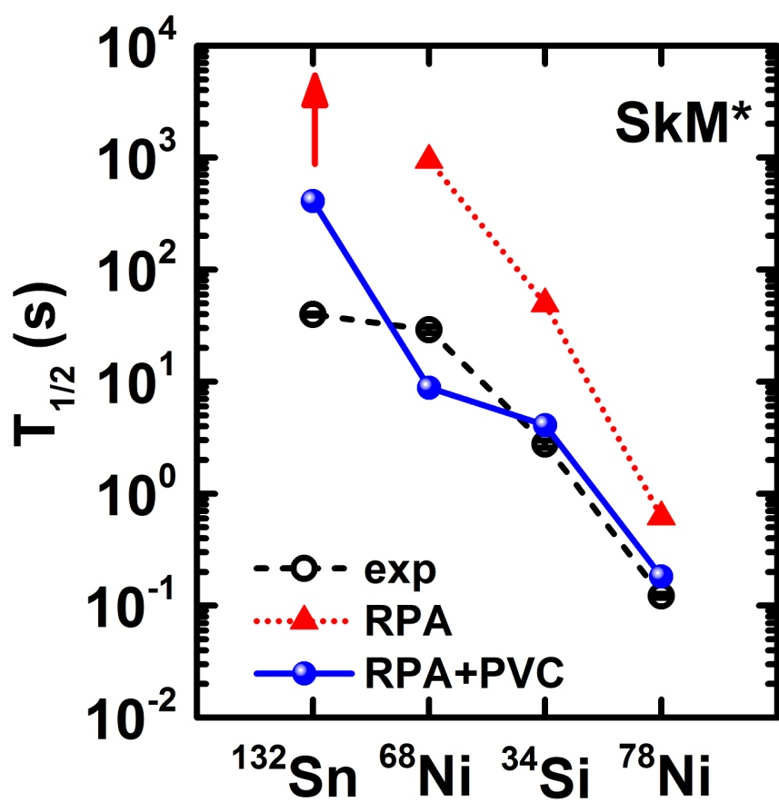
Effect of Quasiparticle Particle Vibration Coupling (QPVC)
QPVC: higher-order of many-body correlations
doubly magic nuclei
Ni isotopes
(Q) PVC:
Reduce half-lives systematically
Reproduce β-decay half-lives
Y. F. Niu, Z. M. Niu, G. Colo, and E. Vigezzi, PRL 114, 142501 (2015)
Y. F. Niu, Z. M. Niu, G. Colo, and E. Vigezzi, PLB 780, 325 (2018)

Slide 12
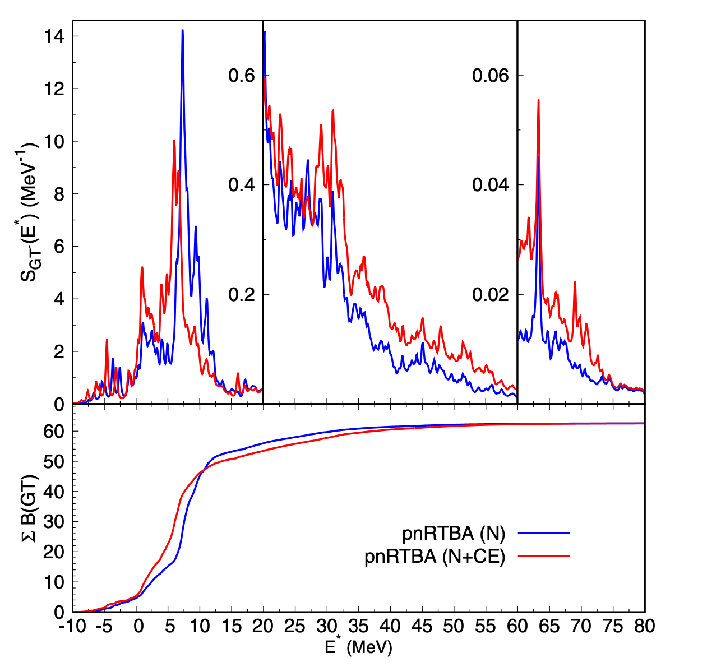
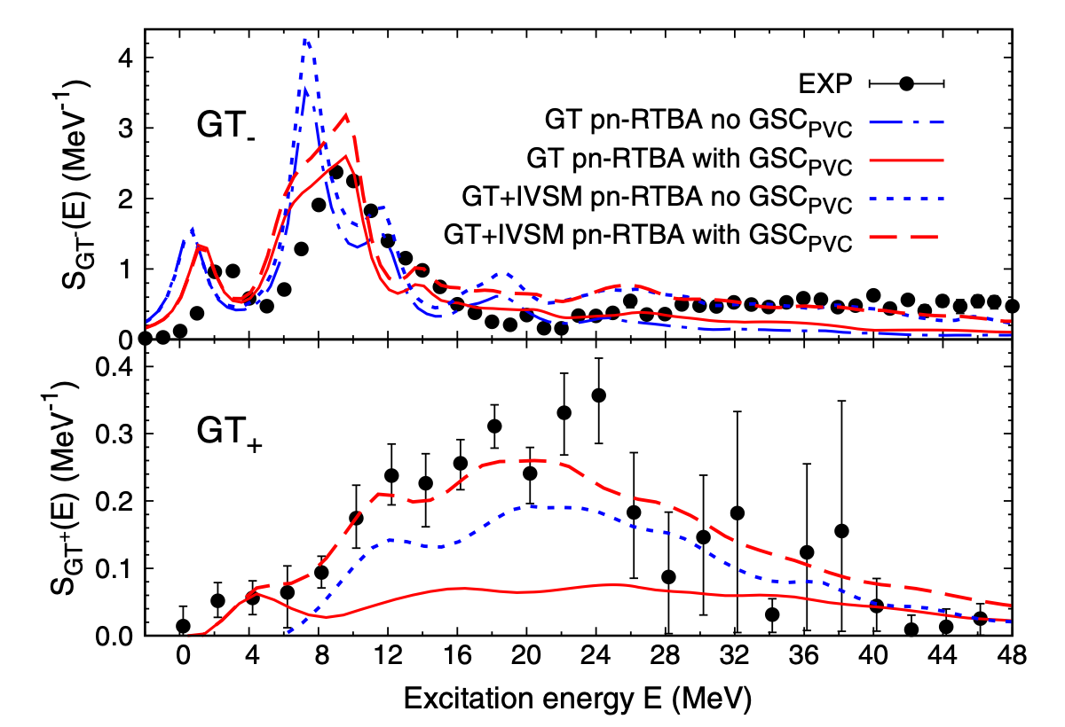




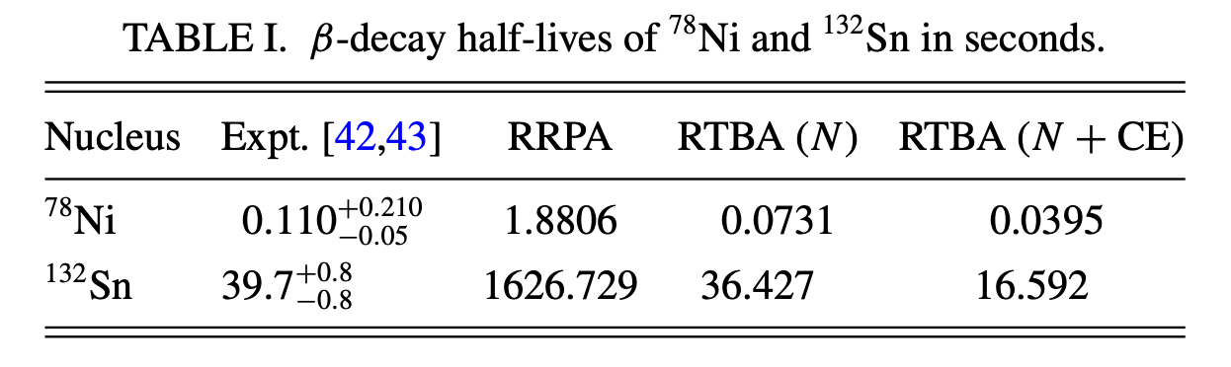
Relativistic PVC model
Based on NL3* interaction a non-linear meson-exchange relativistic interaction
G. Lalazissis et al., PLB 671, 36 (2009)
β-decay half-lives
Gamow-Teller Strength in ⁹⁰Zr
PVC model + ground state correlation
C. Robin and E. Litvinova, Phys. Rev. Lett. 123, 202501 (2019)
Inclusion of charge-exchange phonons
C. Robin and E. Litvinova, Phys. Rev. C 98, 051301(R) (2018)

Slide 13
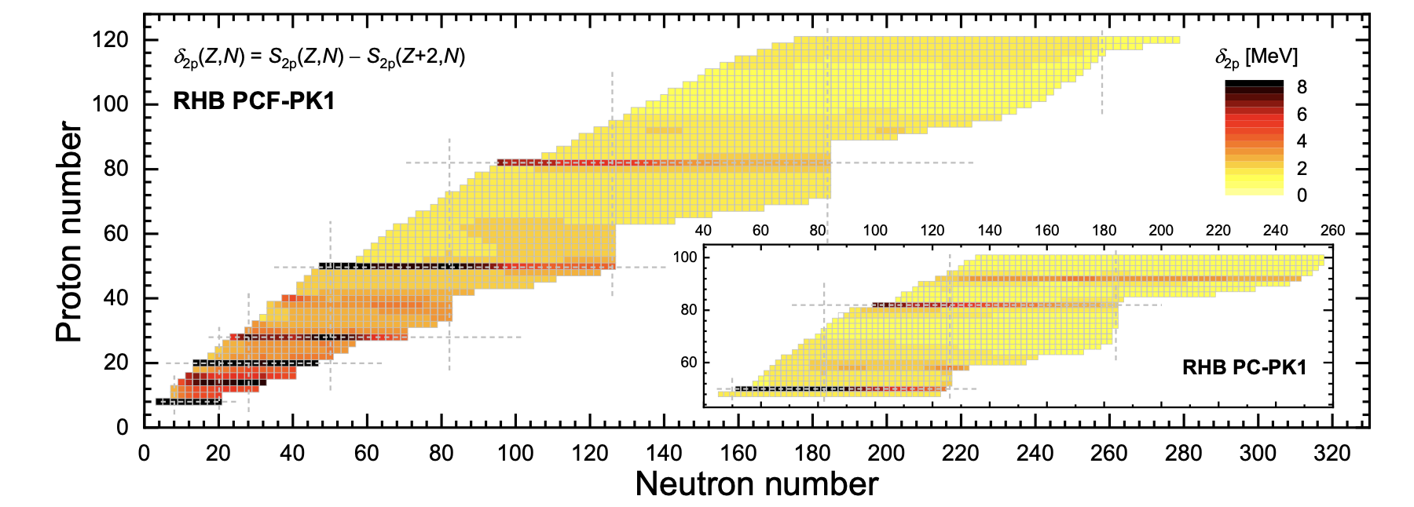

Relativistic interaction: PCF-PK1
Improved single-particle shell structure by the inclusion of tensor coupling
important for β-decay half-lives!
Eliminate pseudo shell structure at 58 and 92
Large level density around Fermi surface due to large Landau effective mass
Q. Zhao et al., Phys. Rev. C 106, 034315(2022)

Slide 14
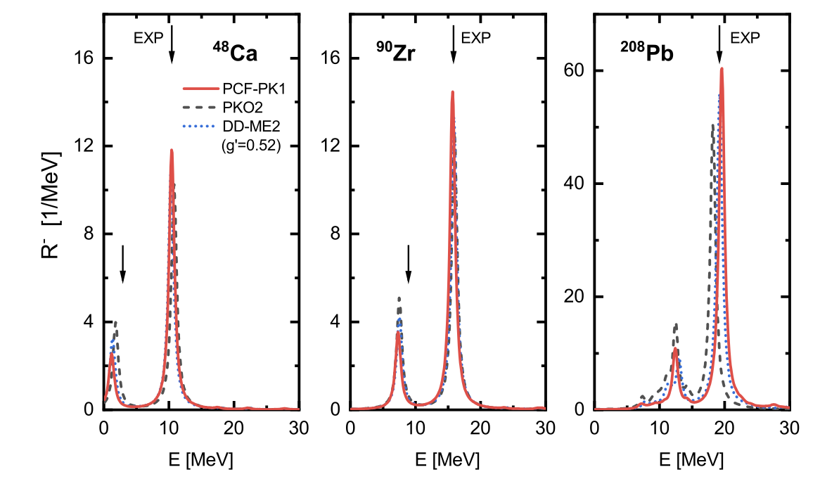
Relativistic interaction: PCF-PK1
Inclusion of exchange terms by Fierz transformation
Exchange (Fock) term is essential for the full self-consitency of QRPA!
Liang et al.,PRL 101, 122502 (2008)
DD-ME2:
RH+RPA
PKO2:
RHF+RPA
PCF-PK1:
Localized RHF+RPA
PCF-PK1:
Without free parameter g’, the exp. data can be reproduced
Q. Zhao et al., Phys. Rev. C 106, 034315(2022)

Slide 15
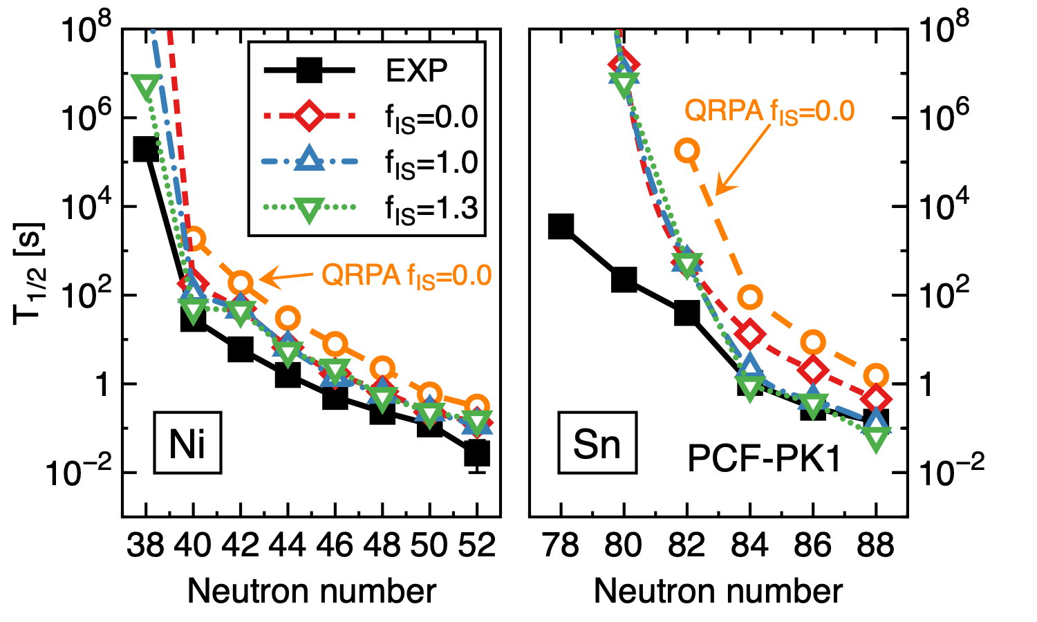
β-decay half-lives by QPVC with PCF-PK1

Slide 16
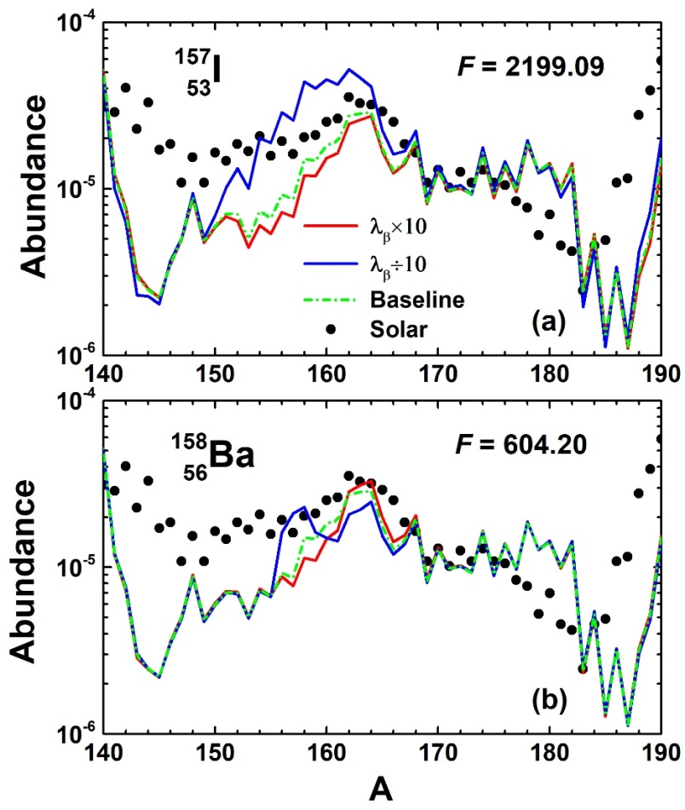
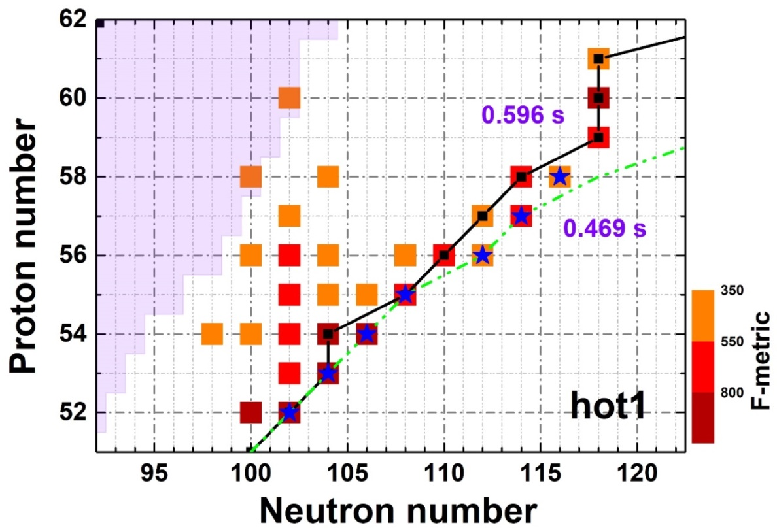
Impact of single β-decay half-life on rare-earth peak
Two different kinds of impact from β-decay half-life of a single nucleus on the rare-earth peak abundance
Y. W. Hao, Y. F. Niu, and Z. M. Niu, PRC 108, L062802 (2023)
r-process freeze-out path
Case I
Case I
Case II
When the β-decay rate decreases:
Case I: Abundance increases in the range of more than 10 mass numbers
Case II: The abundance increases at mass number A of this nucleus and decreases at higher mass numbers in the rare-earth mass region

Slide 17
Summary and Perspectives
Summary
QRPA models for the beta-decay half-life calculations with the inclusion of deformation or with the inclusion of higher-order many-body correlations are reviewed
  We newly developed QFAM method and QRPA+QPVC method based on relativistic point-coupling interaction
The impact of β-decay half-lives for the formation of r-process rare-earth peak is done
Perspectives
Include deformation degree of freedom in QPVC approach
Apply to β-decay calculation

Slide 18
Acknowledgement
Collaborators:
LZU: L. Guo C. Chen Y. N. Huang Y. W. Hao PKU: J. Meng P. W. Zhao
Anhui Uni.: Z. M. Niu
Aizu Univ. and RIKEN: H. Sagawa Milan Univ. : G. Colo, E. Vigezzi
Osaka Univ. : Q. Zhao
Thank you!

Slide 19
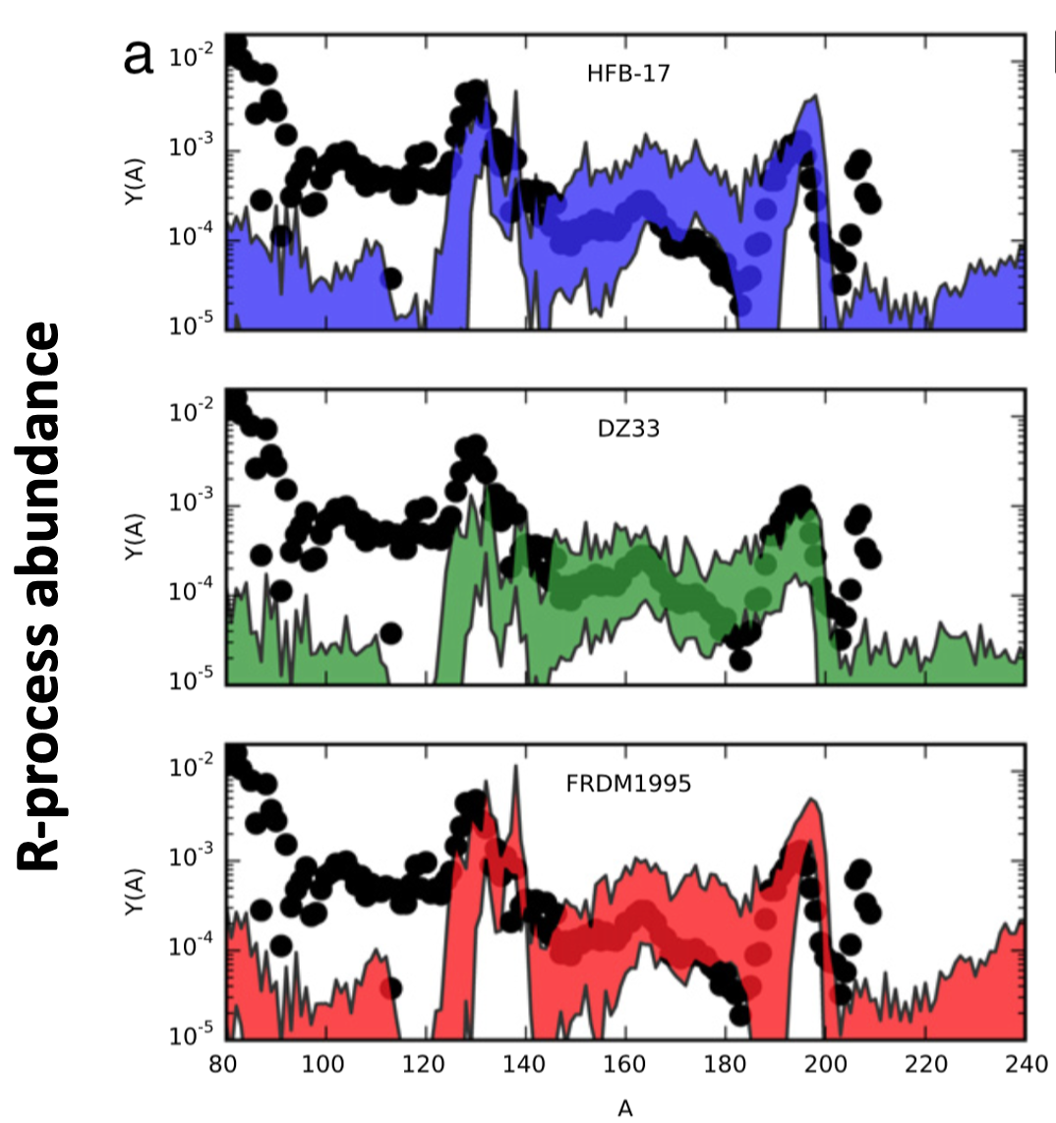
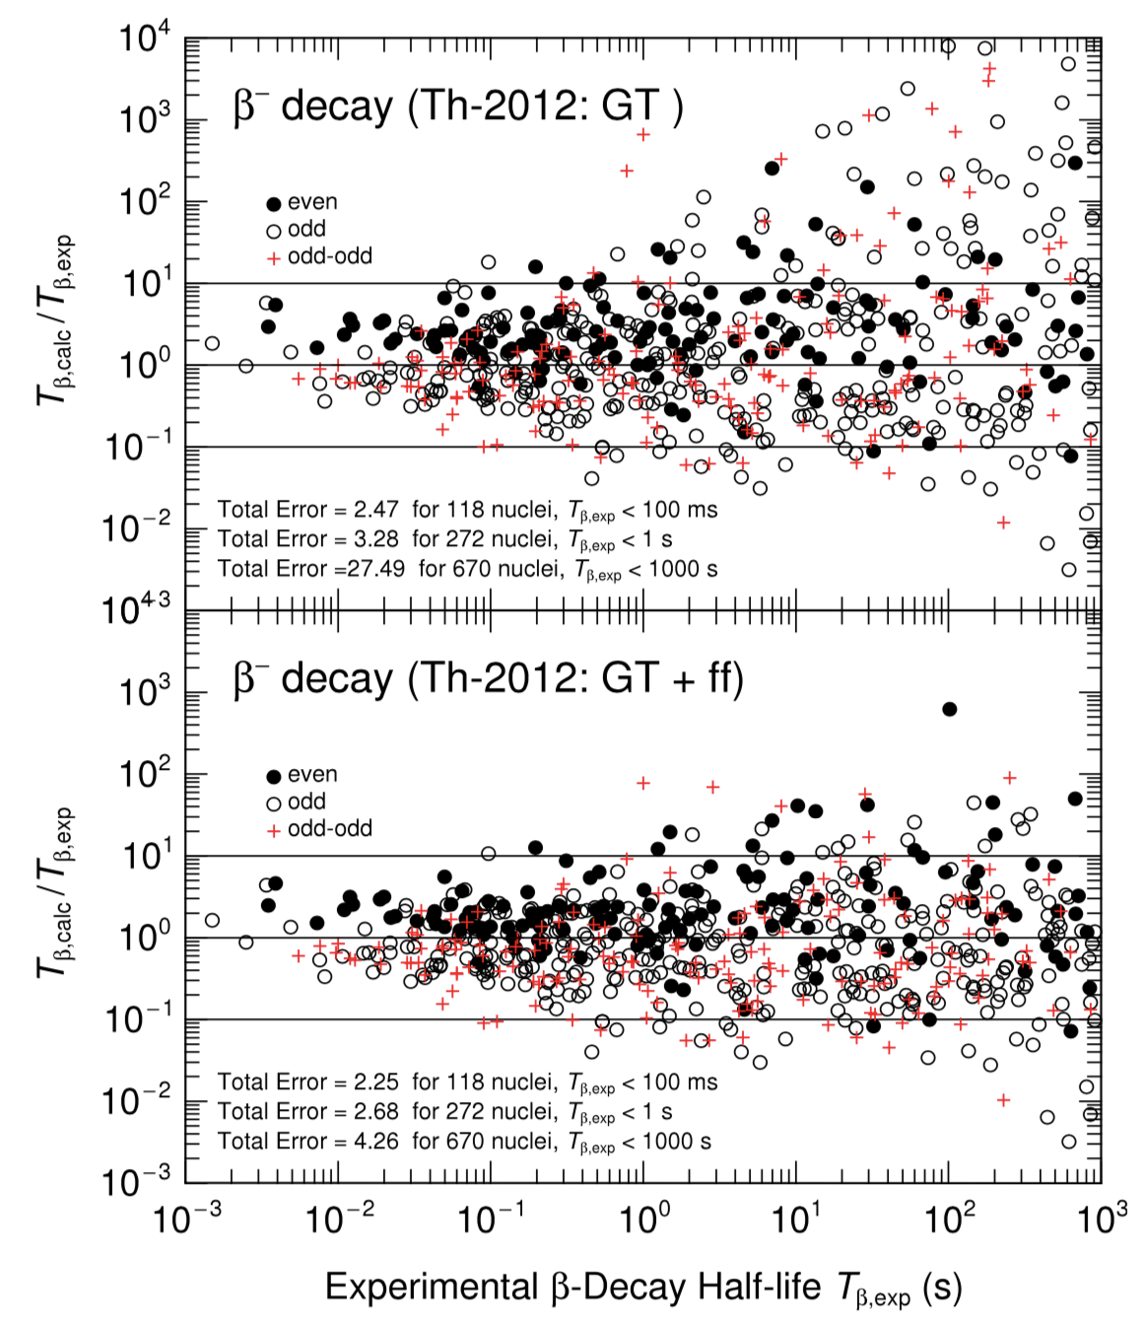
Consequences of uncertainties in β-decay half-lives
β-decay half-lives by finite-range droplet model (FRDM) + quasiparticle random phase approximation (QRPA)
Uncertainties caused by varying half-lives between 10⁻¹ - 10 times randomly
widely used in r-process simulation
span from 0.1-10 times
Möller et al., ADNDT 125, 1 (2019)
Mumpower et al., PPNP 86, 86 (2016)
Accurate description of nuclear β-decay half-lives is important for r-process study

Slide 20
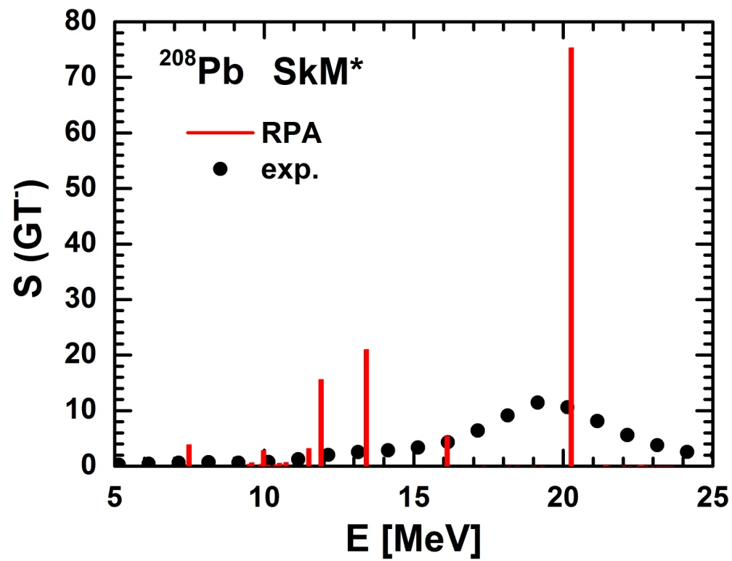
Limitations of (Q)RPA Description
(Q)RPA cannot describe the spreading width
Correlations beyond RPA
RPA
B
1p1h
Spreading Width (Damping Width)
E
energy and angular momentum of coherent vibrations
→ more complicated states of 2p-2h, 3p-3h, … character
B
1p1h
2p2h
E

Slide 21
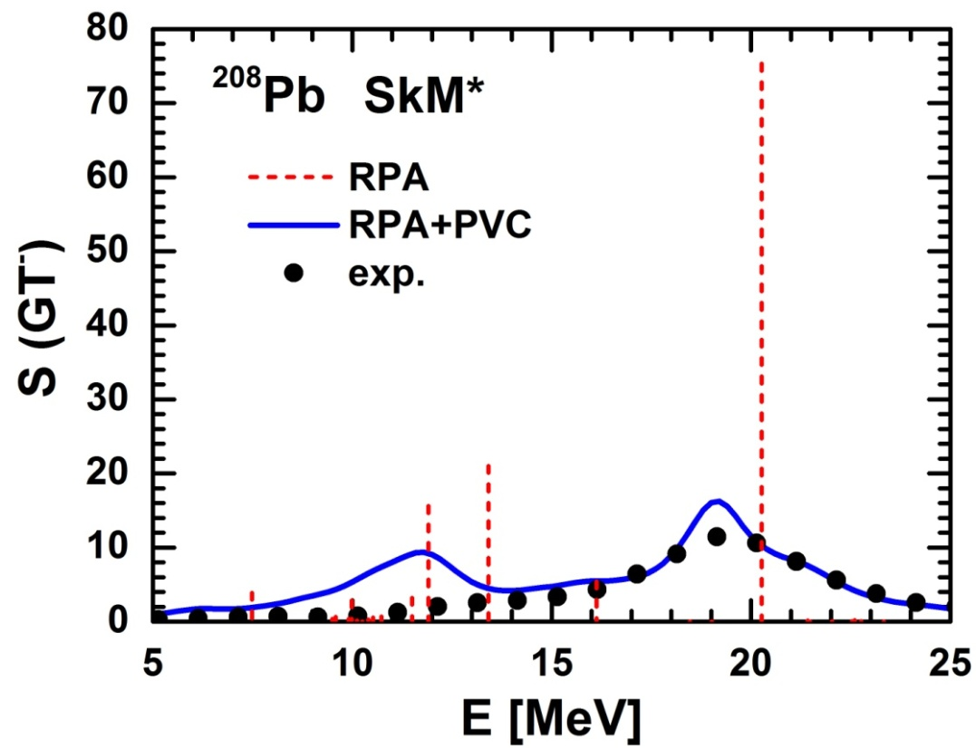
Solution: RPA + PVC
Particle Vibration Coupling (PVC) effect
Correlations beyond RPA
RPA
~PVC
B
1p1h
Spreading Width (Damping Width)
E
B
Develop a spreading width
Reproduce resonance lineshape
1p1h
2p2h
E
Y. F. Niu, G. Colo, and E. Vigezzi, PRC 90, 054328 (2014)

Slide 22
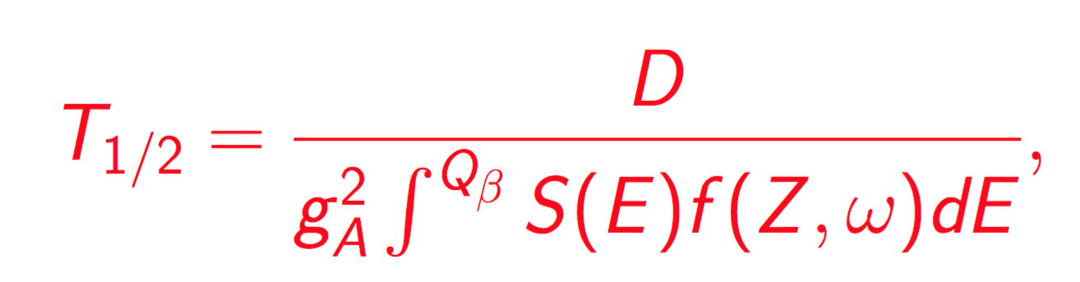
How PVC reduces half-lives?
Half-life
Phase Volume
Exp.: Xu, et al., PRL 113, 032505, 2014
PVC effect:
energy is shifted downwards -> phase space is increased -> half-life is decreased

Slide 23
Inclusion of deformation degree of freedom
Matrix diagonalization: solve the QRPA equation by diagonalization
  deformed QRPA with realistic force Ni and Ren, PRC 89, 064320, 2014
  Skyrme deformed QRPA Sarriguren, et al., PRC 81, 064314 (2013); Yoshida, JPS CP, 6, 020017, 2015
Quasiparticle Finite Amplitude Method (QFAM) : solve the QRPA equation by iteration
  Skyrme QFAM even-even, even-odd, odd-odd nuclei
  Mustonen et al., PRC 93, 014304 (2016); Ney et al., PRC 102, 034326 (2020)
Comparison with exp. data for odd nuclei
First-forbidden contribution to the rates

Slide 24
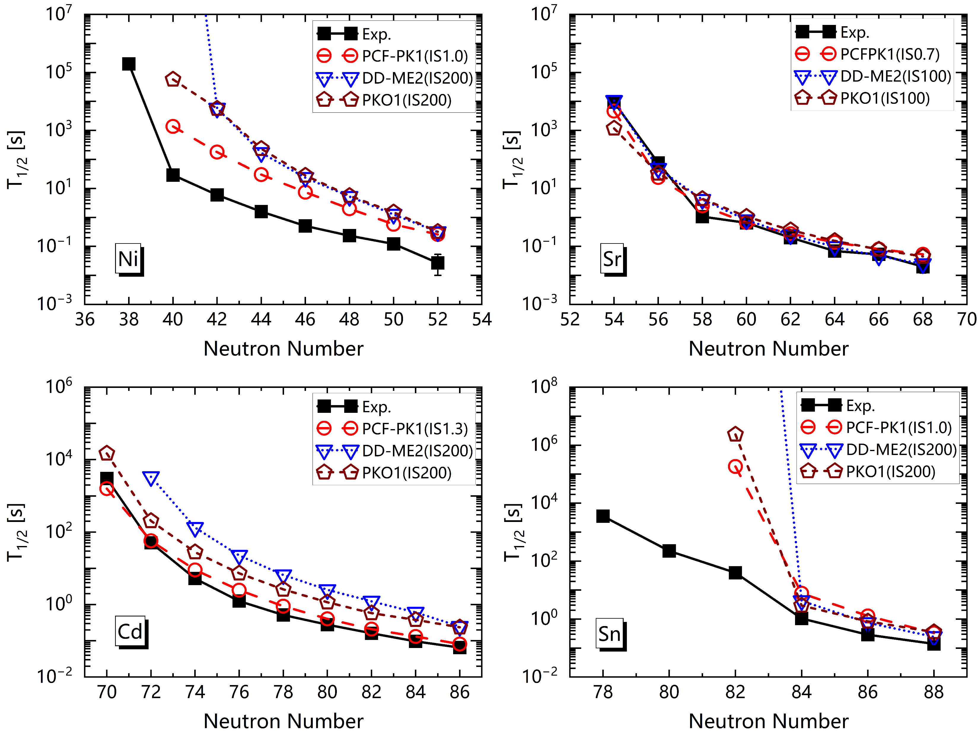
β-decay half-lives by QRPA with PCF-PK1
PCF-PK1 could improve β-decay half-lives due to large Landau effective mass
For Ni and Sn isotopes, correlations beyond QRPA are needed

Slide 25
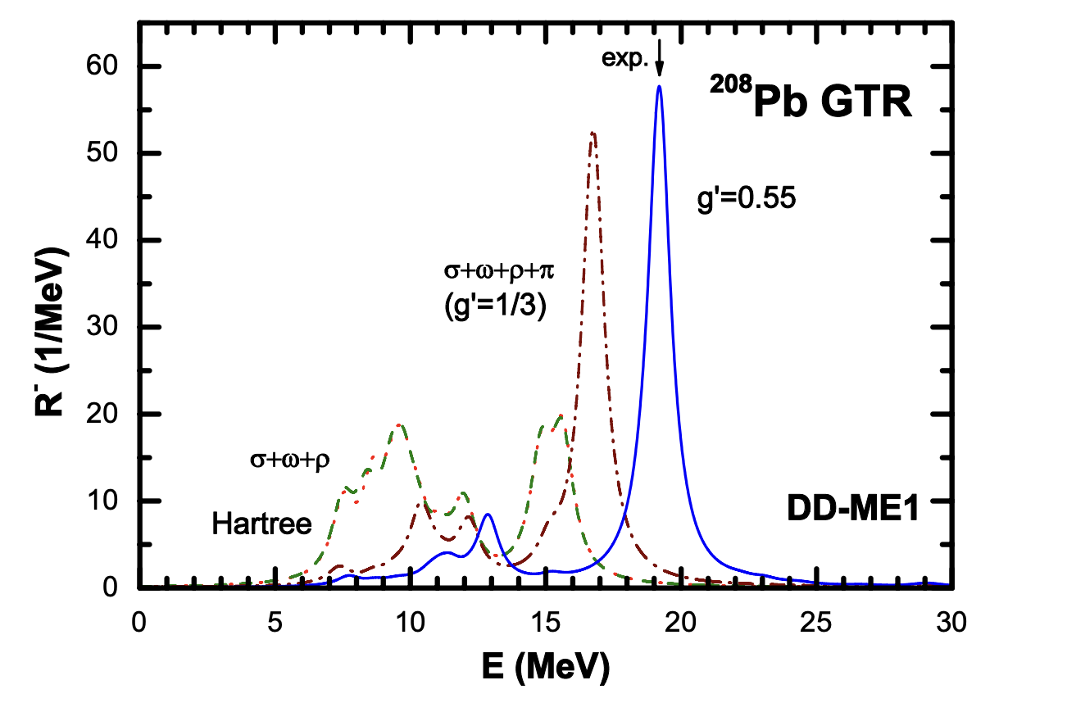
Relativistic interaction: PCF-PK1
Inclusion of exchange terms by Fierz transformation
Exchange (Fock) term is essential for the full self-consitency of QRPA!
Liang et al.,PRL 101, 122502 (2008)
Without Fock term
RH+RPA
Landau-Migdal parameter
g’: free parameter
by adjusting g’, the exp. data can be reproduced

Slide 26
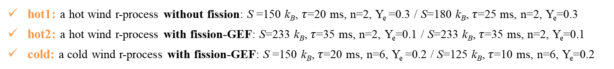

Basic Inputs and Conditions of Network Calculations
Nuclear network ：
Nuclear network NucNet (Bradley S. Meyer) involves more than 6000 isotopes up to No (Z=102) .
http://sourceforge.net/p/nucnet-tools
Nuclear physics inputs：
Nuclear mass: form FRDM-1995.
Neutron capture rates: from JINA REACLIB database / calculated with TALYS as nuclear mass changes.
β-decay rates: from JINA REACLIB database.
Fission is included as in Ref. ApJ, 933 3, 2022.
Fission yields: determined by GEneral Fission model (GEF2021) model.
https://reaclib.jinaweb.org/labels.php
https://tendl.web.psi.ch/tendl 2019/talys.html
Y. W. Hao et al., ApJ,933 3, 2022
http://www.cenbg.in2p3.fr/GEF
Astrophysical scenarios ：
We use a parameterized trajectory where the density as a function of time is given by:
$$ρ\left(t\right)=ρ_{1}e^{−t/τ}+ρ_{2}{\left(\frac{∆}{∆+t}\right)}^{n}$$
M. R. Mumpower et al., ApJ, 752 117, 2012
Three distinct astrophysical scenarios in nuclear mass and β-decay sensitivity studies:
hot1: a hot wind r-process without fission: S =150 k_{B}, $τ$=20 ms, n=2, Y_{e} =0.3 / S=180 k_{B}, $τ$=25 ms, n=2, Y_{e}=0.3
hot2: a hot wind r-process with fission-GEF: S=233 k_{B}, $τ$=35 ms, n=2, Y_{e}=0.1 / S=233 k_{B}, $τ$=35 ms, n=2, Y_{e}=0.1
cold: a cold wind r-process with fission-GEF: S =150 k_{B}, $τ$=20 ms, n=6, Y_{e} =0.2 / S=125 k_{B}, $τ$=10 ms, n=6, Y_{e}=0.2
An additional set of simulations in the cold scenario:
cold-sym: same as cold scenario but use a simple symmetric split for the fission product distributions.

Slide 27
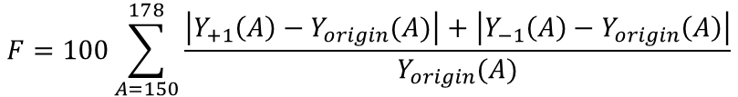
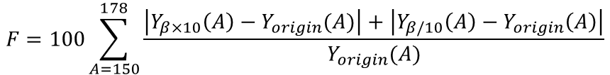
Sensitivity calculations
Mass sensitivity calculations:
Varying nuclear mass ∆𝑀=±1 MeV of every single nucleus in the region of interest for the rare-earth peak formation.
Mass sensitivity measure:
$$F=100\sum_{A=150}^{178}{\frac{\left|Y_{+1}\left(A\right)−Y_{origin}(A)\right|+\left|Y_{−1}\left(A\right)−Y_{origin}\left(A\right)\right|}{Y_{origin}(A)}}$$
$Y_{origin}(A)$ → baseline abundance $Y_{+1}\left(A\right)$ , $Y_{−1}\left(A\right)$ → abundance with $∆M=±1$ MeV
β-decay sensitivity calculations:
Increasing and decreasing β-decay rate by a factor of 10 for each nucleus in the region of interest for the rare-earth peak formation.
β-decay sensitivity measure:
$$F=100\sum_{A=150}^{178}{\frac{\left|Y_{β×10}\left(A\right)−Y_{origin}(A)\right|+\left|Y_{β/10}\left(A\right)−Y_{origin}\left(A\right)\right|}{Y_{origin}(A)}}$$
$Y_{β×10}\left(A\right)$, $Y_{β/10}\left(A\right)$ → abundances with increase and decrease in β-decay rate by a factor of 10

Slide 28
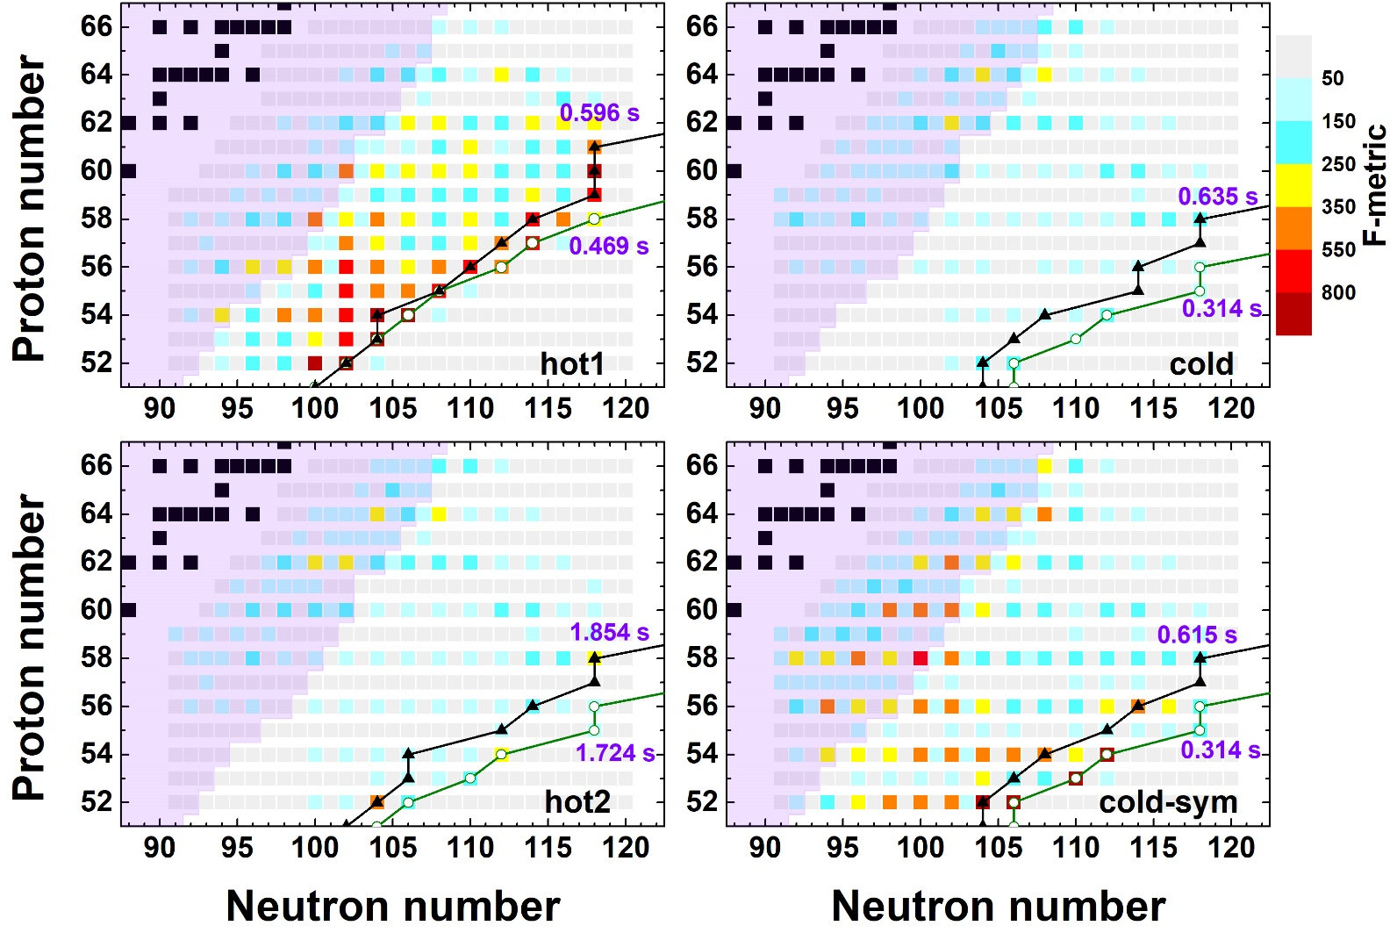
Sensitivity studies for the r-process rare-earth peak
Sensitivity measures F for β-decay sensitivity studies in four different scenarios
freeze-out path
hot1: without fission
N=100, 102, 104
hot2: with fission-GEF
Early equilibrium path
cold: with fission-GEF
cold-sym: symmetric fission ( unrealistic)
Fission deposition significantly reduces the sensitivity
Y. W. Hao, Y. F. Niu, and Z. M. Niu, PRC 108, L062802 (2023)

Slide 29
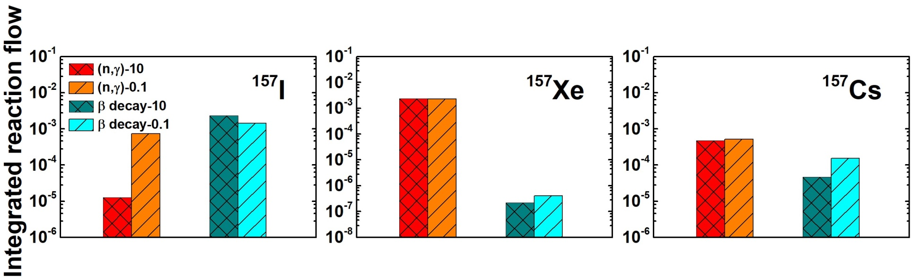
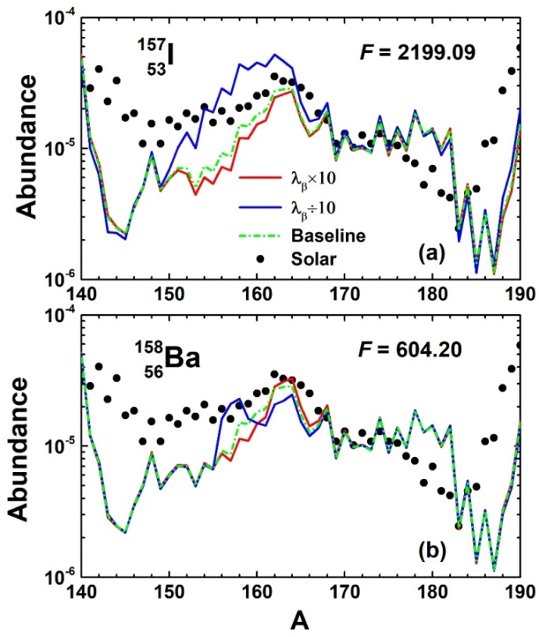
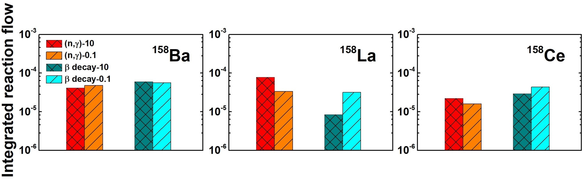
Effects of β-decay on reaction flow
¹⁵⁷I (Category I) β-decay rate changes → Integrated reaction flow of daughter nuclei ¹⁵⁷Xe:
When the β-decay rate of ¹⁵⁷I decreases, the neutron capture flow of the β-decay daughter nucleus ¹⁵⁷Xe remains almost unchanged.
¹⁵⁸Ba (Category II) β-decay rate changes → Integrated reaction flow of daughter nuclei ¹⁵⁸La :
When the β-decay rate of ¹⁵⁸Ba decreases, the neutron capture flow of the β-decay daughter nucleus ¹⁵⁸La decreases obviously.

Slide 30
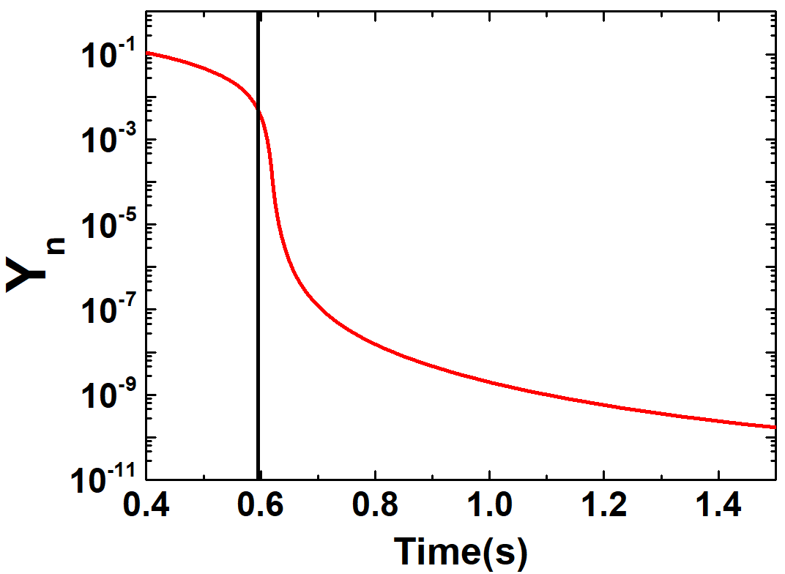
Effects of β-decay on reaction flow
When the β-decay rate decreases:
For nuclei on the right side of the r-process freeze-out path, e.g. ¹⁵⁷ I (Category I):
The number of neutrons in the environment is still very large when the nuclear flow reaches this nucleus
Neutron capture of β-decay daughter nuclei does not decrease much
For nuclei on the left side of the freeze-out path , e.g. ¹⁵⁸ Ba (Category II)：
The neutron abundance decreases significantly with time after freeze-out
Later population of daughter nuclei results in neutron captures inactive due to the low neutron number in the environment at later time.
Evolution of neutron abundance over time ：
r-process freeze-out

