Slide 1




Underground nuclear astrophysics experiments: Status and Future
G.F. Ciani
INFN- Bari

Slide 2
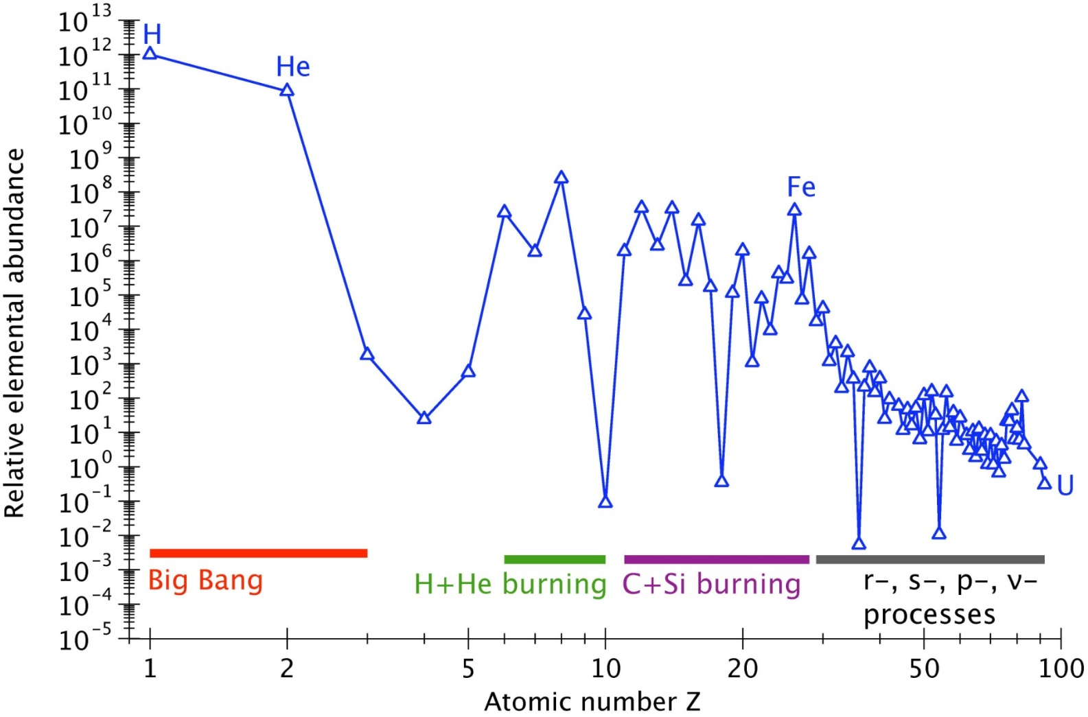
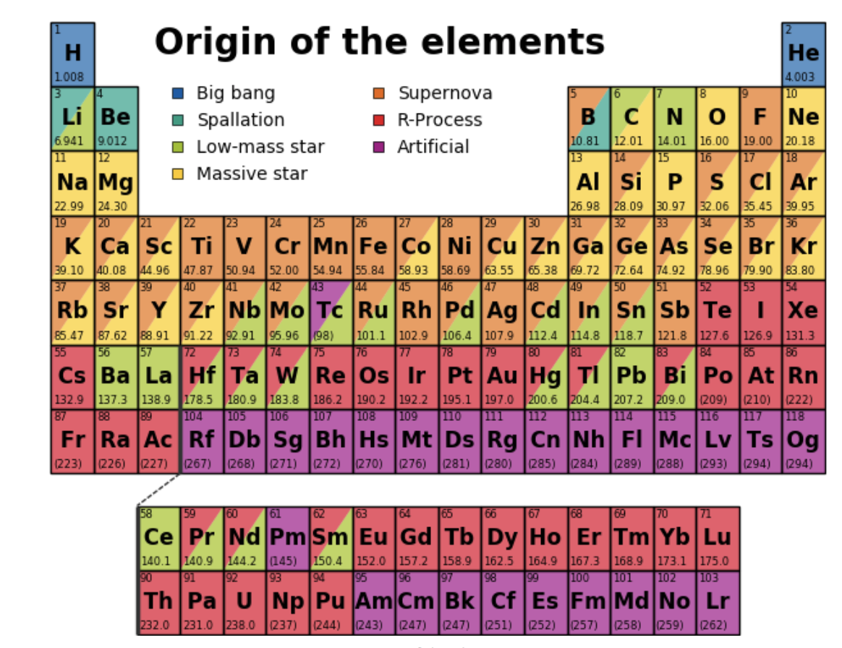
NUCLEAR ASTROPHYSICS TO STUDY
STELLAR EVOLUTION AND ELEMENT NUCLEOSYNTHESIS
Charged-particle induced reactions
neutron capture reactions
Notes:
L’astrofisica nucleare ha lo scopo di comprendere i siti e i meccanismi di nucleosintesi degli elementi della tavola periodica. Si sa che tutti gli elementi sono sintetizzati in processi astrofisici: i più leggeri fino al Berilio nella BBN, gli altri all’interno di ambienti stellari che regolano l’evoluzione dei corpi celesti, oltre a determinare l’abbondanza isotopica che osserviamo al giorno d’oggi.

Slide 3
FOR THE REACTION RATE WE NEED CROSS SECTION
 | E0 [keV]
p+p | 6
³He+³He | 22
³He+⁴He | 23
⁷Be+p | 18
¹⁴N+p | 27
Notes:
Uno dei parametri principali per lo studio dell’evoluzione stellare è il reaction rate, ovvero il numero di processi per unità di tempo e di volume in un determinato ambiente stellare. Questo è dipendente dalla sezione d’urto, grandezza della fisica nucleare. Sebbene l’integrale sia su tutte le energie, la regione di interesse principale energetica, il picco di Gamow, è

Slide 4
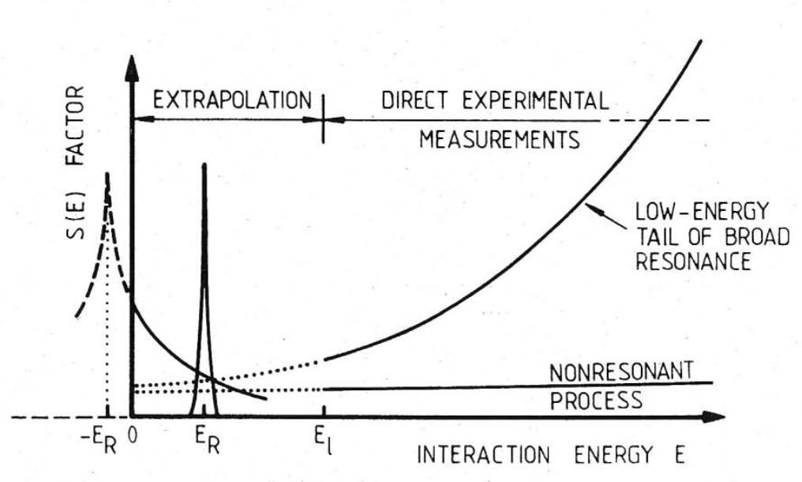
EXTRAPOLATION TO LOW ENERGY
Possibility but not a solution
σ(E)
resonance
LOG
SCALE
CROSS SECTION
E_{G}
non-resonant
many orders
of magnitude
direct measurements
extrapolation needed !
Interaction energy E

Slide 5


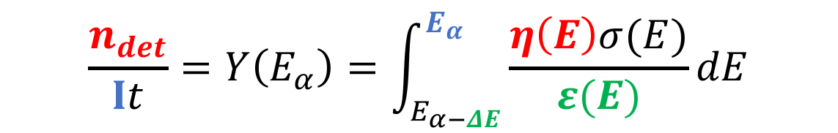
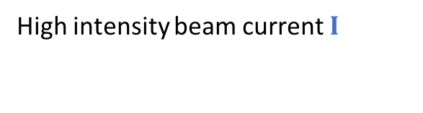
HOW TO PERFORM A DIRECT MEAUREMENT
REACTION PRODUCTS
TARGET
ACCELERATOR
a, p, n, γ
High density,
well know composition
High intensity beam current $I$
DETECTOR
high efficiency $η$
$$\frac{n_{det}}{It}=Y\left(E_{α}\right)=\int_{E_{α−ΔE}}^{E_{α}}{\frac{η\left(E\right)σ(E)}{ε(E)}}dE$$

Slide 6
IS IT ONLY A MATTER OF PATIENCE?
Counting Rate = N_{p} x N_{t} x cross section x detection efficiency
10¹⁴ pps (~100 μA q=1+) typical stable beam intensities
10¹⁹ atoms/cm² typical solid state targets
10⁻¹³ barn (often even smaller)
100% for charged particles
~1-10% for gamma rays (HPGe detectors)
Signal to noise ratio extremely low!!
Counting Rate = 30-3000 counts/year= 0.1- 10 counts/day

Slide 7
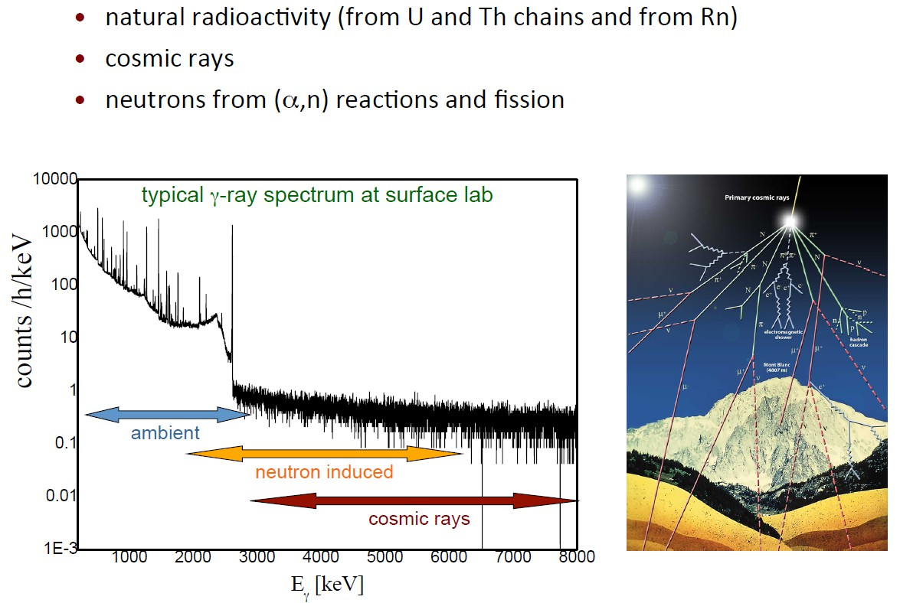
Main Source of Background
Main Source of Background
We can reduce the background by shielding or by Pulse Shape Discrimination techniques

Slide 8
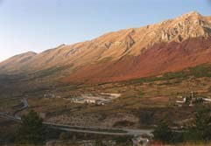
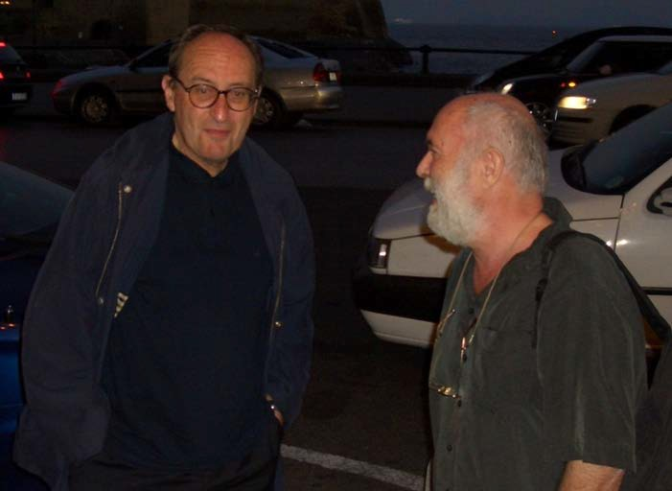
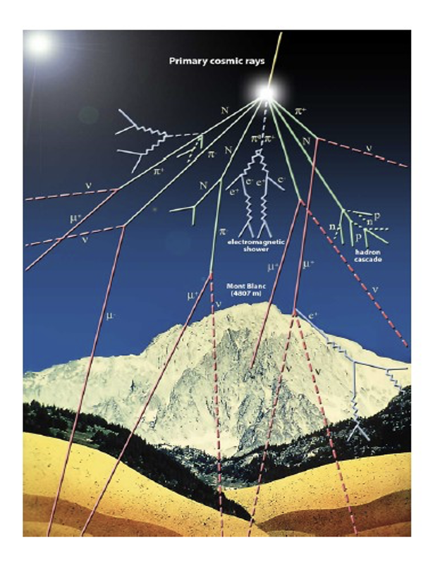
Underground Accelerator: The Beginning
LUNA – Laboratory for Underground Nuclear Astrophysics
initiated: 1st Nuclei in the Cosmos Conference (Baden, Austria, 1990)
Giani Fiorentini INFN Ferrara Italy
Claus Rolfs
Ruhr-Universität Bochum Germany
Why are we not going into the Gran Sasso Lab?

Slide 9
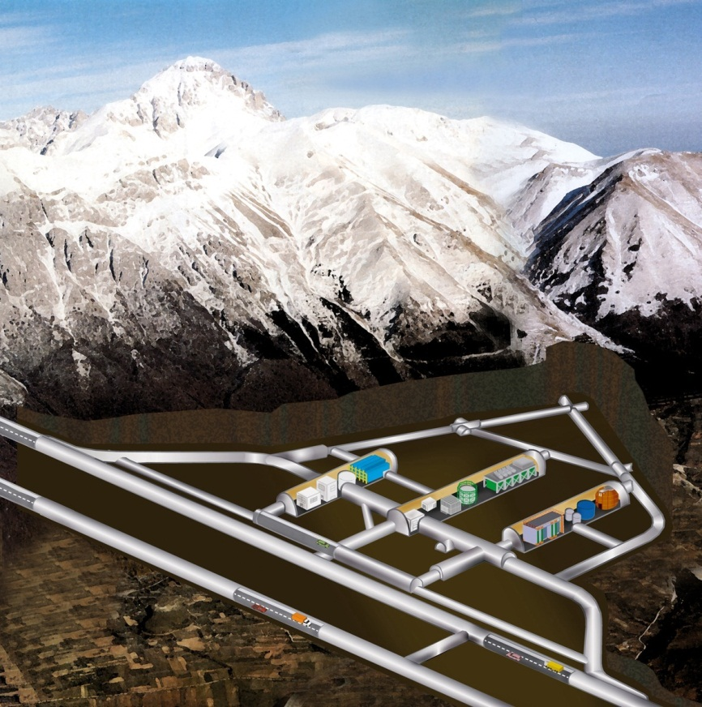
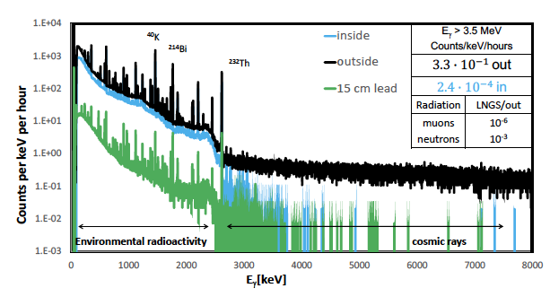
Measurements are performed in the Gran Sasso Underground Laboratory
Background reduction by:
  6 orders of magnitude for muons
  3 orders of magnitude for neutrons
Further background reduction using proper shielding and ultrapure materials
1400 m
3800 m.w.e.

Slide 10
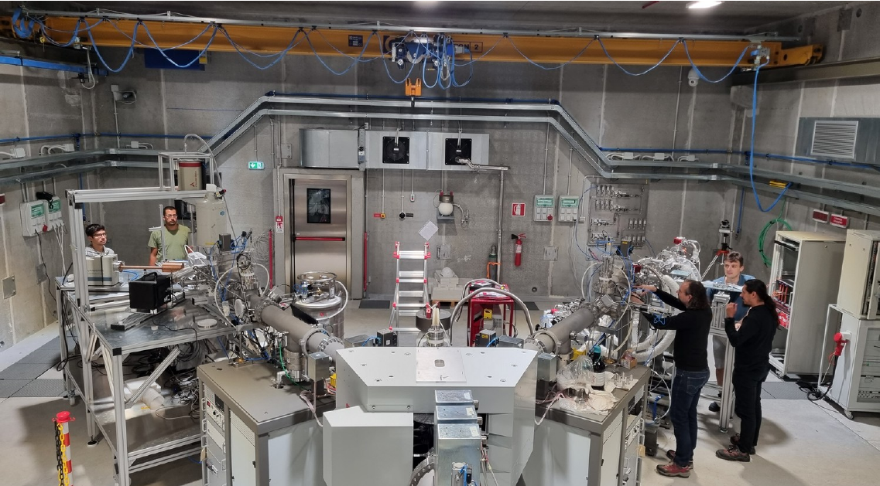
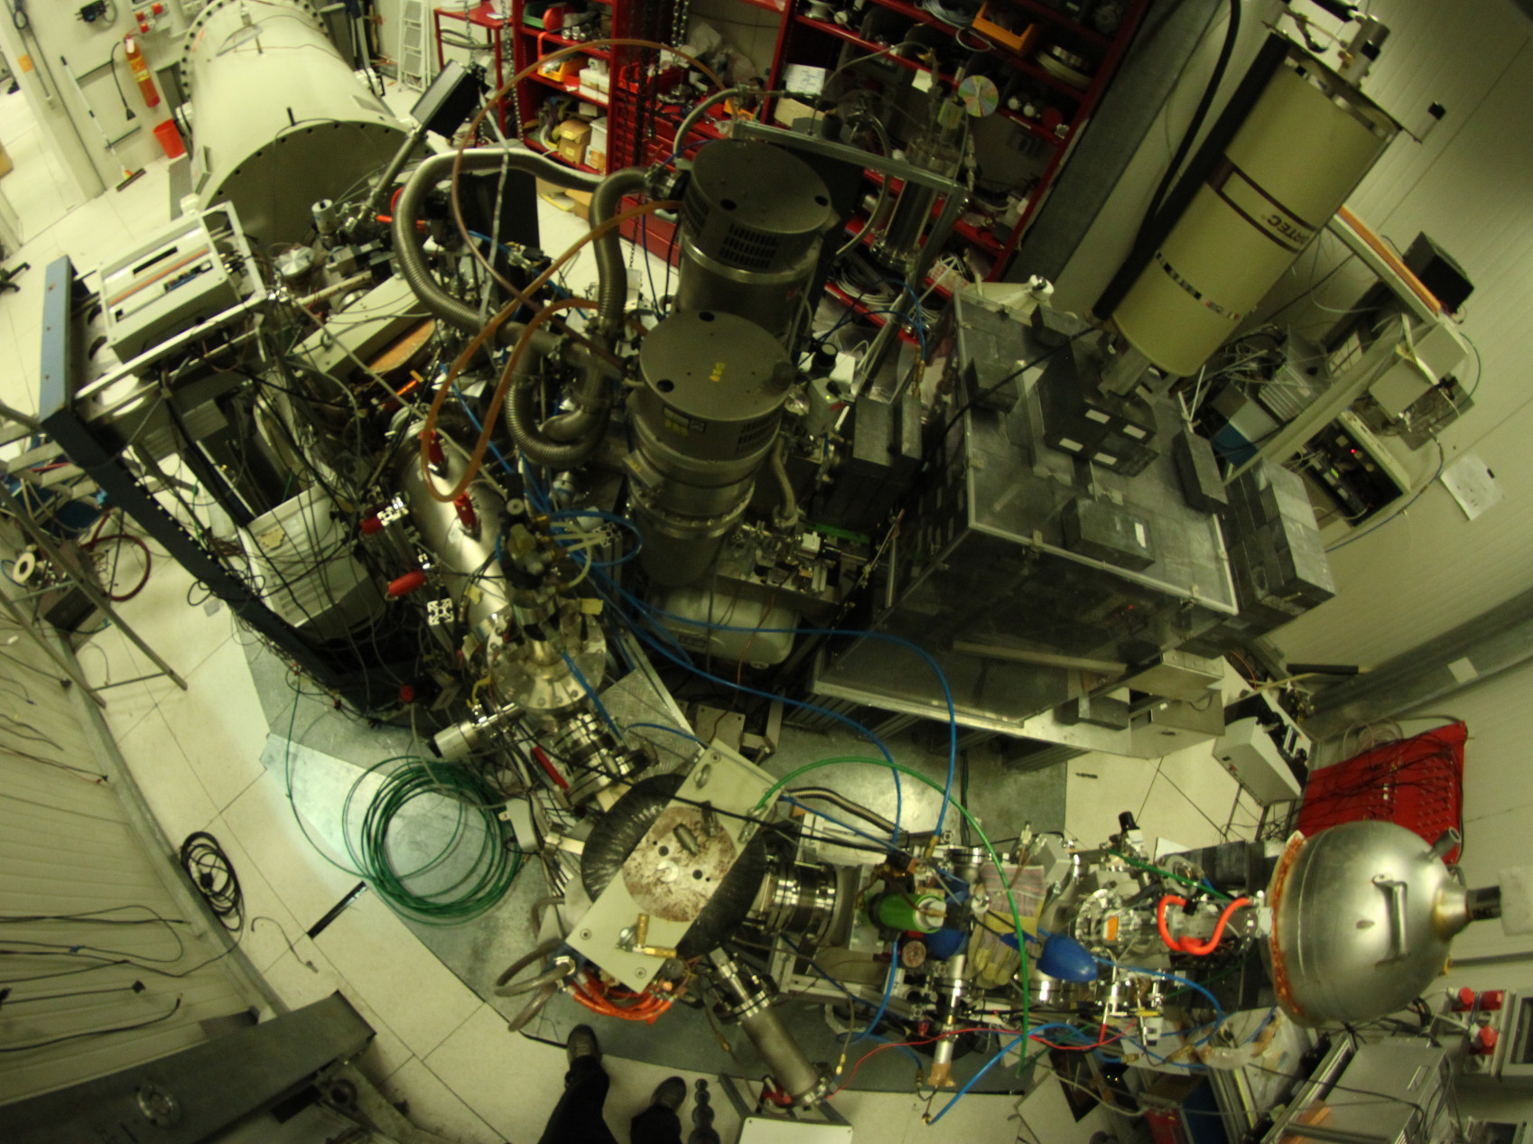
LUNA-400 and Ion Bellotti Facility at LNGS
Beam intensity on target at different terminal voltage
Ion specie | Terminal Voltage
 | 0.3 MV – 0.5 MV | 0.5 MV - 3.5 MV
¹H⁺ | 500 μA | 1000 μA
⁴He+ | 300 μA | 500 μA
¹²C⁺ | 100 μA | 150 μA
¹²C⁺² | 60 μA | 100 μA
Number of beam lines |  | 2
Terminal Voltage range |  | 0.3 – 3.5 MV
OSAT successfully concluded in Spring 2023
First beam given to LUNA the 19th June 2023 for the
commissioning of the machine by the study of the ¹⁴N(p,γ)¹⁵O
(A. Compagnucci’s talk).
Presently under study ²²Ne(α,n)²⁵Mg (A. Best’s talk)
Beam energy (keV） |  | Beam intensity on target（uA）
_{H}+ | He⁺ | _{H}+ | He⁺
50-400 | 50-400 | 250 | 250

Slide 11
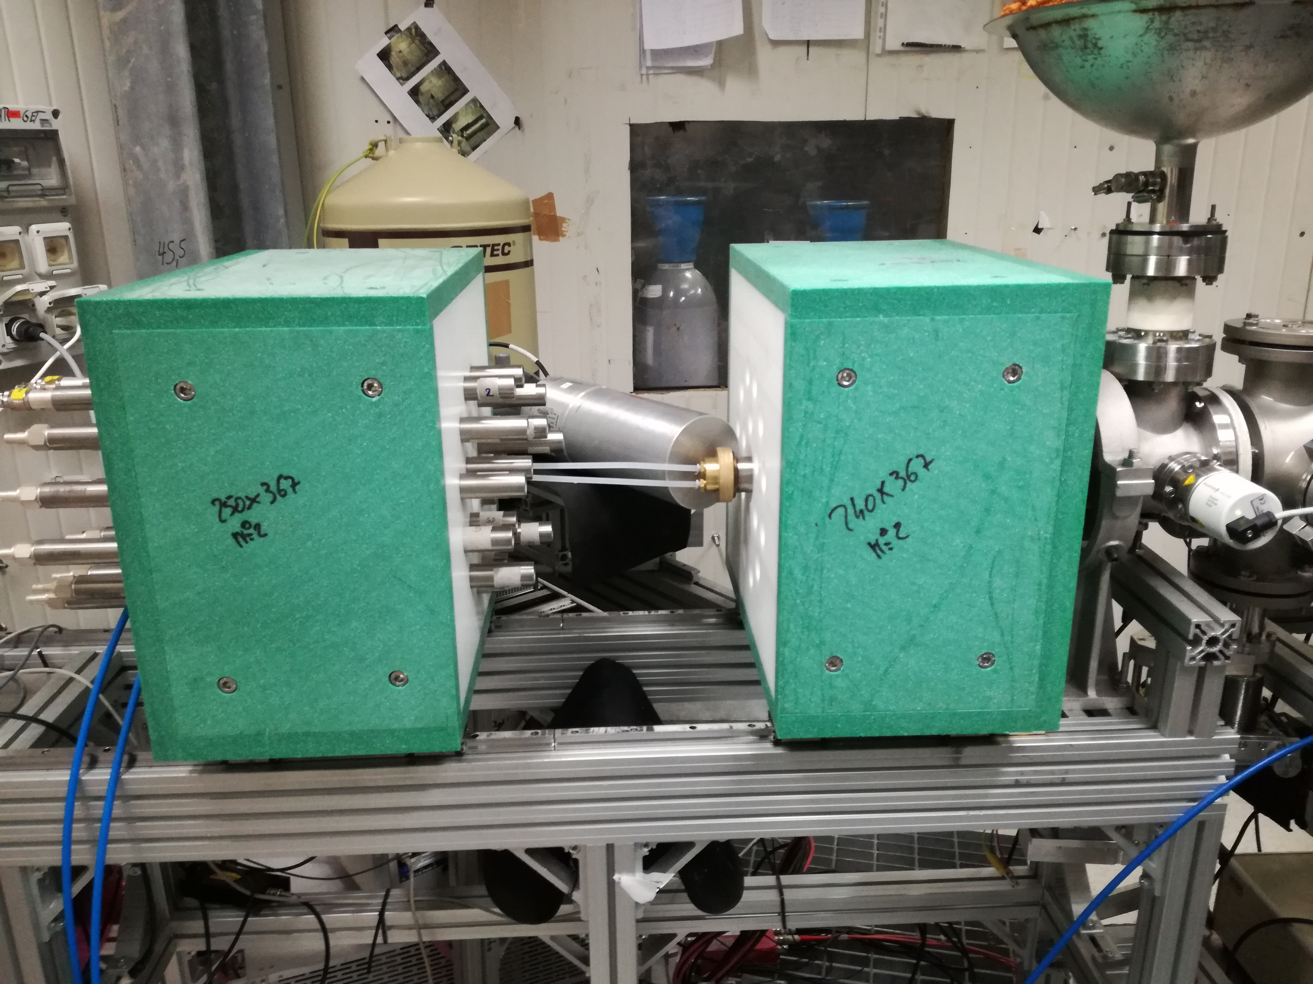
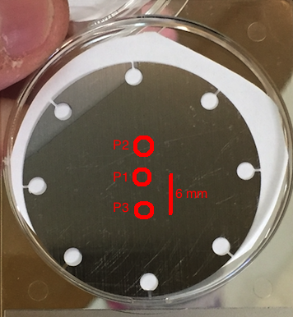
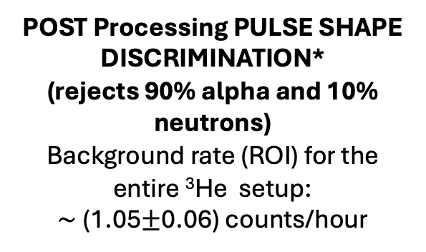
EXPERIMENTAL SETUP
¹³C(α,n)¹⁶O: S(E) factor towards the gamow window
BACKGROUND REDUCTION
ENVIRONMENTAL: neutron flux reduction of a factor 1000 in Underground Laboratory
beam
INTRINSIC: α particles source of intrinsic background from U and Th impurities in the counters’ case
10 atm pressurised ³He counters with a stainless steel case with low intrinsic background
Background (n+α): (2.93+-0.09) counts/h in the ROI
POST Processing PULSE SHAPE DISCRIMINATION*
(rejects 90% alpha and 10% neutrons)
Background rate (ROI) for the entire ³He setup:
$\sim$(1.05$±$0.06) counts/hour
target
³He counter array as detector:
Csedreki et al, NIM, A 994 (2021)
TARGETS
¹³C 99% enriched evaporated targets cooled and monitored in degratation by gamma shape analysis
Ciani et al, Eur. Phys. J. A(2020) 56:75
Notes:
So finally here i show our results.
The black points meausred by LUNA cover an energy range between 230 and 305 keV in the cm.
We reached an unprecedented lowest energy with overall uncertainty lower than 20% for all the dataset. This allowed to perform a more constrained R matrix fit that il 20% lowe that the R matrix without the LUNA data. This allowes to evaluate a reaction rate with much reduced uncertiainty.

Slide 12
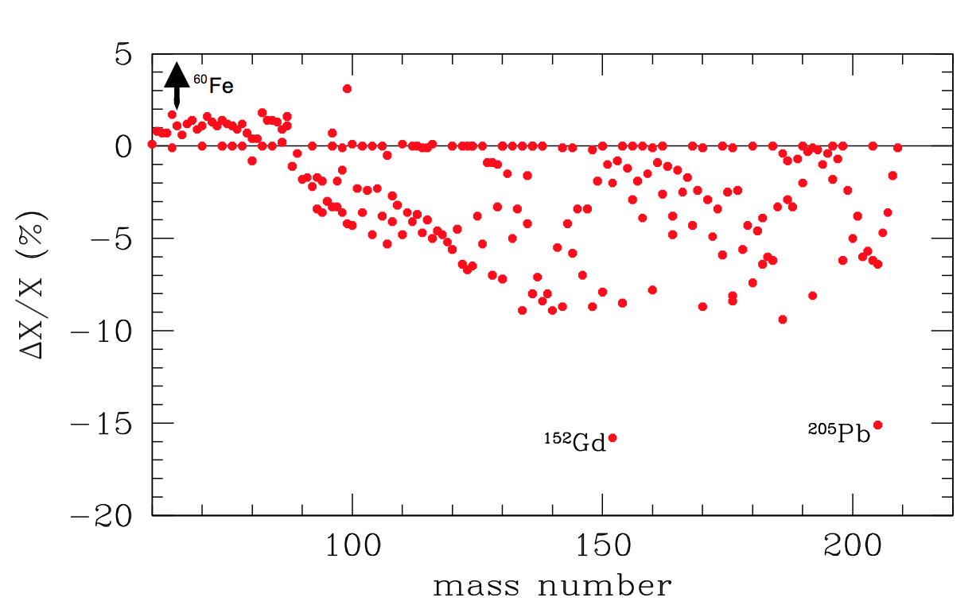

¹³C(α,n)¹⁶O: S(E) factor towards the gamow window
Calculating reaction rate using the S factor at -2σ,simulations show significant variation of isotopes at branching points between r and s process
Ciani et al, PRL, 127, 152701 (2021)
Data taking in 4 campaigns of 3 months each in about 2 years (more than 100 targets used)
Overal uncertainty lower than 20% for the whole dataset (E_{cm} 230-305 keV)
Lowest energy data ever achieved and at the Gamow window edge of low mass AGB.
First step towards improvement of the solution of the puzzle.
Notes:
So finally here i show our results.
The black points meausred by LUNA cover an energy range between 230 and 305 keV in the cm.
We reached an unprecedented lowest energy with overall uncertainty lower than 20% for all the dataset. This allowed to perform a more constrained R matrix fit that il 20% lowe that the R matrix without the LUNA data. This allowes to evaluate a reaction rate with much reduced uncertiainty.

Slide 13
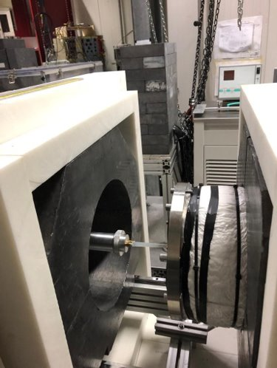
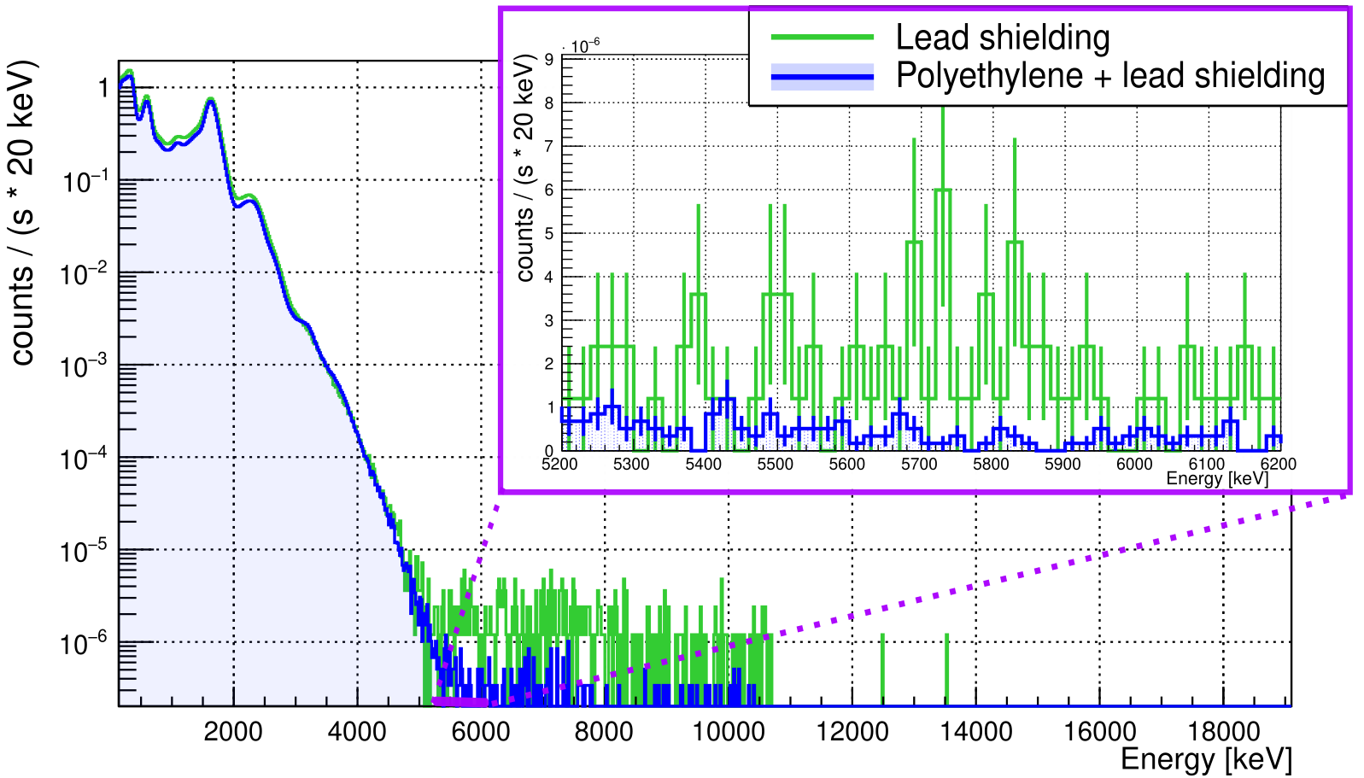
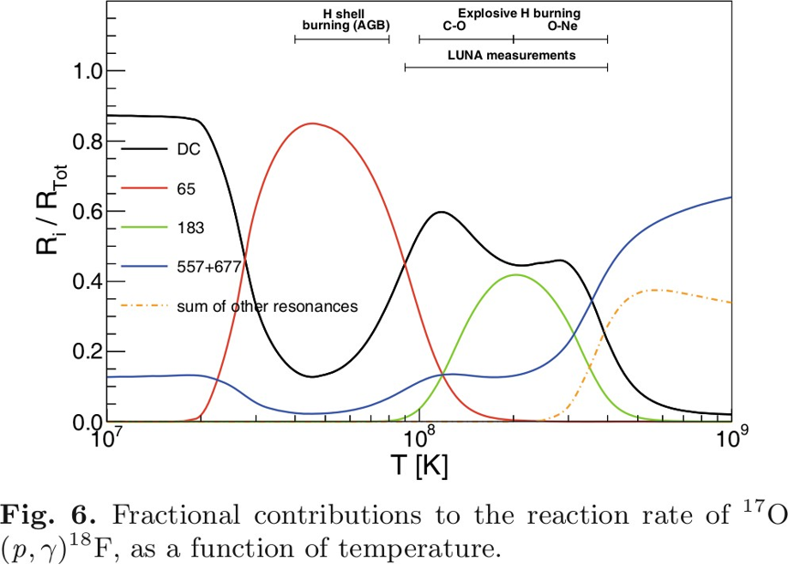
The Challenging First Direct Measurement of the 65 keV Resonance Strength in ¹⁷O(p,𝛾)¹⁸F at LUNA
SCIENTIFIC MOTIVATION
EXPERIMENTAL SETUP
The ¹⁷O(p,γ)¹⁸F reaction (Q = 5607 keV) kicks off the CNOIII cycle.
65 keV resonance dominant in H shell burning in AGB
BGO with 3 layer shielding: BPE + Pb + BPE -> reduction of the background by a factor ~5
Al chamber and target holder -> ~20% increase in efficiency w.r.t. previous brass and stainless steel setup
Reference | MEASUREMENT | 𝜞p [neV] | 𝝎𝜸* [peV]
M.Q. Buckner et al. (2015) | IND | 19(3) | 16(3)
M.L. Sergi et al. (2015) | IND | 14(2) | 11.8(21)
C.G. Bruno et al. (2016) | DIRECT ¹⁷O(p,a) | 36(6)
[Skowronski J., J Phys. G 50, 045201 (2023)]

Slide 14
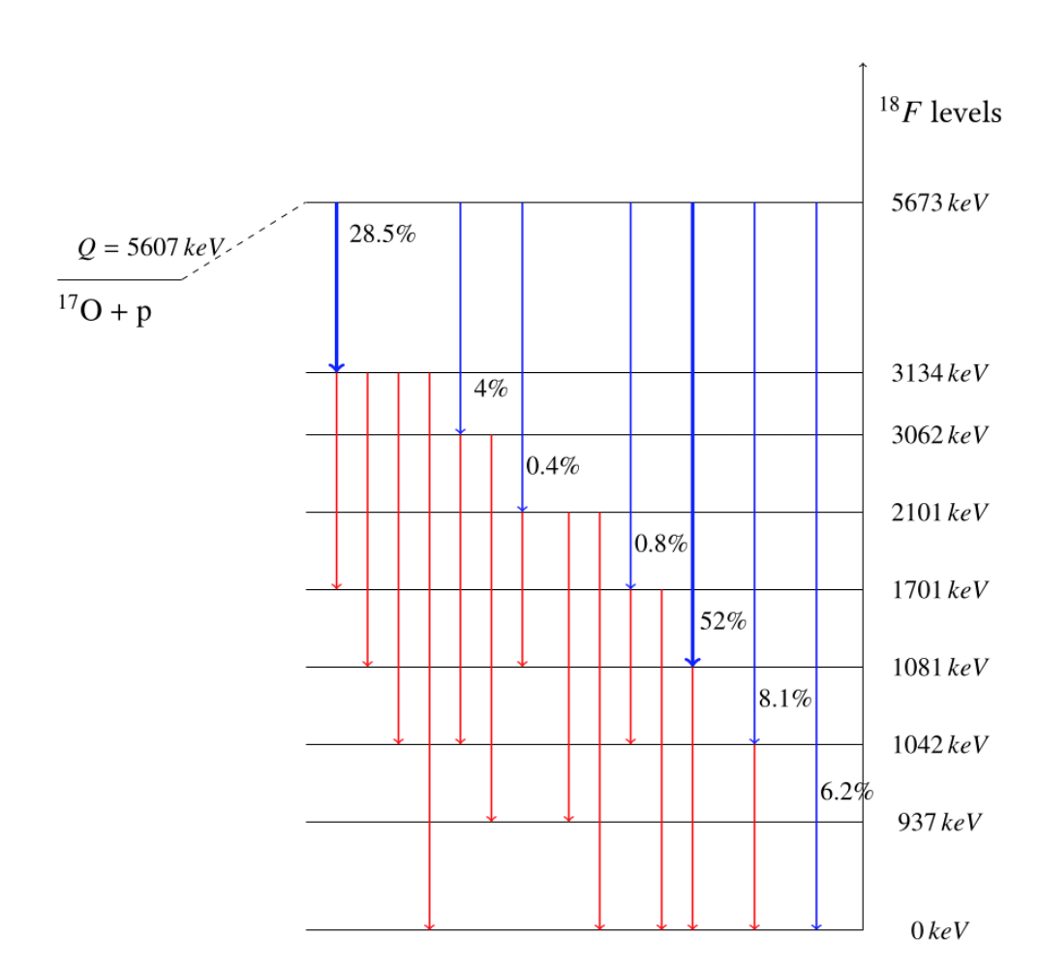
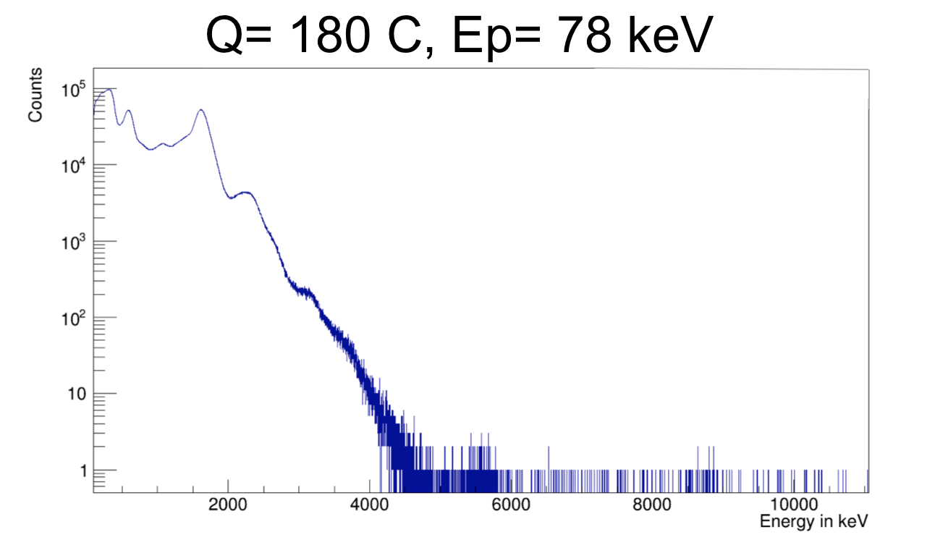

The Challenging First Direct Measurement of the 65 keV Resonance Strength in ¹⁷O(p,𝛾)¹⁸F at LUNA
Background reduction, higher sensitivity and BGO segmentation with gate technique allowed to measure for the first time the Er=65 keV resonance with a direct technique (weakest resonance ever measured)
Reference | MEASUREMENT | 𝜞p [neV] | 𝝎𝜸* [peV]
M.Q. Buckner et al. (2015) | IND | 19(3) | 16(3)
M.L. Sergi et al. (2015) | IND | 14(2) | 11.8(21)
C.G. Bruno et al. (2016) | DIRECT ¹⁷O(p,α) | 36(6)
R.M. Gesué et al. (2024) | DIRECT ¹⁷O(p,γ) | 34(8) | 30(6)
[Gesué R.M., PRL 133, 052701 (2024)]
420 C on resonance with ¹⁷O targets (25-30 C per target)
300 C with UPW targets (NO ¹⁷O) to monitor Beam Induced Background (25-30 C per target)
BIB mainly from deuterium contamination (1 single γ-ray emitted)

Slide 15
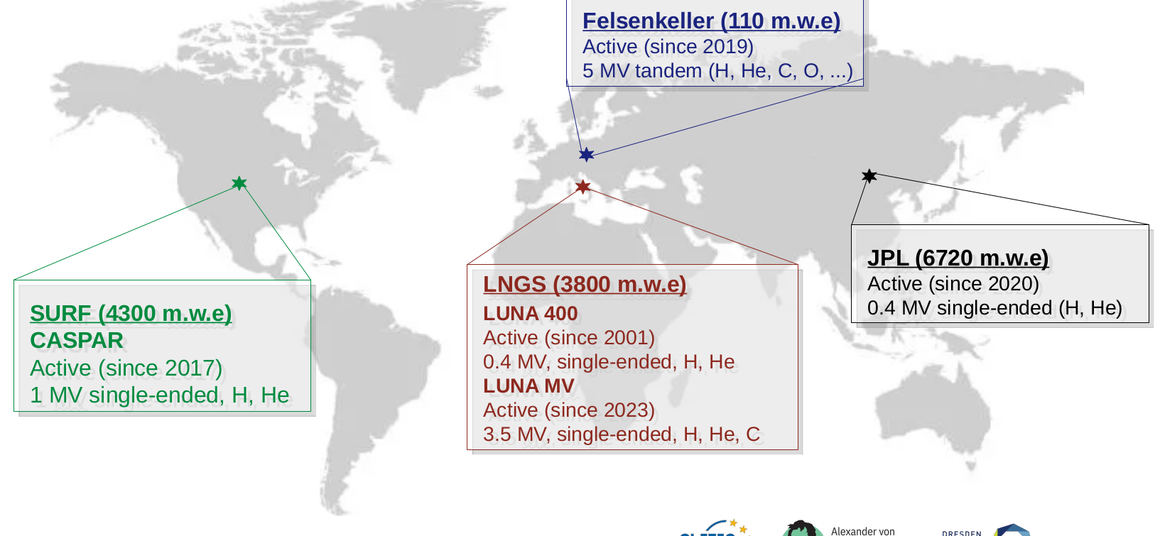
Active Underground accelerator laboratories all over the World
15
Notes:
15

Slide 16
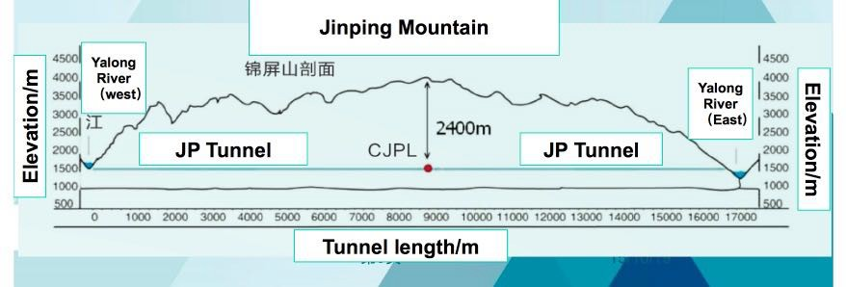
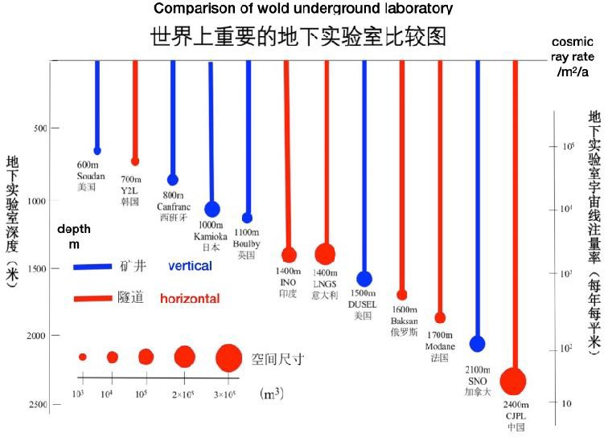
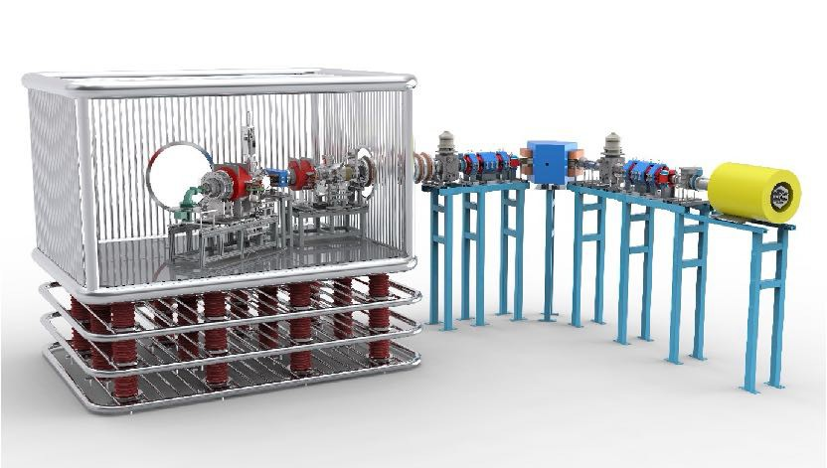
JUNA: Jinping Underground Laboratory for Nuclear Astrophysics
Talk by Prof Weiping Liu on Sunday Morning
HV platform ECR Ion source
Acceleration tube
Beam analyzer
Detector
Beam energy (keV） |  |  | Beam intensity（emA）
_{H}+ | He⁺ | _{He}2+ | _{H}+ | He⁺ | _{He}2+
50-400 | 50-400 | 100-800 | 2-10 | 2-10 | 1-2
Courtesy of Prof. Weiping Liu

Slide 17
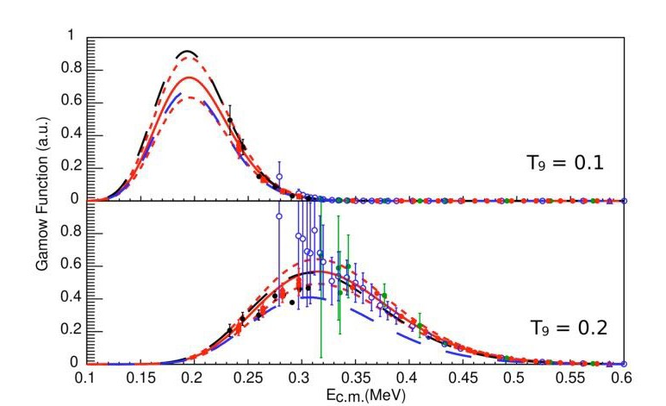
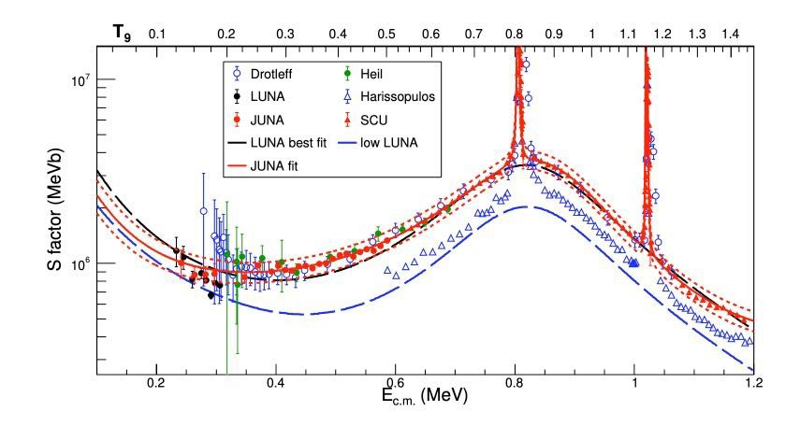
¹³C(α,n)¹⁶O results in broad energy range
JUNA2021
SCU2022
mA thick target, differential method to pin down thickness
magnetic removal of He²⁺，cover 0.4 MeV to 0.8 MeV (JUNA)，
cover i-process; to 1.2 MeV tandem, calibration of eff. , cross check other date
n background 5/ hour，2.5 MeV eff. 25%, good S/N
•
•
B. Gao, …, Y. D. Tang*,…, WPL*, ¹³C(α,n)¹⁶O, PRL 129(2022)132701
For further measurements at JUNA see talks by Jun Su and Yangping Shen
•
Courtesy of Prof. Weiping Liu

Slide 18
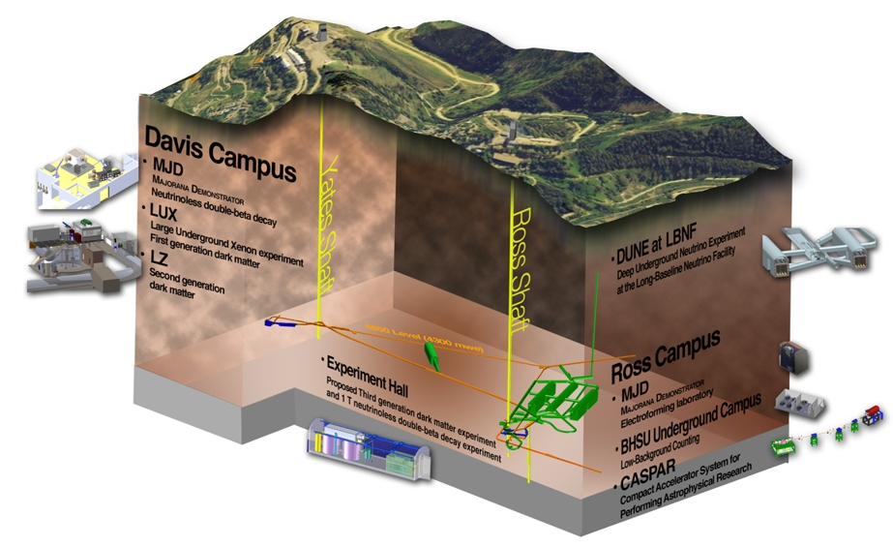
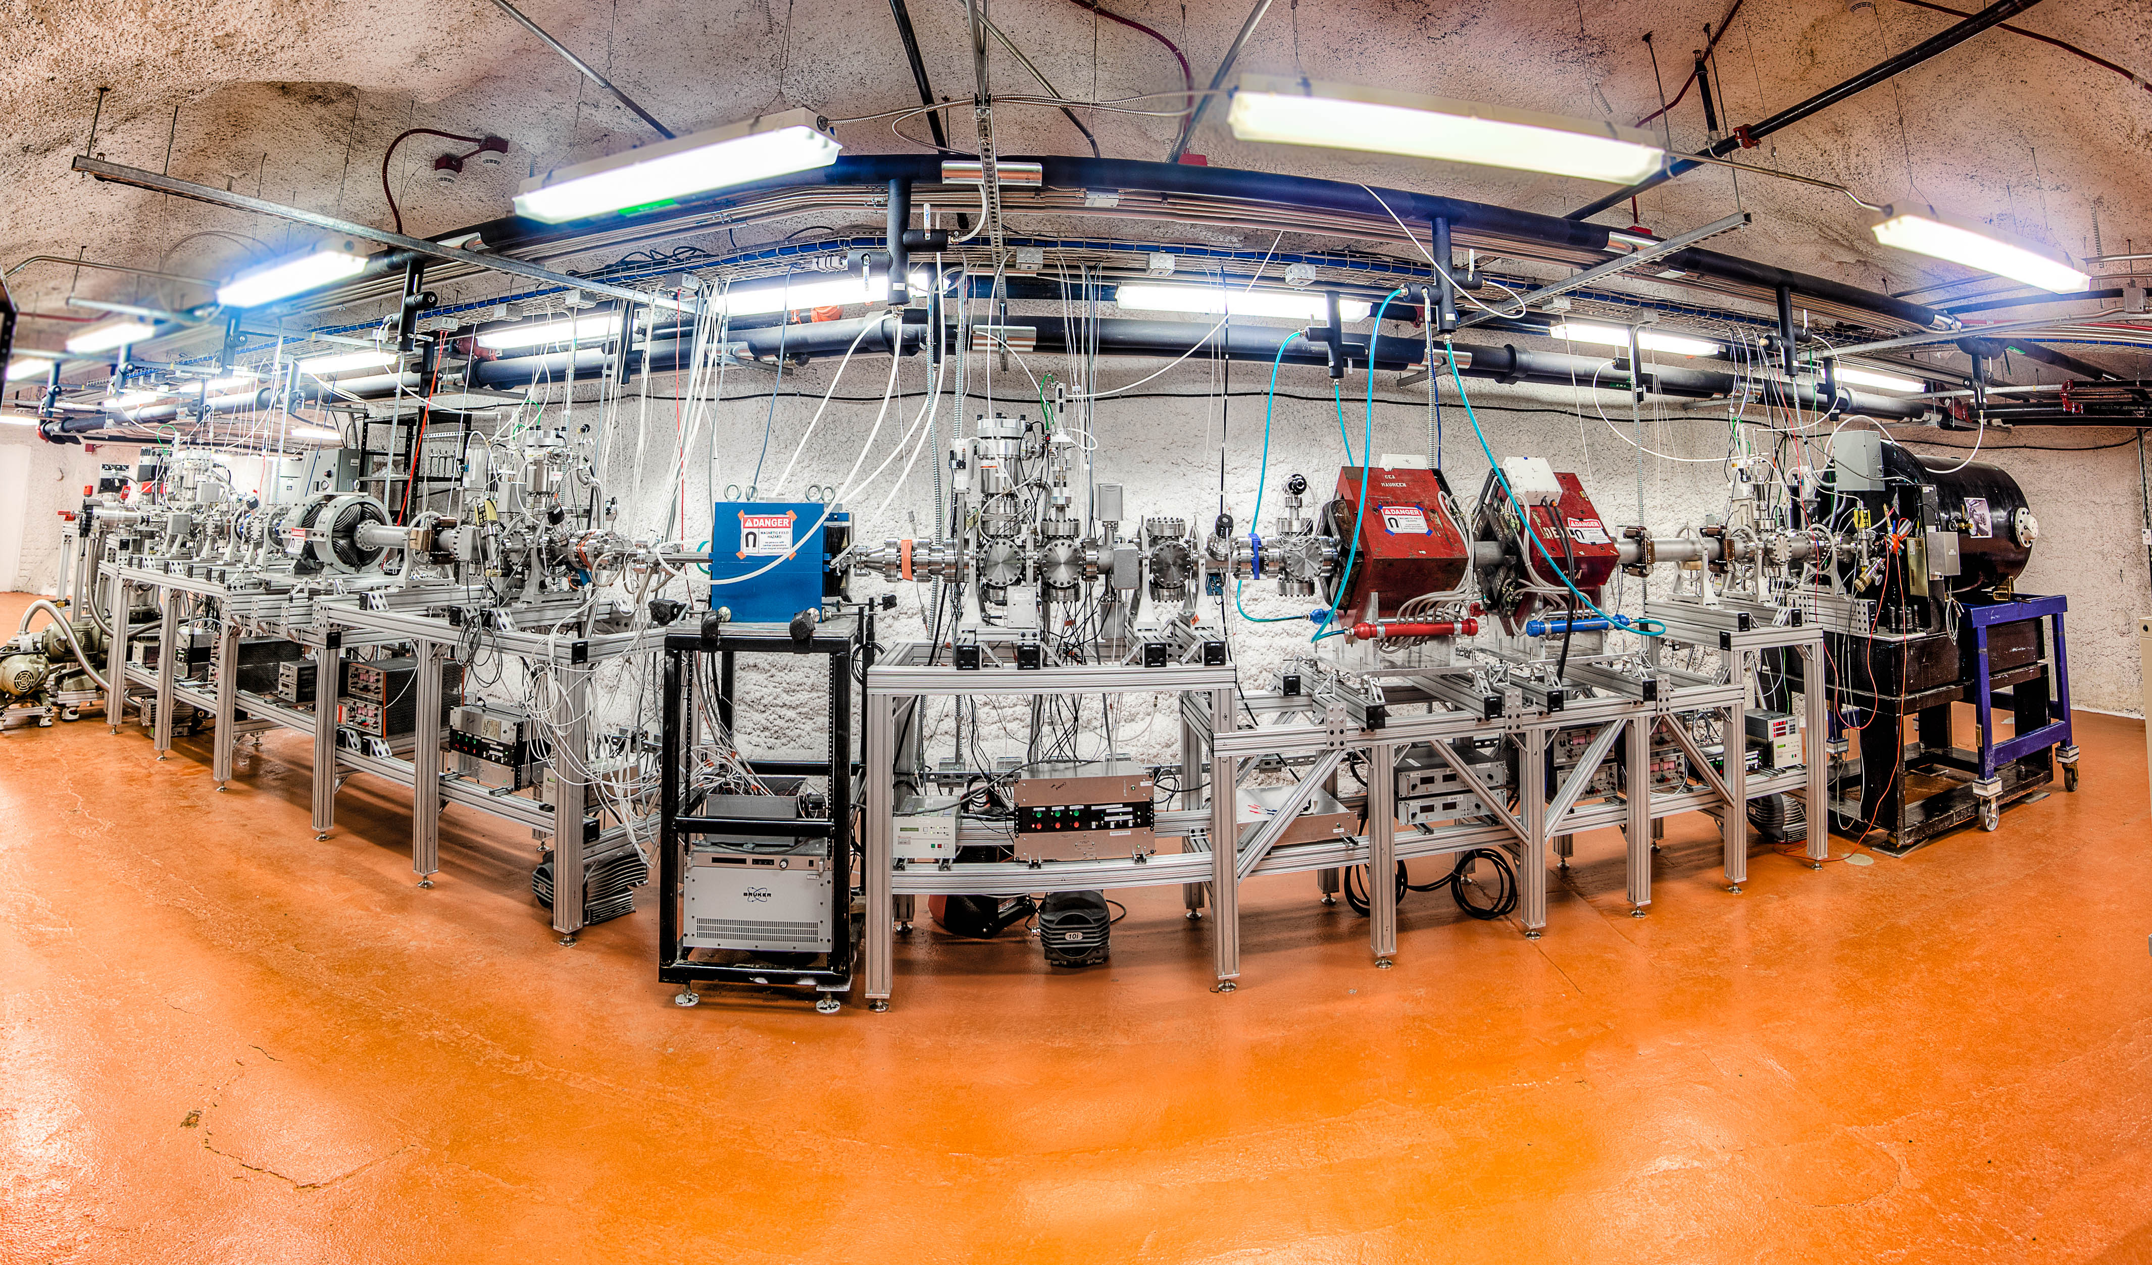


CASPAR: Compact Accelerator System for Performing Astrophysical Research
South Dakota mines : 1500 m
muon background about 7 orders of magnitude suppression
Installation: 2015-2017
Operation: 2018-2021
Operated jointly by the University of Notre Dame and South Dakota Mines
Continuous operation in 2020 because of 2021-2024 shut-down period for DUNE excavation
1 MV JN Model Van de Graff Accelerator | Voltage range ~ 150 kV – 1.1 MV
Gas fed radio frequency source | Proton beam and alpha beam to target, 200 – 250 μA
Analyzing magnet | 25-degree, with 0-degree and “mass-2” ports
Target stations | Extended, recirculating, windowless gas target & Solid target stations interchangeable
Detection | HECTOR 4π NaI, HPGe and NaI, ³He neutron counters, deuterated neutron detection
Courtesy of Prof. Daniel Robertson and Prof. Frank Strieder

Slide 19
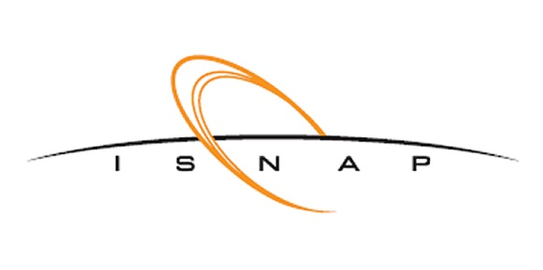
CASPAR Ongoing Timeline
1st Beam on Target
Calibration and Benchmarking
1st Science
First CASPAR Campaign
Data Analysis
High Energy Evaluations
Reoccupation
Second CASPAR Campaign
System Upgrade
2017
2018
2019
2021
Mid
2024
Late
2024
2028
First CASPAR Campaign
Resulted in 6 projects that are now completed or the analysis is in progress
Second CASPAR Campaign
Upgraded passive shielding for γ & n detection
Better signal evaluation eg PSD for neutron and new gating for gammas
Investigation of upper and lower voltage limits
Courtesy of Prof. Daniel Robertson and Prof. Frank Strieder

Slide 20
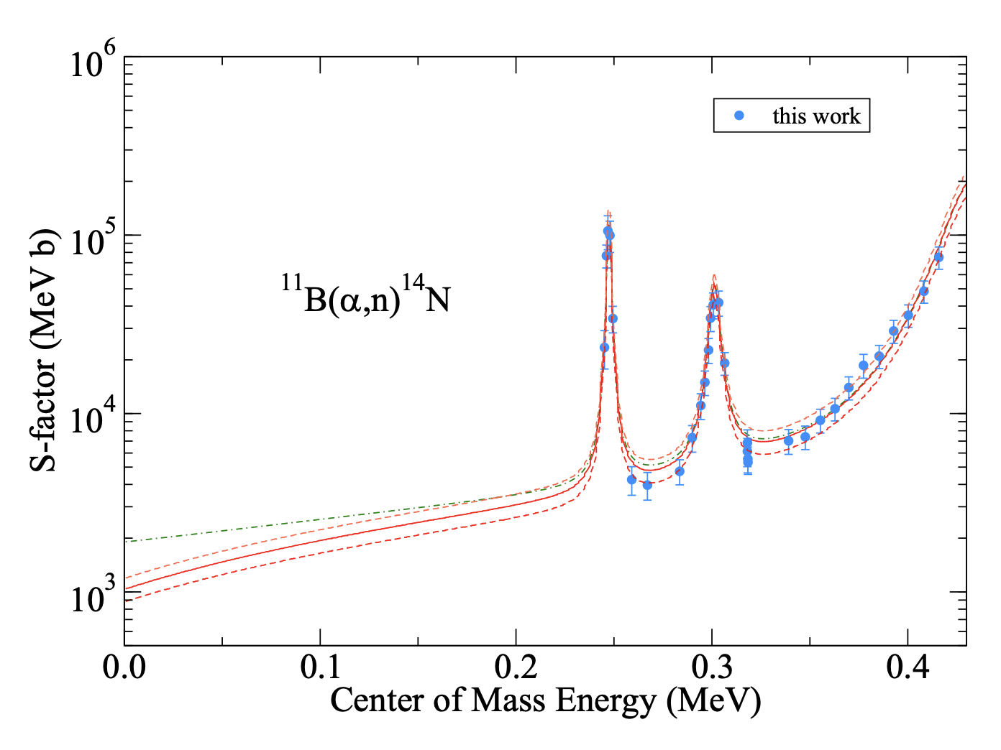
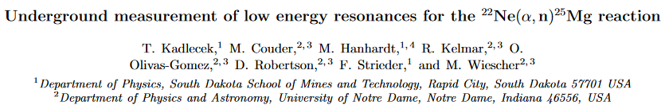

(𝛼,n) reactions at CASPAR
¹¹B(α,n)¹⁴N potential alternative formation of ¹²C in First Stars
²²Ne(α,n)²⁵Mg is a neutron source for the s-process nucleosynthesis
PRC – in preparation
Slide adapted from Prof F. Strieder s-process Workshop Napoli, Italy February 22nd, 2024

Slide 21
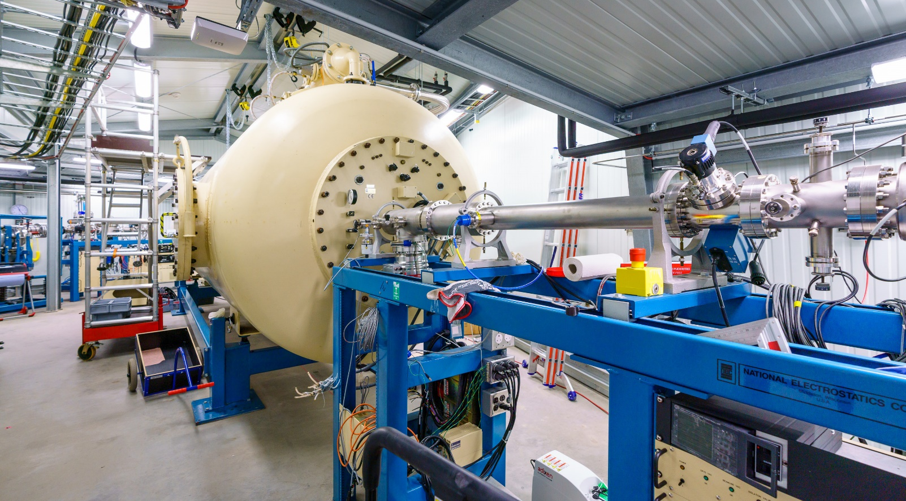
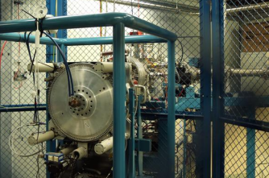
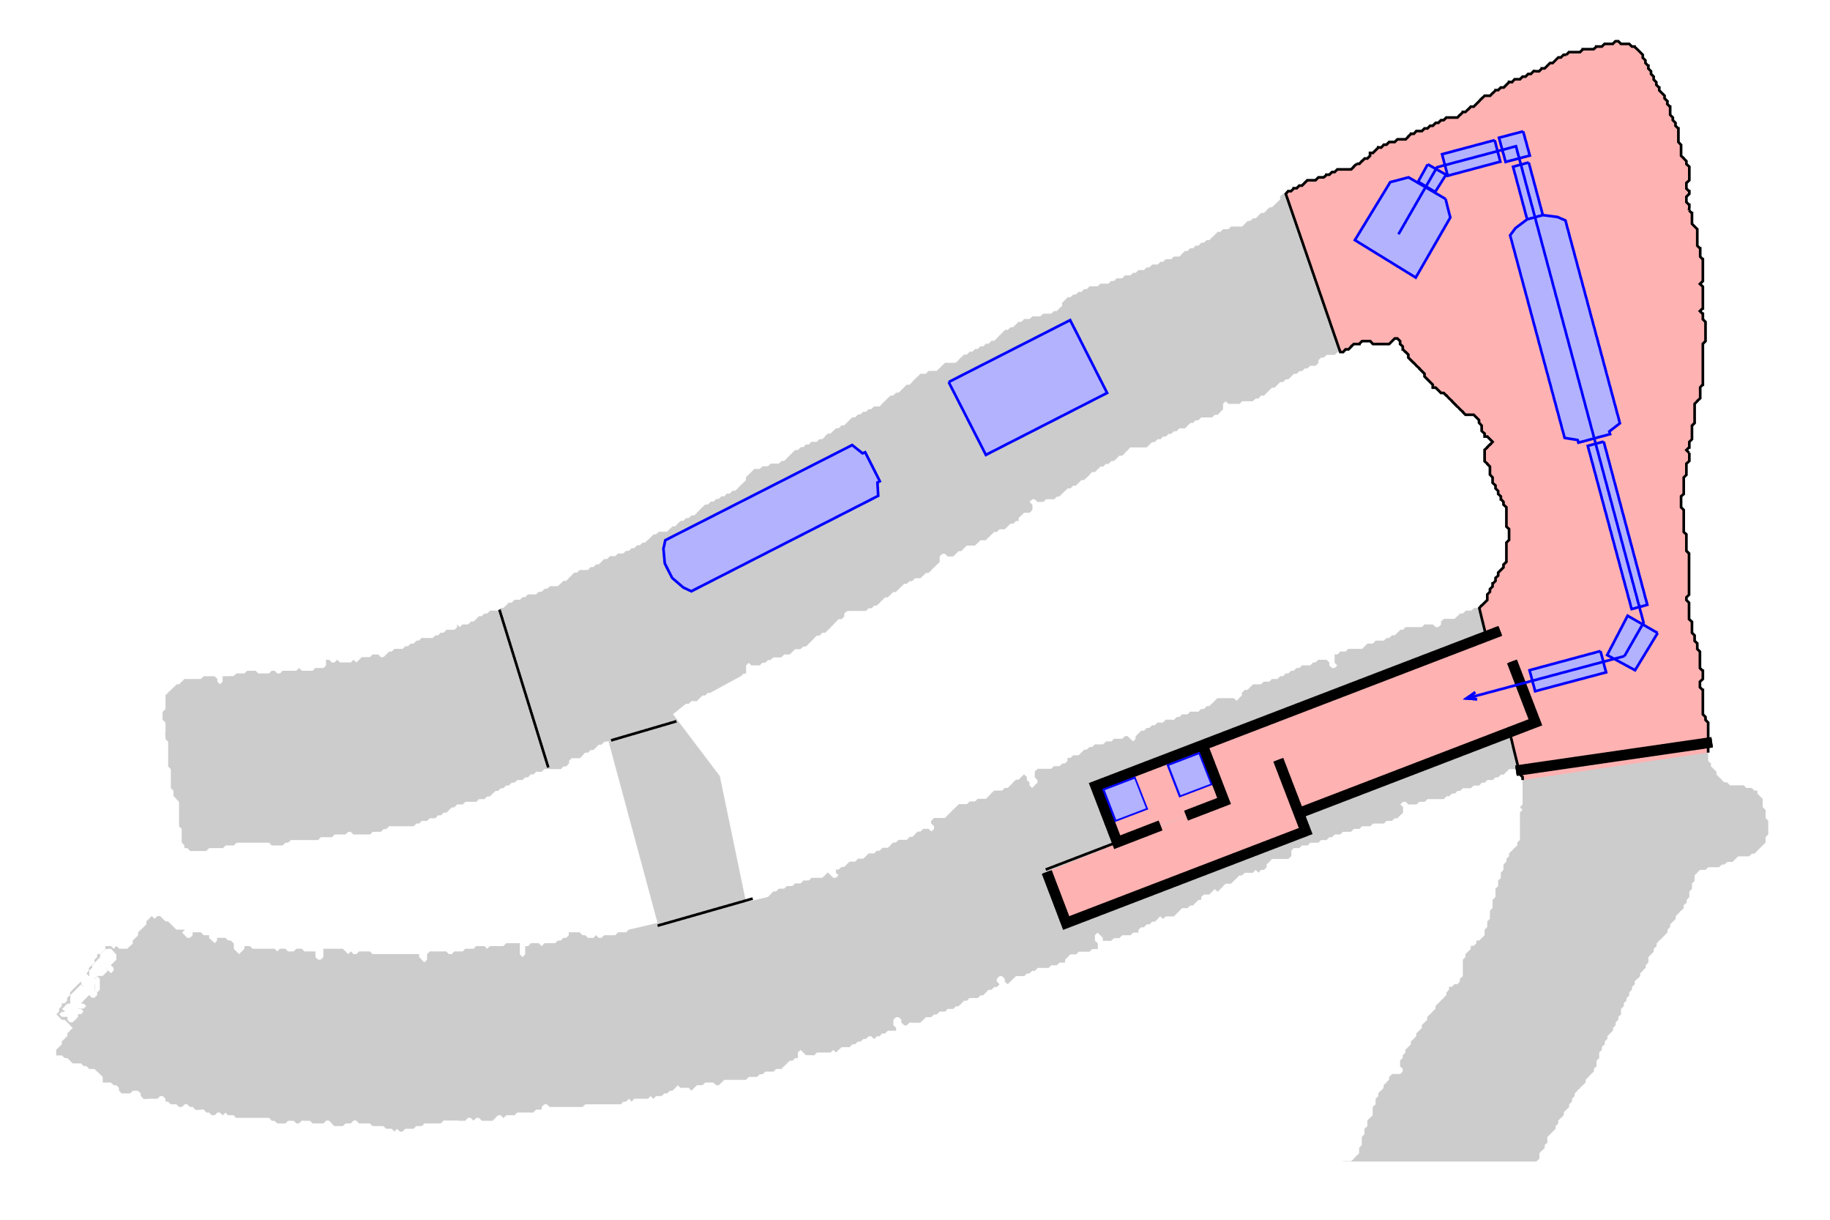
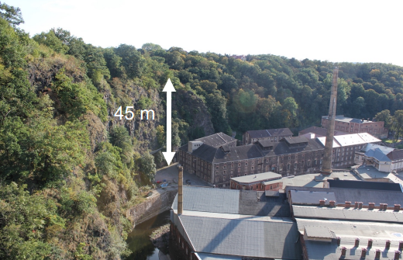
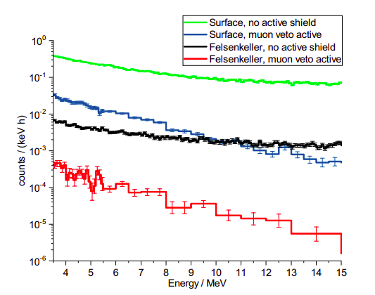
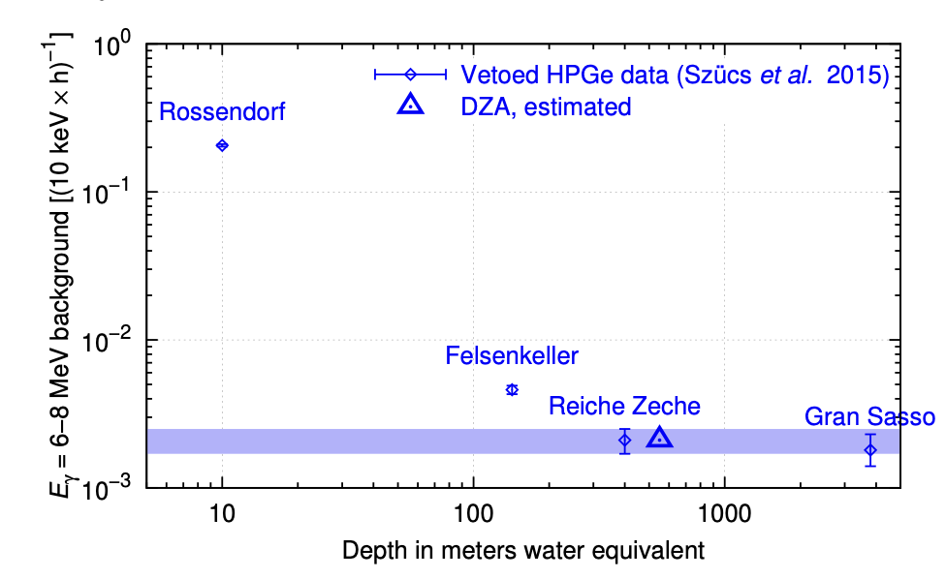
Felsenkeller shallow underground lab
External ion-source
External ion-source
Intensive ¹²C beam
Intensity of 20-30 μA
Other negatively charged ions possible
Internal radio frequency ion-source
Intensive ²H and ⁴He beams
Beam current up to 30 μA
Tunnel IX
Bunker for in-beam experiments
Tunnel VIII
Bunker for low-radiactivity measurements
Courtesy of E. Masha
21
10.01.24
Notes:
21

Slide 22
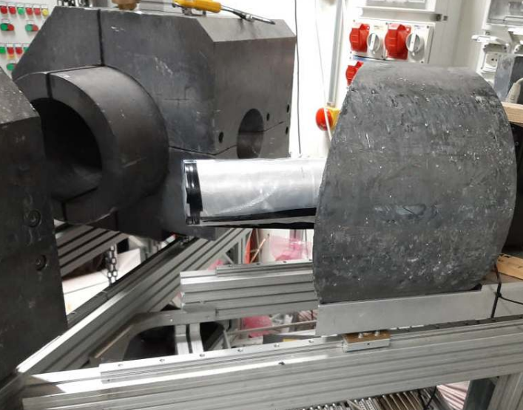
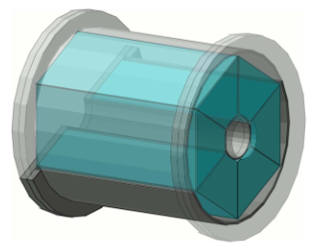
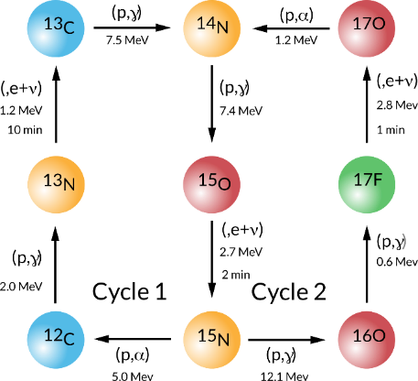
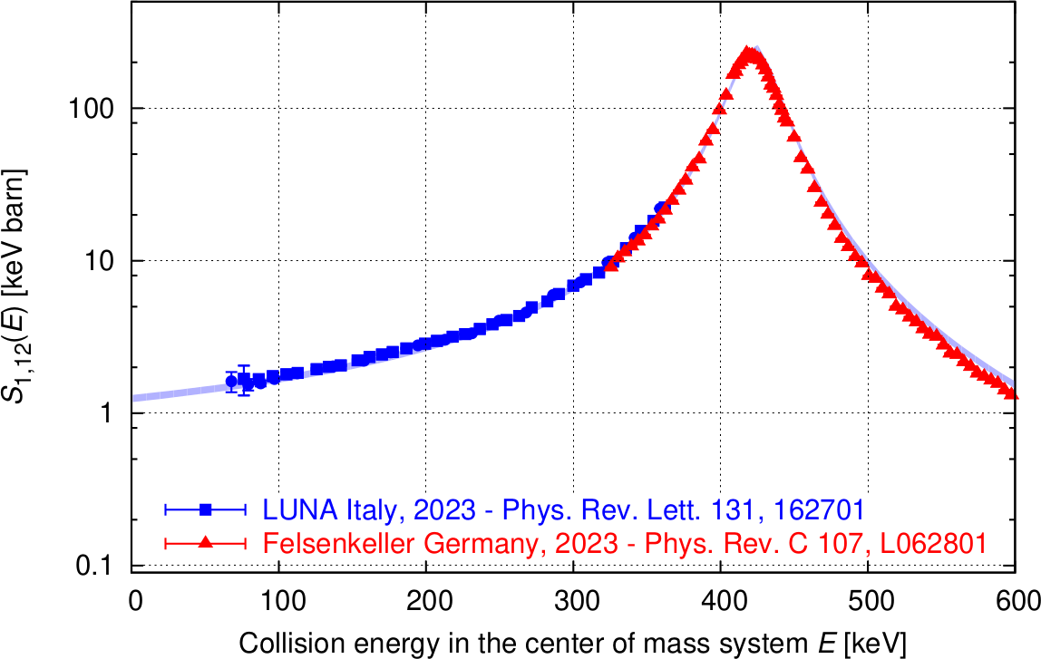
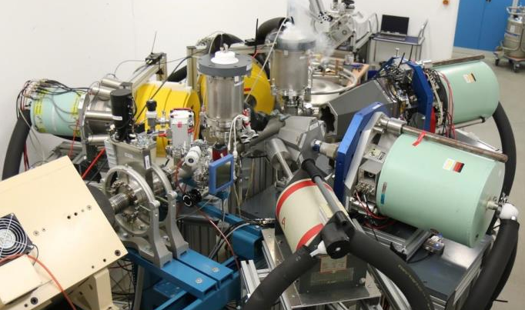
Study of the ¹²C(p,γ)¹³N reaction at LUNA and Felsenkeller
LUNA 400 kV
low-energy region: 80 - 360 keV
Decay of ¹³N creates neutrinos in the Sun, which allow to have a look inside the Sun
Both measurements in agreement
Felsenkeller 5MV
Resonance properties: 0.32 – 0.62 MeV
Correcting Cross Section by up to 25%, reducing extrapolation uncertainty to stellar (RGB/AGB) energies.
Minor change (< 5%) in value at solar energies (neutrino flux).
22
10.01.24
Eliana Masha | Underground nuclear astrophysics | 45th Symposium on Nuclear Physics, Cocoyoc, 2024
Notes:
22

Slide 23
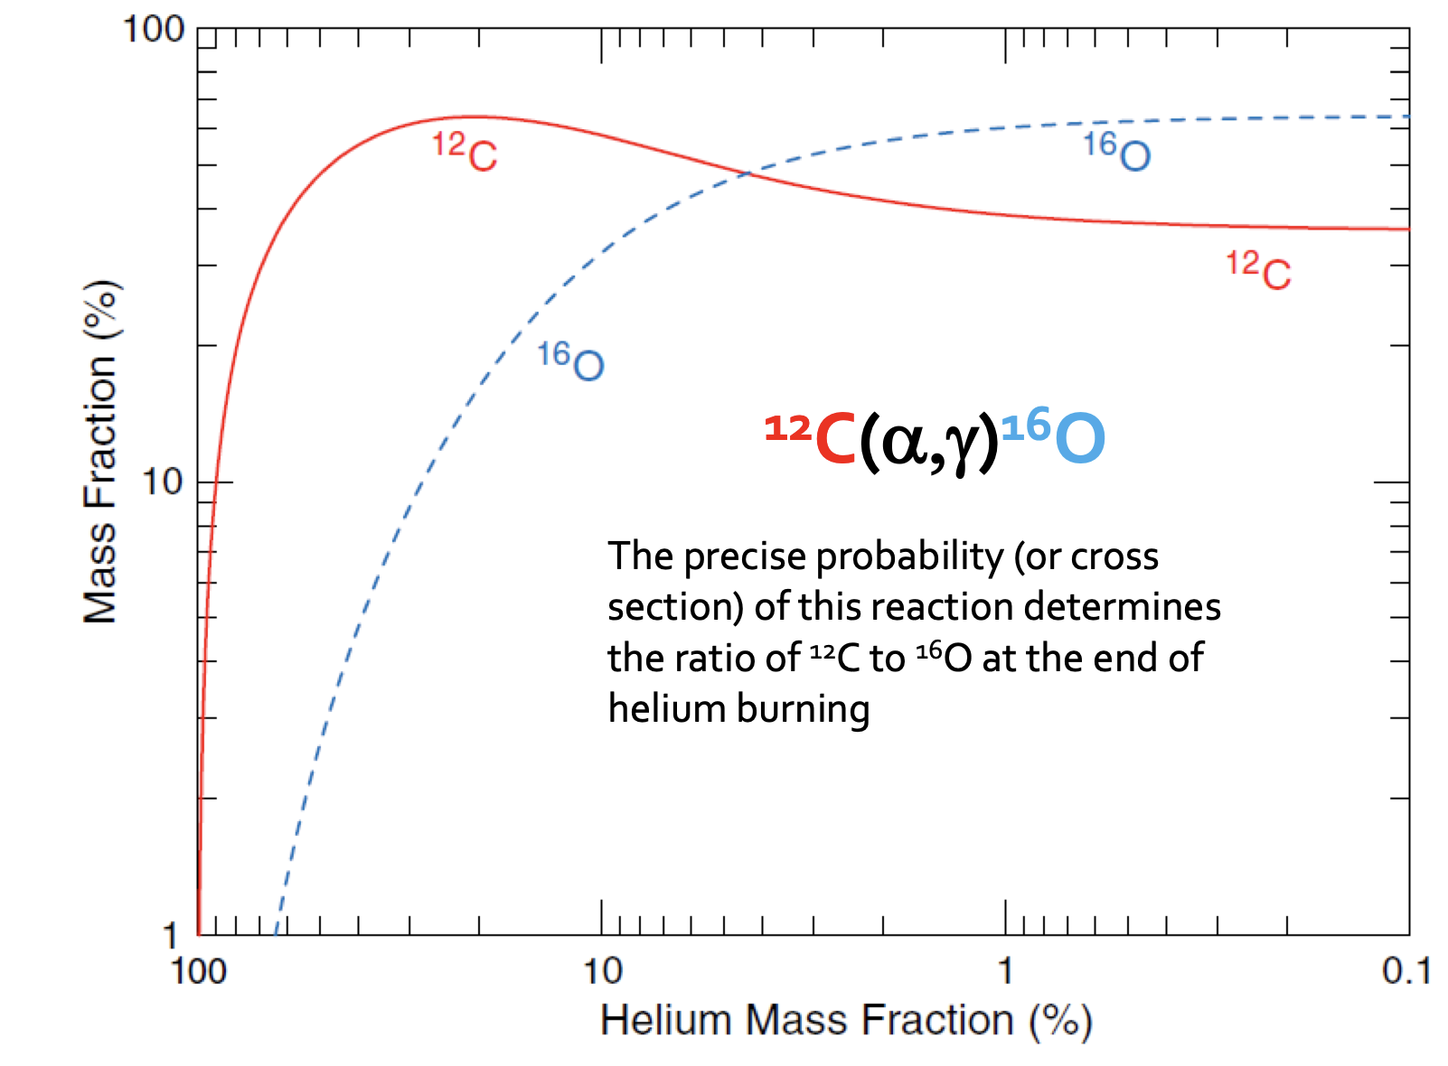
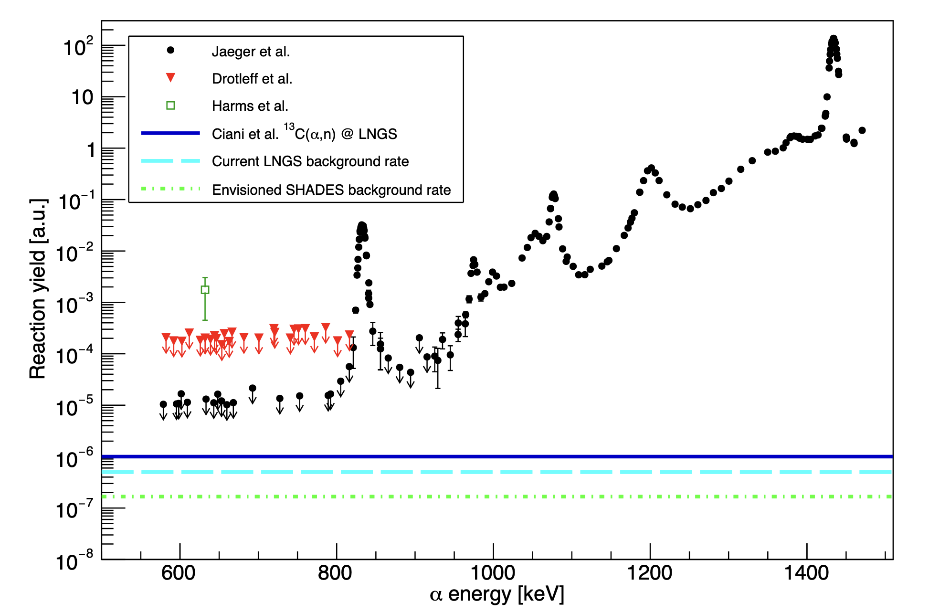
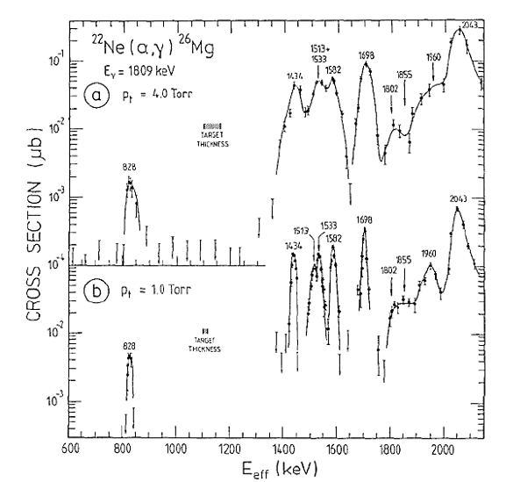
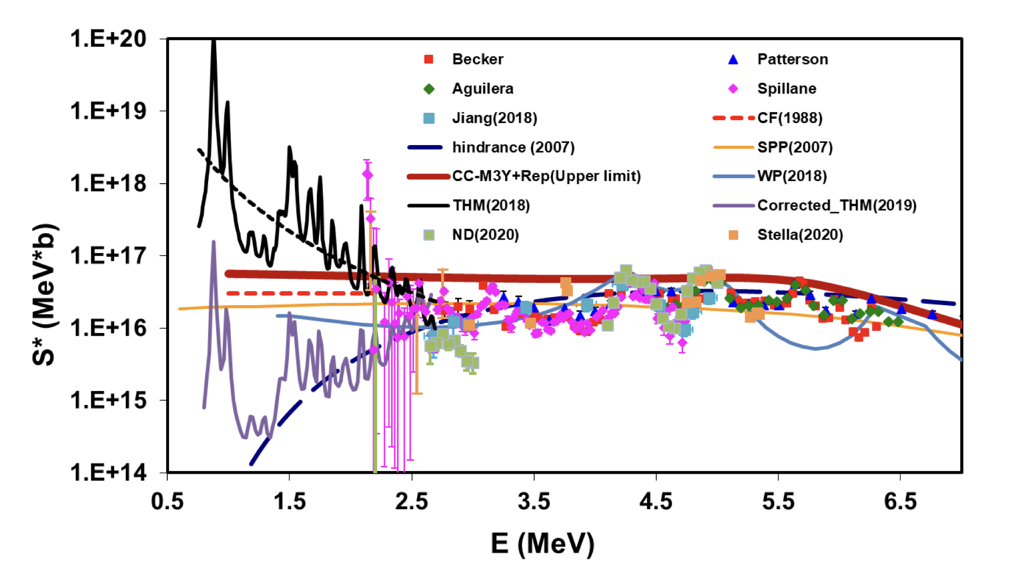
Next main goals (not only in UG laboratories)
¹²C(α, γ)¹⁶O
²²Ne(α,n)²⁵Mg
12C+12C
22Ne(α,γ)²⁶Mg

Slide 24


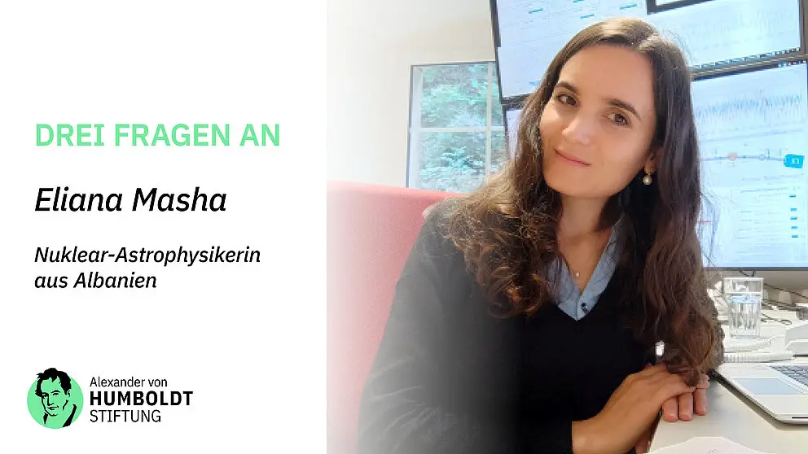
CONCLUSION
Network among Underground experiments wrote and will write the history of nuclear astrophysics measuring dozens of reaction with extremely low cross section
If our results will be in agreement we will be happy because of the consistency, otherwise we will be happy because this will be a reason to discuss and to work more
Thanks to Prof Weiping Liu, to Prof Frank Strieder, Prof Daniel Robertson and Dr Eliana Masha for the material provided

Slide 25





NUCLEAR ASTROPHYSICS: AN INTERDISCIPLINARY FIELD
Cosmology
Observational astronomy
Nuclear astrophysics
Nuclear physics
Neutrino physics
Stellar Models
Notes:
L’astrofisica nucleare è un campo multidisciplinare che interconnette diverse branche di ricerca tra cui l’astronomia osservativa, la fisica nucleare, lo studio di modelli stellari e permette loro di scambiare input e output.
In questa presentazione vi sarà chiaro che il confronto tra risultati di osservazioni astronomiche e le misure di sezioni d’urto nucleare possono dare vincoli più stingenti ai modelli cosmologici,

Slide 26
THE “RARE EVENTS PHYSICS” REGIME
Assume you want to detect an event named Waldo, and you know its main features (type of particle, energy…)

Slide 27
Where is Waldo?
Need to reduce background!

