Slide 1
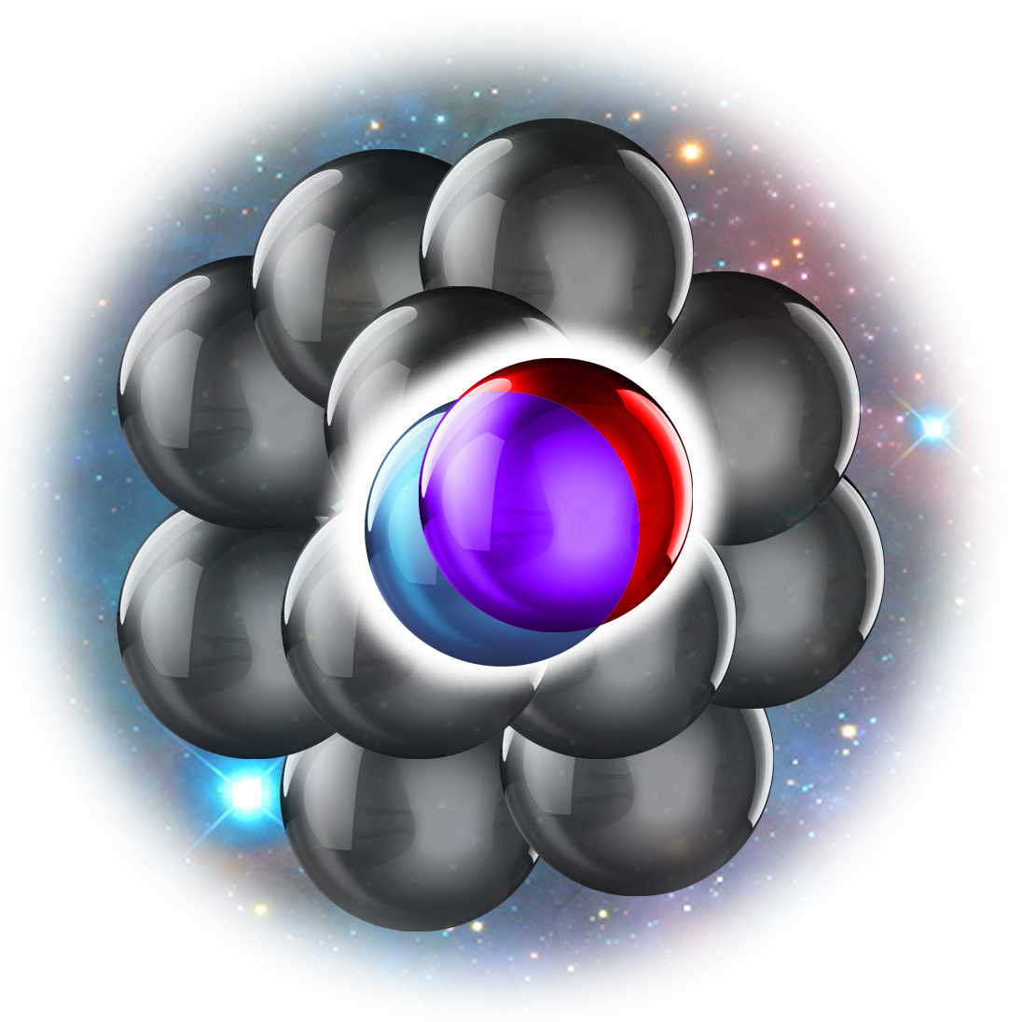
SRC with pA Reaction Overview
Eli Piasetzky
Tel Aviv University
Opportunities of SRC Studies with New Accelerator Facilities in China
Huizhou, China, Nov 2023

Slide 2

Iron Swords War
National Emergency Portal
Rocket and Missile Attacks - Life-Saving Guidelines
When receiving an alert for a rocket and missile attack, enter a protected space and remain inside for 10 minutes.

Slide 3
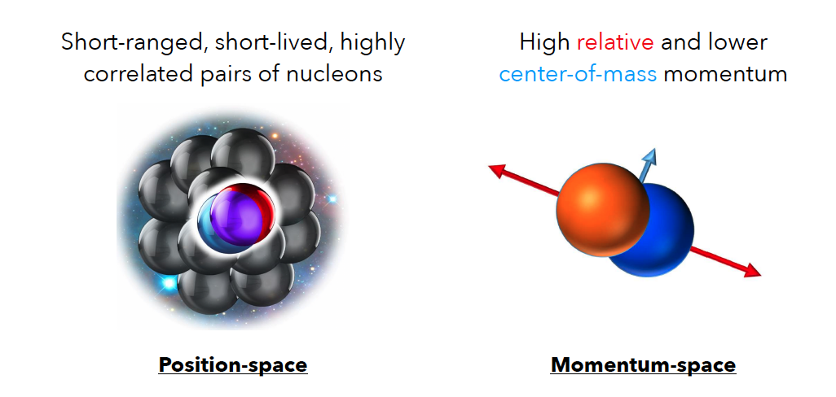

Short-Range Correlations (SRC)
r-space
Nucleon pairs that are close together in the nucleus
k-space
high relative and low c.m. momentum compared to k_{F}
r~r~RR

Slide 4
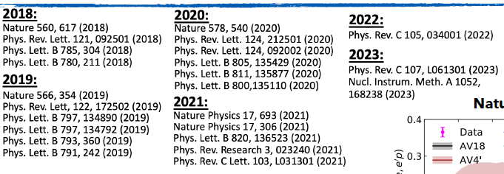

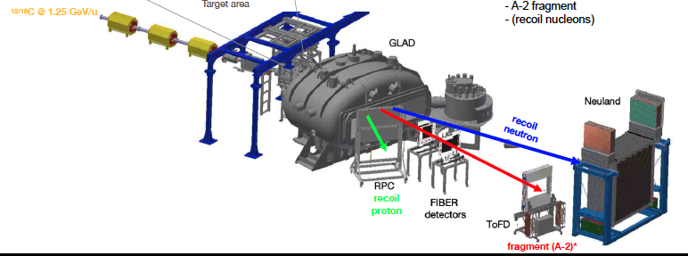
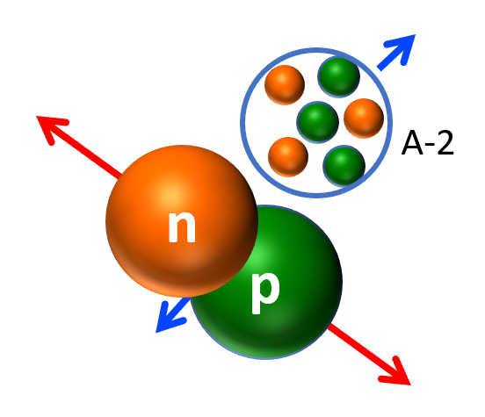
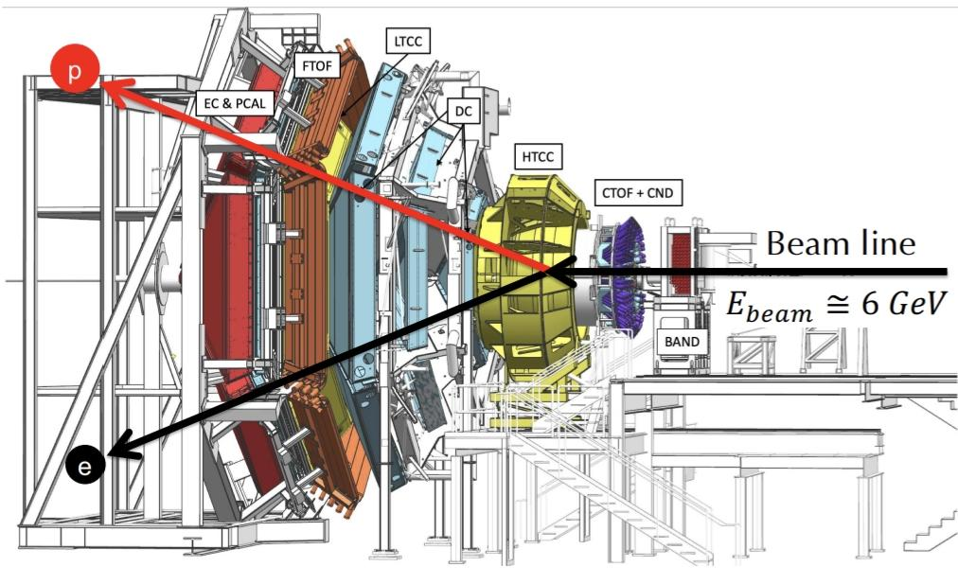
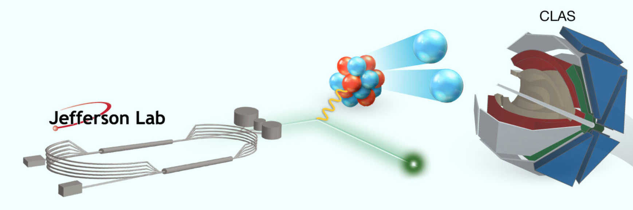

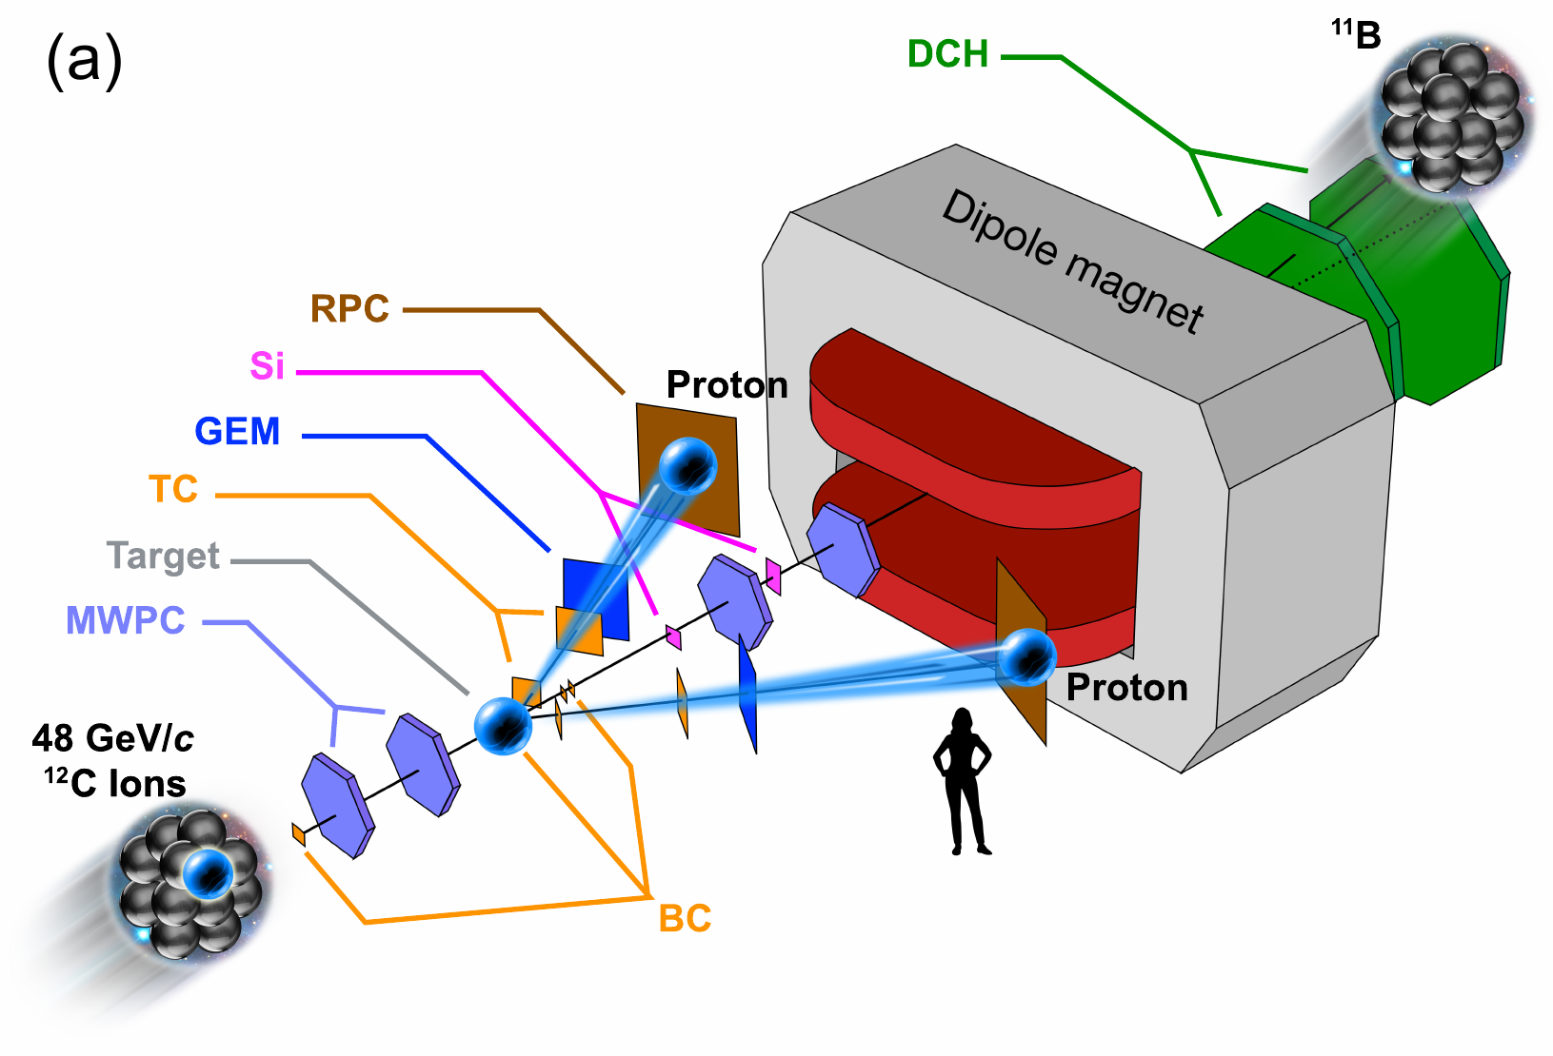
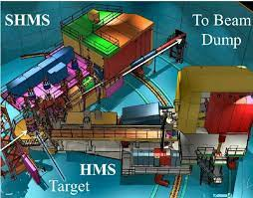
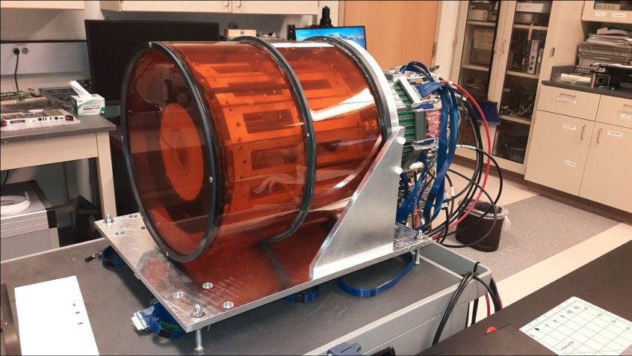
SRC Experiments and results
See:
Jefferson Lab Hall D GlueX
Many-body dynamics
NN interaction
R3B
JINR
Photons
Hadrons
Nucleon substructure
Electrons
Jefferson Lab Halls A, B, C
ALERT

Slide 5
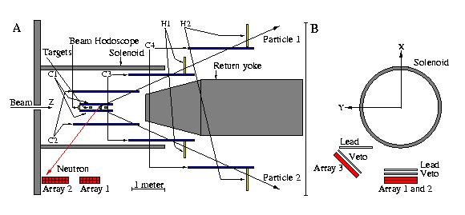
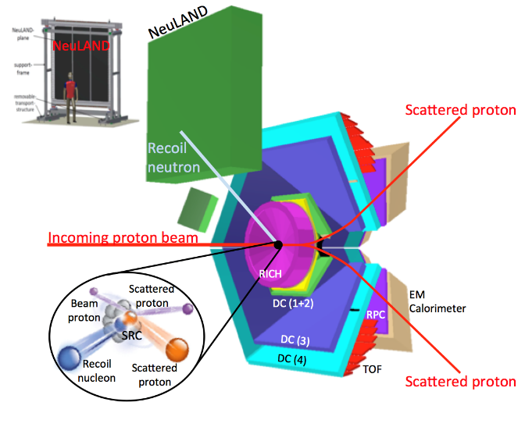
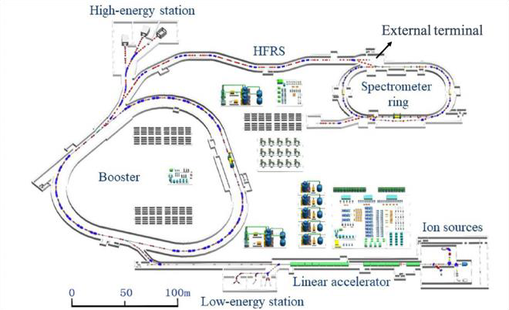
SRC studies with hadrons
SRC studies with leptons
EVA/BNL
Jefferson Lab Hall D GlueX
R3B
JINR
Many-body dynamics
NN interaction
HADES
Photons
Hadrons
Nucleon substructure
Electrons
HIAF
Jefferson Lab Halls A, B, C
ALERT

Slide 6
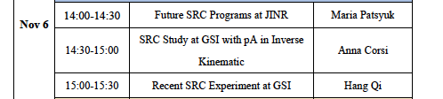
R3B
JINR

Slide 7
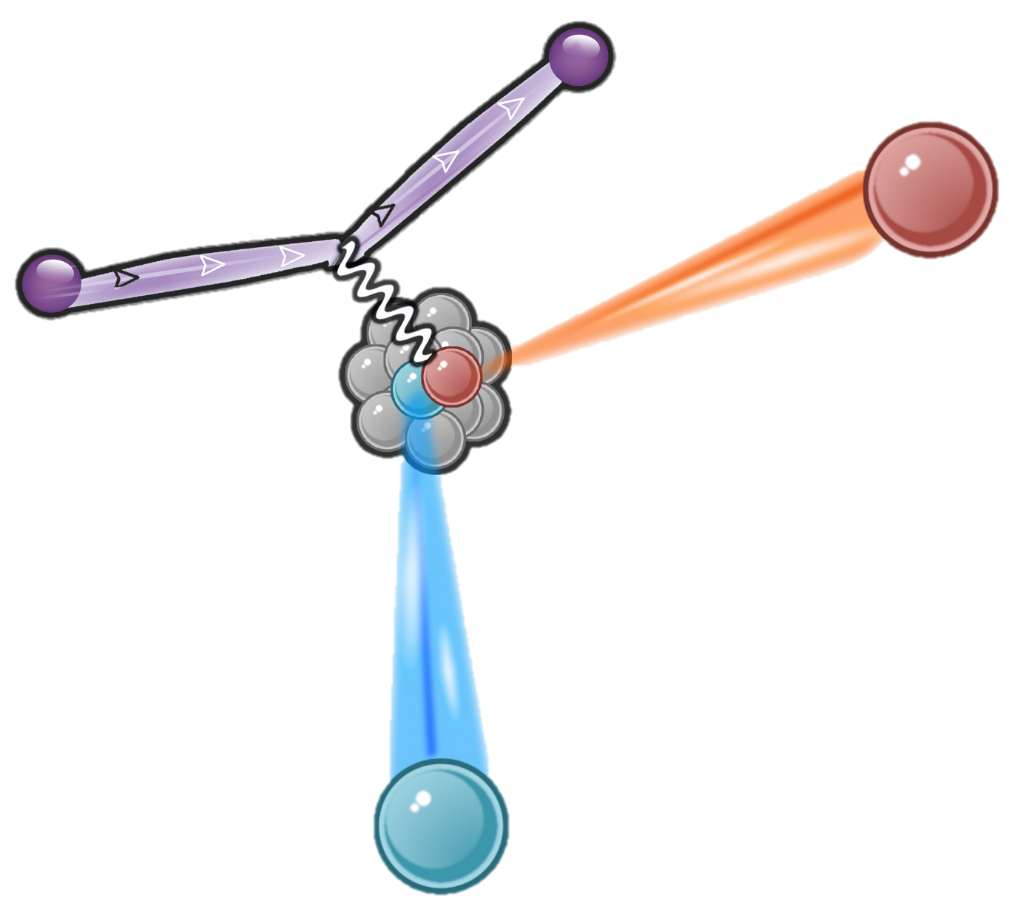
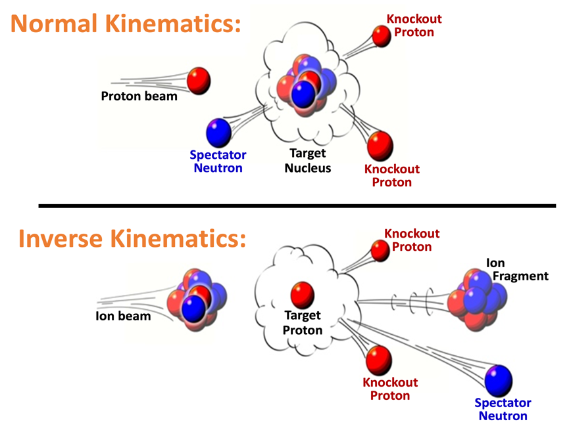
Study SRC with hard scattering.
R
High energy
Large momentum transfer
hard scattering
Direct
Direct
Scattered Electron
Electron beam
Change e⁻ to p beam
Recoil nucleon
Recoil nucleon

Slide 8
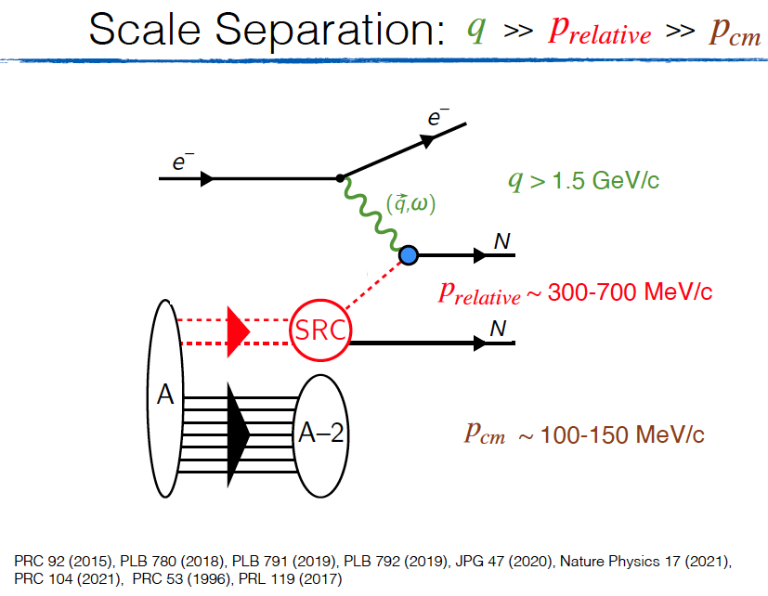
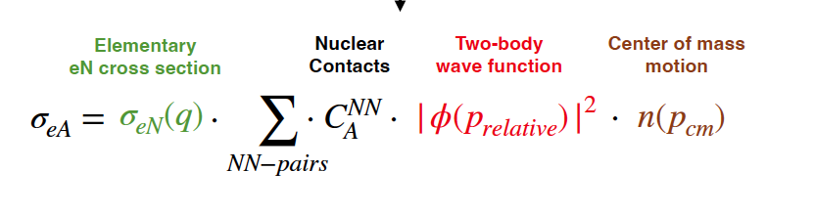
hard scattering

Slide 9
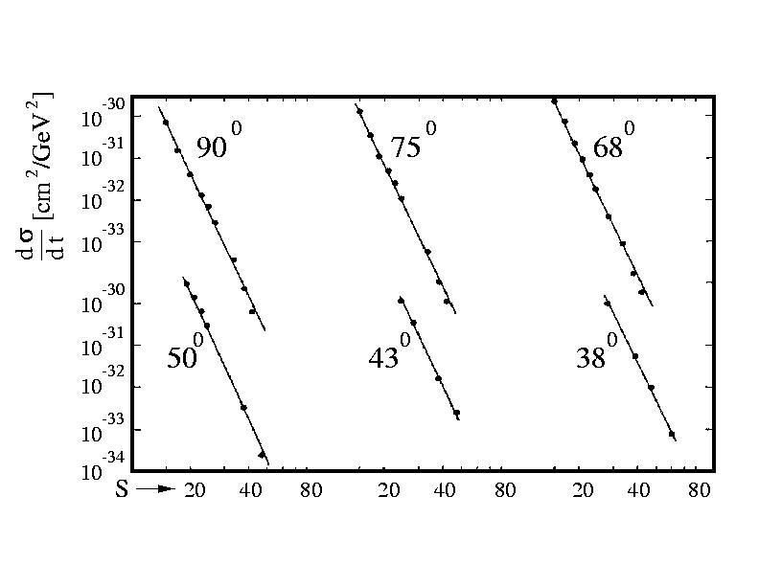

Why pA ?
pp elastic scattering
QE pp scattering have a very strong preference for reacting with high- momentum nuclear protons (lower s).
p₁
p₂
S=(p₁+p₂)²
9

Slide 10
Why pA ?
Scattered Electron
Electron beam
Change e⁻ to p beam
Recoil nucleon
Recoil nucleon
Inverse Kinematics
Flip the kinematics
Recoil nucleon

Slide 11
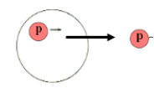
Why pA ?
pp elastic scattering
QE pp scattering have a very strong preference for reacting with high- momentum nuclear protons (lower s).
11

Slide 12
Why pA ?
Direct vs. Inverse kinematics
?
A-2
12

Slide 13
Why pA ?
Advantages of inverse kinematics
Target proton
Scattered proton
A-2 residual nucleus
Beam
Recoil nucleon
Knocked-out proton
Exotic unstable very asymetric nuclei
Fully exclusive measurement
Supress ISI / FSI
More information on initial ground state
More information on recation mechnism

Slide 14
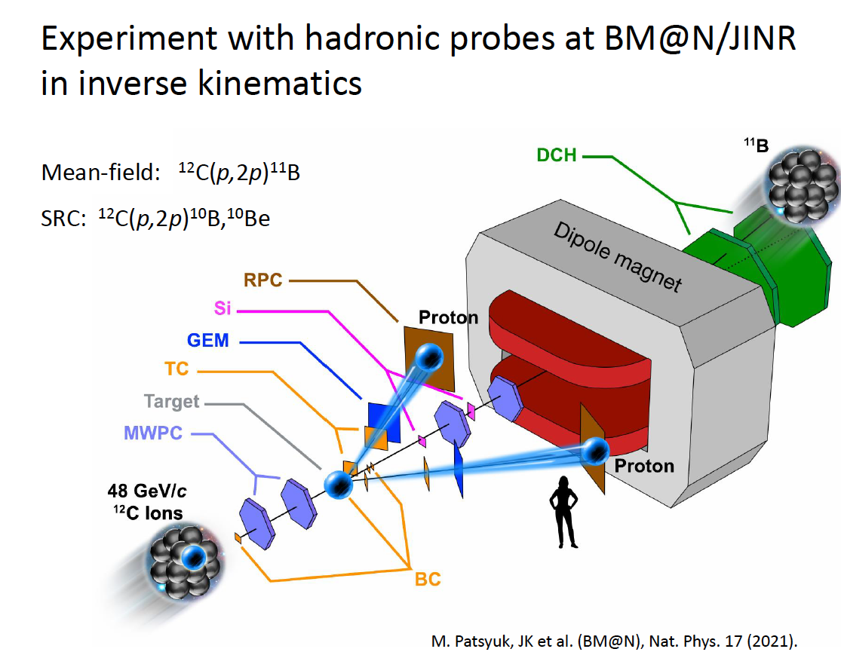
See talk:

Slide 15
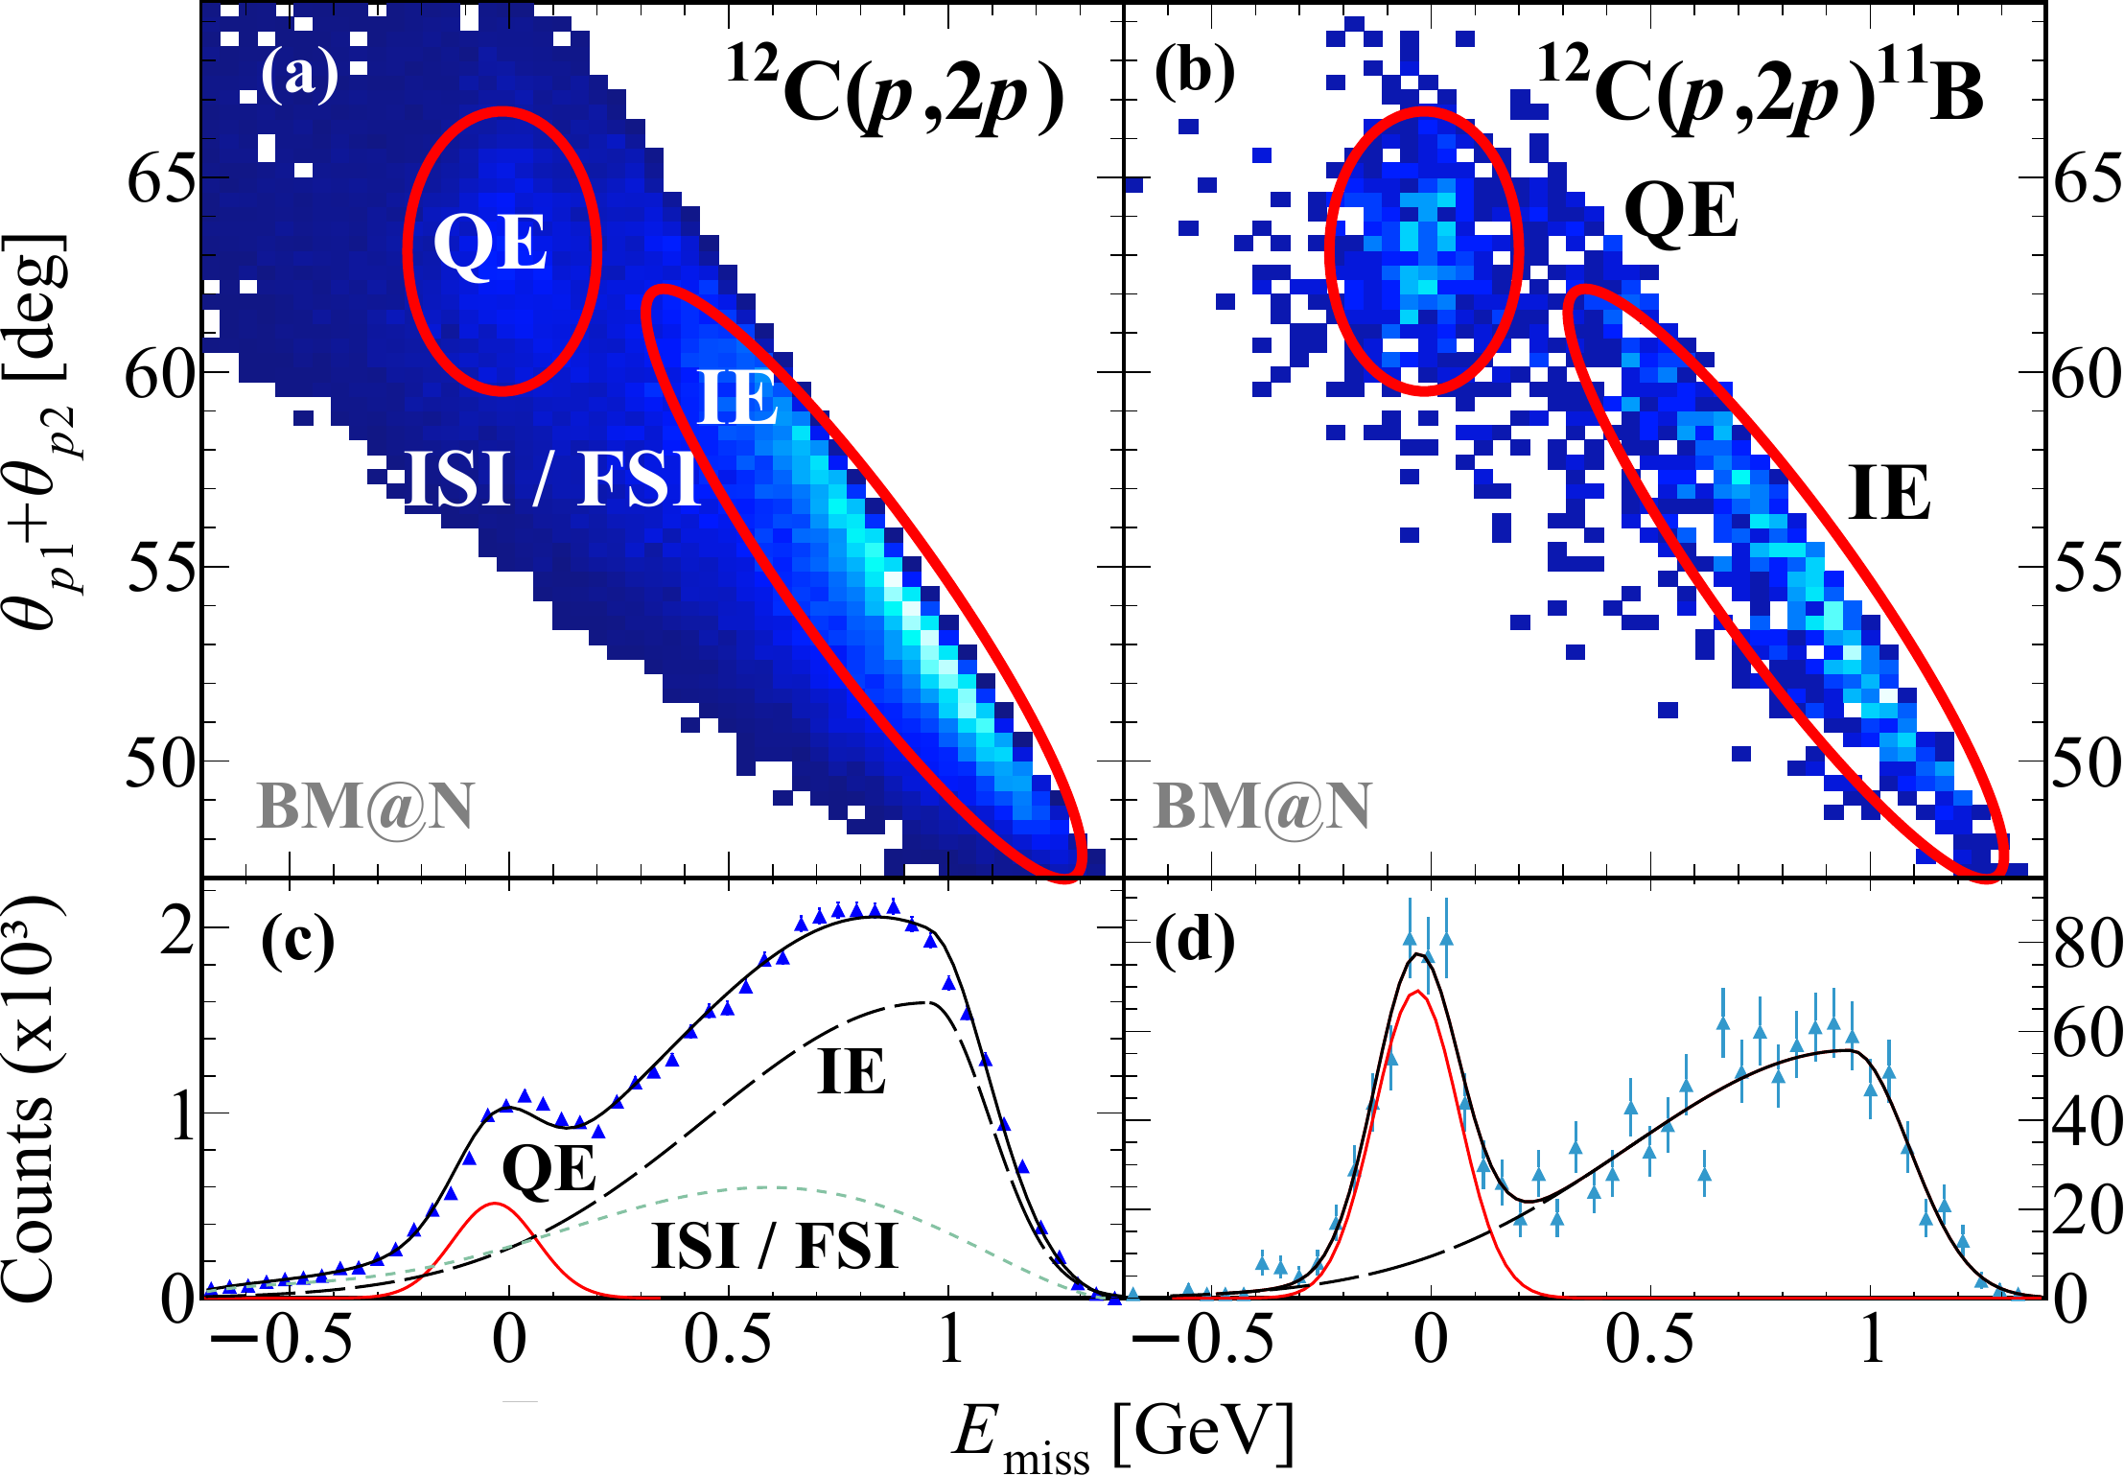
Single proton knockout. ¹²C(p,2p)
Supress ISI / FSI
Exclusive
Inclusive
fragment tagging supress ISI / FSI
JINR measurement
M. Patsyuk, et al. (BM@N),
Nature Physics 17 (2021).

Slide 16
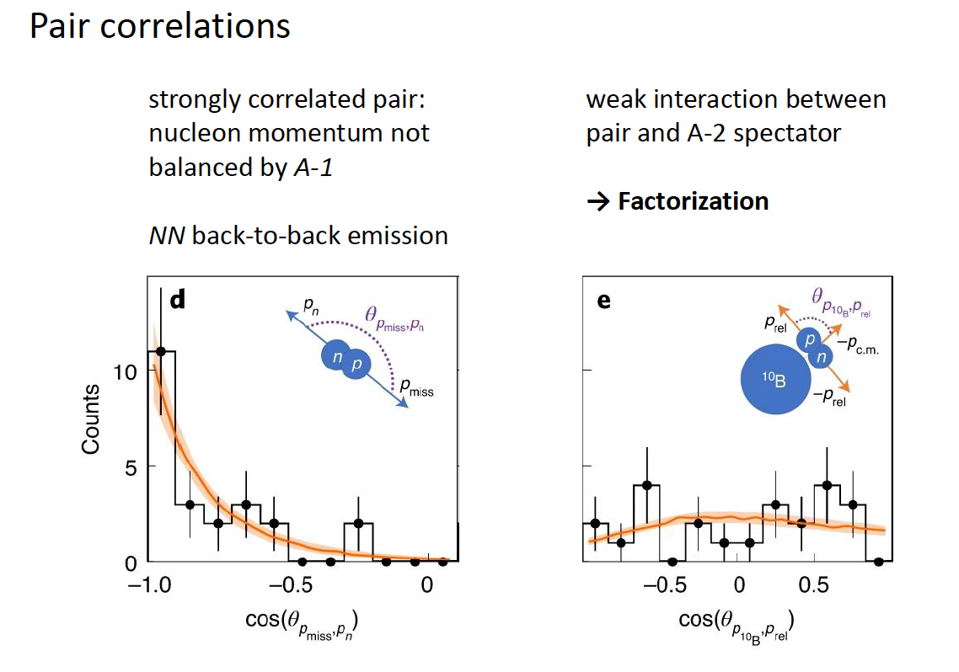
Fully exclusive measurement
→ More information on initial ground state
JINR measurement
M. Patsyuk et al. (BM@N),
Nature Physics 17 (2021).

Slide 17

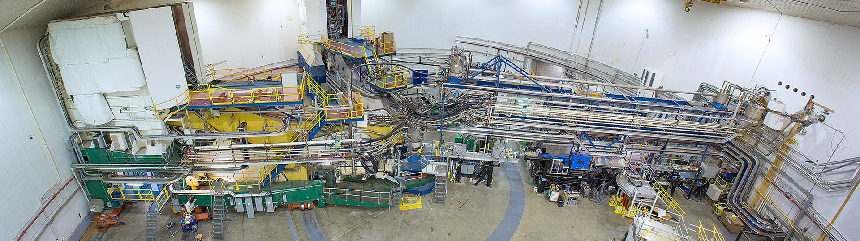
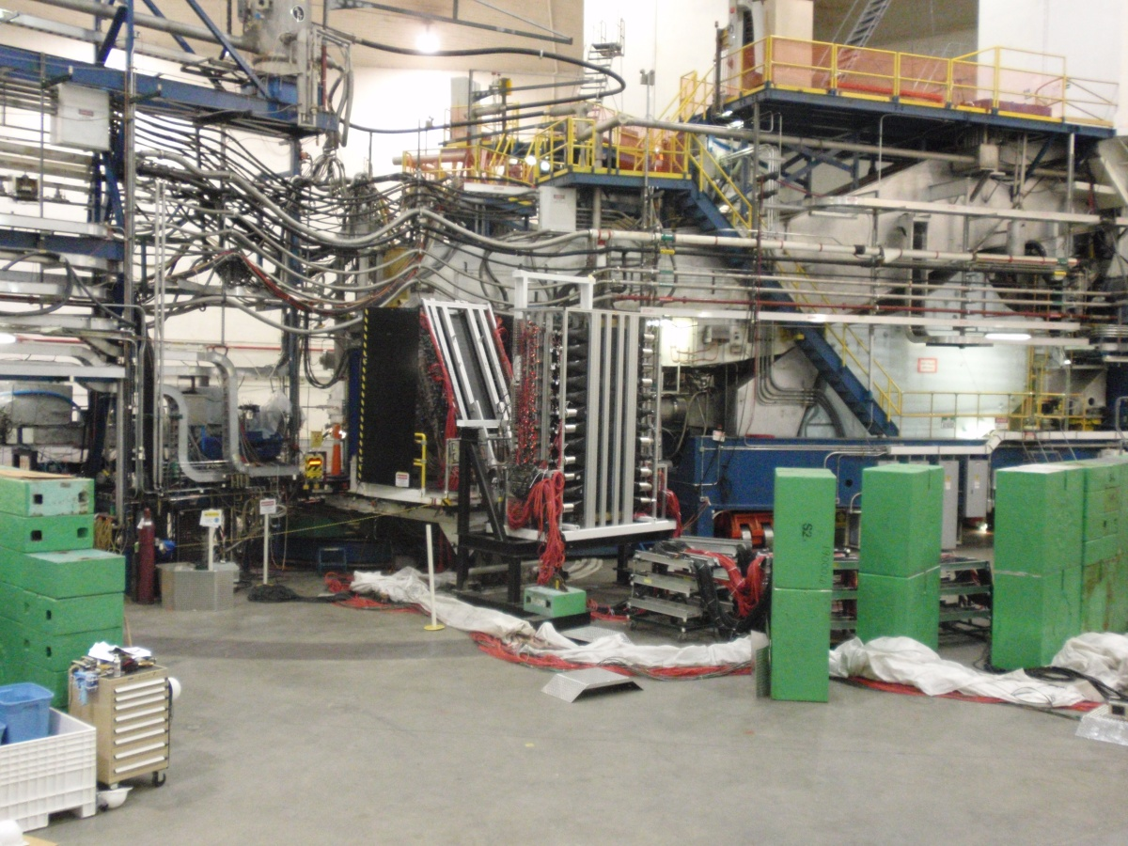
Why pA ?
Multimessenger SRC studies
SRC @
Jefferson Lab Hall D GlueX
R3B
HADES
JINR
Photons
Hadrons
Electrons
Jefferson Lab Halls A, B, C
ALERT

Slide 18
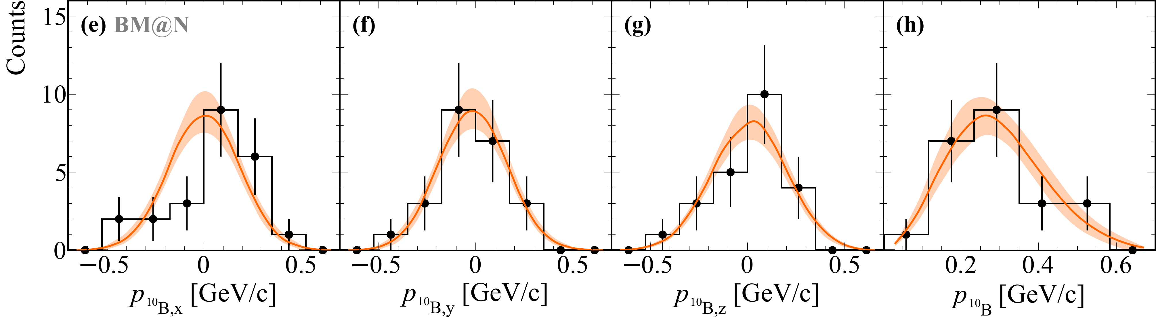
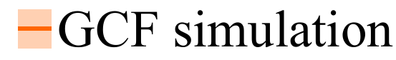
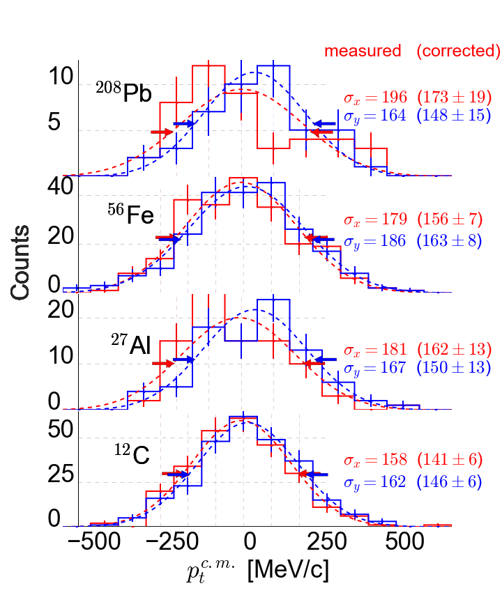
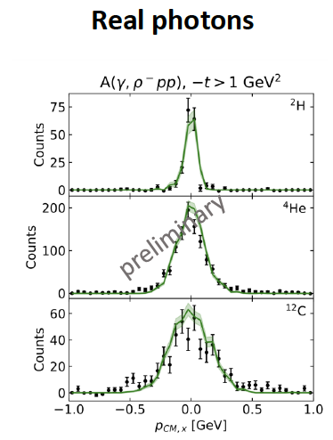
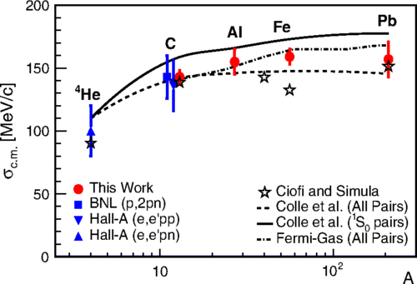

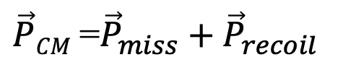

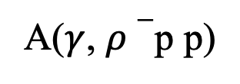
SRC pair c.m. motion
¹²C(p,2p)¹⁰B
JINR
inverse kinematics
¹²C
¹⁰B
$${\vec{P}}_{miss}$$
e
p
e
IA:
$\vec{P}CM$=${\vec{P}}_{miss}+{\vec{P}}_{recoil}$
p
A(e, e’ p p)
$${\vec{P}}_{recoil}$$
JLab
A($γ$, $ρ−$p p)
σ = (156 ± 27) MeV/c
J. Pybus et al.
E. Cohen et al., Phys. Rev. Lett 121 (2018)
M. Patsyuk, JK et al. (BM@N),
Nature Physics 17 (2021).

Slide 19
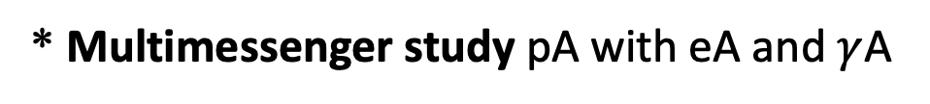
Why pA (summary)
* Selects high momentum nucleons (SRC pairs)
* Allows inverse kinematics:
Fully exclusive (including A-2).
Suppress ISI /FSI.
More information on the G.S.
More inforamtion on the reaction
mechnism.
Acess to exotic (very asymetric) nuclei
* Multimessenger study pA with eA and $γ$A
Precision studies
* Complimentary studies.
* Large cross section , high beam intensity ➔ suprier SRC statistic

Slide 20
SRC studies with hadrons
Fragmnets tagging
(R3B, JINR, HIAF, ALERT@CLAS12)
R3B
JINR
Neutron-rich nuclei / isotopic chains
(R3B, CLAS12, HAIF)
HADES
Polarized probes
(JINR)
HIAF
High statistics
(HADES, JINR, HIAF)

Slide 21
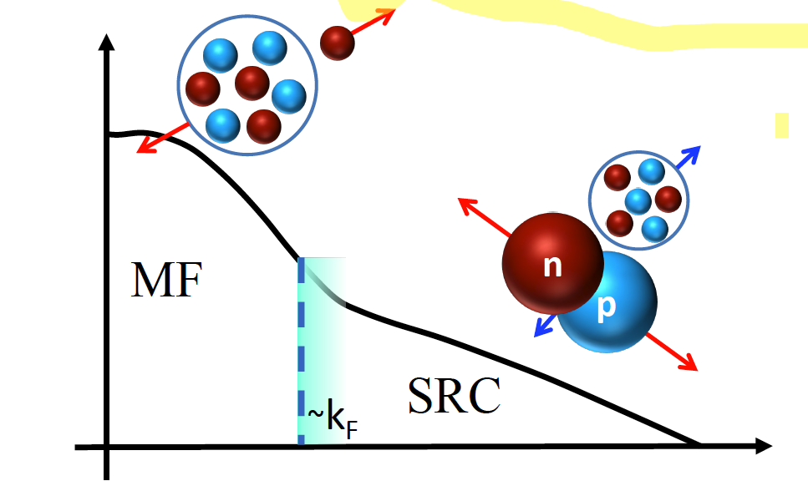
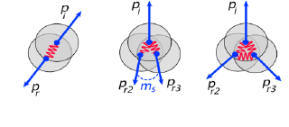
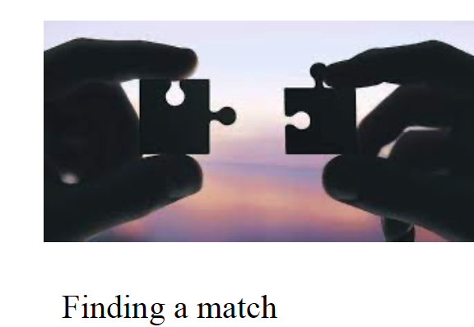
SRC Frontiers to study with pA measurements
Mean Field 🔄 SRC
3 Nucloens – SRC
ALERT, HADES
CLAS12, GlueX, HADES, HAIF
Where ?
CLAS12, R3B, HAIF
Neutron-rich nuclei
Spin structure of the 2N-SRC
Isotopic chains
Relativistic description
Which nucleons create SRC pairs ?
High precision 2N– SRC

Slide 22

MF → SRC
Where ?
Width ?
A-1
Log Momentum Distribution
A-2
n
MF
p
SRC
~k_{F}
Nucleon Momentum

Slide 23


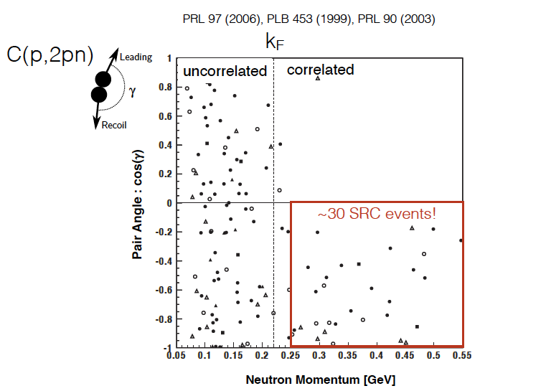
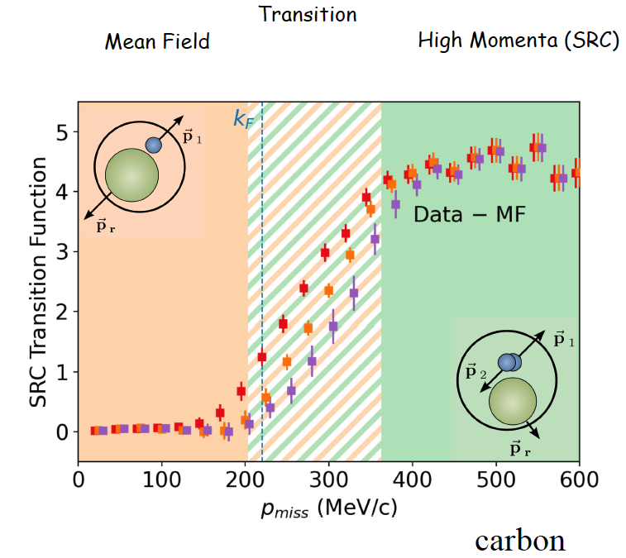
I. Korover et al. (CLAS collabortion)
PRC 107, L 061301 (2023)
p
p_{f}
→
→
p
p₀
p
n
Erf centered around
274 ± 2MeV/c
And has a width of
58 ± 4 MeV/c
Target
nucleus
→
p_{n}
p

Slide 24
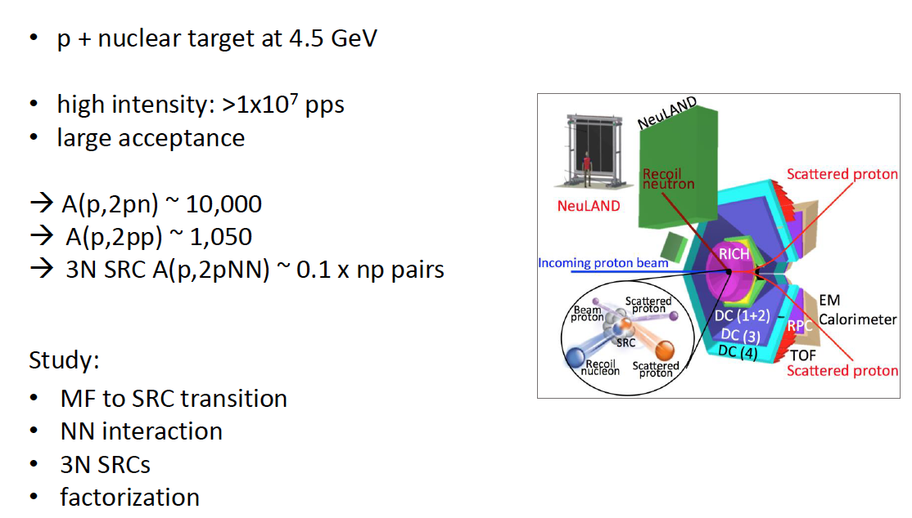
HADES. at GSI / FAIR
Overcome statistic limitations with p probe and direct kinematics

Slide 25
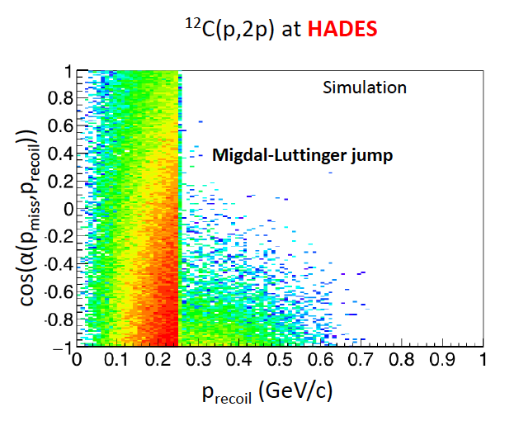
I. Korover et al. (CLAS collabortion)
PRC 107, L 061301 (2023)
p
p_{f}
→
→
p
p₀
p
n
Erf centered around
274 ± 2MeV/c
And has a width of
58 ± 4 MeV/c
Target
nucleus
→
p_{n}
p

Slide 26

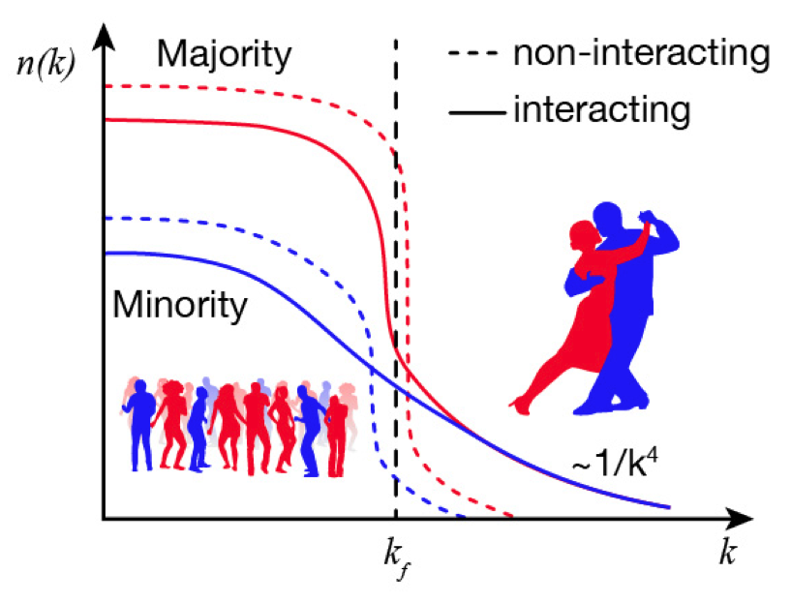
MF → SRC
Finding a match
Exotic (very asymetric) nuclei
SRC pairing in isotopes chains

Slide 27
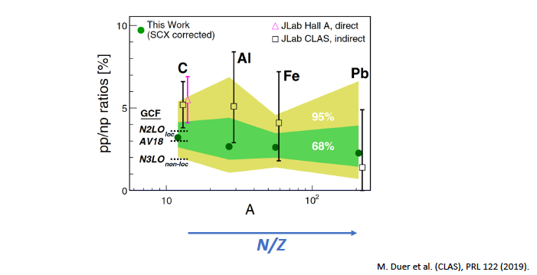
np-SRC dominance
(tensor force)
E. Piasetzky et al., PRL. 97 (2006) 162504.
R. Subedi et al., Science 320, 1476 (2008).
A. Schmidt et al., Nature (in print)

Slide 28
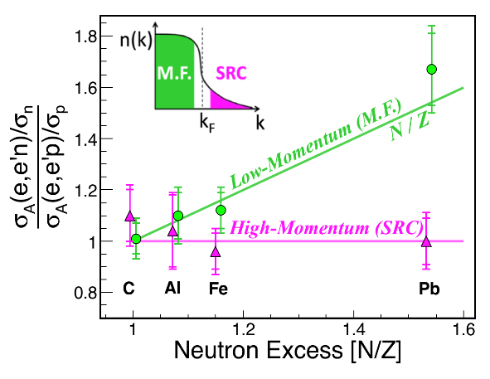
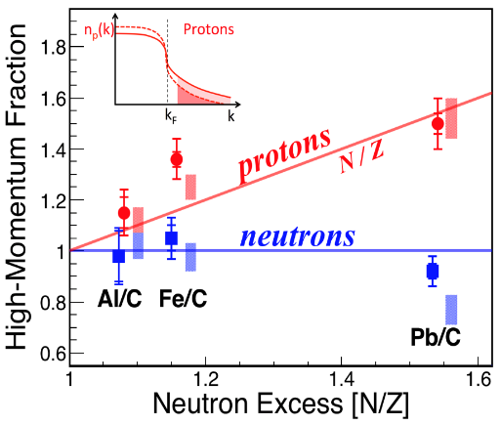
Summary of SRC results
For nuclei with N>Z
Nature, 560 (2018) 617-621.
In the high momentum tail, #protons = #neutrons, irrespectively of the neutron excess.
Protons have a greater probability than neutrons to be above the Fermi sea.
The fraction of correlated protons /neutrons is grow/constant , as a function of neutron excess.
Generalized Nuclear Contact Formalism
Phys. Lett. B780 (2018) 211.

Slide 29
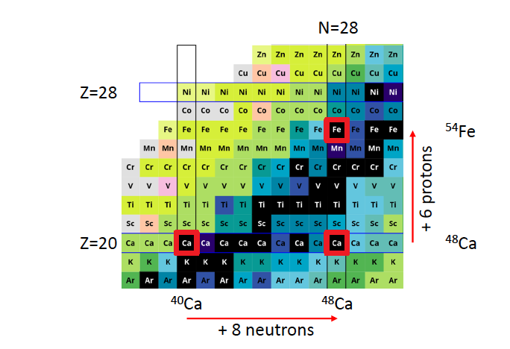
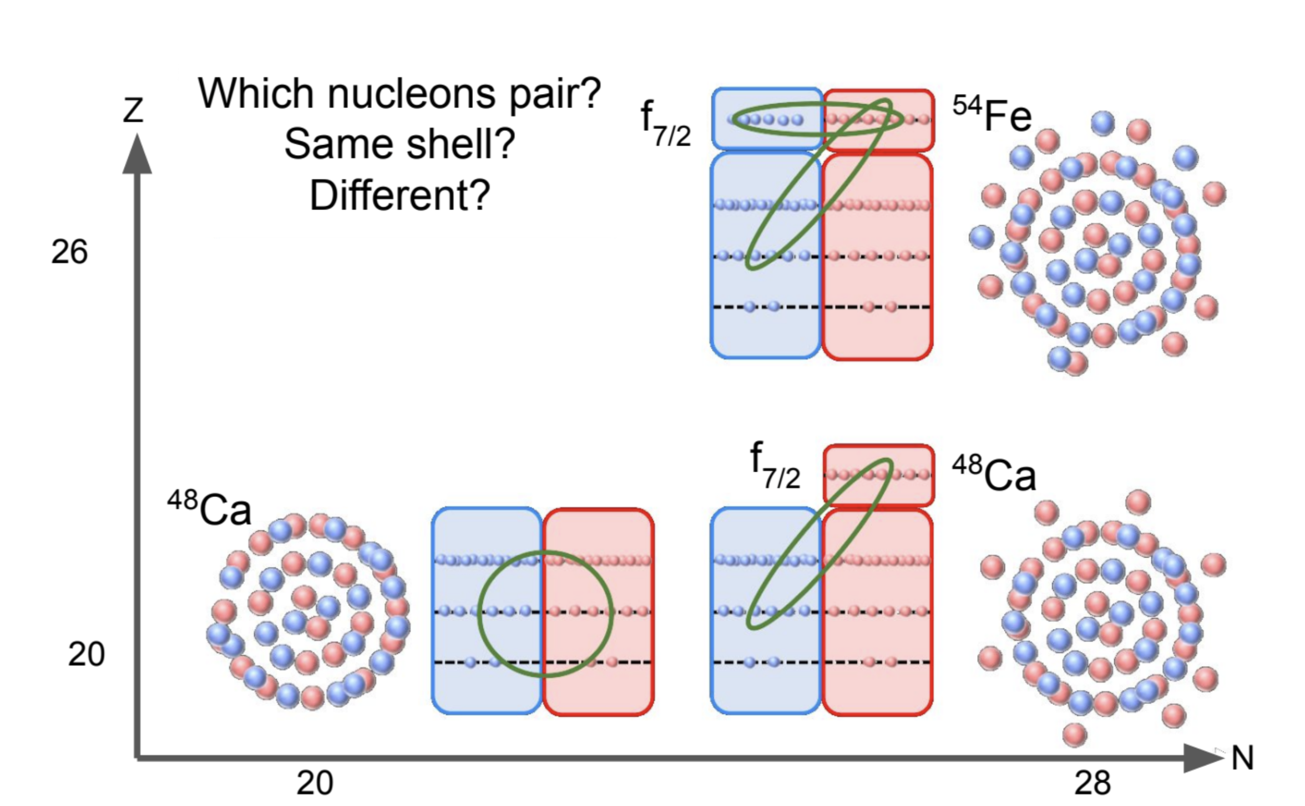
CaFe experiments
40

Slide 30


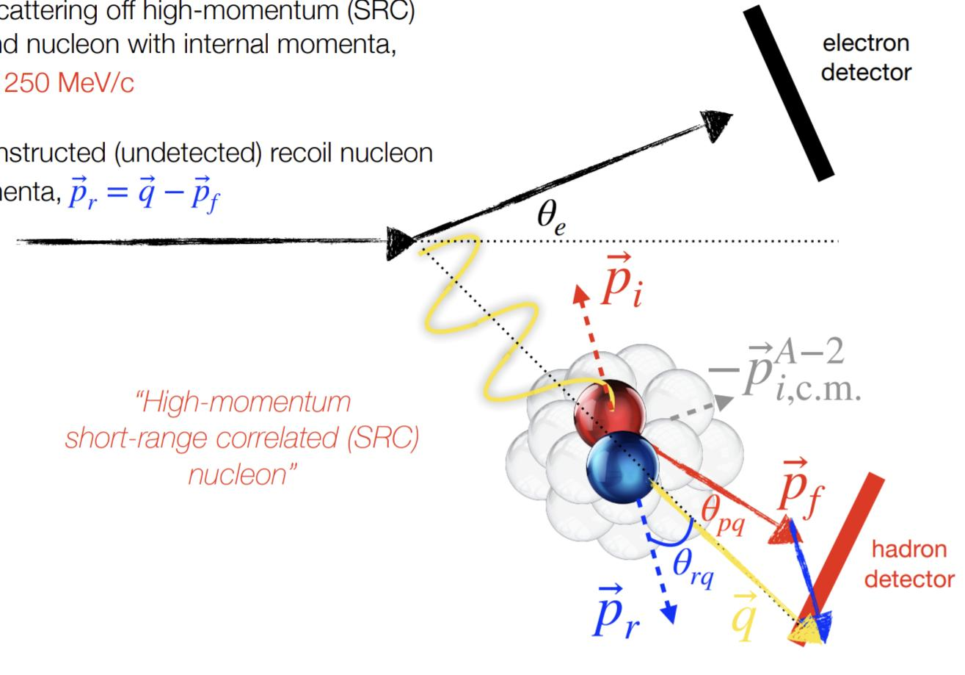
⁴⁰Ca, ⁴⁸Ca, ⁵⁴Fe (e, e’ p)
expectation
⁴⁸Ca
(e,e’p) large pmiss
⁻⁻⁻
~
^{1.2}
⁴⁰Ca
New (Jlab 2022) measurements
Hall C:
⁴⁰Ca, ⁴⁸Ca, ¹²⁰Sn
(e,e’p), (e,e’n), (e,e’pN)
Hall B:

Slide 31
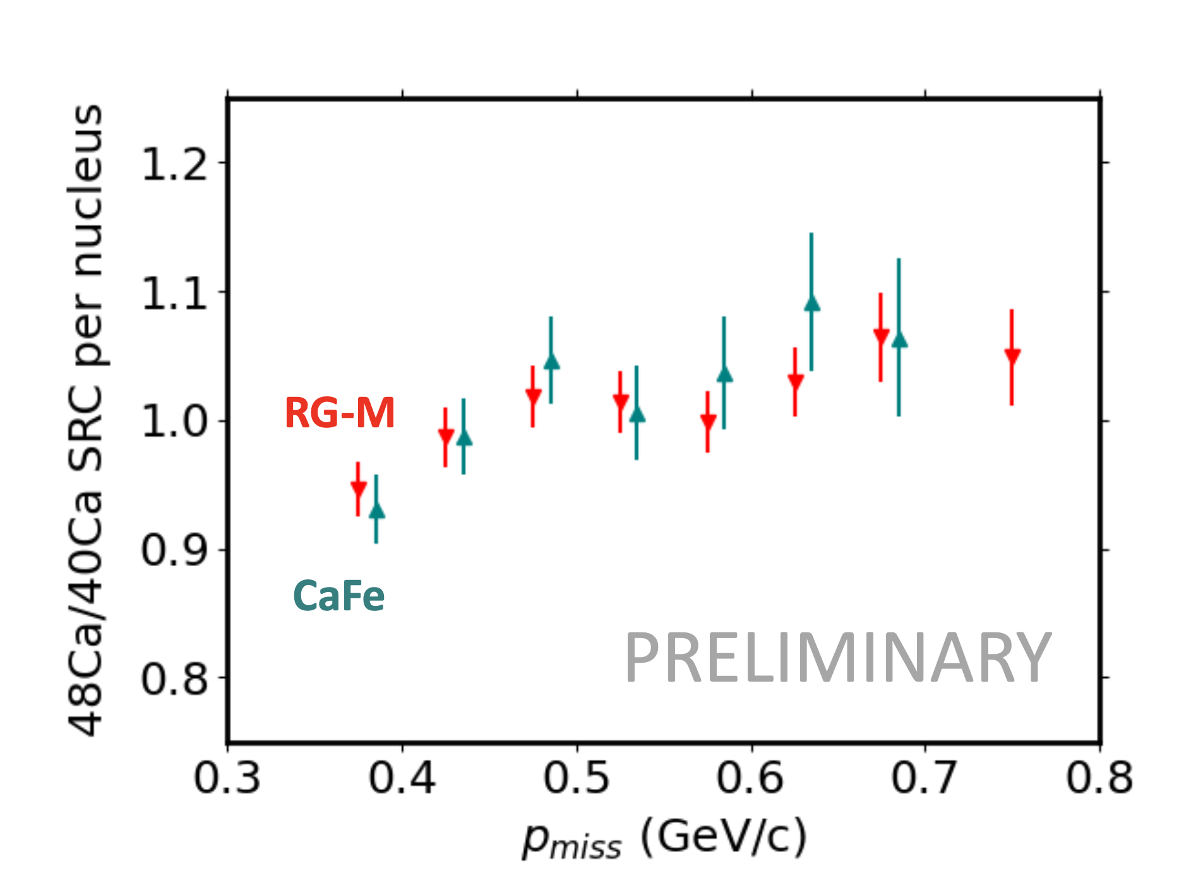
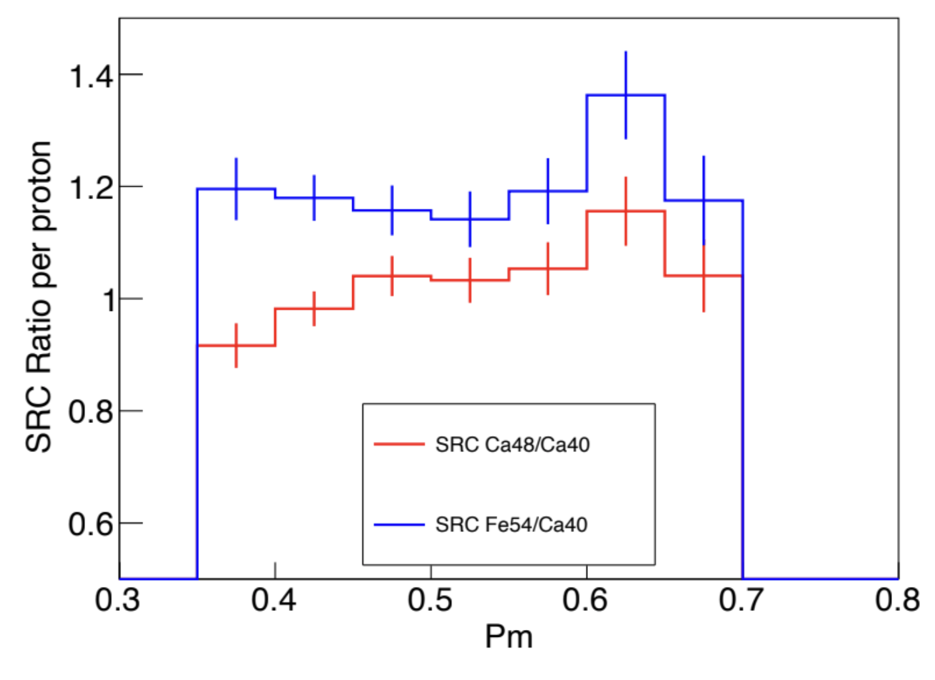
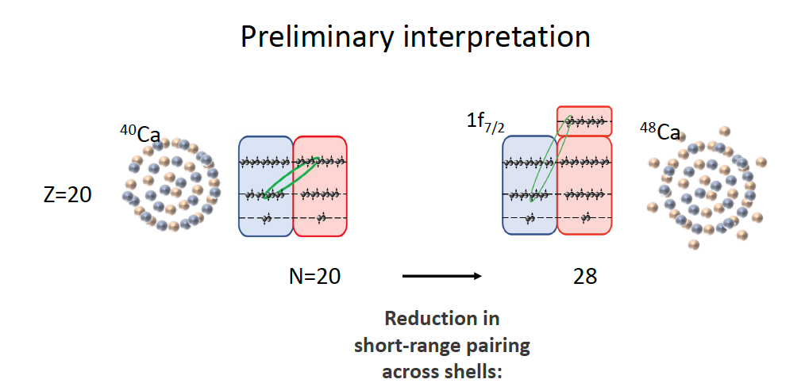


Preliminary Results
(e,e’p)
→Need for Isotopic chain studies
$σ_{48Ca}^{SRC}/σ_{40Ca}^{SRC}$Integrated
$σ_{54Fe}^{SRC}/σ_{40Ca}^{SRC}$Integrated
Hall B (RG-M): 1.01 (1)
Hall C (CaFe): 1.02 (1)
Hall C (CaFe): 1.19 (1)

Slide 32


Isotopic chains studies at R³B (GSI-FAIR)
1st radioactive nucleus measurement ¹⁶C(p,2pN)A-2* done in 2022.
Proposal to measure ^{110,120,132}Sn
N/Z = 1.20, 1.40, 1.64
¹⁶C @ 2 GeV/c/u
proton
neutron
See talks:
fragment (A-2)*

Slide 33



Isotopic chains studies at HAIF
Inverse kinematics measurements with radioactive nuclei
  Long secondary beam line for rare isotope extraction
Jointed NSFC-ISF Research Grant
PI: Eli Piasetzky (Tel Aviv University), Julian Kahlbow (Tel Aviv + MIT).
Hongna Liu (Beijing Normal University, Zhihong Ye (Tsinghua University)

Slide 34


The hunt for 3N SRC

Slide 35


Limitaion on 3N SRC hunt with electron scattering
Statistics
Kinematics
Inclusive A(e,e’)
3N SRC ~ 0.01-0.1 x np pairs

Slide 36







The hunt for 3N SRC (alternatives for electron base searches)
HADES. at GSI / FAIR
~10,000 2N-SRC
100- 1000. 3N-SRC
GLUEX at JLab.
3.4 10⁷ γ/s 95 PAC days on 4He :
3N-SRC
($γ,ρ^{0}$ppp)
100-1000
($γ,ρ^{+}$ppp)

Slide 37


The hunt for 3N SRC
HAIF: potential to overcome statistic limitations with indirect kinematics
  For C12, E=51 GeV/c (4.25GeV/c/u)
  Beam Intensity = 6x10¹¹pps (instant pulse)
  Slow extraction: 1.33s cycle
  → 4.5x10¹¹pps in average
  vs. 3.5x10⁴ pps in average at JINR
  Target Density = 0.073g/cm3, Length =15cm (similar to JINR)
  (See Hongna Liu’s talk)
  Total Luminosity 3x10³⁵ cm⁻² s⁻¹ (slow extraction)
  Full azimuthal angular coverage
High-Energy Station
Rate limiting factors:
Beam counters
Target
DAQ (trigger)
Jointed NSFC-ISF Research Grant
PI: Eli Piasetzky, Julian Kahlbow,
Hongna Liu, Zhihong Ye
6 Nov

Slide 38




High-Energy Station
HAIF: potential best 3N hunting place
Simulation
Kinematic coverages
¹²C⁶⁺ at 51GeV/c ¹²C(p,2p)¹⁰B
One day of running with a
Full 2$π$ azimuthal acceptance
Rate limiting factors:
Beam counters
Target
DAQ (trigger)
Jointed NSFC-ISF Research Grant
PI: Eli Piasetzky, Julian Kahlbow,
Hongna Liu, Zhihong Ye

Slide 39
Summary
SRC studies with hadrons
SRC pairing in isotopes chains
SRC studies with leptons
Jefferson Lab Hall D GlueX
R3B
JINR
HADES
Photons
Hadrons
3N –SRC discovery
Electrons
HIAF
Jefferson Lab Halls A, B, C
Polarized deuteron
ALERT

Slide 40



Organizers
Zhihong Ye
Huizhou
Tel Aviv
Spain, 11th century AD

Slide 42
SRC Frontiers with pA Experiments next 5 years
Acess to exotic (very asymetric) nuclei
R3B
SRC pairing in isotopes chains
HADES
MF→SRC
JINR
Polarized deuteron beam
6 GeV/nucleon
HIAF
3N –SRC
See talks:

Slide 43
Summary
SRC studies with hadrons
SRC studies with leptons
EVA/BNL
Jefferson Lab Hall D GlueX
R3B
JINR
Many-body dynamics
NN interaction
HADES
Photons
Hadrons
Nucleon substructure
Electrons
HIAF
Jefferson Lab Halls A, B, C
3N –SRC discovery
2N-SRC:
MF-> SRC pairing
Spin structure
Relativistic description
ALERT

