Slide 1
EicC Detector Summary
Xin Li
2023/07

Slide 2
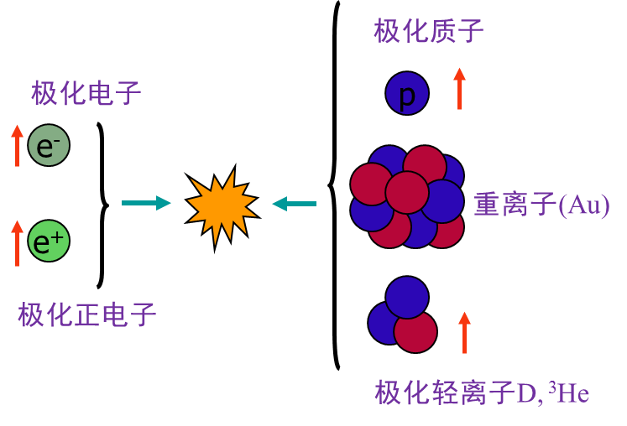
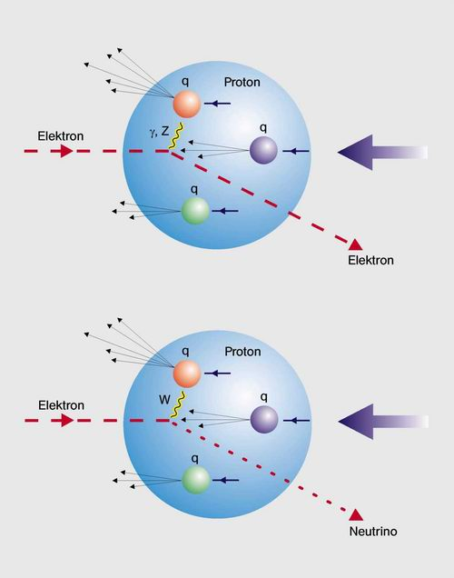
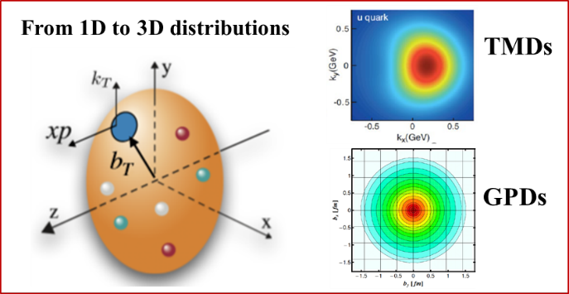
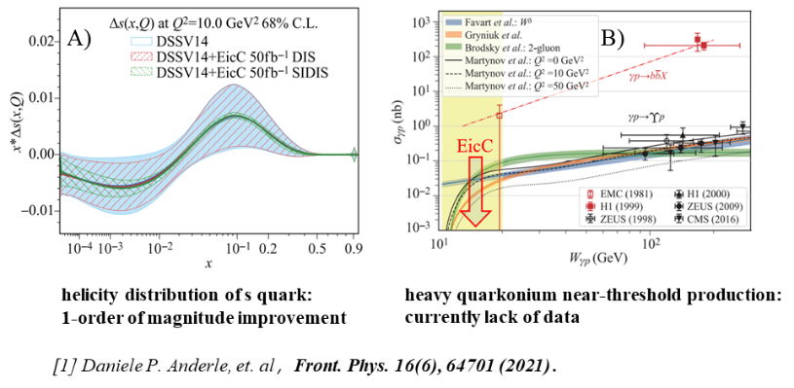
高亮度极化电子-离子对撞机
电子-离子对撞机被誉为核子的“高分辨率的三维立体显微镜”，是国际公认的研究核子结构和核子内夸克胶子分布的高效实验装置
深度：探测核子内部深层次结构
广度：大动量区间覆盖、高极化度测量
精度：高亮度、大数据，实现高精度测量
核子自旋起源: 一维和三维部分子分布函数的精确测量
核子质量起源:
精确测量Upsilon 粒子在阈值附近的产生截面，理解能动量矢量的迹反常的物理本质
Notes:
要解决以上重要物理问题，电子-离子对撞机是国际公认的研究核子结构和核子内夸克胶子分布的最有效实验装置，这主要是因为电子离子对撞机在深度，广度和精度方面的三大优势。在深度方面，通过点状电子的深度非弹性碰撞，探测核子内部深层次结构和性质。在广度方面，具备有大动力学区间覆盖和高极化度测量的能力；在精度方面，得益于高亮度的加速器，获取大量数据，实现高精度测量。因此，电子离子对撞机被称为研究核子结构的“高分辨率的三维立体显微镜” 。
目前，有QCD 理论将质子质量分解为四个部分，其中能动量张量的迹反常的物理本质是质子质量问题中最不清楚的部分，这可以通过矢量介子Upsilon 粒子产生过程的近阈产生截面的测量来研究：因为该截面对Upsilon 粒子与核子间的非微扰胶子相互作用非常敏感，表现为在近阈截面的增强。作为未来研究质子质量物理起源的唯一强相互作用对撞机，EIC能首次精确测量Upsilon 粒子在阈值附近的产生截面。科学家结合粲味J/psi 粒子在阈值附近的产生，将深入了解QCD迹反常机制对质子质量的贡献。这对于理解和最终解决质子质量问题非常重要，还将促进我们从质量角度进一步理解强相互作用和QCD性质。
近期，中美科学家利用光生和电生过程的矢量介子在阈值附近产生的数据，深入了解QCD迹反常机制对质子质量的贡献，

Slide 3
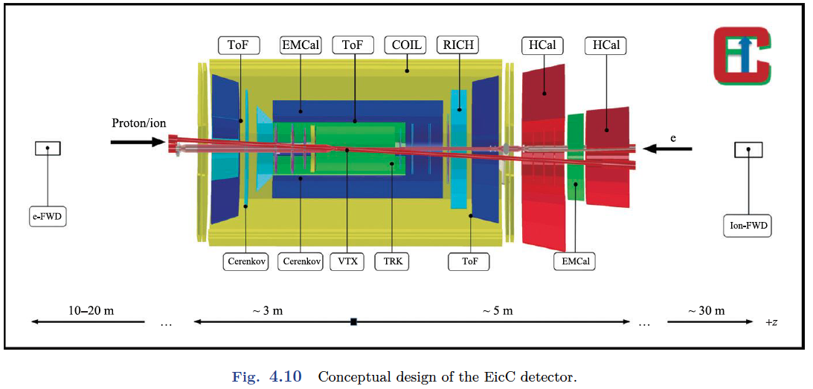
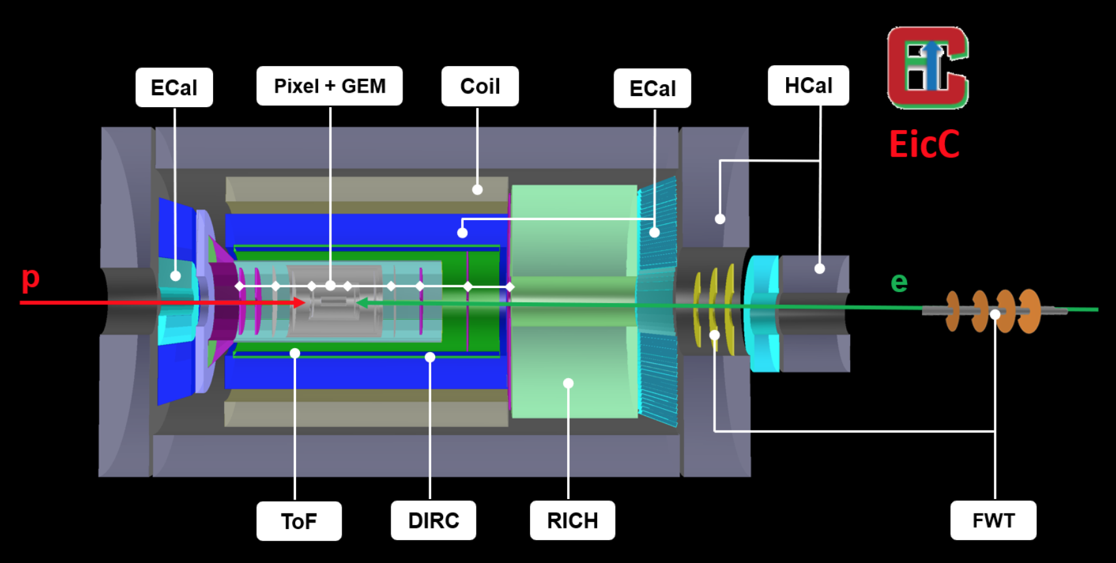
EicC Detector Overview
Subsystems to realize the EicC physics goals:
  Vertex & tracking detectors
  PID detectors
  Calorimeters
  Far Forward detectors
  Luminosity monitor & Polarimetry
  DAQ
  Simulation & software
Questions need to be addressed:
  Targeted resolutions
  Technology candidates
  Simulation results
  R&D activities or plan
  Inputs to DAQ

Slide 4
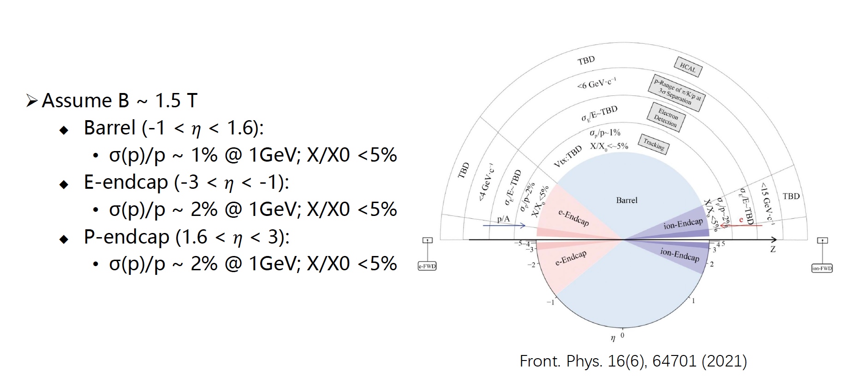
1. Vertex and tracking detector
Yuming Ma, Aiqiang Guo, Yutie Liang, Yuxiang Zhao (IMP)
Physics requirements for EicC tracking:

Slide 5
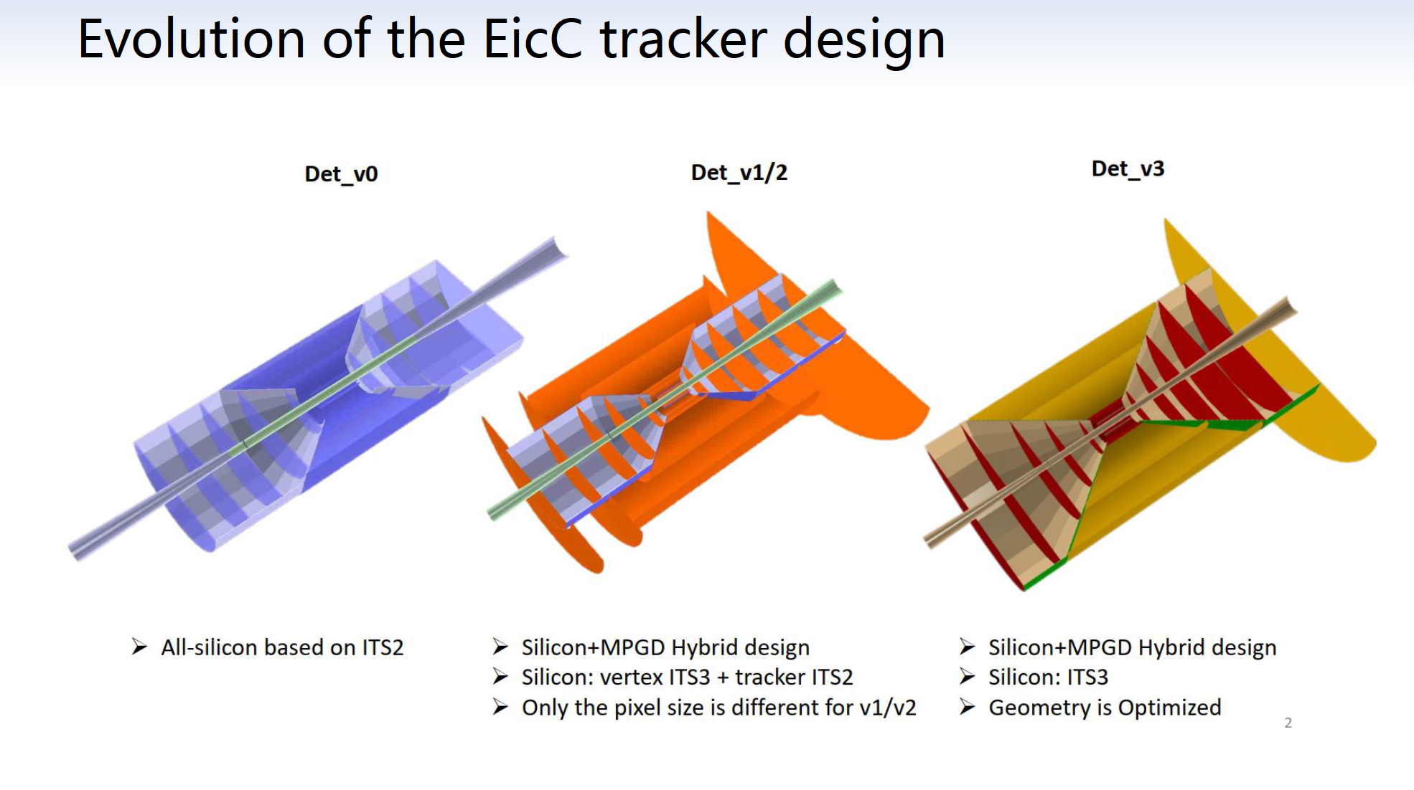
-Yuming Ma
Further dedicated optimization of the scale and structure recently based on Det_v3

Slide 6
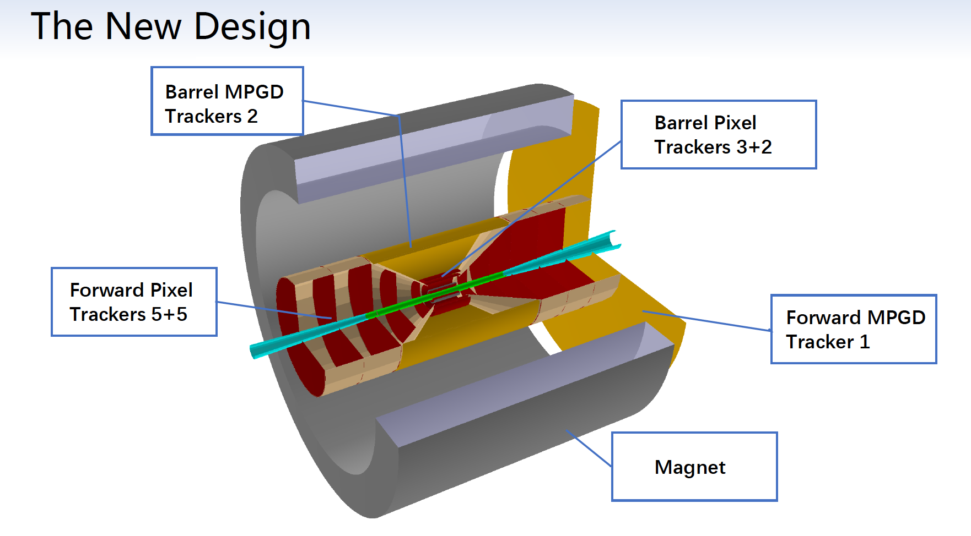
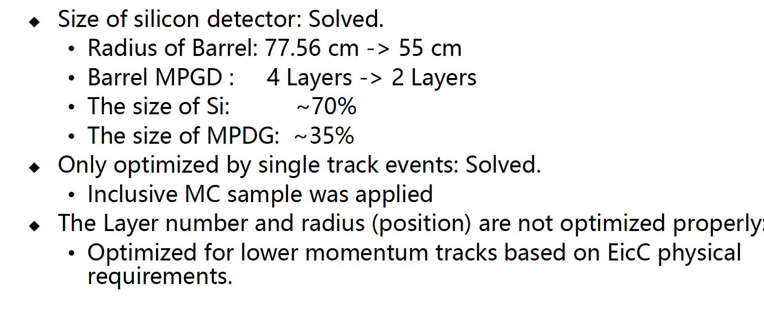
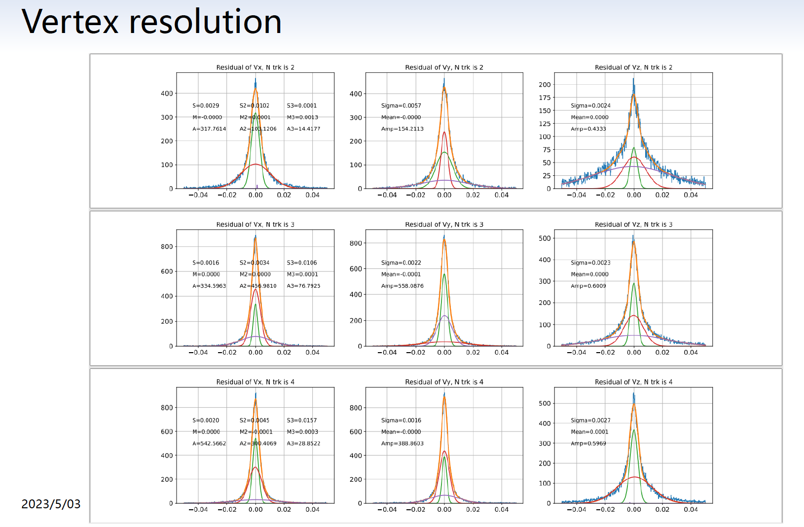
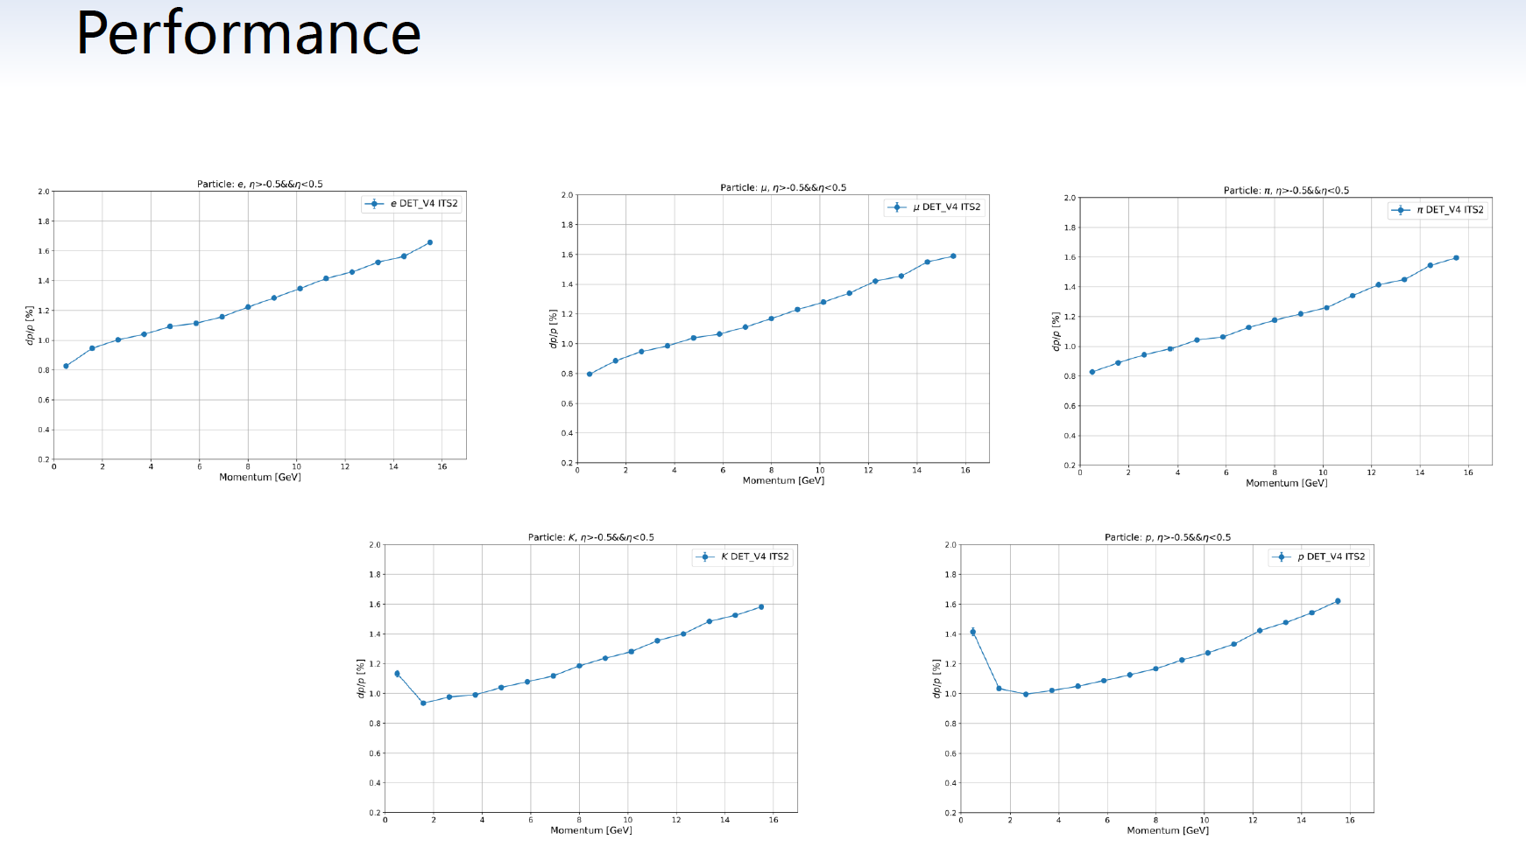
Performance with new tracking design
-Yuming Ma

Slide 7
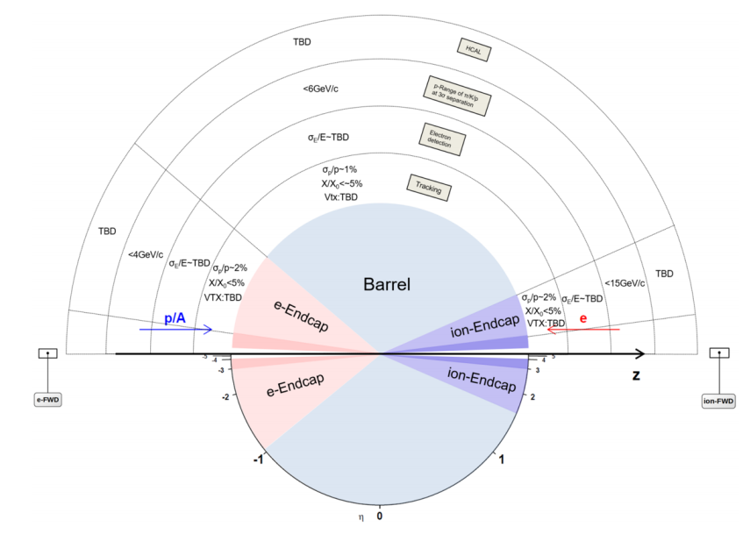
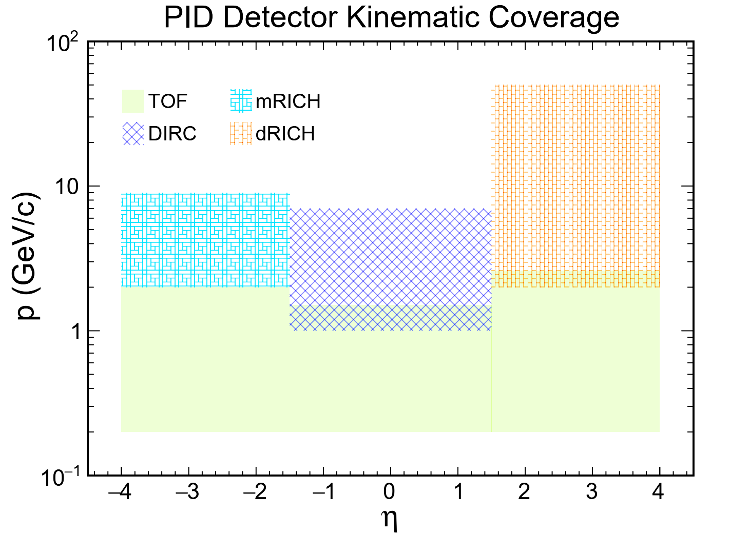
2. PID detectors
- Xin Li (IMP)
实现EicC实验中高亮度、大动量范围的带电粒子鉴别
快速响应和超高分辨
结构紧凑，抗辐照
PID探测器方案：
桶部：内反射切仑科夫探测器（DIRC）
端盖：环形成像切仑科夫探测器（mRICH、dRICH）
低动量（<1GeV/c)：MPRC、LGAD
PID momentum coverage:
<4 GeV/c at e-Endcap;
<15 GeV/c at ion-Endcap ;
<6 GeV/c at Barrel
不同粒子鉴别探测器覆盖动量范围

Slide 8
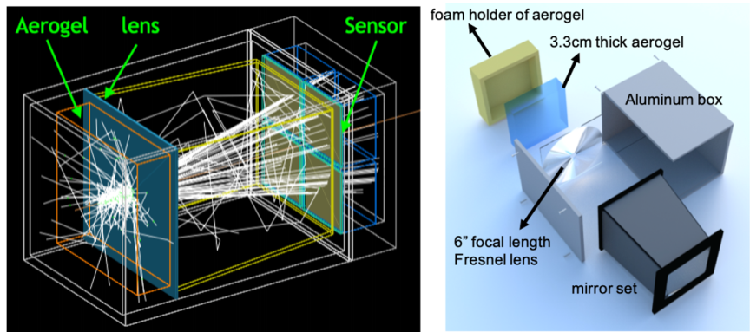
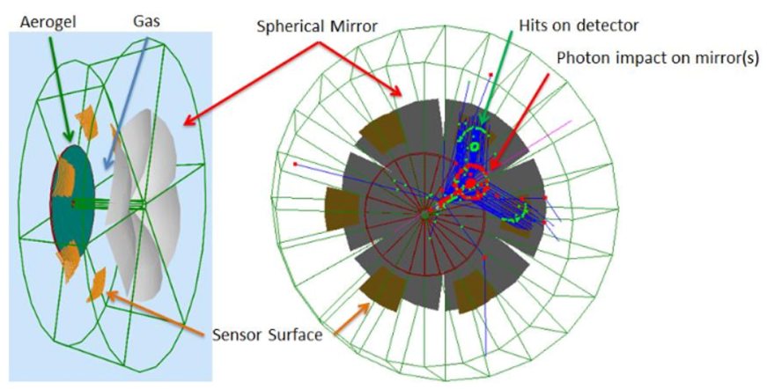
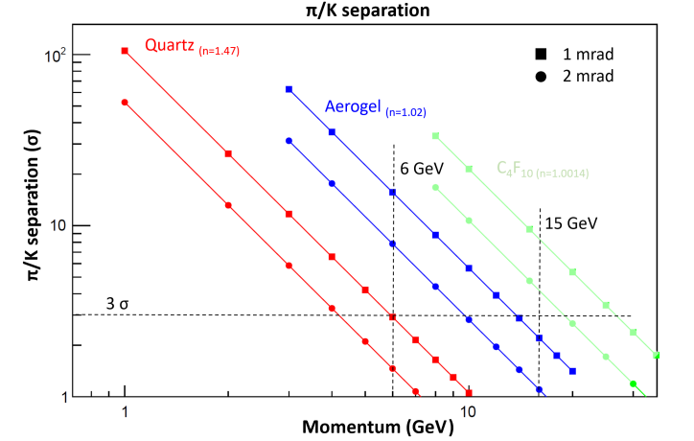
端盖PID探测器
- Xin Li (IMP)
Modular RICH是一种基于气凝胶的切仑科夫探测器。它利用菲涅耳透镜产生聚焦作用以提高粒子分辨能力（菲涅耳透镜聚焦对透射光波长范围具有限制作用，可减小瑞利散射效应）。其结构紧凑灵活，可以在末端安装高精度PMT测量飞行时间信息，进而提高其PID能力。
Dual RICH则包含两种不同折射率的辐射体，因此能够覆盖更大动量范围。由于气凝硅胶辐射体可覆盖低动量区，在中等动量区与气体辐射体覆盖范围重叠，因此dRICH测量范围不存在中间“空白区”。
预期目标：
Modular RICH实现3σ π/K分辨范围 ~6 GeV/c（径迹角分辨~1mrad）
采用气凝胶+气体辐射体（C₂F₆）dRICH探测器，预期可达15GeV/c的3σ π/K分辨。
目前方案调研中

Slide 9
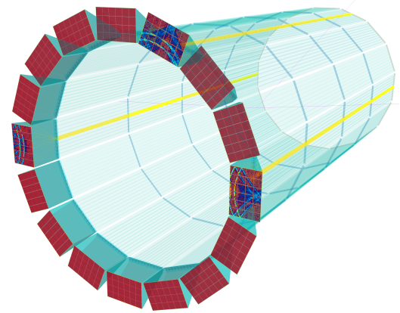
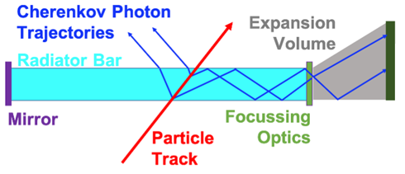
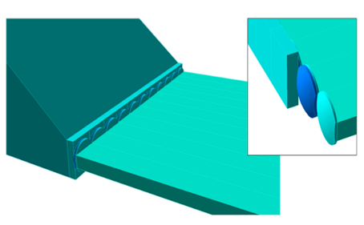
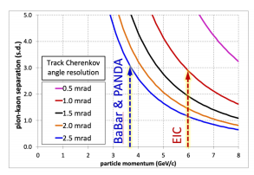
桶部PID探测器
- Xin Li (IMP)
内反射切仑科夫探测器（DIRC）：
不同带电粒子激发的切仑科夫辐射角不同，基于这一原理的DIRC探测器通过测量不同粒子激发切仑科夫光的传输时间和出射角度不同进行粒子鉴别。
预期目标：
采用熔融石英作为切仑科夫辐射体，MPC-PMT作为光电探测阵列，作为紧凑型桶部探测器实现高动量（1~6GeV/c）的粒子鉴别
为此需要~1mrad的角分辨，以及皮秒量级的时间分辨（<100ps)
多通道皮秒定时电子学的配套研发
研究进度：
参考PANDA和EIC的桶部DIRC探测器设计，模拟完成DIRC初步方案，小尺寸DIRC原型制作中
桶部DIRC方案
PANDA和EIC的DIRC粒子鉴别范围

Slide 10
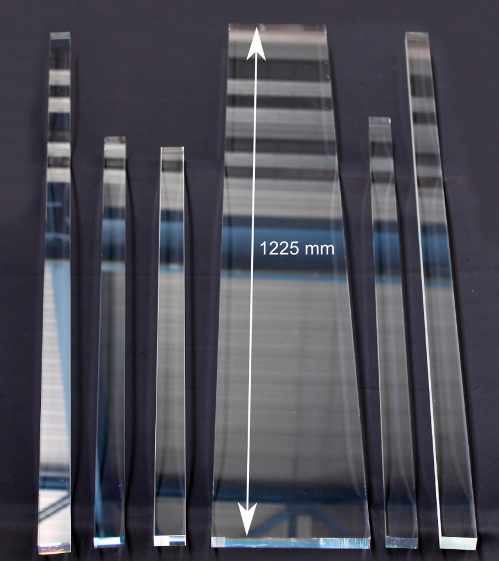
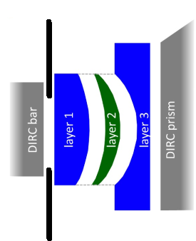
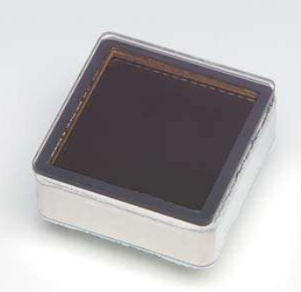
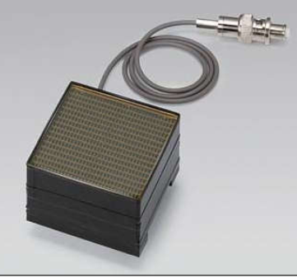
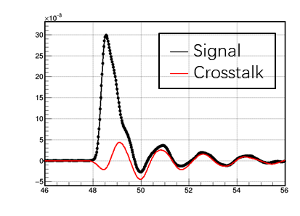
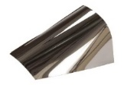
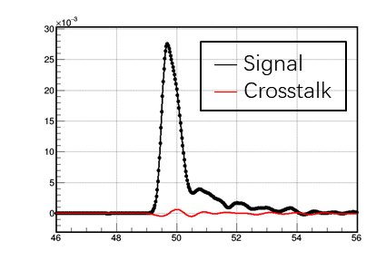
桶部DIRC方案
- Xin Li (IMP)
NLAK33B/PbF
Heraeus suprasil-312
Fused silica
MCP-PMT array
R10754/H13700
ESR reflection film
聚焦前
Fused silica radiator
聚焦后
Focus Lens
石英辐射体: 13mm x 35mm x 2600mm
梯形光导: (30mm+220mm) x 320mm x 300mm
MCP-PMT: 滨松 R10754 (5.75mm, 4x4 Pixel) / H13700 (3mm, 16x16 Pixel)
聚焦透镜: 3-layer lens (fused silica + NLAK33B glass) curvature radius: 30◦, 30/7.5cm, 厚度1cm
微型光导：漏斗形光导(厚度2~3mm)连接梯形光导和单个PMT像素单元，消除PMT边框死区和减小串扰影响

Slide 11
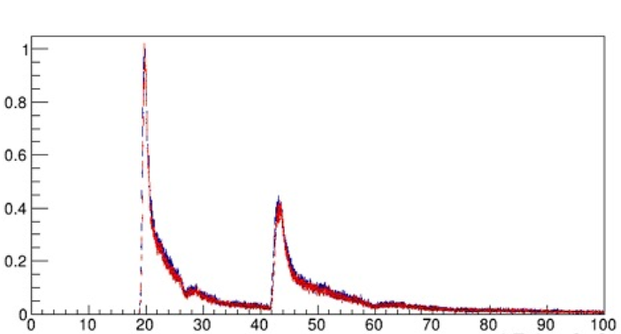
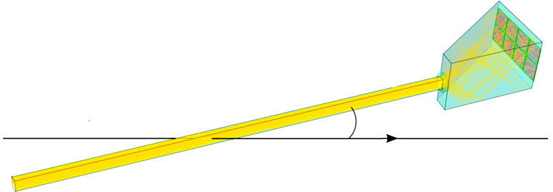
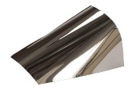
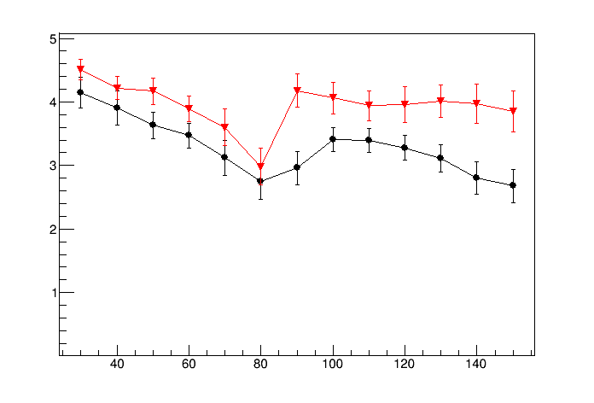
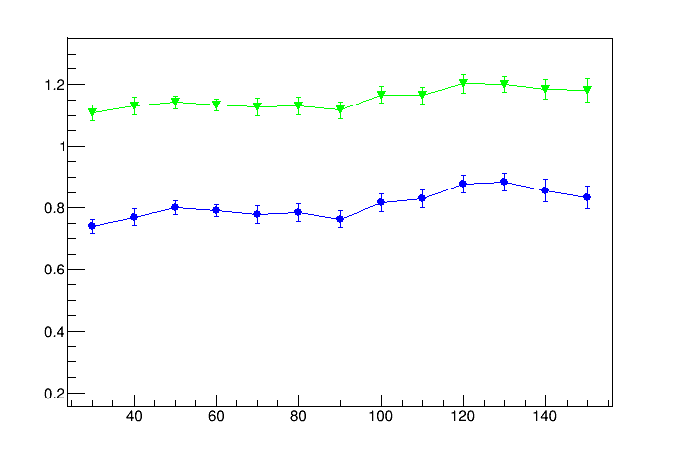
单块DIRC角分辨和PID性能模拟
- Xin Li (IMP)
Different transit time cut & correlation for forward & backward photons
Entries/1000
Forward photons
ESR film
6GeV/c Pion
Backward photons
Transit time(ns)
σ_{θc} (mrad)
前后向出射光子分开进行传输时间甄别和切仑科夫辐射角重建
不同位置分辨PMT（R10754/ 13370）对应的DIRC角分辨(~1mrad)；角分辨~1mrad时，不同时间分辨对应的6GeV/c π/k分辨能力随粒子入射角的变化(>3σ)。
Separation power [s. d.]
Black: σ_{t} = 120ps
Red: σ_{t} = 70ps
Green: 5.75mm PMT pixel
Blue: 3mm PMT pixel
Polar Angle (◦)
Polar Angle (◦)

Slide 12
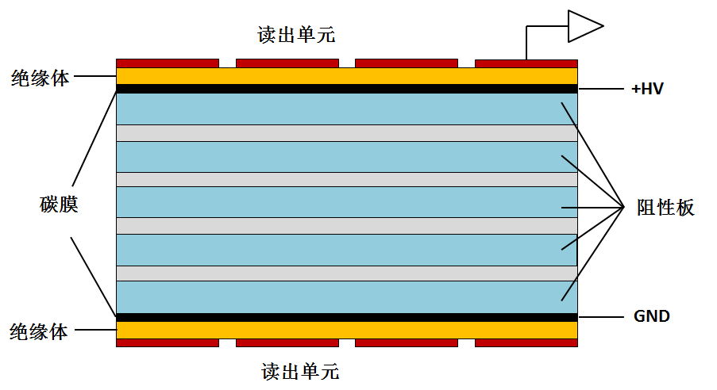
MRPC/TOF PID at low momentum
- Yi Wang (Tsinghua)
Standard parameters:
Resistivity of glass: ~10¹² Ω.cm
Working gas: 90%Freon+5%iso-butane+5% SF6
Time resolution <100ps
Efficiency >95%
Charge: a few PC
Dark current: a few nA
Noise ~1Hz/cm²
Rate <100 Hz/cm²
Large area, low cost
Read out
Insulator
Carbon
Resistive
plate
Insulator
Read out
MRPC structure
TOF PID:
π /k ~1.6 GeV/c,
(π,k)/p ~ 3.0 GeV/c

Slide 13
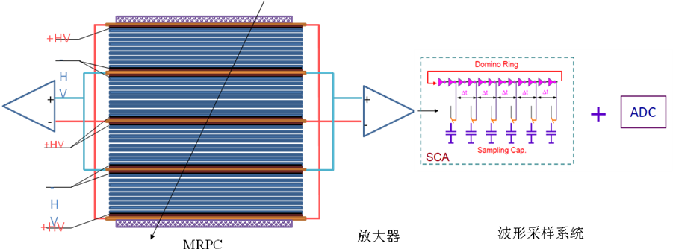
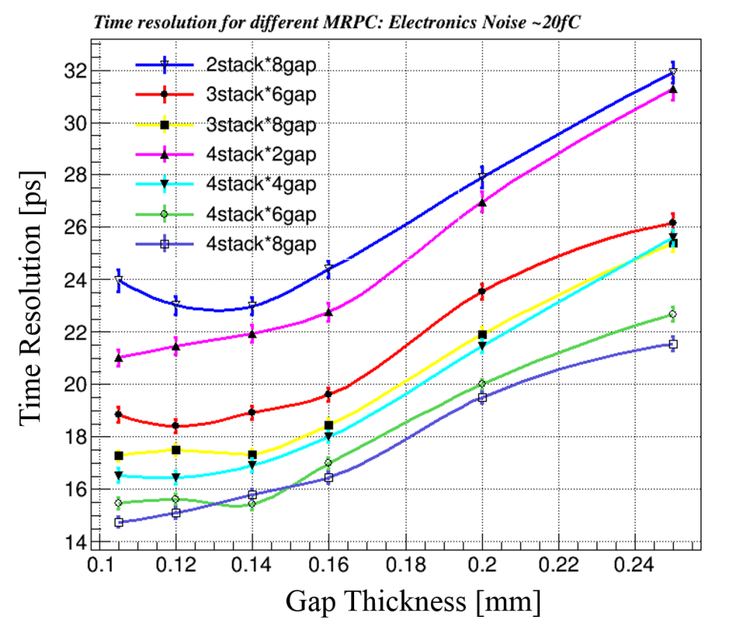
Toward 20ps resolution: narrow gap MRPC
- Yi Wang (Tsinghua)
Simulation indicates proper ways to design the gap thickness and arrange the stacks
Narrower gap thickness required
σ_{TOF} <20 ps，the intrinsic resolution of narrow gaps MRPC is around 15ps，so the time jitter of readout electronics <13~15 ps。
σ_{MRPC} <20 ps，the gas gap: <0.18mm
gap number: >16

Slide 14
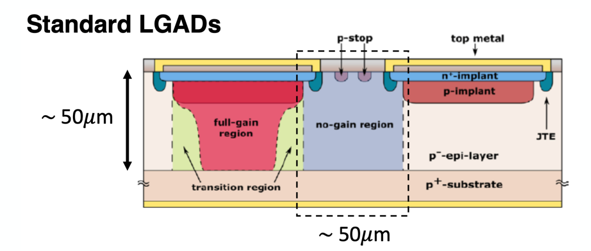
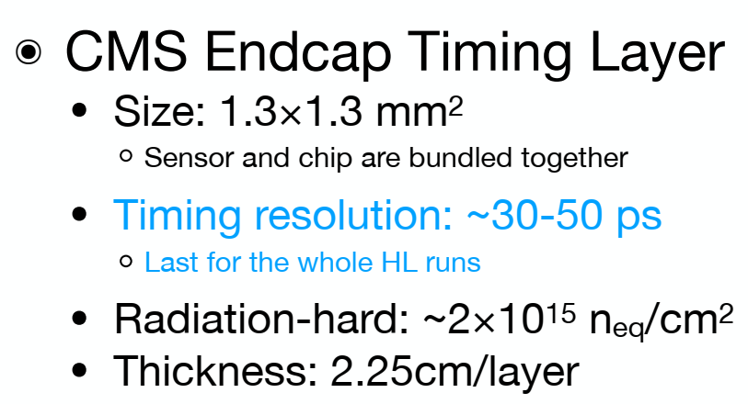

LGAD Reference
低增益雪崩探测器(LGAD)：一种超快响应硅探测器。通过半导体中局部雪崩放大产生具有快速上升沿的信号脉冲，进行高时间分辨的粒子鉴别。相比MRPC，它的结构更紧凑，测量飞行时间之外还可提供高分辨粒子径迹位置信息。
预期目标：
实现低动量（0.1~2GeV/c)的带电粒子鉴别
皮秒量级的高时间分辨（~30ps）。
LGAD的像素探测单元尺寸可达几十um，提供高精度粒子径迹重建信息。
EicC Barrel
Radius ~80cm (try to achieve 50cm)
Time resolution ~20ps

Slide 15
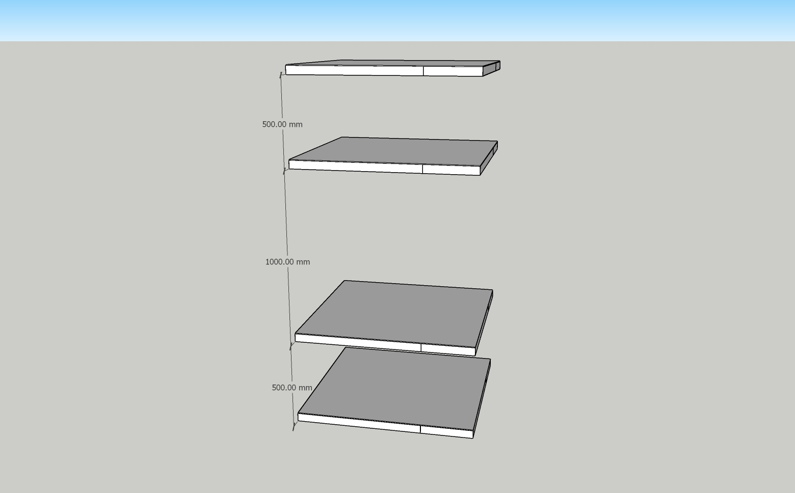
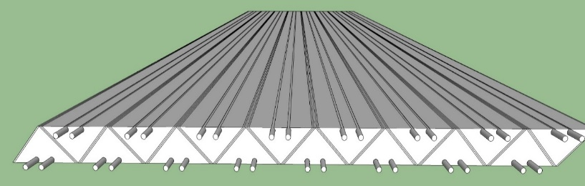
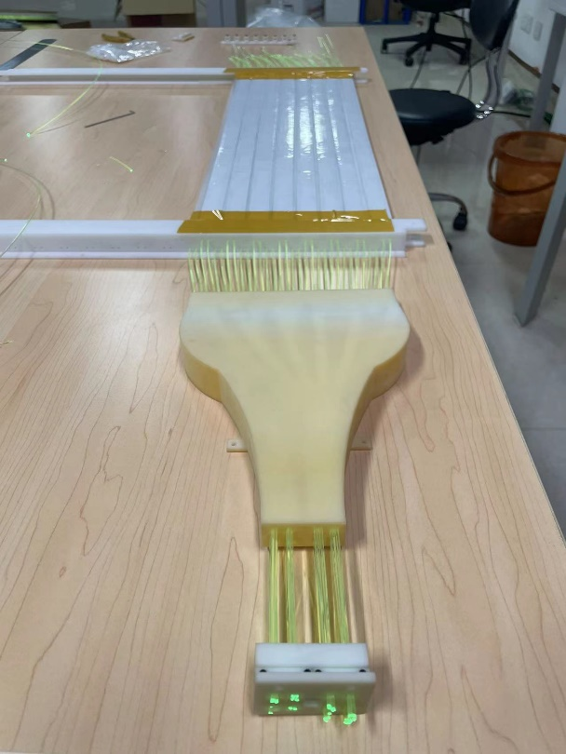
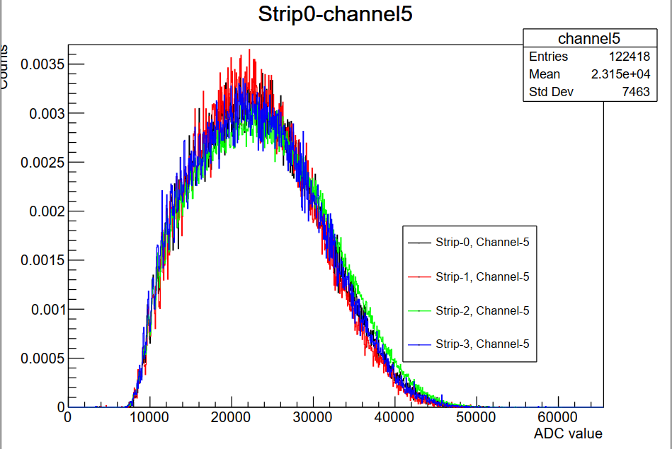

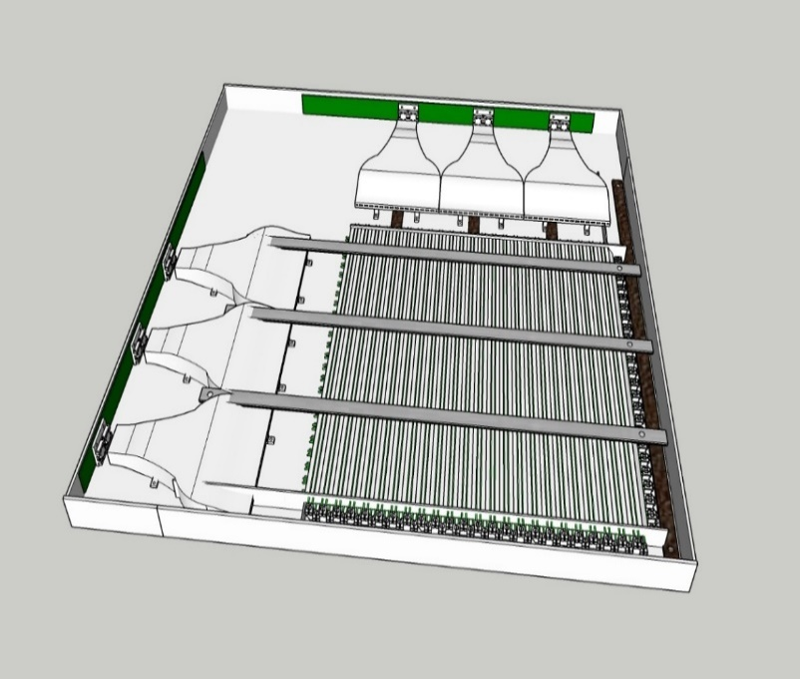
Cosmic Ray Platform
不同批次闪烁体的发光效率
宇宙线测试平台：闪烁体 + SiPM, 8 layer (4 layer for x, y each), 探测面积 50cm x 50cm
One layer：3 module + 1 electronics
One module：16块EJ-200 + 32根光纤 + 8 SiPM
位置分辨~1mm, 时间分辨<100ps
*Cooperation with the EicC USTC group

Slide 16
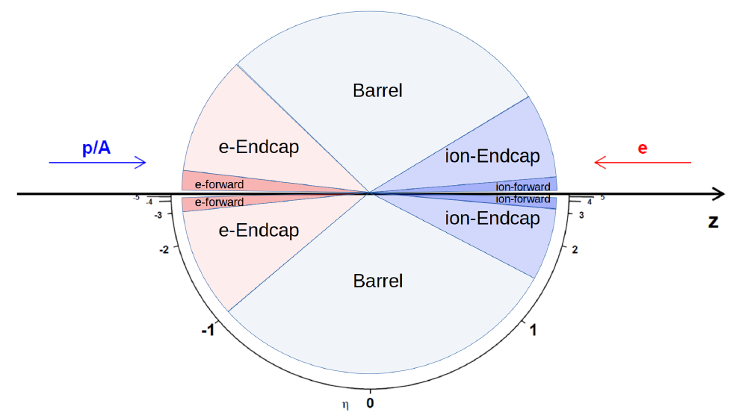
3. Calorimeter system for EicC
Ye Tian, Dexu Lin/ (IMP)
Basical ECal special requirement:
E-endcap: good low energy resolution
Barrel: short radius, good angle resolution
Ion-endcap: angle resolution, π⁰ reconstruction, PID.
e-Endcap
ion-Endcap
Barrel
Detector | Pseudorapidity | Angle(degree)
Ion-Endcap | 3 | 5.7
 | 1.5 | 25.2
Barrel
 | -1 | 139.6
e-Endcap
 | -3 | 174.3

Slide 17
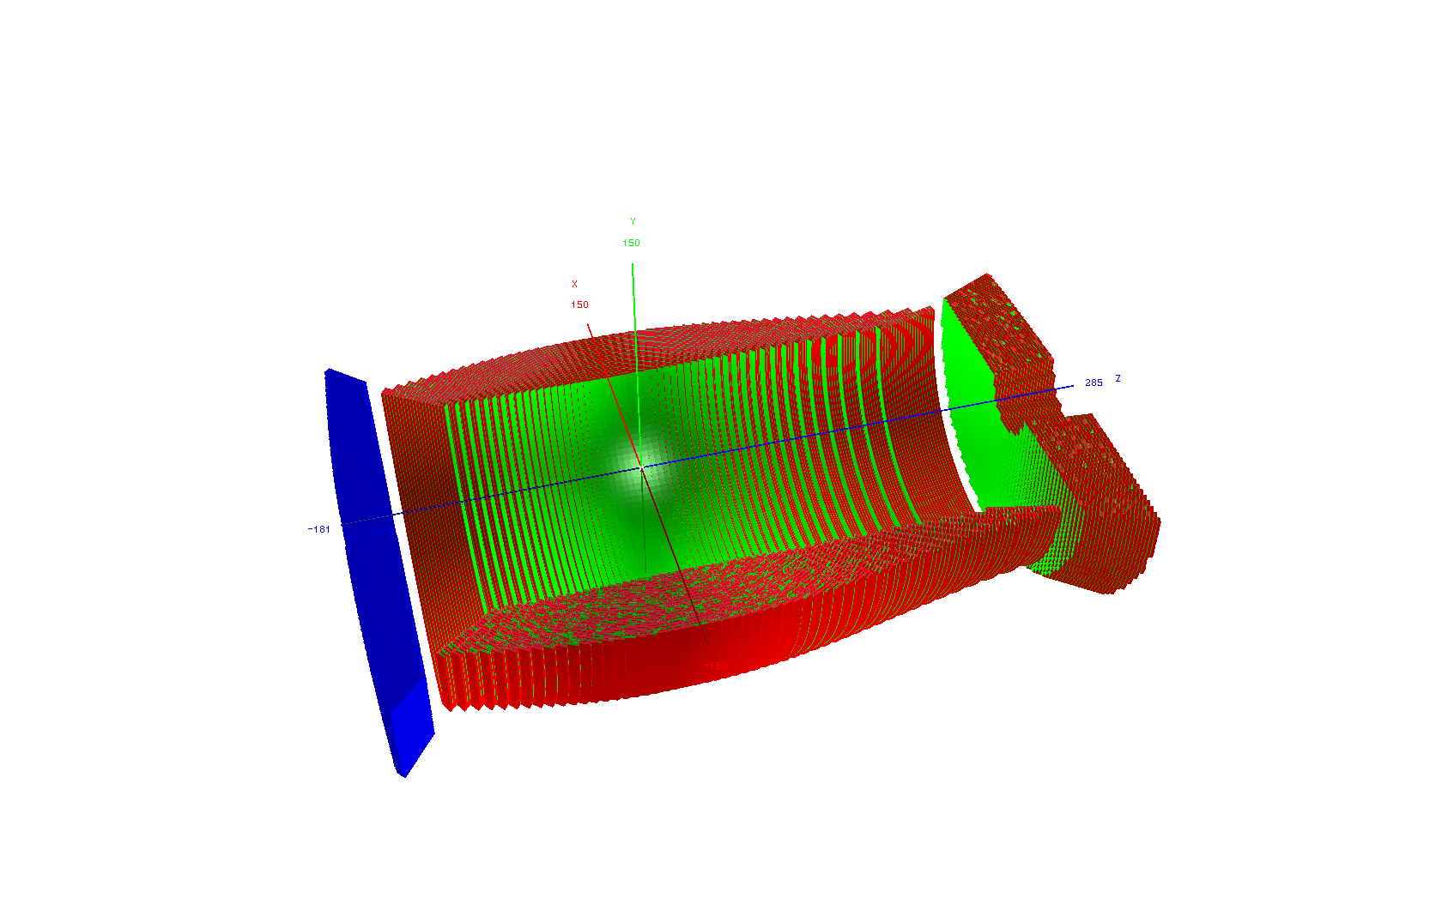
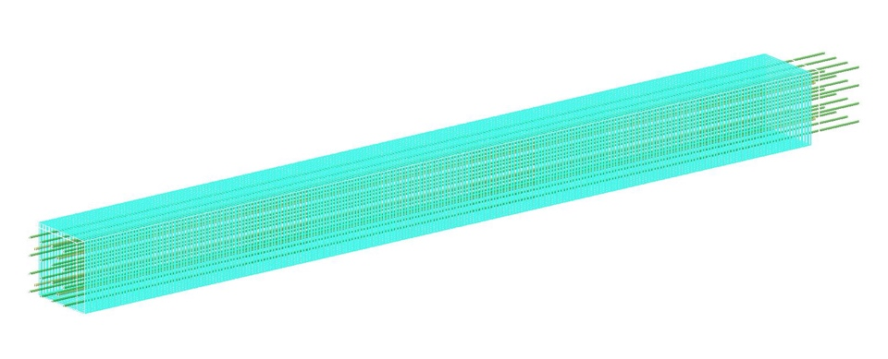
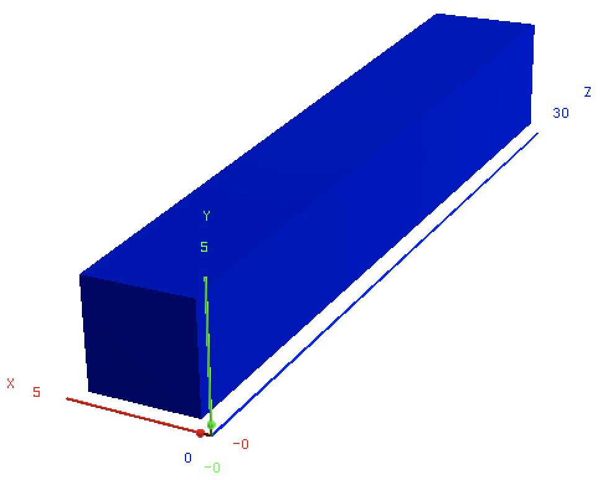
Ecal Design in Simulation
Ye Tian (IMP)
Shashlik module
General design of whole Ecal Detector.
CsI is applied in e-endcap, Shashlik style is applied in both barrel and ion-endcap
The actual distances of the two endcaps to IP depend on the available space of the EicC design
Z=2.4 m
Z=-1.5m +
R=0.9m
CsI module
 | EMC | type | z/r[m] | Length[cm],X₀ | Coverage[cm] | pseudorapidity | Tower size
EicC | e-endcap | CsI | Z=-1.5 | 30, 16X₀ | 15.0<r<128 | (-3.0, -1.0) | 4.0*4.0(front)
 | barrel | Shashlik | R=0.9 | 45, 16X₀ | -105.8<z<187.5 | (-1.0, 1.5) | 4.0*4.0 (front)
 | Ion-endcap | Shashlik | Z=2.4 | 45, 16X₀ | 24.0<r<113 | (1.5, 3.0)

Slide 18
Module (7x7) array simulation result
Ye Tian (IMP)
Shashlik simulation result
CsI simulation result
Energy resolution
Energy resolution
Position resolution
Position resolution
Energy resolution

Slide 19
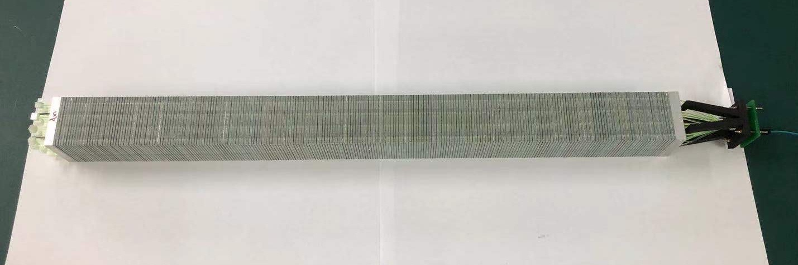
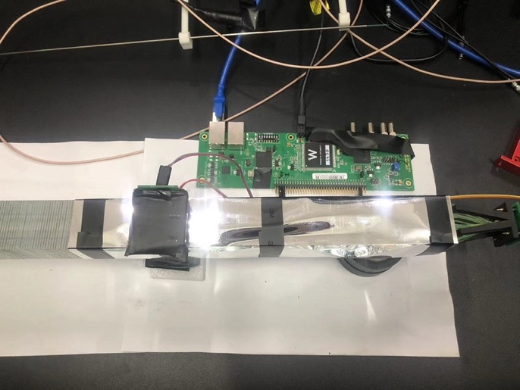
Shashlik ECal cosmic ray test result
Ye Tian (IMP)
Assembled Shashlik module
Horizontal cosmic ray NPE spectrum (PMT)
Landau peak: 62.8 (NPE)
Horizontal test setup
Module
Trigger scintillator

Slide 20
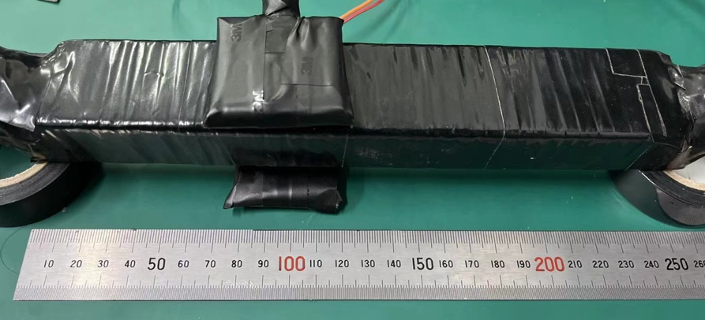

CsI(Tl) attenuation cosmic ray test
Ye Tian (IMP)
The attenuation length is a main parameter of CsI(Tl), influence the uniformity of energy deposit
Simulation shows muon deposit 22.3 MeV in CsI, created 1.1M photons.
Fitted by $y=A∙e^{− \frac{x}{λ}}$
λ=21.6 ± 4 cm
λ=24.8 ± 4.4 cm
Cosmic ray signal sample
Short attenuation length confirmed, even though the appearance of crystal is transparent!

Slide 21

4. Far Forward Detectors
Weizhi Xiong(SDU), Yutie Liang (IMP)

Slide 22
New Design of FF Beamline
Dipole 1: z = 5 m B = 2.52 T L = 0.8 m
R1 = p*10/3./B1 = 20GeV*10/3./2.52 = 26.455 m
Bending angle = asin(L/R) = 0.03 rad = 30 mrad
Dipole 3: z = 15.4 m B = -3.4 T L = 0.8 m
R2 = p*10/3./B2 = 20GeV*10/3./2.69 = 19.61 m
Bending angle = asin(L/R) ~ 0.04 rad = 40 mrad
Dipole 2: z = 10 m B = 2.69 T L = 2.0 m
R2 = 24.783 m
Bending angle = 80 mrad
Dipole 4: z > 16 m B = ? L = ? m
R2 = ? m
Bending angle = 120 mrad
O
L=0.8m
50 mrad
A
R3
= 19.61m
B
50 mrad
30 mrad
R1
= 26.455m
50 mrad
30 mrad
80 mrad
R2
= 24.783m
C
D
L=0.8m
40 mrad
120 mrad
Slides from Yutie

Slide 23


Material Effect for Neutron
Weizhi Xiong(SDU)
ZDC
Current ZDC acceptance +/- 15 mrad, 13.5m from IP
New beamline design effectively reduce all material effect due to beam pipe and air
Plan to work on ZDC digitization and full detector response studies
+/- 15 mrad cone
Result shown in EicC 3rd CDR
Current result

Slide 24


5. Beam polarimetry & luminosity monitor
Boxing Gou (IMP), Jinlong Zhang(SDU), Yutie Liang (IMP)
Electron end
Luminosity & e polarimetry
Ion end

Slide 25


Slide 26




Recent studies on proton polarimetry
Boxing Gou (IMP)

Slide 27

6. DAQ design
Kai Chen (CCNU)
- Streaming Readout

Slide 28

Kai Chen (CCNU)

Slide 29

Yutie Liang (IMP)
7. Simulation framework & software
Structure of EiccRoot
Top level: ROOT, Virtual MC, etc.
Middle level: FairRoot framework manages the general infrastructure with simulation and tasks
EiccRoot: implementation of the EicC detector sim. and rec. inside FairRoot framework
Notes:
FairRoot is a software framework mainly for high energy and nuclear physics experiments.
FairRoot is developed based on ROOT. In this plot, the top level shows the common used softwares, such as ROOT and Geant4. FairRoot depends on these softwares.
The middle level shows the structure of FairRoot. It manages the general infractructure with simulation and tasks.
The bottom level shows the specific experiment implementation using FairRoot. Currently, there are many experiments using FairRoot, such as PANDA, CBM, and EicC.

Slide 30

Yutie Liang (IMP)

Slide 31


Yutie Liang (IMP)
EicC software update & status
Tracking, ECal, Forward detector packages in good shape
EiccRoot_2.0.0 released with main updates of:
  Full magnetic fields (16 field maps) in the IR region
  GenFit package adapted using field map service in EiccRoot
  EiccBoxGenerator and EiccEvtGenHybrid updates
  Complete beam pipe design from -40 to 20 meters
IR + Magnet
Beam Pipe
Central: solenoid
Ion Forward region: 3 dipoles + 3 quadrupoles
Electron Forward region: 4 dipoles + 5 quadrupoles

Slide 32
Summary
A lot of progress on detector subsystems to realize the physics goal:
  Vertex & tracking detectors
  - silicon+MPGD, simulation, R&D
  2) PID detectors
  - DIRC, RICH identified, simulation, R&D
  3) Calorimeters
  - CsI, Shashlik for ECal, simulation, R&D
  4) Far Forward detectors
  - EDT, FDT design available
  5) IR+Magnet: to do
  6) Luminosity monitor & Polarimetry
  - Methodology, technology identified, simulation
  7) DAQ
  - stream readout/trigger, R&D
Simulation & software: simulation framework available, beam background simulation is important.
  Physics requirements
  Targeted resolutions
  Technology candidates
  Simulation results
  Coordination of subsystems
  R&D activities or planning
->CDR
Thanks for your attantion!

