Slide 1
MRPC和量能器-高精度时间和能量测量
Yi Wang
Department of Engineering Physics
Tsinghua University

Slide 2
Outline
Introduction of MRPC and Shashlyk ECAL
Future requirement for MRPC-TOF:
-- High rate >20kHz/cm²
-- High time resolution <20ps
-- Use sealed MRPC to reduce gas consumption
-- Find Eco-friendly working gas
Development of Ecal for NICA/MPD
五维Shshlyk型ECAL的概念设计
Summary

Slide 3
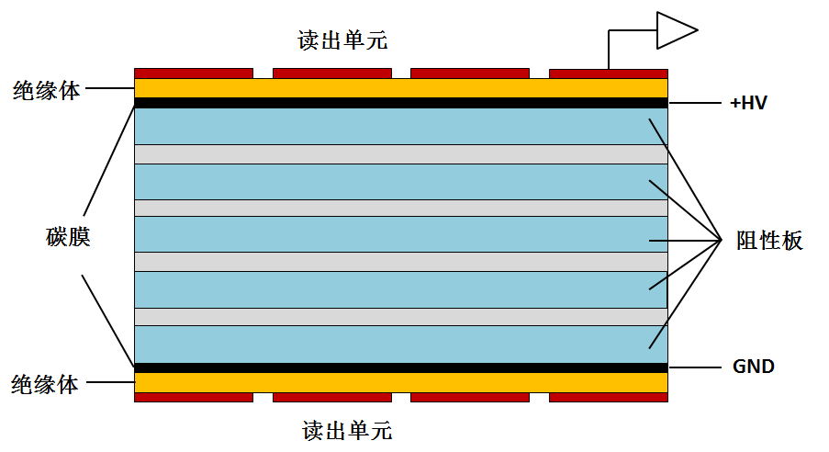
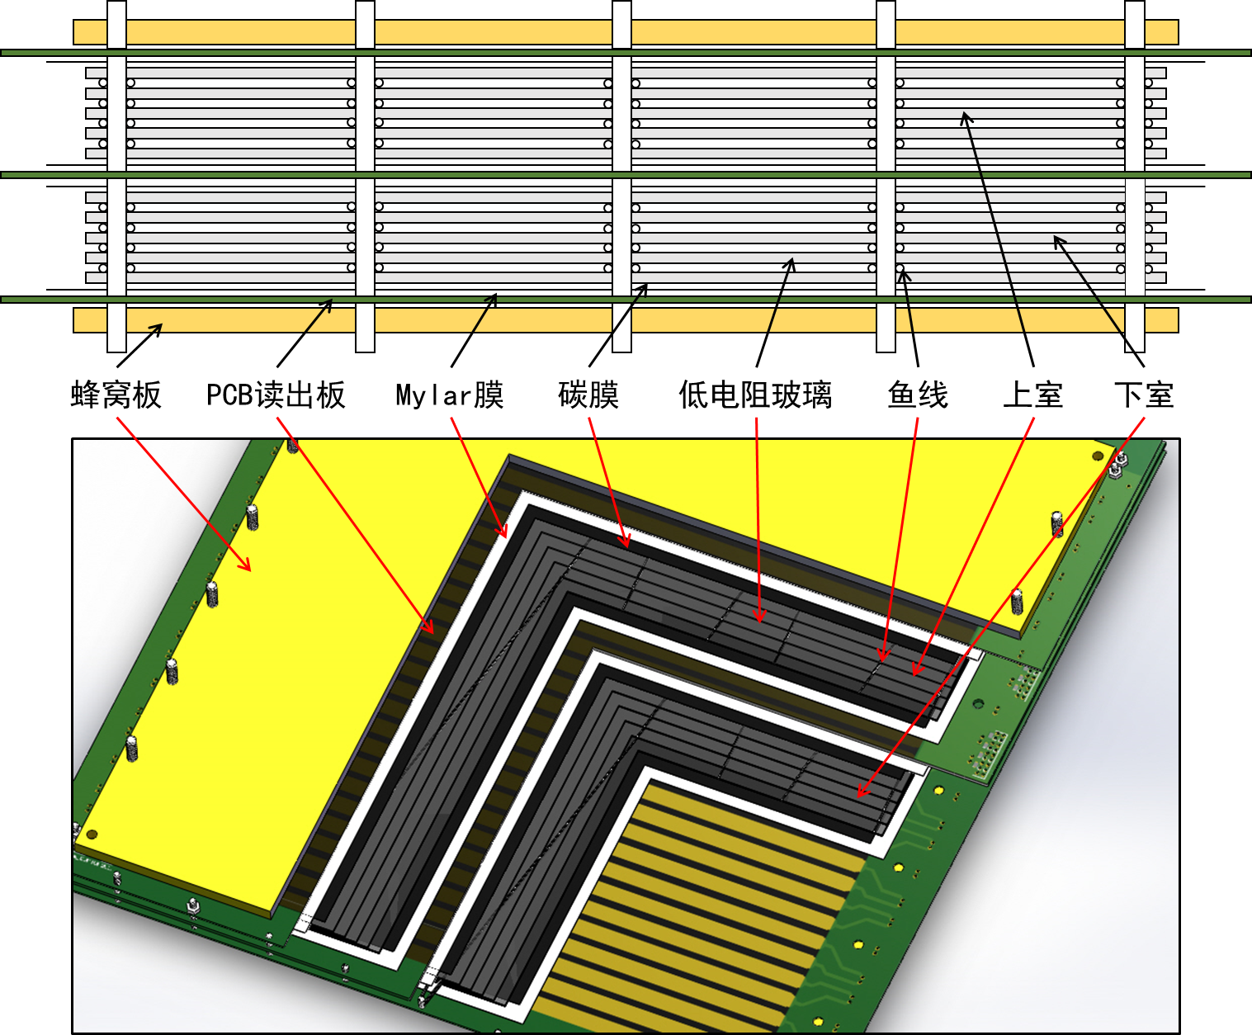
MRPC introduction
Honey
PCB
Mylar
Graphite
Glass
Fish line
Upper stack
Read out
lower stack
Insulator
Carbon
Resistive
plate
Insulator
Read out
MRPC structure
MRPC application：
主要优点:
时间分辨达到： 几十ps量级
探测效率：>98%
造价便宜
长期工作稳定！
Application in nuclear physics experiments
Application in industry（Muon tomography)
Application in medicine（TOF-PET）

Slide 4
MRPC in ToF system
MRPC has been widely adopted to construct the Time of Flight (TOF) systems in HEP experiments.
 | ALICE | STAR | FOPI | BESIII | CBM | SoLID
Active area per detector (cm) | 120 x 13 | 22 x 8.4 | 90 x 4.6 | 0.5x(9.2+14.8)x32.8 | 33 x 27.6 | --
Total active area (m²) | 141 | 50 | 5 | 1.33 | 120 | 10
Pad size (cm) | 3.7 x 2.5 | 6.3 x 3.1 | 90 x 0.3 | (9.1~14.1) x 2.4 | 27 x 1.0 | (16~28) x 2.5
Gap×thickness(mm) | 10 x 0.25 | 6 x 0.22 | 6 x 0.3 | 12 x 0.22 | 10 x 0.25 | 32 x 0.128
Gas mixtures (C₂H₂F₄/ C₄H₁₀/SF₆) | 90/5/5 | 95/5/0 | 85/5/10 | 90/5/5 | 90/5/5 | 90/5/5
Operating field (kV/cm) | 96 | 107 | 110 | 109 | 110 | 140
Efficiency | 99.9% | 95-97% | 97±3% | 99% | 97% | 98%
Time resolution(ps) | 40 | 60 | 73±5 | 60 | 60 | 20 ps
Max rate (Hz/cm²) | 50 | 10 | 50 | 50 | 30k | 20k
higher counting rate and time precision.

Slide 5
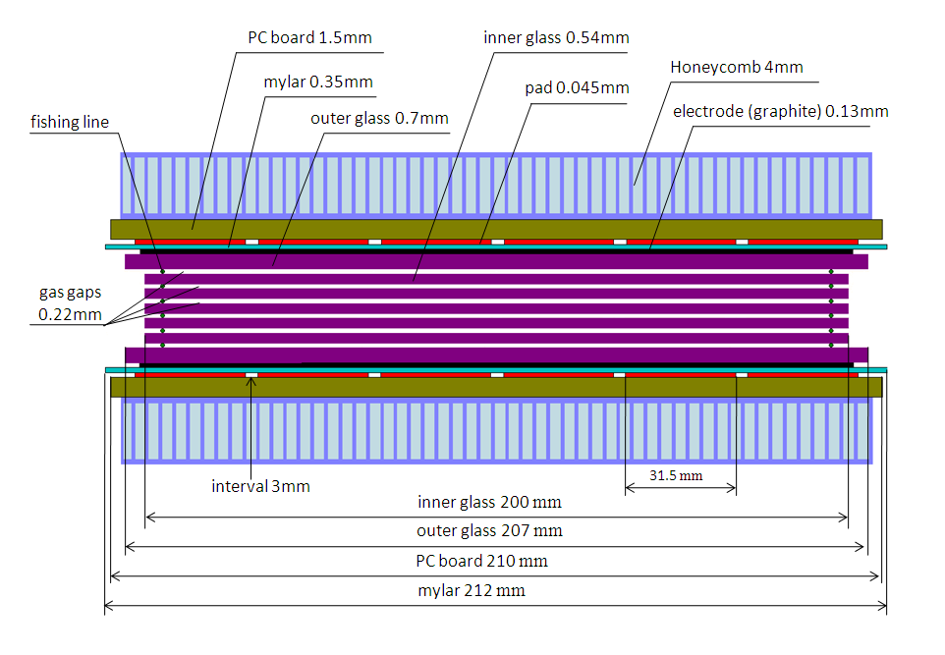
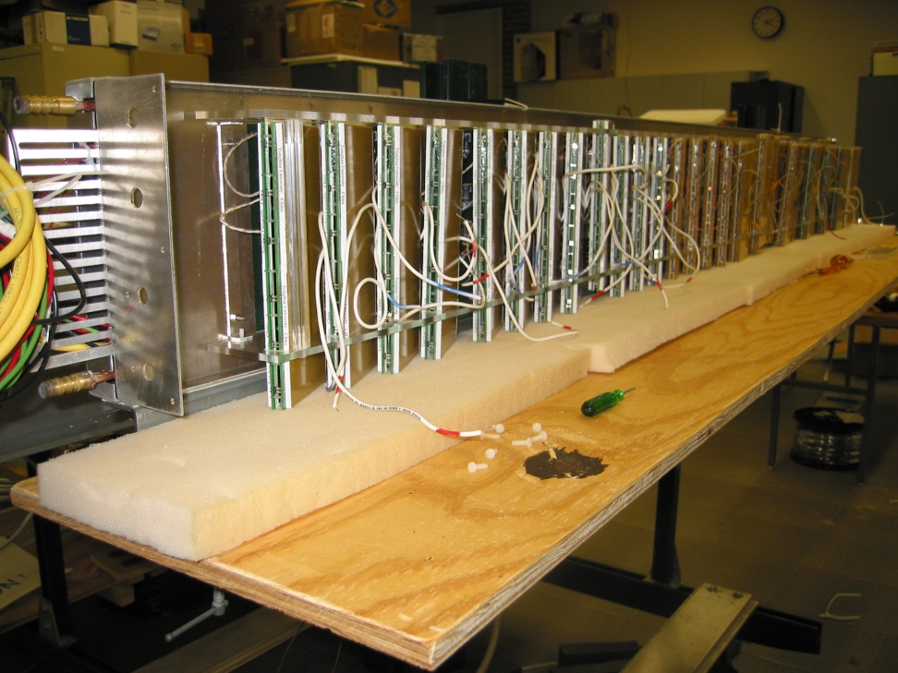
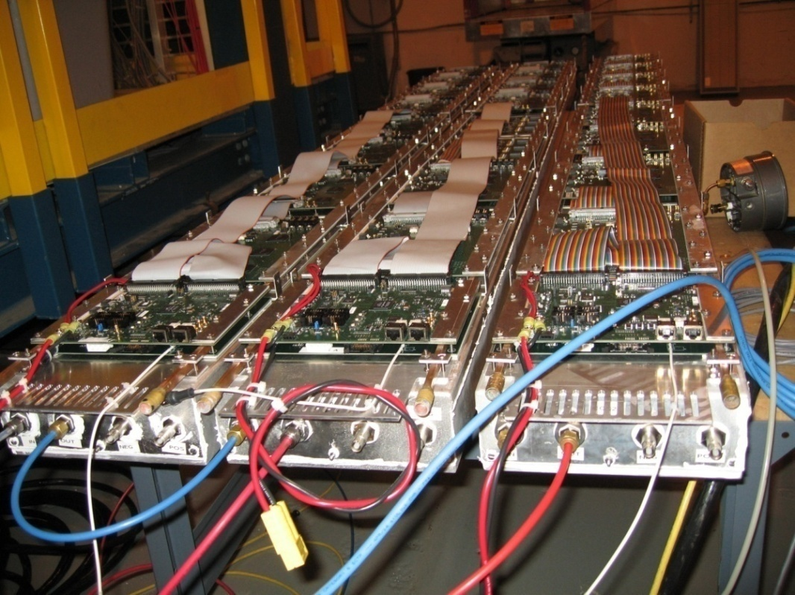
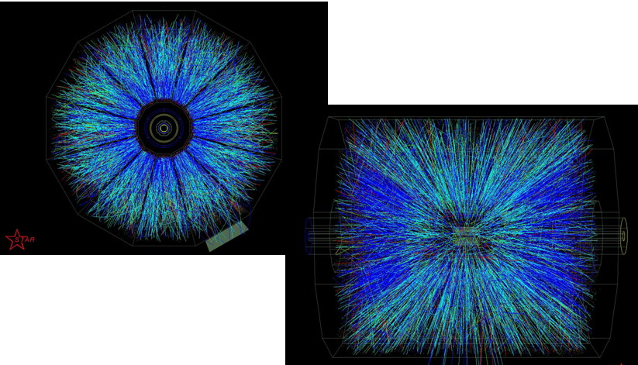
RHIC-STAR TOF system
STAR TOF-Tray
Long side view

Slide 6
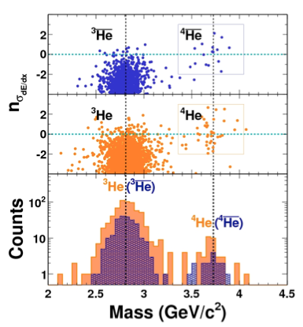
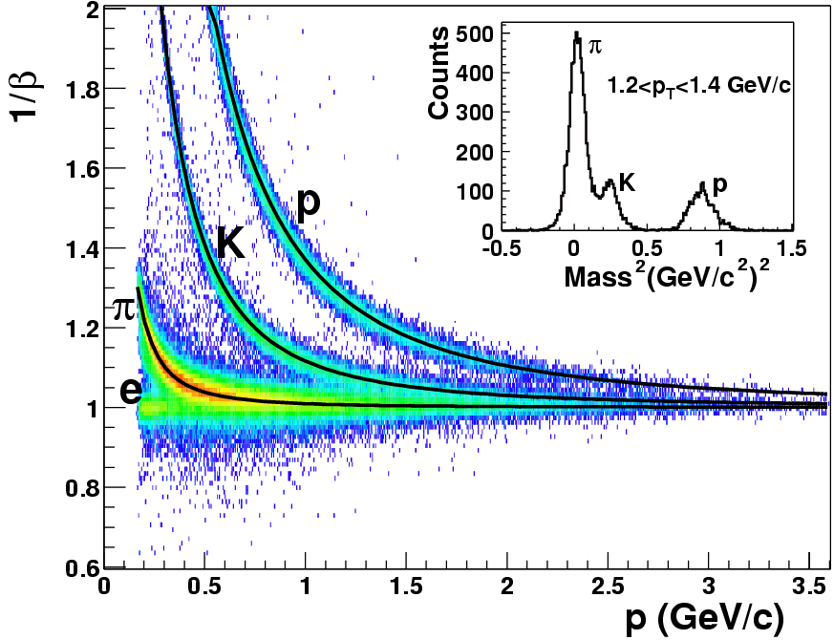

PID and physics success
TOF
TOF PID:
π /k ~1.6 GeV/c,
(π,k)/p ~ 3.0 GeV/c
Nature 473 (2011) 353

Slide 7
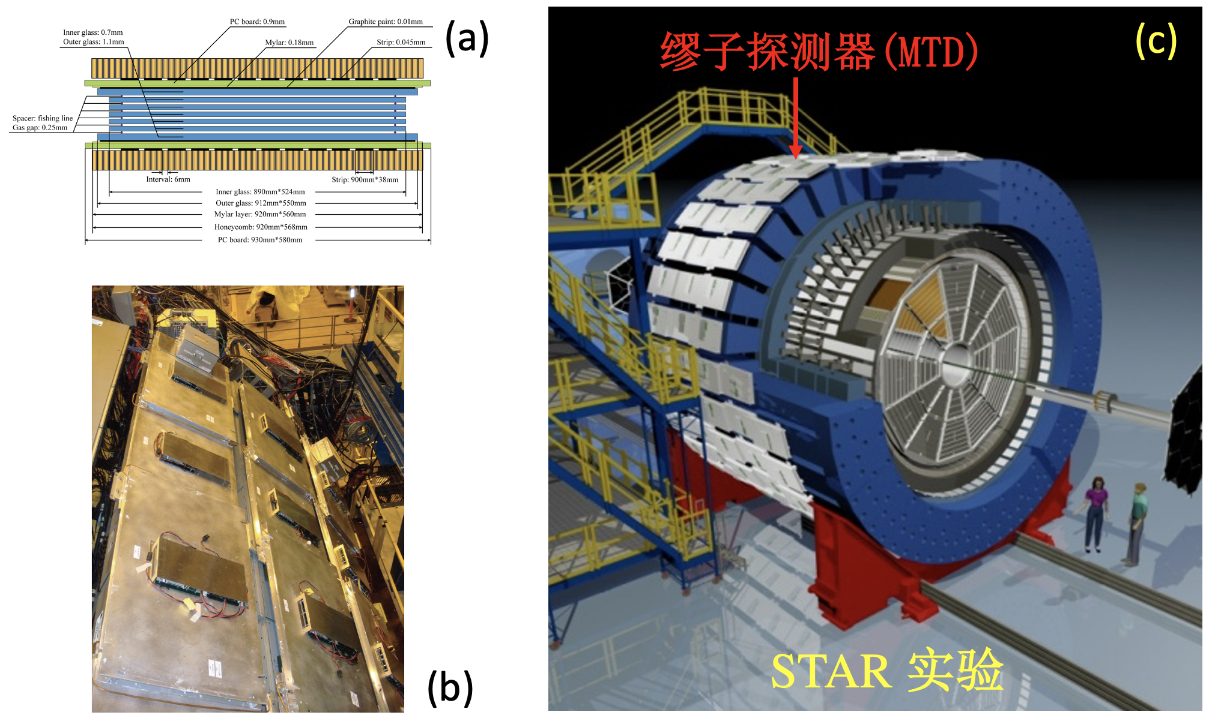
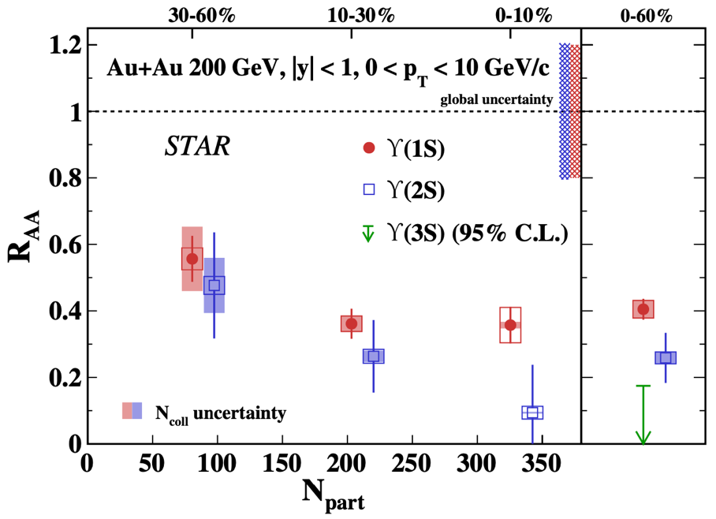
PID and physics success
Υ−>μ⁺μ⁻
STAR实验在200 GeV金核-金核碰撞中发现底夸克偶素“顺次压低”的实验迹象.
The STAR Collaboration* Phys. Rev. Lett. 130 (2023) 112301
2014年，STAR采用MRPC技术建造了新型的缪子探测器，通过测量双缪子的信号来重建底夸克偶素。MRPC的优秀时间分辨率（70ps）可以压低强子本底，提高双缪子道的时间窗匹配精度。

Slide 8
Future requirement for MRPC-TOF
High counting rate: >20kHz/cm²
Electrode material, detector structure, spacer…
High time resolution: <20ps
Detector structure, readout electronics (FEE + sampling, TDC…)
Economic and lower gas consumption
Detector structure, eco-gas…

Slide 9
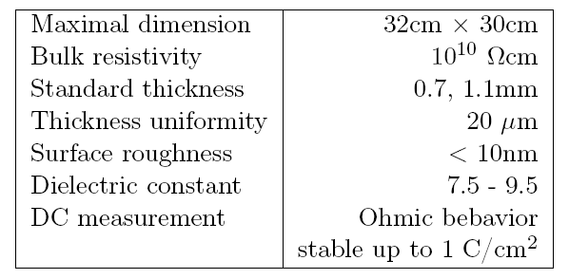


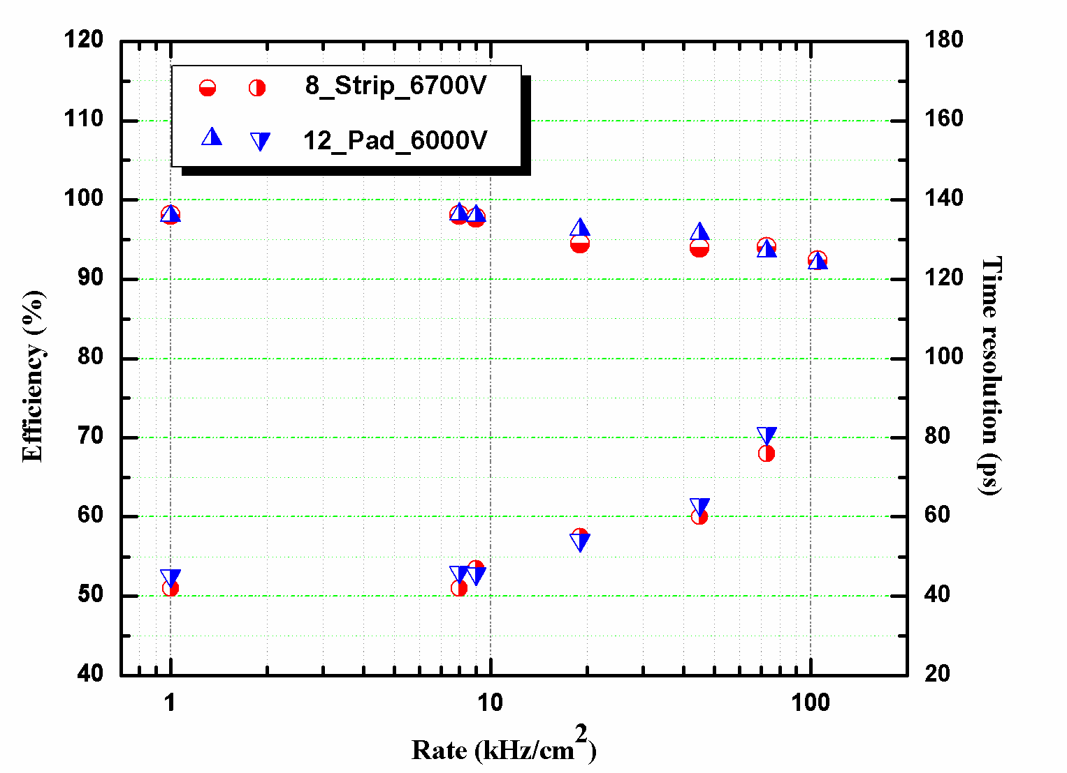
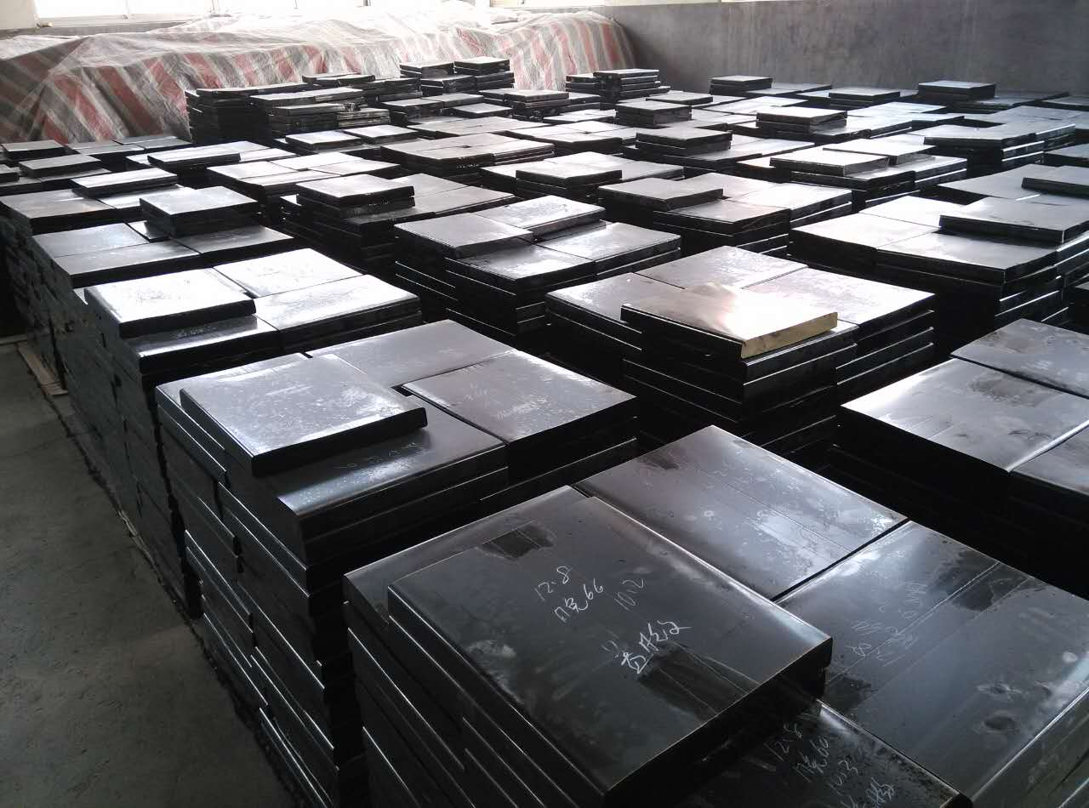
Higher counting rate: low-resistive glass
low-resistive glass control the voltage drop (efficiency loss) when incident flux goes up by Decrease the resistivity of the electrodes
Specifications of low resistive glass
Low-resistive glass has been operating at FAIR-Phase 0 programs like STAR-eTOF and mCBM
It will be applied in CBM-ToF Wall
Beam test result:
93%, 80ps ,70kHz/cm²
Notes:
在介绍为

Slide 10
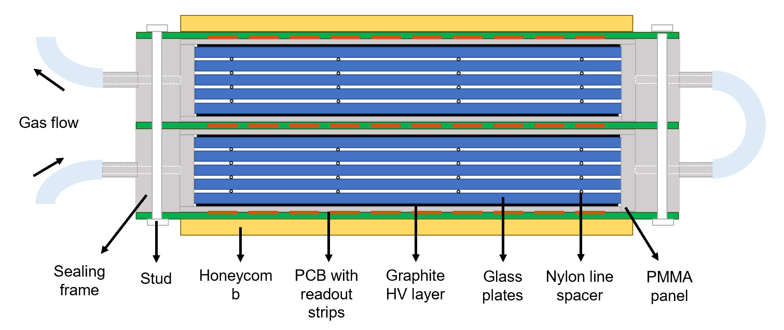
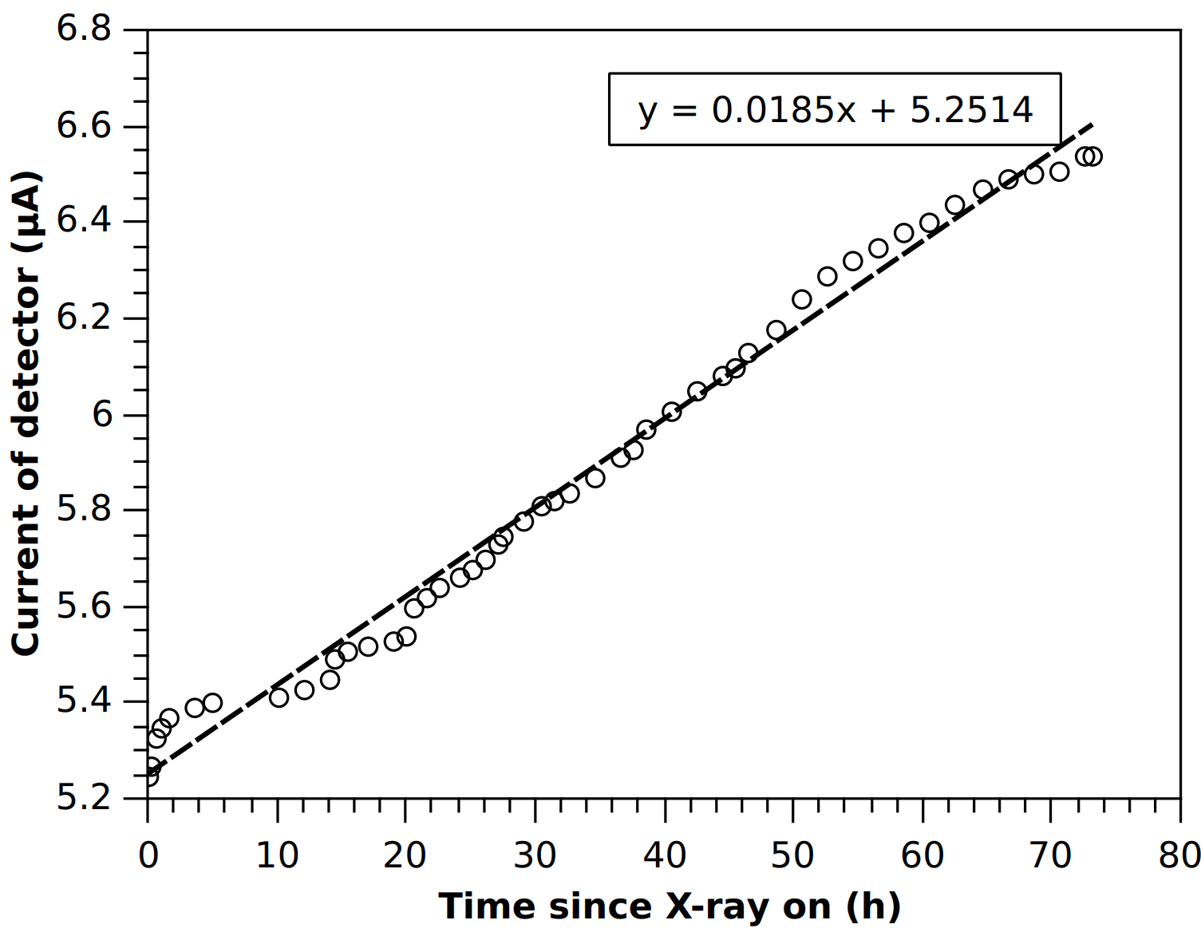
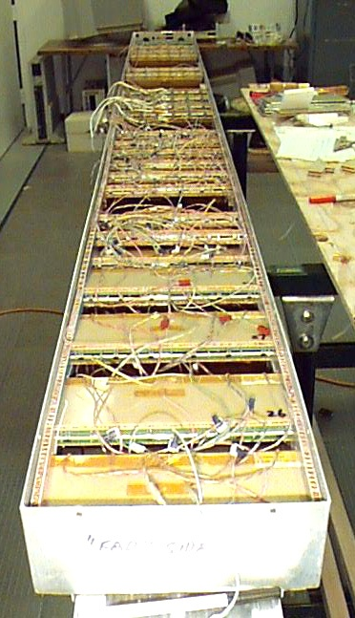
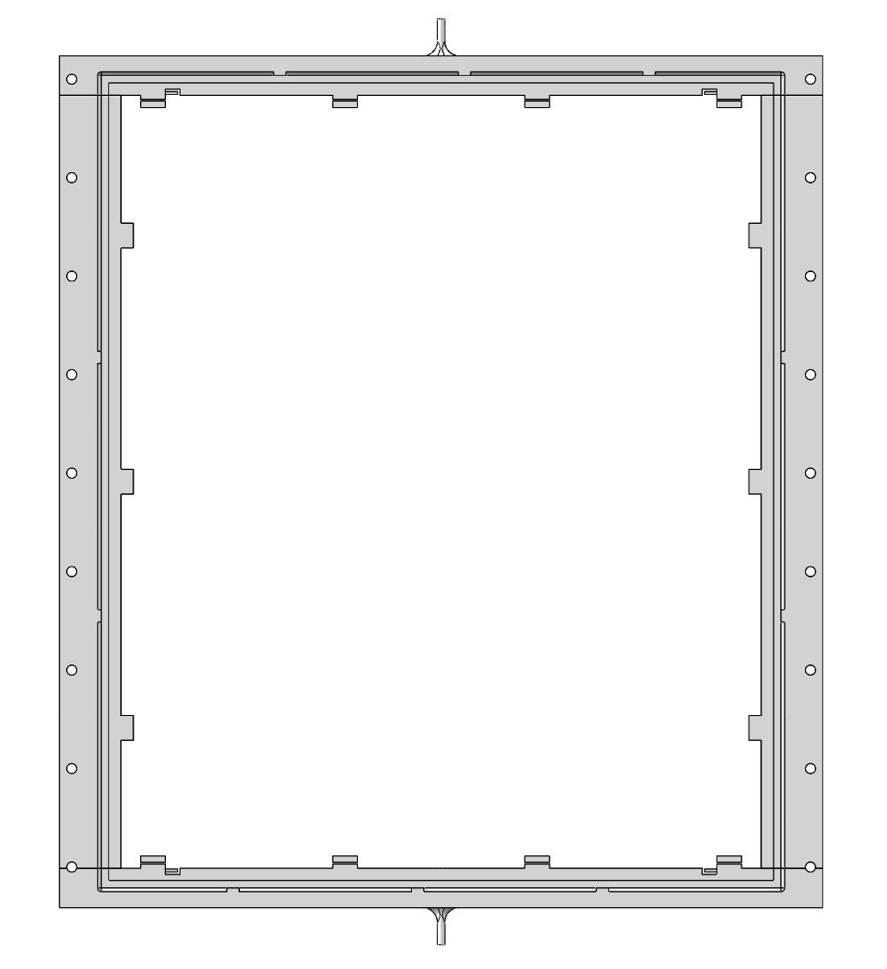
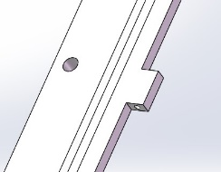
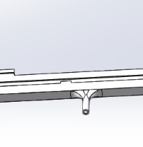
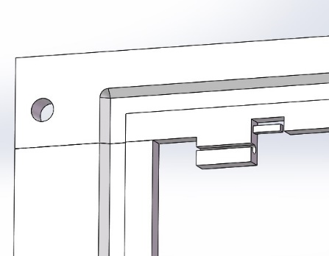
Higher counting rate (<7kHz/cm²): gas pollution
Constant rate condition of 1kHz/cm²
Gas tube
Inlet/outlet
The gas pollution in the gas gap caused the increase of current!
Fishline hook
3D printed sealing frame with Good strength, insulation and radiation persistency
Sealing MRPC speed up gas exchange and can reduce to 1sccm/m² flush rate at cosmic experiment!

Slide 11
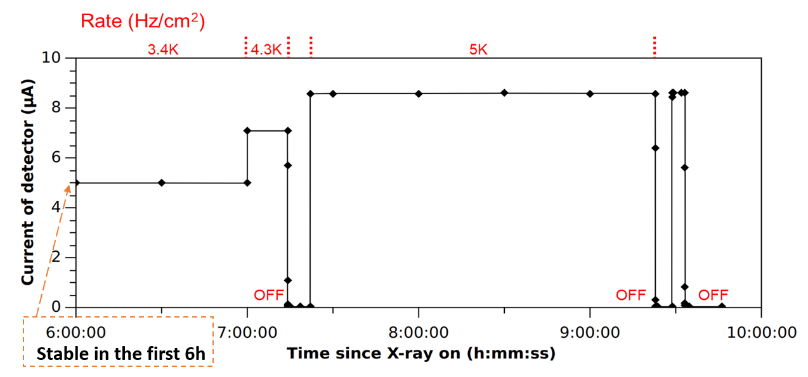
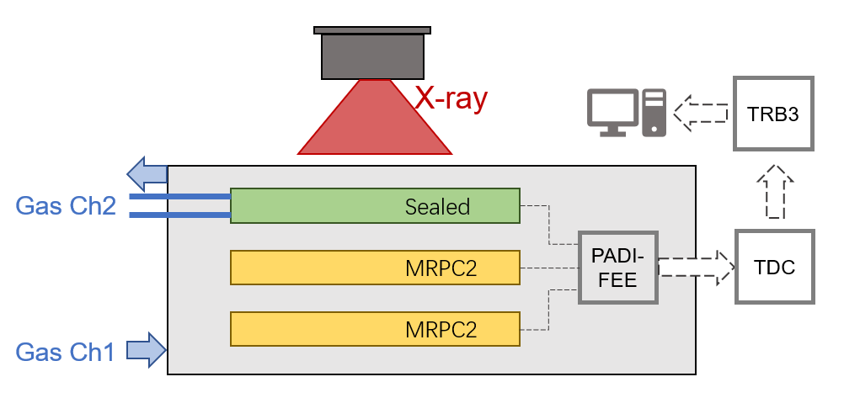
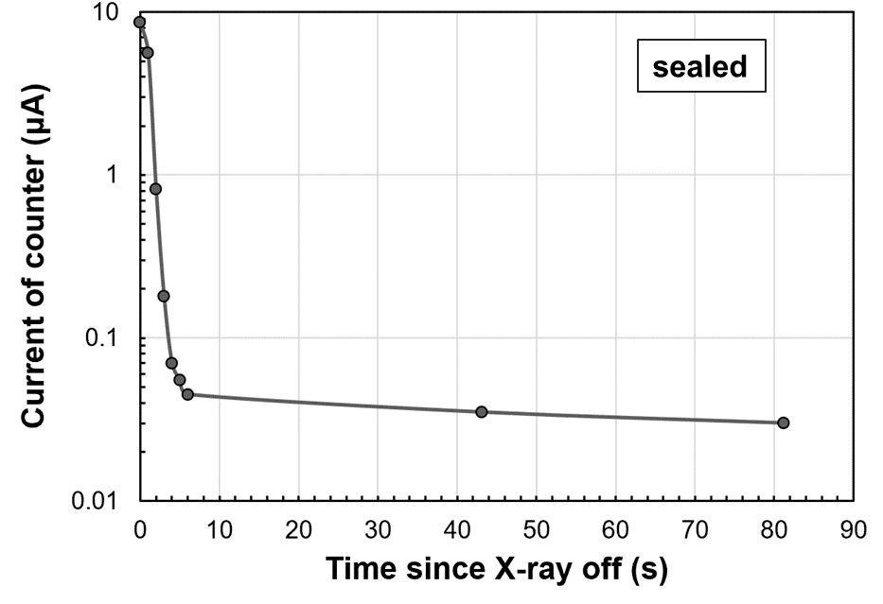
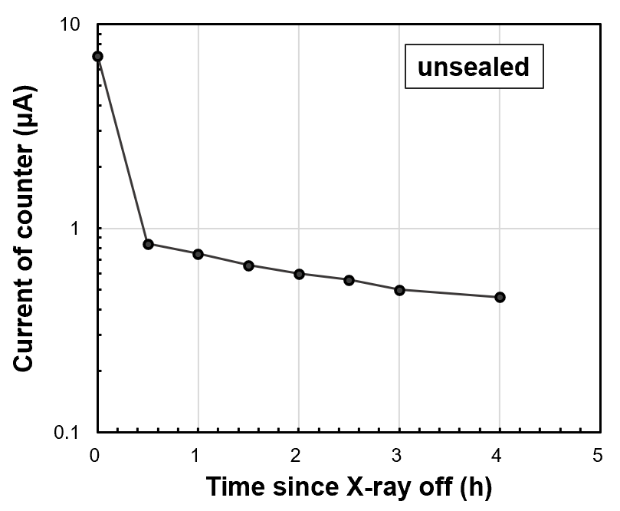
Excellent performance of sealed MRPC
Sealed MRPC promoted gas exchange
Decrease the wait time of gas purging:
Reach the working HV in 2h since flowing the gas
Excellent current behavior under high rate irradiation:
Stable current with constant rate condition.
Fast decay of dark current since when X-ray is off

Slide 12
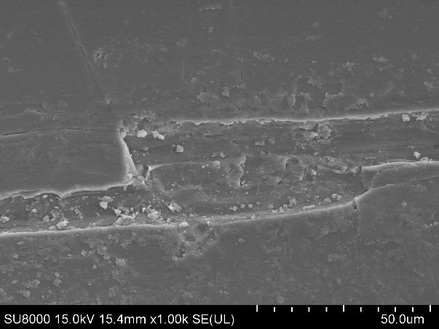
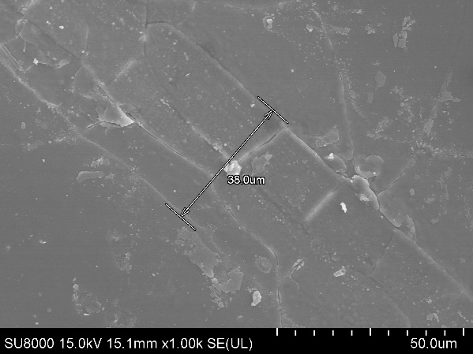
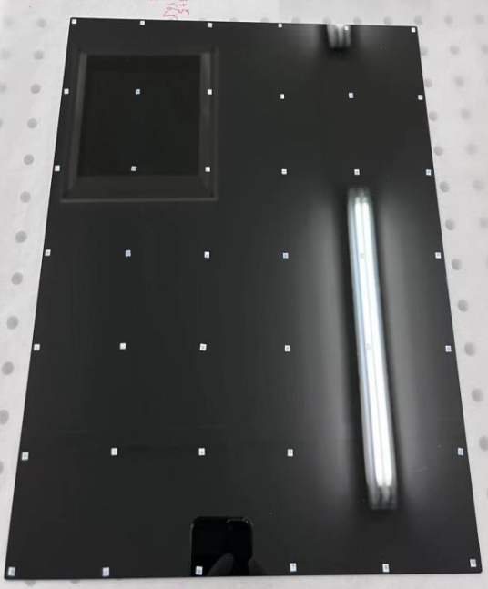
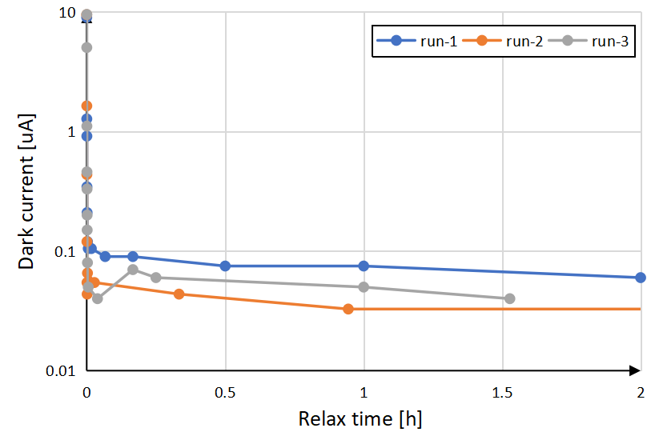
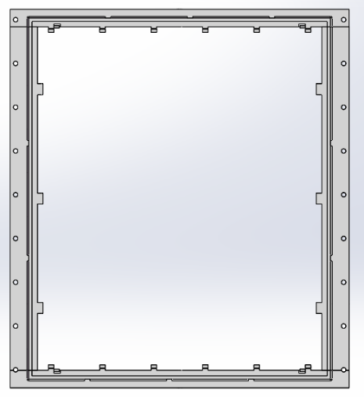
High counting rate (>7kHz/cm²): creepage on fishing line
35 um
fishline contact
The creepage on the fishing line caused the high current and deposition!
Gas outlet
Gas flow
Dark current decay after 10h
@7 kHz/cm² radiation
Mylar spacer: 3 x 3 x0.25mm
Gas inlet

Slide 13
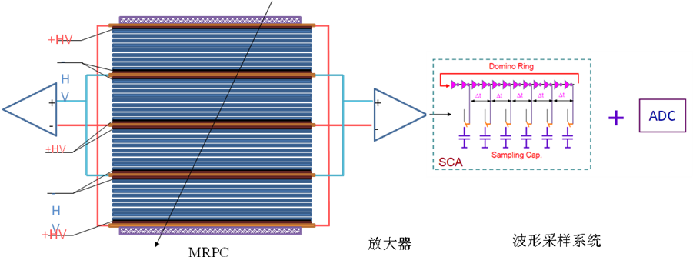
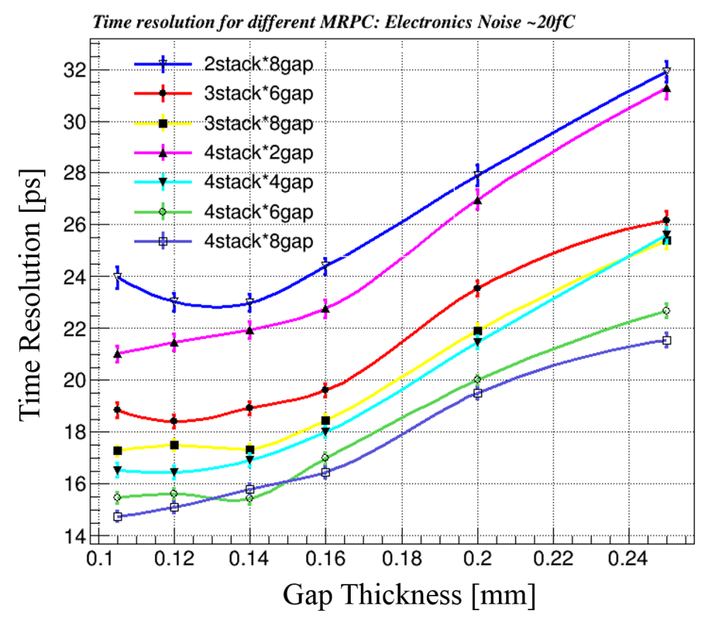
Toward 20ps resolution: narrow gap MRPC
Simulation indicates proper ways to design the gap thickness and arrange the stacks
Narrower gap thickness required
σ_{TOF} <20 ps， the intrinsic resolution of narrow gaps MRPC is around 15ps，so the time jitter of readout electronics <13~15 ps。
σ_{MRPC} <20 ps，the gas gap: <0.18mm
gap number: >16

Slide 14
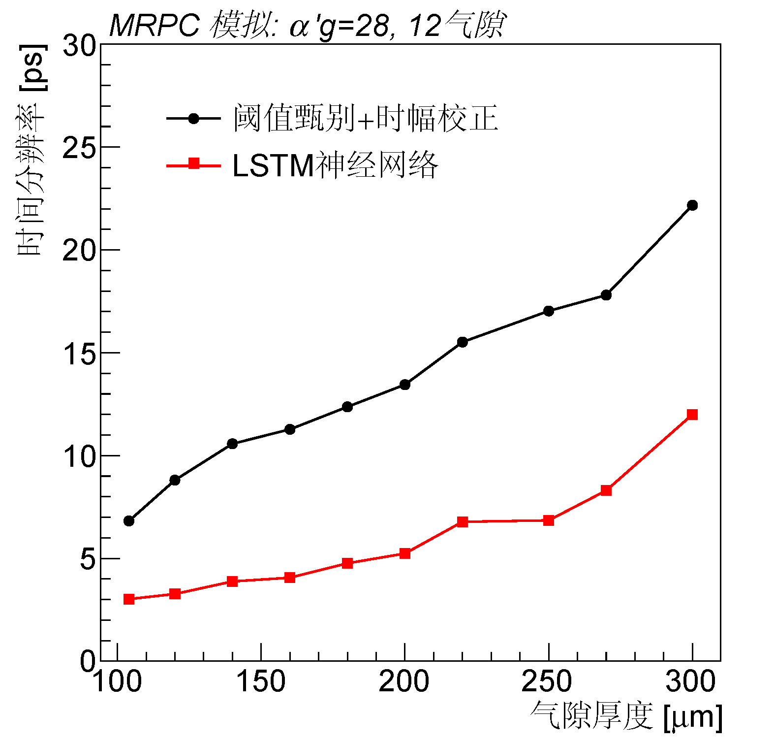
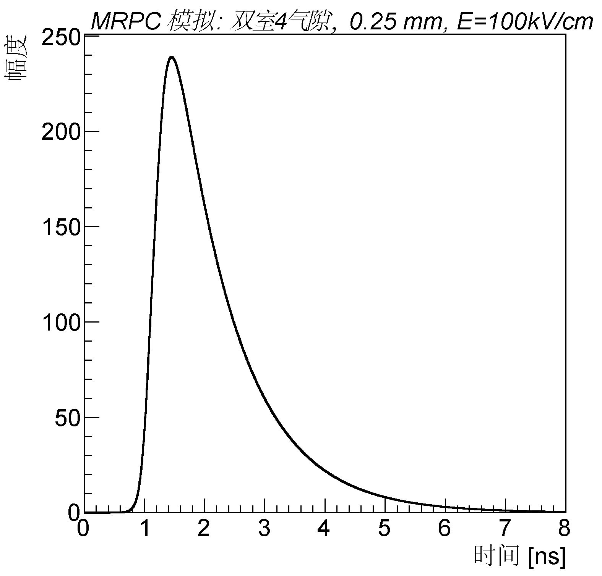
基于机器学习的MRPC时间重建算法
传统读出方式：设置固定阈值，得到
  信号过阈时间：
  信号大于阈值的持续时间：
新的读出方式：完整信号波形
新的时间重建算法：使用神经网络挖掘波形规律，给出粒子飞行时间的估计。
MRPC
粒子源
复杂神经网络
结构变化可能性多
待定参数众多
机器学习
网络+训练参数
输入信息
多种可能模型
时幅矫正
过阈甄别
时幅拟合
矫正偏差
固定的一种数据分析模型
固定阈值

Slide 15
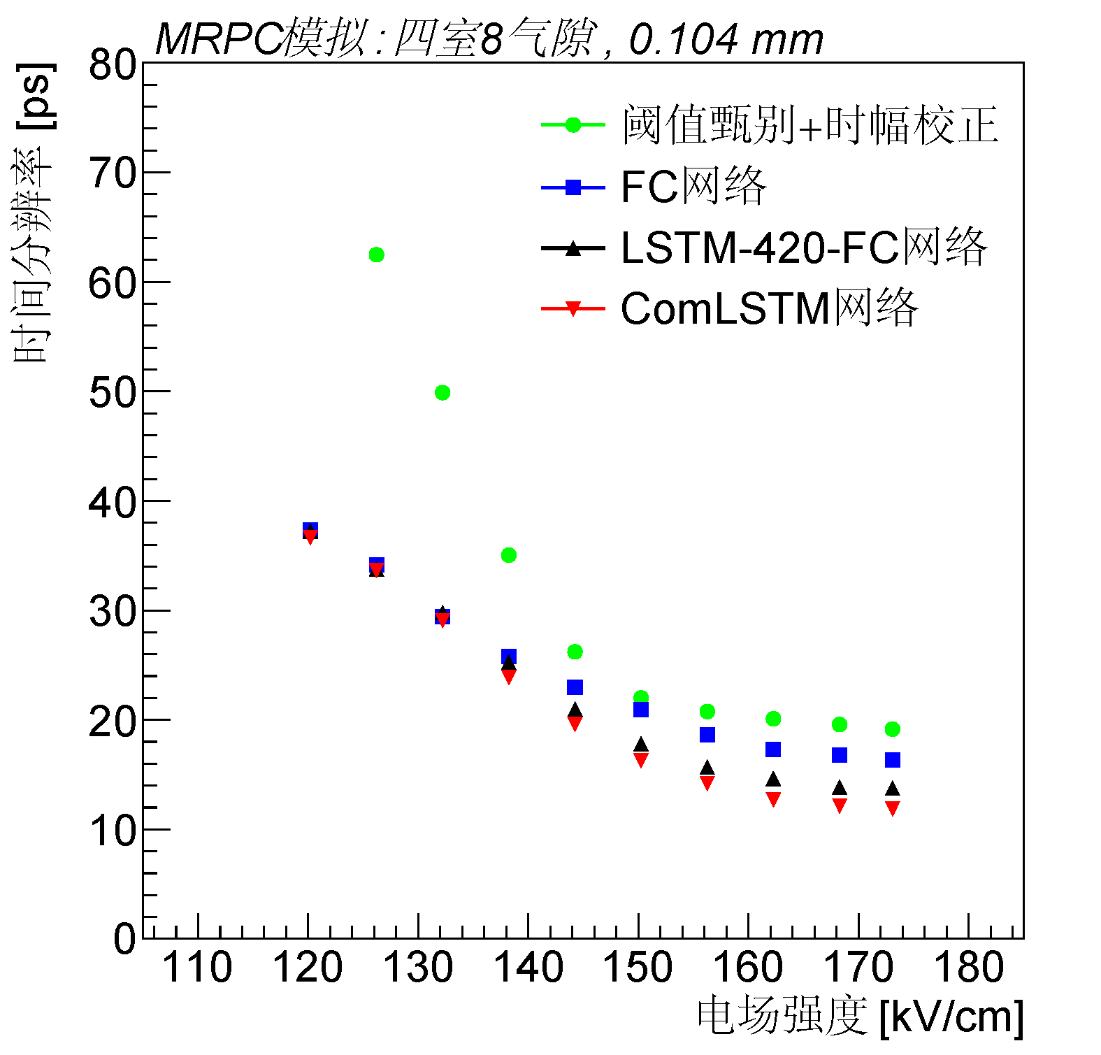
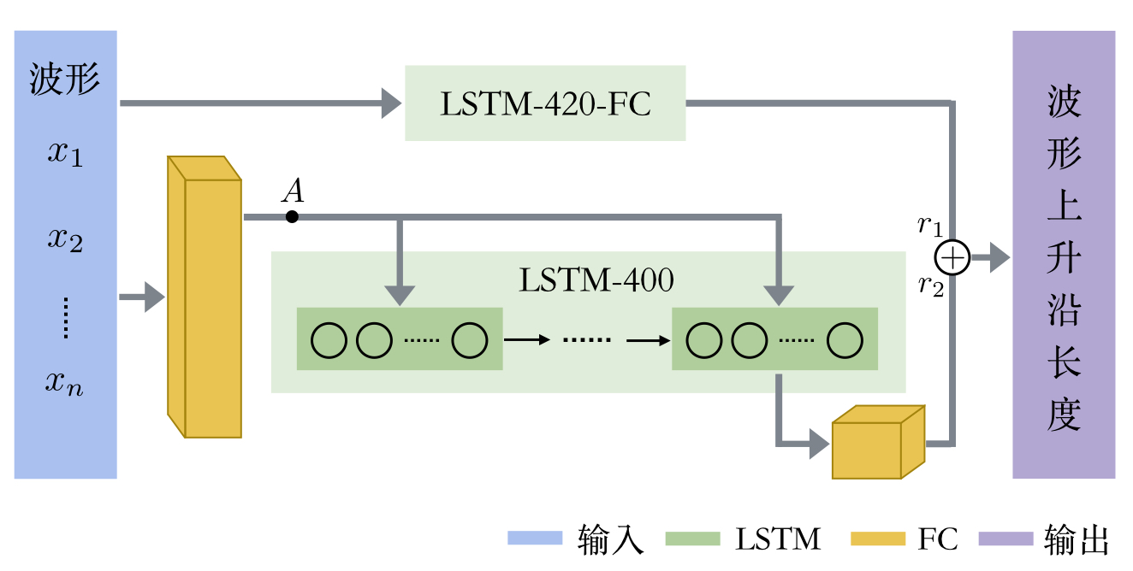
改进型comLSTM网络
ComLSTM (Combined LSTM)：结合FC和LSTM，网络的输入分成两路，
1. 原有LSTM网络（LSTM-420-FC）
2. 先进入FC扩大输入特征维度，再进入一LSTM-400，提取放大后的细节信息
两路输出加权求和后为ComLSTM输出
网络训练：6万模拟数据，输入为上升沿上10个点

Slide 16
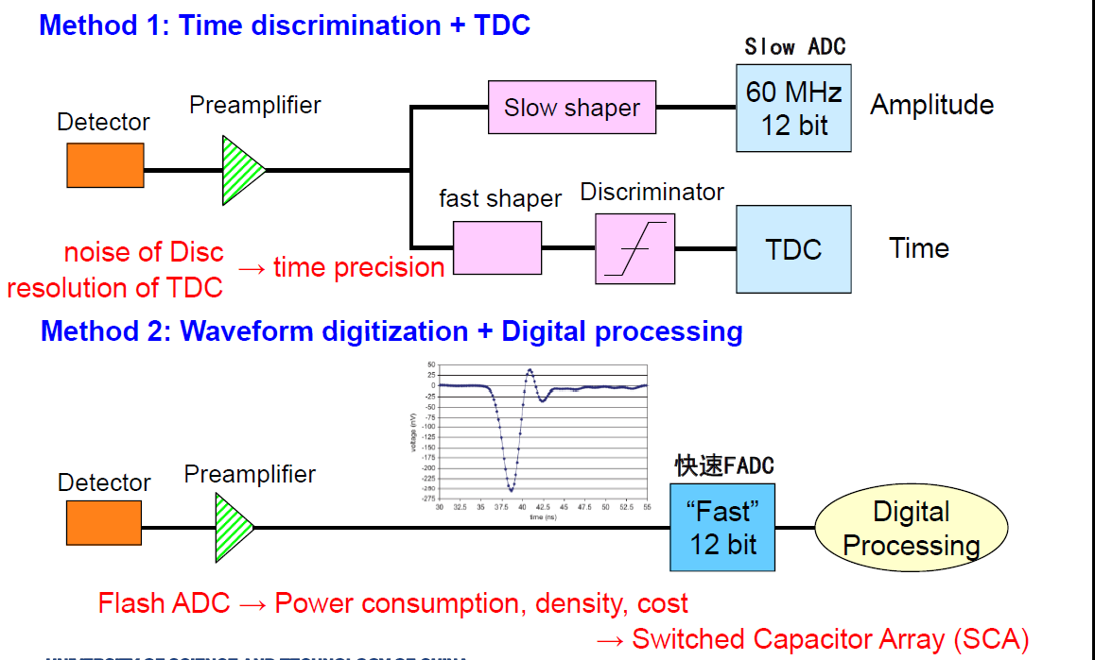
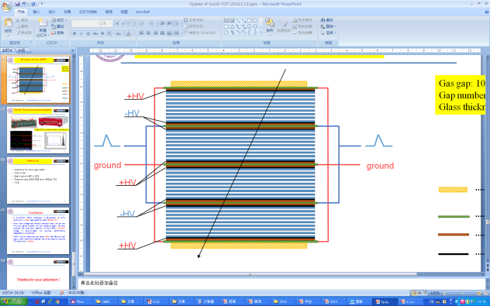
Toward 20ps resolution: fast readout electronics
low

Slide 17
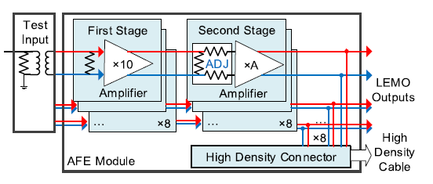
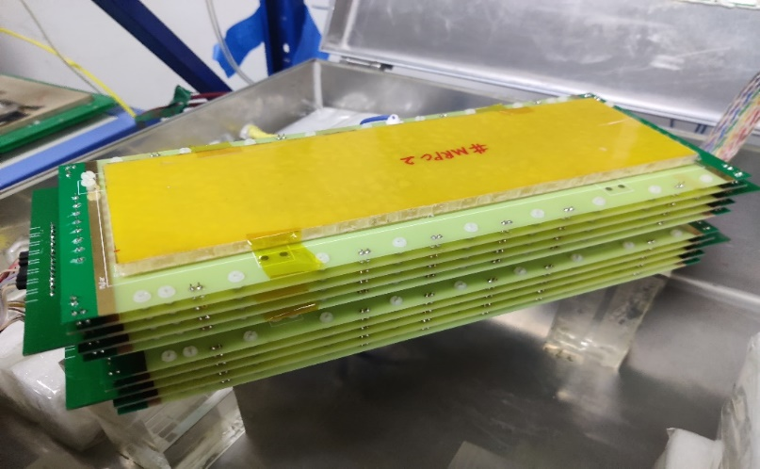
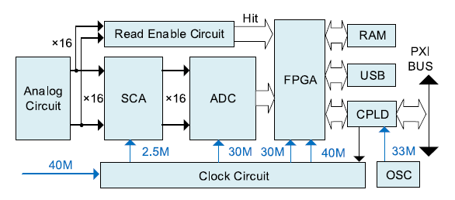
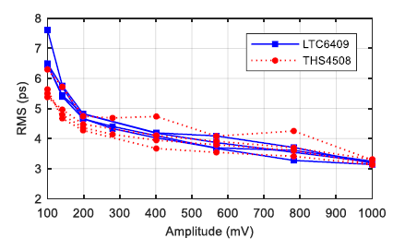
Toward 20ps resolution: fast readout electronics
Fast amplifier
Bandwidth=1.4GHz
 | MRPC prototype
gas gap thickness | 128 μm
number of gas gaps | 4 chambers × 8 gaps
glass material | low resistivity glass
glass thickness | 400
readout strips | 5 mm in width (2 mm clearance)
Waveform sampling
Based on DRS4
Sampling freq=5 GS/s
材料厚度：<0.1X₀
Fast amplifier & Waveform sampling
Electronic system time σ<7ps

Slide 18
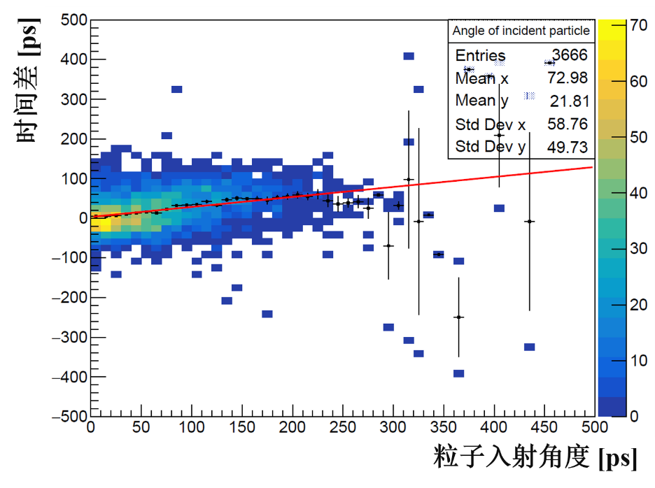
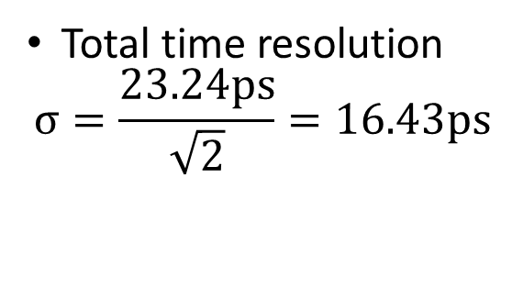
Cosmic test
MRPC + fast amplifier + DRS4
Timing：CFD
Event choose：Vertical cosmic ray
E=140 KV/cm
Total time resolution
$$σ=\frac{23.24ps}{\sqrt{2}}=16.43ps$$

Slide 19
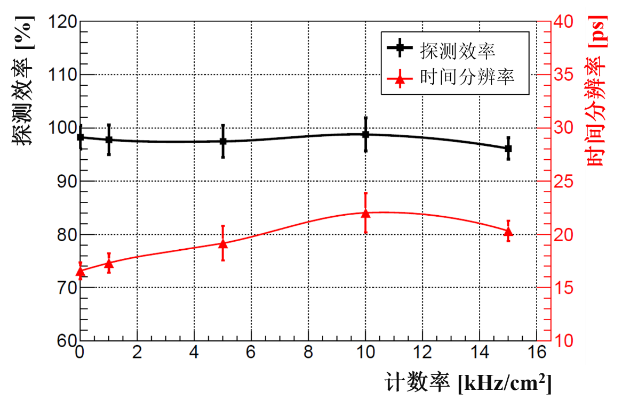
20ps,15kHz/cm² MRPC
detection efficiency
time resolution
detection efficiency
time resolution
rate
We are also trying with NINOs+ FPGA TDC to get good resolution!

Slide 20
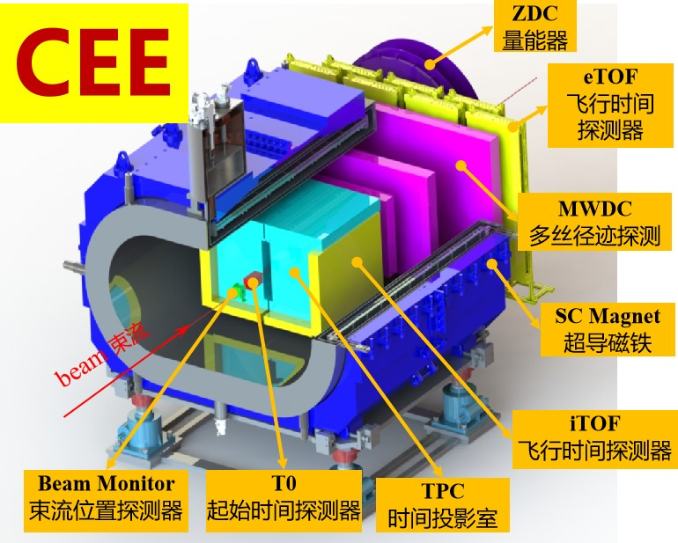
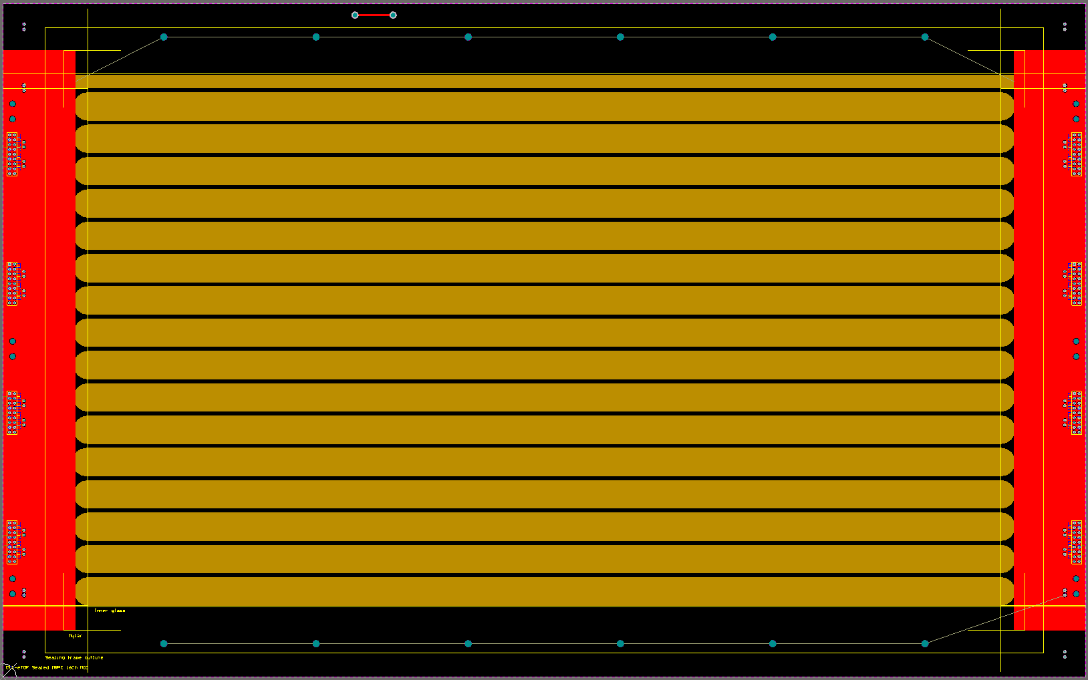
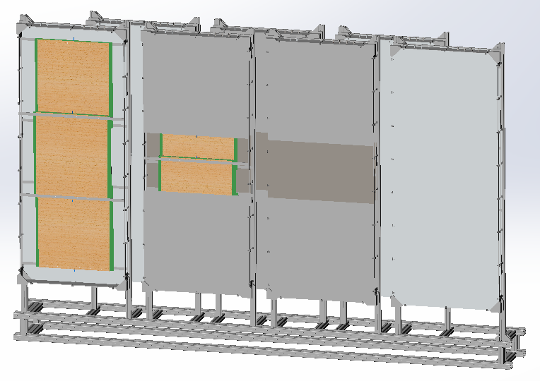
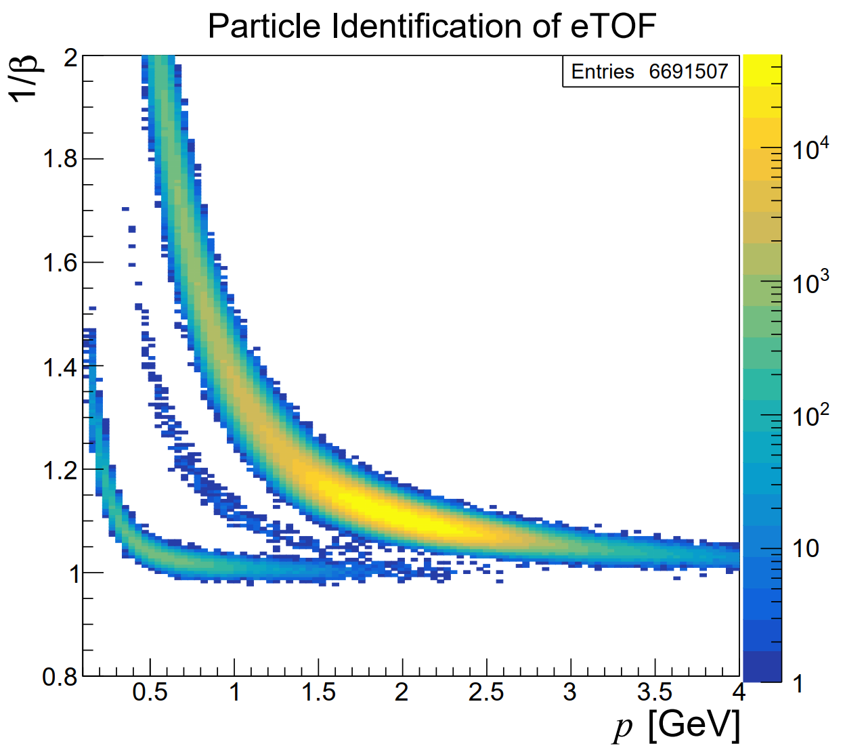



Sealed MRPC for CEE-eTOF
Cosmic test result:
Gas: 90% F134a+5% Iso-butane + 5% SF6
Efficiency=97%
Time resolution=53ps
N of strips | 32 | 16
N of gaps | 2× 5
Gap thickness(mm) | 0.25
Glass thickness(mm) | 0.7
N of counters | 18 | 6
Active area(mm²) | 480×560 | 480×280
Strip interval(cm) | 1.5+0.2 | 1.5+0.2
Strip length(cm) | 48
$$K$$
$$p$$
$$π$$
Gas consumption rate <10sccm/m² MRPCs at CEE condition.
CEE-eTOF wall, 5m², 1500 channels
Notes:
先描述它的结构，再描述它的通气量。
这里也需要注意因为宇宙线实验的计数率很低，如果到束流会怎么样呢？是否需要更高的

Slide 21
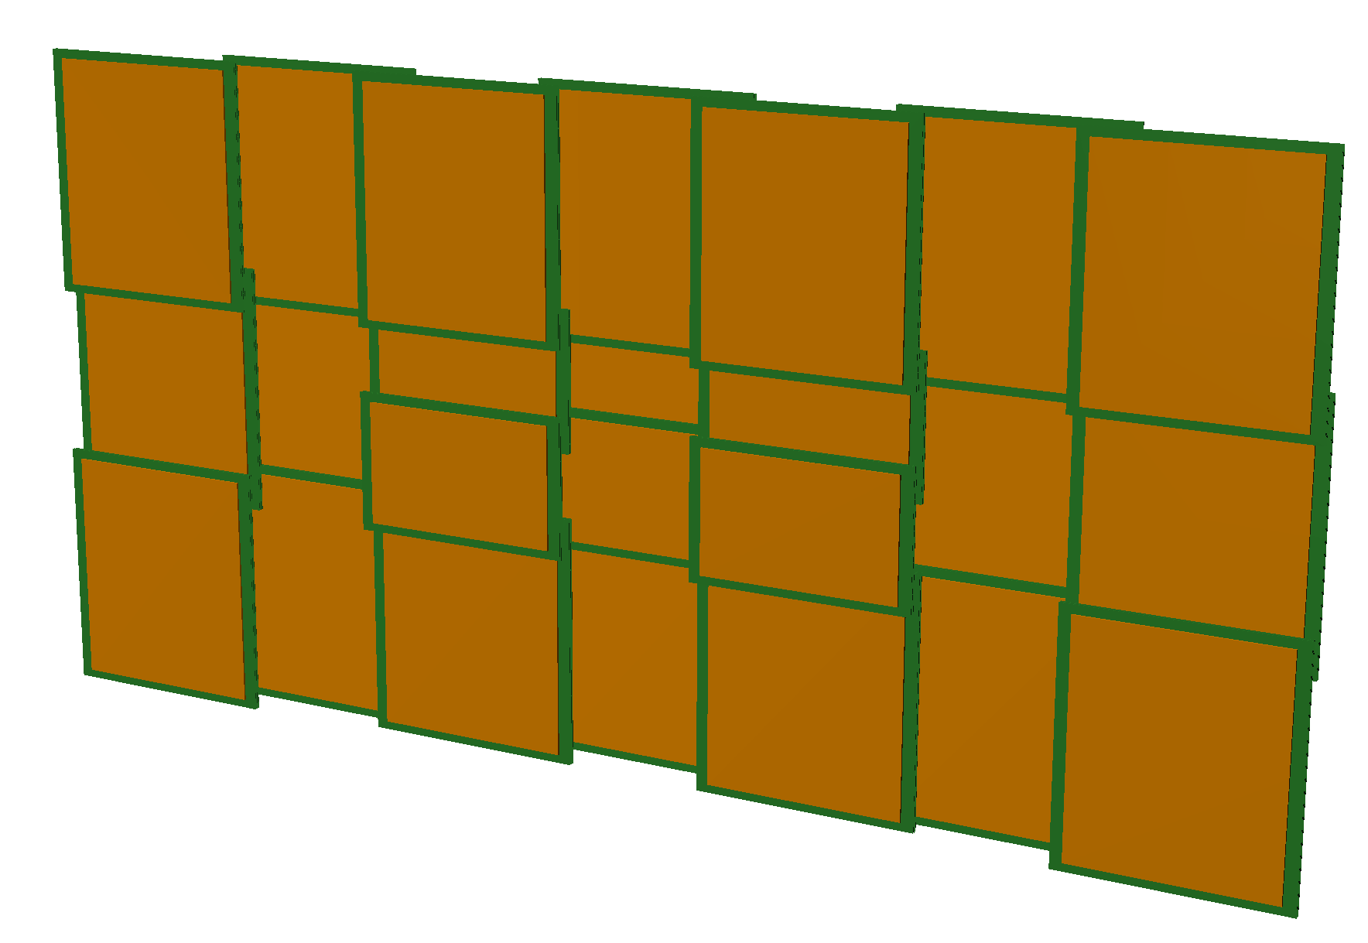
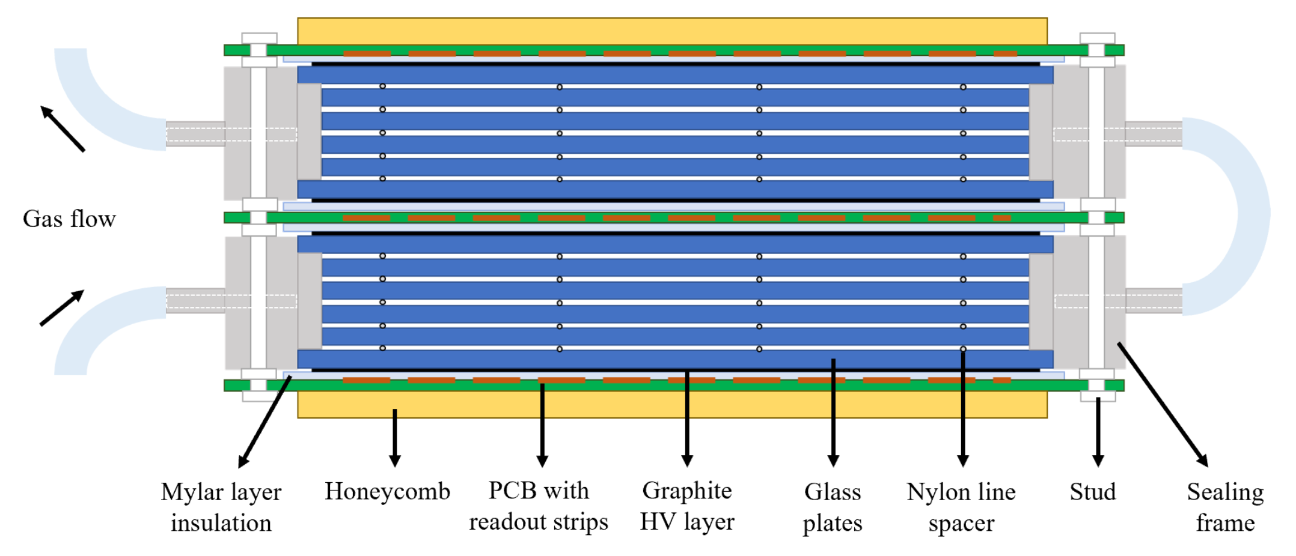









研制技术及研制计划流程
$$K$$
$$p$$
$$π$$
58ps
严格按照研制技术流程进行。

Slide 22

系统束流实验
2023年4月1日-28日，兰州CSR加速器
Fe-Fe @300AMeV

Slide 23



初步实验结果
束流末端闪烁探测器计数（束流强度） | MRPC工作电流（两个之和）[uA]
199949 | 0.08
517000 | 0.33
1000000 | 0.6
1120000 | 1.2
1600000 | 1.9
双粒子径迹重建, iTOF1+iTOF2+eTOF1+eTOF2
时间分辨59ps @ 6400V，效率98%，
做了位置修正，通道延时修正，动量修正

Slide 24







基于NICA的中俄科技合作
Present and future HI experiments
BM@N
SPD
Collider ring (c=503 m)
Center NICA
MPD
ECal
Nuclotron ring (c=251,5 m)
applied research area
24
24

Slide 25

Electromagnetic Calorimeter for NICA/MPD
MPD-ECal requirements:
particle occupancy : < 5%
Time resolution : <1~2ns
Energy resolution : < 5% @1GeV
Operate in the magnetic FIELD : ~ 0.5T
Adequate space resolution.
Cut on time in Ecal (2ns）
具有高时间性能的ECAL能够提高粒子鉴别能力！

Slide 26



ECAL的组成结构
闪烁体：塑料闪烁体
WLSF： Y11
光电读出： SiPM
均是快响应器件，能够达到高时间分辩

Slide 27


ECAL模块的性能
时间分辨
Linearity
Spatial resolution Vs. energy
 | 矫正前后 | 时间分辨[ps]
束流实验 | 时幅矫正前 | 823
 | 时幅矫正后 | 190
模拟结果 | 时幅矫正前 | 469
 | 时幅矫正后 | 146
Spatial resolution

Slide 28




800个ECAL模块的批量生产
JINR 的接收及装配测试
Module production in THU
Module production in THU
Module production in SDU

Slide 29



五维Shashlyk电磁量能器的概念
e
提高了粒子入射位置和方向精度
传统的Shashlyk量能器,没有能量沉积的深度信息
220 layer is separated into 4 parts, each part consists of 55 layers
Readout with 32 WLSFs, each part is readout with 8 WLSFs+SiPM
Mask technology of WLSF
5D: x,y,z, energy (5%), time (~50ps)
能量沉积的深度分布 + 优秀的时间分辨 大大提高了粒子鉴别能力

Slide 30
Summary
The rate capability of MRPC assembled with low resistive glass can reach 70kHz/cm²
Sealed MRPC was developed in THU:
Promote gas exchange in gas gap; Prevent creepage @20kHz/cm² ;Reduce gas consumption greatly. Has been used in CBM-TOF and CEE-eTOF
The time resolution of narrow gap MRPC with fast electronics can be better than 20ps
Shashlyk ECAL can reach:
Energy resolution <5%; Position resolution<5mm; Time resolution <150ps
五维Shashlyk ECAL:
时间分辨可达50ps，还具有深度分度，具有更好的粒子鉴别能力！

Slide 31
谢谢大家！

