Slide 1
JLab Eta Factory (JEF) experiment
Liping Gan
University of North Carolina Wilmington
Outline
Overview of η and ηꞌ Physics
JLab Eta Factory (JEF) experiment and status
Summary

Slide 2
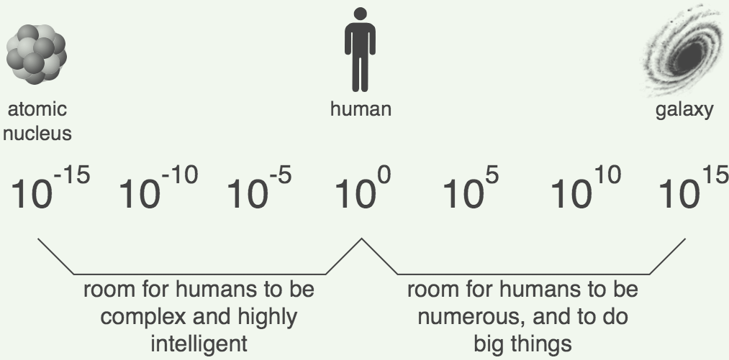
Challenges in Physics
Confinement QCD
Nature of QCD confinement
Its relationship to the dynamical chiral symmetry breaking
New physics beyond the Standard Model (SM)
New sources of CP violation
Dark matter
Dark energy
η and ηꞌ decays provide sensitive probes to explore both fundamental issues

Slide 3
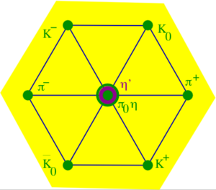

Why η is a unique probe for QCD and BSM physics?
A Goldstone boson due to spontaneous breaking of
QCD chiral symmetry
η is one of key mesons bridging our
understanding of low-energy hadron dynamics
and underlying QCD
All its possible strong and EM decays are forbidden in the lowest order so that η has narrow decay width (Γ_{η} =1.3KeV compared to Γ_{ω}=8.5 MeV)
    Enhance the higher order contributions (by a factor of ~7000
    compared to ω decays). Sensitive to weakly interacting forces.
Eigenstate of P, C, CP, and G:
tests for C, CP
Its quantum numbers are the same as Higgs or vacuum (except parity) and its decays are flavor-conserving
effectively free of SM backgrounds for new physics search.

Slide 4
Rich η (and ηꞌ) Physics
Standard Model Tests:
Chiral symmetry and anomalies
Extract η-ηꞌ mixing angle and quark mass ratio
Theory inputs to HLbL for (g-2)_{μ}
QCD scalar dynamics
Fundamental Symmetry Tests:
C, CP violations
P, CP violations
Lepton flavor violations
BSM Physics in Dark Sector:
Vector bosons (B boson, dark photon and X boson)
Dark scalars
Pseudoscalars (ALPs)
BSM weak decays
Phys. Rept. 945 (2022) 1-105

Slide 5
Low-Energy QCD Symmetries and Light Mesons
QCD Lagrangian in Chiral limit (m_{q}→0) is invariant under:
Chiral symmetry SU_{L}(3)xSU_{R}(3) spontaneously breaks to SU(3)
  8 Goldstone Bosons (GB)
U_{A}(1) is explicitly broken:
(Chiral anomalies)
  Γ(π⁰→γγ), Γ(η→γγ), Γ(η′→γγ)
  Non-zero mass of η₀
SU_{L}(3)xSU_{R}(3) and SU(3) are explicitly broken:
  GB are massive
  Mixing of π⁰, η, η′
  The π⁰, η, η′ system provides a rich laboratory to study the symmetry structure of QCD at low energies.

Slide 6
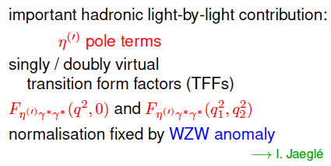
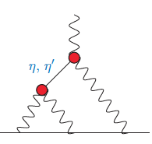

Transition Form Factor and ${(g−2)}_{μ}$
HLbL

Slide 7
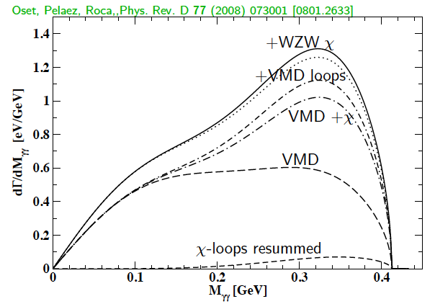
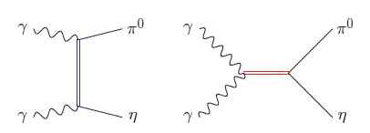
SM allowed η→π⁰γγ
A rare window to probe interplay of VMD & scalar resonances in ChPT to calculate O(p⁶) LEC’s in the chiral Lagrangian
The major contributions to η →π⁰γγ are two O(p⁶) counter-terms in the
chiral Lagrangian an unique probe for the high order ChPT.
L. Ametller, J, Bijnens, and F. Cornet, Phys. Lett., B276, 185 (1992)
Shape of Dalitz distribution is sensitive to the role of scalar resonances.
LEC’s are dominated by resonances
Gasser, Leutwyler 84; Ecler, Gasser, Pich, de Rafael1989; Donoghue, Ramirez, Valencia 1989
a₀, a₂
ρ, ω

Slide 8
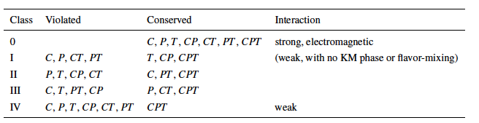
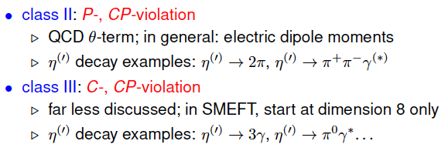
Discrete Symmetries
A new C- and T-violating, and P-conserving interaction was proposed by Bernstein, Feinberg and Lee Phys. Rev.,139, B1650 (1965) and Lee
Class III has much weaker experimental constraint, offer a opportunity for new physics search.

Slide 9
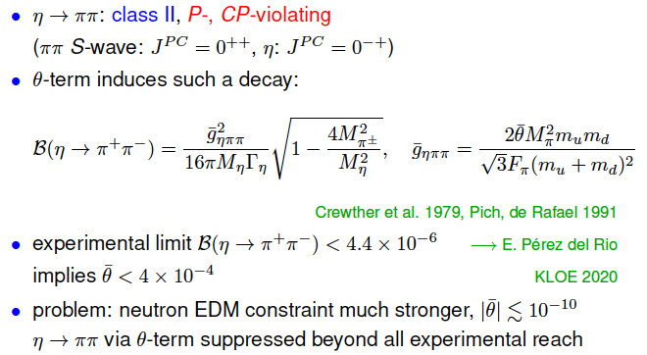
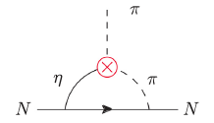

Class II: P-, CP-Violation in $η^{(′)}→ππ$

Slide 10


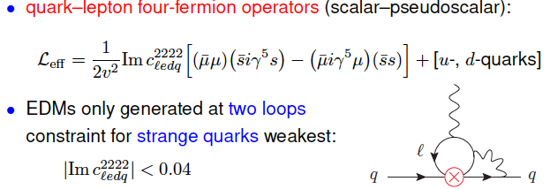
Class II: P-, CP-Violation via Strange-Quark-Muon Operators
Offer good opportunities for P-, CP-violation tests

Slide 11
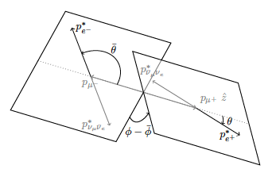

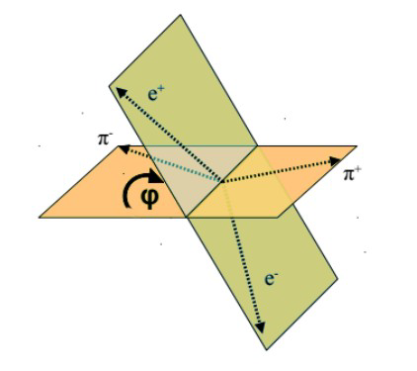
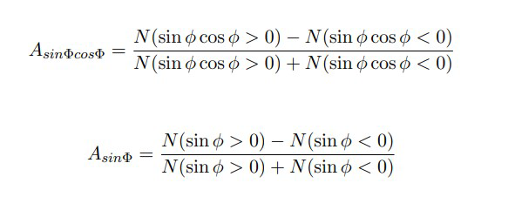



Class II: P-, CP-Violation via Scalar Operators (cont.)
$μ$-polarization asymmetry in $η^{(′)}→μ^{+}u^{−}$, $η^{(′)}→γμ^{+}u^{−}$, $η^{(′)}→π^{0}μ^{+}u^{−}$
JHEP 01, 031 (2019)
hep-ph/0202002
Angular asymmetry in decay planes:
$η^{(′)}→μ^{+}u^{−}e^{+}e^{−}$
$$η^{(′)}→π^{+}π^{−}e^{+}e^{−}$$

Slide 12
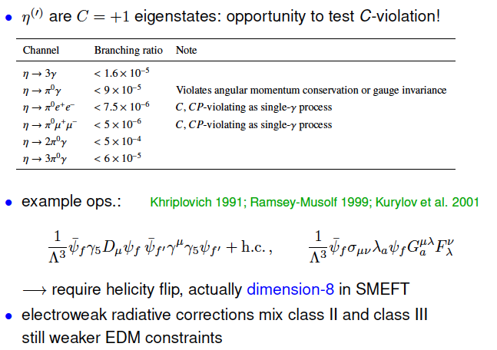
Class III: C- and CP-Violation

Slide 13

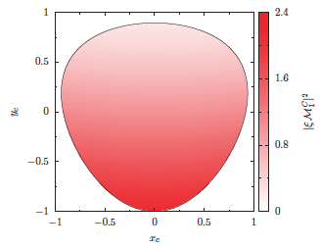
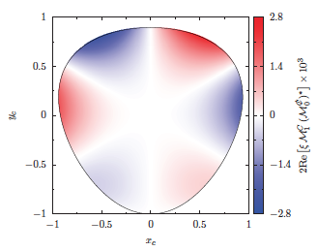
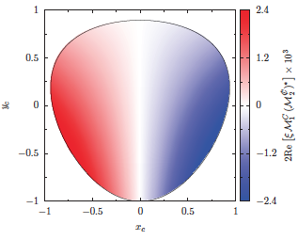
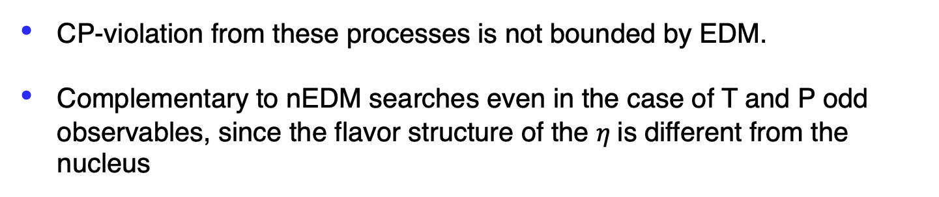
Class III: C- and CP-Violation in $η^{(′)}→π^{+}π^{−}π^{0}$, $η^{′}→π^{+}π^{−}η$
CP-violation from these processes is not bounded by EDM.
Complementary to nEDM searches even in the case of T and P odd observables, since the flavor structure of the $η$is different from the nucleus

Slide 14
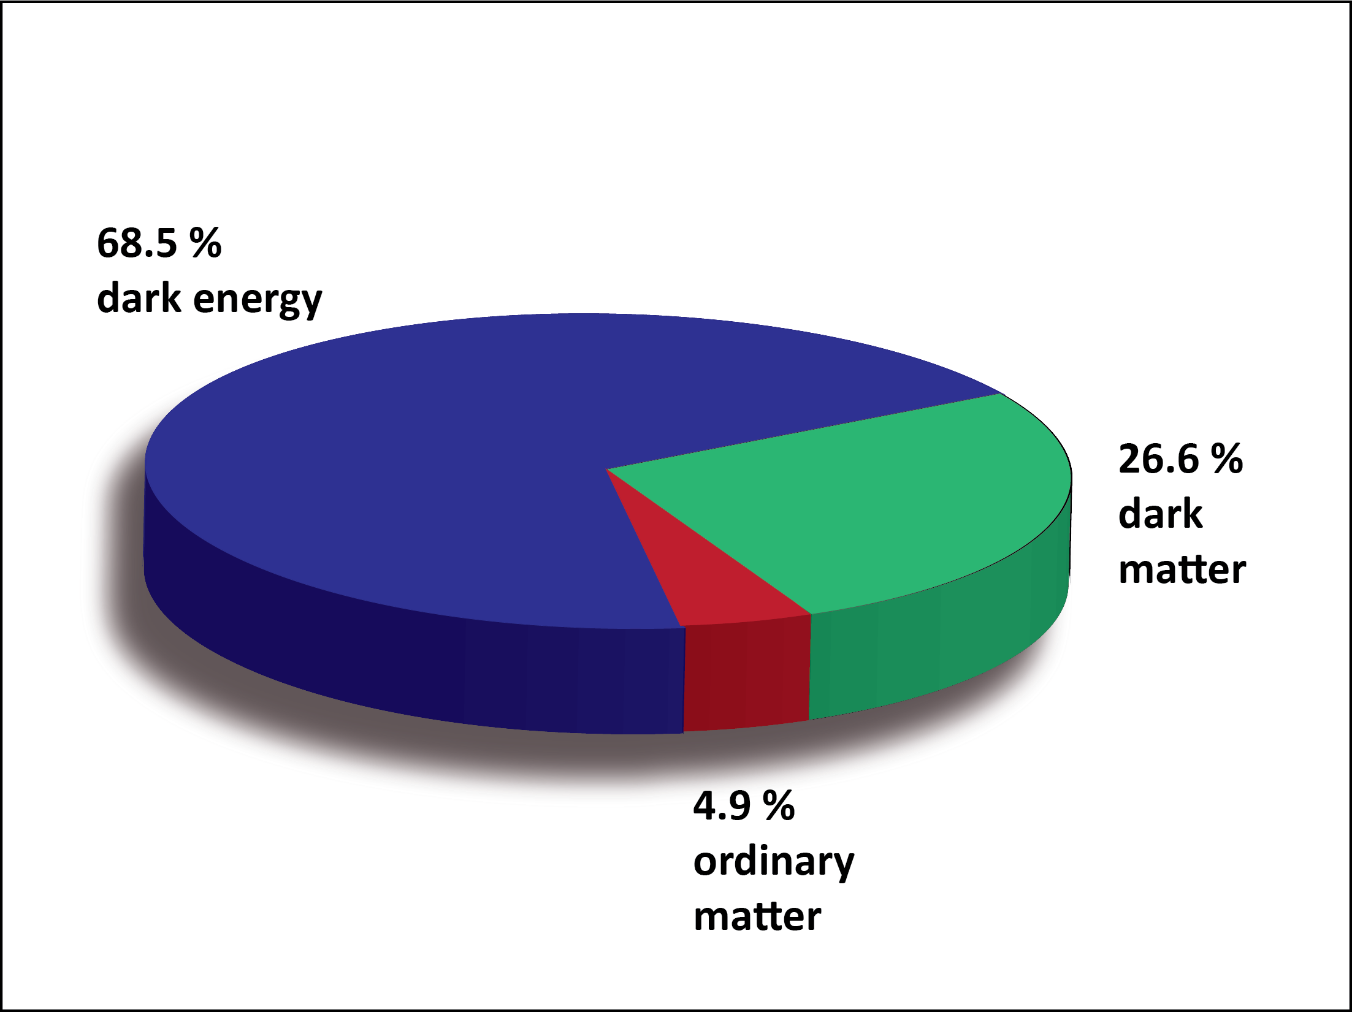
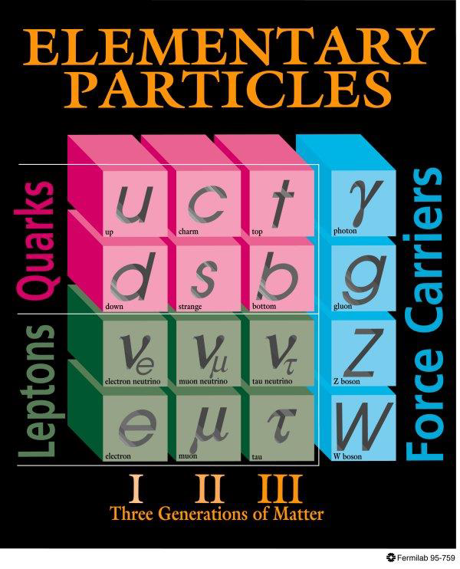
BSM Physics in Dark Sector
Dark Sector
New gauge forces, bosons and fermions beyond SM.
The stability of dark matter can be explained by the dark charge conservation.

Slide 15
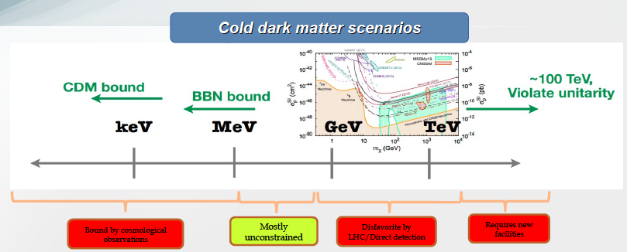
Where to Search for Dark Matter?
Sub-GeV region represents a good discovery opportunity

Slide 16
Landscape of BSM Physics Search
arXiv:1504.04855
η/ηꞌ
Complementary to other types of experiments, η/ηꞌ decays offer unique sensitivity for sub-GeV new physics that are flavor-conserving, light quark-coupling, PC-conserving.

Slide 17
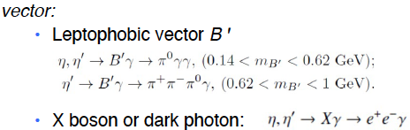


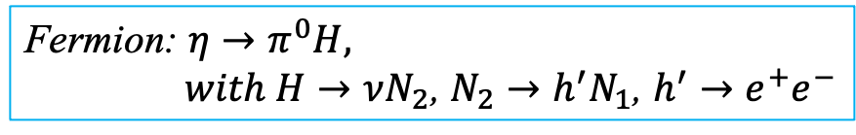
Portals Coupling SM and Dark Sector
Standard Model:
Dark Sector:
Gauge Interactions?
Dark matter?
Portals:
vector
Scalar
Fermion
ALP
Fermion: $η→π^{0}H,$
$with H→νN_{2}$, $N_{2}→h^{′}N_{1}$, $h^{′}→e^{+}e^{−}$
Phys. Rept. 945 (2022) 1-105, arXiv:2207.06905, arXiv:2203.07651

Slide 18
JLab Eta Factory (JEF) Experiment
FCAL-II
Simultaneously produce η/ηꞌ on LH₂ target with 8.4-11.7 GeV tagged photon beam via γ+p → η/ηꞌ+p
Reduce non-coplanar backgrounds by detecting recoil protons with GlueX detector
Upgraded Forward Calorimeter with High resolution, high granularity
PWO insertion (FCAL-II) to detect multi-photons from the η/ηꞌ decays
The GlueX detector will detect the charged products from the η/ηꞌ decays
18

Slide 19
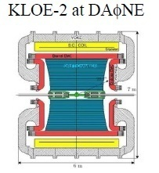
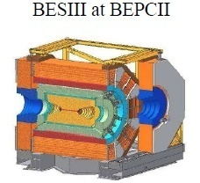
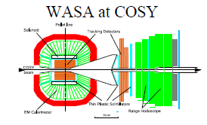
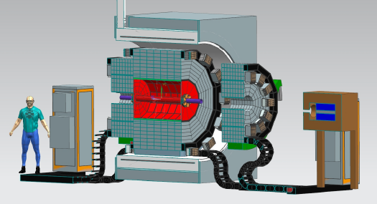
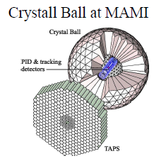
World Competition in η Decays
Low-energy
e⁺e⁻ Collider
Proposed REDTOP
Fixed-target
High-energy
hadroproduction
CBELSA/TAPS at ELSA
JEF at JLab
Photoproduction

Slide 20
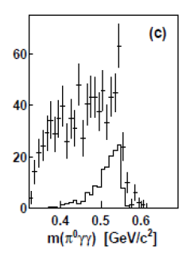
Uniqueness of JEF Experiment
Two-orders of magnitude background suppression comparing to all other experiments:
a) η/η’ energy boost; b) FCAL-II; c) exclusive detections
A2 at MAMI: γp→ηp (E_{γ}=1.5 GeV)
(P.R. C90, 025206)
JEF: γp→ηp (E_{γ}=8.4-11.7 GeV)
Signal+backgrounds
η→π⁰γγ signal
η →π⁰π⁰π⁰ background
other backgrounds
η →π⁰π⁰π⁰
other backgrounds
1 day’s running
2. Capability of running in parallel with GlueX and other experiments in Hall D
high-statistics data set
3. Simultaneously produce tagged η and ηꞌ with similar rates

Slide 21
Production Rate
JEF for 100 days of beam:
 | η | η’
Tagged mesons | 6.5x10⁷ | 4.9x10⁷
Previous Experiments:
Experiment | Total η | Total η’
CB at AGS | 10⁷ | -
CB MAMI-B | 2x10⁷ | -
CB MAMI-C | 6x10⁷ | 10⁶
WASA-COSY | ~3x10⁷ (p+d), ~5x10⁸ (p+p) | -
KLOE-II | 3x10⁸ | 5x10⁵
BESIII | ~10⁷ | ~5x10⁷
JEF offers a competitive η/η’ production rate with much cleaner backgrounds

Slide 22
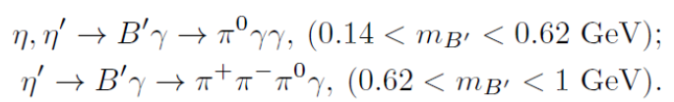

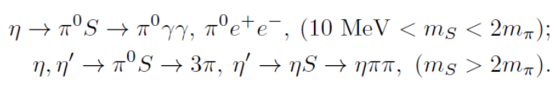





Main JEF Physics Objectives
1. Search for sub-GeV hidden bosons
vector:
    Leptophobic vector B ꞌ
    Hidden or dark photon:
scalar S:
Axion-Like Particles (ALP):
2. Directly constrain CVPC new physics:
3. Precision tests of low-energy QCD:
  Interplay of VMD & scalar dynamics in ChPT:
  Transition Form Factors of η⁽ꞌ⁾ :
4. Improve the quark mass ratio via Dalitz distributions of η→3π
$$η^{(′)}→3γ,{ η}^{(′)}→2π^{0}γ,{ η}^{(′)}→π^{+}π^{−}π^{0}$$

Slide 23
Example of a Key Channel: η→π⁰γγ
New physics:
Search for sub-GeV gauge bosons
  A leptophobic vector B’:
  η→γB’, B’ →π⁰γ
  An electrophobic scalar Φ’:
  η→π⁰Φ’, Φ’→γγ
  PRL 117,101801 (2016); PL B740,61(2015)
Dark Sector:
Gauge Interactions?
Dark matter?
PR,D89,114008
Standard Model:
Portal:
vector
Scalar
fermion
Confinement QCD:
A rare window to probe interplay of VMD & scalar resonance in ChPT

Slide 24
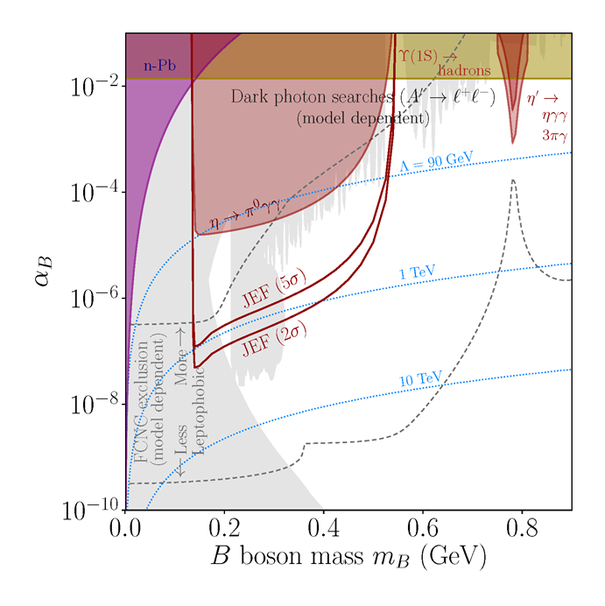
JEF Experimental Reach for B’
A search for a leptophobic dark B’ boson coupled to baryon number is complementary to ongoing searches for a dark photon
η→ B’γ →π⁰γγ
B’
γ
100 days’ beam
PL, B221, 80 (1989)
PR,D89,114008

Slide 25
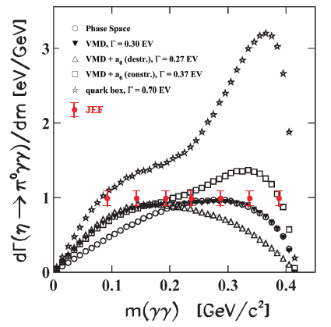
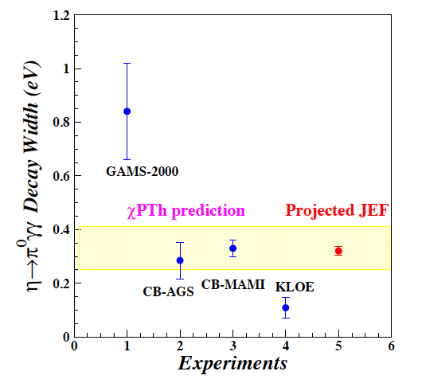
Projected JEF on SM Allowed η→π⁰γγ
J.N. Ng and D.J. Peters, Phys. Rev. D47, 4939
χPTh by Oset et al., Phys. Rev. D77, 073001
(100 days’ beam)
We measure both BR and Dalitz distribution
model-independent determination of two LEC’s of the O(p⁶) counter- terms
probe the role of scalar resonances to calculate other unknown O(p⁶) LEC’s
J. Bijnens, talk at AFCI workshop

Slide 26
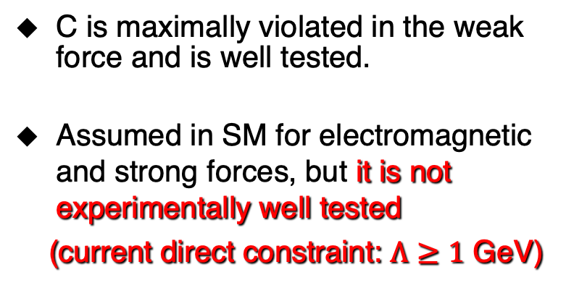
Test Charge Conjugation Invariance
C Violating η neutral decays
Mode | Branching Ratio (upper limit) | No. γ’s
3γ | < 1.6•10⁻⁵ | 3
π⁰γ | < 9•10⁻⁵
2π⁰γ | < 5•10⁻⁴ | 5
3γπ⁰ | Nothing published
3π⁰γ | < 6•10⁻⁵ | 7
3γ2π⁰ | Nothing published
C is maximally violated in the weak force and is well tested.
Assumed in SM for electromagnetic and strong forces, but it is not experimentally well tested
(current direct constraint: $Λ≥1$ GeV)

Slide 27
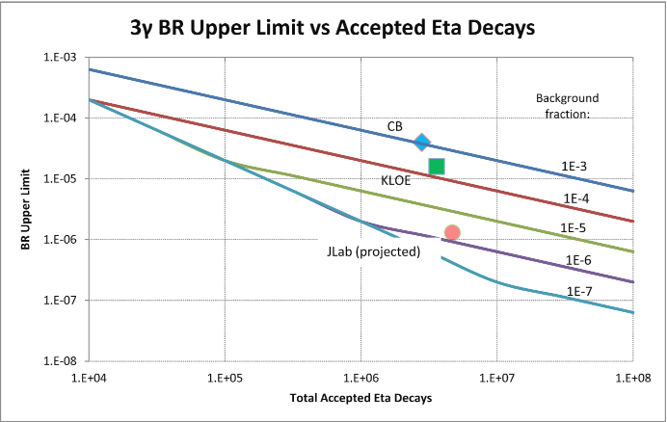
Experimental Improvement on C-violating η→3γ
SM contribution:
BR(η→3γ) <10⁻¹⁹ via P-violating
weak interaction.
A calculation due to new
physics by Tarasov suggests:
BR(η→3γ)< 10⁻²
Sov.J.Nucl.Phys.,5,445 (1967)
Proj. JEF
(100 days’ beam)
Improve BR upper limit by one order of magnitude to directly tighten the constraint on CVPC new physics

Slide 28
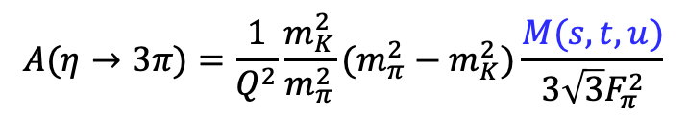
Improve Quark-Mass Ratio via 𝜂→3π Dalitz Distributions
  A clean probe for quark mass ratio:
    Decays through isospin violation:
    is small
    Amplitude:
  Uncertainties in quark mass ratio
$$A(η→3π)=\frac{1}{Q^{2}}\frac{m_{K}^{2}}{m_{π}^{2}}(m_{π}^{2}−m_{K}^{2})\frac{M(s,t,u)}{3\sqrt{3}F_{π}^{2}}$$
Phys. Rept. 945 (2022) 1-105

Slide 29
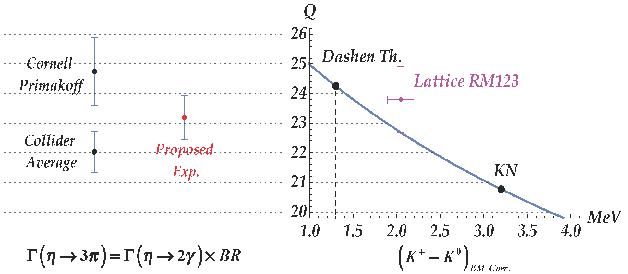
Precision Determination Light Quark Mass Ratio via PrimEx-eta
  A clean probe for quark mass ratio:
    decays through isospin violation:
    is small
    Amplitude:
$$A(η→3π)=\frac{1}{Q^{2}}\frac{m_{K}^{2}}{m_{π}^{2}}(m_{π}^{2}−m_{K}^{2})\frac{M(s,t,u)}{3\sqrt{3}F_{π}^{2}}$$

Slide 30
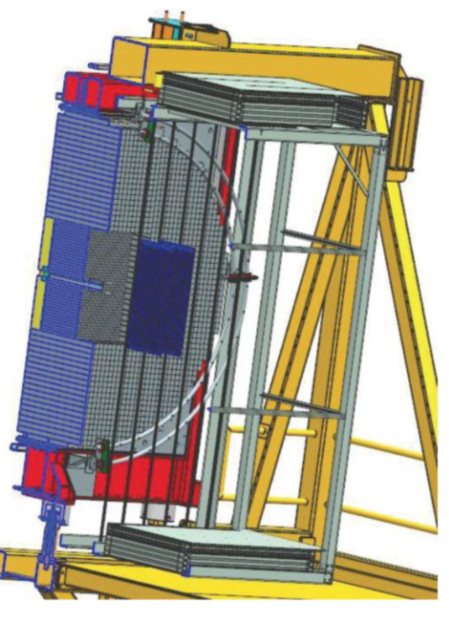
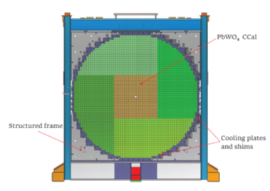
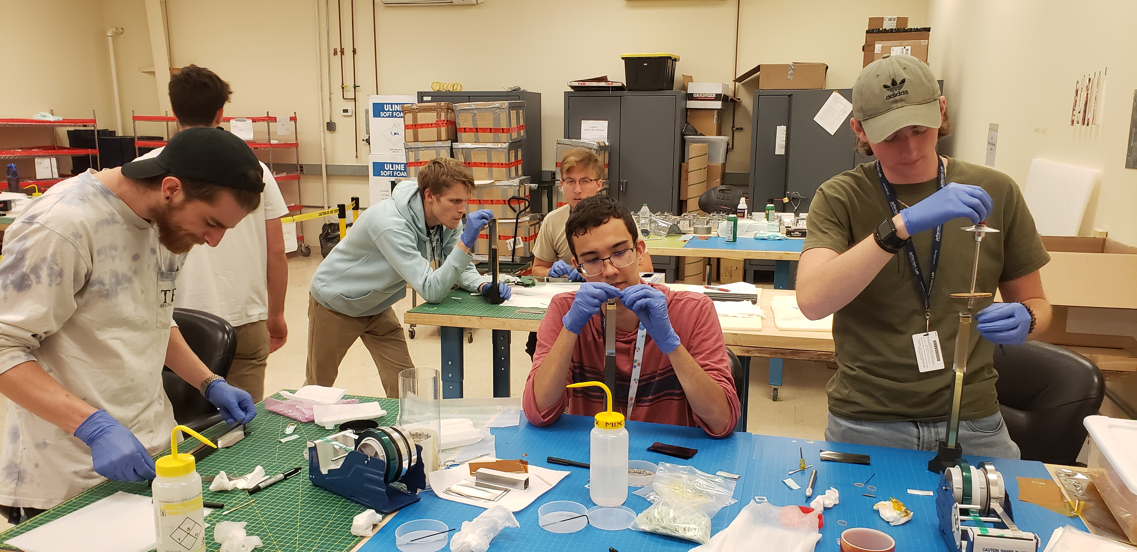
Current Status of the JEF Experiment
Non-rare decay data has been collecting with the GlueX spectroscope experiment since 2016.
An upgraded FCAL-II with a PWO insert.:
  Mass production of 1600 PWO modules is done.
  Installation of the upgraded FCAL-II is on-going and will be completed by the end of 2023.
PWO module
Undergraduate workforce
(2x2x20 cm³)
  Rare decay data with FCAL-II is expected in 2024.

Slide 31
Summary
12 GeV tagged photon beam with GlueX setup offers a unique η/ηꞌ factory to test SM and search for new BSM physics, with two orders of magnitude in background reduction in the neutral rare decay modes compared to other facilities.
Simultaneously measure η/η’ decays with main physics goals of:
  Search for sub-GeV hidden bosons: vector, scalar, and ALP
  Directly constrain CVPC new physics
  Precision tests of low-energy QCD: the role of scalar dynamics in ChPT; transition form factors of η/η’ to calculate HLbL contributions in (g-2)_{μ}
  Improve the light quark mass ratio via η→3π, ηꞌ→3π
Data collection for non-rare decays has been on-going with the GlueX spectroscope experiment since 2016.
The rare decays require an upgraded FCAL-II with a PWO insert that is currently under installation. Data taking will start in 2024.
Thanks for support by NSF PHY-1812396 and PHY-2111181

