Slide 1
Update on Far-forward detector
Aiqiang Guo, Yutie Liang, Ting Lin, Weizhi Xiong
2023.03.29

Slide 2
Outline
Far-forward detector design
Performance study
Summary

Slide 3
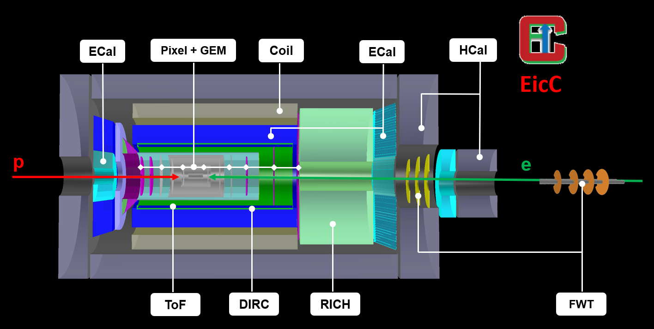
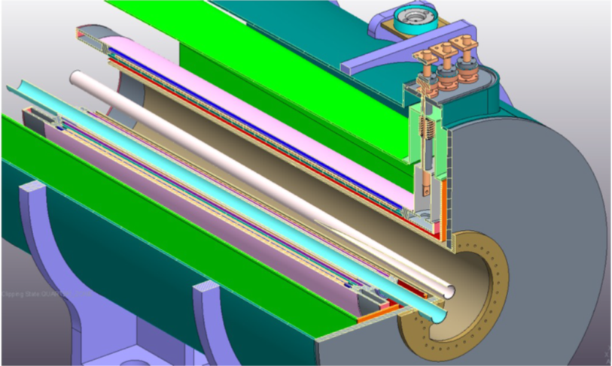
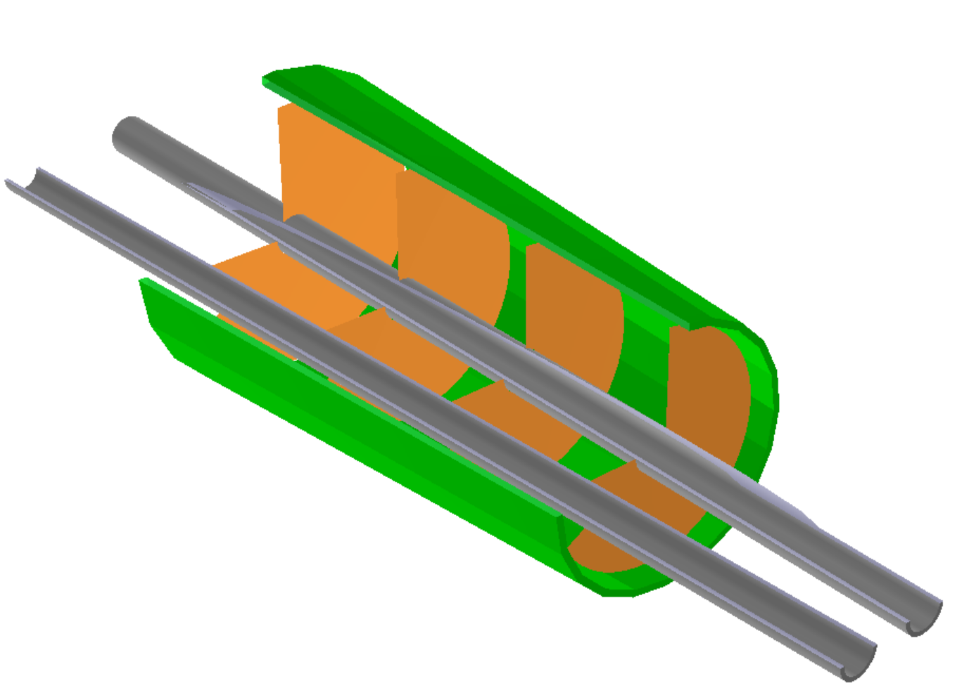
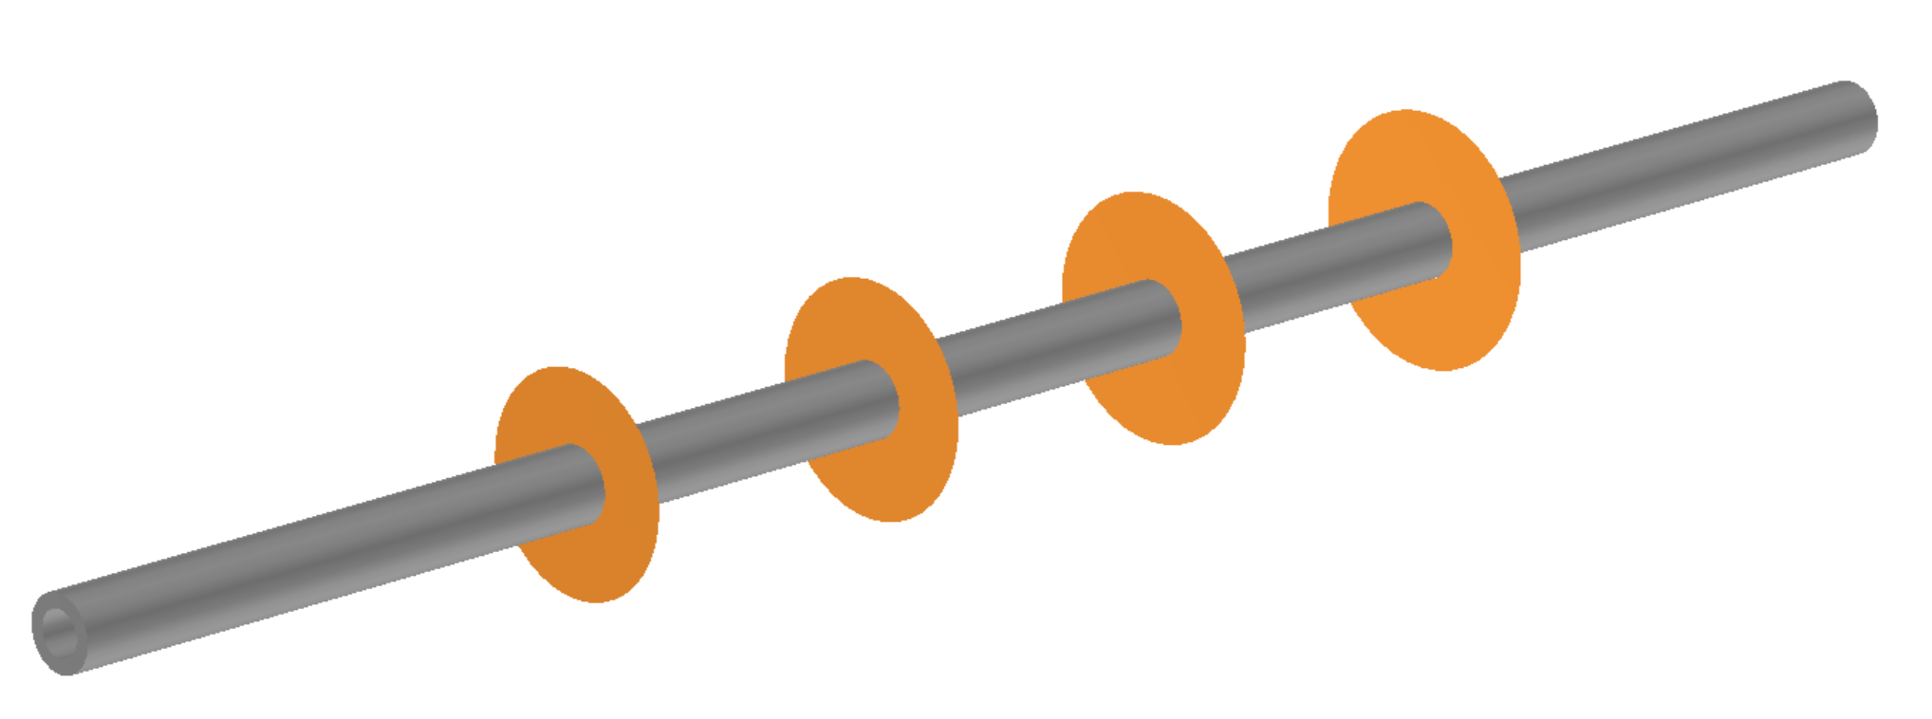
Far-forward Detector design based on dipoles
Four disks with pixel size of 10 μm same as the central vertex detector
ZDC(Zero Degree Calorimeter)
OMD(Off-Momentum Detector)
EDT (Endcap Dipole Tracking)
FDT (Forward Dipole Tracking)
Notes:
Previously，we have designed the forward tracking detector, utilizing the 1st and 2nd dipoles.
There are two detector sets, one is named EDT (Endcap Dipole Tracker) and the other is FDT (Forward Dipole tracker).
Both EDT and FDT are designed with 4 disks with pixel size of 10 um same as the central vertex detector.

Slide 4
Dipoles in the ion forward direction
Dipole 1: z = 5 m B = 2.52 T L = 0.8 m
R1 = p*10/3./B1 = 20GeV*10/3./2.52 = 26.455 m
Bending angle = asin(L/R) = 0.03 rad = 30 mrad
Dipole 3: z = 15.4 m B = -3.4 T L = 0.8 m
R2 = p*10/3./B2 = 20GeV*10/3./2.69 = 19.61 m
Bending angle = asin(L/R) ~ 0.04 rad = 40 mrad
Dipole 2: z = 10 m B = 2.69 T L = 2.0 m
R2 = 24.783 m
Bending angle = 80 mrad
Dipole 4: z > 16 m B = ? L = ? m
R2 = ? m
Bending angle = 120 mrad
O
L=0.8m
50 mrad
A
R3
= 19.61m
B
50 mrad
30 mrad
R1
= 26.455m
50 mrad
30 mrad
80 mrad
R2
= 24.783m
C
D
L=2.0m
40 mrad
120 mrad
4

Slide 5
Quadrupoles in the ion forward direction
Dipole 1: z = 5 m B = 2.52 T L = 0.8 m
R1 = 26.455 m
Bending angle = 30 mrad
Position of B(-28.1453, 0, 538.6）
Position of Q1(-36.1368, 0, 638.3）
Position of Q2(-40.9317, 0, 698.1）
Position of Q3(-52.5193, 0, 842.6）
O
50 mrad
A
L=0.8m
B
50 mrad
L=0.4m
30 mrad
0.8m
Q1
L=0.6m
Q2
Dipole 2: z = 10 m B = 2.69 T L = 2.0 m
R2 = 24.783 m
Bending angle = 80 mrad
L=1.1m
R1 = 26.455m
0.1m
Q3
0.6m

Slide 6
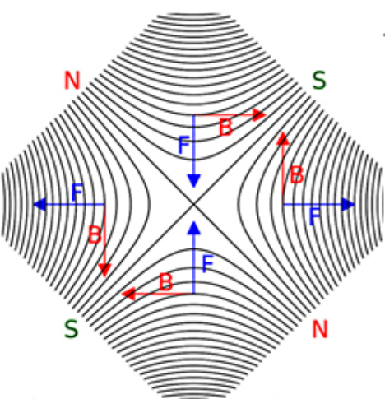
Quadrupoles in the ion forward direction
Slides from Weizhi

Slide 7
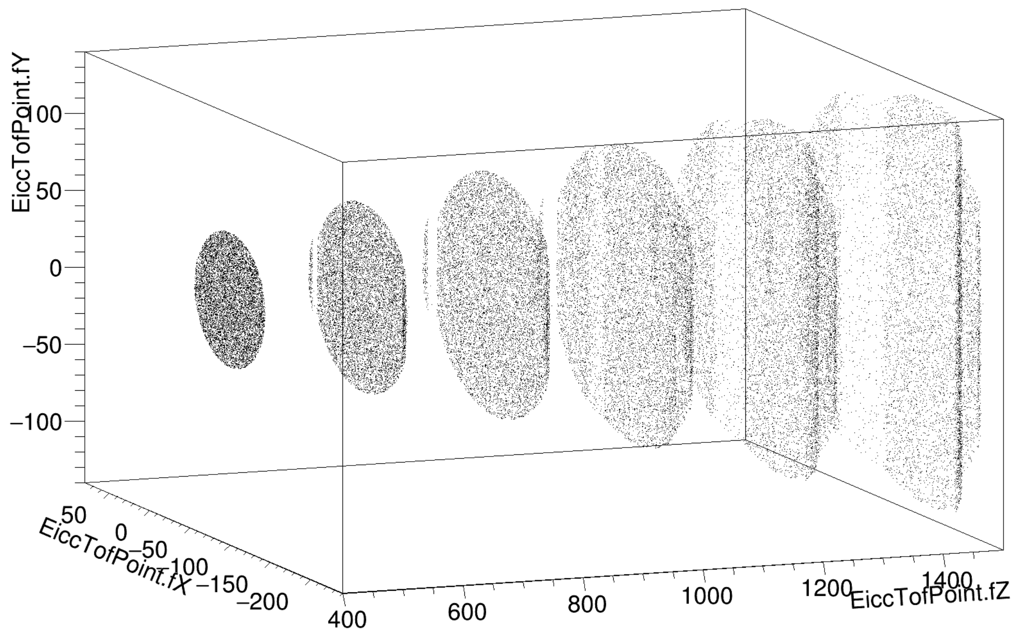
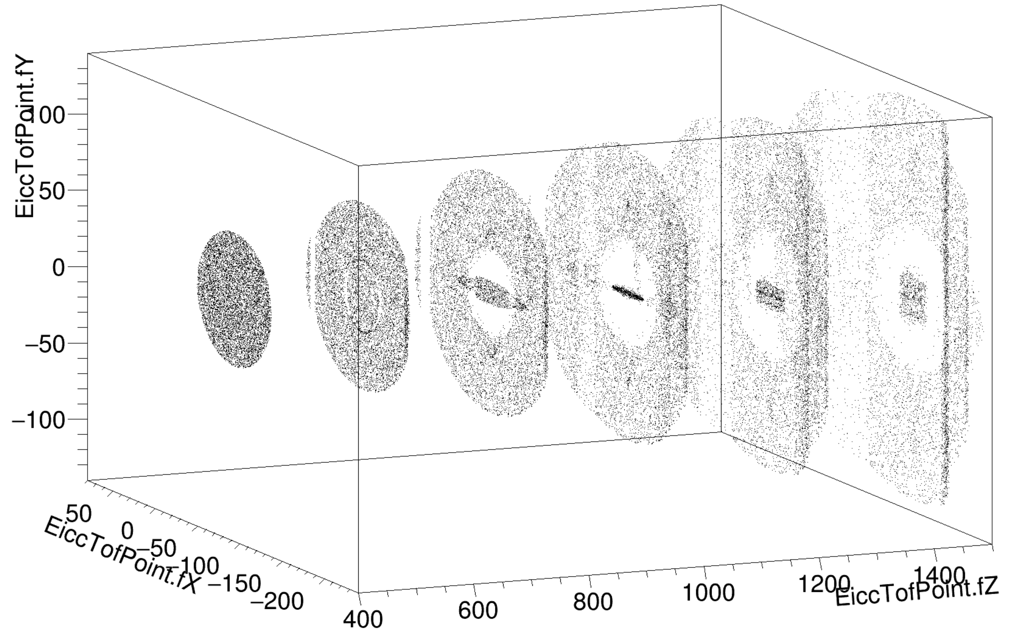
Impact of Quadrupoles
DIPOLE
DIPOLE+QUAD

Slide 8
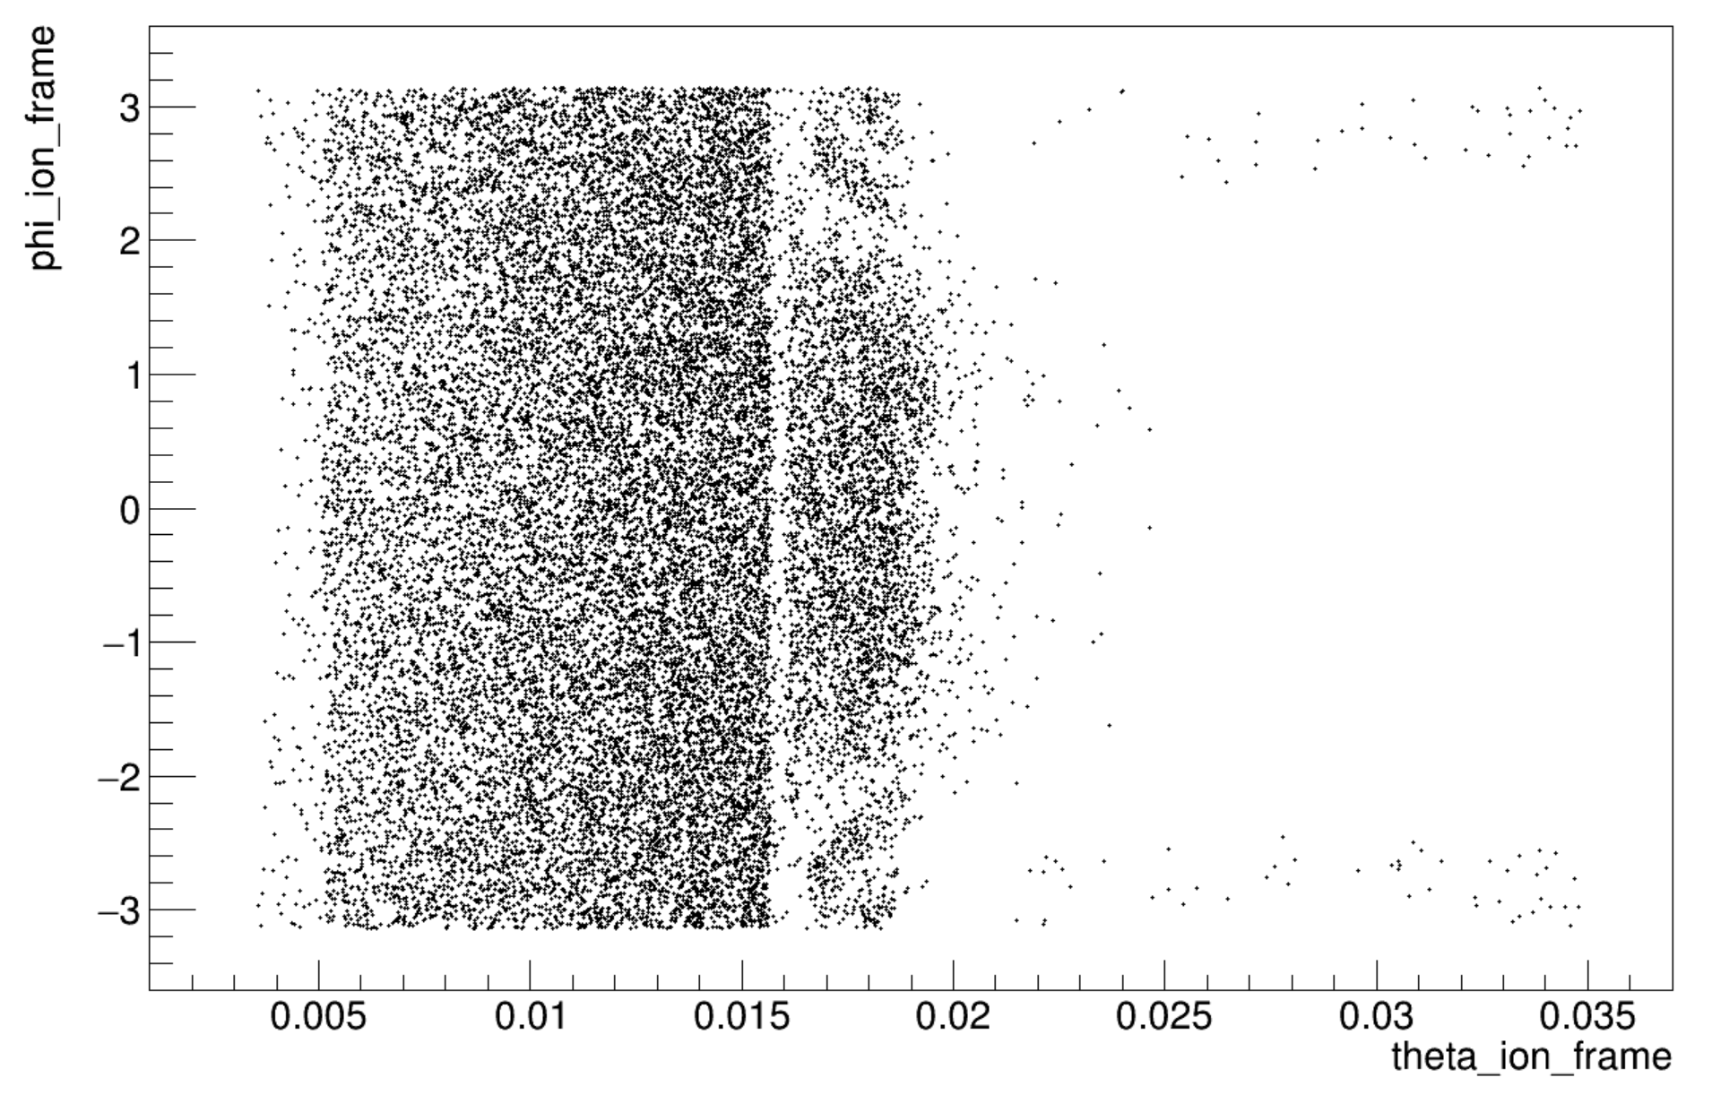
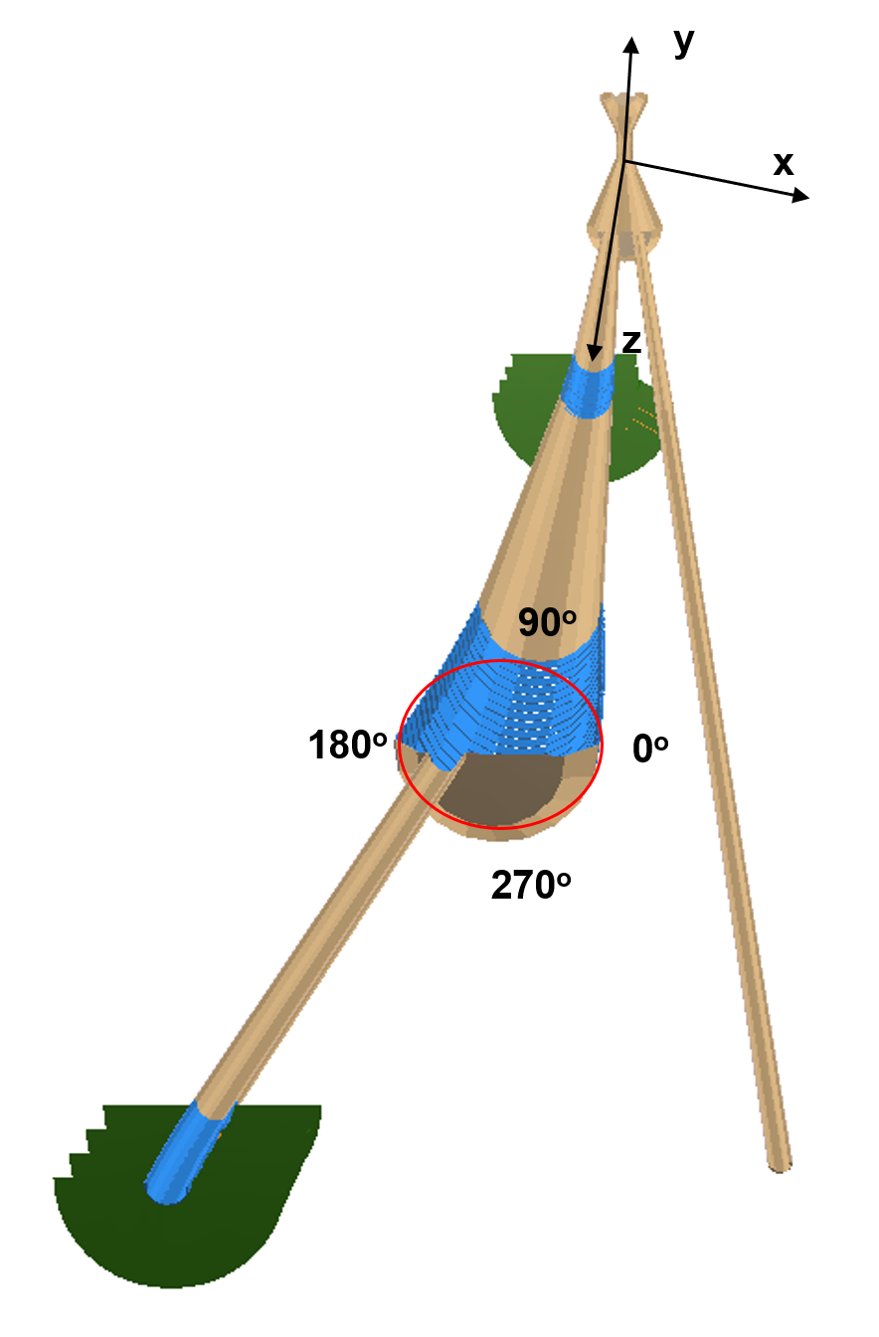
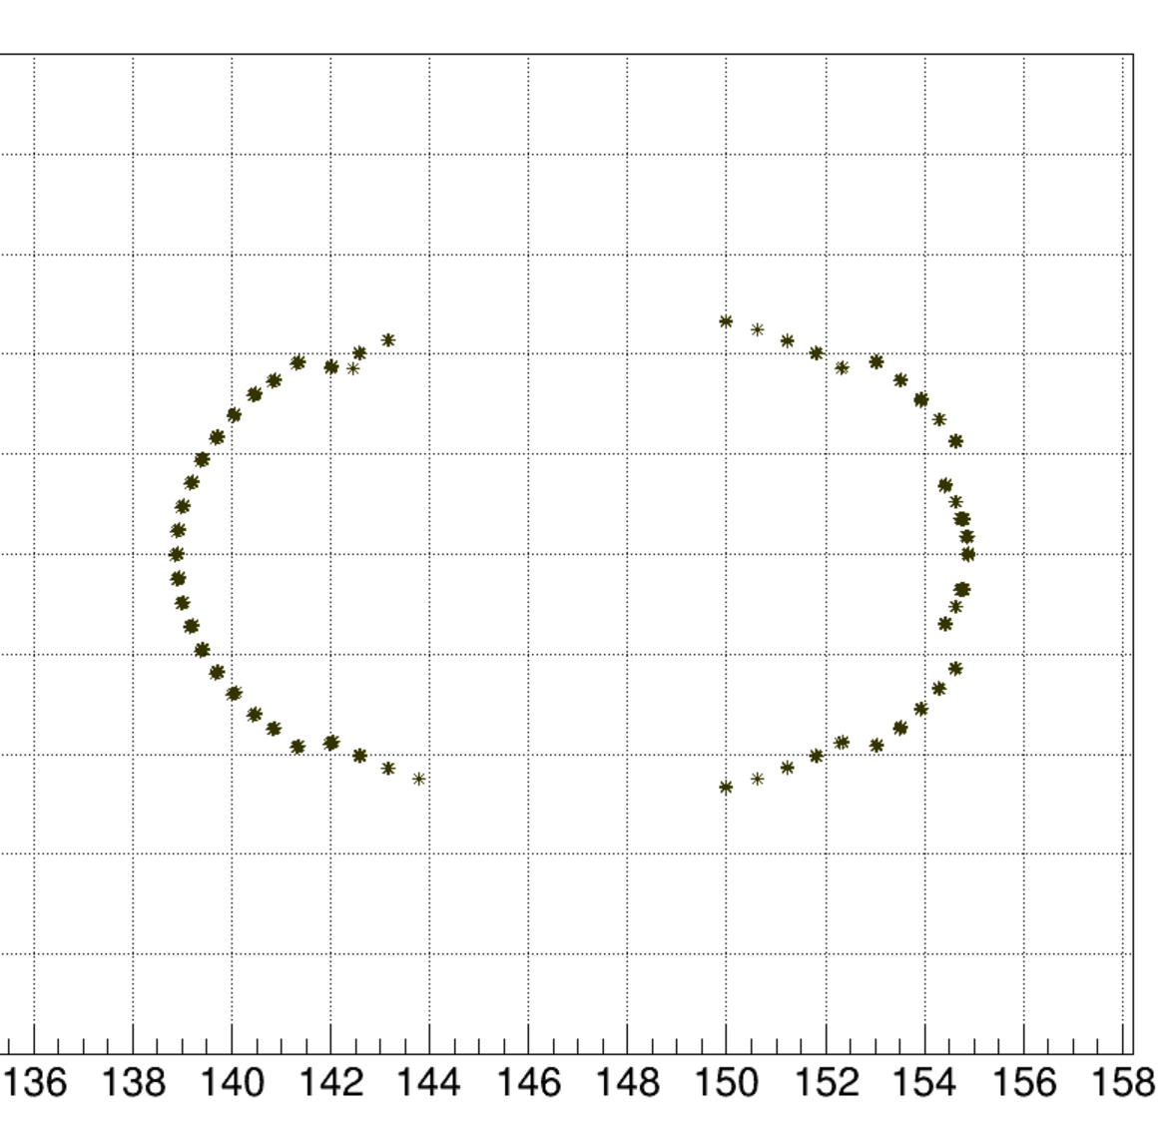
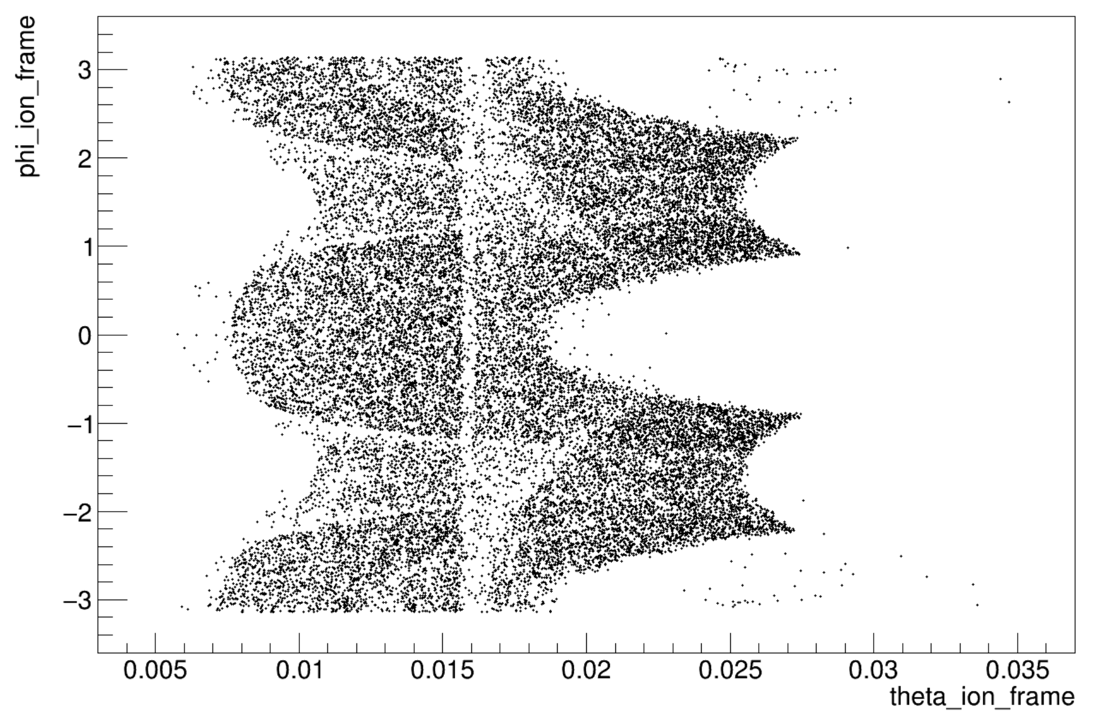
Impact of Quadrupoles
n__{FDT} > 1 DIPOLE
phi=270
phi=0
phi=180
n__{FDT} > 1 DIPOLE+QUAD
phi=90

Slide 9
Performance study

Slide 10
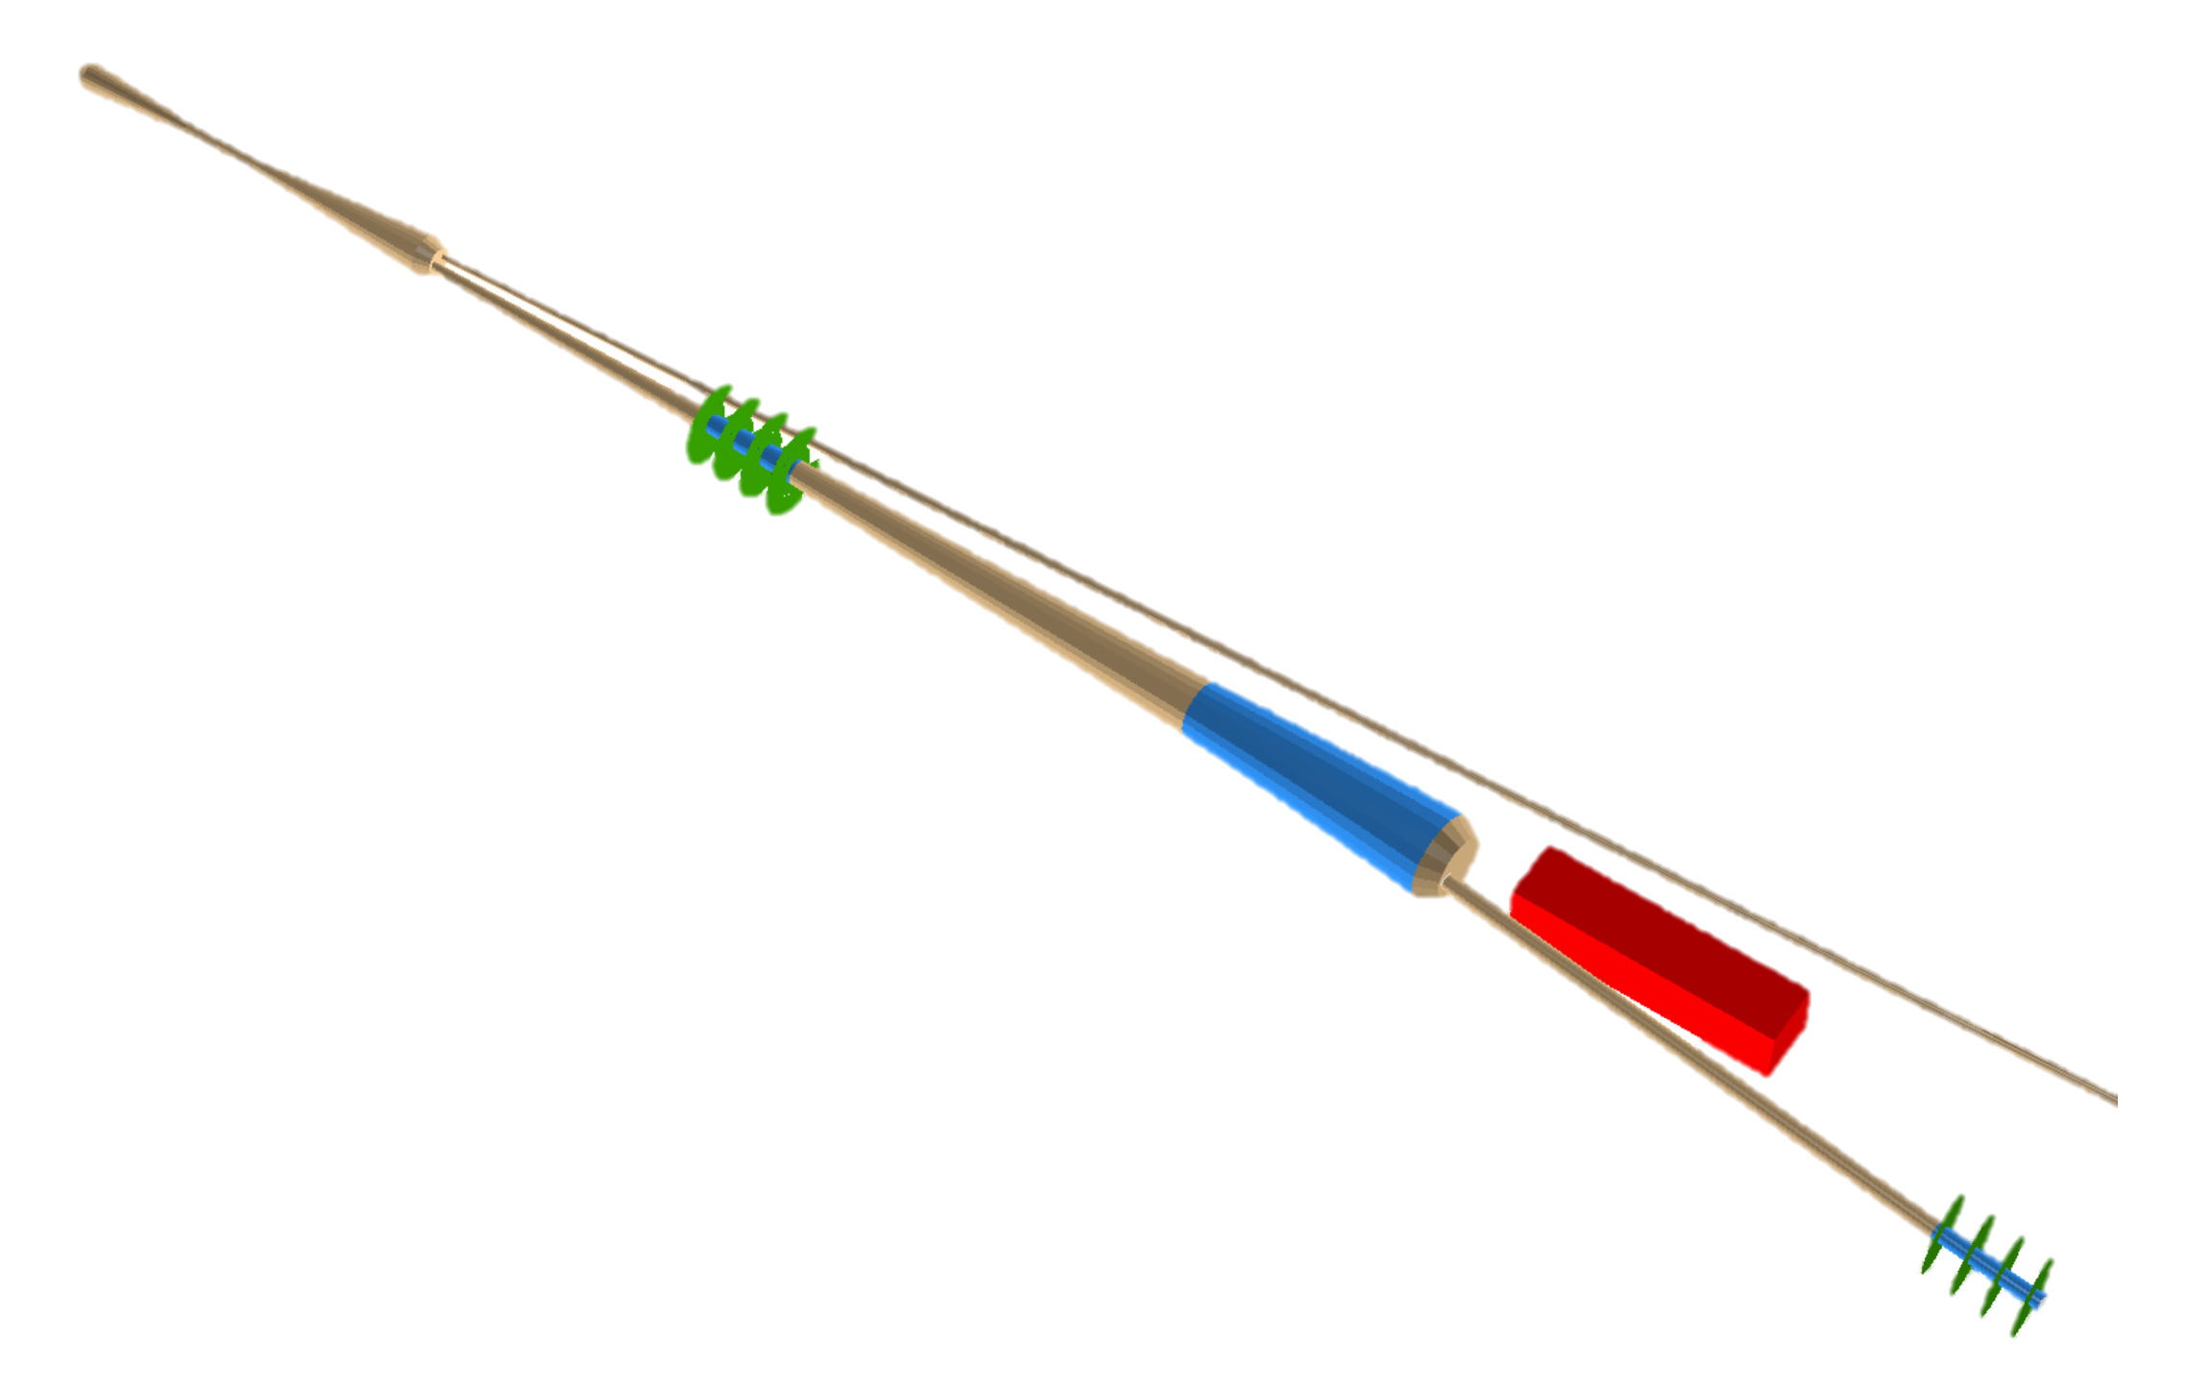
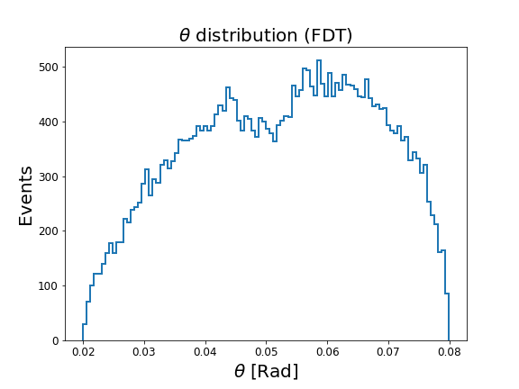
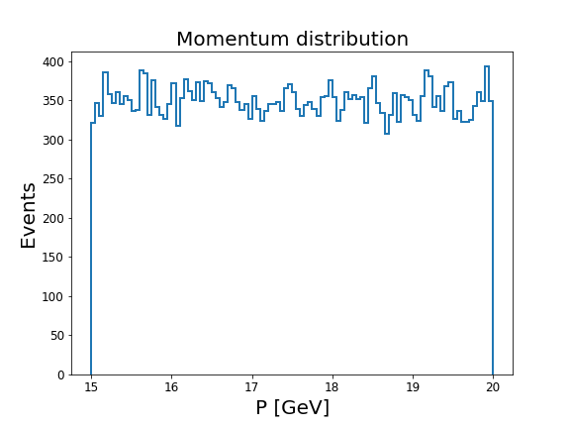
Distributions in the generation
ZDC
EDT
FDT

Slide 11
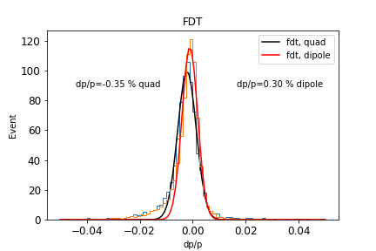
Momentum resolution

Slide 12
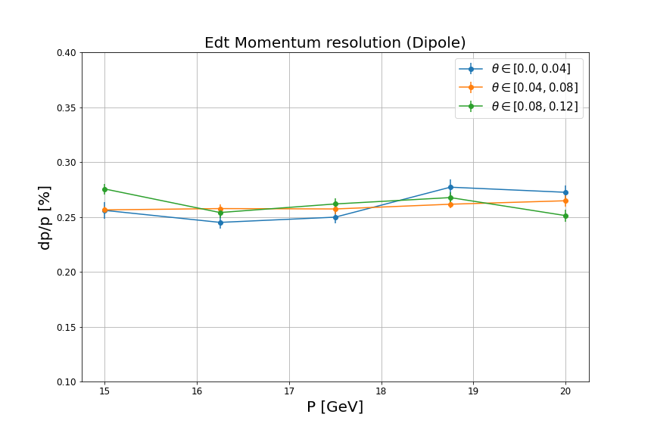
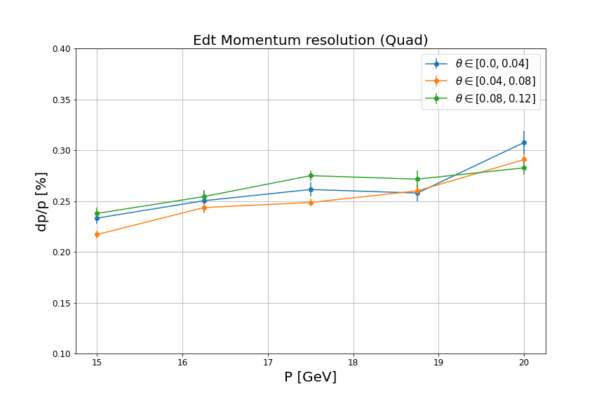
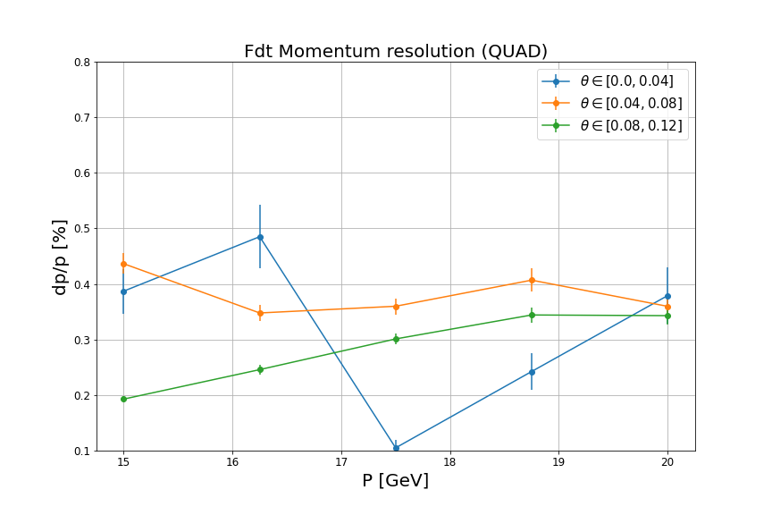
Momentum resolution vs P & $θ$

Slide 13
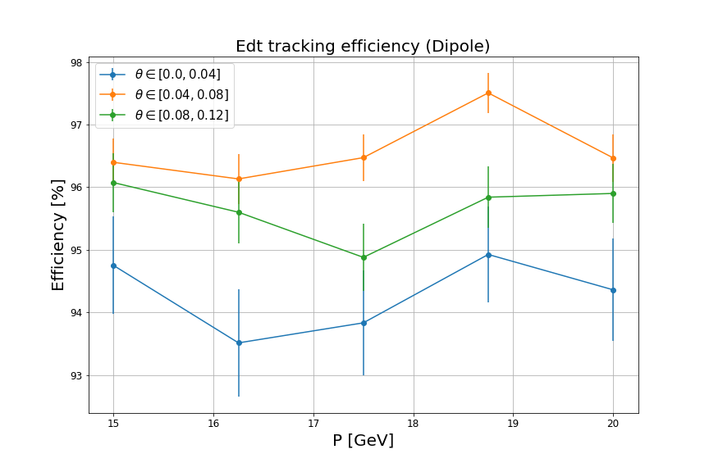
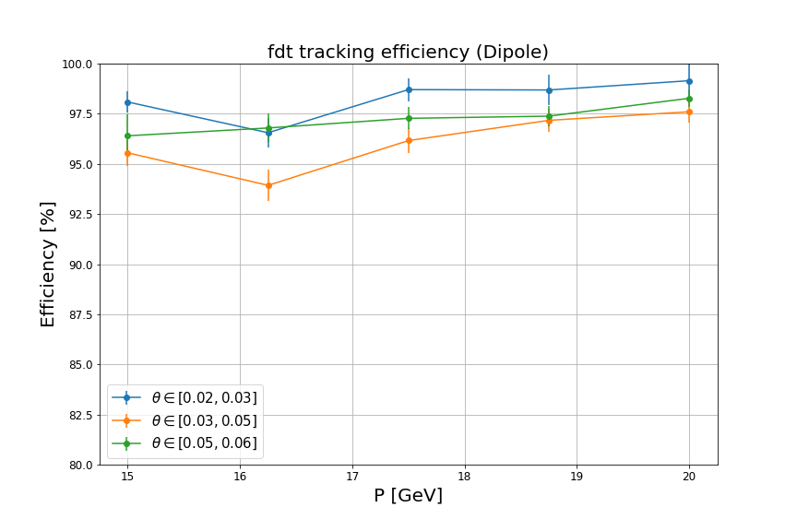
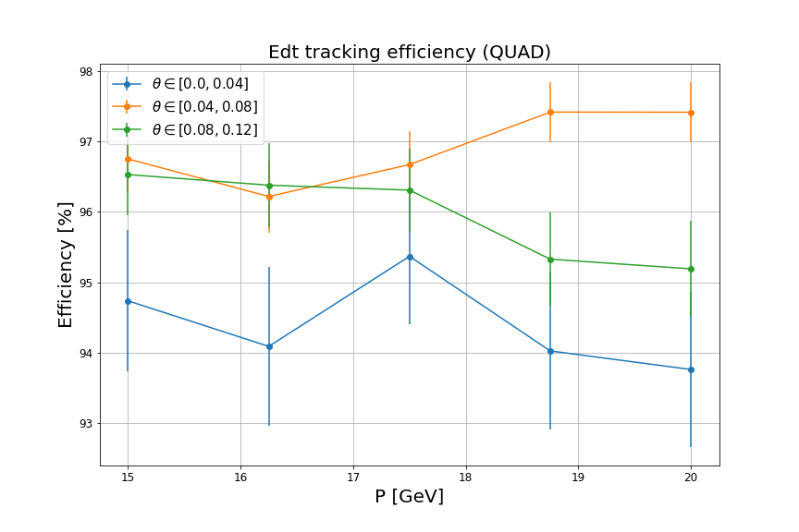
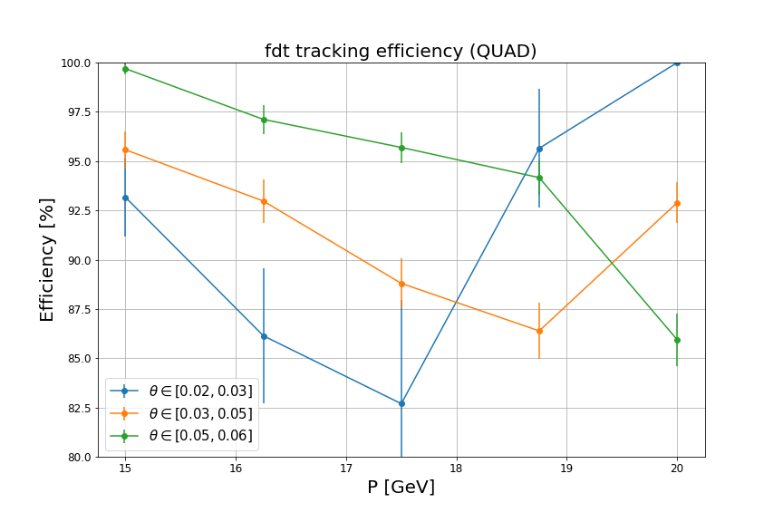
Tracking efficiency vs P & $θ$

Slide 14
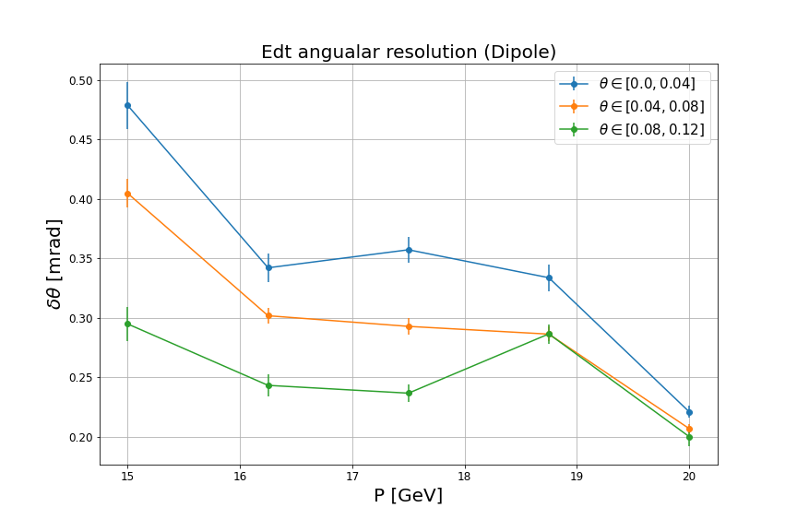
$θ$ resolution
Some time, the distribution is non-gaussian distribution

Slide 15
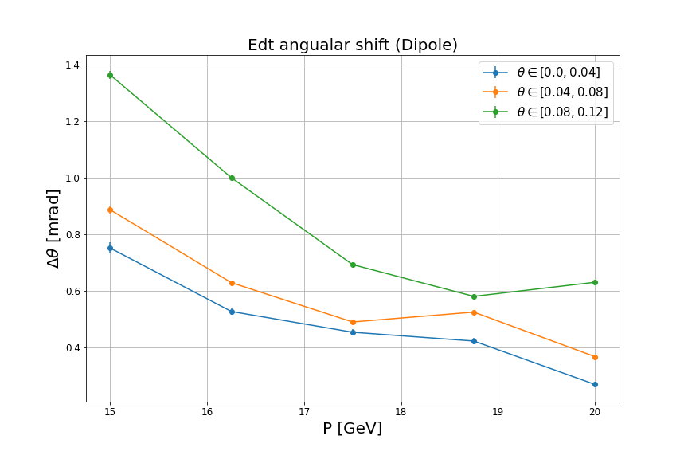
$θ$ bias

Slide 16
Summary and next-to-do
Design of EDT FDT and ZDC in FF is good shape.
Impact of three quadrupole magnets is investigated.
strong azimuthal dependency on the FDT
a reduction on the tracking efficiency
resolution slightly worse
Far-forward OMD design is ongoing.
Thank you

Slide 17
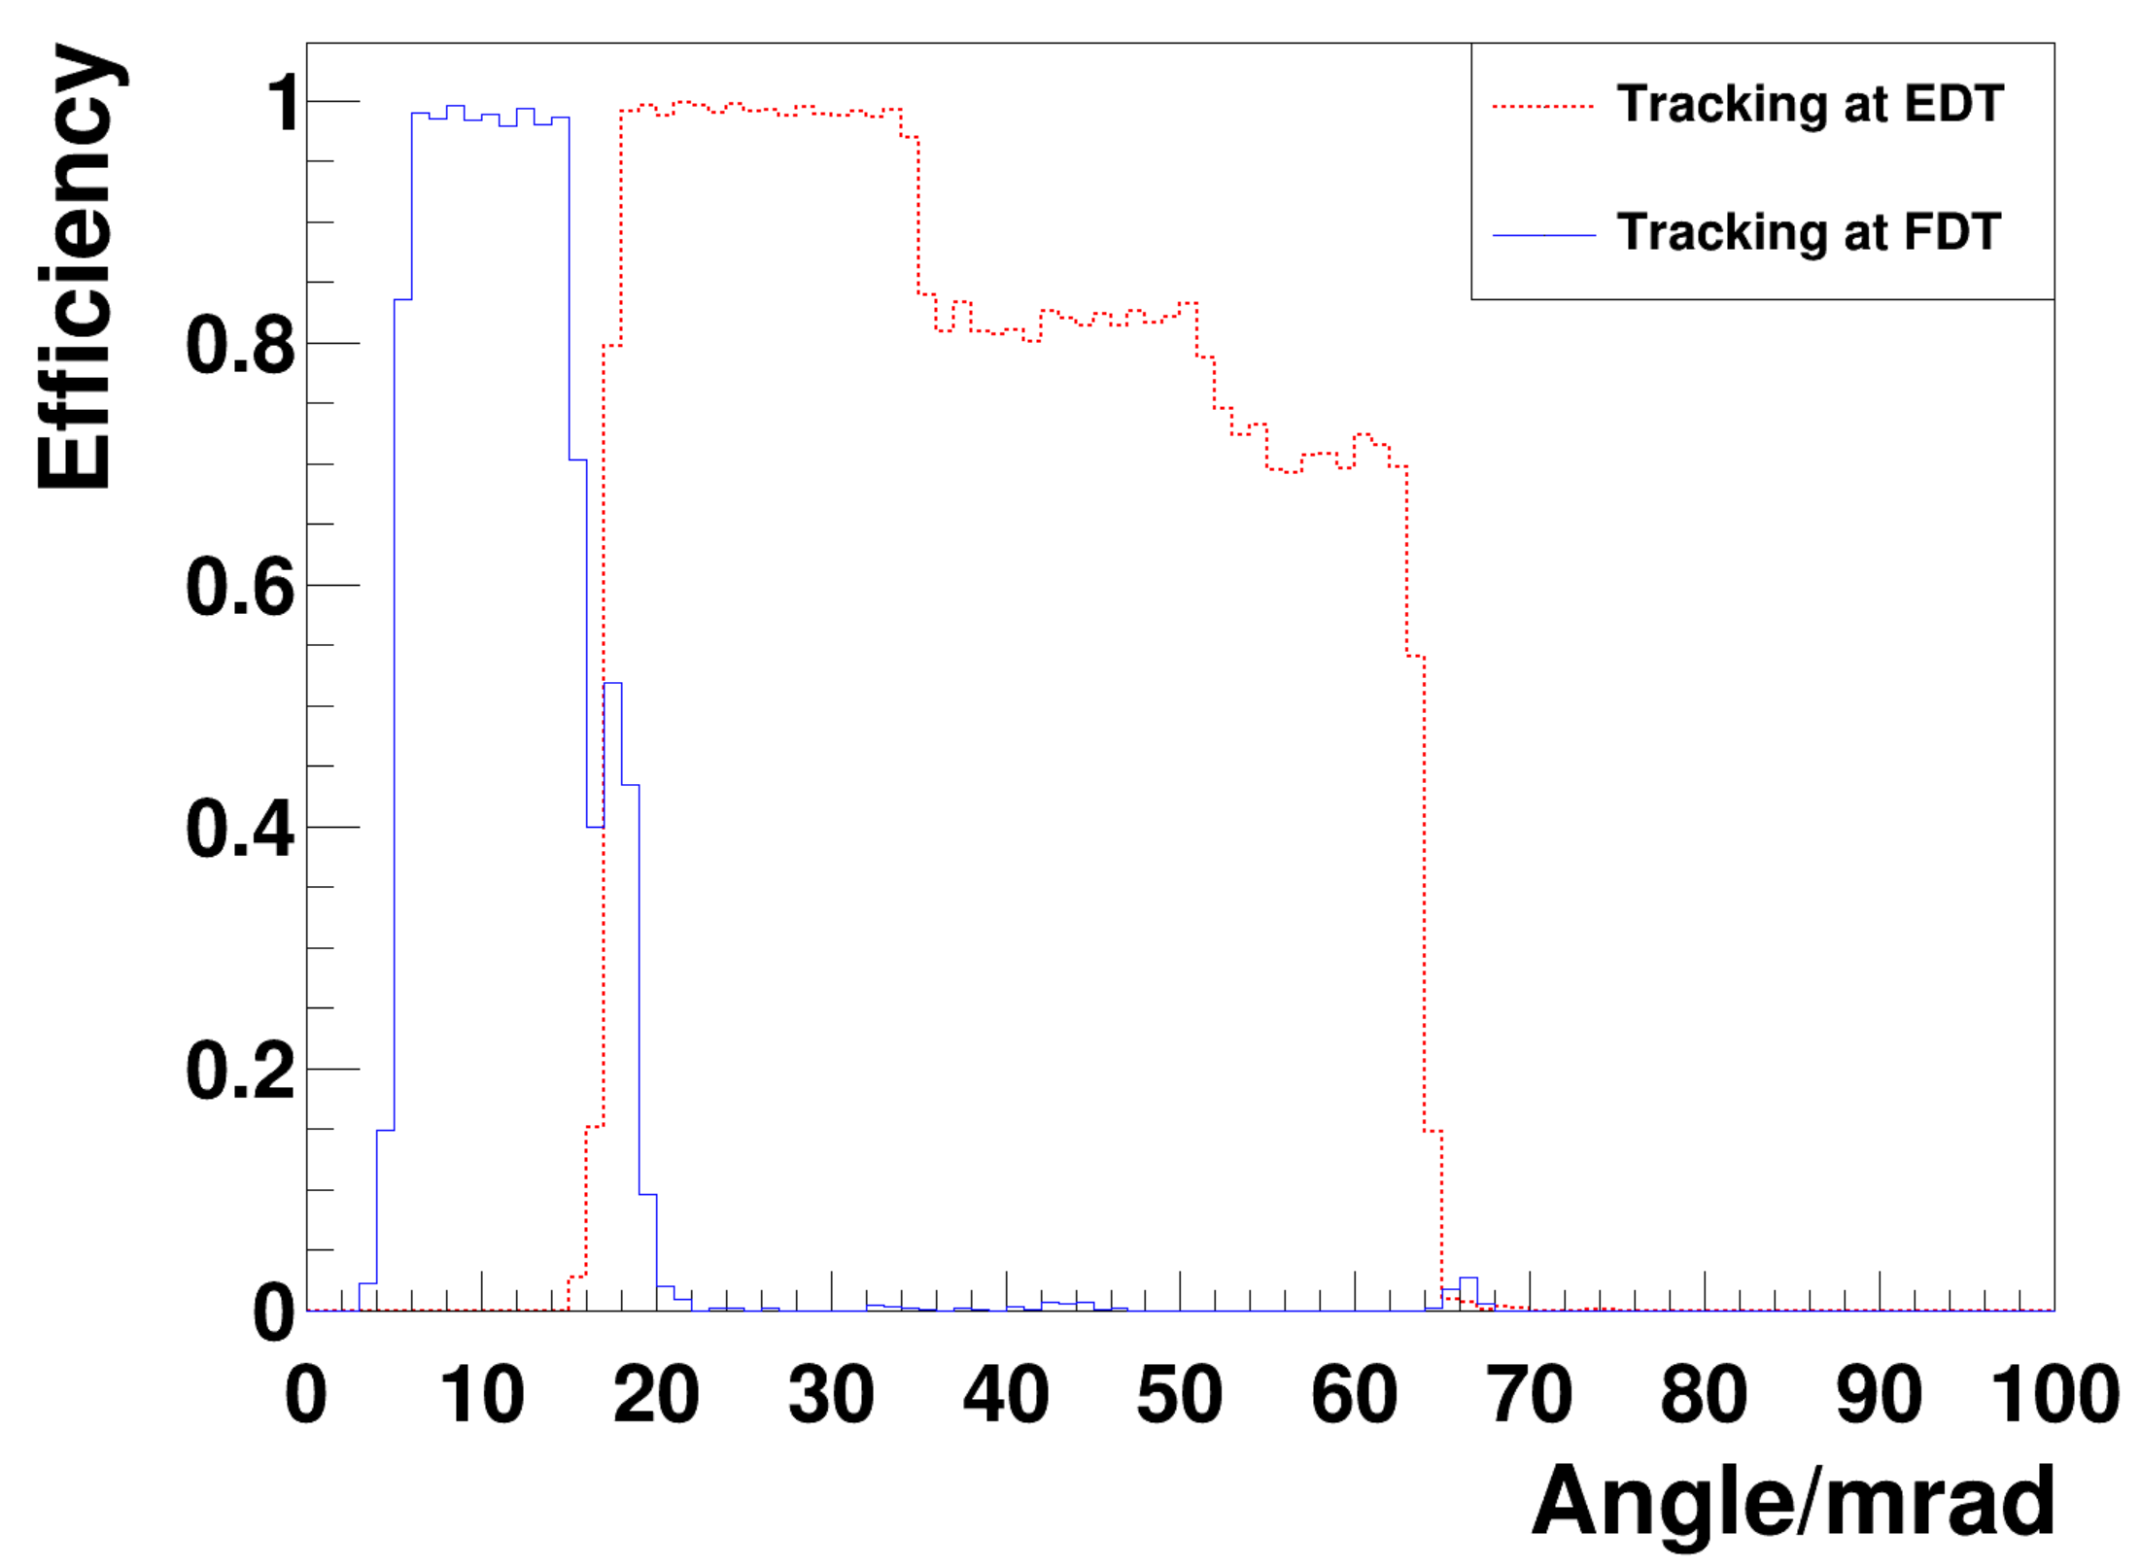
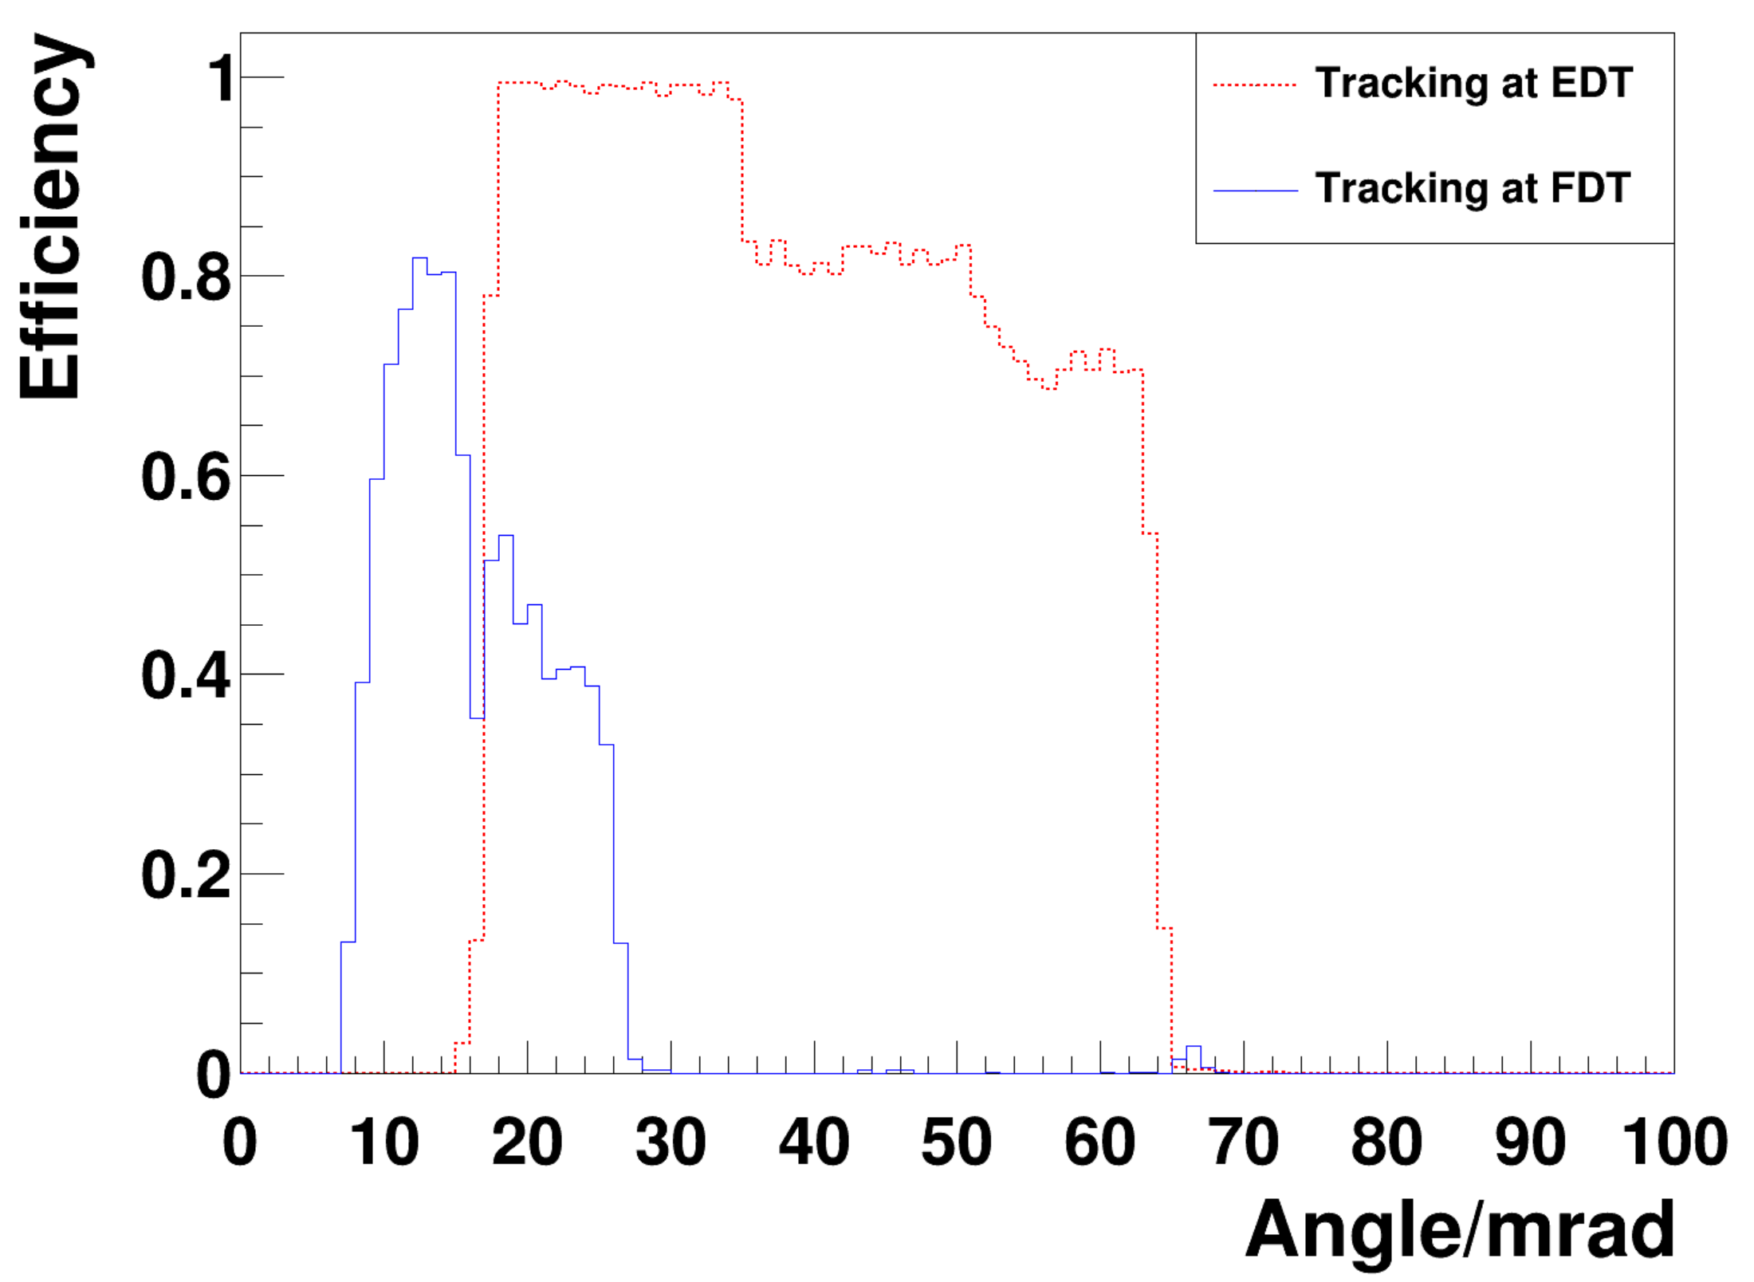
Impact of Quadrupoles -- Acceptance
Previously with only DIPOLE
DIPOLE and QUAD

Slide 18
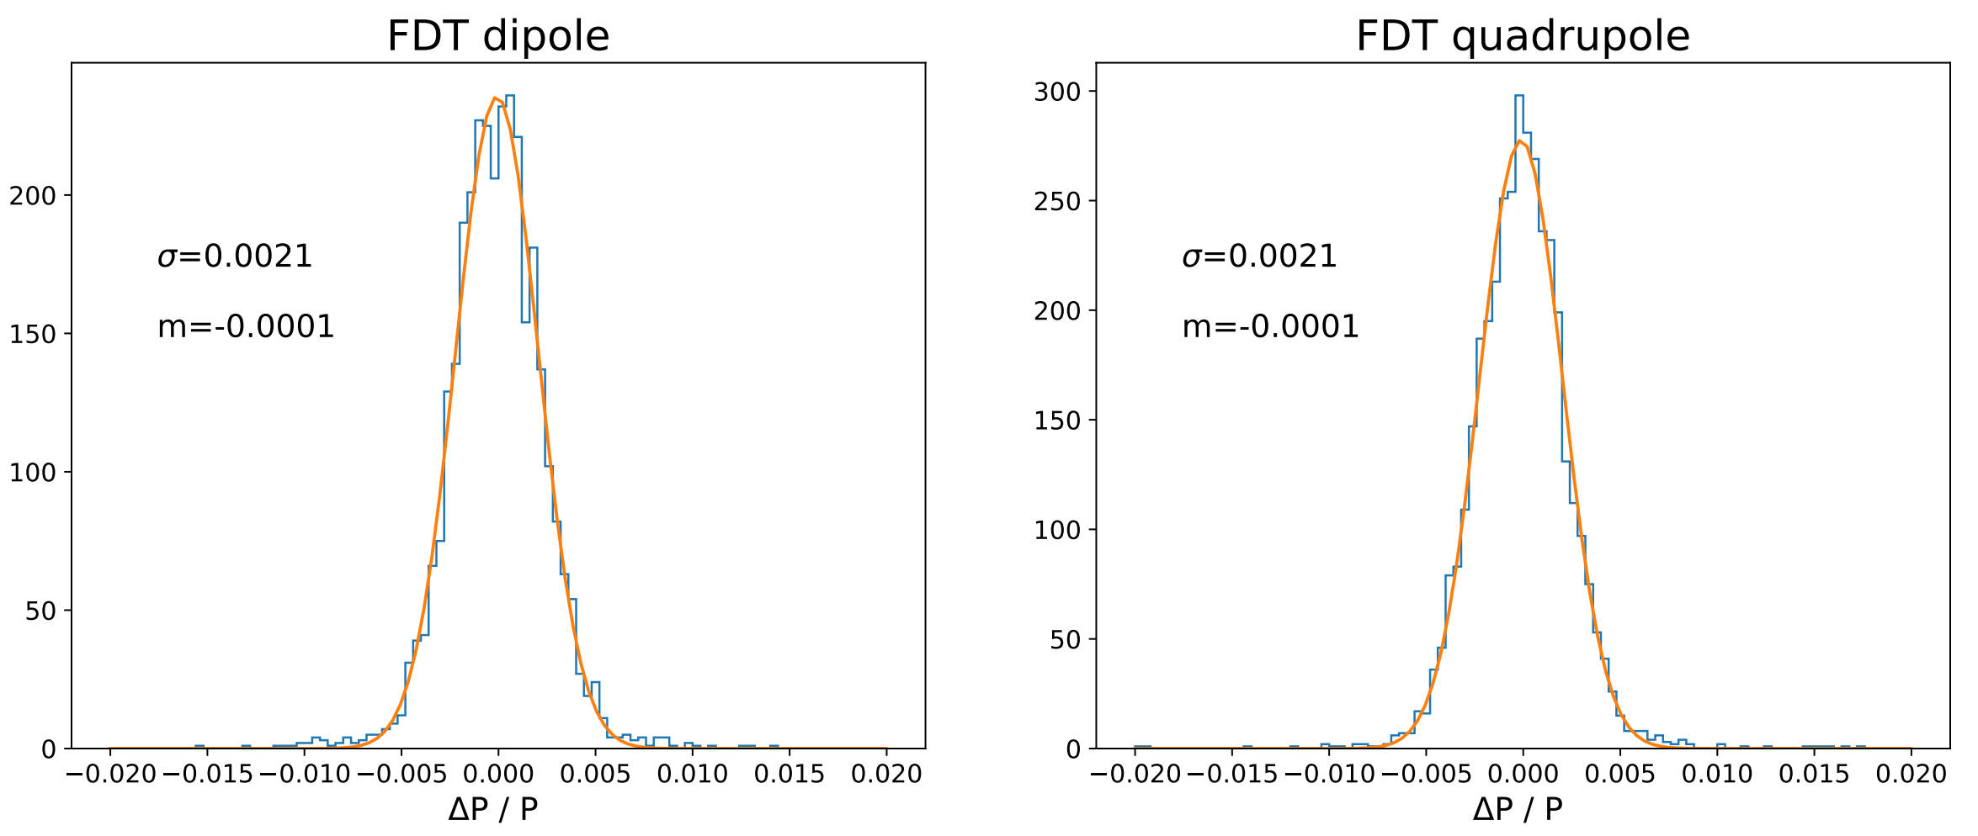
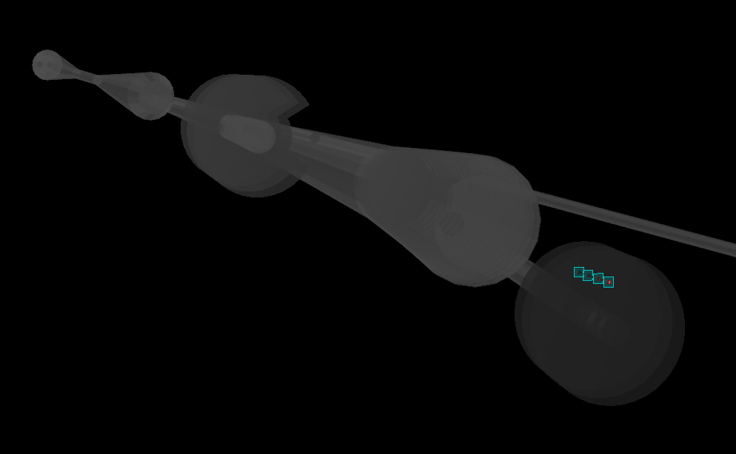
Impact of Quadrupoles -- resolution
To-do: extrapolate back to the IP!

Slide 19
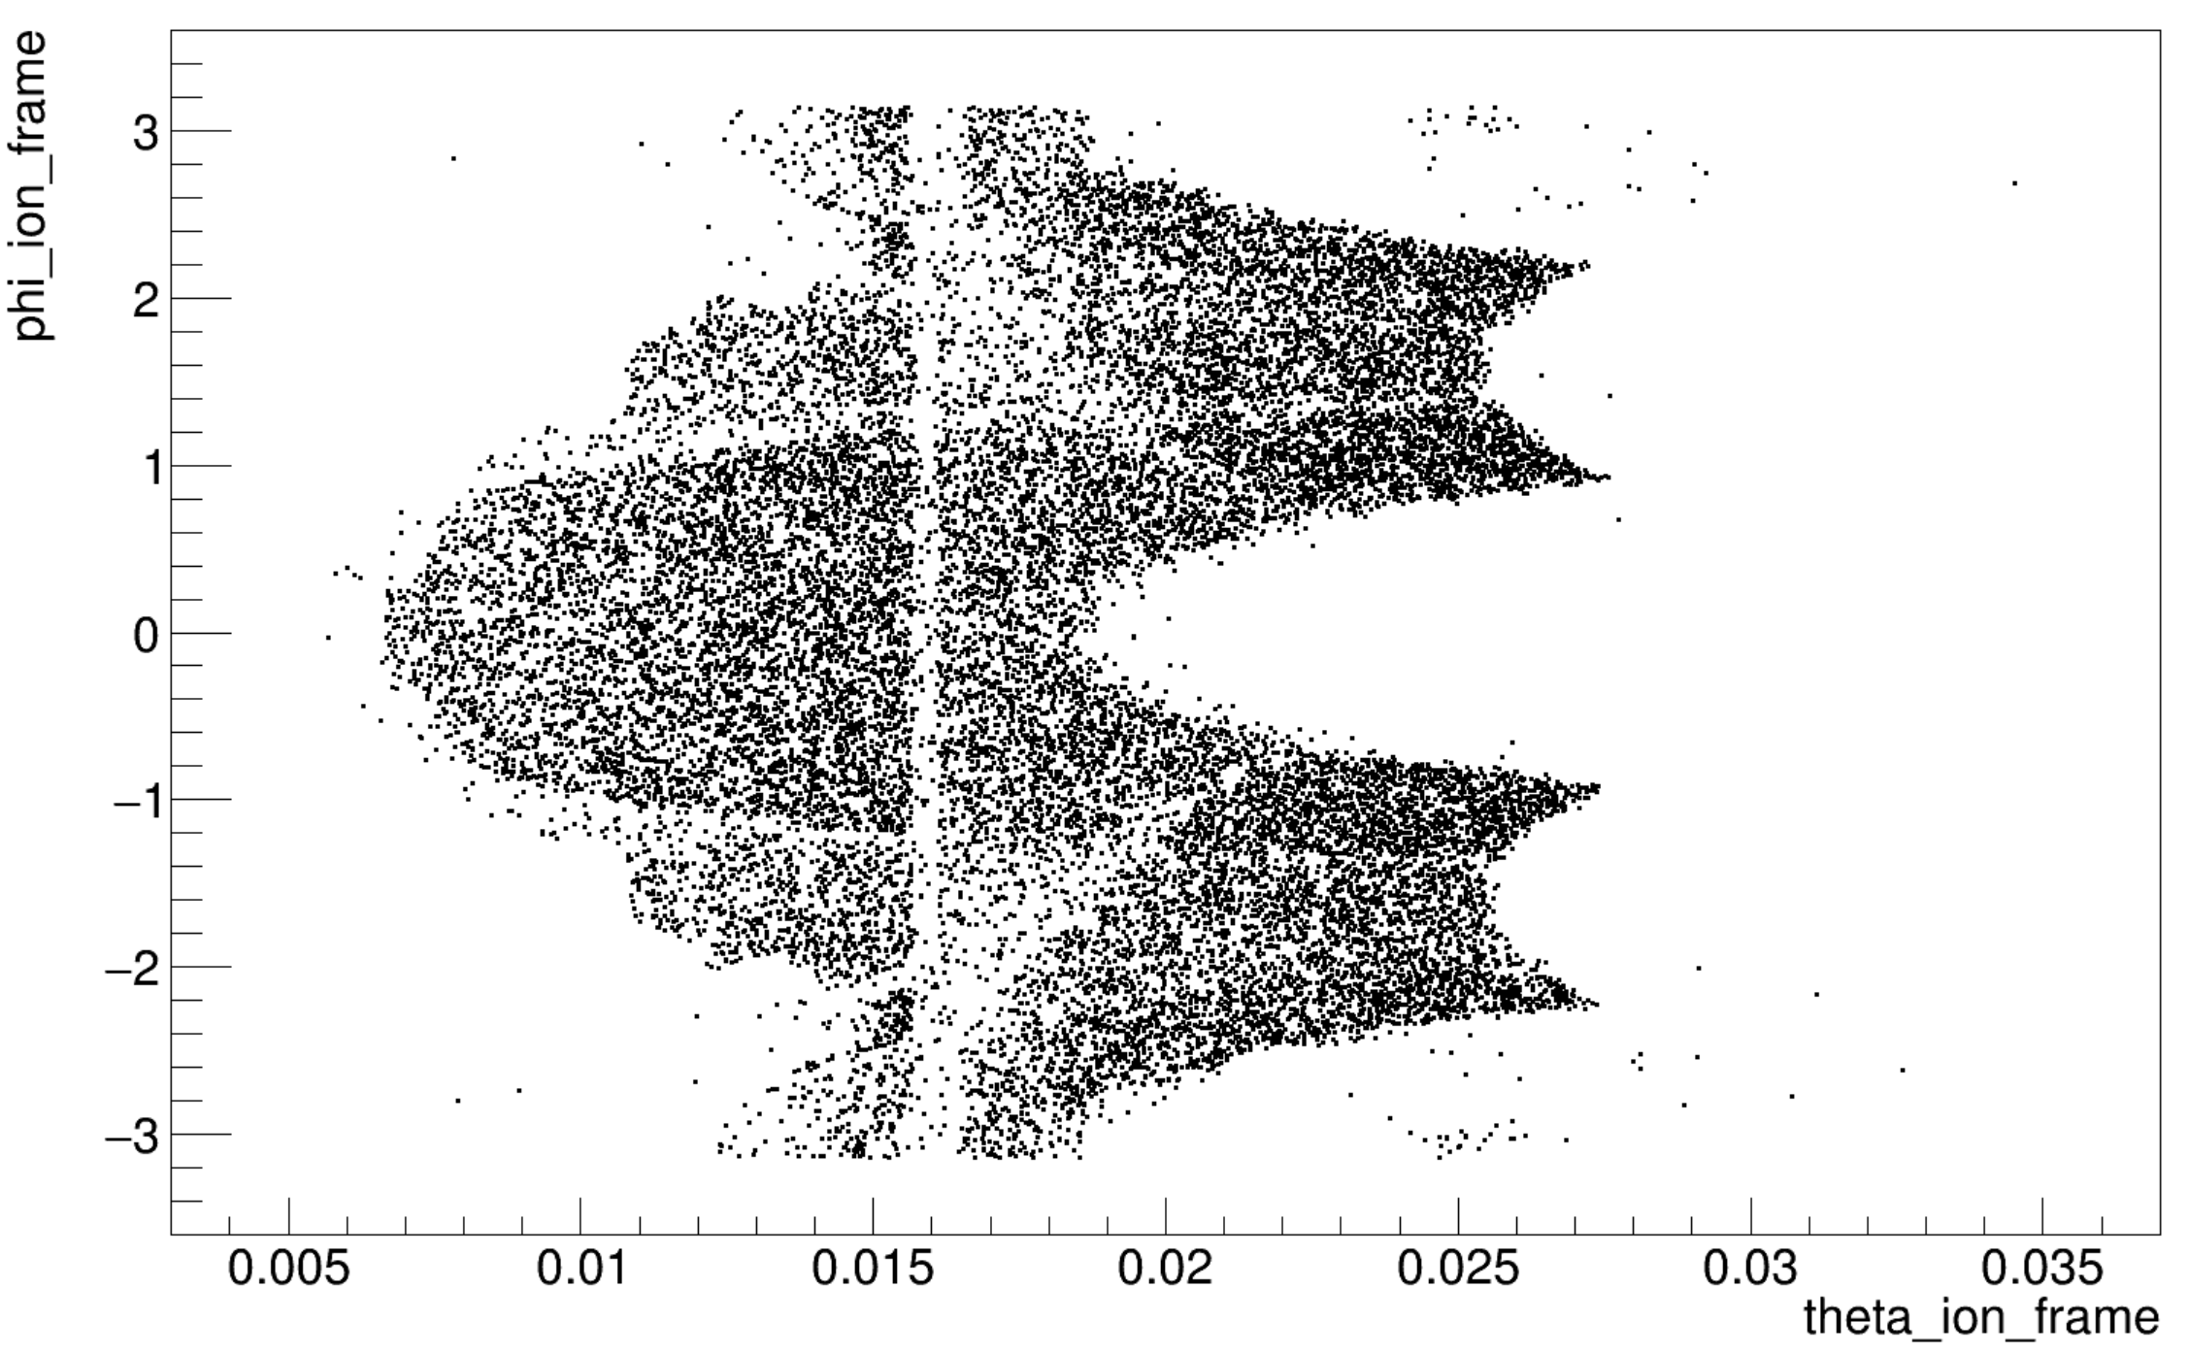
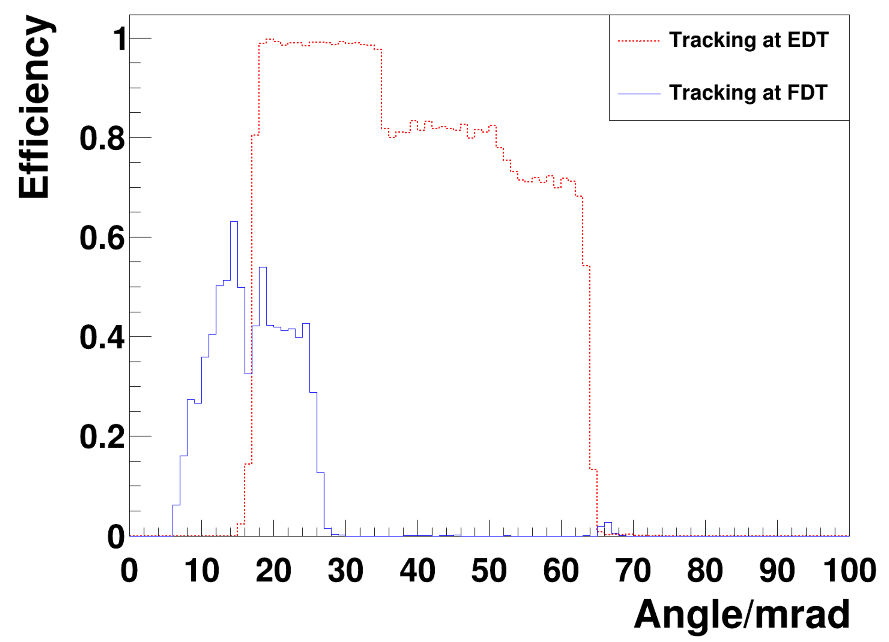
Impact of stronger quadrupole fields
Current QUAD
QUAD increase by 50%
Current QUAD
QUAD increase by 50%

Slide 20
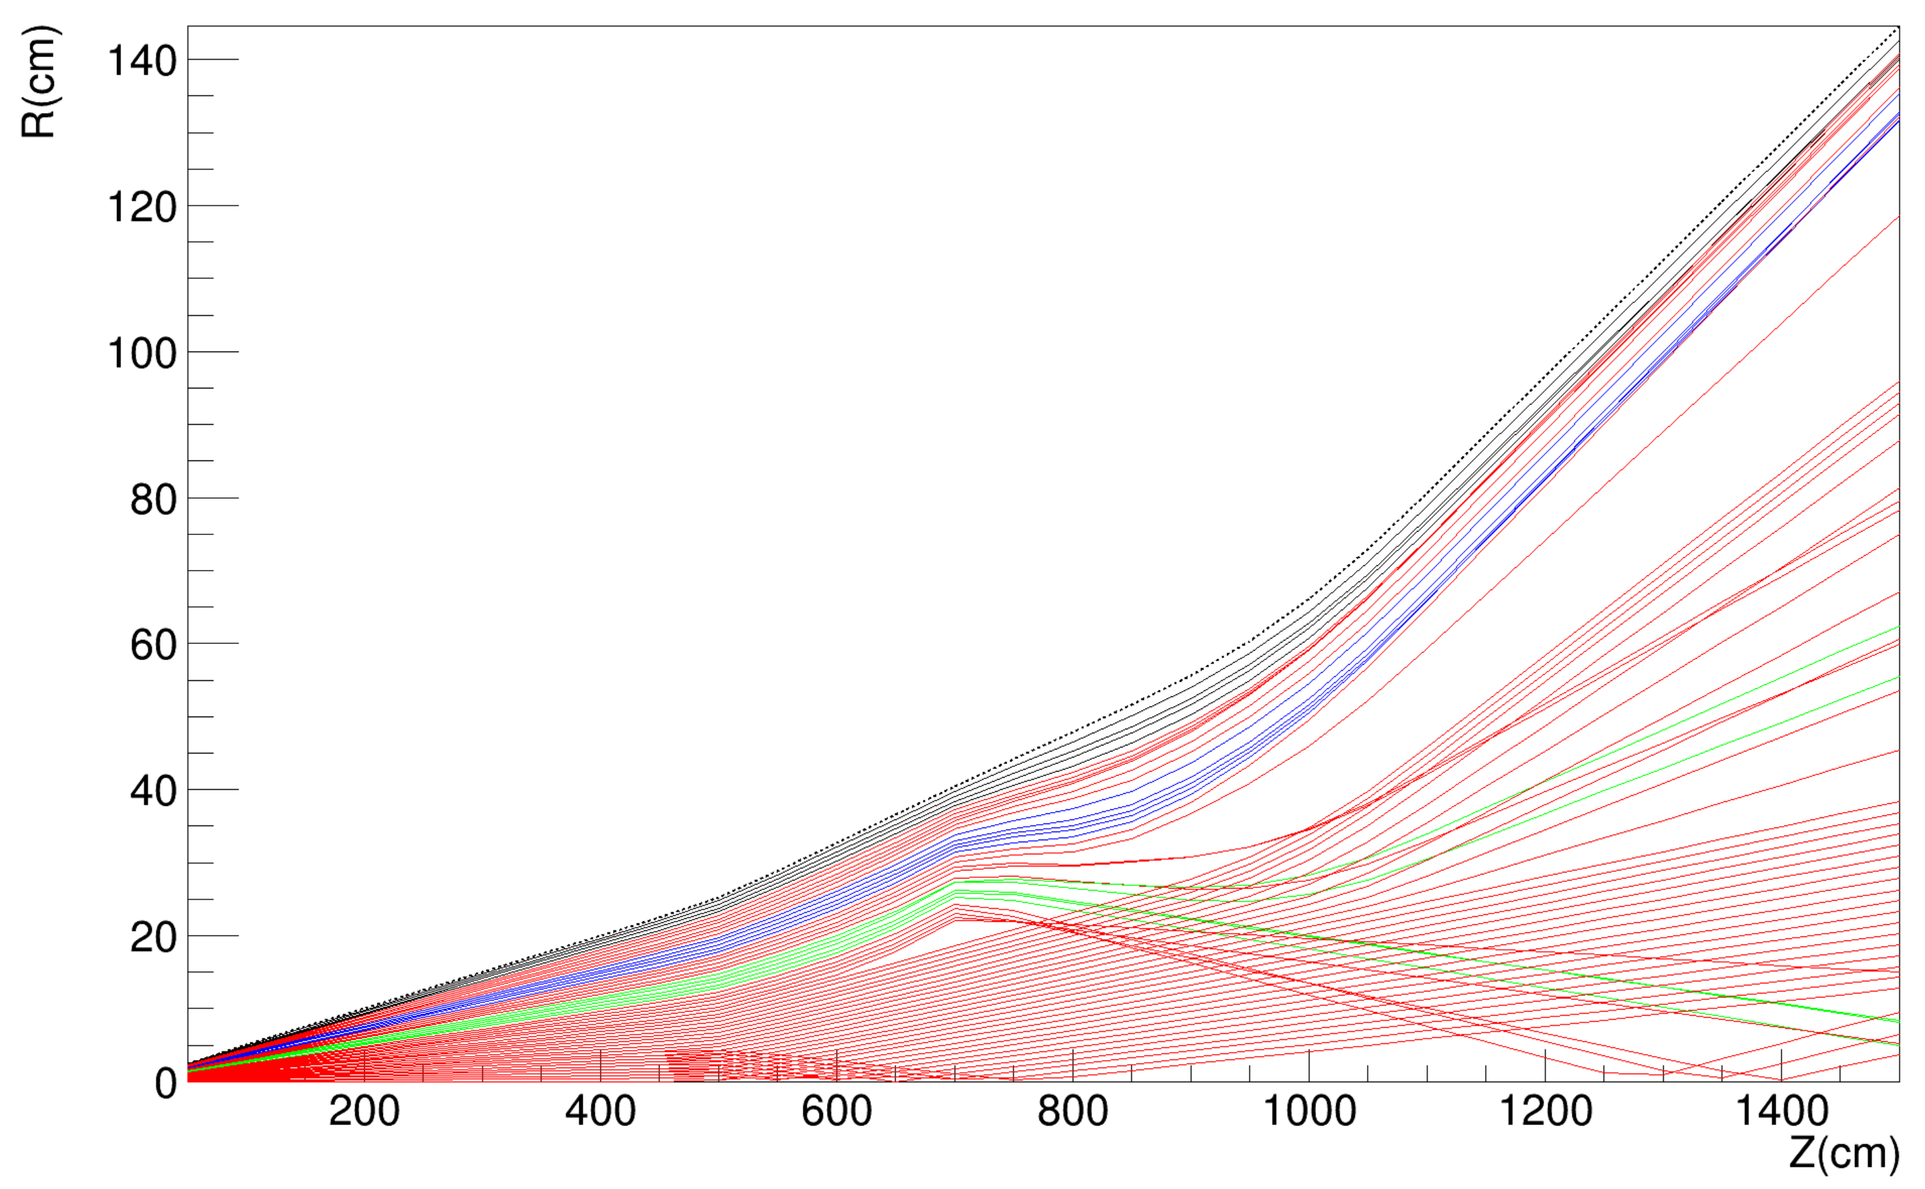
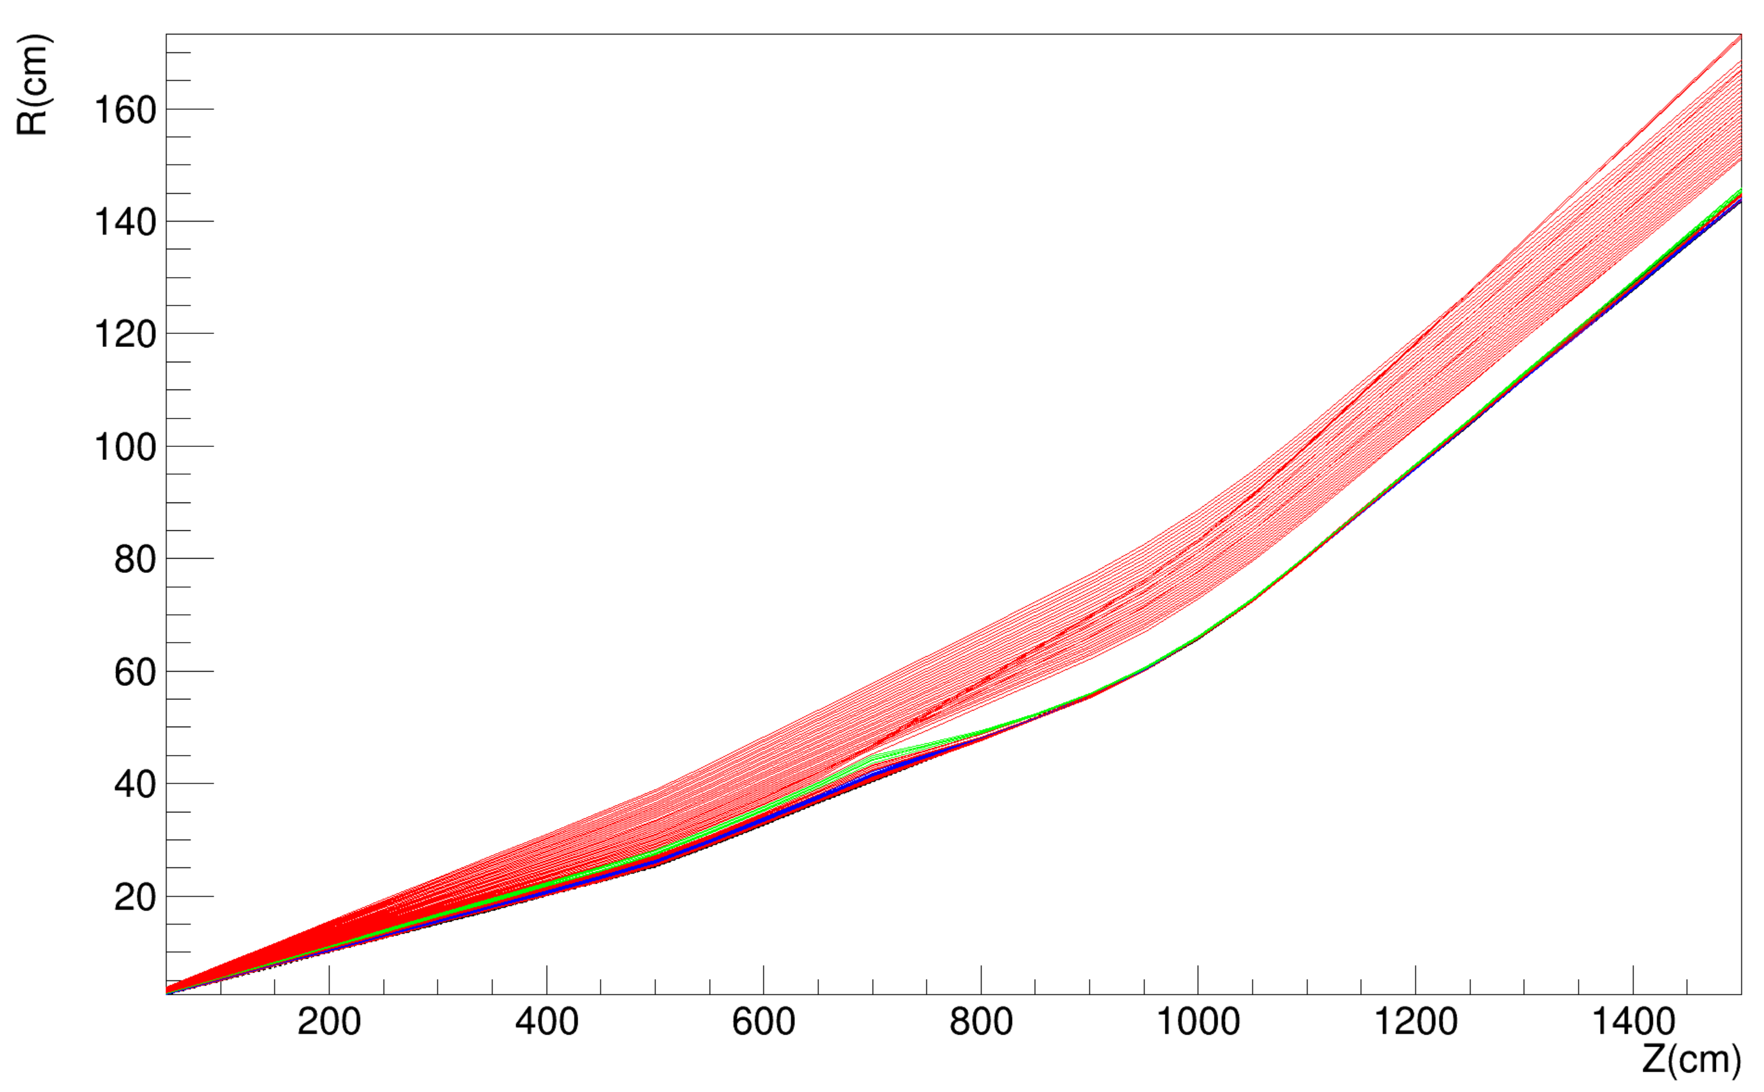
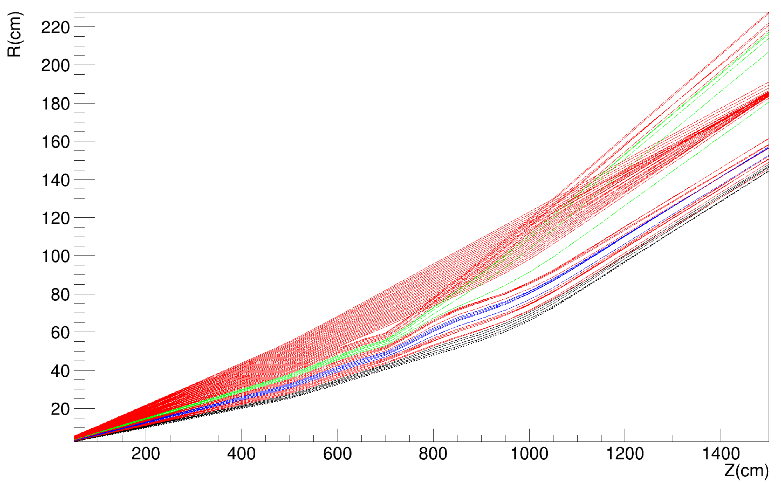
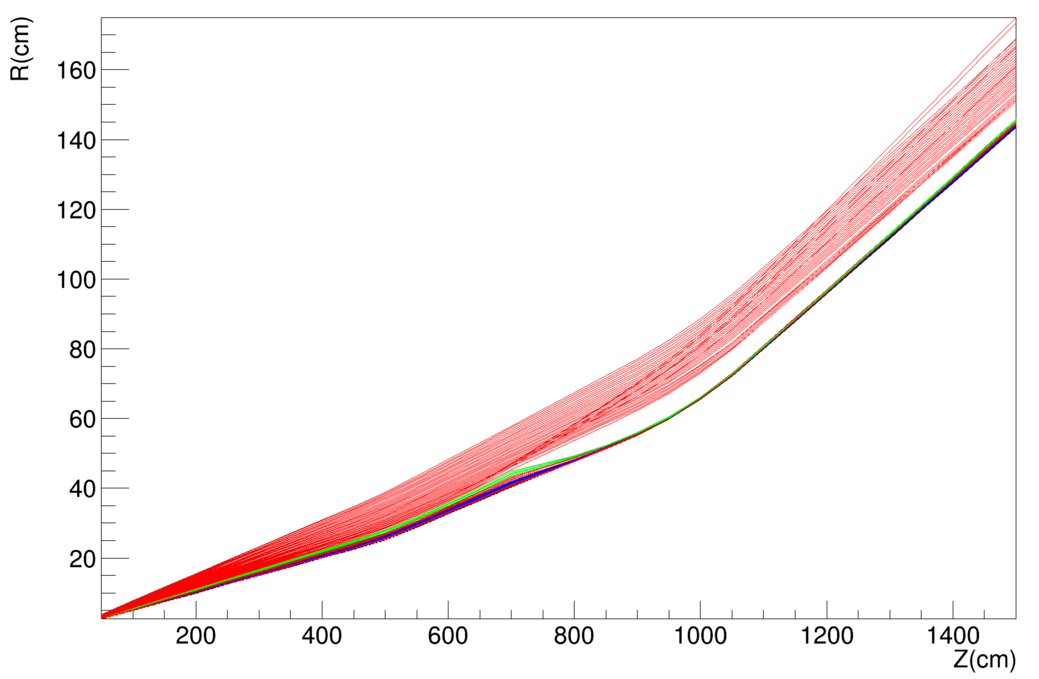
Theta = [0 - 60] mrad
Impact of Quadrupoles
Phi=0
Phi=90
Low acceptance below 10 mrad !
Phi=180
Phi=270
Low acceptance below 10 mrad !

Slide 21
Impact of Quadrupoles
Theta = 10 mrad DIPOLE
Z=800cm
Z=1500cm
Z=700cm
phi=270
Theta = 10 mrad DIPOLE+QUAD / vacuum
phi=0
phi=180
phi=90
Theta = 10 mrad DIPOLE+QUAD + beampipe

Slide 23
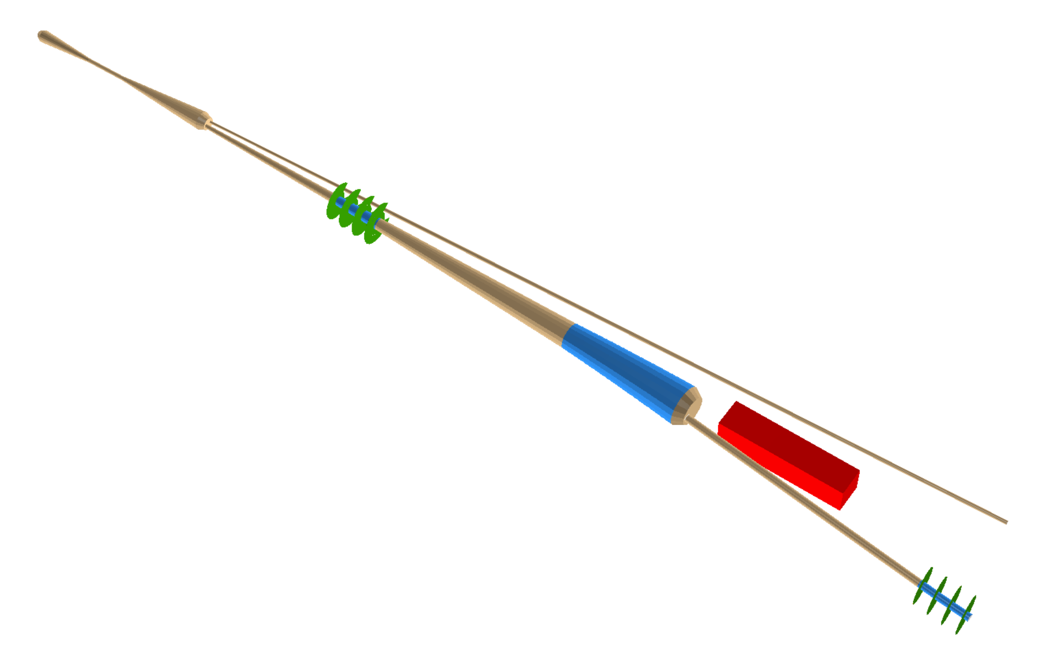
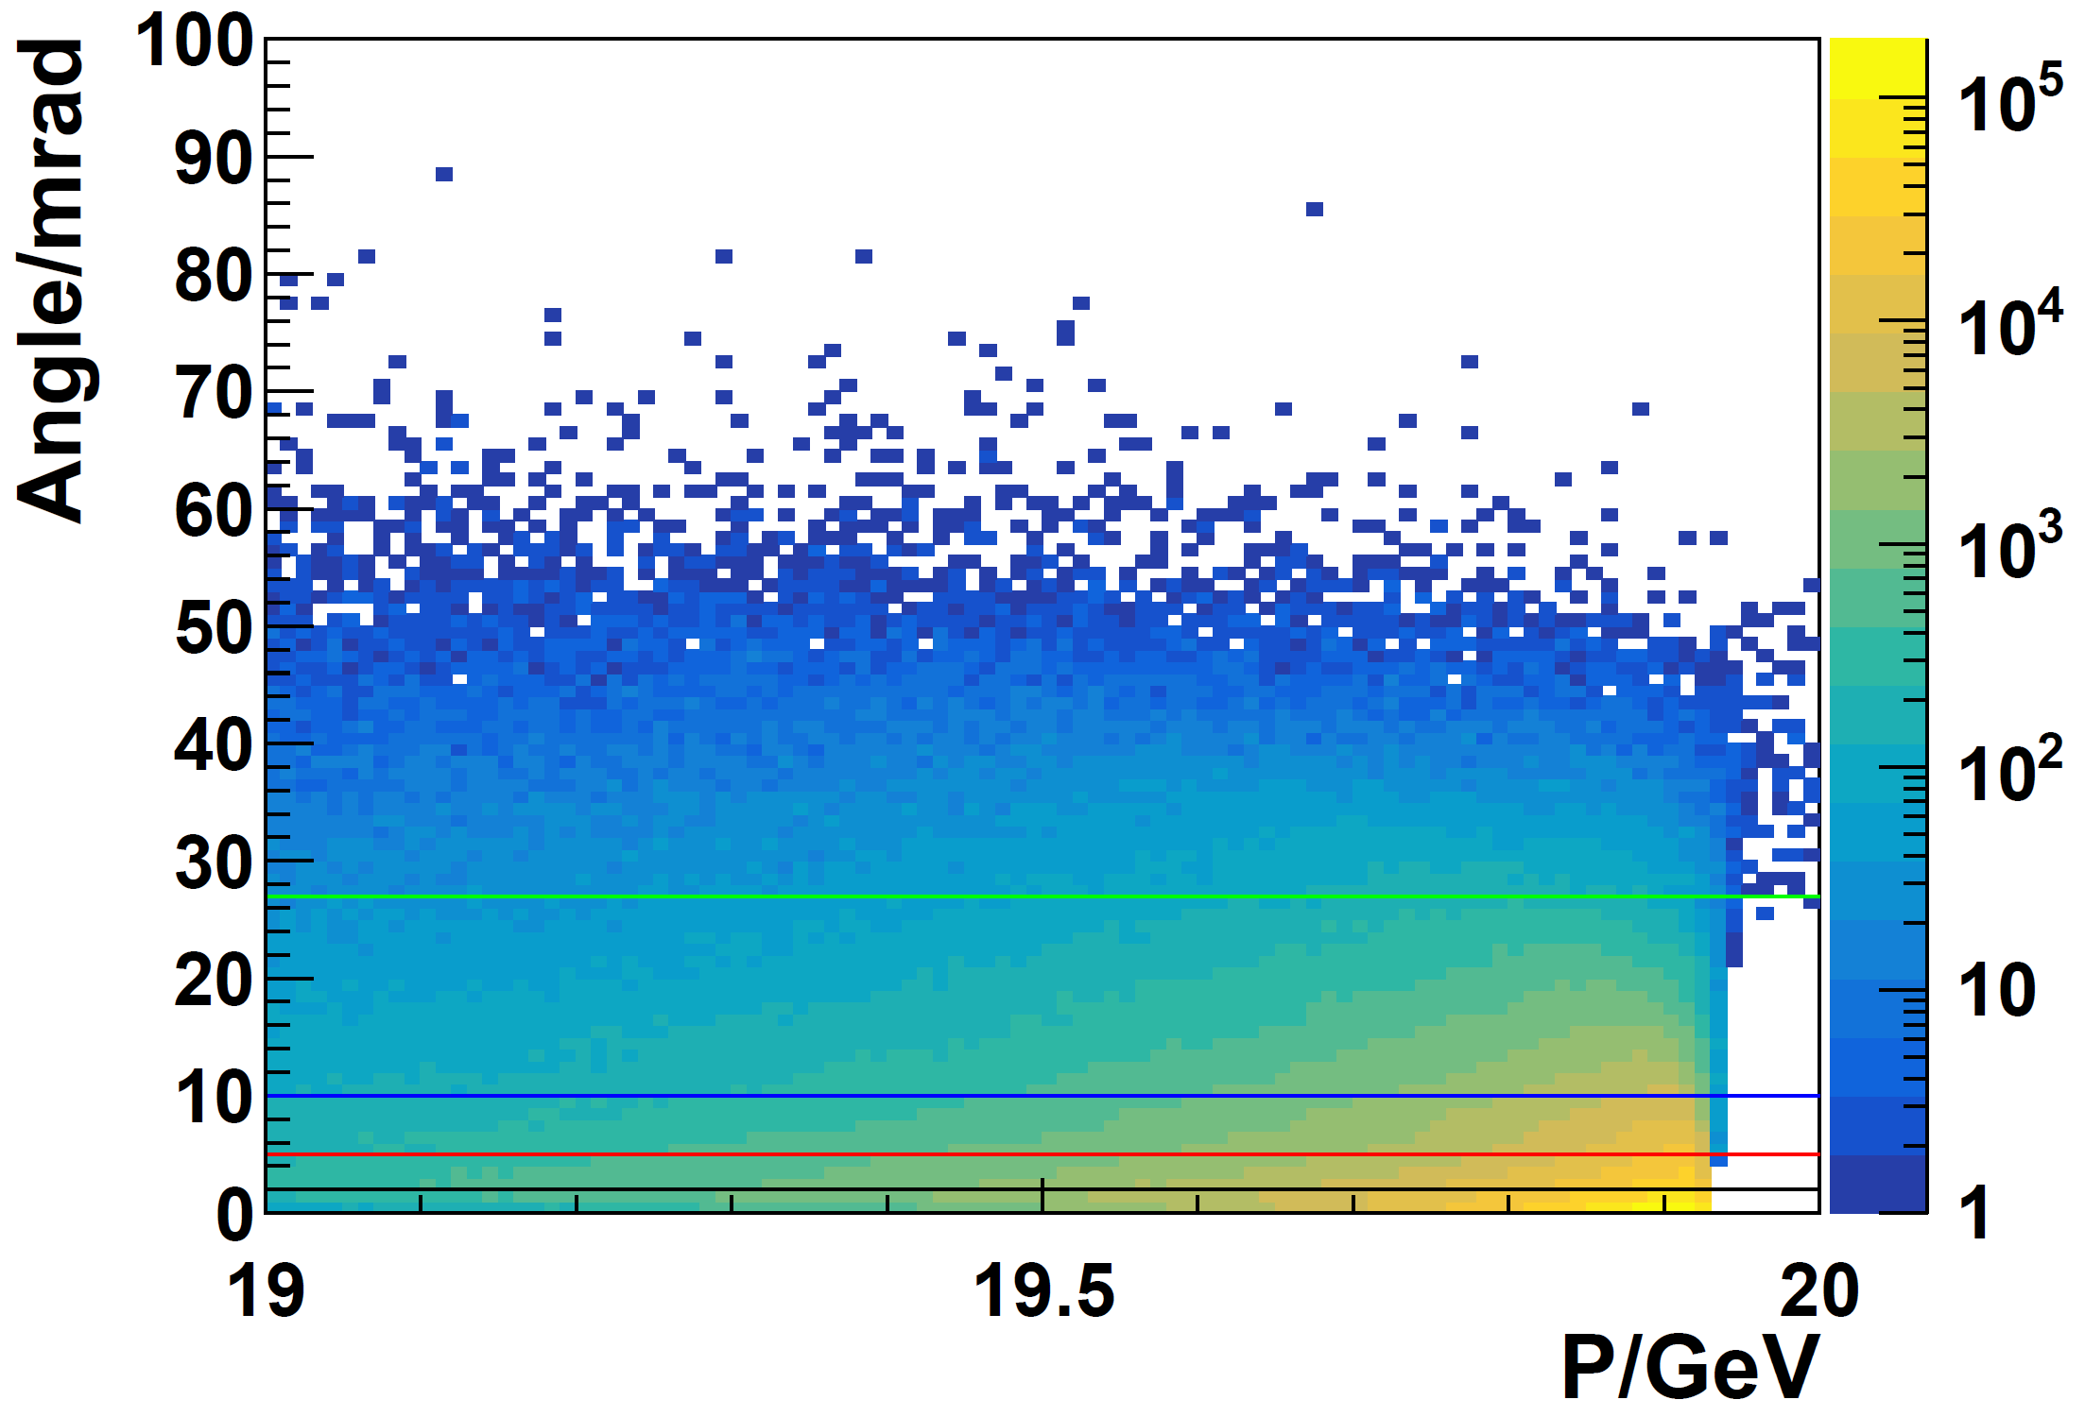
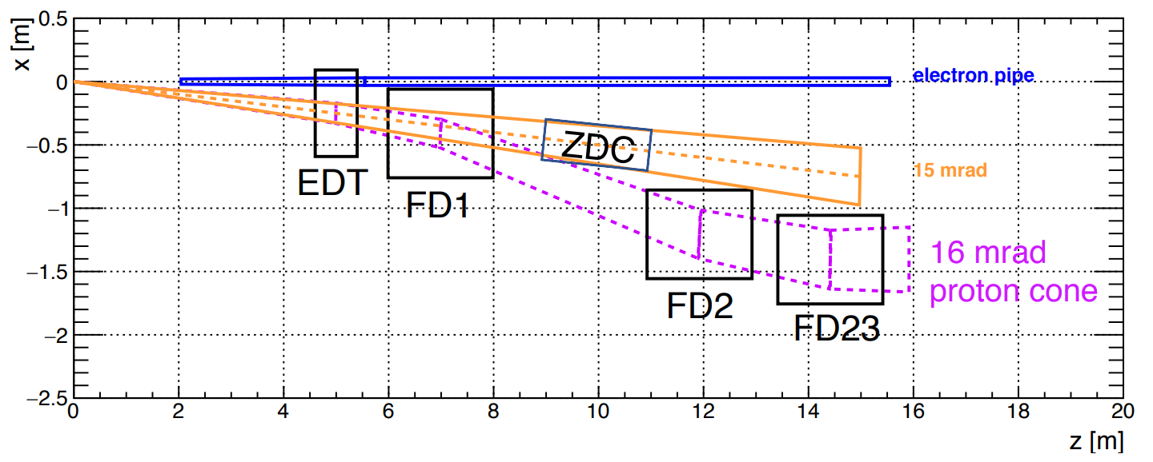
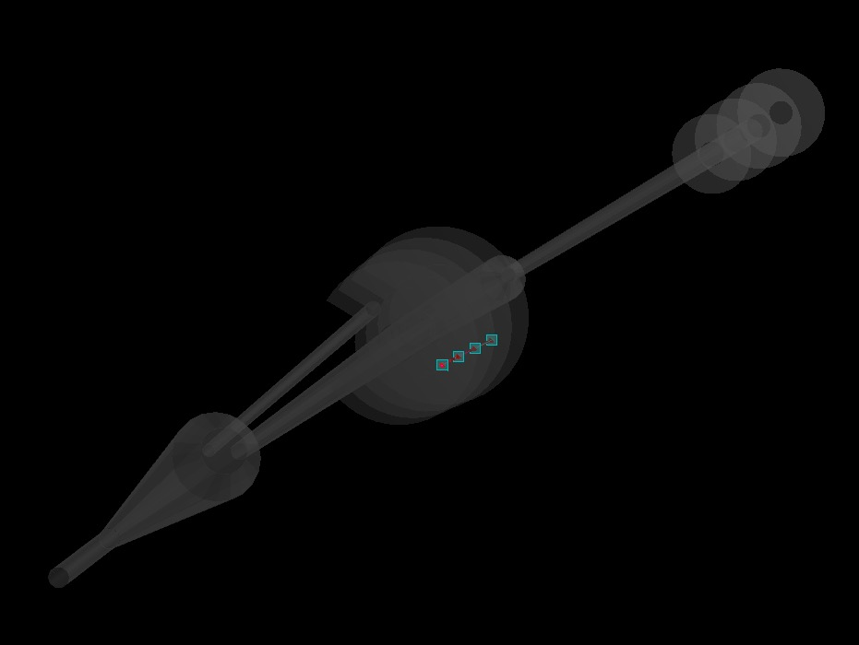
Far-forward detectors
EDT: 16-60 mrad
EDT
ZDC: 15 mrad
FDT
FDT: 5-16 mrad
From Weizhi
mrad : DVCS ratio relative to 2 mrad
16-34: 9.3%
16-60: 9.9%
5-16: 45.3%
2-5： 44.7%
Notes:
One of the main physics focus of the forward detector is the measurement of DVCS process.
In the whitepaper, the DVCS process was investigated with a cut of theta_p_prime (the angle between scatter proton and the original proton beam) larger than 2 mrad.
In our first Forward detector design, EDT has a coverage of 16-60 mrad with the DVCS acceptance of 9.9% (relative to 2 mrad cut)
FDT has a coverage of 5-16 mrad, with the DVCS acceptance of 45.3% (relative to 2 mrad cut)
A combination of EDT and FDT may recover more than 55% of the DVCS events.

Slide 24
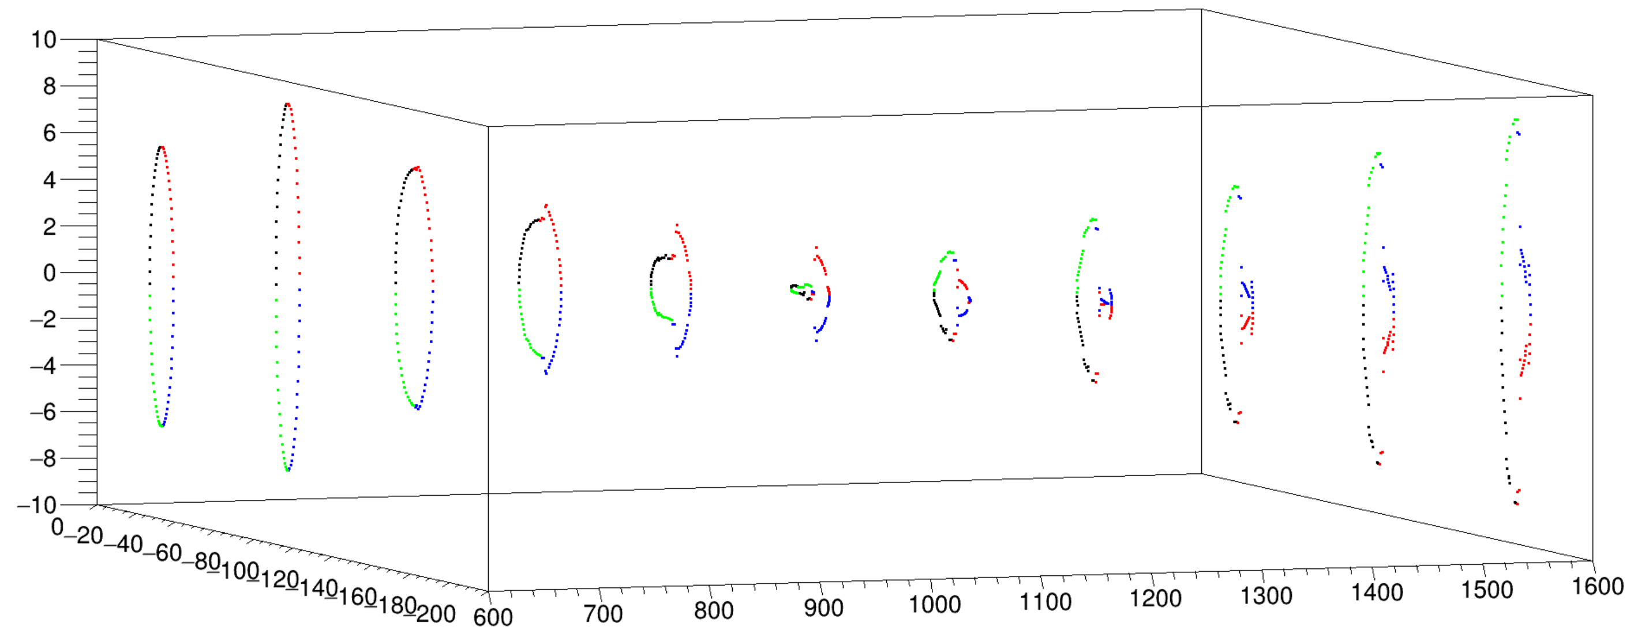

Slide 25
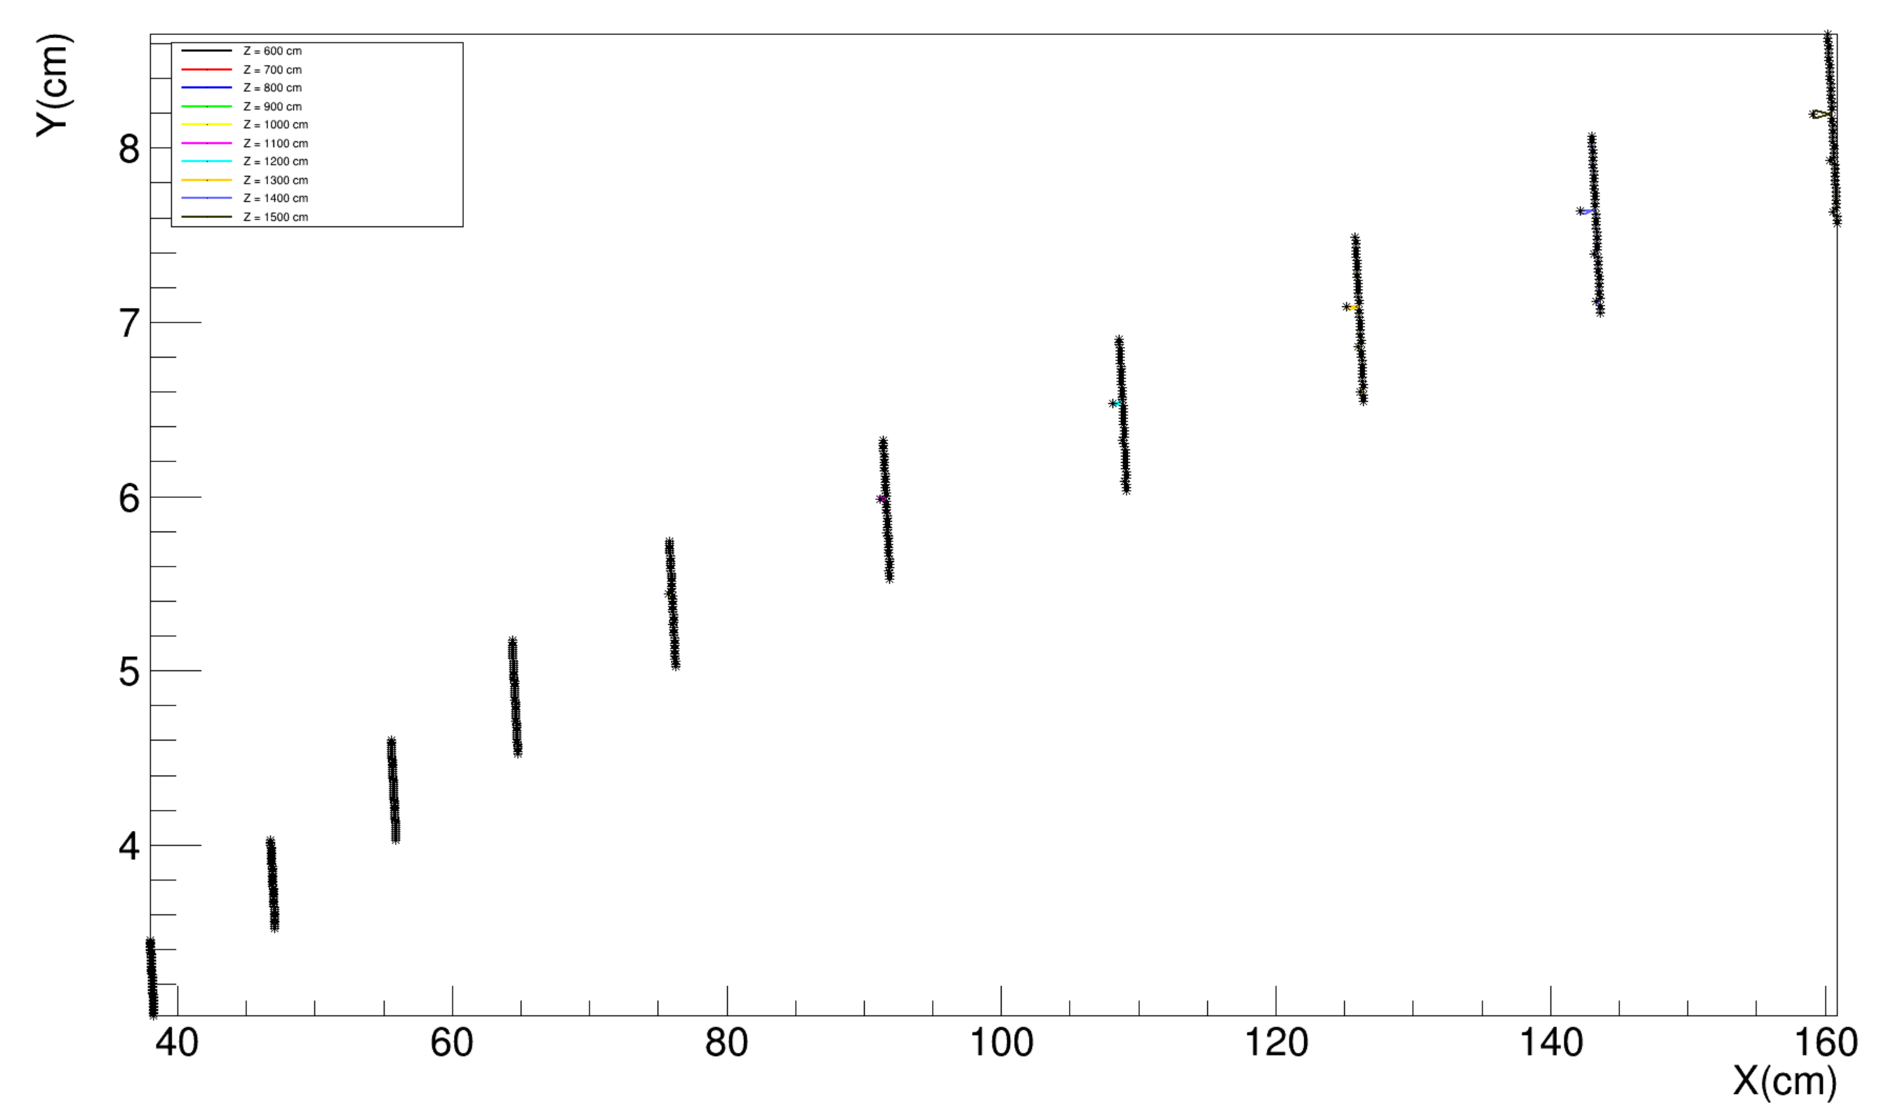
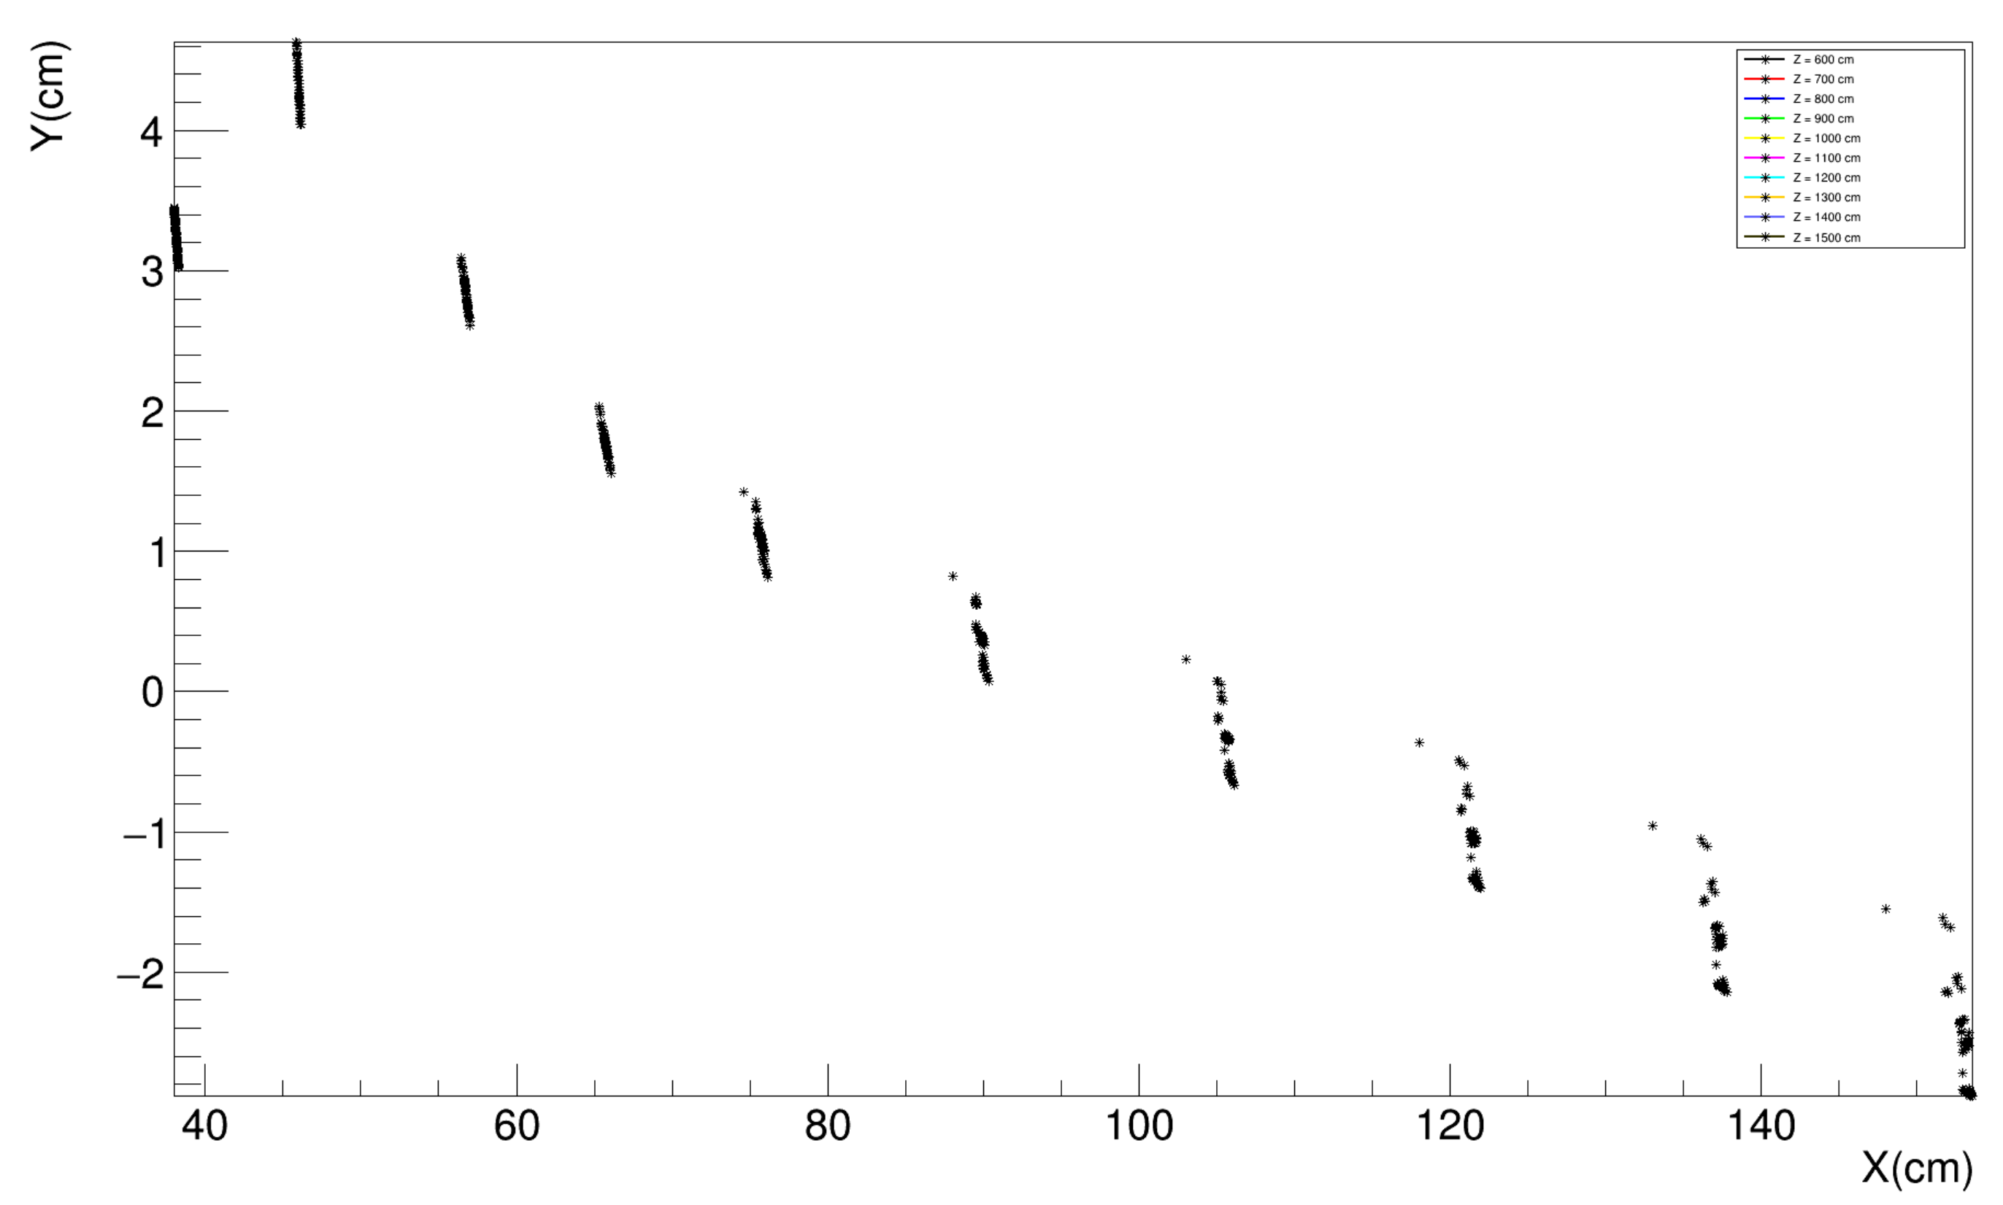
Theta = 10 mrad Phi = 145-150 DIPOLE
Theta = 10 mrad Phi = 145-150 DIPOLE+QUAD

Slide 26
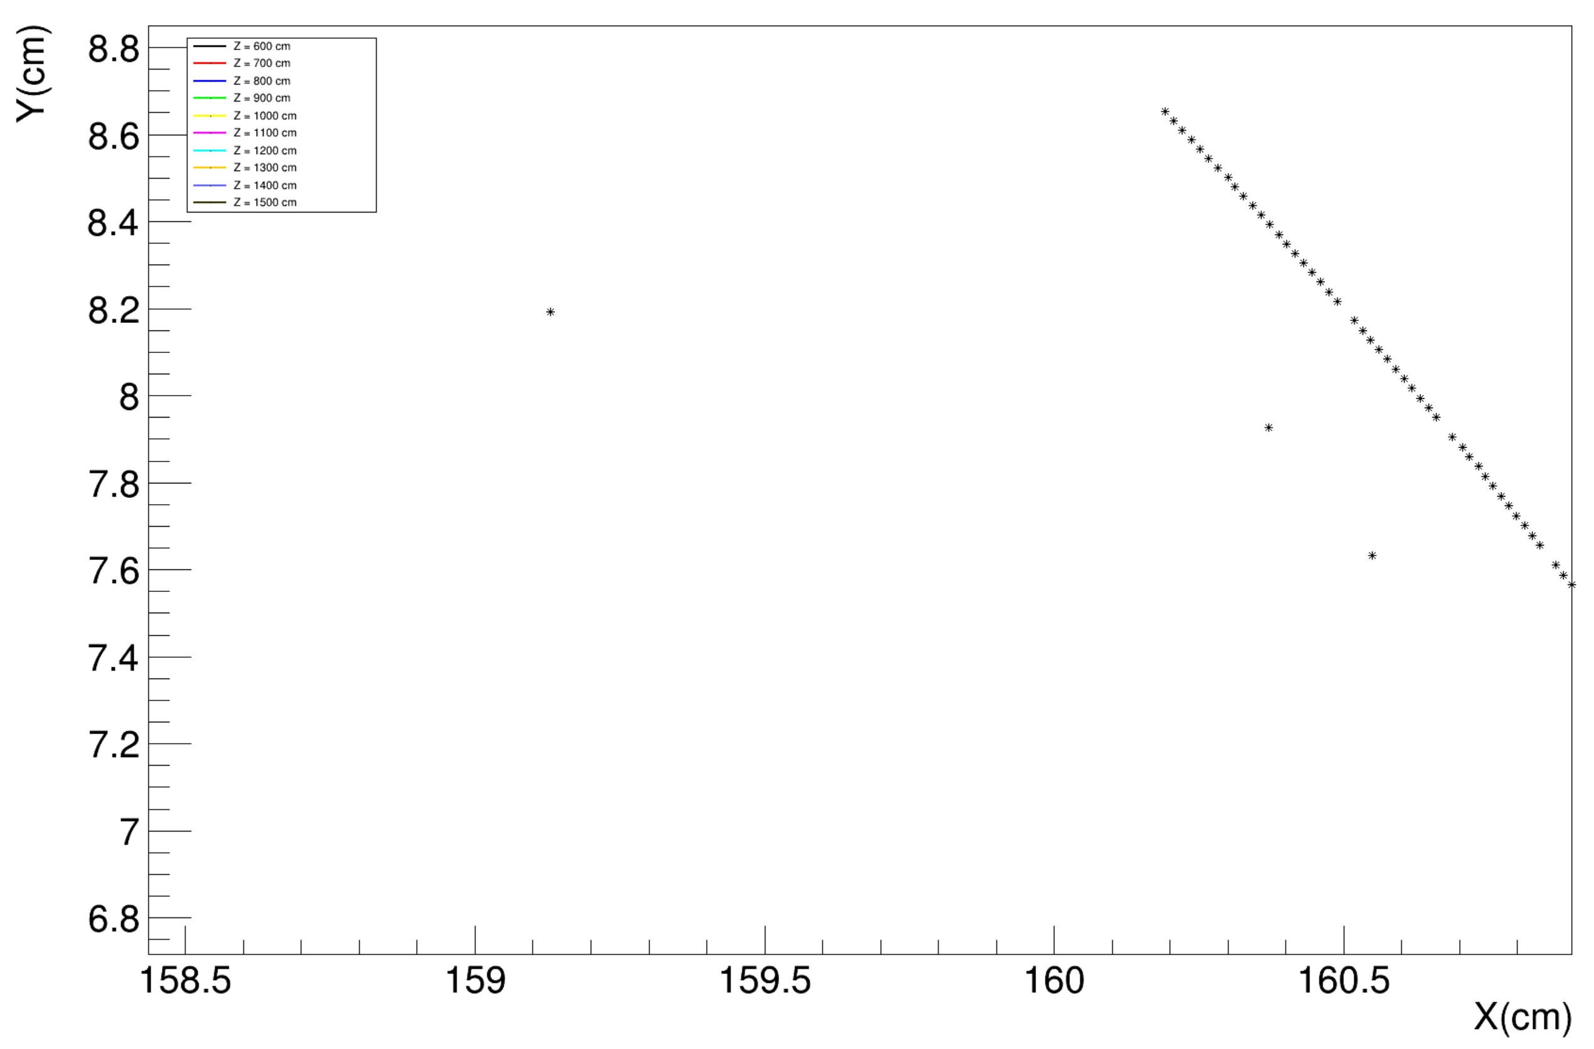
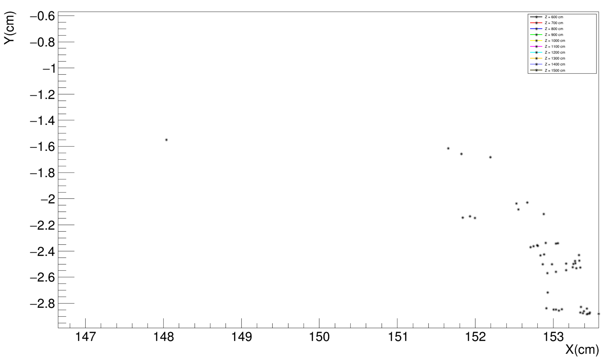

Slide 27
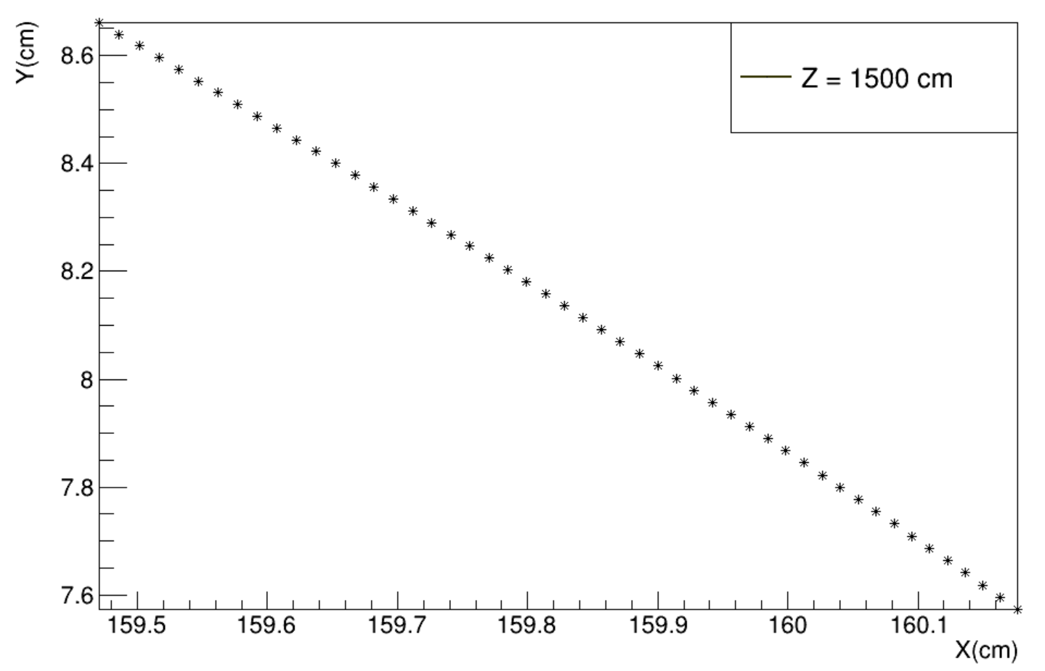
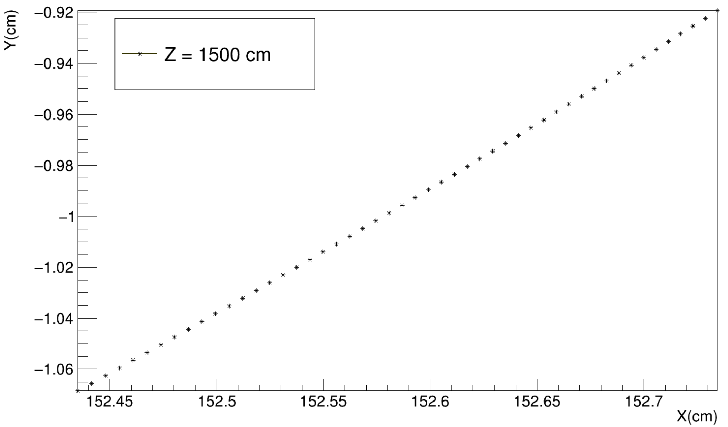
All Vacuum
Theta = 10 mrad Phi = 145-150 DIPOLE
Theta = 10 mrad Phi = 145-150 DIPOLE+QUAD

Slide 28
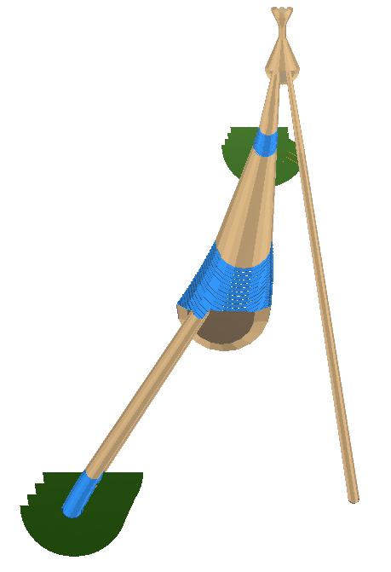
y
x
z
90º
180º
0º
270º

Slide 29
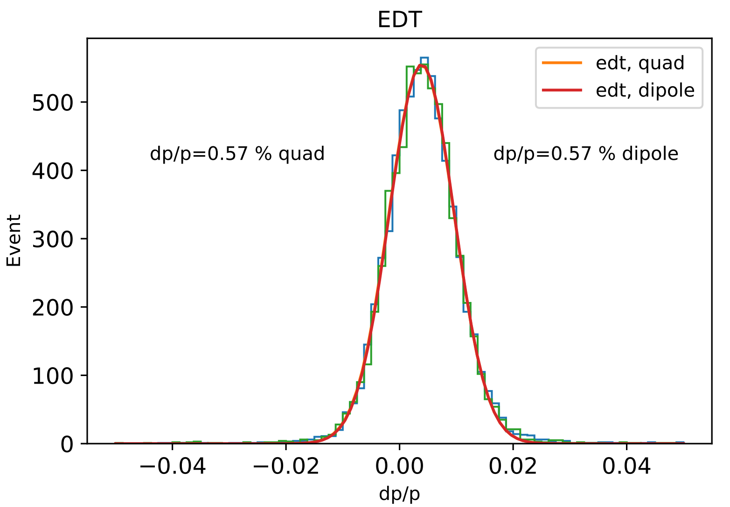
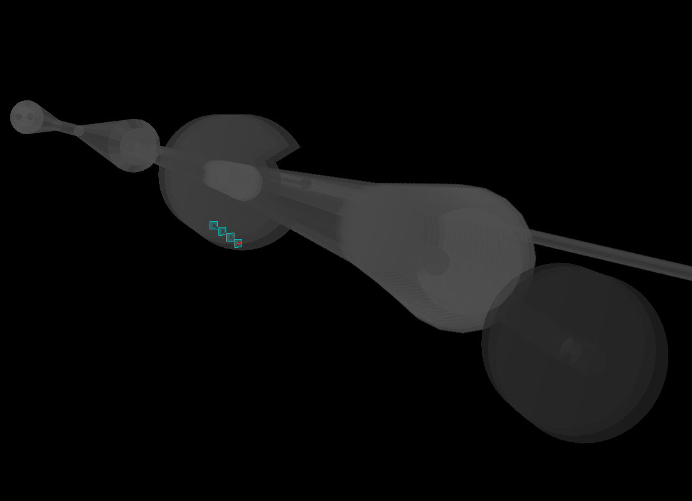
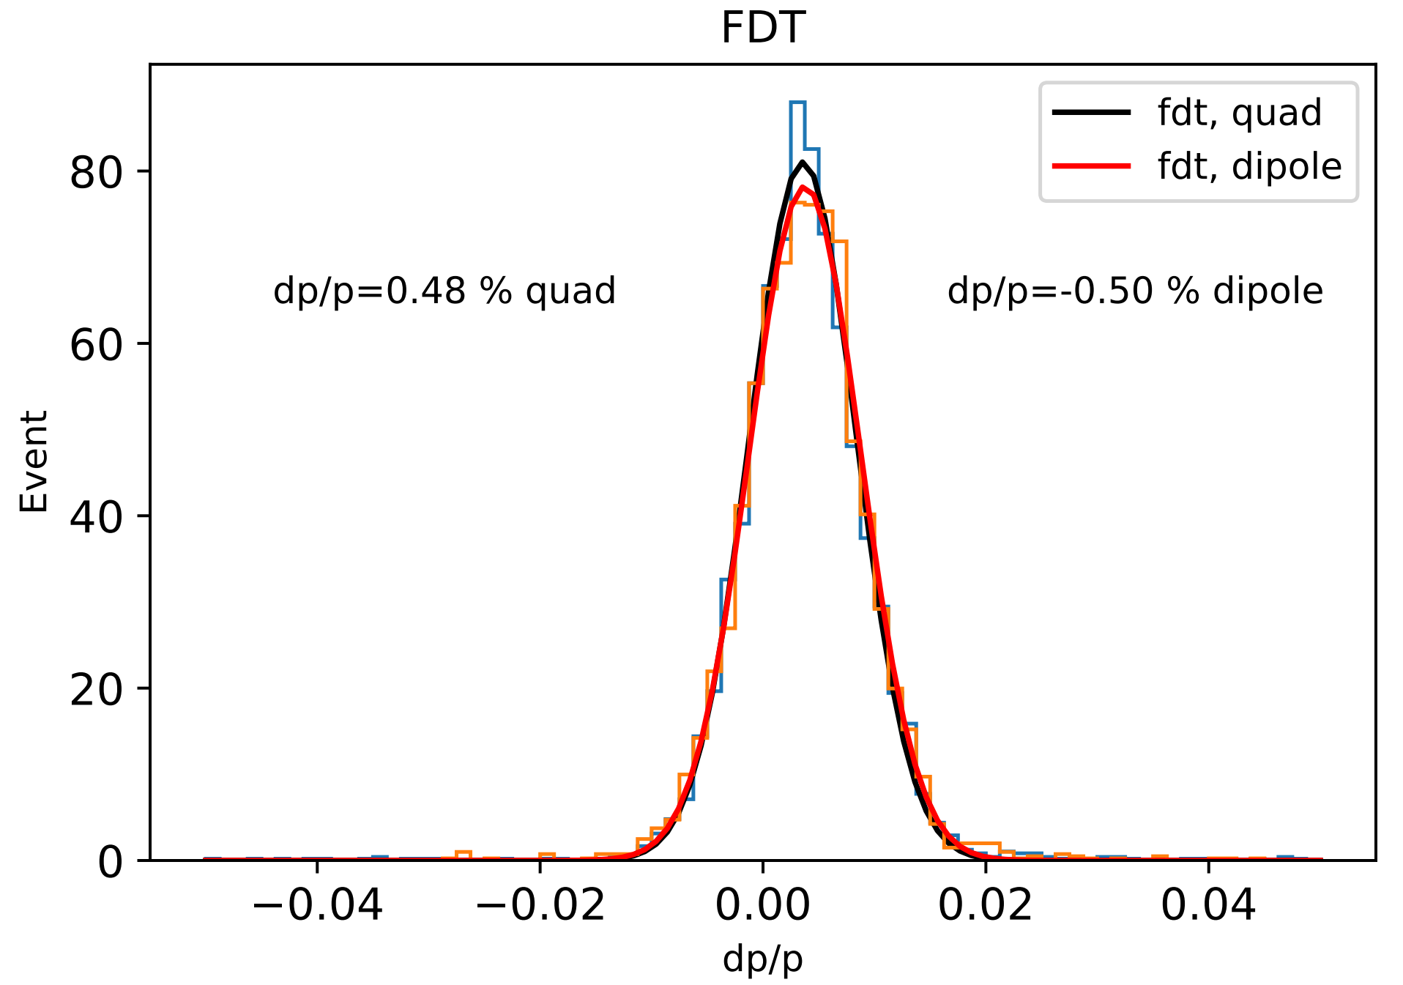
Impact of Quadrupoles -- resolution
Genfit in EiccRoot need to be tuned.
Mean value shift
Resolution could be better
Track is not extrapolated back to the IP!

