Slide 1
Far-forward detector at EicC
Aiqiang Guo, Yutie Liang, Ting Lin, Weizhi Xiong
2023.01.18

Slide 2
Outline
Review of far-forward detector design
Recent updates
Summary

Slide 3
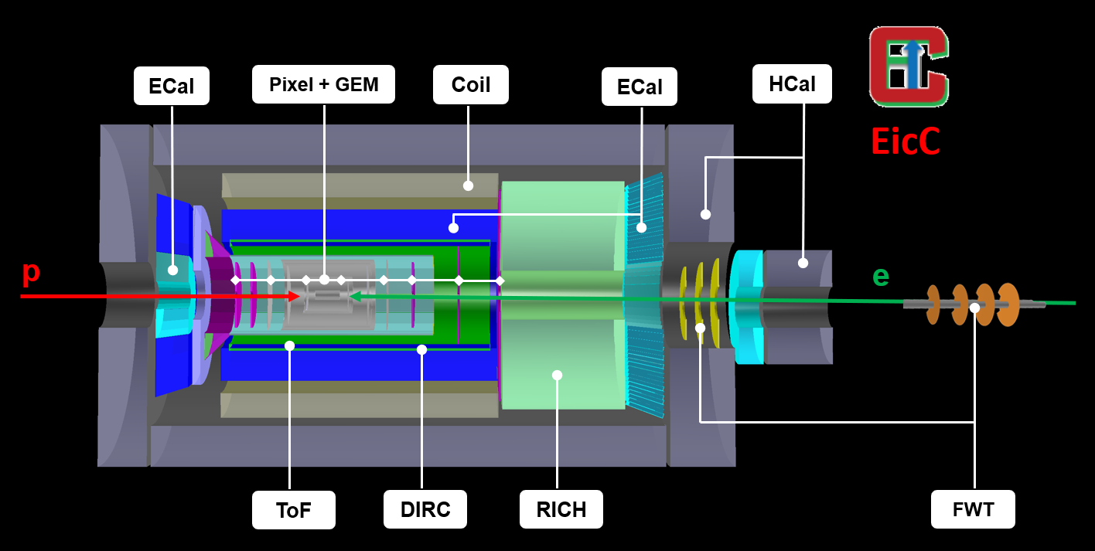
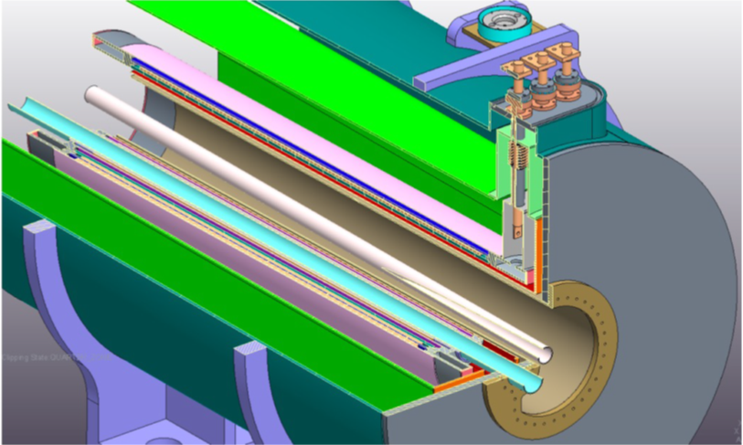
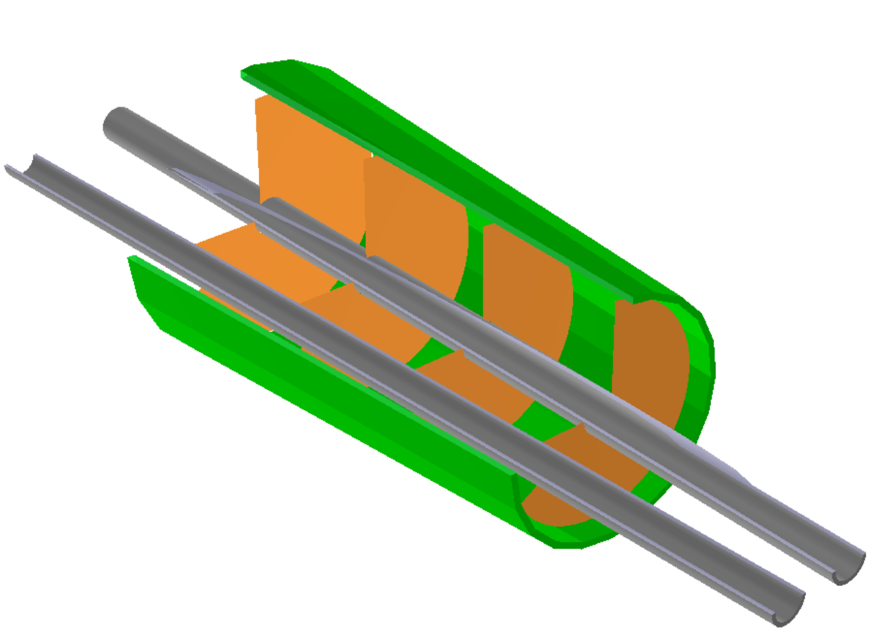
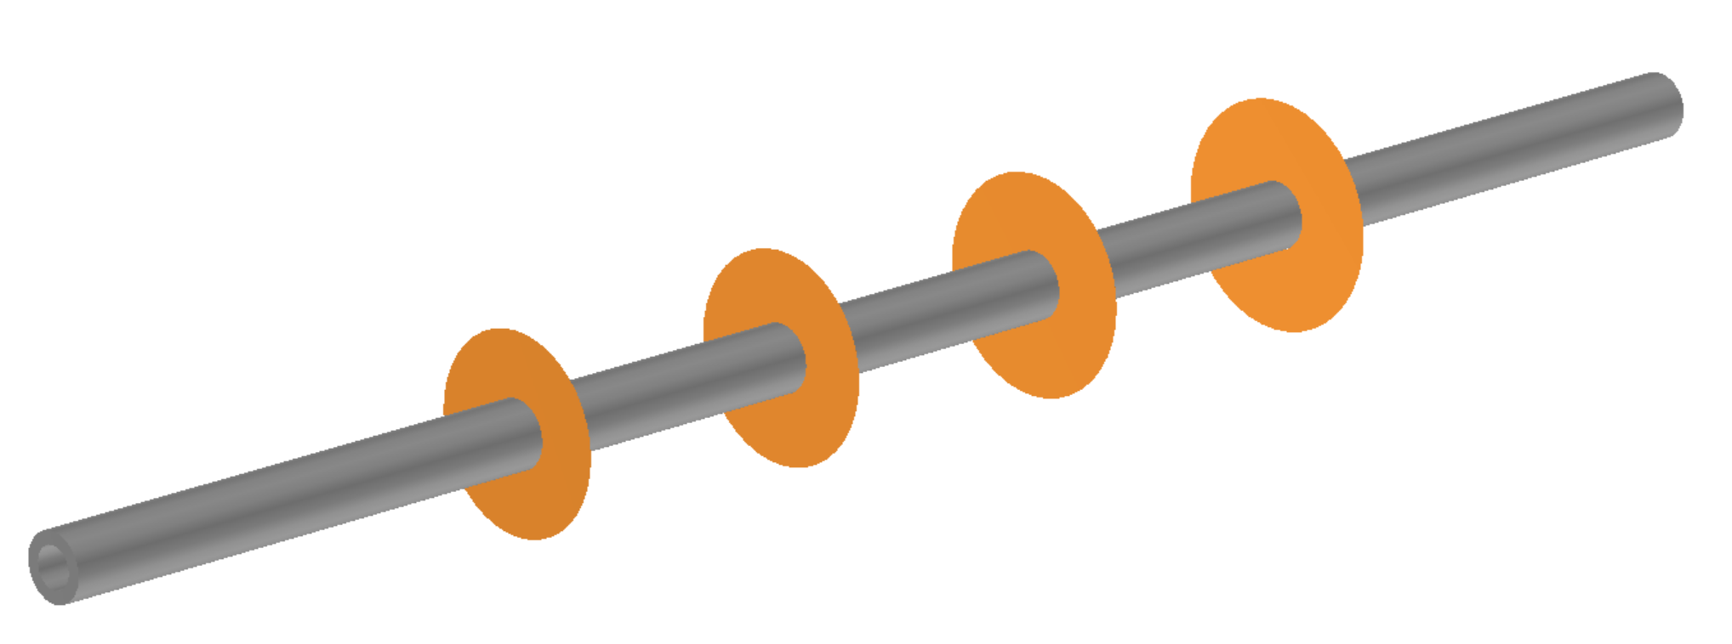
Far-forward Detector design based on dipoles
Four disks with pixel size of 10 μm same as the central vertex detector
ZDC(Zero Degree Calorimeter)
OMD(Off-Momentum Detector)
EDT (Endcap Dipole Tracking)
FDT (Forward Dipole Tracking)
Notes:
Previously，we have designed the forward tracking detector, utilizing the 1st and 2nd dipoles.
There are two detector sets, one is named EDT (Endcap Dipole Tracker) and the other is FDT (Forward Dipole tracker).
Both EDT and FDT are designed with 4 disks with pixel size of 10 um same as the central vertex detector.

Slide 4
Dipoles in the ion forward direction
Dipole 1: z = 5 m B = 2.52 T L = 0.8 m
R1 = p*10/3./B1 = 20GeV*10/3./2.52 = 26.455 m
Bending angle = asin(L/R) = 0.03 rad = 30 mrad
Dipole 3: z = 15.4 m B = -3.4 T L = 0.8 m
R2 = p*10/3./B2 = 20GeV*10/3./2.69 = 19.61 m
Bending angle = asin(L/R) ~ 0.04 rad = 40 mrad
Dipole 2: z = 10 m B = 2.69 T L = 2.0 m
R2 = 24.783 m
Bending angle = 80 mrad
Dipole 4: z > 16 m B = ? L = ? m
R2 = ? m
Bending angle = 120 mrad
O
L=0.8m
50 mrad
A
R3
= 19.61m
B
50 mrad
30 mrad
R1
= 26.455m
50 mrad
30 mrad
80 mrad
R2
= 24.783m
C
D
L=2.0m
40 mrad
120 mrad
4

Slide 5
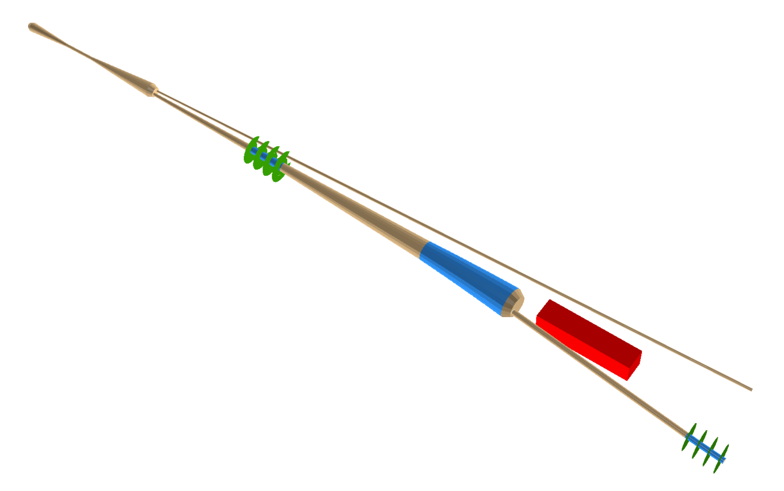
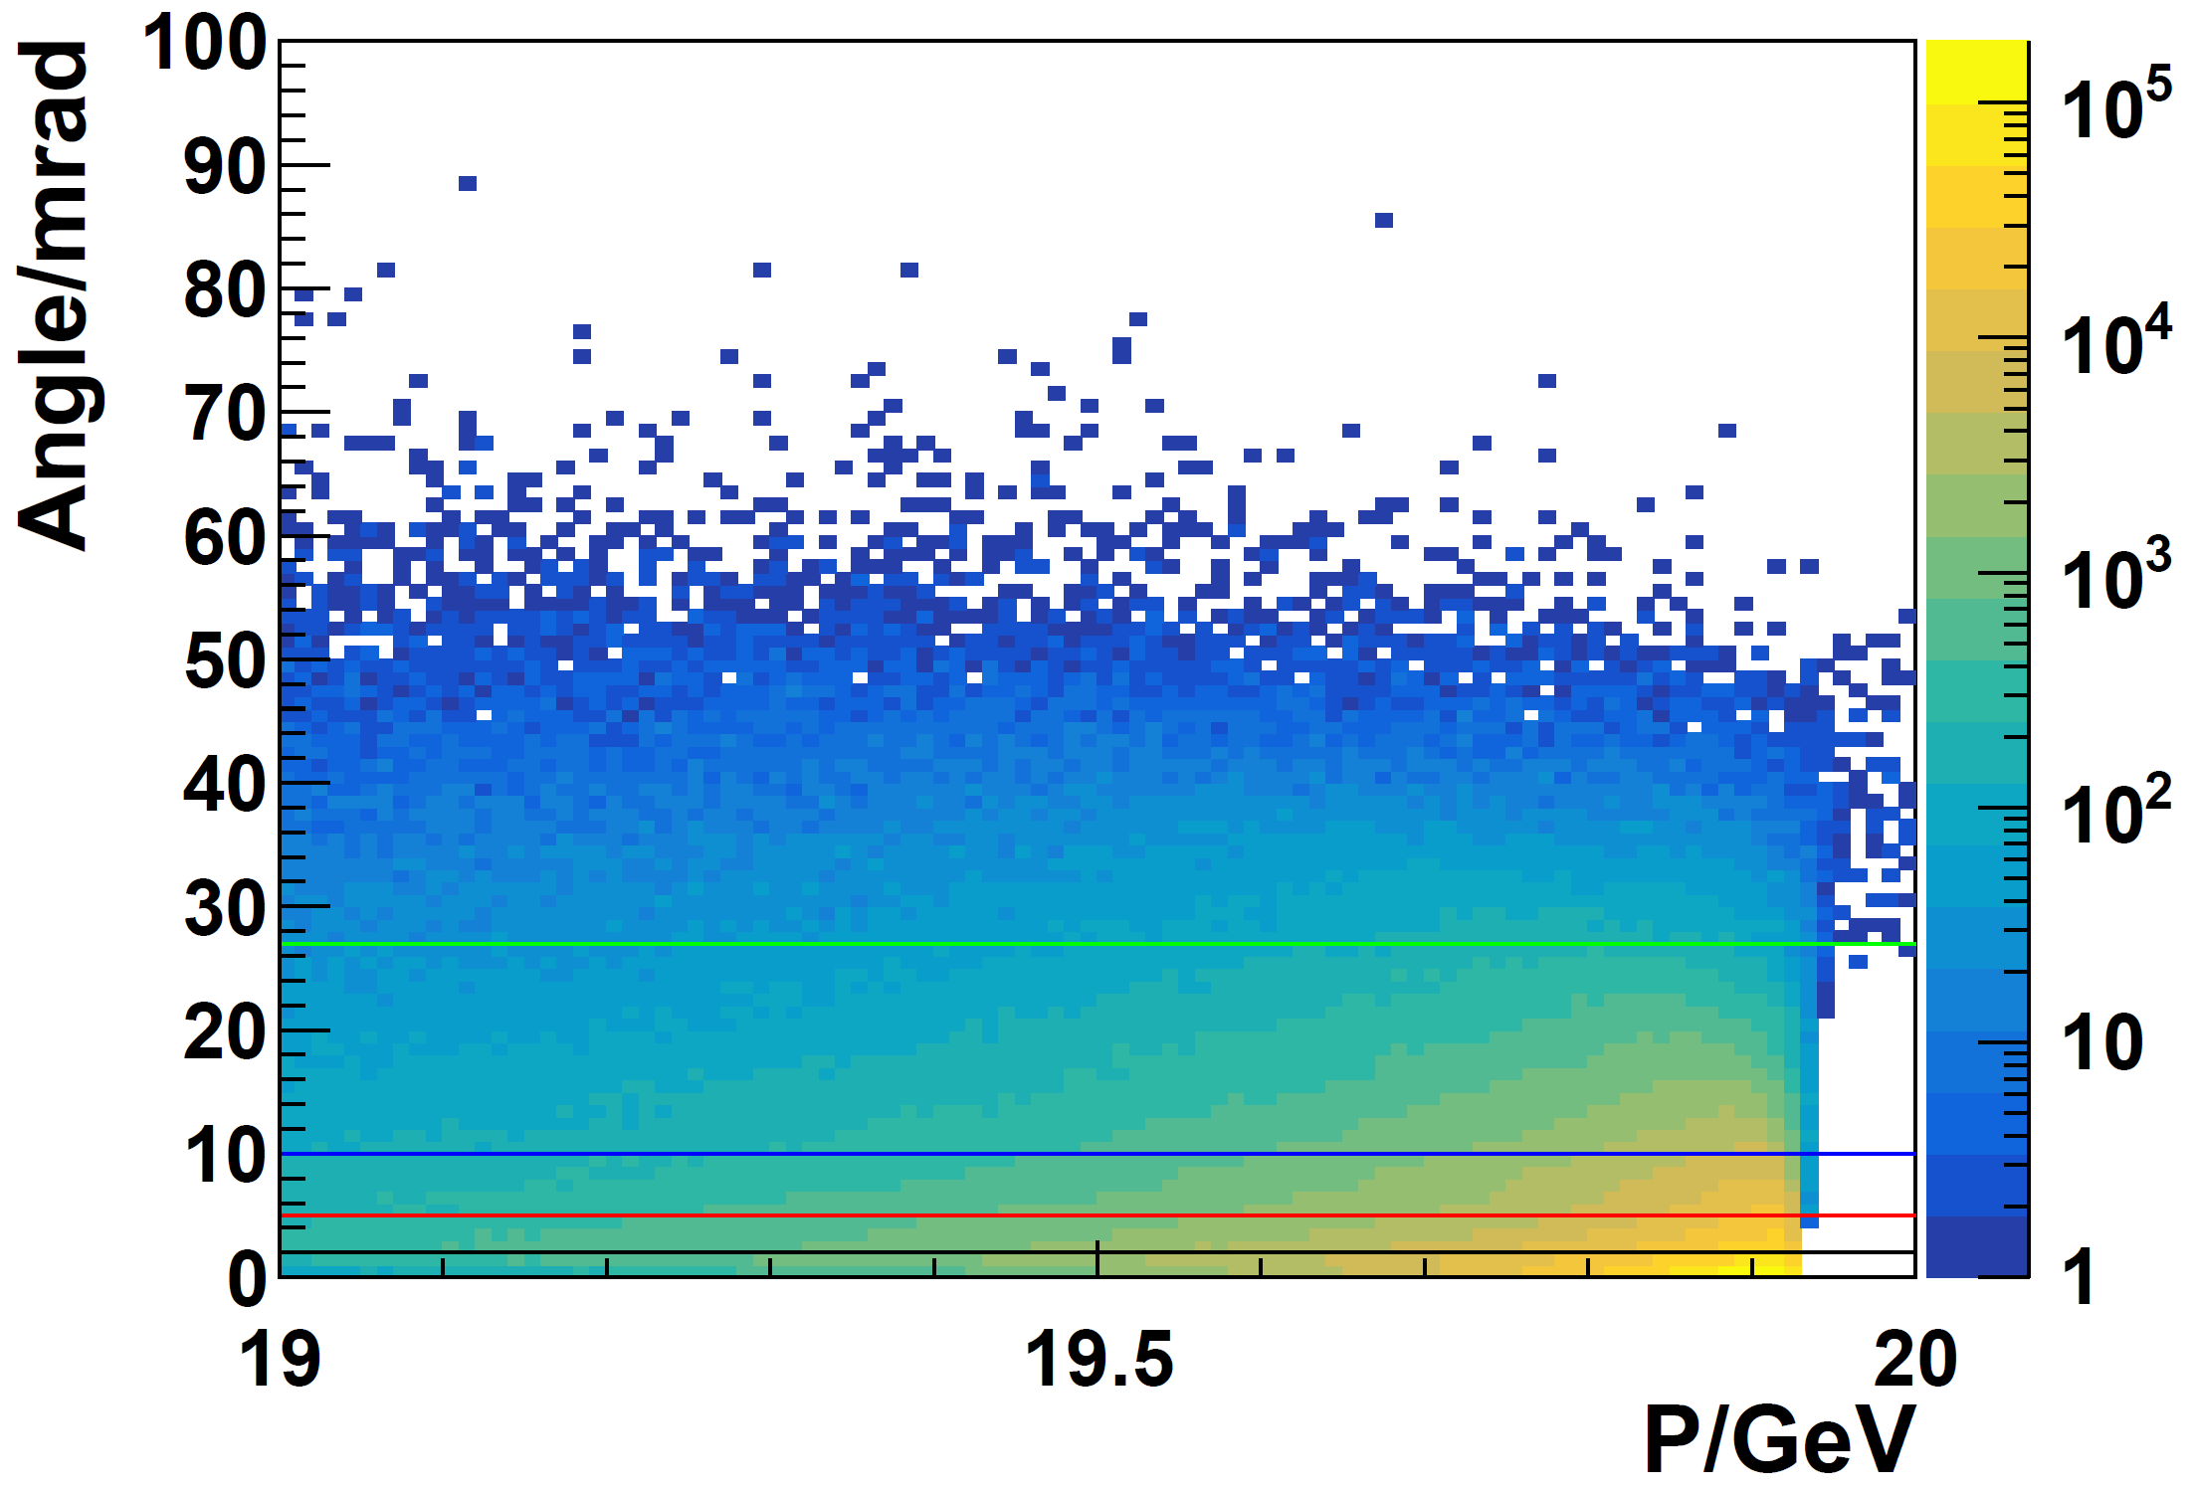
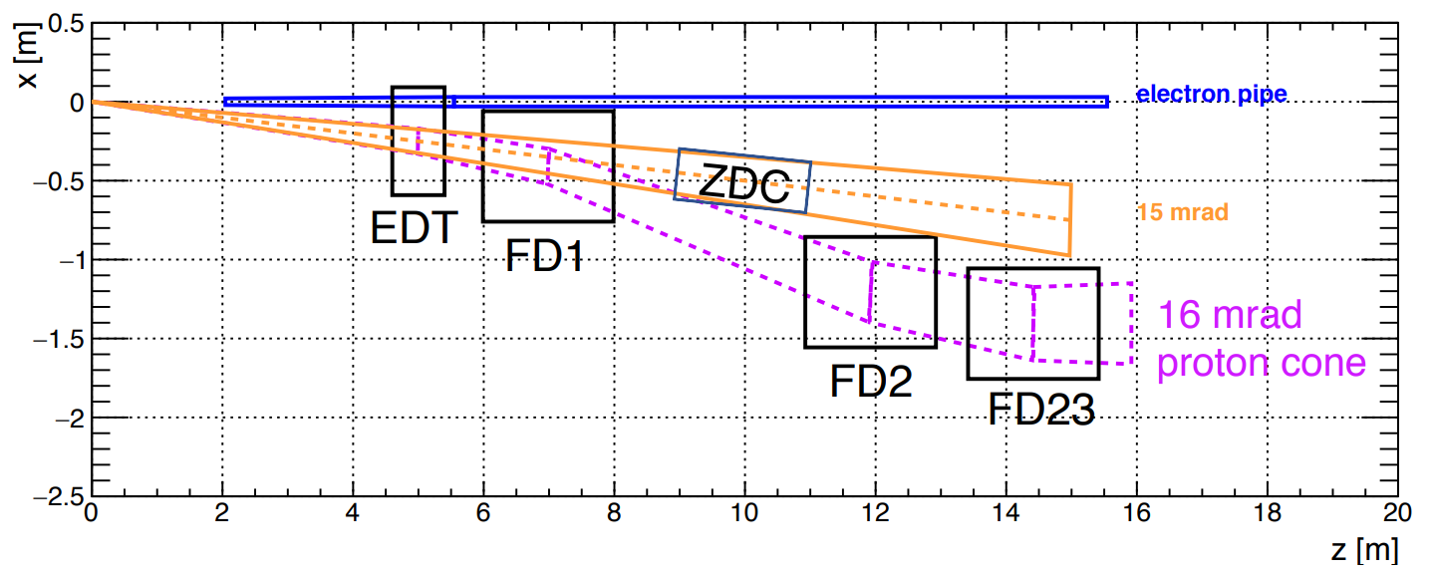
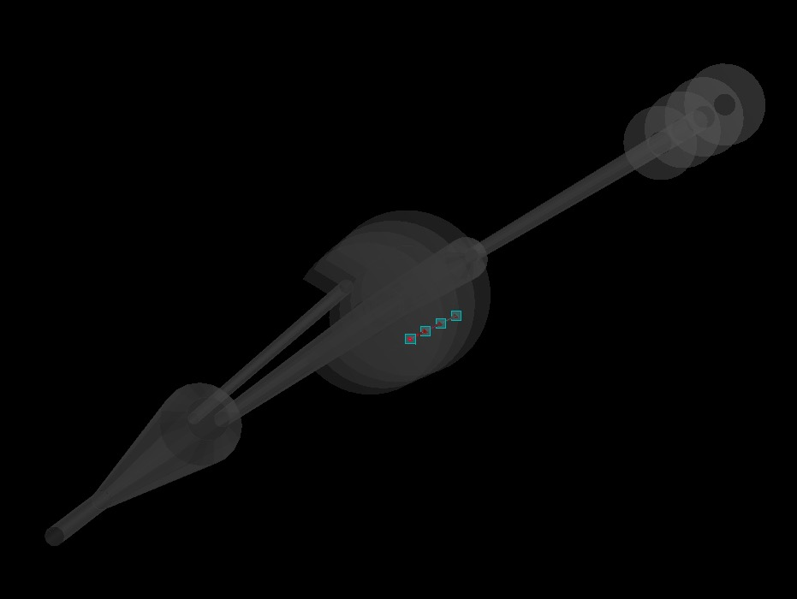
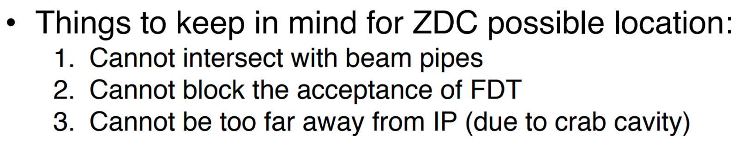
Far-forward detectors
EDT: 16-60 mrad
EDT
ZDC: 15 mrad
FDT
FDT: 5-16 mrad
From Weizhi
mrad : DVCS ratio relative to 2 mrad
16-34: 9.3%
16-60: 9.9%
5-16: 45.3%
2-5： 44.7%
Notes:
One of the main physics focus of the forward detector is the measurement of DVCS process.
In the whitepaper, the DVCS process was investigated with a cut of theta_p_prime (the angle between scatter proton and the original proton beam) larger than 2 mrad.
In our first Forward detector design, EDT has a coverage of 16-60 mrad with the DVCS acceptance of 9.9% (relative to 2 mrad cut)
FDT has a coverage of 5-16 mrad, with the DVCS acceptance of 45.3% (relative to 2 mrad cut)
A combination of EDT and FDT may recover more than 55% of the DVCS events.

Slide 6
Recent updates
-- Quadrupoles magnets

Slide 7
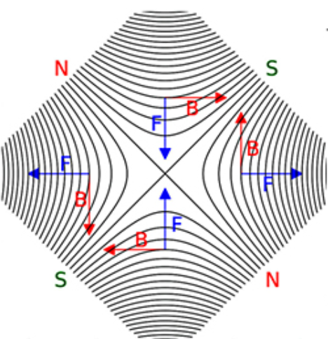
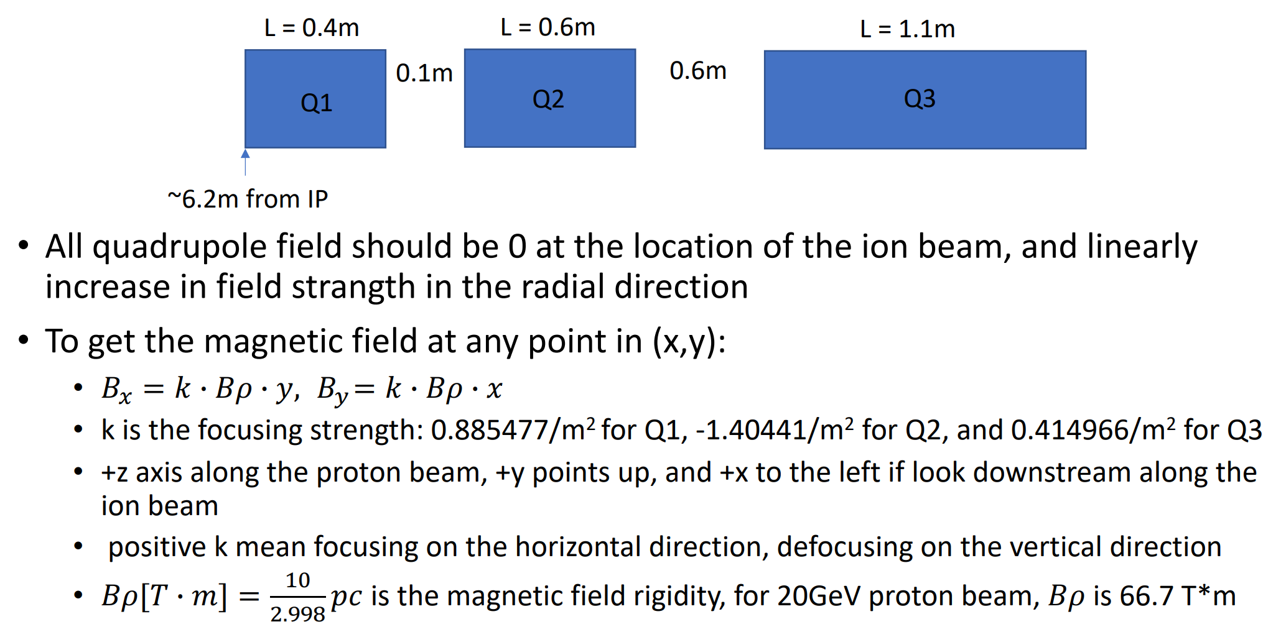
Quadrupoles in the ion forward direction
Slides from Weizhi

Slide 8
Quadrupoles in the ion forward direction
Dipole 1: z = 5 m B = 2.52 T L = 0.8 m
R1 = 26.455 m
Bending angle = 30 mrad
Position of B(-28.1453, 0, 538.6）
Position of Q1(-36.1368, 0, 638.3）
Position of Q2(-40.9317, 0, 698.1）
Position of Q3(-52.5193, 0, 842.6）
O
50 mrad
A
L=0.8m
B
50 mrad
L=0.4m
30 mrad
0.8m
Q1
L=0.6m
Q2
Dipole 2: z = 10 m B = 2.69 T L = 2.0 m
R2 = 24.783 m
Bending angle = 80 mrad
L=1.1m
R1 = 26.455m
0.1m
Q3
0.6m

Slide 9
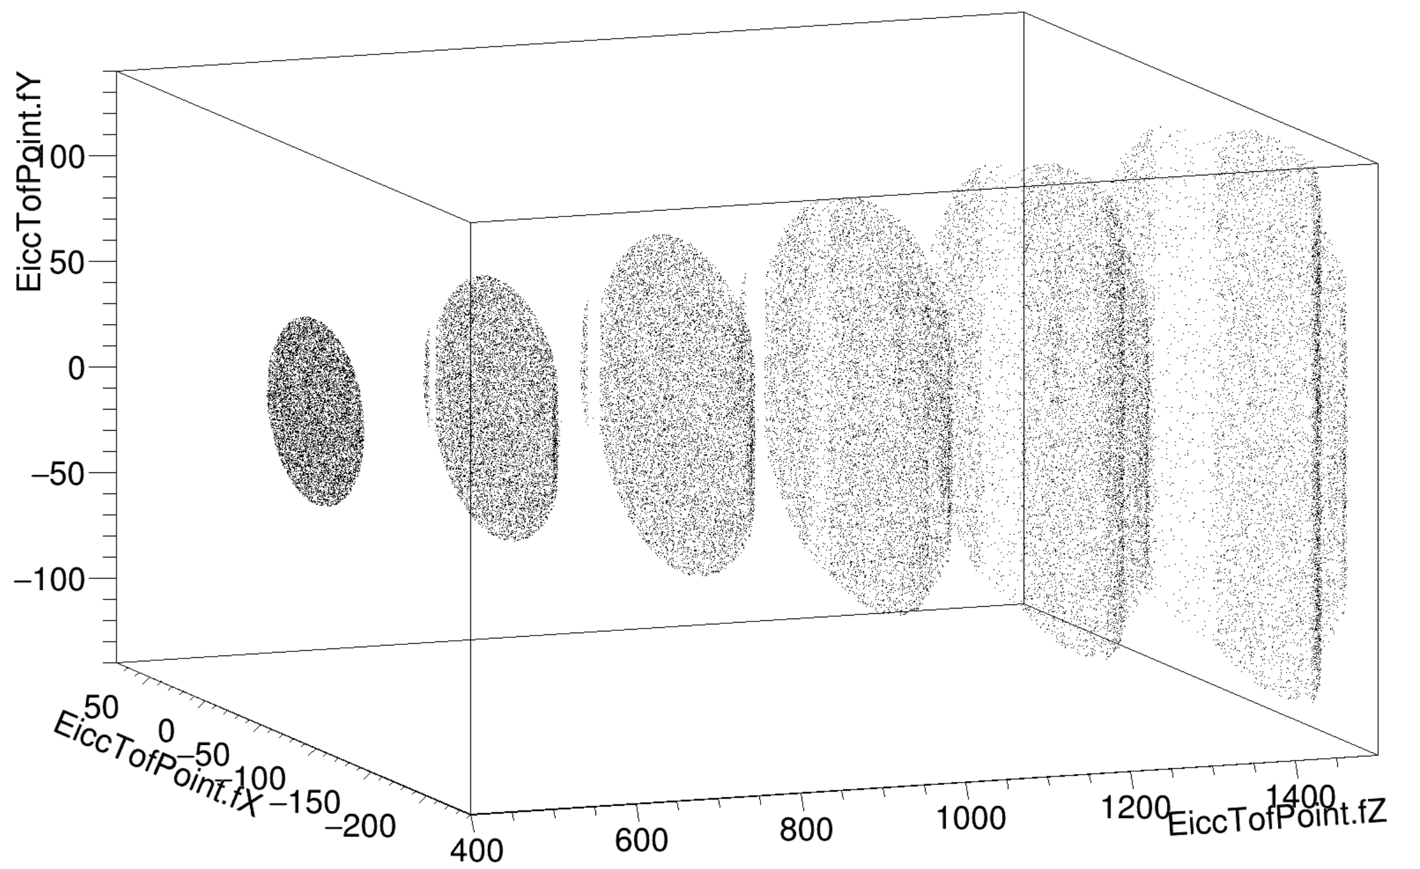
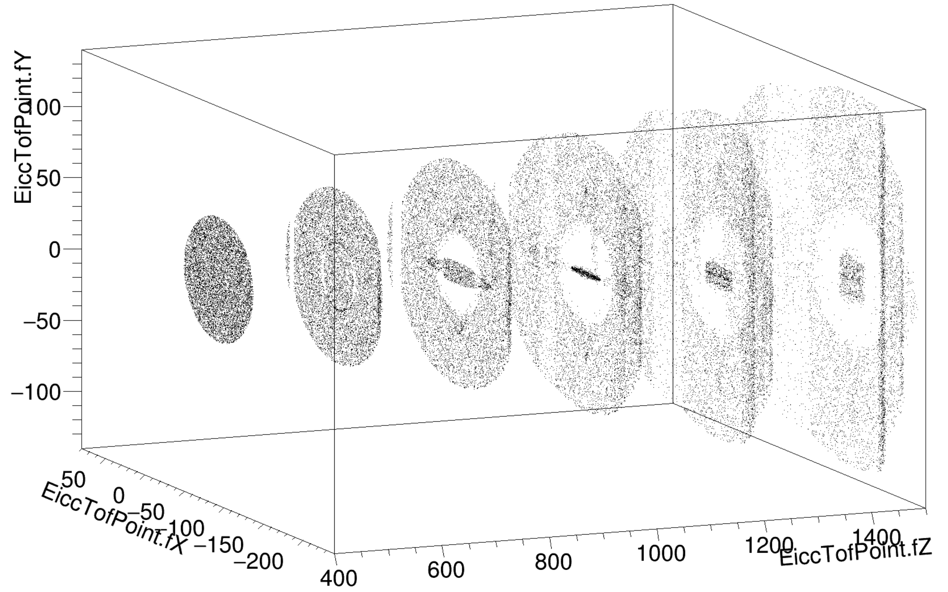
Impact of Quadrupoles
DIPOLE
DIPOLE+QUAD

Slide 10
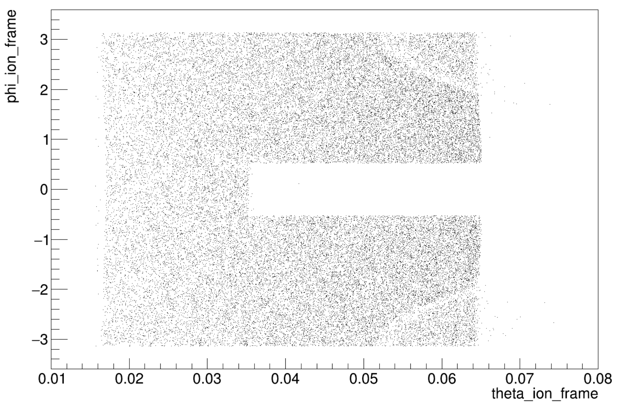
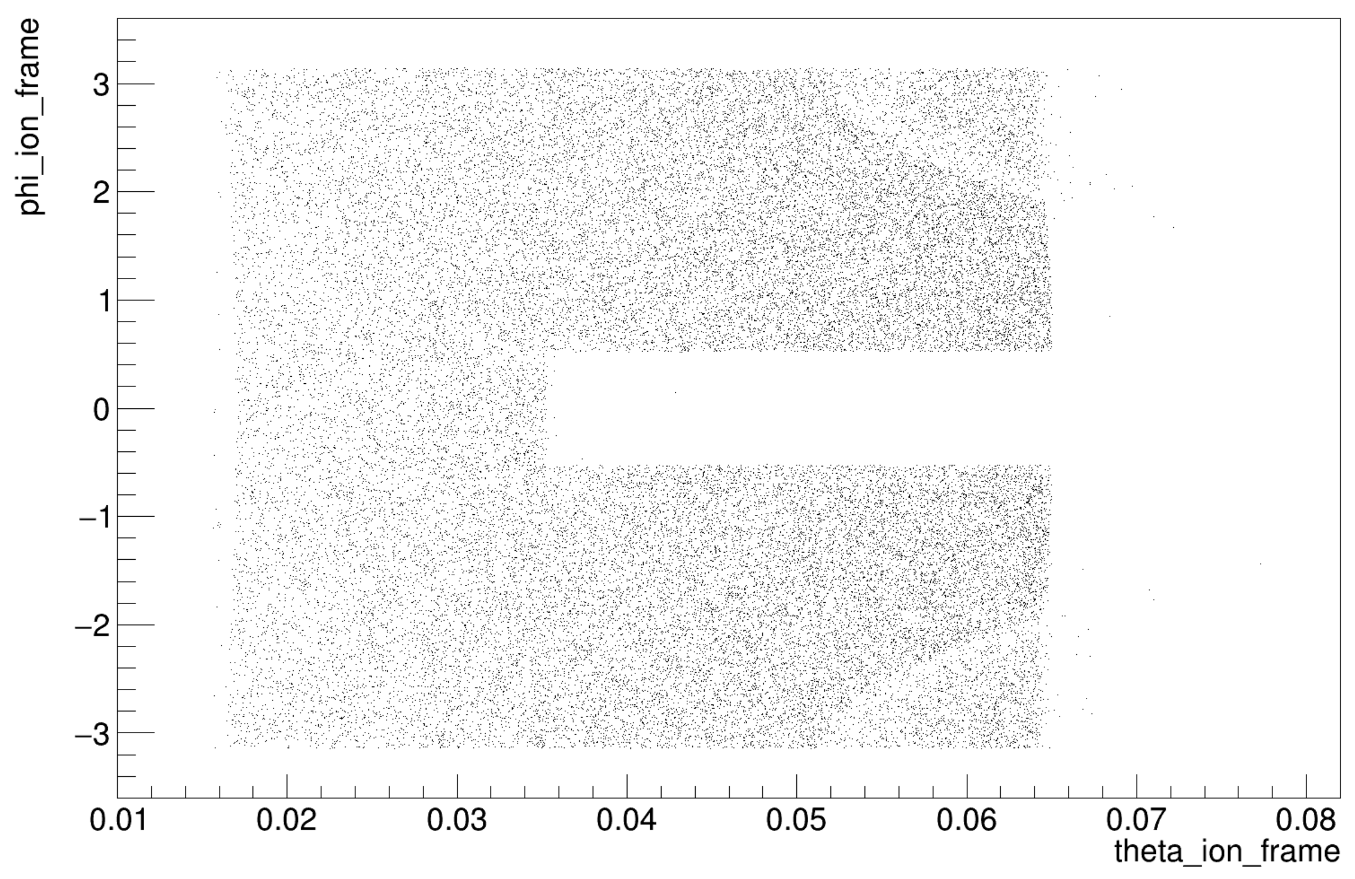
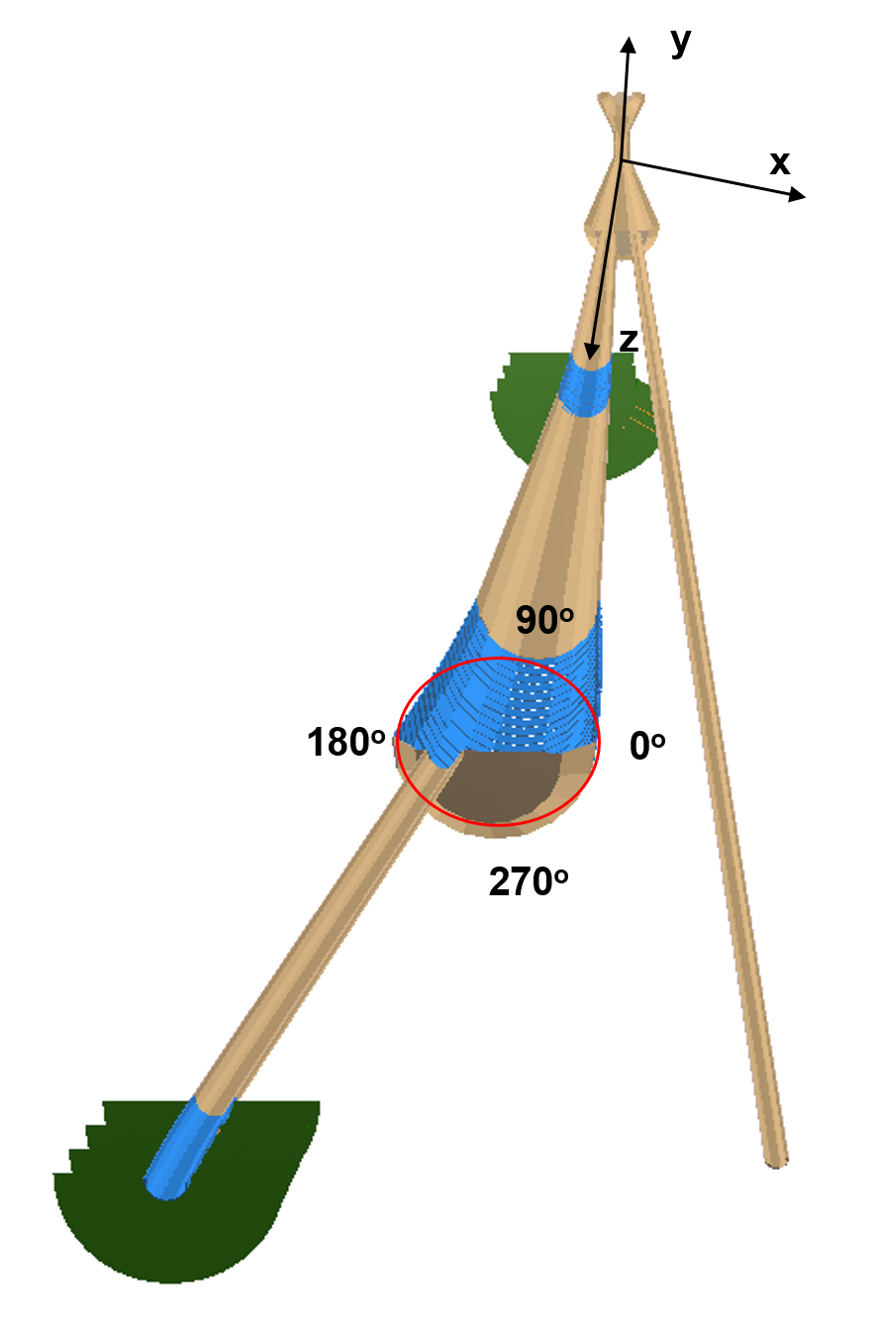
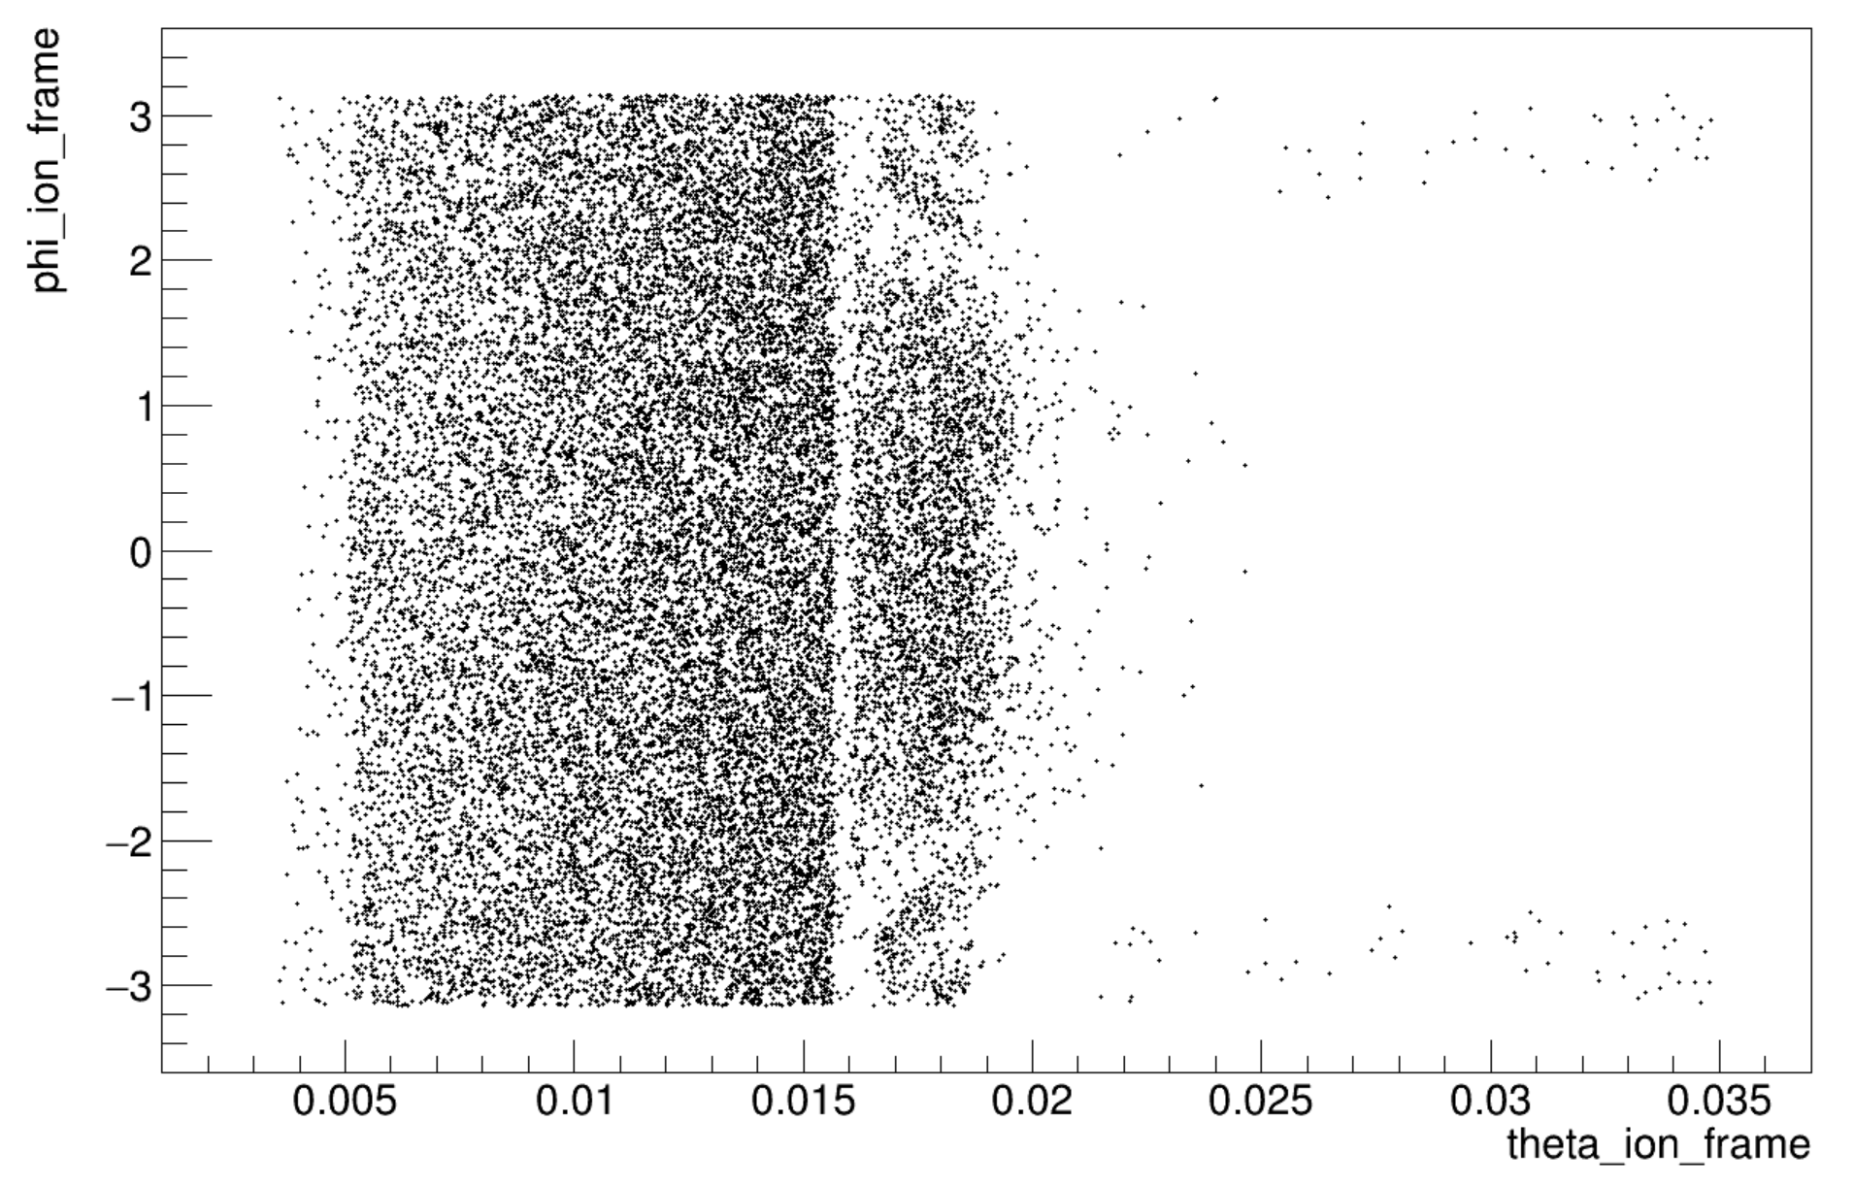
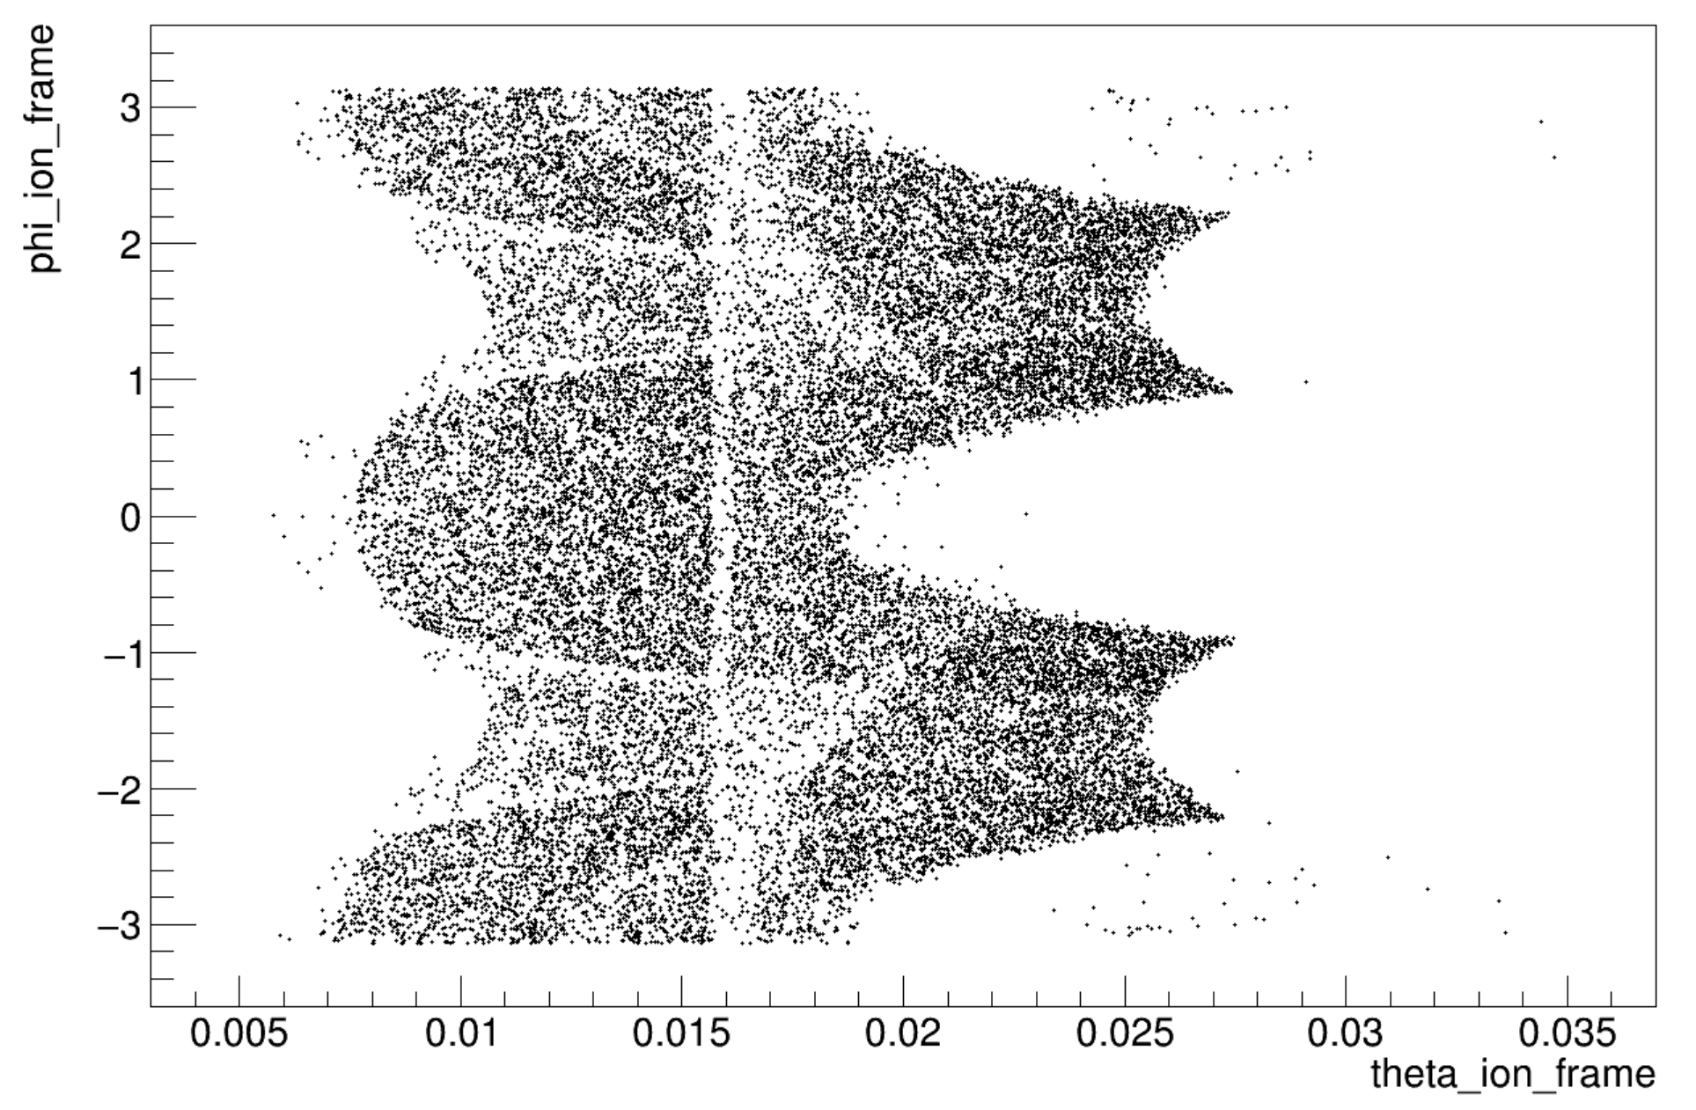
Impact of Quadrupoles
n__{EDT} > 1 DIPOLE
n__{EDT} > 1 DIPOLE+QUAD
n__{FDT} > 1 DIPOLE
n__{FDT} > 1 DIPOLE+QUAD

Slide 11
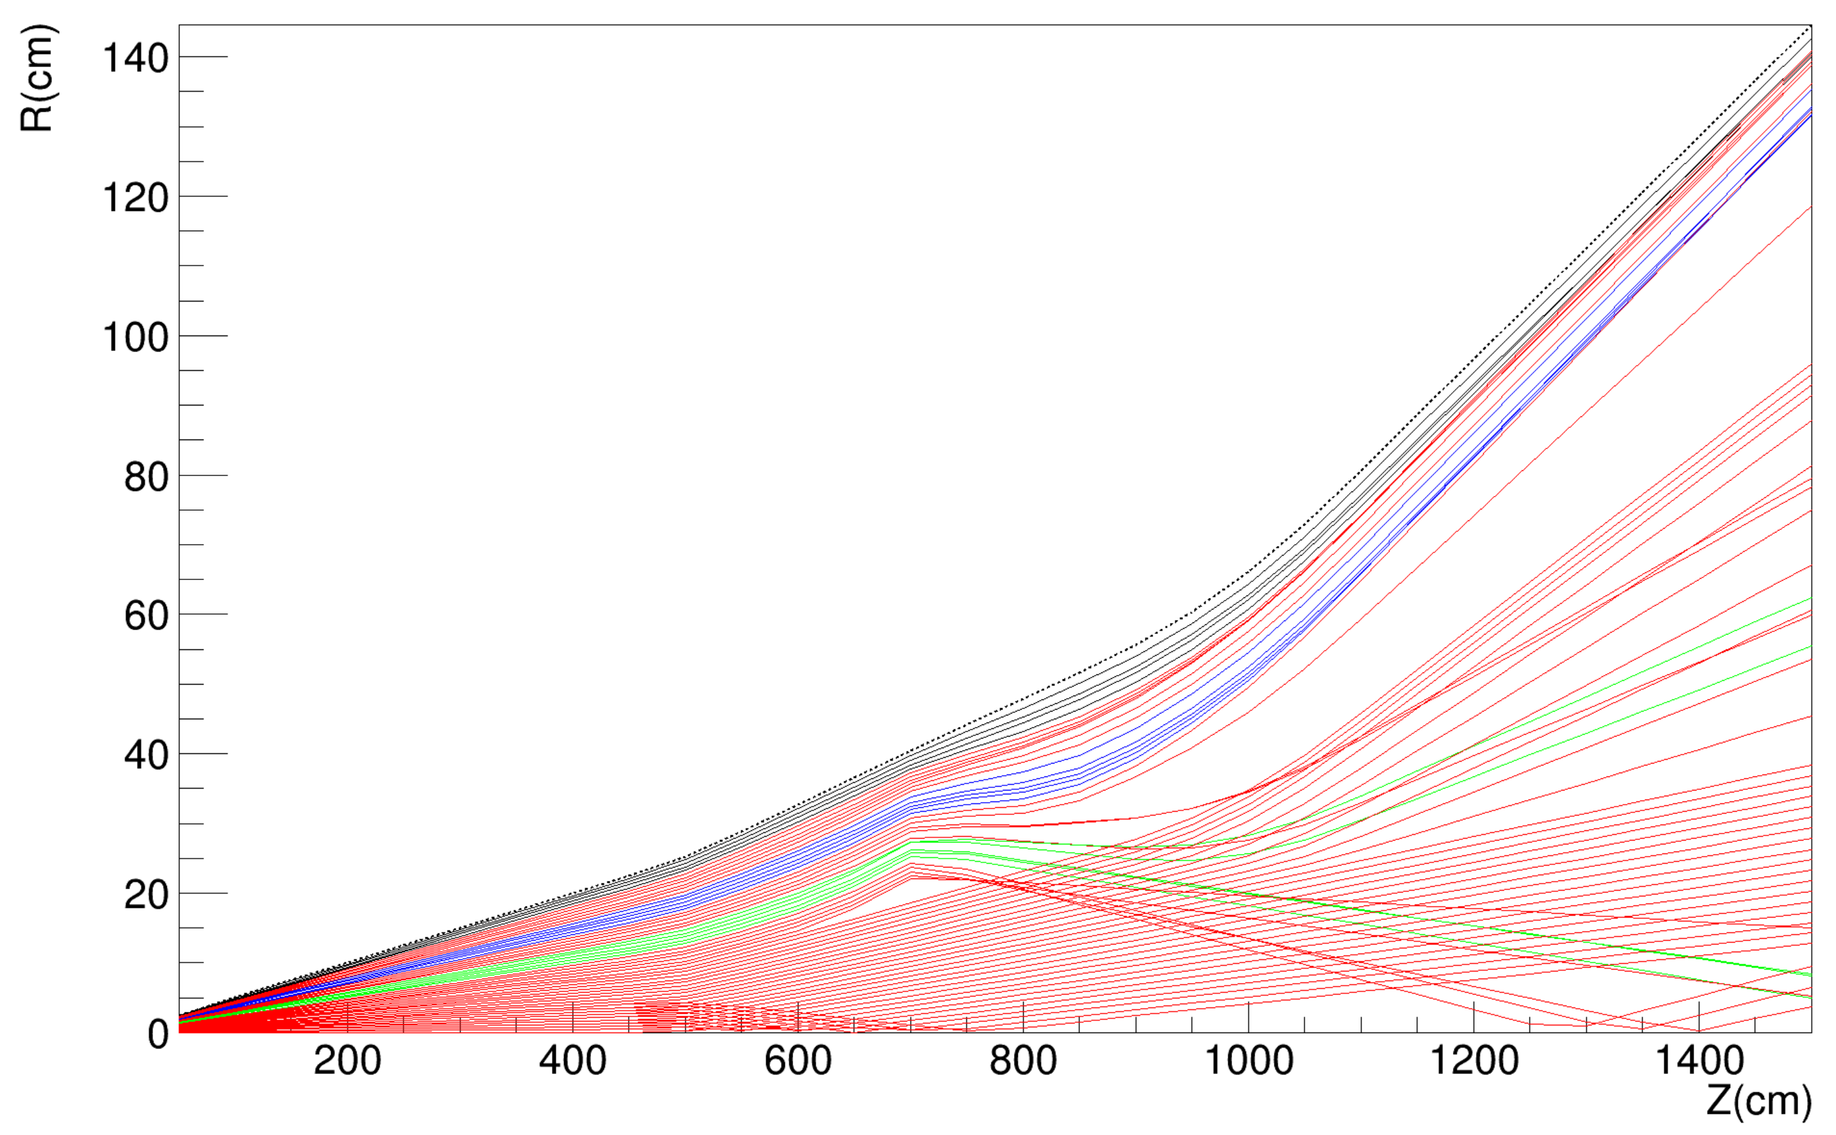
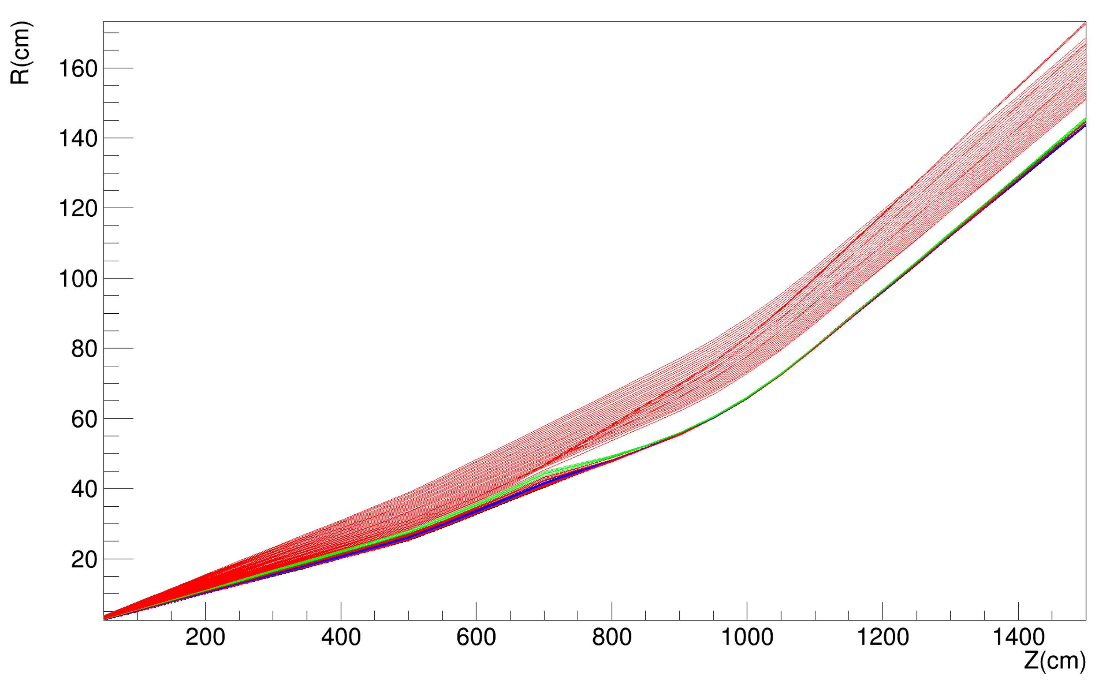
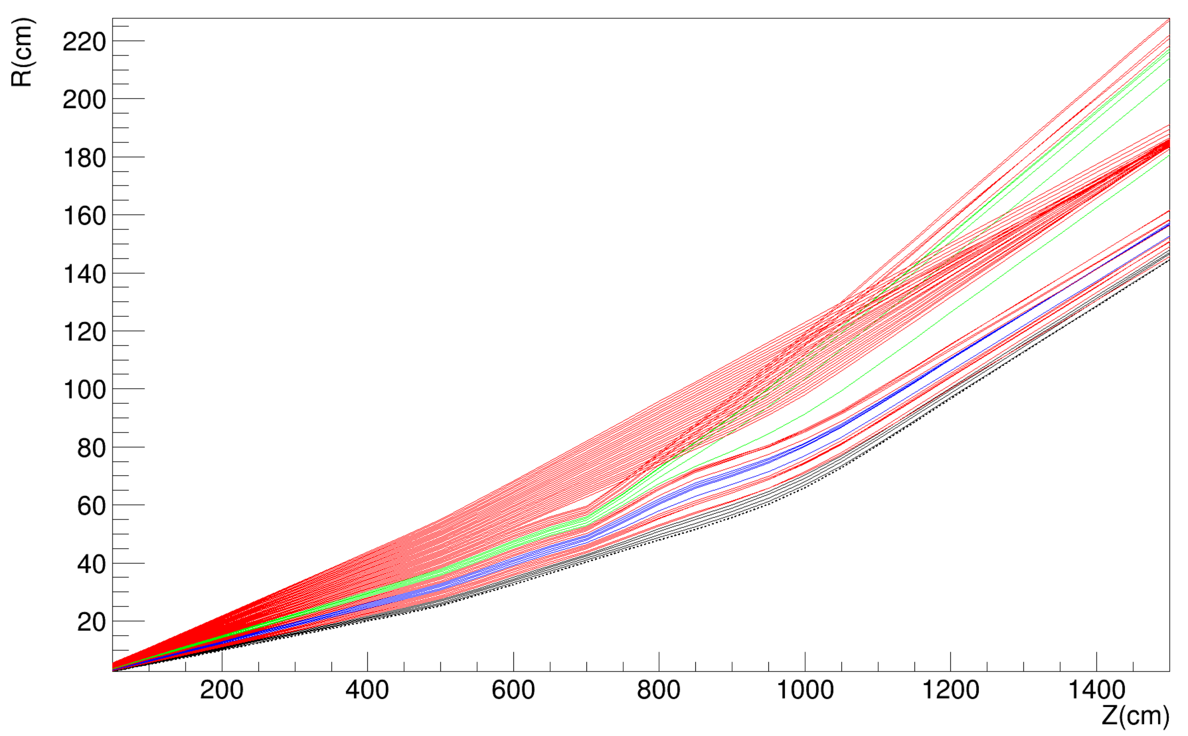
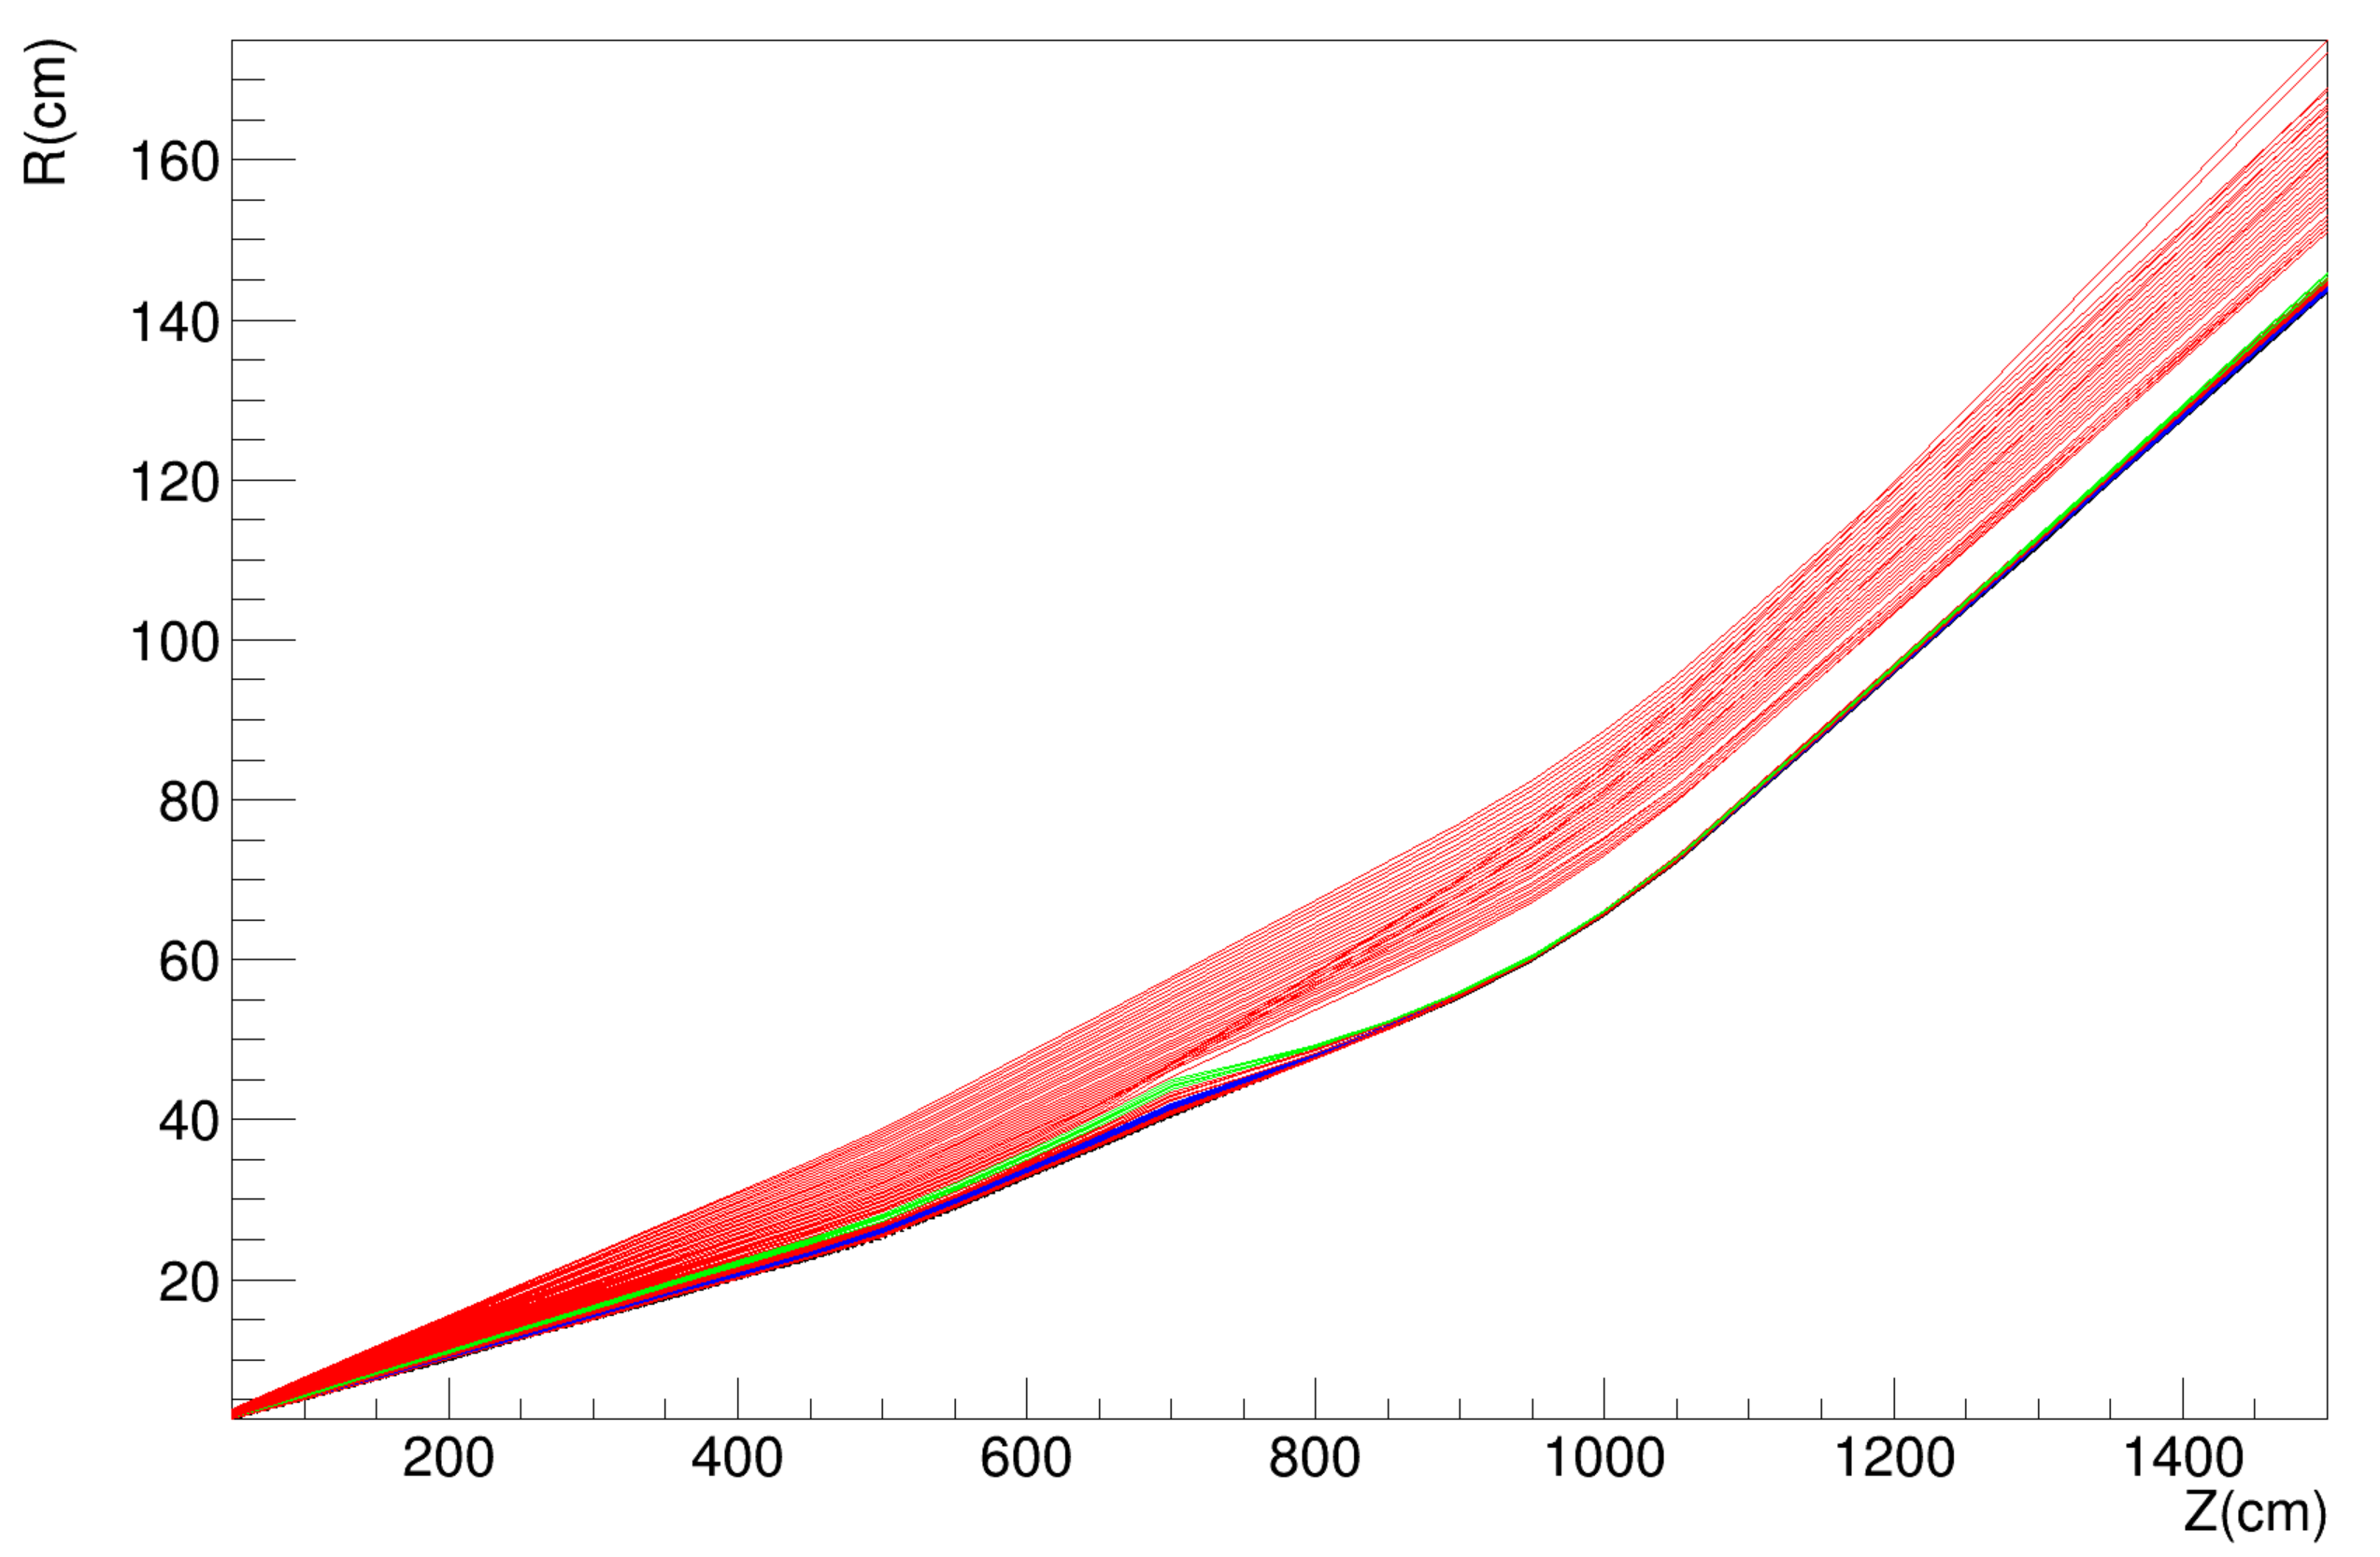
Theta = [0 - 60] mrad
Impact of Quadrupoles
Phi=0
Phi=90
Low acceptance below 10 mrad !
Phi=180
Phi=270
Low acceptance below 10 mrad !

Slide 12
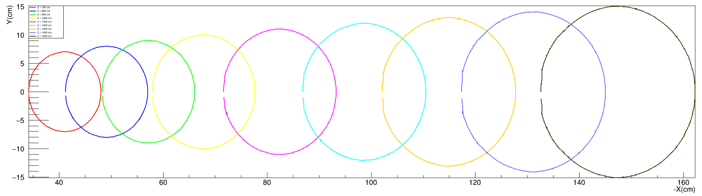
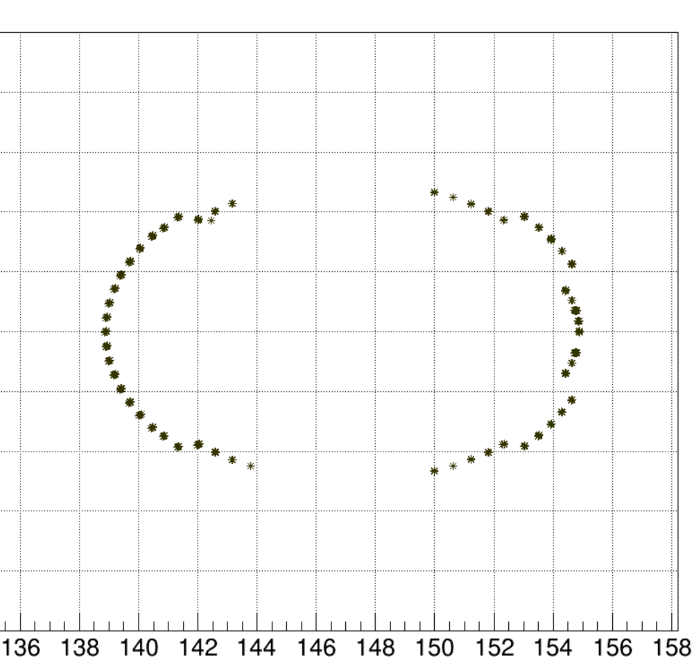
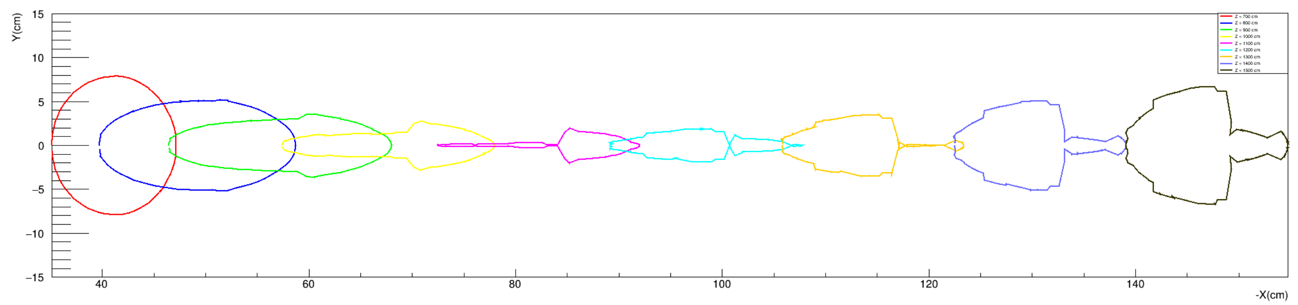
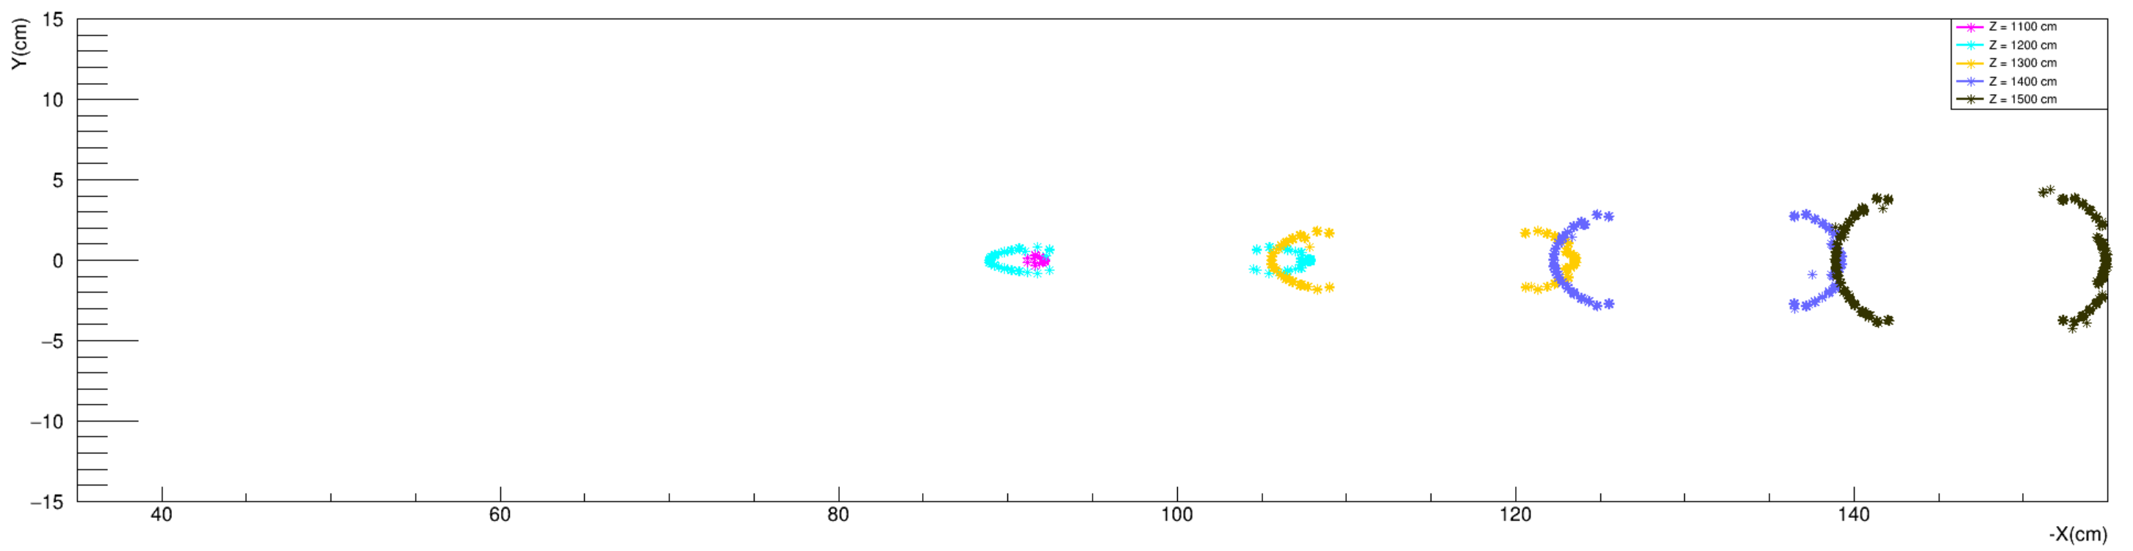
Impact of Quadrupoles
Theta = 10 mrad DIPOLE
Z=800cm
Z=1500cm
Z=700cm
phi=270
Theta = 10 mrad DIPOLE+QUAD / vacuum
phi=0
phi=180
phi=90
Theta = 10 mrad DIPOLE+QUAD + beampipe

Slide 13
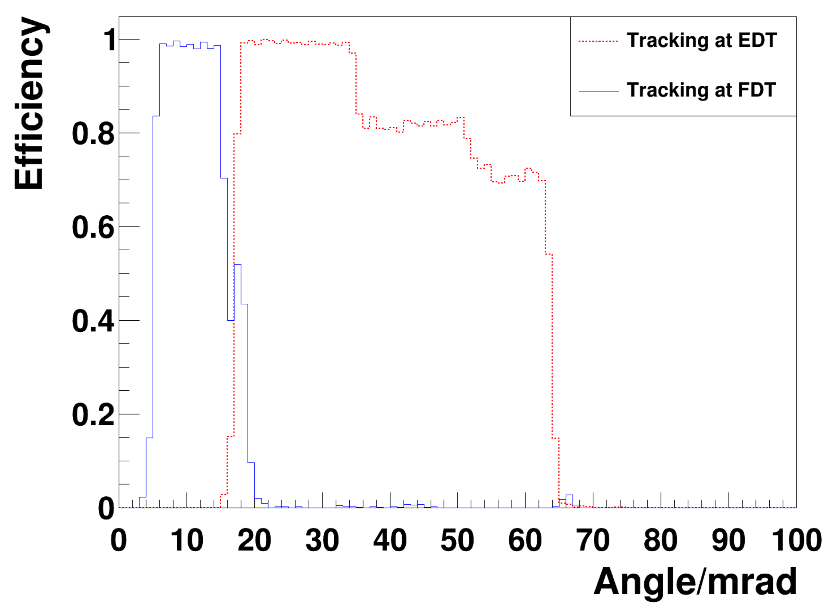
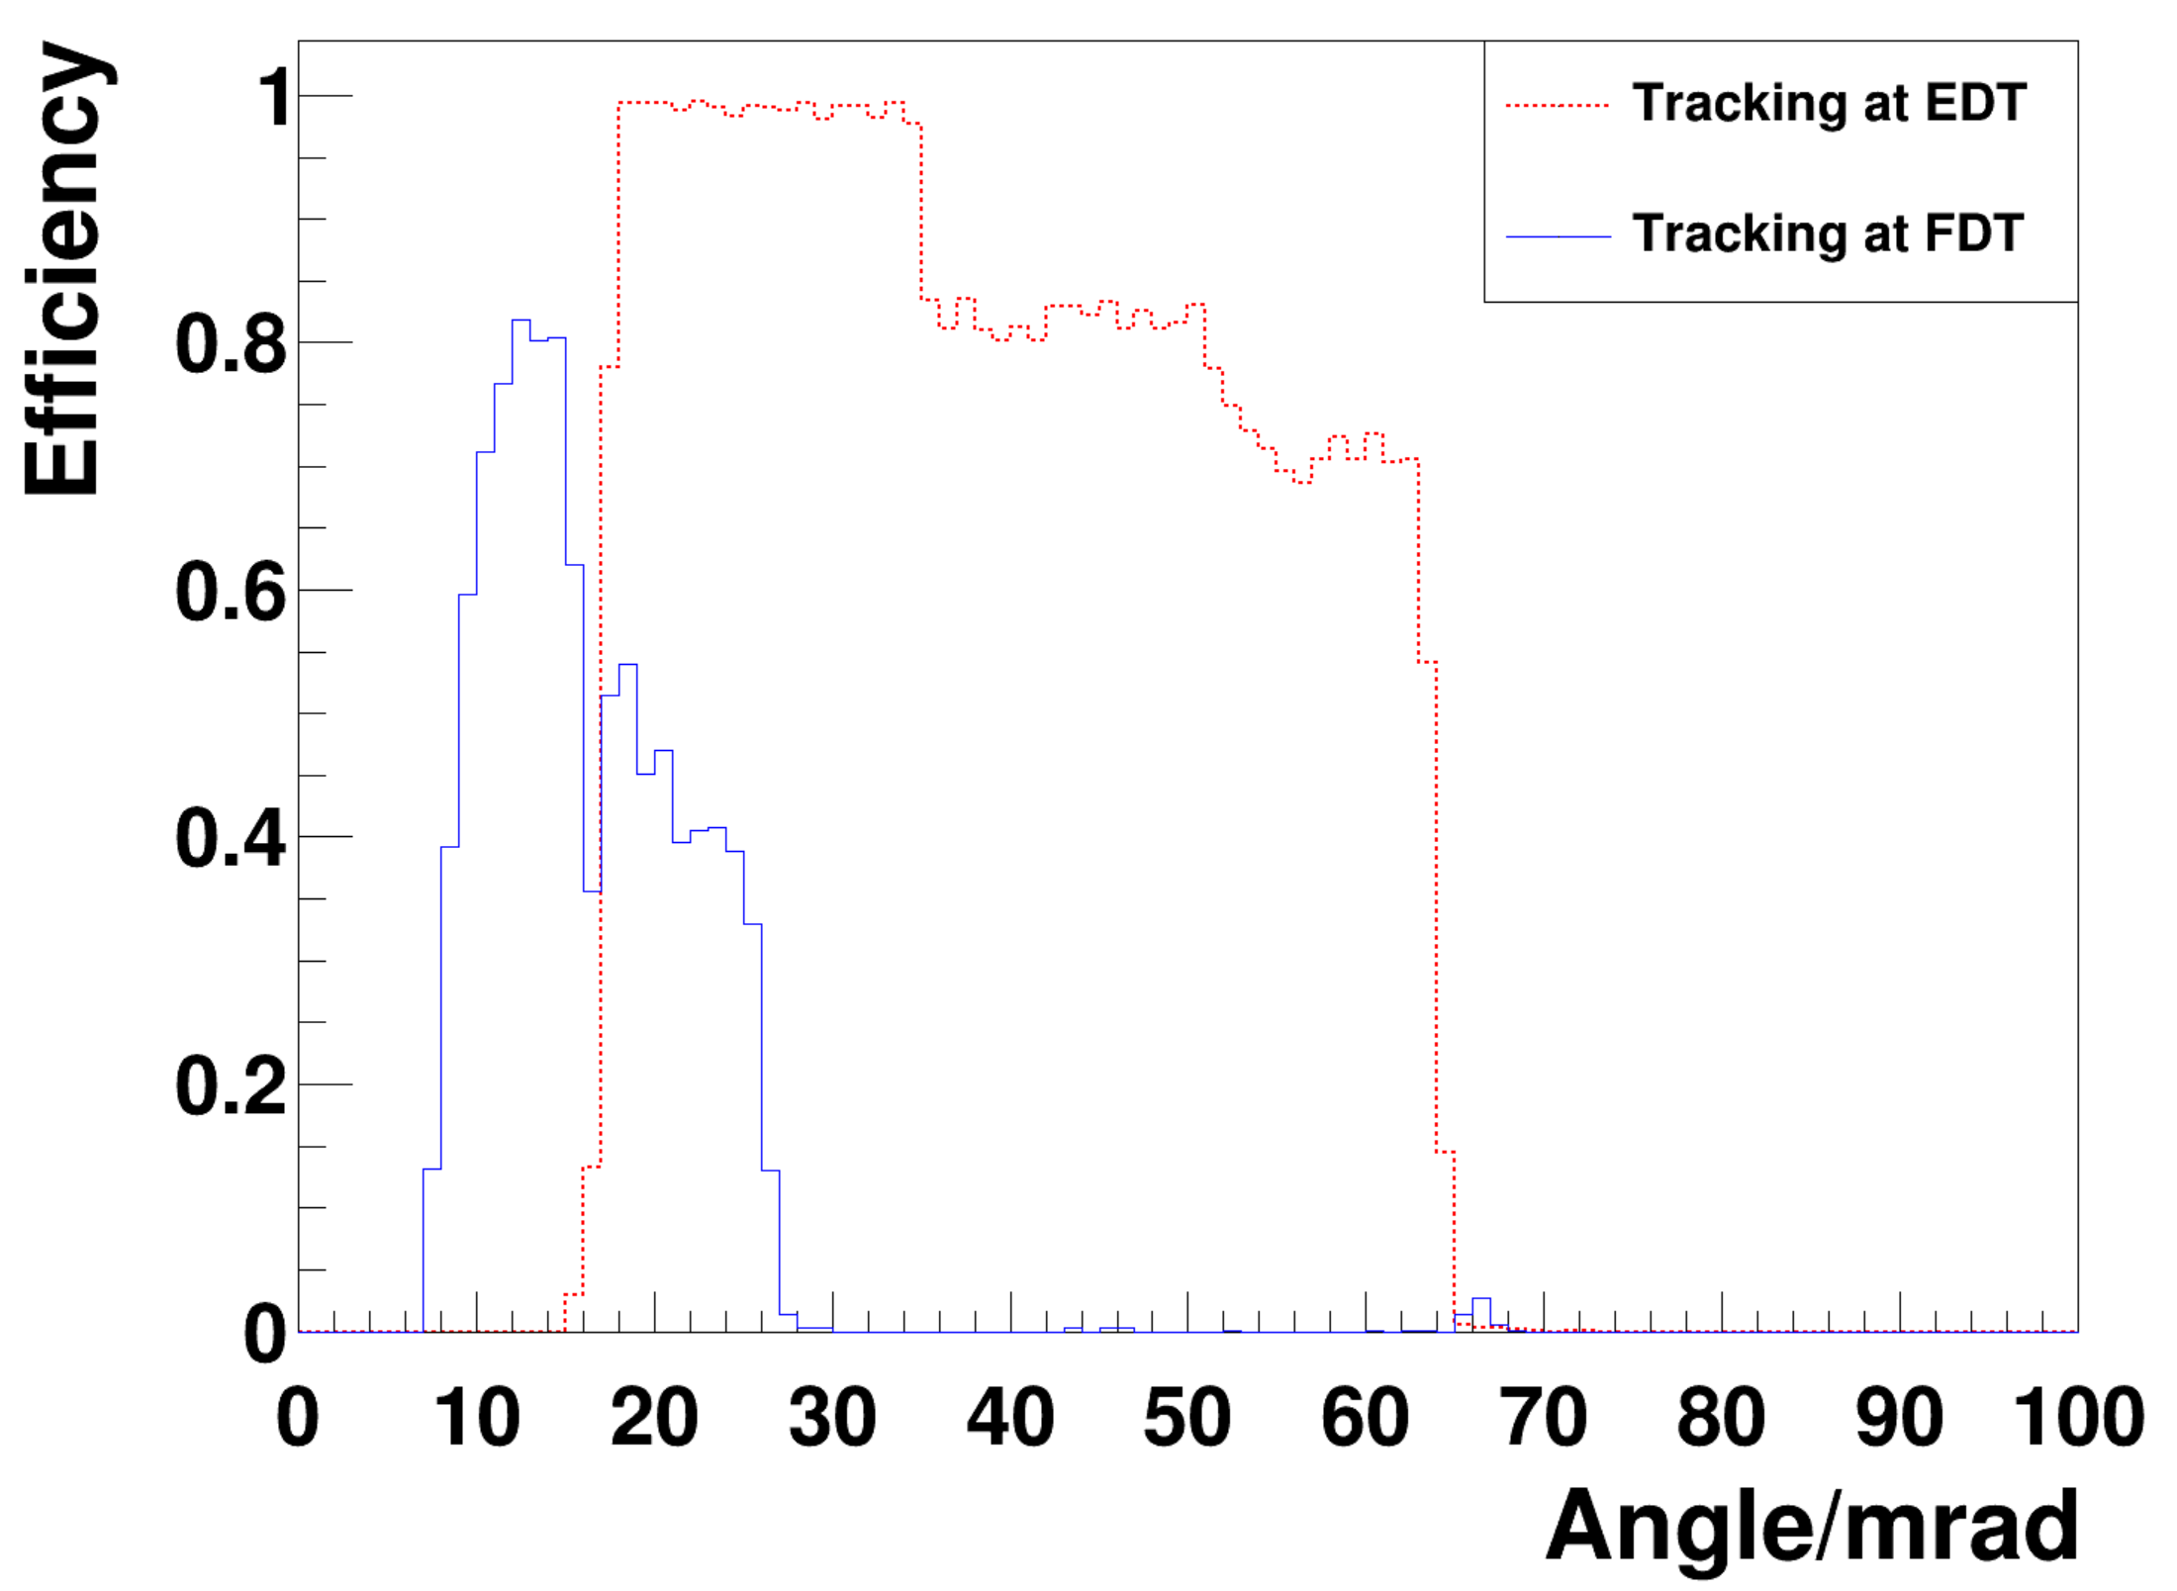
Impact of Quadrupoles -- Acceptance
Previously with only DIPOLE
DIPOLE and QUAD

Slide 14
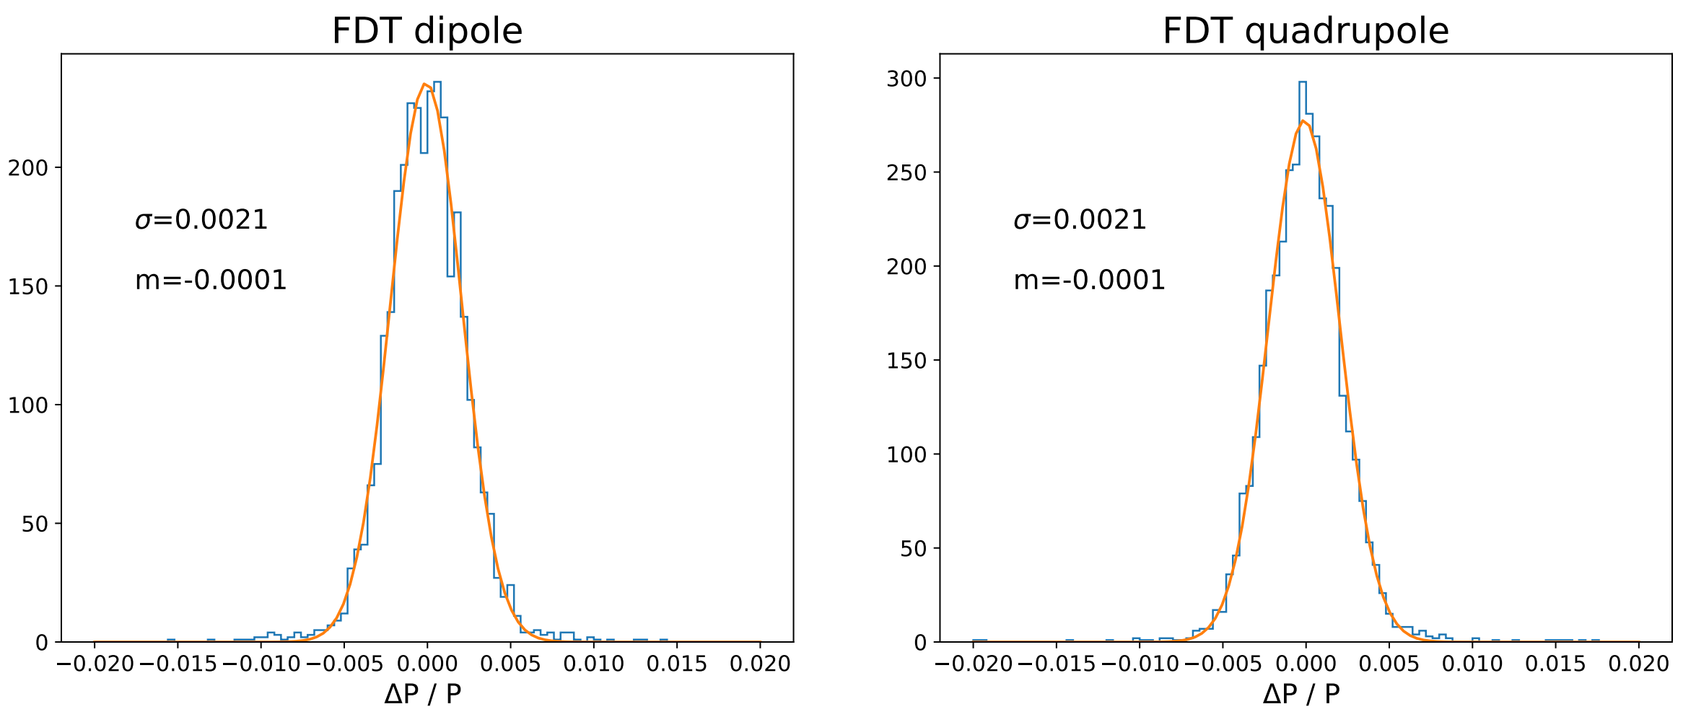
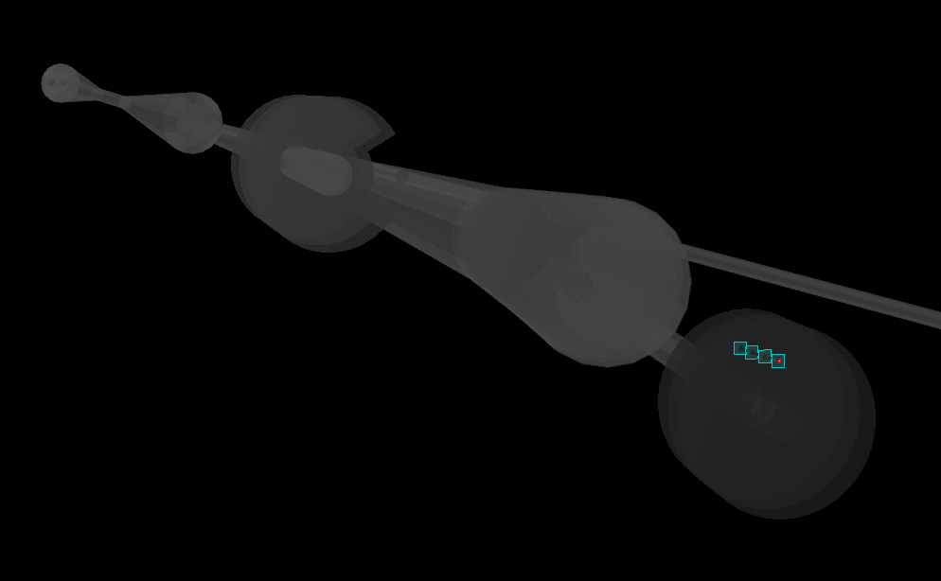
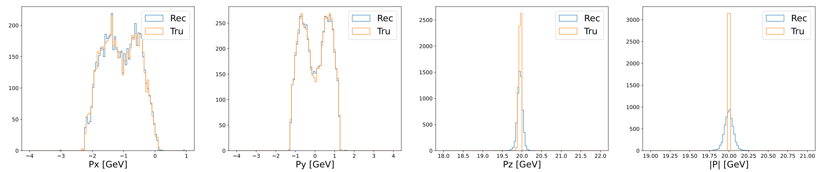
Impact of Quadrupoles -- resolution
To-do: extrapolate back to the IP!

Slide 15
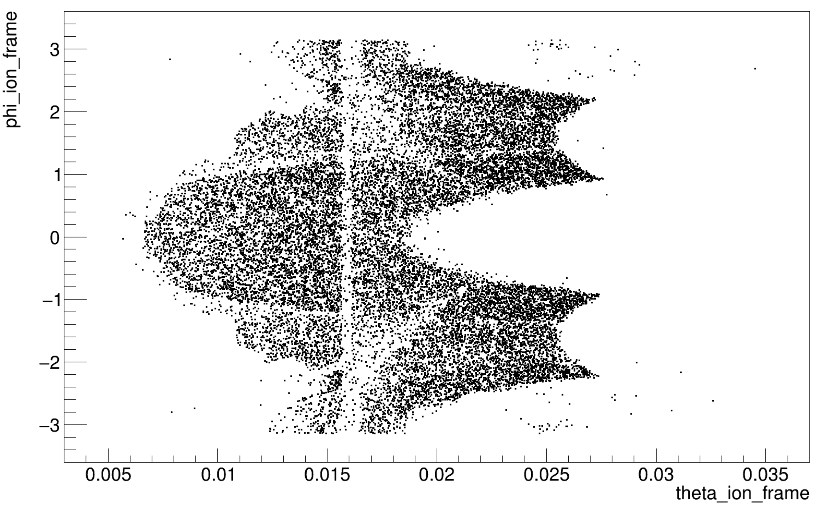
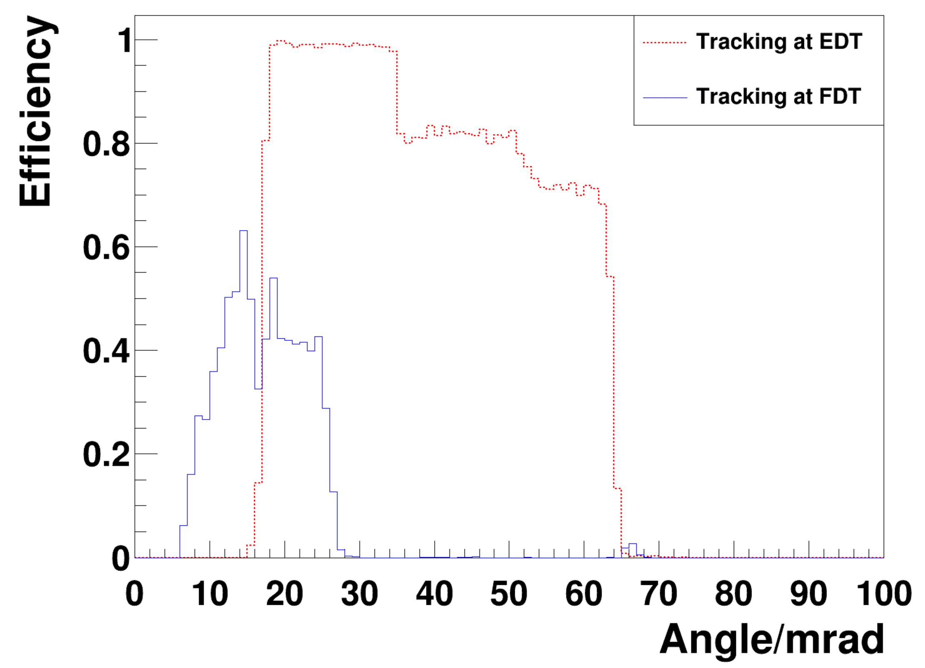
Impact of stronger quadrupole fields
Current QUAD
QUAD increase by 50%
Current QUAD
QUAD increase by 50%

Slide 16
Summary and next-to-do
Design of EDT FDT and ZDC in FF is good shape.
Impact of three quadrupole magnets is investigated.
  strong azimuthal dependency on the FDT
  a reduction on the tracking efficiency
  resolution? need to extrapolate back to IP
Far-forward OMD design is ongoing.
Thank you

Slide 18
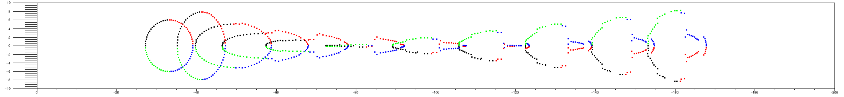
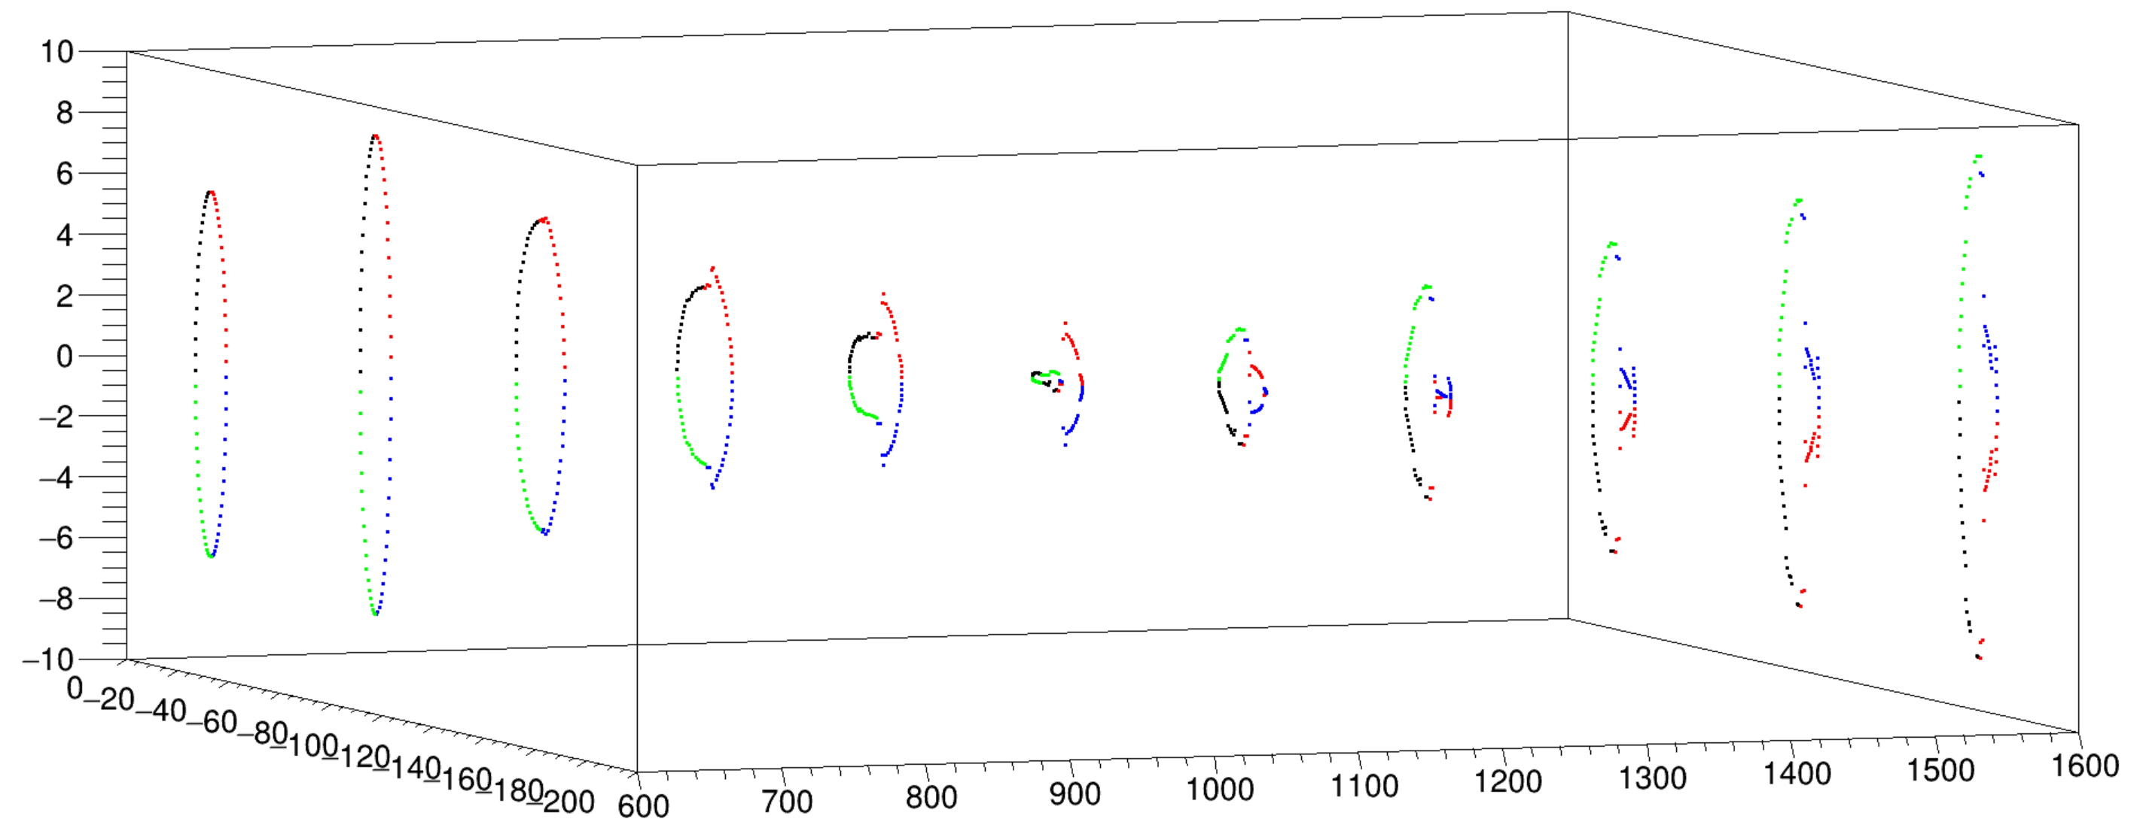

Slide 19
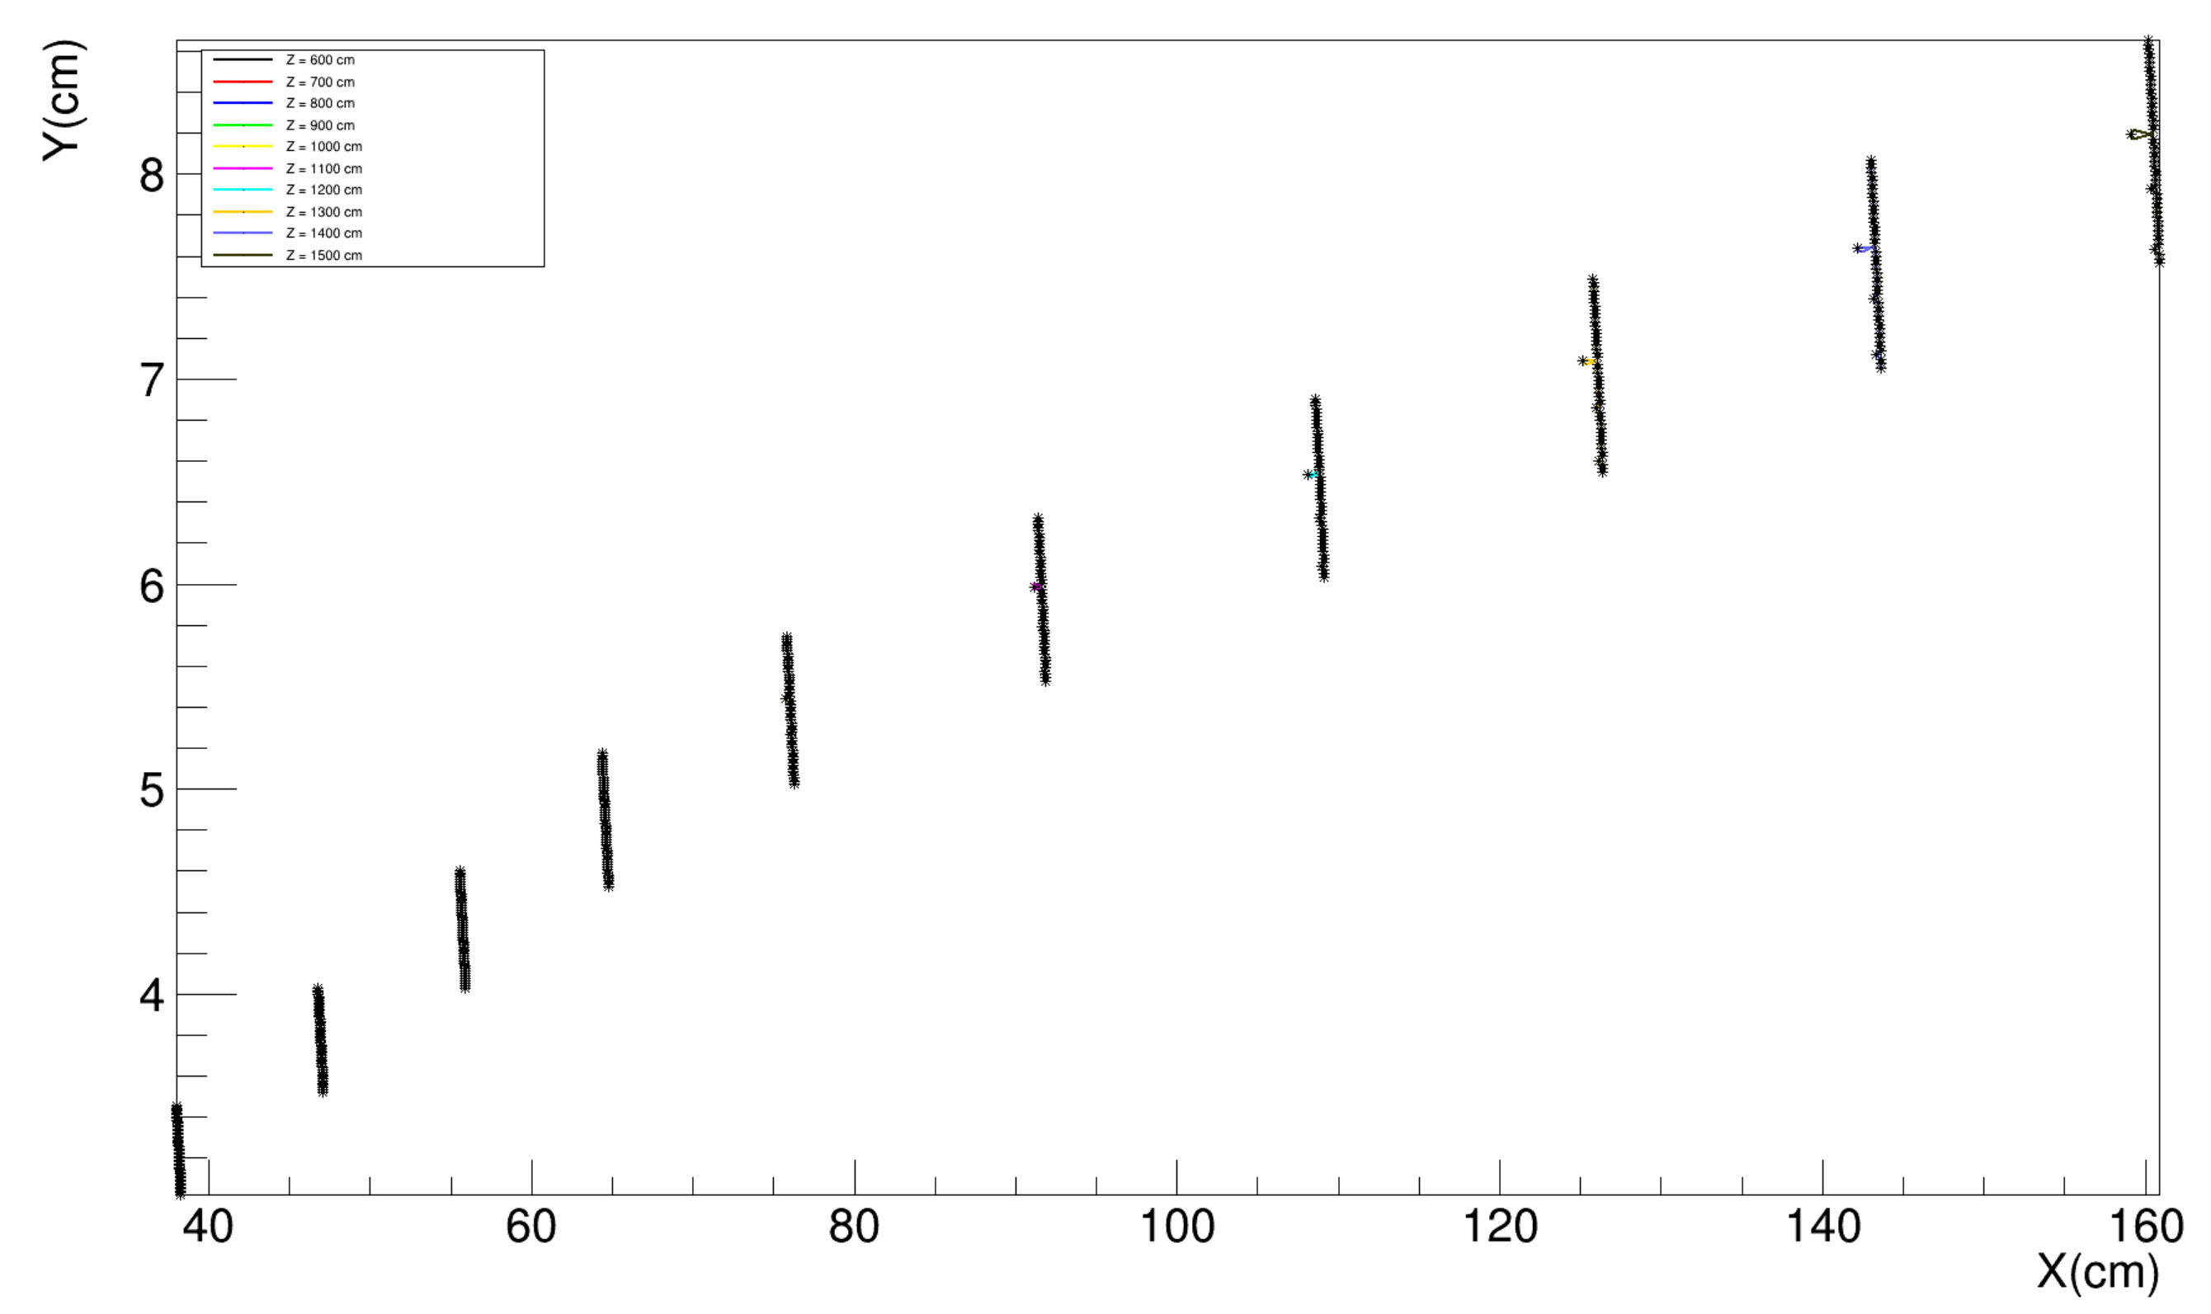
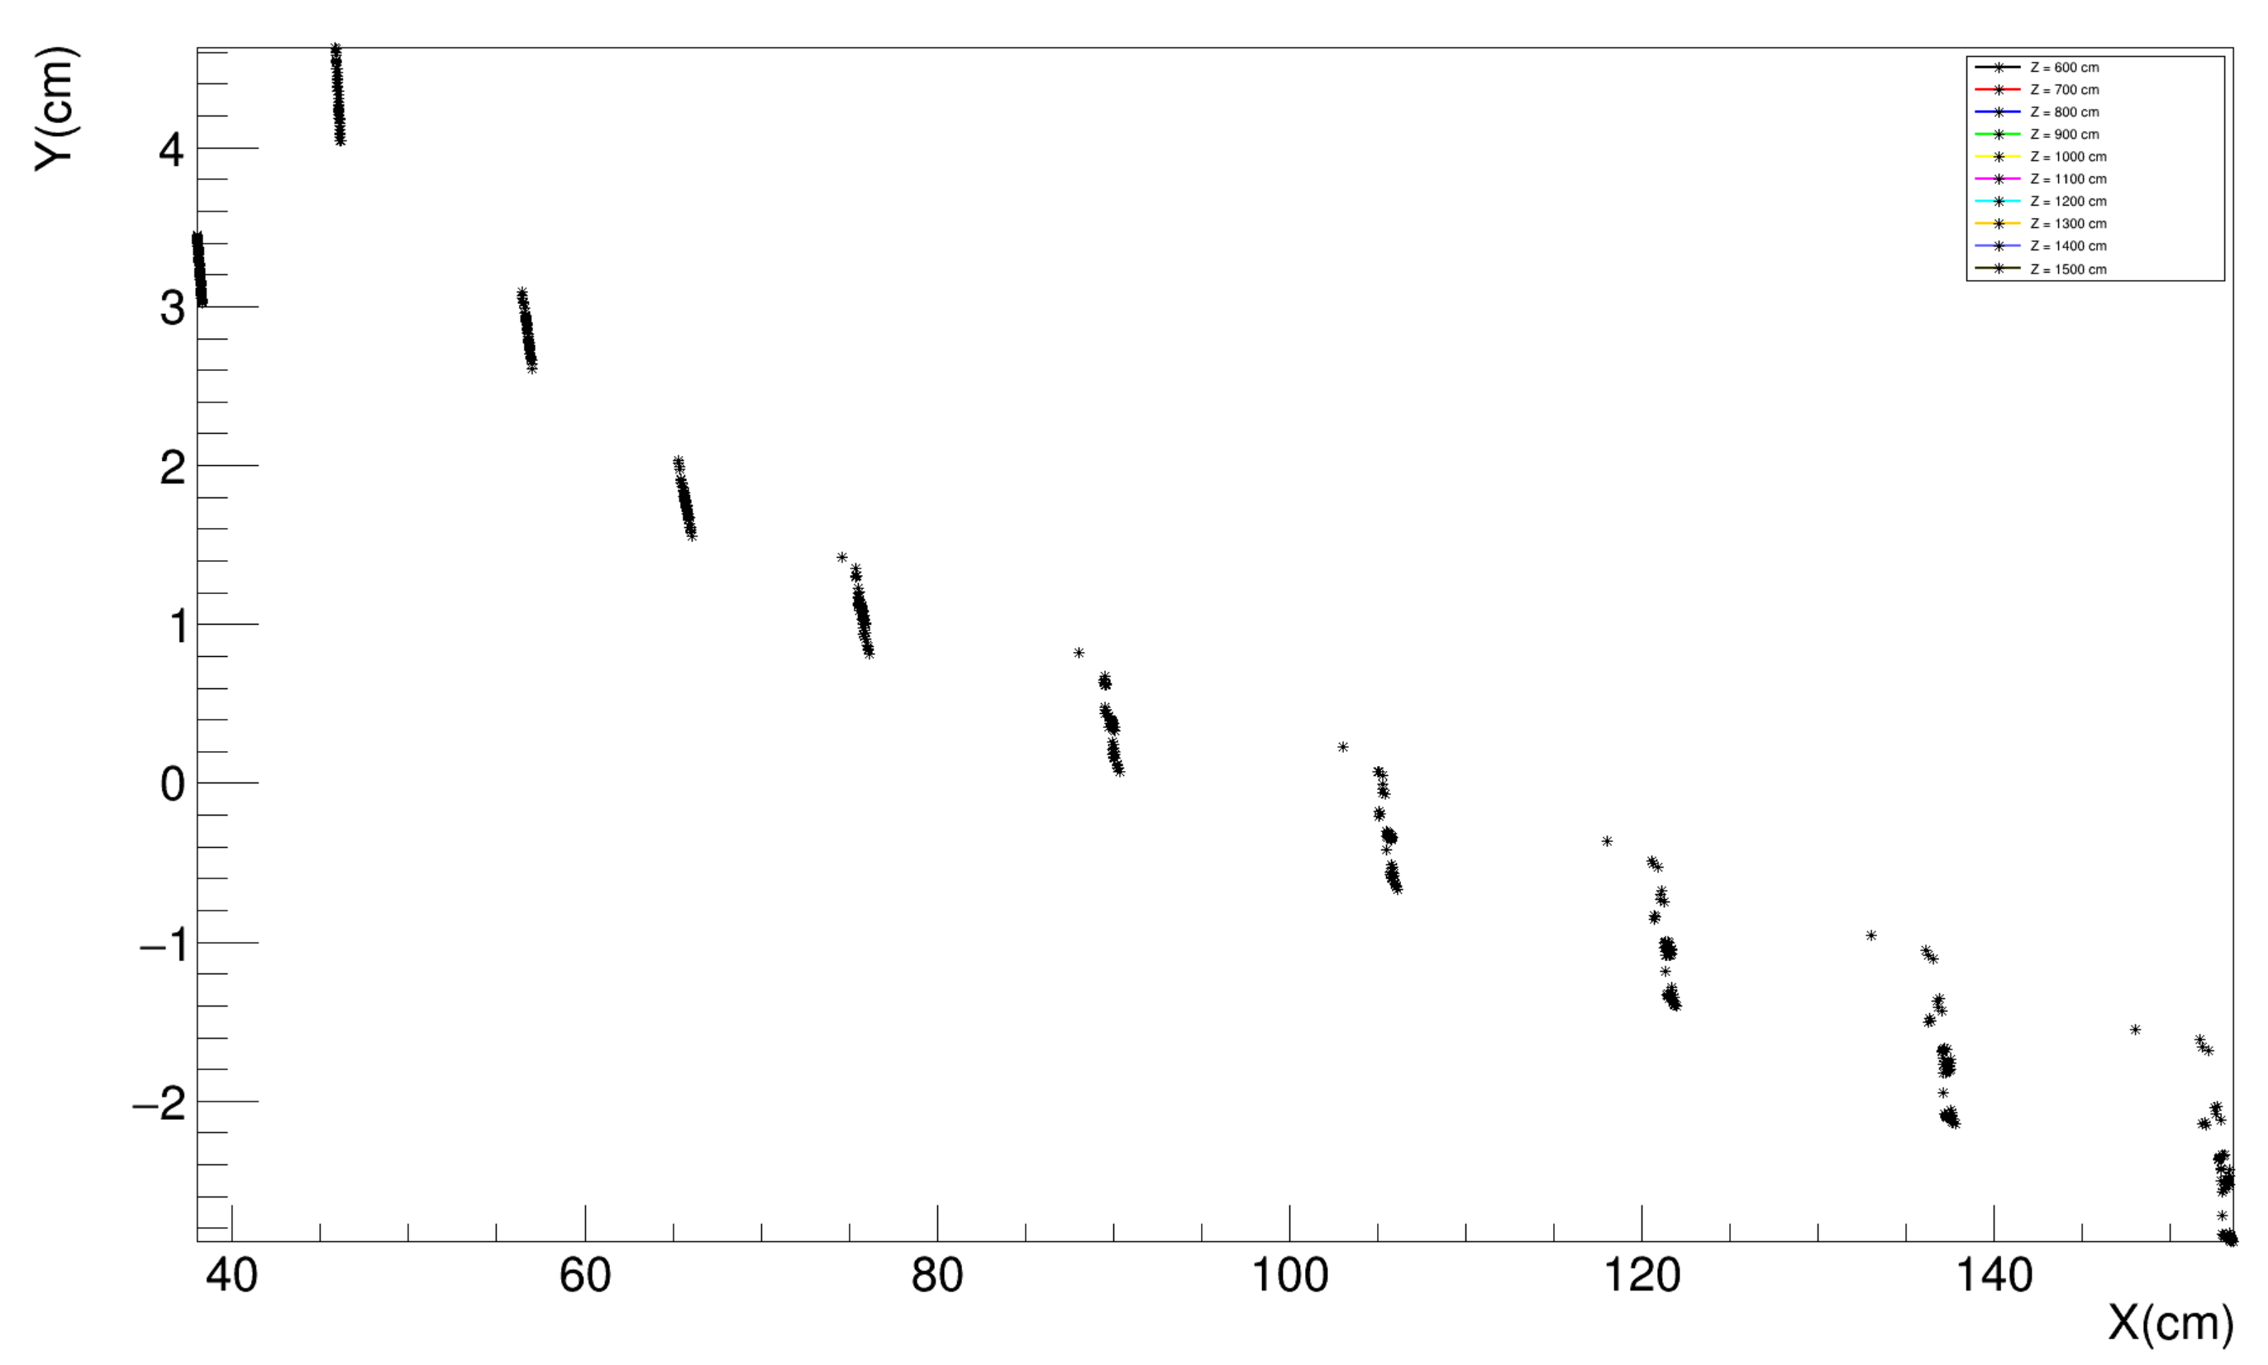
Theta = 10 mrad Phi = 145-150 DIPOLE
Theta = 10 mrad Phi = 145-150 DIPOLE+QUAD

Slide 20
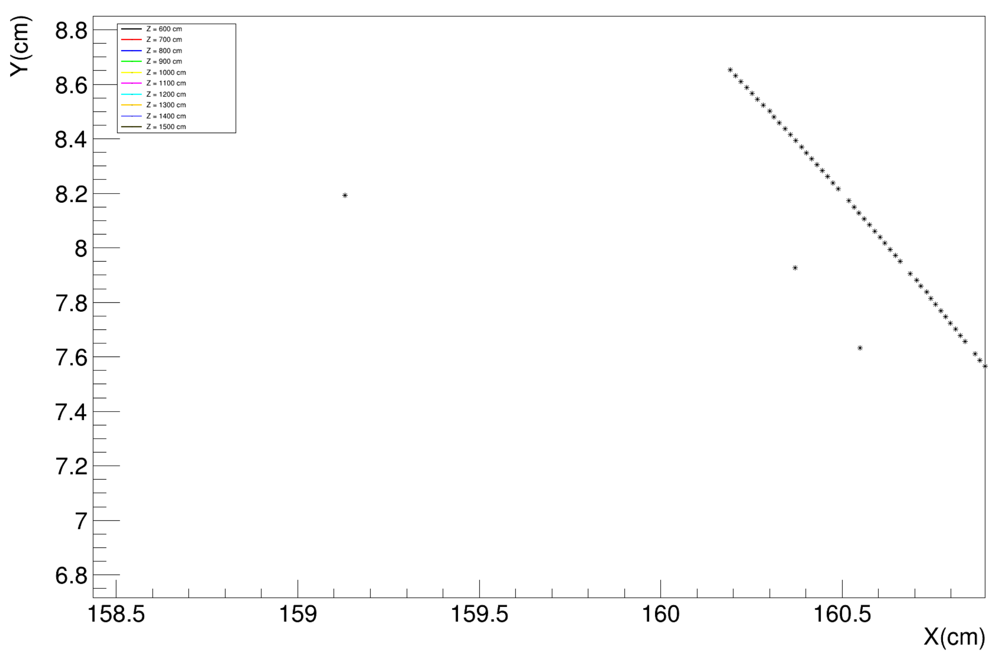
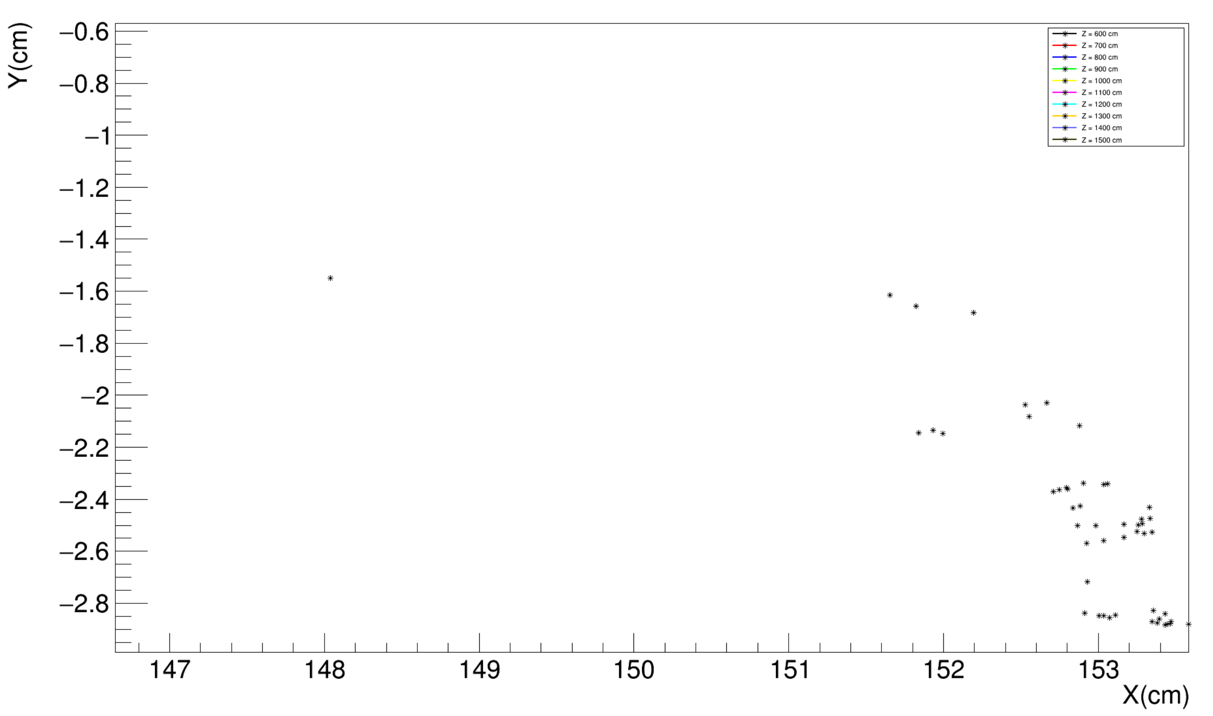

Slide 21
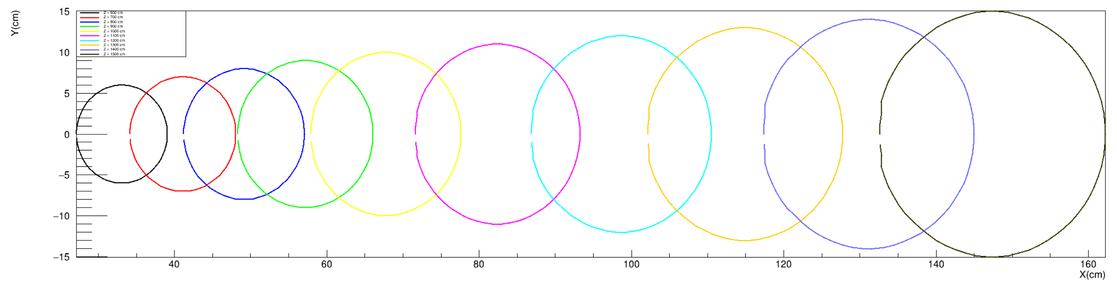
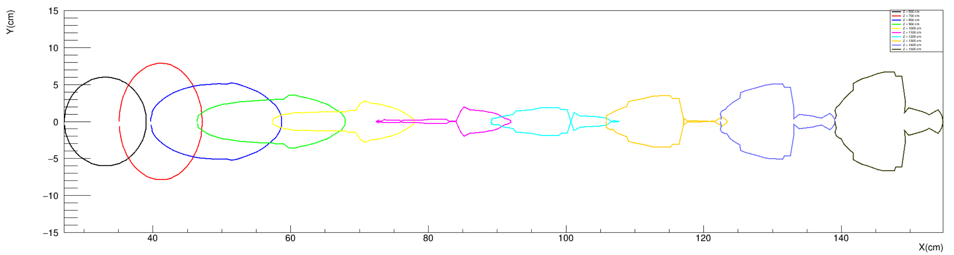
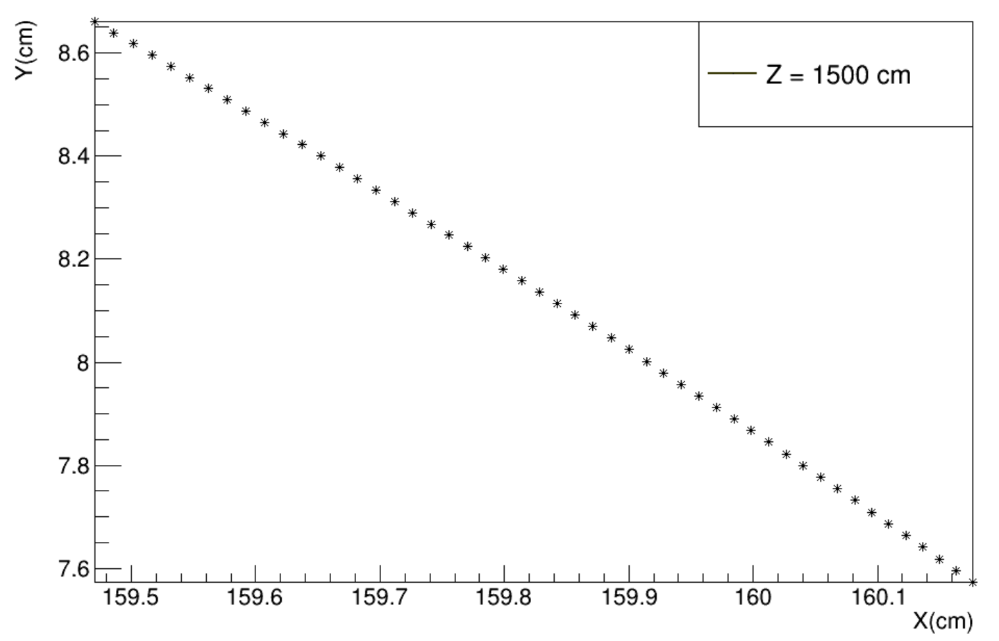
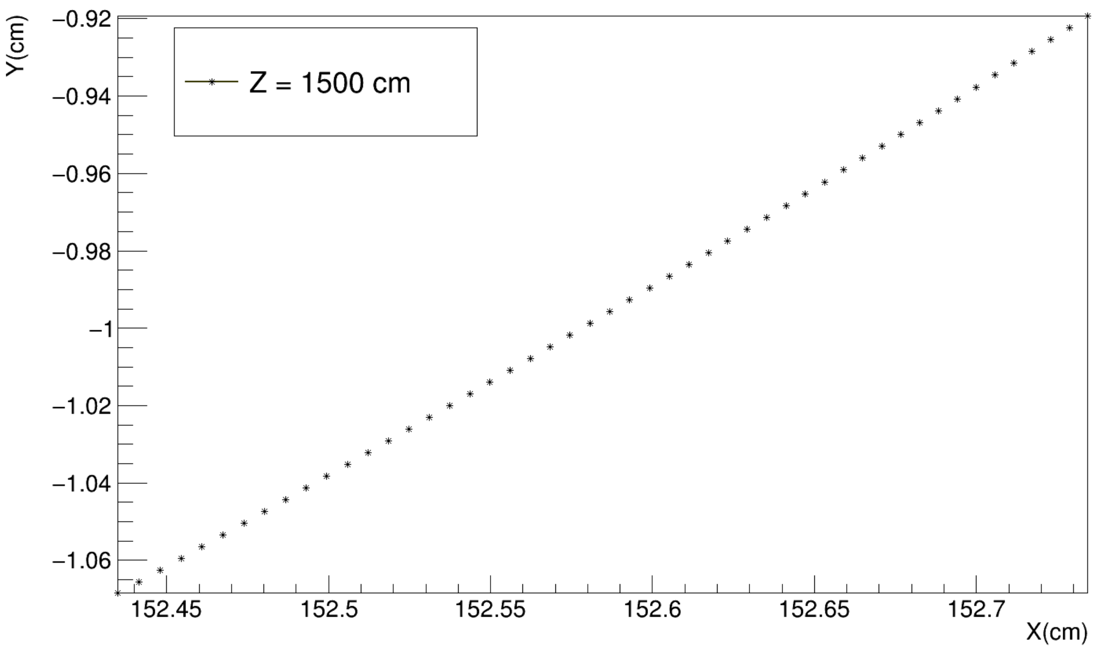
All Vacuum
Theta = 10 mrad Phi = 145-150 DIPOLE
Theta = 10 mrad Phi = 145-150 DIPOLE+QUAD

Slide 22
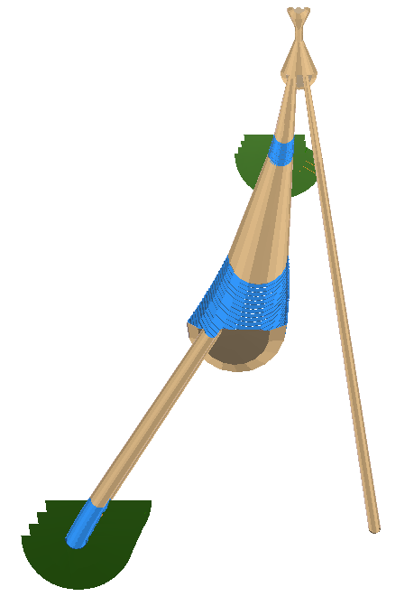
y
x
z
90º
180º
0º
270º

Slide 23
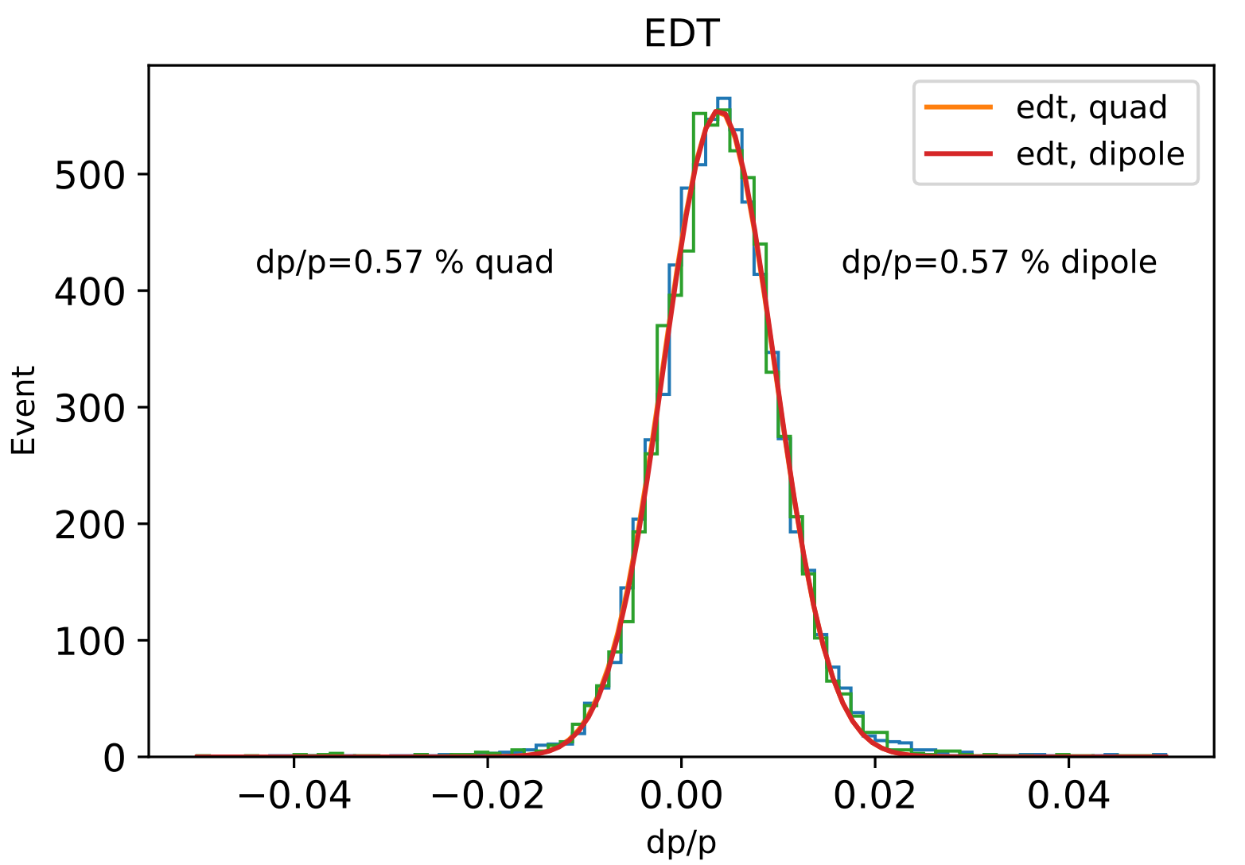
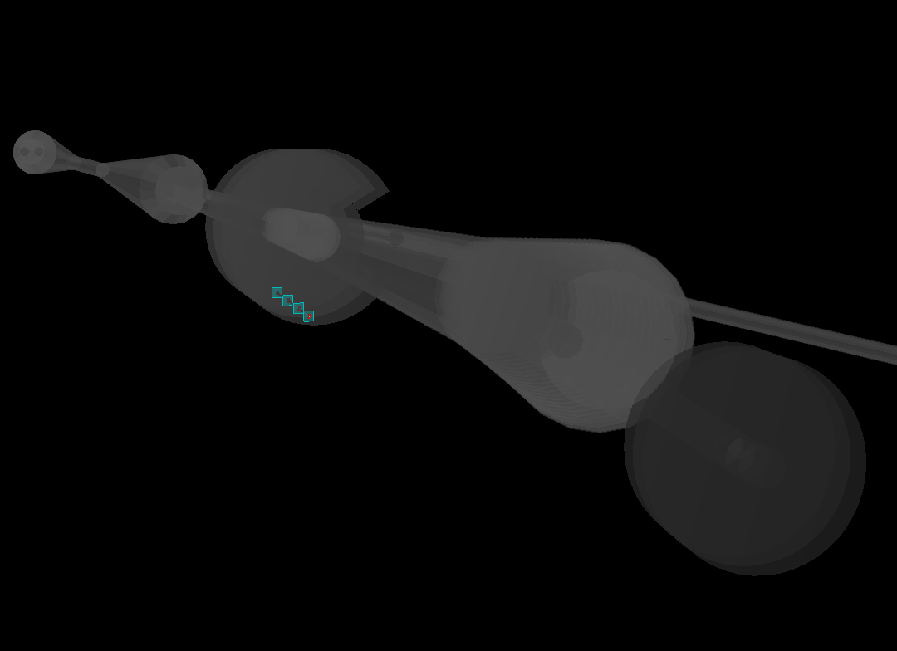
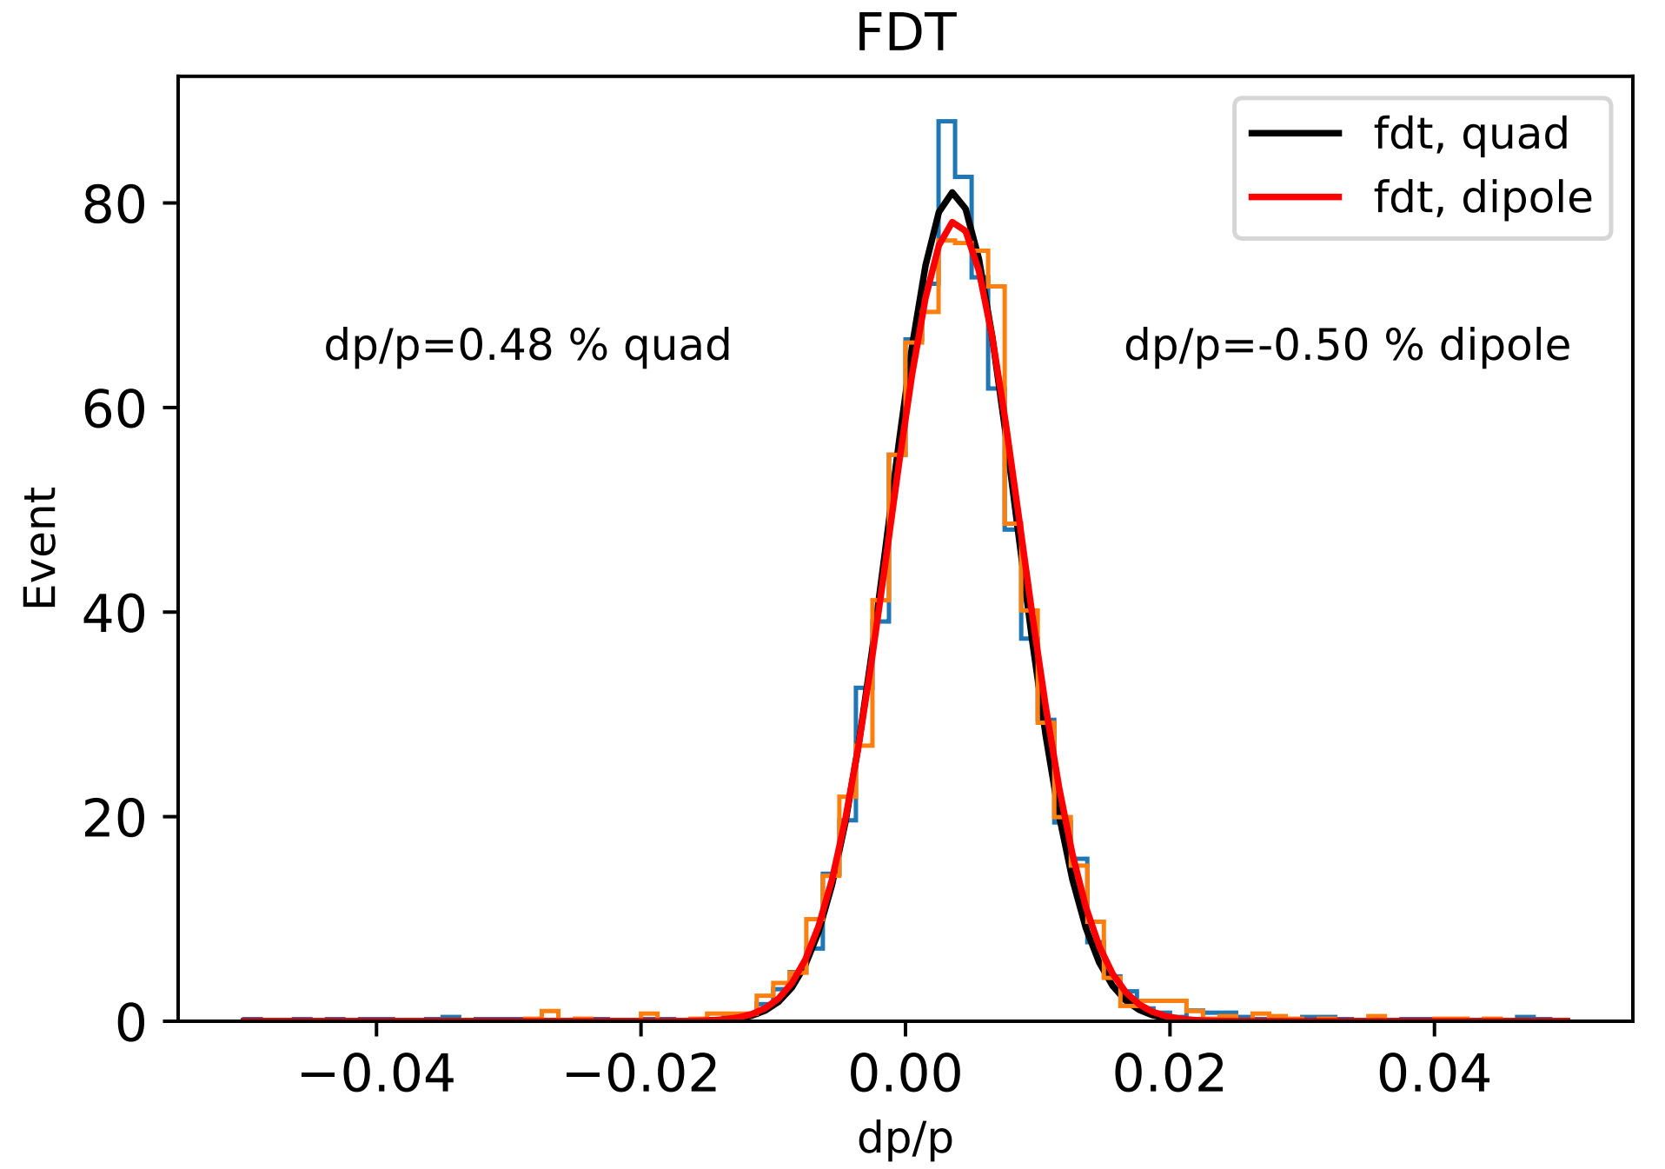
Impact of Quadrupoles -- resolution
Genfit in EiccRoot need to be tuned.
Mean value shift
Resolution could be better
Track is not extrapolated back to the IP!

