Slide 1
Study on Exotics – Zc(3900)
Xu Cao, Aiqiang Guo, Yutie Liang, Yaping Xie

Slide 2
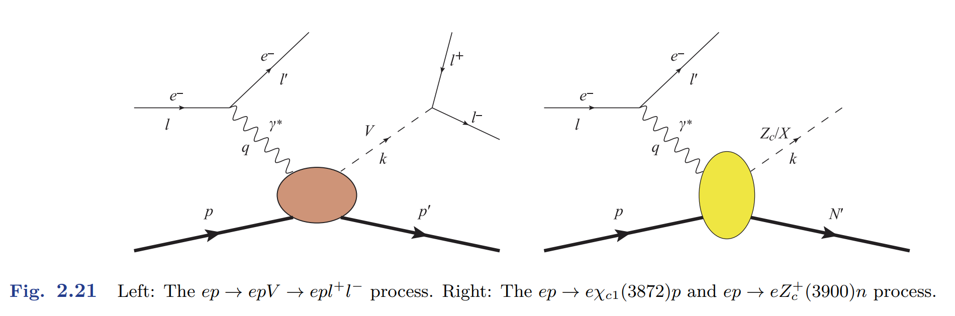
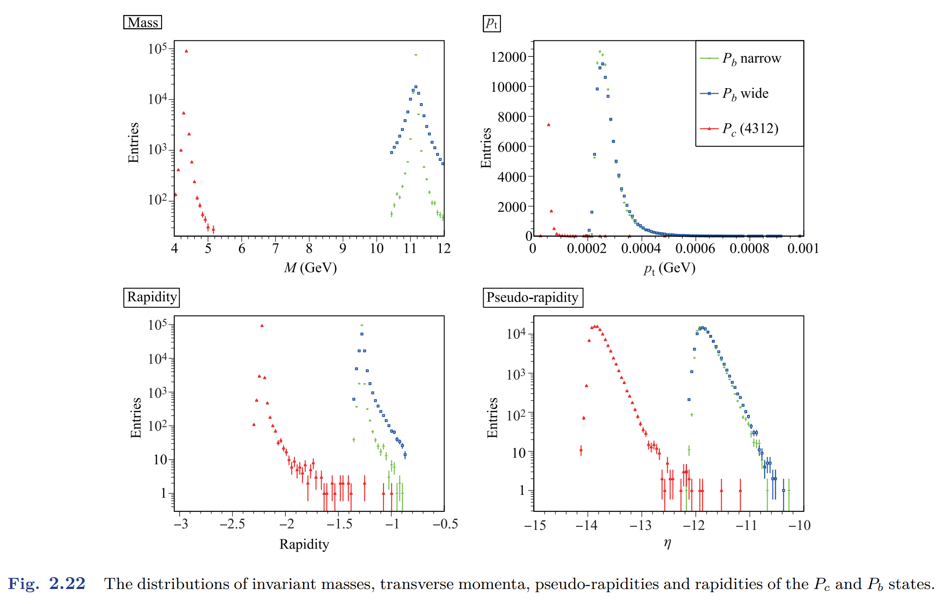
Status of Exotic in EicC WP
eStarLight, is a Monte Carlo that simulates coherent vector meson photo- and electro-production in electron-ion collisions. It can produce a variety of final states at different center of mass energies for different collision systems at arbitrary values for the photon virtuality.

Slide 3
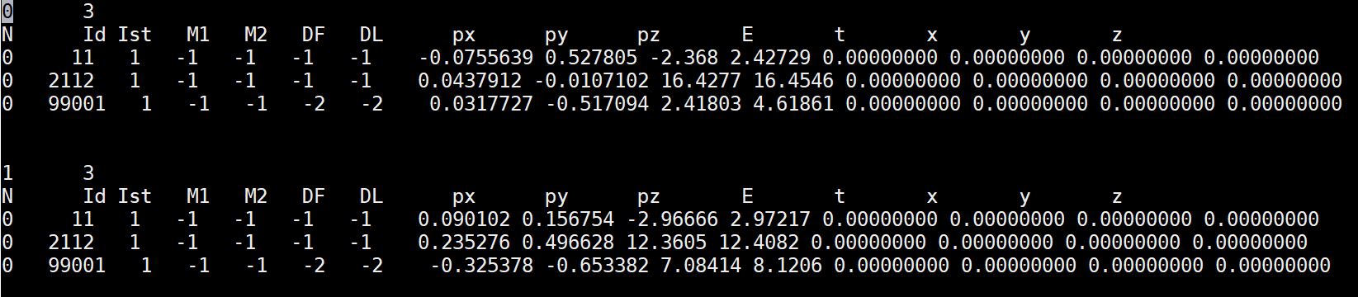
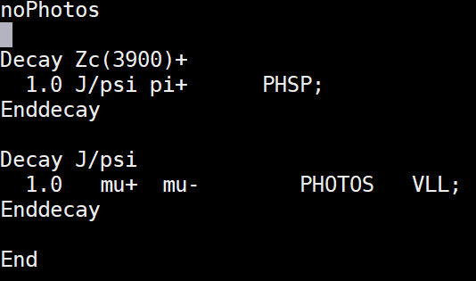
Plans for the CDR
Step 1:
Zc(3900), X(3872) eSTARLight
Pc: eSTARLight/LAger
Yaping Xie
√
Step 2:
Zc(3900), X(3872), Pc decay
Using EiccEvtGenHybrid
Aiqiang Guo
√
Yutie Liang
Step 3:
Implement the detector impact
Resolution + Efficiency table?
Update the physics output
Aiqiang Guo

Slide 4
Step1: Production of Zc(3900)
--Yaping Xie

Slide 5
Photoproduction of Zc(3900)
We use the effective method to calculate the photoproduction of Zc(3900) and fit the cross section as a function of W

Slide 6
Zc(3900) production in EicC
Adopting the photoproduction and estarlight, we can obtain the production of Zc(3900) in EicC.

Slide 7
Zc(3900) production in EicC
Adopting the photoproduction and estarlight, we can obtain the production of Zc(3900) in EicC.

Slide 8
Zc(3900) production in EicC
Adopting the photoproduction and estarlight, we can obtain the production of Zc(3900) in EicC.

Slide 9
Zc(3900) production in EicC
Adopting the photoproduction and estarlight, we can obtain the production of Zc(3900) in EicC.

Slide 10
Step2: Decay of Zc(3900)
--Yutie

Slide 11
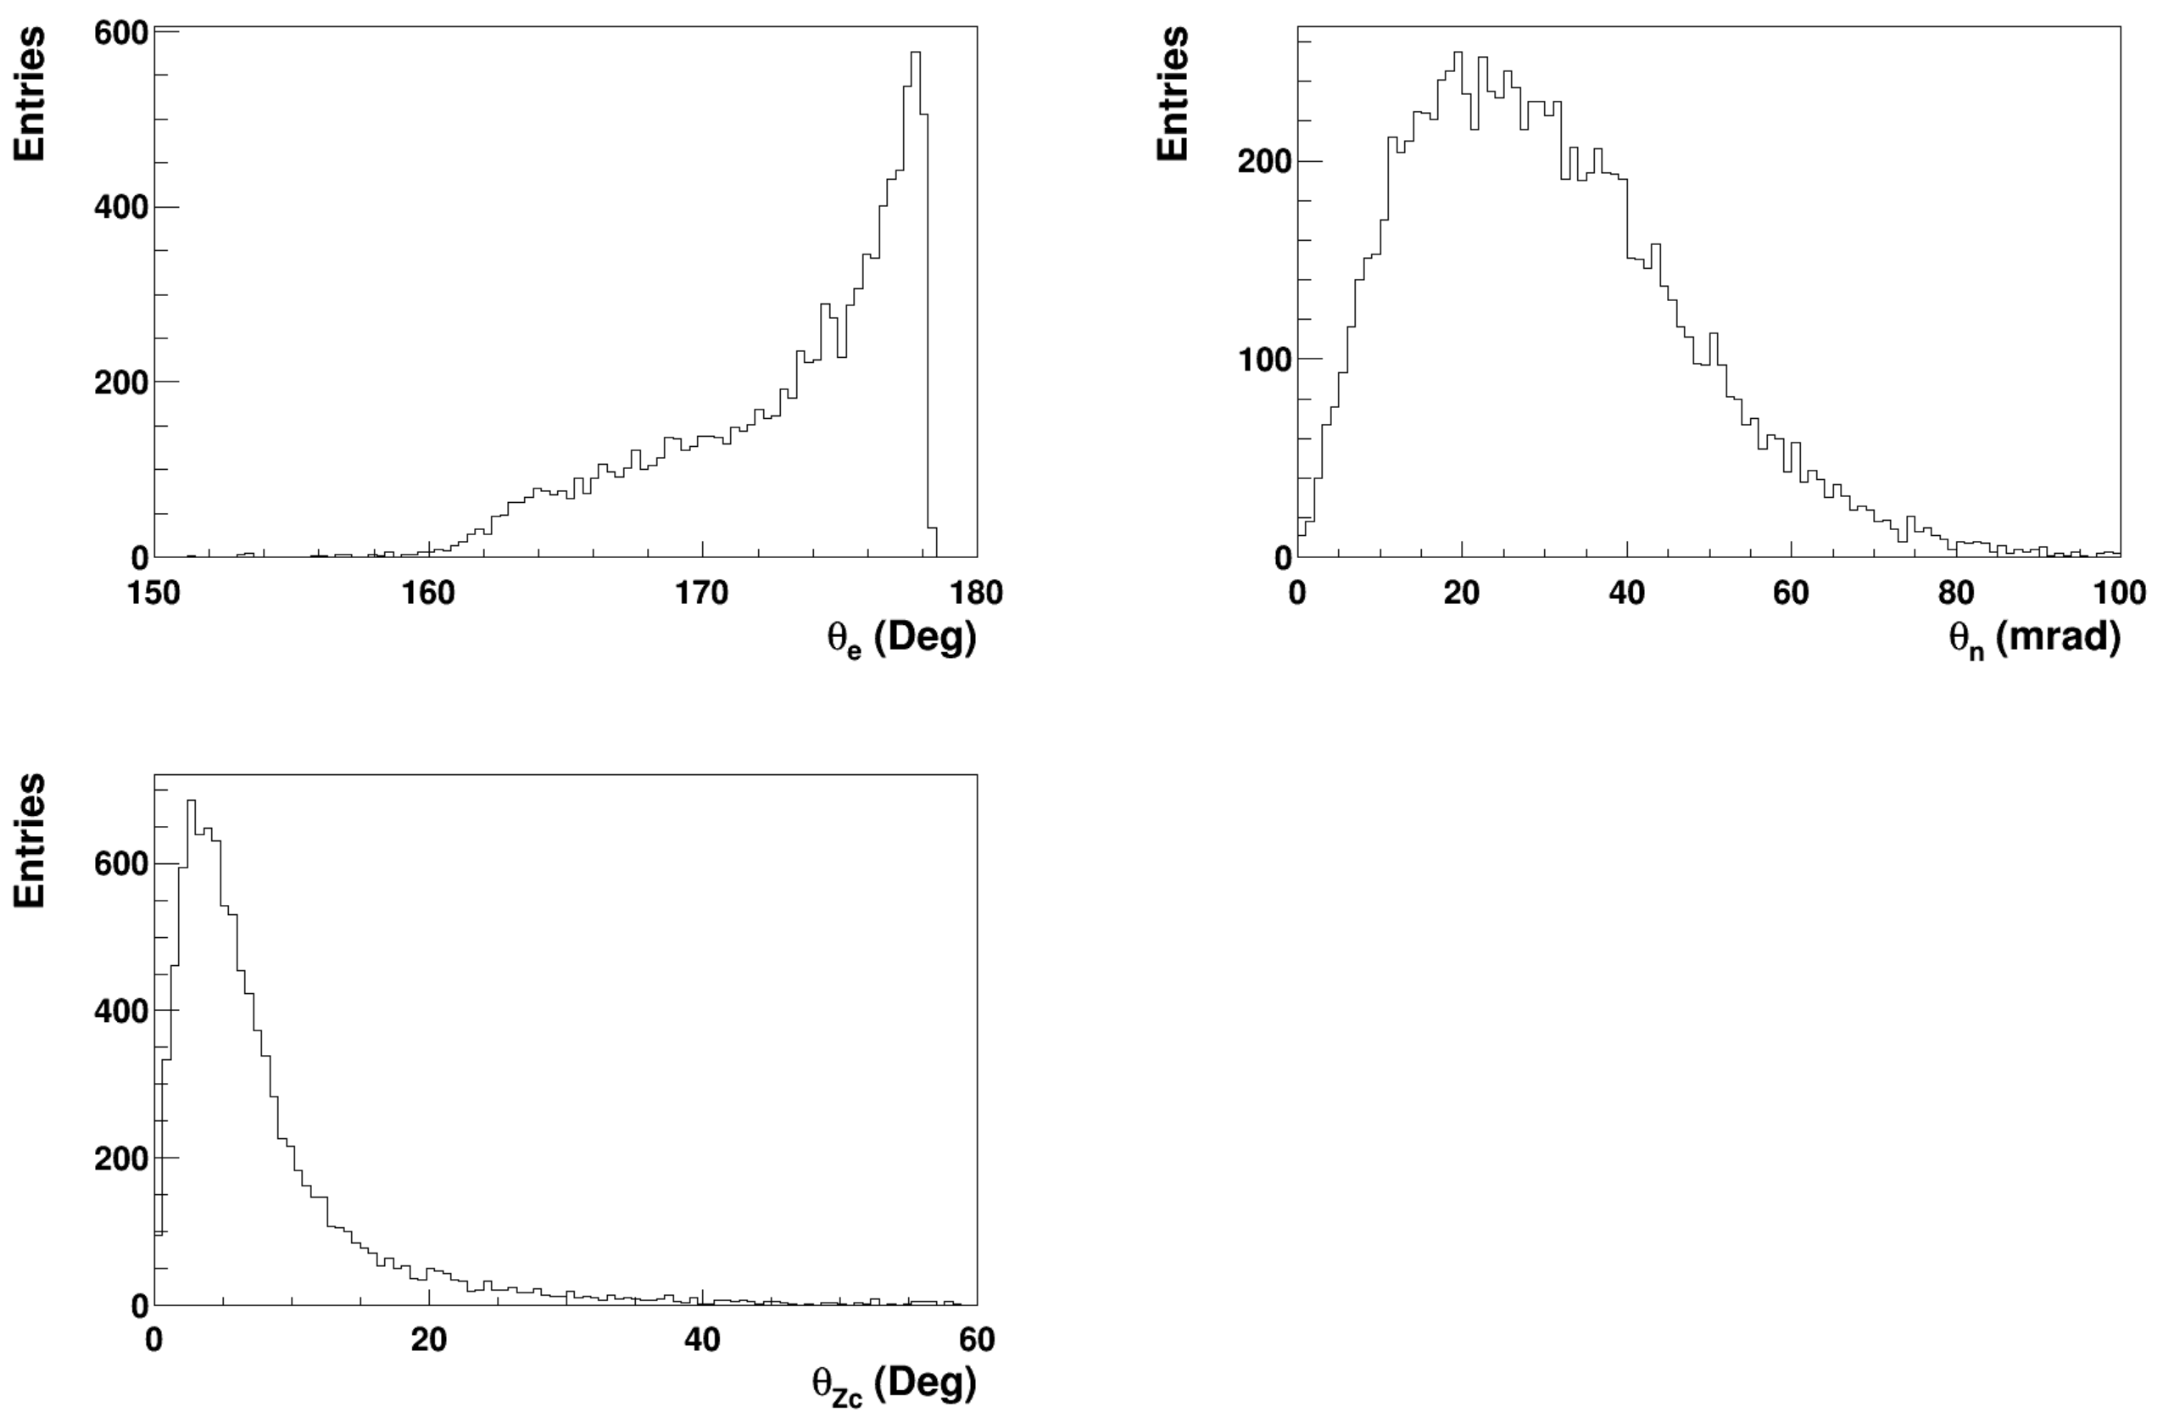
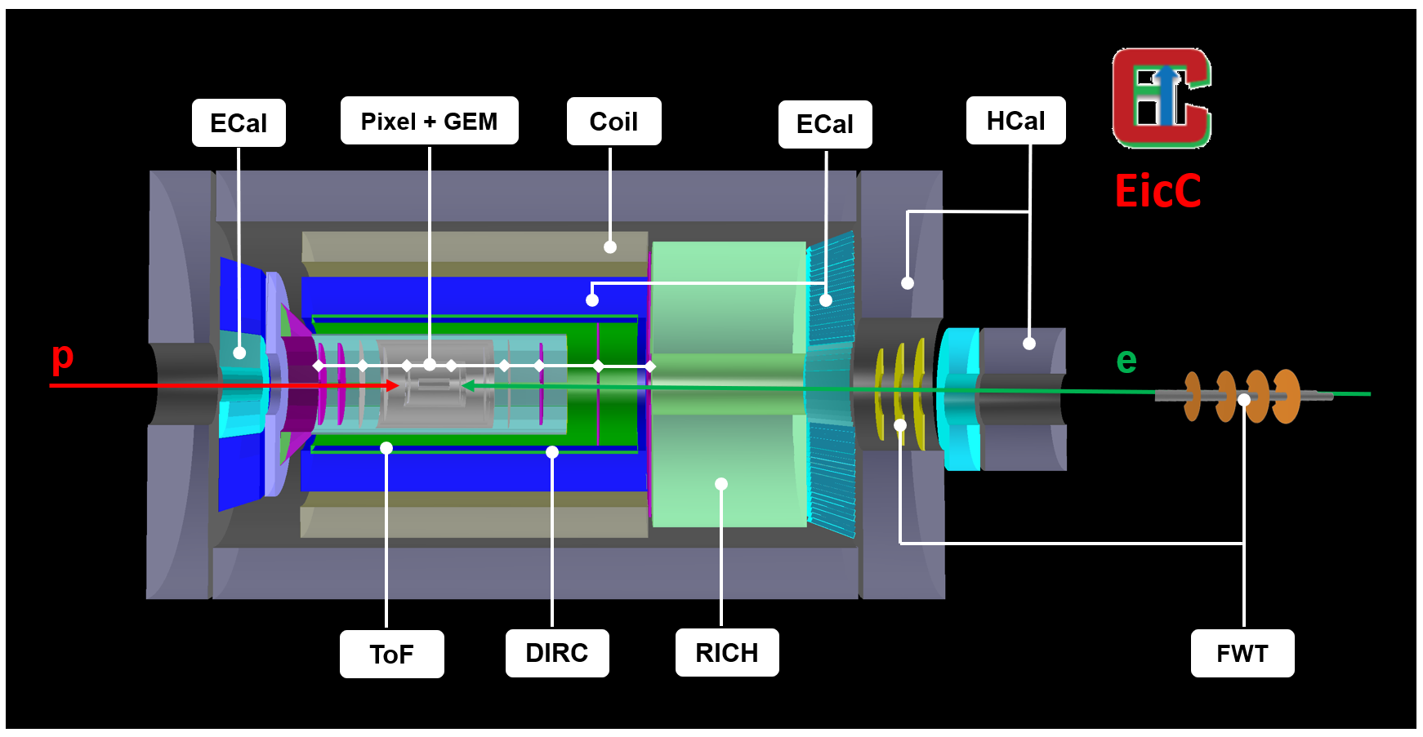
e p→ e n Zc

Slide 12
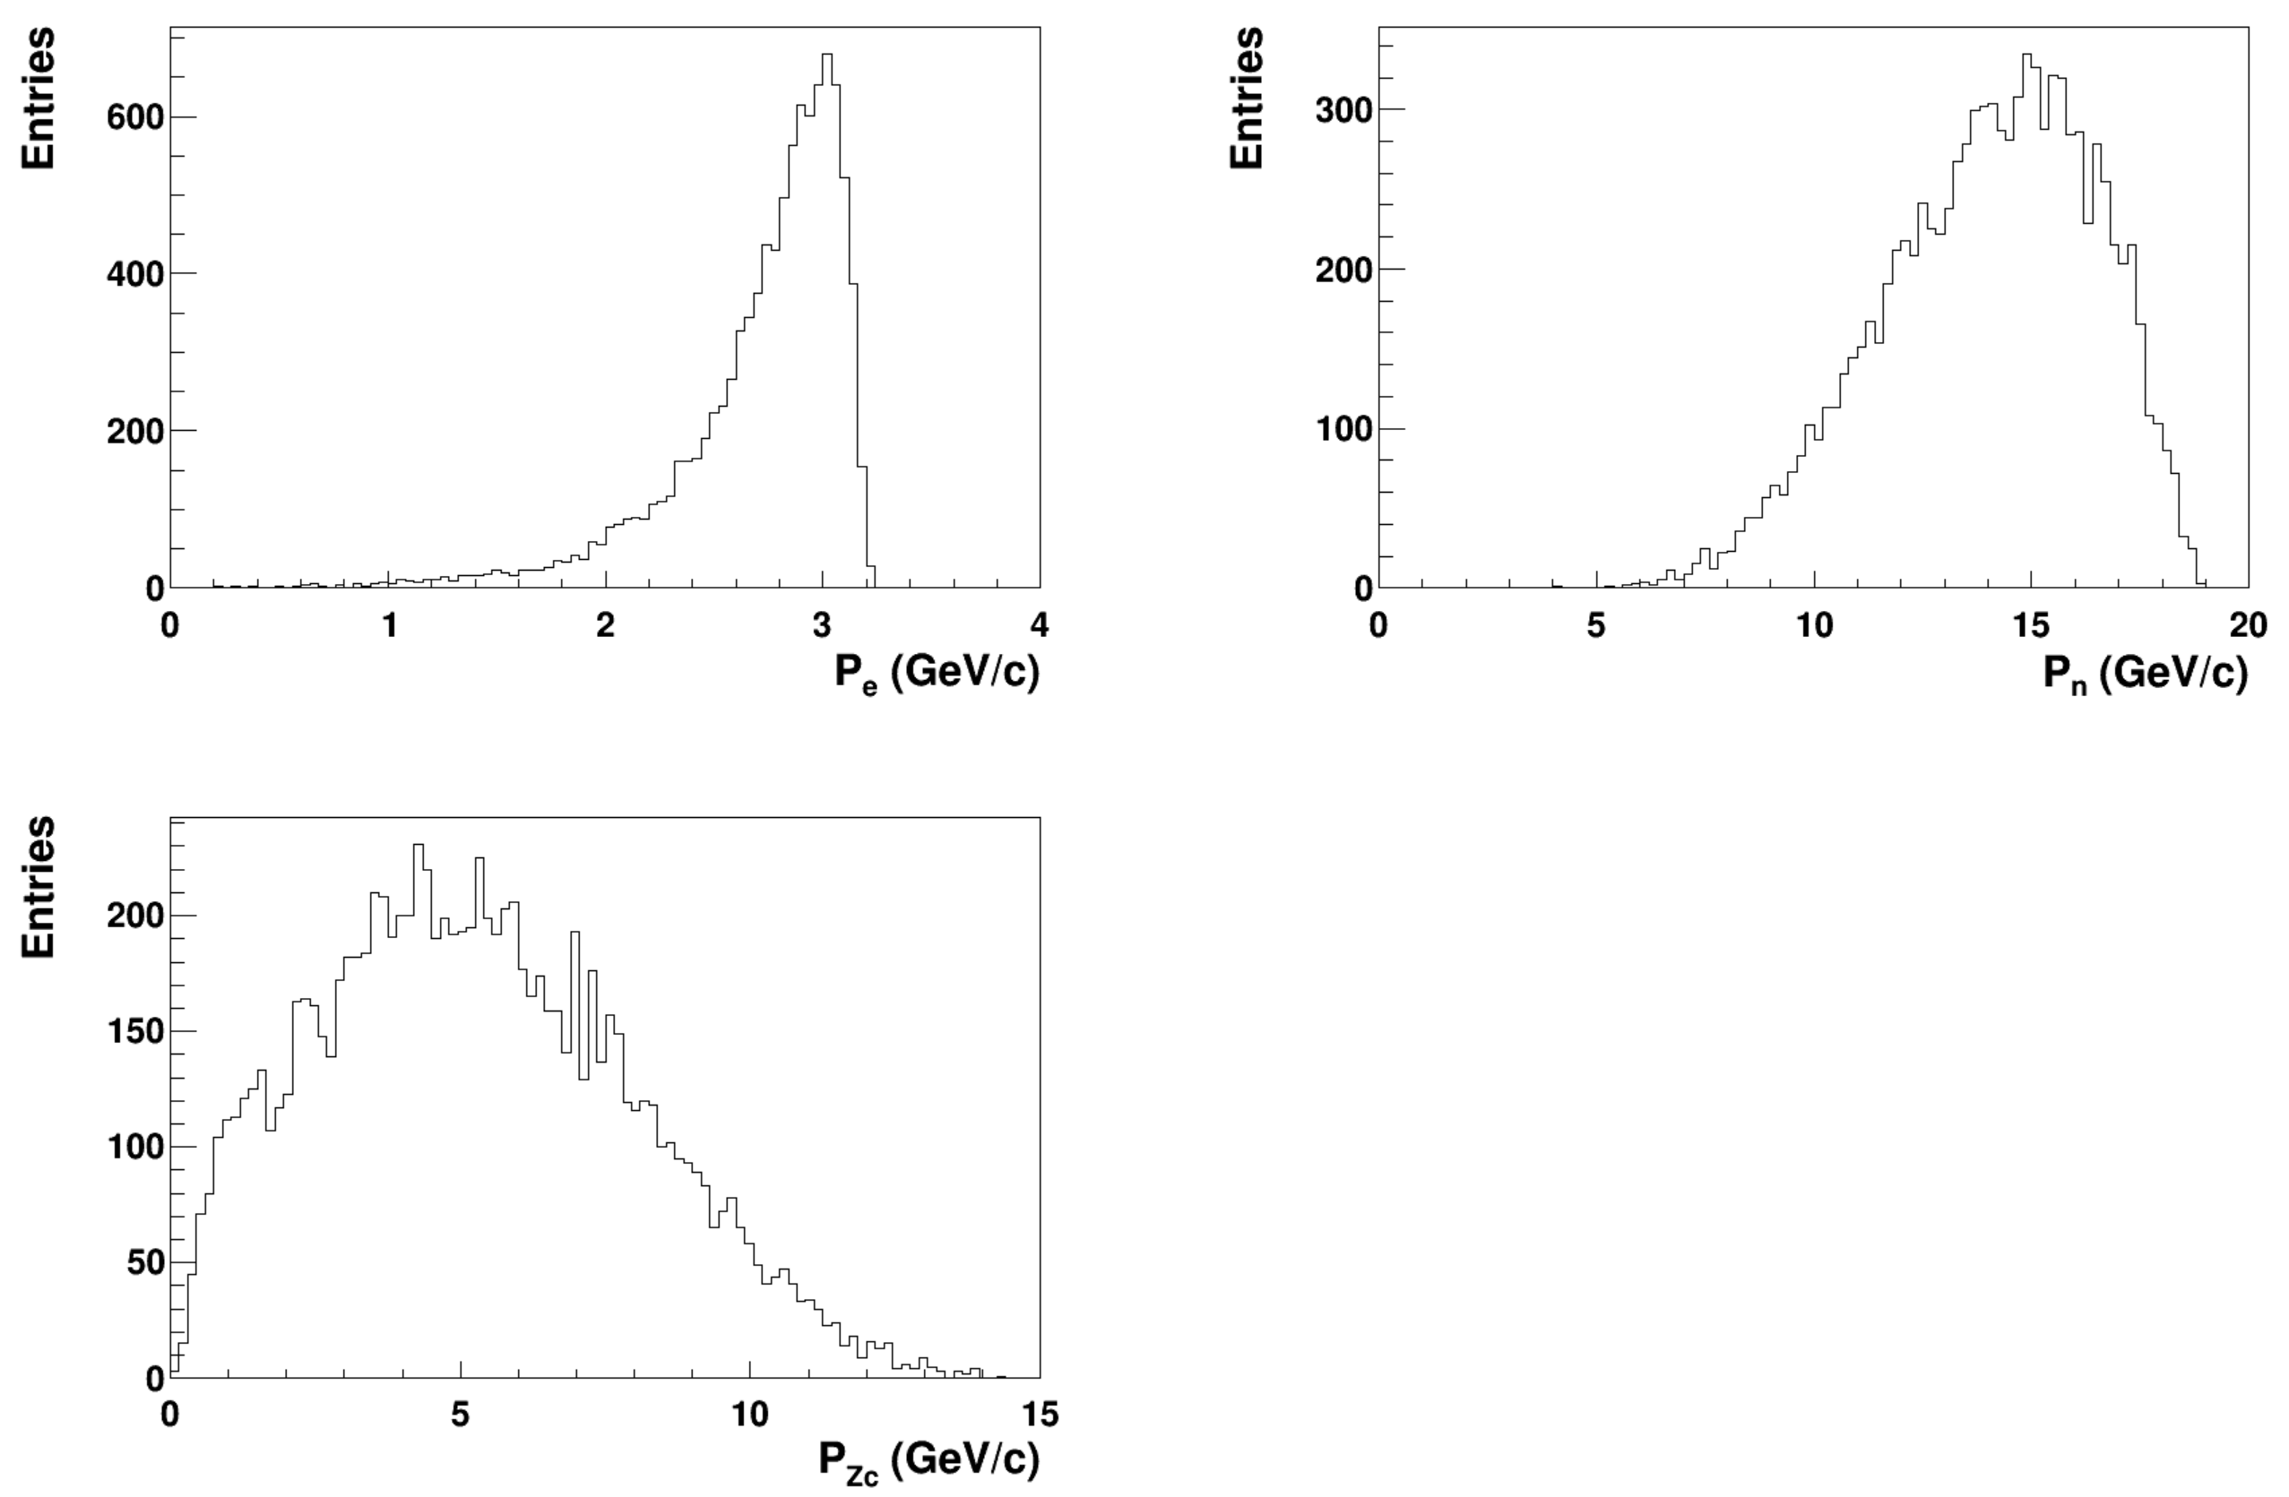
e p→ e n Zc

Slide 13
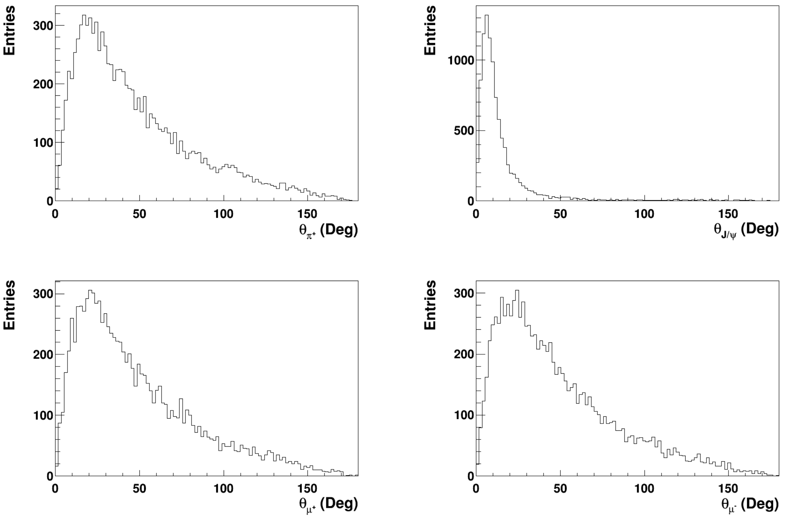
e p→ e n Zc → e n + π J/ψ → e n + πμμ

Slide 14
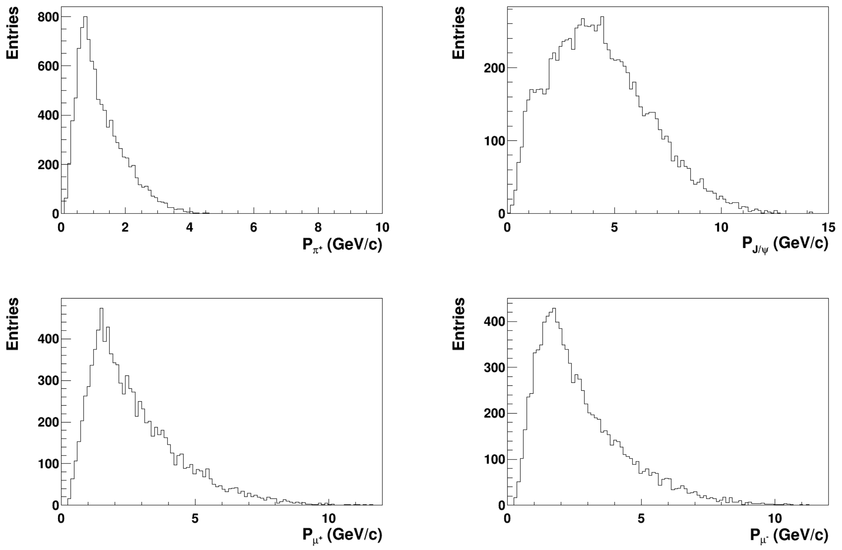
e p→ e n Zc → e n + π J/ψ → e n + πμμ

Slide 15
Summary
For Zc(3900), the final states include e n π⁺ e/μ⁺ e/μ⁻.
  e π⁺ e/μ⁺ e/μ⁻ are in the central detector acceptance.
  Part of the neutron in the forward detector acceptance.
How to include the crossing angle?
The detector impact need to be included.
The other exotic states, such as X(3872) and P_{b}, will be studied soon.

