Slide 1
$${Λ_{C}^{+}}/{D^{0}}Projection$$
朱森杰，黄逍
中国科学技术大学

Slide 2
Outline
Introduction
$Λ_{c}^{+}Reconstruction$
${Λ_{C}^{+}}/{D^{0}}Projection$
Conclusion

Slide 3
Hadronization
partons $→$ hadrons
$e^{+}ⅇ^{−}$ collider
electron-ion collider
hadron collider
Phenomenological models:
Lund String Model
…

Slide 4
Hadronization
Hadron cross section $→$ convolution of the parton distribution functions (PDFs), the parton hard-scattering cross sections, and the fragmentation functions
Different models $→$ different fragmentation functions
Baryon-to-meson ratios are sensitive to fragmentation functions used in calculations

Slide 5
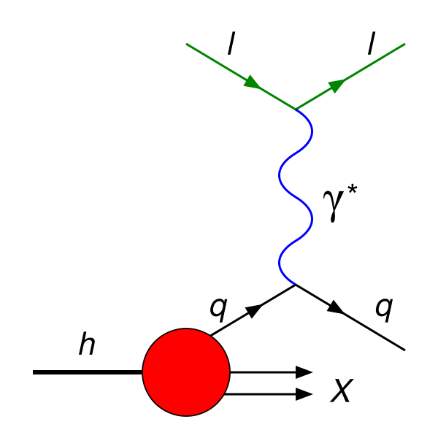
${Λ_{c}^{+}}/{D^{0}}$ ratio
Polarized Electron Ion Collider in China (EicC)
Deep Inelastic Scattering
ep 3.5GeV $×$ 20GeV at $100{fb}^{−1}$
PYTHIA
Models:
QCD Color Reconnection
MPI Color Reconnection

Slide 6
$$Λ_{C}^{+} Reconstruction$$

Slide 7
$Λ_{C}^{+}$ Reconstruction
MC ep collision events (3.5GeV $×$ 20GeV )
Smearing events (simulating detector responses)
Cut Calculation
Distinguishing signals from backgrounds with Boosted Decision Tree (BDT)

Slide 8
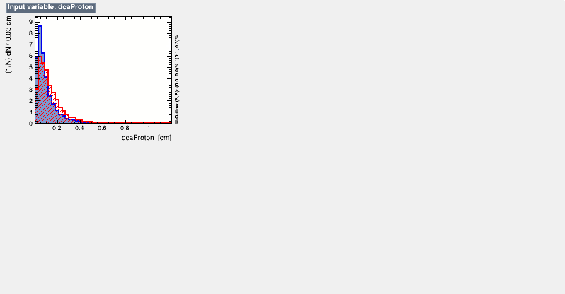
BDT Training Results

Slide 9
BDT Training Results

Slide 10
$Λ_{C}^{+}$ Reconstruction Results (MPI-CR Model)
$$\left|y\right|<1$$
$$1<y<3$$

Slide 11
$Λ_{C}^{+}$ Reconstruction Results (QCD-CR Model)
$$\left|y\right|<1$$
$$1<y<3$$

Slide 12
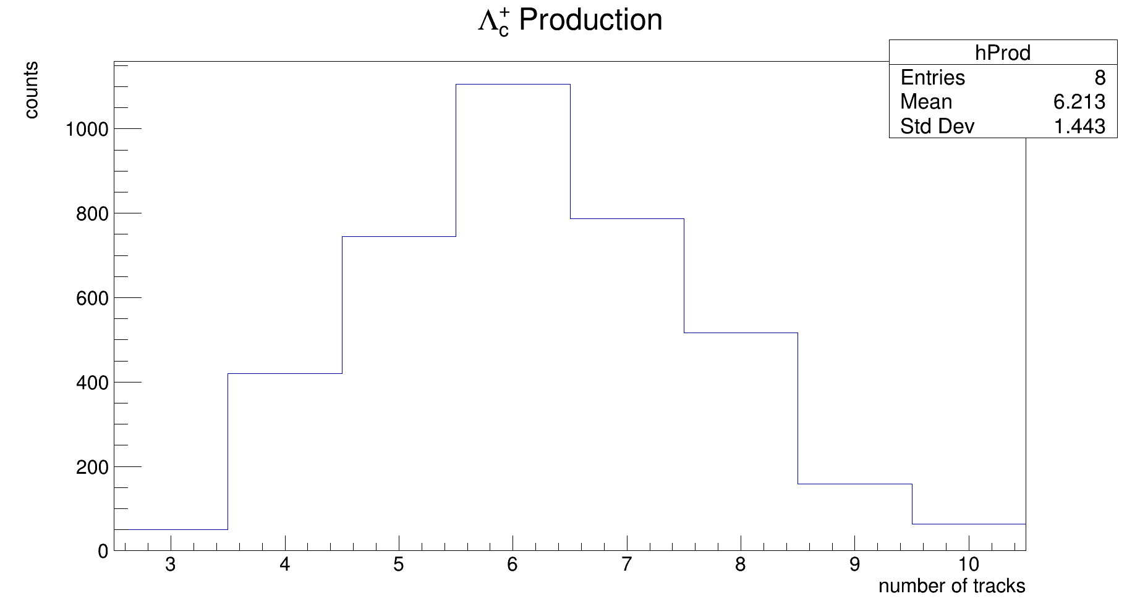
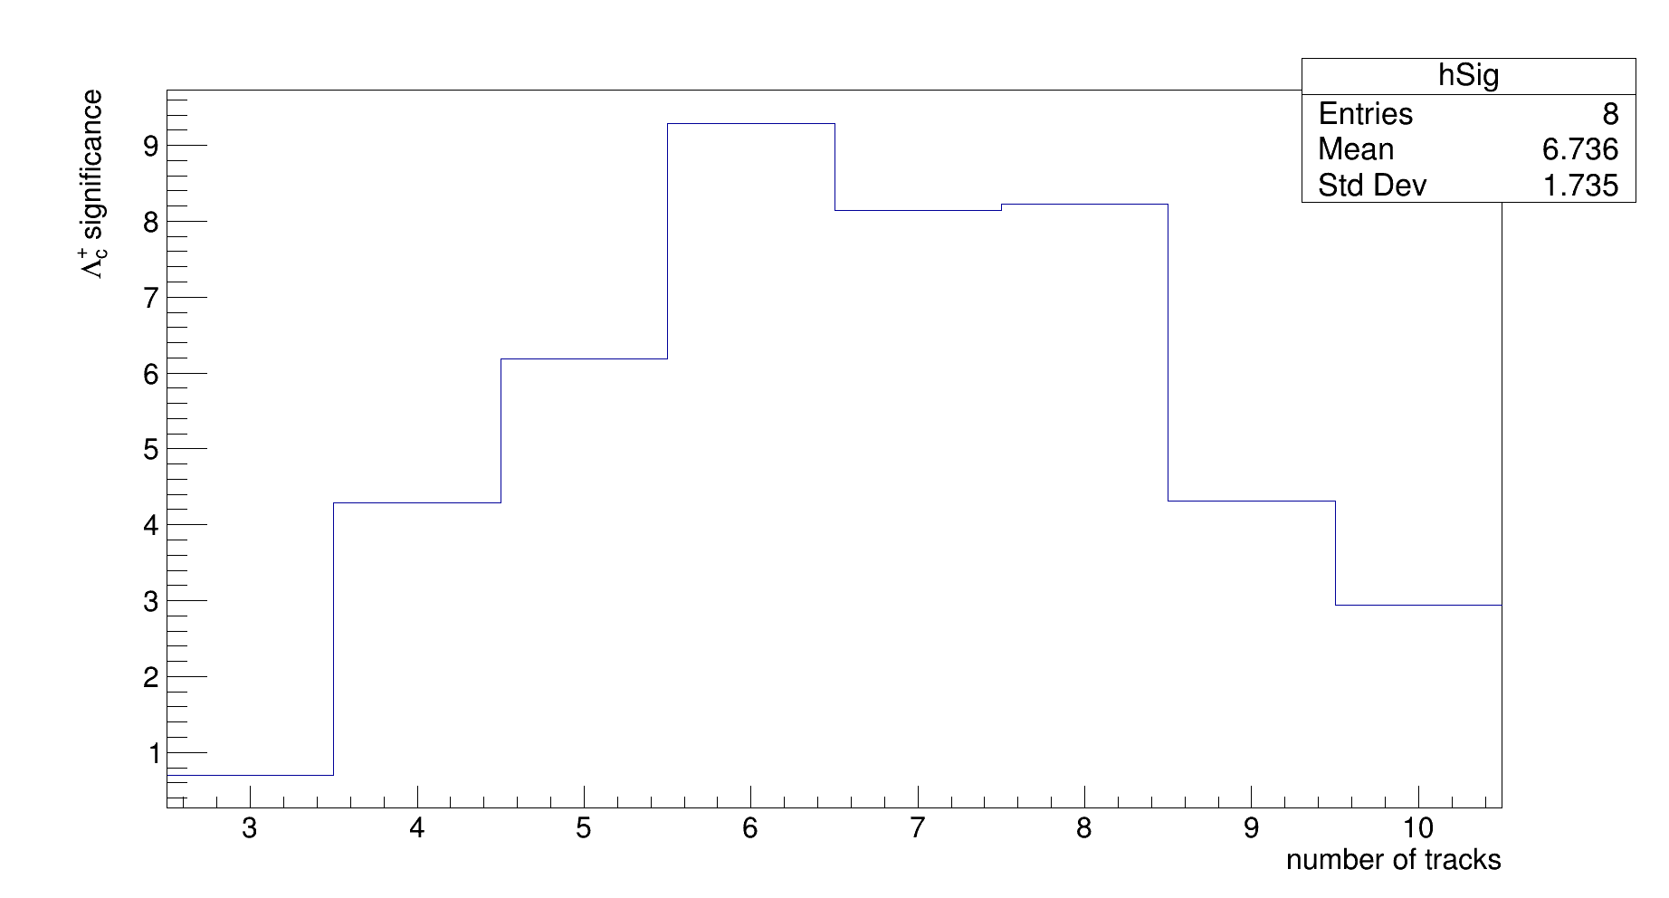
$Λ_{C}^{+}$ Reconstruction Results (MPI-CR Model)
$\left|y\right|<1$ $significance=\frac{S}{\sqrt{S+B}}$

Slide 13
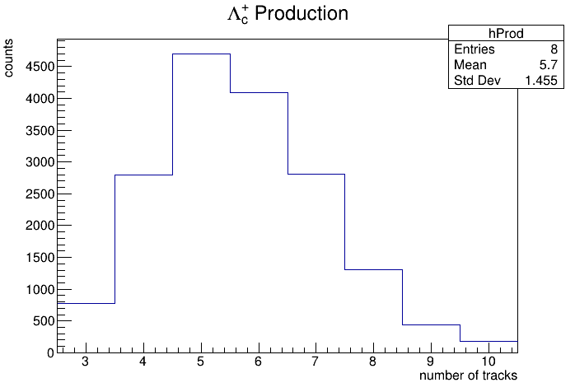
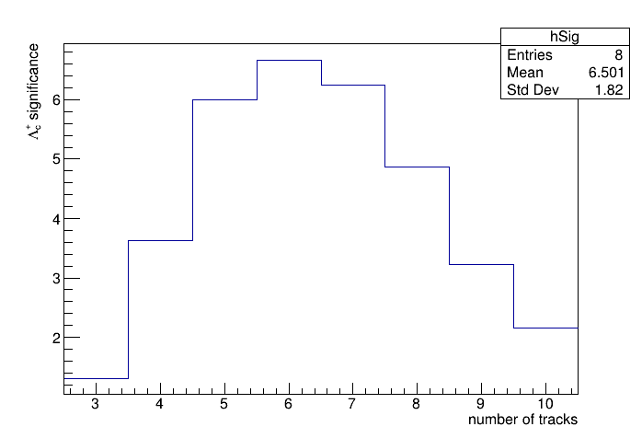
$Λ_{C}^{+}$ Reconstruction Results (MPI-CR Model)
$1<y<3$

Slide 14
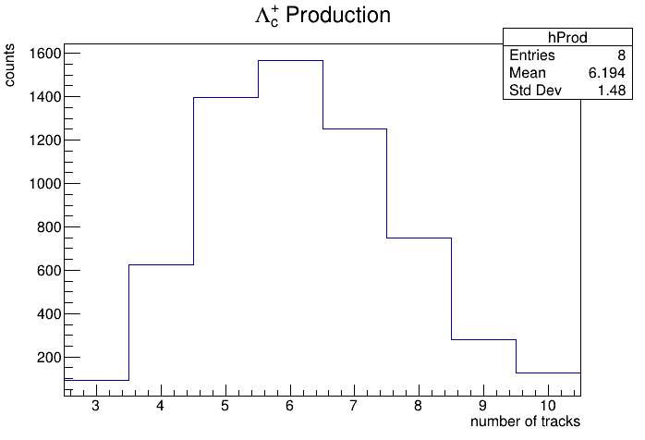
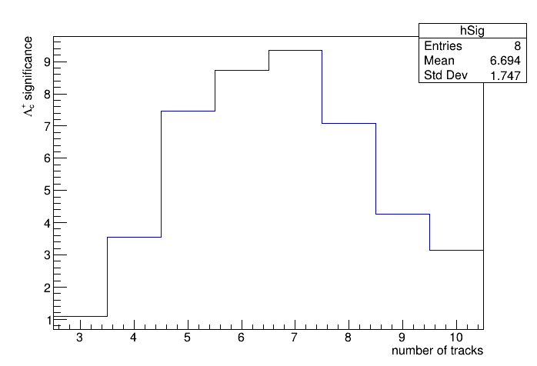
$Λ_{C}^{+}$ Reconstruction Results (QCD-CR Model)
$\left|y\right|<1$

Slide 15
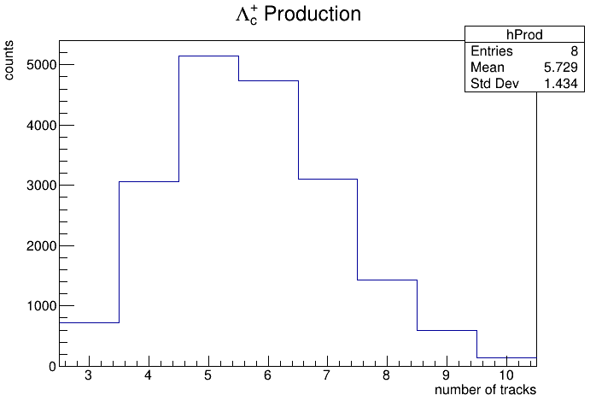
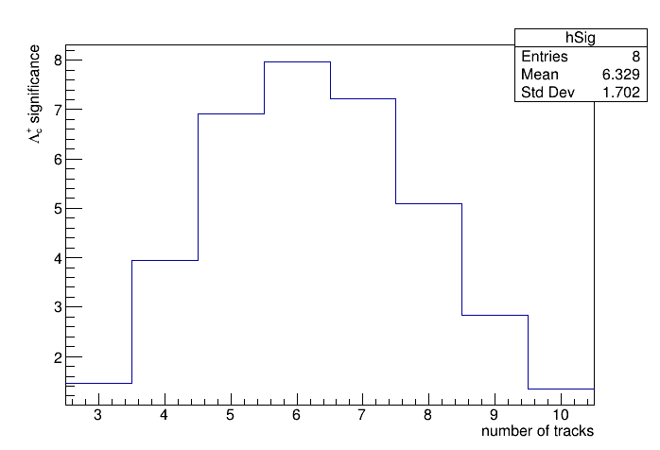
$Λ_{C}^{+}$ Reconstruction Results (QCD-CR Model)
$1<y<3$

Slide 16
$D^{0}$ Reconstruction Result (MPI-CR Model)
$$\left|y\right|<1$$
$$1<y<3$$

Slide 17
$D^{0}$ Reconstruction Result (QCD-CR Model)
$$\left|y\right|<1$$
$$1<y<3$$

Slide 18
$${Λ_{C}^{+}}/{D^{0}}Projection$$

Slide 19
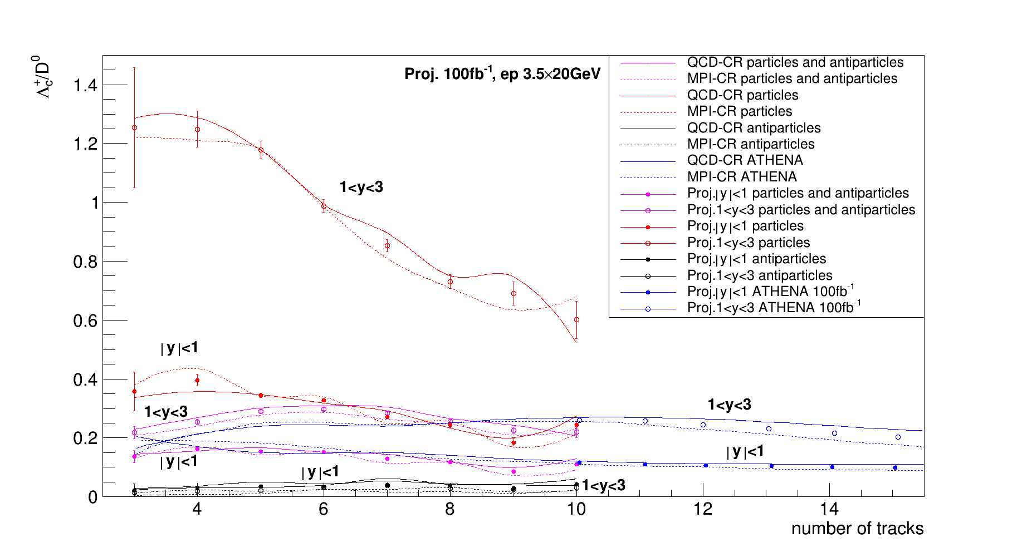
${Λ_{C}^{+}}/{D^{0}}$ Projection
$error=\frac{n}{significance}$
$σ_{\frac{u}{v}}=\left|\frac{\overline{u}}{\overline{v}}\right|\sqrt{{\left(\frac{σ_{u}}{\overline{u}}\right)}^{2}+{\left(\frac{σ_{v}}{\overline{v}}\right)}^{2}}$

Slide 20
${Λ_{C}^{+}}/{D^{0}}$ Projection
The results of EicC and EiC cover different multiplicity regions.
With a luminosity of $100{fb}^{−1}$, the results are conducive to our comprehension of hadronization models.

Slide 21
Conclusion
There is a significant asymmetry in the production of particles and antiparticles.
As the energy of EicC is lower, we can attain ${Λ_{c}^{+}}/{D^{0}}$ ratio at smaller multiplicities.
The statistics that can be measured is estimated.

Slide 22
Reference
[1] S. Acharya et al, $Λ_{C}^{+}$ Production and Baryon-to-Meson Ratios in pp and p-Pb Collisions at $\sqrt{s_{NN}}$= 5.02 TeV at the LHC, PHYSICAL REVIEW LETTERS 127, 202301 (2021).
[2] ATHENA Collaboration, ATHENA Detector Proposal: A Totally Hermetic Electron Nucleus Apparatus proposed for IP6 at the Electron-Ion Collider.

Slide 23
Thanks for your attention!

