Slide 1
Heavy Flavor Simulation for Nuclear Effect at EicC
Senjie Zhu
17th January, 2023

Slide 2
Motivation
Fragmentation and hadronization can be very different in different system.
Because of the shorter formation time of heavy flavor mesons, they have stronger interaction with nuclear matter than light mesons.
In heavy ion collisions, the picture is even more complicated, indeed initial and final state effects are entangled. The main initial state effect, in nuclear lepton scattering, is the EMC effect. It can be canceled with inclusive measurements.
Their measurement at the EIC is expected to avoid most of the heavy-ion background subtraction challenges due to the much cleaner DIS environment.

Slide 3
Simulation Setup
Detector Geometry
Geant4 Simulation
Detector Performance
Events from Generators
Physics Projections

Slide 4
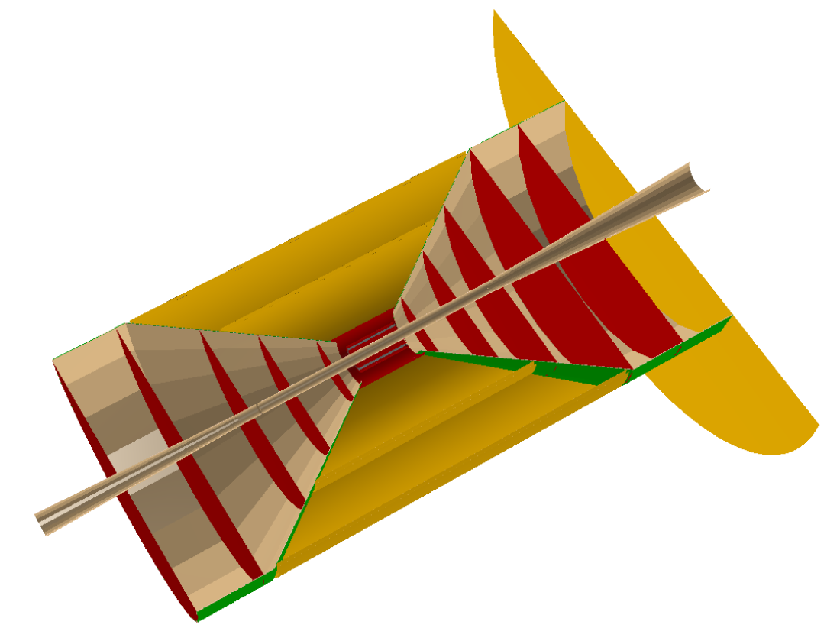
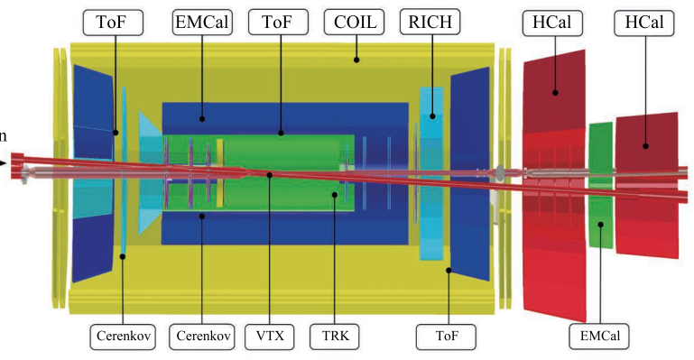
Detectors
Front. Phys. 16, 64701 (2021)
ITS3, pixel size 10 $μm$
$$\left|η\right|<3.5$$
 | p-going | Barrel | e-going
Silicon | 5 | 5 | 5
MPGD | 1 | 4 | 0
Tracking Detectors & Vertex Detectors
Latest resolutions applied:
https://gitee.com/aiqiang-guo/EicC_Mvd_DP

Slide 5
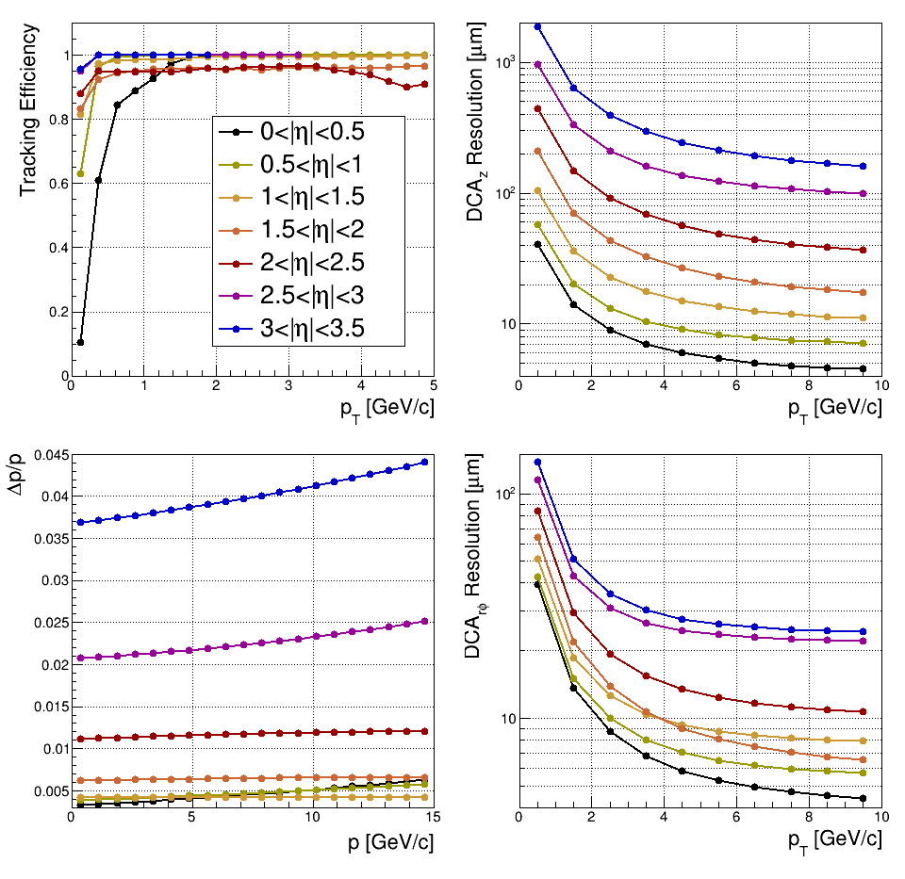
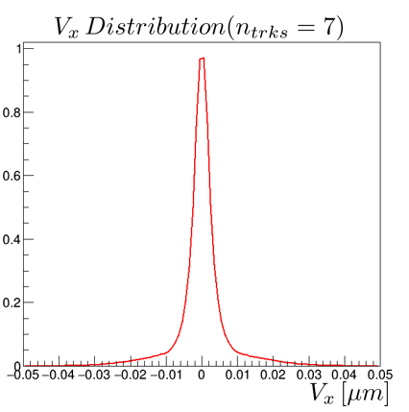
Detector Parameters
$$V_{x}[cm]$$
eID Acceptance($3 σ separation$)
$p_{e}>0.35GeV/c, p_{e}<20GeV/c$
PID Acceptance ($π\backslash K\backslash p$) ($3 σ separation$)
$$η$$ | $$[−3.5,1]$$ | $$(−1,1]$$ | $$\left(1,3.5\right]$$
$$p_{max}$$ | $$4 GeV$$ | $$6 GeV$$ | $$15 GeV$$
$$p_{hadron}>0.3GeV/c$$

Slide 6
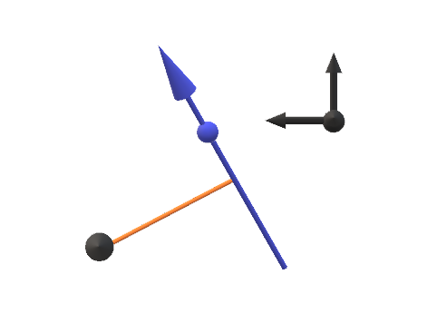
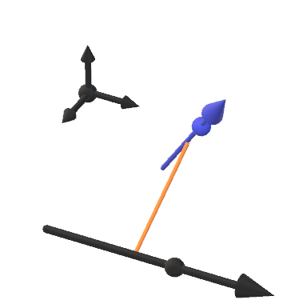
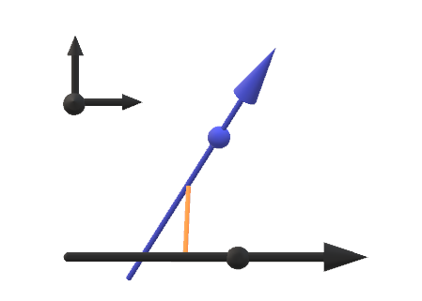
Vertex Smearing Process
X
X
DcaXY(Det)
X
At X-Y plane, find the closest point to z-axis to calculate DcaXY(Det) and use the DcaXY resolution to smear DcaXY(Det)
Use the z coordinate of the point above as DcaZ(Det) and smear it
DcaZ(Det)

Slide 7
Event Generator
pythiaeRHIC: $e\left(3.5 GeV\right)×p\left(20 GeV\right)$ $L_{int}=8.064 fb^{−1}$
EicC run for 2 months
DIS cut:
$Q^{2}>2GeV/ c^{2}$, $W^{2}>4GeV^{2}$, $0.05<y<0.8$
PID Acceptance ($π\backslash K\backslash p$) ($3 σ separation$)
$$η$$ | $$[−3.5,1]$$ | $$(−1,1]$$ | $$\left(1,3.5\right]$$
$$p_{max}$$ | $$4 GeV$$ | $$6 GeV$$ | $$15 GeV$$
$$p_{hadron}>0.3GeV/c$$

Slide 8
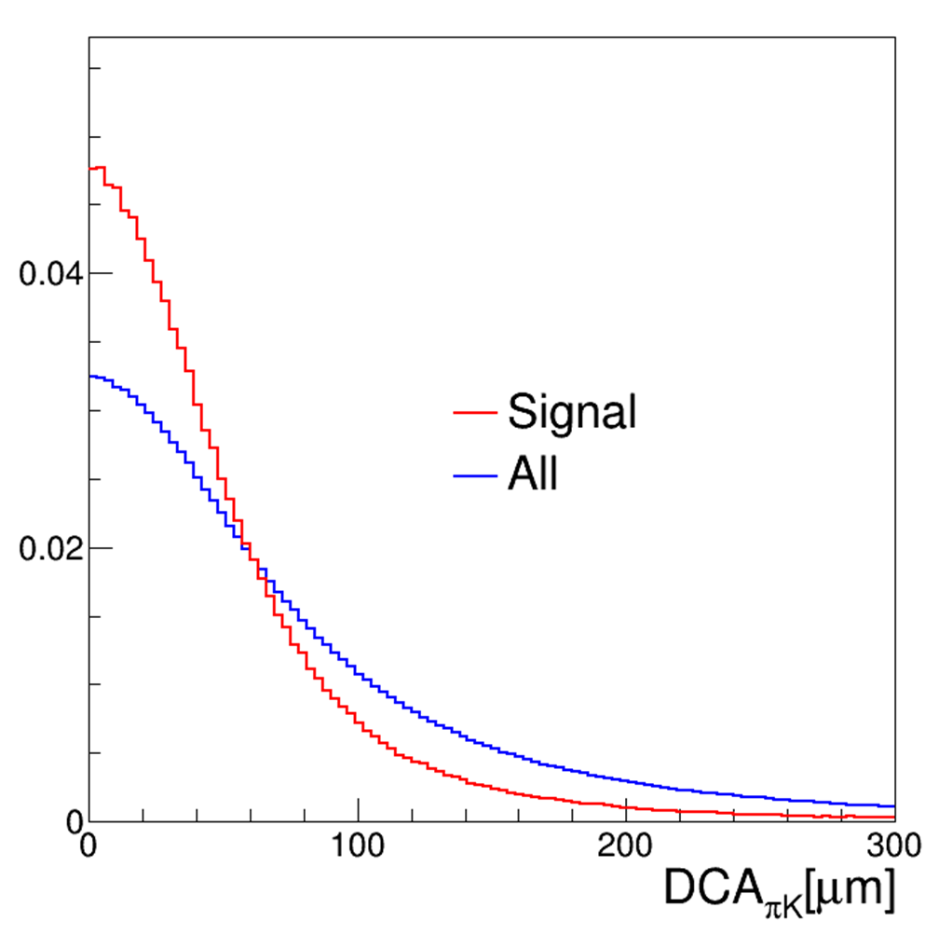
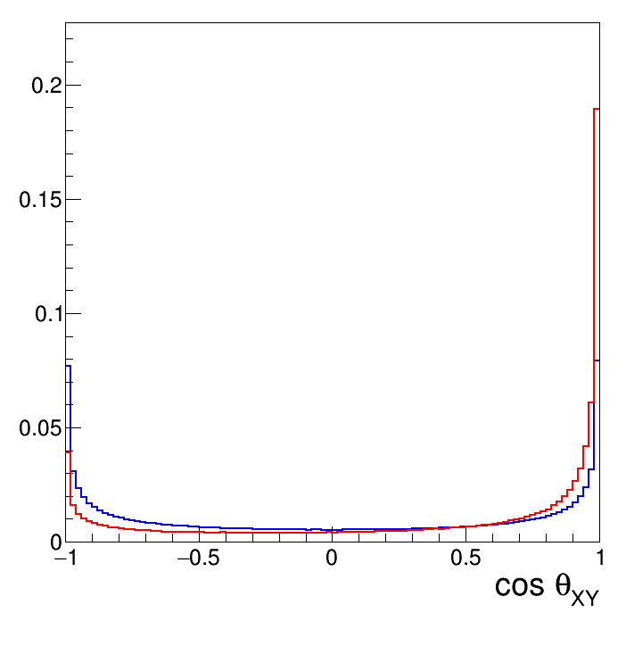
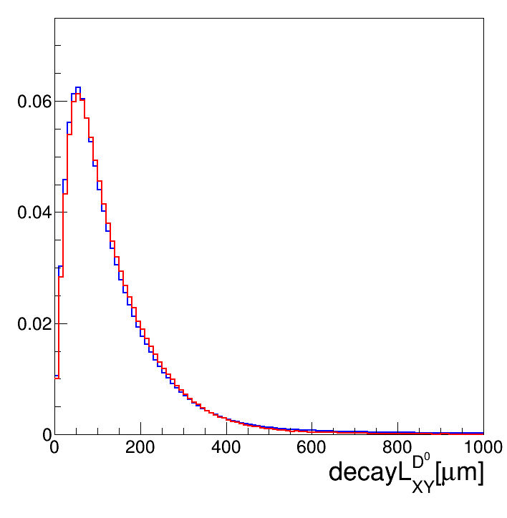
Reconstruction
$$π^{+}$$
$$K^{−}$$
$$DCA_{πK}$$
$$θ$$
$$DecayL_{XY}^{D^{0}}$$
$$D^{0} topological cut$$
$DCA_{πK}$
$DecayLength_{XY}^{D^{0}}$
${\cos{θ}}_{XY}$

Slide 9
Reconstruction
Cut scanning is recursively from left to right.
Applied Cut
$DCA_{πK}<110 μm$
$cosθ_{XY}>−0.75$
$DecayLength_{XY}^{D^{0}}>35 μm$

Slide 10
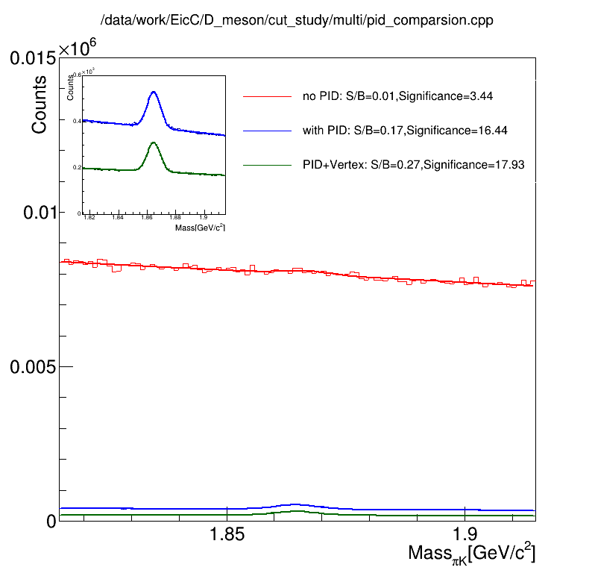
$$D^{0} Reconstruction$$
no PID: all combination between opposite charge particles
with PID: perfect PID at acceptance and abandoned out of acceptance
Vertex: topological cut applied to suppress background

Slide 11
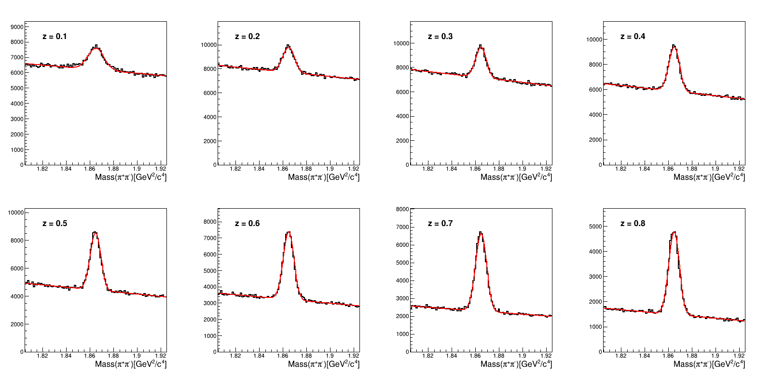
Mass Spectrums vs. z

Slide 12
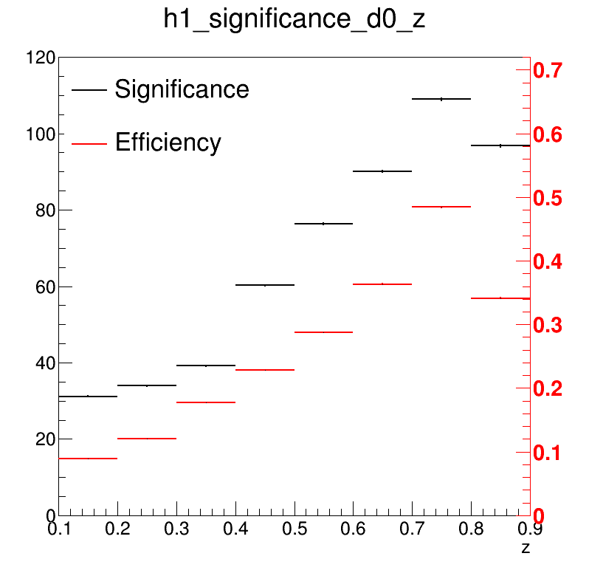
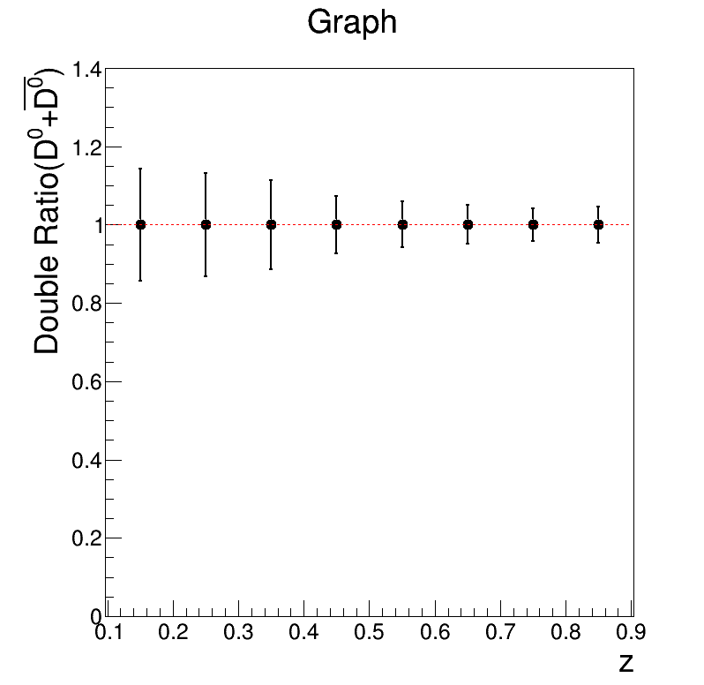
$D^{0}$Double Ratio
ep data is applied to both ep system and eA system.
Higher efficiency can be achieved at high z.
Corresponding to significance distribution, the errors of double ratio at high z are lower than those at low z.

Slide 13
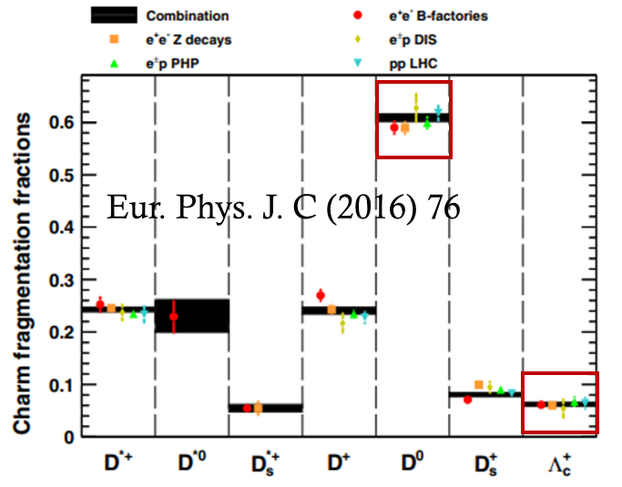
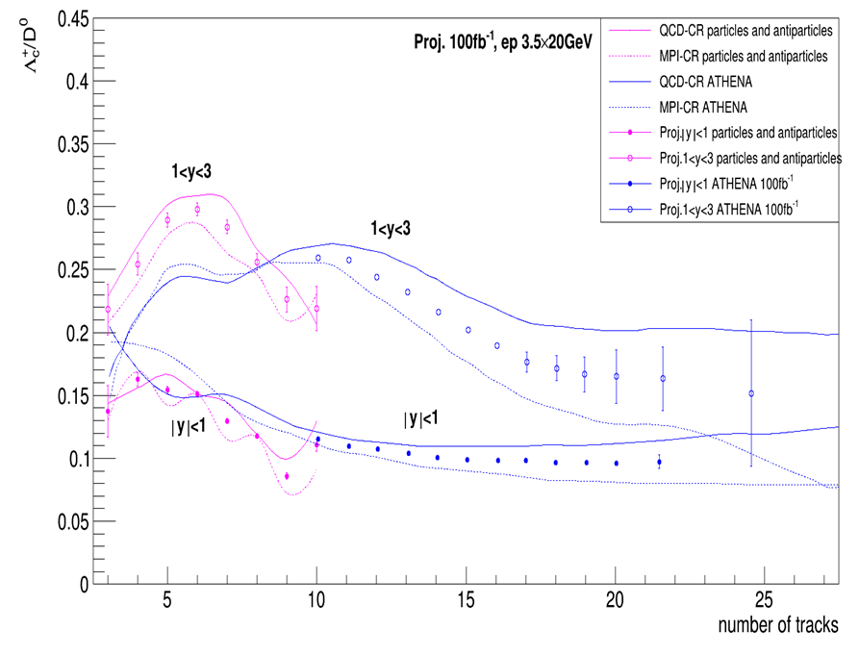
Baryon-to-meson Ratio
Patron fragmentation varies with different system.
Data is produced by pythia8 and two fragmentation model (QCD-CR and MPI-CR)are used.

Slide 14
Conclusions
Basic structures of track & vertex detectors are proposed and are being optimizing.
With the performance of the detector we have simulated, we have projected errors of some physics observables.
Double Ratio of $D^{0}$
Baryon-to-meson Ratio

