Slide 1

AI for HEP with a focus on AI at BESIII
李科（like@ihep.ac.cn)
Institute of High Energy Physics

Slide 2
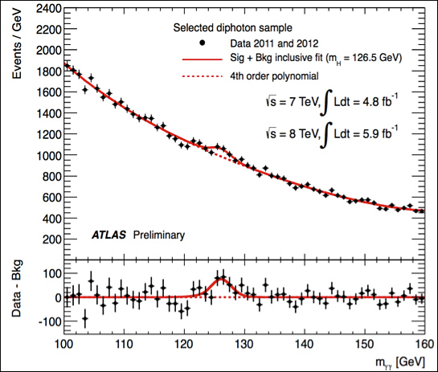
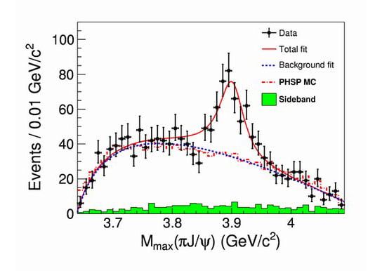
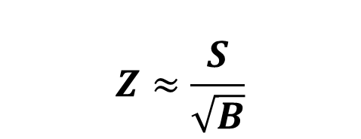
AI at lepton colliders
More than 10B events
Higgs at ATLAS
Data analysis
$$Z≈\frac{S}{\sqrt{B}}$$
Significance
AI4S 3 main approaches：
Improve S
Reduce B (more important at LHC)
Accelerate analysis
Zc(3900) at BESIII

Slide 3
Outline
New ways to search for new particles
  Accelerate physics analysis: DrSai
    The systematic search by automating the full analysis
  Improve S: Foundation model and resonance tagger
    The unified event representation model to cover all known physics channels
Summary and outlook

Slide 4
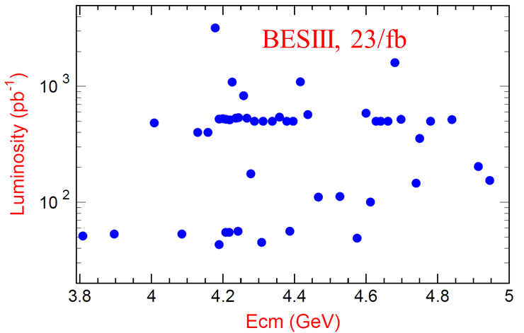
Personal Notes
Many NP theories predict new particle/phenomena
Typically, most searches are based on a specific production or decay process
  Limitted by resources
Maybe two new approaches at lepton collider？
  Systematic search via automated tools of all possible processes
    Dr.Sai
  Dataset level anomaly detection
    Assuming the signal is not universal across all samples

Slide 5
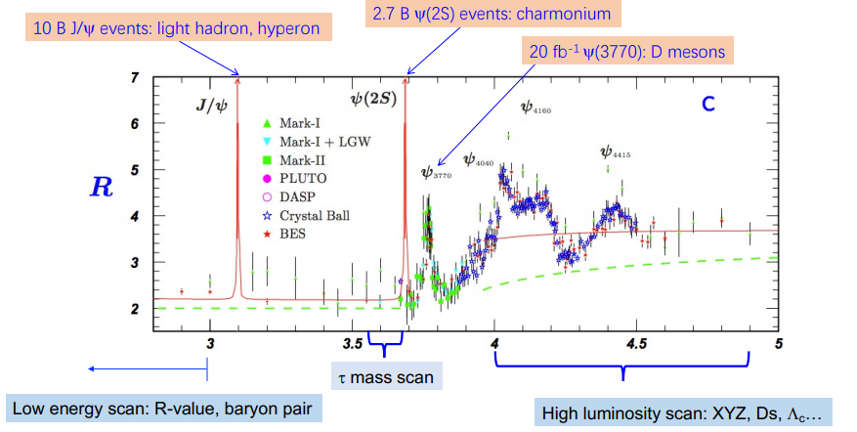

Introduction of BESIII - physics program
>700 scientists and engineers
Tau-charm factory, rich physics programs
  Light hadrons
  Charm meson/baryons
  Charmonium
  Precise test of SM
  Search for new physics
Hundreds of physics results
  Discovered >30 new hardrons
    First tetraquark: Zc(3900)
  Clear and relative simpler workflow for effective modelling
  Different from LHC, unique challenges and advantages in lepton collider experiments
High energy scan: exotic hadrons, charm meson/baryons

Slide 6
Agentic AI for HEP
Traditional approach
Detector
DAQ
Reconstruction
Selections
Statistical analysis
Generator
Simulation
Step N.1
What is the purpose?
What are the input/output?
Setup tools or make a new one
Monitoring & test
Is this result correct?
What is the next step?
Etc.
.
Step N
Step N.2
.
.
Driven by
human
Step N.n

Slide 7
Agentic AI for HEP
In traditional approaches, human involvement is required at all times.
Expertise is often unstructured, though some can be represented by natural language.
Today, we can leverage LLMs to build an AI partner for scientists.
  The AI partner designs and conducts the entire workflow based on human commands and feedback.
In the future, with a well-defined representation of knowledge, we can further develop an AI scientist.
  Humans would only need to propose a goal — and leave everything else to the AI.
Step N.1
What is the purpose?
What are the input/output?
Setup tools or make a new one
Monitoring & test
Is this result correct?
What is the next step?
Etc.
Step N
.
Step N.2
.
.
Driven by
human
Step N.n

Slide 8
The DrSai project
Purpose: Pioneering autonomous physics discovery at BESIII (and beyond) through Agentic AI
Traditional software,
ML models, etc.
Expertise -> Skills;
Analyses representation-> DSL; Internal notes -> RAG
Orchestration: Skills+DSL+RAG+ human correction
DrSai
Tools + Knowledge + Strategy
LLMs

Slide 9







DrSai Evolution Milestones
Physics results
Measure the hadronic cross sections below 2GeV using DrSai
Working Group formed
Dr.Sai V1: Feasibility verified
Dr.Sai V2: Protetype
DrSai V3: Ready for analysis
Core team of ~20 established to explore multi-agents architecture right after GPT-3
Core system setup and toolchains integrated to verify basic technical feasibility.
Capable of simple analysis through fixed workflows. Validated via 10 re-measurement tests.
Refactored. Internal testing phase. Knowledge and expertise interpreted into skills and DSL.
ChatGPT (GPT-3.5)
Manus
Claude Code 2.1
Extending to other experiments
DeeoSeek-V2
DeepSeek-V4

Slide 10
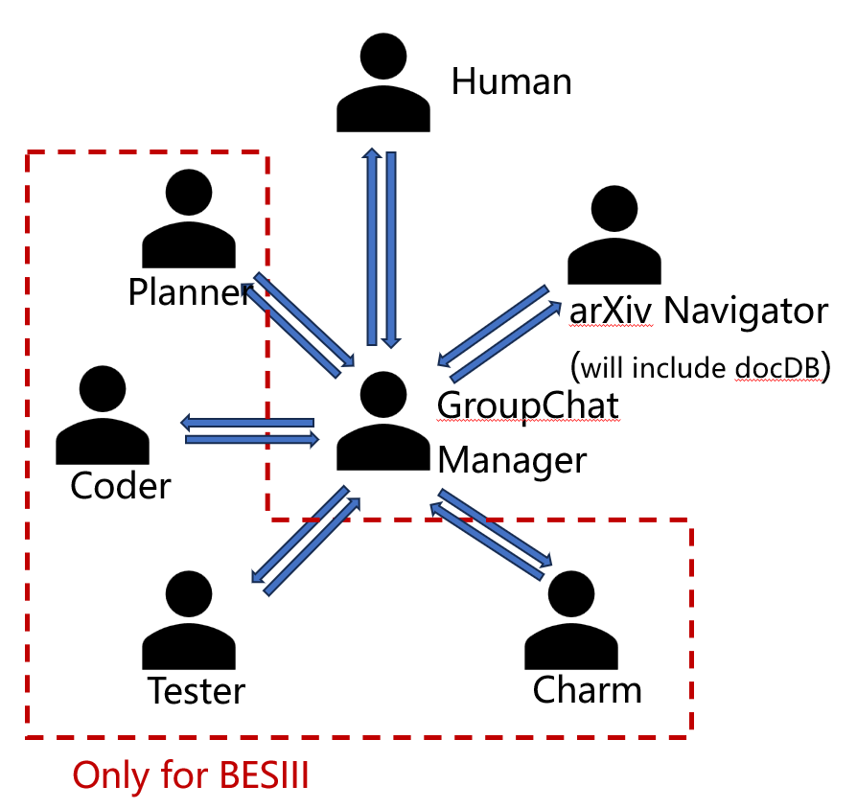
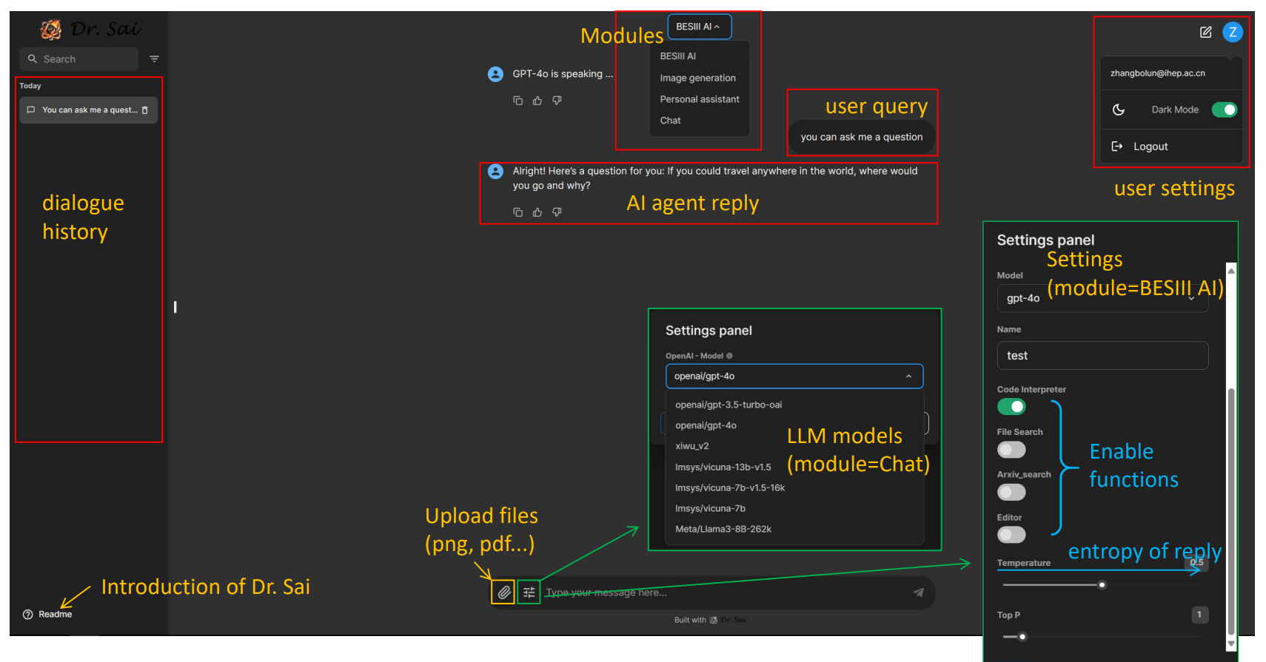
DrSai V1
Developed based on open-source multi-agents framework: AutoGen.
Deploy workers to wrap-up the tools
Tested LLMs on intent understanding, orchestration, tool invocation, etc.
Verified feasibility
More details in the talk at ICHEP2024

Slide 11
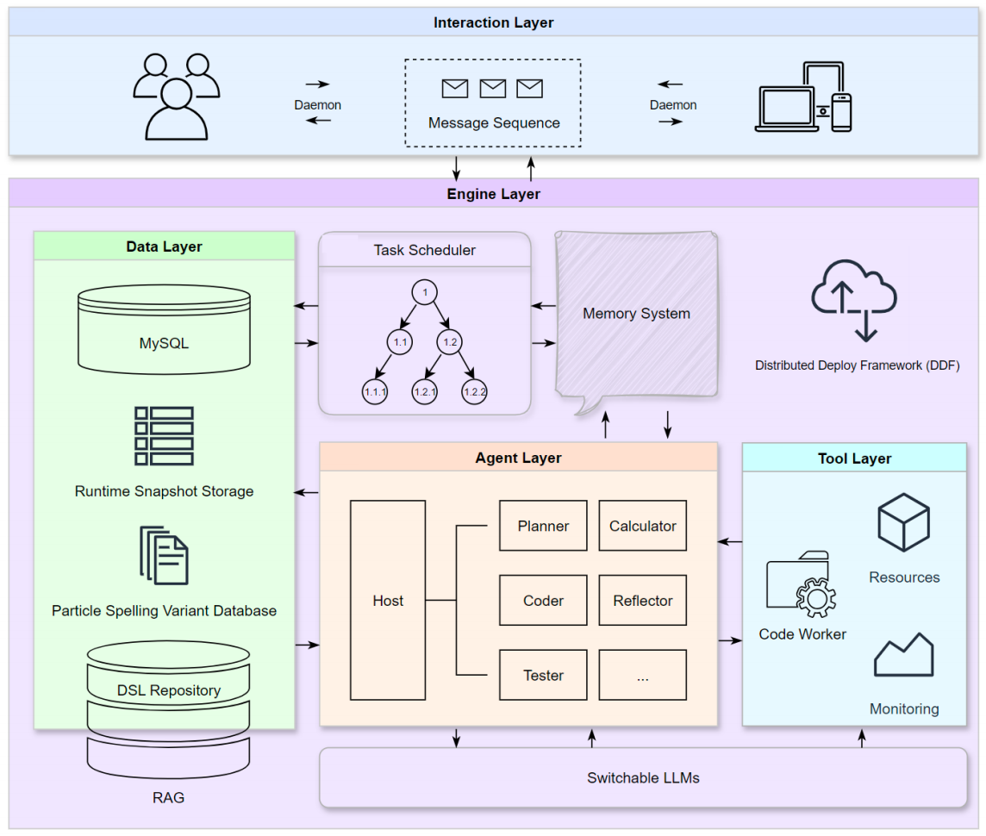
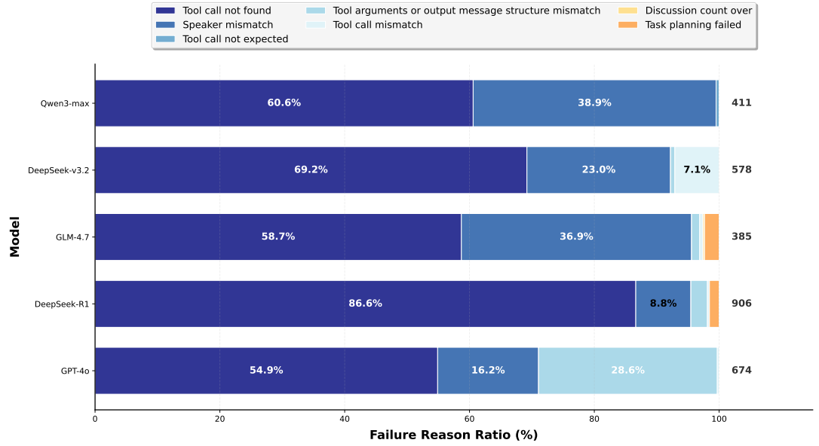
DrSai V2
Make BESIII analysis agent-based
Analysis represented via DSL (preliminary)
Built a benchmark for BESIII analysis
Tested several LLMs
arXiv:2604.22541

Slide 12
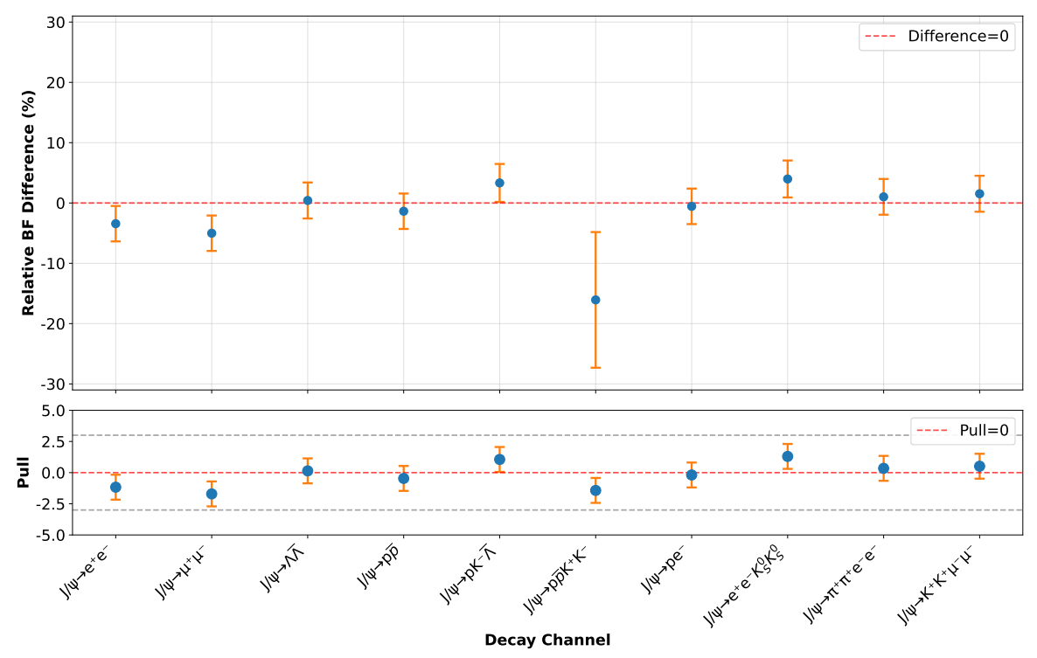
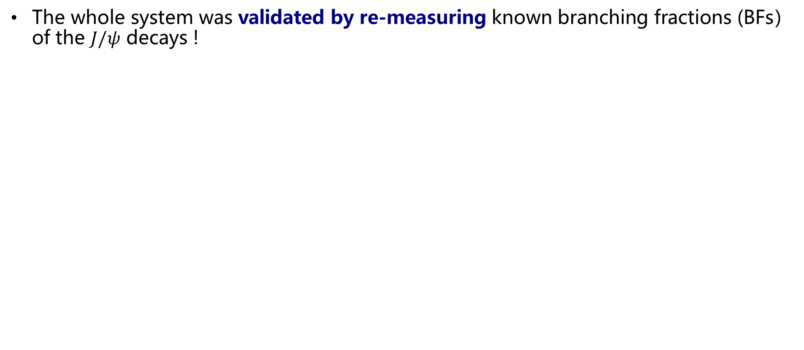
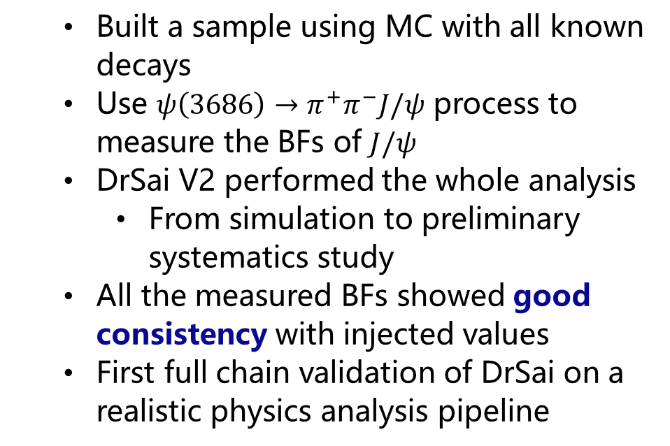
DrSai V2
The whole system was validated by re-measuring known branching fractions (BFs） of the $J/ψ$ decays !
  Built a sample using MC with all known decays
  Use $ψ\left(3686\right)→π^{+}π^{−}J/ψ$ process to measure the BFs of $J/ψ$
  DrSai V2 performed the whole analysis
    From simulation to preliminary systematics study
  All the measured BFs showed good consistency with injected values
  First full chain validation of DrSai on a realistic physics analysis pipeline
Accepted by Science Bulletin

Slide 13
Identified Core Challenges
Knowledge & Self-Evolution
Reasoning & Task planning
Often unstructured (experience, intuition). How to make it computable, reasonable, and continuously growing?
High level goals need complex and hallucinations-free decomposition + environment-aware reflections
Solution
Solution
Domain-Specific-Language (DSL) represent analysis with an on-the-fly extraction and iterative refinement from expert feedback
Expert guides the system to orchestrate workflows for multiple analyses → distills into Skills → next workflow iteratively refined
Tools/codes & Execution
Infrastructures & Safety
Complex software system, and must align with physics goals, as well as auto-checking
Scaling bottlenecks (GPU costs) vs. data privacy and autonomous safety risks
Solution
Solution
Error‑Aware GraphRAG – stores long connections.
DSL/Skill align with code blocks or tools, enabling multiple checkpoints (e.g., injection tests).
Local deployment of open-source LLM (DeepSeek) at IHEP + Cloud support.
Only allow predefined operations.

Slide 14
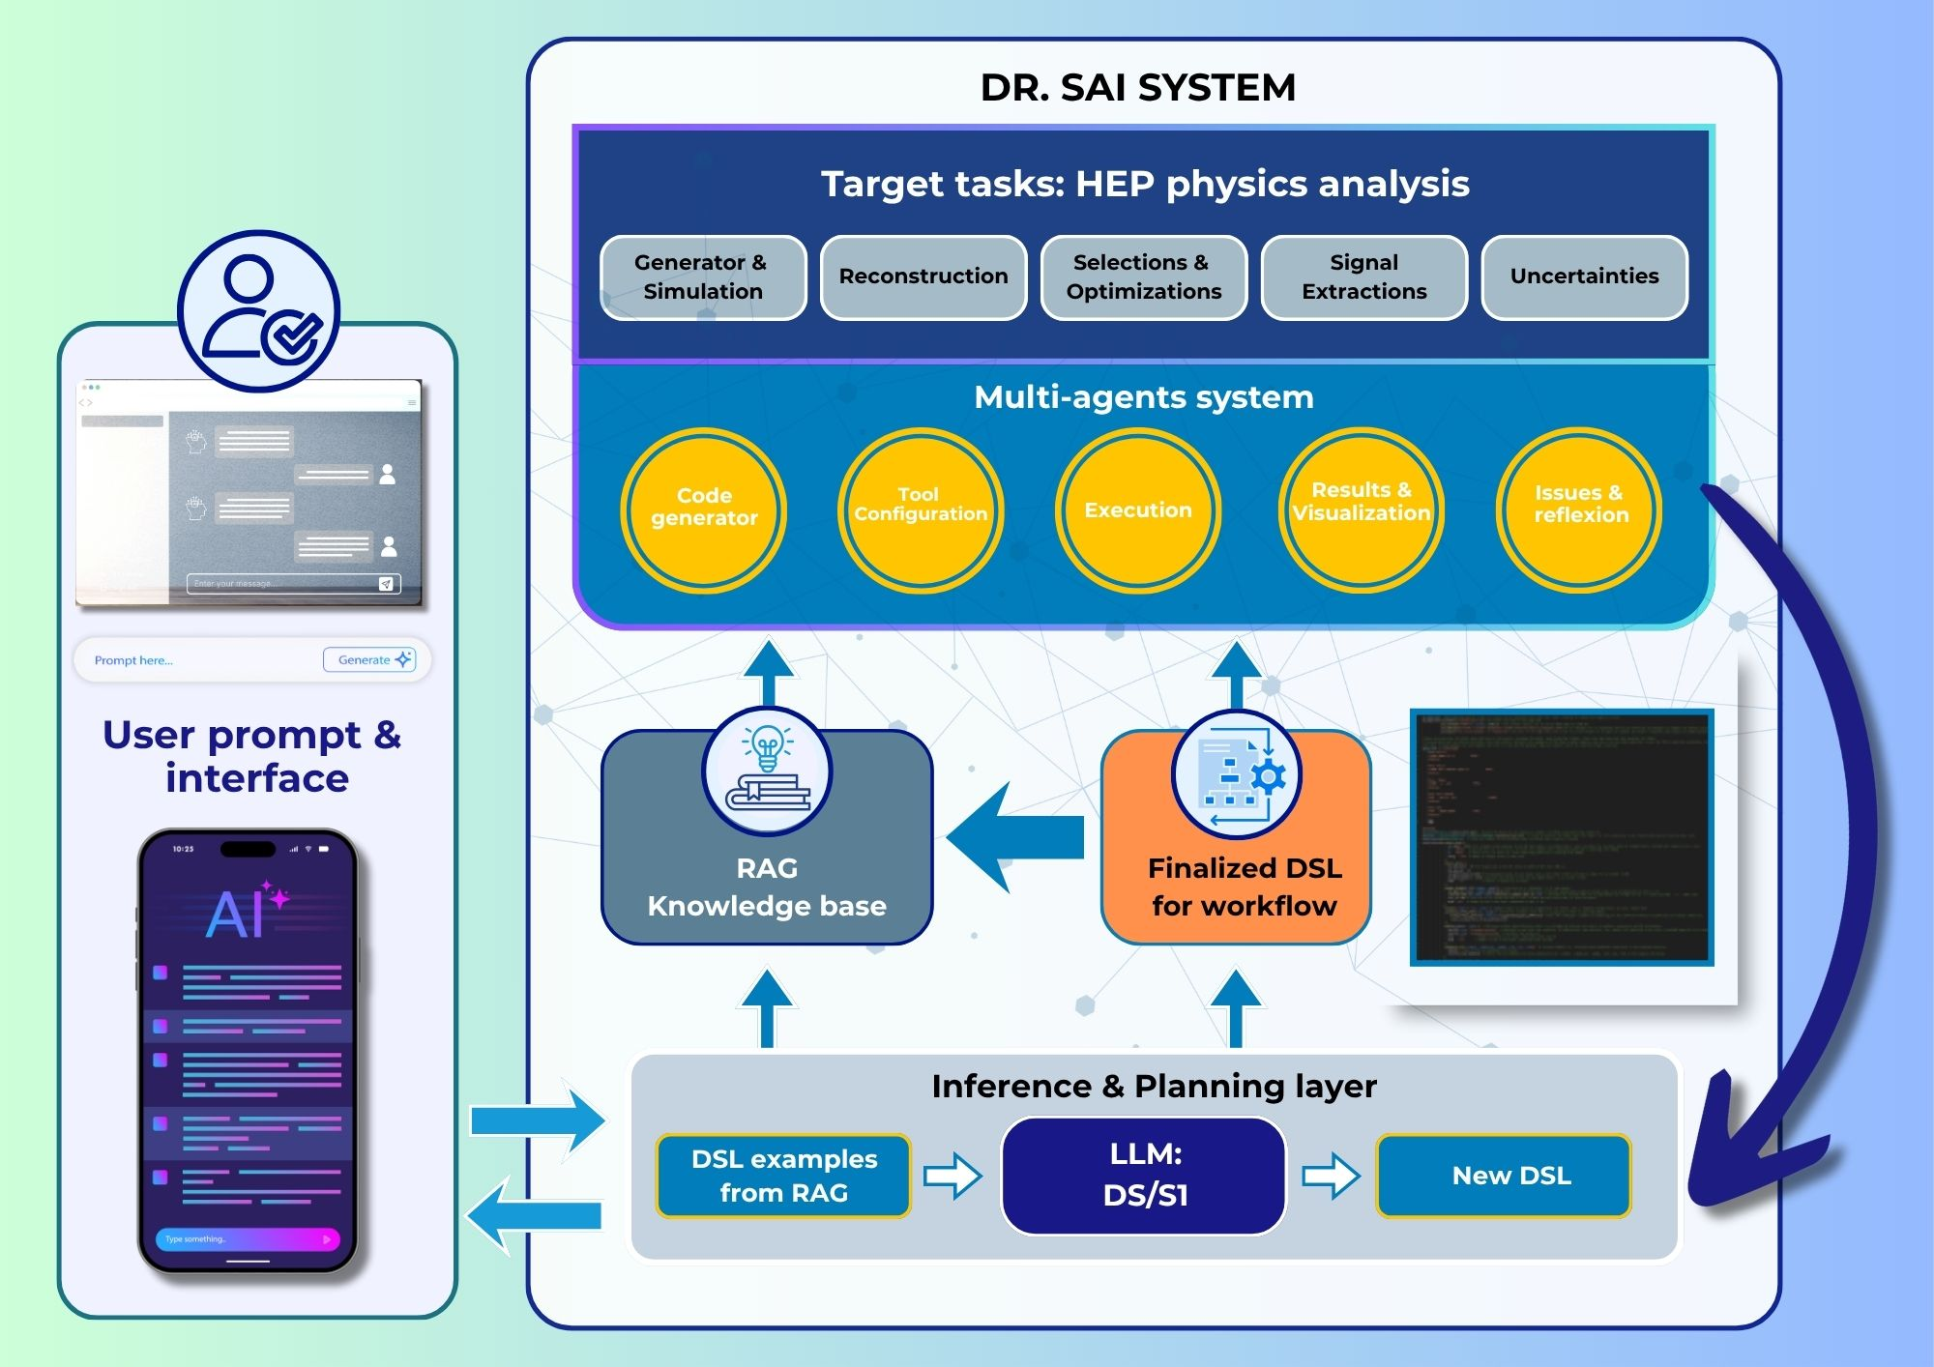
DrSai V3
With DrSai V2, we have identified four core challenges and developed corresponding solutions
Major updates
  AutoGen-based framework -> Claude Code agent runtime
    Also DeepSeek-TUI, Cline, etc.
  A set of analysis Skills – built and refined
  Hundreds of DSLs extracted from published papers
  Error‑aware GraphRAG for code generation
  Agentic RAG for internal notes of previous analyses
Front. Phys., 2026, 21(9): 096401

Slide 15
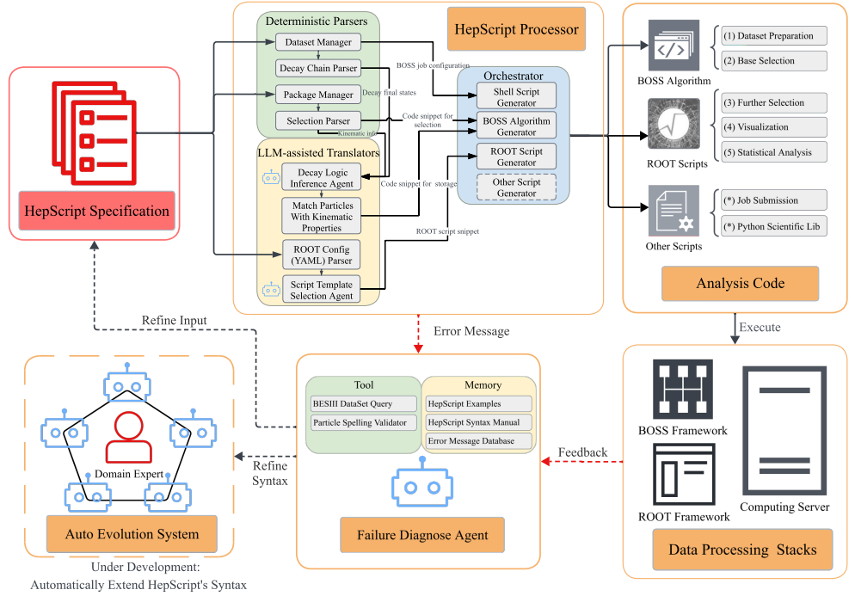
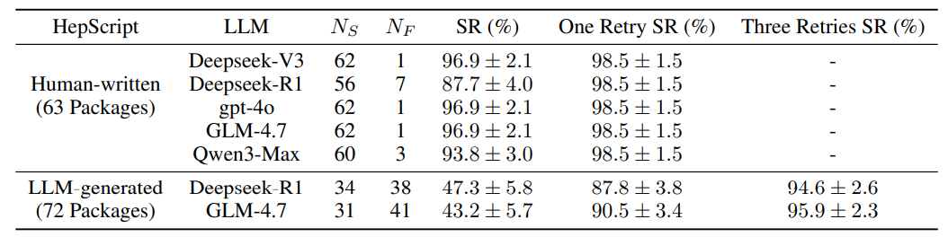
Analysis representation: HepScript (a DSL)
Represent BESIII analysis
  Pseudocode in Ruby/YAML format
Bridges high-level intent with code/tools
Defines a constrained action space
The majority are mapped into code blocks
  Only a small part need conversion by LLM
Scalable: automatically extracted from published paper or generated on-the-fly for new analysis
Good accuracy for generation of analysis algorithms
arXiv:2605.01423

Slide 16
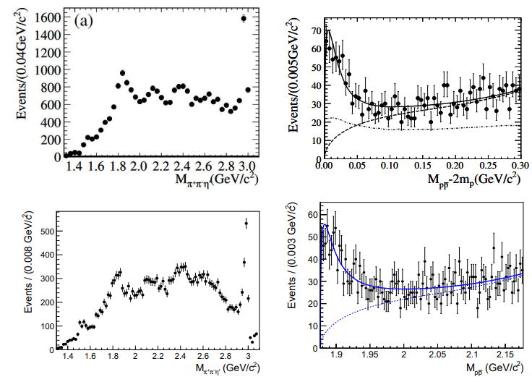
HepScript-driven analysis reproduction
Necessary for real-world complex analysis
A showcase: re-produce the previous analysis
Used in the DrSai V3 for intent understanding, information completion, and code generation
From publication
Published paper
HepScript
Configs/ software
LLM
LLM
LLM
Analysis pipeline: simulation, reconstruction, selection, statistical analysis
Re-produced using HepScript
Only for technical validation

Slide 17
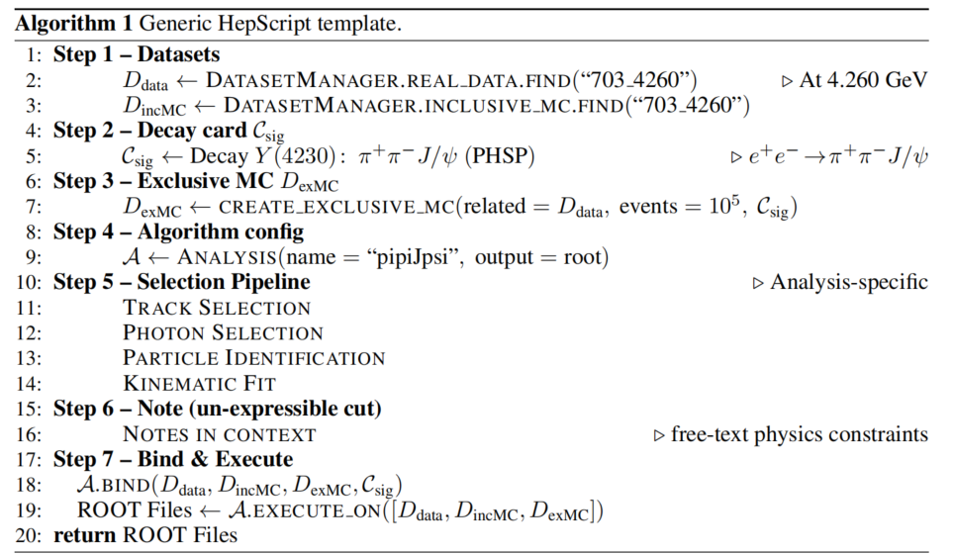
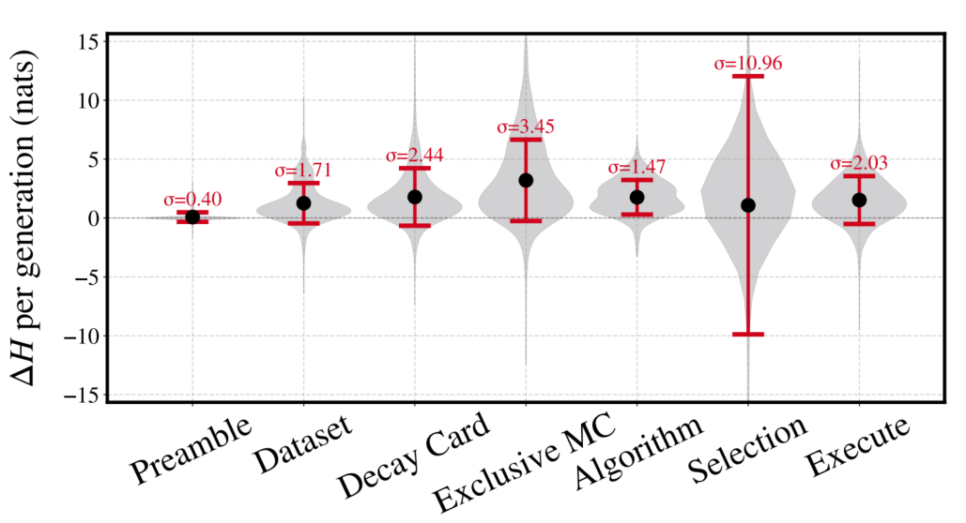
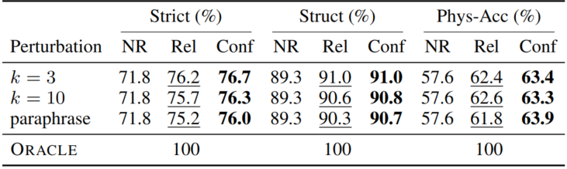
Knowledge base
HepScript Example
RAG + LLM-wiki, Content in knowledge base
  Internal docs, e.g. memo and question-answer pairs from internal review
    Chunked by analysis steps
  Internal website and introdcutions
  HepScript for published papers
Introduce “systematic uncertainty” when building knowledge base
  Define weights by “statistical” and “systematic” uncertainties
  LLM generation quality improved
arXiv:2605.01423

Slide 18
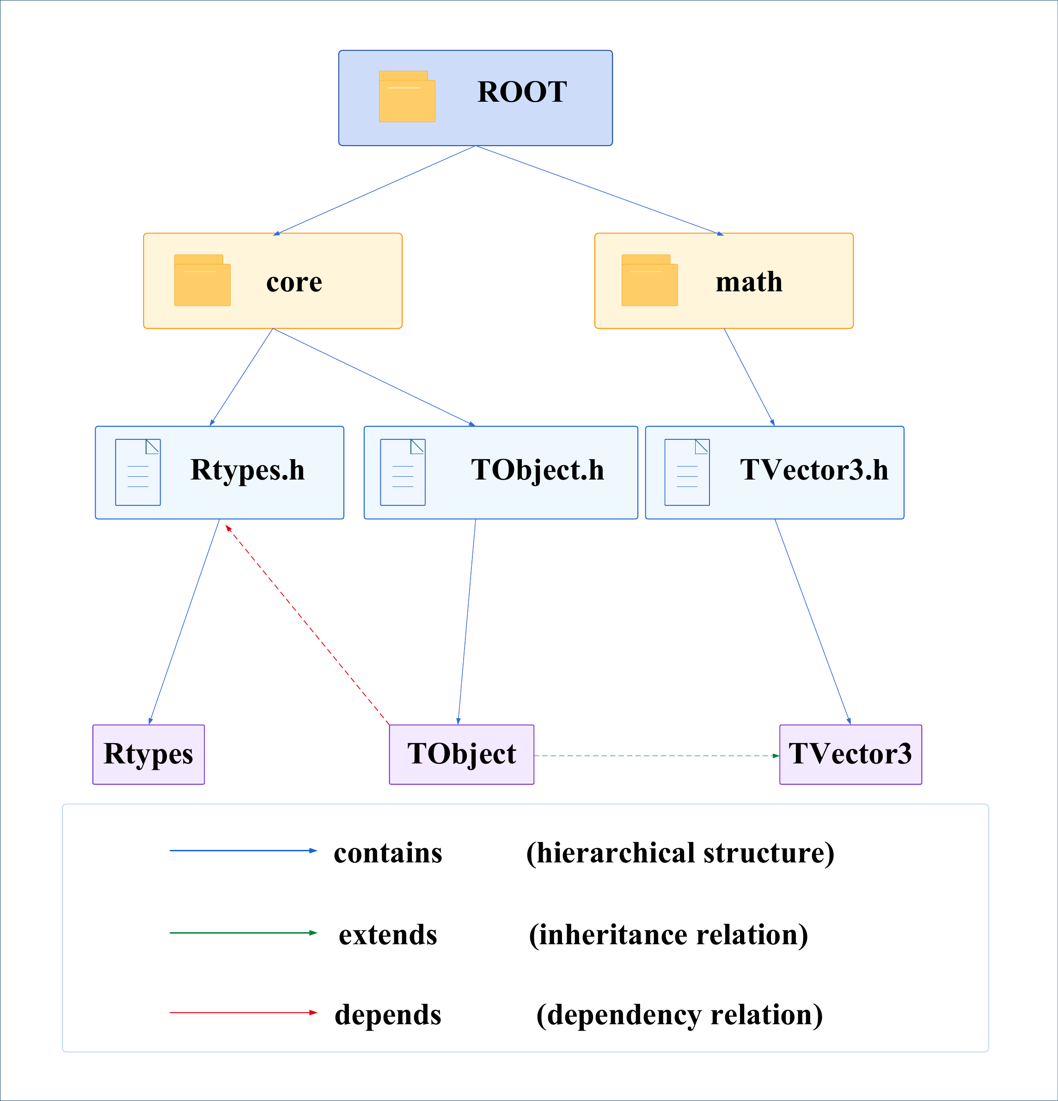
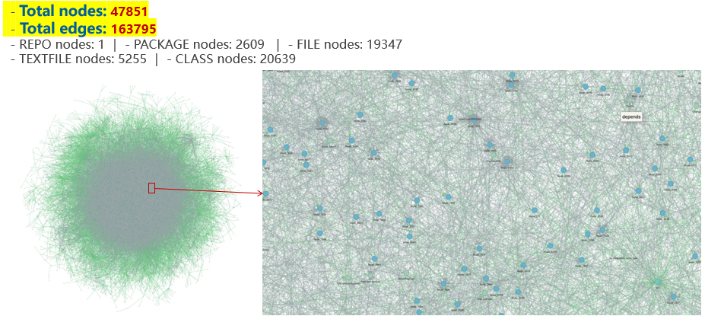
Domain code/script generation
Complex code dependencies at HEP
  LLMs struggle to reason over large-scale, intricate dependency correctly and efficiently
We start with open-source software - ROOT
  Massive interconnections -> a large graph
    Nodes : class, package, etc.
    Edges : contains, extends, depends
  Obvious improvement on accuracy
  Further improvement from Error-Aware RAG
    First find the related subGraph, then feed LLM
This method can be easily applied to HEP software development
Graph for whole ROOT source code
Zoom in
Github Repo:
https://github.com/yues36067-cmd/ROOTER
arXiv:2609.01095

Slide 19
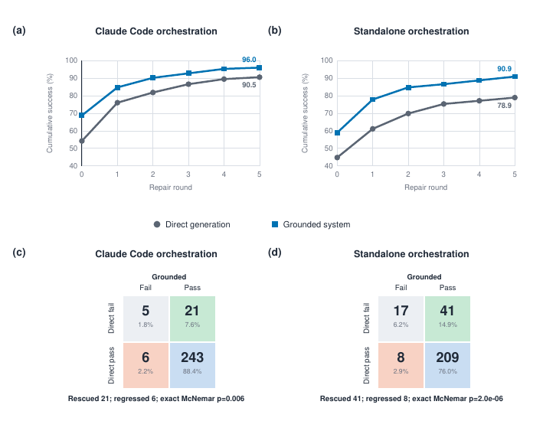
Domain code/script generation
Two benchmarks and evaluation methods have been developed
  Good improvement on accuracy
  LLM: deepseek V4 pro
Success rate improved by ~10%
  Still helpful for SOTA coding agent, claude code (~5%)
Integrated to DrSai, works well

Slide 20
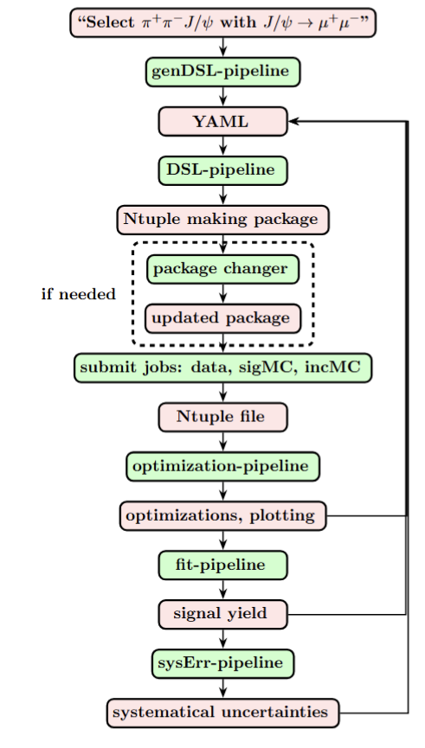
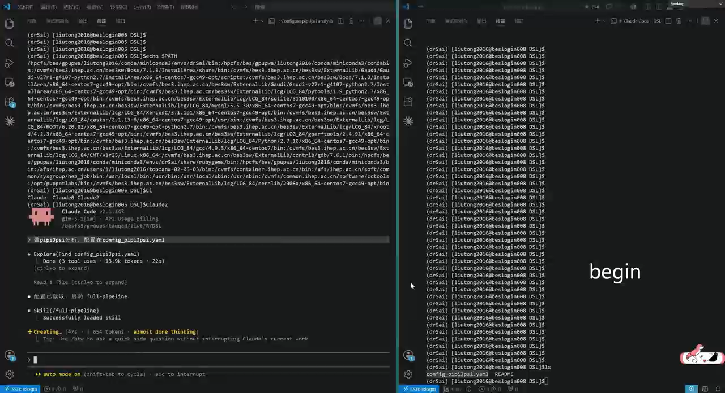
A recording for Zc(3900) re-discovery
Skills
Input/Output

Slide 21
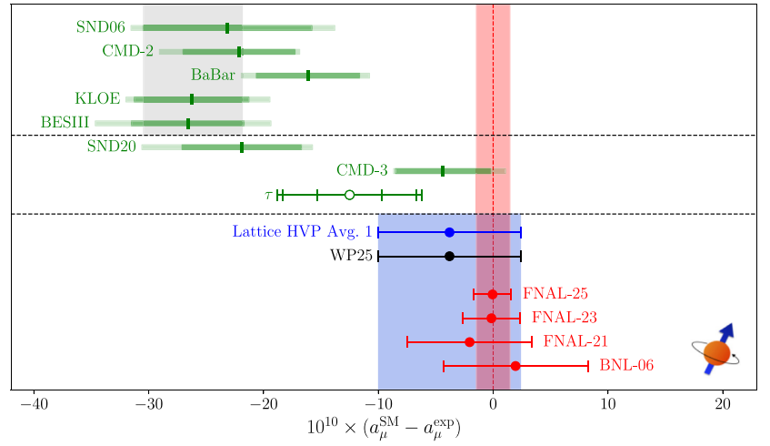
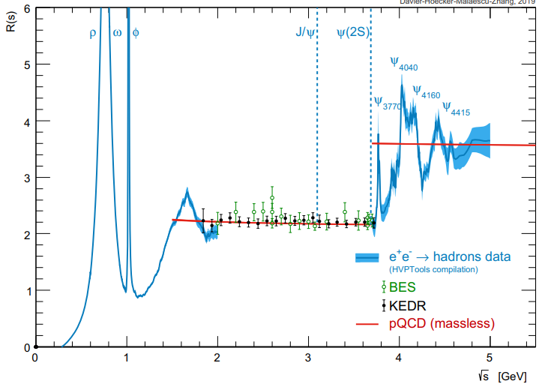
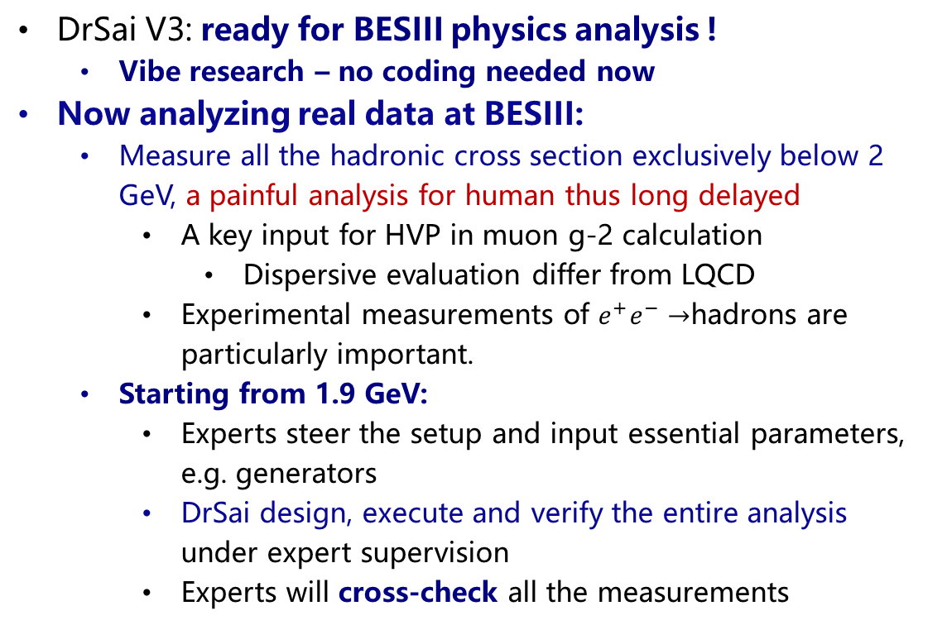
Analysis using DrSai at BESIII
DrSai V3: ready for BESIII physics analysis !
  Vibe research – no coding needed now
Now analyzing real data at BESIII:
  Measure all the hadronic cross section exclusively below 2 GeV, a painful analysis for human thus long delayed
    A key input for HVP in muon g-2 calculation
      Dispersive evaluation differ from LQCD
    Experimental measurements of $e^{+}e^{−}→$hadrons are particularly important.
  Starting from 1.9 GeV:
    Experts steer the setup and input essential parameters, e.g. generators
    DrSai design, execute and verify the entire analysis under expert supervision
    Experts will cross-check all the measurements
Physics Reports
1143 (2025) 1-158
Eur. Phys. J. C 80, 241 (2020)

Slide 22
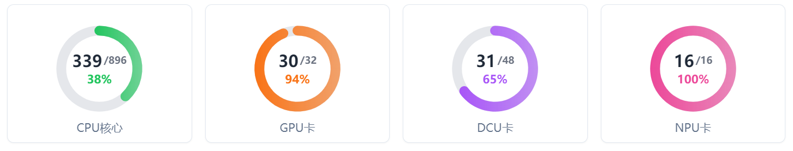
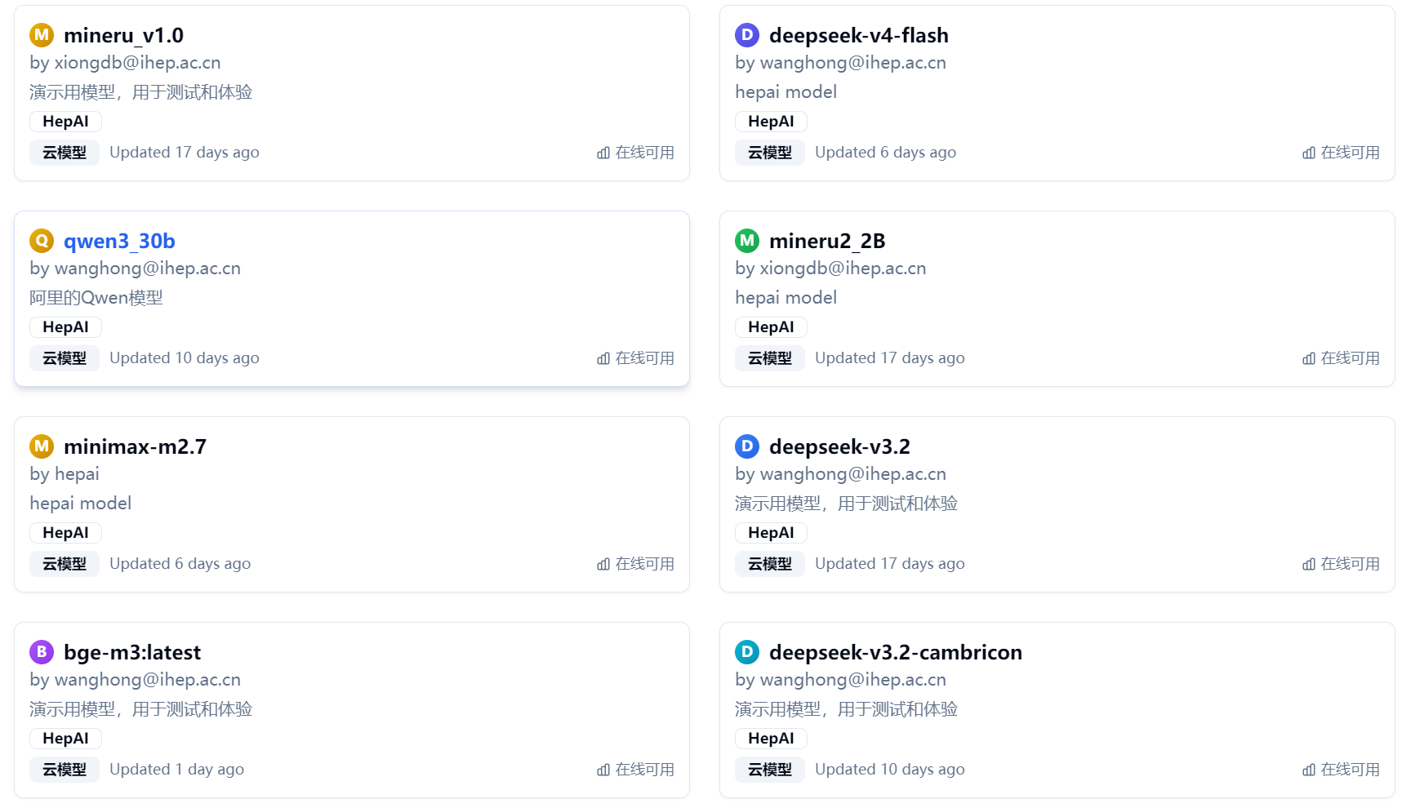
AI Infrastructure at IHEP
New dedicated AI platform:
  2240 CPU cores, 40 GPU, 48 DCU, 16 NPU
  More (2X) are coming
LLMs access and deployment
  Unified API via Distributed Deployment Framework
  Hybrid solution: local deployment + commercial cloud
    Open-source LLMs (e.g. DeepSeek)
    High concurrency
    Ensure data security
  Closed-source LLMs accessible via API
  Cache-hit techniques reduce the cost to 2-10%

Slide 23
DrSai Collaboration
DrSai is already yielding physics results
  Physicists interact with DrSai using natural language, only a few times with zero coding!
Now extending to other experiments:
  Jiangmen Underground Neutrino observatory (JUNO)
  Large High Altitude Air Shower Observatory (LHAASO)
  Neutron/Light source, etc.
We are forming a DrSai collaboration
  Solving Agentic AI challenges together
  Shared AI infrastructure & computing resources in collaboration
  Welcome to join!

Slide 24
On-going efforts
提示词：请用质心系能量为4.26GeV的数据分析e+e→pi+pi- J/psi过程，并寻找pi+J/psi上新的粒子
Migrating the DrSai to DeepSeek Harness
  Open-source, good maintenance
  Consist physics results with Claude-Code
Developing a new module: Truth-Anchored Recursive Self-Improvement
  Use injection test to help the Agent to improve the whole workflow
Many cutting-edge techniques
  Welcome to collaborate
目标解析、编排，初步生成工作流
知识库
模拟
自我验证
定义目标
构建样本
Debug全部工作流
重建
事例初筛
全局记忆
背景分析、优化
信号提取
赛博士DrSai
显著提升稳定性，目前可并行处理>30个物理过程

Slide 25
AI at lepton colliders
More than 10B events
Higgs at ATLAS
Data analysis
$$Z≈\frac{S}{\sqrt{B}}$$
Significance
AI4S 3 main approaches：
Improve S
Reduce B (more important at LHC)
Accelerate analysis
Zc(3900) at BESIII

Slide 26
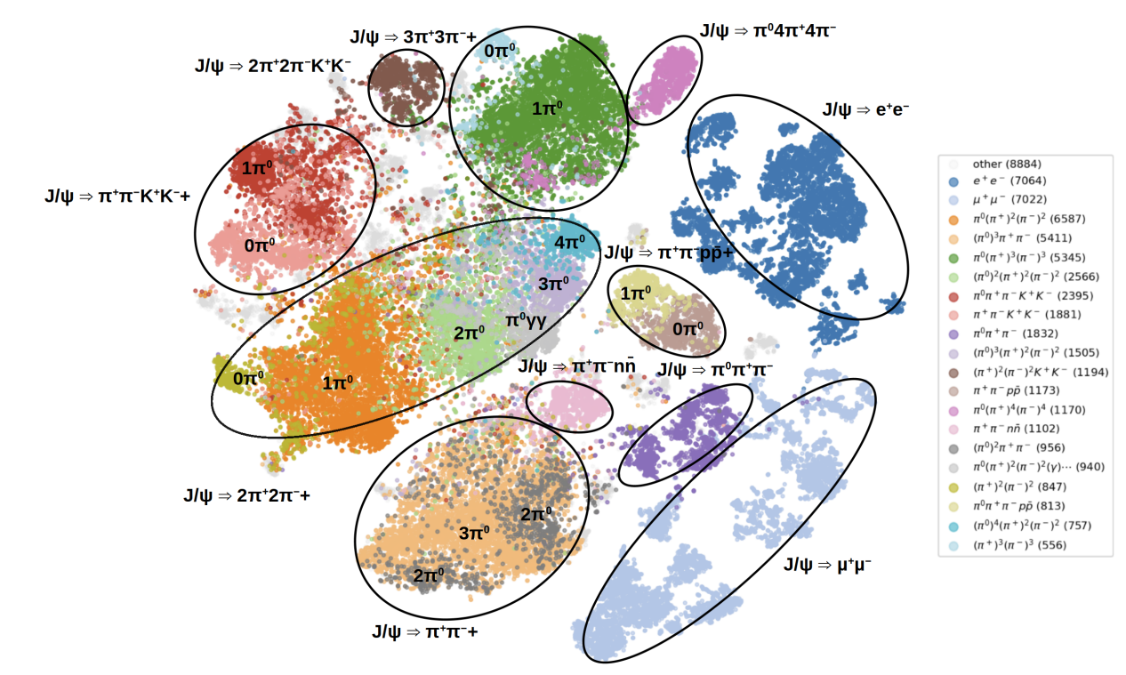
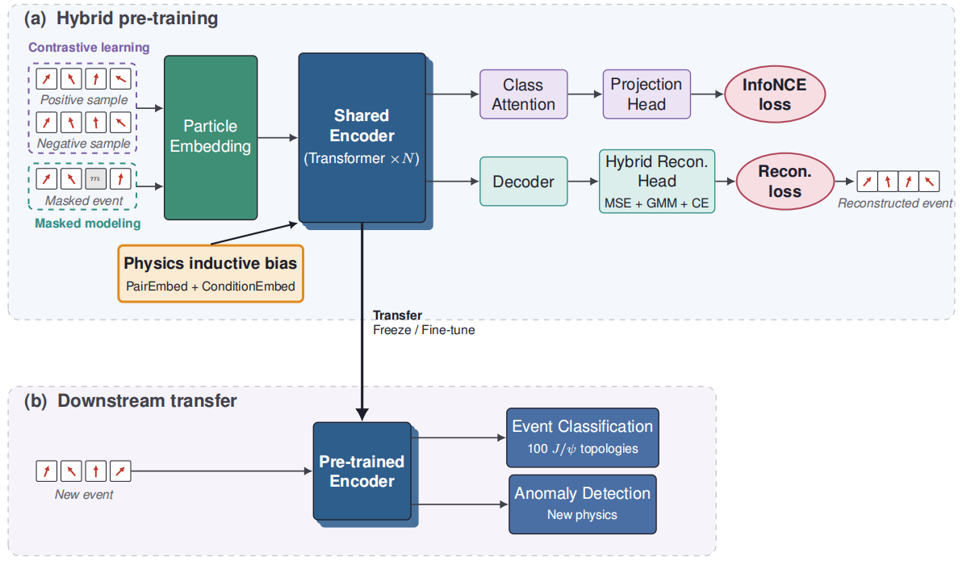
Foundation model to classify all the events
Goal: classify all the channels and support all downstream analyses
Event representation using self-supervised and Contrastive Learning
  Mask one particle then predict
  Gate attention conditioned on event level features
  Supervised fine-tune with a small dataset

Slide 27
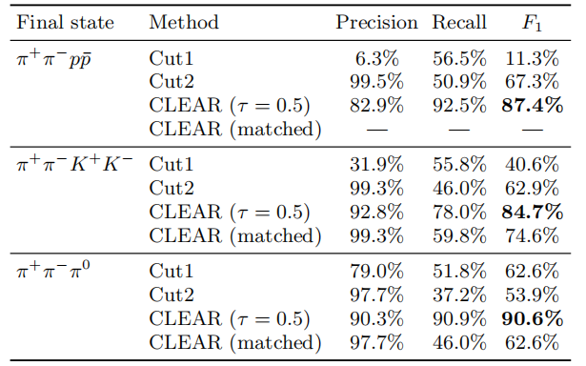
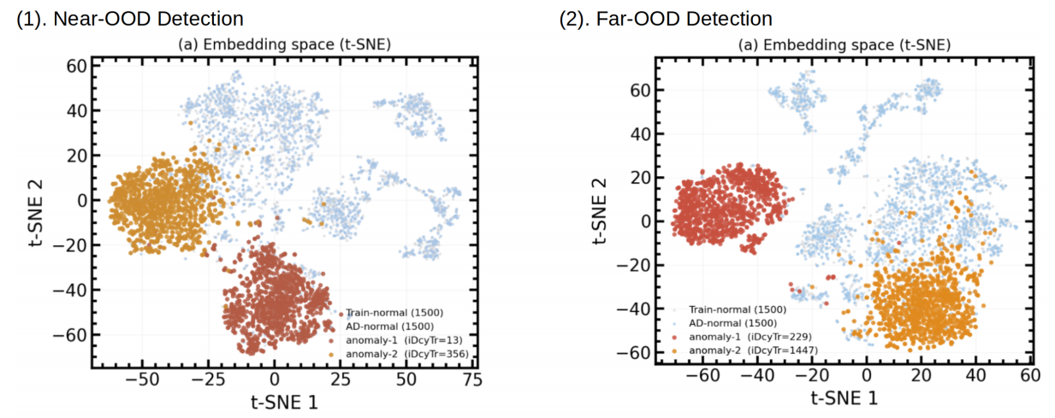
Foundation Model
Compared to cut-based analysis
  Higher signal efficiency, cover all the decay channels
  Lower background, all the bkg can be classified as well
  Support almost all downstream analysis tasks
Compared to ML-based analysis
  No need to retrain the model
For the new particle or channel
  Auto-clusterization as anomaly
  Different new particles or channels can be clusterized to different “shower”
Now only use 10M events for training, will expand to 1B

Slide 28
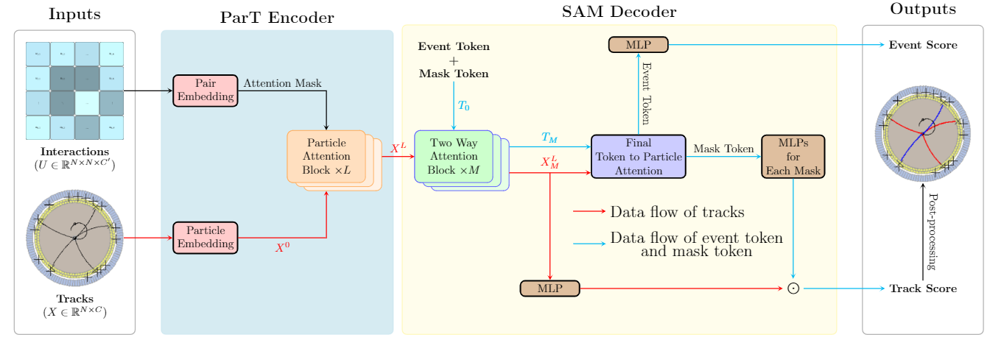
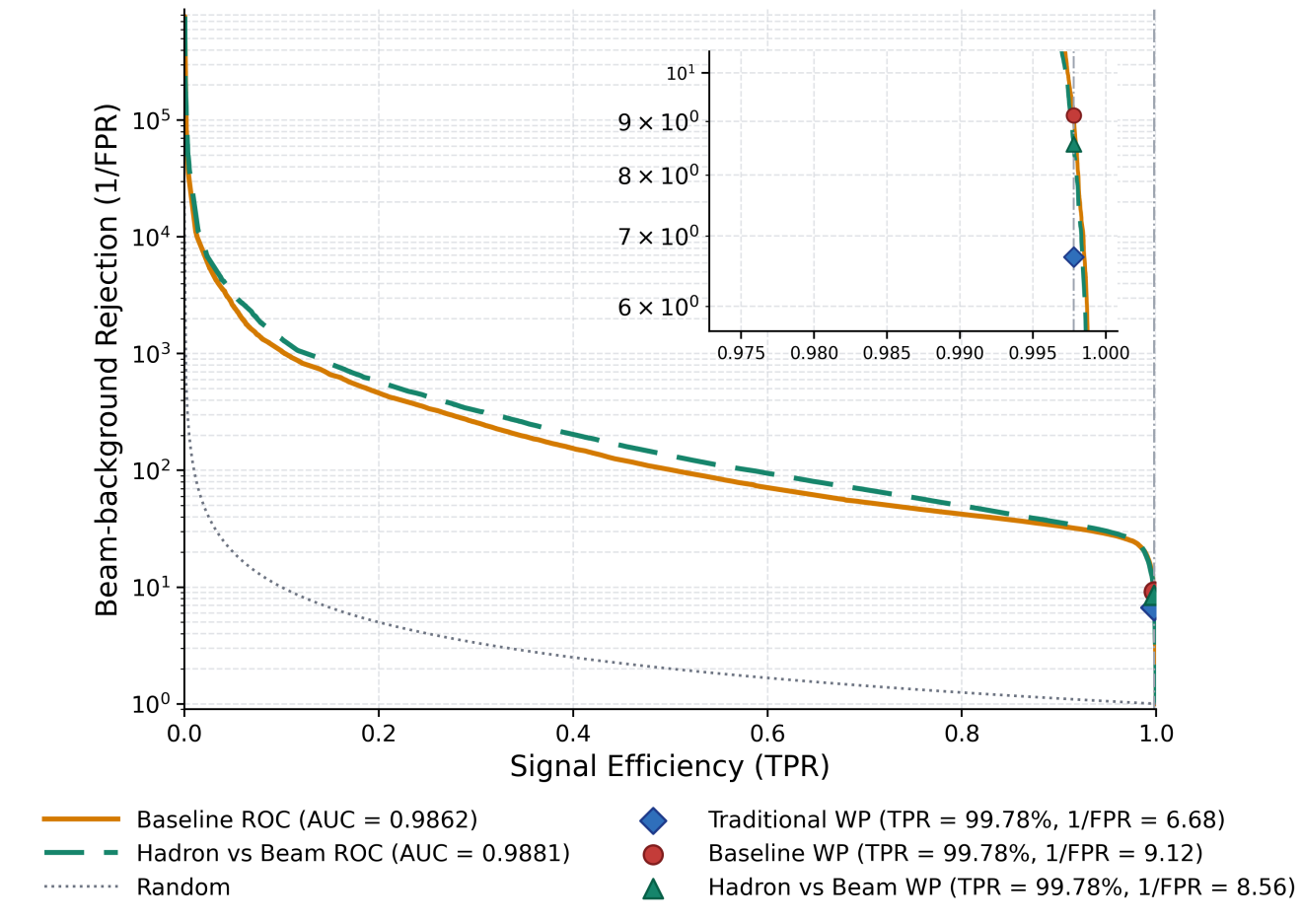
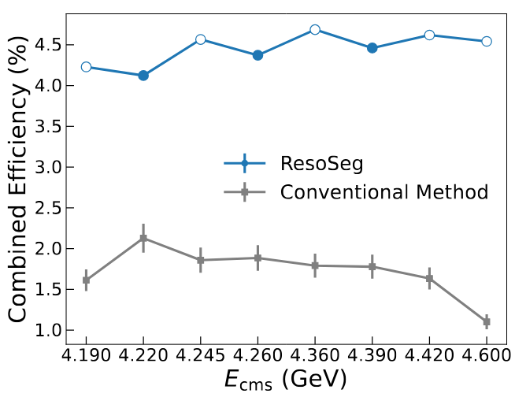
Other studies
在FPGA上部署轻型NN用于快速去除背景
基于真实数据训练
束流背景排除提升20-50%
延迟仅35ns
对BEPCII升级和下一代对撞机尤其重要
通用强子标记器
利用Transformer训练表征空间
利用SAM模型分割末态粒子
效率相比于传统方法提升2.6倍

Slide 29
Summary and outlook
Possible two new approaches for AI4S studies at lepton collider
  Unique scenario w.r.t. hadron collider
  Systematically analyze all possible process automatically
    Autonomous analysis using DrSai - analyzing real data now
  Use experimental data to build a large model - finalizing prototype
    Classify all the events with foundation model
    Tag the intermediate resonance by segmentation
Welcome to join ! We are forming a DrSai collaboration now
  Extending to: JUNO/TAO data production, LHAASO analysis, ATLAS DQM, CMS ntuple analysis, neutron/light source analyses, etc.

Slide 30
backup

