Slide 1
EicC vertex & tracking detector simulation and performance study
Aiqiang Guo, Yuming Ma,
Yutie Liang, Yuxiang Zhao
Institute of Modern Physics, CAS

Slide 2
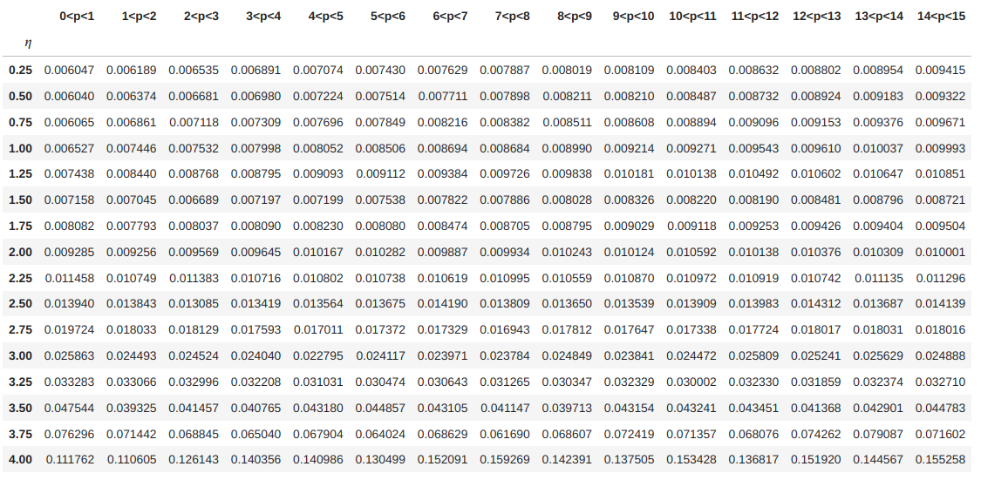
Momentum resolution

Slide 3
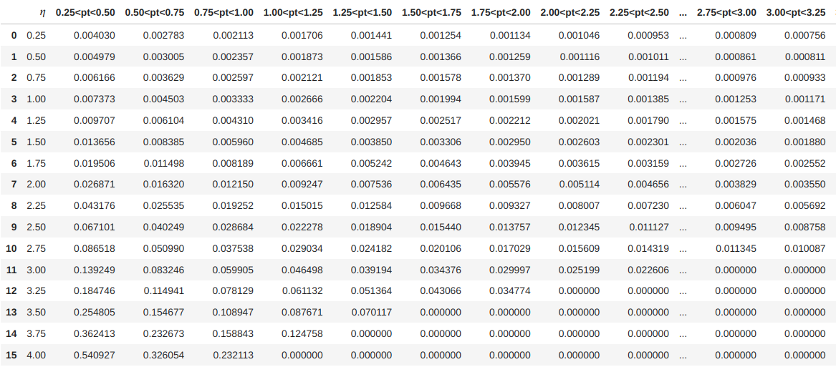
DCAz resolution

Slide 4
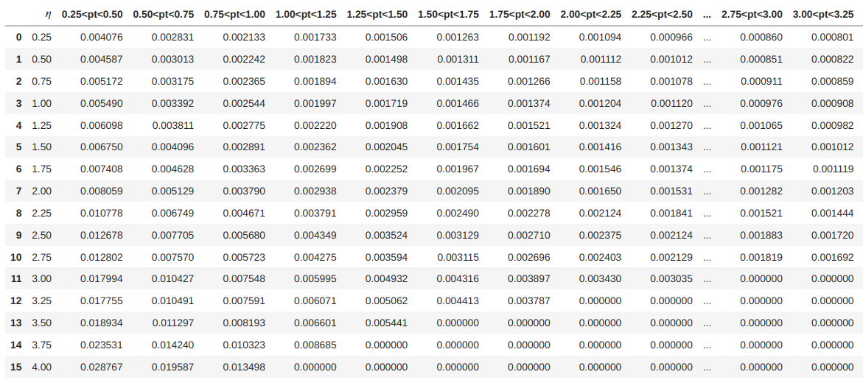
DCArphi resolution

Slide 5
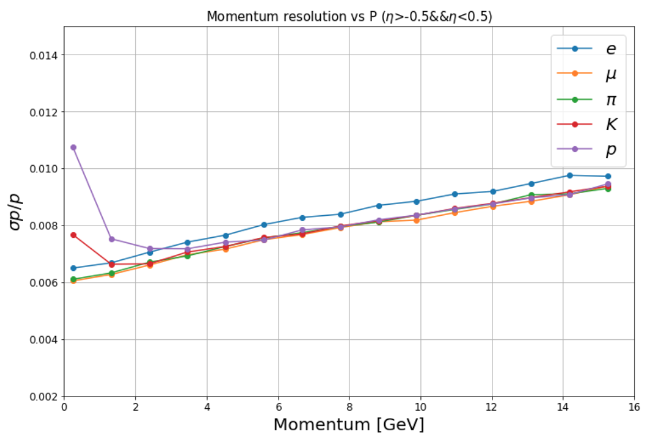
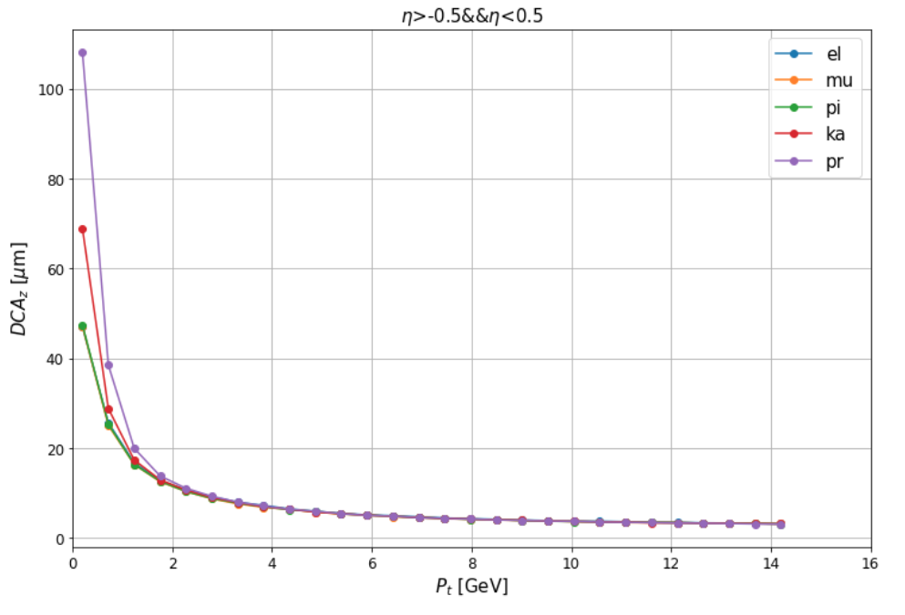
Issues-1
Behaviors of different particles are different

Slide 6
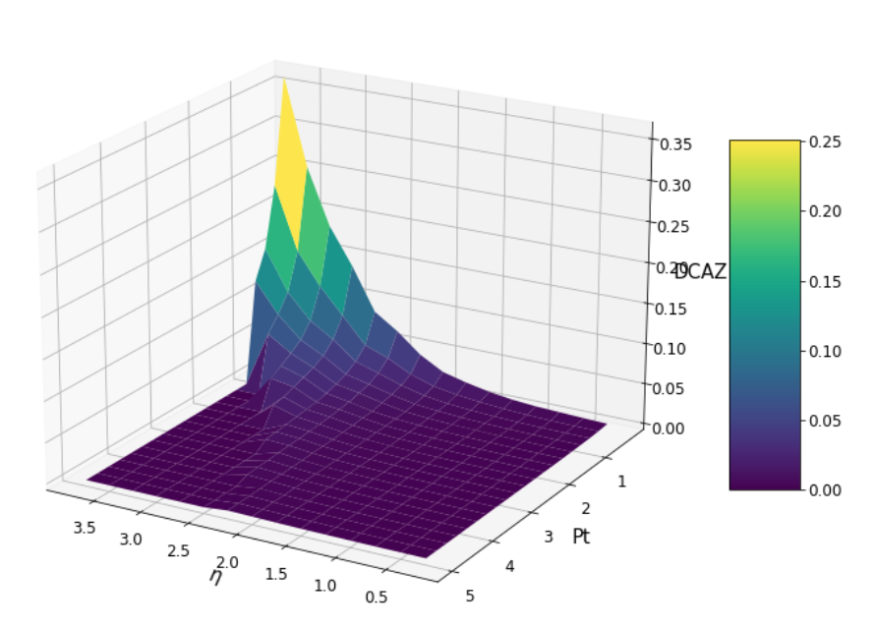
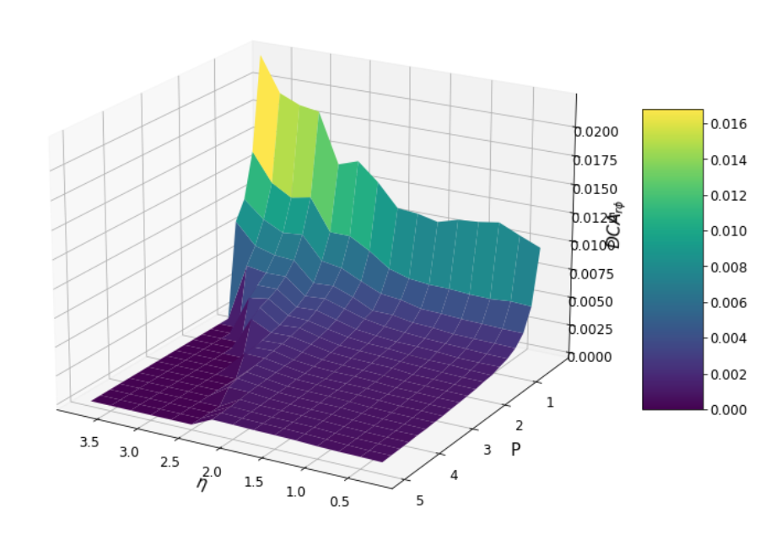
Issues-2
There are cut off in the large Pt&$η$ region

Slide 7
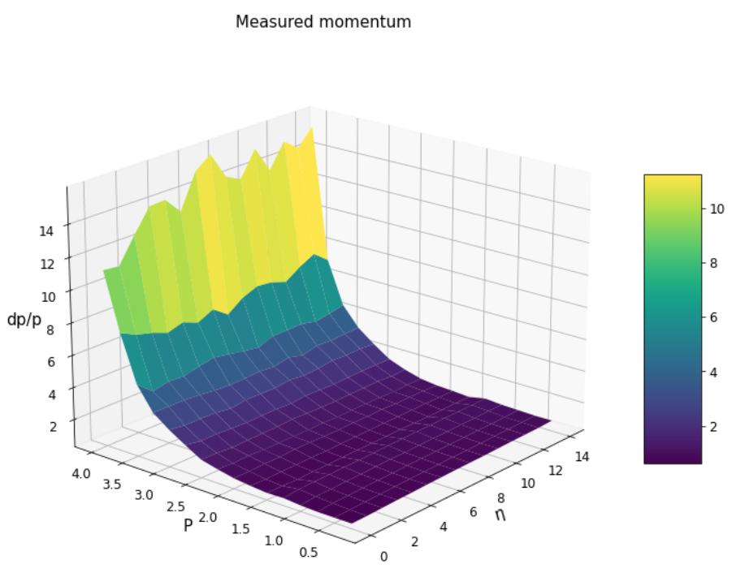
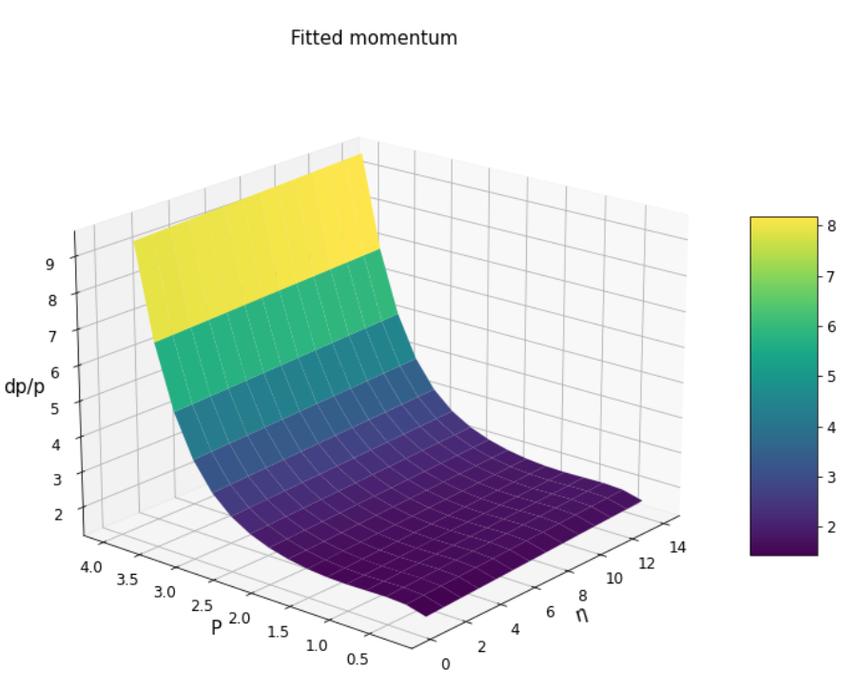
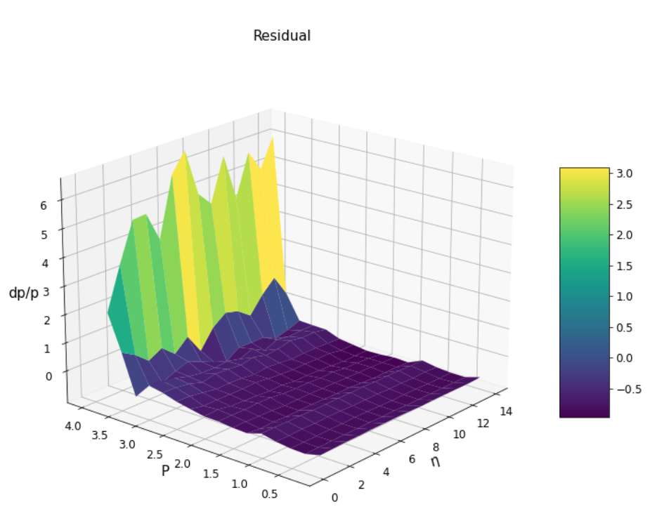
A possible solution- 2D fit
The fit is imperfect

Slide 8
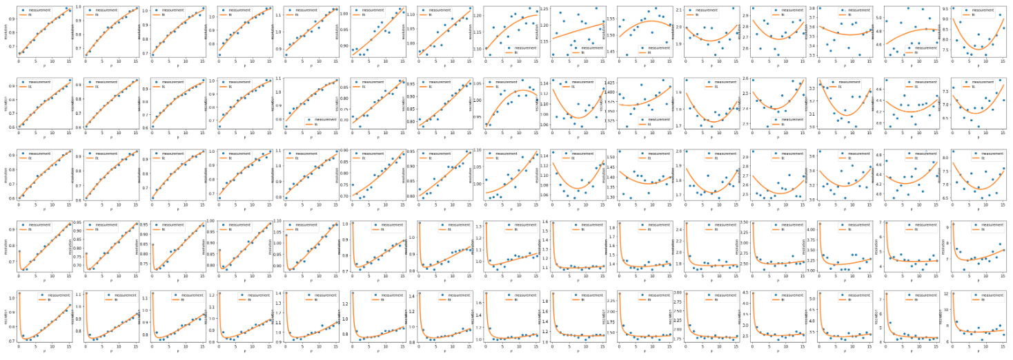
Another solution- 1D fit at each $η$ bin: P resolution
$$e$$
$$μ$$
$$π$$
$$K$$
$$p$$
Different $η$ region: from 0 to 3.75 with interval of 0.25

Slide 9
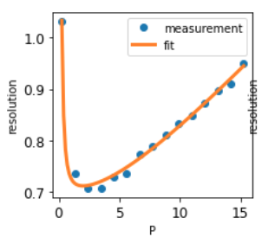
Another solution- 1D fit at each $η$ bin: P resolution
$$e$$
$$μ$$
$$π$$
$$K$$
$$p$$
Different $η$ region: from 0 to 3.75 with interval of 0.25

Slide 10
Another solution- 1D fit at each $η$ bin: P resolution
$$e$$
$$μ$$
$$π$$
$$K$$
$$p$$
Different $η$ region: from 0 to 3.75 with interval of 0.25

Slide 11
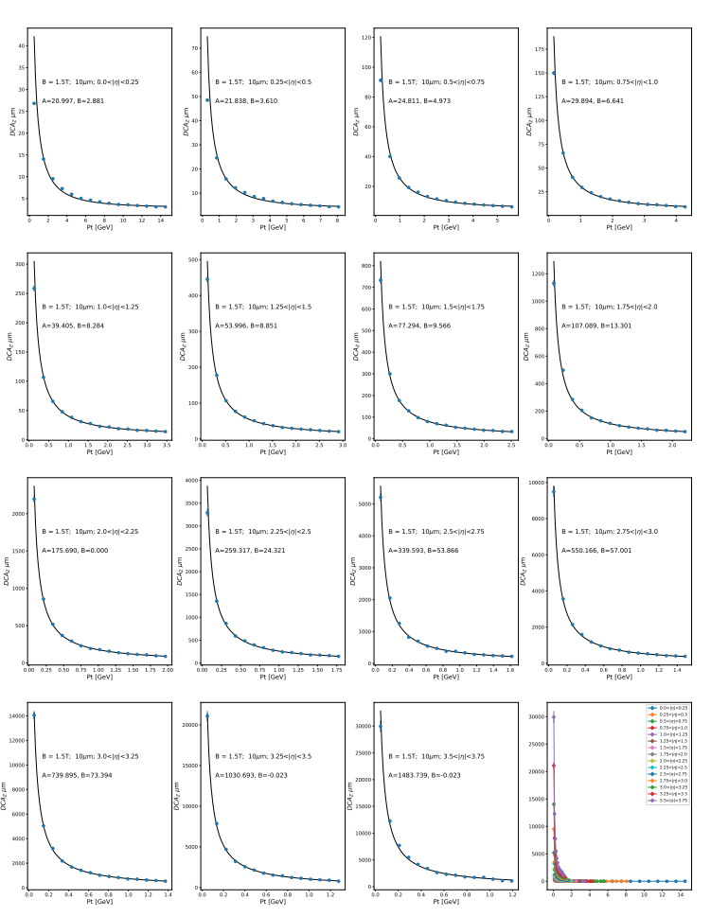
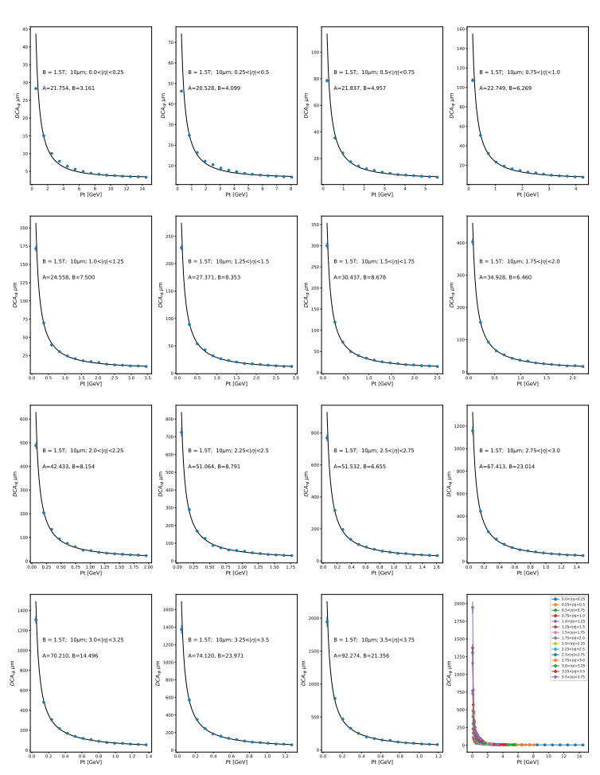
1D fit at each $η$ bin: DCA resolution
$$e$$
$$e$$
DCA_{z}
DCA_{r}$φ$

Slide 12
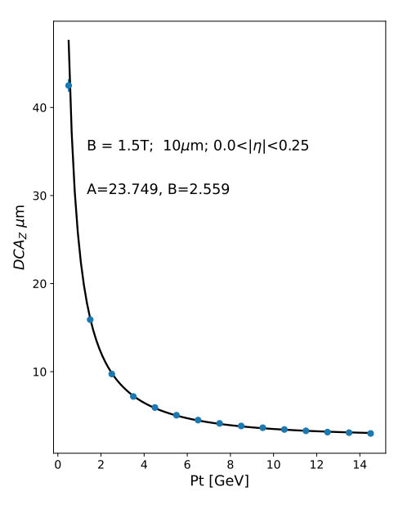
1D fit at each $η$ bin: DCA resolution
$$e$$
$$e$$
DCA_{z}
DCA_{r}$φ$

Slide 13
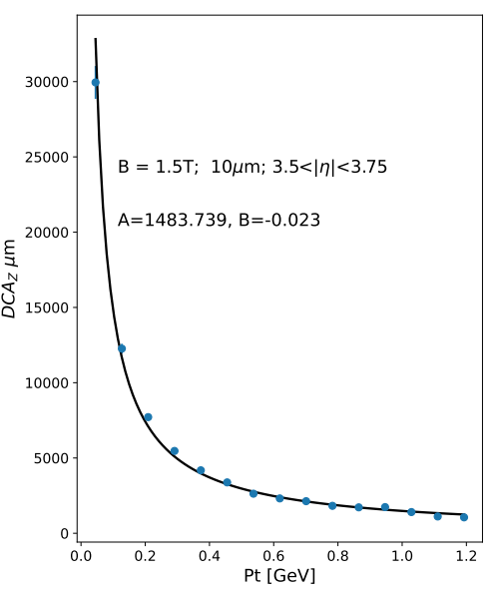
1D fit at each $η$ bin: DCA resolution
$$e$$
$$e$$
DCA_{z}
DCA_{r}$φ$

Slide 14
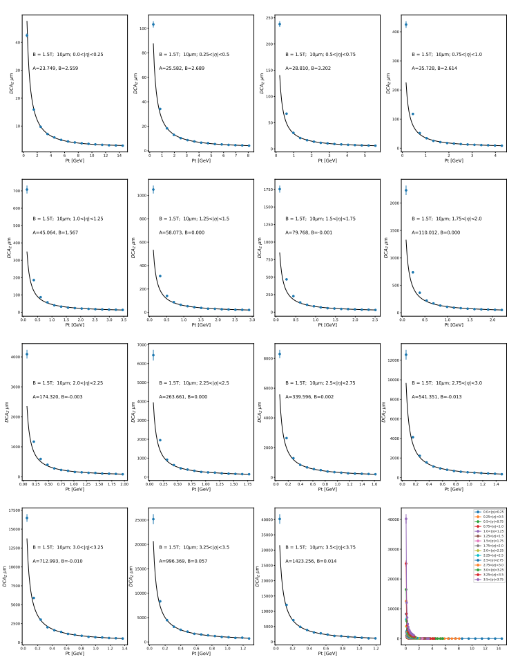
1D fit at each $η$ bin: DCA resolution
$$e$$
$$p$$
DCA_{z}
DCA_{z}

Slide 15
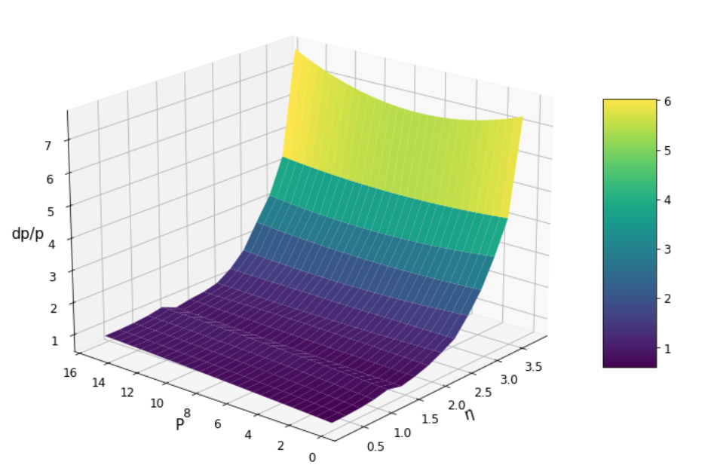
Comparison of measurement and fitted results
Measurement
Fitted result

Slide 16
Comparison of measurement and fitted results
Measurement
Fitted result

Slide 17
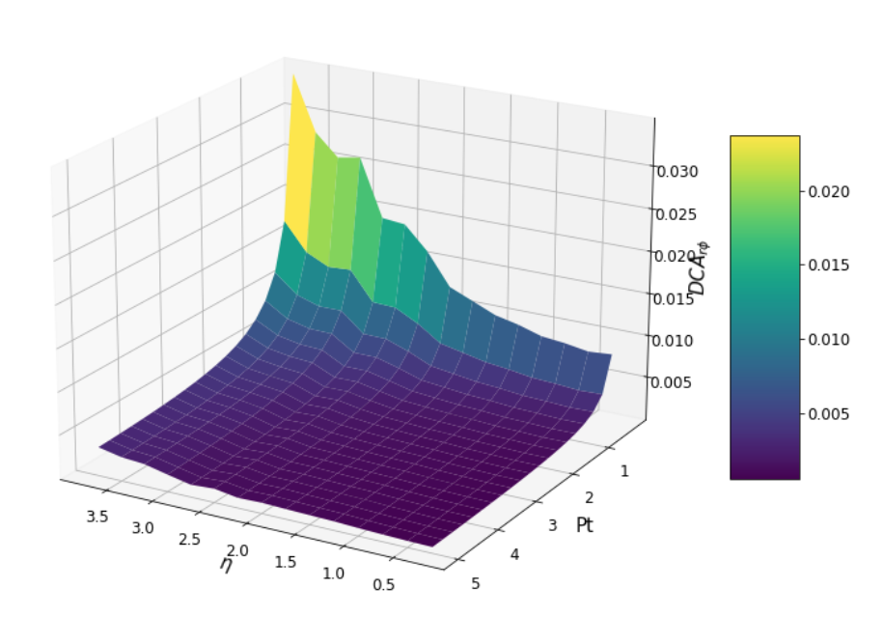
Comparison of measurement and fitted results
Measurement
Fitted result

Slide 18
Parameterization of the performance
[0,1,2,3,4]=>$[e,μ,π,K,p]$

Slide 19
Parameterization of the performance
[0,1,2,3,4]=>$[e,μ,π,K,p]$

Slide 20
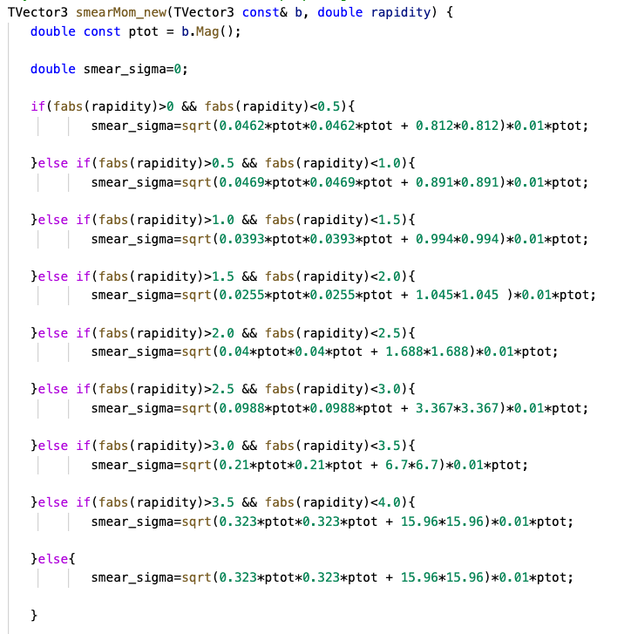
Parameterization of the performance
[0,1,2,3,4]=>$[e,μ,π,K,p]$

Slide 21
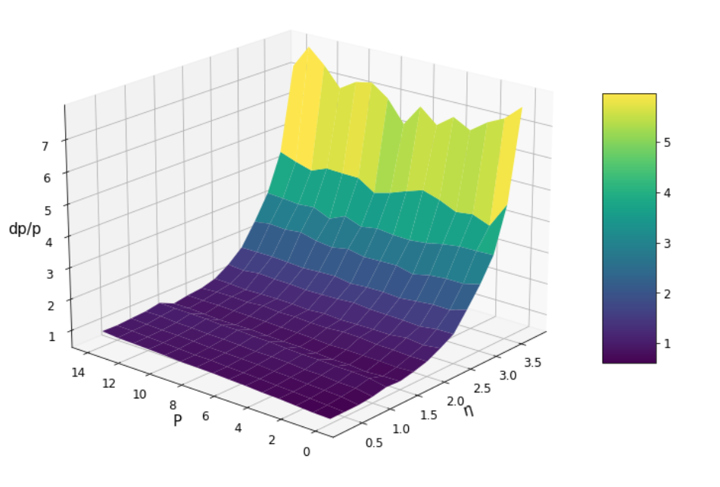
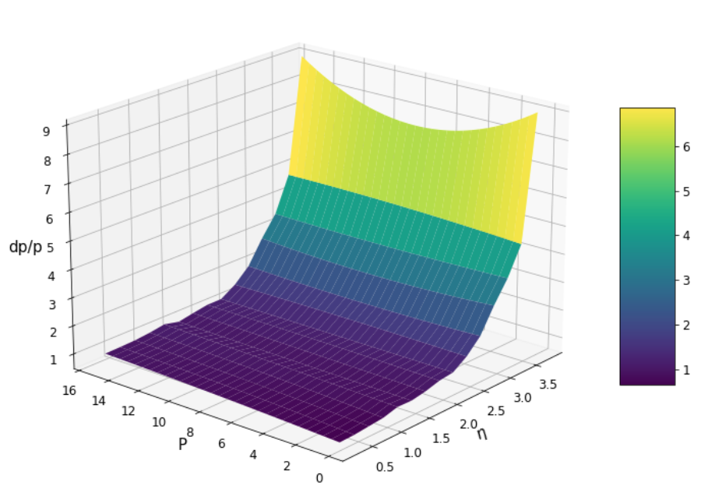
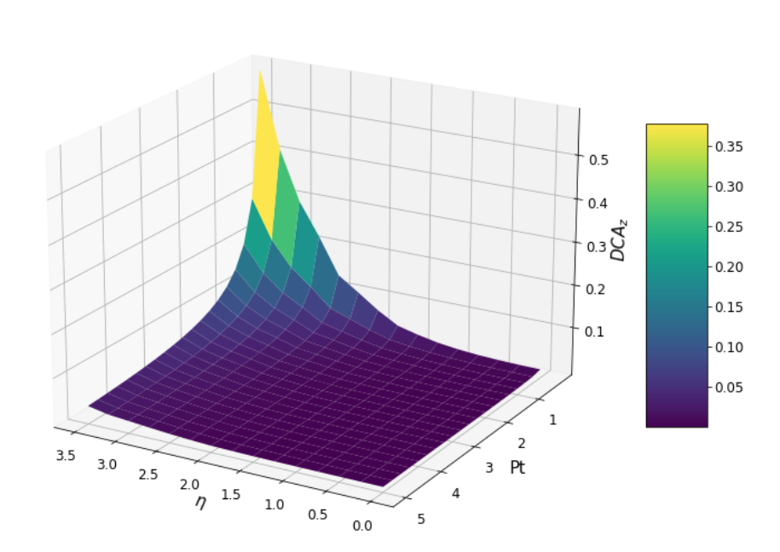
Validation of the functions
Simulated results
Calculated results

Slide 22
Design of the EicC Detector Performance Class
Interface
Data base
Documentation
EicC_Mvd_DP::GetResP(p,eta,par)
EicC_Mvd_DP::GetResDCAz(pt,eta,par)
EicC_Mvd_DP::GetResDCArp(pt,eta,par)
EicC_Mvd_DP::GetEff(pt,eta,par)
EicC_Mvd_DP::GetResVx(nTrk)
EicC_Mvd_DP::GetResVy(nTrk)
EicC_Mvd_DP::GetResVz(nTrk)
EicC_Mvd_DP::SetTag(“Det_v1”)
Double Par_Res_P[[[…]]];
Double Par_Res_DCAz[[[…]]];
…
If(Tag==“Det_v1”)
{Par_Res_P=[[[…]]];
Par_Res_DCAz=[[[…]]];
…;}
If(Tag==“Det_v2”)
{…;}
Det_v1:
Barrel:
Layer1:
R:3.0 cm
L:10 cm
Mat:silicon
Endcap_e_go:
…
Endcap_p_go:

Slide 23
Backup

Slide 24
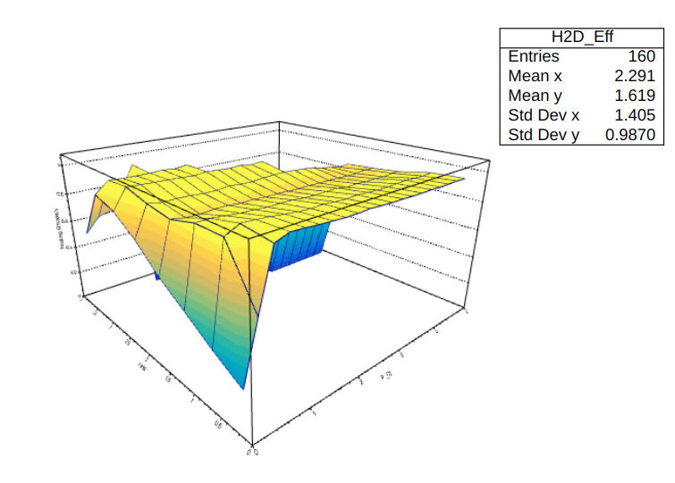
Tracking efficiency

Slide 25
Vertex resolution vs multiplicity

