Slide 1
Update on the PID Detectors for EicC
Xin Li
05/09/2022

Slide 2
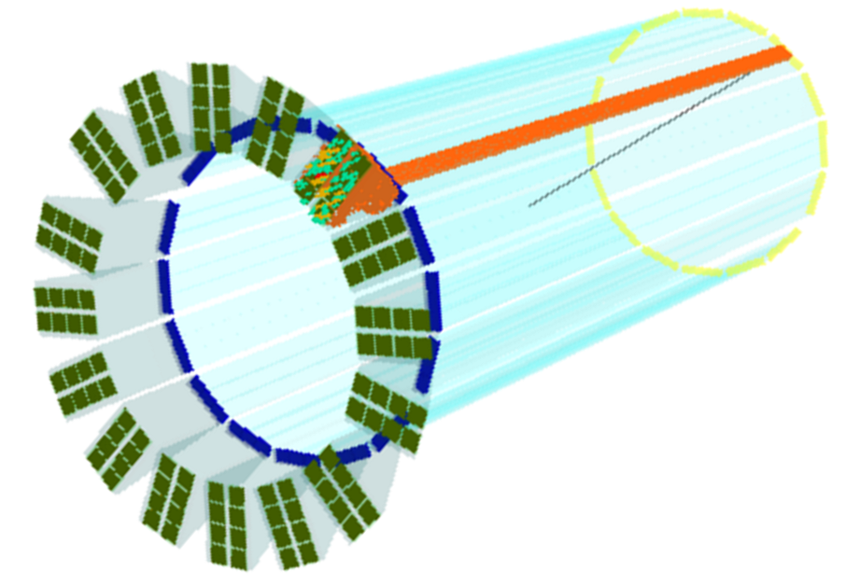
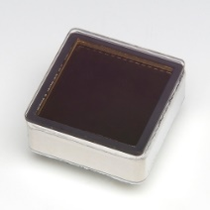
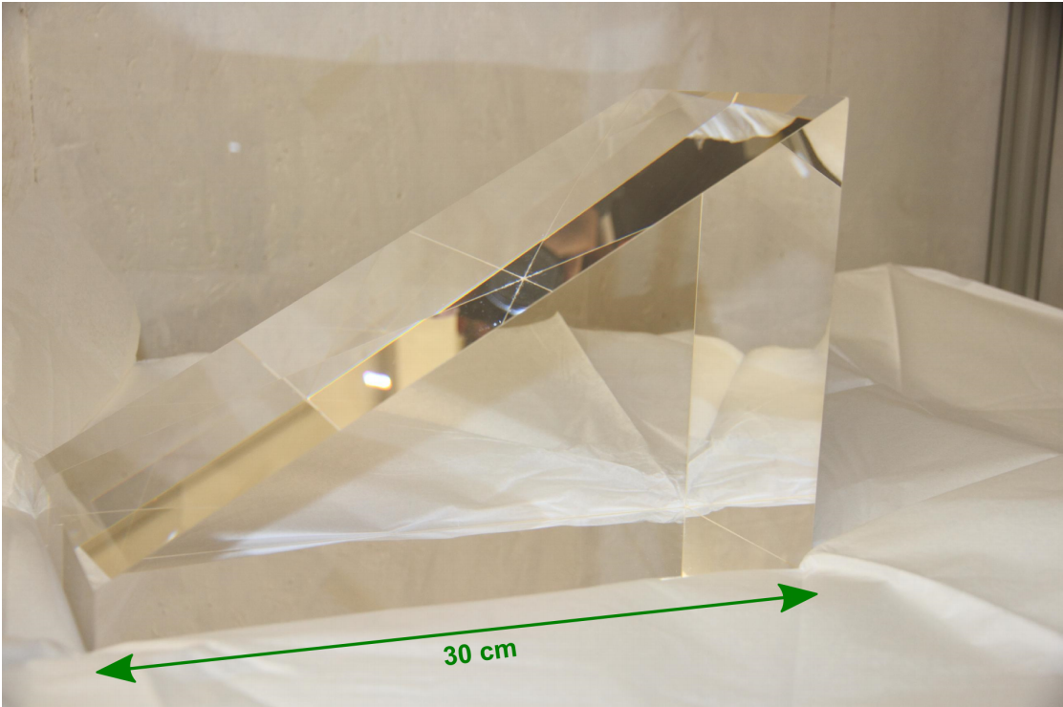
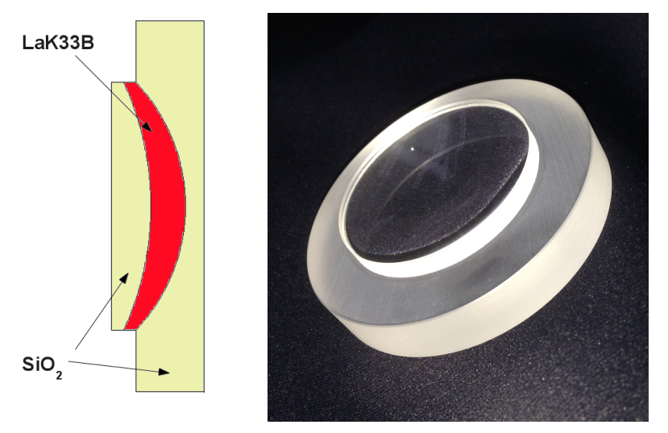
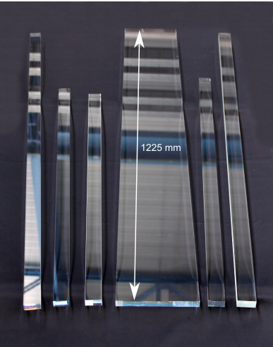
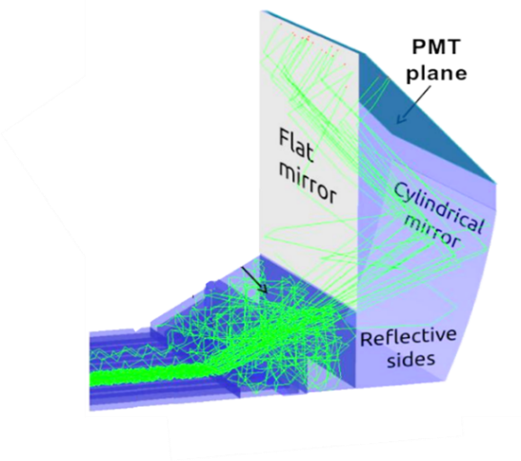
Geant4 Simualtion on Barrel DIRC
(a)
Barrel DIRC: L~3m, inner radius~0.8m
Radiator: 13mm x 36mm x 2400mm
Expansion volume: 240mm x 360mm x 300mm
MCP-PMT: Hamamastu R10754
4 x 4 array, pixel size: 5.75mm x 5.75mm
Focusing: spherical 3-layer lens (Fused silica + LaK33B glass)
curvature radius: 30◦, 30/7.5cm, thickness: 1cm

Slide 3
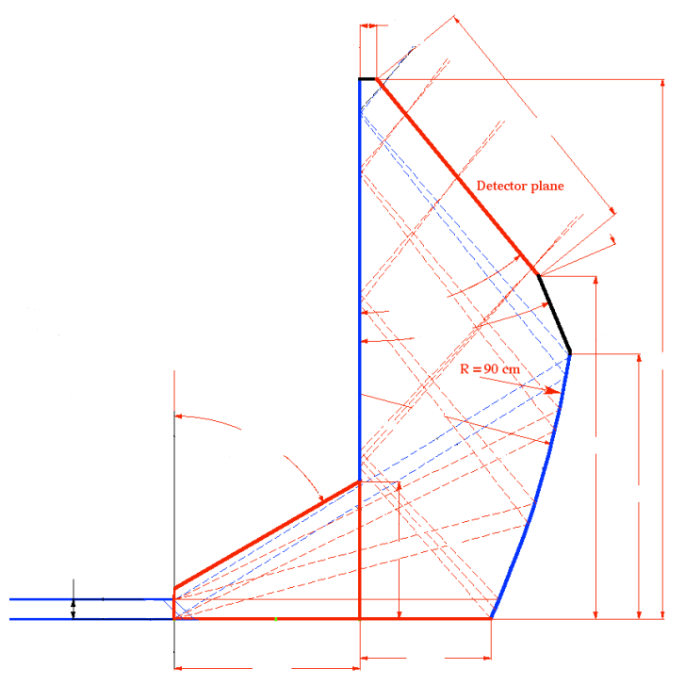
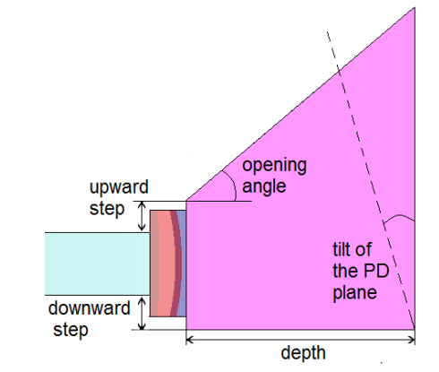
Current Simulation on DIRC Expansion Volume
1.5cm
25cm
8cm
40◦
23◦
50cm
60◦
30◦
32cm
25cm
15cm
1.7cm
20cm
15cm
20cm
Simulate the DIRC performance with one more focusing expansion volume of different shapes.

Slide 4
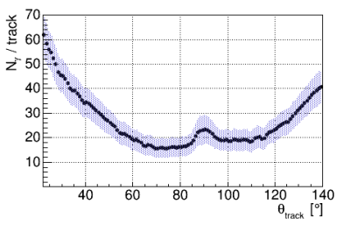
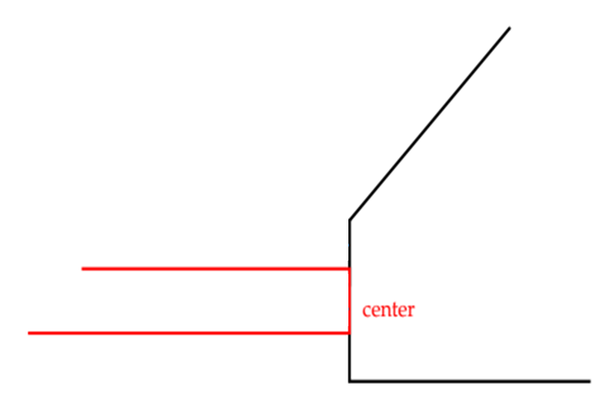
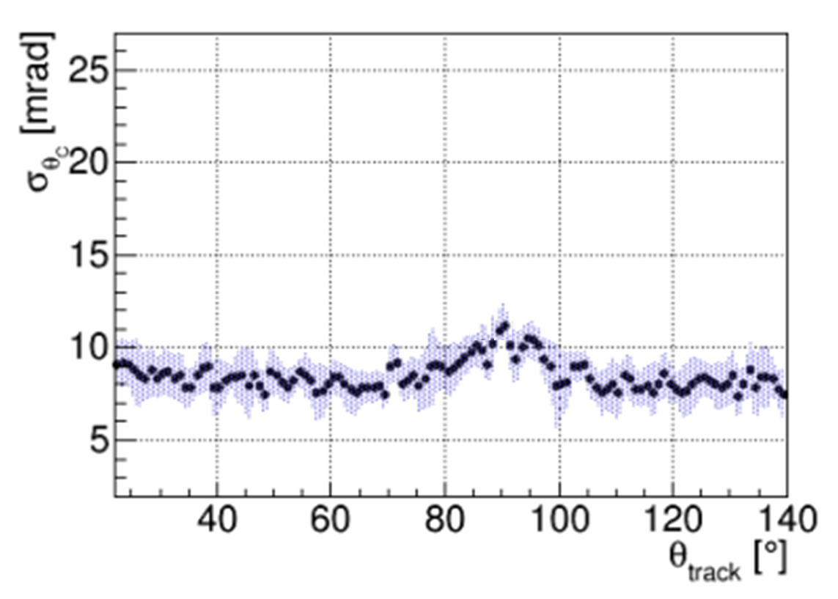
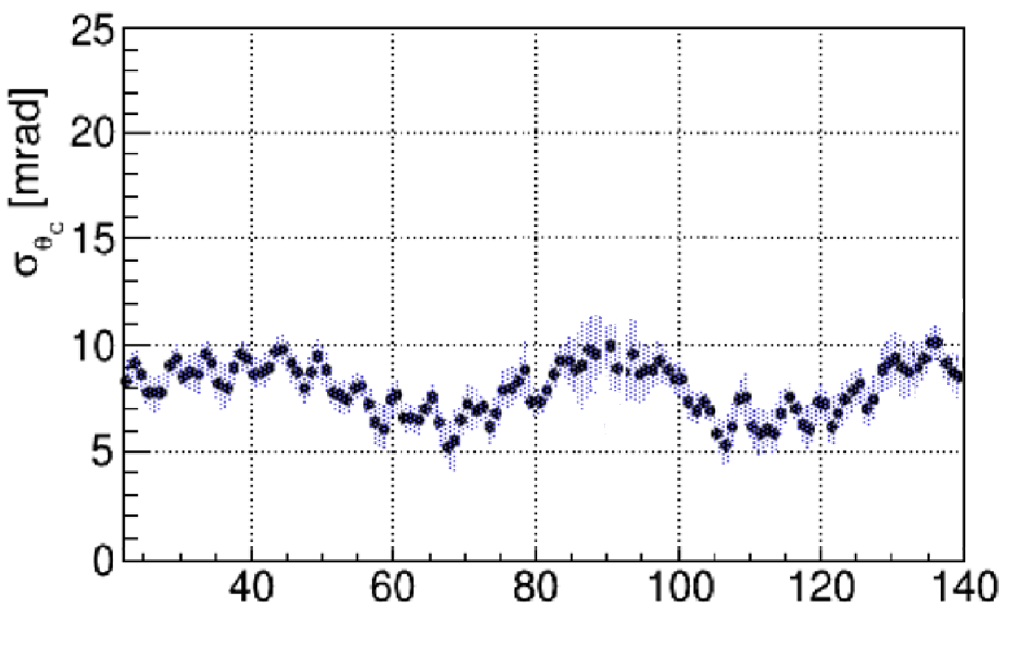
Simulation on different PMT tilt Angles
Photon collected at PMT tilt angle = 40◦
PMT plane Tile angle | Photon number | SPE Angle resolution (mrad)
30◦ | 11 ~ 58 | 8 ~ 11
35◦ | 13 ~ 60 | 7 ~ 11
40◦ | 14 ~ 62 | 5 ~ 10
45◦ | 12 ~ 59 | 6 ~ 10
PMT tilt Angle
SPE angle resolution at PMT tilt angle = 35◦
SPE angle resolution at PMT tilt angle = 40◦

Slide 5
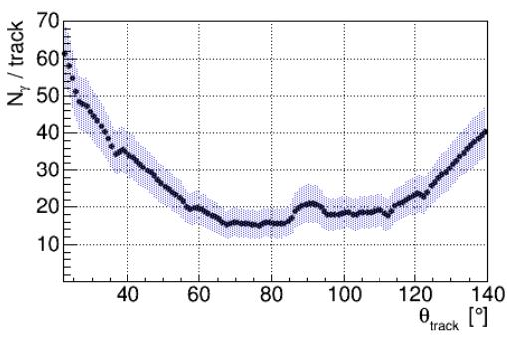
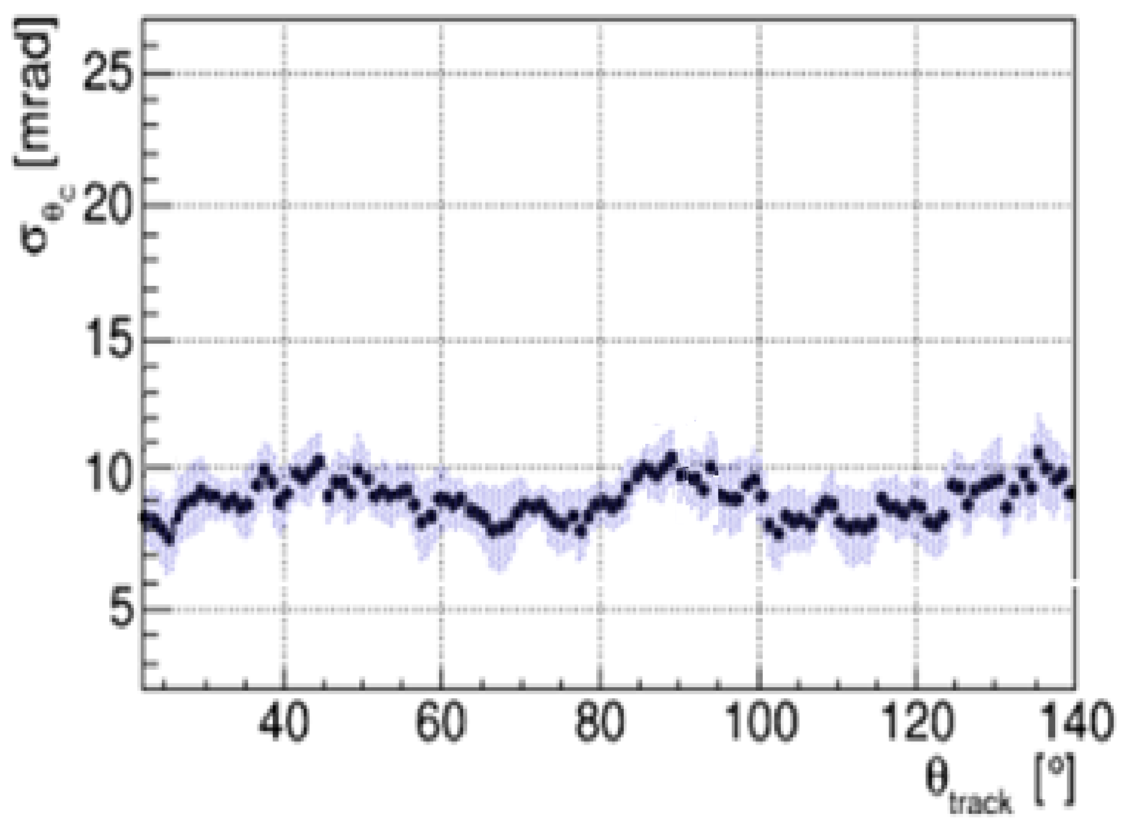
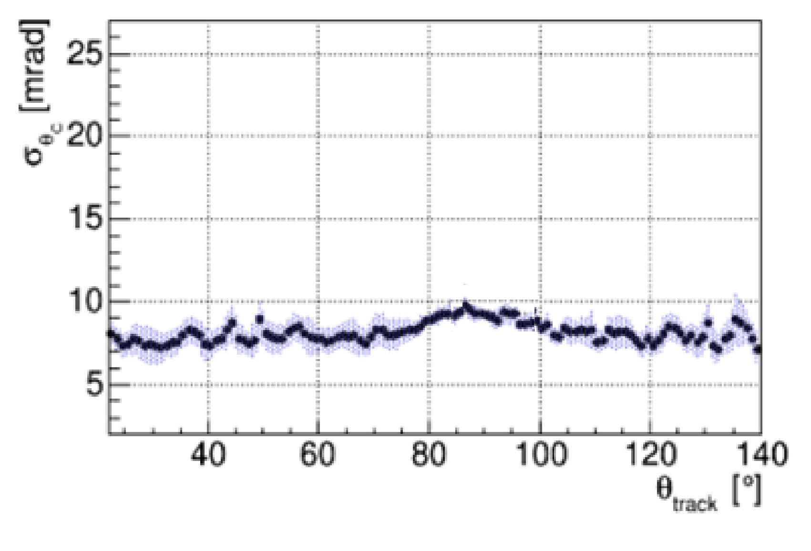
Simulation on different EV Sizes
Photon collected at EV depth = 18cm
EV depth / PMT plane size | Photon number | SPE Angle resolution (mrad)
15cm / 25cm | 17 ~ 65 | 8 ~ 12
18cm / 30cm | 14 ~ 62 | 7 ~ 10
21cm / 35cm | 12 ~ 60 | 7 ~ 10
24cm / 40cm | 11 ~ 57 | 6 ~ 10
SPE angle resolution at EV depth = 21cm
SPE angle resolution at EV depth = 18cm

Slide 6
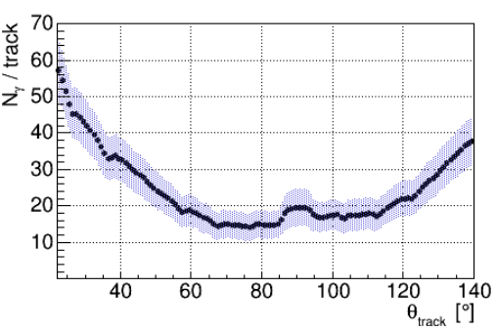
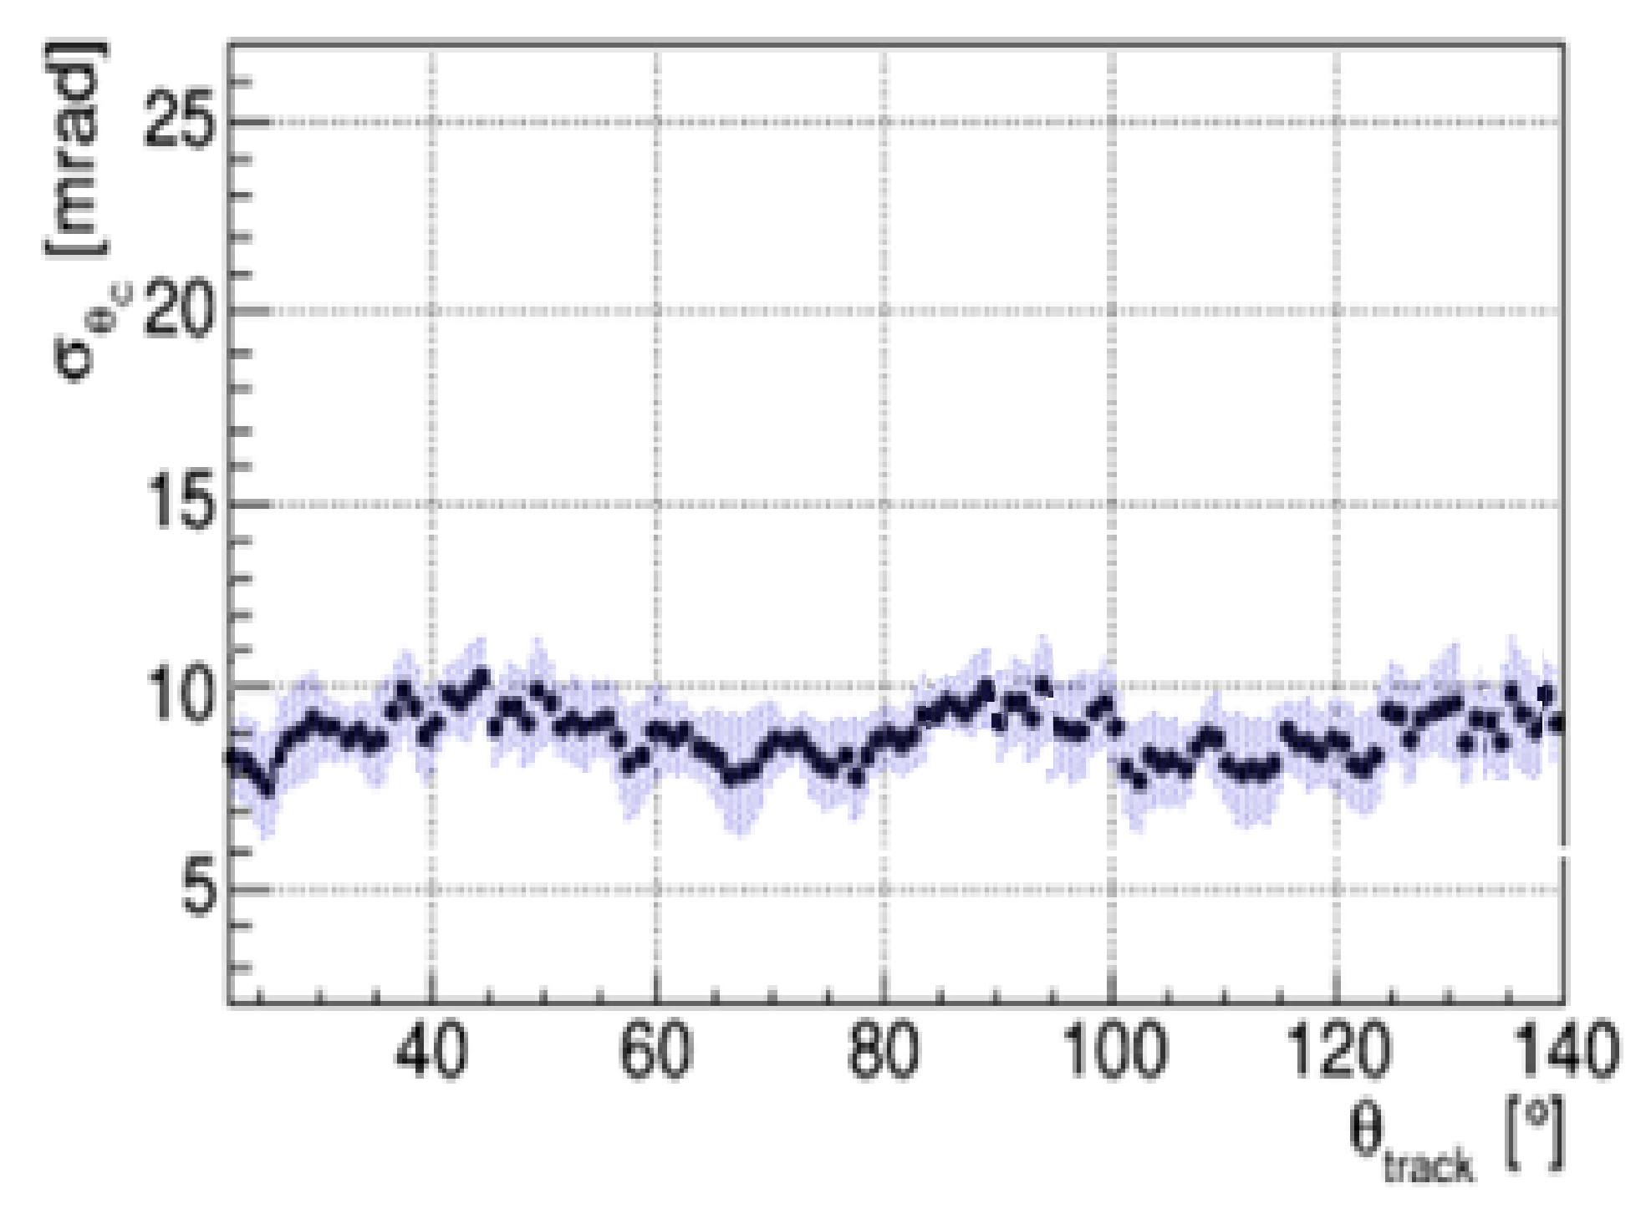
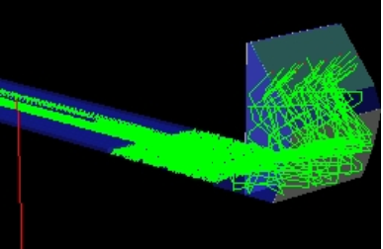
Simulation on different EV Bar Lengths
Photon collected at bar length = 20cm
EV bar length (cm) | Photon number | SPE Angle resolution (mrad)
10 | 18 ~ 65 | 8 ~ 13
15 | 16 ~ 62 | 7 ~ 11
20 | 14 ~ 58 | 6 ~ 10
30 | 11 ~ 52 | 6 ~ 11
radiator
EV bar
SPE angle resolution bar length = 20cm

Slide 7
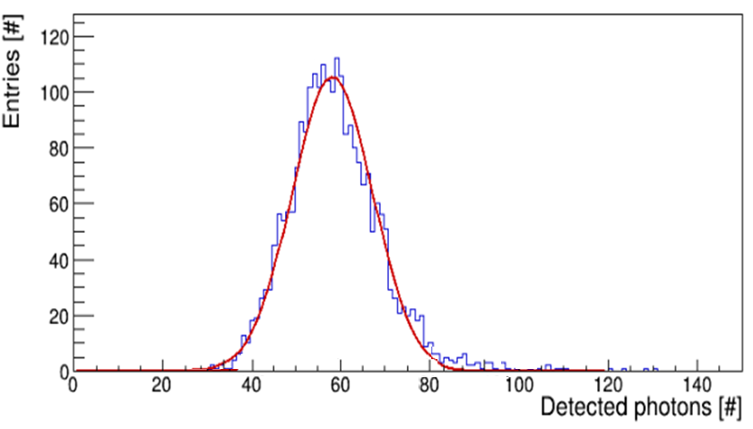
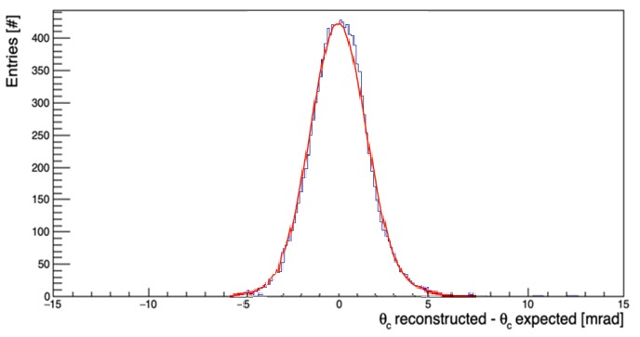
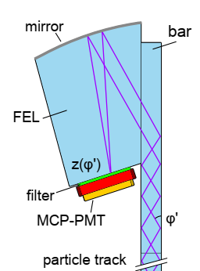
Simulated performance of single DIRC module
Detected photons per pion track
Reconstructed Cherenkov angle
6 GeV/c Pion incident at 30◦ polar angle,
Detected phtons per pion track:
Mean number= 58
Reconstructed Cherenkov angle resolution:
σ_{C} = 1.37 mrad

Slide 8
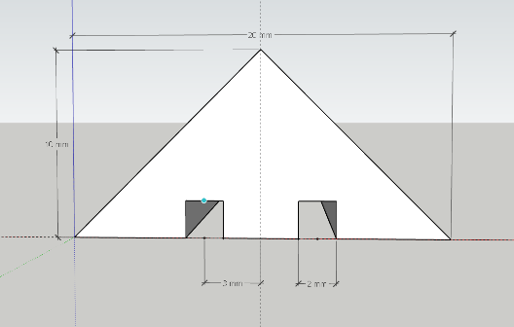
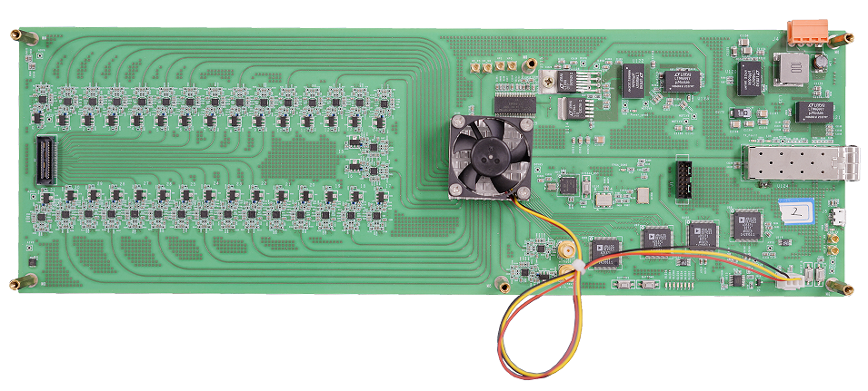
Cosmic ray test setup
4 layer, 8 Module, time & x-y position measurement
Reconstructed angle resolution~1mrad
Module size: 40 ~ 50cm
EJ200 + optical fiber + SiPM S13360 Triangular scintillator + optical fiber
256 channel electronics, time resolution < 100ps
Tested DIRC
Material Type | Amount | Price | Total
Scintillator: EJ-208 | 18 | 10000
Light fiber: Y11 | 500m | 130000
Werroc chip | 10 | 4000
SiPM: S13360-3075PE | 300 | 140
Tyvek: 1025D&1056D | 30 | 100
Electronics: TMP116 | 30 | 175 | 400250

