Slide 1

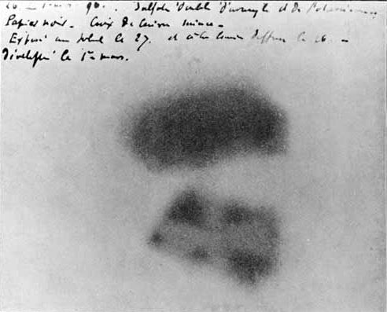



The 13th International Conference on Direct Reactions with Exotic Beams (DREB2026)
Shenzhen · 1–6 November 2026
The ⁸Be NUCLEUS AND HOYLE STATE IN THE DISSOCIATION OF RELATIVISTIC NUCLEI
BECQUEREL
project
BEryllium
Clustering
QUEst in
RELativistic multifragmentation
Andrei ZAITSEV
On behalf of the Becquerel Project
VBLHEP, Joint Institute for Nuclear Research (Dubna)
becquerel.jinr.ru

Slide 2
Nuclear emulsion research in China
1950: He Zehui initiated nuclear emulsion research in China.
1956: proton-sensitive N-2/N-3. 1958: electron-sensitive N-4/N-5.
Central China
Normal University
Shanxi Normal
University
Tsinghua
University
Wuhan
Linfen
Beijing
Relativistic heavy ions
Nuclear fragmentation
Neutrinos with FASERν
Prof. Daicui Zhou
Deputy Head / Head of the
Nuclear Emulsion Laboratory
(1983–1997)
EMU01 / EMU12 collaborations
¹⁶O fragmentation in emulsion
at 3.7 and 60 GeV/nucleon
Charge topology and
fragment multiplicities
Emulsion detector construction
and data analysis
Film production, development
and scanning within FASER
EMU01 participants listed in 1993: IHEP (Beijing), CCNU (Wuhan), Shanxi Normal University
and Hunan Education Institute (Changsha).
H. Sun, Nuclear Tracks Radiat. Meas. 22, 233–242 (1993). doi:10.1016/0969-8078(93)90056-A
Additional sources: CCNU biography of D. Zhou; Zhang et al. (2002, 2005); Tsinghua University (2024).

Slide 3
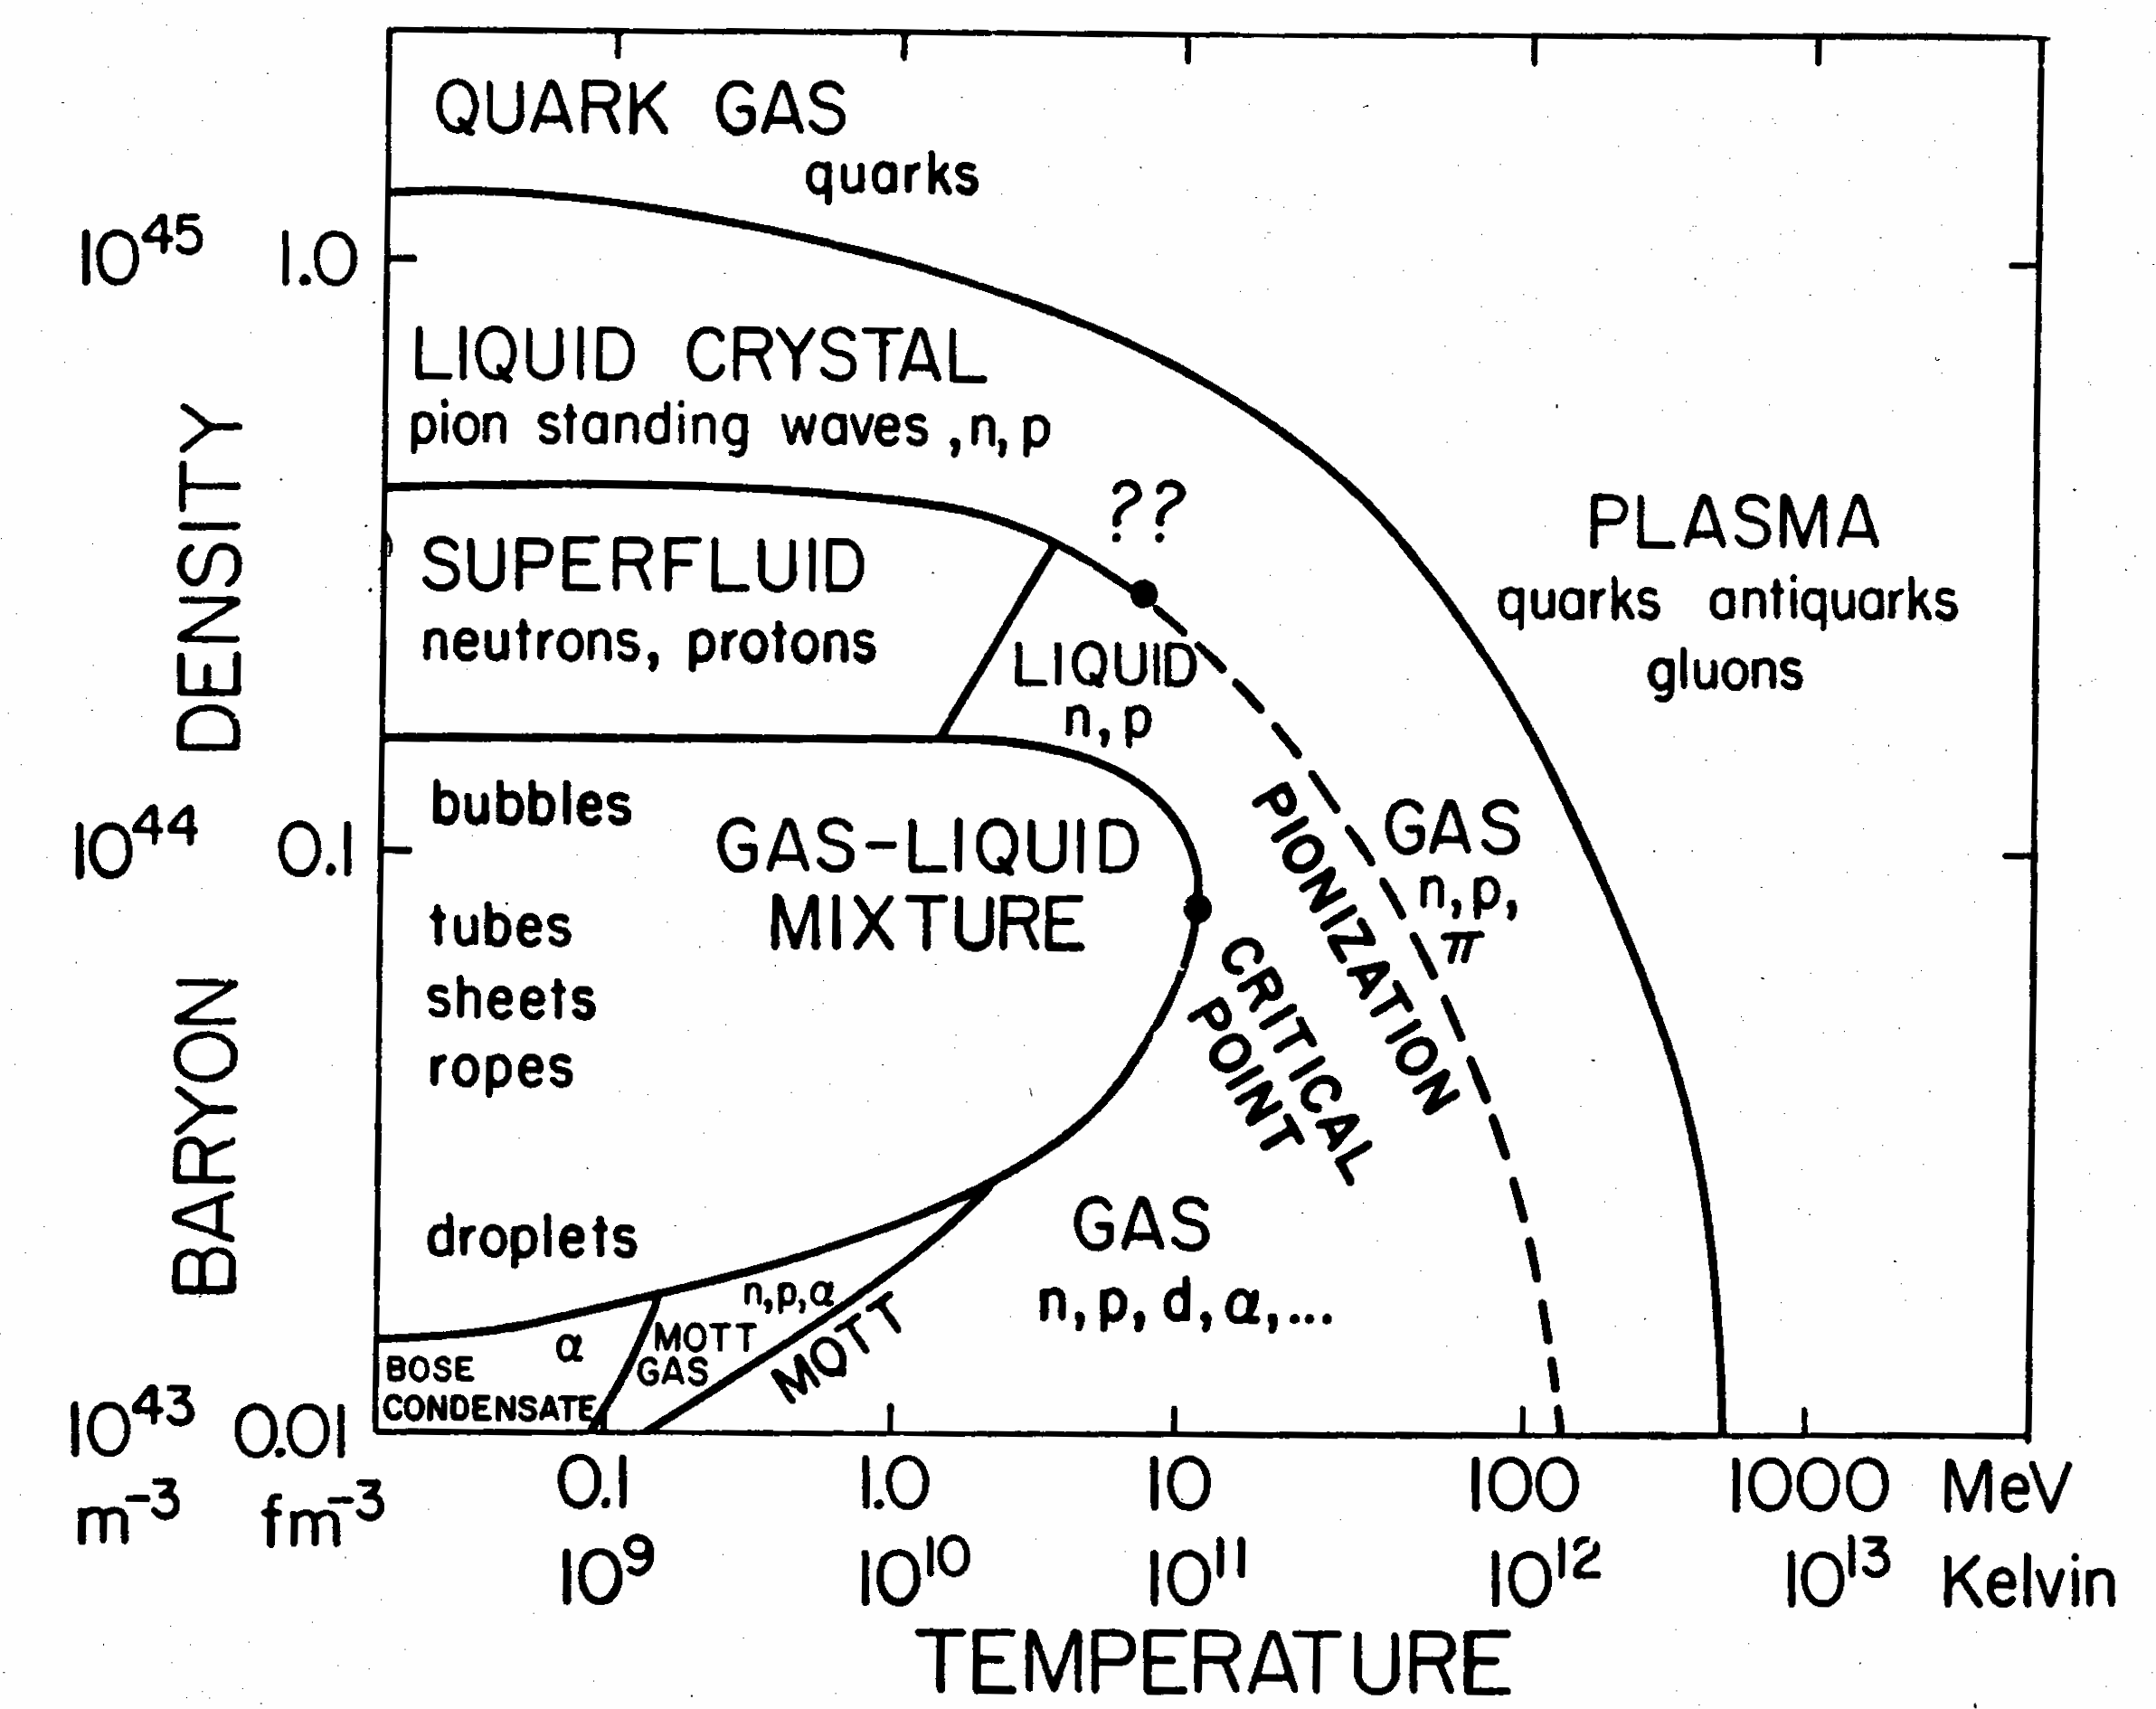
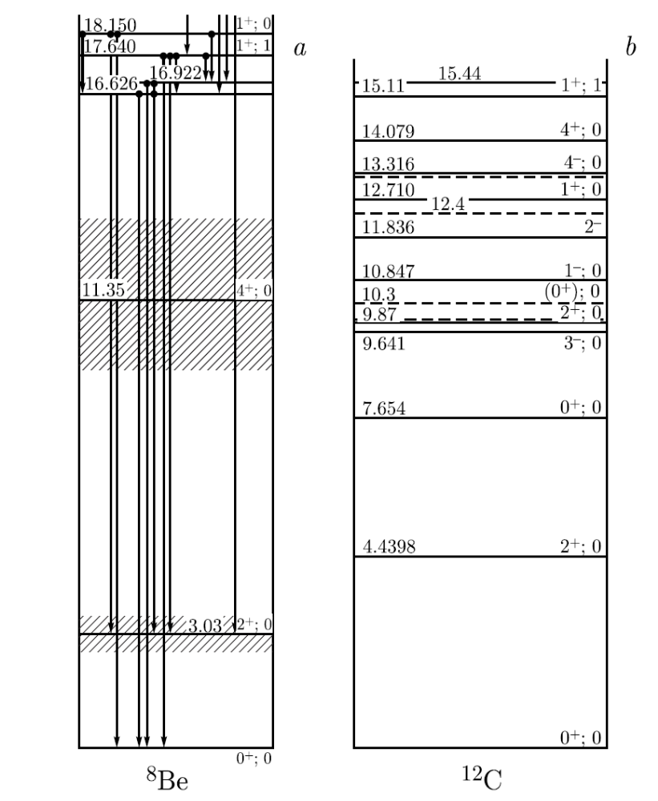
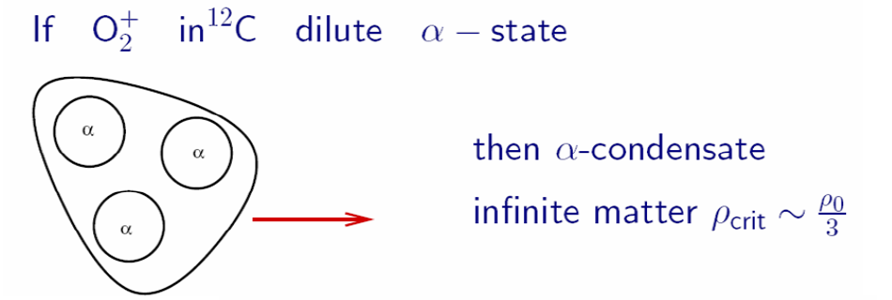
Search for αBEC states

Slide 4
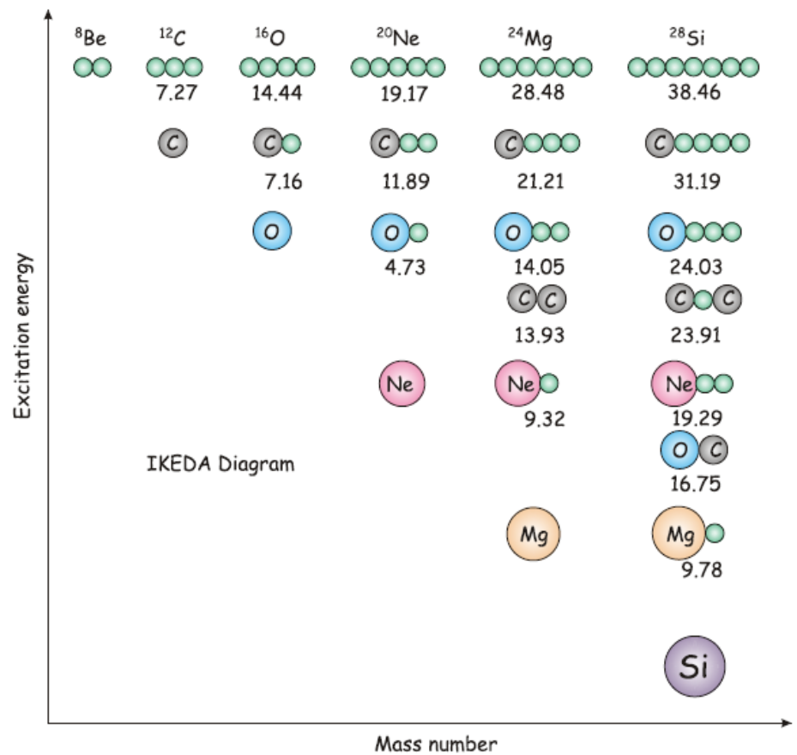
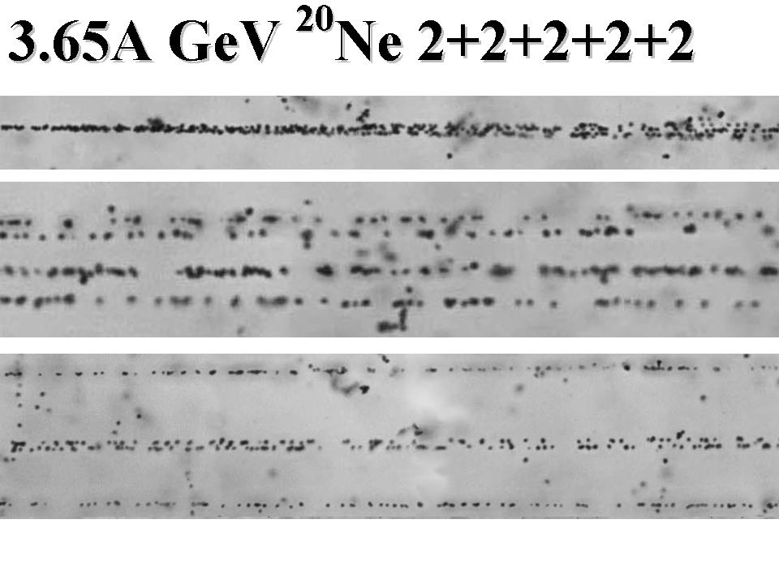
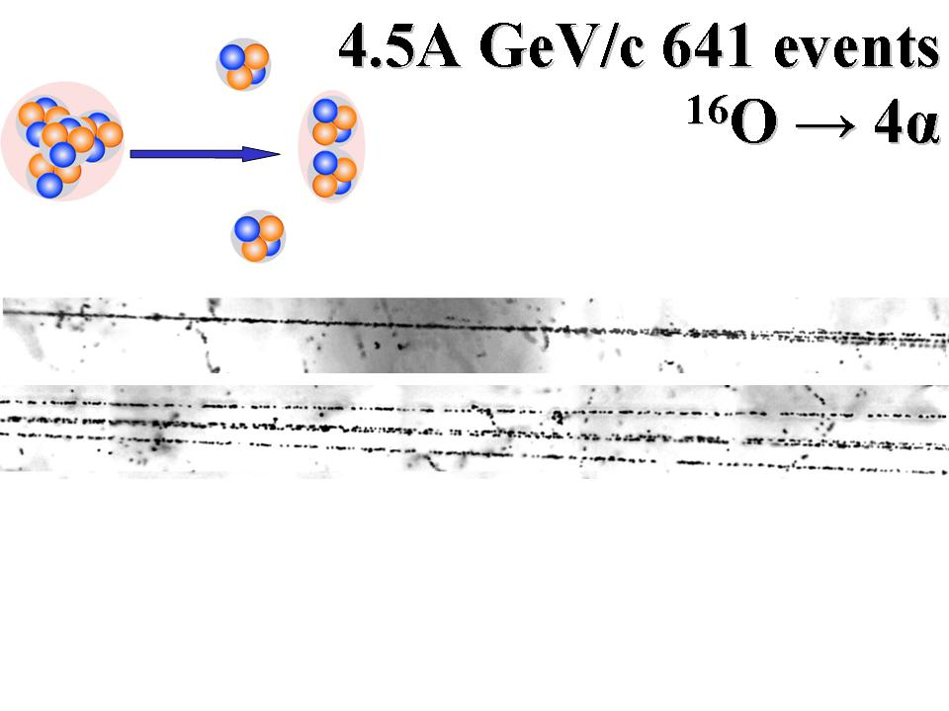
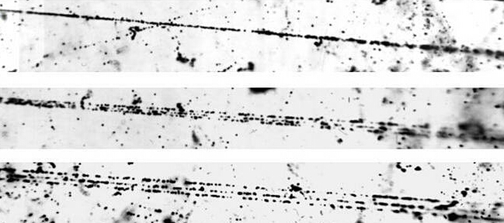
²⁴Mg → 6α
²²Ne → 5α
¹⁶O → 4α
Is the formation of ⁸Be, ¹²C(0₂⁺) or other near-threshold states possible in relativistic fragmentation?
¹²C → 3α

Slide 5
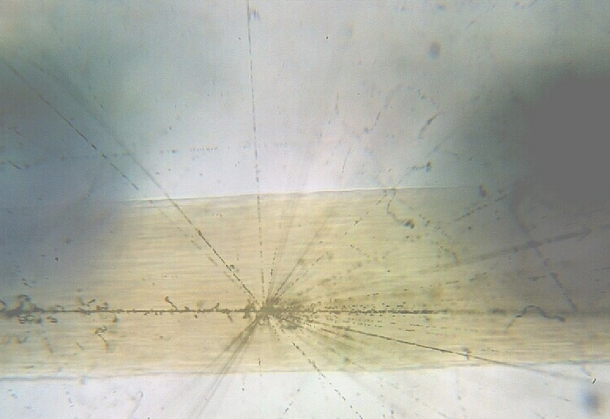
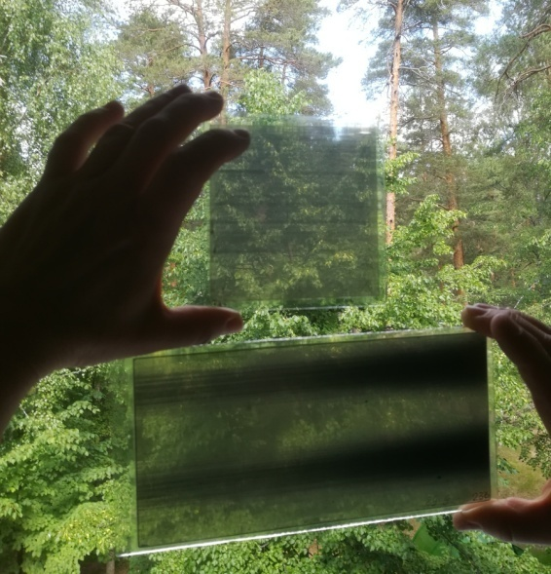
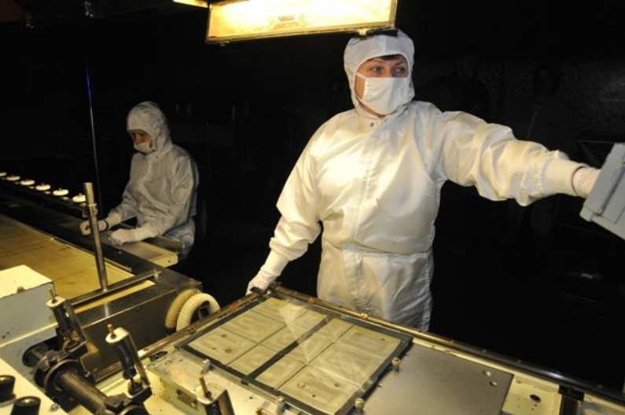

Nuclear track emulsion (NTE) method
High spatial resolution: the spatial accuracy of the tracks is 0.5 μm, angular accuracy can reach ~10⁻³ rad.
Full 3D tracking: measurement of the angles of all charged fragments in a single nuclear emulsion layer (500 µm).
Fragment identification: determination of Pβc via multiple Coulomb scattering.
Q-value reconstruction: calculation of the invariant mass of excited systems.
Pereslavl-Zalessky
Russia

Slide 6
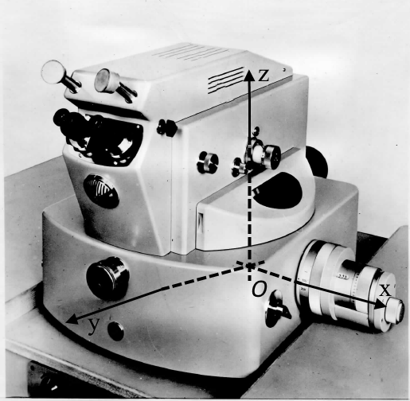
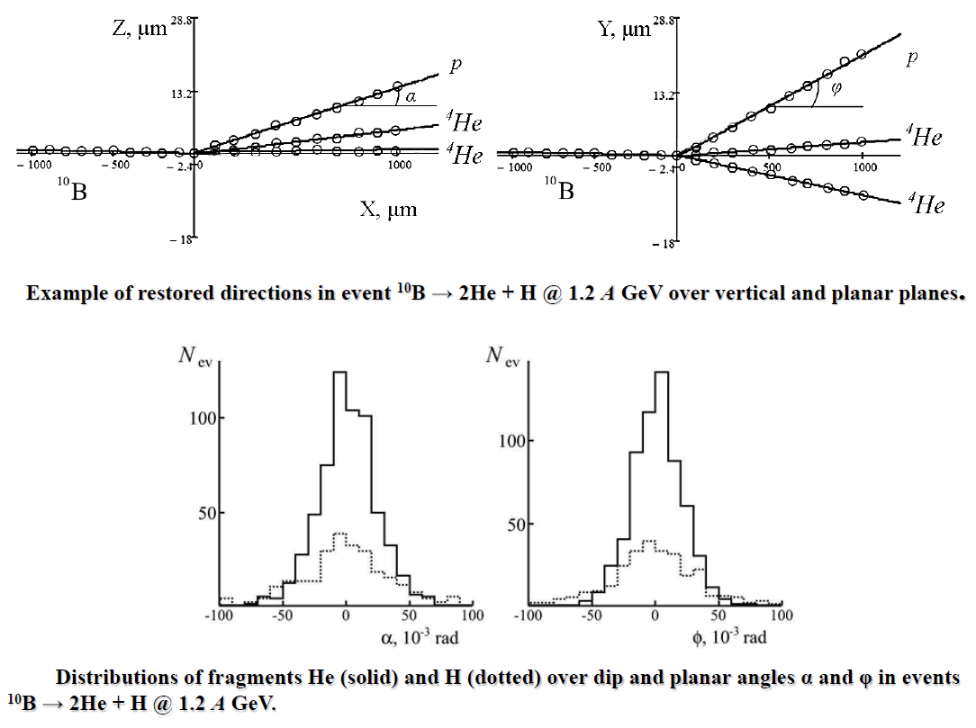
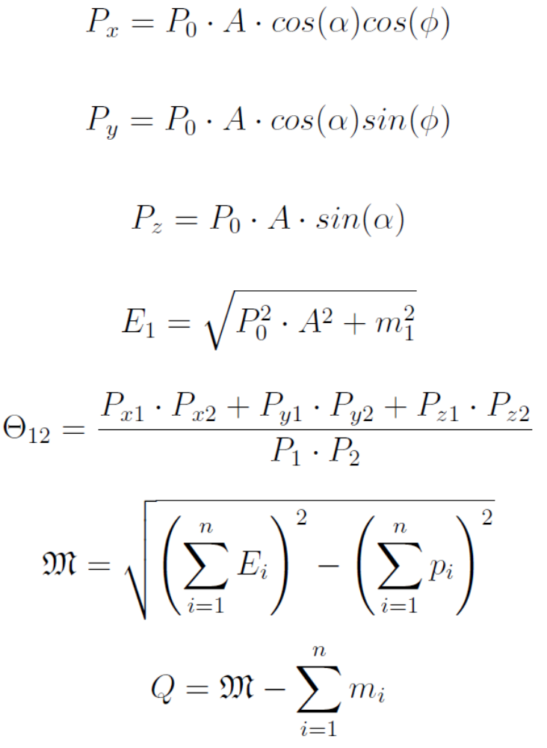
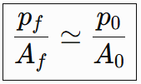
Momentum assignment in the forward fragmentation cone
L. Anderson et al, Phys. Rev. C 28, 1224

Slide 7
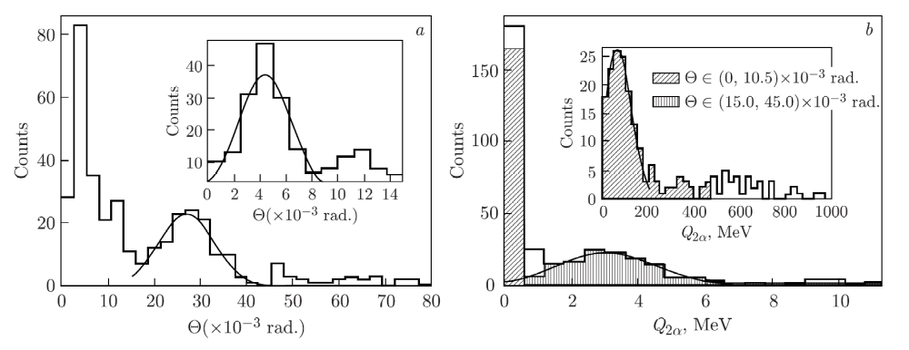
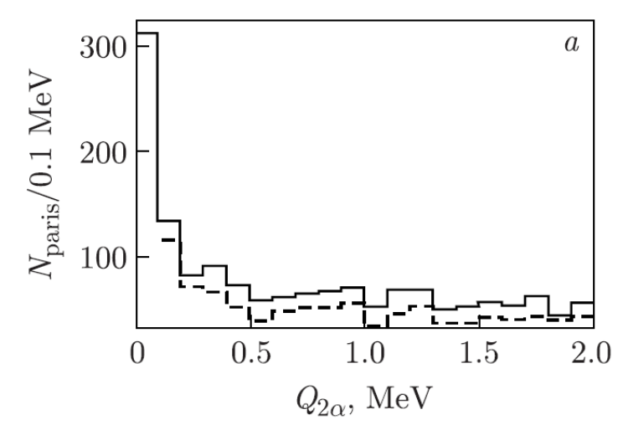
Identification of the decay of relativistic ⁸Be nuclei
⁹Be → 2α at 1.2 GeV per nucleon
⁹Be
α
α
Few Body Syst (2008) 44: 273–276
⁹Be → 2α: 712 measured stars; about 80% show ⁸Be(0⁺) or ⁸Be(2⁺) contributions.
The ⁸Be criterion Q_{2α} < 200 keV is reproduced under the cleanest conditions.
Applied condition Q_{2α} < 0.2 MeV identifies ⁸Be(0⁺) decays with contributions of 45±4% in ¹²C → 3α and 62±3% in ¹⁶O → 4α, including 5% of ¹⁶O → 2⁸Be channel.
VPK-100
3.65A GeV
¹²C → 3α
¹⁶O → 4α
¹⁶O(p,p)[2-4]α
3.25A GeV
Physics of Atomic Nuclei, 2021, Vol. 84, No. 9, pp. 1641–1646.

Slide 8
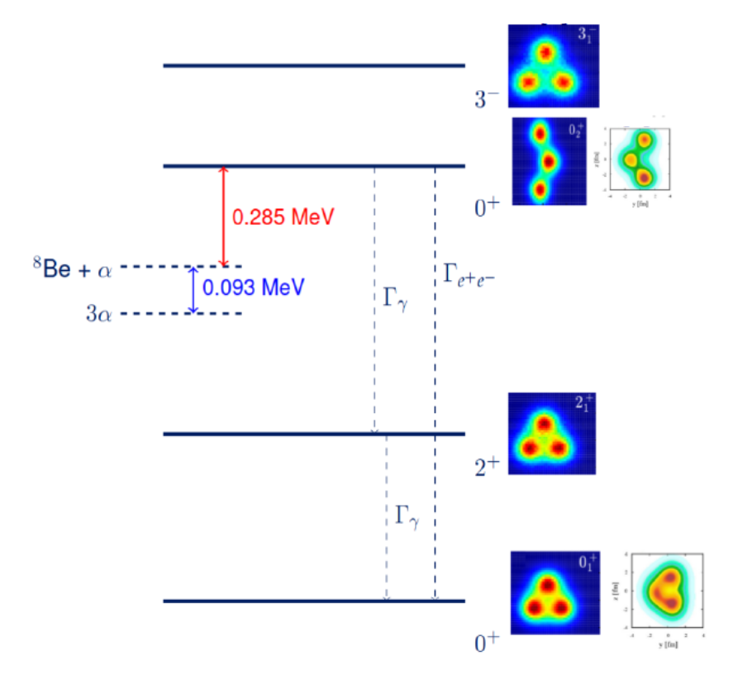
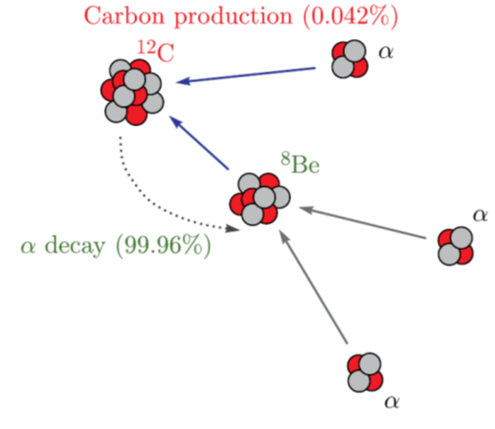
Hoyle state in dissociation of light nuclei
Hoyle state: Γ ≈ 9.3 eV — near-threshold 3α cluster

Slide 9
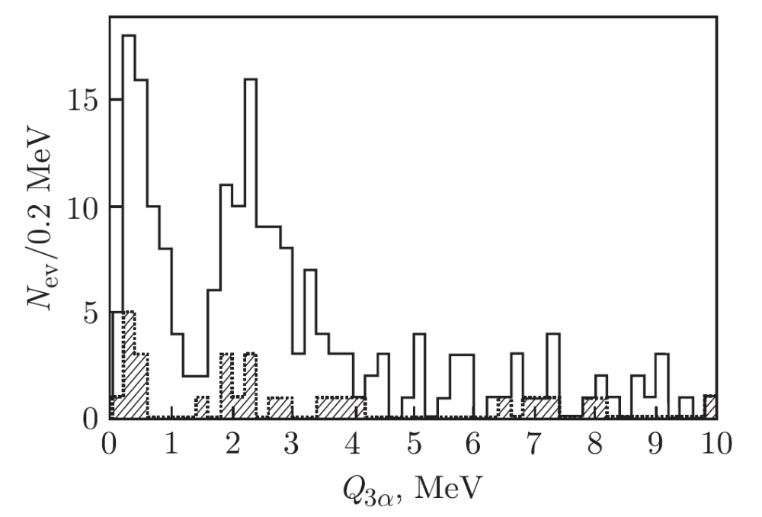
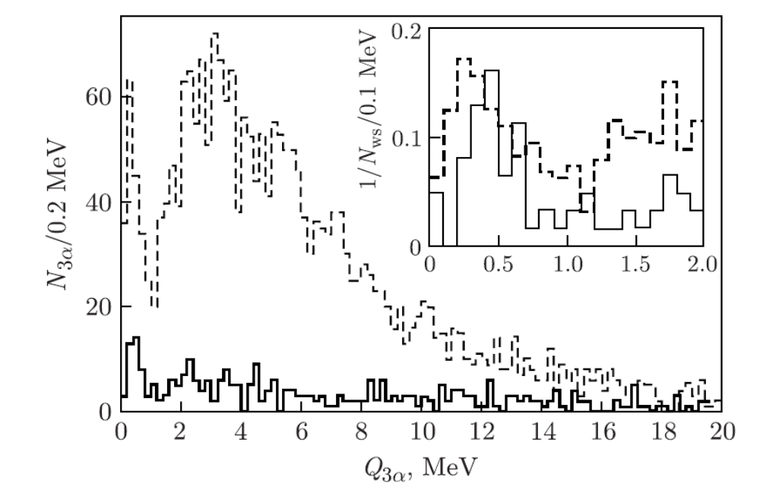
Hoyle state in dissociation of ¹²C and ¹⁶O nuclei
¹²C→⁸Be(0⁺)+α
@3.65A GeV
@0.45A GeV
¹⁶O→4α
¹²C→3α
Combined analysis: 100 events of ¹²C → 3α at 450 MeV/nucleon and 510 at 3.65 GeV/nucleon together with 641 coherent ¹⁶O → 4α.
With Q_{2α}(⁸Be) < 200 keV, two structures appear in Q_{3α}.
Hoyle peak: ⟨Q_{3α}⟩ = 417 ± 27 keV; selection Q_{3α} < 0.7 MeV has been chosen.
Relative contributions of ⁸Be(0⁺) to the decays of the Hoyle state in dissociation of ¹²С is 0.36±0.06 and for ¹⁶O - 0.35±0.04

Slide 10
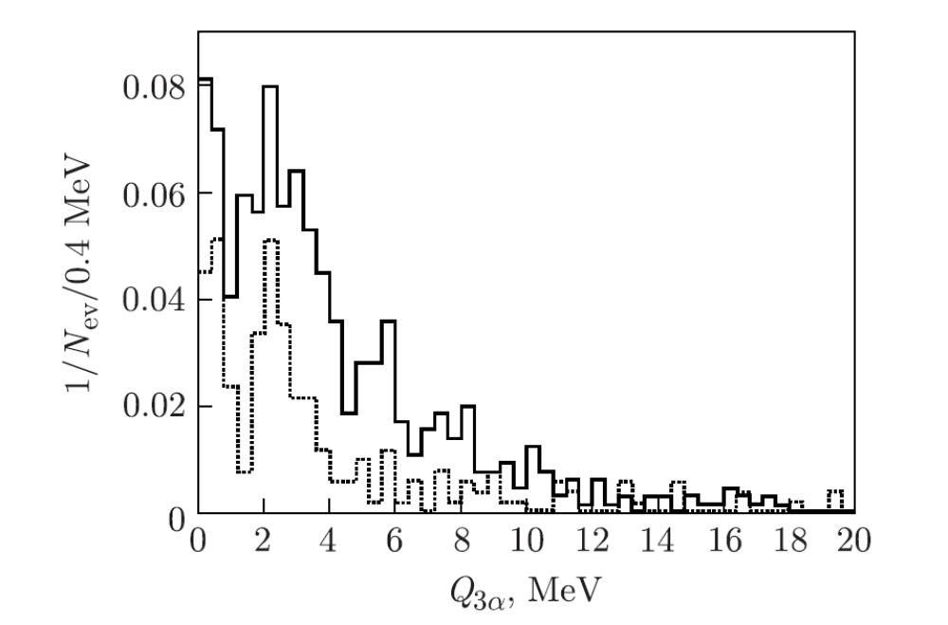


Formation of the ¹²C(3⁻) in relativistic dissociation of light nuclei
¹²C: The contributions of ⁸Be(0⁺), ¹²C(0⁺₂) and ¹²C(3⁻) are estimated as 43±4, 11±2, 19±2%, respectively.
¹⁶O: The contribution of the ¹²C(0⁺₂)α channel is 23±2%, ¹²C(3⁻)α - 32±2%, 2⁸Be(0+) - 5±1%
D. A. Artemenkov, A. A. Zaitsev, P. I. Zarubin
Natural Sci. Rev. 3 200603 (2026)

Slide 11
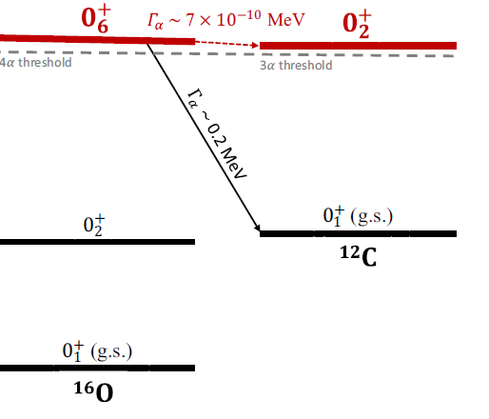
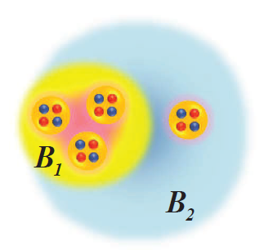
Search for the ¹⁶O(0⁺₆)→¹²C(0⁺₂/0⁺₁)+α channels
Just 296 keV !
The coexistence decays ¹⁶O(0⁺₆) → ¹²C(0⁺₂)α and ¹²Cα cannot be ruled out. The duality requires both decay modes to be examined.

Slide 12
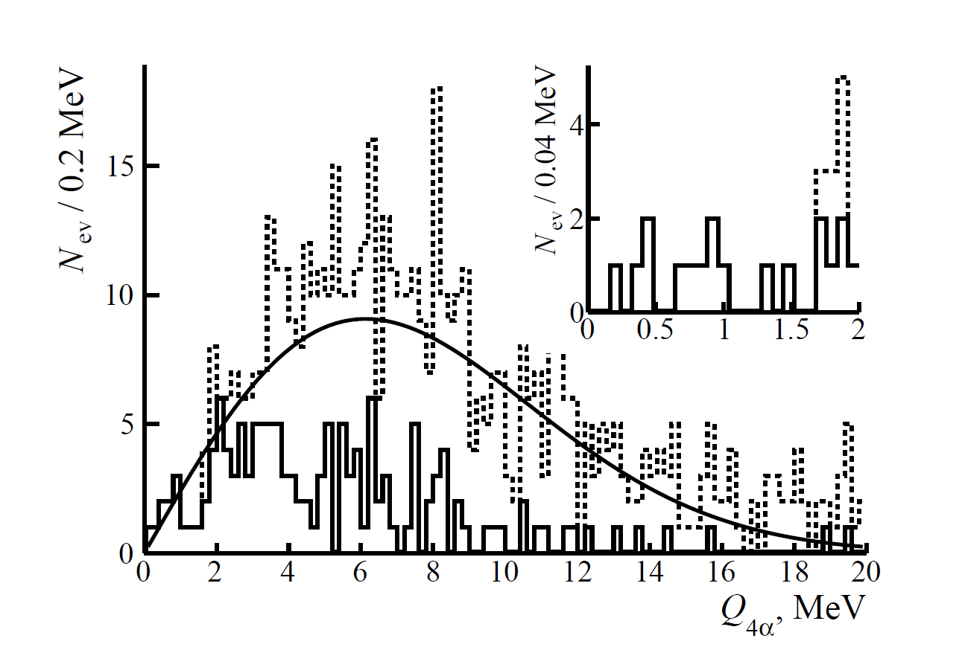

Search for the ¹⁶O(0⁺₆)→¹²C(0⁺₂)+α channel
¹²C(0⁺₂)+ α

Slide 13
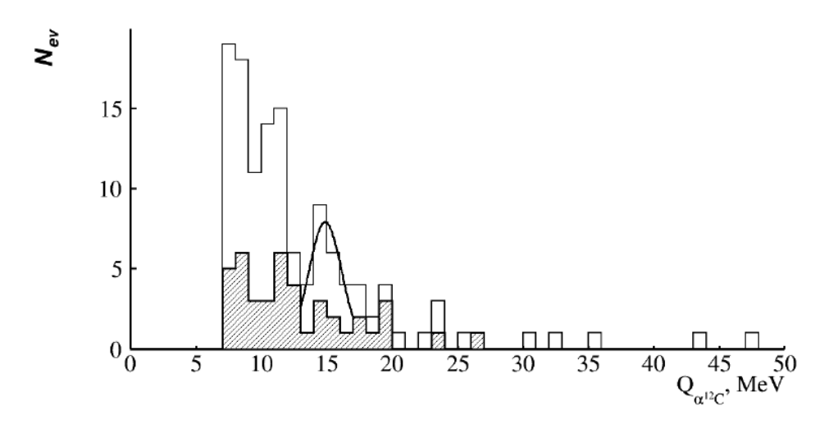
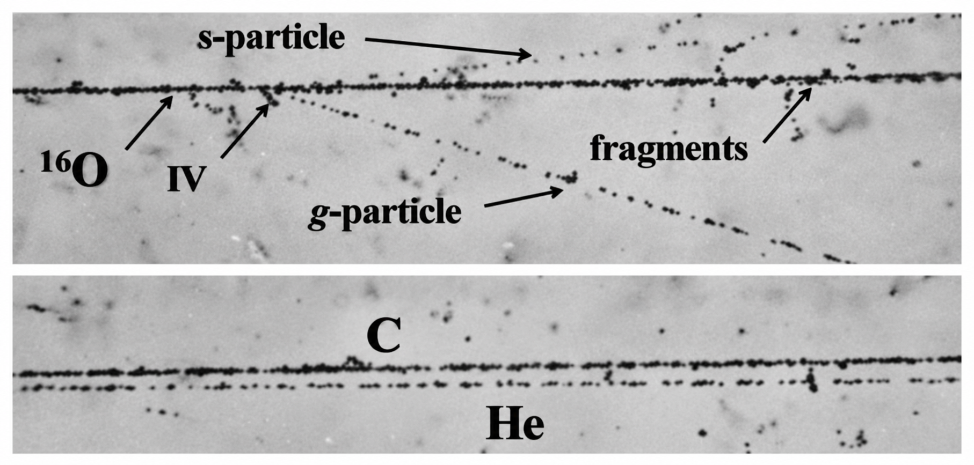
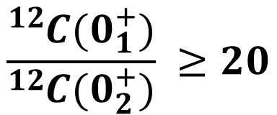
Search for the ¹⁶O(0⁺₆)→¹²C(0⁺₁)+α channels
$$\frac{{}_{ }^{12}{C(0_{1}^{+})}}{{}_{ }^{12}{C(0_{2}^{+})}} ≥20$$
〈 Q_{12Cα}〉 = 14.9 ± 0.4 MeV RMS 0.6 MeV

Slide 14
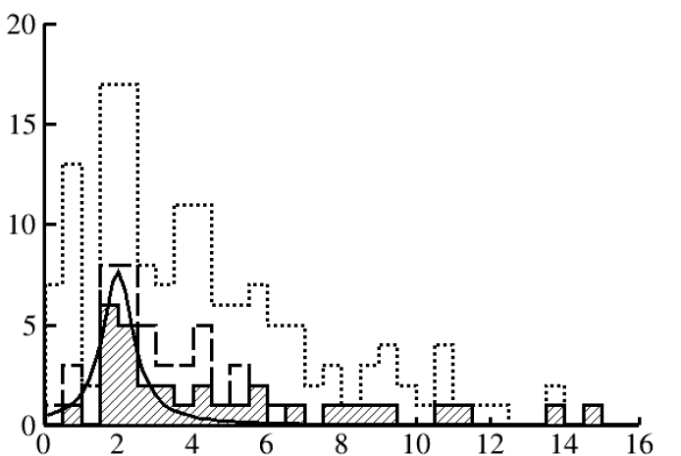
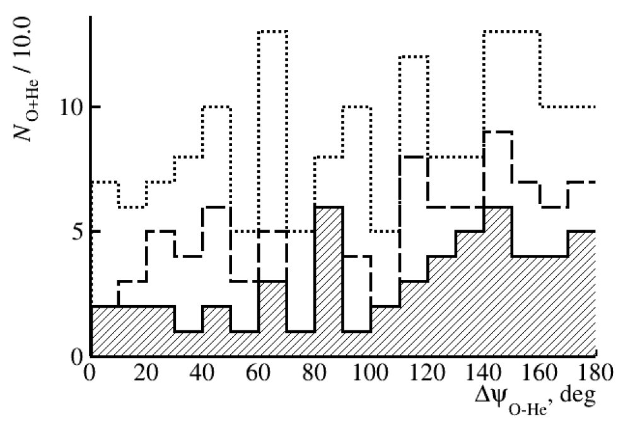
Search for ¹⁸O + α resonances in relativistic ²²Ne dissociation
⟨ Q_{18Oα}⟩ = 2.0 ± 0.2 MeV
(U_{Coulomb} ≈ 7 MeV)
n_{s} = 0&n_{h} = 0
arXiv:2610.05984 [nucl-ex]
Q_{18Oα}, MeV
Distribution of O + He pairs from the dissociation of ²²Ne nuclei at 3.22 GeV per nucleon over the invariant mass Q_{18Oα} (dots), “white” stars (dashed line) and “white” stars (hatched line) with the condition ∆ψ_{Oα} > 100◦.

Slide 15
SUMMARY
Nuclear track emulsion enables high-precision reconstruction of near-threshold cluster states from fragment emission angles, including ⁸Be(0⁺), ⁹B and ¹²C(0₂⁺) (Hoyle state).
The Hoyle state is observed in relativistic dissociation: its contribution is 11±3% in ¹²C→3α and 22±2% in ¹⁶O→4 α.
The invariant mass distribution of ¹²C+α pairs produced in the dissociation of ¹⁶O confirms the hypothesis of decay of the ¹⁶O(0⁺₆) state via conversion of its ¹²C(0⁺₂) substructure to ¹²C(0⁺₁). This opens up the possibility of synthesizing the isotope ¹²C without a radiative transition, as a supplement to the known 3α-process.
The search for near-threshold resonances deserves to be continued in the dissociation of ¹⁸O → ¹⁴C + α and ¹⁴C → ¹⁰Be + α. The choice of several GeV per nucleon in the context of nuclear clustering is determined by historical reasons. Longwise NE exposures should be performed in the region of several hundred MeV per nucleon where achieving beam profile uniformity and isotope separation is easier.

Slide 16

Thank you for your attention!
感谢各位的聆听
becquerel.jinr.ru

Slide 17
Backup

Slide 18
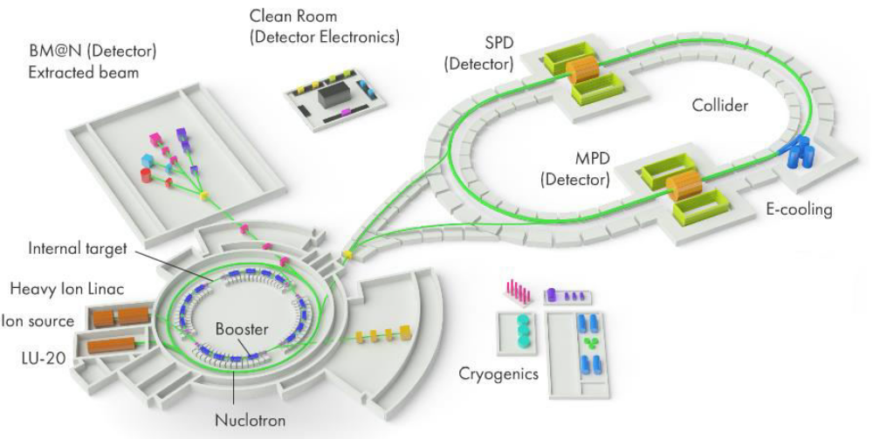
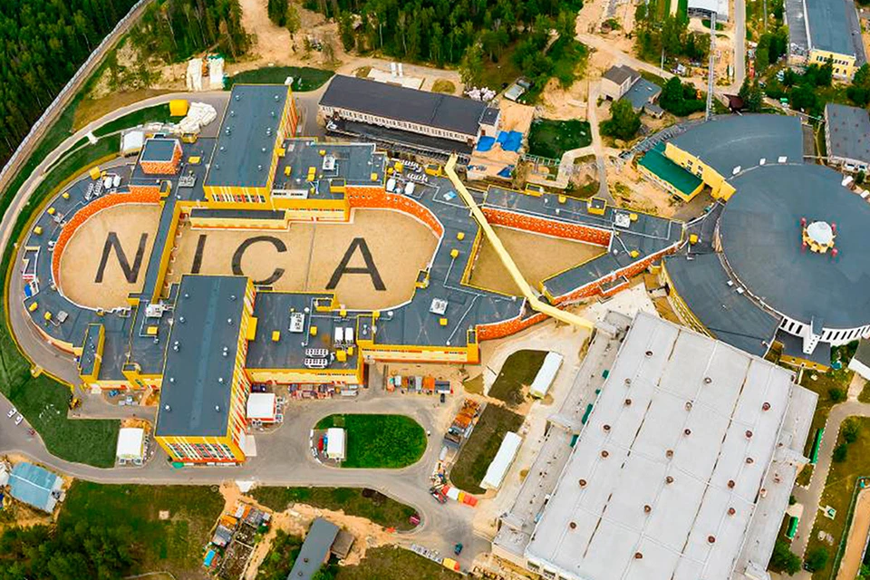
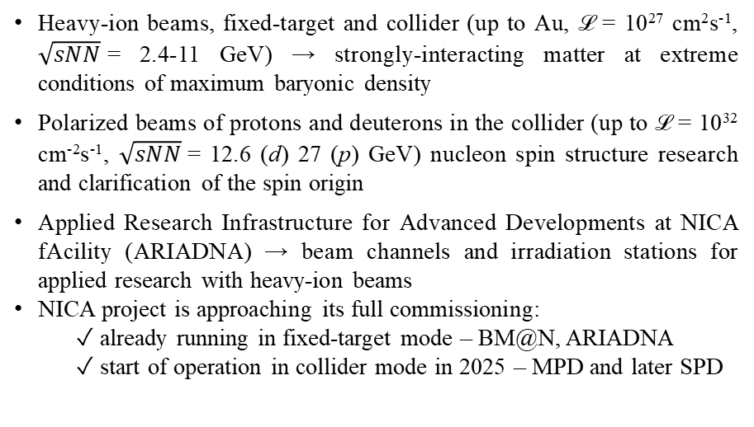
JINR Facility: NICA Accelerator Complex
NICA — Nuclotron-based Ion Collider fAcility
Heavy-ion beams, fixed-target and collider (up to Au, ℒ = 10²⁷ cm²s⁻¹, $\sqrt{sNN}$= 2.4-11 GeV) → strongly-interacting matter at extreme conditions of maximum baryonic density
Polarized beams of protons and deuterons in the collider (up to ℒ = 10³² cm⁻²s⁻¹, $\sqrt{sNN}$= 12.6 (d) 27 (p) GeV) nucleon spin structure research and clarification of the spin origin
Applied Research Infrastructure for Advanced Developments at NICA fAcility (ARIADNA) → beam channels and irradiation stations for applied research with heavy-ion beams
NICA project is approaching its full commissioning:
  ✓ already running in fixed-target mode – BM@N, ARIADNA
  ✓ start of operation in collider mode in 2025 – MPD and later SPD
Experimental hall

Slide 19
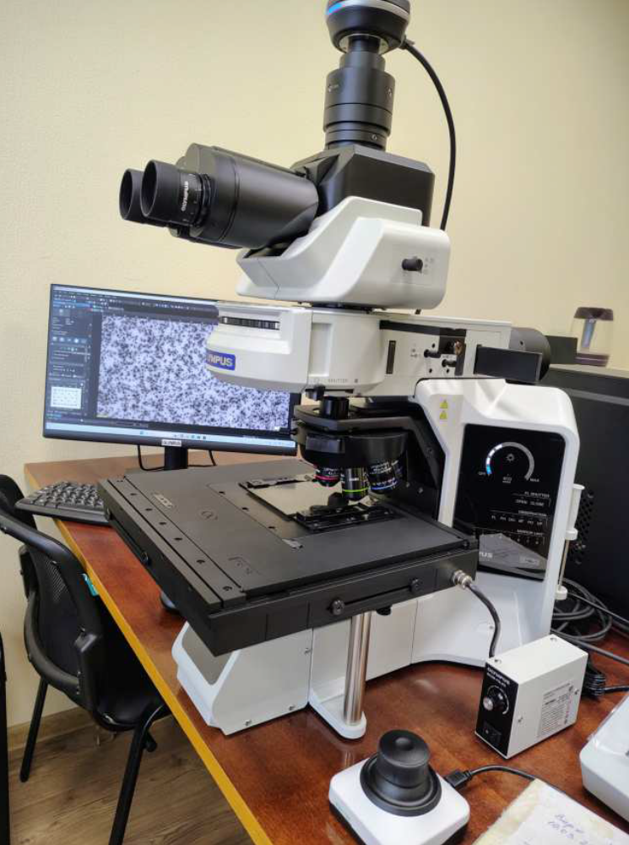
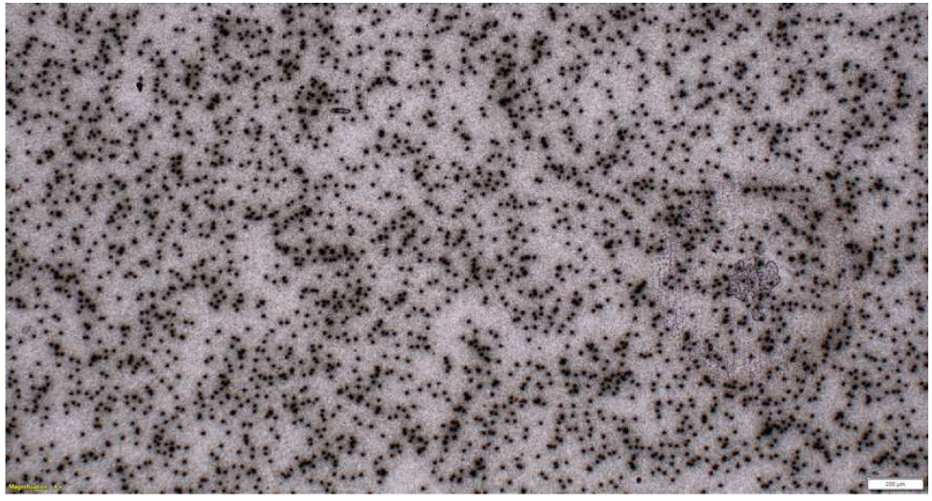
The Xe beam spot is resolved grain by grain
REPORT
4× objective image of an emulsion plate showing the beam spot region. Individual grain clusters from the Xe beam and its fragments are visible as dark features against the lighter emulsion background

Slide 20
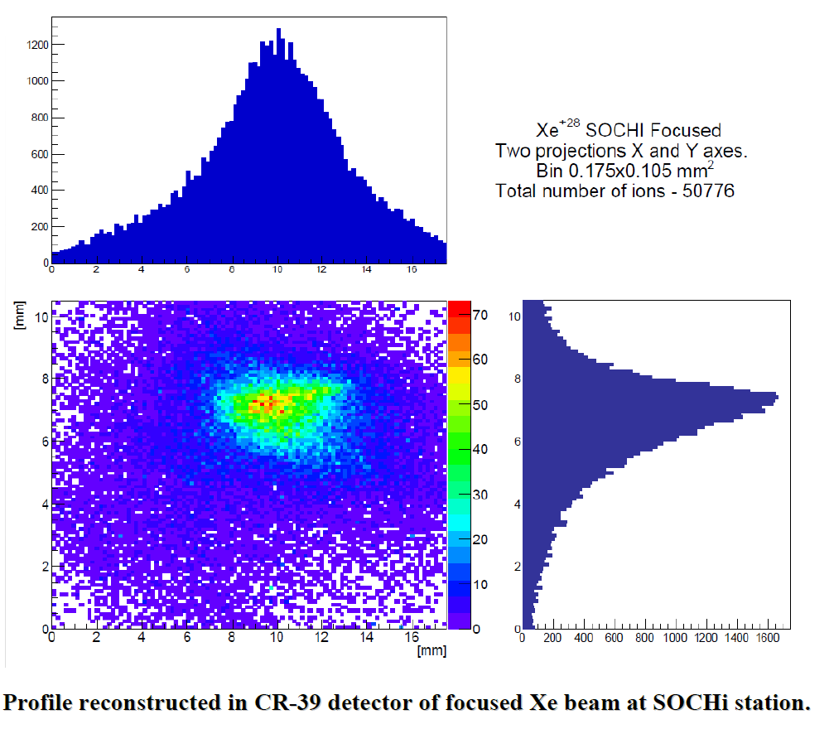
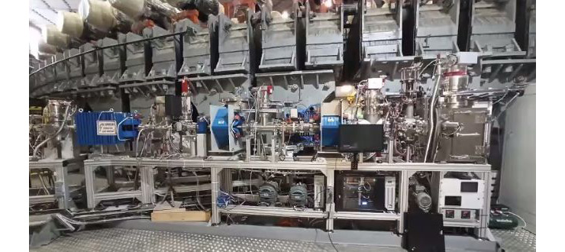
CR-39 studies to low-energy ion beams
REPORT
SOChI (Station of Chip Irradiation), operating with ion beams at approximately 3.2 MeV per nucleon for radiation-effects studies in microelectronics, detector calibration and materials research.
Phys. Part. Nuclei 56, 881–885 (2025)

Slide 21
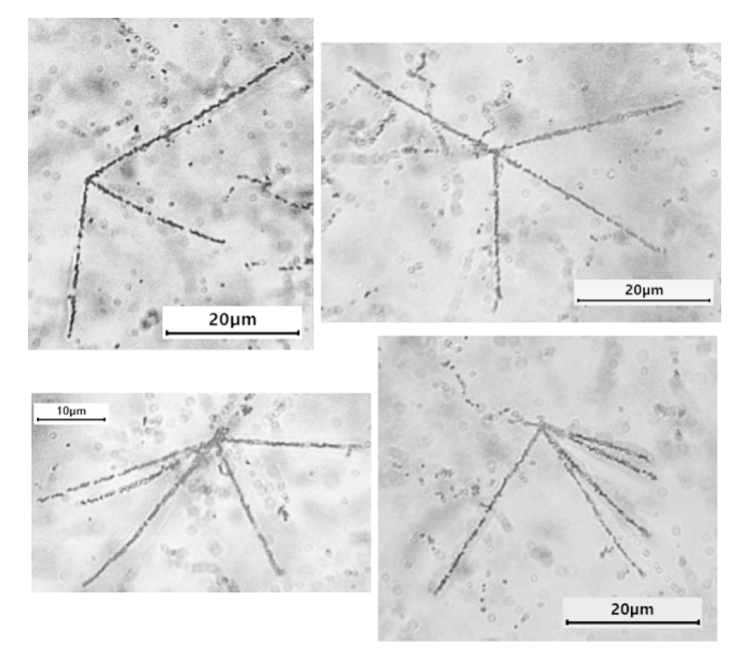
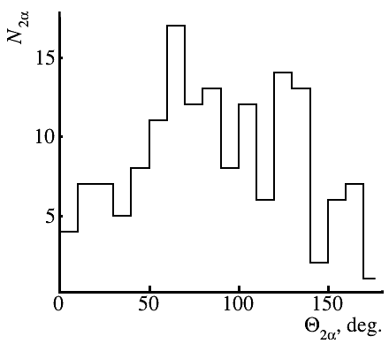
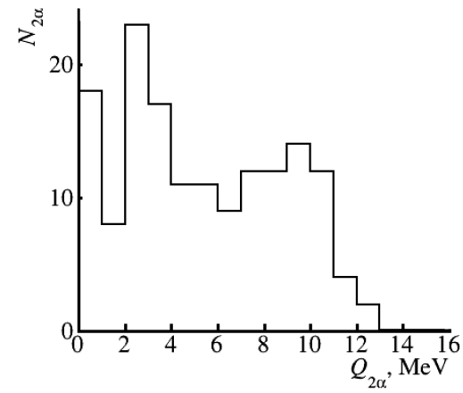
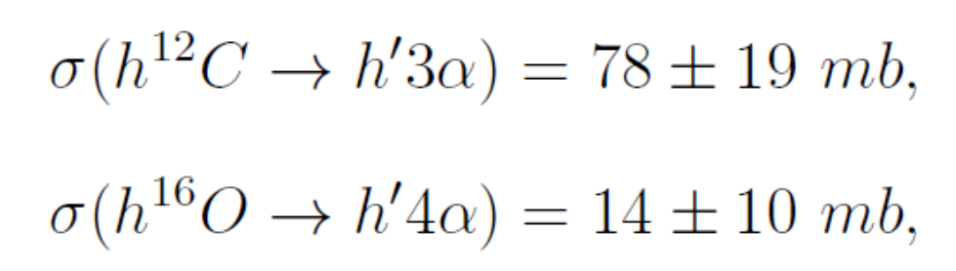
Nucleus fragmentation induced by relativistic hadrons
Phys. Atom. Nuclei 86, 2478–2486 (2023)

Slide 22
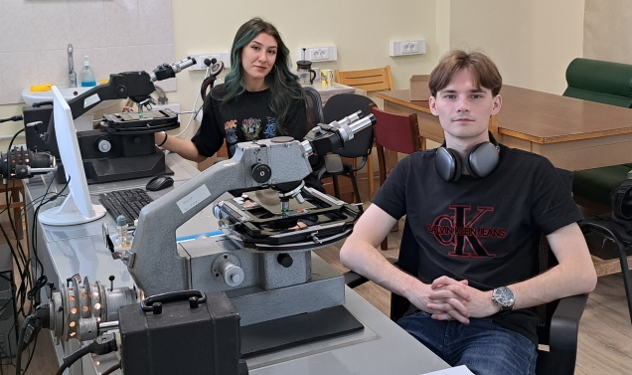
2025 https://start.jinr.ru/

Slide 23
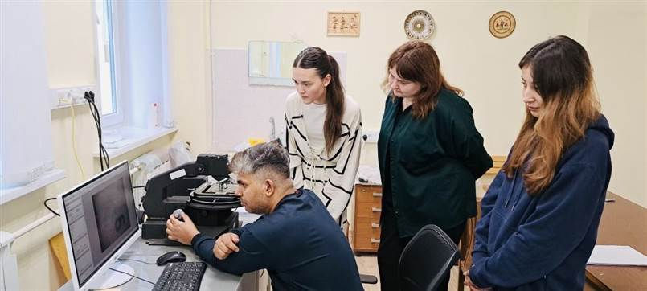
2026 https://start.jinr.ru/

Slide 24

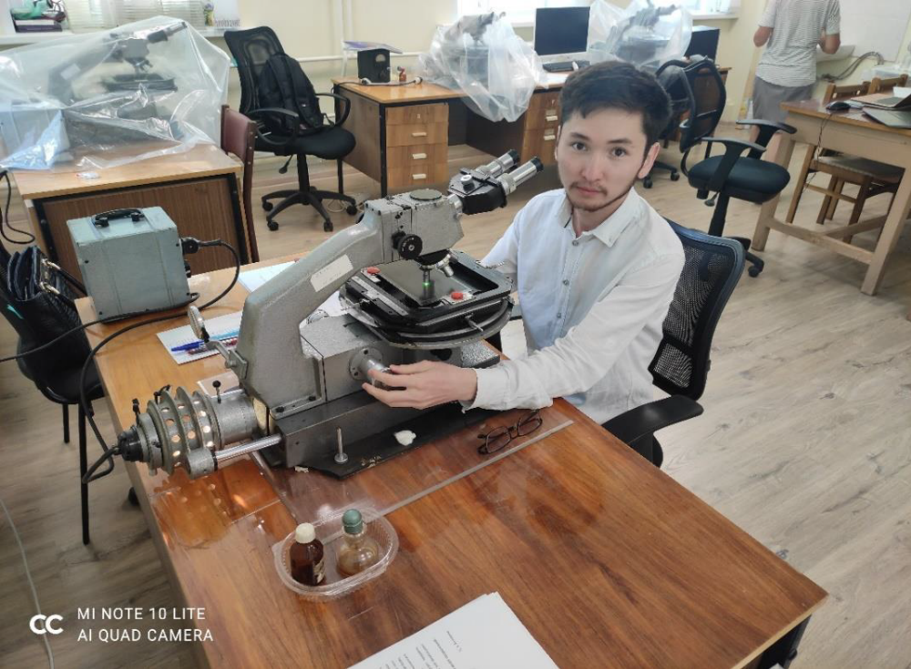
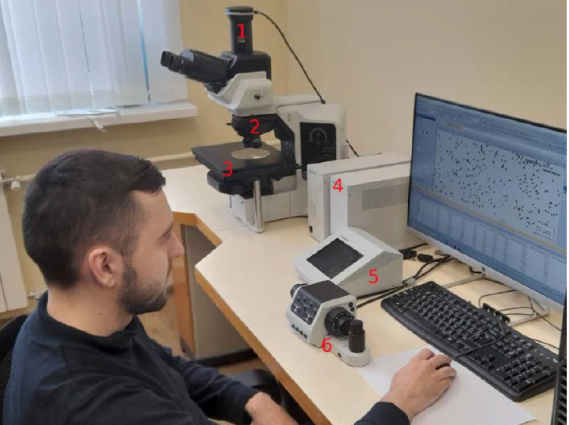
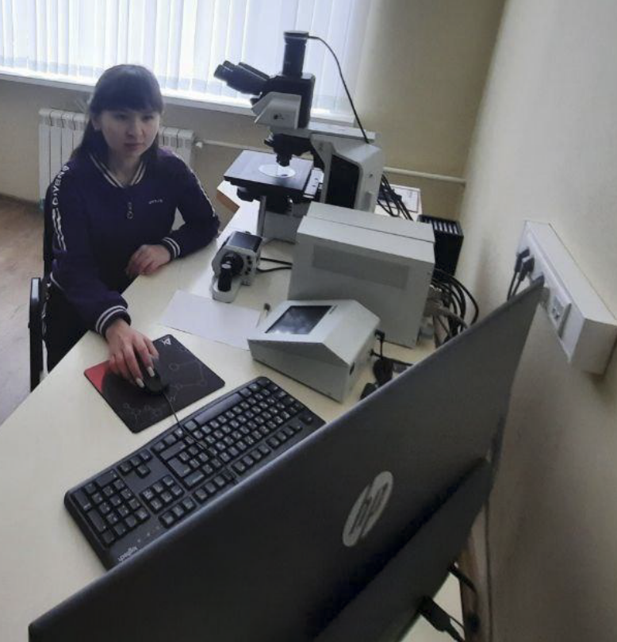
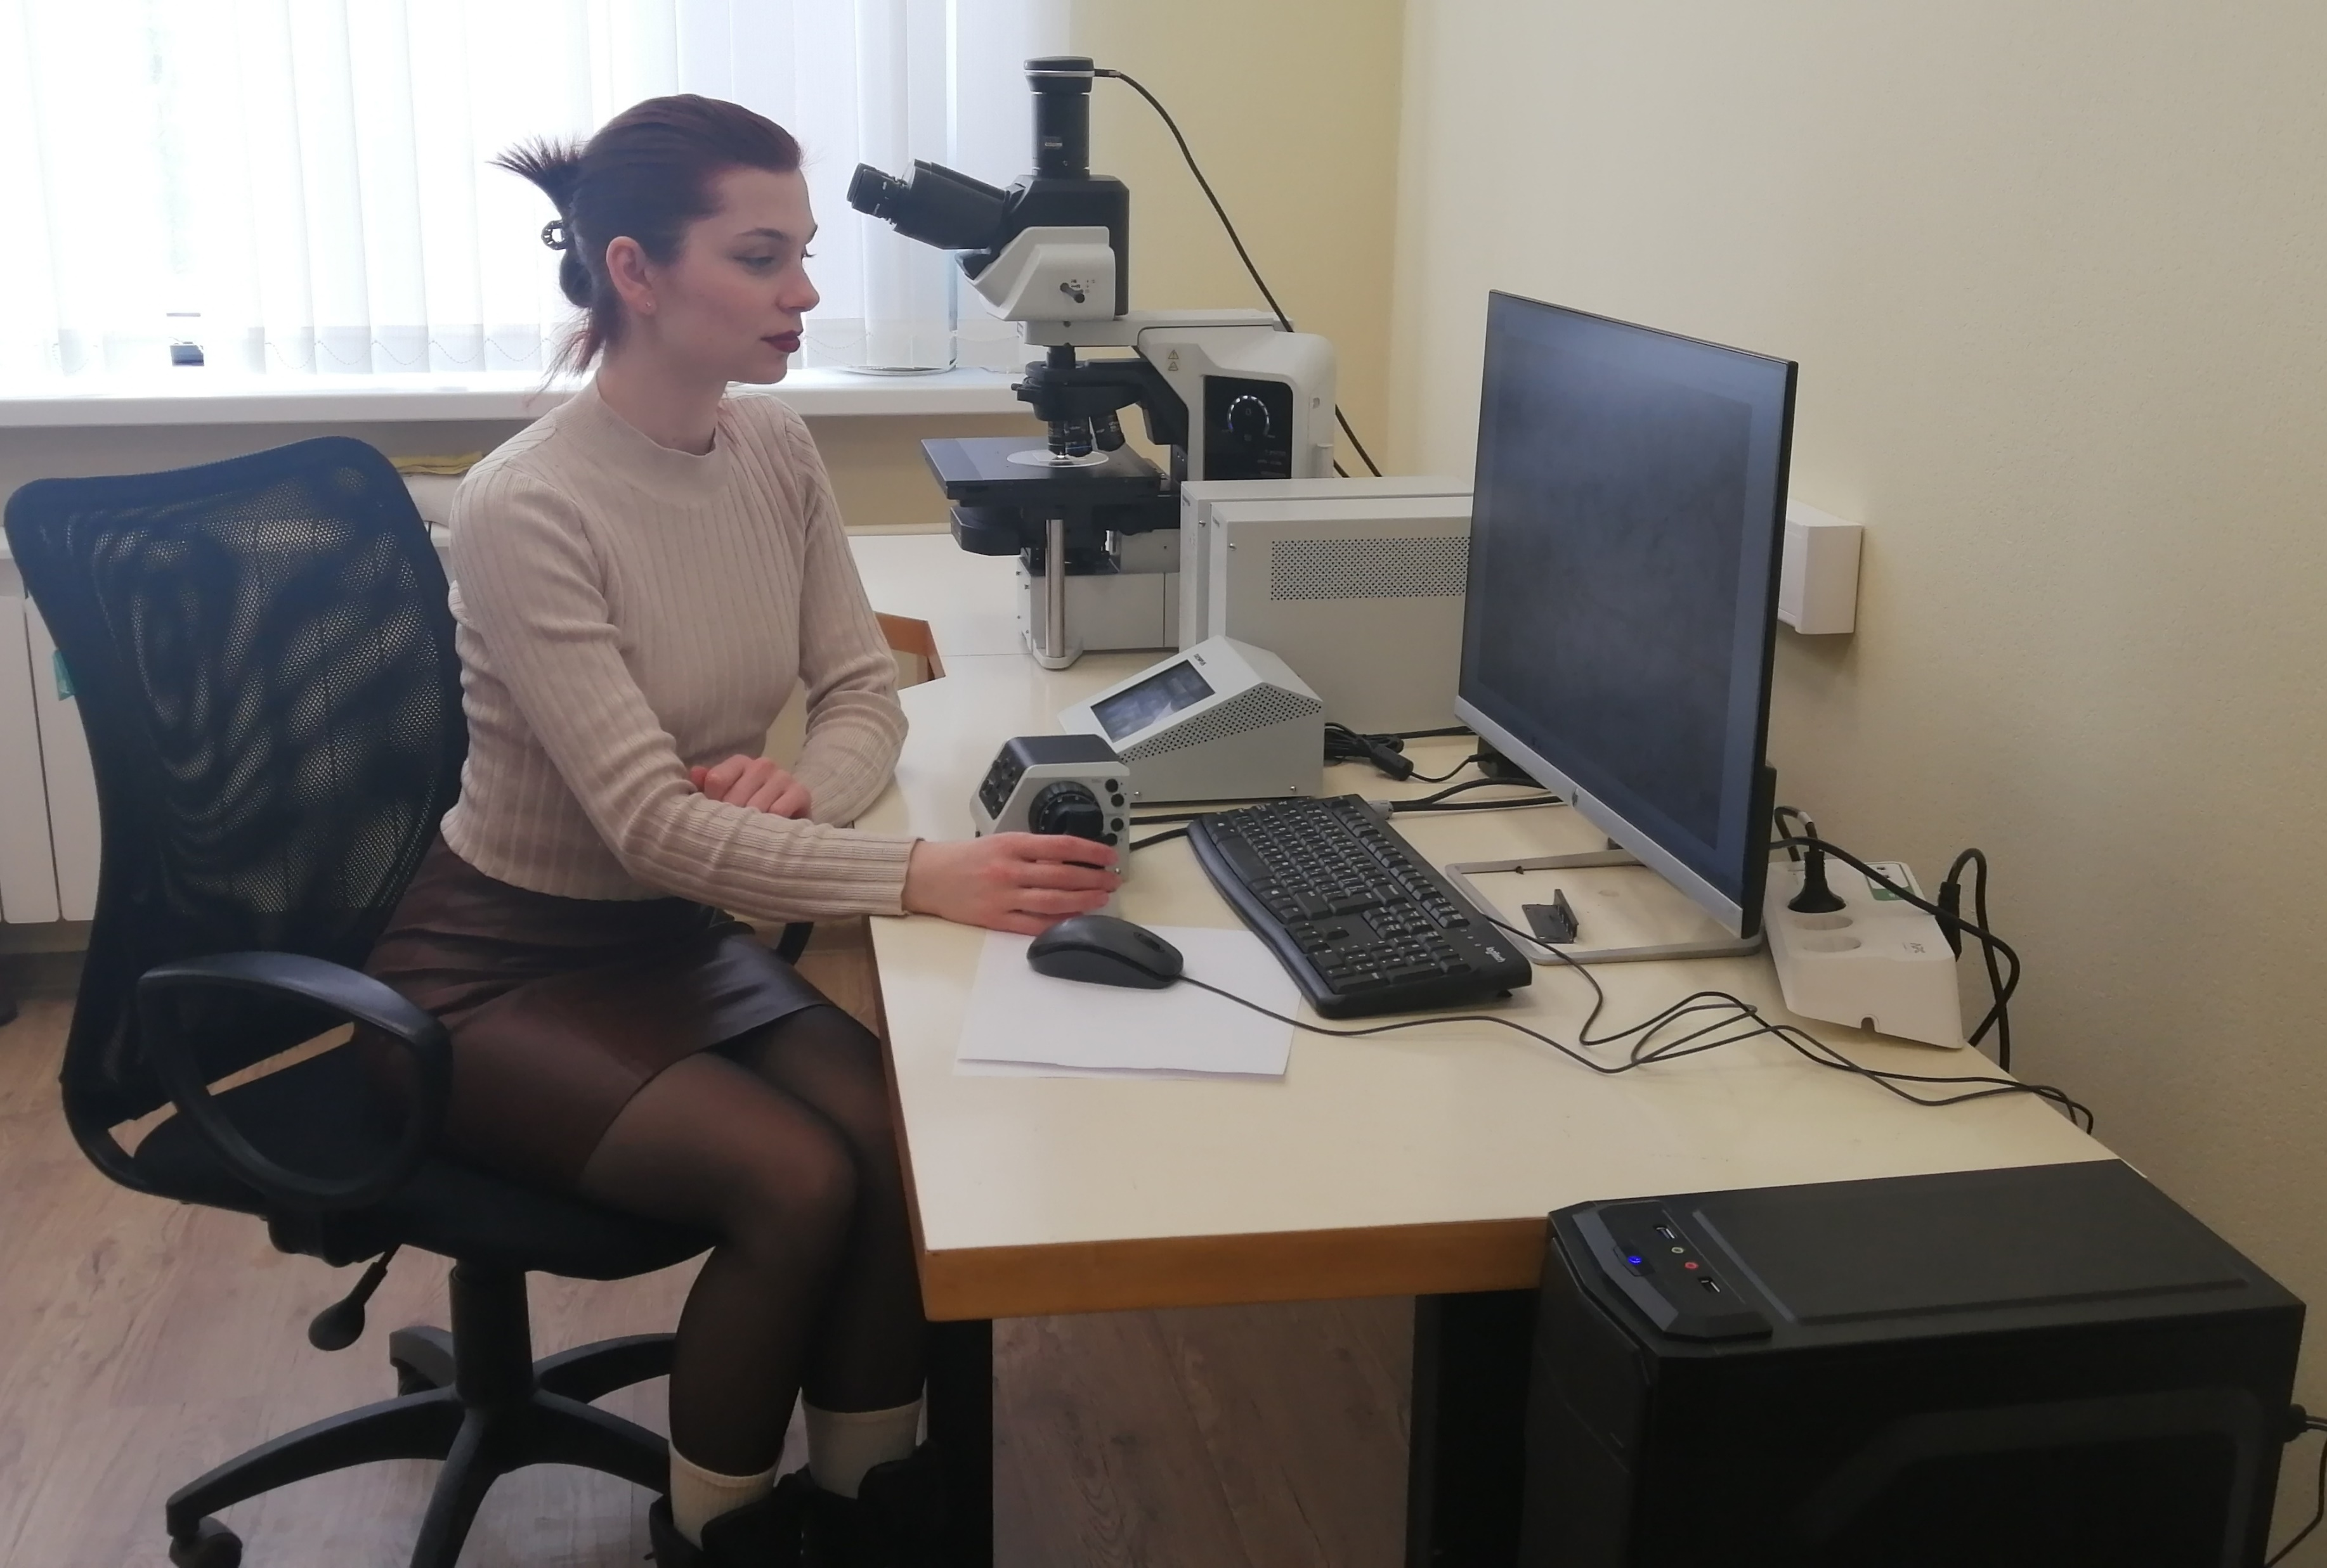




Winter session: February-June 2027
6-8 weeks on-site
Applications open till
October 16th
Fully funded
start.jinr.ru
students@jinr.ru

Slide 25
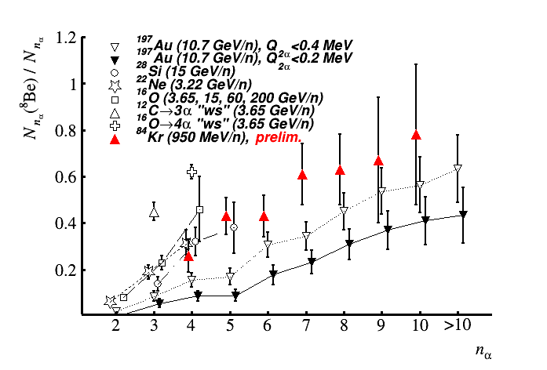
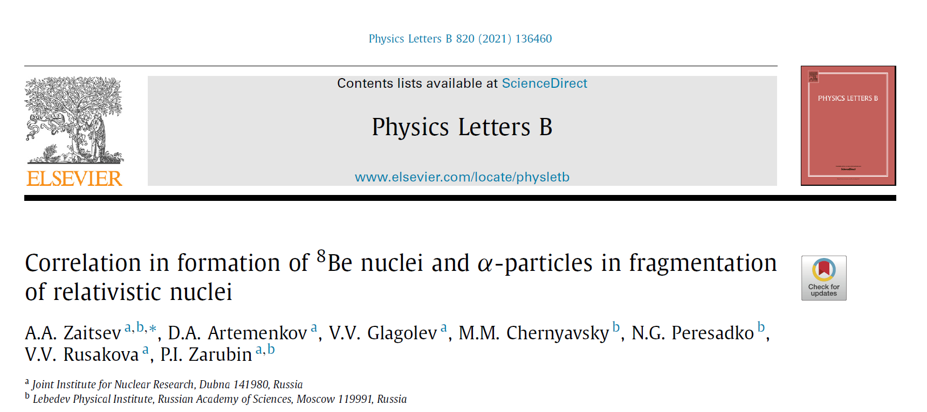
Correlation in formation of ⁸Be nuclei and α-particles
Phys. Lett. B. 820 136460 (2021)
The same multiplicity dependence is observed for ⁹B and ¹²C(0₂⁺)
n_{α}

Slide 26
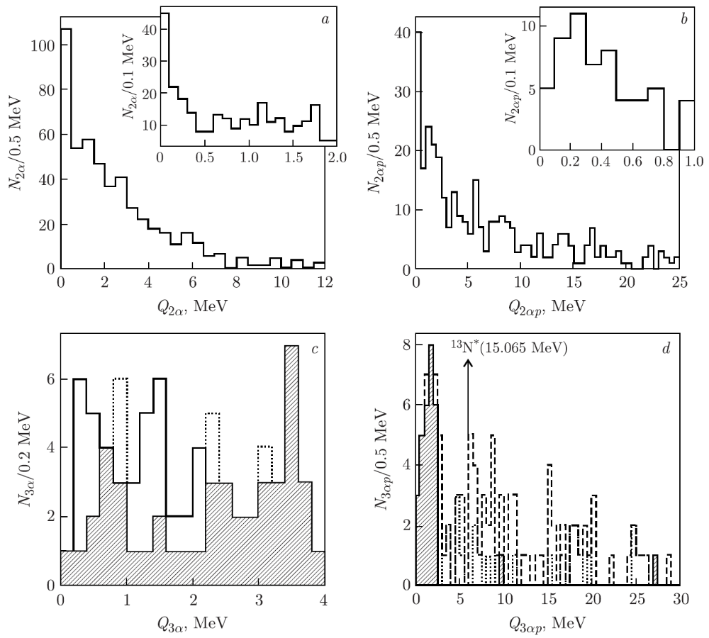

Boson and fermionic states in ¹⁴N dissociation
128 events in ¹⁴N → 3α + H, including 29 white stars.
⁸Be(0⁺) contribution: 41 ± 6%.
⁹B contribution: 23 ± 4%.
About 10% is consistent with Hoyle-state decay, but roughly half overlaps with the ⁹Bα channel.
This shows the importance of combinatorial background and sufficient statistics.
Phys. Part. Nuclei 53, 456–460 (2022)

Slide 27






Heavy nucleus multifragmentation
Having been tested, this approach was used to identify ⁸Be and HS and search for more complex states of α-particles in fragmentation of medium and heavy nuclei. Recently, based on the statistics of dozens of ⁸Be decays, we have found the enhancement of the probability to detect ⁸Be in the event while increasing the number of relativistic α-particles. A preliminary conclusion has been made that contributions of ⁹B and HS decays also increase. The exotically large sizes and lifetimes of ⁸Be and HS allow us to assume an opportunity of synthesizing αBEC by means of successively connected emerging α-particles.

Slide 28


Dissociation of ¹⁹⁷Au nuclei at 10.7 GeV per nucleon

Slide 29

Triple fission of Cf nucleus
96 planar events with fragment triples were also found during examination of the surface of NTE layers irradiated by the Cf source. The vertices of triples should be located deeper than the track diameter in order for the track triples to be observed fully.

Slide 30


Low-Energy Particle Ranges in Nuclear Emulsion
The ion range calibration of in NTE needs to be extended below 1 A MeV.

Slide 31





Exposure of emulsion to ⁸He nuclei at the ACCULINNA separator
e
⁸He
e

Slide 32




⁸Be and ⁹B production in Emulsion Cloud Chamber exp.
Sihver Mod.
T. Toshito et al, PHYSICAL REVIEW C 78, 067602 (2008)
L. Sihver, C. H. Tsao, R. Silberberg, T. Kanai, and A. F. Barghouty, Phys. Rev. C 47, 1225 (1993).

