Slide 1
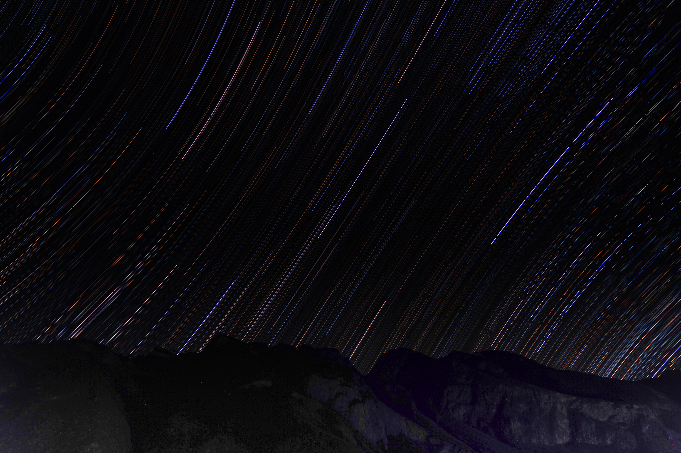
第一届中微子、原子核物理和新物理研讨会(νNN2025)
Neutrinoless Double beta decay with PandaX
HAN, Ke 韩柯 (SJTU)
For the PandaX Collaboration
2025/7/23

Slide 2
Outline
Introduction to PandaX and liquid xenon TPC
PandaX-4T
  ¹³⁴Xe 2νββ (0νββ) results
  ¹³⁶Xe 0νββ limits
  ¹³⁶Xe decay to excited states and ¹²⁴Xe double electron capture
Future: PandaX-xT

Slide 3
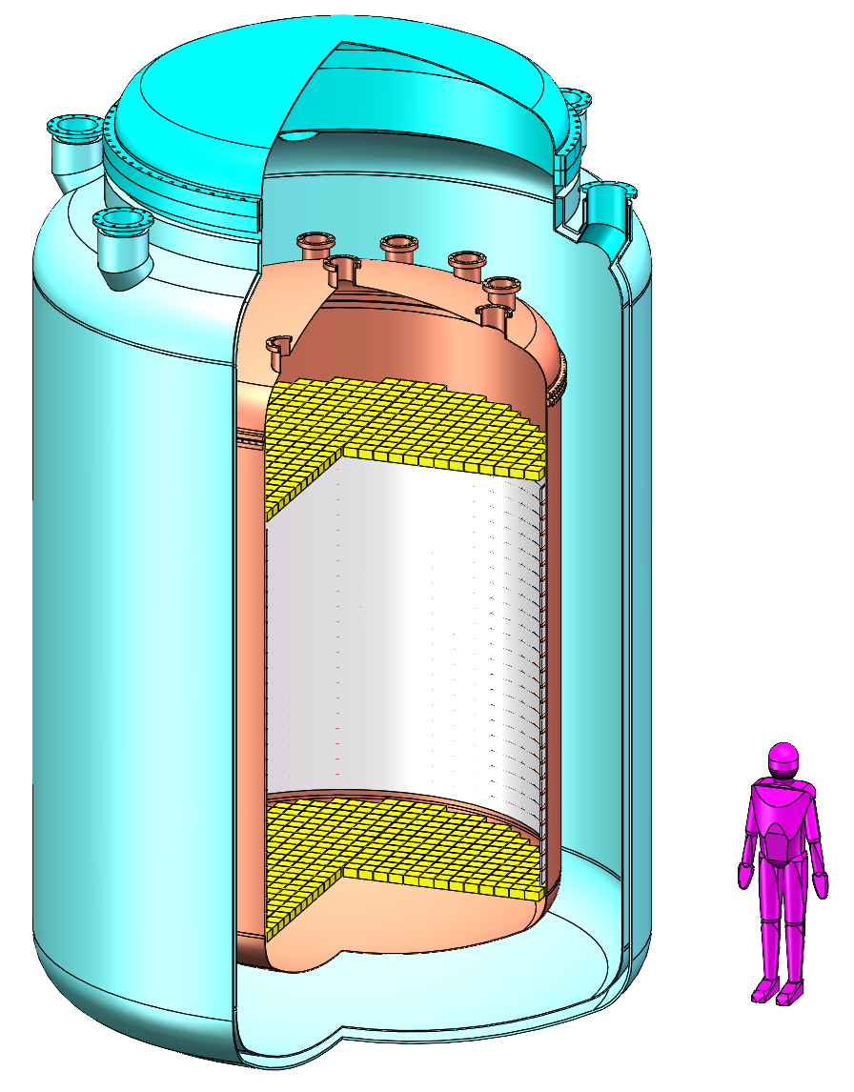
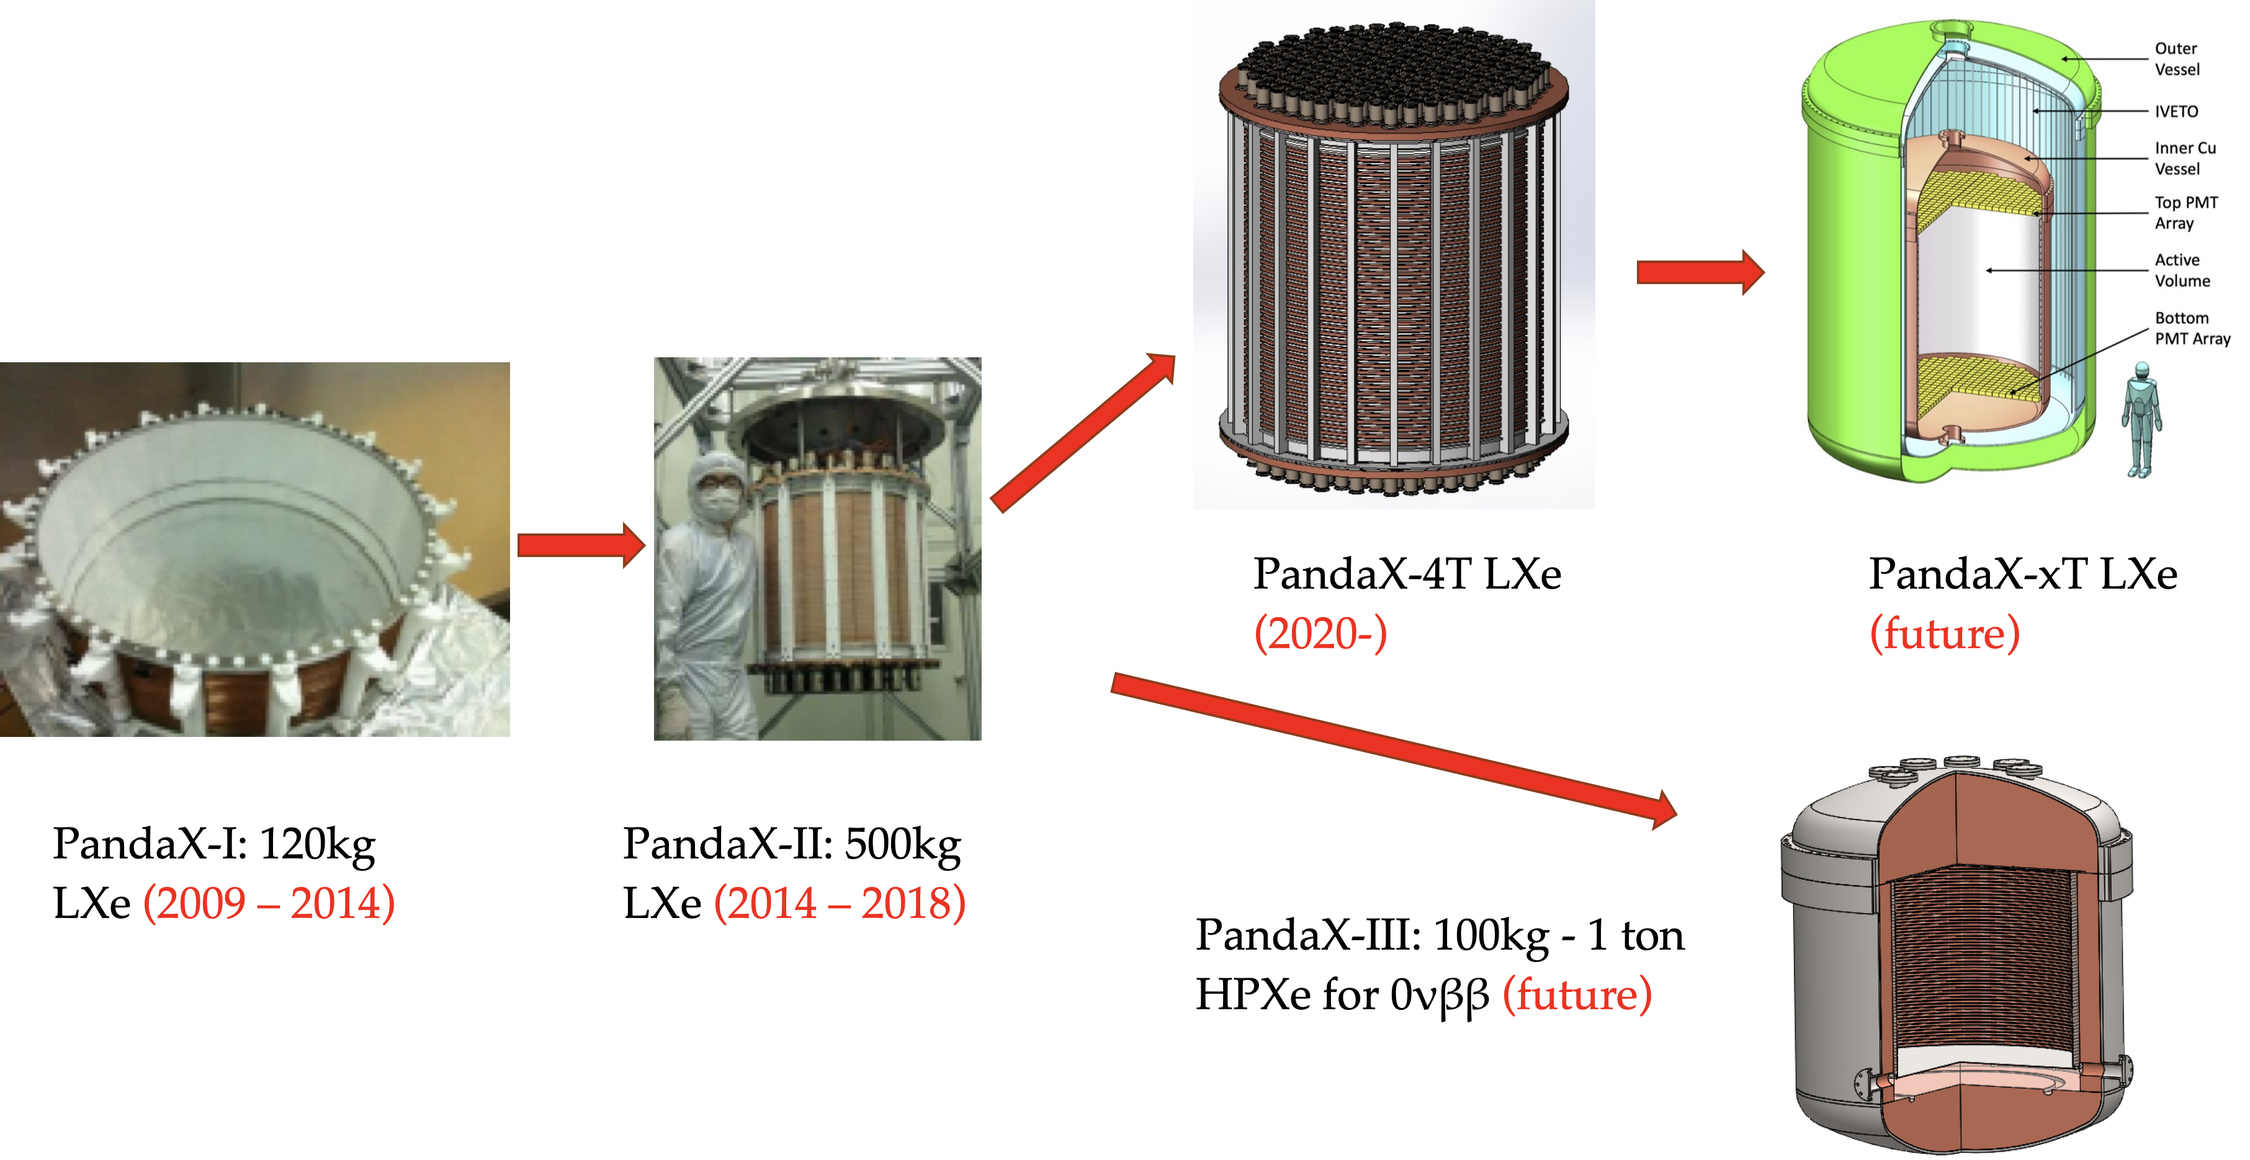
PandaX: Particle and astrophysical Xenon Experiment

Slide 4
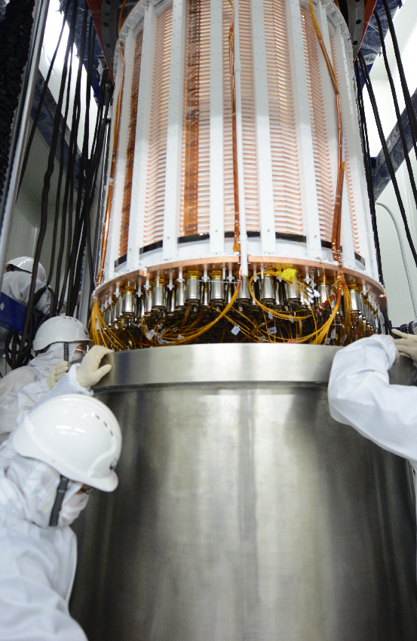
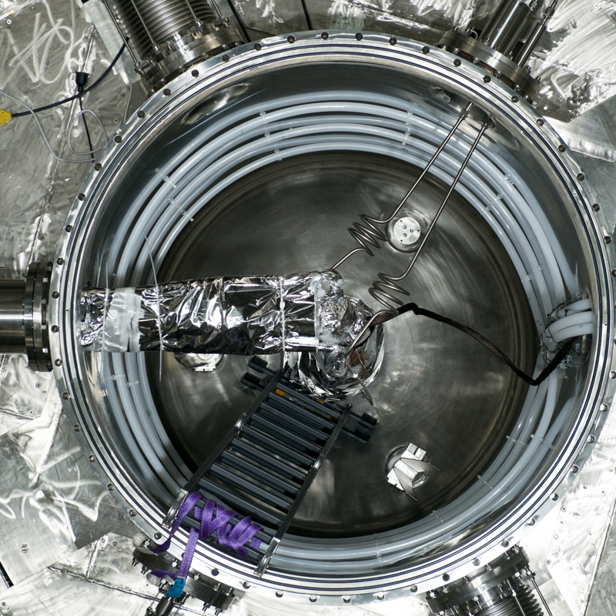
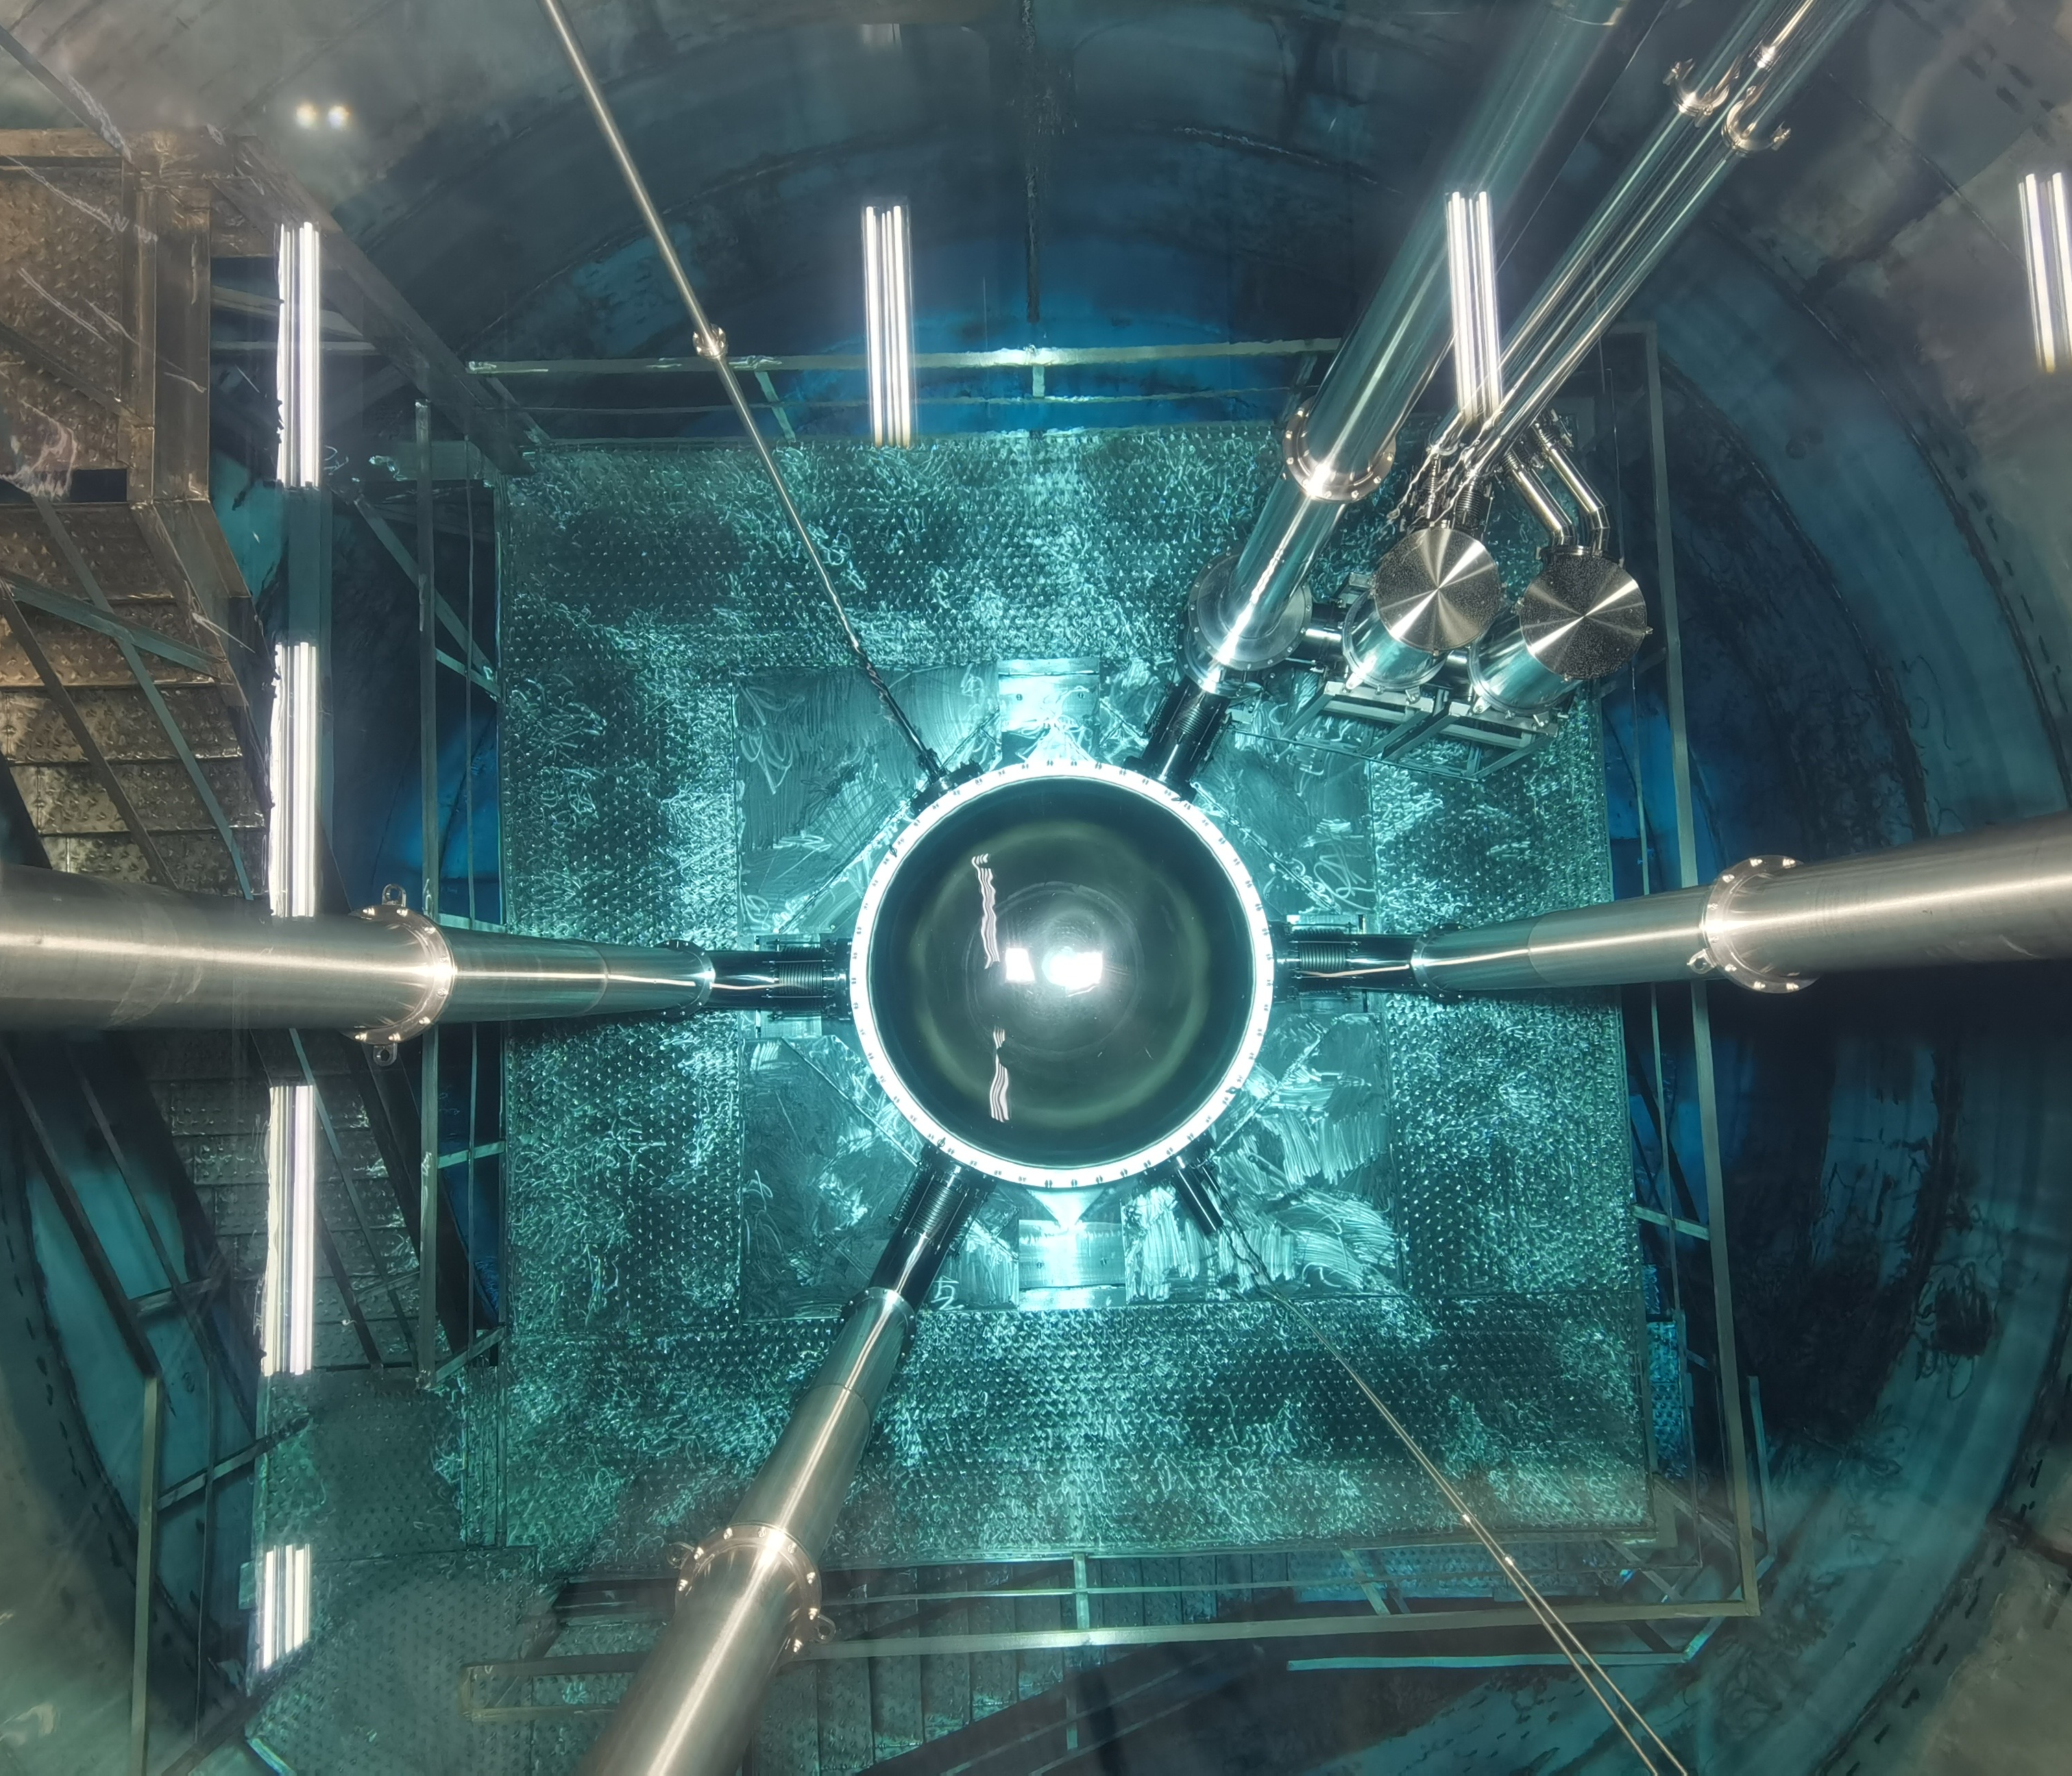
PandaX-4T
A multi-ton dual-phase xenon TPC at B2 hall of China Jinping Underground Laboratory
1.2 m (D) ×1.2 m (H); Sensitive volume: 3.7-ton LXe; 3-inch PMTs: 169 top / 199 bottom
Water shielding

Slide 5
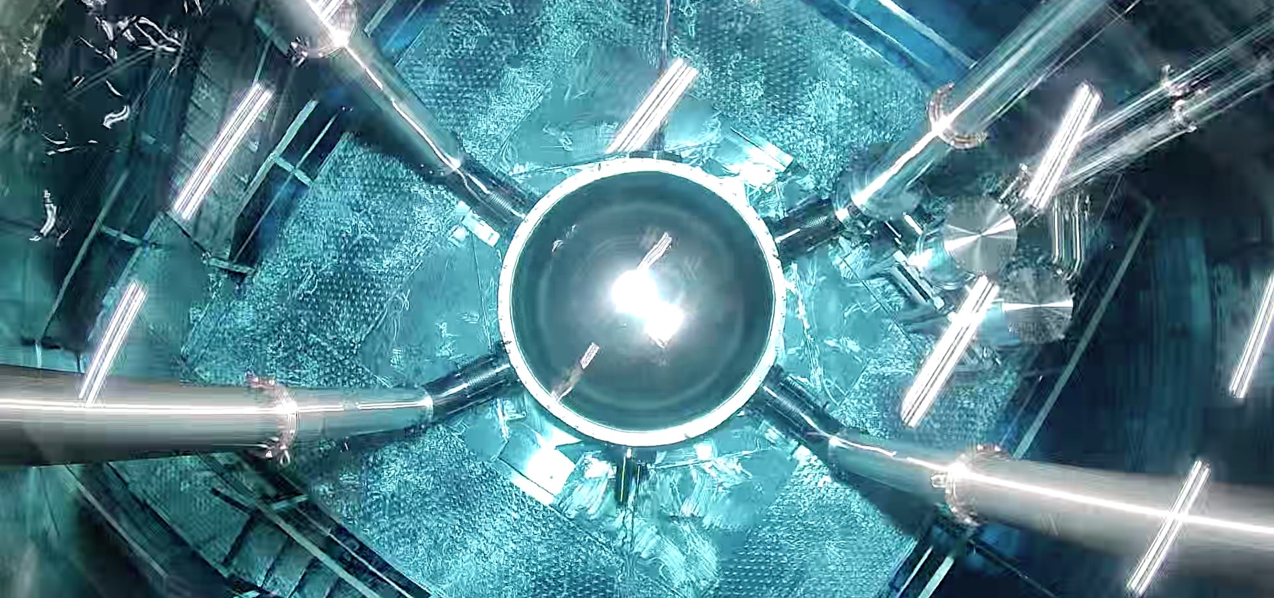
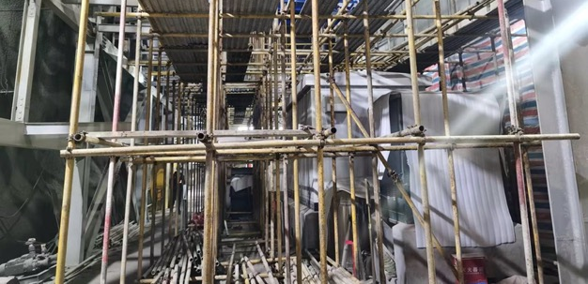
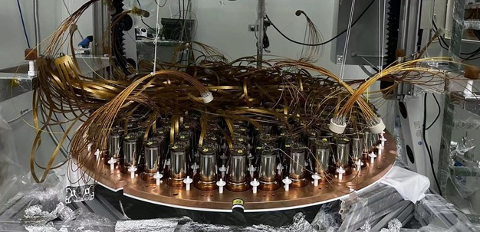
PandaX-4T timeline
2020/11 – 2021/04 | Commissioning (Run 0) 95 days data
2021/07 – 2021/10 | Tritium removal xenon distillation, gas flushing, etc.
2021/11 – 2022/05 | Physics run (Run 1) 164 days data
2022/09 – 2023/12 | CJPL B2 hall construction xenon recuperation, detector upgrade
Detector is taking Run 2 data

Slide 6
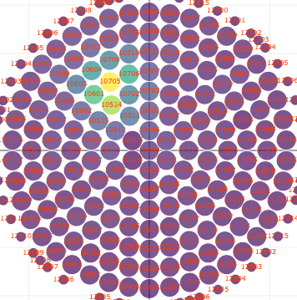
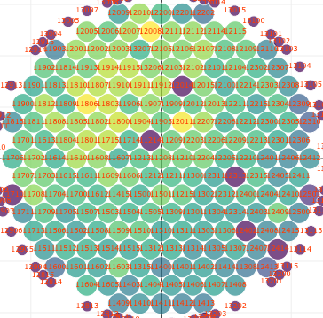
Liquid Xenon Time Projection Chamber (LXe TPC)
Prompt scintillation signal (S1) followed by drift electron signal (S2)
Measures the 3D position, energy, and time
Nuclear Recoil (NR) and electron recoil (ER) discrimination
Single-site (SS) and multi-site (MS) event discrimination
Large monolithic target: High signal efficiency and effective self-shielding
LXe TPC as a Total-Absorption 5D Calorimeter
S2
S1
e
e
e
e
e

Slide 7
3D Position
S2
Energy
Time
LXe
TPC
S1
e
e
e
e
e

Slide 8
Coincidence
Particle ID
Fiducialization
SS/MS
ER/NR
3D Position
S2
Energy
Time
LXe
TPC
S1
e
e
e
e
e

Slide 9
Nuclear decay
Multi-Messenger
Exotic 𝜈 property
Other DM
Solar 𝜈
WIMP
Majorana 𝜈
Coincidence
Particle ID
Fiducialization
SS/MS
ER/NR
3D Position
S2
Energy
Time
LXe
TPC
S1
e
e
e
e
e

Slide 10
S2
S1
e
e
e
e
e

Slide 12
¹³⁴Xe 2νββ and 0νββ
Q=826 keV; Half-life from theoretical predictions: 10²⁴-10²⁵ yr; Never been observed
Previous 2νββ (0νββ) half-life limit from EXO-200 : 𝑇 >8.7x10²⁰ yr (1.1x10²³ yr) at 90% CL
Discovery within reach with a natural Xe TPC
EXO-200 (2017)

Slide 13
¹³⁴Xe (0)2νββ searches at PandaX-4T
Q=826 keV; Half-life from theoretical predictions: 10²⁴-10²⁵ yr; Never been observed
Previous 2νββ (0νββ) half-life limit from EXO-200 : 𝑇 >8.7x10²⁰ yr (1.1x10²³ yr) at 90% CL
PandaX-4T: more ¹³⁴Xe; much less ¹³⁶Xe; wider energy range; discovery possible
 | PandaX-4T | EXO-200
¹³⁴Xe mass | 68.7 kg | 18.1 kg
¹³⁶Xe abundance | 8.90% | 81%
Analysis threshold | 200 keV | 460 keV
Live Time | 94.9 days | 600 days

Slide 14
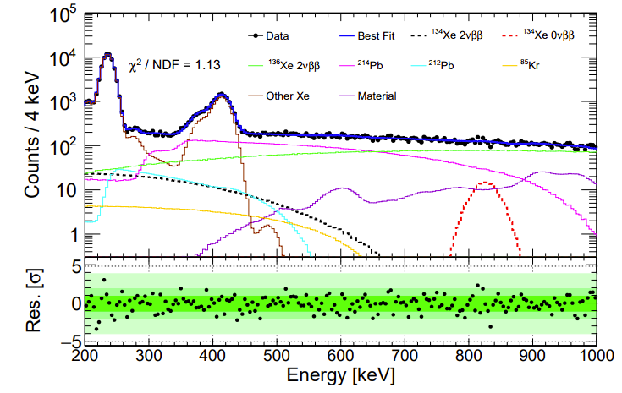
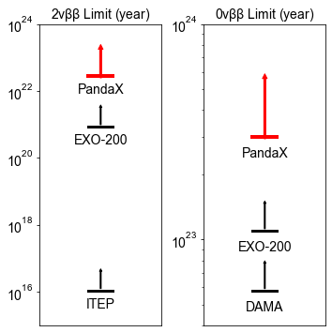
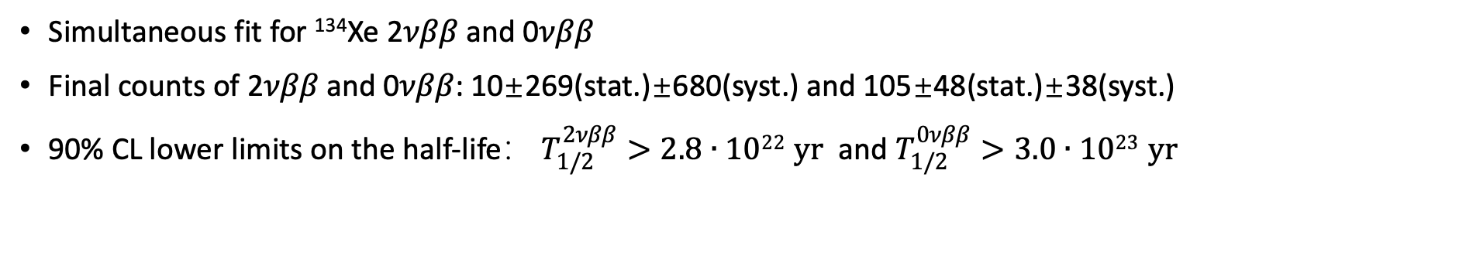
¹³⁴Xe half-life limits @ PandaX-4T
Simultaneous fit for ¹³⁴Xe 2𝜈𝛽𝛽 and 0𝜈𝛽𝛽
Final counts of 2𝜈𝛽𝛽 and 0𝜈𝛽𝛽: 10±269(stat.)±680(syst.) and 105±48(stat.)±38(syst.)
90% CL lower limits on the half-life： $T_{1/2}^{2νββ}>2.8∙1022 yr$ and $T_{1/2}^{0νββ}>3.0∙1023 yr$
PRL 132, 152502 (2024)

Slide 16
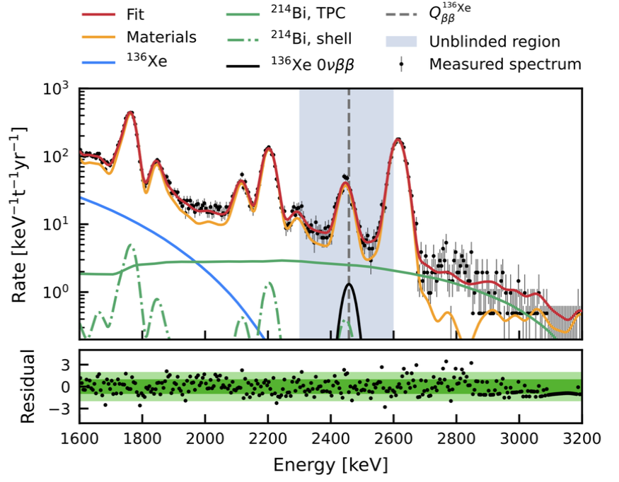
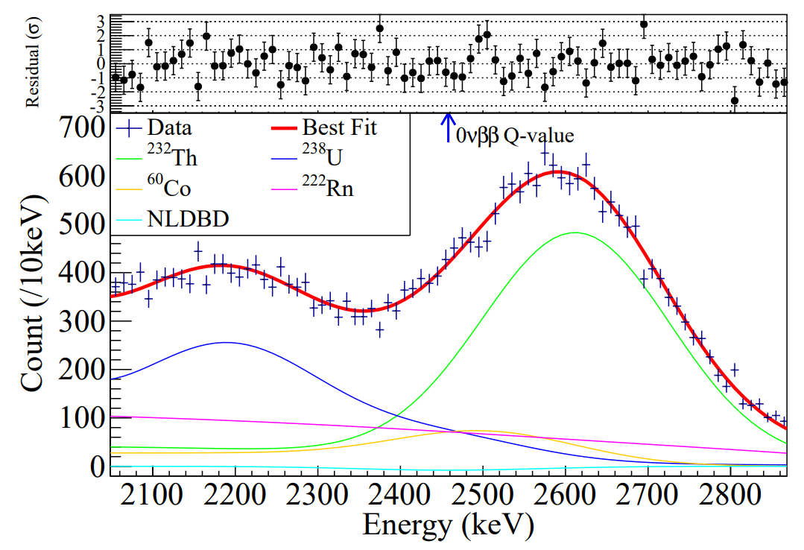
Search for ¹³⁶Xe 0νββ with natural Xe TPC
 | Bkg rate (/keV/ton/y) | Energy resolution | FV mass (kg) | Live time | Sensitivity/Limit (90% CL, year) | Year
PandaX-II | ~200 | 4.2% | 219 | 403 days | 2.4 ×10²³ | 2019
XENON1T | ~20 | 0.8% | 741 | 203 days | 1.2 × 10²⁴ | 2022
Xenon1T
PandaX-II

Slide 17
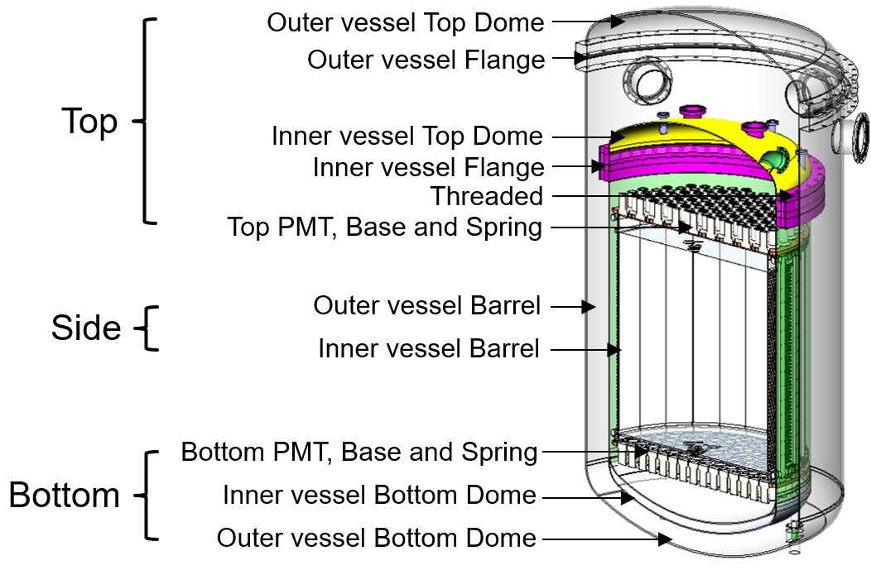
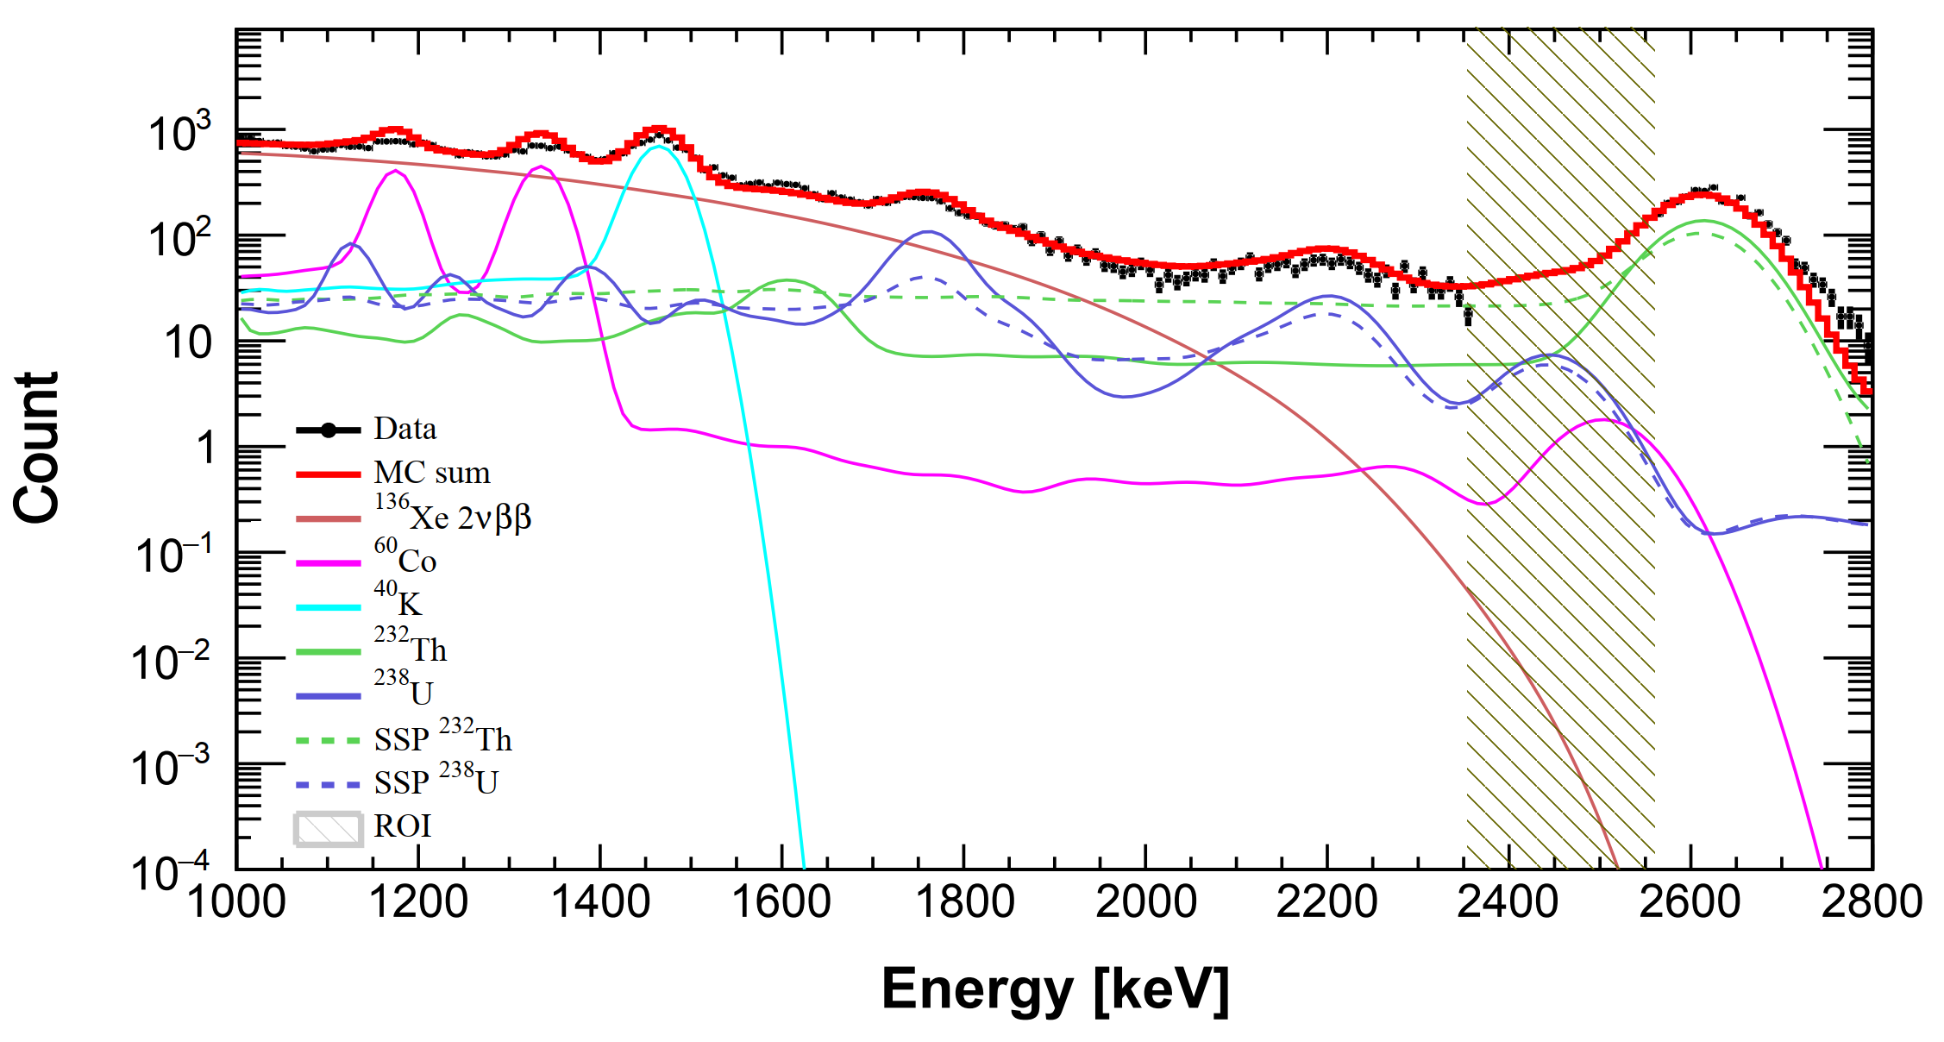
Background Model
¹³⁶Xe 2𝜈𝛽𝛽 (from PandaX measured ¹³⁶Xe half-life)
Detector material: ⁶⁰Co, ⁴⁰K, ²³²Th, ²³⁸U (from HPGe material assay), and grouped into top, side, and bottom parts
Stainless steel platform (SSP): ²³²Th, ²³⁸U (from MS fitting)

Slide 18
Stainless steel platform (SSP) contribution
ArXiv:2502.03017; JHEP

Slide 19
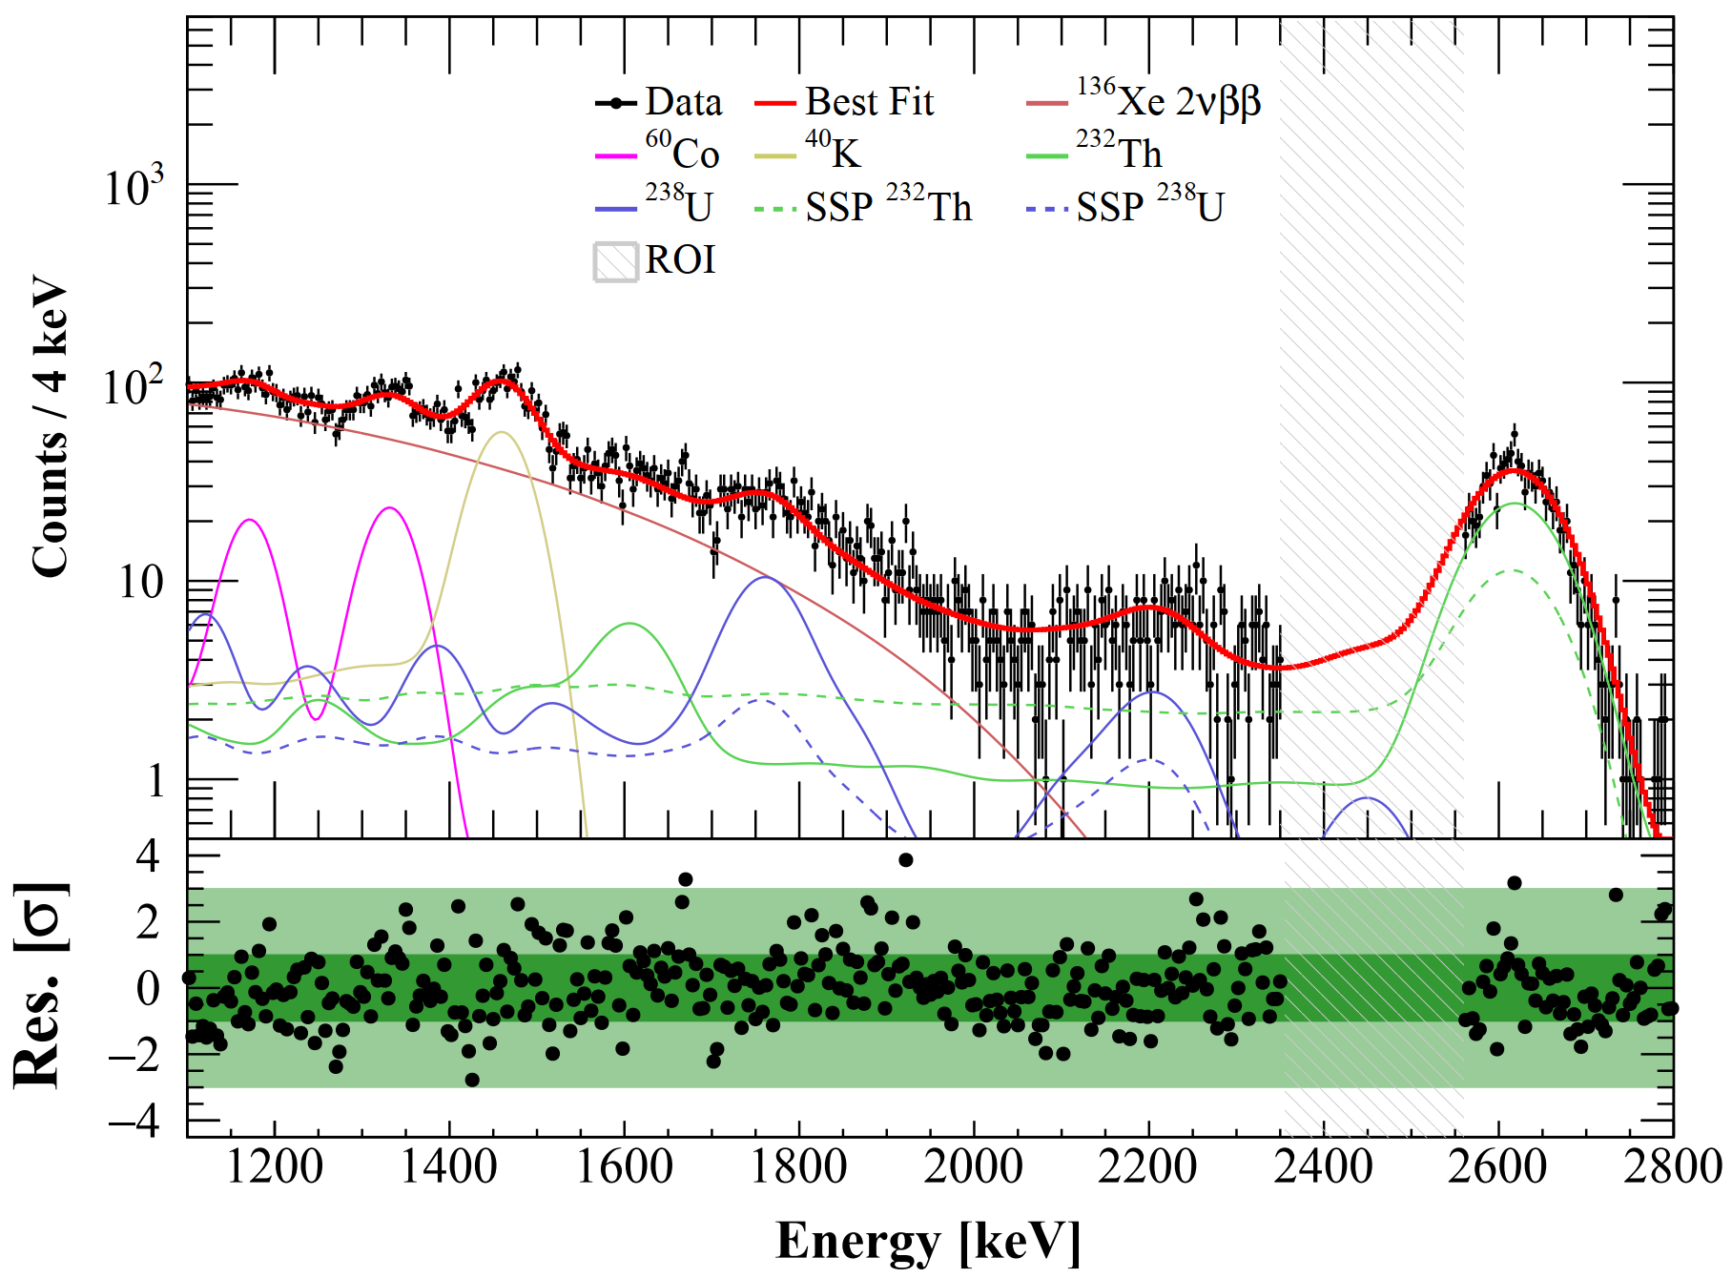
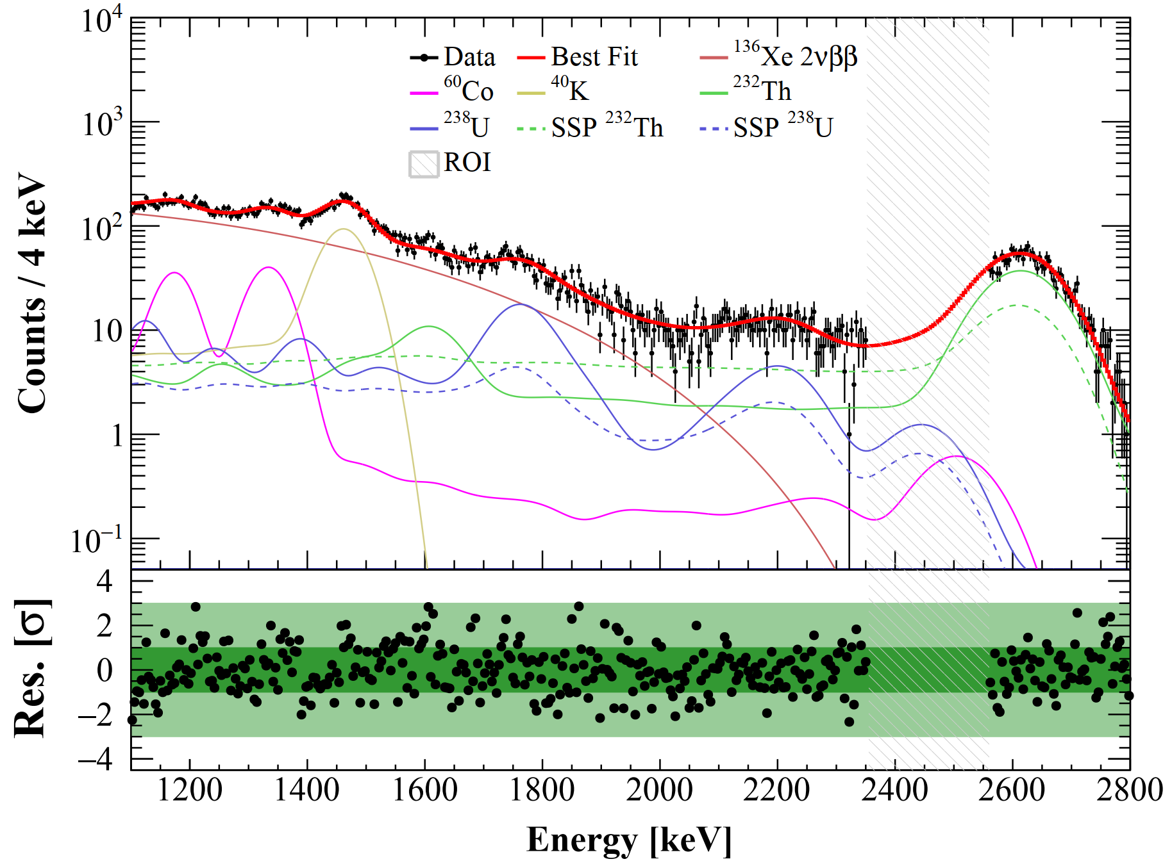
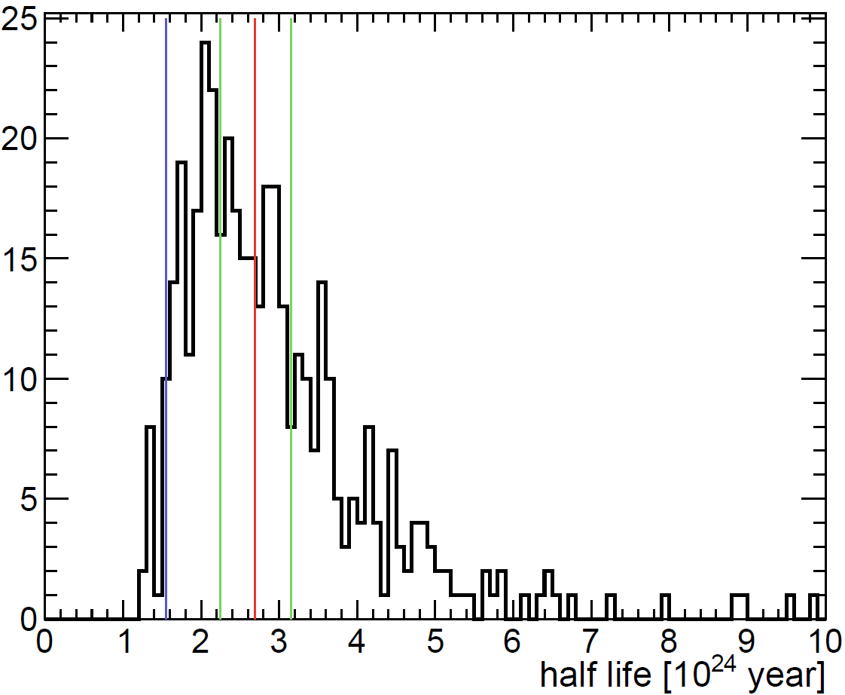
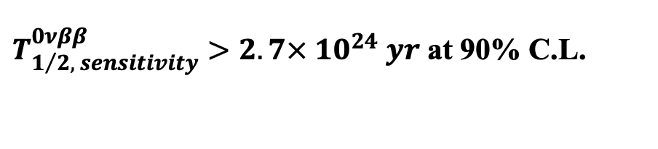
Blinded Fit and Sensitivity
Run0
Run1
Goodness-of-fit:
χ²/NDF = 1.14
median
1σ
2σ
Median sensitivity is estimated by fits to toy-data, generated from background model.
$T_{1/2, sensitivity}^{0νββ}>2.7× {10}^{24} yr$ at 90% C.L.

Slide 20
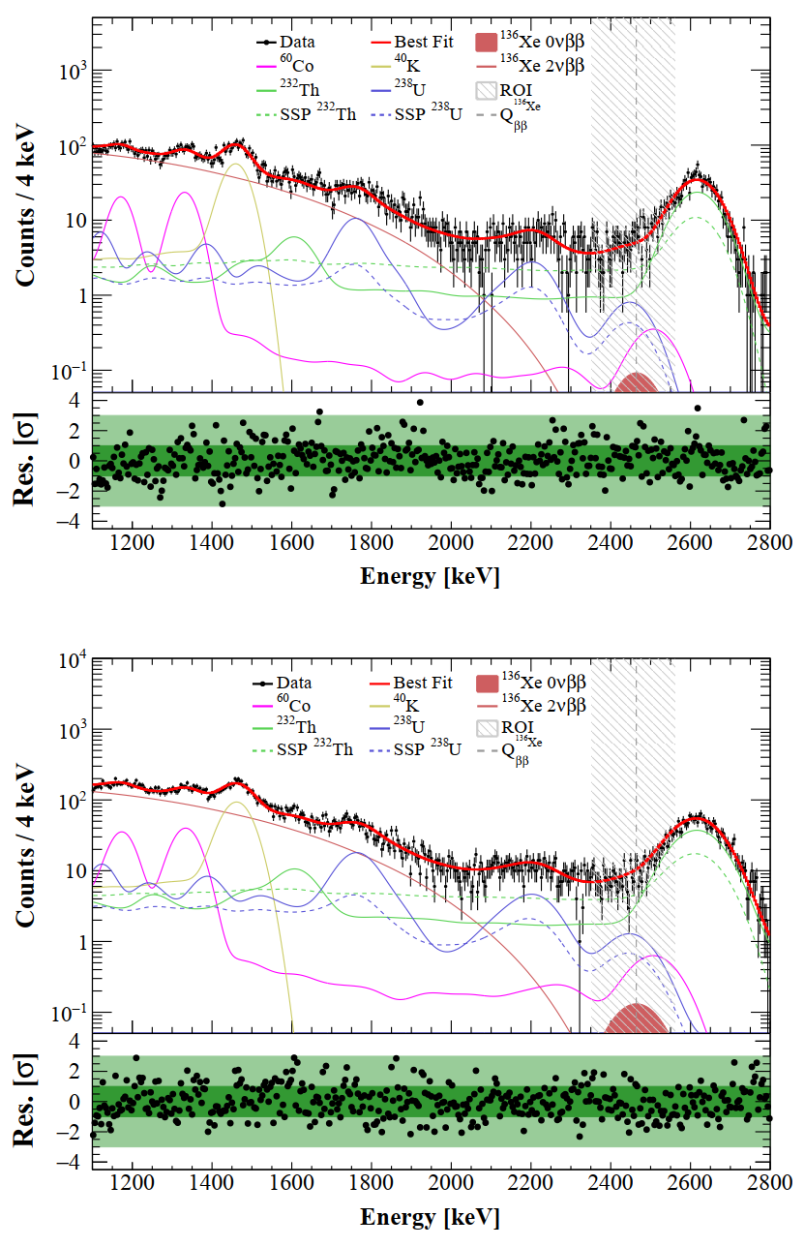

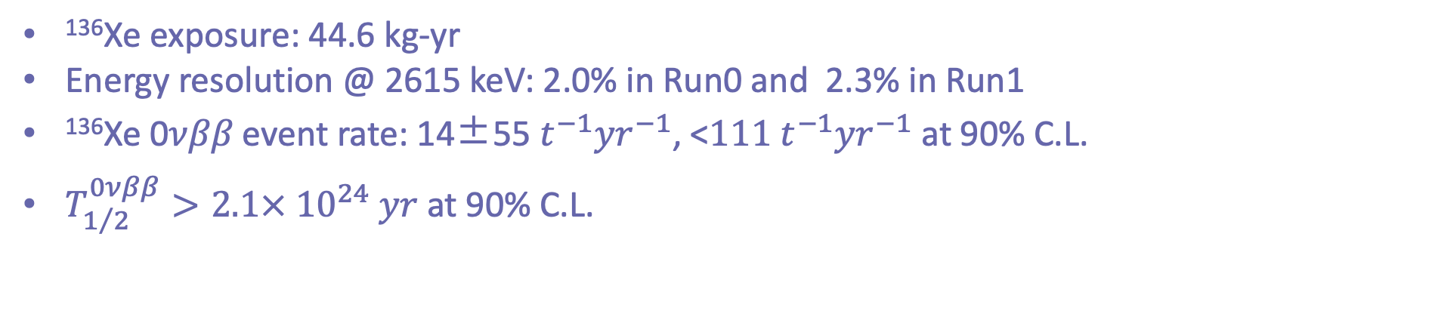
Unblinded Fit and Results
Run0
Run1
¹³⁶Xe exposure: 44.6 kg-yr
Energy resolution @ 2615 keV: 2.0% in Run0 and 2.3% in Run1
¹³⁶Xe 0𝜈𝛽𝛽 event rate: 14±55 $t^{−1}{yr}^{−1}$, <$111 t^{−1}{yr}^{−1}$at 90% C.L.
$T_{1/2}^{0νββ}>2.1× {10}^{24} yr$ at 90% C.L.
arXiv:2412.13979, Science Bulletin

Slide 21
Search for ¹³⁶Xe 0νββ with natural Xe TPC
 | Bkg rate (/keV/ton/y) | Energy resolution | FV mass (kg) | Live time | Sensitivity/Limit (90% CL, year) | Year
PandaX-II | ~200 | 4.2% | 219 | 403 days | 2.4 ×10²³ | 2019
XENON1T | ~20 | 0.8% | 741 | 203 days | 1.2 × 10²⁴ | 2022
PandaX-4T | ~10 | 2.0-2.3% | 735 | 258 days | 2.1 × 10²⁴ | 2024
The most stringent constraint from a natural xenon detector
Improvement w.r.t PandaX-II by an order of magnitude and XENON1T by a factor of 1.8
Demonstrating the potential of ¹³⁶Xe 0νββ search with next-generation multi-ten-tonne natural xenon detectors

Slide 22
¹³⁶Xe Decay to excited states (ArXiv:2502.03017, JHEP)

Slide 23
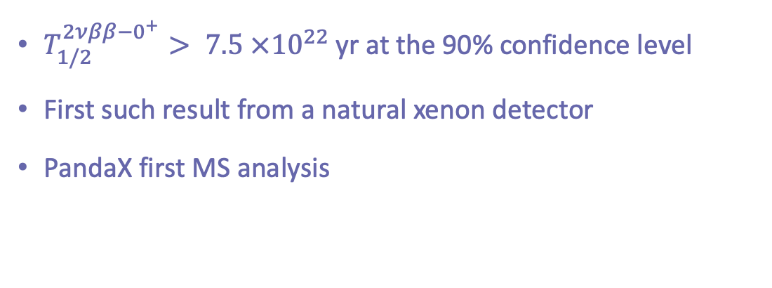
Results
$T_{1/2}^{2νββ−0^{+}}> 7.5 ×{10}^{22}$ yr at the 90% confidence level
First such result from a natural xenon detector
PandaX first MS analysis

Slide 25
¹²⁴Xe double electron capture (arXiv:2411.14355, JHEP)

Slide 26
Nuclear decay
Multi-Messenger
Exotic 𝜈 property
Other DM
Solar 𝜈
WIMP
Majorana 𝜈
Coincidence
Particle ID
Fiducialization
SS/MS
ER/NR
3D Position
Energy
Time
LXe
TPC
Larger
Cleaner
Detector

Slide 27
PandaX-xT: Multi-ten-tonne Liquid Xenon Observatory
Active target: 43 tons of Xenon
  Test the WIMP paradigm to the neutrino floor
  Explore the Dirac/Majorana nature of neutrino
  Search for astrophysical or terrestrial neutrinos and other ultra-rare interactions
Notable detector improvements:
  High-granularity, low-background 2-in PMT array
  Cu/Ti vessel for improved radiopurity
  Inner liquid scintillator veto
SCPMA 68, 221011 (2025)

Slide 28
PandaX-xT: Multi-ten-tonne Liquid Xenon Observatory
Active target: 43 tons of Xenon
  Test the WIMP paradigm to the neutrino floor
  Explore the Dirac/Majorana nature of neutrino
  Search for astrophysical or terrestrial neutrinos and other ultra-rare interactions
Notable detector improvements:
  High-granularity, low-background 2-in PMT array
  Cu/Ti vessel for improved radiopurity
  Inner liquid scintillator veto
SCPMA 68, 221011 (2025)

Slide 29
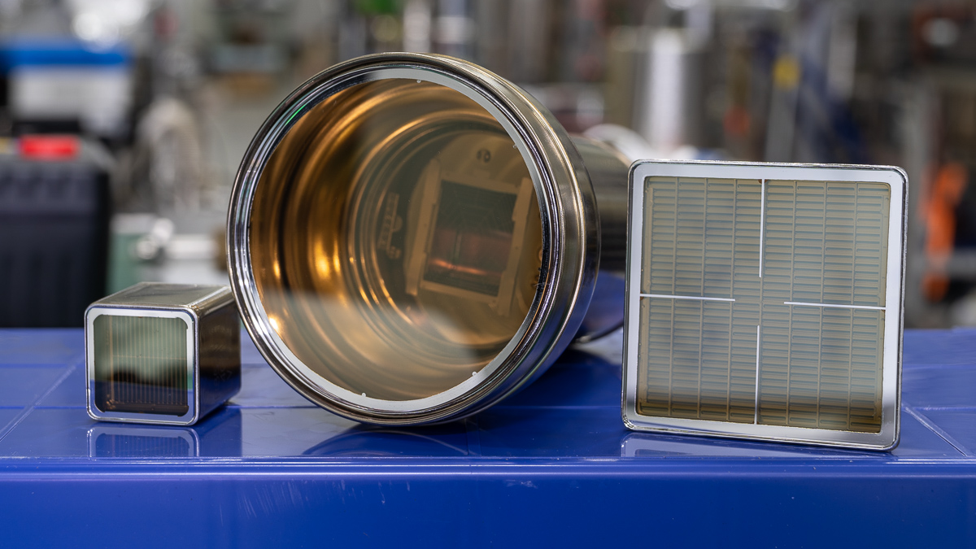
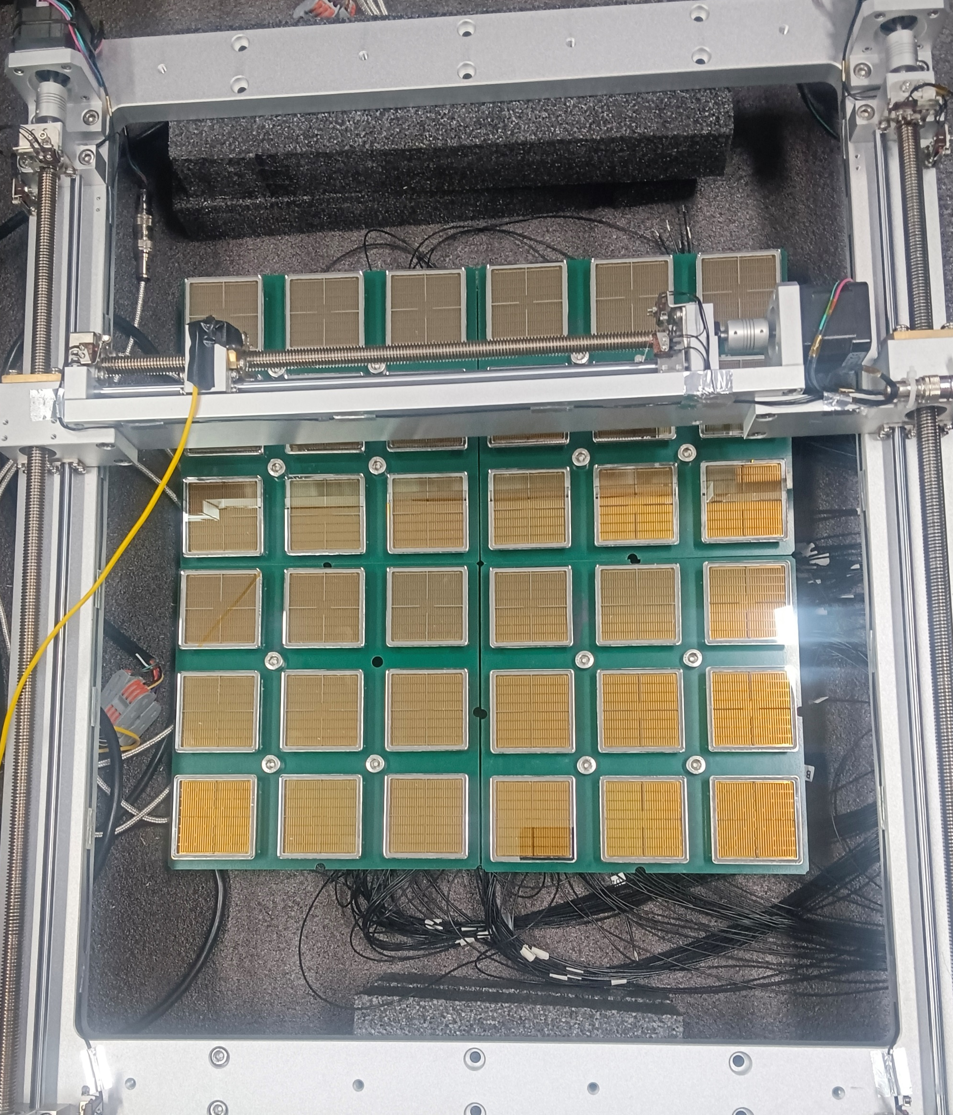
New 2” multi-anode R12699 PMT for LXe TPC
Higher granularity while maintaining low dark noise: best of both large PMT and SiPM
  Improved position reconstruction for better event topology
  2” array has an effectively wider dynamic range for DM and DBD simultaneously
  Faster timing for possible pulse shape analysis or Cerenkov/Scintillation separation
Collaboration between PandaX and Hamamatsu for a low-radioactivity version of R12699
R8520 R11410 R12699
Conceptual array for a PandaX-xT

Slide 30
Timeline
20T
43T

Slide 31
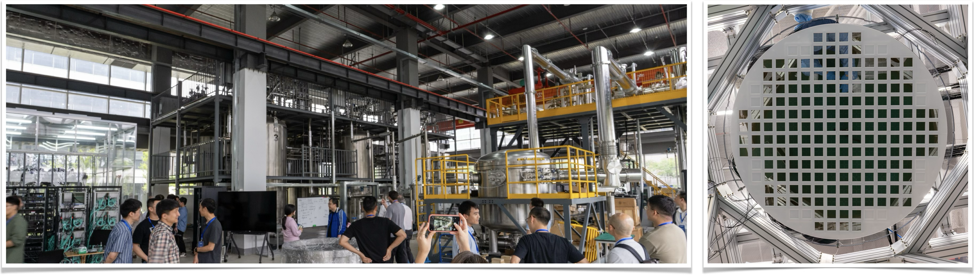
PandaX-xT 20T stage
Mostly funded
Detector prototyping and construction in progress
More at PandaX-xT Open Meeting: https://indico-tdli.sjtu.edu.cn/event/2934

Slide 32
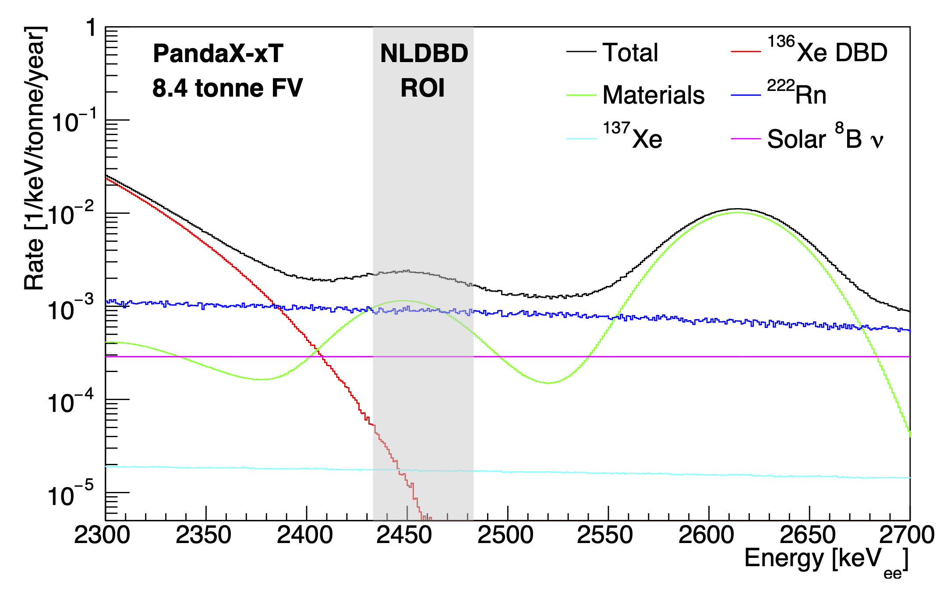
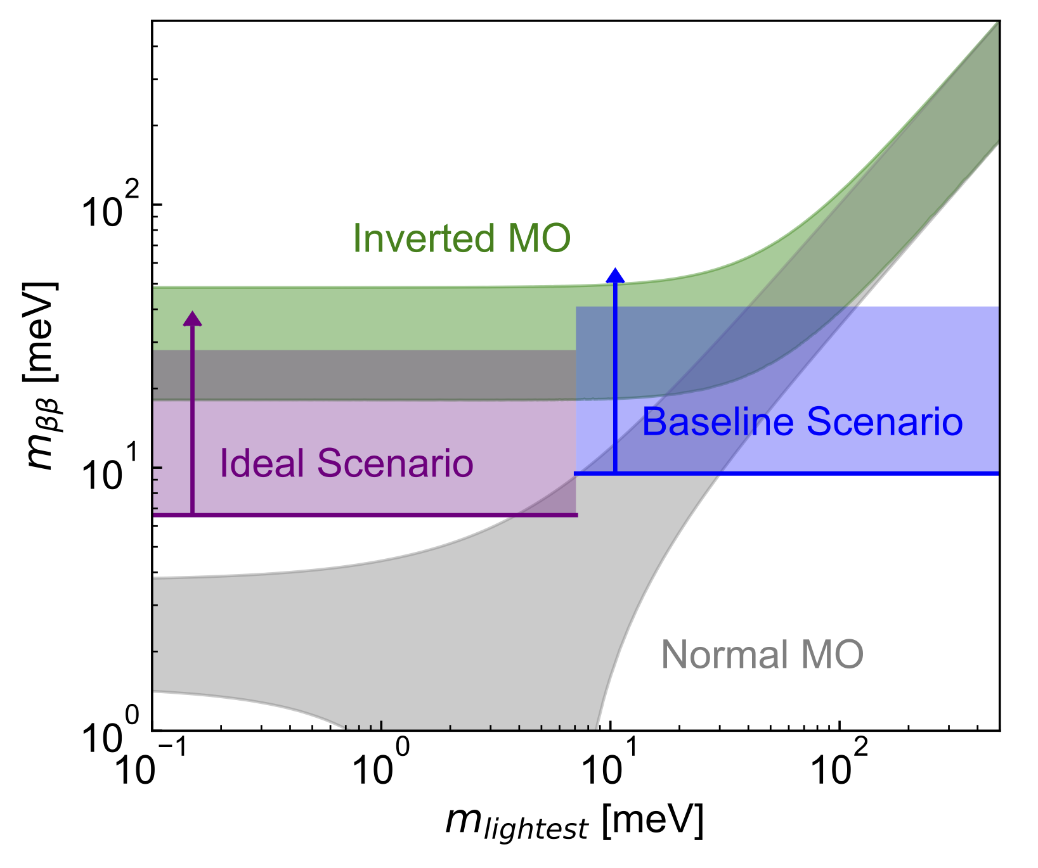
PandaX-xT for 0νββ
4 ton of ¹³⁶Xe: one of the largest 0νββ experiments
Effective self-shielding: Xenon-related background dominates in the 8.4-tonne center FV
41 meV
10 meV

Slide 33
Head-to-head with other DM/0νββ experiments
 | Bkg rate (/keV/ton/y) | Energy resolution | Mass (ton) | Run time | Sensitivity/Limit (90% CL, year)
PandaX-4T | 6 | 1.9% | 4 | 94.9 days | > 10²⁴
XENONnT | 1 | 0.8% | 6 | 1000 days (expected) | 2 × 10²⁵
LZ | 0.3 | 1% | 7 | 1000 days (expected) | 1 × 10²⁶
KamLAND-ZEN | 0.002 | 5% | 0.8 (¹³⁶Xe) | 1.5 years | 2.3 × 10²⁶
nEXO | 0.006 | 1% | 5 (¹³⁶Xe) | 10 years | 1.35 × 10^{28 **}
DARWIN/XLZD | ～0.004*/2E-4 | 0.8%/0.6% | 40/80 | 10 years | 2 × 10²⁷/1.35 × 10²⁸
PandaX-xT | 0.002* | 1% | 43 | 10 years | 3⨉10²⁷
* Major difference from cosmogenic ¹³⁷Xe; ** $\frac{S}{\sqrt{B}}$sensitivity is 6⨉10²⁷ yr, for detector performance comparison in the table.

Slide 34
0νββ + 0νββ-ES
Future 0νββ projects:
  Modular solid-state detectors (LEGEND, CUPID, etc)
  Liquid scintillator detectors (K2Z, JUNO)
  Xenon TPC (PandaX, XLZD)
Xenon TPC is the most effective technology to detect 0νββ-ES
  tag beta + gamma
  Less background-prone
A combined analysis of 0νββ + 0νββ-ES helps improve the sensitivity to m_{ββ}.
  Chenrong Ding, KH, Shaobo Wang, Jiangming Yao

Slide 35
Possible isotope seperation/enrichment
Xenon with artificially modified isotopic abundance (AMIA) for smoking gun discovery
  A split of odd and even nuclei
  Further enrichment of ¹³⁶Xe
  to improve sensitivity to spin-dependence of DM-nucleon interactions and 0νββ
AMIA1
AMIA2
Y. Suzuki

Slide 36
Double beta decay with PandaX natural xenon TPC
0νββ: important neutrino physics topic
Competitive results from PandaX-4T
Exciting future with PandaX-xT

Slide 37

Thank you very much
We welcome new collaborators at PandaX-xT

Slide 38
SS vs. MS
MeV gamma events are mostly multiple-scattering events; while signals (DBD) are mostly single site (SS)
Identifying Multi-Site (MS) events with PMT waveforms
Width of waveforms dominated by Z (electron diffusion)

Slide 39
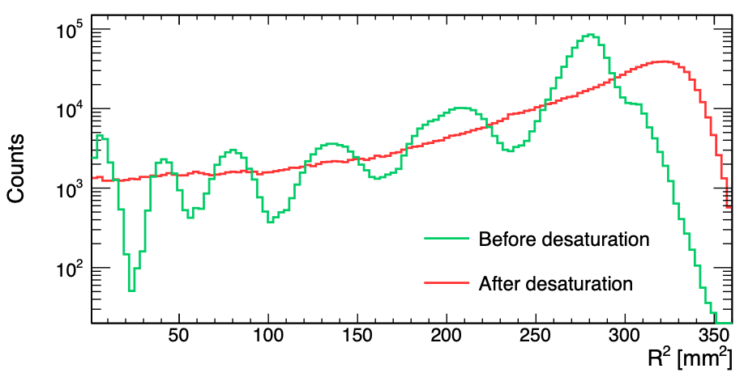

Extending energy from keV to O(100 keV) – O(MeV)
PMT desaturation for large S2 signals
Improvement of X-Y position reconstruction, energy linearity and energy resolution
No longer an issue in Run 2
Research
2022 9798721
Minimizing reduced $χ^{2}$

Slide 40
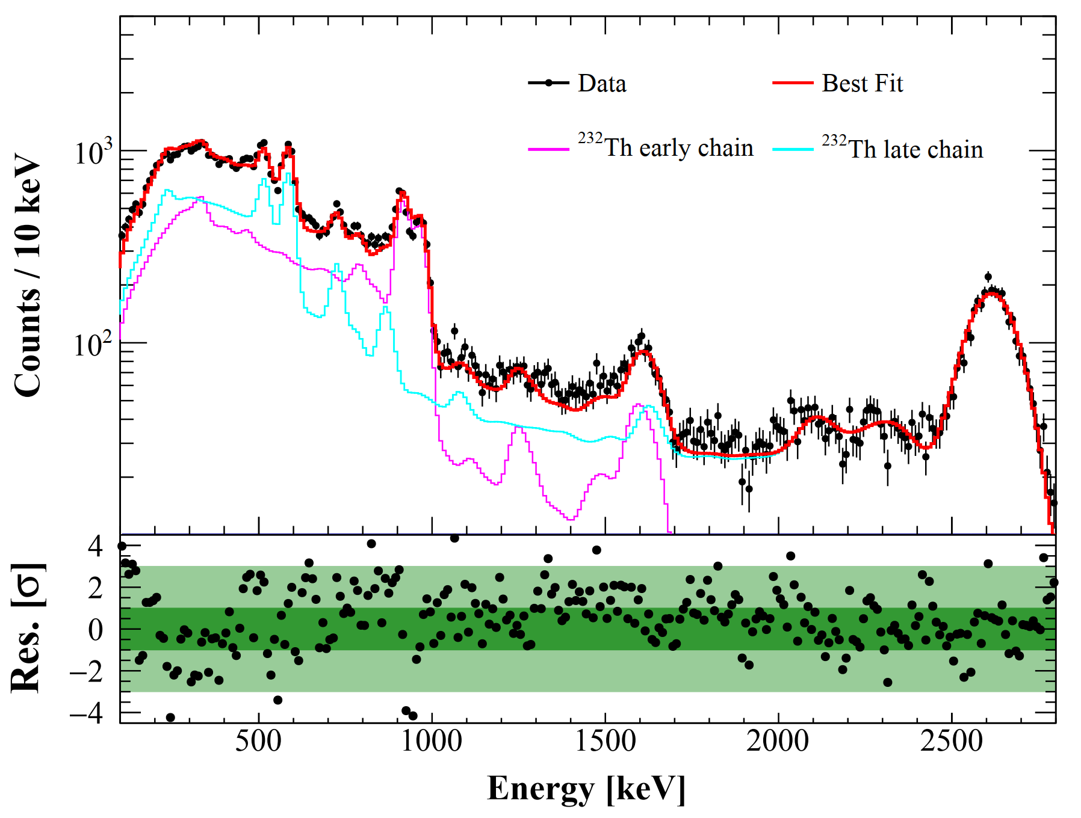
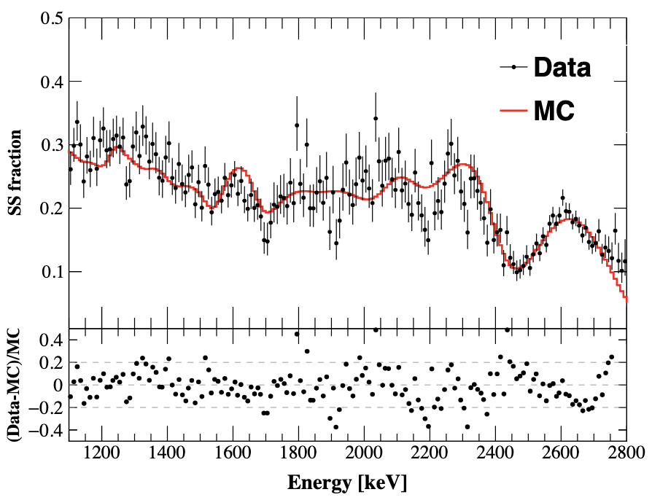
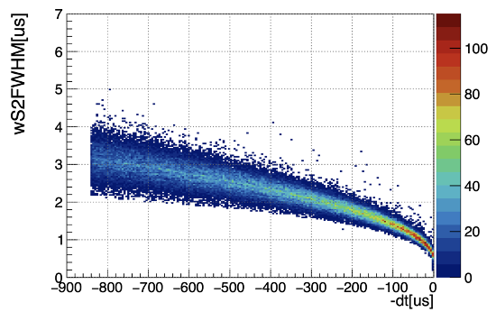
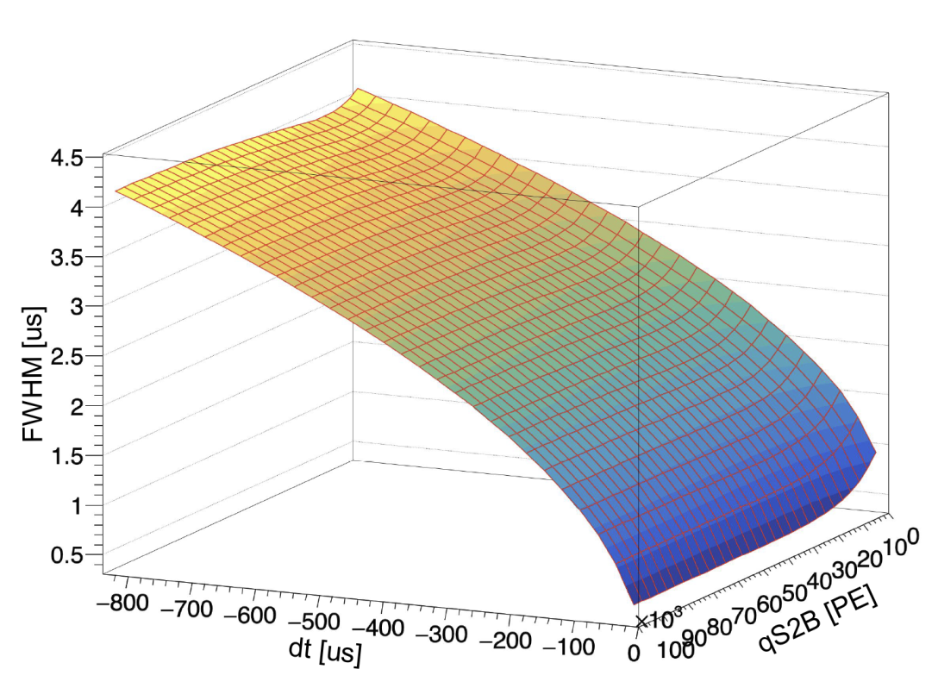
SS Fraction (SS/Total) determination
Data-driven S2 waveform simulation + data processing
SS fraction uncertainty is estimated by comparison MC/data of ²³²Th calibration
Spectrum average of the absolute bin-by-bin deviation between data and MC taken as SS fraction uncertainty

Slide 41
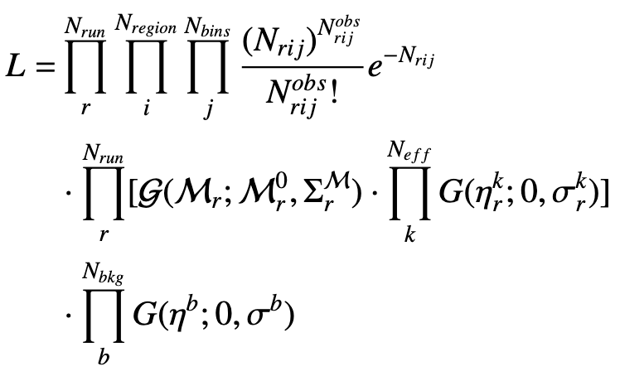
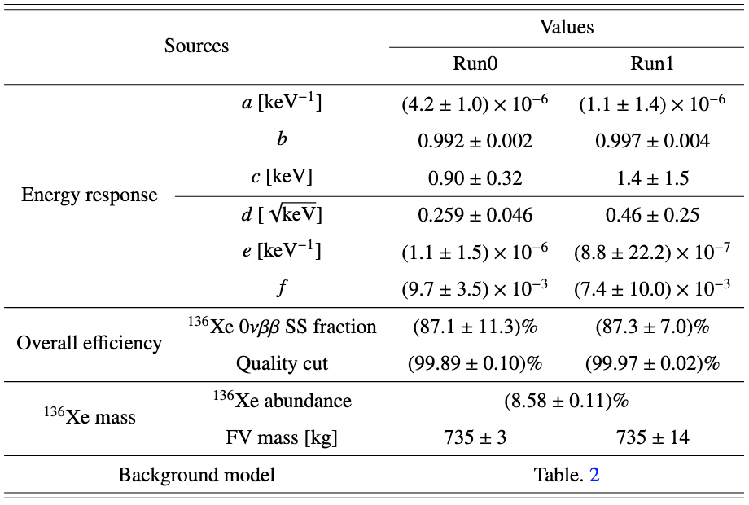
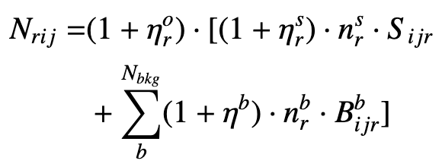
Likelihood and Systematics
Binned Poisson likelihood with Gaussian penalty terms to constrain nuisance parameters
Systematics include three categories: energy response, overall efficiency, ¹³⁶Xe mass
¹³⁶Xe mass uncertainties: abundance from RGA measurement; FV mass from the non-uniformity of ^{83m}Kr + LXe density fluctuation

Slide 42
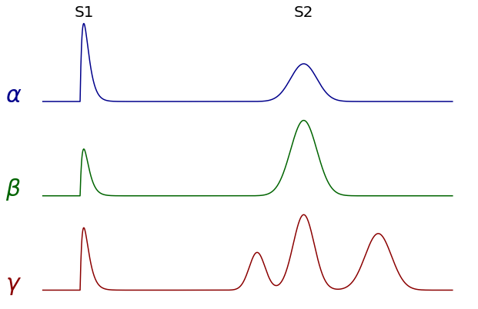
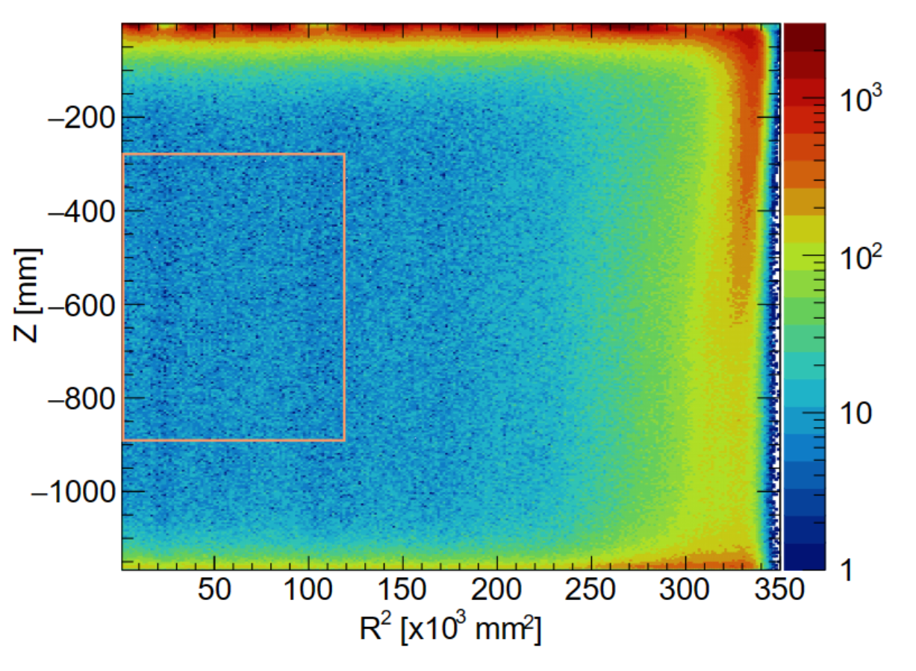
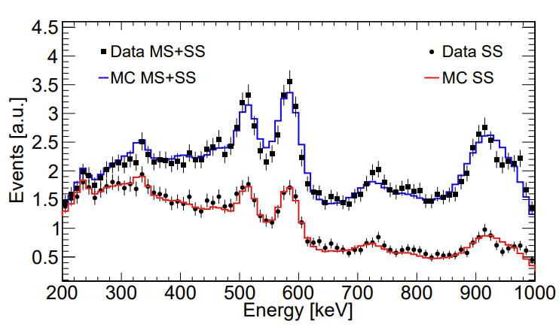
Data selection
An identical FV as in ¹³⁶Xe analysis, total isotopic exposure: 17.9 kg·yr
Single site vs multi-site selection measured by ²³²Th calibration data
  Little impact to DBD signals (𝛽 SS events)
PandaX, Phys.Rev.Lett. 132 (2024) 15, 152502

Slide 43
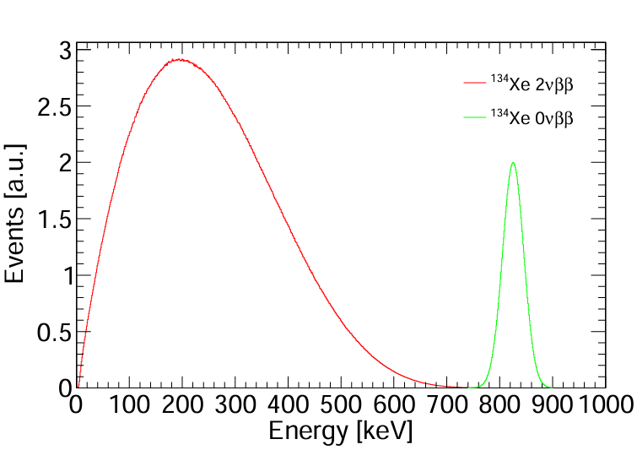
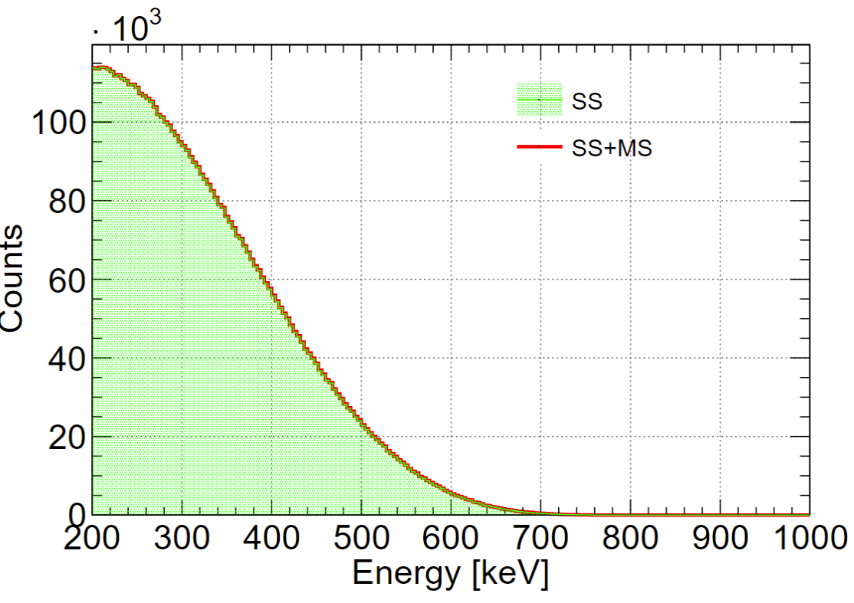
Signal efficiencies
¹³⁴Xe 2𝜈𝛽𝛽 and 0𝜈𝛽𝛽 events generated with the theoretical calculation
The signal events went through PandaX-4T simulation and data processing chain
ROI [200,1000]keV cut:
  2𝜈𝛽𝛽: 60.56%
  0𝜈𝛽𝛽: 99.98%
SS ratio in ROI:
  2𝜈𝛽𝛽: 99.89%
  0𝜈𝛽𝛽: 98.23%
Physical Review C 85, 034316 (2012)

Slide 44
Background model
 | Component | Input Counts | Constraint
 | ⁶⁰Co | 130 | 13%
Materials | ⁴⁰K | 133 | 8%
 | ²³²Th | 950 | 5% | Measured in ¹³⁶Xe 2𝜈𝛽𝛽 analysis
 | ²³⁸U | 274 | 8% | Research 2022 (2022) 9798721
 | ¹³⁶Xe | 12372 | 5%
 | ²¹²Pb | 1012 | 29% | Measured by its daughter ²¹²Po alpha decay
 | ⁸⁵Kr | 296 | 52% | Determined by β−γ emission through the metastable state ^{85m}Rb
LXe | ¹³³Xe | 3423 | 10% | Estimated the β+γ shoulder of ¹³³Xe between 90 and 120 keV
 | ²¹⁴Pb | 19429 | Free | Determined by ²²²Rn
 | ¹²⁵Xe | - | Free | short-lived xenon isotopes induced by neutron calibration
 | Other Xe | - | Free | ¹²⁷Xe and ^{129m}Xe

Slide 45
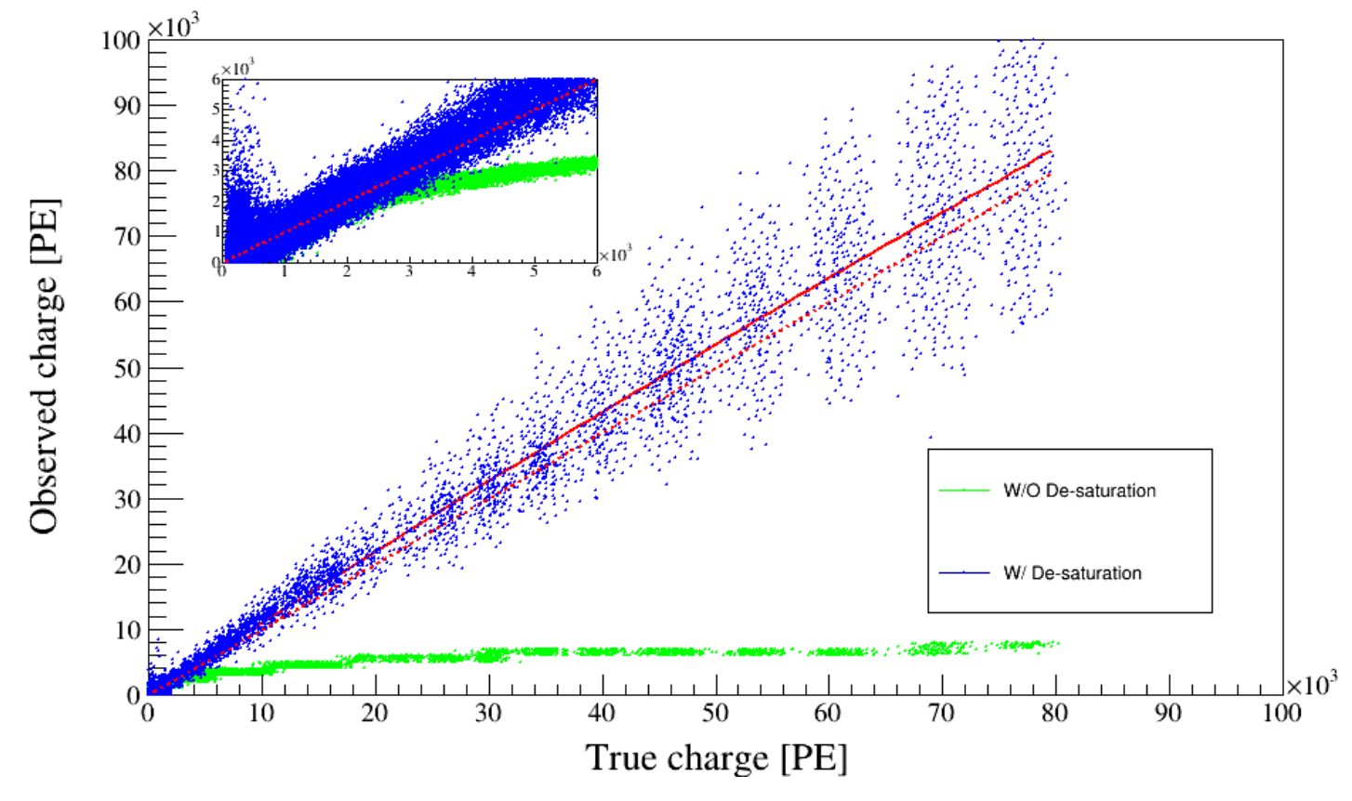
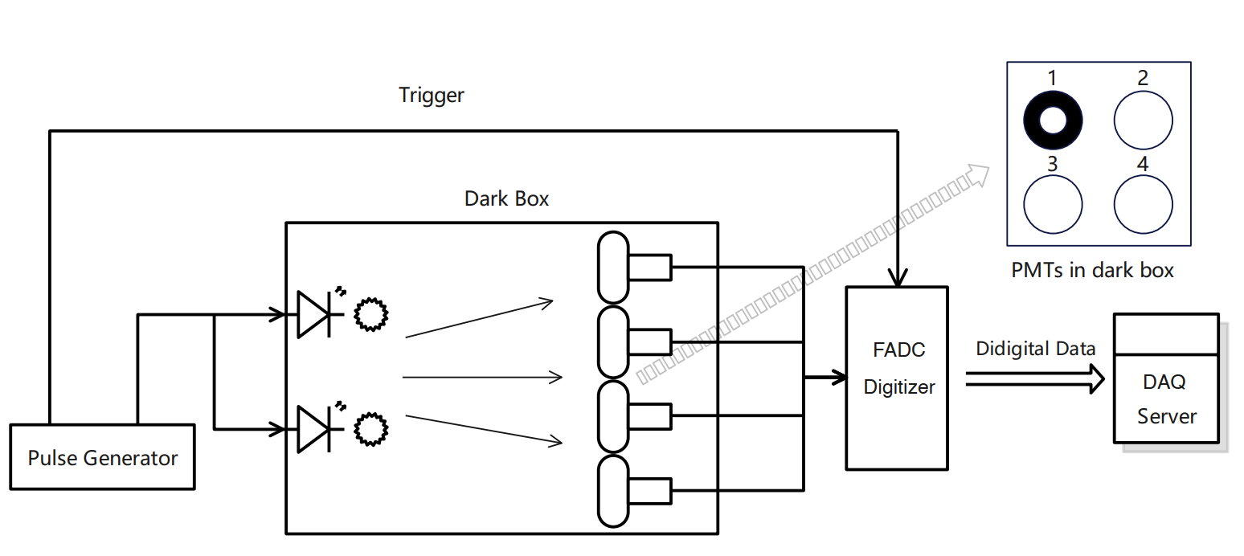
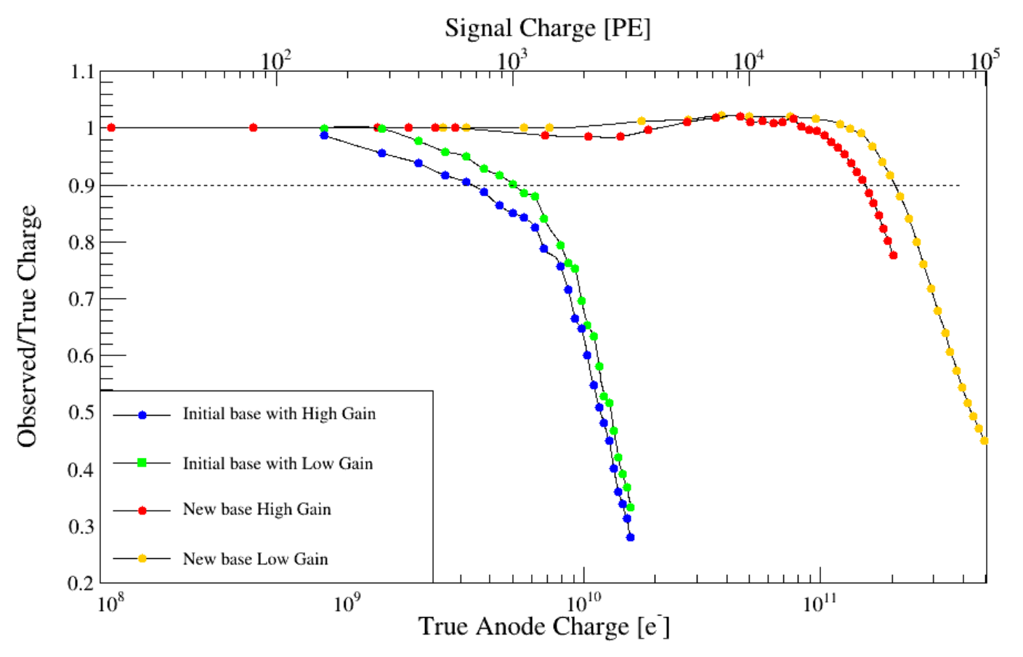
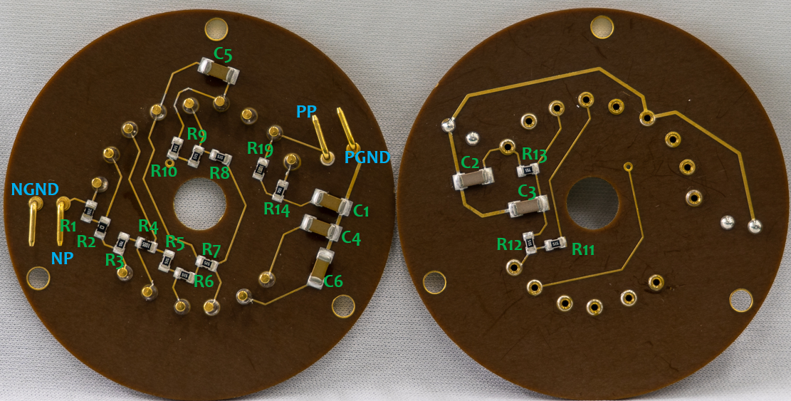
Bench test for saturation and new PMT base design
PMT waveform saturation is studied by independent bench tests
Desaturation algorithm is checked and verified
JINST 19 P05021 (2024)
New PMT base design to increase the dynamic range
All PMT bases have been changed in Run2

Slide 46
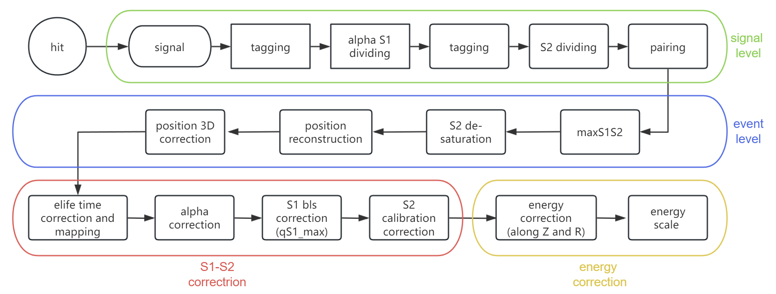
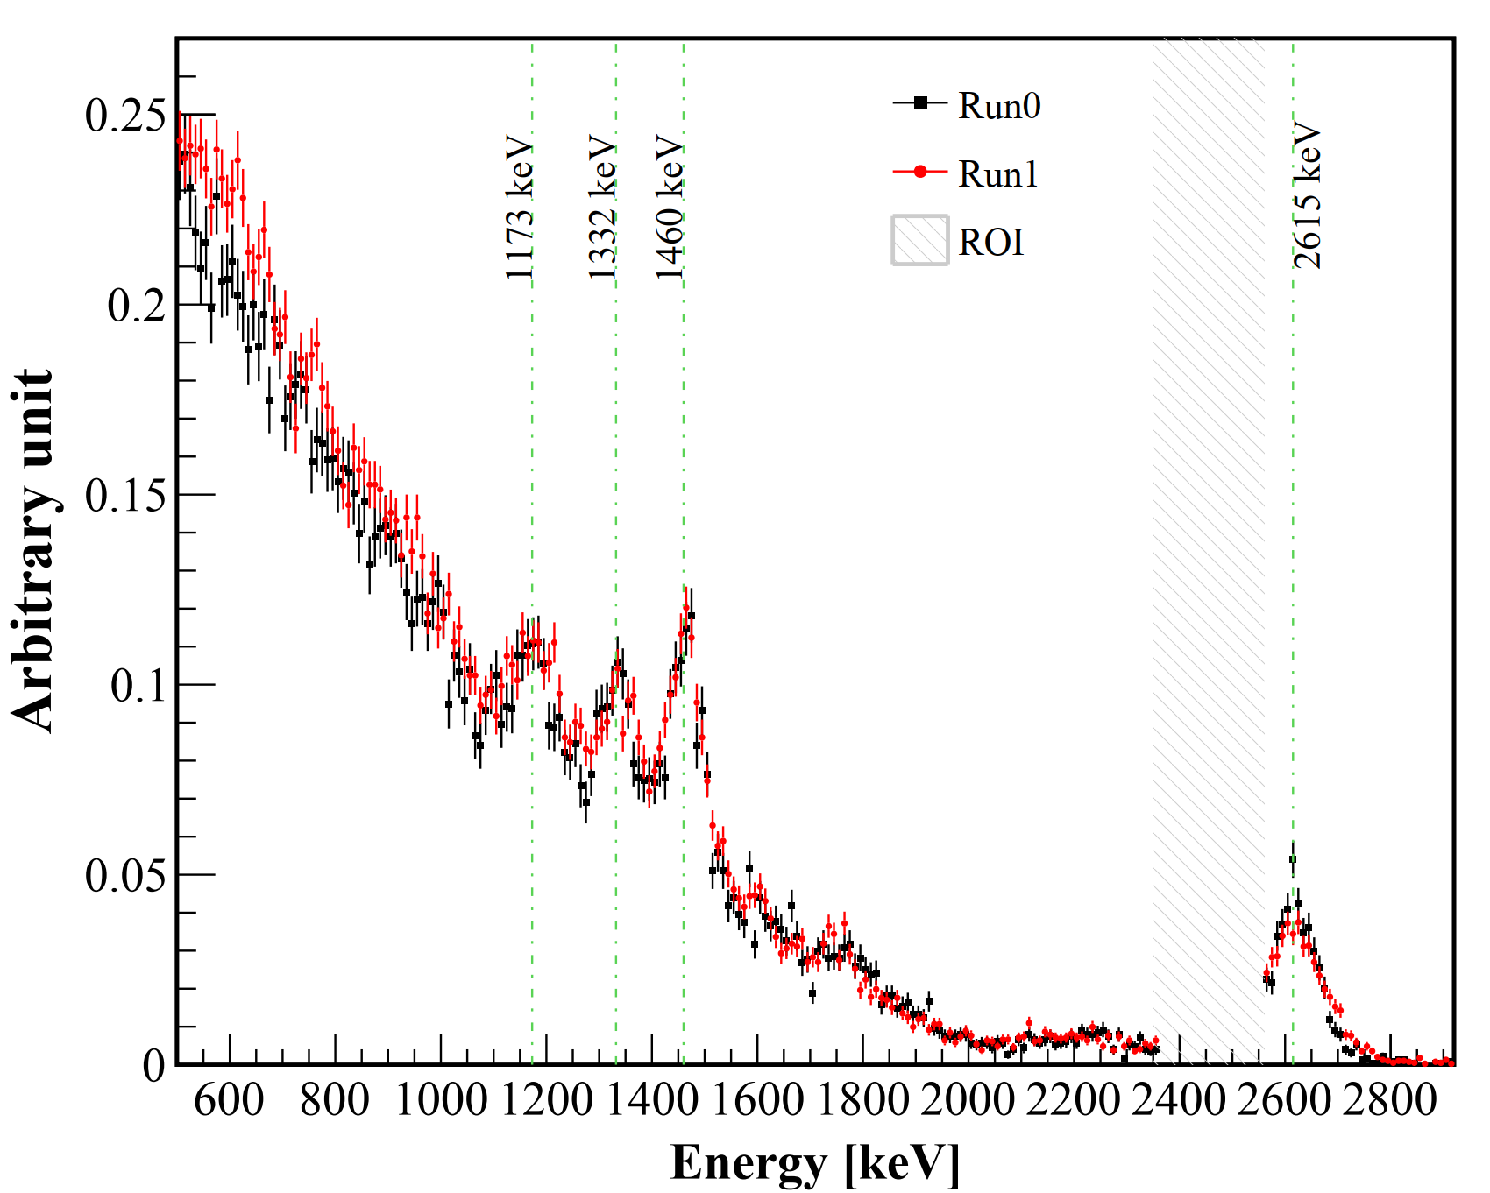
Unified Data Reconstruction Pipeline
Optimizations in data processing:
Recovered ~0.5% SS events by an improved time window cut
S1 waveform slicing to improve alpha events reconstruction
3.5 ms dead-time cut before ²¹⁴Po events to remove isolated ²¹⁴Bi events: ~1% background reduction and negligible data loss
And more...
Unified pipeline for Run0 and Run1
Reconstructed spectra of Run0 and Run1 are consistent, considering the ²²²Rn increase in Run1
Blind analysis: ROI = [2356, 2560] keV, only SS events used

Slide 47
Background Model
¹³⁶Xe 2𝜈𝛽𝛽 (from PandaX measured ¹³⁶Xe half-life)
Detector material: ⁶⁰Co, ⁴⁰K, ²³²Th, ²³⁸U (from HPGe material assay), and grouped into top, side, and bottom parts
Stainless steel platform (SSP): ²³²Th, ²³⁸U (from MS fitting)
Other background components are checked:
Residual ²¹⁴Bi in TPC -> negligible
Gammas of ²¹⁴Bi from LXe skin region -> negligible
2.5 MeV peak from ⁶⁰Co cascade gammas -> well modelled

Slide 48
Likelihood and Systematics
Binned Poisson likelihood with Gaussian penalty terms to constrain nuisance parameters
Systematics include three categories: energy response, overall efficiency, ¹³⁶Xe mass
Background model and systematics are included in likelihood fitting
¹³⁶Xe abundance is measured by RGA with xenon samples from detector
FV mass uncertainty is estimated from the non-uniformity of ^{83m}Kr calibration data distribution, plus the LXe density fluctuation (pressure fluctuation) during data-taking

Slide 49
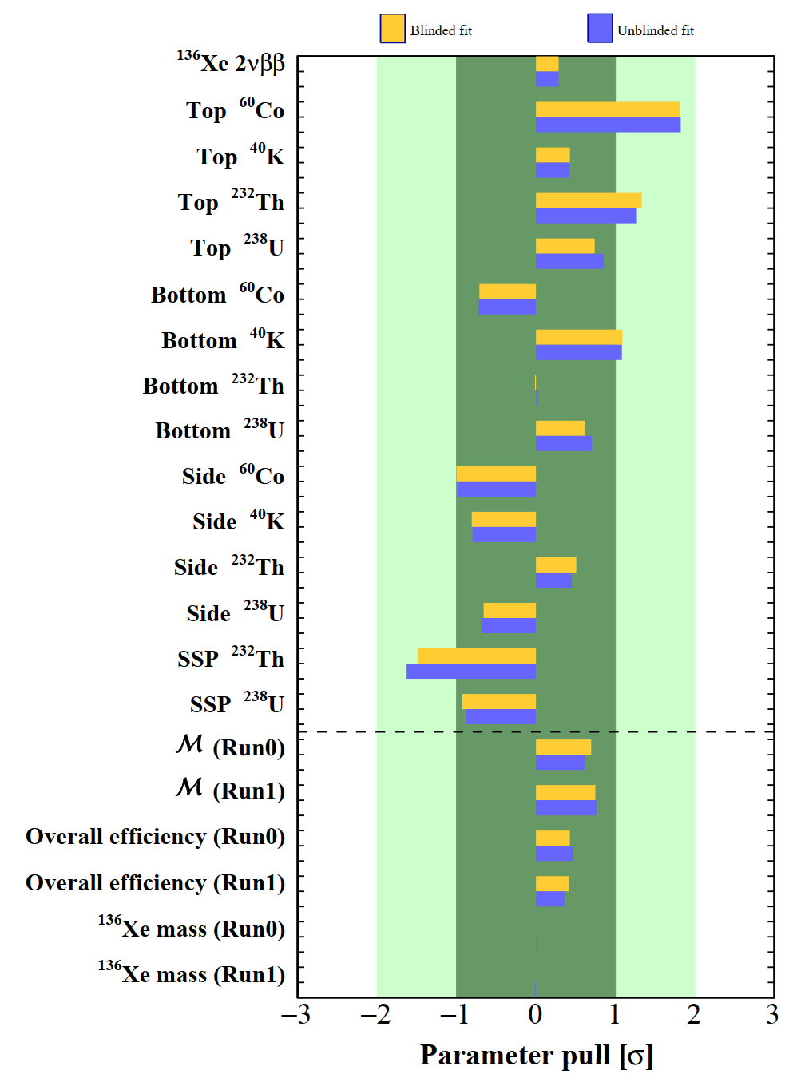

Background counts and parameter pulls
Background counts in the ROI
paper on arXiv
arxiv:2412.13979
All pulls of nuisance parameters fall within the ±2σ range
All best-fit nuisance parameters are consistent between the blinded and unblinded fits
Pull of top ⁶⁰Co reaches 1.8σ, indicating that the model expectation from the HPGe material ﻿assay might be slightly underestimated

Slide 50



Fiducial Volume (FV)
FV is optimized by maximizing the FoM
FV is further divided into four regions to better constrain detector material background from top, side, and bottom parts
FoM
Z(lower limit) [mm]

Slide 51




Energy Response Model
Residual shift between simulated energy and reconstructed energy
Energy resolution vs. reconstructed energy
Response model from physics data in slim regions outside FV
Model parameters naturally included in the likelihood fitting

Slide 53
3D Position
S2
Energy
Time
LXe
TPC
S1
e
e
e
e
e

Slide 54
Coincidence
Particle ID
Fiducialization
SS/MS
ER/NR
3D Position
S2
Energy
Time
LXe
TPC
S1
e
e
e
e
e

Slide 55
Nuclear decay
Multi-Messenger
Exotic 𝜈 property
Other DM
Solar 𝜈
WIMP
Majorana 𝜈
Coincidence
Particle ID
Fiducialization
SS/MS
ER/NR
3D Position
S2
Energy
Time
LXe
TPC
S1
e
e
e
e
e

