Slide 1

第一届中微子，原子核物理与新物理研讨会
Lattice QCD & Nuclear Physics
The blending method to deal with lattice simulation
Peng Sun
2025/07/22

Slide 2
Outline
Background
Blending method in lattice simulation
Some applications
Summary

Slide 3
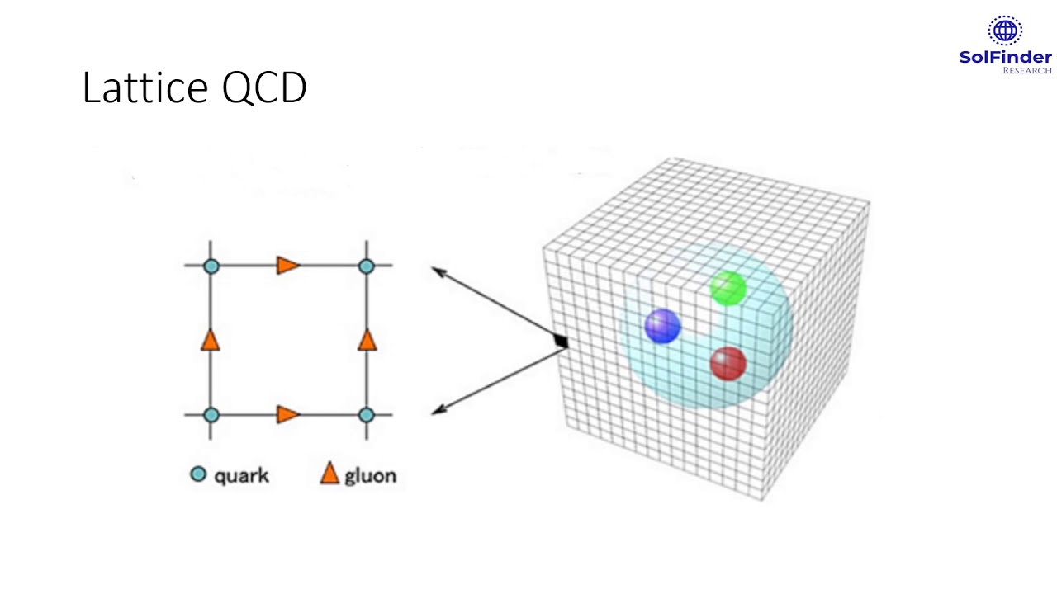

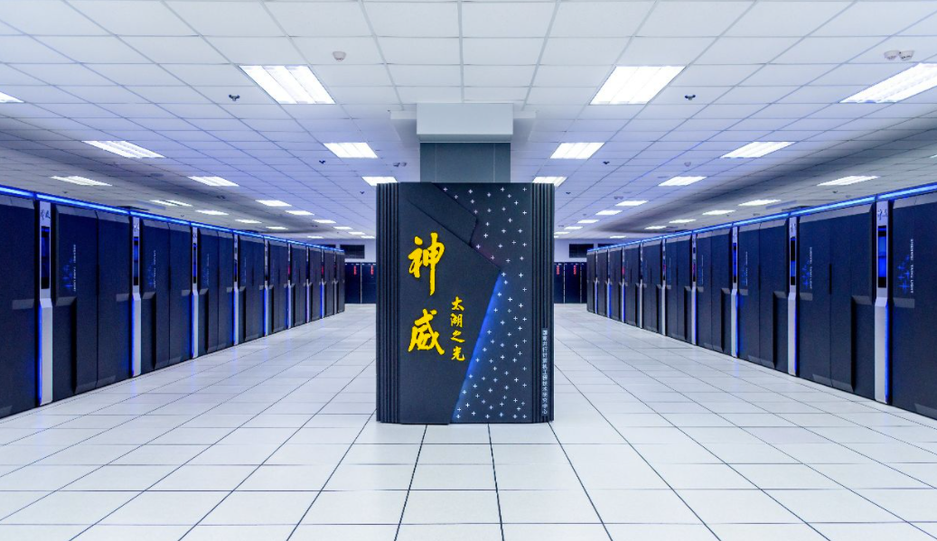
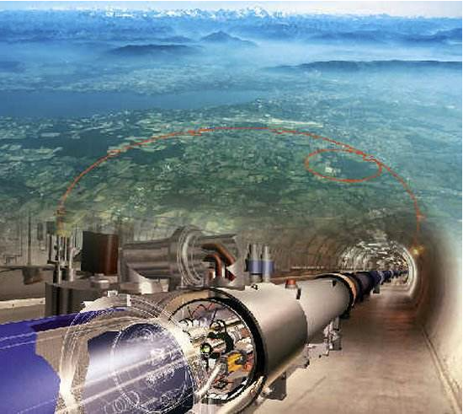
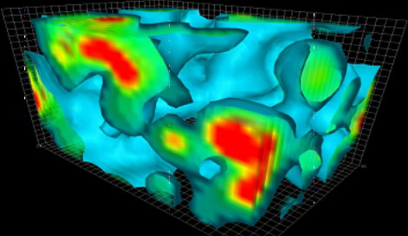
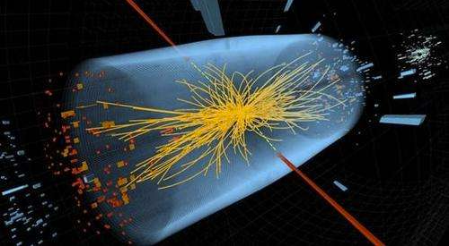
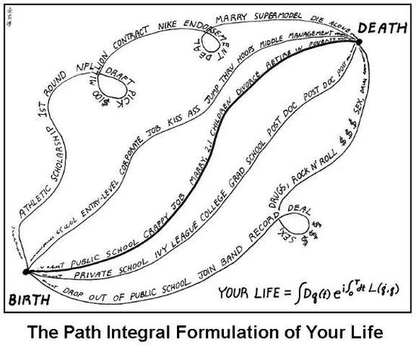

Lattice QCD
超级计算机
粒子加速器
QCD真空 （组态）
对撞事例

Slide 4
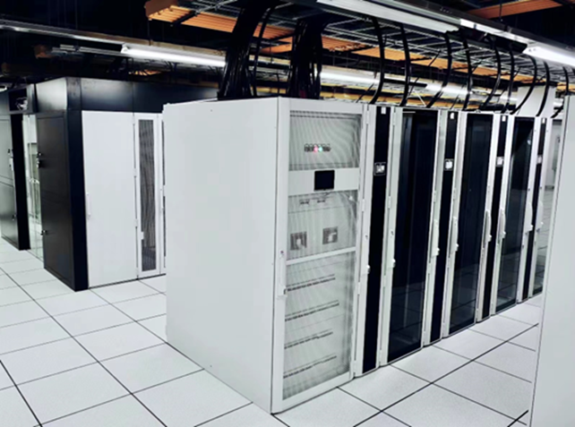
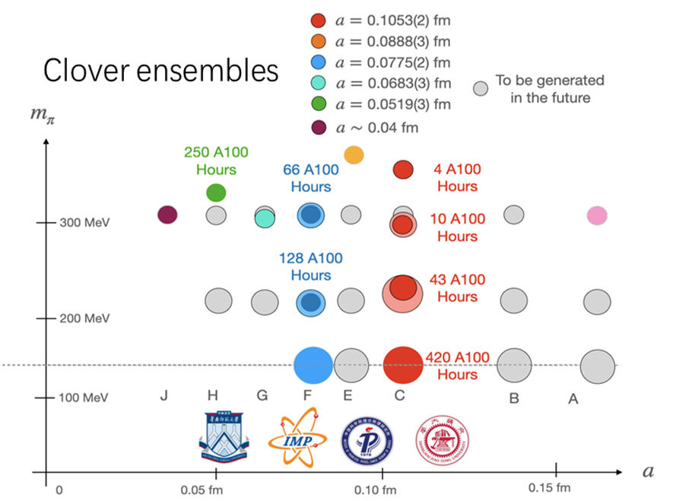

CLQCD ensembles
感谢华南师范大学为中国格点QCD组态产生做出的贡献！！！

Slide 5
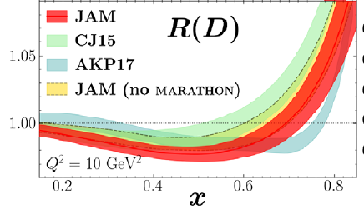

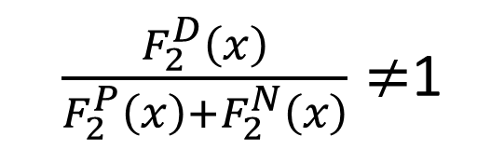
EMC effect and Deuteron PDF on Lattice QCD
EMC effect
PDF of Deuteron ：
It can describe the difference between nuclear and free nucleon
It can help us understand the interaction between nucleon
At tree level,
$\frac{F_{2}^{D}\left(x\right)}{F_{2}^{P}\left(x\right)+F_{2}^{N}\left(x\right)}≠$1

Slide 6
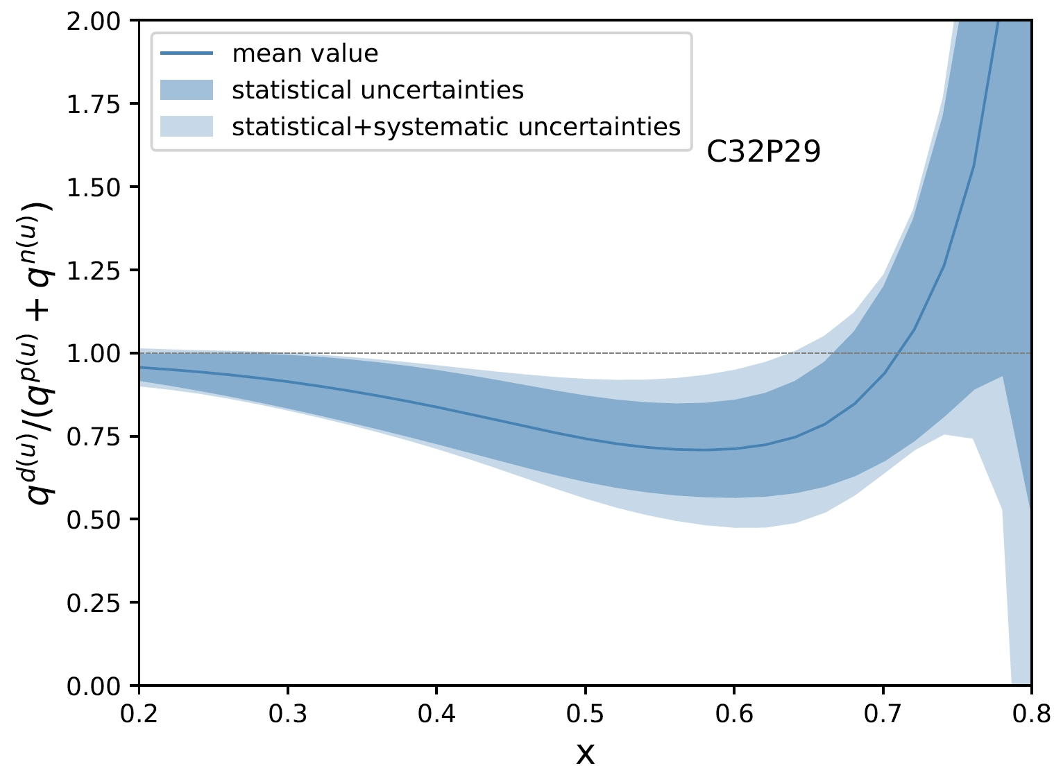
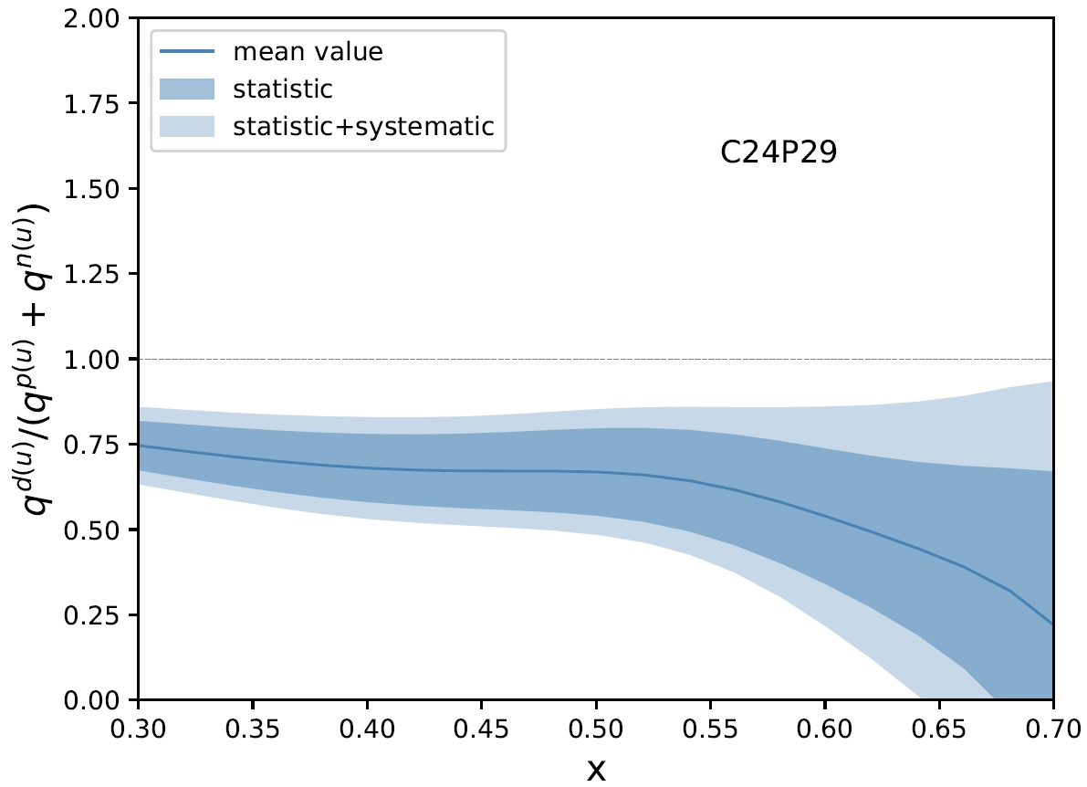
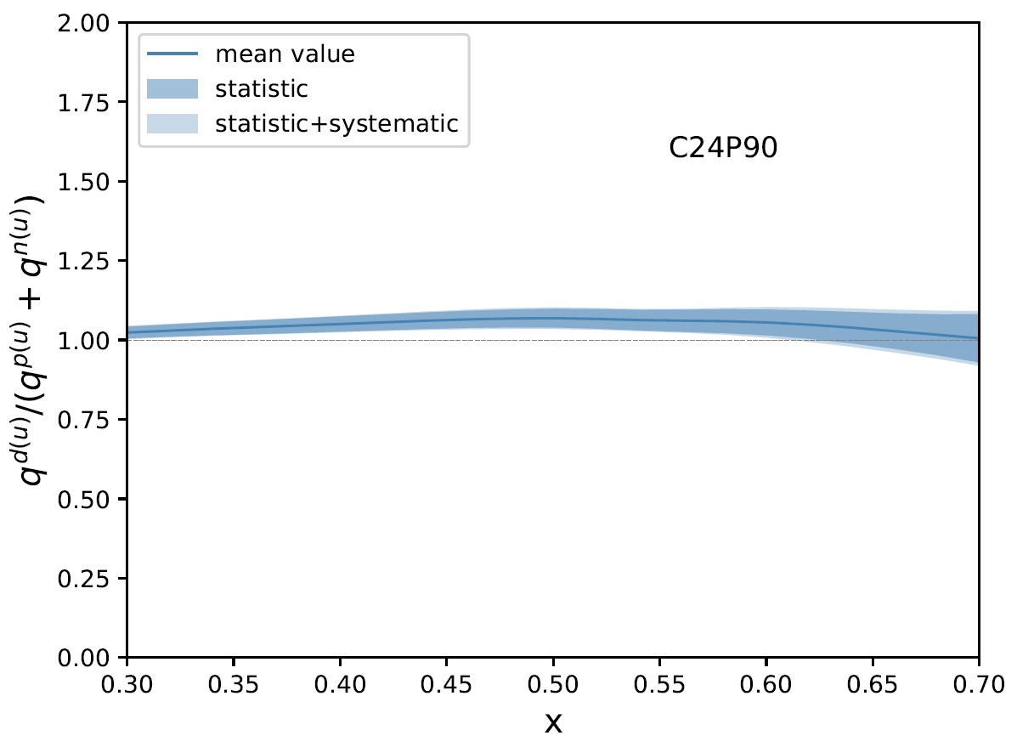
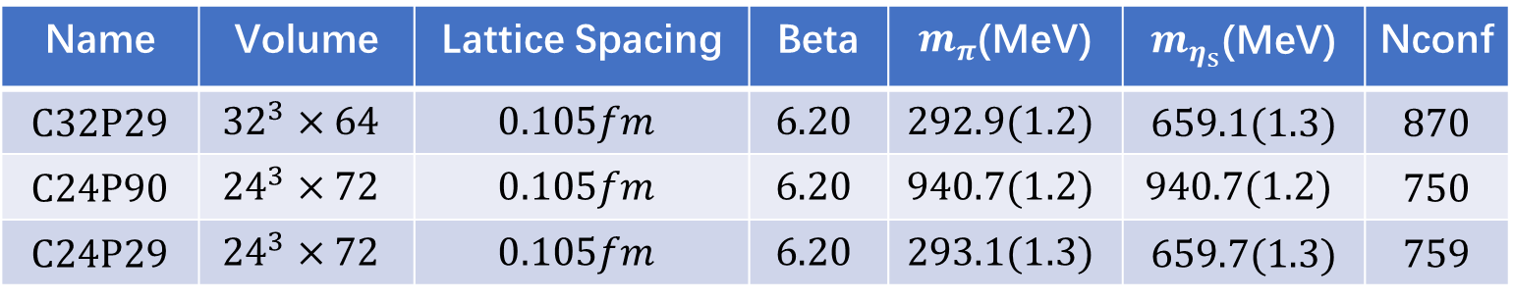
EMC effect on CLQCD ensembles
Phys.Rev.D 111 (2025) 7, 074506

Slide 7
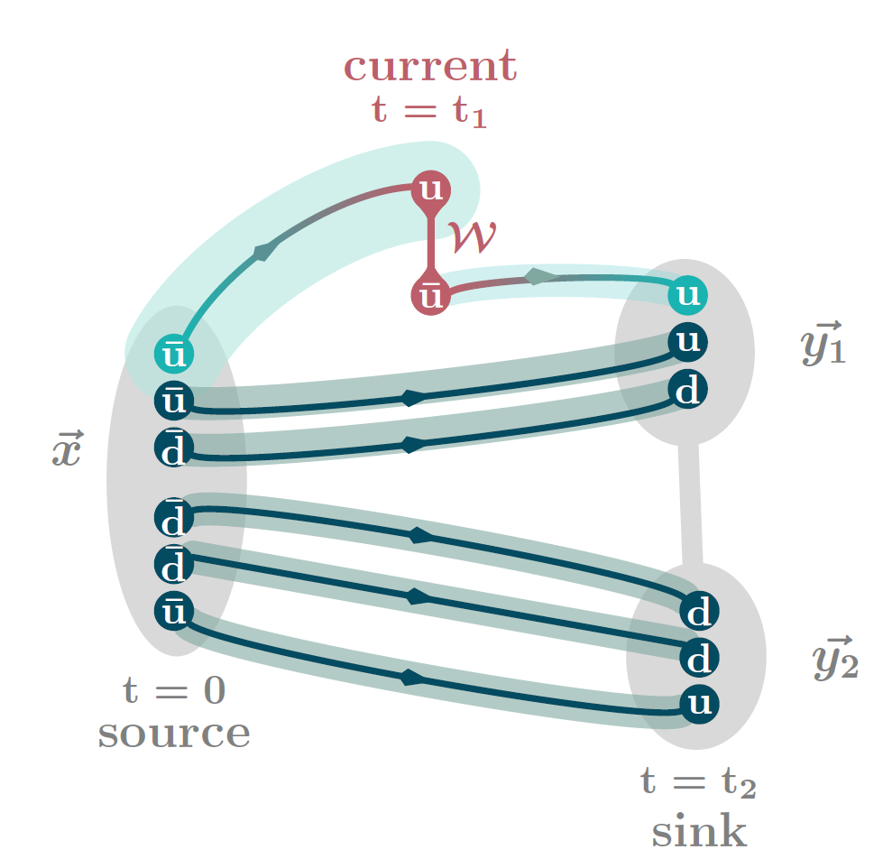
Lattice Simulation of Deuteron PDF
three point correlators
The statistic is very low, signal is not good enough.
We only consider three ensembles, system errors are not taken into account.
Three-point correlator of Deuteron-like dibaryon system
(one possible way of contraction)

Slide 8
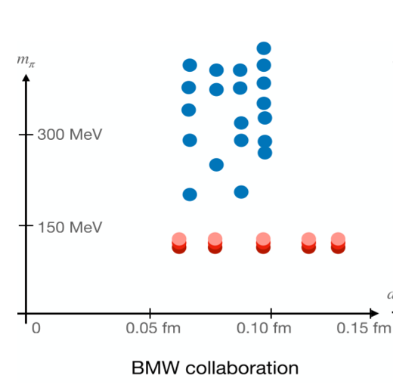
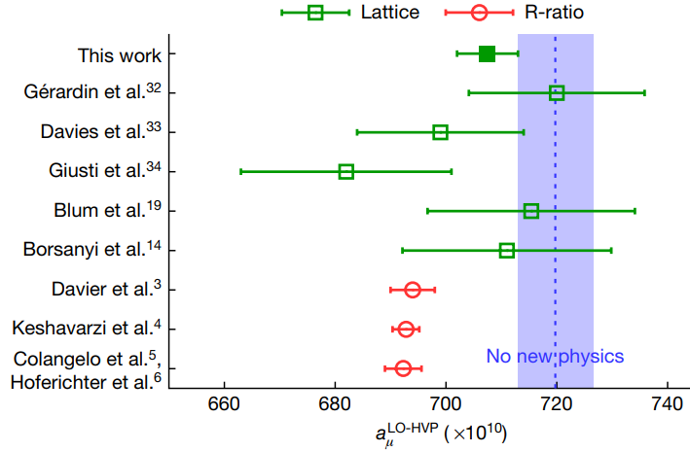
LQCD is a powerful tool, but it is very expensive.
Nature 593 7857, 51-55 (2021)
Notes:
格点QCD是世界公认的第一性原理计算，是由著名诺贝尔奖得主Kenneth Wilson创立，他创造性地将4维时空离散化，借助计算机的出现，实现了QCD运动方程的数值求解。近年来，得益于超级计算机的迅猛发展，格点QCD取得了众多令世人瞩目的重要成果，如精确地计算了质子和中子的质量差，强子真空极化对缪子反常磁矩的贡献等。

Slide 9

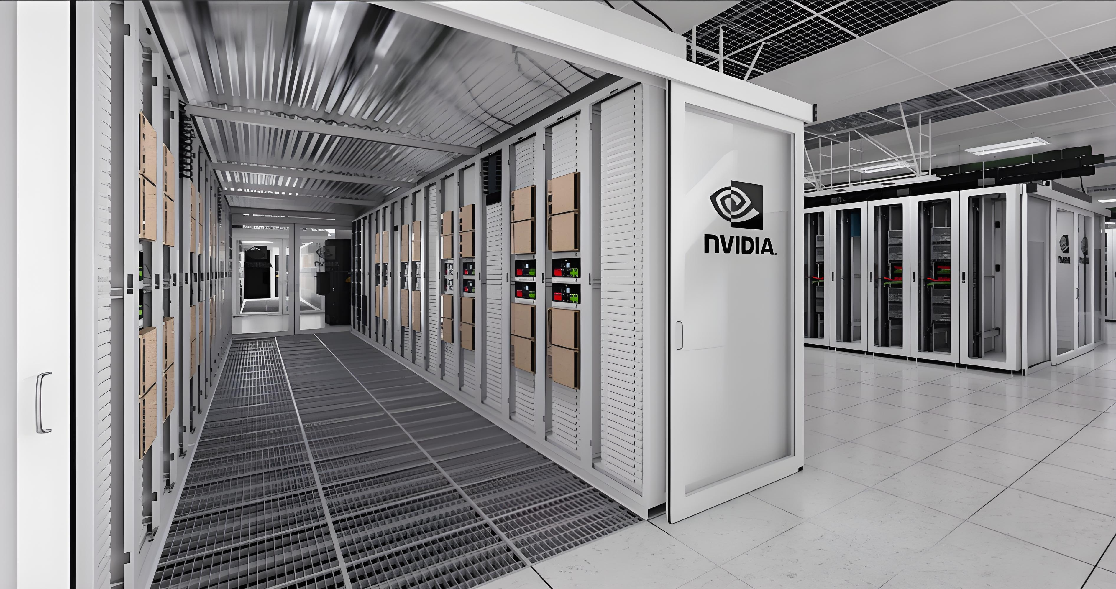
LQCD is expensive, but we can reduce the cost.
Good compute resource
Good strategy or idea

Slide 10
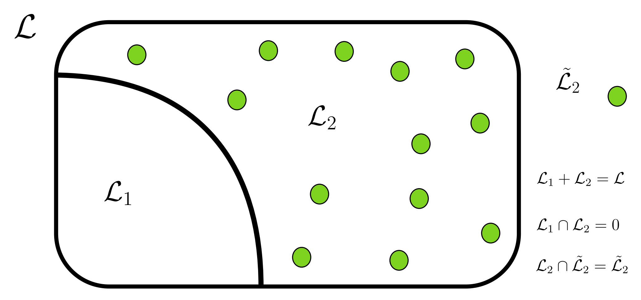
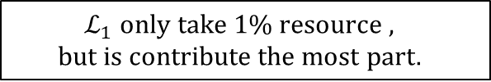
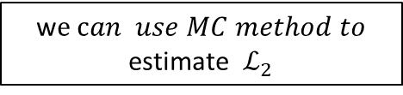
A Method to reduce the cost
Distillation method has been wildly used in lattice calculation of two-point functions
P.R.D. 80, 054506 (2009)
w$e can use MC method to$
estimate $ℒ_{2}$
~1%
$$ℒ_{1} only take 1\% resource ,$$
$$but is contribute the most part.$$

Slide 11


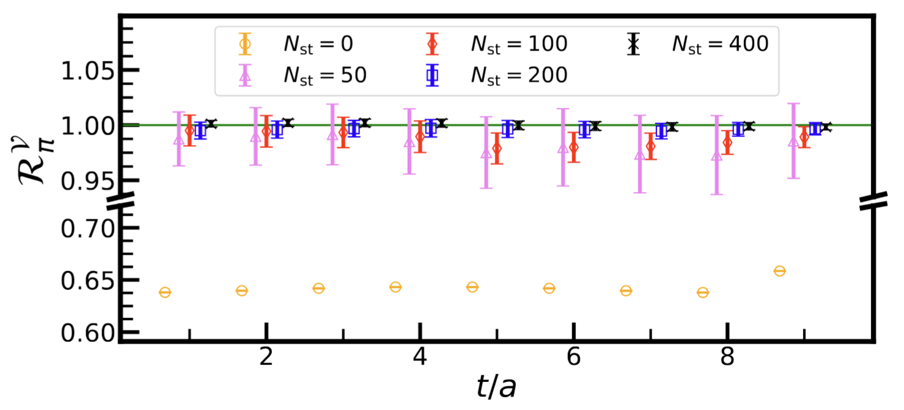
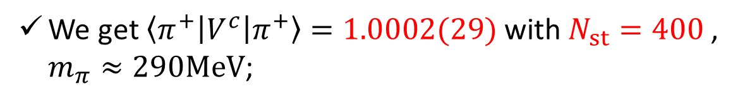






The blending Method to reduce the cost
ArXiv:2505.01719
All-to-All propagator will be
All-to-all propagator size: ${ \left(4N_{c}N_{T}N_{V}^{ }\right)}^{2}$
Unacceptable!
1. Vectors
2.Perambulator
$$\frac{N_{e}+N_{st}}{[ℒ]}≈1\%$$
+
$${\left(N_{c}N_{T}N_{V}^{ }\right)(N_{e}+N_{st})}^{ }$$
$${\left[4N_{T}\left(N_{e}+N_{st}\right)\right]}^{2}$$
Acceptable!
A numerical example to verify unbiasedness, conserved current ME;
$$n_{e}=100$$
$$n_{cfg}=90$$
We get $\left\langle π^{+}\left|V^{c}\right|π^{+}\right\rangle =1.0002(29)$ with $N_{st}=400$ , $m_{π}≈290MeV$;

Slide 12
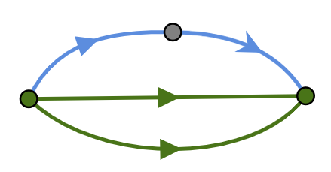
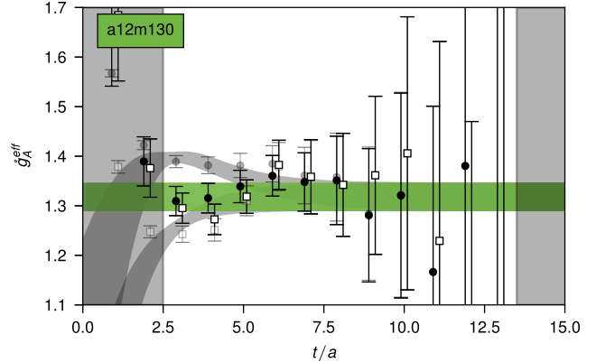
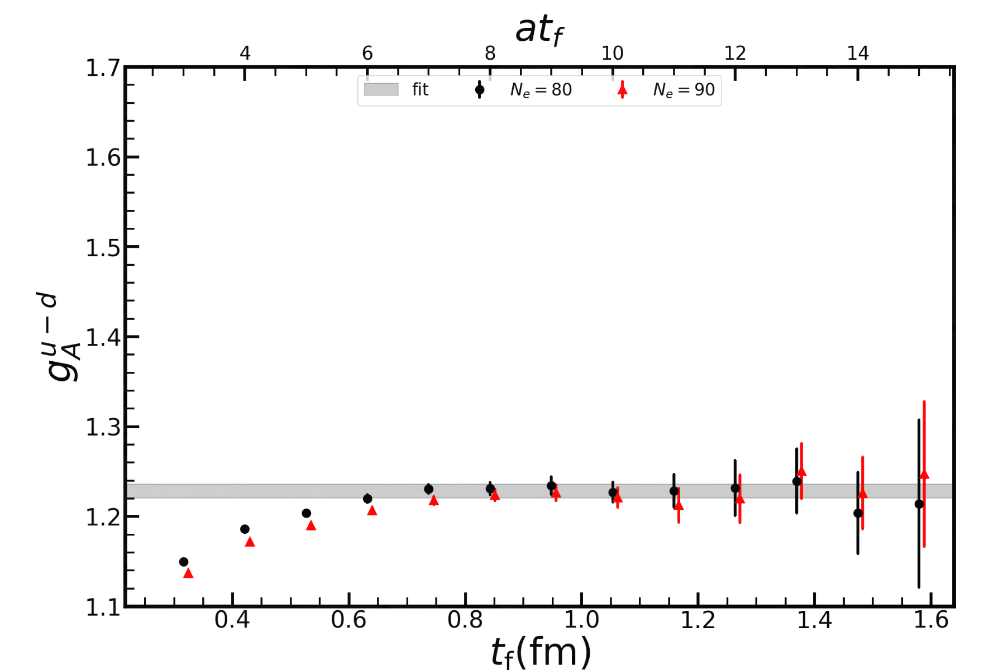
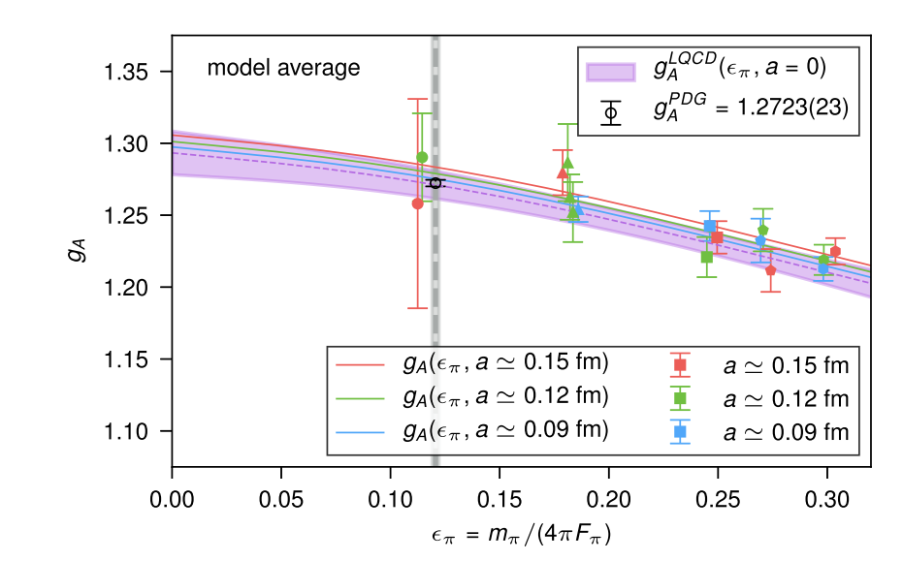
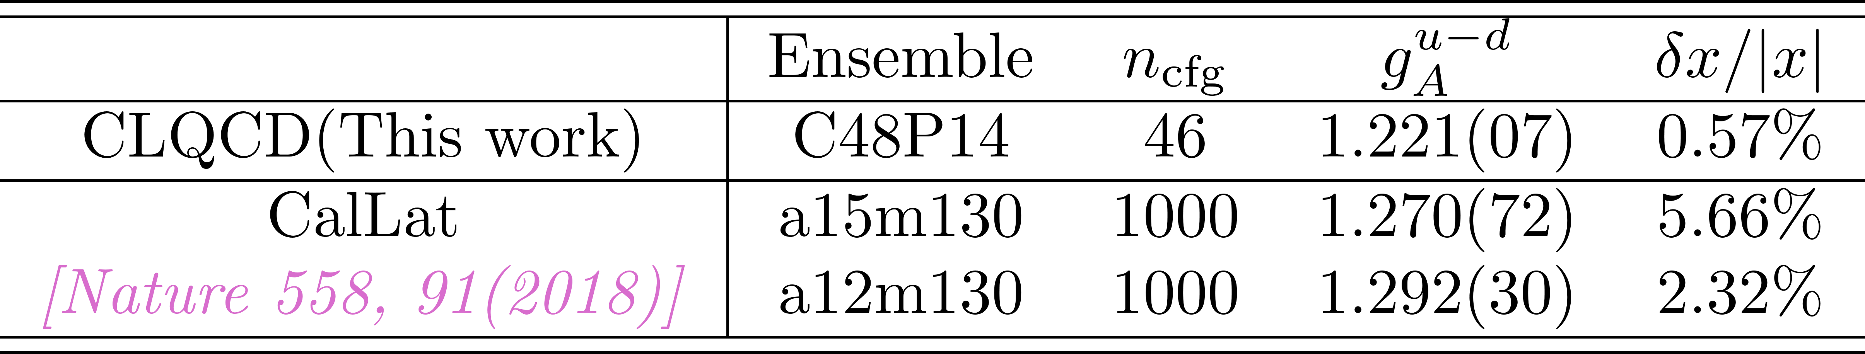

Application: Determine Nucleon ME with high precision
We observe substantially improved results at the physical point($m_{π}=135MeV$);
$$\hat{A}$$
This work
C48P14
preliminary
Nature 558,91 (2018)
preliminary

Slide 13
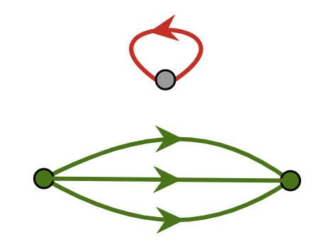
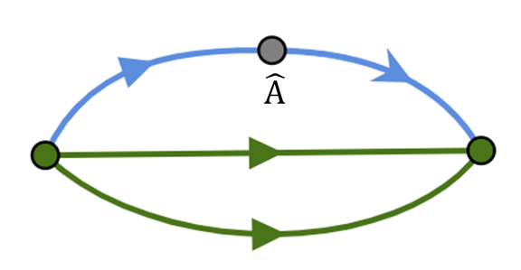
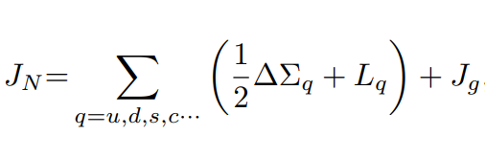
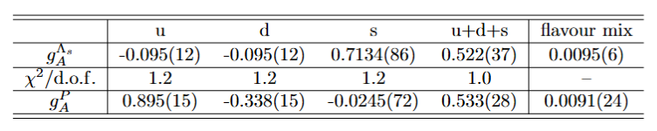
Application: Determine flavor singlet physics with high precision
Quark Loop contribution is the Main uncertainties for quark $g_{A}$
u,d,s
Traditional method need $𝒪(1000)$ configurations and $𝒪(1000−10000)$ inversion of propagator to get similar uncertainties on each ensemble.
P.R.D 98, 094512(2018), P.R.D 102, 054517(2020)
Statistical uncertainty of “Blending” converges at $N_{st}≈20$ for $g_{A}$.

Slide 14
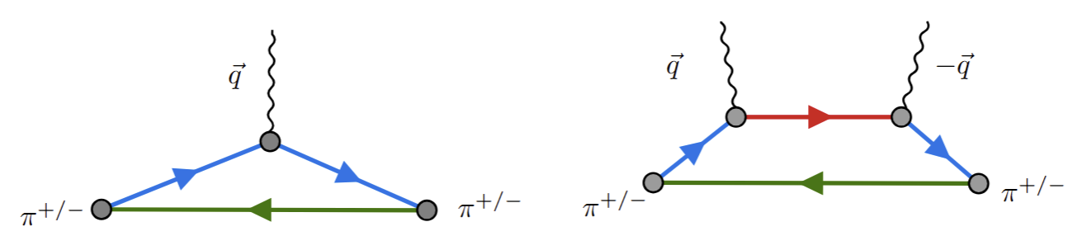
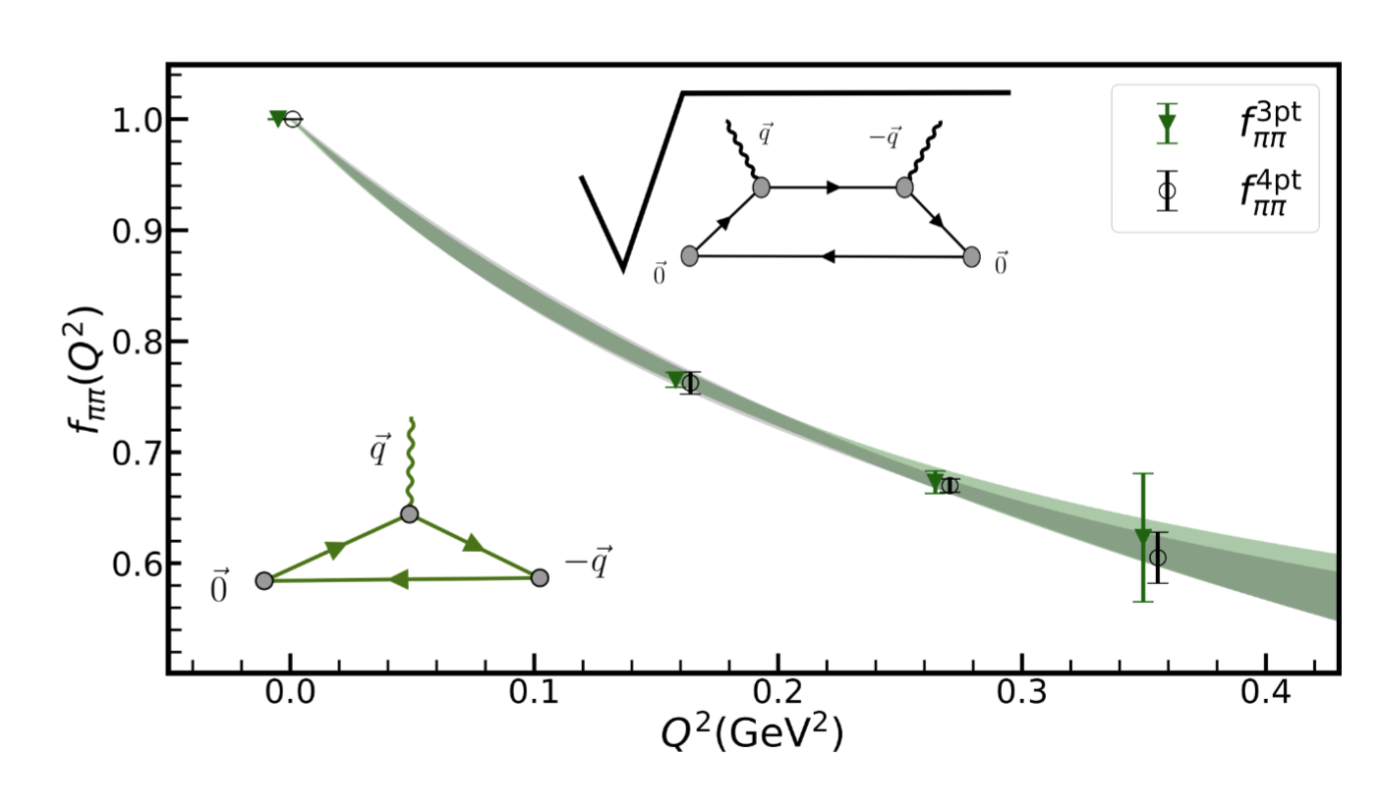
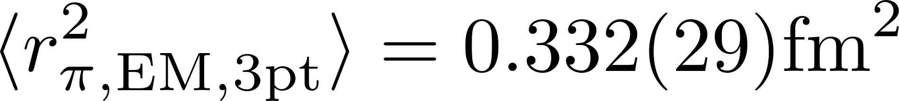
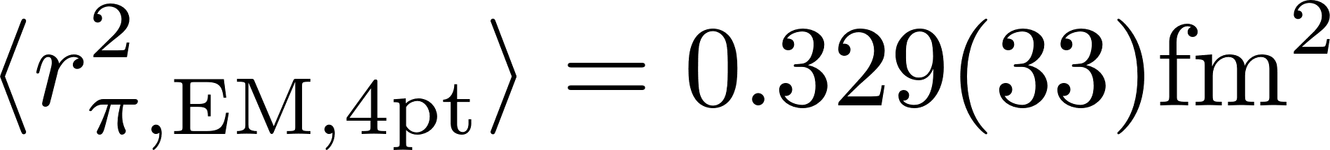

Application: Multiple-Point Function
Many physical processes depend on multi-point functions, $\left\langle H\left|𝓞_{1}\left(t_{1}\right)𝓞_{2}\left(t_{2}\right)⋯𝓞_{n}\left(t_{n}\right)\right|H\right\rangle$;
Pion EM form factor
Single photon exchange
Two photon exchange
$$n_{cfg}=90$$
The 'blending' method successfully extracts the 4-point function signal and shows consistency with the 3-point results.

Slide 15
Summary
LQCD is a powerful tool, but it is very expensive, especially for nuclear system.
We figure out the blending Method, it can reduce the cost a lot. It can be use to calculate Multiple-Point Function and disconnect diagrams.
We will apply this method to more complicated problem like nuclear effect in 0vββ decay.

