Slide 1



Good LO Hunting
—Chiral EFT for Nuclear Forces
Bingwei Long
Sichuan University
In collaboration with Songlin Lyu, Lin Zuo, Rui Peng & Sebastian Koenig

Slide 2
Outline
From chiral Lagrangian to nuclear forces
Simplifying EFT nuclear forces:
  Towards perturbative-pion interaction: Why and How?

Slide 3
Outline
From chiral Lagrangian to nuclear forces
Towards perturbative-pion interaction: Why and How?
Halo/Cluster EFTs at very-low momenta (no pions at all)
Understanding Luscher’s formula by energy-dependent EFT
Combining the operator product expansion with nuclear EFTs

Slide 4


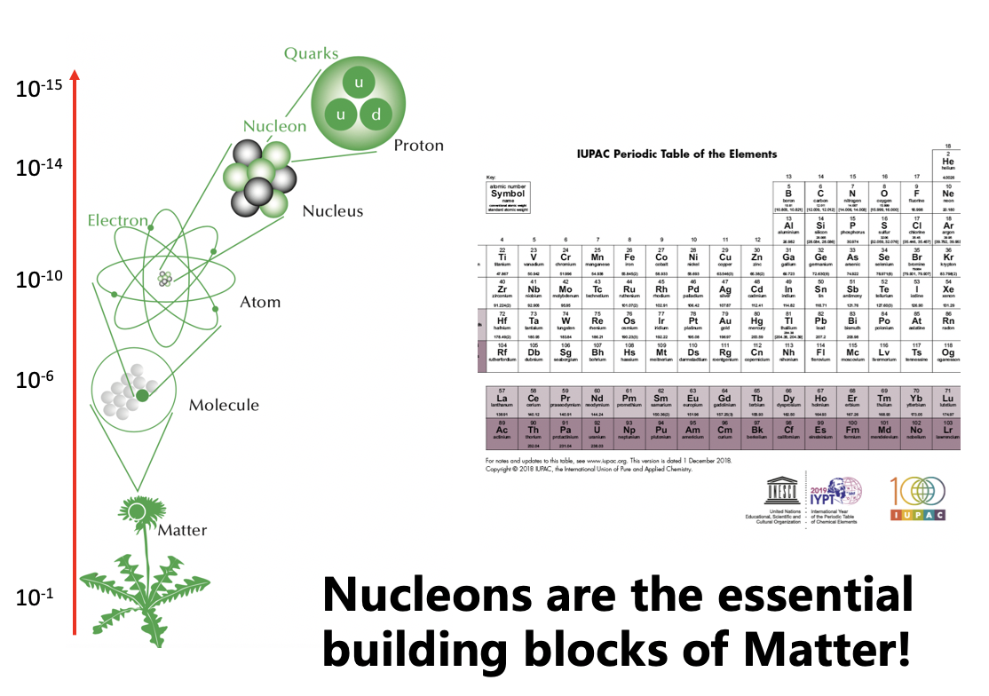
粒子物理与核物理结合，大有可为

Slide 5
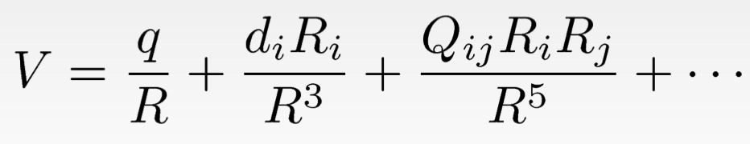
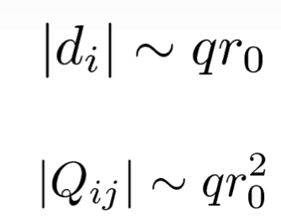
Multipole expansion
A classical example of EFT
Observer
R
r0
charge distribution
Separation of scales: R >> r0
Controlled approximation, able to estimate uncertainty
Naturalness
⇒ power counting based on naive dim. analysis (NDA)
What if it is a rod?
Slow convergence of a regular PC ⇒ possible fine-tuning ⇒ change PC

Slide 6




Hierarchy of EFTs
Momentum / Energy
beyond SM
10? TeV
Standard Model
MH
100 GeV
1 GeV
Chiral EFT
~ 100 MeV
45 MeV
Pionless EFT
Halo
Cluster
8 MeV

Slide 7

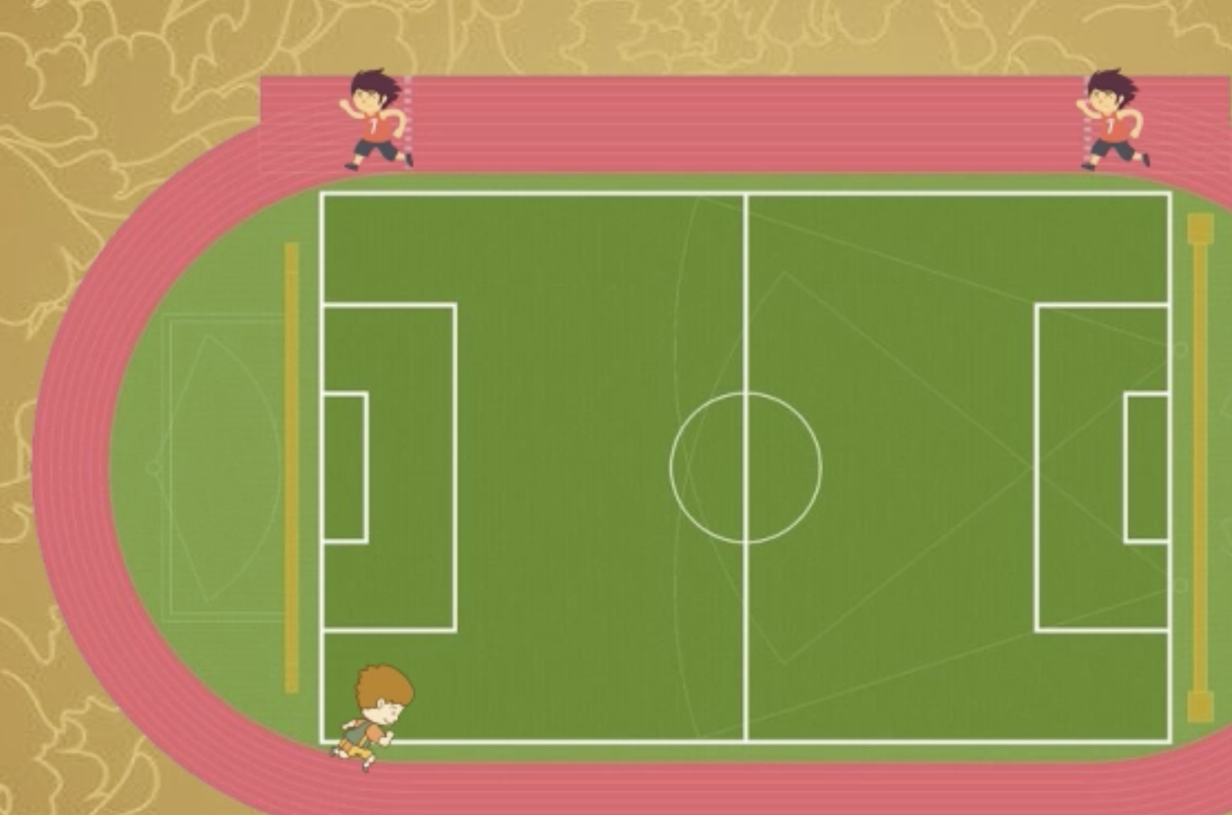


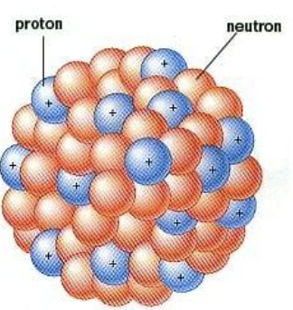
Relay: from quarks & gluons to Uranium
Low-energy constants
Chiral EFTs
Lattice QCD
²H & ³H
A: number of nucleons ↑
Light nuclei : A = 4 ~ 12
Cluster/Halo EFTs/Other EFTs
Many-body methods

Slide 8
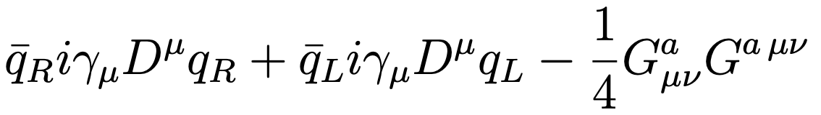
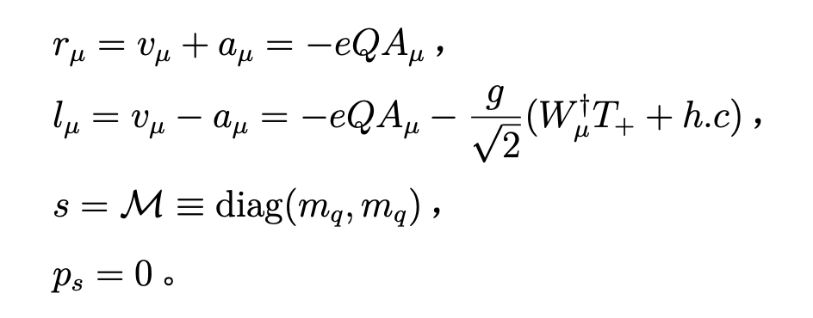
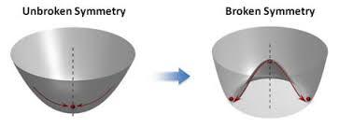
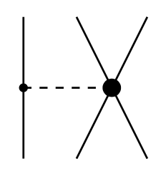
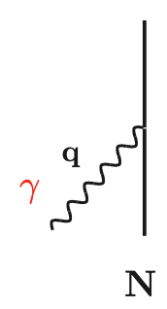
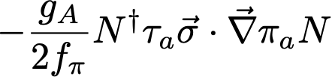




QCD → Chiral Lagrangian
External sources: v, a, s, ps
$$ℒ_{QCD}=$$
Incomplete!
nonlinear realization
CCWZ; Weinberg; …
$$C_{D}$$
Constraints by chiral symmetry

Slide 9
QCD → Chiral Lagrangian
External sources: v, a, s, ps
$$ℒ_{QCD}=$$
+ …
nonlinear realization
CCWZ; Weinberg; …
Constraints by chiral symmetry
$$C_{D}$$
Wavy lines: axial currents

Slide 10
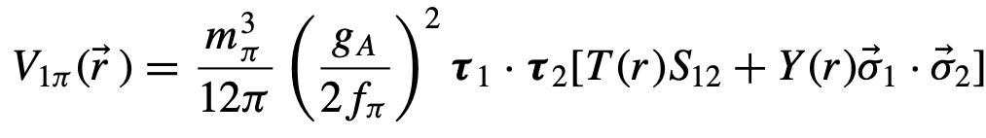


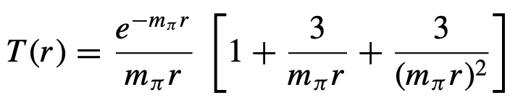
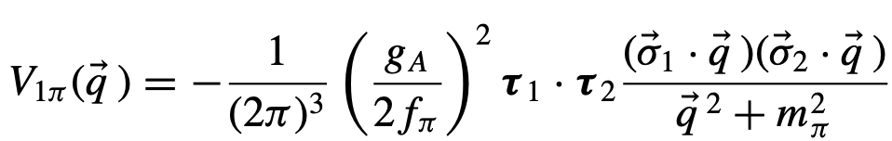
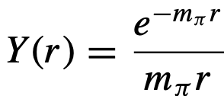
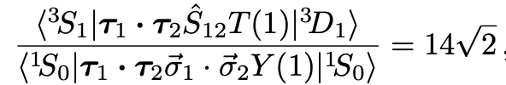

Potential diagrams
One-pion exchange
F.T.
Many contact terms parametrize NN short-range forces, e.g.,

Slide 11
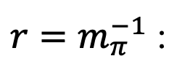
Potential diagrams
One-pion exchange
Tensor F
Tensor force dominant
$r=m_{π}^{−1}$ :
Many contact terms parametrizing NN short-range forces, e.g.,
For Q << mpi —> pionless EFT w/ only contact interactions

Slide 12
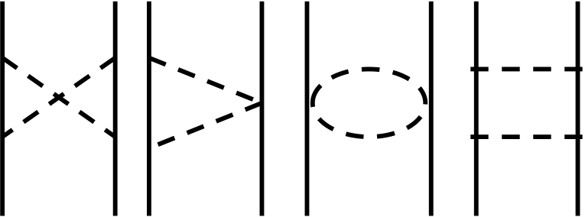
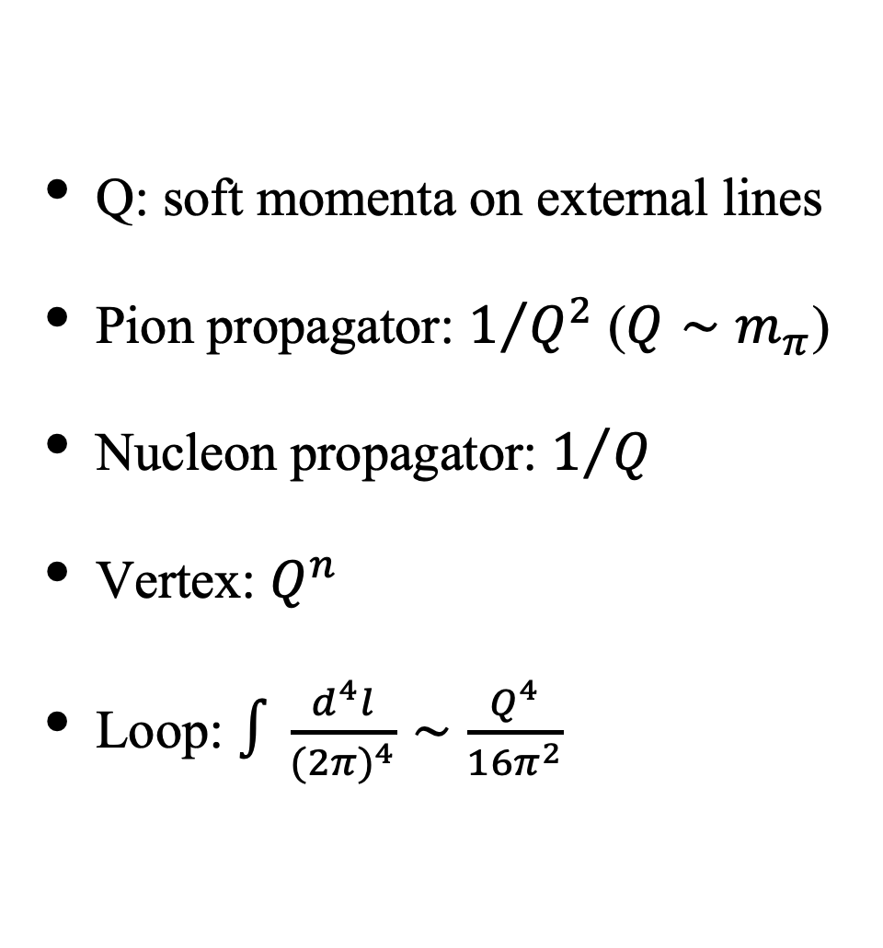
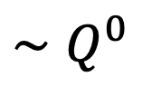
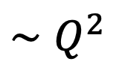
Power counting diagrams
$$∼Q^{0}$$
Q: soft momenta on external lines
Pion propagator: $1/{Q^{2}}$ ($Q∼m_{π}$)
Nucleon propagator: $1/Q$
Vertex: $Q^{n}$
Loop: $∫\frac{d^{4}l}{(2π)^{4}}∼\frac{Q^{4}}{16π^{2}}$
$$∼Q^{2}$$

Slide 13
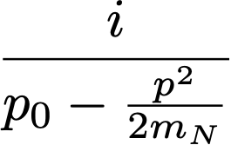
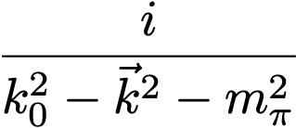
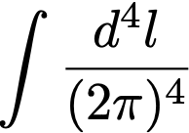
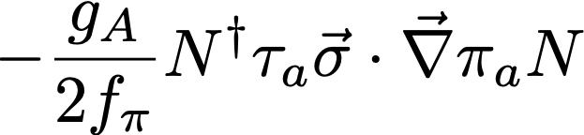
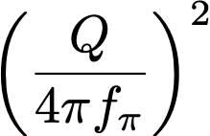
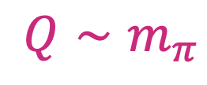
Power counting for loops (HBChPT)
Nucleon propagator — 1/Q or mN/Q²
Pion propagator — 1/Q²
Loop integral — Q⁴/(16π²)
Vertex with ν derivatives — Q^{ν}
A pion loop brings a suppression factor of
$$Q∼m_{π}$$

Slide 14
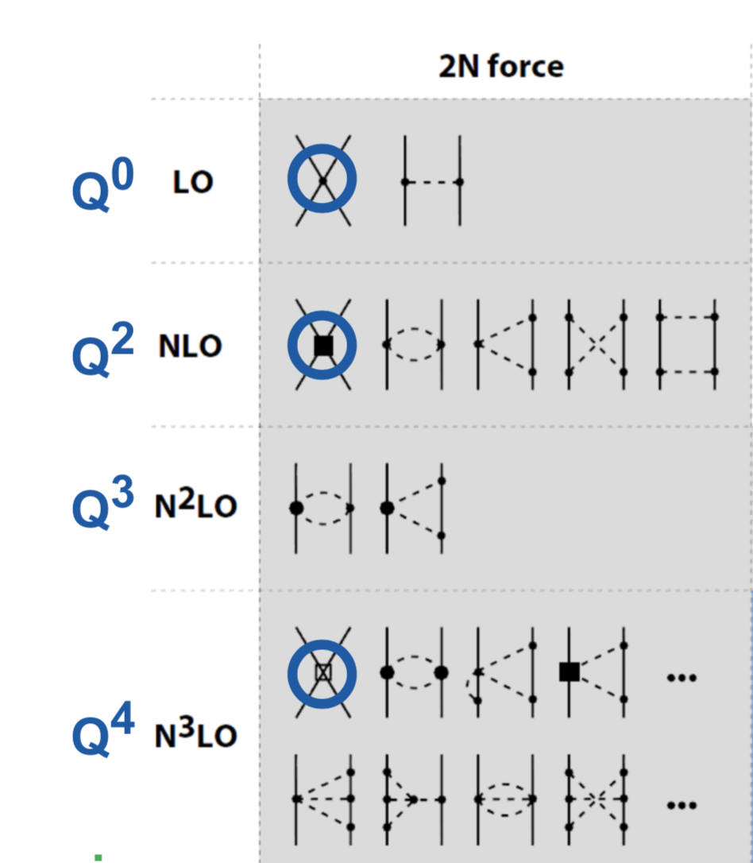
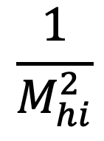
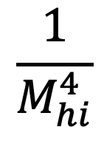
NN potentials from ChEFT
Contact forces doing heavy lifting
$$\frac{1}{M_{hi}^{2}}$$
24 contact terms
in NDA up to Q⁴
NDA = naive dim. analysis
$$\frac{1}{M_{hi}^{4}}$$
van Kolck et al. ’92
Entem & Machleidt ’03
Epelbaum et al. ’99
Pastore, Piarulli, et al. ’09
Ekstrom, et al. ’13
…
To promote, or not to promote ?

Slide 15
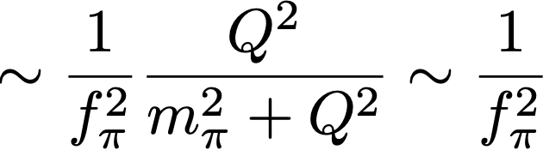
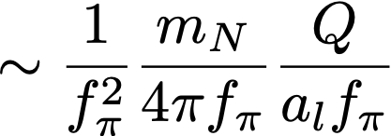
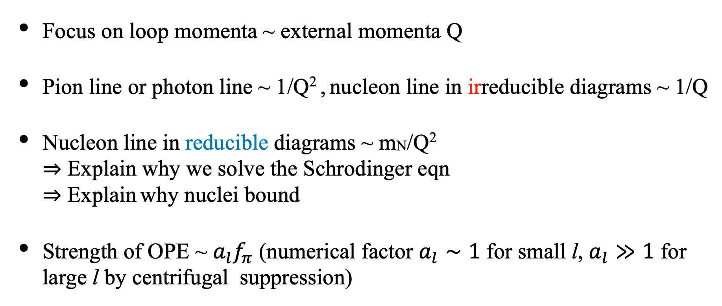
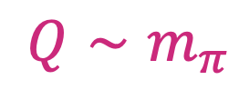
Strength of OPE
Typical size of external momenta:
$$Q∼m_{π}$$
NN reducible
Focus on loop momenta ~ external momenta Q
Pion line or photon line ~ 1/Q² , nucleon line in irreducible diagrams ~ 1/Q
Nucleon line in reducible diagrams ~ mN/Q²
⇒ Explain why we solve the Schrodinger eqn
⇒ Explain why nuclei bound
Strength of OPE ~ $a_{l}f_{π}$ (numerical factor $a_{l}∼1$ for small l, $a_{l}≫1$ for large l by centrifugal suppression)
Notes:
there must be low-energy scales to enhance contacts
MNN is like Bohr radius, emerging out of QM dynamics

Slide 16
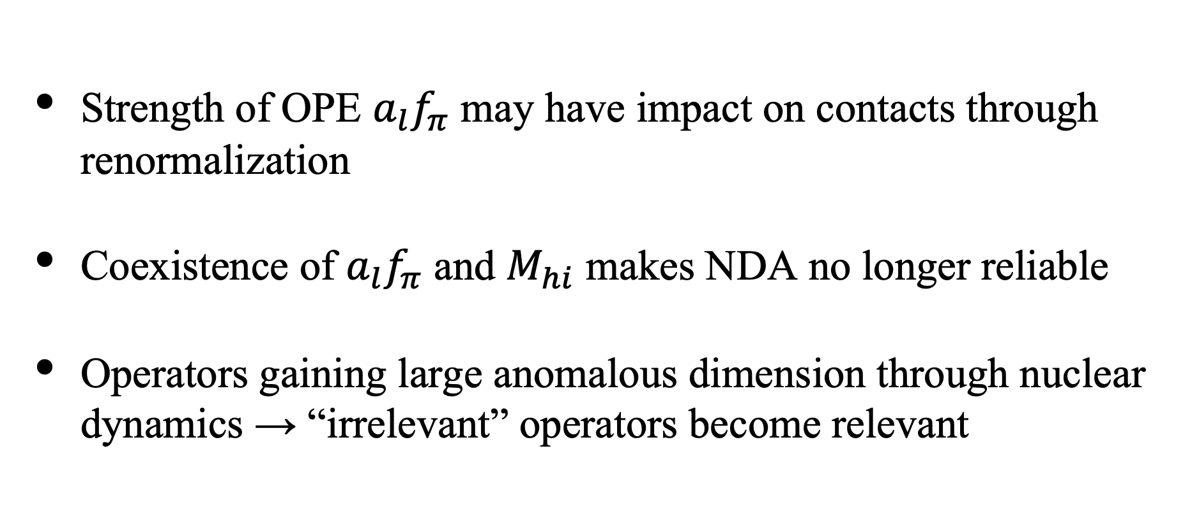
Power counting: short-range physics
Renormalizing
Strength of OPE $a_{l}f_{π}$ may have impact on contacts through renormalization
Coexistence of $a_{l}f_{π}$ and $M_{hi}$ makes NDA no longer reliable
Operators gaining large anomalous dimension through nuclear dynamics → “irrelevant” operators become relevant
Notes:
there must be low-energy scales to enhance contacts
MNN is like Bohr radius, emerging out of QM dynamics

Slide 17

UV cutoff
“NN Potential”: two-nucleon irreducible diagrams
=
…
$$V$$
Λ: UV cutoff
Lippmann-Schwinger eqn (equivalent to Schrodinger eqn)
T
=
V
+
V
V
+
…
T
=
V
+
V
T

Slide 18
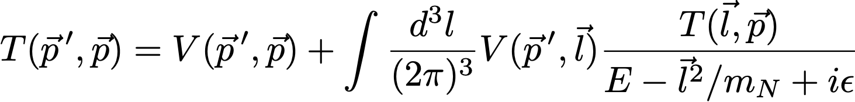
Lippmann-Schwinger equation
T
=
V
+
V
T
Nucleons only propagate “forward”, so l0 can be integrated out
Otherwise, antifermion-fermion pairs make this a many-body problem
p << mN, relativistic corrections added as perturbations
A = 3, 4 … nonrelativistic few-body diagrams similarly resummed
Regularized by UV cutoffs, numerically solved

Slide 19
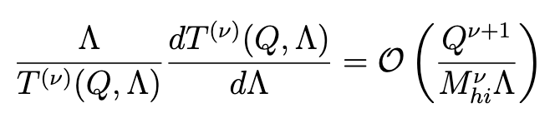
Renormalization group and power counting
Power counting of subleading pot. = how (ir)relevant they are in
Wilson's RG
Program1: Explicitly solving RG equation → PC of contacts
Program 2: Speculating a PC and testing it against cutoff indep
→ one possible solution of RGE, thus an acceptable PC
Birse et al. ’99
Pavon Valderrama & Phillips ‘15

Slide 20
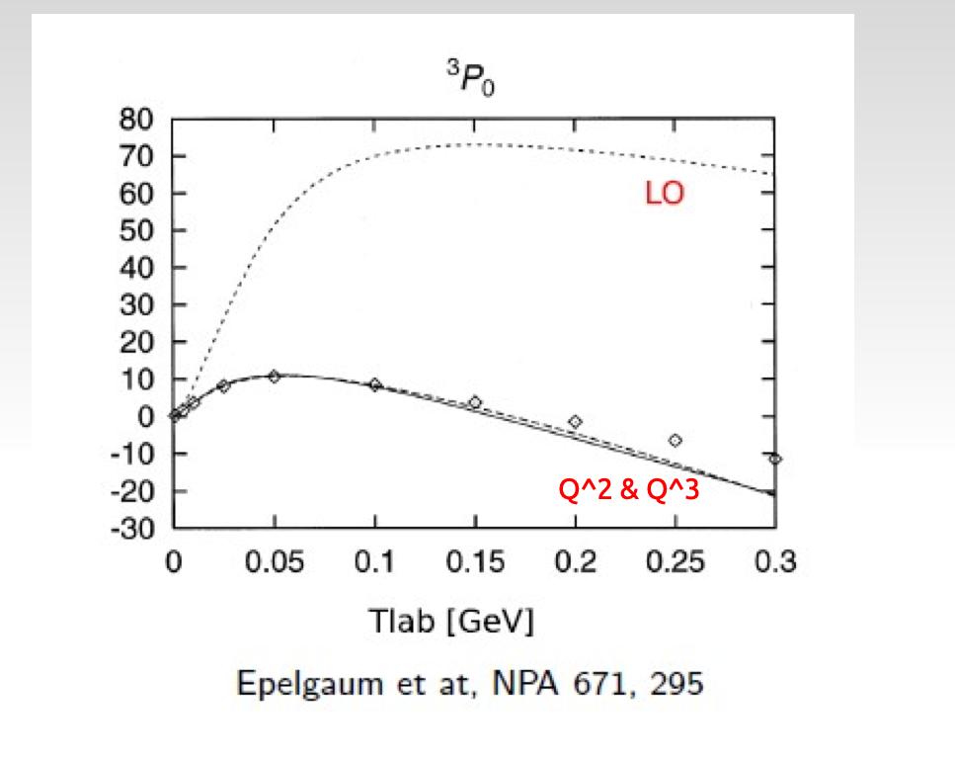
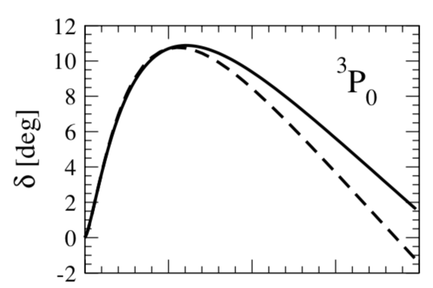

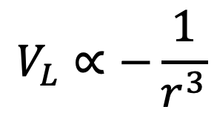
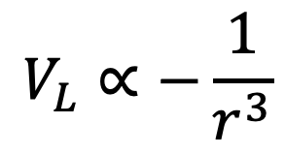
Renormalizing singular attraction
Beane et al (’01)
Pavon Valderrama & Ruiz Arriola (’05 ~ ’07)
Nogga et al (’05)
V
r
Vs
Unphysical bound states
V
r
Modify PC
$$V_{L}∝−\frac{1}{r^{3}}$$
⟹
$$V_{L}∝−\frac{1}{r^{3}}$$
Λ⁻¹
Λ⁻¹
LO
PWA
Nogga et al (’05)
Notes:
Nontrivial that this can be done

Slide 21
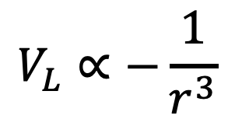
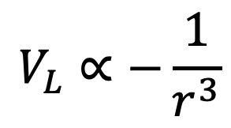
Renormalizing singular attraction
Beane et al ’01
Pavon Valderrama & Ruiz Arriola ’05, ’07
Nogga et al ’05
BwL & van Kolck ’07
Regularized contact potentials
V
r
Vs
Unphysical bound states
V
r
Modify PC
$$V_{L}∝−\frac{1}{r^{3}}$$
⟹
$$V_{L}∝−\frac{1}{r^{3}}$$
Λ⁻¹
Λ⁻¹
Notes:
Nontrivial that this can be done

Slide 22
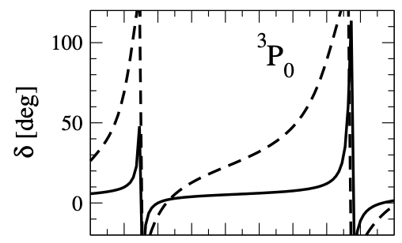

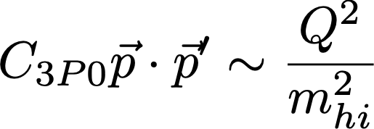
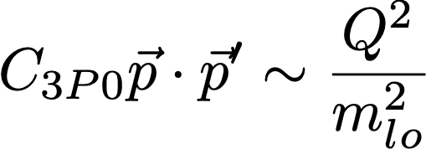
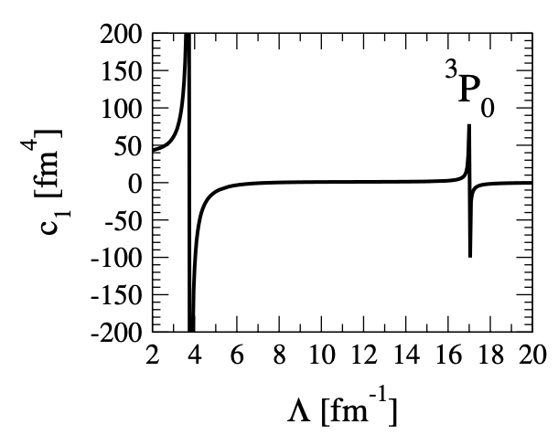
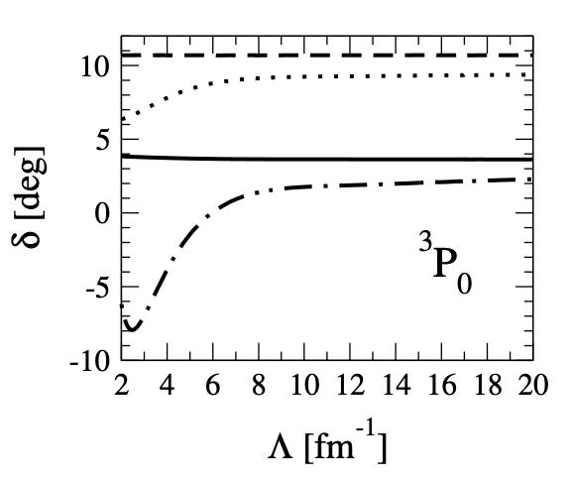
Renormalizing singular attraction
Nogga, Timmerman & van Kolck (2005)
Manifestation via cutoff dependence
Solid: Tlab = 10 MeV, dashed: 50 MeV
Phase shifts vs. Λ :
Solution: change power counting
promote

Slide 23
Renormalizing singular attraction
promote
LO
PWA
Nogga et al (’05)

Slide 24
Can we simplify these nuclear interactions?

Slide 25
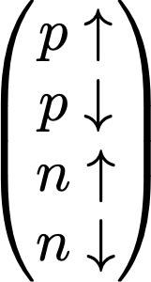
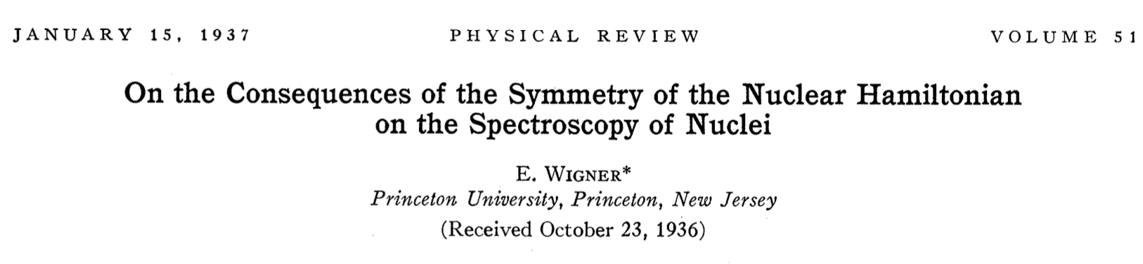




A motivation: Wigner SU(4) symmetry
Approximate SU(4) invariance of nuclear forces
SU(4) transformation
Interactions between NN pairs : (S = 0, T = 1) ≈ (S = 1, T = 0)
2-body:
$a_{1S0}≃−20$ fm ; $a_{3S1}≃5$ fm
$$\frac{1}{−1/a+\frac{r}{2}k^{2}+⋯−ik}$$
Approximate degenerate states of nuclei:
⁴He, ¹²C, ¹⁶O, etc. can be viewed as alpha clusters
Filled

Slide 26




Wigner symmetry via Chiral EFT?
OPE tensor force breaks SU(4), badly
Tensor F
$r=m_{π}^{−1}$ :
But, SU(4) can implemented in pionless EFT by letting CT to be perturbation

Slide 27

Success of pionless-like interactions
Microscopic explanation for recent pionless-like (short-ranged) structure calculations:
Koenig et al. ’16
Lyu BN et al. ’18
Gattobigio et al. ‘19
…
Lyu et al. ’18, Lattice EFT calaboration

Slide 28



Perturbative pions?
Kaplan, Savage & Wise ’98
Fleming, Mehen & Stewart ’99
Beane, Kaplan & Vuorinen ’08
Same LO as pionless:
LO of NN = bubble sums =
Subleading orders = distorted-wave expansion in OPE
NLO:
+ …
N2LO:
+ …

Slide 29





Where KSW works
Wu & Long ’18
Kaplan ‘19
OK for $k<Δ≃290$ MeV for $l>0$ except 3P0
TPEs included in N3LO & N4LO
Wu & Long ’18
NLO
N4LO
N2LO
N3LO

Slide 30


KSW
Fleming, Mehen & Stewart ’99
Convergence not better than pionless, esp. for higher waves
N2LO
N2LO
PWA
PWA
NLO
NLO
N2LO + C4

Slide 31


KSW
Fleming, Mehen & Stewart ’99
Convergence not better than pionless, esp. for higher waves
N2LO
NLO
NLO
N2LO
PWA

Slide 32





Pushing pert-pion interactions
Nonpert ren of OPE
$V_{π}$ + $C_{3P0}p^{′}p$
Re-organizing higher contact terms
Vs
V
$$V_{π}$$
r
$$V_{L}∝−\frac{1}{r^{3}}$$
Λ⁻¹
From nonpert renormalization: Vs always repulsive (towards lower $Λ$)
Using Vs to moderate the OPE tensor force

Slide 33




PPI in 3P0
Peng, Lyu & BwL ’20
Expansion in $V_{π}$ + $C_{3P0}p^{′}p$ (Born approximation)
Higher-order contacts are identified when needed for renormalization at second, third-order Born approximation
Updated fit
$Λ=800$ MeV
NLO
N2LO
N3LO

Slide 34





PPI: 3S1-3D1
Lyu, Zuo, Peng, Koenig & BwL
Mixing angle vanishing at unitarity & chiral limits despite strong OPE tensor force
$ε_{1}$=
$m_{π}→0$ :

Slide 35

PPI: 3S1-3D1
Not enough though
Only works for on-shell kinematics
N2LO 3D1, mixing angle are large
N2LO
PWA
NLO
D
S
D
NLO
N2LO

Slide 36


PPI: 3S1-3D1
Expansion in ($V_{π}$ + SD mixing contact)
D
S
D
}
Cancellation

Slide 37





PPI: 3S1-3D1
PC of high-order contacts by counting divergence
$Λ=800$ MeV
Preliminary
N3LO
N2LO
NLO
Lyu, Zuo, Peng, Koenig & BwL

Slide 38

Summary
A new perturbative-pion scheme with re-organized contacts
Simplify LO nuclear interactions to emphasize accidental symmetries like SU(4)-Wigner, unitarity limits, etc.
W/ larger validity range and 3NF at LO, implies 3NF important even for Q > $m_{π}$

