Slide 1

Effective Field Theories for Neutrinos
Shun Zhou
Institute of High Energy Physics, Beijing
1st Symposium on Neutrinos, Nuclear Physics & New Physics (νNN2025)
IMP, Lanzhou, July 22, 2025

Slide 2
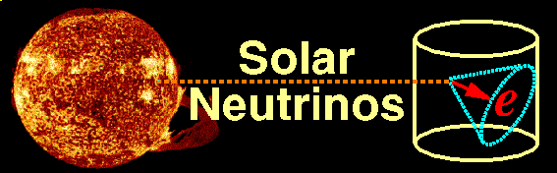
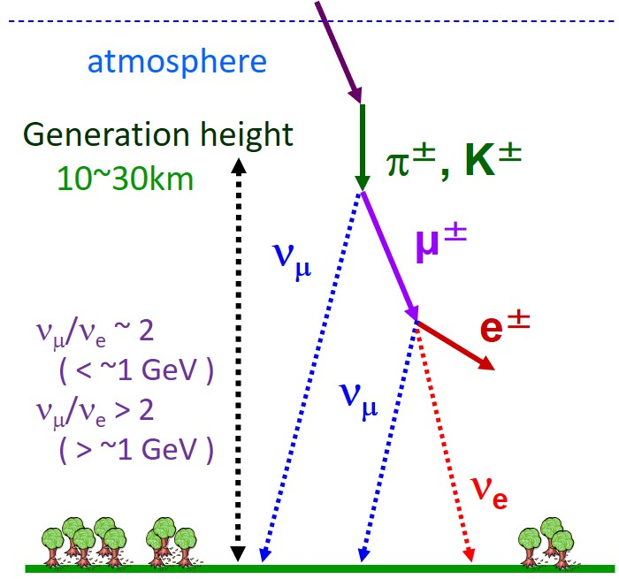
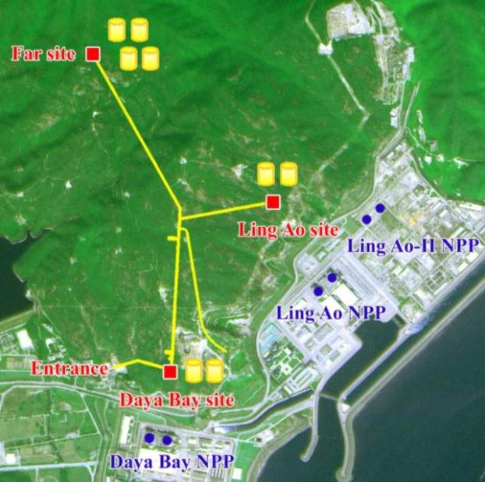
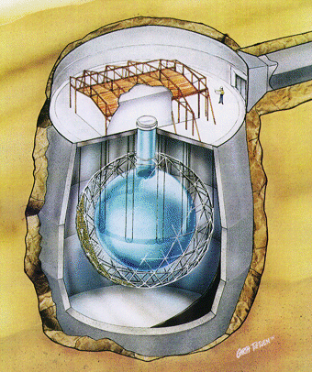
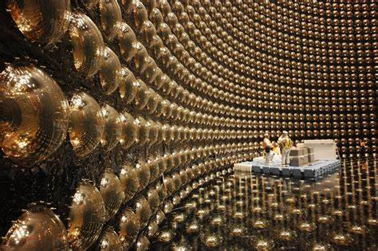
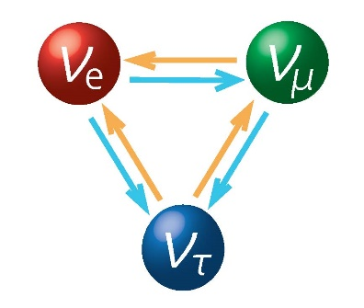


Discovery of Neutrino Oscillations
Daya Bay
SNO
Evidence for New Physics
Neutrinos are actually massive !!
Large lepton flavor mixing exists
Nobel Prize in 2015
Super-K

Slide 3
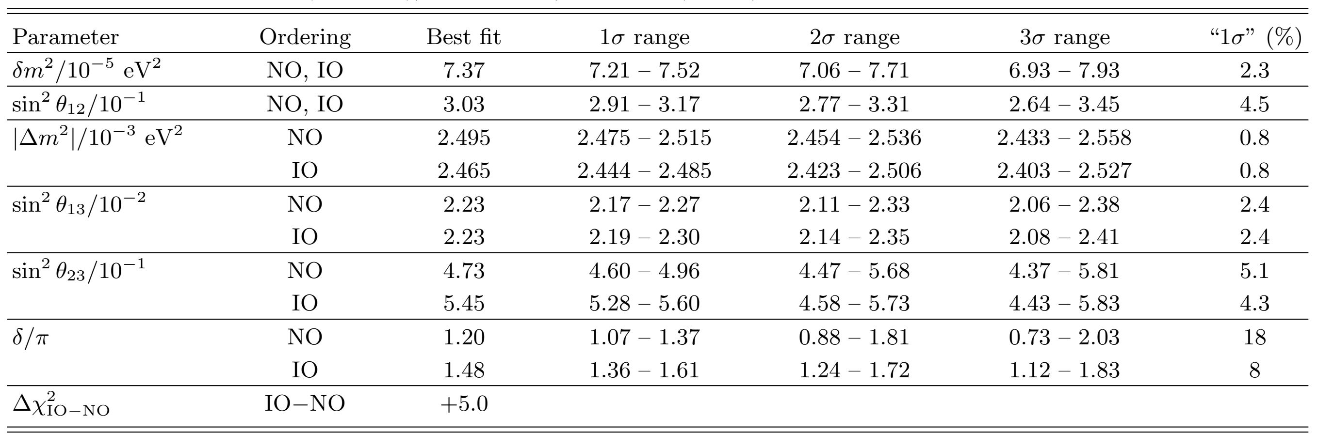
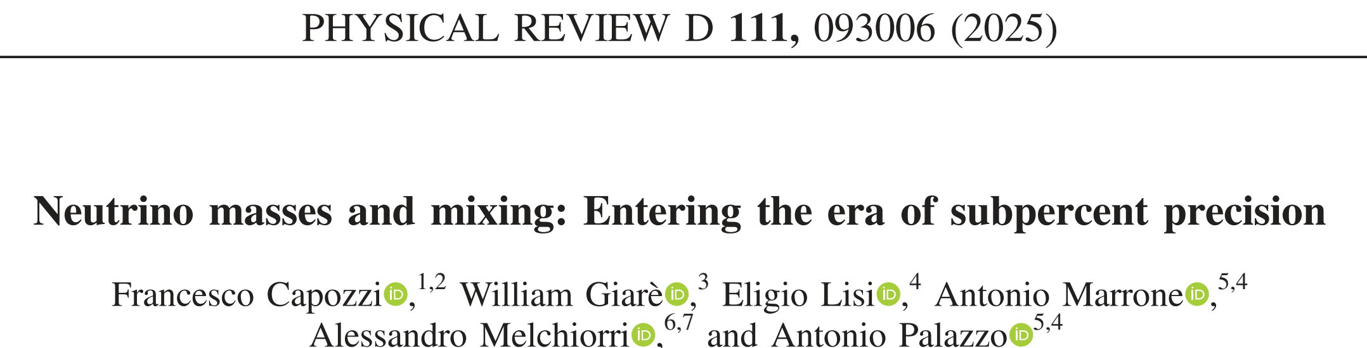
Current Status of Neutrino Oscillations
Latest global-fit analysis of neutrino oscillation data
More challenging questions:
2503.07752
Absolute neutrino masses
Majorana nature of neutrinos
Origin of neutrino masses

Slide 4
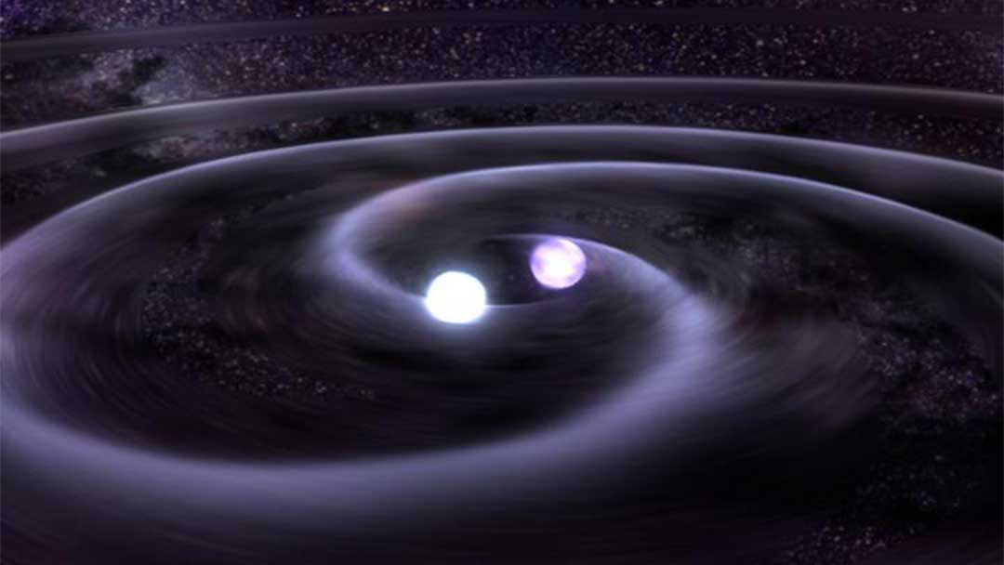
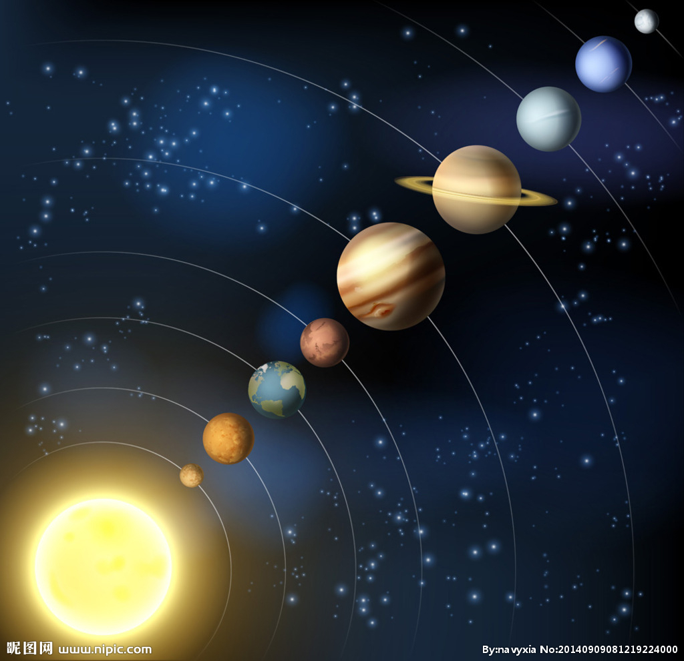
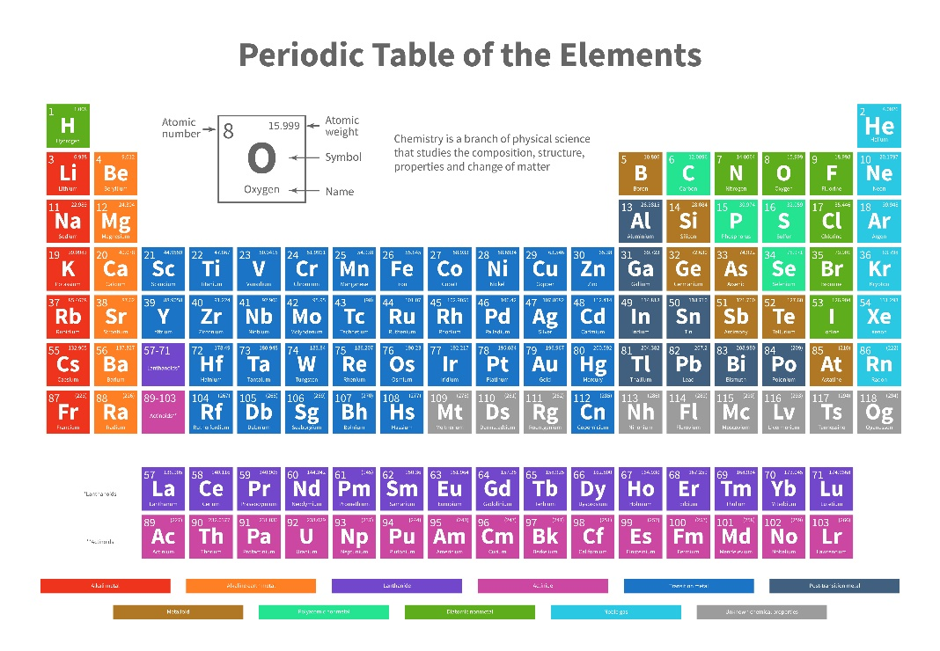
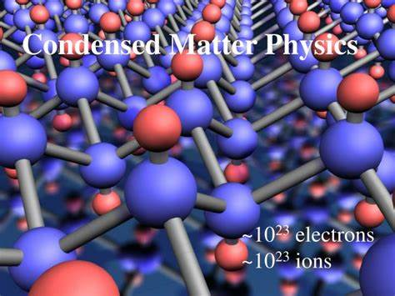

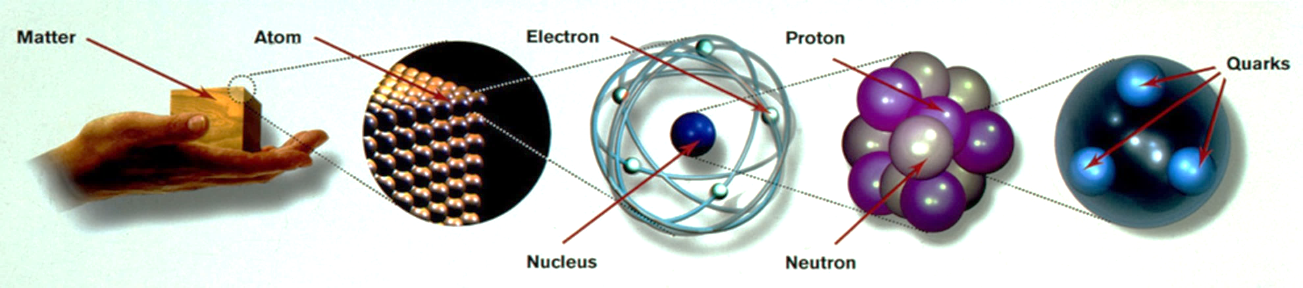
A. Introduction to EFTs
Phenomena at various different scales
Focus on one scale leads to one discipline
Systematic methods for multi-scale problems

Slide 5
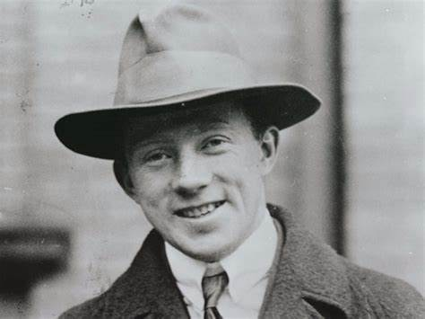
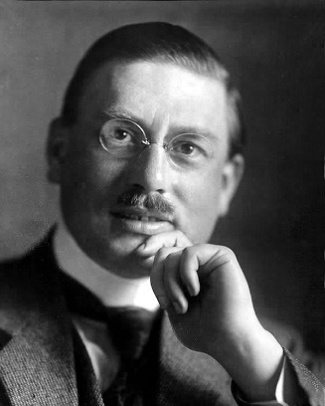
The Euler-Heisenberg Effective Lagrangian
A realistic example in Quantum Electrodynamics (QED)
Dittrich, IJMPA, 2014
Question raised to Heisenberg by Debye: @Leipzig U. in mid-1930s
Is there a light-by-light scattering in Dirac’s theory of electrons?
If so, there will definitely be a modification of Maxwell’s equations
Then Heisenberg assigned this task to his PhD student-Hans Euler
H. Euler, PhD thesis, Ann. Phys. 26, 398 (1936)
Hans Euler was killed in the World War II, already missed on June 21, 1941, one day before the Nazi Germany started the war against the Soviet Union
H. Euler & B. Kockel, Naturwissenschaften 23, 246 (1935)
W. Heisenberg & H. Euler, Z. Phys. 98, 714 (1936)
Low-energy light-by-light scattering induced by the electrons and positrons
The EH effective Lagrangian for constant background EM fields (cf. Euler-Kockel in weak-field limit)

Slide 6
The Euler-Heisenberg Effective Lagrangian: bottom-up approach
The EH effective Lagrangian in modern language
Grozin, Lectures on QED and QCD, 2007
Grozin, 0908.4392
In the world of only low-energy photons, we can write down the dimension-4 (dim-4) terms
light
light
Lorentz- and gauge-invariant terms in the Lagrangian
light
light
Retain further known symmetries (C- and P-parities)
Include all possible dim-6 and dim-8 invariant terms
No scattering
Scattering observed
How to construct the basis of high-dim. operators
First, specify the building blocks of high-dim. operators and their representations under symmetry groups
Gauge invariant Lorentz tensor
Mass dim.
Second, power counting of 1/Λ (inverse cutoff) to figure out all possible operators at a given mass dim.
Find out all gauge & Lorentz invariant dim-4 operators and see why only the ordinary term in L₀ is kept.
Dim-6:
①
②
③
④

Slide 7
The Euler-Heisenberg Effective Lagrangian: bottom-up approach
Third, implement integration by parts (IBP), the equation of motion (EoM) and the (Bianchi) identities to get rid of redundant operators
Example: Demonstrate that no dim-6 operators exist
①
reflecting the conservation of C-parity
②
Bianchi identity
②
③
②
③
Total derivative
④
Equation of motion
④
When the EoM is applied, one can immediately see that all the dim-6 operators vanish

Slide 8
The Euler-Heisenberg Effective Lagrangian: bottom-up approach
Dim-8:
Another form of the dim-8 operators via
[c₁] = [c₂] = -4
Transformation between two different bases of dim-8 operators
Rewrite the Lagrangian in terms of operators in the new basis
c₁
c₂
Note: We have constructed the effective Lagrangian for low-energy photons based only on symmetry arguments (Lorentz, gauge, C and P), and thus the coefficients in front of the operators are arbitrary constants.

Slide 9
The Euler-Heisenberg Effective Lagrangian: bottom-up approach
The EFT as a quantum field theory with the following Lagrangian
Particle content: photon; Coupling constants: c₁ and c₂
Let’s go to the one-loop order in the EFT
Phenomenological Lagrangians
Massless loop
Working at the order of 1/Λ⁴
No corrections to the photon self-energy
Couplings also need not be renormalized
Too simple to reveal more features
Weinberg, Physica 96A (1979) 327

Slide 10
The Euler-Heisenberg Effective Lagrangian: top-down approach
Feynman diagrams in QED for the light-by-light scattering
Grozin, 0908.4392
We do have a perfect theory of photons and electrons/positrons
Karplus & Neuman, Phys. Rev. 80 (1950) 380
Constantini et al., Nuovo Cim. A 2 (1971) 733
Left: 3 diagrams + fermion lines in the opposite direction
Consider γ (μ₁, p₁) + γ (μ₂, p₂) → γ (ν₁, p₁) + γ (ν₂, p₂) and |p₁|, |p₂| << M
Dimensional regularization
Amplitude in QED
Amplitude in the EFT
Finite in d = 4 –2ε → 4
The cutoff scale Λ = M
Matching between the full theory and the EFT

Slide 11
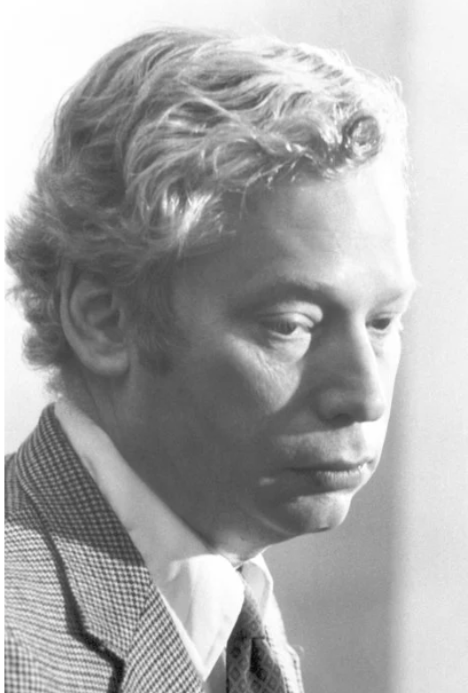
B. Bottom-up Approach to New Physics: SMEFT
Given evidence for possible new physics, the SM should be viewed just an effective field theory at the electroweak scale (called the SMEFT)
Given the field content and symmetries of the SM, one may think it is straightforward to construct the basis of operators of mass dimensions higher than four. But not…
The dim-5 operator is unique
Mass dim. @d = 4
Lorentz-invariant combinations
Weinberg, 79
Balsiger et al., 2005.08573
Check gauge invariance
Unique dim-5 Weinberg operator for Majorana neutrino masses
Correctly estimate neutrino masses and predict that they are observable in neutrino oscillation experiments

Slide 12
Operator Basis of the SMEFT
Systematic analyses of dim-6 operators in the SMEFT
Buchmuller & Wyler, NPB, 1986
Gauge invariance
Total derivatives
Redundant via EoM
Balsiger et al., 2005.08573
Leung, Love & Rao, ZPC, 1986
within each class
Fermion Fierz identities
Lie group Fierz identities
Flavor identities
Aguilar-Saavedra, 1008.3562
Grzadkowski et al., 1008.4884
The Warsaw basis
Higgs field
For example
Fermion fields
Gauge fields
Choose less number of derivatives
Hermitian derivative

Slide 13
Warsaw Basis
The Warsaw basis of dim-6 operators in the SMEFT: in total 59 operators conserving B and L
4
1
2
3
8
8
8
Four-fermion operators: 25
Grzadkowski et al., 1008.4884
Very rich phenomenology at the energy / intensity / cosmology frontiers, which are under active studies

Slide 14
Number of Operators
Henning, Lu, Melia, Murayama, 1512.03433
Li et al., 2005.00008
Buchmuller & Wyler, 86
Murphy, 2005.00059
Grzadkowski et al., 1008.4884
Harlander, Kempkens & Schaaf，2305.06832
up to dim-12
Li et al., 2007.07899
Liao & Ma, 1607.07309
Liao & Ma, 2007.08125
Weinberg, 79
Lehman,1410.4193
Counting of independent operators up to dim-15

Slide 15
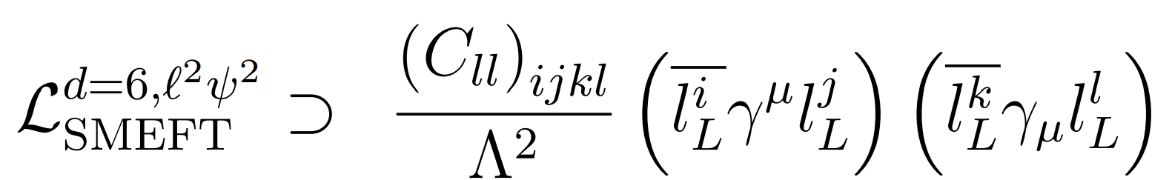
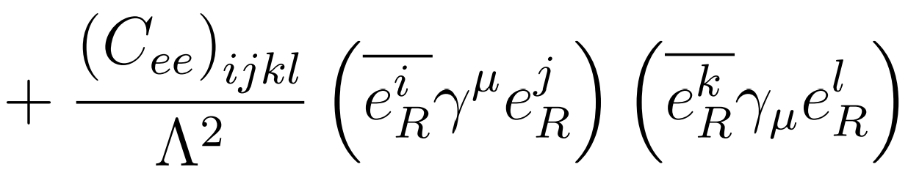
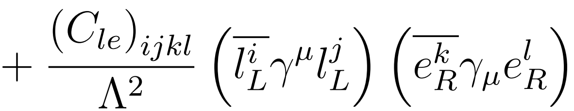
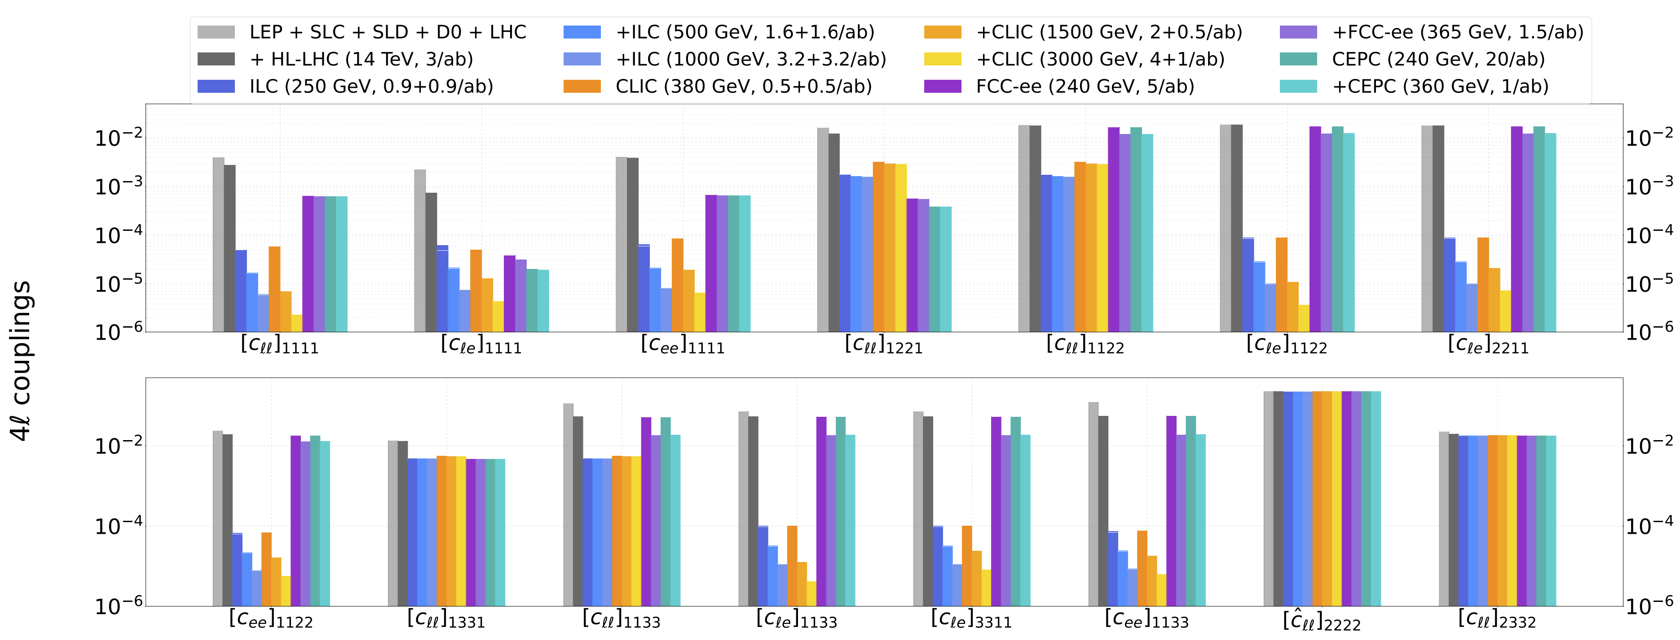
Phenomenology of the SMEFT
Take the four-lepton operators of mass dimension six and measure their coefficients in future collider experiments
De Blas et al., Global SMEFT Fits at Future Colliders, 2206.08326

Slide 16
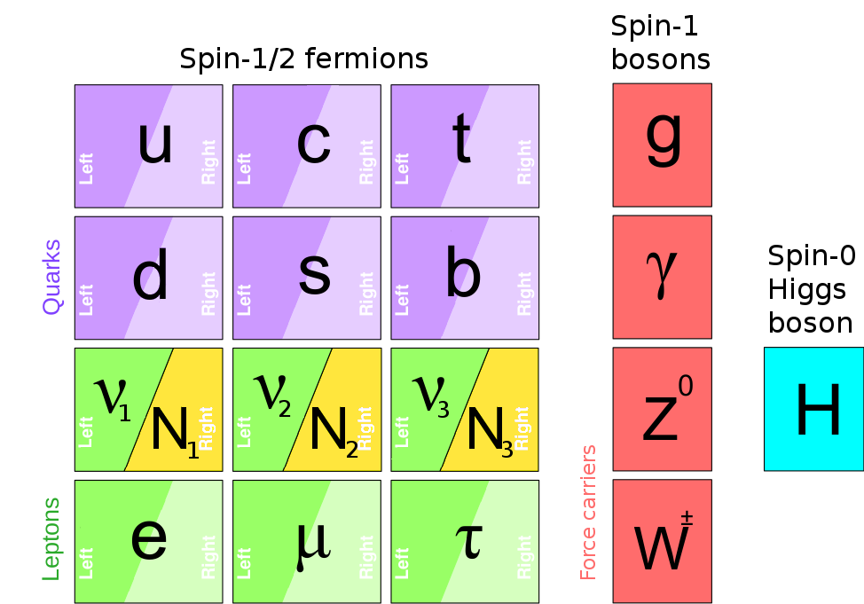



C. EFTs for Neutrinos
Why neutrinos are massless in the SM
Why not just take massive Dirac neutrinos
Must be renormalizable
No Yukawa interaction
Minimal particle content
Similar to quarks & charged leptons, neutrinos get Dirac masses after spontaneous gauge symmetry breaking
$$≈174 GeV$$
$$O(0.1 eV)$$
$$O({10}^{−12})$$
Difficulties with Dirac neutrinos
Tiny Dirac masses worsen fermion mass hierarchy problem (i.e., m_{i}/m_{t} < 10⁻¹²)
Mandatory lepton number conservation, which is actually accidental in the SM
Extend the SM with right-handed neutrinos

Slide 17
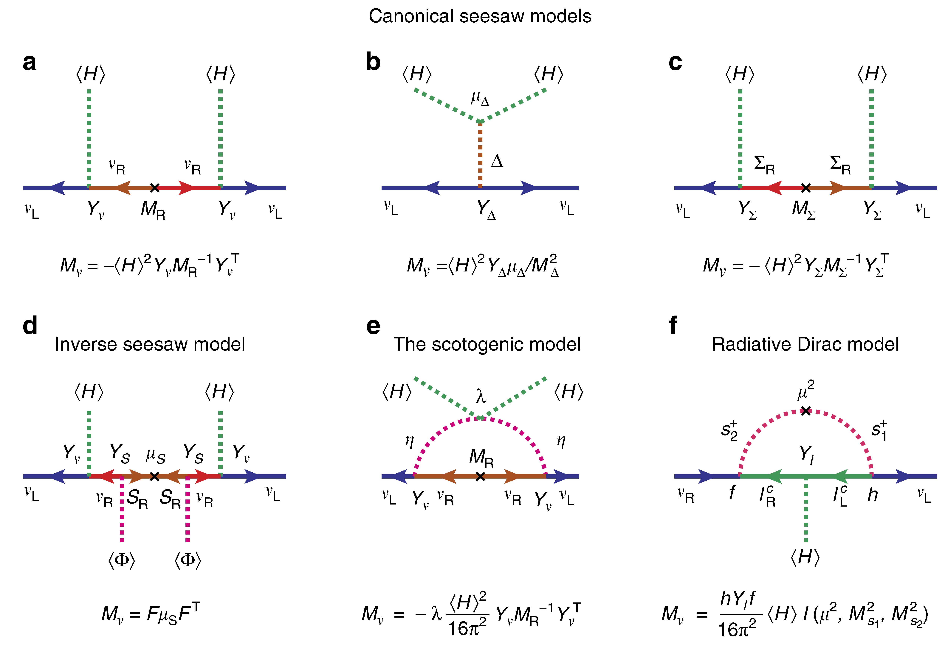
Neutrino Mass Models
Minkowski, 77
Konetschny, Kummer, 77
Foot, Lew, He, Joshi, 89
Mohapatra, Valle, 87
Kanemura et al, 11
Z. Tao, 96; E. Ma, 06
Zee, 80, 86; Babu, 88

Slide 18
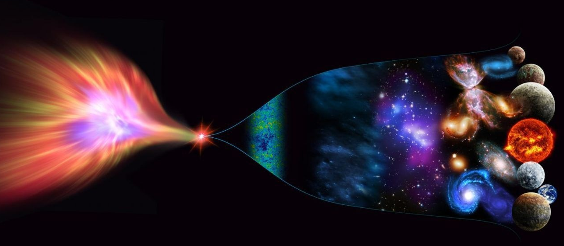
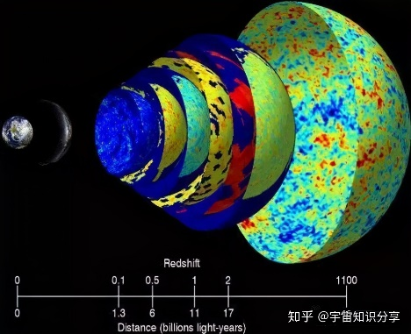

Seesaw Effective Field Theories (SEFTs)
Energy Scale of New Physics
Cosmic Frontier：Matter-antimatter asymmetry/CMB/LSS
10¹⁹ GeV
Planck scale
10¹⁶ GeV
GUT scale
High-intensity Frontier：
Construct low-energy effective field theories (EFTs)，do precision calculations, compare with experimental data
Seesaw scale？
High-energy Frontier: Direct searches at colliders
Cai, Han, Li, Ruiz, Front. in Phys. 6 (2018) 40
10³ GeV
TeV
EW
10² GeV
ν oscillations → ν masses → NP

Slide 19
Functional Method for Matching
Henning, Lu, Murayama., 1412.1837, 1604.01019
Fuentes-Martin et al., 1607.02142
Zhang, 1610.00710
Cohen, Lu, Zhang, 2011.02484
Diagrammatic method: calculate the amplitudes twice, one in the UV theory and the other in EFT
Functional method: start with the UV theory, construct the operators and identify the coefficients

Slide 20
Tree-level Matching of Seesaw Models to SMEFT
The type-I seesaw model as an UV-complete theory
Tree-level matching: simply applying the EOM
Expansion up to M ⁻² (dim-6 operators)
Seesaw Effective Field Theory (SEFT) @ tree level
Two operators in the Warsaw basis
Neutrino masses &
flavor mixing
Unitarity violation of
flavor mixing matrix

Slide 21
One-loop Matching of Seesaw Models
At the one-loop level
Calculated to the given order of mass dimension
Log-type
Power-type
Field multiplet
Only three gauge singlets added into the SM

Slide 22
One-loop Matching of Seesaw Models
Interaction matrix
Fuentes-Martin et al., 2012.08506
2212.04510
Integration by parts
Fierz identities
Field redefinitions
Equations of motion
Further reduction to the Warsaw basis

Slide 23
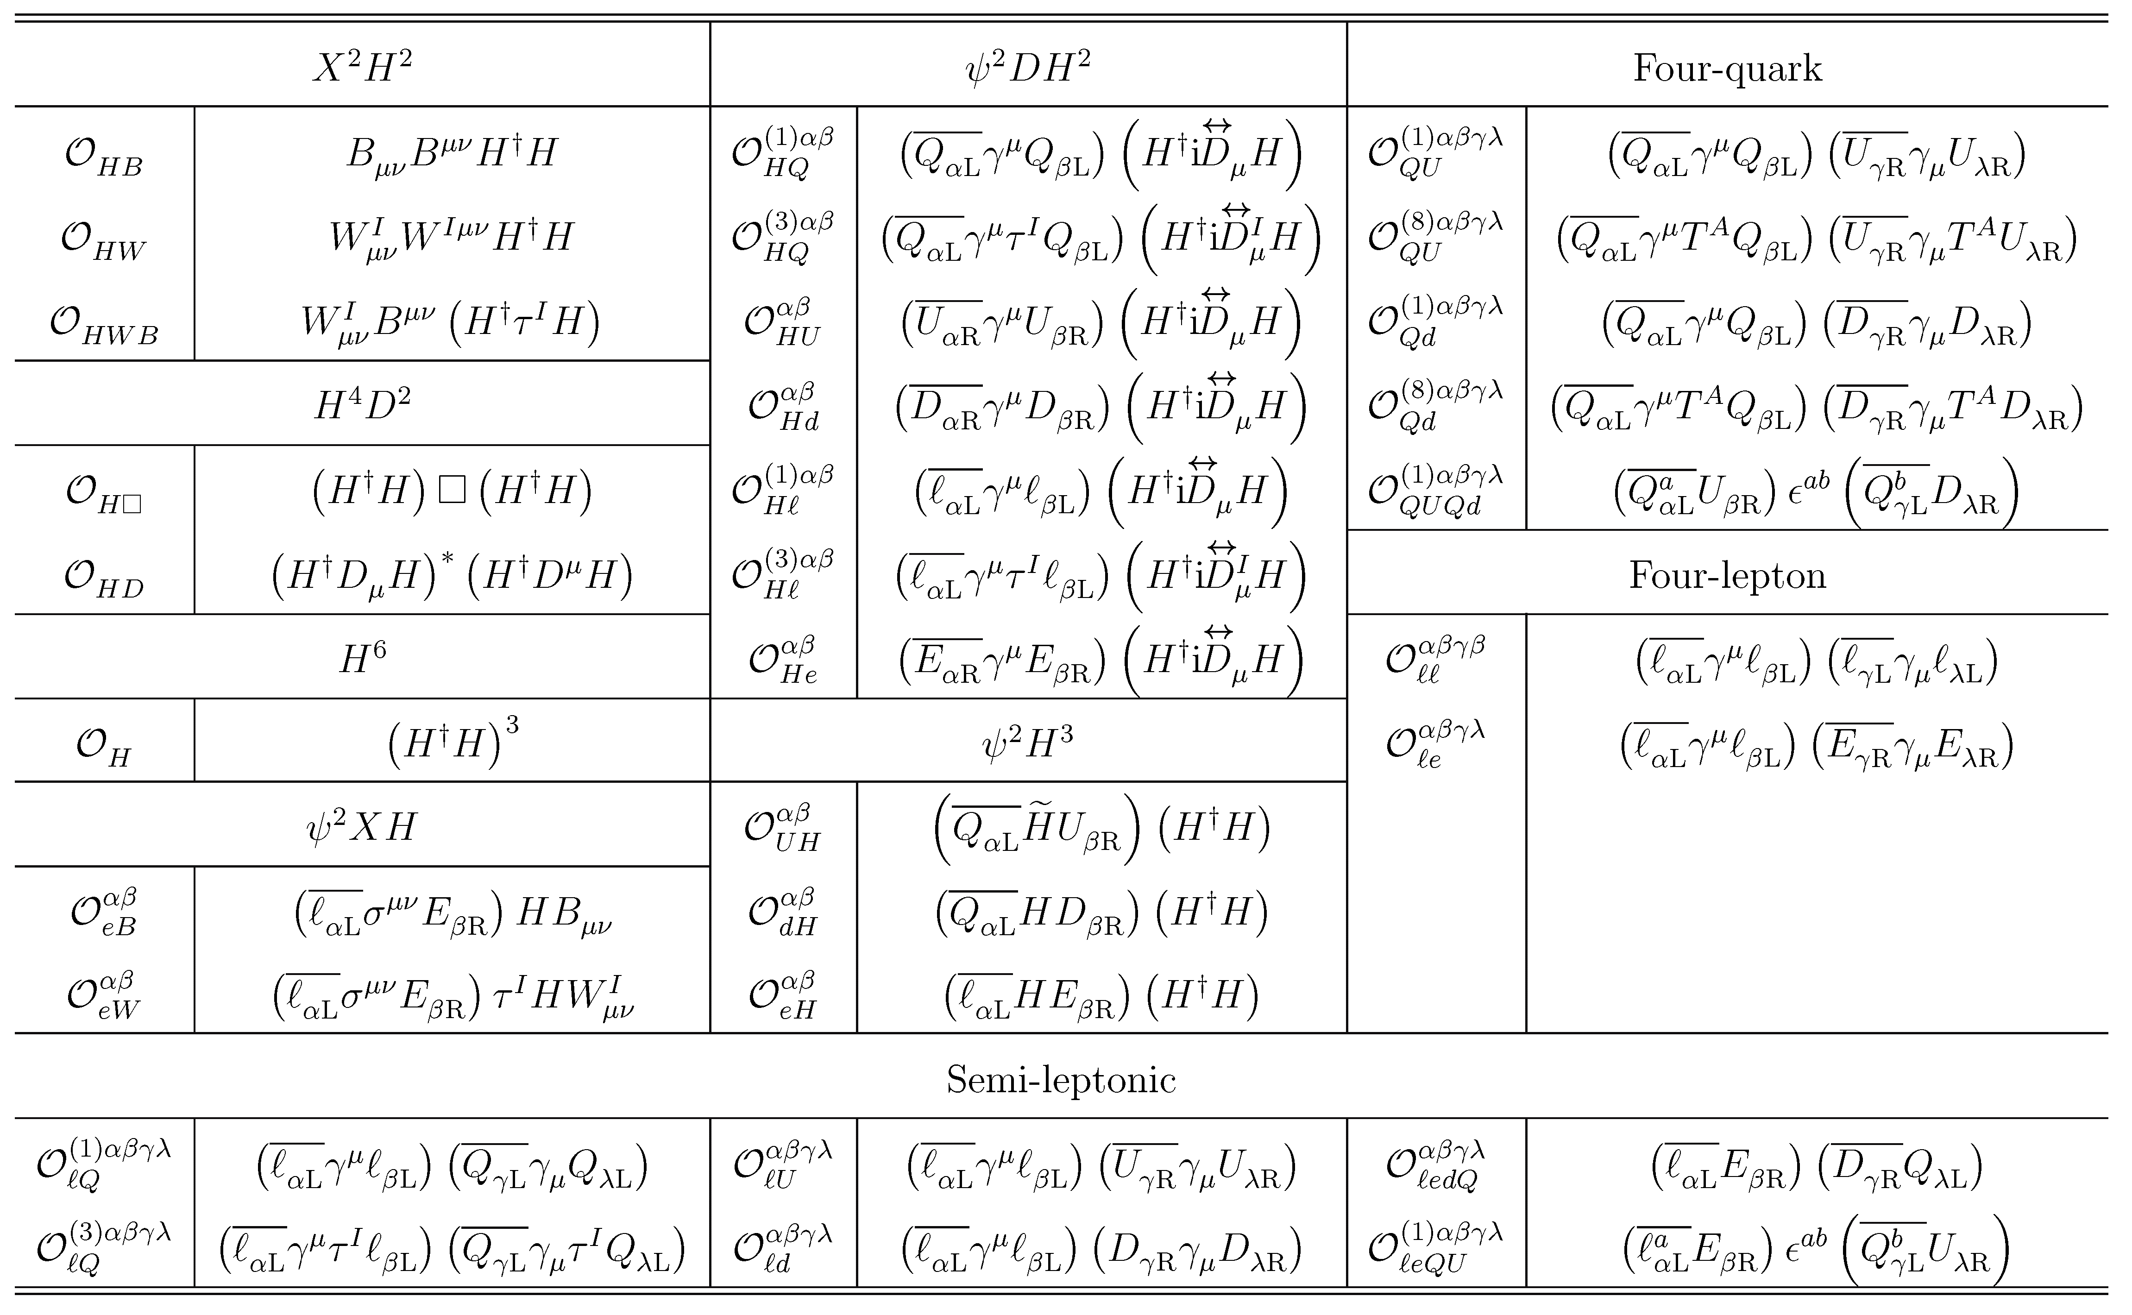
One-loop Matching of Seesaw Models
Zhang & Zhou, 2107.12133
Out of 59 operators in the Warsaw basis, 31 dim-6 operators in Seesaw EFT (SEFT)-I

Slide 24
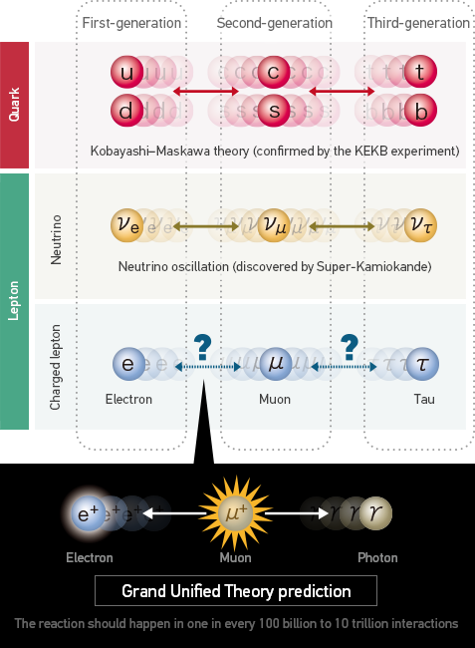
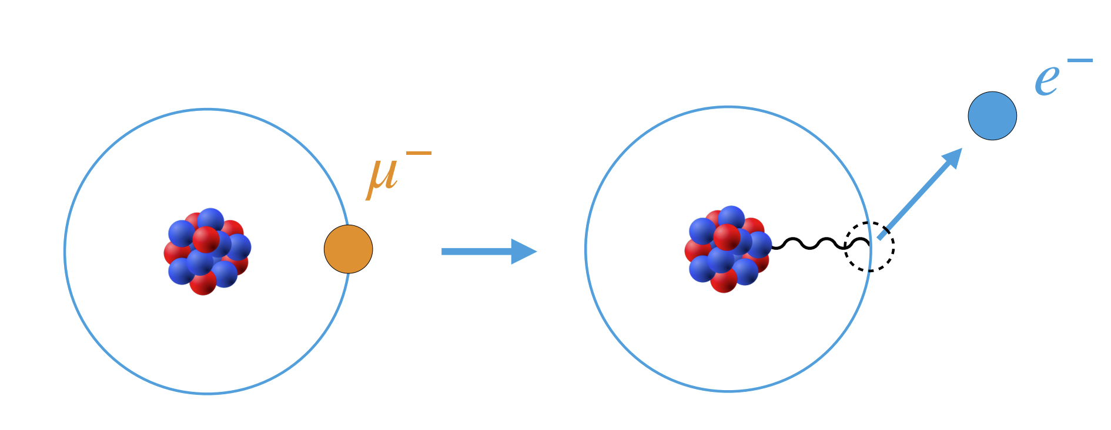
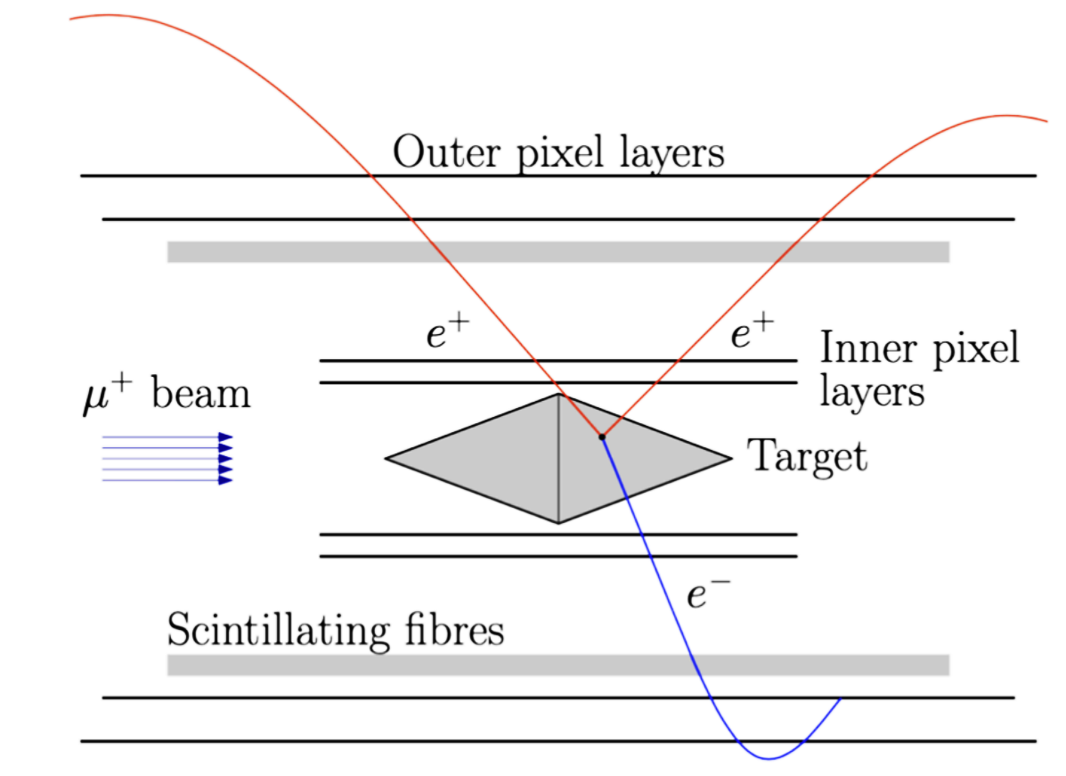




Precision Measurements
Charged-lepton Flavor Violation
Bernstein & Cooper, Phys. Rep. 532 (2013) 27
$$B\left(μ→eγ\right)<{10}^{−14}$$
Villanueva @ FPCP 22
$$B\left(μ→3e\right)<{10}^{−16}$$
$$B\left(μN→eN\right)<{10}^{−17}$$
$$<{10}^{−19}$$
Lepton-flavor-violating decays of
Z & H bosons @ CEPC & FCCee

Slide 25
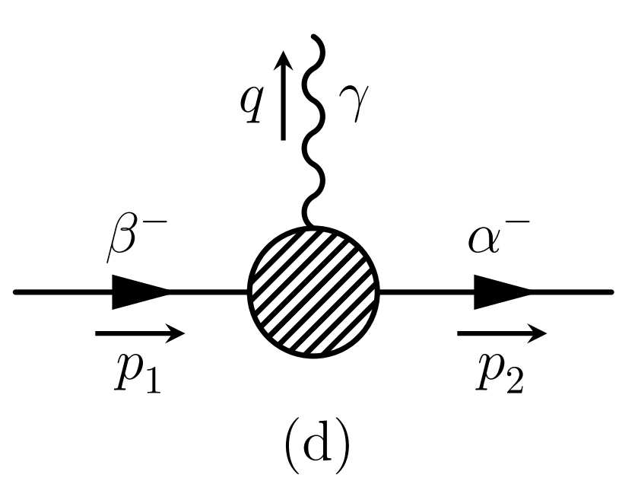
Why One-loop Matching
Lepton-flavor-violating decays of charged leptons
EFT with tree-level matching
The decay width
Antusch et al., JHEP, 06
Xing, Zhang, EPJC, 20
However, the calculation in the full theory for M_{i} >> M_{W} gives
EFT with one-loop matching: two more relevant dim-6 operators

Slide 26
Summary and Outlook
The one-loop matching of seesaw models onto the SMEFT has been accomplished
Together with the RGEs we can make more precise predictions at low energies
Henning, Lu & Murayama, 1412.1837
Li, Zhou, 2309.14702
41 in SEFT-II
31 in SEFT-I
33 in SEFT-III

Slide 27
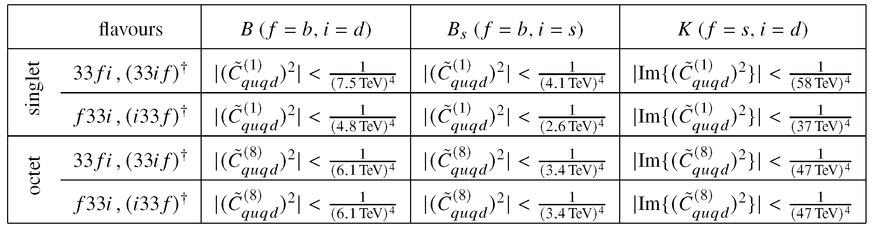
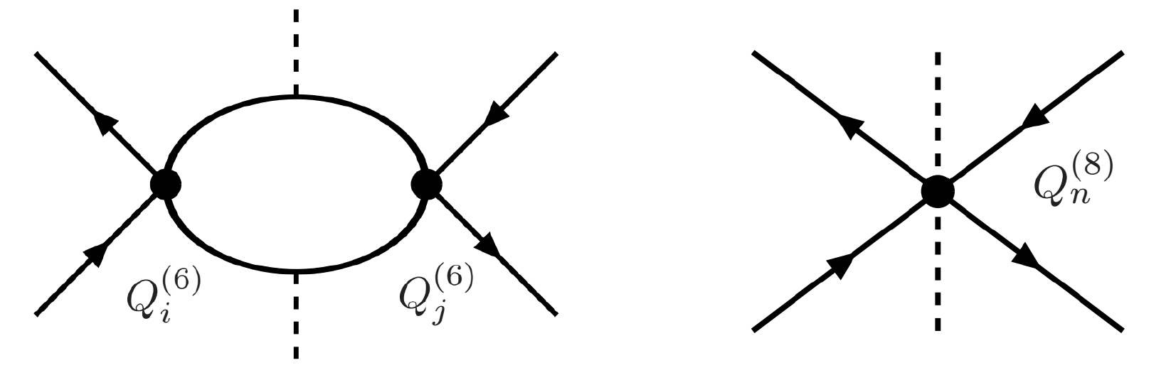
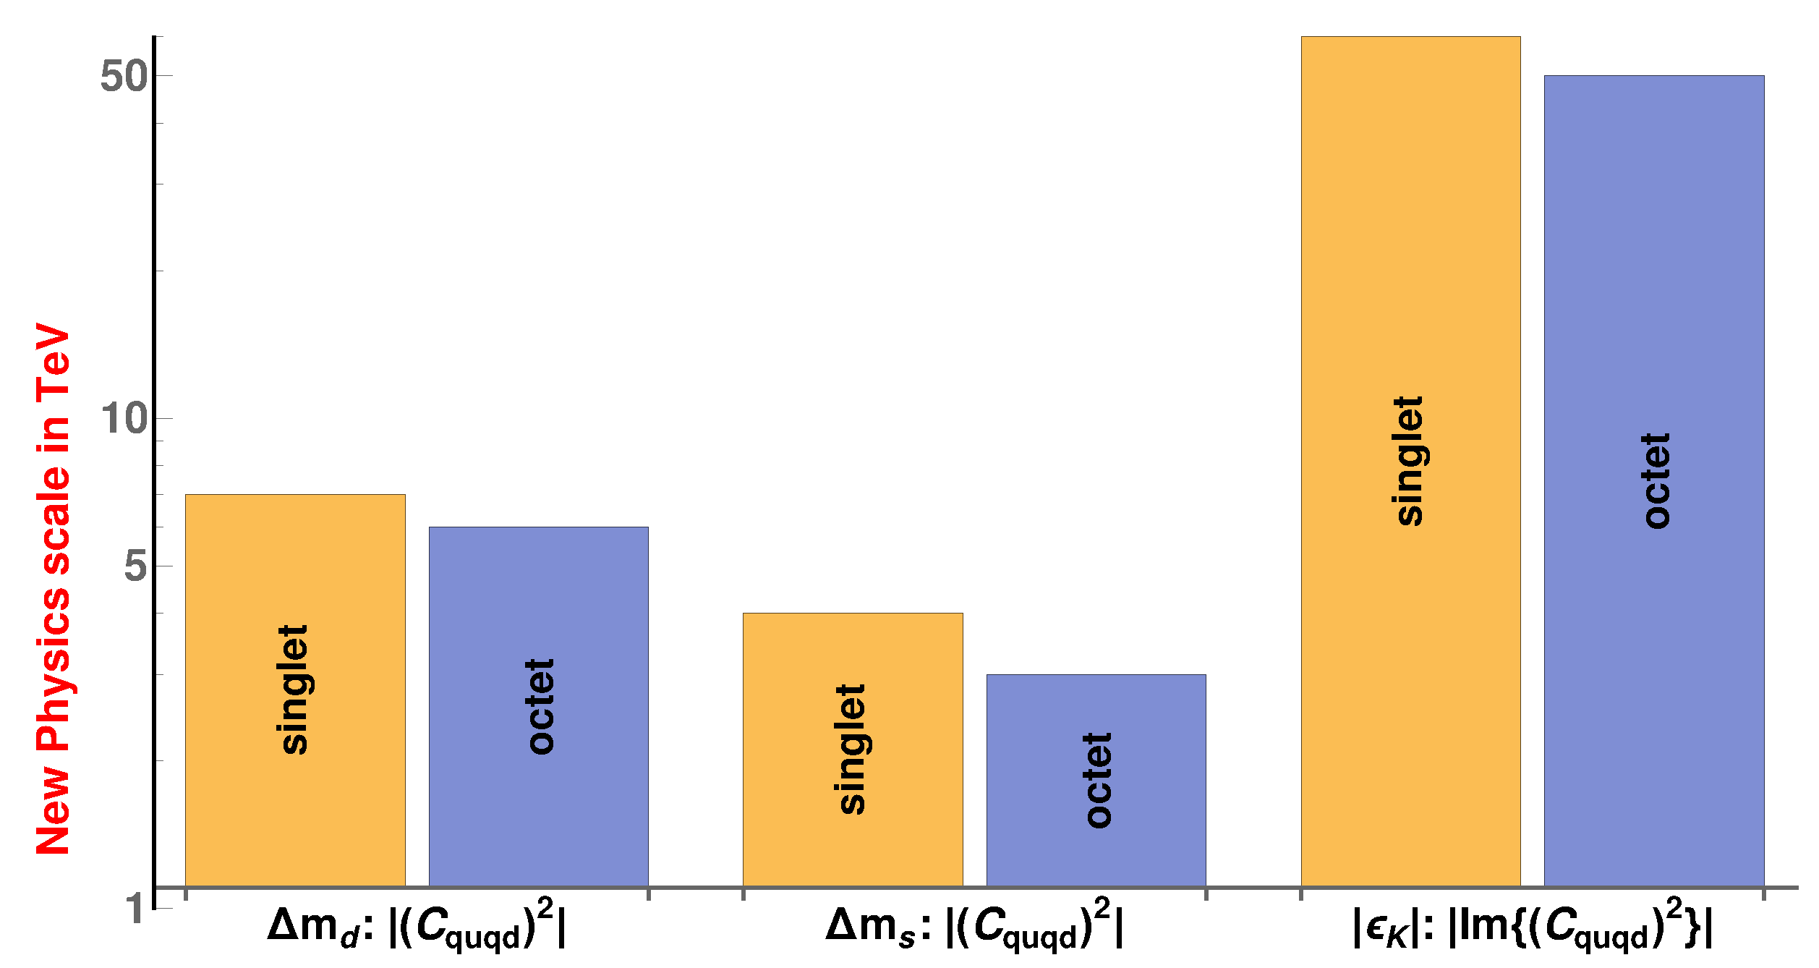
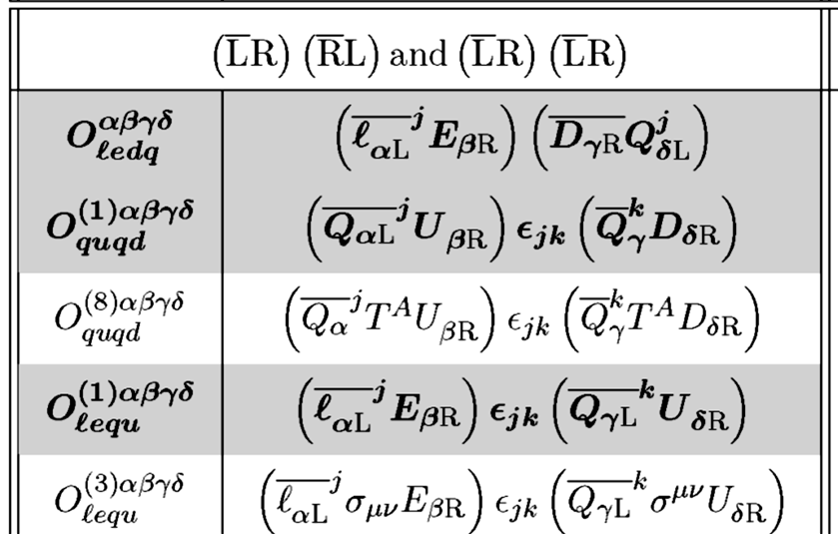
Summary and Outlook
For example, current constraints on the Wilson coefficients of dim-6 operators from meson-mixing
Luiz Vale Silva, 2201.03038
Dim-6 operators from Seesaw EFTs
Global SMEFT Fits at Future Colliders
2206.08326
Promising to probe the NP scales and the origin of neutrino masses

Slide 28
Summary and Outlook
Cirigliano et al., 1806.02780
Discovery of neutrino oscillations
Dim-5 Operator
Discovery of 0νββ decays
Dim-6 Operators
Origin of ν masses = New Physics

