Slide 1
Nuclear Theory Overview
-on the calculation of NME
白春林
四川大学物理学院
第一届中微子、原子核核物理和新物理研讨会(vNN2025)
兰州，2025年7月21-25日

Slide 2
outline
Brief introduction
Factors affect NME
Including proton-neutron pairing in HFBCS
Summary and perspective

Slide 3
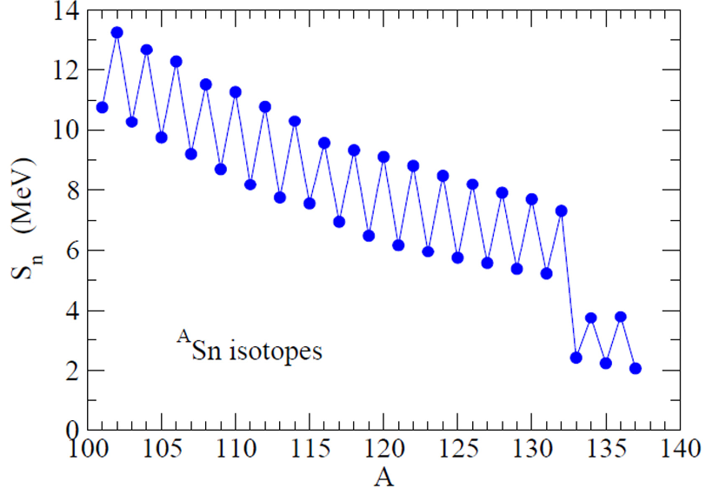
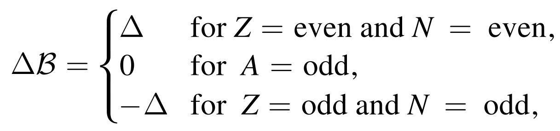
原子核中的对关联 I

Slide 4
原子核中的对关联 II
T=1, S=0 pair
T=1 pairing or Isovector pairing
p(n)
p(n)
T=0, S=1 pair
T=0 pairing or Isoscalar pairing
p
n
Frauendorf, Macchiavelli, Prog. Par. Nucl. Phys. 78, 24(2014)
Sagawa, Bai, Colo, Phys. Scr. 91, 083011(2016)

Slide 5
outline
Brief introduction
Factors affect NME
Including proton-neutron pairing in HFBCS
Summary and perspective

Slide 6

Calculation of NME
Theoretical method to
calculate the
half-life of 2v decay
(N, Z)
β-
β-
(N-1, Z+1)
β-
β+
(N-2, Z+2)
exp
Theory
The overlap factor:

Slide 7
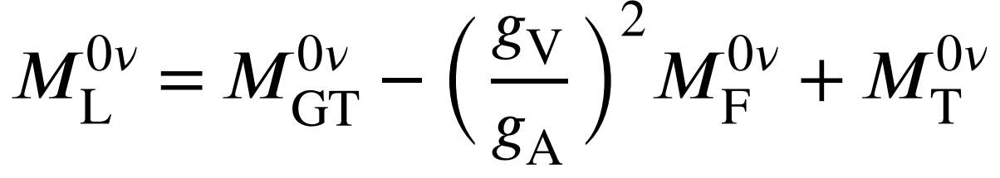
Calculation of NME
Theoretical method to
calculate the
half-life of 0v decay

Slide 8
What is fixed for the 0v double beta decay half-life

Slide 9
Status of NME calculation
Yao, Meng, Niu, Ring, PPNP 126, 103965(2022)

Slide 10
Efforts through more foundamental mechanism
Within a left-right symmetric model
D.L. Fang, B. A. Brown, F. Simkovic, PRC 110, 045502(2024)
Next-to-Leading-Order Prediction
Y.L. Yang, P. W. Zhao, PRL 134, 242502(2025)
Benchmarking NME with High-Energy Nuclear Collision
Y. Li, X. Zhang, G. Giacalone, J. M. Yao, PRL 135, 002301(2025)

Slide 11
Calculation of NME I
Castillo, Jokiniemi, Soriano, Menendez, PLB 860, 139181(2025)

Slide 12
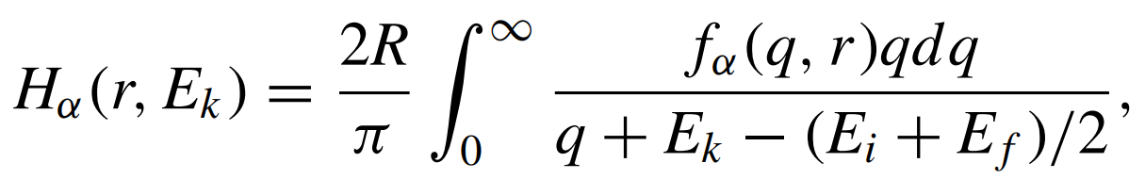

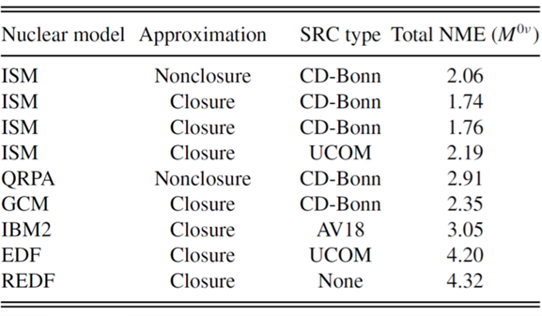
Calculation of NME II
Short Range correlation
Closure Approximation
Sarkar, Iwata, Jha, Chatterjee, PRC 111, 014326(2025)

Slide 13
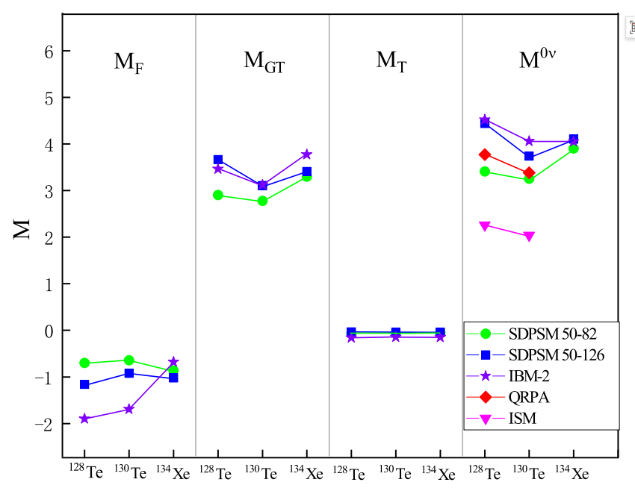
Effect of Model Space on NME
Li, Zhang, Xue, He, Luo, Li, Pan, Draayer, PRC 111, 024318(2025)

Slide 14
Effect of Deformation
Song, Yao, Ring, Meng, PRC 90,054309(2014)

Slide 15
Effect of IV pairing
Ding, Zhang, Yao, Ring, Meng, PRC 108, 054304(2023)

Slide 16
Introduction of collective excitations
Realistic excitation is not such single-particle transitions.
Closed-shell RPA
Open-shell QRPA
Bogolyubov transformation

Slide 17
开壳偶偶核的HFB方程
Bogolyubov变换和能量密度泛函：
密度和对密度矩阵：
HFB方程

Slide 18
HFB+QRPA theory for open-shell nuclei I
HFB+pnQRPA in canonical basis
Receive p-h contribution
Reveive p-p
contribution
Transition strength:

Slide 19
HFB+QRPA theory for open-shell nuclei I
HFB+pnQRPA in canonical basis
The single-particle states are obtained by HFB
J. Dobaczewski, et.al, NPA 422, 103(1984)
For more details of the theory one may refer to:
D.J.Rowe, nuclear collective motion
J. Terasaki. et. al, Phys. Rev. C 71, 034310(2005)

Slide 20
Effects of IS pairing in QRPA I
M.T. Mustonen, J.Engel, PRC 87,064302(2013)

Slide 21
Effects of IS pairing in QRPA II
Lv, Niu, Fang, Yao, Bai, Meng, PRC 108, L051304(2023)

Slide 22
Effects of IS pairing in QRPA III
Wu, Bai, Fang, Niu, Sagawa, Zhang, CPC 49, 074112(2025)

Slide 23
Possible data to fix IS pn pairing I
⁵⁸Ni（³⁶Ar，2n)⁹²Pd*
B. Cederwall, et al., Nature 469, 68(2011)

Slide 24
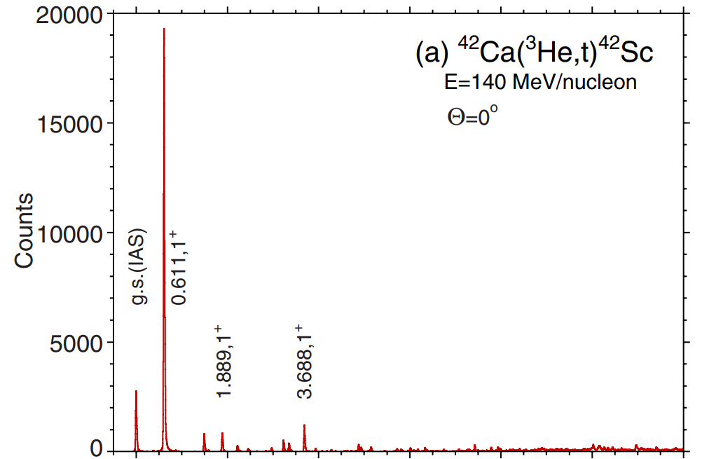
Possible data to fix IS pn pairing II
Y. Fujita, et al., PRL 112, 112502(2014)
Bai, Sagawa, Colo, Fujita, Zhang, Zhang, Xu,
PRC 90, 054335(2014)

Slide 25
Possible data to fix IS pn pairing III
Wang, Wang, Xu, Zhao, Meng, PRL 132, 232501(2024)

Slide 26
outline
Brief introduction
Factors affect NME
Including proton-neutron pairing in HFBCS
Summary and perspective

Slide 27
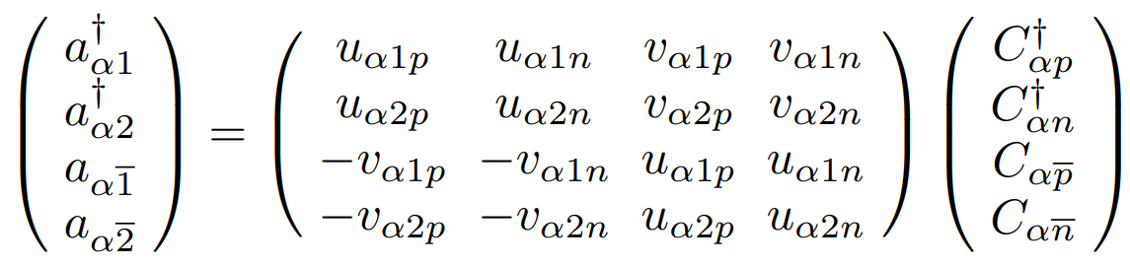
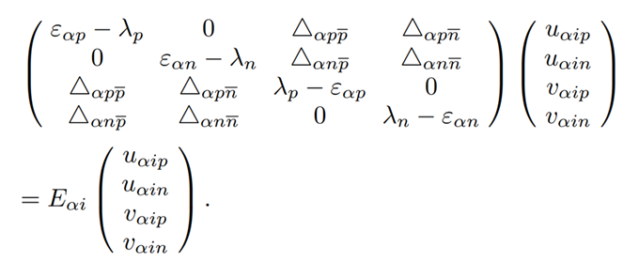
HF+pnBCS I
pn BCS transformation
pn BCS equation

Slide 28
HF+pnBCS II
IV pn pairing cannot coexistence with
nn, pp, and IS pn pairing

Slide 29
pn HF+BCS III

Slide 30
HF+pnBCS III
Xin Lian, Bai, Sagawa, Zhang, To Be submitted soon.

Slide 31
Difficulty in HF+pnBCS+pnQRPA
M.T. Mustonen, J.Engel, PRC 87,064302(2013)
Very strong IS pairing strength is needed in oblate and weak deformation case.

Slide 32
Summary and Perspective
LO operator contribution to the NME is the most important
Higher order operators、short-range correlations、closure approximation ~10% difference
Model space, deformation, and pn pairing is very important for NME
HF+pnBCS+pnQRPA calculations will be done

Slide 33
Thank your for your attention!

