Slide 1


Charge-exchange reaction and its applications in neutrino physics
Bingshui Gao
Institute of Modern Physics,
Chinese Academy of Sciences
第一届中微子、原子核物理和新物理研讨会(νNN2025) Jul. 21 – 25, 2025, 兰州

Slide 2

01
Introduction to charge-exchange reactions
CONTENTS
02
Neutrino detectors
03
Double beta decay
04
Double charge-exchange reaction
05
Summary

Slide 3
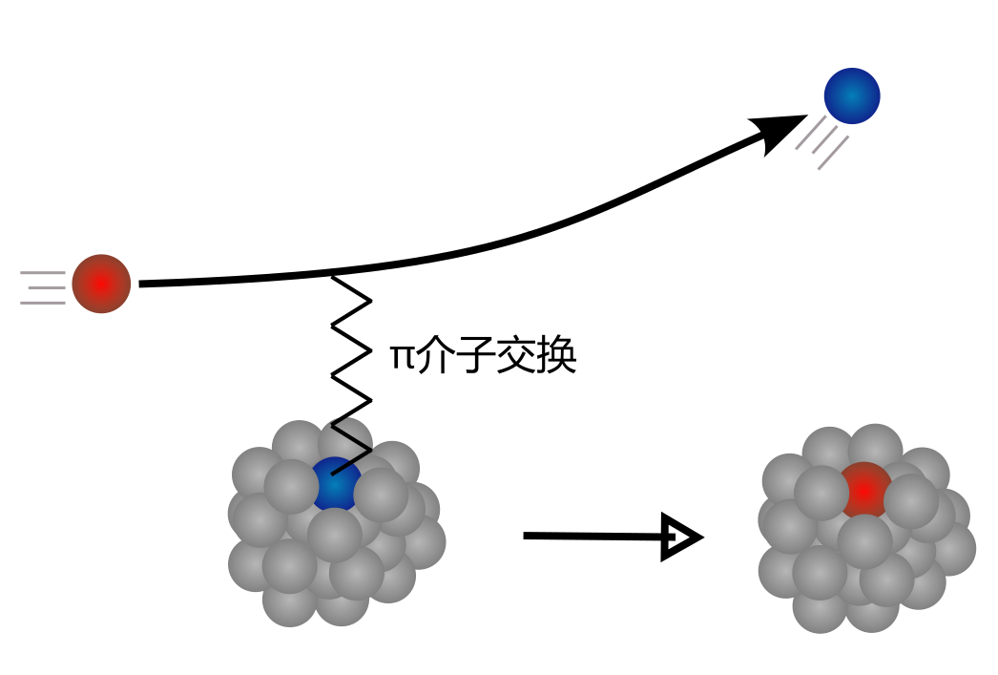
(Hadronic) Charge-exchange reaction
E ≥ 100 MeV/u
one/two pion exchange
3/23

Slide 4
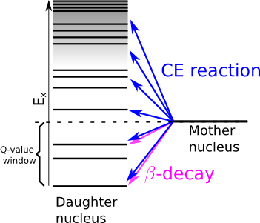
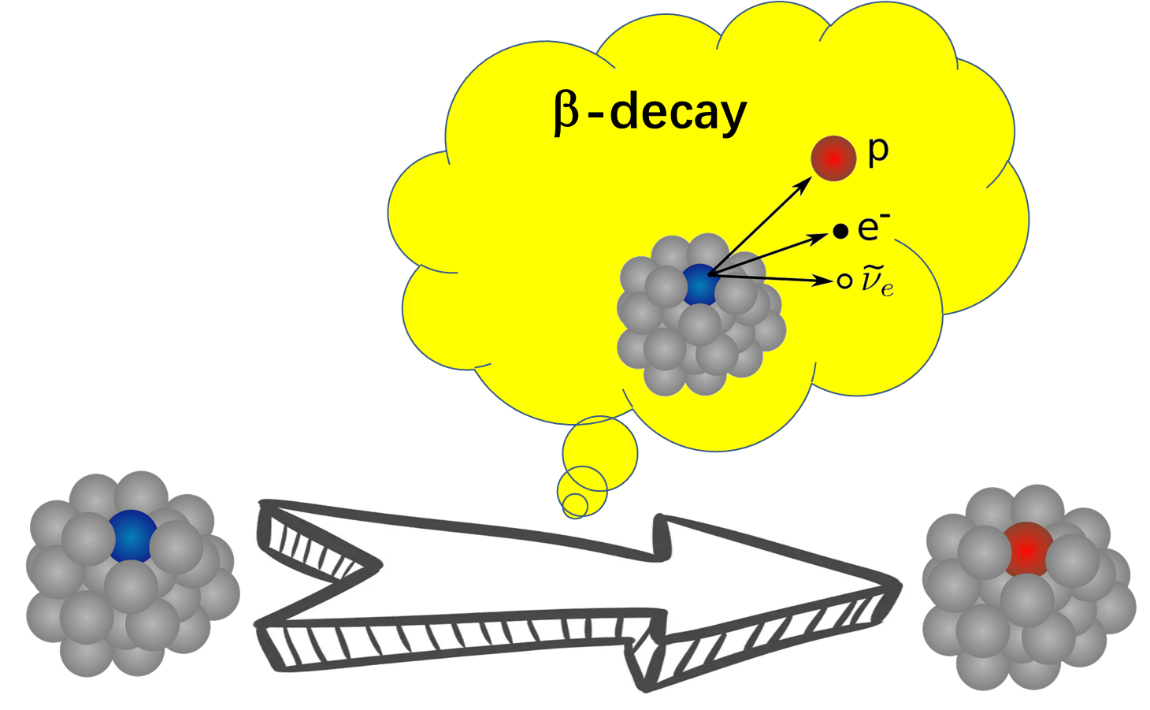
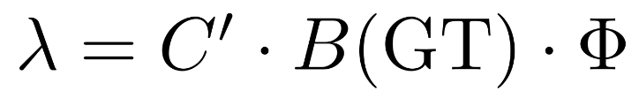
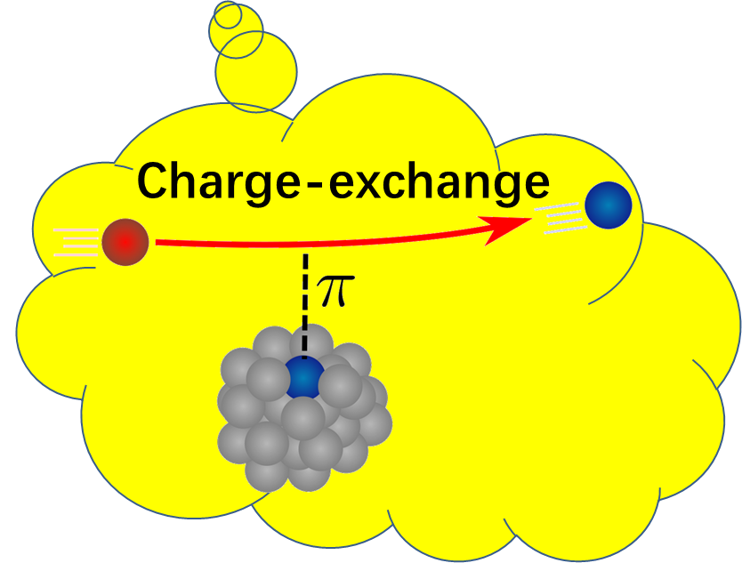
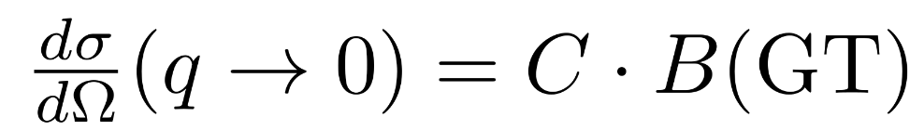
(Hadronic) Charge-exchange reaction
Both charge-exchange reaction and beta-decay measurements provide information of B(GT),
but charge-exchange reaction is not limited by the Q-value window.
Ex
Charge-Ex
Nuclear transition
Q-value
window
β-decay
4/23

Slide 5
Application: Neutrino Detectors
E ≥ 100 MeV/u
one/two pion exchange
5/23

Slide 6
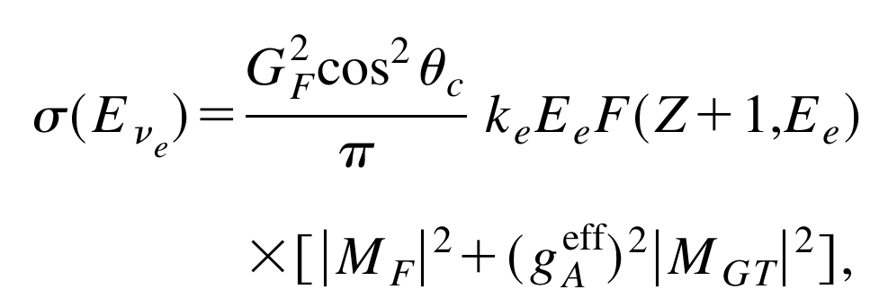
Application: Neutrino Detectors
e⁻
ν_{e}
W⁺ Boson exchange
B(F)
B(GT)]
6/23

Slide 7
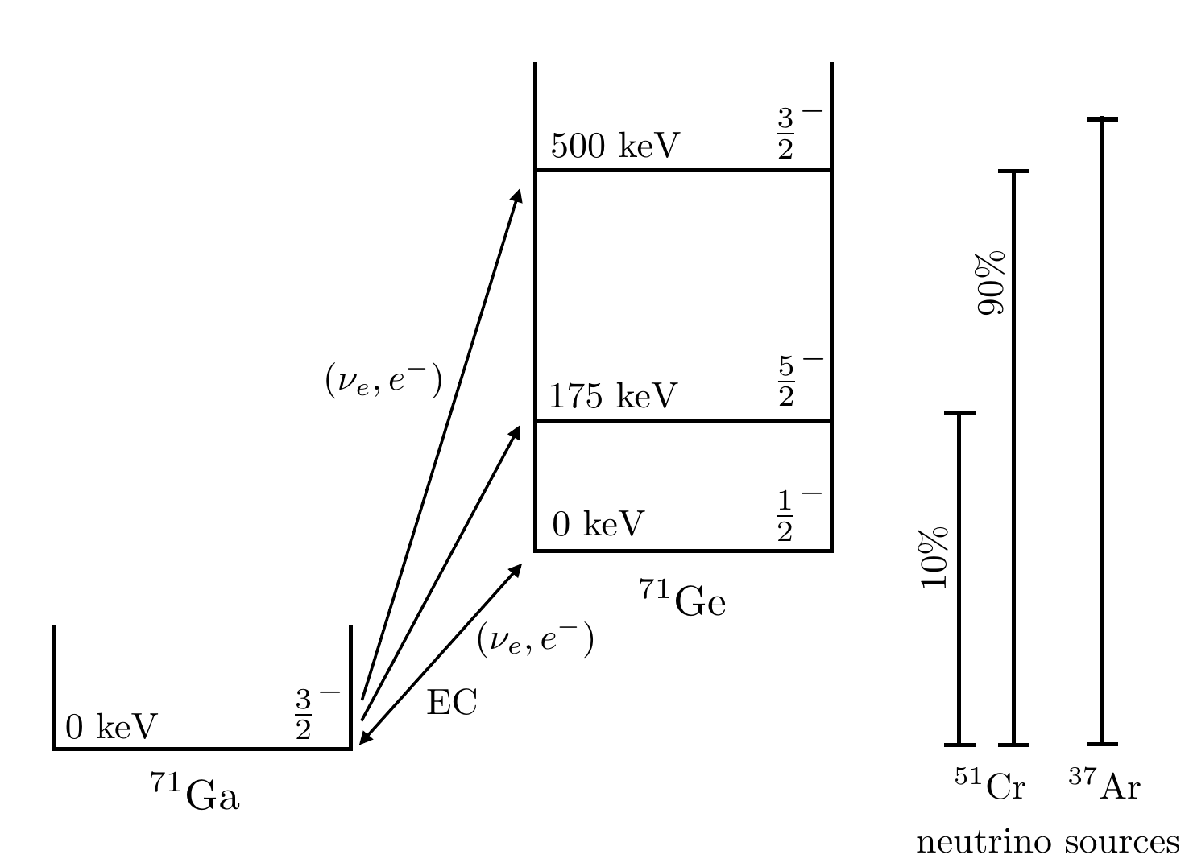
Application: Neutrino Detectors
GALLEX、SAGE etc. use ⁷¹Ga as the detector medium, accurate cross sections are important!
Gallium anomaly: measured counts lower than expected by ~20% when using ⁵¹Cr or ³⁷Ar sources. Uncertain nuclear inputs or new physics ?
ν_{e}
7/23

Slide 8
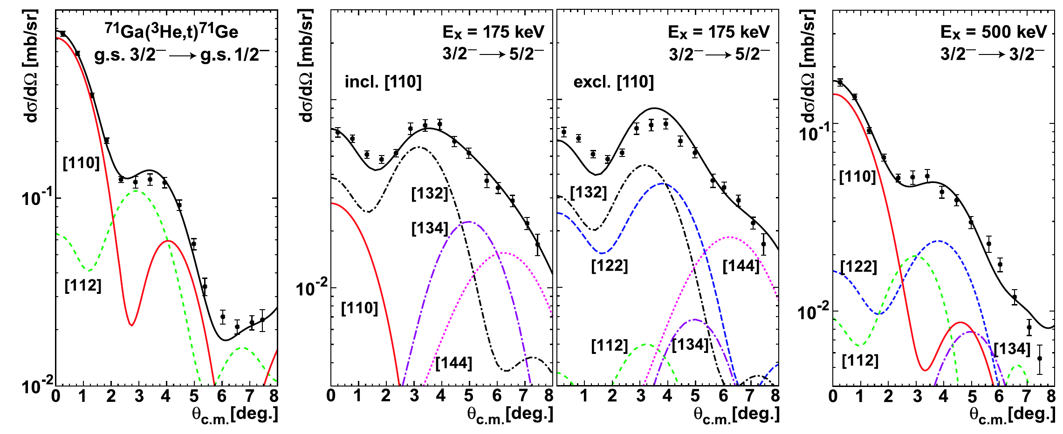
Application: Neutrino Detectors
The ⁷¹Ga(³He,t)⁷¹Ge charge-exchange experiment:
Frekers et al., PLB 706, 134 (2011)
(1) g.s.: (2) 175-keV state: (3)500-keV state:
B(GT) = 0.085(4) (from ⁷¹Ge β decay)
B(GT) = 0.0034(26)
B(GT) = 0.017(2)
7(2)%
8/23

Slide 9
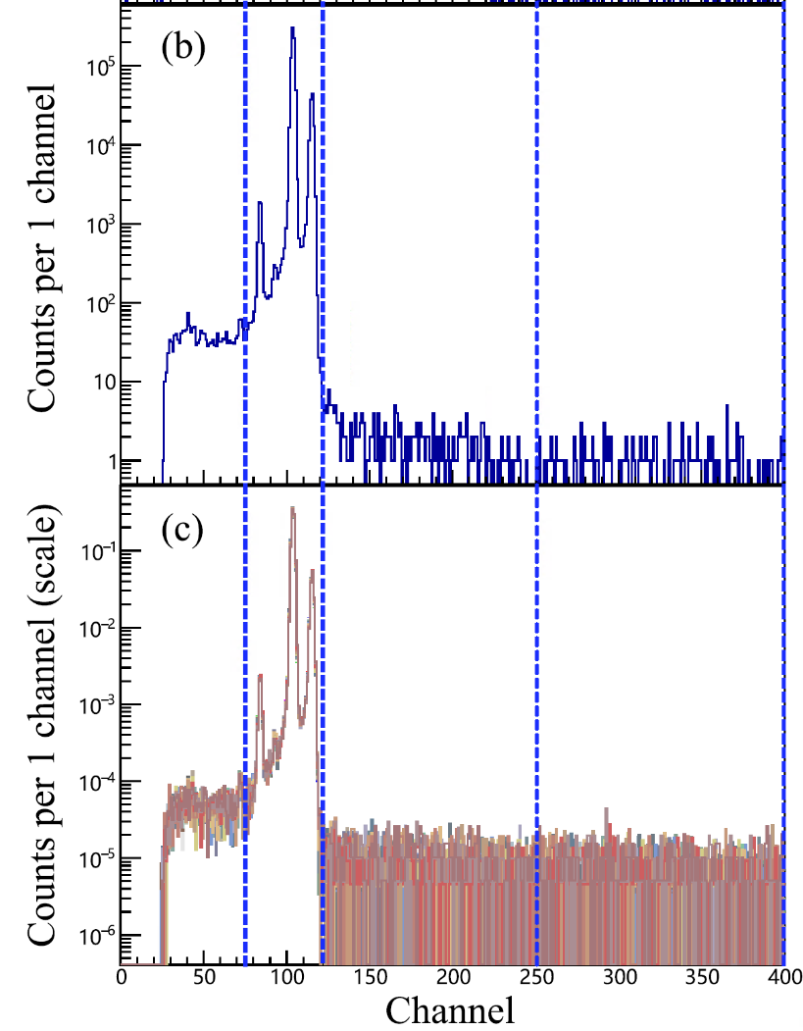
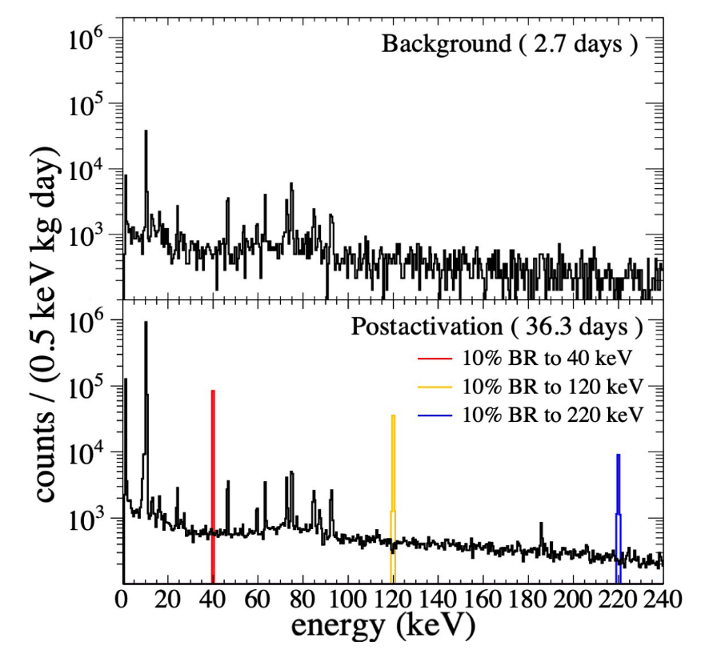
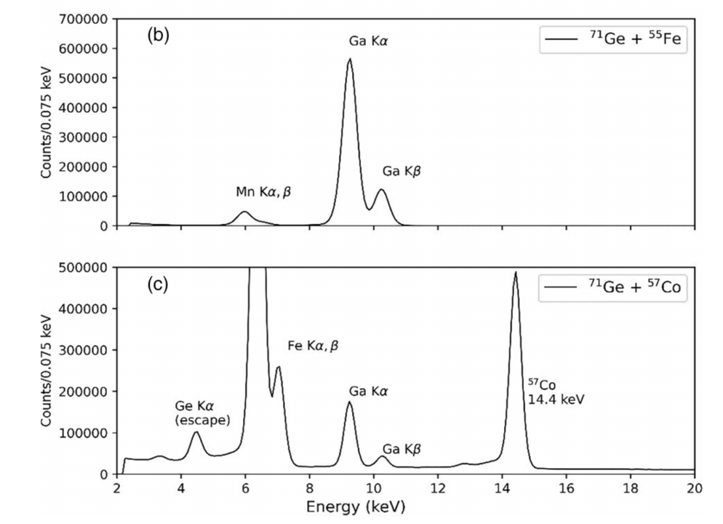
Application: Neutrino Detectors
New life-time measurements of ⁷¹Ge (literature value T_{1/2} = 11.43 ± 0.03 days ):
T_{1/2} = 11.46 ± 0.04 days
T_{1/2} = 11.468 ± 0.008 days
T_{1/2} = 11.477 ± 0.004 days
Collar and Yoon, PRC 108, L021602 (2023)
Norman et al., PRC 109, 055501 (2024)
Cai et al., to be submitted
9/23

Slide 10
Application: Neutrino Detectors
Branching ratios of the ⁵¹Cr decay (ν_{e} source):
Neutrino Radiation
EM
Radiation
7/2-
0
⁵¹Cr
9.93%
⁵¹Cr (2.8MCi)
⁵¹Cr (3.4MCi)
5/2-
320
7/2-
0
⁵¹V
10/23

Slide 11
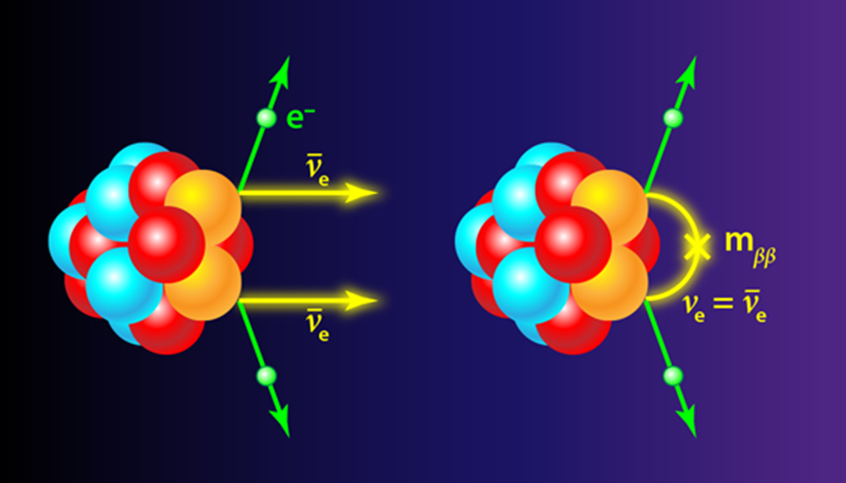
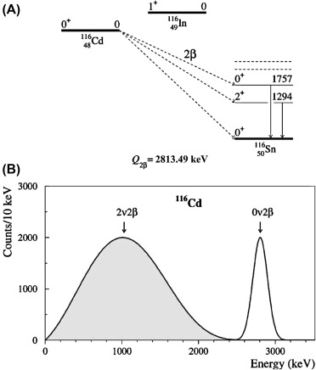
Application: Double beta decay
absolute neutrino mass scale
Majorana particles
matter-antimatter asymmetry of the Universe
New physics…
2νββ
0νββ
2νββ have been observed and T_{1/2} obtained for ⁴⁸Ca, ⁷⁶Ge, ⁸²Se, ⁹⁶Zr, ¹⁰⁰Mo, ¹¹⁶Cd, ¹²⁸Te, ¹³⁰Te, ¹³⁶Xe, ¹⁵⁰Nd, ²³⁸U, ⁷⁸Kr, ¹²⁴Xe and ¹³⁰Ba have been obtained.
11/23

Slide 12
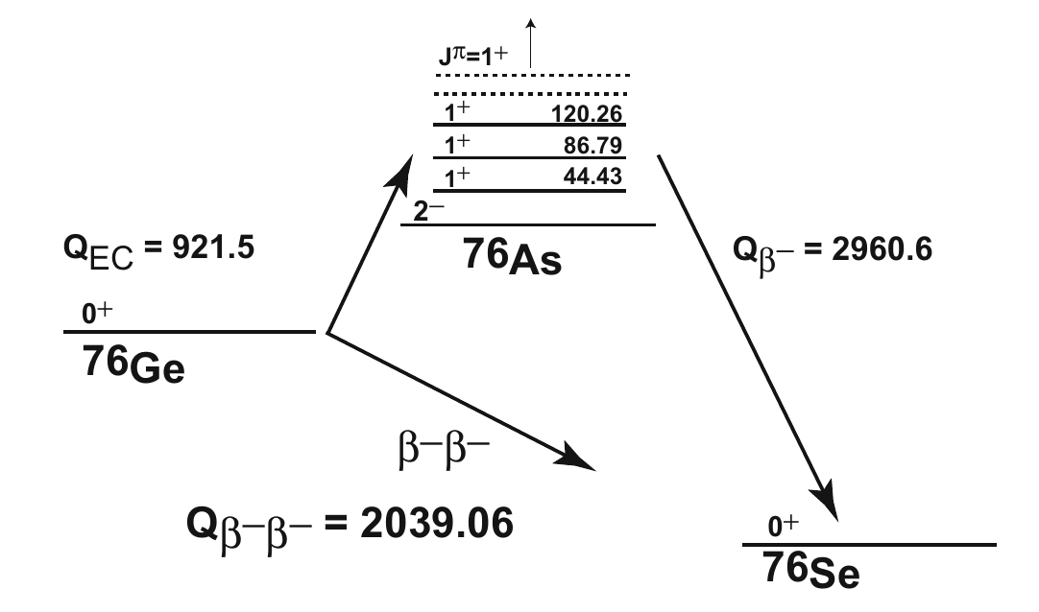
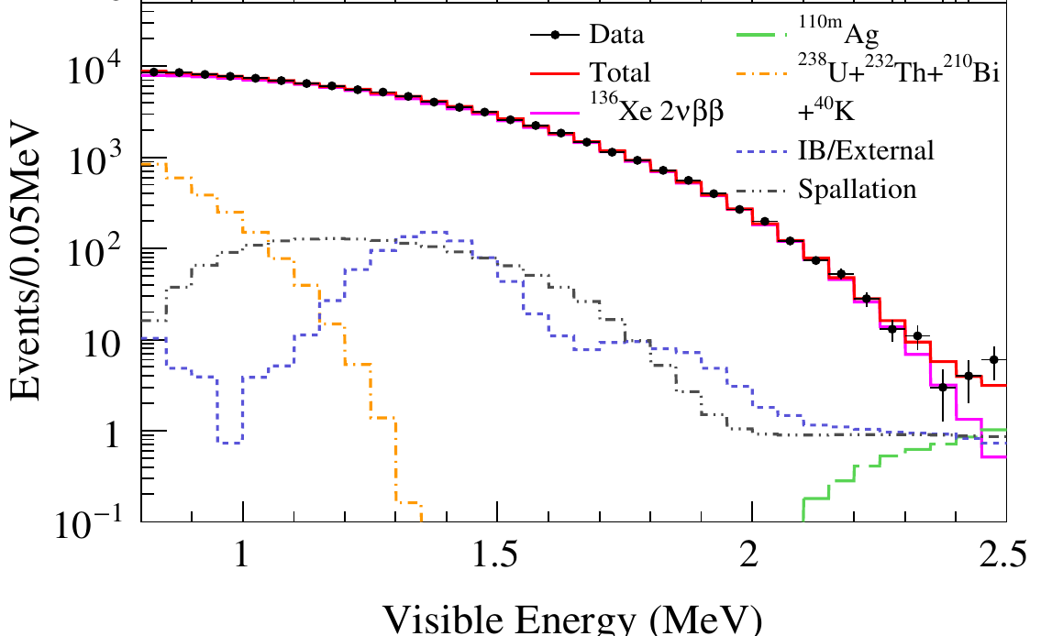
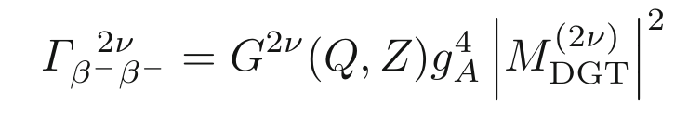
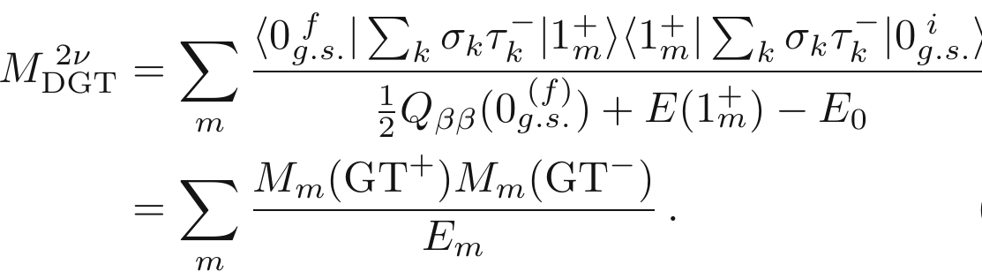
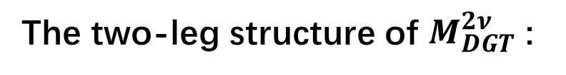
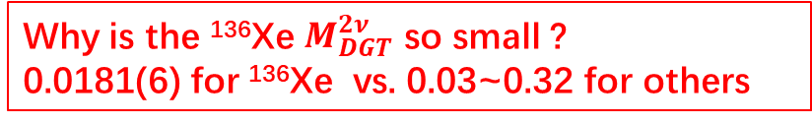
Application: Double beta decay
The two-leg structure of $M_{DGT}^{2ν}$ :
¹³⁶Xe ββ decay: EXO-200, nEXO, KamLAND-Zen, NEXT PandaX-III etc.
850
Gando et al., PRL 122, 192501 (2019)
590
90.3 keV
¹³⁶Cs
2548.2 keV
¹³⁶Xe
2451.9 keV
¹³⁶Ba
Why is the ¹³⁶Xe $M_{DGT}^{2ν}$ so small ?
0.0181(6) for ¹³⁶Xe vs. 0.03~0.32 for others
12/23

Slide 13
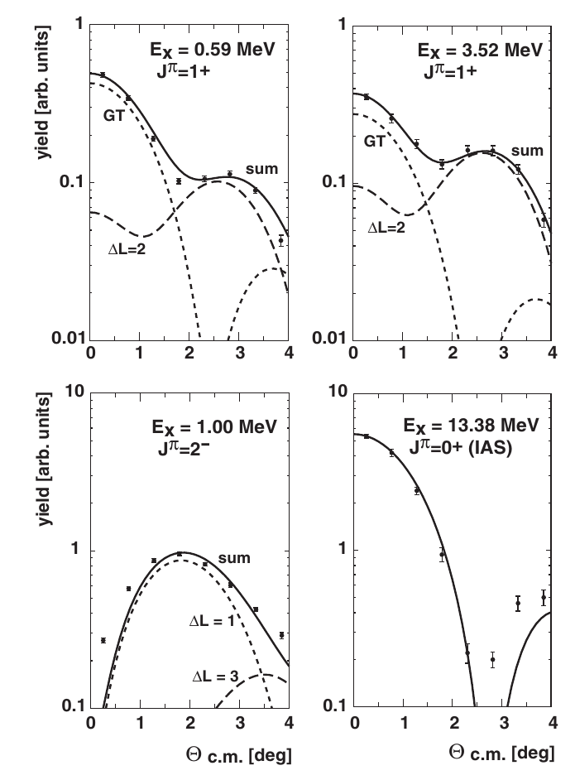
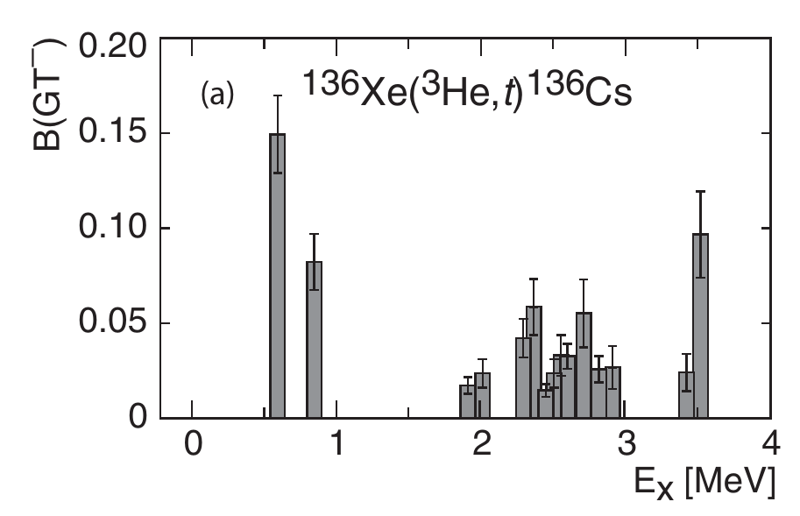
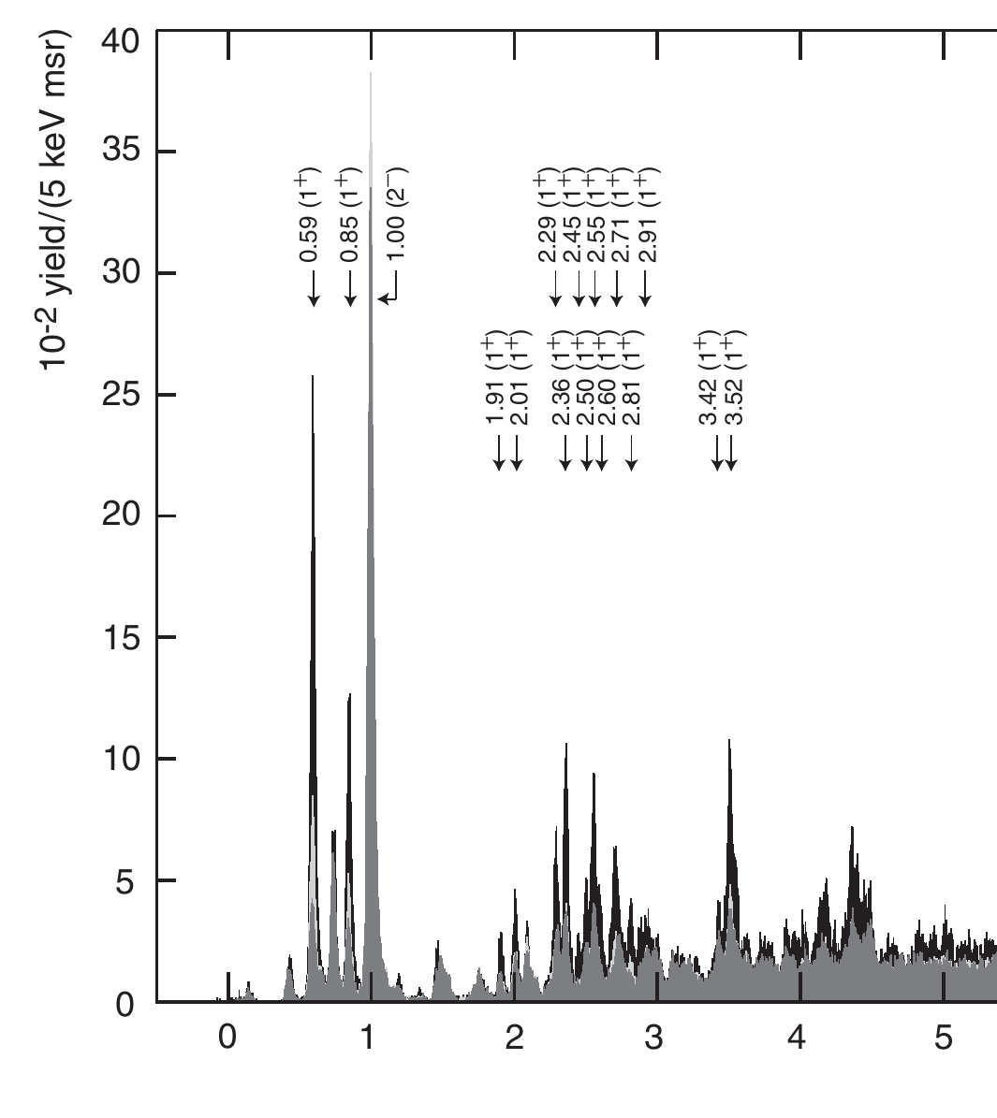
Application: Double beta decay
One leg is known for ¹³⁶Xe
Puppe et al., PRC 84, 051305(R) (2011)
Ex (MeV)
13/23

Slide 14
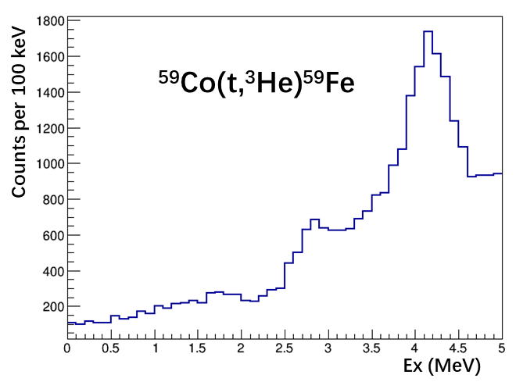
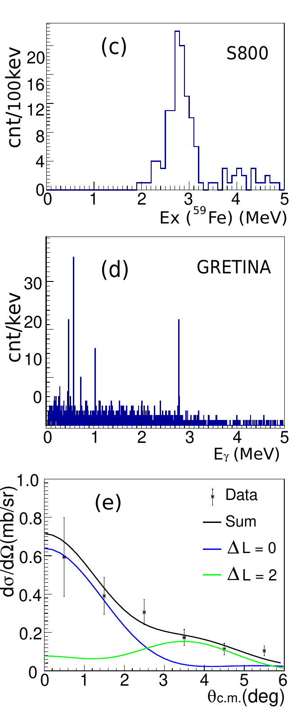
Application: Double beta decay
Let’s measure the other leg via ¹³⁶Ba(t,³He)¹³⁶Cs charge-exchange reaction!
14/23

Slide 15
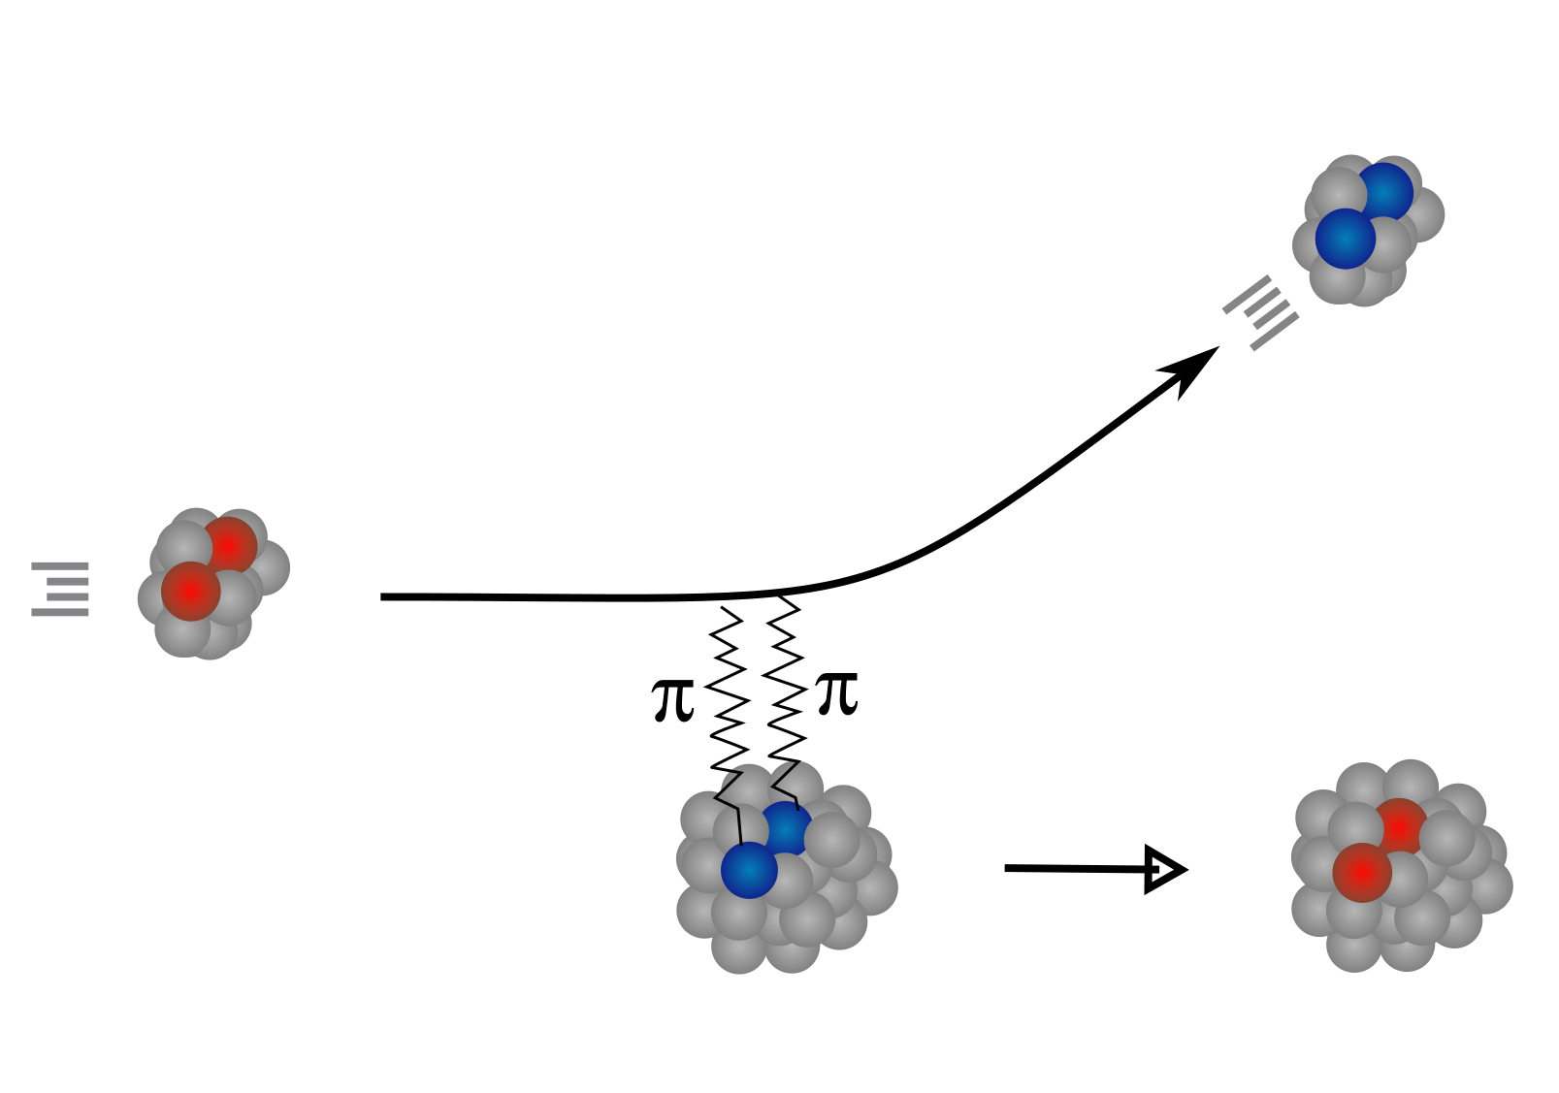
(Heavy-ion) Double charge-exchange reaction
15/23

Slide 16
(Heavy-ion) Double charge-exchange (DCE) reaction
Compared to single charge-exchange reaction:
  The probe is heavy ion
  Much lower cross section
  More difficult to extract NME from cross section data
16/23

Slide 17
Complicated reaction channels in DCE
Problem: More reaction channels, more complicated reaction mechanism
Solution: By choosing favorable beam energies and reaction angles, the unwanted channels can be largely suppressed.
F. Cappuzzello et al., PPNP 128 (2023) 103999
17/23

Slide 18
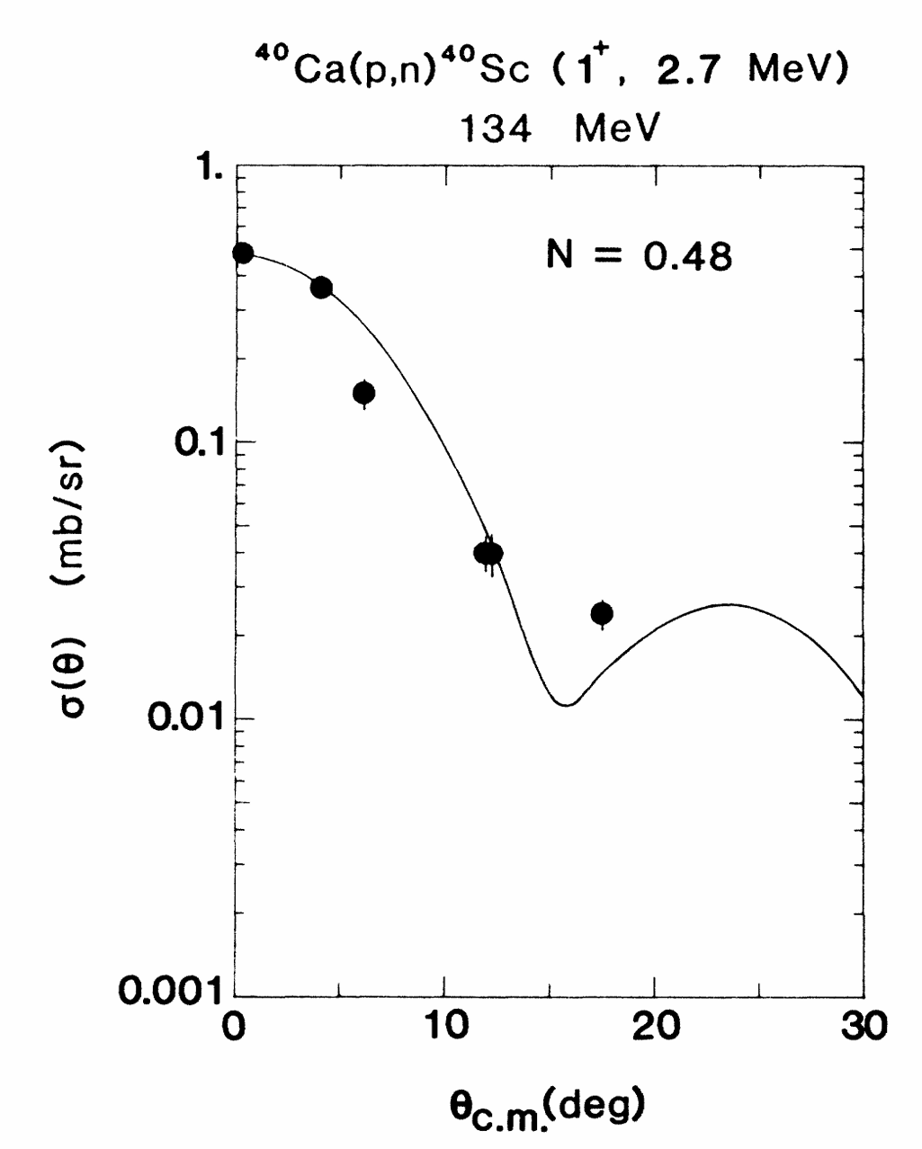
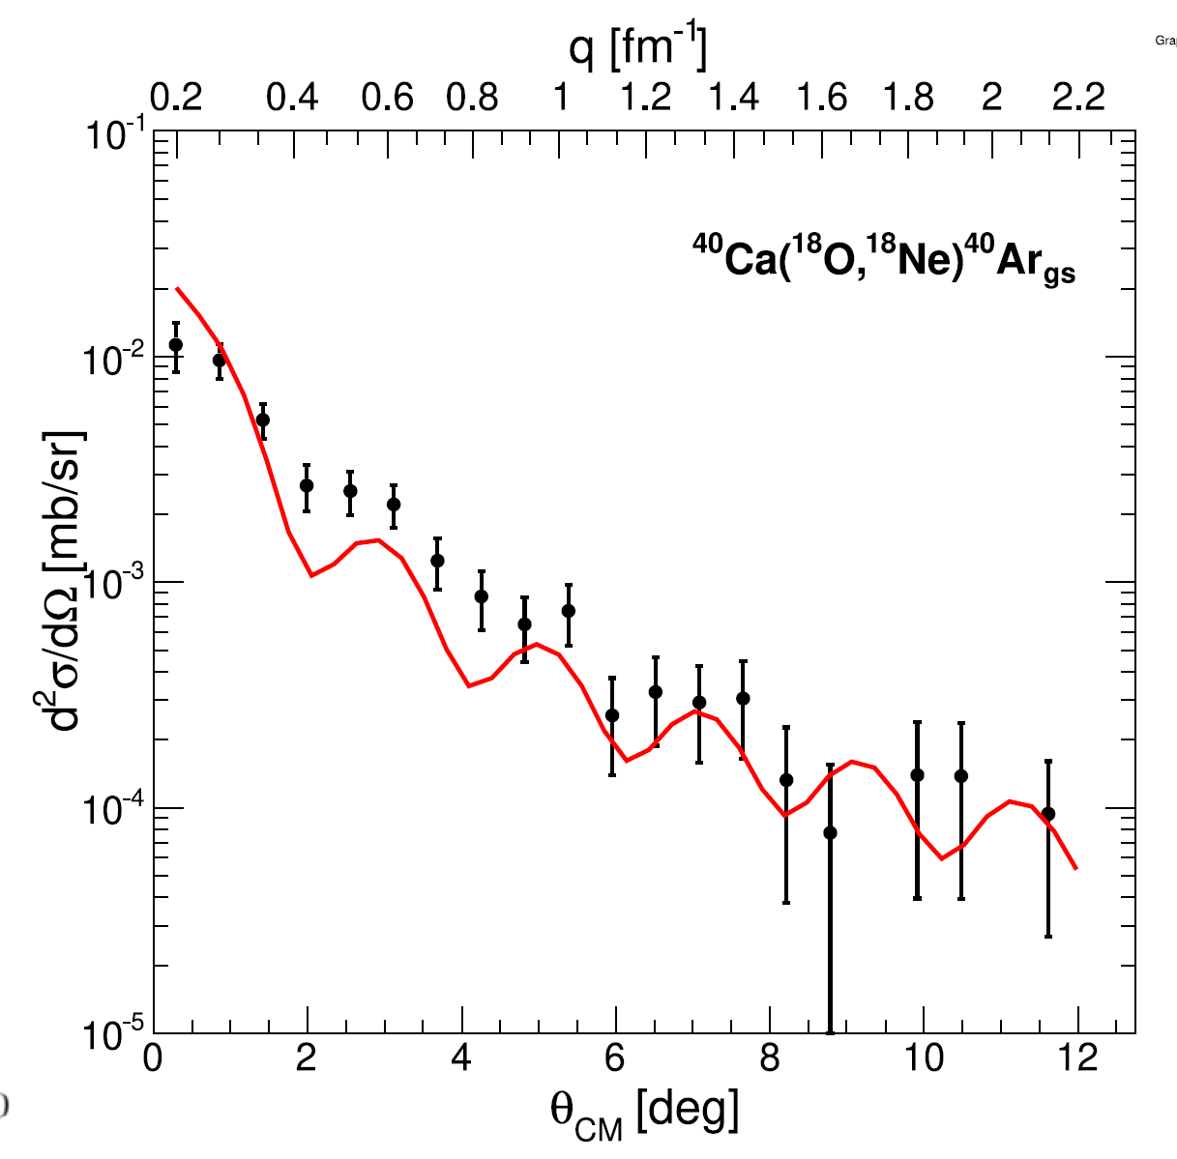
Low cross section with DCE
T. Chittrakarn, et al., PRC 34, 80 (1986)
F. Cappuzzello et al., PPNP 128 (2023) 103999
18/23

Slide 19
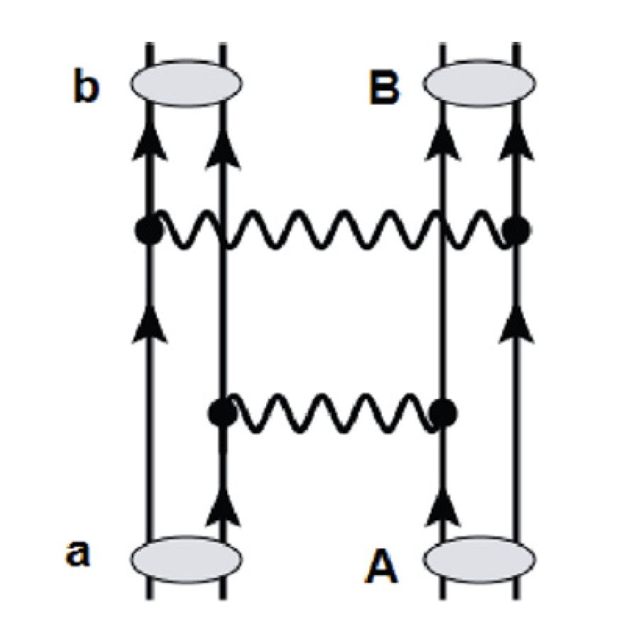
Theoretical interpretations of DCE data
Two-step (sequential) process (DSCX).
Correspond to 2νββ
One-step process (MDCE).
Correspond to 0νββ
19/23

Slide 20
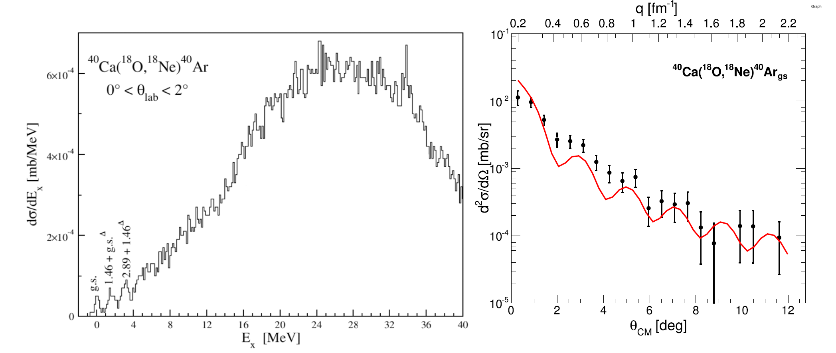
The NUMEN project
The NUMEN project: NUclear Matrix Elements for Neutrinoless double beta decay
F. Cappuzzello et al., PPNP 128 (2023) 103999
20/23

Slide 21
The NUMEN project
The NUMEN project: NUclear Matrix Elements for Neutrinoless double beta decay
F. Cappuzzello et al., PPNP 128 (2023) 103999
21/23

Slide 22
The NUMEN project
The NUMEN project: NUclear Matrix Elements for Neutrinoless double beta decay
Problem: How to disentangle contributions from DSCE and MDCE ?
Solution: Perhaps by their angular distributions (on going efforts…)
F. Cappuzzello et al., PPNP 128 (2023) 103999
22/23

Slide 23
Summary
From charge-exchange reaction, B(GT) can be extracted (not limited by Q-value!)
Useful in studying weak interactions: neutrino detectors, ββ decay, neutrino-induced nucleosynthesis, stellar beta-decay rates, isospin symmetry etc.
Coincident γ-ray measurement significantly boosts the resolution
Double charge-exchange is a more powerful but more challenging tool for double beta decay studies
Thanks!
23/23

