Slide 1
EicC vertex & tracking detector simulation and performance study
Aiqiang Guo, Yuming Ma,
Yutie Liang, Yuxiang Zhao
Institute of Modern Physics, CAS

Slide 2
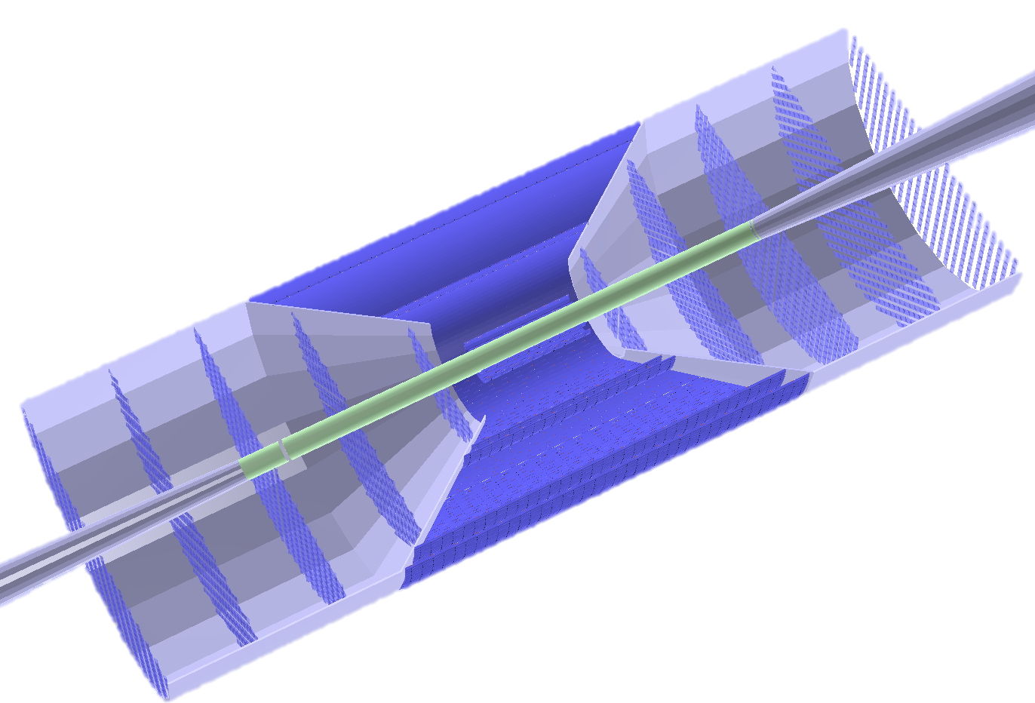
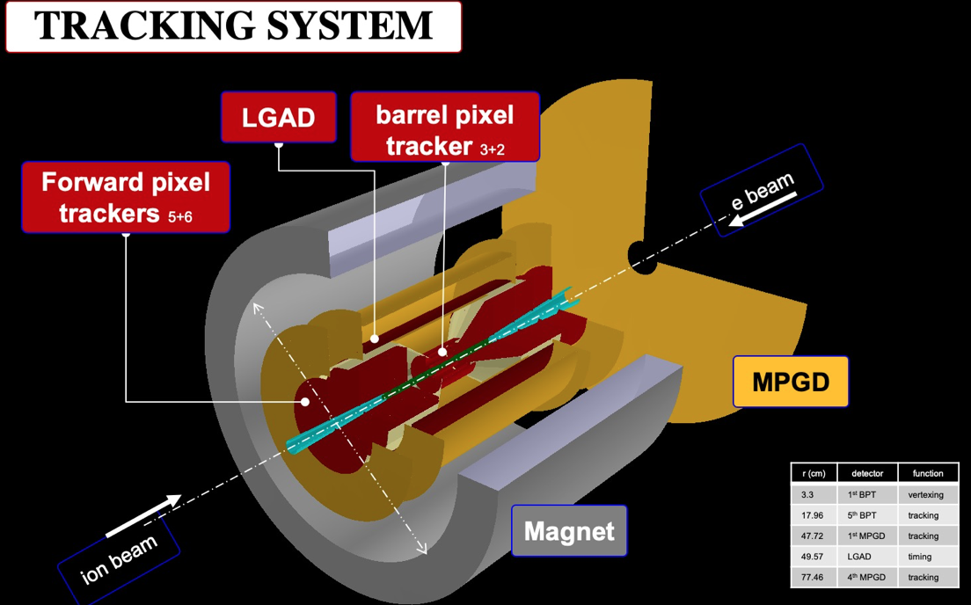
New Tracker design

Slide 3
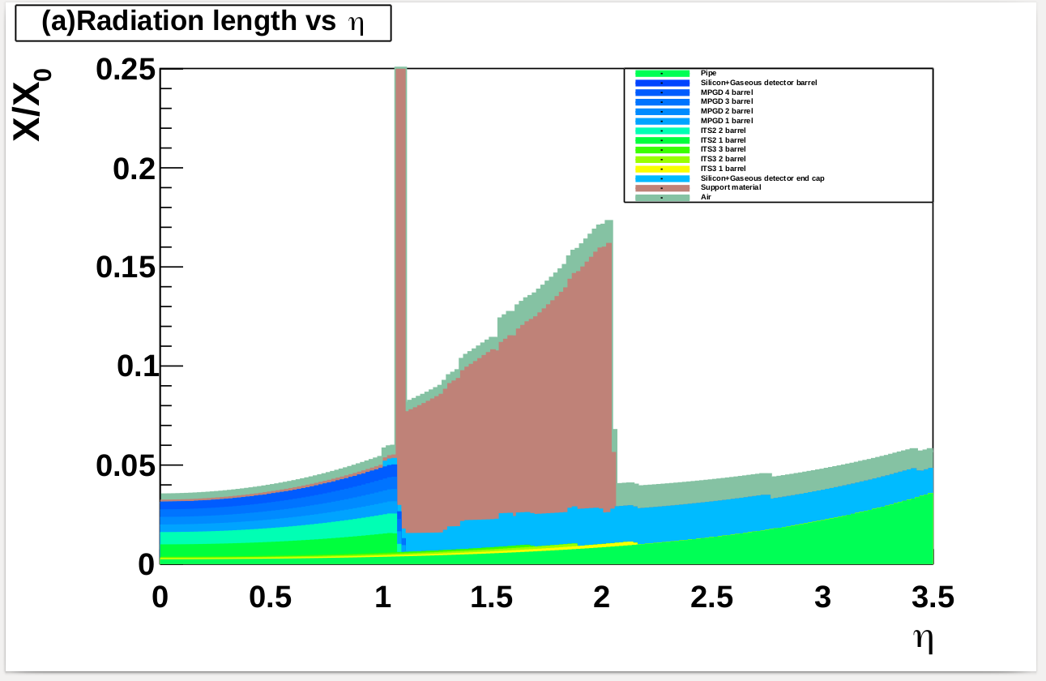
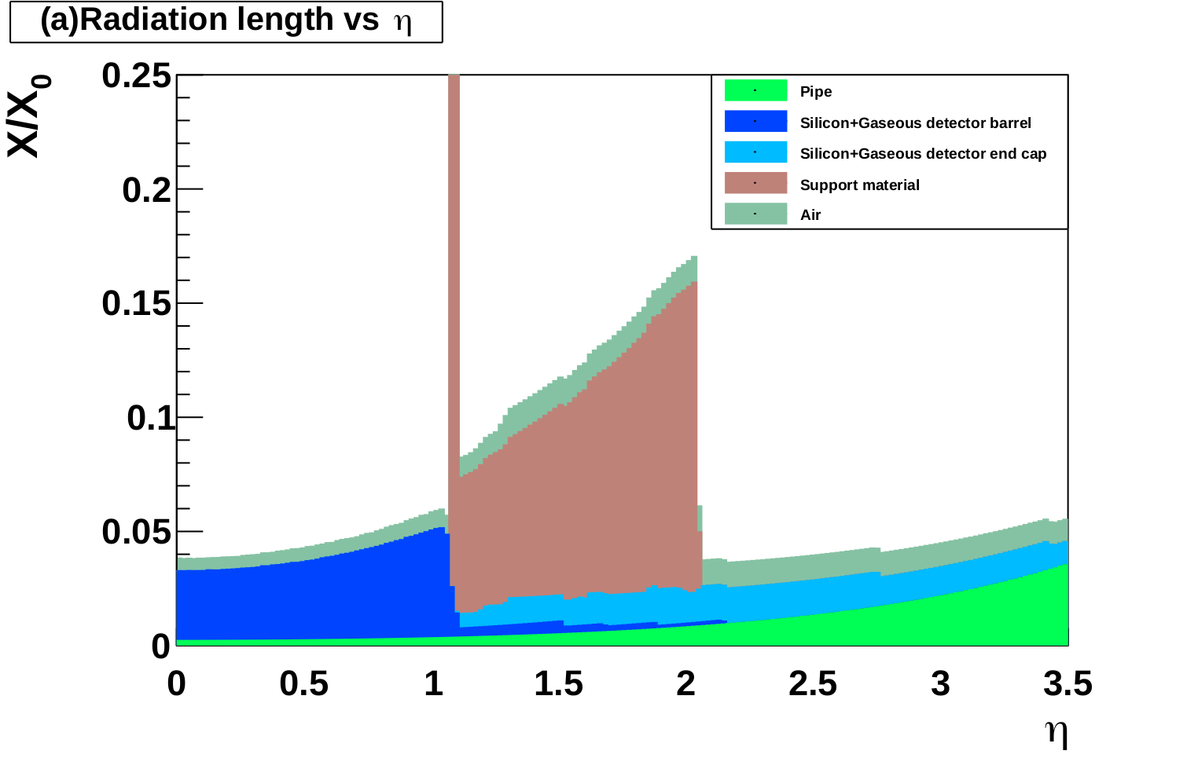
Material budget comparison

Slide 4
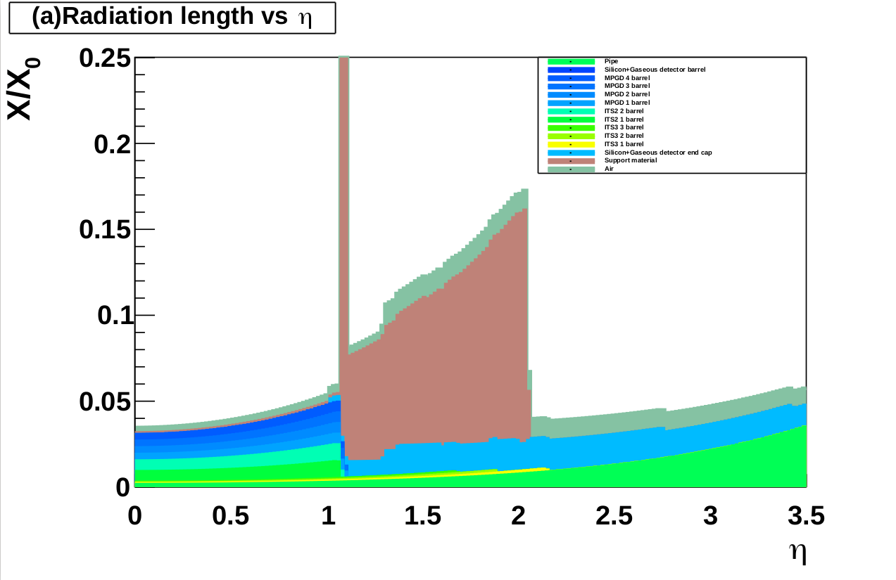
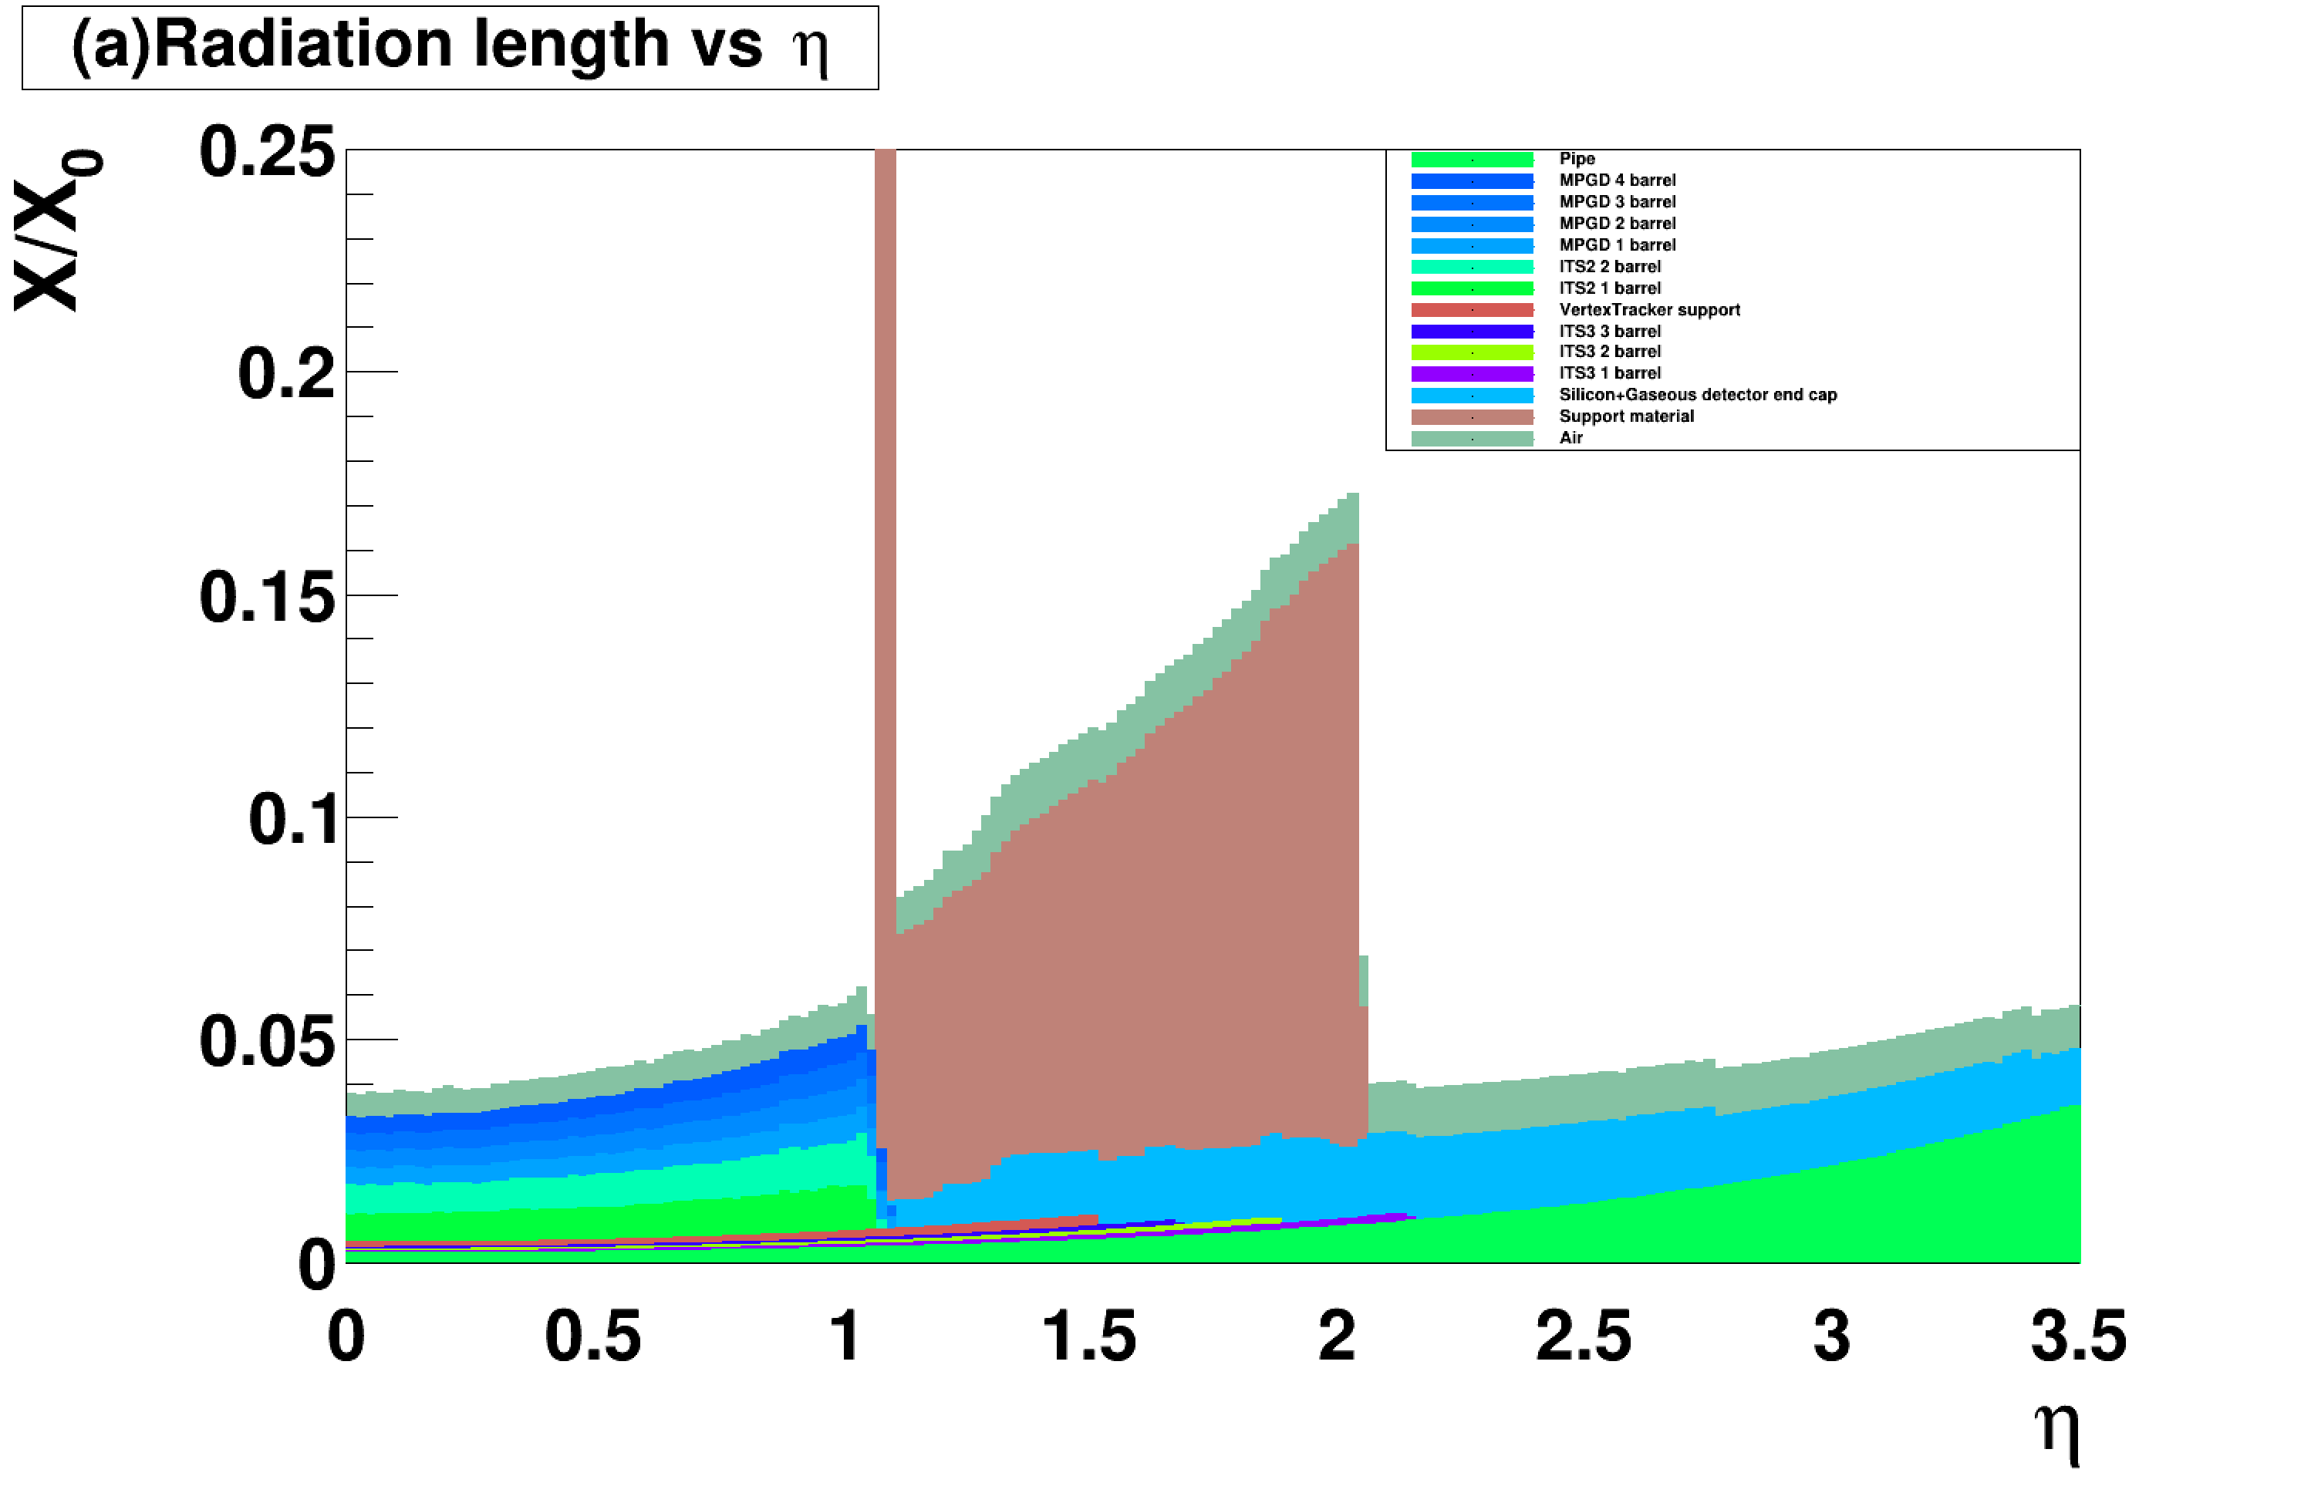

Slide 5
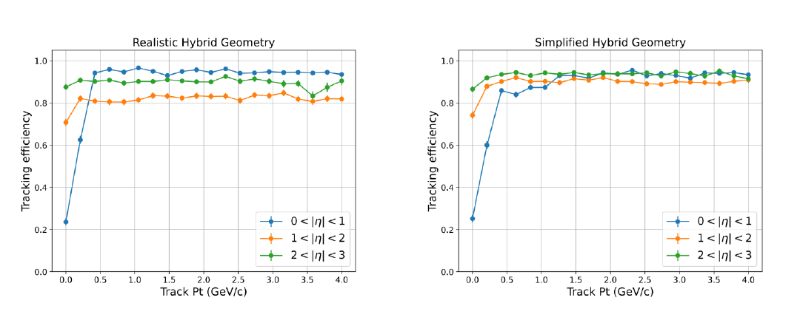
Tracking efficiency

Slide 6
Tracking efficiency

Slide 7
Tracking efficiency

Slide 8
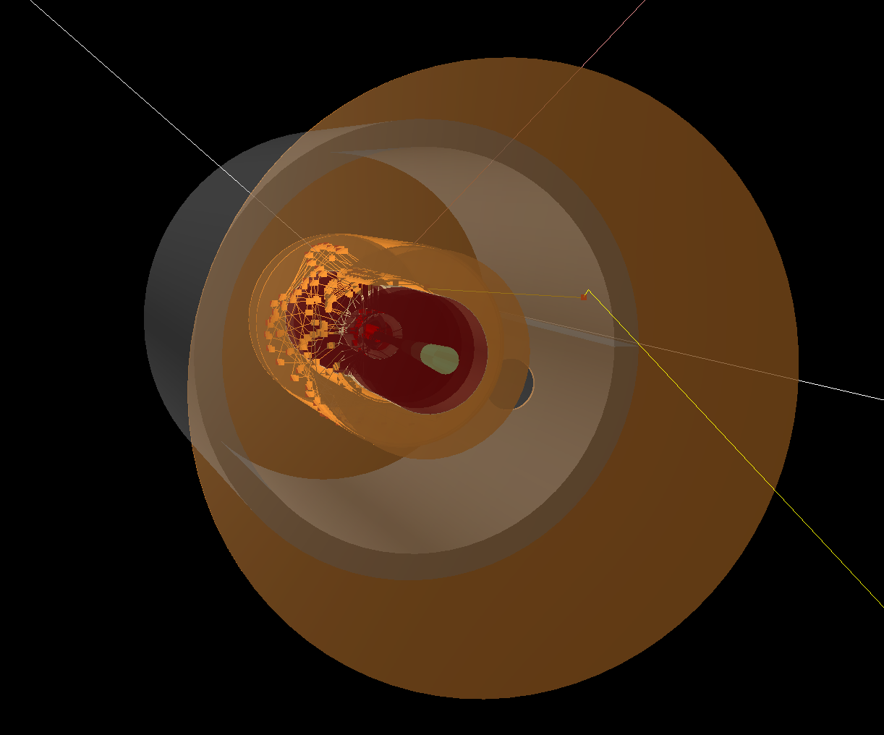

Slide 9
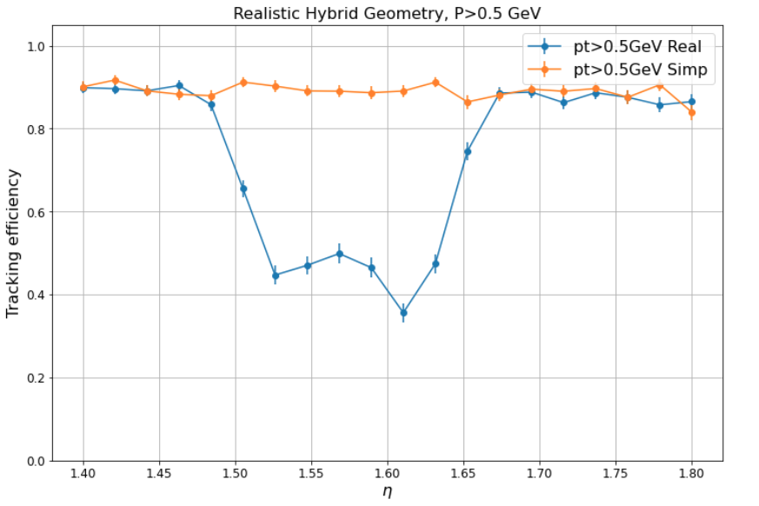
Efficiency vs eta&phi

Slide 10
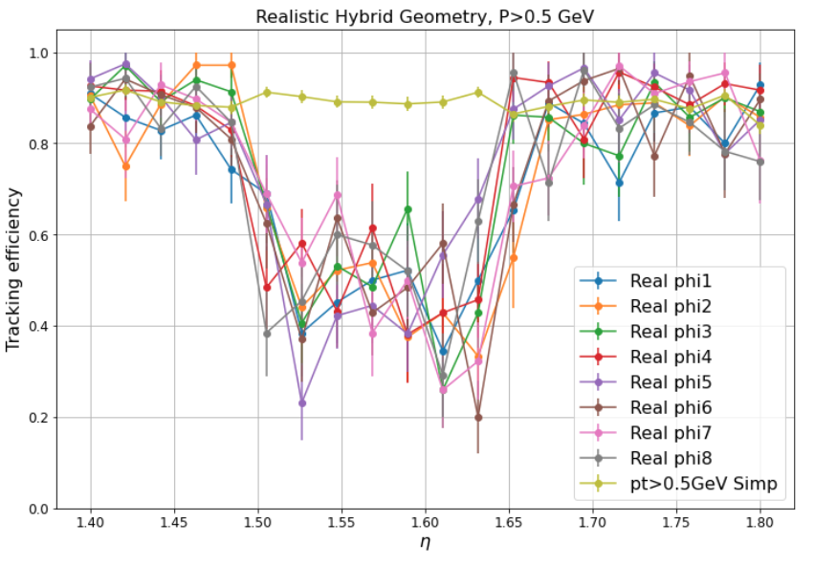
Efficiency vs eta&phi

Slide 11
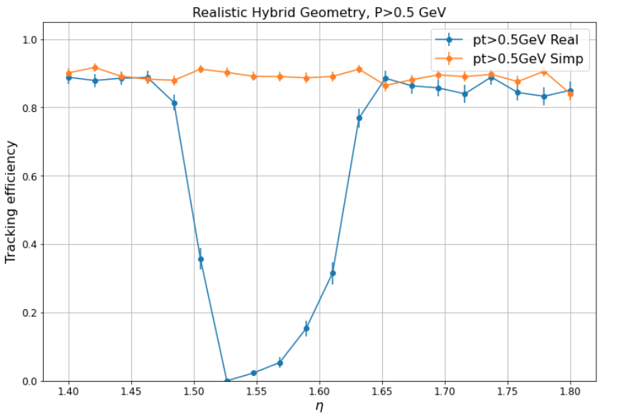
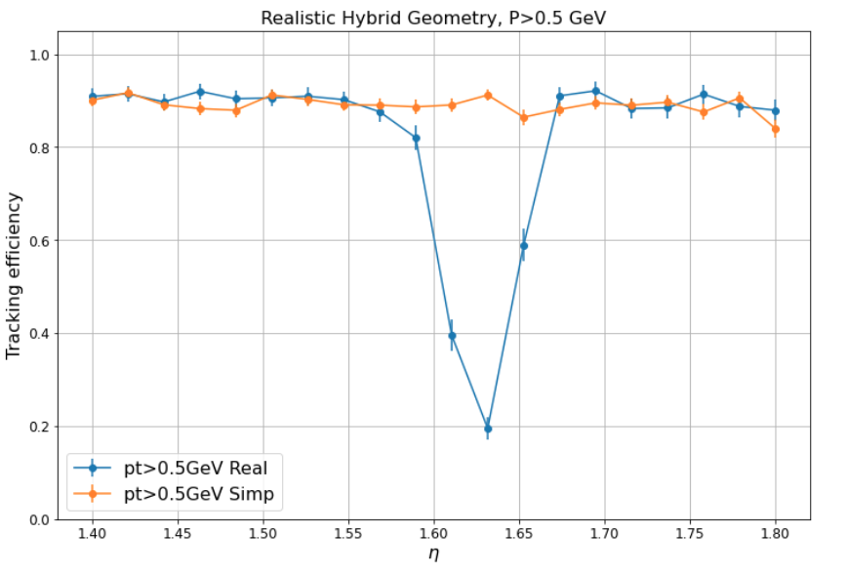
Efficiency in forward and backward
forward
Backward

Slide 12
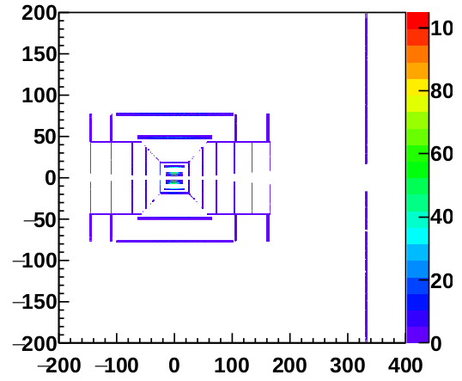
Detector profile
simp
real
$$η=1.5$$
$$η=1.65$$

