Slide 1
Progress on the MDC Track Reconstruction for STCF L1 Trigger Pre-Research
Zixuan Zhou , Changqing Feng, Yidi Hao, Wenhao Dong, Zhujun Fang
On behalf of STCF Trigger Working Group
2025/7/23
Workshop on Trajectory Reconstruction in Particle Physics Experiments
Huizhou 2025

Slide 2
Outline
STCF trigger system preliminary design
MDC track reconstruction algorithm
  2D tracking and reconstruction
  Time reconstruction
  3D tracking and reconstruction
Summary

Slide 3
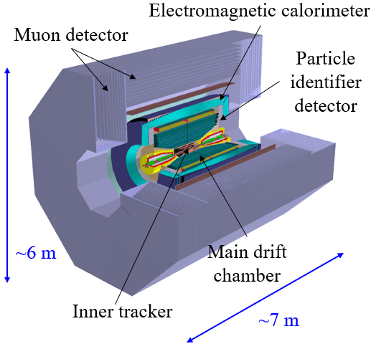
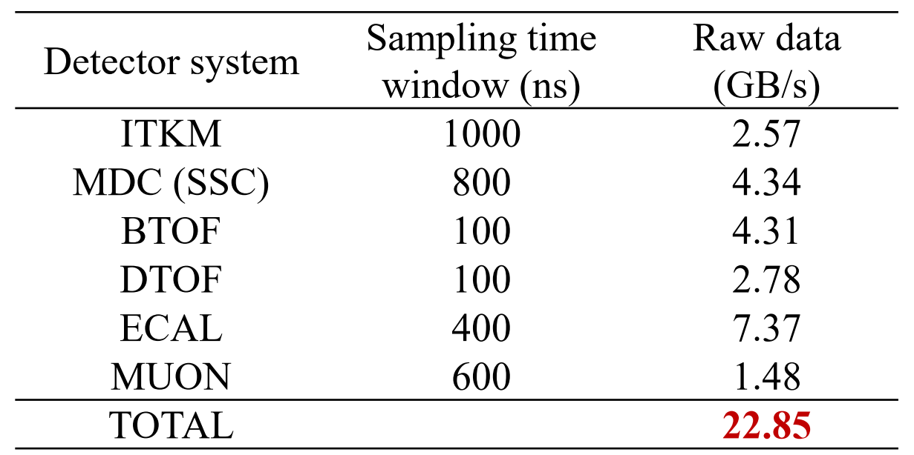
STCF Experimental Requirements
Key parameters:
A new generation of high-luminosity electron-positron collider
Peak luminosity: >0.5×10³⁵ cm⁻²s⁻¹
Peak physics event rate: 400 kHz
Data size per event (at 1× background): ~18 kB/event
STCF Trigger requirements:
Extremely high physics trigger efficiency (~99%)
Low background trigger rate (< 50 kHz)
High data throughput with low latency
Event separation capability: ΔT < 100 ns
Estimated Data Volume at 1× Background:

Slide 4
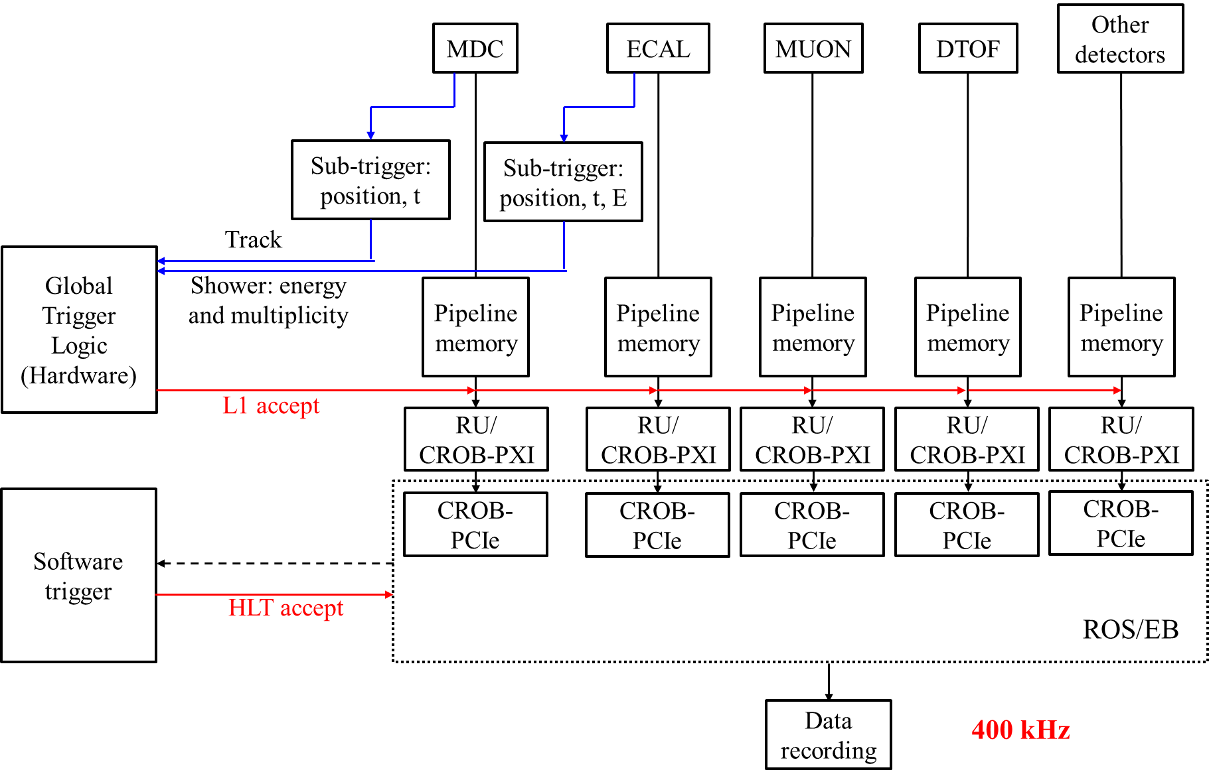
Trigger System Design
Two-stage trigger system:
Level 1 Trigger:
Identifying physics events window
Based on FPGA platform
Latency ~ 5 μs
High Level Trigger (HLT):
Suppressing backgrounds in each time window
Based on server cluster
L1 Trigger
HLT

Slide 5
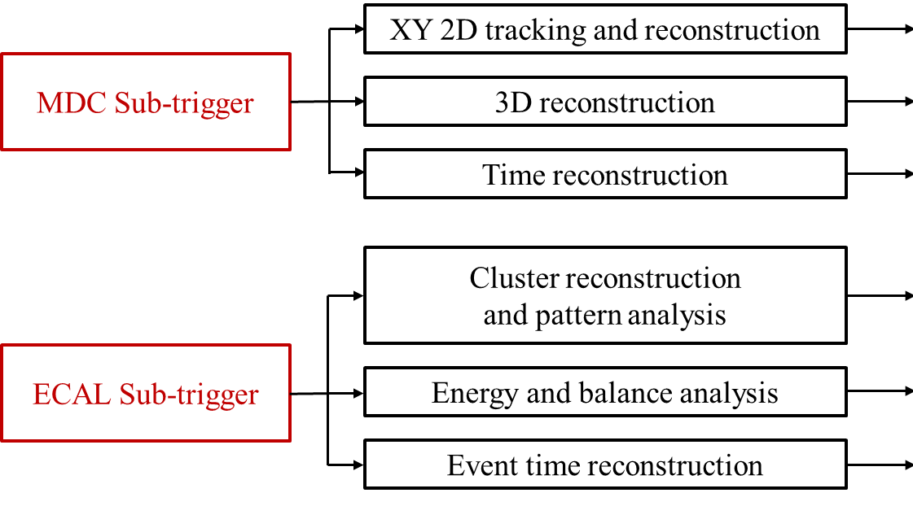
Preliminary design of L1-level trigger
ITK: high background
MDC: key tracking detector
RICH: complex Cherenkov ring reconstruction
DTOF: auxiliary in Endcap
ECAL: key calorimeter, fast response
MUON: auxiliary for μ/π/n/K_{L}
L1 level GTL

Slide 6
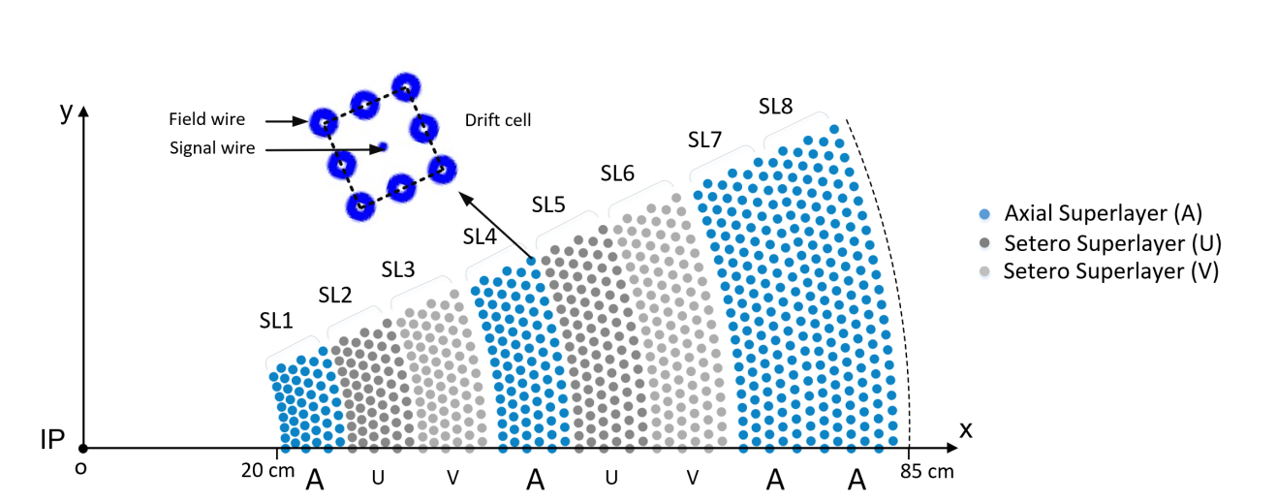
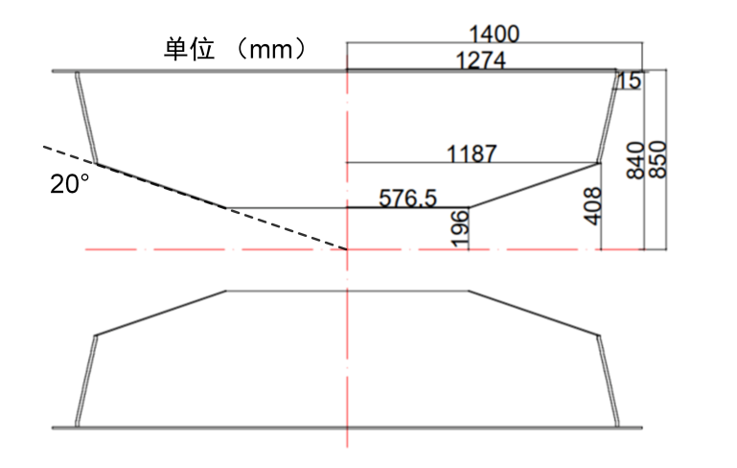
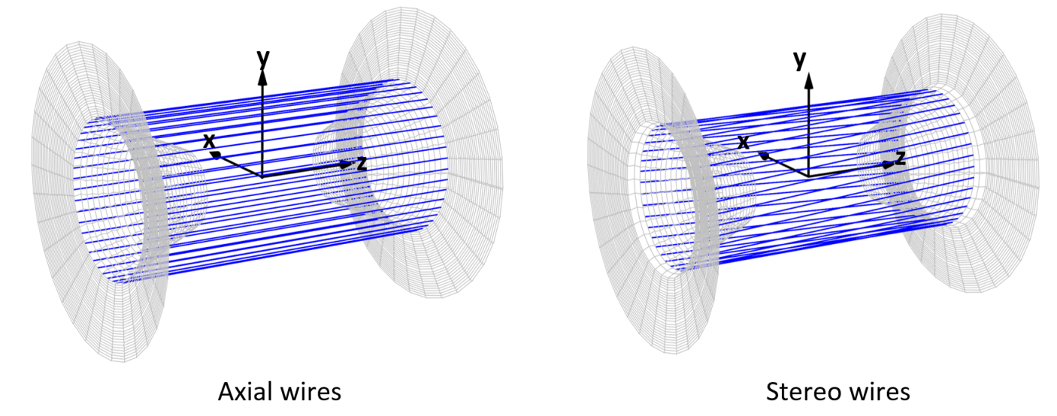
MDC sub-trigger
Baseline design:
48 layers of small cell
1,4,7,8---axial superlayers
2,3,5,6---stereo superlayers
Region division:
Barrel & Endcap
Long track: passes through the full barrel
Short track: escapes toward the endcap
33.4 deg
33.4 deg
Endcap
Barrel
20 deg
z-axis

Slide 7
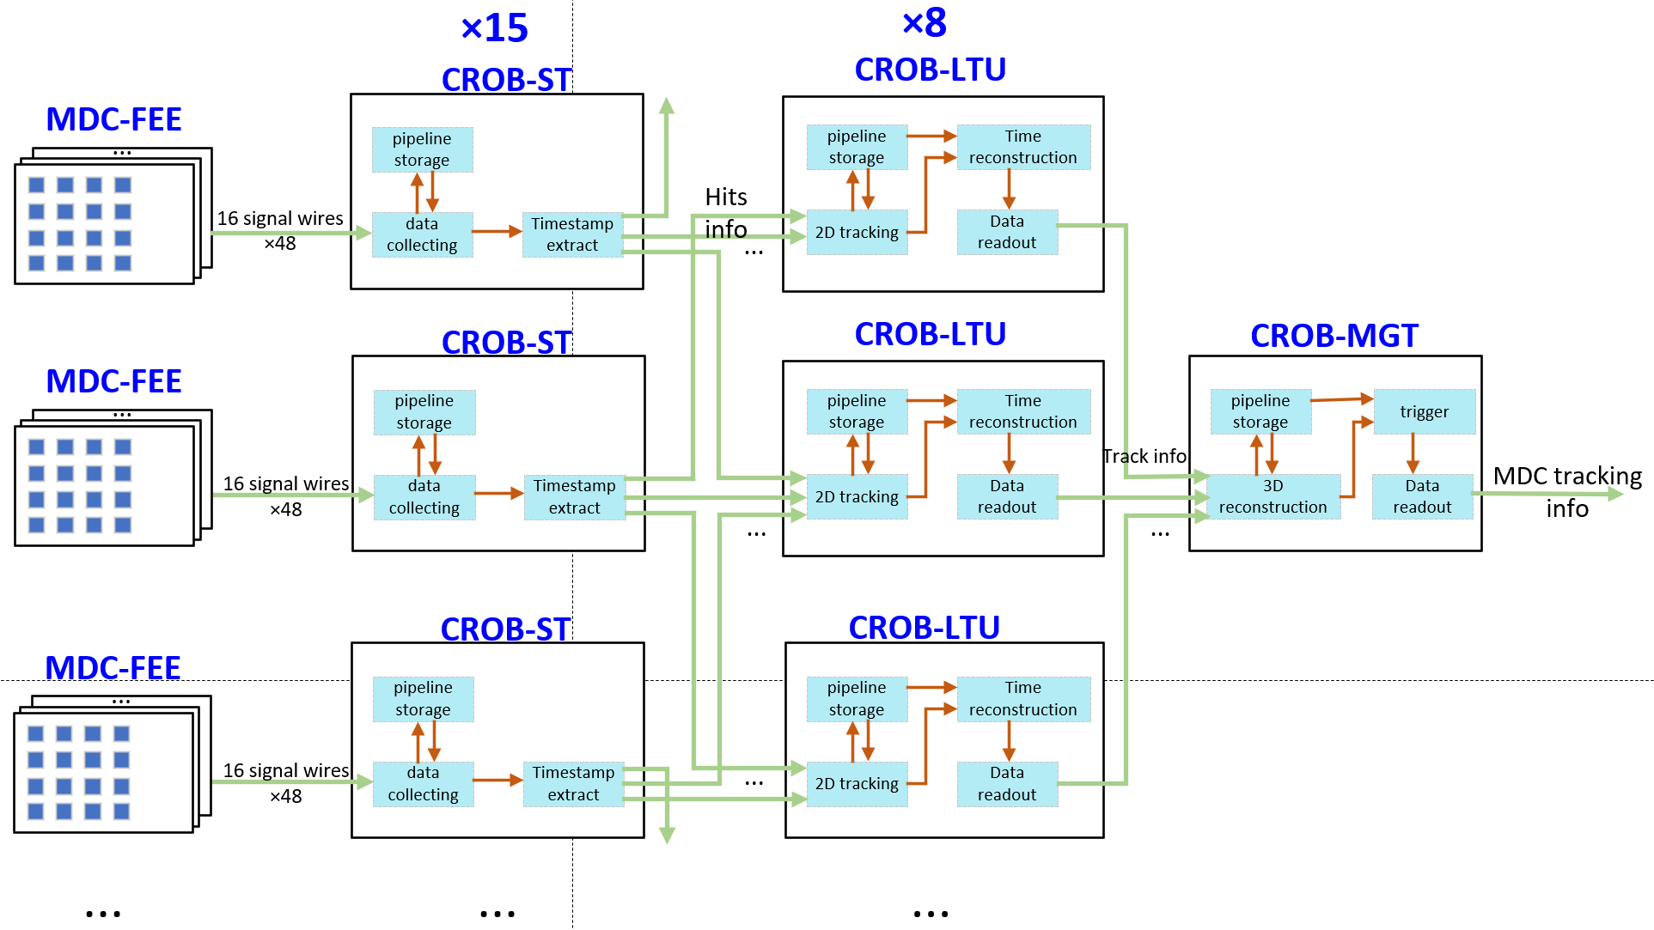
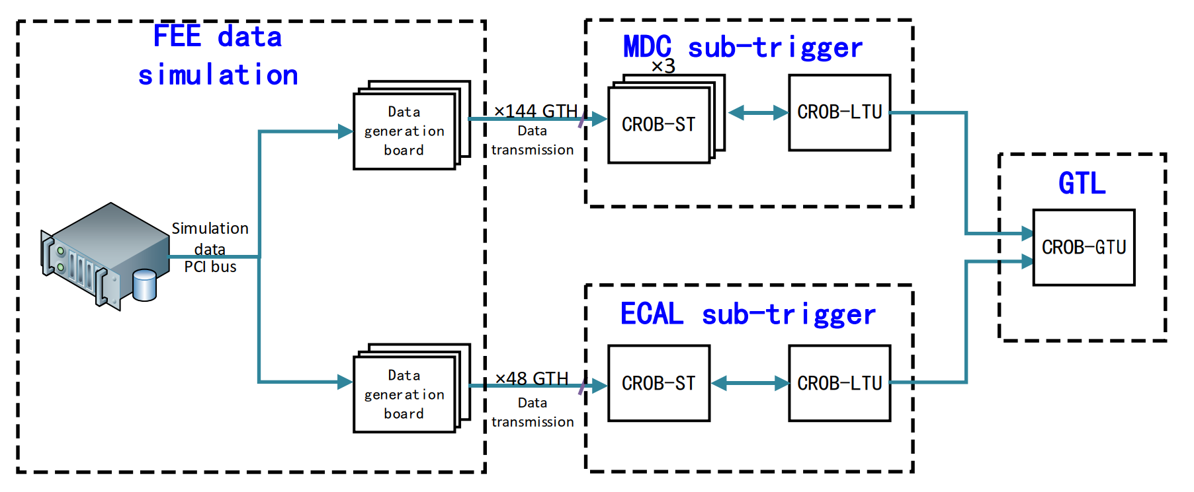
MDC FPGA Hardware Platform Architecture
MDC Sub-trigger Hardware Structure:
L1 Trigger Prototype Architecture Design：

Slide 8
Outline
STCF trigger system preliminary design
MDC track reconstruction algorithm
  2D tracking and reconstruction
  Time reconstruction
  3D reconstruction
Summary

Slide 9
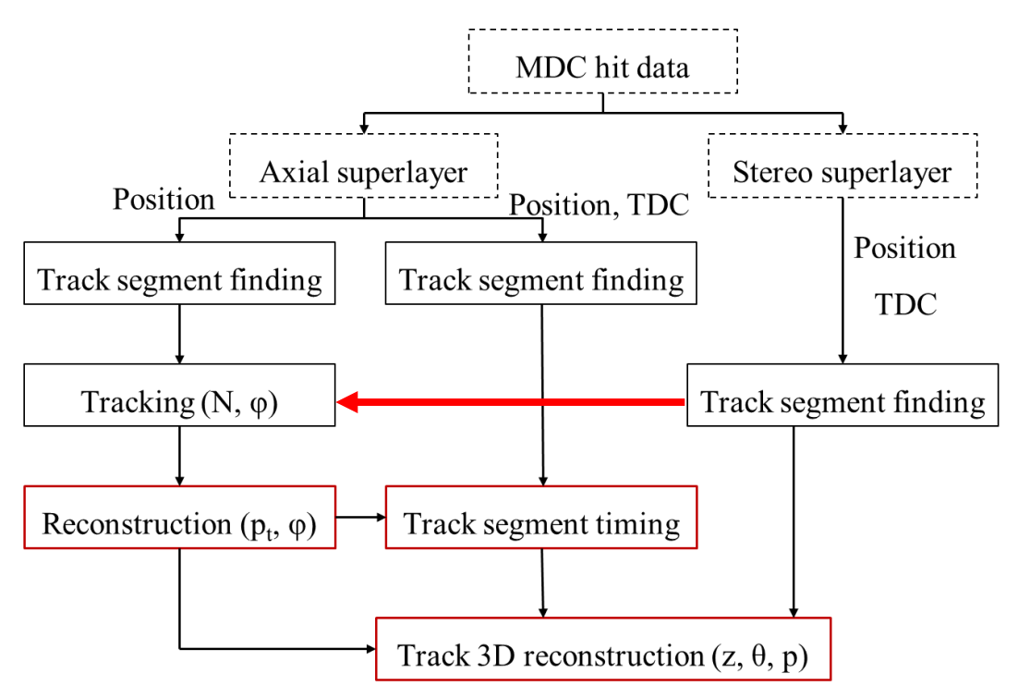
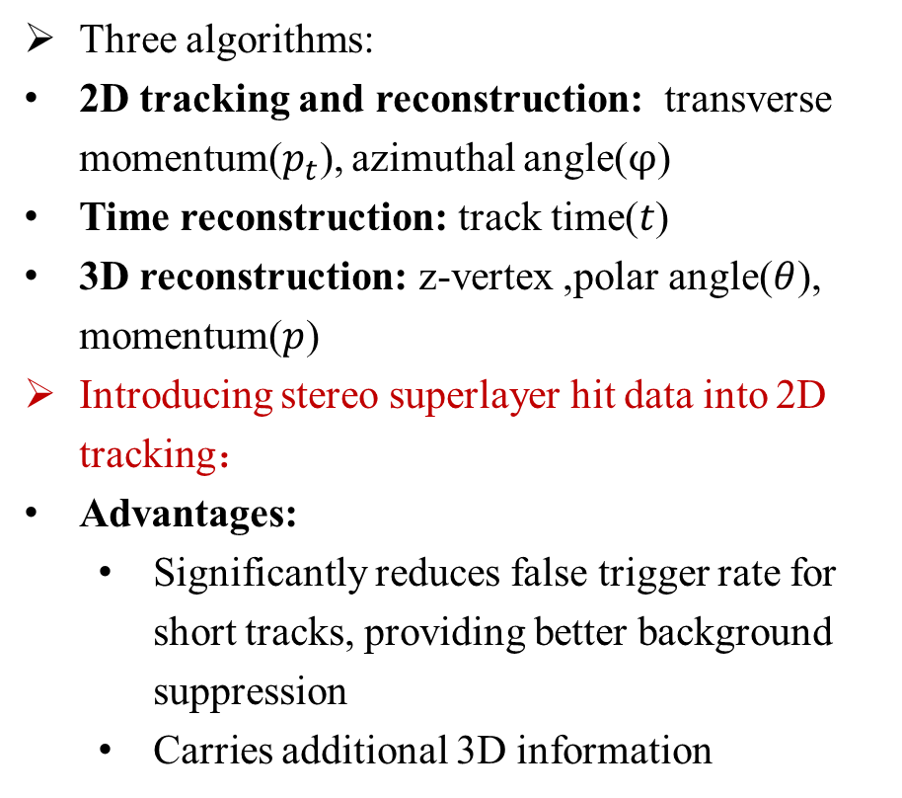
MDC track reconstruction algorithm process
MDC Sub-trigger Processing Flow:
Three algorithms:
2D tracking and reconstruction: transverse momentum($p_{t}$), azimuthal angle($φ$)
Time reconstruction: track time($t$)
3D reconstruction: z-vertex ,polar angle($θ$), momentum($p$)
Introducing stereo superlayer hit data into 2D tracking：
Advantages:
  Significantly reduces false trigger rate for short tracks, providing better background suppression
  Carries additional 3D information

Slide 10
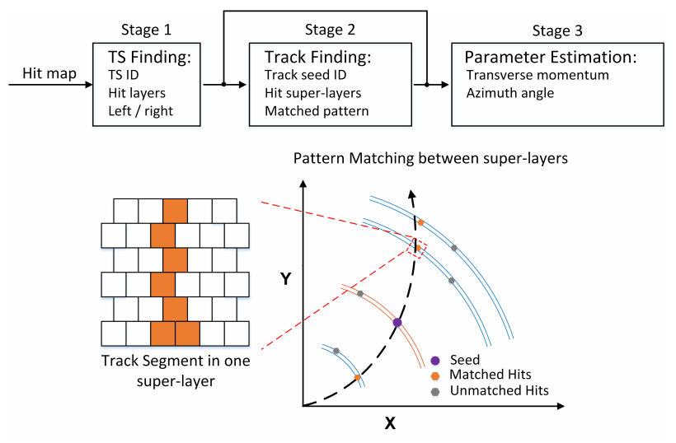
2D tracking and reconstruction
Pattern matching operation:
Generate pattern banks through simulated data
  Write into distributed storage units on the FPGA
Match event data with the pattens
  Implement high-speed parallel processing with FPGA logic
Three stages:
Track segment (TS) finding: reduce the input, reject background hits
Track finding: pattern matching---fast but sketchy
Estimation of track parameters: matching with an accurate pattern bank
10

Slide 11
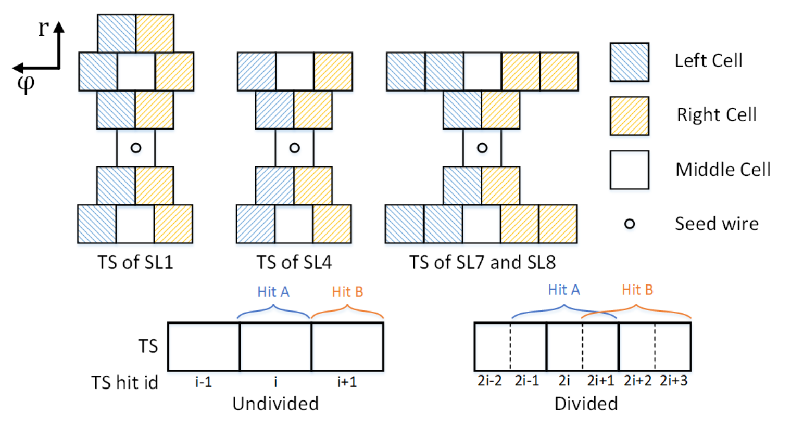
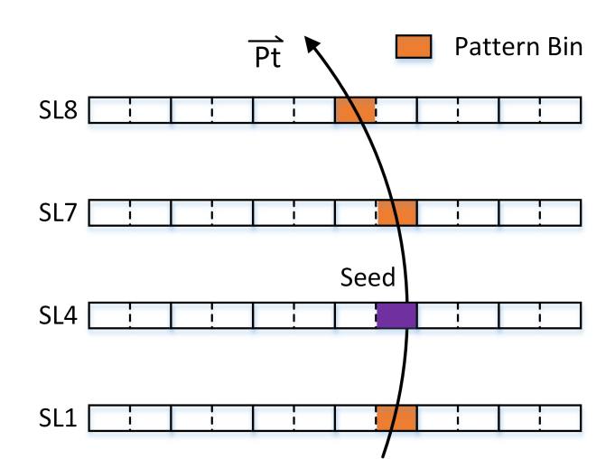
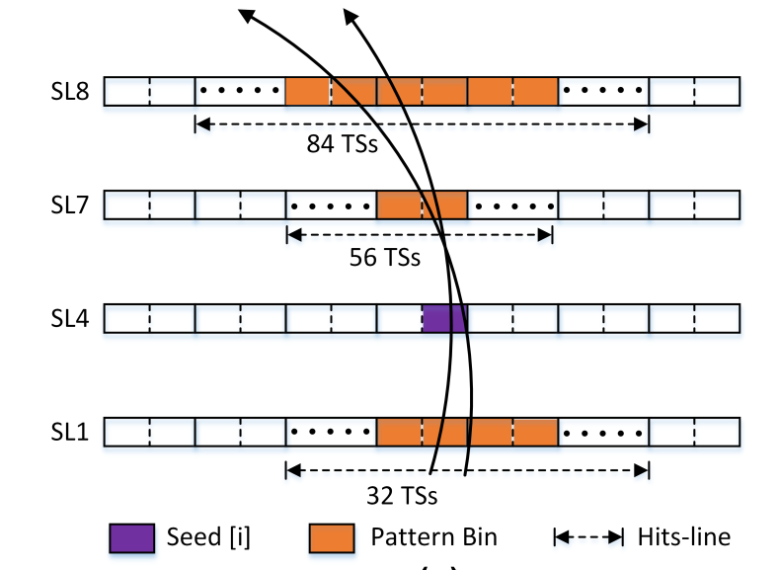
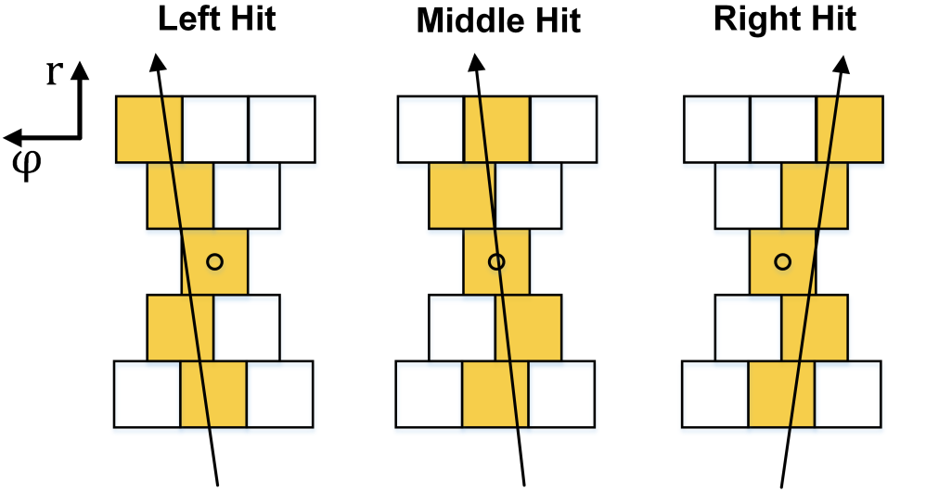
2D tracking and reconstruction
Track segment finding:
Undivided TS: for track finding
Divided TS: for parameter estimation
Pattern matching
Track finding: merged patterns for fast tracking
  total number：784
Track reconstruction: accurate patterns
  total number: ~7800
  p_{T} > 170 MeV

Slide 12
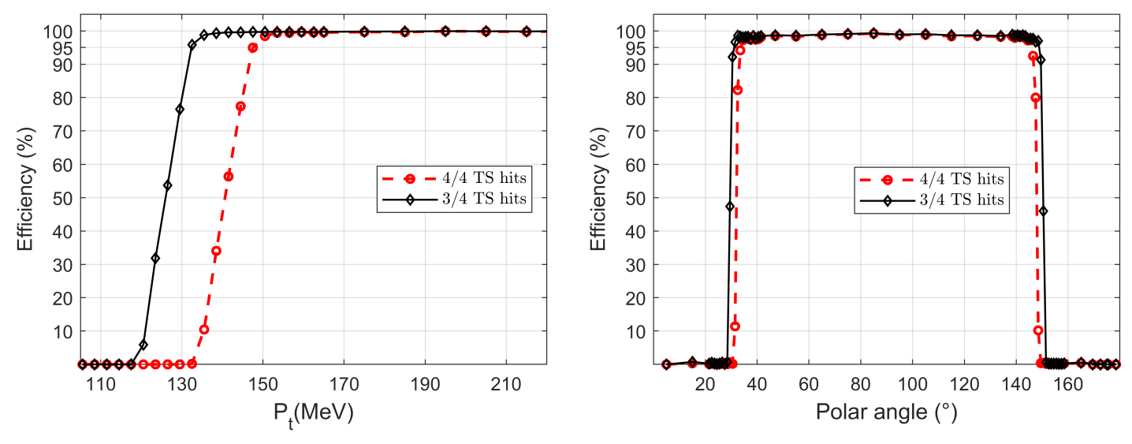
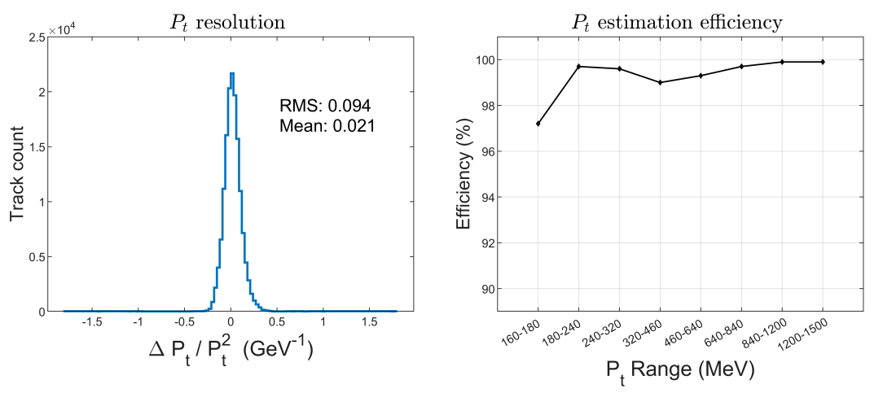
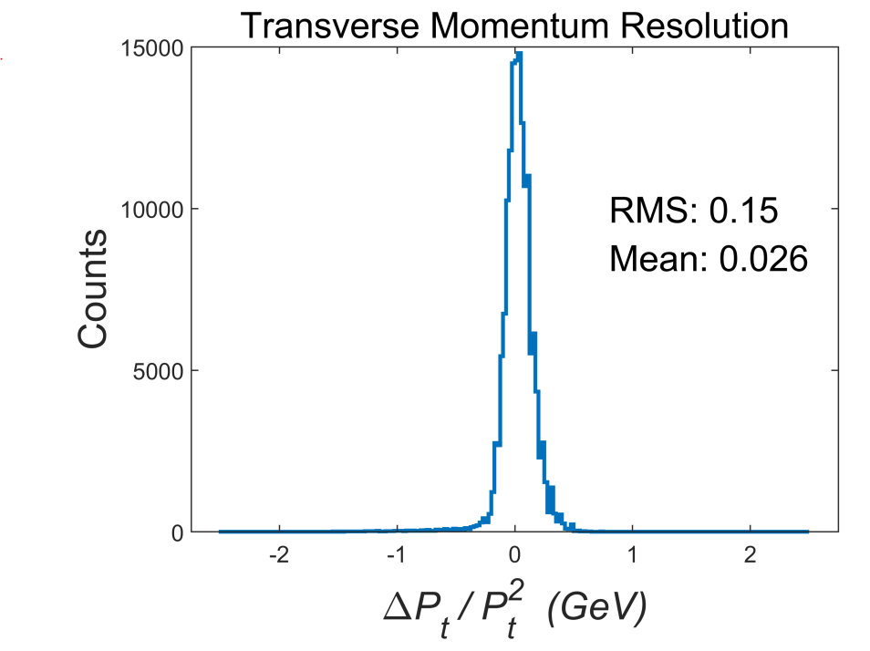
2D tracking and reconstruction
Long track efficiency
Single track
  Track finding: p_{T} > 130MeV θ > 30°
  Parameter estimation: p_{T} > 170MeV θ > 30°
  Δ𝑝_{T}/𝑝²_{T} ~ 0.1
Physics event
  The cut of θ: reason for 90% lost events
p_{t} resolution in events

Slide 13
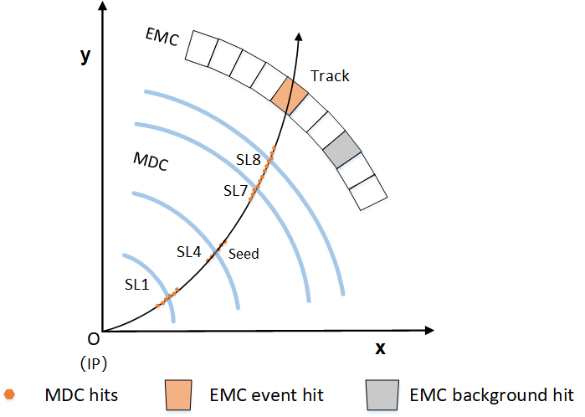
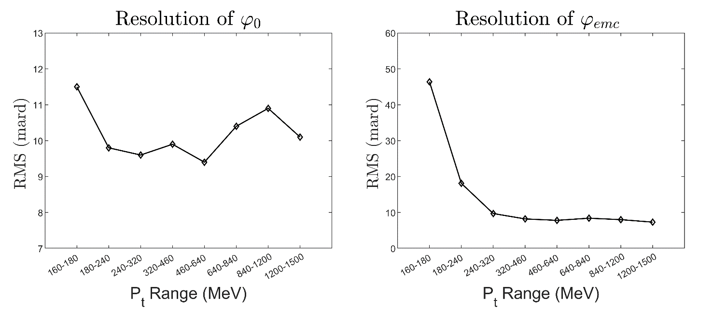





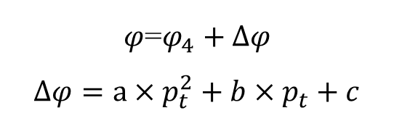
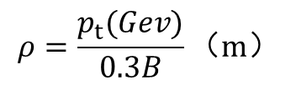

2D tracking and reconstruction
φ reconstruction
FPGA implementation
$φ$=$φ_{4}+∆φ$
$$∆φ=a×p_{t}^{2}+b×p_{t}+c$$
IP：$φ_{0}=φ_{4}−arcsin⁡(\frac{r_{4}}{2ρ})$
Piecewise interpolation
Resource friendly
EMC：$φ_{e}=φ_{4}−\arcsin\left(\frac{r_{4}}{2ρ}\right)+\arcsin\left(\frac{r_{e}}{2ρ}\right)$
$$ρ=\frac{p_{t}(Gev)}{0.3B}（m）$$
Coefficient lookup table
Quadratic term Linear term Constant term
Calculation of quadratic polynomials
O’
  precision
    For tracks with p_{t} > 180 MeV，
    Δ $φ_{e}$< 20 mrad
    For track matching with EMC, 50 mrad is OK
$$φ_{e}$$
$$φ_{4}$$
$$φ_{0}$$
13

Slide 14
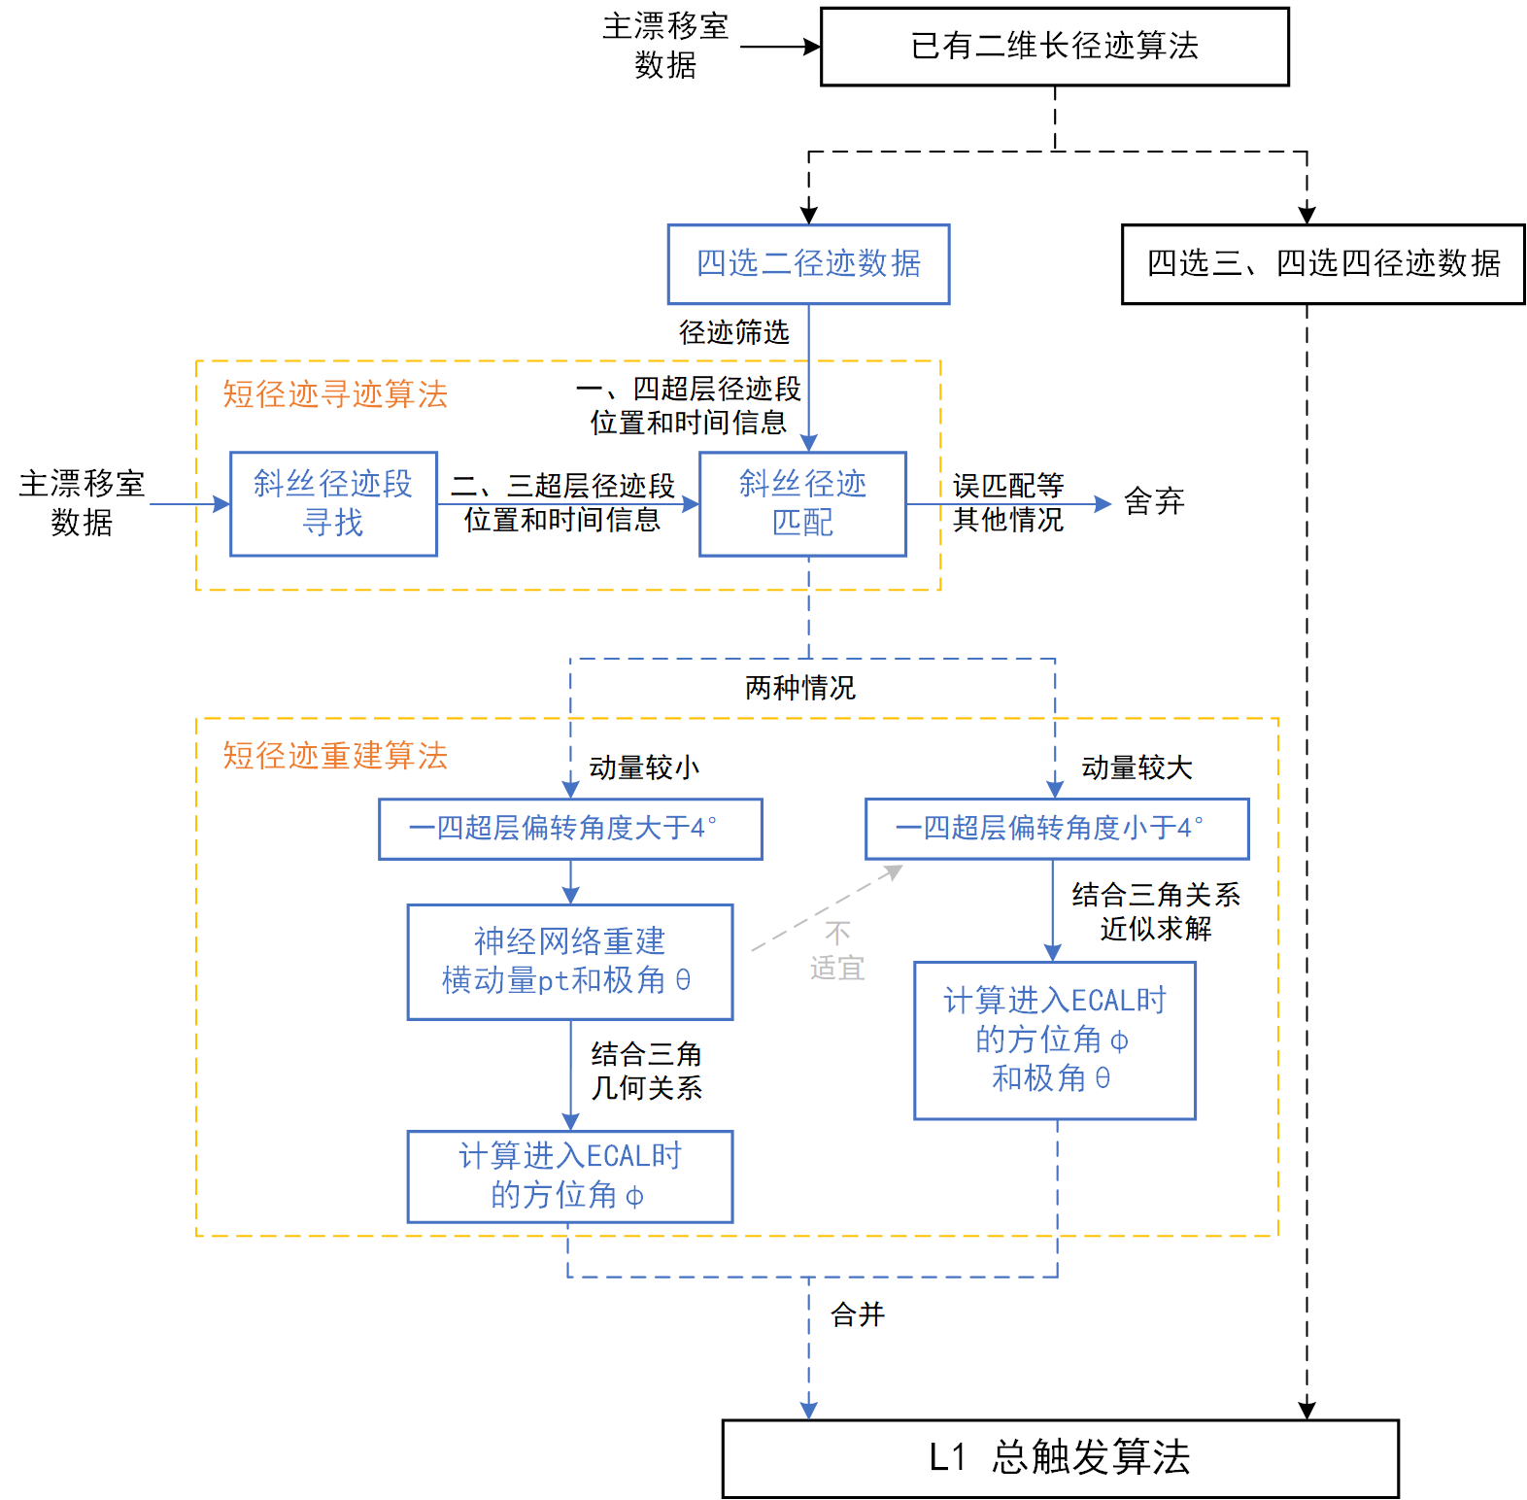
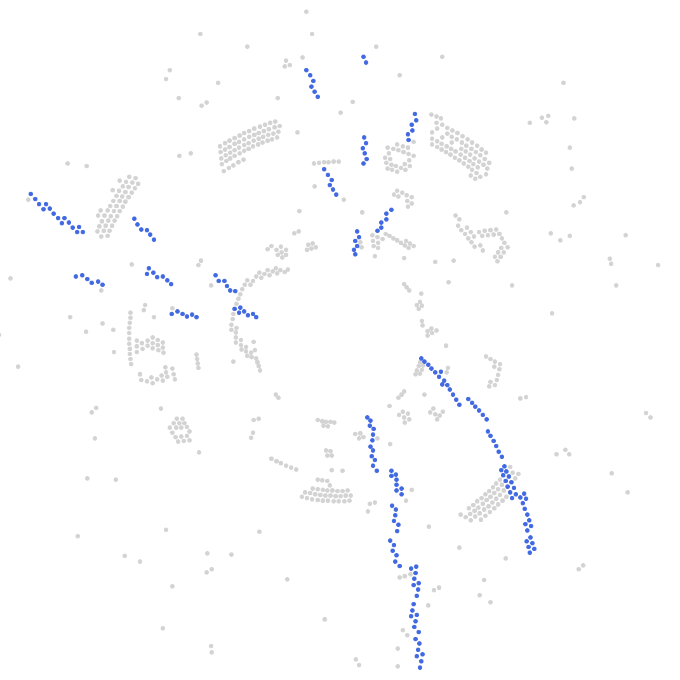
2D tracking and reconstruction
Optimization——Short track reconstruction:
  Purpose：
    Reduce false trigger rate during tracking
    Extend reconstruction to include parameter information of short tracks
  hits only in the first and fourth superlayers
  Introduce hits from the second and third superlayers to select short tracks
  Challenge：z-displacement leads to inaccurate hit positions on signal wires

Slide 15
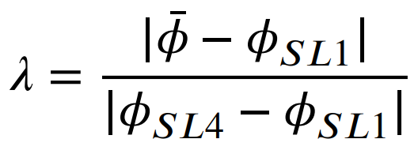
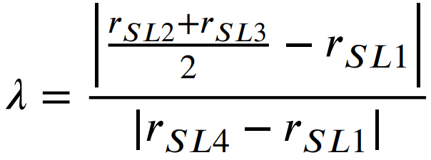

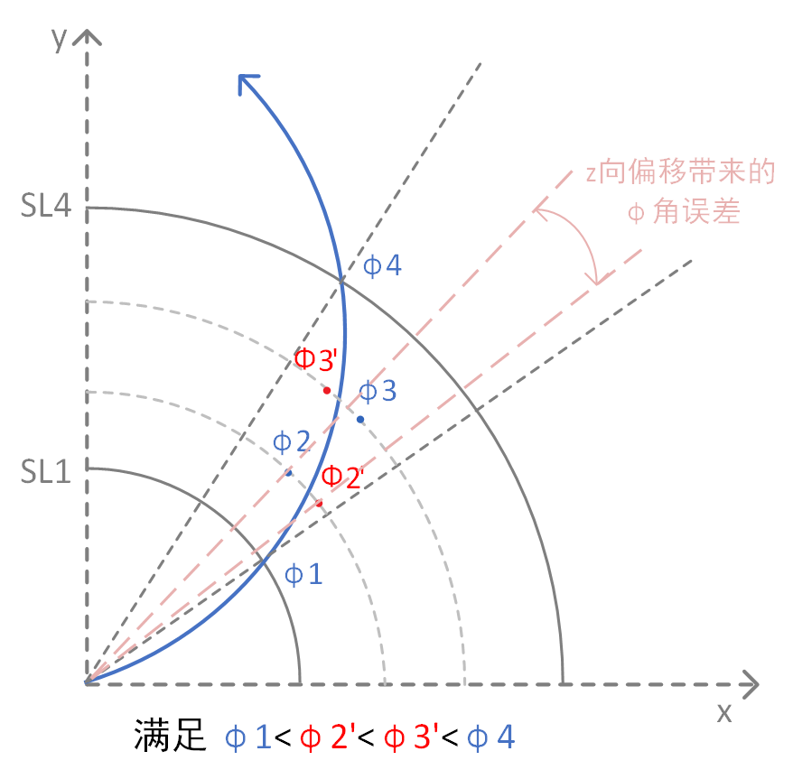
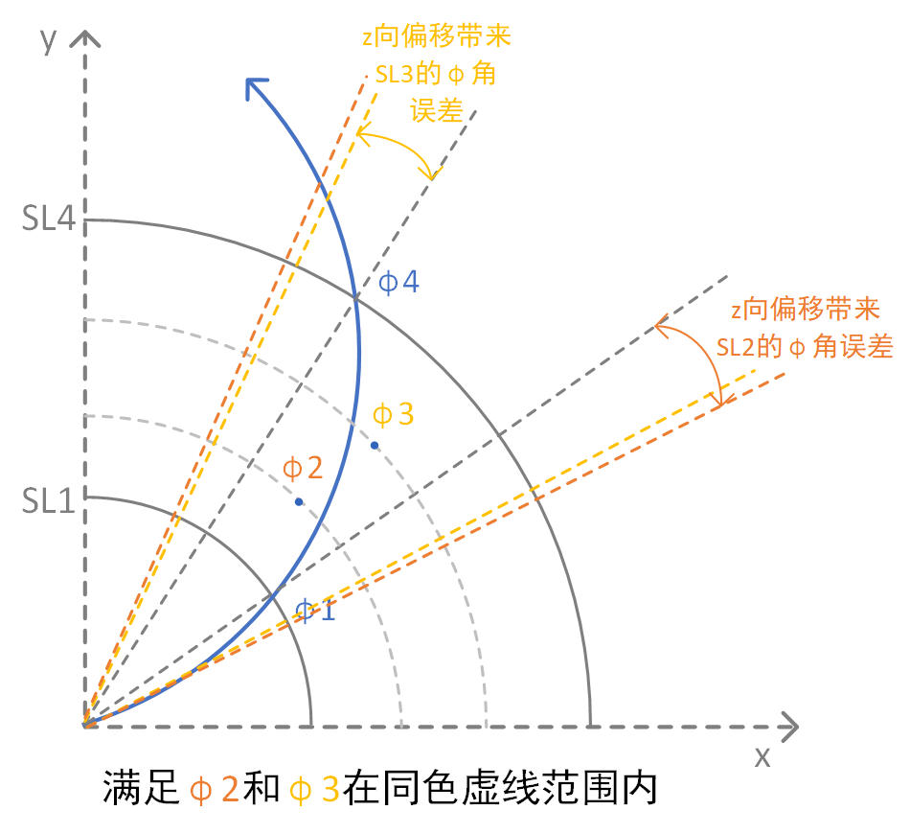
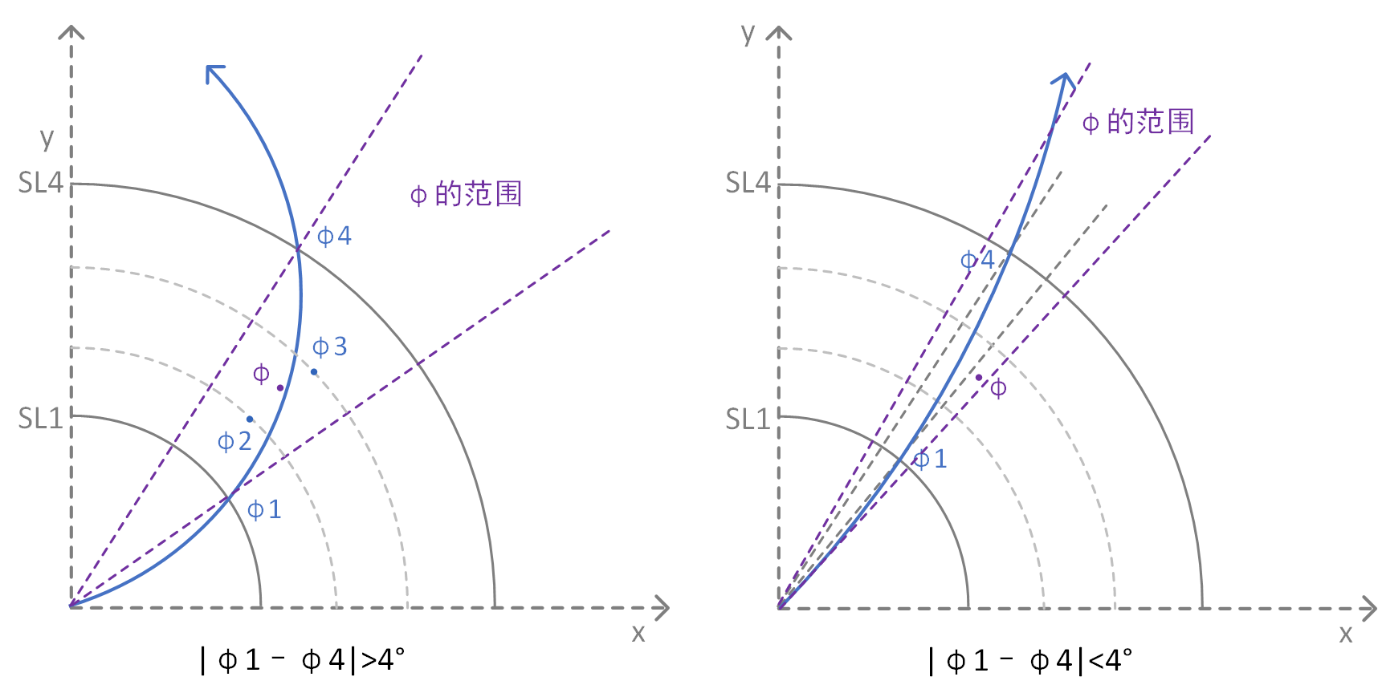
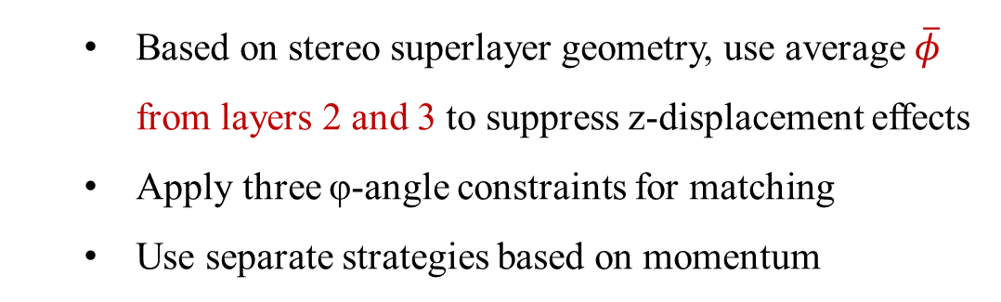
Short track reconstruction
Stereo TS matching rules：
Eliminate duplicate matches of stereo TS ：
  Determine the maximum φ-angle deviation caused by stereo TS wire shifts
  Caused by background hits and interactions between tracks
  Keep
  Based on stereo superlayer geometry, use average $\overline{φ}$ from layers 2 and 3 to suppress z-displacement effects
  Apply three φ-angle constraints for matching
  Use separate strategies based on momentum
Tracking Efficiency：
  Single track：Efficiency exceeds 99%
  Physics event：Reduces background false triggers in charged trigger channel by 50%
规则1
规则2
规则3

Slide 16
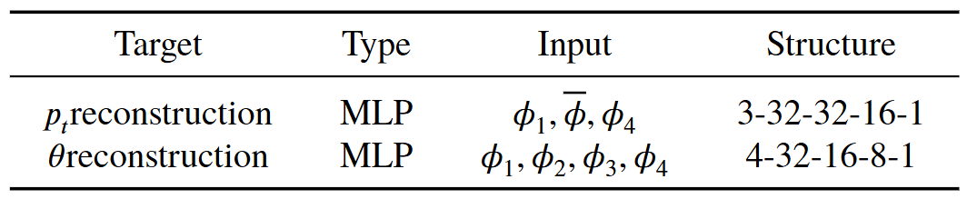
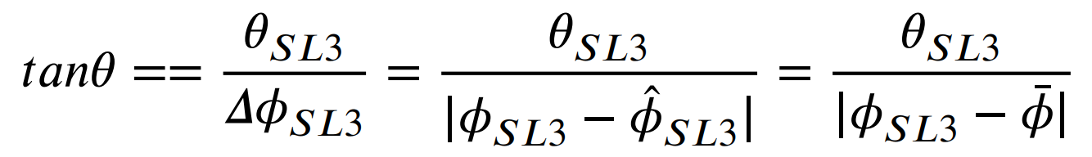
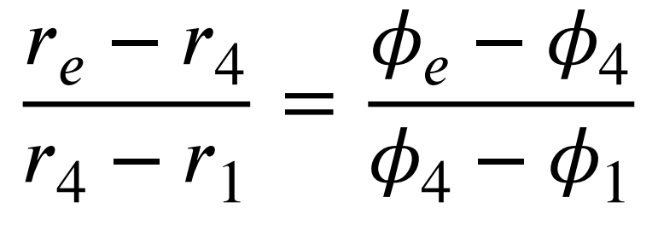
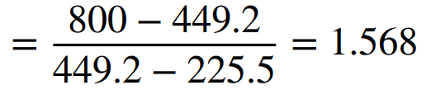
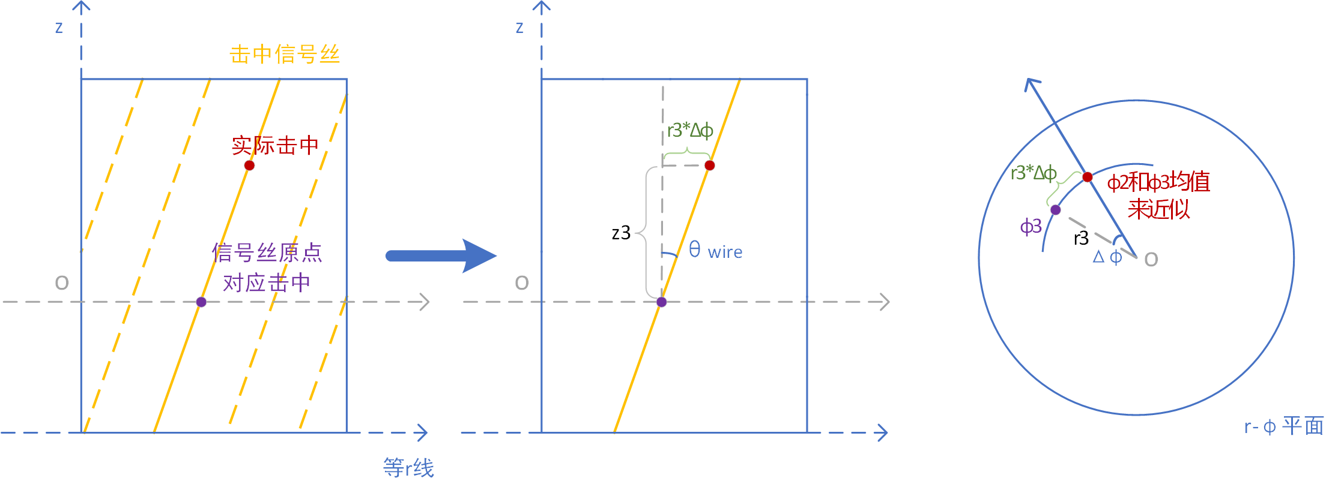
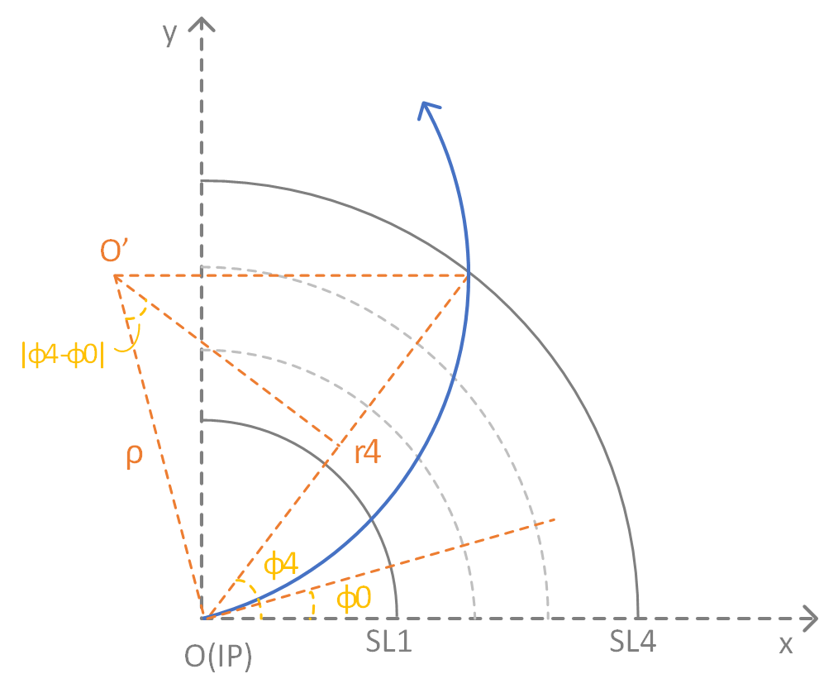
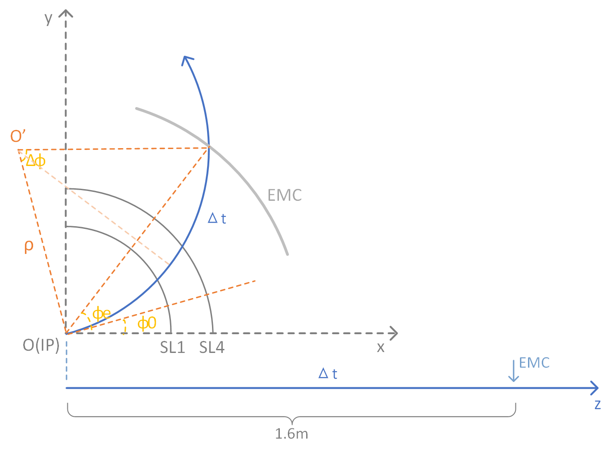
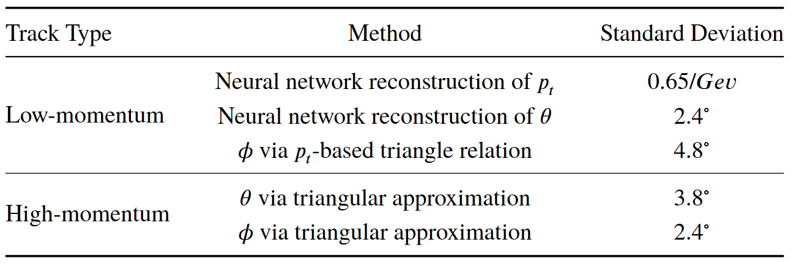
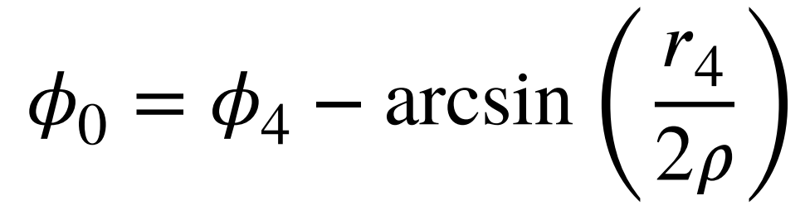




Short track reconstruction
Construct neural network ：
Partial high-momentum tracks：
Reconstruct $φ_{e}$based on 𝑝𝑡：
Solve for $φ_{0}$
Solve for${ φ}_{e}$
Reconstruction efficiency：
Single track：

Slide 17
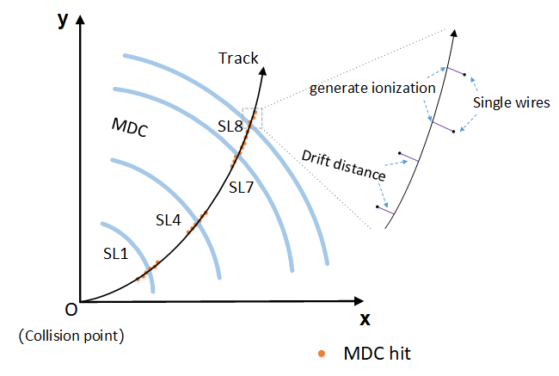
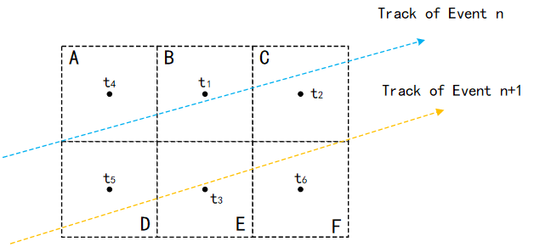
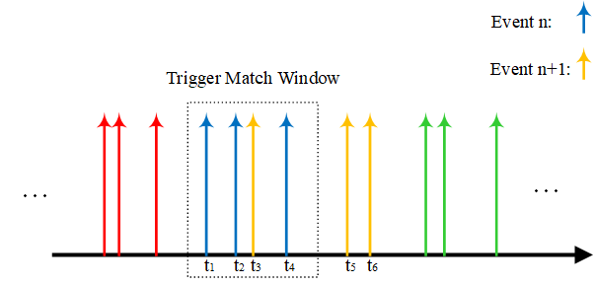
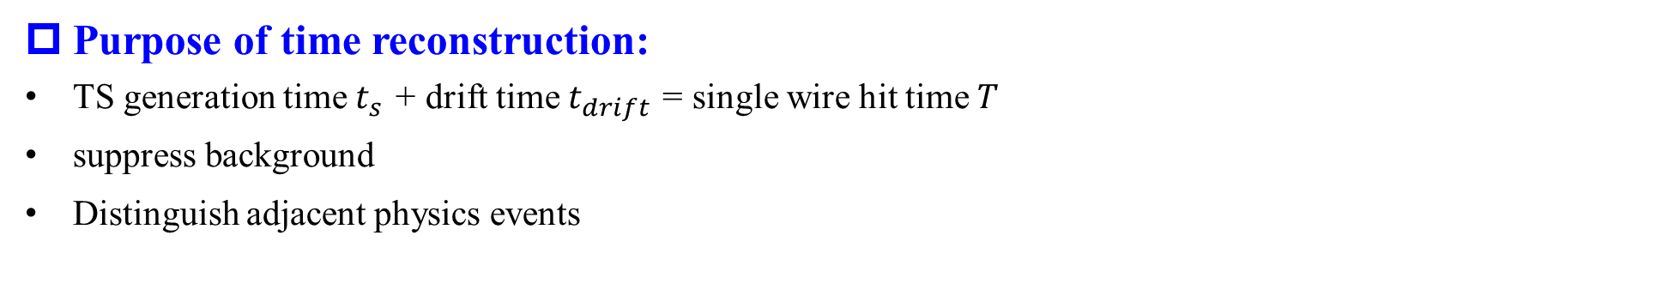
Time reconstruction
Purpose of time reconstruction:
TS generation time $t_{s}$ + drift time $t_{drift}$ = single wire hit time $T$
suppress background
Distinguish adjacent physics events

Slide 18
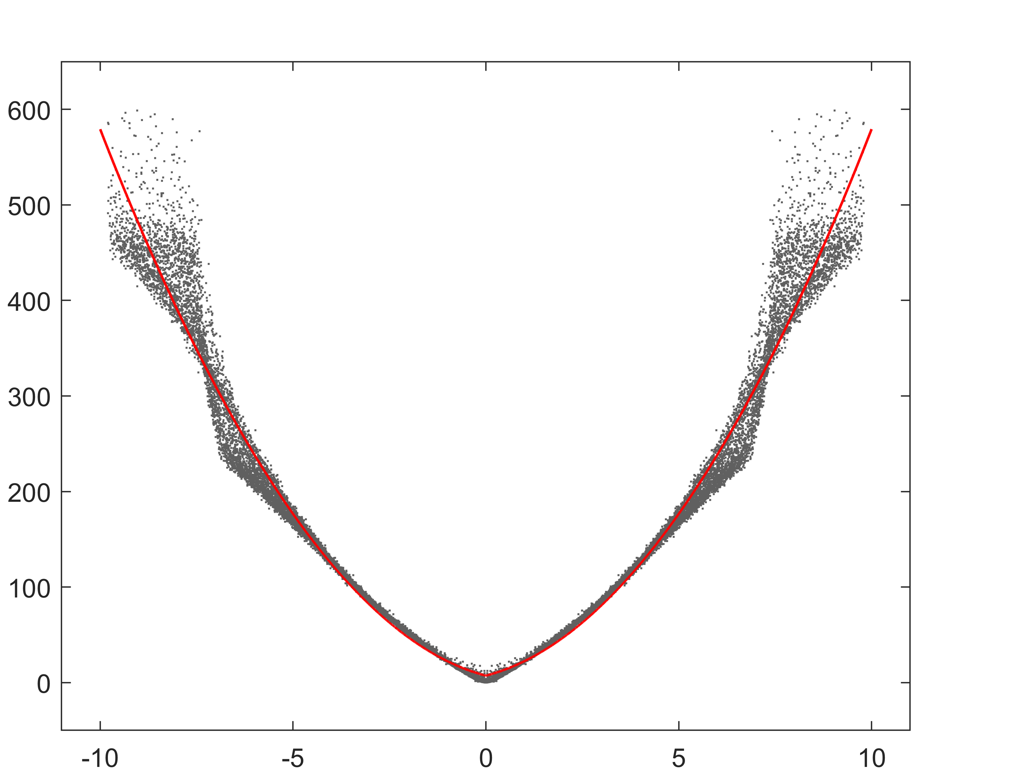
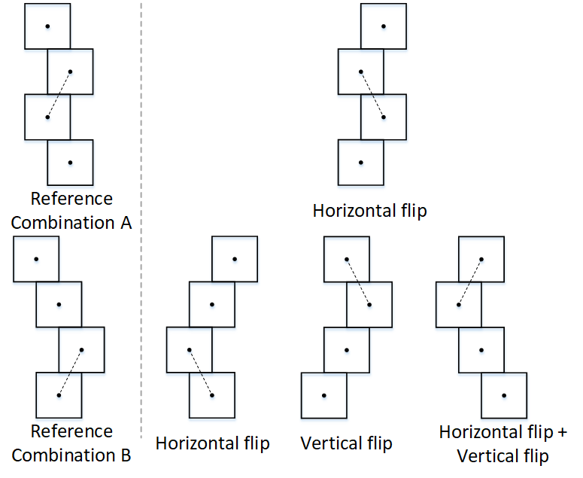
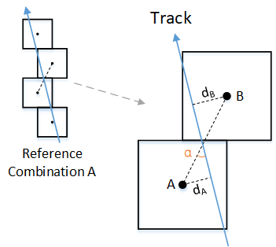
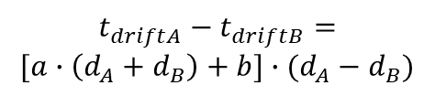

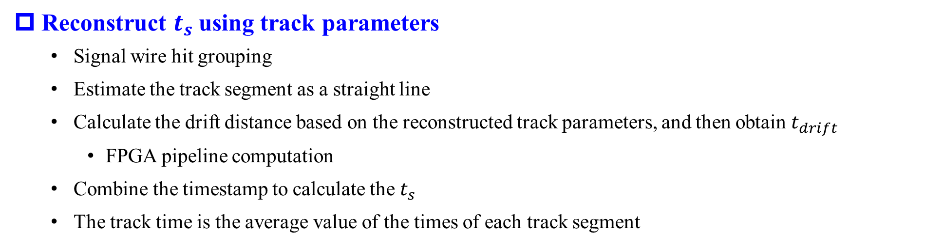



Time reconstruction
Reconstruct $t_{s}$using track parameters
  Signal wire hit grouping
  Estimate the track segment as a straight line
  Calculate the drift distance based on the reconstructed track parameters, and then obtain $t_{drift}$
    FPGA pipeline computation
  Combine the timestamp to calculate the $t_{s}$
  The track time is the average value of the times of each track segment
$$t_{driftA}−t_{driftB}=T_{A}−T_{B}$$
Drift time (ns)
$t_{drift}=a∙d^{2}+b∙d+c$
$$t_{driftA}−t_{driftB}=$$
$$[a∙\left(d_{A}+d_{B}\right)+b]∙(d_{A}−d_{B})$$
$$l_{AB}∙sinα=d_{A}+d_{B}$$
$$α=\arcsin\left(\frac{r}{2ρ}\right)+arcsin(0.5)$$
Drift distance (mm)

Slide 19



Time reconstruction
Noise Suppression
Introduce the outermost layer to validate$t_{drift}$
Use the median difference of associated TS ${ t}_{s}$to extract track time
  Calculate the median
  Abandon TS whose time deviates from the median (based on a predefined threshold)
Test with single tracks
  For tracks with p_{T} > 180 MeV:
  efficiency > 80%，Δt < 8 ns

Slide 20



Z-vertex reconstruction
Performance Requirements
Stereo TSs Filtering and Matching
Resolution of about 3 cm
Support for |z| < 10 cm truncation with an error within ±3σ
Most background tracks passing the 2D algorithm have z-vertex far from the IP and can be rejected
Stereo TS：Two seeds per superlayer, each containing position and timestamp information
Combine the four stereo TSs into an existing track
Sectorization and Normalization

Slide 21


Z-vertex reconstruction
Neural network training
Network Compression
MLP selection: Low computational cost, sufficient accuracy
Input: track segment numbers and timestamps for 8 superlayers
Output: z-vertex in various pt regions
Structure: 24-48-32-16-8-1
High Granularity Quantization (HGQ)
  Certain parts of the network can accommodate lower precision without compromising performance
  Fine-tune the per-weight and per-activation precision
Hyperparameter β：controls quantization strength
  The first two layers 3×10⁻⁸，the remaining layers 5×10⁻⁸
Single track：z-vertex resolution is approximately 2.8 cm

Slide 22



Z-vertex reconstruction
FPGA Logic Implementation
IP generation using hls4ml
Vivado HLS Resource Report：
Vivado IP Functional Testing and Simulation
  Clock frequency：320 MHz
  Dead time：1 clk
  Latency：125 ns < 400 ns
Comparison between FPGA logic and Python software results:
  Maximum deviation: 0.16 cm (well below algorithm resolution)
Vivado synthesis result：Resource usage < 10%
±0.05cm
99.8%

Slide 23
Outline
STCF trigger system preliminary design
MDC track reconstruction algorithm
  2D tracking and reconstruction
  Time reconstruction
  3D reconstruction
Summary

Slide 24
Algorithm Summary
Algorithm Performance
Recent Updates
2D tracking and reconstruction (J/ψ -> anything)
  Δp_{T}/ p_{T}²~ 15%， Latency = 339 ns
Time reconstruction (single track)
  Δt < 16 ns， Latency = 207 ns
Z-vertex reconstruction (clear single track)
  Δz ~ 2.8 cm， Latency (MLP) = 125 ns
Completed simulation and testing of z-vertex reconstruction
Completed initial software design for short track reconstruction

Slide 25
Further Work Plan
Algorithm optimization
Z-vertex reconstruction combined with other algorithms
Supplementary reconstruction of additional 3D parameters
Hardware implementation of the short track algorithm
Engineering principle prototype testing
Port the FPGA GBT protocol and establish the data link.
Validate the MDC hardware reconstruction algorithm.
  2D reconstruction algorithm
  3D reconstruction algorithm
  Time reconstruction algorithm
Purpose:
  Conduct on-board hardware logic test to verify the reliability of timing.
  Ensure consistency between actual test results and simulated behavior.

Slide 26
Thanks

