Slide 1
Tracking system in LHCb
Xuhao Yuan (IHEP, CAS)
2025-07-22

Slide 2

Outline
Overview of LHCb tracking system
LHCb tracking in Run3
Tracking @ GPU (HLT1)
Tracking @ CPU (HLT2)
LHCb tracking in Upgrade II

Slide 3
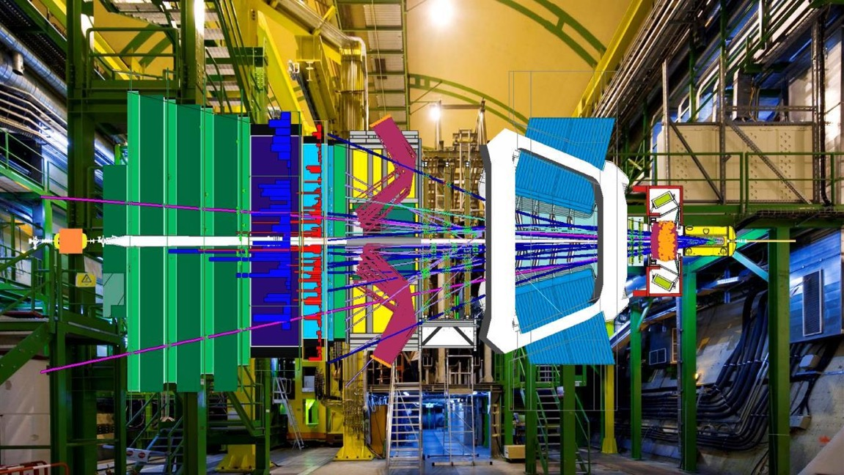
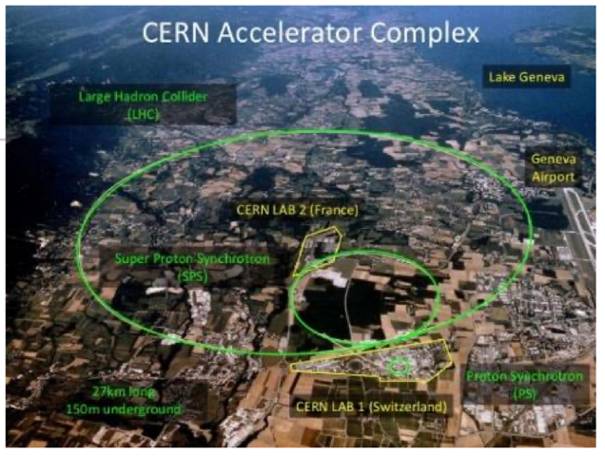

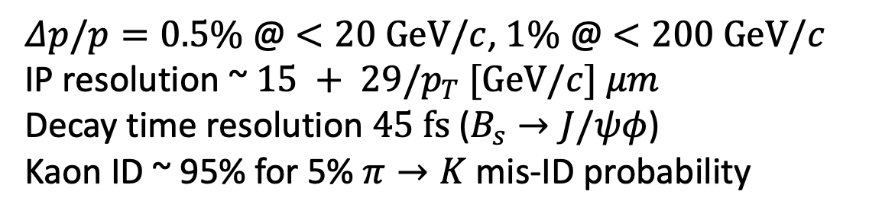
LHCb: a forward spectrometer @ LHC
250/300 mrad
TT→UT after U1
Velo
LHCb
10 mrad
beam
CALOs
Muon
pp collisions
Magnet
Trackers
Detector before 2019
RICHs
Main physics goal
To study $b$ & $c$ sectors on CPV, rare decays, new physics...
$Δp/p=0.5\%$ @ $<20 GeV/c$, $1\%$ @ $<200 GeV/c$
IP resolution ~ $15 + 29/p_{T} [GeV/c] μm$
Decay time resolution $45 fs$ ($B_{s}→J/ψφ$)
Kaon ID ~ 95% for 5% $π→K$ mis-ID probability

Slide 4
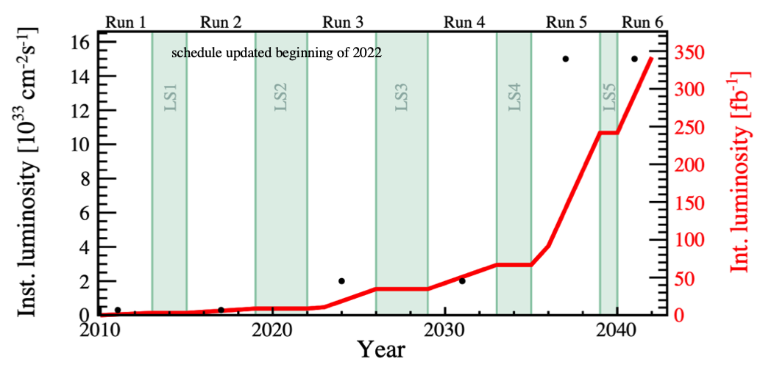
LHCb Upgrades
Upgrade I (U1), started in LS2
ℒ_{max}~2x10³³ cm⁻²s⁻¹
ℒ_{int}~50 fb⁻¹
Upgrade I
Upgrade II
Upgrade II (U2), starts in LS4
ℒ_{max}~1.5x10³⁴ cm⁻²s⁻¹
ℒ_{int}~300 fb⁻¹
Some smaller detector consolidation and enhancements in LS3 (2026) ⇦ U1b
x7.5ℒ_{Run3&4}
x5ℒ_{Run1&2}
Major upgrade of ATLAS/CMS
LHCb also plan enhancements (U1b)

Slide 5
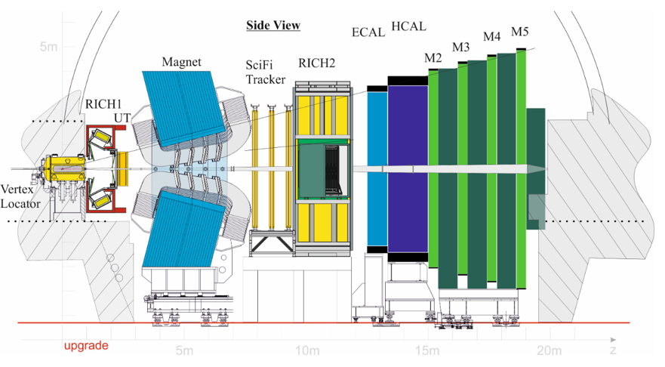
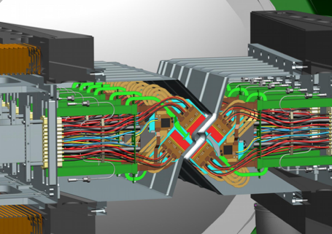
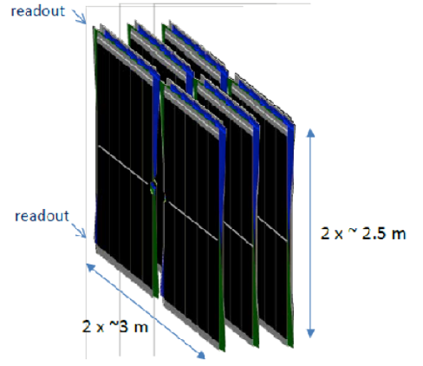
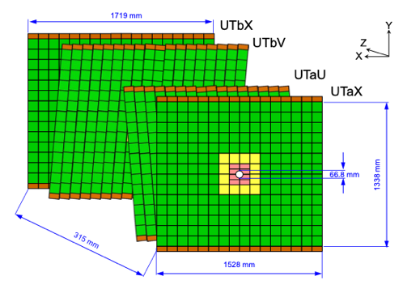
Upgrade I: a brand new detector
Higher luminosity (5xℒ_{Run1&2}) results in
Higher rate, pile up, occupancy, fluence
VELO: hybrid pixel detector
Closer to the beam
(from 8.2 mm to 5.1 mm)
Pixel size: 55x55 μm²
26 layers
UT: Si Strip detector
Higher coverage, segmentation, resolution
Speed up tracks reconstruction
& reduce P_{GhostTrk}
SciFi: Scintillating fibers detector
3 station with 4 detection layers
2x2.5 m long modules with Readout
SiPMs at the outer edge

Slide 6
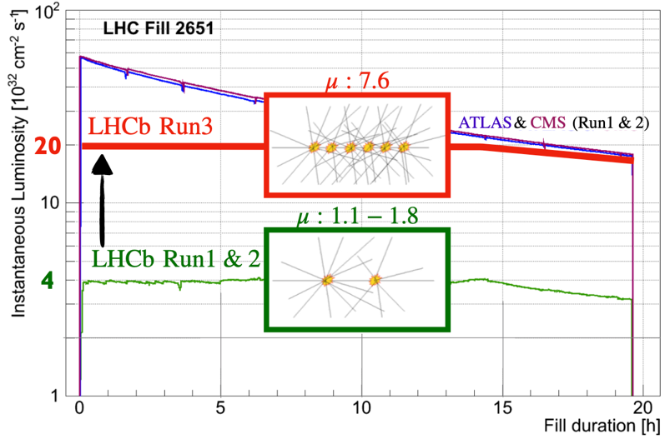
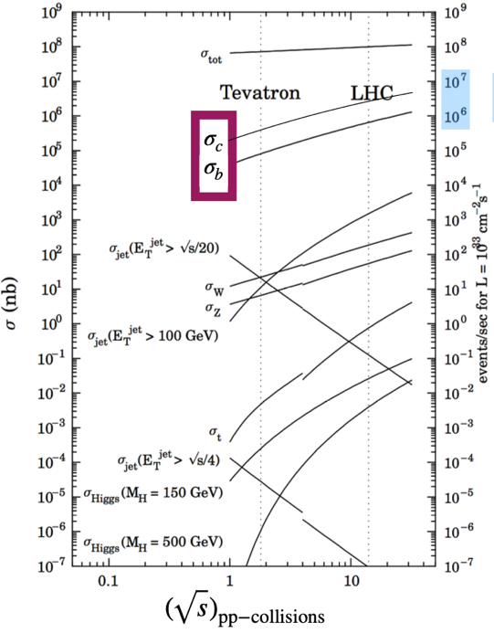
LHCb physics in Run1,2 → Run3
Run3: LHC pp collisions at $\sqrt{s}=14 TeV$, 25ns bunch spacing → 40MHz collision rate
LHCb aims at boosting physics output by increasing the instantaneous luminosity and the signal rate
MHz signal rate
For μ~7.6
0.02 b hadron/event
0.2 c hadron/event
2 light-long-lived/event
More PVs, more tracks, more signal
Almost all events will have a b or c hadron in Run3

Slide 7
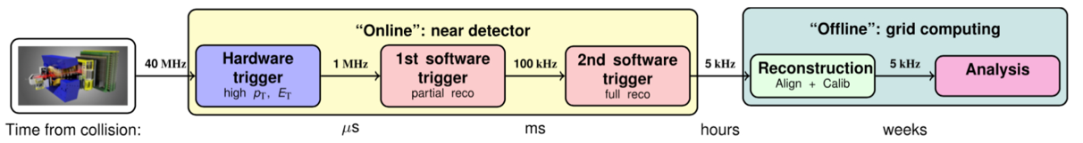
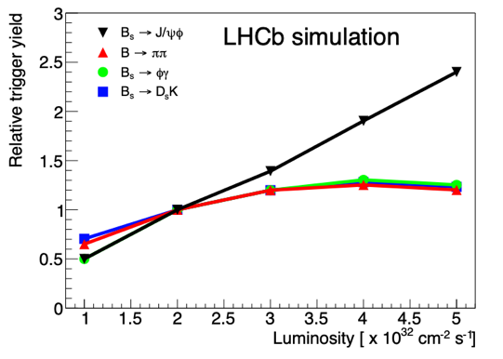
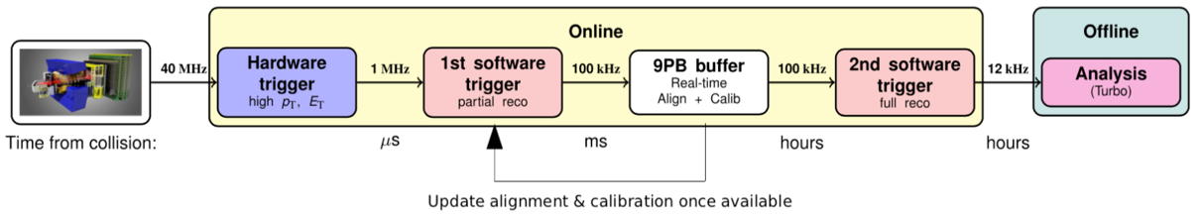

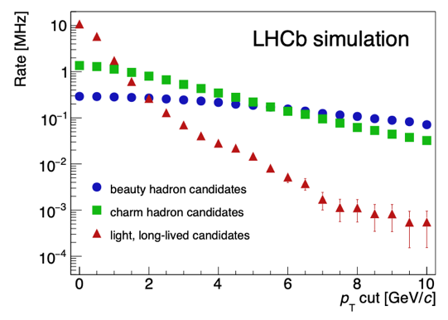
LHCb trigger in run 1-2
Run1 2011-2012
Run2 2015-2018
Run1
Run2
Bottleneck for higher luminosity is in LHCb, not LHC
Hardware trigger: 40 ⇒ 1 MHz readout-out limit in Run1&2 based on Muon & CALO signatures (fixed-latency trigger)
Hardware trigger limits 1MHz saturates for hadronic decays
Buffer data to disk to perform real time alignment and calibration;
HLT1(partial) and HLT2(full) event reconstruction split in Run2

Slide 8
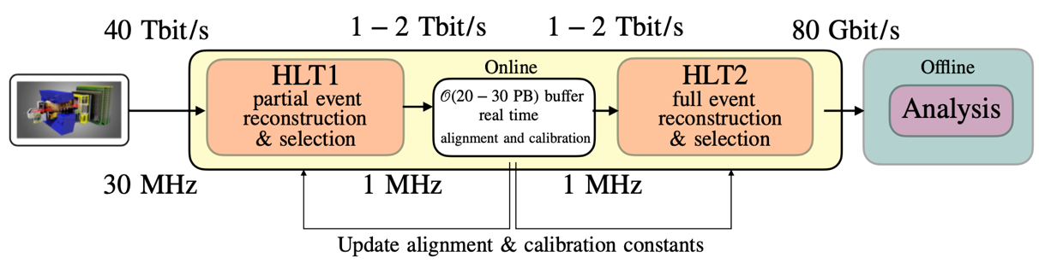

LHCb trigger in run 3
Run1 2011-2012
Run 3
Remove hardware trigger, a full software-trigger based HEP
Full detector read-out @ 30MHz (HLT1)
Real time alignment & calibration with 10x higher data rate than Run2
Event reconstruction at collision rate
offline-quality reconstruction in ”real-time”
Hadronic trigger efficiency by 2~4 w.r.t. Run2
Run2 2015-2018
Run3 2022-2026
32 Tb/s
1 Tb/s
1 Tb/s
10 Gb/s

Slide 9
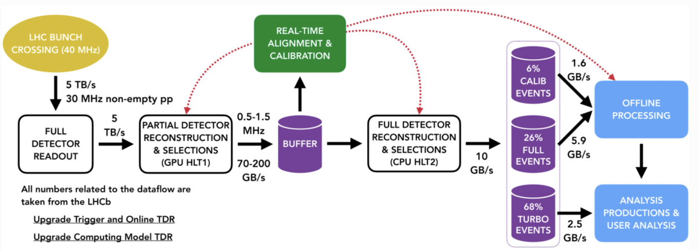
LHCb data flow
Read data @ 30 MHz
Analyze and reduce data in two stages:
  HLT1 running on GPUs
  HLT2 running on CPUs
Buffer data in between HLT1 and HLT2 on 𝒪(30PB) disks
Alignment & Calibration determined before HLT2, latest update used in HLT1
Save roughly 10 GB/s of data to offline storage, including calibration samples

Slide 10
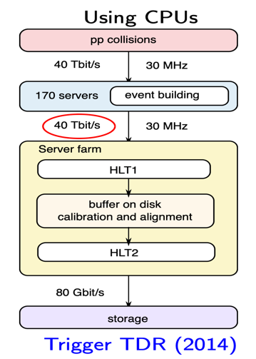
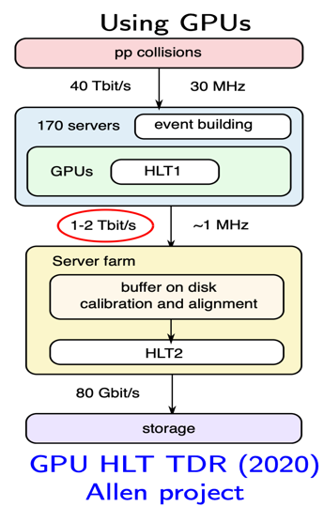
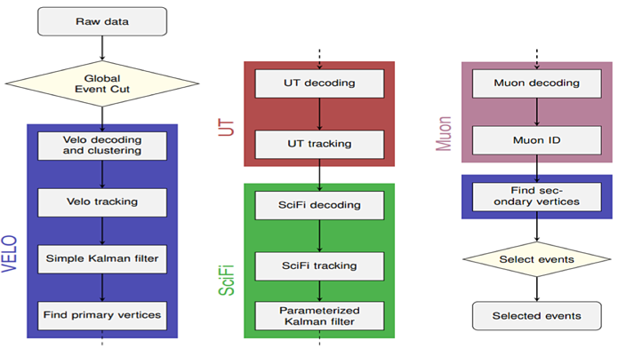
HLT1 on GPU vs CPU
Benefit of running HLT1 on GPUs:
Reduce network bandwidth between Event Builder and filter farms
Free up filter farm CPUs for HLT2 only
~170 event builder (EB) node with 3 GPUs each to trigger with HLT1, output up to 200 GB/s
HLT1 filters 30 MHz pp collisions to 1MHz with GPU architecture
Partial reconstruction using hits from VELO, UT, SciFi & Muon
  High momentum long charged track reconstruction & muon identification
  Few inclusive single and two-track selections to reduce rate

Slide 11
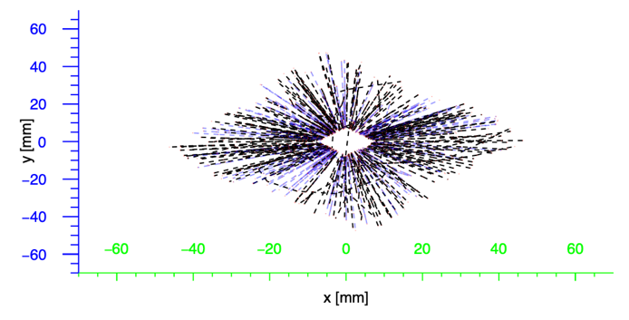
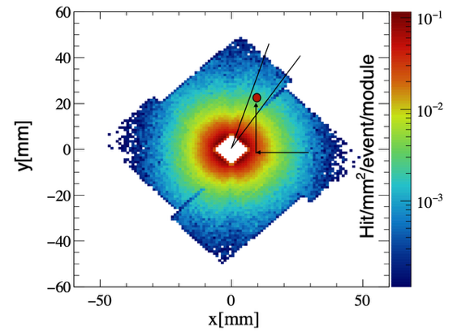
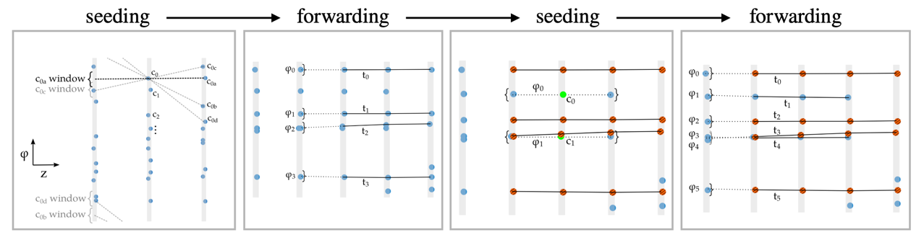
VELO track reconstruction
VELO: 26 layers of silicon pixel detector
NO B field in VELO region, only multiple scattering leads to tiny bending
Tracks are almost fully contained in small ɸ windows
Hits sorted by ɸ → memory accesses as contiguous as possible
Search for combinations of hits in parallel given 3 input layers
Choice of triplets based on alignment in ɸ
Forward triplet to next layer

Slide 12
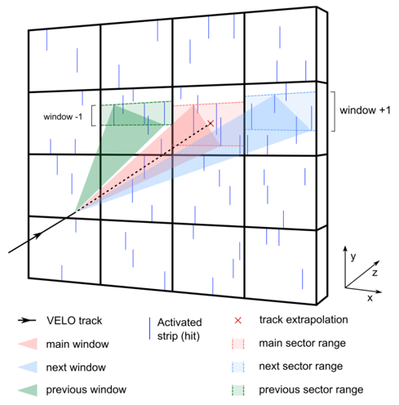
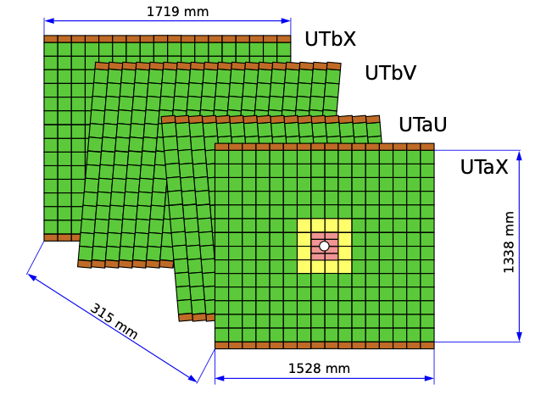
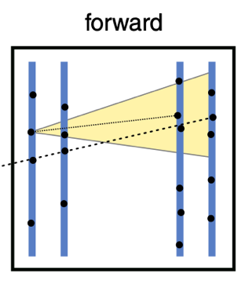
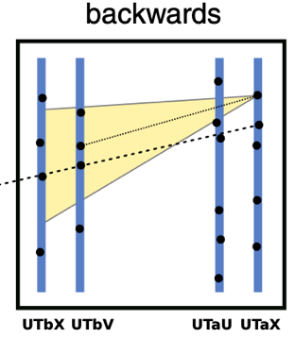
UT track reconstruction
UT: four layers of silicon strip detector
Extrapolate VELO tracks to UT planes according to lookup table for minimum momentum requirement
Define search regions in each UT plane: hits are stored in sector ranges and optimized for parallel processing
Tracklets finding inside windows from 4 layers building combinatorics in parallel
Searching both in forward & backward

Slide 13
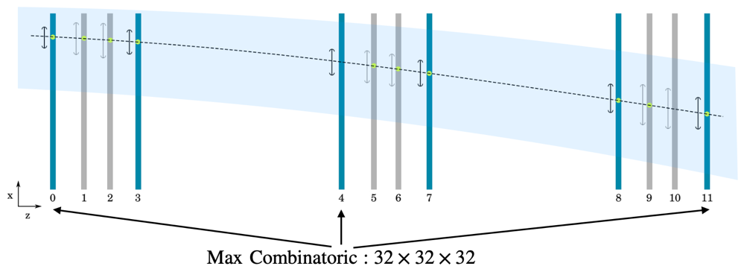
SciFi track reconstruction
3 stations with 4 layers scintillating fibers
Extrapolate each Upstream track in the 12 SciFi layers
Build triplets combinations, best triplets selected according to local parameterization of magnetic field
Forward all triplets to remaining layers with an extra parameterized corrections in the non-bending plane
Fits
Improve track description close to the beam line for precise determination of the impact parameter
Only fit part of the track within VELO
Para. Kalman filter → no need for magnetic field map and detector material description

Slide 14
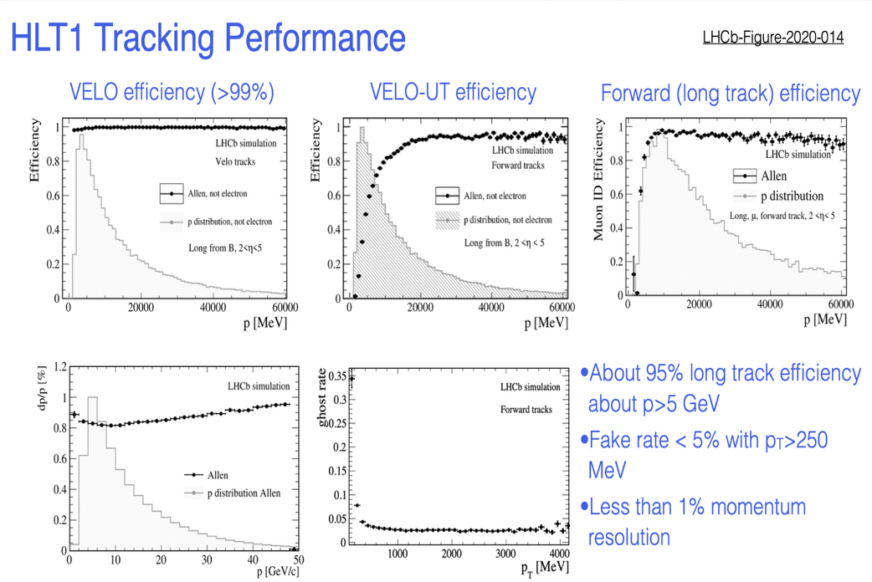
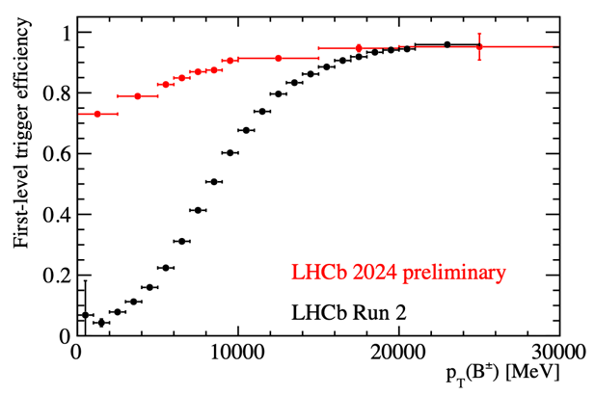

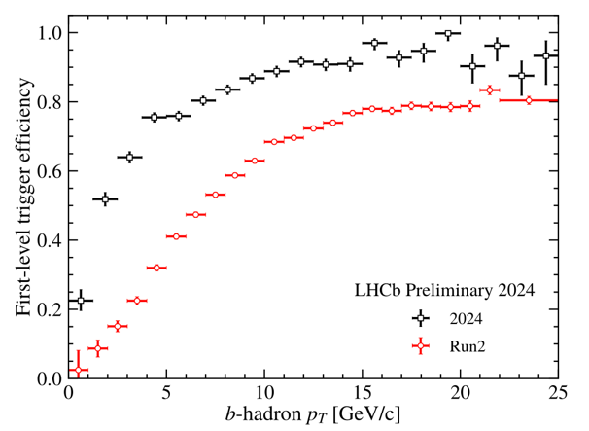

Hlt1 performance @ 2025
Better efficiency than Run2
LHCB-FIGURE-2024-007
Results from LHCb in last year
More efficient for electrons

Slide 15
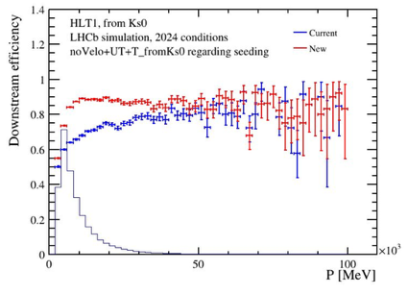
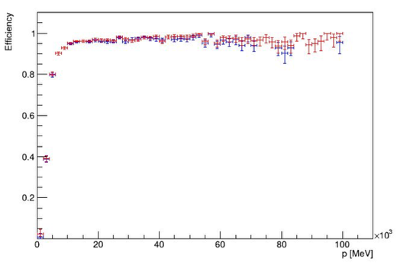
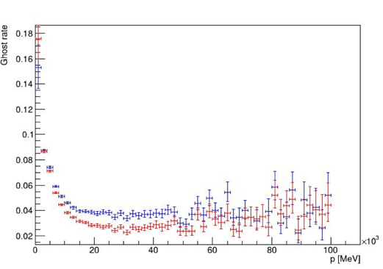
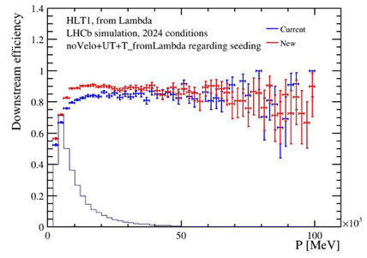
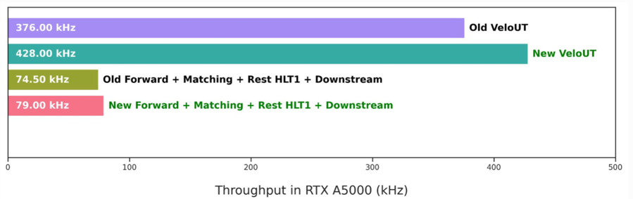
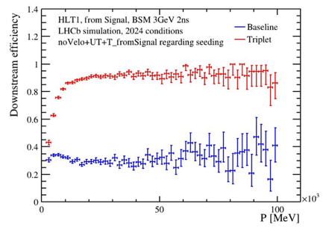
Tracking performance by UT
New UT decoder + new VeloUT/Downstream algorithm
Better Ghost rate suppression
More downstream tracks recovered
Better efficiency
Better throughput

Slide 16
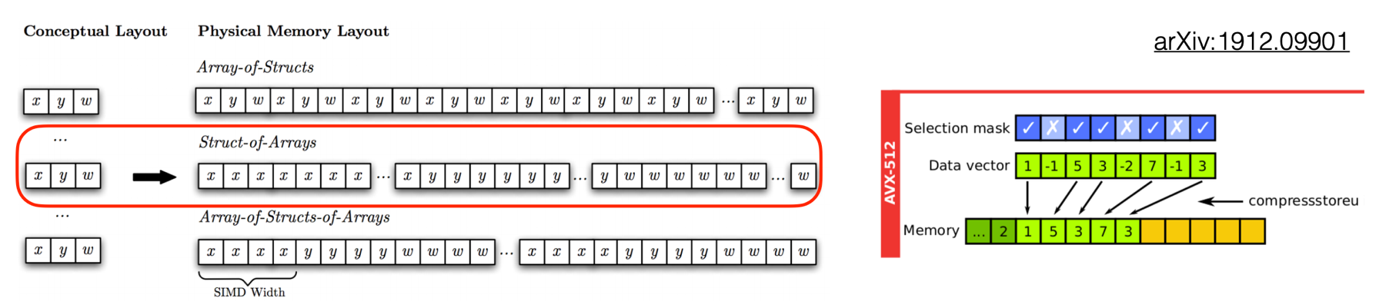
LHCb tracking in HLT2
HLT2 reconstruction directly related to physics outputs and physics quality
Full, offline-fidelity event reconstruction on at least 1 MHz
Charged track reconstruction with full momentum range & delicate Kalman fit
Common intra-event parallelization tech as in GPU
All reconstruction algorithms with SOA structure
Developed custom SIMD wrappers to support all the backends

Slide 17
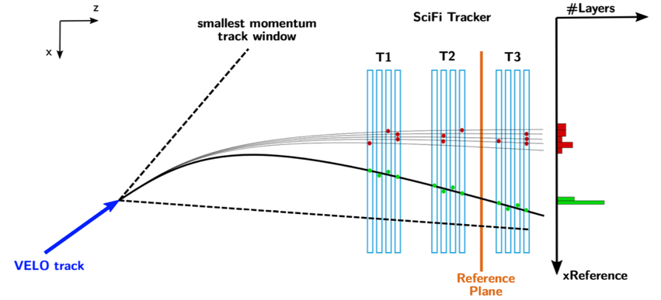
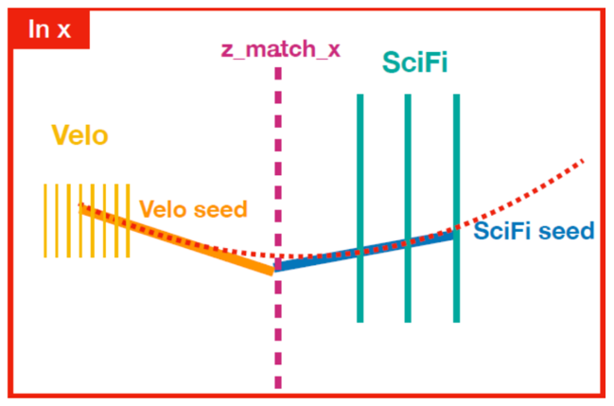
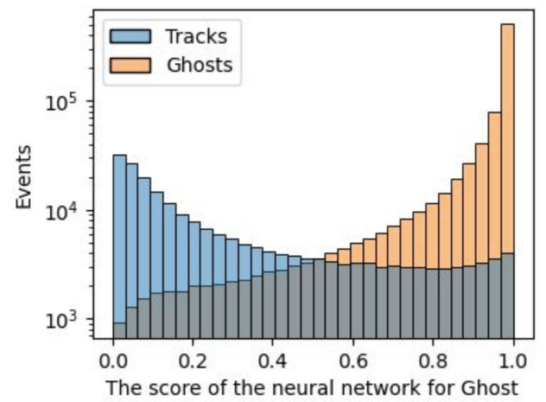
LHCb tracking in HLT2
Two long track reconstruction methods
Forward algorithm
Velo/VeloUT tracks as input
Matching algorithm
Velo+SciFit tracks + UT hits
Downstream: A NN based classifier to reduce fake

Slide 18
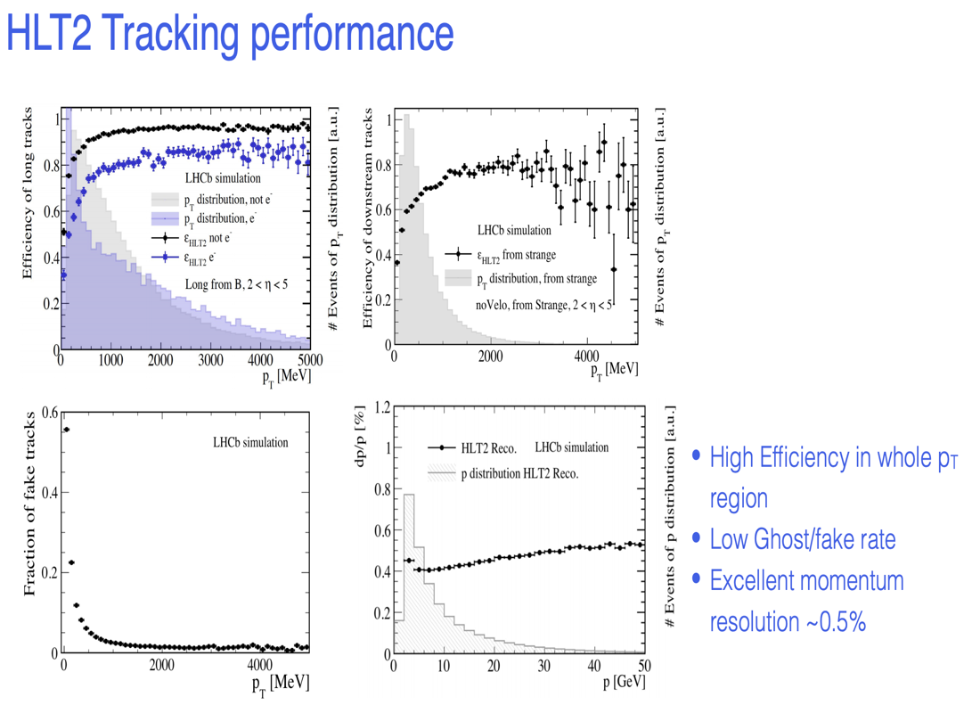
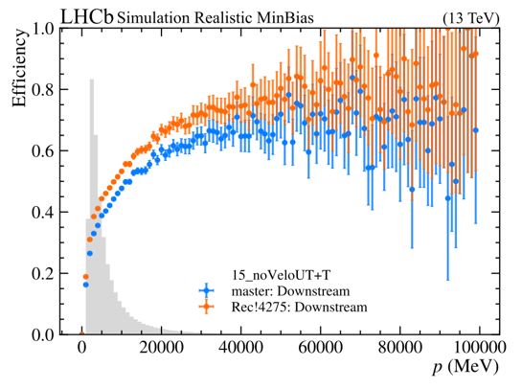
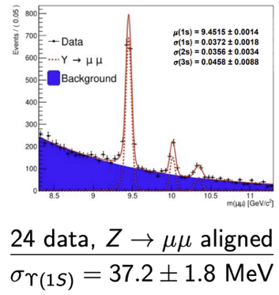
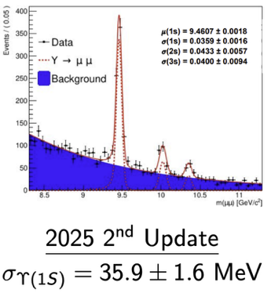
LHCb tracking in HLT2
Better performance in Downstream
Better performance in resolutions
Results from LHCb in last year

Slide 19
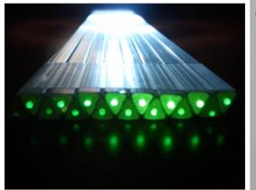
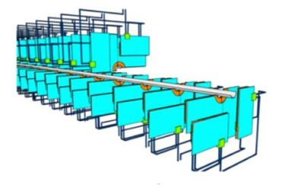
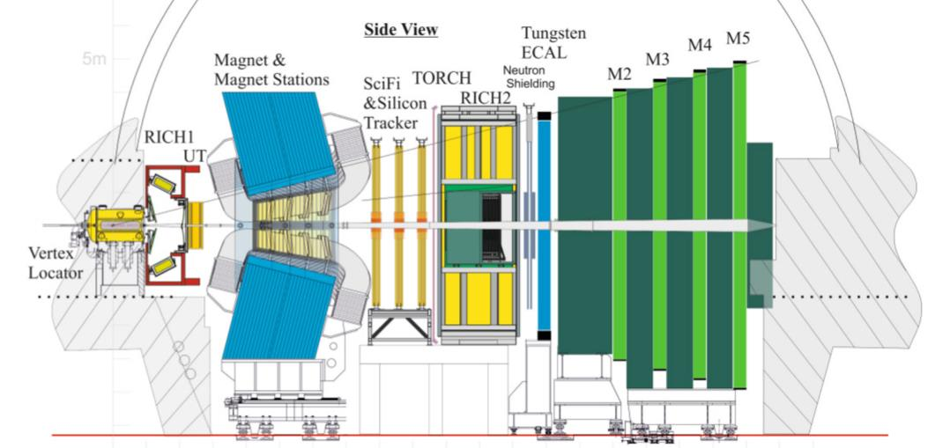
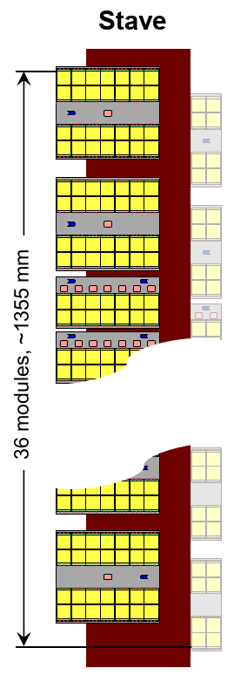
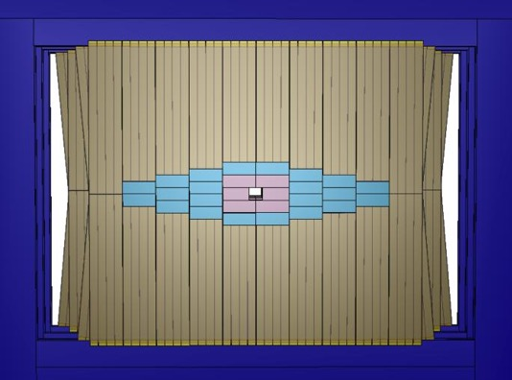
The Tracking System in Upgrade II
Vertex Locator (VELO)
Pixel with timing
New RD-foil
3D, LGAD, 28 nm
Magnet Stations (MS)
Scintillating bar
Low P particles
Might Tracker (MT)
MAPS CMOS pixel (inner)
Keep SciFi (outer)
Upstream Tracker (UT)
MAPS CMOS pixel
Radiation tolerant

Slide 20
summary
In LHCb Upgrade I
Partial reconstruction at 30 MHz at HLT1 (GPU)
Full reconstruction at 1 MHz at HLT2 (CPU)
In LHCb Upgrade II
R&D studies on optimal use of hybrid architectures ongoing

Slide 21
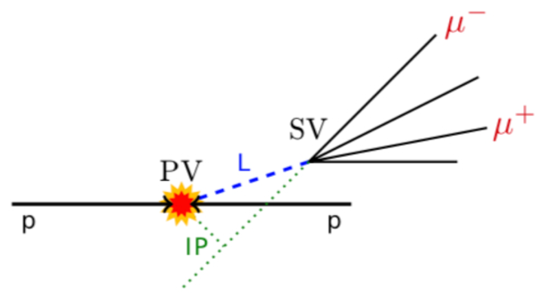

Signatures in LHCb from b or c hadrons
m_{B} ~ 5.28 GeV → p_{T}(daughters) ~ 𝒪(GeV)
𝜏_{B} ~ 1.16 ps. Δ(SV-PV) ~ 1 cm
m_{B} ~ 1.86 GeV → p_{T}(daughters) ~ 𝒪(GeV)
𝜏_{B} ~ 0.4 ps. Δ(SV-PV) ~ 0.4 cm
Key ingredients for efficient triggering and signal discrimination
Primary vertex finding, high p_{T} tracks reconstruction and optimal μ-Identification
Inclusive triggers on 1&2 track signatures
Challenge in Run3 is not only to have an efficient trigger, but also be able to identify the topology of events as early as possible in the triggering process: more information than single sub-detector readout needed
Track reconstruction at collision rate required: huge computing challenge

Slide 22

LHCb physics performance in Run 1 & 2
A decade of important discoveries and precision measurements (9 fb⁻¹ pp data by end of 2018)

