Slide 1



Application of ACTS to the CEPC Reference Detector
Yizhou Zhang¹, Weidong Li¹, Xiaocong Ai², Tao Lin¹
1. Institute of High Energy Physics, CAS
2. Zhengzhou University
Huizhou
22nd July 2025

Slide 2
2
1
Introduction
2
Application of ACTS to CEPCSW
Outline
3
Performance
4
R&D

Slide 3
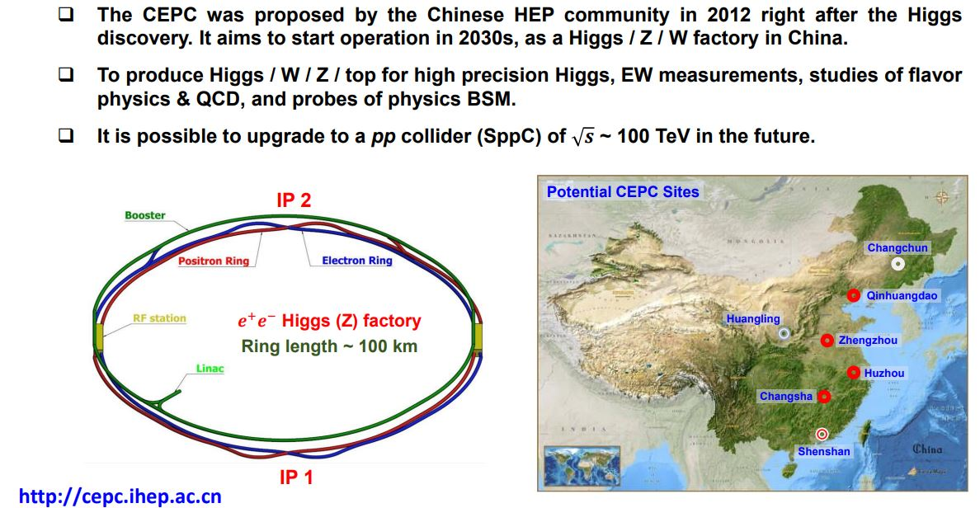
1
3
Introduction
Circular Electron Positron Collider (CEPC)
Accelerator design and technology R&D are approaching maturity, with the TDR completed and progressing into the EDR phase. The TDR for the reference detector is currently in preparation and is expected to be finalized within the year.

Slide 4
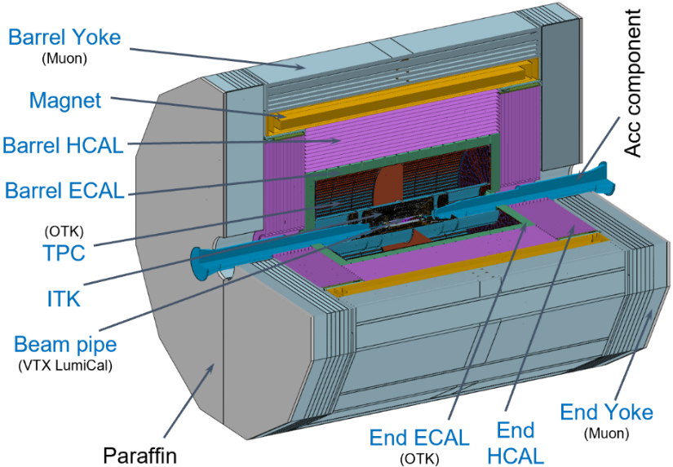
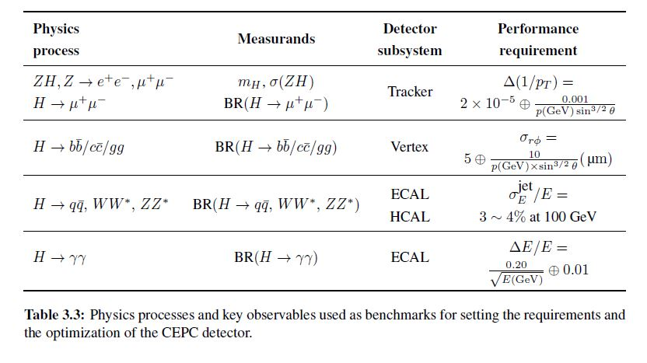
1
4
Introduction
CEPC Detector
CEPC Reference Detector
VTX: Vertex Detector
ITK/OTK: Inner Silicon Tracker/Outer Silicon Tracker
TPC: Time Projection Chamber
ECAL: Crystal-bar ECAL
HCAL: Glass Scintillator HCAL
Muon: Muon Detector
Physics requirements
Tracking efficiency: Nearly 100%
Momentum resolution: About 0.1%
Particle Identification (PID): 2𝜎 separation between pions and kaons for P < ~ 20 GeV/c
Boson Mass Resolution (BMR): Better than 4%, among other features
CEPC CDR

Slide 5
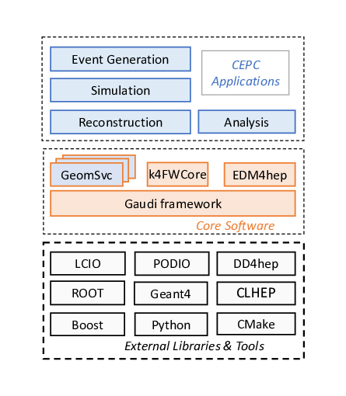
1
5
Introduction
CEPC Software: Architecture
The CEPC experiment is among the first to integrate with Key4hep
A common software stack designed for future HEP experiments such as CEPC, CLIC, FCC, and ILC
CEPCSW is organized as a multi-layer structure
Applications：simulation, reconstruction and analysis
Core software
External libraries
The key components of core software include:
Gaudi: defines interfaces to all software components
EDM4hep: generic event data model
DD4hep: detector geometry description
CEPC-specific components: GeomSvc, simulation framework, RDFAnalysis, beam background mixing, fast simulation, machine learning interface, etc.

Slide 6
1
6
Introduction
ACTS: Tracking Library
Software development background
Hardware: Computing is shifting toward multi-core CPUs and diverse accelerators (GPUs, FPGAs).
ML: Machine learning has become an essential component of high-energy physics experiments.
ACTS, A Common Tracking Software
Open source and experiment-independent toolkit for track reconstruction
Developed with modern C++ with unit testing and continuous integration
https://github.com/acts-project
Several R&D projects within the ACTS ecosystem
  traccc: GPU R&D line
  Exa.TrkX: GNN based tracking available
Four other talks [1][2][3][4] of this workshop also give the applications of acts

Slide 7
7
1
Introduction
2
Application of ACTS to CEPCSW
Outline
3
Performance
4
R&D

Slide 8
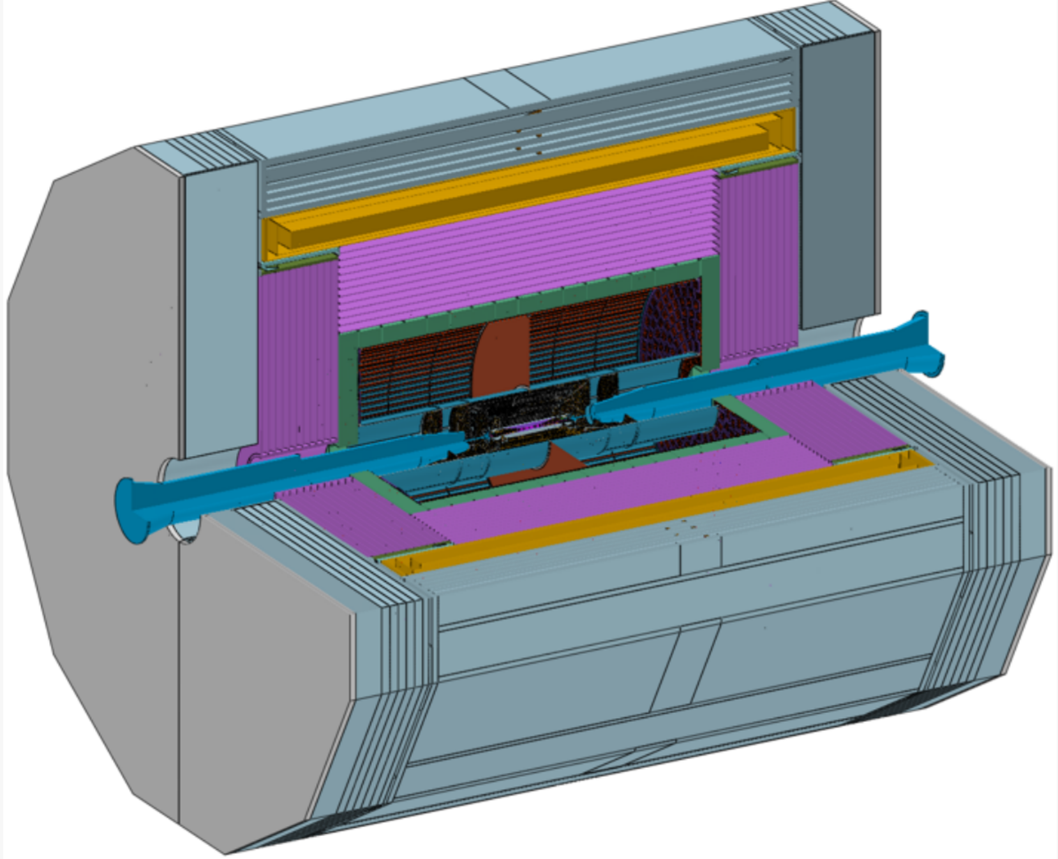

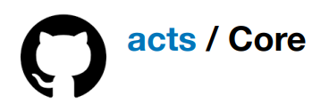
2
8
Application of ACTS to CEPCSW
ACTS Geometry Building
A simplified tracking-optimized geometry is converted from detailed geometry through ACTS’ tools.
ACTS material mapping mechanism
*0-3 layers of CEPC VTX
Detailed geometry
described by DD4Hep / Tgeo / GeoModel
Usually interfaced to Geant4
is unnecessary in track reconstruction
Geometry building in ACTS
Representing sensitive surfaces
Simplifying material

Slide 9
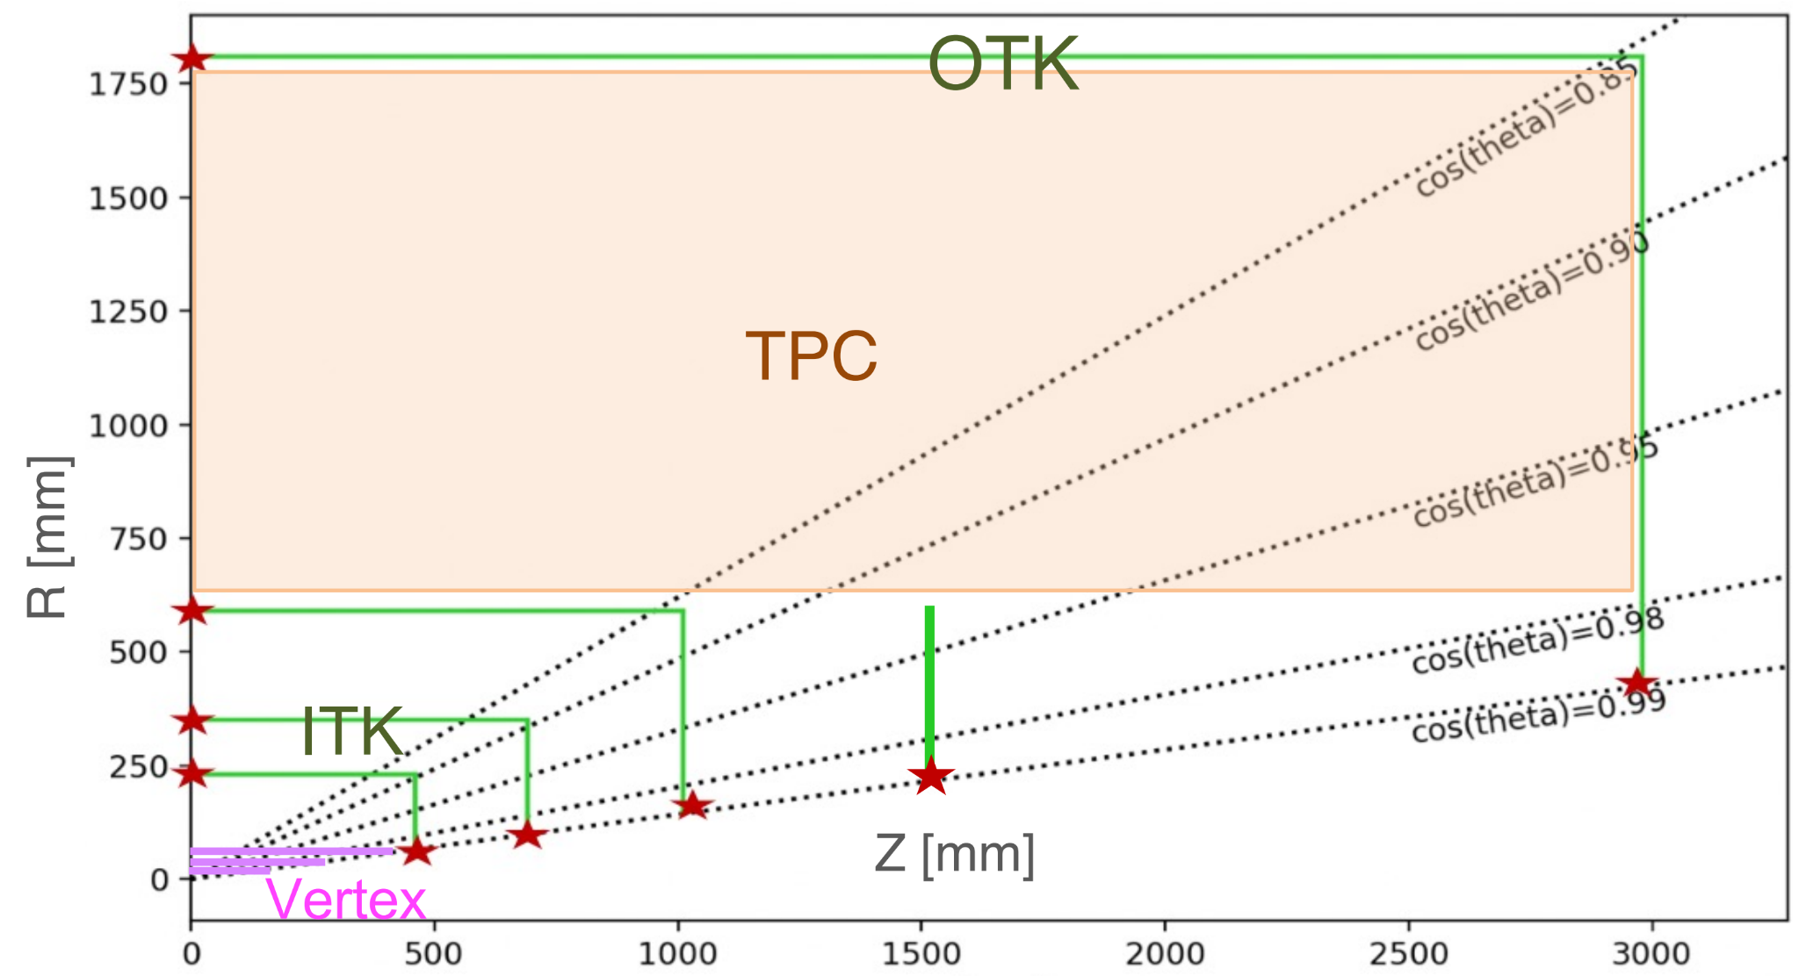
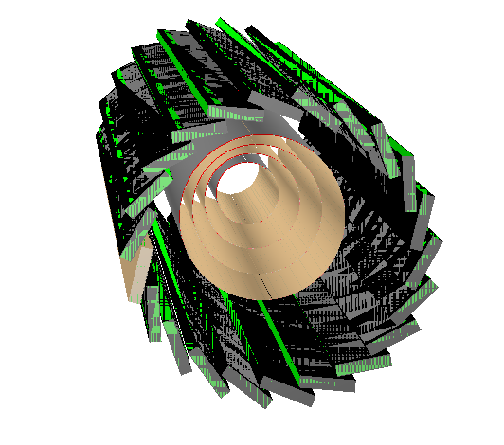
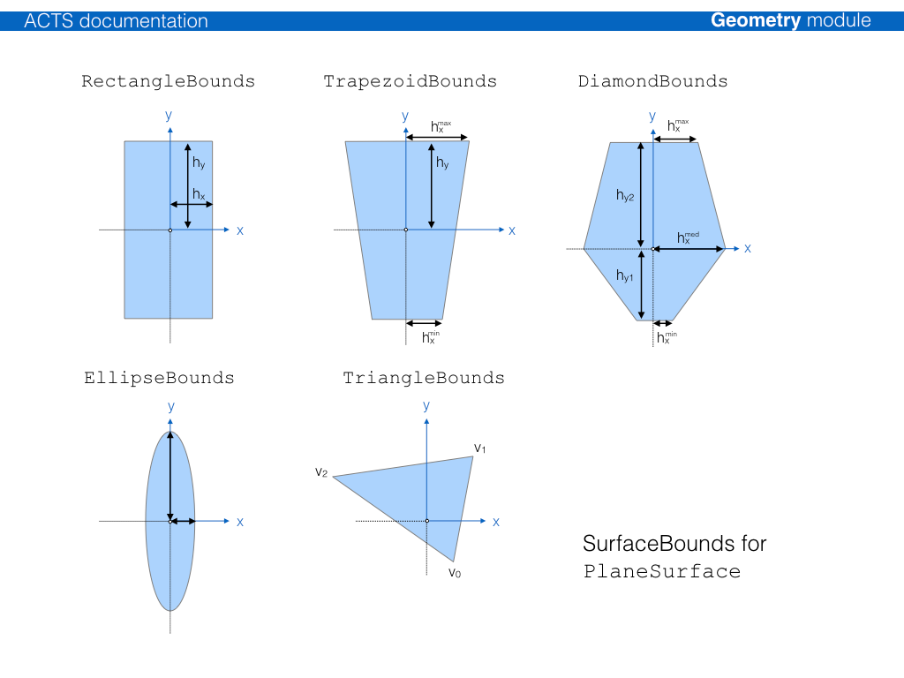

2
9
Application of ACTS to CEPCSW
ACTS Geometry Building
CEPC Tracking geometry in z-r
Full G4 simulation geometry of CEPCSW is described in DD4hep format
Convert to ACTS geometry through ACTS TGeo plugin (*DD4hep plugin should also work)
Barrels (VTX 5th|6th layer & ITK & OTK)
  → Acts::PlaneSurface (RectangleBounds)
EndCaps (ITK & OTK)
  → Acts::PlaneSurface (TrapezoidBounds)
Vertex Detector
4 Cylinder layers
1 Double-sided planer layer
Vertex Detector
ITK ( Inner Tracker )
TPC ( Time Projection Chamber )
OTK ( Outer Tracker )
CEPCSW geometry
(DD4hep)
ACTS
TGeo plugin
ACTS geometry
Class link

Slide 10
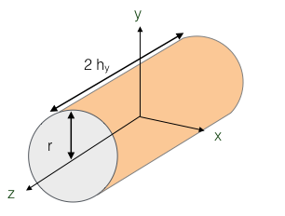
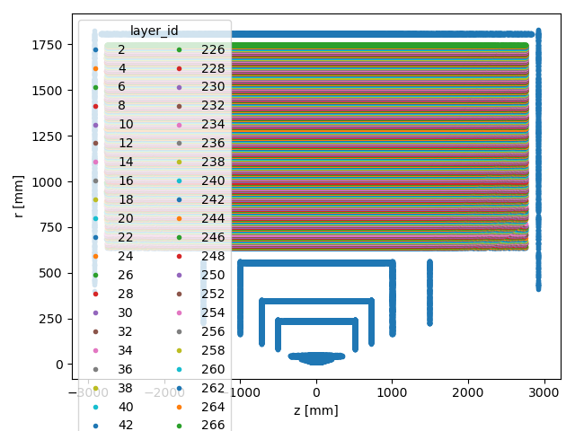
2
10
Application of ACTS to CEPCSW
ACTS Geometry Building
VTX (1st-4th layers) & TPC
→ Acts::CylinderSurface
Implementation of ACTS in the TPC（gaseous tracker）
The surfaces required by ACTS are virtually constructed within the TPC gas volume, aligning with the TPC readout layers.
Consists of 223 layers of cylinder surface with a thickness of 5mm
Class link
CEPC Tracking geometry in z-r
(layer ids in colors)

Slide 11
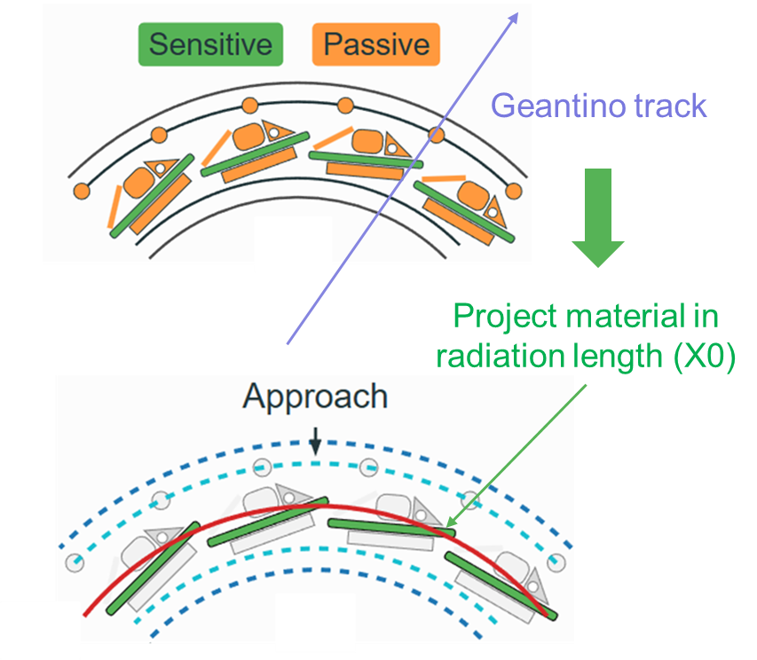
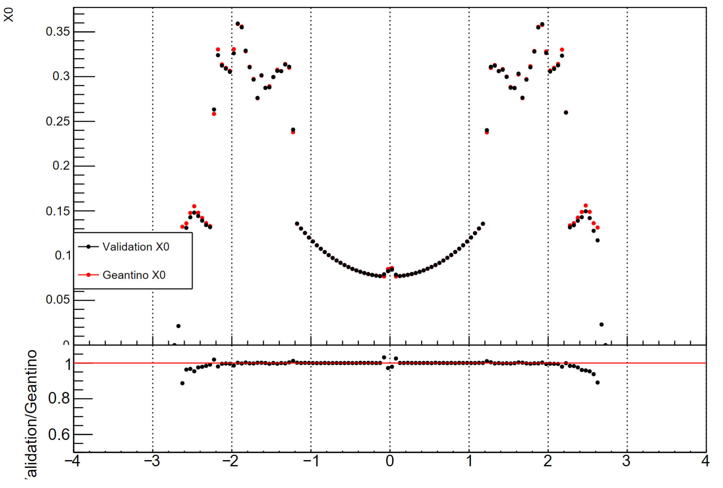
2
11
Application of ACTS to CEPCSW
Material Mapping
Geant4 simulation using detailed geometry
The Geant4 simulation employs detailed geometry to simulate particle steps using Geantinos.
It records the materials traversed by these steps and stores their corresponding radiation lengths (X₀)
Mapping
Each step is projected onto the nearest sensitive surface, then averaged across multiple events to generate a map.
Reference link
Validation of material mapping for the tracking detector in the CEPC RefDet
ACTS material mapping allows quasi-exact material modeling
η

Slide 12
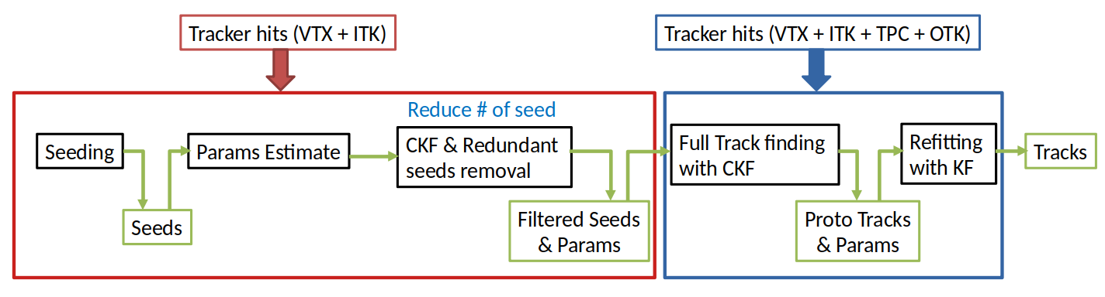
2
12
Application of ACTS to CEPCSW
Tracking chain with ACTS
Track finding has two steps
Silicon Tracking: Track finding in VTX + ITK (reduce # of seed)
  ACTS forms seeds by combining 3 space points, typically from 3 different detector layers
  Seeding in VTX + ITK (total 9 layers) will produce ≈ 80 triplets for single track
  Duplicate seeds are reduced by running CKF and removing the seeds with measurements already associated to found tracks
Full Tracking: Track finding in VTX + ITK + TPC + OTK
  With filtered seeds & parameters from silicon tracking

Slide 13
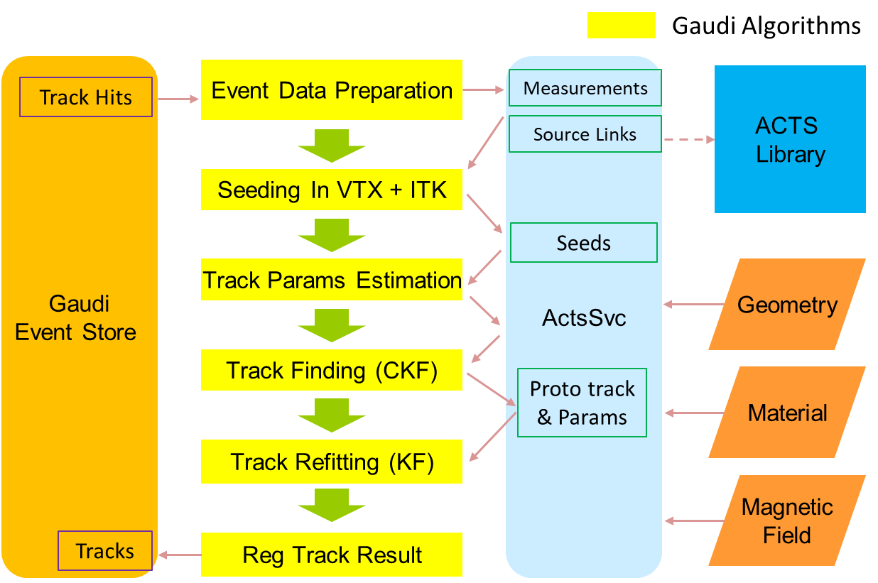
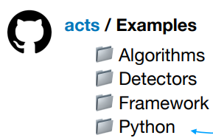
2
13
Application of ACTS to CEPCSW
Interface with CEPCSW
Integrate ACTS into the CEPCSW using the Gaudi Algorithms
Event Data Preparation
  Retrieves Track Hits from the Gaudi Event Store
  Convert the hits in EDM4hep format to ACTS’ Measurements & Source Links
Tracking chain algorithms
  Seeding & params estimation
  Track finding using CKF
  Track fitting using KF
Register tracking results with the Gaudi Event Store
Not intended for production
But showcase how to assemble a track reconstruction chain using the tools from the toolbox
A Gaudi Service ActsSvc was also developed to store the data across the Gaudi Algorithms.

Slide 14
14
1
Introduction
2
Application of ACTS to CEPCSW
Outline
3
Performance
4
R&D

Slide 15
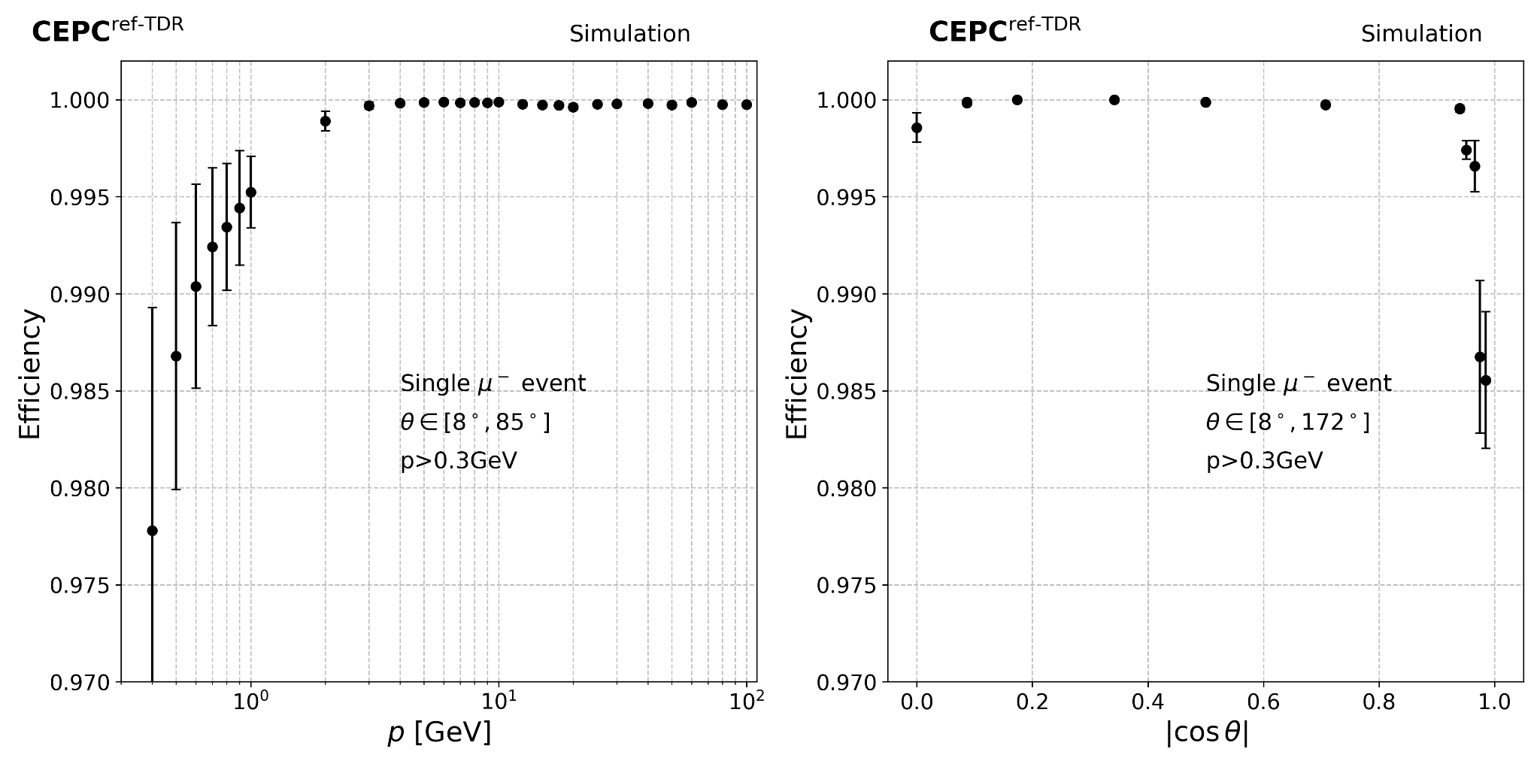
3
15
Performance
Tracking efficiency
Around the region θ=90°, efficiency drops due to the membrane cathode spanned between two rings in the center of the TPC.

Slide 16
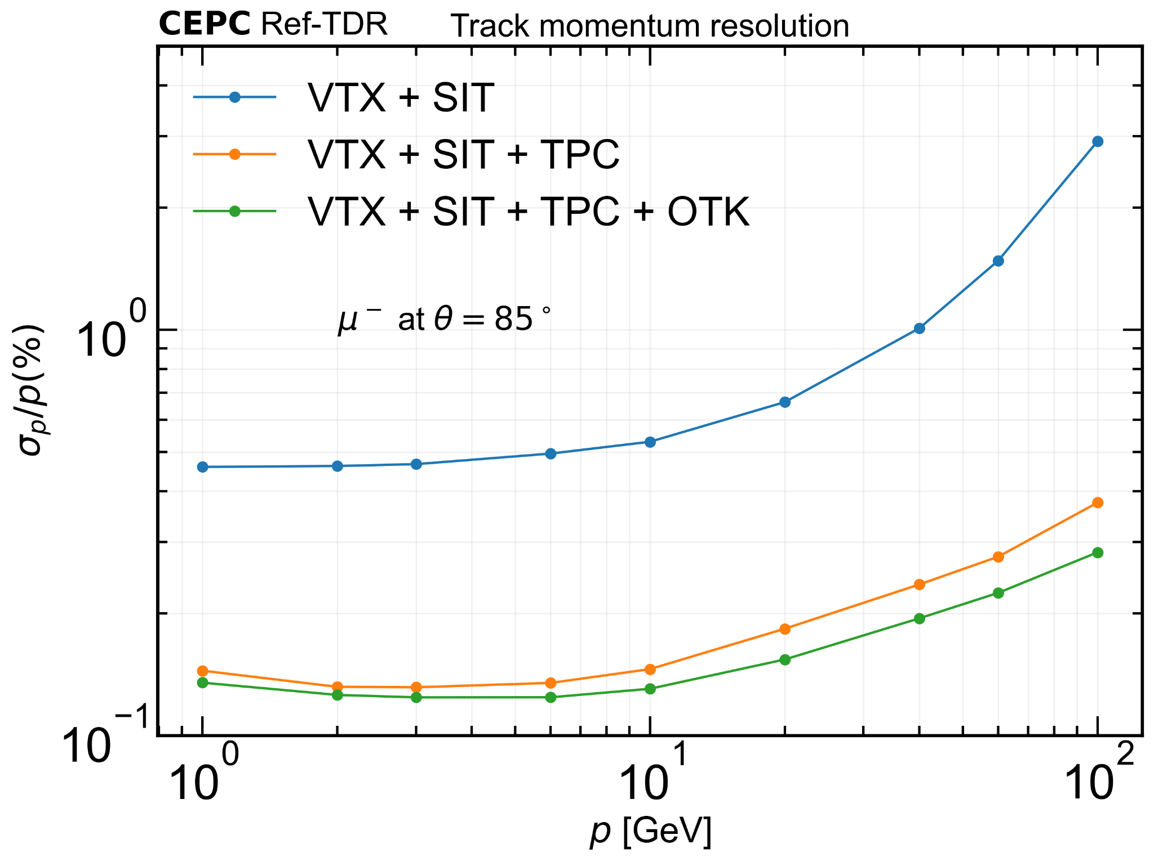
3
16
Performance
Tracking resolution
The TPC in conjunction with the OTK is able to provide the longest possible radial lever arm for the track fit, improving the resolution at the high momentum region (about 10-20% better than without OTK)

Slide 17
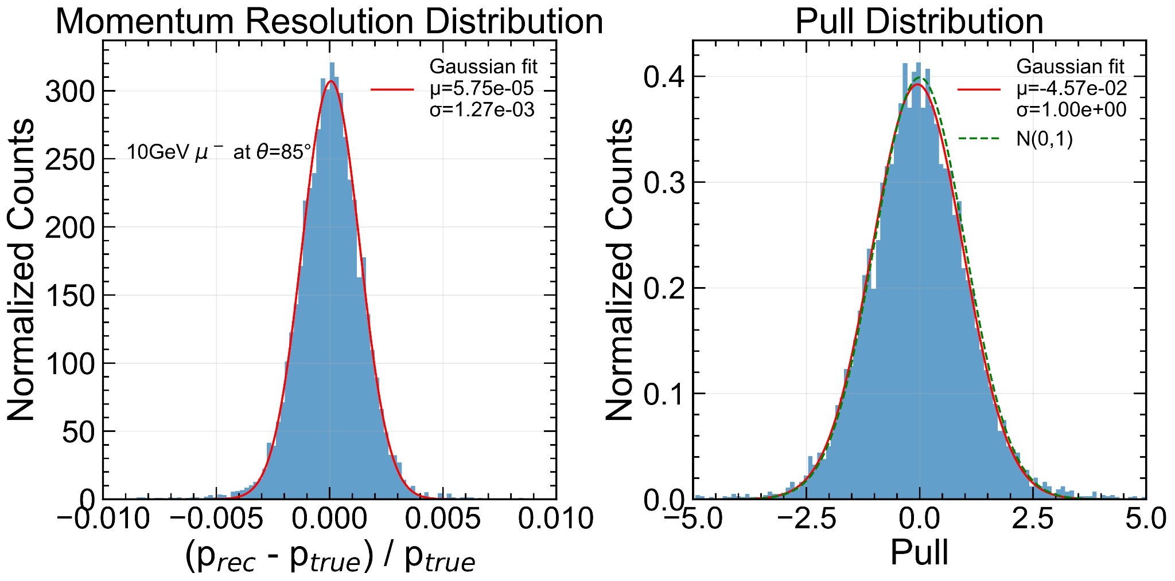
3
17
Performance
Track fitting validation
Pull distribution shows the uncertainties of momentum provided by ACTS Kalman Fitter (KF) are valid
The tracking performance achieved with ACTS shows excellent agreement with full detector simulations.

Slide 18
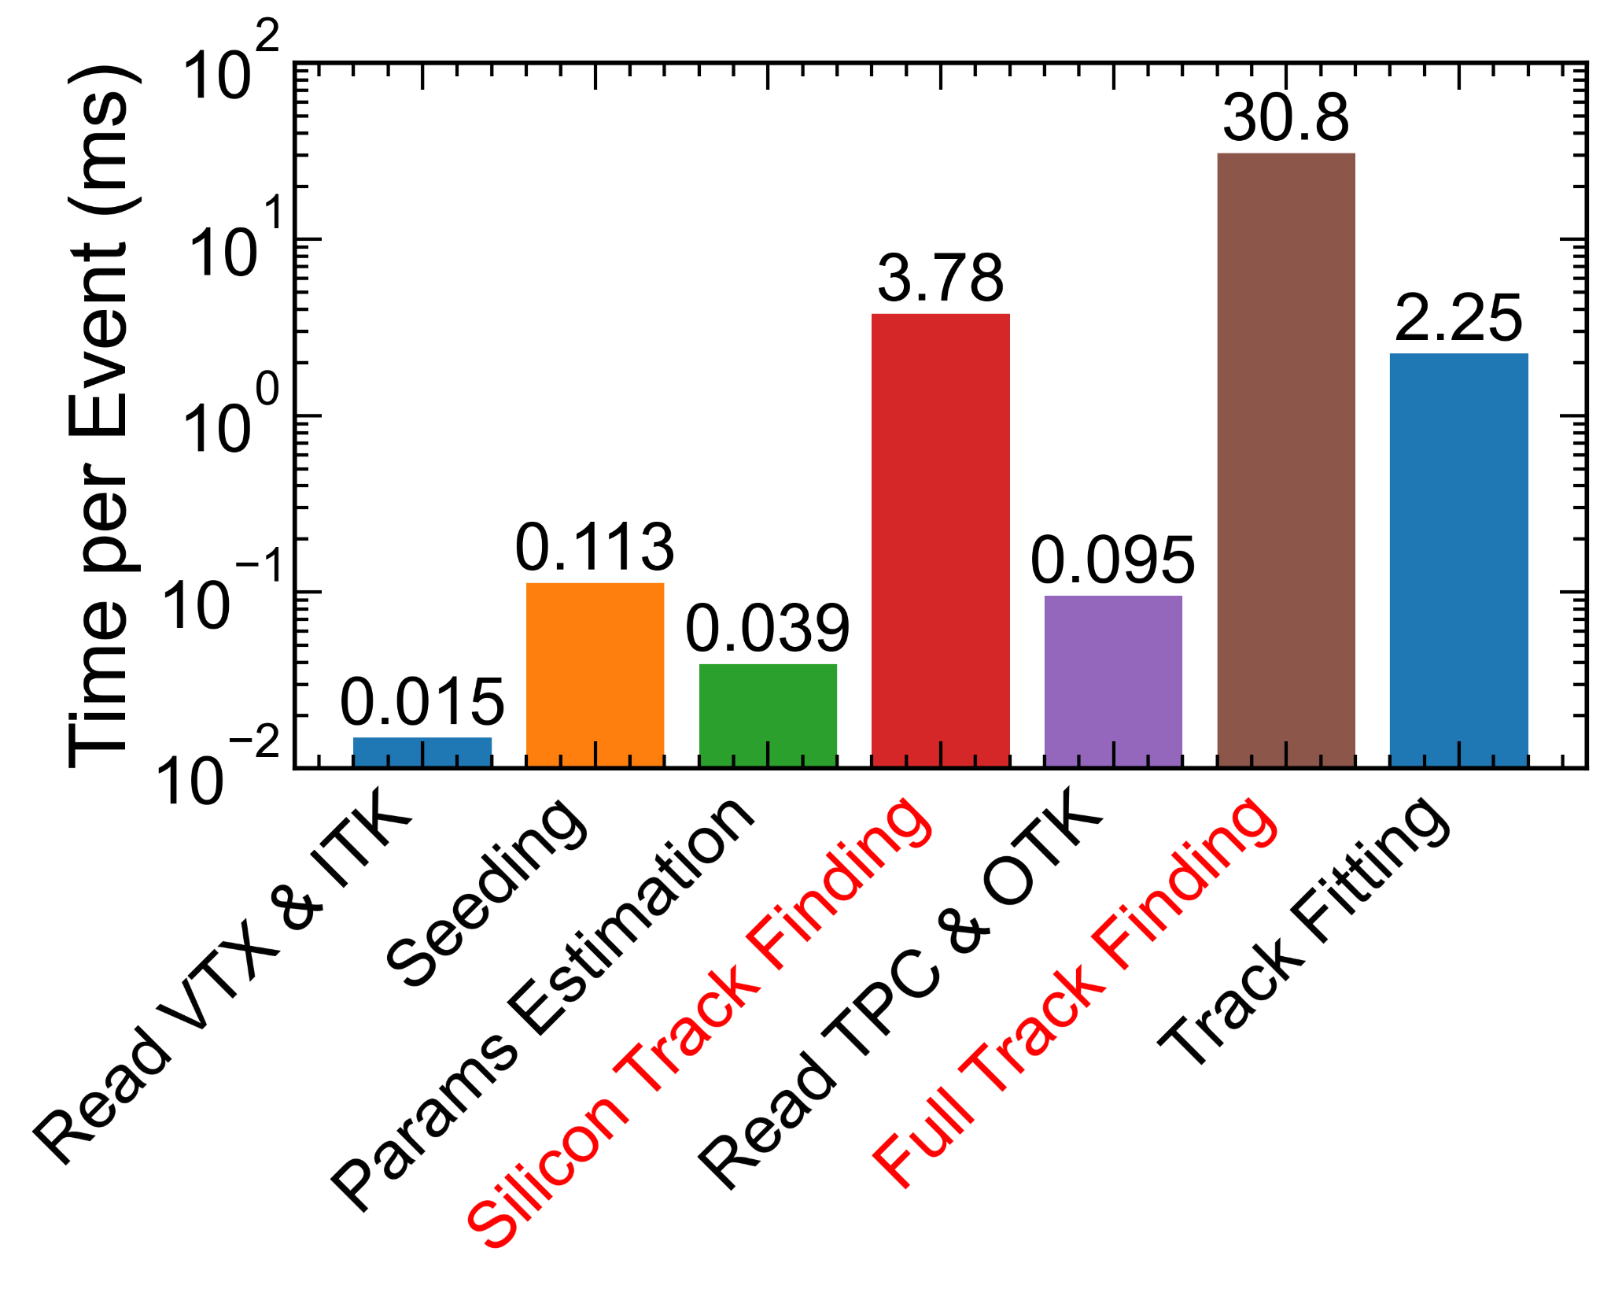
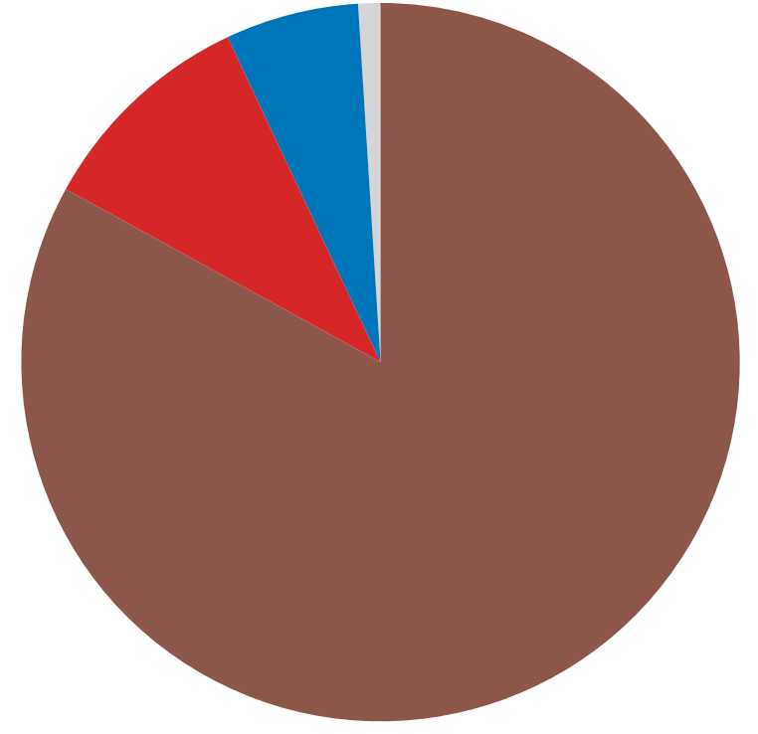
3
18
Performance
Computing performance
Time cost of reconstruction for single-track events:
Tested with single thread at:
  Intel(R) Xeon(R) Silver CPU 4214 @ 2.20GHz
Total ≈ 37ms/event
Time cost percentages
  Full Track Finding 83%
  Silicon Track Finding 10.2%
  Track Fitting 6.07%
  Others 0.73%

Slide 19
19
1
Introduction
2
Application of ACTS to CEPCSW
Outline
3
Performance
4
R&D

Slide 20
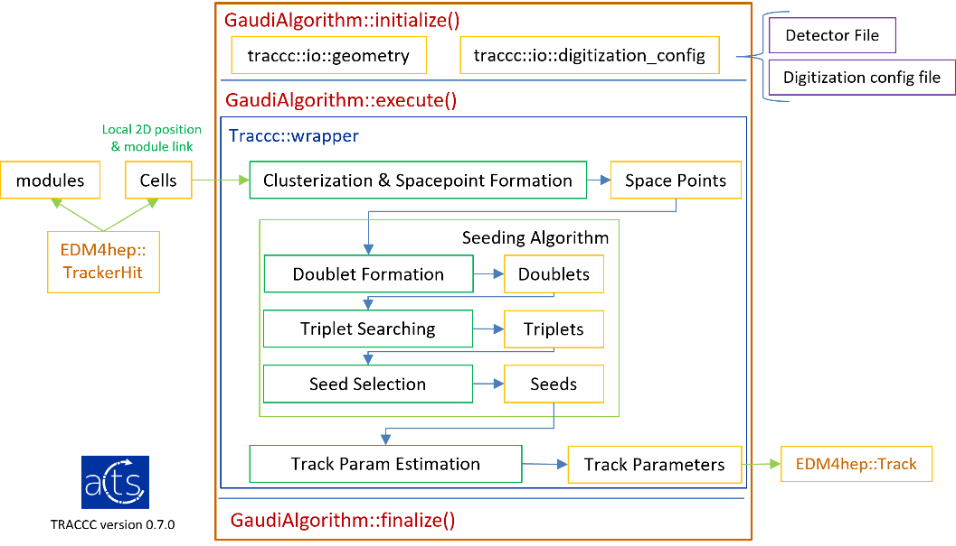
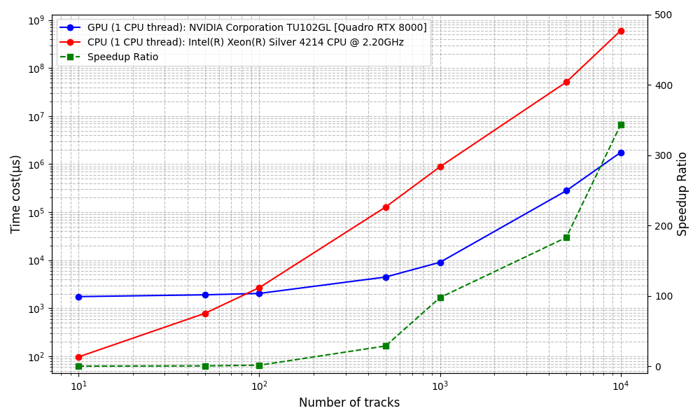
4
20
R&D
traccc
Apply traccc seeding algorithm in CEPCSW
Seeding time comparing CPU & GPU vs # of tracks
traccc, one of the R&D project of ACTS, provides high-performance parallel tracking software
Compatible with complex hardware architectures (e.g., CPU, GPU, FPGA)
Applied in CEPCSW, tested its physical & computing performance, details see link

Slide 21
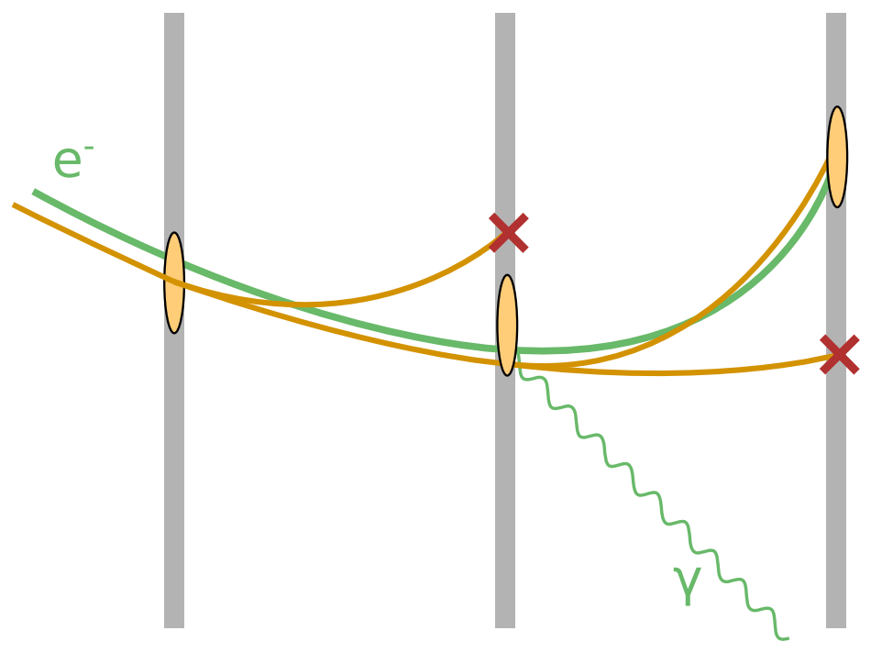
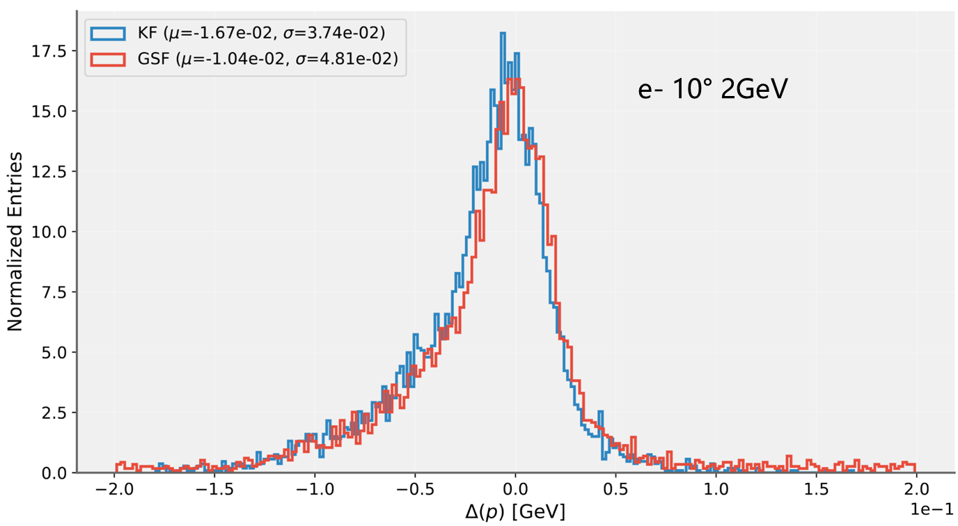
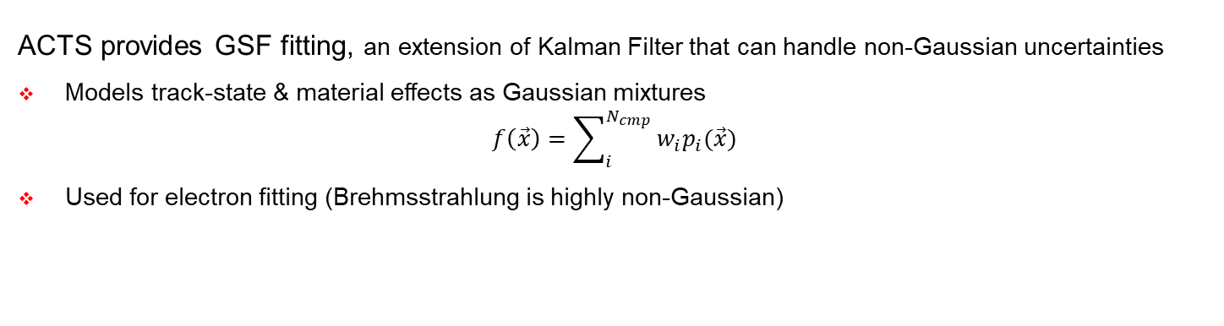
4
21
R&D
Gaussian Sum Fitter
p resolution comparison kf & gsf
ACTS provides GSF fitting, an extension of Kalman Filter that can handle non-Gaussian uncertainties
Models track-state & material effects as Gaussian mixtures
$$f\left(\vec{x}\right)=\sum_{i}^{N_{cmp}}{w_{i}p_{i}(\vec{x})}$$
Used for electron fitting (Brehmsstrahlung is highly non-Gaussian)

Slide 22
22
Summary
ACTS has been successfully integrated into CEPCSW
  See repository
ACTS has been implemented for track reconstruction in the trackers of the CEPC RefDet.
  Covering a wide range of trackers, e.g. silicon (planar, stitched) and gaseous (TPC)
R&D works
  traccc: implies seeding algorithm in GPU to CEPCSW
  GSF: implied in electron fitting; no significant improvement due to the thin tracking material
Next to do:
  Further ACTS’ GPU & ML implement in CEPCSW

Slide 23
Thank you
Yizhou Zhang¹, Weidong Li¹, Xiaocong Ai², Tao Lin¹
1. Institute of High Energy Physics, CAS
2. Zhengzhou University
Huizhou
22nd July 2025

Slide 24
Backup

Slide 25
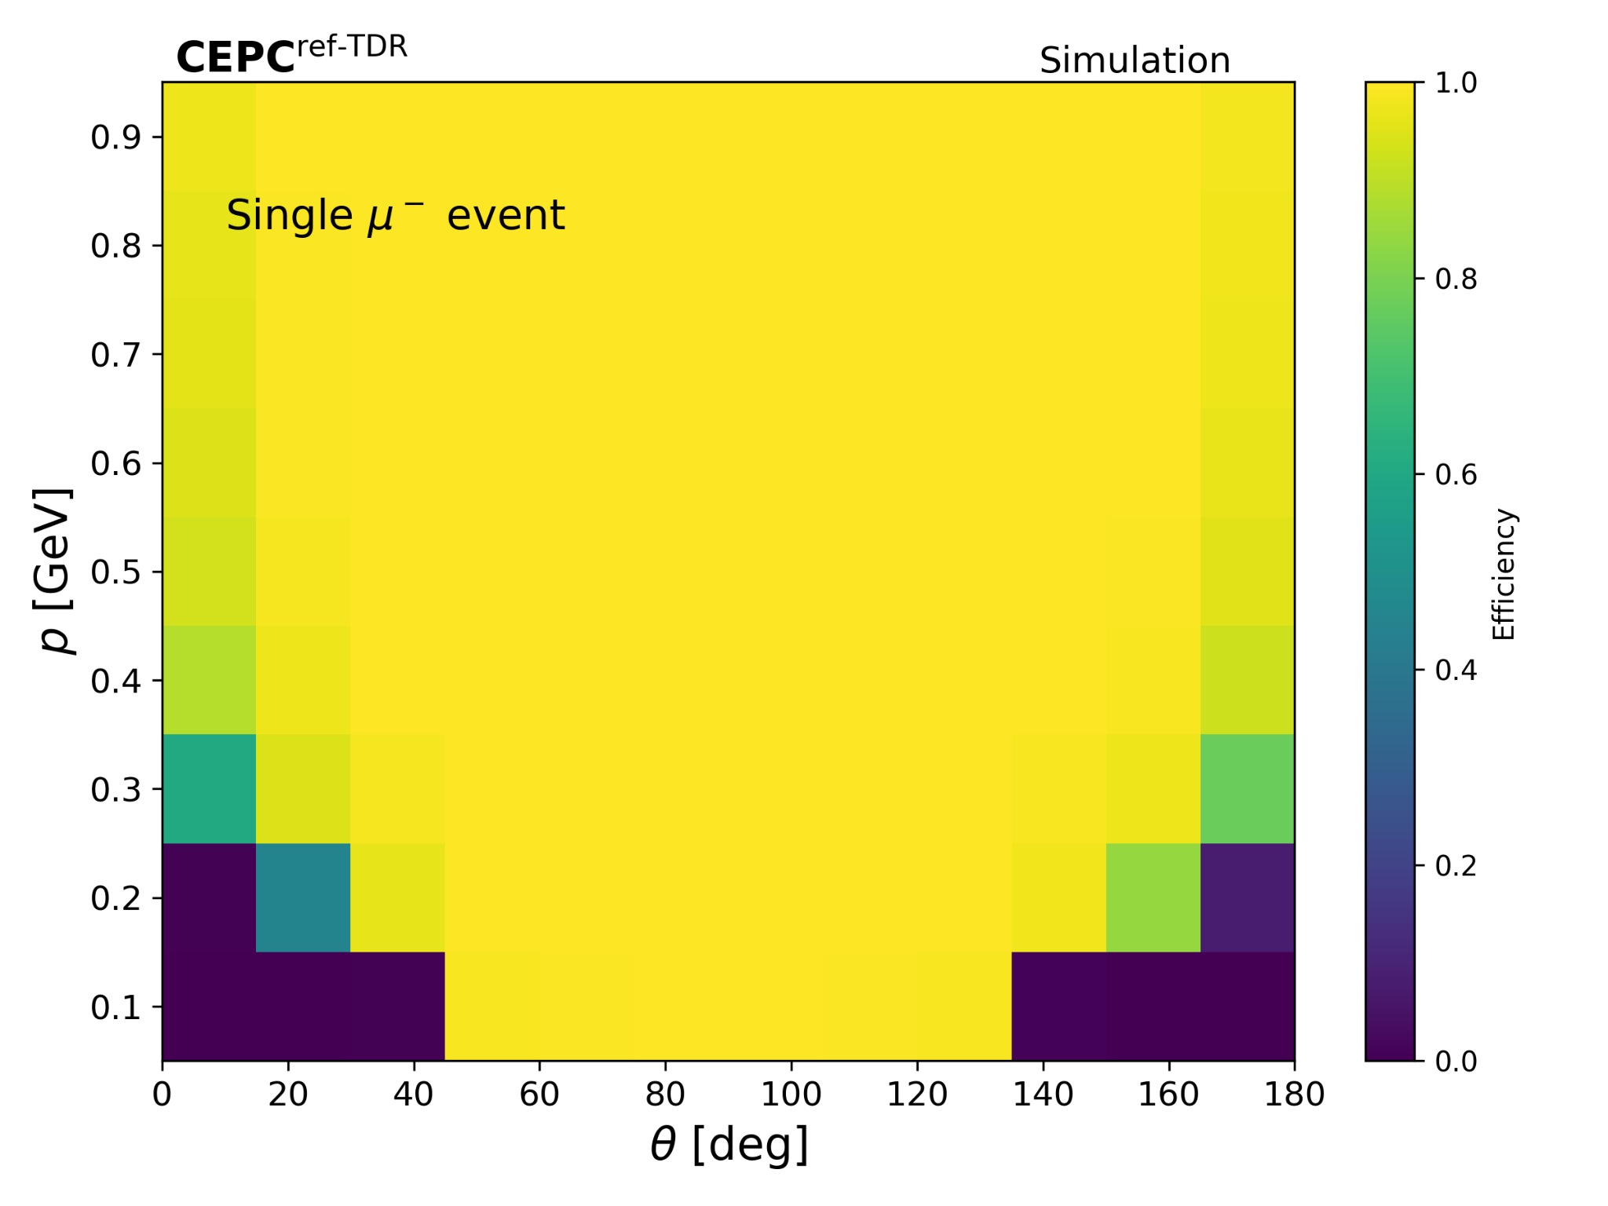
3
25
Performance
Tracking efficiency
Good efficiency for low momentum tracks as well
The efficiency of each bin is analysed with fixed p and theta.

Slide 26
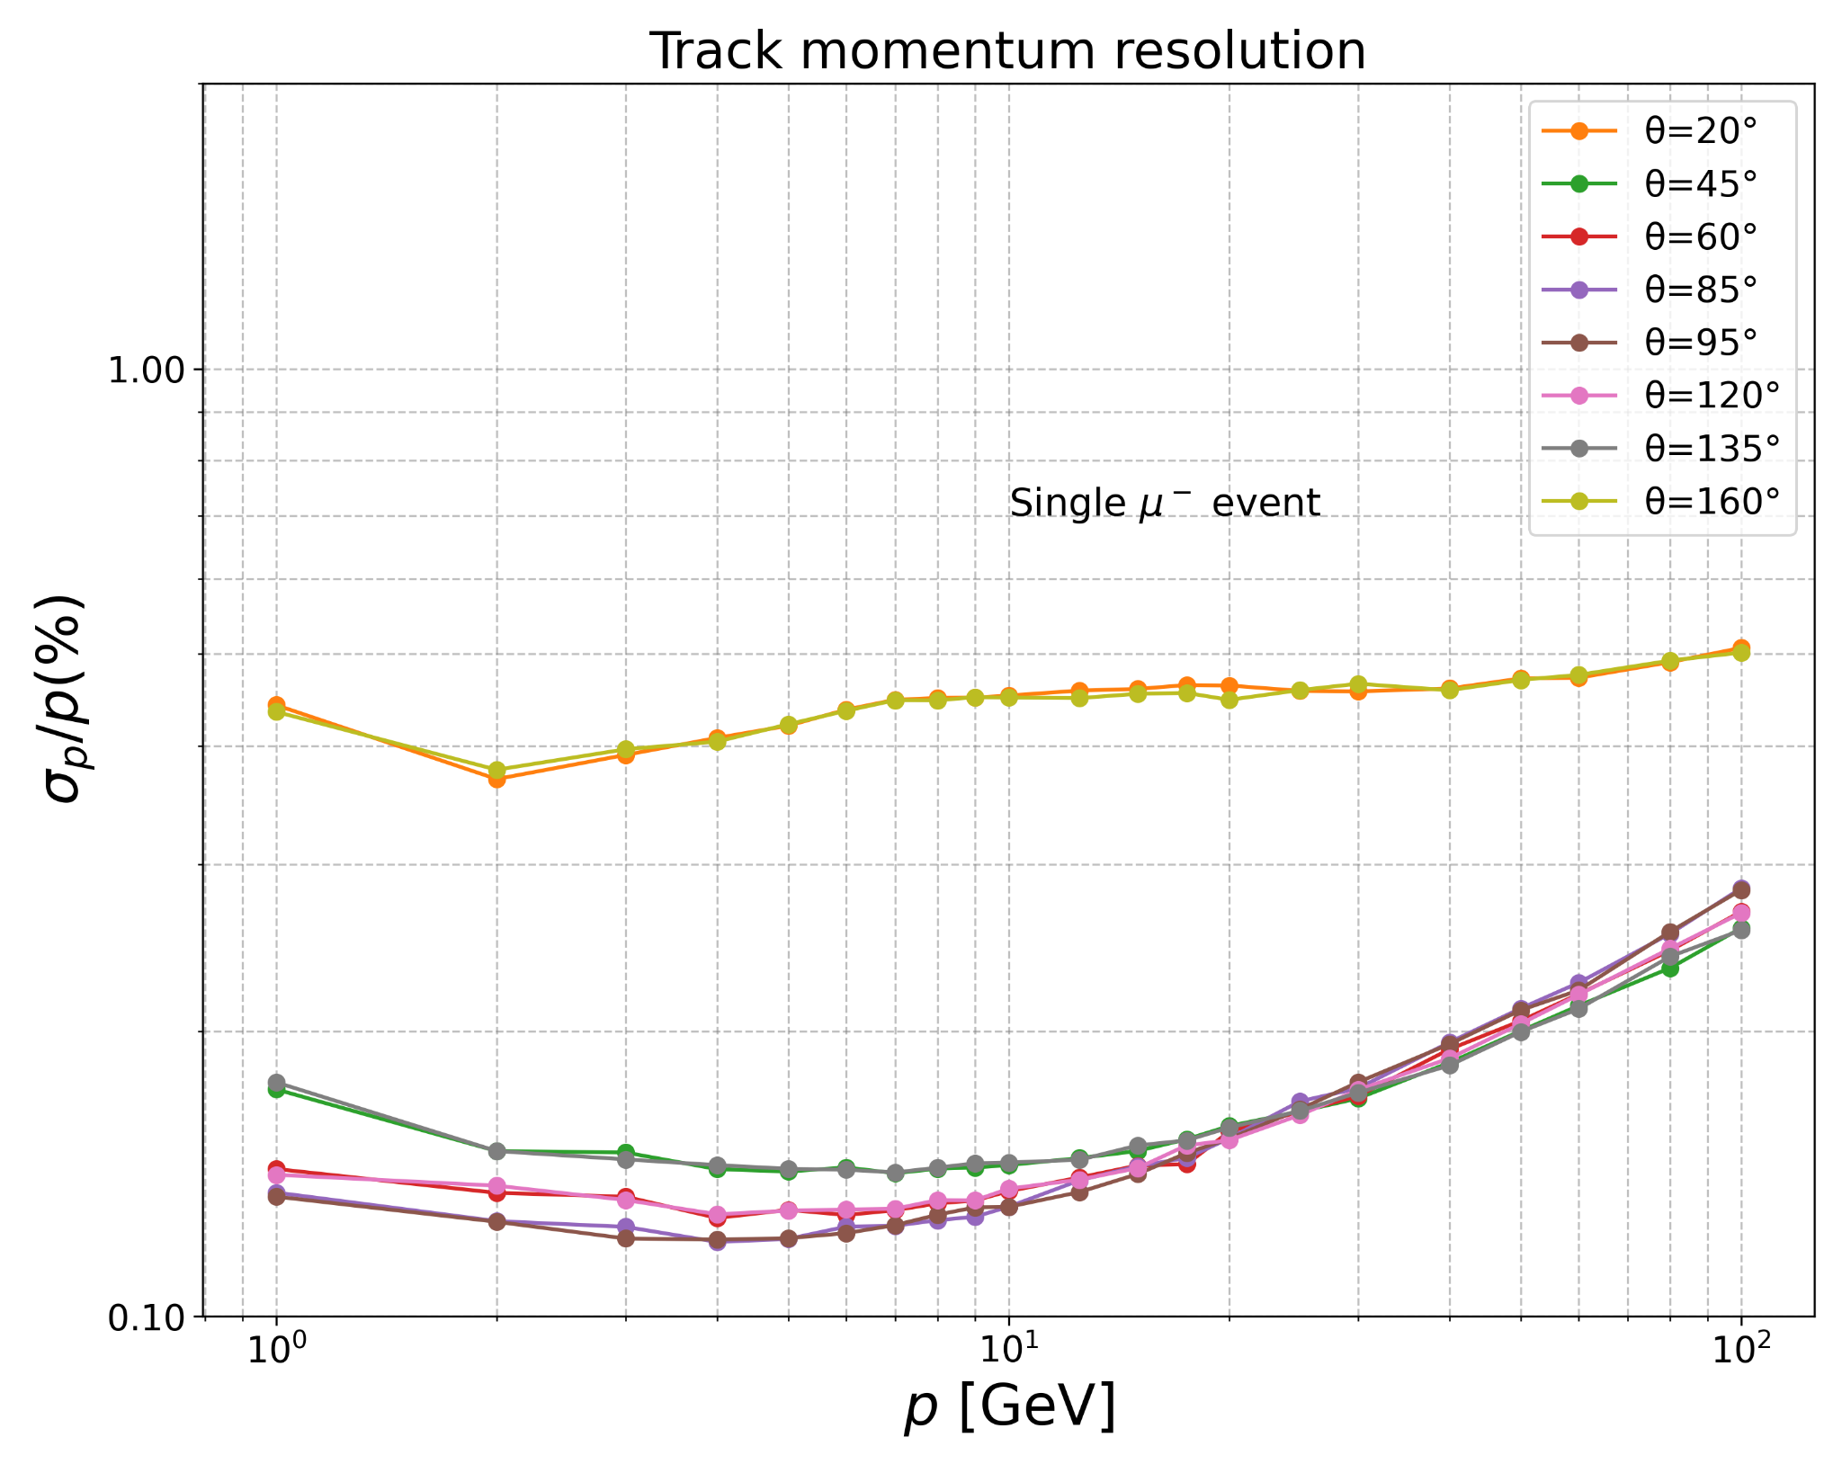
3
26
Performance
Tracking resolution
With a theta of 20° or 160°, track hits are mainly distributed on EndCaps.
Momentum resolution is not gaussian distributed at low momentum (≈ 1 GeV)

Slide 27
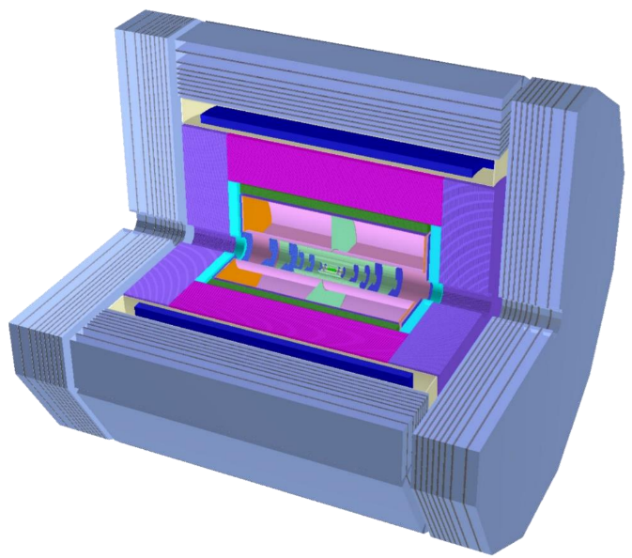
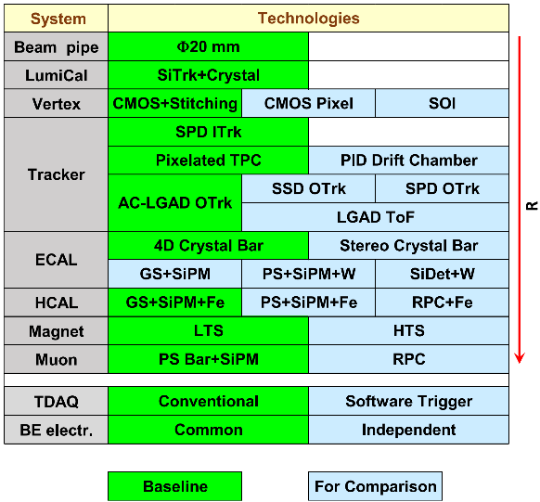
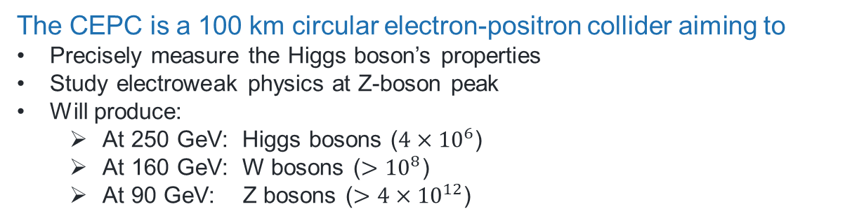
1
27
Introduction
Circular Electron Positron Collider (CEPC)
The CEPC is a 100 km circular electron-positron collider aiming to
Precisely measure the Higgs boson’s properties
Study electroweak physics at Z-boson peak
Will produce:
  At 250 GeV: Higgs bosons ($4×{10}^{6}$)
  At 160 GeV: W bosons ($>{10}^{8}$)
  At 90 GeV: Z bosons ($>4×{10}^{12}$)
Software development background
Hardware: Computing is shifting toward multi-core CPUs and diverse accelerators (GPUs, FPGAs).
ML: Machine learning has become an essential component of high-energy physics experiments.

Slide 28
1
28
Introduction
Acts: A Common Tracking Software
Open source and experiment-independent toolkit for track reconstruction
https://github.com/acts-project
Developed with modern C++ with unit testing and continuous integration
Several R&D projects within the ACTS ecosystem
  traccc: GPU R&D line
  Exa.TrkX: GNN based tracking available
  …
Four [other talks] that can be found also intro the application of acts

Slide 29
3
29
Performance
CEPC tracker parameters setup
The truth hits are smeared by tentative tracker resolution for now:
Vertex Detector
  1st-4th layer RPhi, Z = [5 µm, 5 µm]
  5th & 6th layer U, V = [5 µm, 5 µm]
ITK ( Inner Tracker )
  Barrel U, V = [8 µm, 40 µm]
  Endcap U, V = [8 µm, 40 µm]
TPC ( Time Projection Chamber )
  RPhi, Z = [144 µm, 40 µm]
OTK ( Outer Tracker )
  Barrel U, V = [10 µm, 1 mm]
  Endcap U, V = [10 µm, 1 mm]
Tracking Requirements
High-precision measurement places stringent demands on tracking, requiring
near 100% tracking efficiency
momentum resolution of approximately 0.1%.

