Slide 1
EicC vertex & tracking detector simulation and performance study
Aiqiang Guo, Yuming Ma,
Yutie Liang, Yuxiang Zhao
Institute of Modern Physics, CAS

Slide 2
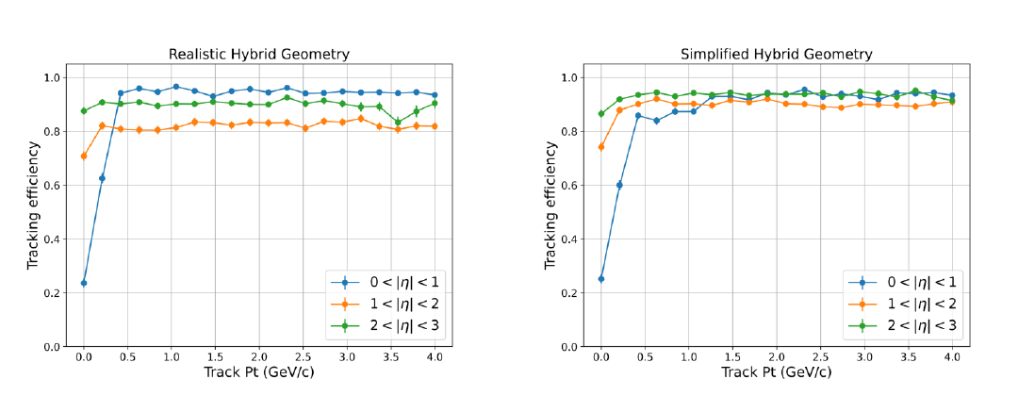
Tracking efficiency

Slide 3
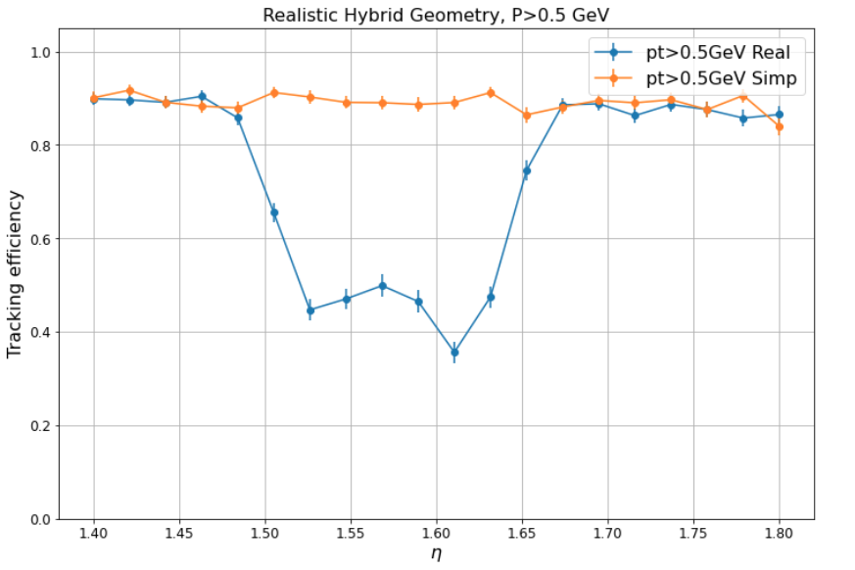
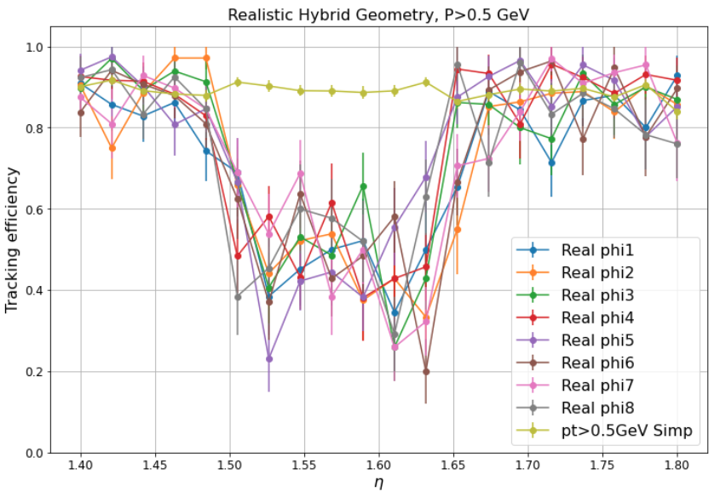
Efficiency vs eta&phi

Slide 4
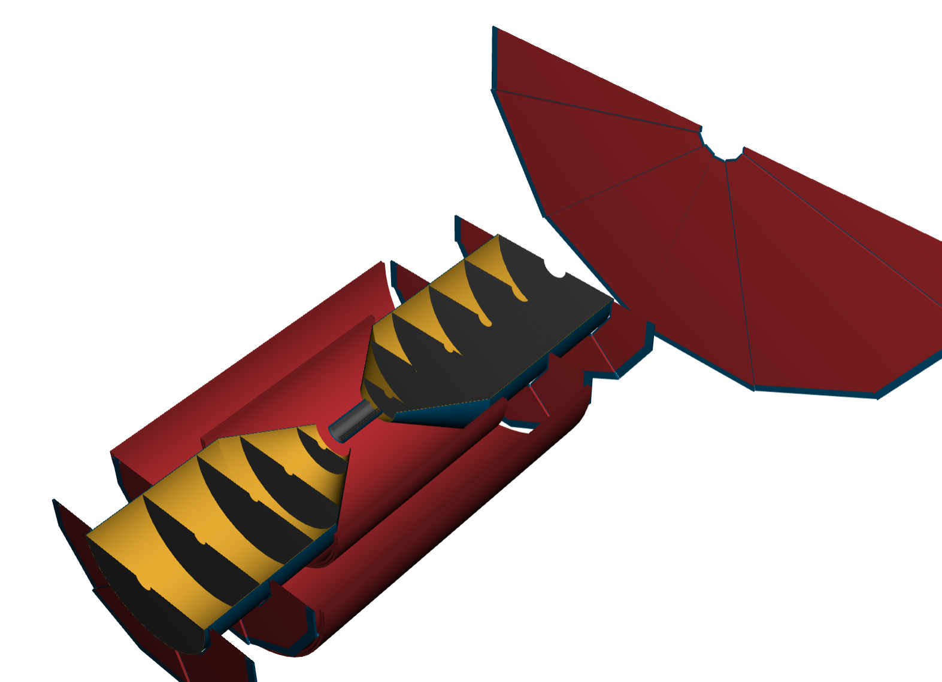
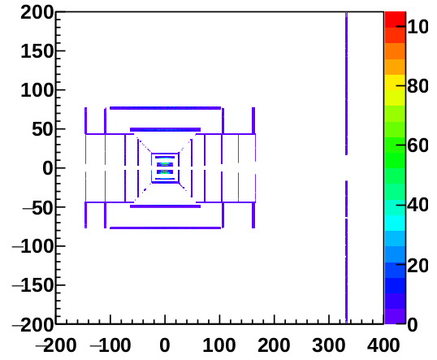
Detector profile

Slide 5
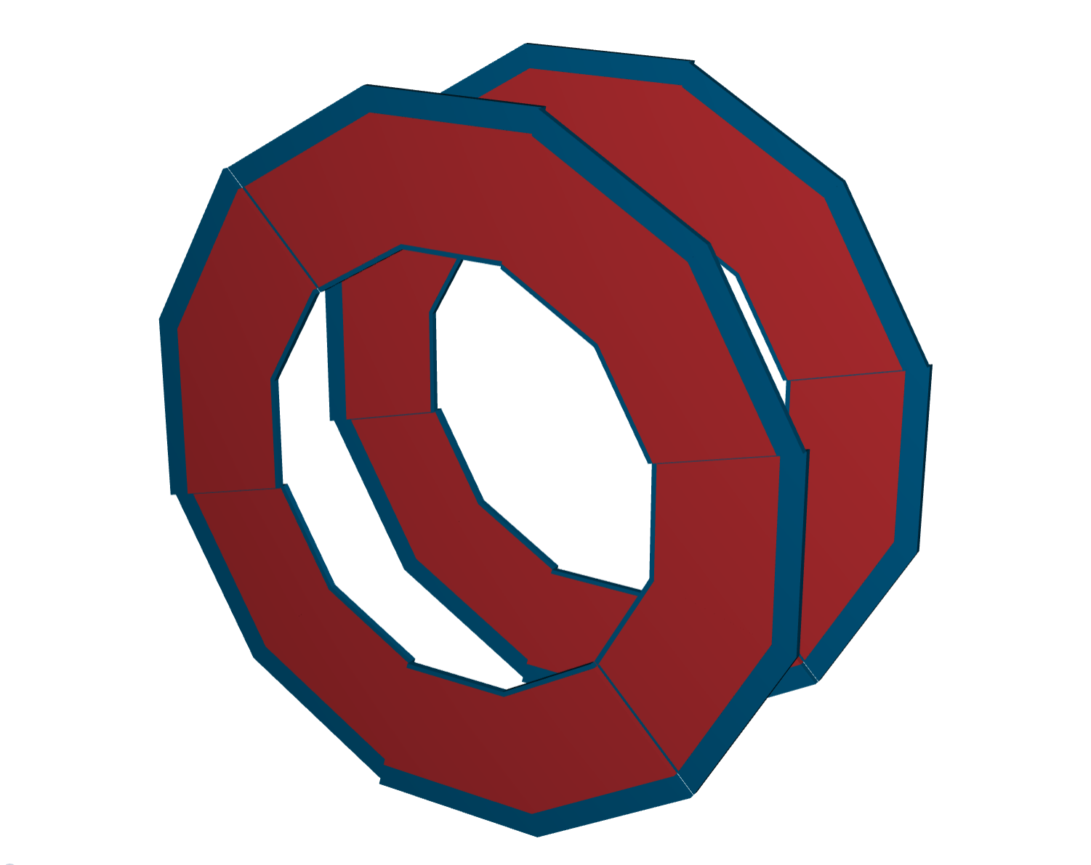
Detector profile
The material here isn’t set properly

Slide 6
Tracking efficiency
Before correction
After correction

Slide 7
Performance study
Hybrid design
properties:
component | Tech. | Pitch size ($μm$) | Material budget (X/X0 %)
vertex | ITS3 | 10 | 0.05
Silicon tracker (B) | ITS2 | 10 | 0.55
Silicon tracker (E) | ITS2 | 10 | 0.24
Gaseous tracker (B) | MPGD | 150*150 (r-phi * Z) | 0.4
Gaseous tracker (E) | MPGD | 250*50 (r * r-phi) | 0.4

Slide 8
Kinematic character

Slide 9
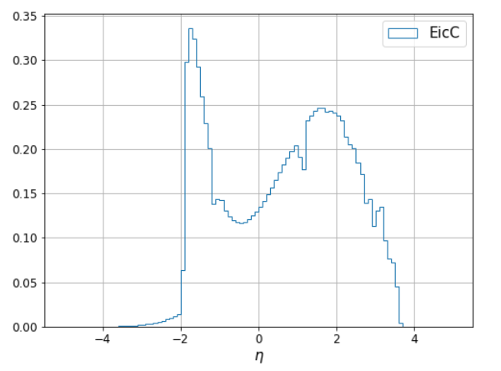
Kinematic character

Slide 10
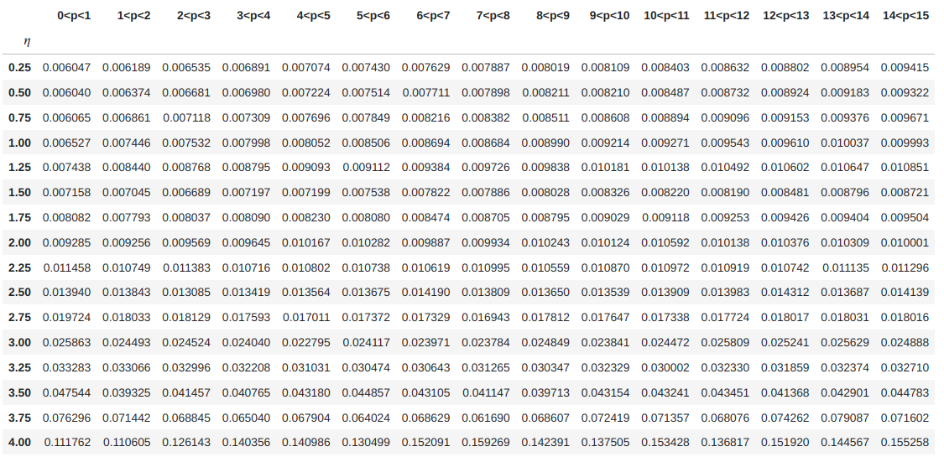
Momentum resolution

Slide 11
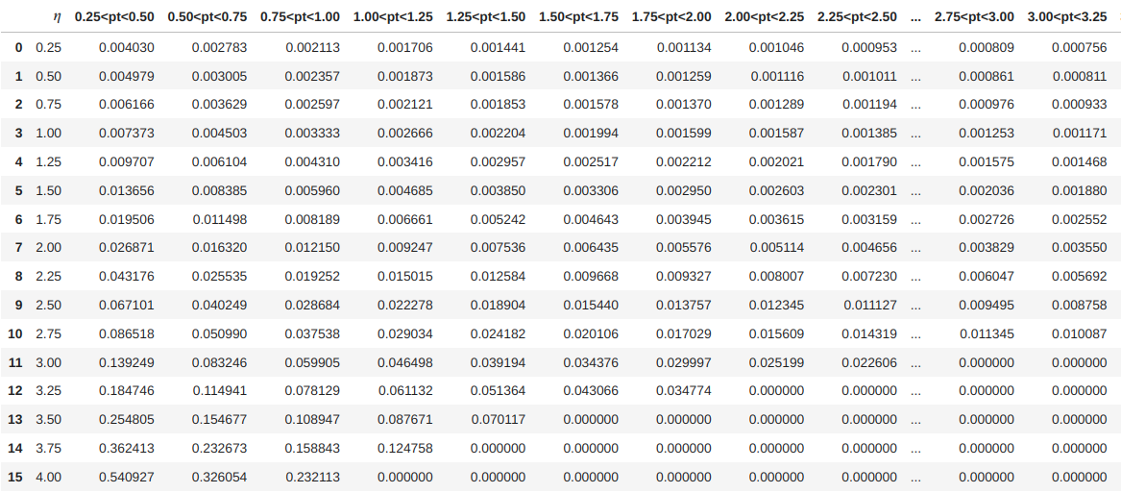
DCAz resolution

Slide 12
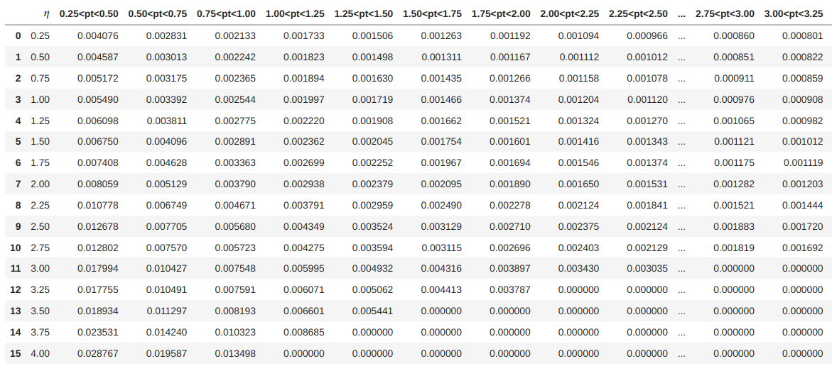
DCArphi resolution

Slide 13
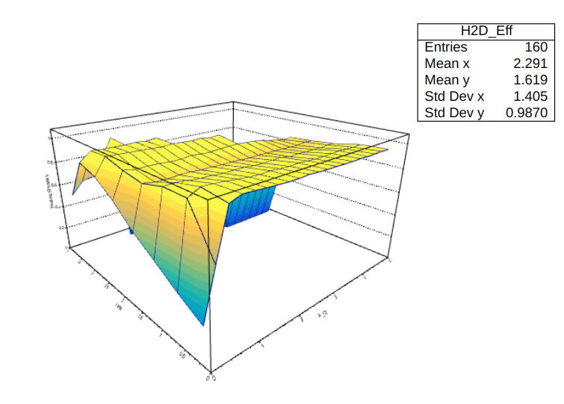
Tracking efficiency

Slide 14
Vertex resolution vs multiplicity

Slide 15
Backup

Slide 16
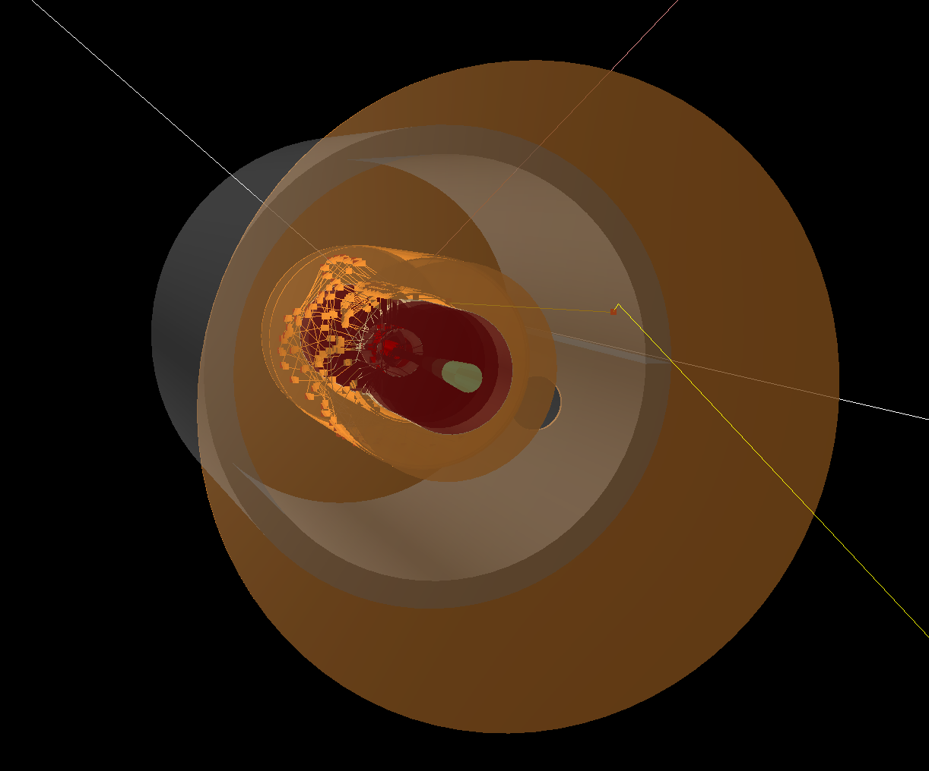

Slide 17
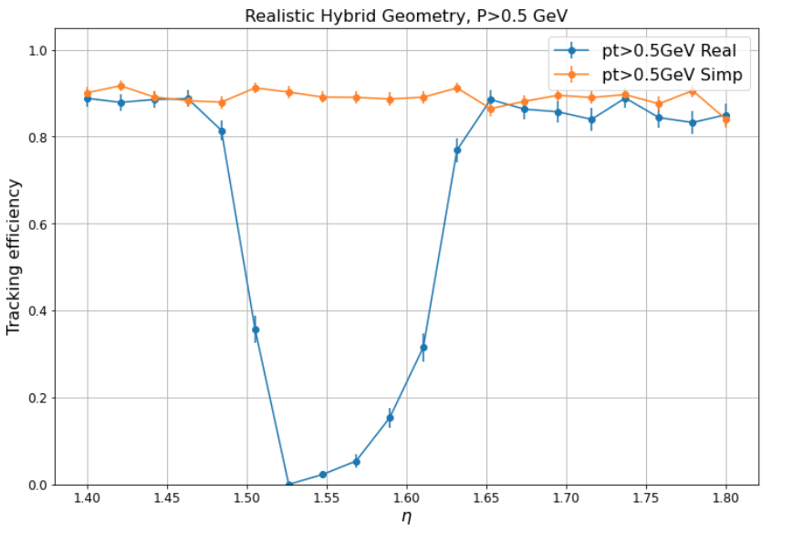
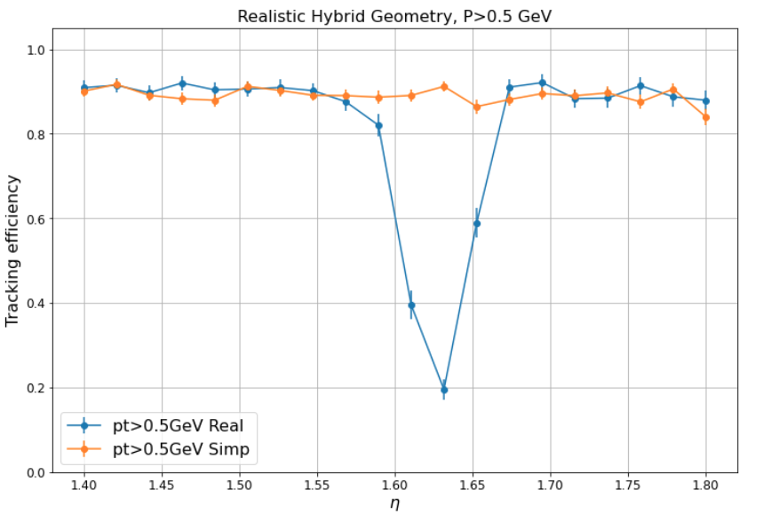
Efficiency in forward and backward
forward
Backward

