Slide 1
EicC vertex & tracking detector simulation and performance study
Aiqiang Guo, Yuming Ma,
Yutie Liang, Yuxiang Zhao
Institute of Modern Physics, CAS

Slide 2
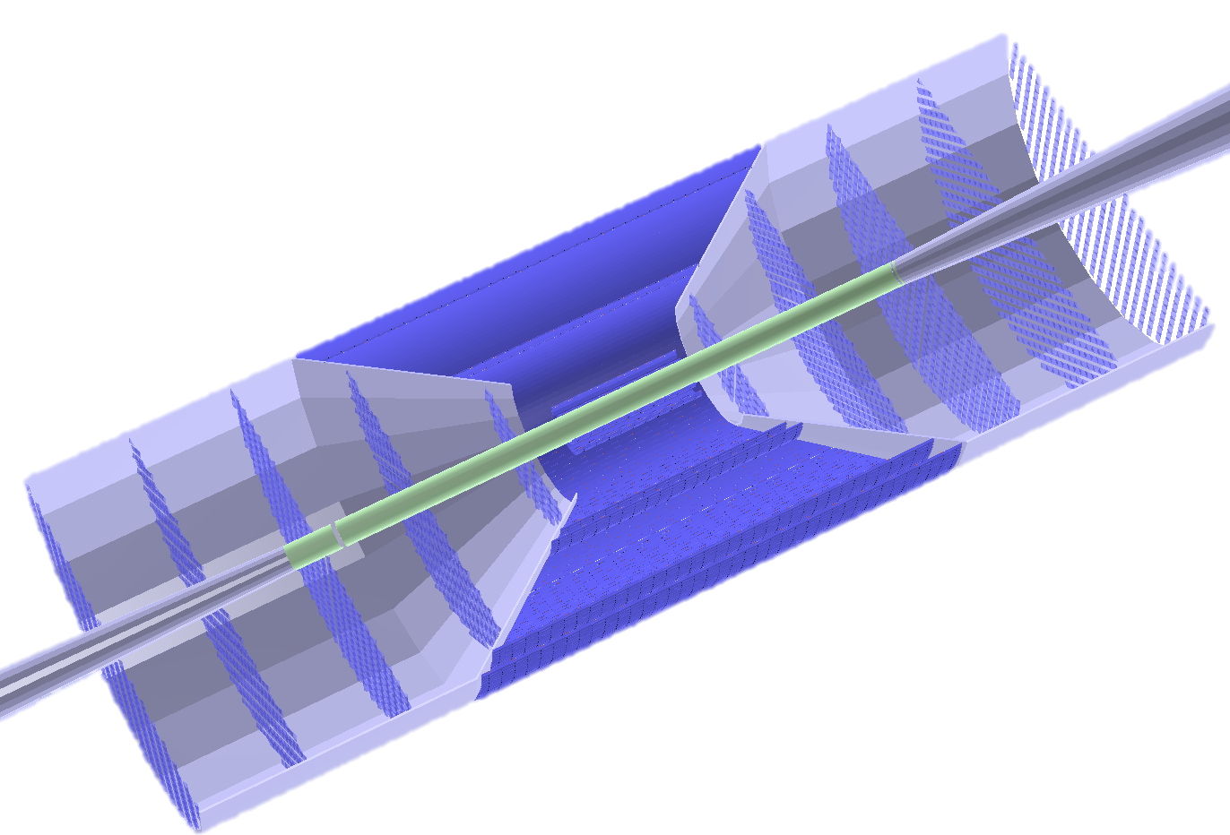
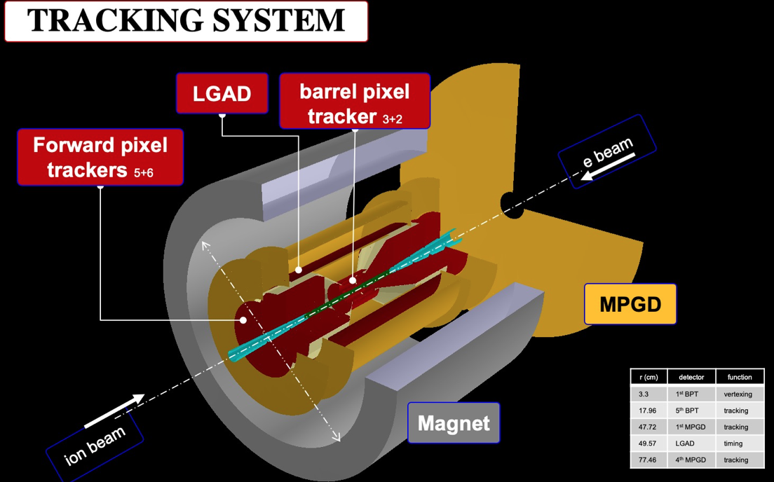
New Tracker design

Slide 3
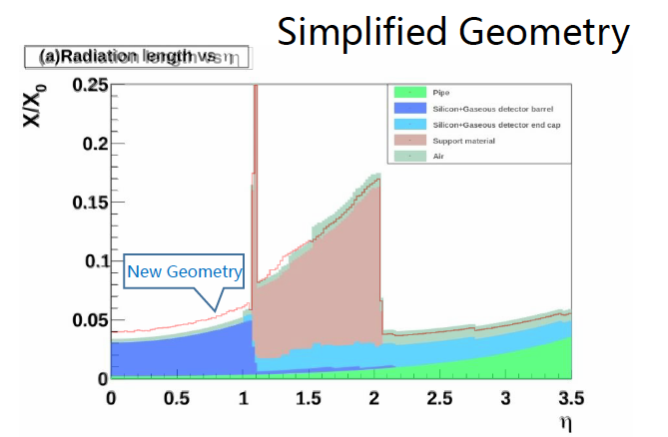
Material budget

Slide 4
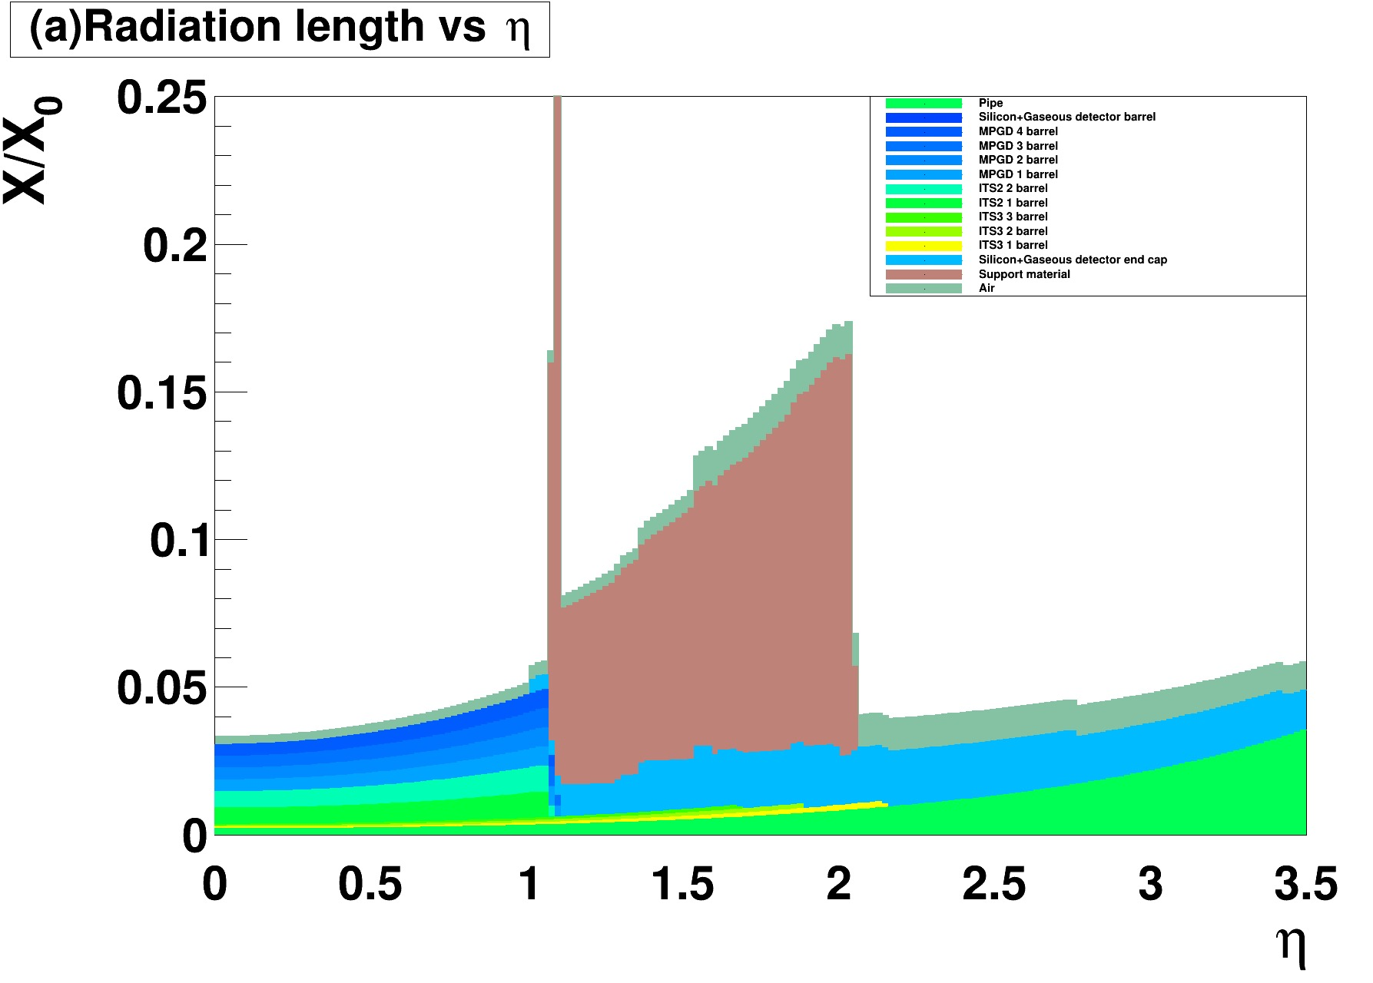
Material budget

Slide 5
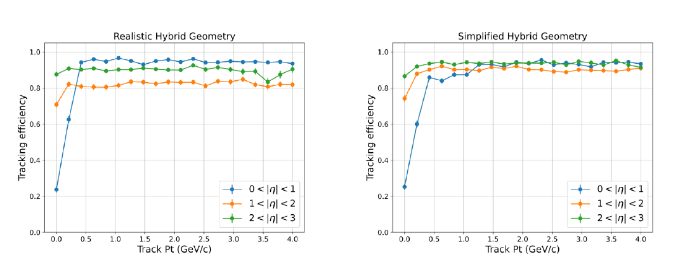
Tracking efficiency

Slide 6
Tracking efficiency

Slide 7
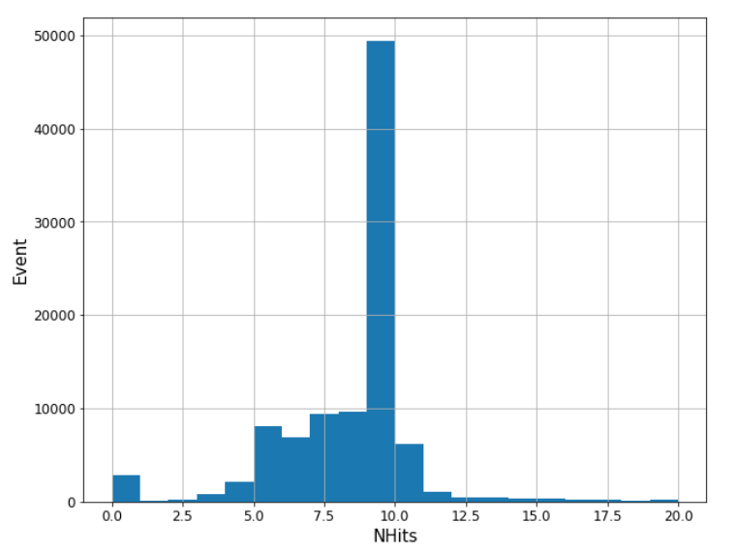
Study of hit requirement

